Slide 1

Introduction to Accelerator Diagnostics
John Byrd
Lawrence Berkeley National Laboratory

Slide 2
Diagnostics: What do we want to measure?
Beam Energy
Beam Charge/Current
Beam Position
Beam Timing
Transverse Beam Emittance
Longitudinal Beam Emittance

Slide 3
Introduction
Accelerator performance depends critically on the ability to carefully
measure and control the properties of the accelerated particle beams
In fact, it is not uncommon, that beam diagnostics are modified or
added after an accelerator has been commissioned
This reflects in part the increasingly difficult demands for high beam
currents, smaller beam emittances, and the tighter tolerances place on
these parameters (e.g. position stability) in modern accelerators
A good understanding of diagnostics (in present and future accelerators)
is therefore essential for achieving the required performance
A beam diagnostic consists of
the measurement device
associated electronics and processing hardware
high-level applications

Slide 4
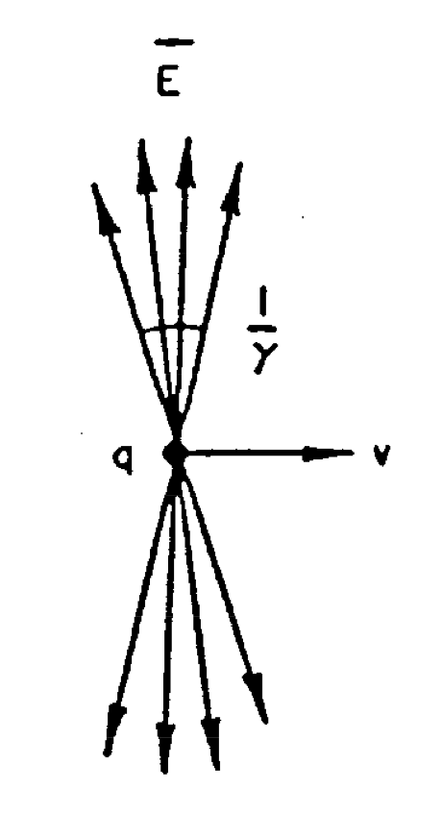
Beam Image Current
For relativistic beams, the EM fields are flattened to an opening angle of 1/γ, approximating a TEM wave.
Image current flows on the inner surface of the beam pipe.
A beam pickup (PU) intercepts some fraction of the image current
+
+
+
+
-
+
+
+
+

Slide 5
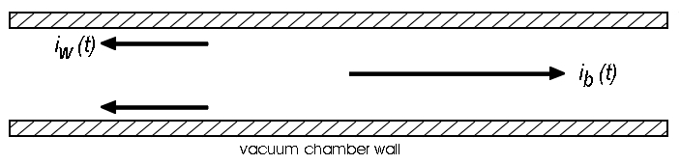
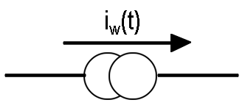


General Concept of ElectroMagnetic Detector
induced wall current i_{w}(t)
has opposite sign of beam
current i_{b}(t): i_{b}(t)=-i_{w}(t)
Lorentz-contracted “pancake”
Detection of charged particle beams – beam detectors:
i_{w} is a current source
with infinite output impedance, i_{w} will flow through any
impedance placed in its path
many “classical” beam detectors consist of a modification of the
walls through which the currents will flow
Sensitivity of beam detectors:
(in Ω)
= ratio of signal size developed V(ω) to
the wall current I_{w}(ω)
beam
charge:
beam
position:
(in Ω/m)
= ratio of signal size developed /dipole mode
of the distribution, given by D(ω)=I_{w}(ω) z,
where z = x (horizontal) or z = y (vertical)

Slide 6
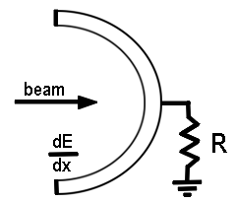
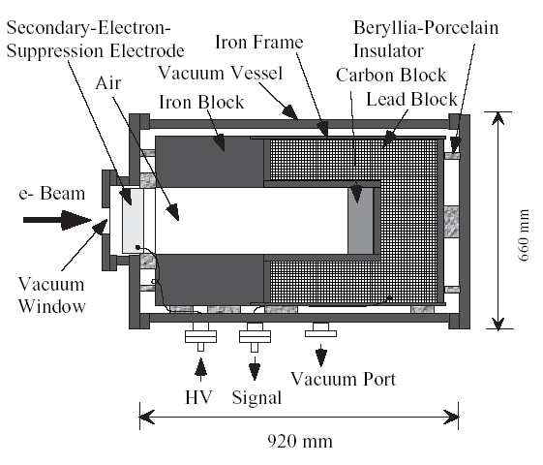
Beam Current – the Faraday Cup
thick (e.g. ~0.4 m copper for 1 GeV electrons) or series
of thick (e.g. for cooling) charge collecting recepticles
Principle: beam deposits (usually) all energy into the cup (invasive)
charge converted to a corresponding current
voltage across resistor proportional to instantaneous current absorbed
In practice:
termination usually into 50 Ω; positive bias to cup to retain e- produced by
secondary emission; bandwidth-limited (~1 GHz) due to capacitance to ground
cylindrically symmetric
blocks of
lead (~35 rad lengths)
carbon and iron
(for suppression of
em showers generated
by the lead)
bias voltage (~many 100 Volts)
for suppression of secondary
electrons
cross-sectional
view of the FC
of the KEKB
injector linac
(courtesy T.
Suwada, 2003)

Slide 7
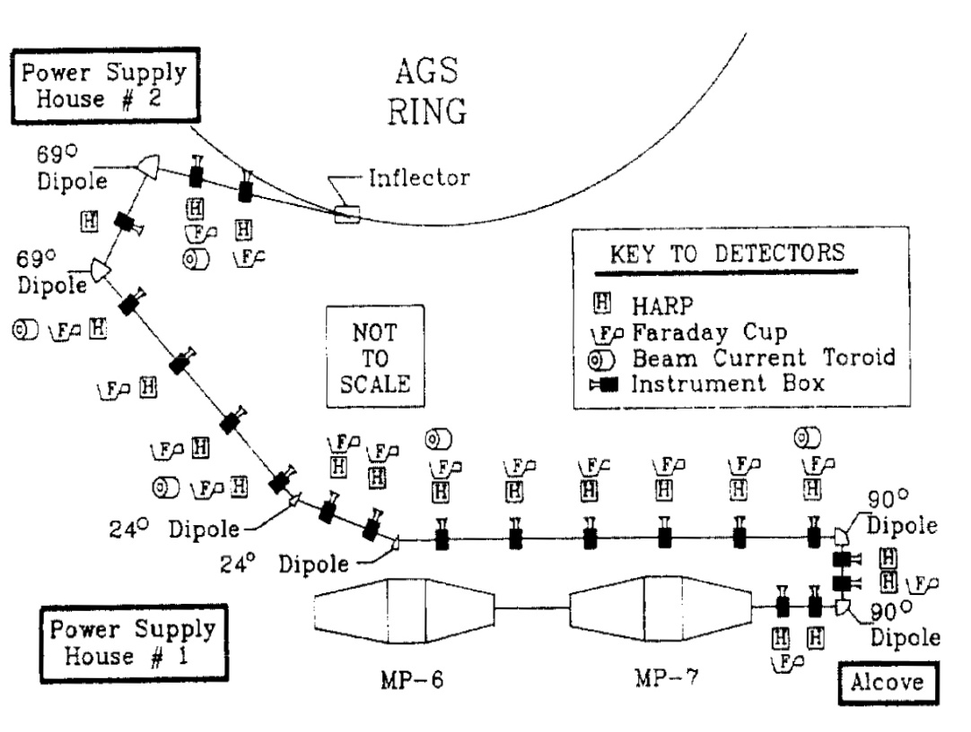
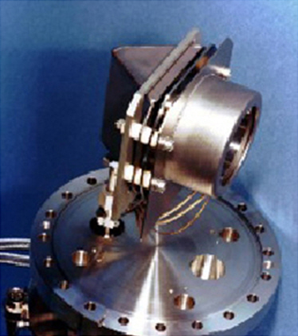
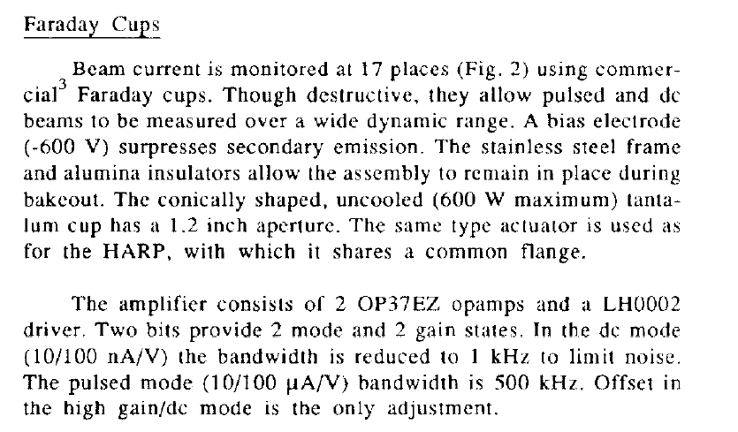
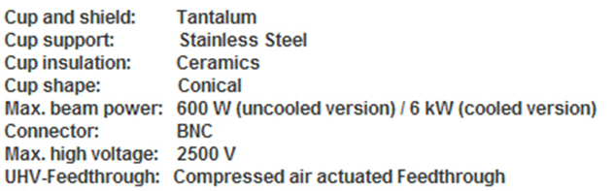
Example: Faraday Cup BNL Transfer Line
photo of FC used in the BNL tandem-to-downstream
transfer lines
http://www.n-t-g.de/beam_diagnostic_Seite_2.htm
“Beam instrumentation for the BNL Heavy Ion Transfer Line”,
R.L. Witkover et al, 1987 PAC

Slide 8
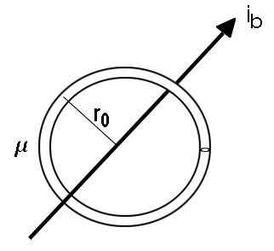


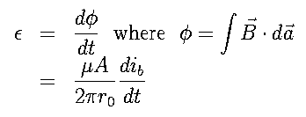
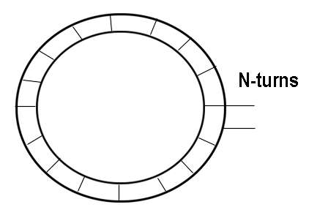
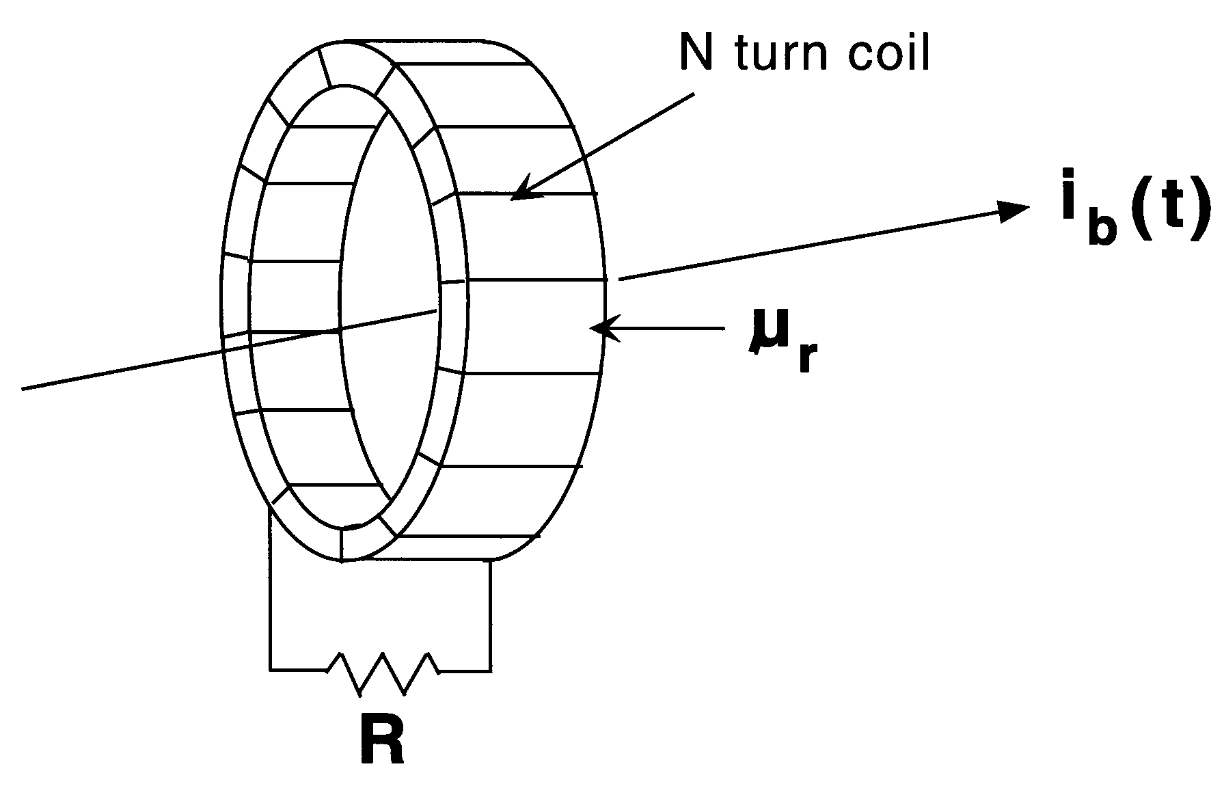
Beam Current – Current Transformers
Consider a magnetic ring surrounding the beam, from Ampere’s law:
if r₀ (ring radius) >> thickness of the toroid,
Add an N-turn coil – an emf is induced which acts to oppose B:
Load the circuit with an impedance; from Lenz’s law, i_{R}=i_{b}/N:
Principle: the combination of core, coil,
and R produce a current transformer
such that i_{R} (the current through
the resistor) is a scaled replica of
i_{b}. This can be viewed across R as
a voltage.

Slide 9
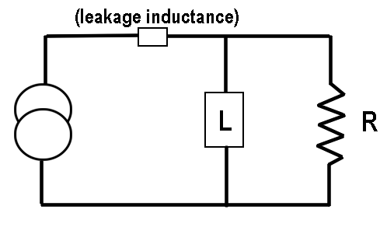



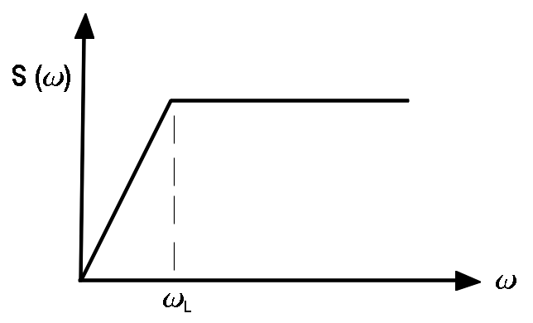



Current Transformer Bandwidth
with R_{h} = reluctance of magnetic path
sensitivity:
cutoff frequency, ω_{L}, is small if L~N² is large
detected voltage:
trade-off
between
bandwidth
and signal
amplitude
if N is large, the voltage detected is small

Slide 10
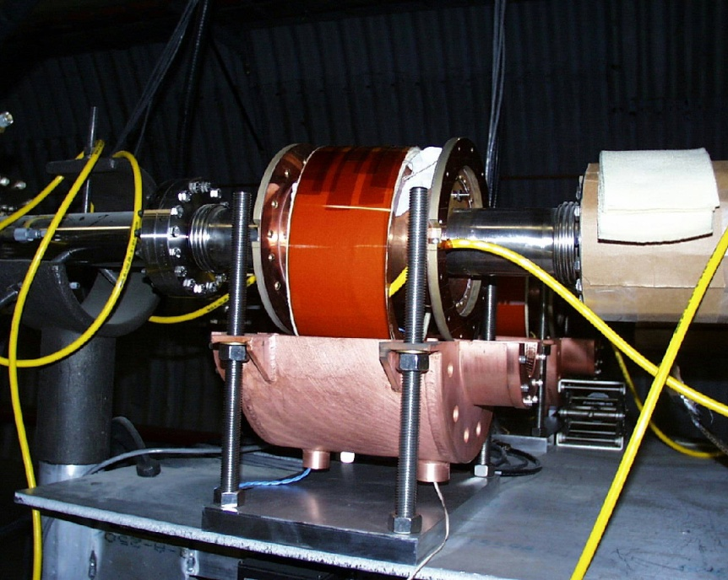
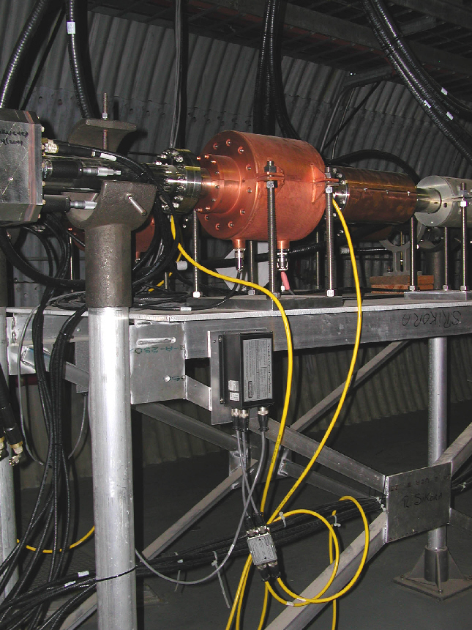
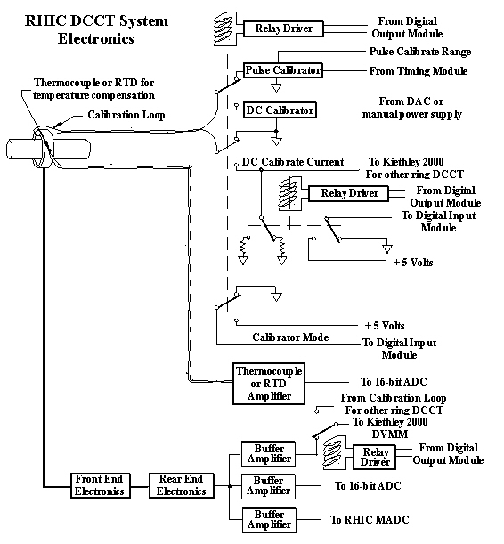
Example: RHIC Current Transformer
http://www.agsrhichome.bnl.gov/RHIC
/Instrumentation/Systems/DCCT
“Overview of RHIC Beam Instrumentation and
First Experience from Operations”, P. Cameron
et al, DIPAC 2001

Slide 11
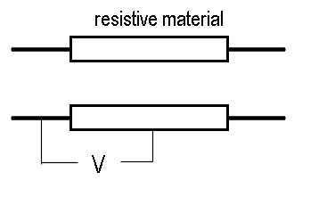
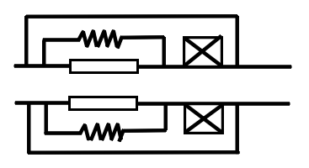
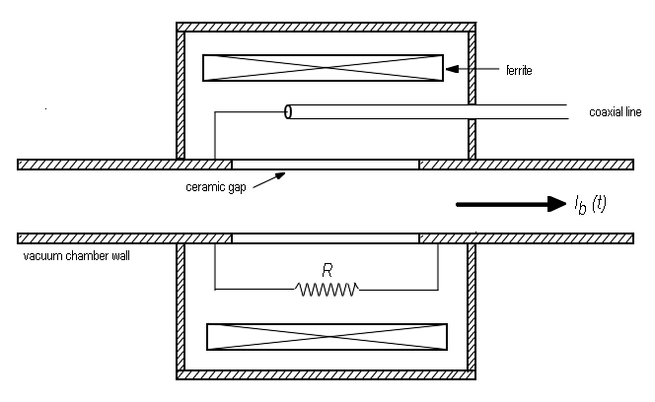
Beam Current – Wall Gap / Current Monitor
principle:
remove a portion of the vacuum chamber and replace
it with some resistive material of impedance Z
detection of voltage across the impedance
gives a direct measurement of beam current
since V= i_{w}(t) Z = -i_{b}(t) Z
(susceptible to em pickup
and to ground loops)
add high-inductance metal shield
add ferrite to increase L
add ceramic breaks
add resistors (across which V is to be measured)
alternate topology - one
of the resistors has been
replaced by the inner con-
ductor of a coaxial line

Slide 12
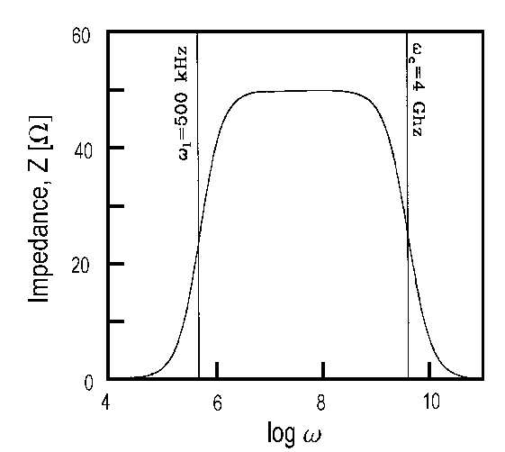



Wall Current Monitor Bandwidth
sensitivity:
circuit model using parallel
RLC circuit:
high frequency response is determined by C:
(ω_{C} = 1/RC)
low frequency response determined by L:
(ω _{L} = R/L)
intermediate regime: R/L < ω < 1/RC – for high bandwidth, L should be
large and C should be small
remark: this simplified model does not take into account the fact that
the shield may act as a resonant cavity

Slide 13
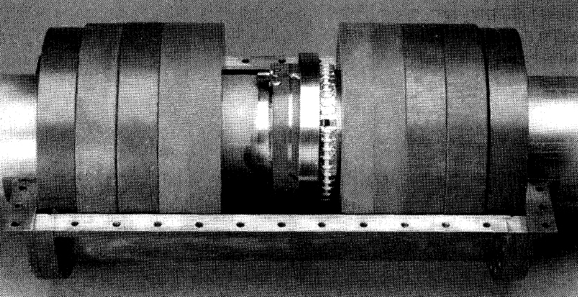
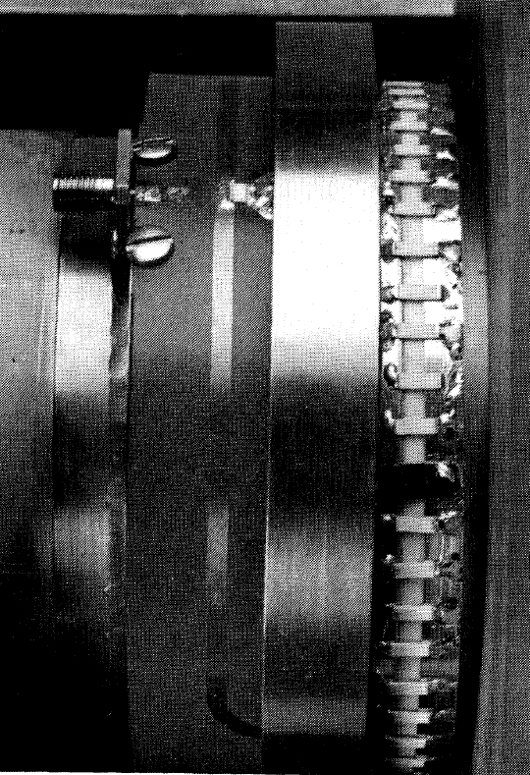
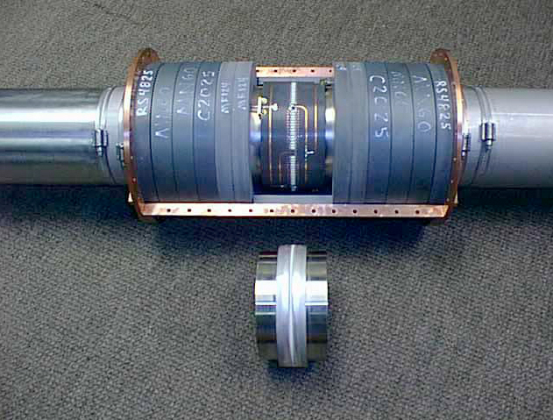
Example WCMs
RHIC design based on prototype WCM shown below by R.C. Webber.
“The RHIC [WCM] system”, P. Cameron, et al, PAC (1999)
resistors
ceramic
gap
ferrite
“An Improved
Resistive Wall
Monitor”, B. Fellenz
And Jim Crisp,
BIW (1998) for
the FNAL main
injector
“Longitudinal Emittance: An Introduction to the Concept and Survey of Measurement Techniques
Including Design of a Wall Current Monitor”, R.C. Webber (FNAL, 1990) available at:
http://www.agsrhichome.bnl.gov/RHIC/Instrumentation/Systems/WCM
/WCM%20Shafer%20BIW%201989%2085_1.pdf

Slide 14
Electromagnetic Beam Position Monitors
In electromagnetic BPMs, the image charge in an electrode is proportional to the beam current and to the angle included between the beam and the electrode extremes:
In addition to this geometric effect, the field lines tend to cluster closely in the region of the nearest electrode (the E field must be perpendicular to the walls). For this geometry, this gives an additional factor two:

Slide 15
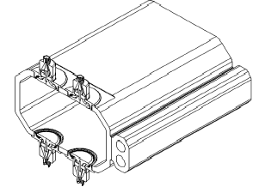
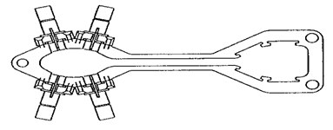
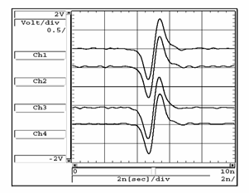
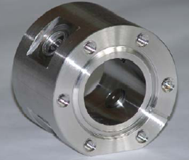
“Button” Type BPMs
Typical geometry used in the presence of synchrotron radiation.
PEP II
APS
Capacitive type (derivative response), low coupling impedance, relatively low sensitivity, best for storage rings.
DELTA
SOR-Ring

Slide 16
Stripline as a Pickup
Beam passes upstream port of PU
  Induced voltage at gap
  If stripline impedance is matched to upstream output port, half of pulse exits port, the other half travels downstream. For vacuum, pulses moves at c.
-
L
16

Slide 17
Stripline as a Pickup
Beam passes downstream port of PU
  Induced voltage at gap (opposite polarity to upstream port)
  If stripline impedance is matched to downstream output port, half of pulse cancels pulse from upstream port, the other half travels upstream and is observed at upstream port at a time 2L/c.
L
-
L

Slide 18
Stripline as Pickup
The downstream pulse exits through the upstream port at a time 2L/c. No signal from downstream port (ideal case)
2L/c
upstream port
-
L
L

Slide 19
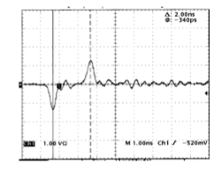
Example Stripline Signal
Advanced Light Source stripline. Signal at the upstream port. Kicker length is 1 nsec (30 cm)
2 nsec

Slide 20
Multibunch signals
Multibunch beam with bunches separated by 2L/c. The next bunch signal cancels the downstream signal from the previous bunch. Therefore, NO SIGNAL for this bunch spacing! Maximum signal power for a bunch spacing of L/c.
-
-
2L
L

Slide 21
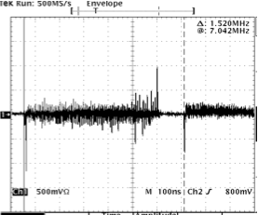
Example Multibunch Signal
ALS stripline kicker (used as a PU, upstream port)
L=30 cm (1 nsec), Bunch spacing 60 cm (2 nsec)
Signals only at start and end of bunch train

Slide 22
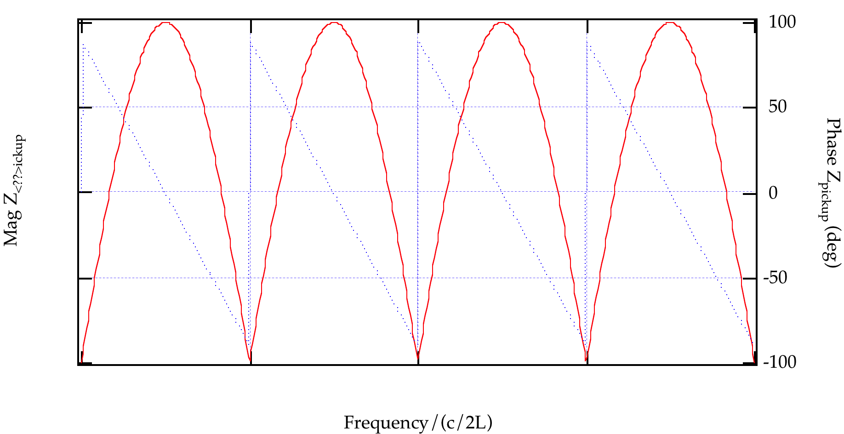
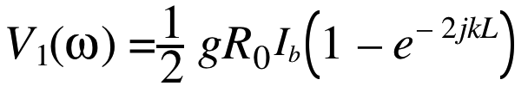
Frequency Response
The signal from the upstream port is a bipolar pulse separated by 2L/c
This signal in the frequency domain is given by (assume the pulses are delta functions)
2L/c
g=fraction of image current intercepted by stripline
R₀=stripline characteristic impedance

Slide 23
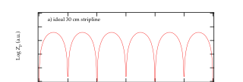

Beam Signal in Frequency Domain
Frequency domain signal is the product of the beam spectrum with the pickup impedance
  Signal bunch
  Multibunch
    Separation by 2L/c
    Separaction by 4L/c

Slide 24

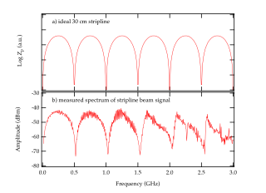
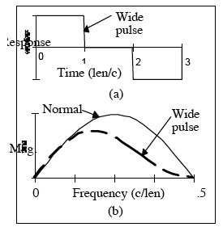
Bandwidth Limitations
At higher frequencies, the stripline deviates from the ideal response.
One issue is width of the pickups broadening the delta function response at the pickup. Wider pickups have larger signal but lower bandwidth

Slide 25
Stripline kickers: a simplified model
We apply an alternating voltage between the plates:
From Maxwell’s equations, there are electric and magnetic fields between the plates:
A particle traveling in the +z direction with speed c will experience a force:
For an ultra-relativistic particle, and the electric and magnetic forces almost exactly cancel: the resultant force is small. But for a particle traveling in the opposite direction to the electromagnetic wave, and the resultant force is twice as large as would be expected from the electric force alone.
V+
-
x
E_{x}
z
B_{y}
V-
L

Slide 26
Stripline Kickers
Consider a differential voltage pulse into the downstream port
  Forces from E and B fields are equal and in the same direction
  Pulse must be twice as long as kicker length for greatest efficiency
  To give individual bunches separate kicks, kicker must be less than twice the bunch spacing.
2L
V+
-
x
E_{x}
z
B_{y}
L
V-

Slide 27
Transverse kicker frequency response
Transverse kicker frequency response can be found from transform of square pulse
  Nonzero DC response (i.e. works as constant deflector)
  First zero in response at f=c/2L
  Best response at baseband. Reduced response in upper bands.

Slide 28
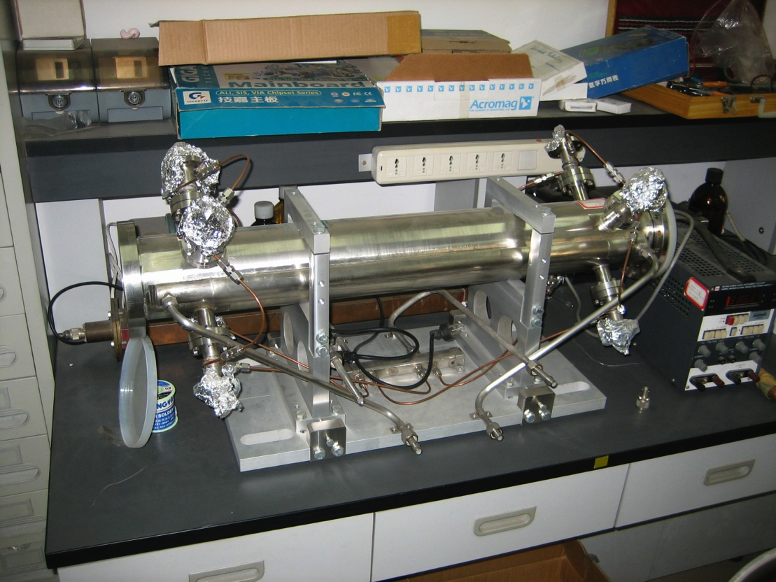
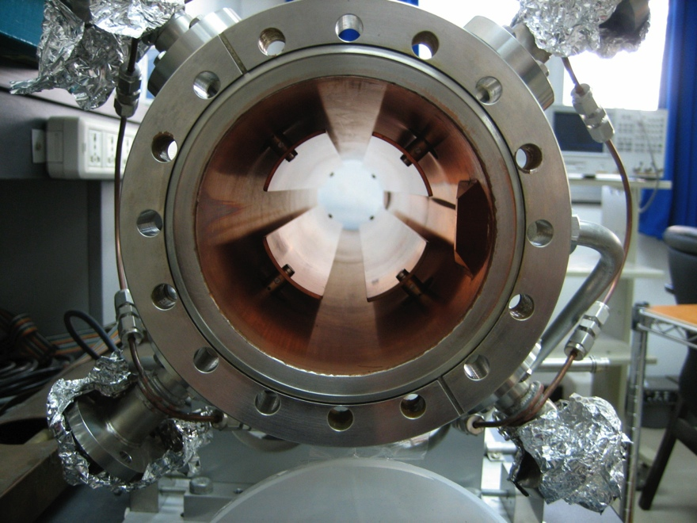
Example: BEPC-II Stripline Kicker
Often, horizontal and vertical electrodes are combined in the same tank.

Slide 29
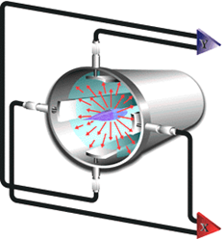
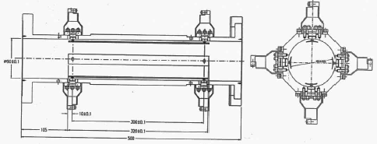
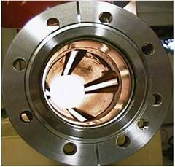
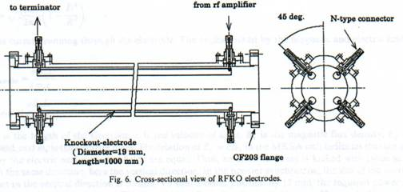
Stripline BPM
SLAC
LCLS
FNAL Injector
Stripline structures are also widely used as the “kicker” in transverse and longitudinal feedback systems.
SPRING 8 Kicker
HERA Stripline BPM

Slide 30
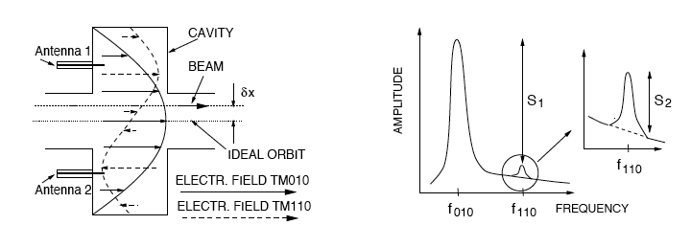
Beam Position – Cavity BPMs
principle: excitation of discrete modes (depending on bunch charge, position,
and spectrum) in a resonant structure; detection of dipole mode signal
proportional to bunch charge, q×transverse displacement, δx
theoretical treatment: based on solving Maxwell’s equations for a cylindrical
waveguide with perpendicular plates on two ends
motivation: high sensitivity (signal amplitude / μm displacement)
accuracy of absolute position, LCLS design report
dipole mode cavity BPM consists of (usually) a cylindrically symmetric cavity, which
is excited by an off-axis beam:
reference:
“Cavity BPMs”, R. Lorentz
(BIW, Stanford, 1998)
TM₀₁₀, “common mode” (∝ I)
TM₁₁₀, dipole mode of interest
amplitude detected at position of antenna contains
contributions from both modes → signal processing

Slide 31
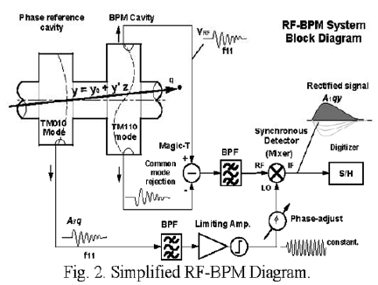
Cavity BPM Signal Processing
One example of a typical Cavity BPM signal path
  Dipole cavity gives offset signal. Magic-
  T used to subtract monopole mode
  Separate monopole cavity used to produce reference signal

Slide 32
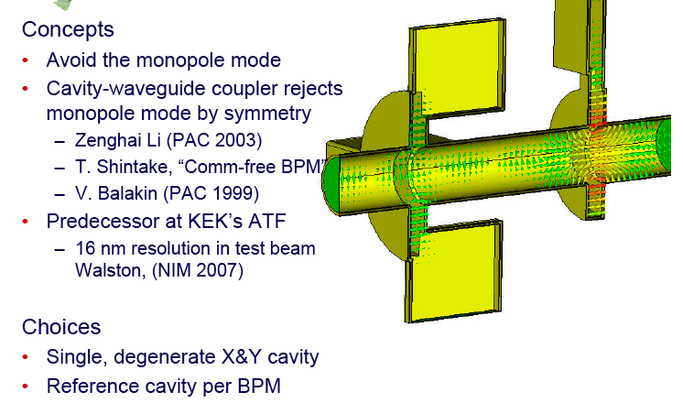
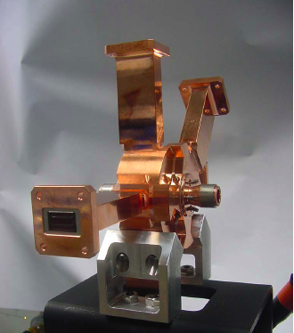
Example: LCLS Cavity BPM
Steve Smith, SLAC

Slide 33
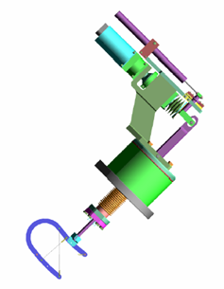
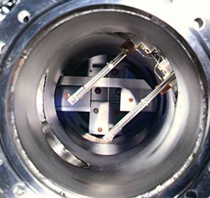
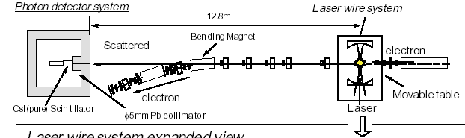
Beam Profile Monitors: Wire Scanners
A moveable wire scans the beam transversally.
The interaction between the beam and the wire generates (by ionization, bremsstrahlung, atomic excitation, …) a “shower” of secondary emission particles proportional to the number of beam particles hitting the wire.
Oxford-Danfisik
SNS
The secondary particles (mainly electrons and photons) are detected and the beam transverse profile can be reconstructed.
The wire material can be a metal, carbon, or …
a laser beam (Compton scattering,
neutralization)
H⁻ beam
profile
BNL-SNS
KEK

Slide 34
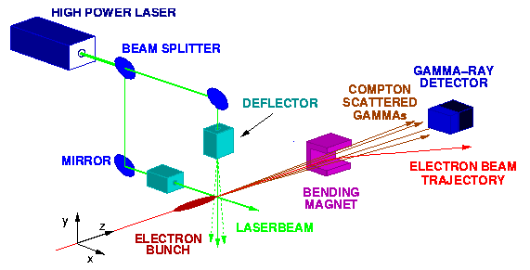

Transverse Beam Emittance – Laser Wire Scanners
principle: laser wire provides a non-invasive and non-destructable target
wire scanned across beam (or beam across wire)
constituents: laser, optical transport line, interaction region and optics, detectors
beam size measurements: forward scattered Compton γs or
lower-energy electrons after deflection by a magnetic field
schematic of the laser wire
system planned for use at
PETRA and for the third
generation synchrotron light
source PETRA 3 (courtesy
S. Schreiber, 2003)
high power pulsed laser
overview of the laser wire
system at the ATF (courtesy
H. Sakai, 2003)
optical cavity pumped by
CW laser (mirror reflectivity
~99+%)

Slide 35


Photon-based Beam Profile Monitors
Photon diagnostics exploiting the described emission mechanisms are widely used for measuring the transverse and longitudinal profiles of relativistic beams.
In fact, the spatial distribution of the photons reproduces the particle distribution of the beam and can be conveniently used for the characterization of the beam.
Monitors exploiting transition and Cerenkov radiation are relatively invasive and are mainly used in single pass or few-turns accelerators.
A. Lumpkin
The angular distribution of the photons depends on several beam parameters. This fact can be exploited for the measurements of quantities other than the beam distribution as well.

Slide 36


Synchrotron Radiation Monitors
Synchrotron radiation, very abundant in electron and positron accelerators and present in very high energy proton storage rings, is widely used for transverse and longitudinal beam profile measurements.
One of the appealing features of such diagnostic systems is that they are non-invasive.
The resolution of these monitors are limited by the geometry of the system and by the radiation diffraction.
The geometric limitation requires small aperture systems while the diffraction term requires large apertures and shorter photon wavelengths. Tradeoff solutions must be adopted.
ALS
The typical resolution in electron storage rings using hard x-ray photons ranges between few and tens of microns.

Slide 37



Photon-based Longitudinal Profile Monitors
In photon-based longitudinal beam profile monitors, “fast” detectors such as streak cameras, fast photodiodes and photomultipliers are used.
In last generation streak cameras systems, time resolutions of several hundreds of fs have been achieved.
STREAK CAMERA Scheme
LEP
ESRF
Image from
Max Planck Institute web site
Photocathode
Streak cameras with an additional pair of sweeping electrodes (orthogonal to the other one) have single bunch-single turn capabilities and can be used for the characterization of single and multibunch intabililities.
APS

Slide 38


Bunch Length – Transverse Mode Cavities
Principle: use transverse mode deflecting cavity to “sweep”/kick the beam,
which is then detected using standard profile monitors
Principle of the TM₁₁
transverse mode
deflecting cavity
introduce x-z correlation
oriented to displace beam
vertically while a horizontal
bending magnet deflects the
beam onto the screen
σ_{y}² = A(V_{rf}-V_{rf,min})² = σ_{y0}²
σ_{z} = A^{1/2}E₀λ_{rf}/2πR₃₄
σ_{z} expressed in terms of fit
parameter, A
(figures courtesy R. Akre, 2003)

Slide 39
Other Beam Profile Monitors
The simplest beam profile monitor is probably the one using fluorescent screens intercepting the beam.
The beam particles hitting the screen material excite the atoms that subsequently radiate a photon in the visible range when decaying back to the ground state.
The resulting image of the beam on the screen can be visualized by a ccd camera and eventually digitized by a frame grabber for further analysis.
Such monitors are destructive and are typically used only in beam transferlines.
Another category of beam profile monitors are the ionization chambers.
In this monitor, a gas in a dedicated portion of the vacuum chamber is ionized by the passage of the beam.
Depending on the scheme used, either the electrons or the ionized atoms can be detected for the beam profile reconstruction. Time of flight analysis of the ionized particles is usually necessary.
Because of their perturbative nature, these monitors are mainly used in single pass accelerators.

Slide 40


Schottky Noise Monitors
A beam is composed by a finite number of particles.
The beam signal collected by a detector at a fixed position in a storage ring shows statistical fluctuations of the intensity due to the random arrival time of the particles at the detector position.
Such intensity fluctuations are referred as Schottky noise (SN).
FNAL
SN spectra contain a lot of information concerning a number of beam quantities, including longitudinal and transverse tunes, momentum spread and beam current.
Schottky noise monitors are actually the main non-invasive diagnostic tool used in heavy particle storage rings.
FNAL
Schottky noise cannot be used in electron and positron machines because in those accelerators, the noise due to synchrotron radiation quantum fluctuations is strong and covers the Schottky noise.
Revolution
harmonic
Synchrotron
sidebands

Slide 41

Tune Measurement
In electron and positron machines, in order to measure the betatron tunes in the absence of instabilities, coherent beam oscillations need to be excited.
RATIO B/A
AMPLITUDE
NETWORK
ANALYZER
DAΦNE
PHASE
HP 4195 A
RF OUT
A
B
BAND-PASS
FILTER
Horizontal
Vertical
100 W
CLASS A
0
KICKER
0
π
π
0
0
100 W
CLASS A
BEAM
POSITION
MONITOR
Synchrotron tune can be measured by modulating the RF phase or amplitude and by measuring the induced sidebands using the sum signal from a pick-up.The same detection part of the betatron tune measurement system can be used.

Slide 42


Momentum and Momentum
Spread Measurement
In linacs and transferlines the momentum and momentum spread are mainly measured by spectrometer systems.
The beam enters in the field of a dipole magnet where particles with different momenta follows different trajectories.
The particle position is then measured on a detector downstream the magnet.
DAΦNE
Secondary emission
hodoscope
Spectrometer
control window
DAΦNE-Linac
The spectrometer resolution is limited by the intrinsic beam size at the detector plane and by field non-linearities.

Slide 43




Momentum Spread & Emittance
Measurement in Rings
In electron and positron storage rings the equilibrium beam emittance and the momentum spread can be measured by the combined measurement of at least two transverse beam profiles at two different ring locations.
The beam size at a particular azhimutal position is given by:
If the beam size is measured in two different points of the ring and the optical functions at such points are known, then:
ε: emittance
p: momentum
β: beta function
η: dispersion
κ: emittance ratio
x_{rms}: rms beam size

Slide 44

Emittance Measurement
In Linacs and Tranferlines
A “popular” technique for measuring the emittance in linacs or transferlines uses the so-called “three gradient method”.
Quadrupole
The gradient (focusing-defocusing strength) of a quadrupole is changed and the related transverse beam profiles are recorded by a detector downstream the quadrupole.
Beam profile
monitor
The measurement requires a minimum of 3 different quadrupole gradients but the accuracy can be improved if more points are taken.
The beam size at the detector is defined by the beam emittance and by the local beta function.
The emittance is an invariant while the beta changes with the changing quadrupole gradient.
An analytical expression linking the transverse profiles with the beam emittance can be derived and used for fitting the experimental data.
From the fit, the values for the emittance and for the optical functions at the quadrupole position can be finally extracted.
DAΦNE
LINAC

Slide 45
References
R. Littauer, “Beam Instrumentation”, Proc. Physics of High Energy Particle Accelerators (Stanford, CA, 1982); AIP Conf. Porc. 105 (1982) 869.
M. Serio, “Diagnostica e misure”, Seminars on DAΦNE, February 2000.
M. Zolotorev, “Radiation and Acceleration”, tutorial, LBL 2005.
M. Minty, “Diagnostics”, CAS Synchrotron Radiation and Free-Electron Lasers, Brunnen, Switzerland, July 2003.

Slide 46



More on Longitudinal
Profile Monitors
For relatively long bunches ~ 100 ps or longer electromagnetic pickups can be efficiently used.
DAΦNE
Accumulator
In this example, the beam inside the DAΦNE Accumulator (~ 150 ps rms) is measured by using the signal from a stripline.
Femtoseconds resolution (or even smaller) can be achieved by interferometric techniques involving coherent light in the Far-IR (coherent synchrotron radiation, coherent transition radiation, …) or by electro-optic techniques using non-linear crystals and laser probing.
L’OASIS - LBL
L’OASIS - LBL

Slide 47
Beam Current Monitors:
The DC Current Transformer
For measuring the average beam current (DC component), the parametric current transformer or DC current transformer (DCCT) is used:
The DCCT uses two high permeability cores driven to saturation by a low frequency current modulation.
The signals from two secondary coils of the cores are mutually subtracted.
Because of the non-linear magnetization curve of the core material, this difference signal is zero only when the beam current is zero.
Demodulator
In the presence of beam current this difference signal is non-zero and in particular shows a second harmonic component.
A current proportional to the amplitude of this component is fed back into a third coil in order to compensate for the beam current and to make the difference signal zero.
At equilibrium, the current flowing in this third coil is equal in amplitude to the beam current but opposite in sign.

