Slide 1

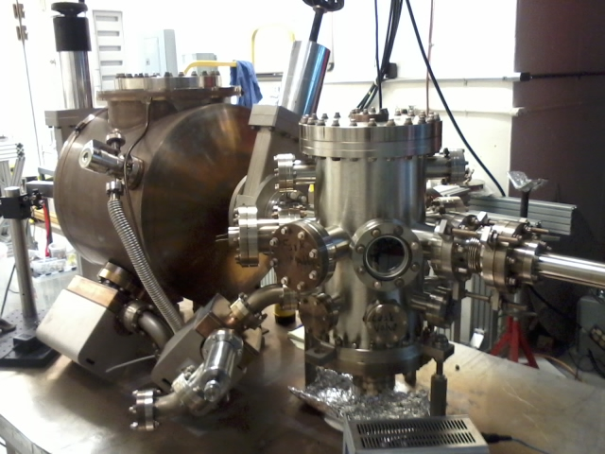
Vacuum Systems I
basic concepts
Second Mexican Particle
Accelerator School
Carlos Hernandez Garcia
JLAB
November 11 – 21 2015, Guanajuato, Mexico

Slide 2
Vacuum fundamentals Outline
Definitions and philosophical musings
Why do we need vacuum and other practicalities
Ideal Gas Law and units
Velocity of gas molecules and mean free path
Gas flow regimes definition
Vacuum regimes definition and atmospheric composition
Sources of gas in a vacuum system
Pumping speed
Throughput
Conductance

Slide 3
What is vacuum?
Nothing? Nada?
“How can ‘nothing’ be something” asked the Greek philosophers
“Vacuums are nothings. We only mention them to let them know we know they're there.” Middle school student’s definition of vacuum.
Vacuum occurs in nature, but even in intergalactic space there is a presence of particles and fields
In practical life, vacuum is defined as any reduction in atmospheric gas density, which decreases with altitude and with weather related low pressure systems.
Inside a “closed” system (known as ‘vessel’ or ‘vacuum chamber’) vacuum is defined as any reduction in the gas density compared to the outside atmospheric density.

Slide 4
Pressure!
There are 2.5x10¹⁹ molecules of air in 1 cm³ at sea level and 0°C.
Pressure is defined a force per unit area.
  In the Standard Units:
1 Newton
1 Pascal = 1 Newton / m²
1 m²

Slide 5
Atmospheric pressure and units
Atmospheric pressure (Atm) at sea level and 0° Celsius
  760 Torr (United States)
  1013 mBar (mili-Bar, Europe)
  101,330 Pa (Pascal, Asia)
  14.7 PSI (Pounds per Square Inch)
  29.92 (inches of mercury, United States)
  33.79 feet of water!!

Slide 6
Pressure unit conversions
1 Atm = 760 Torr
1 Pascal = 7.5 x 10⁻³ Torr
1 mBar = 0.750 Torr
1 PSI = 51.7 Torr

Slide 7
Wait!...How is vacuum related to pressure?
They are the same physical concept, both have units of Force per unit area.
Vacuum is any level below atmospheric pressure.
  This means that the force exerted by a number of particles per unit volume on a surface is less than that at atmospheric pressure.
1 Atm ≈ 10⁵ Pascals
Vacuum < 1 Atm

Slide 8
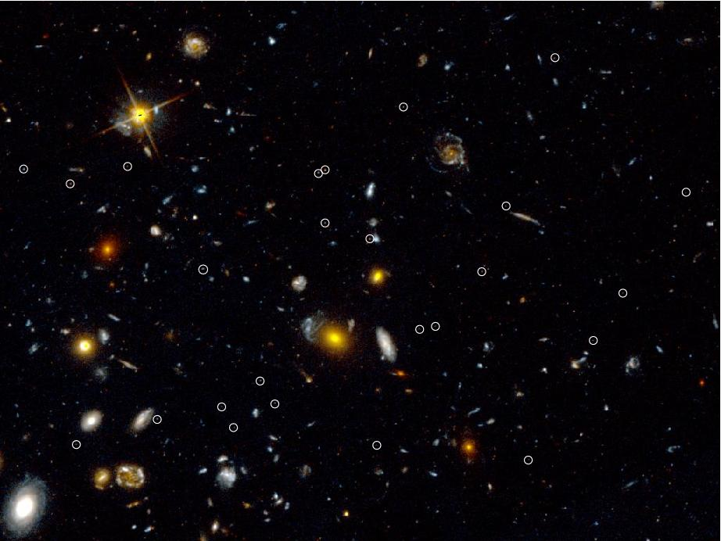
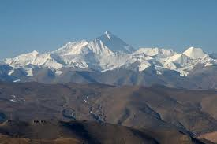
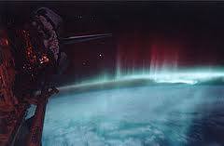
Where do we find vacuum?
Since the atmospheric gas density decreases with altitude, vacuum incrementally improves from sea level, to tall mountains, to the upper layers of the atmosphere, to interplanetary space, to interstellar space, to intergalactic space.

Slide 9
Where else do we find vacuum?
In a filament light bulb
In old TV’s (cathode ray tube) and radios (vacuum tube or thermionic valve)
In X-ray tubes
In microwave generator tubes (klystrons) for radar, radio and tv broadcast systems, for cooking ovens…
In electron microscopes
In thin film deposition systems
Crystal growth and assembly for the semiconductor industry
Photomultiplier tubes for astronomy and particle/high energy physics detectors
And of course, in particle accelerators

Slide 10

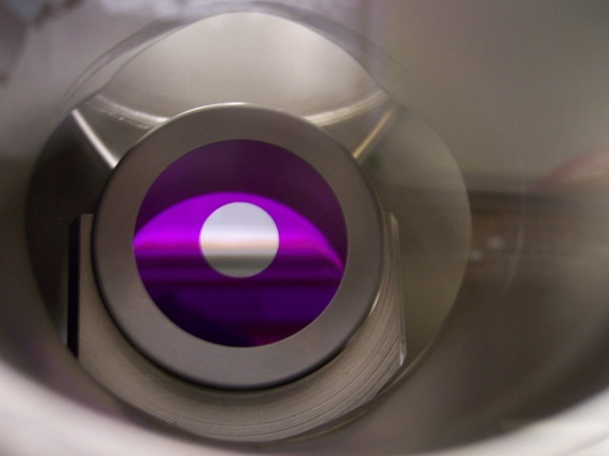
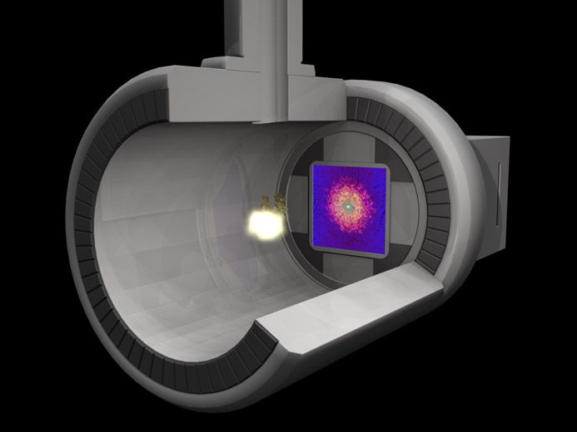
What do all those applications have in common?
Some use a hot filament to produce light or a stream of electrons
Some rely on sensitive surface chemistry
Some involve generation and transport of particles

Slide 11
What would happen to those devices if there was no vacuum environment to operate in?
Filaments will burn out
Electronic and photomultiplier devices will not work with surface contamination
Particles generated will scatter in air preventing any kind of transport and acceleration
No semiconductor devices for the electronic industry
No electron microscopes
No x-ray generators
No particle accelerators
No radar, radio, TV, microwave ovens,…
…total chaos…
…and yet, humans beings have managed just well without knowing about vacuum for about 200,000 years, until technology dominance in the last century.

Slide 12
Vacuum is multidisciplinary subject
Surface science
Modeling and computer science
Materials science
Mechanical engineering and design
Chemistry
Physics
Fluid dynamics
Metallurgy
Heat transfer
Molecular thermodynamics

Slide 13
Ideal Gas Law
The behavior of a collection of gas molecules in a vessel is dependent upon tits volume, the pressure, temperature and composition of the gas.
  P = pressure (Pascal)
  V = volume (m³)
  n = number of moles
  R = Universal gas constant 8.3145 J/mol K
  T = temperature (degrees Kelvin, K)
  N = number of molecules
  k =Boltzmann constant = 1.38x10⁻²³ J / K = R/N_{A}
  N_{A} = Avogrado’s number = 6.022 x 10²³ /mol

Slide 14

Velocity of gas molecules
The velocity of gas molecules is independent of the pressure of the gas, and depends only on the molecular weight of the gas and its absolute temperature.
V = average velocity (cm/sec)
T = absolute temperature (K)
M = molecular weight of gas (g/mole)

Slide 15
Mean Free Path
The mean free path is the
average distance that a gas
molecule can travel before
colliding with another gas
molecule.
Mean Free Path is determined by
  Size of molecule
  Pressure
  Temperature

Slide 16
Mean Free Path Equation
λ_{i} = mean Free Path of gas species “i” (m)
K = Boltzman’s constant (1.38x10⁻²³ Joules/K)
T = Temperature (K)
P = Pressure (Pa)
d_{i} = gas species diameter (m)

Slide 17
Gas Flow
The flow of gases in a vacuum system is divided into three regimes. These regimes are defined by specific value ranges of a dimension-less parameter know as the Knudsen number.
λa = mean free path
a = characteristic dimension of flow channel (pipe radius)

Slide 18
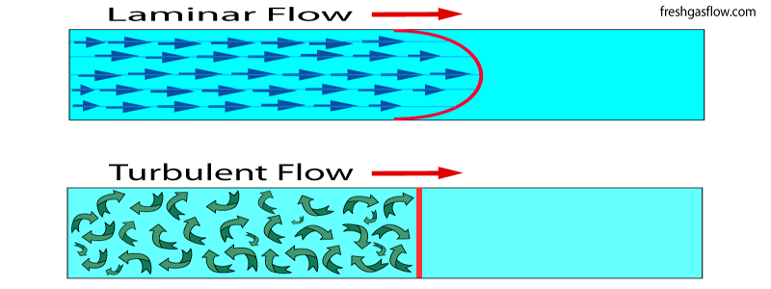
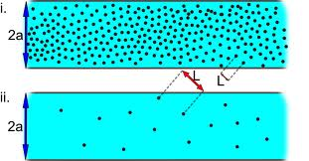
Gas flow regimes
Viscous flow K_{n} = λ_{a}/a < 0.01
Transition flow 0.01 < K_{n} < 1.0
Molecular flow K_{n} > 1.0

Slide 19
Vacuum regimes and atmospheric composition
Low, Medium Vacuum (>10⁻³ Torr)
  Viscous flow
    interactions between particles are significant
  Mean free path less than 1 mm

Slide 20
Vacuum regimes and atmospheric composition
High Vacuum (10⁻³ to 10⁻⁶ Torr)
  Transition region

Slide 21
Vacuum regimes and atmospheric composition
High and Ultra High Vacuum (10⁻⁶ - 10⁻¹² Torr)
  Molecular flow
    interactions between particles are negligible
    interactions primarily with chamber walls
  Mean free path 100-10,000 km

Slide 22
Vacuum regimes and atmospheric composition
Extreme High (<10⁻¹² Torr)
  Molecular flow
  Mean free path 100,000 km or greater

Slide 23
Vapor Pressure
At thermal equilibrium the net flux of particles at the surface of bulk material is zero
Each element has a specific saturation pressure for a given temperature. The saturation pressure is also referred as the saturation vapor pressure, equilibrium pressure, or just vapor pressure
Psat
Pvap < Psat
In this case the gas above the bulk is considered to be saturated
In this case there is not sufficient bulk material to support a saturation vapor pressure

Slide 24
Sources of gas in a vacuum system
True Leaks
Diffusion
Desorption
Permeation
Backstreaming
Mechanical Pump
Evaporation
Virtual Leaks

Slide 25
Adsorption
Adsorption is the arrival of gas molecules on a surface
Adsorbed gas molecules exist as molecular layers and in some ways behave like a sheet of liquid
Pressure (Torr) | Molecules on surface/molecules in volume | Time to form a monolayer (sec)
10⁻³ | 0.5 | 2.2x10⁻³
10⁻⁶ | 500 | 2.2
10⁻⁹ | 500,000 | 2.2x10³

Slide 26
Desorption (outgassing)
Desorption is the evolution of adsorbed gas from the internal surfaces of a vacuum vessel (chamber)
Desorption is a function of:
  Gas molecule characteristics
  Surface material
  Surface treatment
  Surface temperature
  Exposure at time of vacuum
High temperature bakeout under vacuum is required to desorb gasses in the shortest possible time
Desorption can also be photon stimulated

Slide 27
Evaporation
QE = gas load due to evaporation (Torr-liters/sec)
T = temperature (K)
M = molecular weight (grams/mole)
PE = vapor pressure of material (Torr)
P = pressure (Torr)
A = surface area of material evaporating (cm2)

Slide 28
True Leaks
True Leaks are steady-state gas loads, which limit the ultimate pressure of a vacuum system.
True leaks are due to a physical hole or crack in the vessel wall allowing gas to enter the vessel.
Atmosphere
Pump
Vacuum

Slide 29
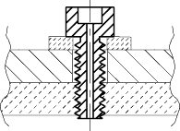
Virtual or Internal Leaks
A virtual leak is a volume of trapped gas that leaks in the vacuum vessel through holes or cracks that do not go through the wall vessel.
Vacuum
Vacuum
Atmosphere
Two welds
Unvented screw

Slide 30

Permeation is the transfer of a fluid through a solid. It depends on:
Atmosphere
Material combination (fluid & solid)
Temperature
Permeation thickness
Area Pressure differential
Vacuum

Slide 31
Diffusion
Atmosphere
Diffusion is defined as the migration of gas trapped in the bulk of vessel material to the internal surface walls.
Vacuum

Slide 32
Pumping Speed
Defined as the measure of volumetric displacement (liters/sec, or cubic meters/minute)
It is the volume of gas flowing past a point per unit time
Pumping speed is independent of pressure
Pumping speed is an abstract concept used to describe the behavior of gas in a vacuum system

Slide 33
Throughput: The measure of gas flow rate (Torr-liters/sec)
For constant pumping speed throughput varies with pressure:
Q leak
Q outgas
Under dynamic conditions:
Q pump

Slide 34
Conductance
Defined as the measure of ease with which abstract volumes can pass from one place in a vacuum system to another
Has units of liters per second
Is an abstract concept used to describe the behavior of gas in a vacuum system
Is specific to a particular geometrical configuration
When the mean free path is a gas species in a system is less than the dimensions of the system the conductance is pressure dependent.

Slide 35
Conductance in molecular flow
Aperture
  A = aperture area (cm2)
  T Temperature (K)
  M molecular weight (g/mole)
Long tubes (L>10D)
  D = pipe diameter (cm)
  L = pipe length (cm)

Slide 36
Conductance in series
C2
C1
C3

Slide 37
Conductance in parallel
C1
C2
C3

Slide 38
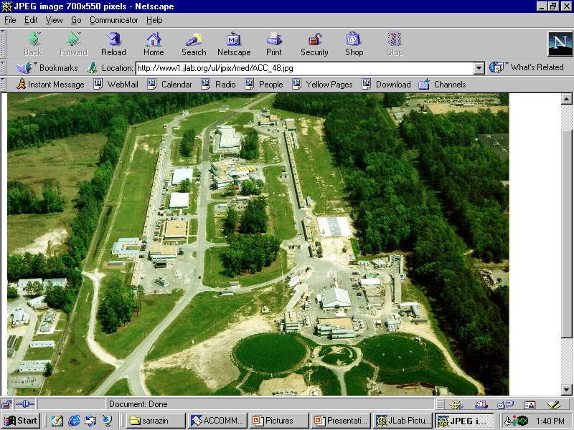
Now lets learn about how the vacuum concepts are applied into techniques and equipment to provide vacuum for accelerator applications
Areal view of the Jefferson Lab
Continues electron beam accelerator facility
* Courtesy of Matt Poelker. CEBAF Polarized Source Group.

