Slide 1
LS1: some more work for detector and ACC experts
FSM
  SOR/EOR
  SAFE/SUPERSAFE
Dist
Web screenshots
Safety data
Alerts
Instructions
INTEGRATION

Slide 2
FULL/FAST SOR/EOR
FULL SOR/EOR is the actual one, used during Run1
  SOR is accepted in READY (and some other states)
  EOR is accepted in all FSM states
FAST SOR/EOR is being introduced in ECS for Run2
  ECS+DCS agreed to implement it introducing a parameter in the actual SOR/EOR command instead of a new command
SOR(RUN_TYPE, RUN_NO, …, SOR_MODE)
  SOR_MODE = [FAST, FULL]
EOR (RUN_TYPE, RUN_NO, EOR_MODE)
  EOR_MODE = [FAST, FULL, COMPLETE_FAST]

Slide 3
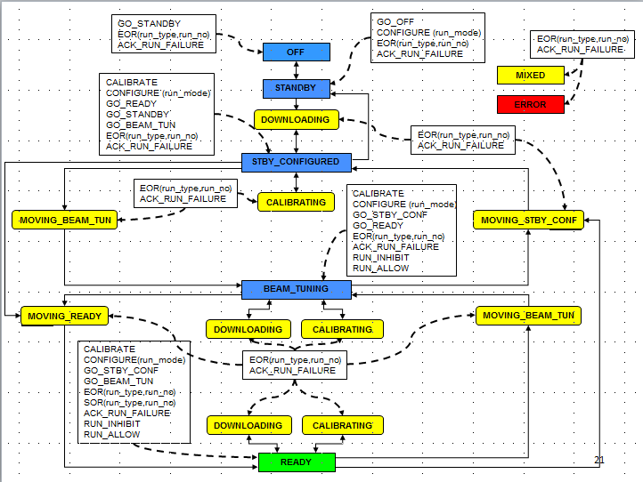
Renewing the FSM for ALICE RUN2 operations
ALICE will move between READY, SAFE and SUPERSAFE conditions
READY
MOVING_READY
SAFE
MOVING_SAFE
SUPERSAFE
MOVING_SSAFE
ERROR
FSM during Run1
ALICE FSM for Run2

Slide 4
New FSM including SAFE concept
CU unchanged
ALI_DCS
CU new or modified
new DU
ACO_DCS
EMC_DCS
HV
LV
RUN
HV
Gas
RUN
SAFE
HV
LV
RunUnit
HV
Gas
RunUnit
SafeUnit
Run1 version
Run2 version

Slide 5
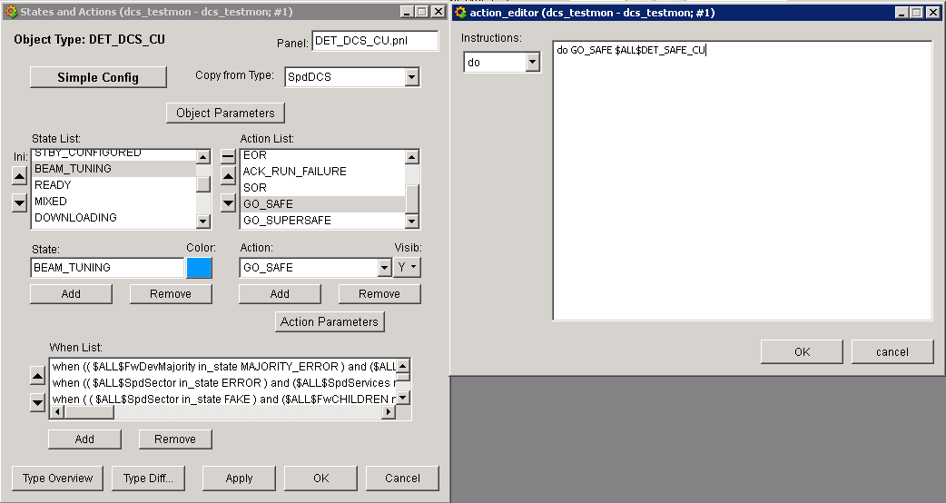
Changes on the top node
Presented at DCS workshop 18/3/2013
All states shall accept commands GO_SAFE GO_SUPERSAFE. These commands can be simply translated or sent to the DET_SAFE_CU
The FSM states of the TOP NODE don’t change
DET top node
DET_DCS
ERROR
MIXED
MOVING_...
GO_SAFE
STANDBY
STBY_CONF
BEAM_TUNING
READY
Run1: RESTORE_SAFE, RESTORE_READY were translated
on the ALICE side as FSM commands (GO_BEAM_TUN, …)
Run2: RESTORE_SAFE, RESTORE_READY are translated
in the TOP NODE as FSM commands (GO_BEAM_TUN, …)

Slide 6
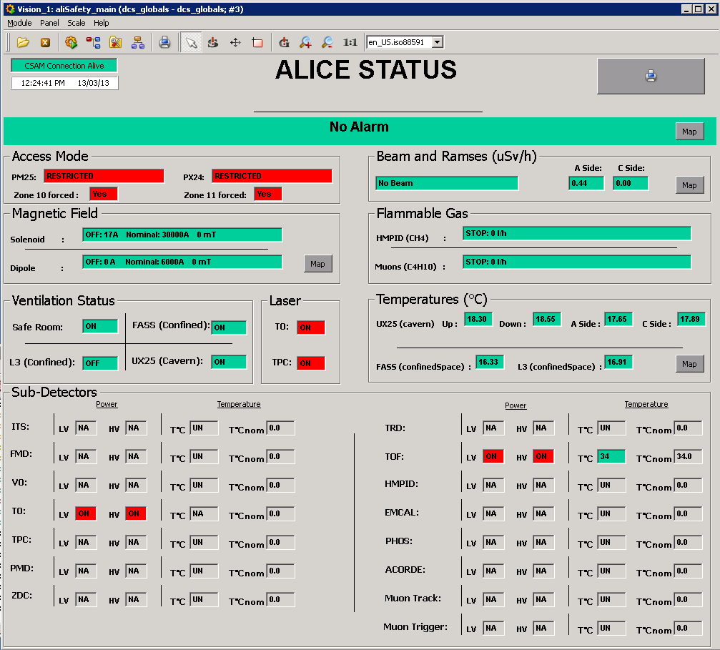
(FIRE) SAFETY datapoint
Script and datapoint to publish safety related info for the firebrigade:
AliFireSafety:
    det.isOnHV (bool)
    det.isOnLV (bool)
    det.avgTemp (float)
    det.refTemp (float)
New DpType
New dp
Example: new dp for ACO
aco_dcs:acoFireSafety.isOnHV
aco_dcs:acoFireSafety.isOnHL
aco_dcs:acoFireSafety.avgTemp
aco_dcs:acoFireSafety.refTemp
DPL file available in Z:\Install\ALICE Framework\ALICE FW Components\aliFireSafety

Slide 7
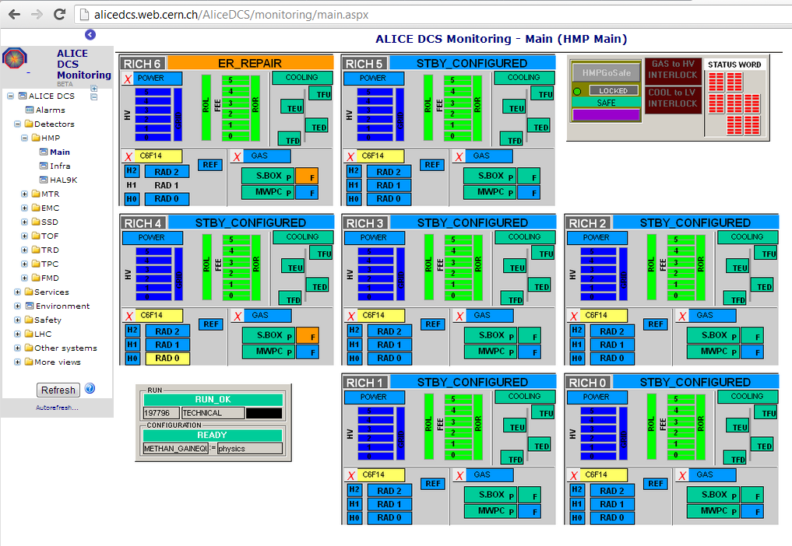
Panels screenshots for the web
Web monitoring
  at present, the screenshots are produced centrally using a script to open the panels found in the shared area in a background UI
  each panel must stay open for several seconds to load all data
  The script producing panels
  screenshots shall run in the
  detector projects, and save
  PNGs in the FS shared area
Package and instructions ready and available in
Z:\Install\ALICE Framework\ALICE FW Components\aliScreenshot

