Slide 1
Managing Storage in a (large) Grid data center
Alberto Pace
Head, Data and Storage Services group
CERN, Geneva, Switzerland
2nd symposium on Grid computing in the Americas
Instituto de Ciencias Nucleares (UNAM)
Nov. 3-4, 2014
Mexico City

Slide 2
Scientific Computing
Scientific computing for large experiments is typically based on a distributed infrastructure
Storage is one of the main pillars
A key parameter in distributed scientific computing is the efficiency
  High efficiency requires to have the CPUs colocated with the data to analyze, using the network.
Scientific Computing
DATA
CPU
NET

Slide 3
Storage Services for Science
Storage in scientific computing is distributed across multiple data centres
Data flows from the experiments to all datacenters where there is CPU available to process the data
Tier-0
(LHC Experiments)
Tier-1
Tier-1
Tier-1
Tier-1
Tier-2
Tier-2
Tier-2
Tier-2
Tier-2
Tier-2
Tier-2
Tier-2

Slide 4
Storage Services for Science
Whenever a site has
  idle CPUs (because no Data is available to process)
  or excess of Data (because there is no CPU left for analysis)
the efficiency drops

Slide 5
Why storage is complex ?
Analysis made with high efficiency requires the data to be pre-located to where the CPUs are available
Tier-0
(LHC Experiments)
Tier-1
Tier-1
Tier-1
Tier-1
Tier-2
Tier-2
Tier-2
Tier-2
Tier-2
Tier-2
Tier-2
Tier-2

Slide 6
Why storage is complex ?
Analysis made with high efficiency requires the data to be pre-located to where the CPUs are available
Or to allow peer-to peer data transfer
  This allows sits with excess of CPU, to schedule the pre-fetching of data when missing locally or to access it remotely if the analysis application has been designed to cope with high latency
Tier-0
(LHC Experiments)
Tier-1
Tier-1
Tier-1
Tier-1
Tier-2
Tier-2
Tier-2
Tier-2
Tier-2
Tier-2
Tier-2
Tier-2

Slide 7
Why storage is complex ?
Both approaches coexists in WLCG
Data is pre-placed
  This is the role of the experiments that plans the analysis
Data is globally accessible and federated in a global namespace
  The middleware always attempt to take the local data and uses an access protocol that redirects to the nearest remote copy when the local data is not available
  All middleware and jobs are designed to minimize the impact of the additional latency that the redirection requires
Using access protocols that allows global data federation is essential
  http, xroot

Slide 8
Within a Storage site
A simple storage model: all data into the same storage
  Uniform, simple, easy to manage, no need to move data
  Can provide sufficient level of performance and reliability
TIER-2 (or 3) STORAGE

Slide 9
Limitations
Different storage solutions can offer different quality of services
  Three parameters: Performance, Reliability, Cost
  You can have two but not three
To deliver both performance and reliability you must deploy expensive solutions
  Ok for small sites (you save because you have a simple infrastructure)
  Difficult to justify for large sites
Expensive
Flash, Solid State Disks
Mirrored disks
Tapes
Disks
Slow
Unreliable

Slide 10
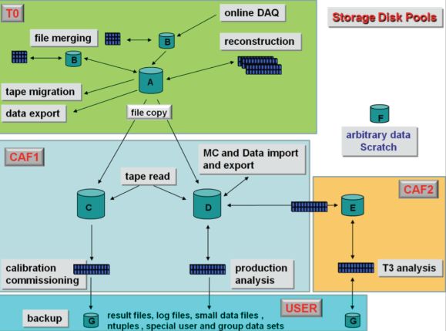
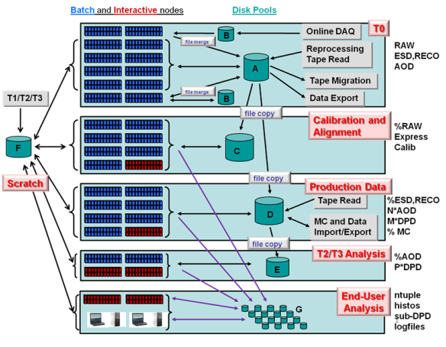
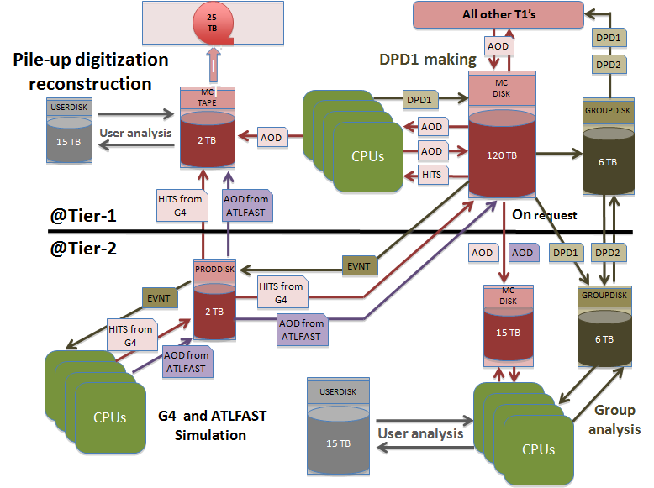
What is data management ?
Examples from LHC experiment data models
Two building blocks to empower data analysis
  Data pools with different quality of services
  Tools for data transfer between pools

Slide 11
Storage services
Storage need to be able to adapt to the changing requirement of the experiments
  Cover the whole area of the triangle and beyond
Expensive
Slow
Unreliable

Slide 12
Examples
Why multiple pools with different quality of services are needed ?
Derived data used for analysis and accessed by thousands of nodes
  Need high performance, Low cost, minimal reliability (derived data can be recalculated)
Raw data that need to be analyzed
    Need high performance, High reliability, can be expensive (small sizes)
Raw data that has been analyzed and archived
    Must be low cost (huge volumes), High reliability (must be preserved), performance not necessary

Slide 13
But the balance is not simple
Many ways to split (performance, reliability, cost)
Performance has many sub-parameters
Cost has many sub-parameters
Reliability has many sub-parameters
Performance
Cost
Reliability
Scalability
Electrical consumption
Latency /
Throughput
Ops Cost
(manpower)
Consistency
HW cost

Slide 14
And reality is complicated
Key requirements: Simple, Scalable, Consistent, Reliable, Available, Manageable, Flexible, Performing, Cheap, Secure.
Aiming for “à la carte” services (storage pools) with on-demand “quality of service”
And where is scalability ?

Slide 15
Tools needed
Needed:
  Tools to transfer data effectively across pools of different quality
  Storage elements that can be reconfigured “on the fly” to meet new requirements without moving the data
Examples
  Moving petabytes of data from a multiuser disk pool into a reliable tape back-end
  Increasing the replica factor to 5 on a pool containing condition data requiring access form thousands of simultaneous users
  Deploying petabytes of additional storage in few days

Slide 16
Roles Storage Services
Three main roles
  Storage (store the data)
  Distribution (ensure that data is accessible)
  Preservation (ensure that data is not lost)
Size in PB
Availability
Reliability
Tier-0
(LHC Experiments)
Storage, data distribution, data preservation
Tier-1
Storage, data distribution, data preservation
Tier-2, Tier-3
Storage, data distribution

Slide 17
Reliability …
You can achieve high reliability using standard disk pools
  Multiple replicas
  Erasure codes
Here is where tapes can play a role
  Tapes ??

Slide 18

Do we need tapes ?
Tapes have a bad reputation in some use cases
  Slow in random access mode
    high latency in mounting process and when seeking data (F-FWD, REW)
  Inefficient for small files (in some cases)
  Comparable cost per (peta)byte as hard disks

Slide 19
Do we need tapes ?
Tapes have a bad reputation in some use cases
  Slow in random access mode
    high latency in mounting process and when seeking data (F-FWD, REW)
  Inefficient for small files (in some cases)
  Comparable cost per (peta)byte as hard disks
Tapes have also some advantages
  Fast in sequential access mode
    > 2x faster than disk, with physical read after write verification
  Several orders of magnitude more reliable than disks
    Few hundreds GB loss per year on 80 PB tape repository
    Few hundreds TB loss per year on 50 PB disk repository
  No power required to preserve the data
  Less physical volume required per (peta)byte
  Inefficiency for small files issue resolved by recent developments
  Nobody can delete hundreds of PB in minutes
Bottom line: if not used for random access, tapes have a clear role in the architecture

Slide 20
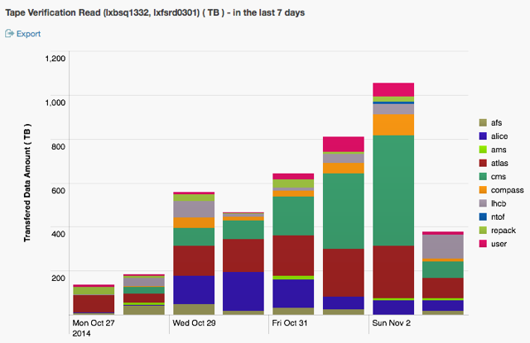
Verifying more than 1PB in 24h
Source: G. Cancio / CERN

Slide 21
Practically … which solution ?

Slide 22
… not a single answer
There are fixed costs for the skilled manpower that is required to manage the high efficiency but complex solutions
  Disk technology, Database technology, Tape technology, Networks, Databases…
Tier-2
(partial infrastructure)
COST
Tier-1
(complete infrastructure)
STORAGE SIZE

Slide 23
AT CERN
Many options available
  interoperability is a key requirement for WLCG
  DPM, dCache
AT CERN
  Separation between HOT (disks) and COLD (tapes) storage
  CASTOR (used for the tape storage backend)
  EOS (used for the disk storage frontend)
    guaranteed low-latency file access for analysis
    collaborative storage platform with space and access regulations
    expand/exchange/shrink during operation
    semi-automatic disk ejection & healing – reduced maintenance

Slide 24
Why this diversity
Example:
  DPM is a consolidated product which is fully supported by CERN. It meets all requirements of a small site
    Integrates well within both xroot and http data federations
  EOS is the new design for a scalable infrastructure designed to minimize management cost. It is ready to meet the requirements for larger sites
    Larger functionalities

Slide 25
Summary
Storage for High Energy Physics or Scientific computing can be
  Too simplistic
  Simple
    Typical for Small Tier-2
  Scalable and Reliable
    Typical for a Tier-1 / Large Tier-2
  Too complex
Behind the software you use, it is always the people that makes the difference

Slide 26
Areas of developments in storage at CERN
For EOS (Reserve slides)
Source: A.J.Peters/ CERN

Slide 27
EOD design
No need for a central relational database
Designed for infinite scalability and arbitrary reliability
expand/exchange/shrink during operation semi-automatic disk ejection & healing

Slide 28
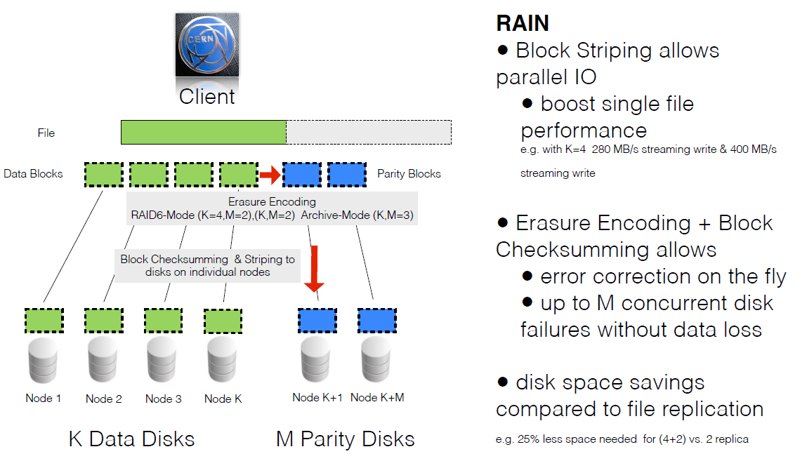
EOS
Arbitrary Reliability – RAIN
  Redundant Array of Independent Nodes

Slide 29
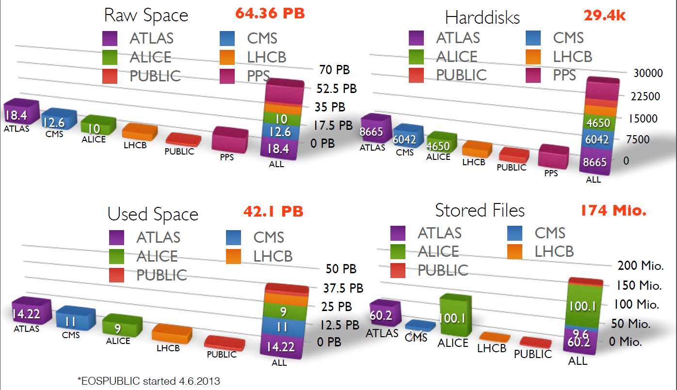
EOS in production at CERN

Slide 30
EOS in production
Five multi-PB installations
  few thousand disks per instance
Simplified life-cycle management workflows for on-going replacement/repair of hardware
JBOD disks (no RAID controller) using software RAIN
low-latency file access with in-memory namespace - 174M files
fine-grained access control and quota management
GRID storage element

Slide 31
Accessed from thousands of CERN-local and remote batch nodes with Kerberos and GSI authentication
Full support for XRootD, GridFTP, HTTP(S) & WebDav protocol - and – mountable with FUSE as a remote file system

