Slide 1



ALICE distributed data processing – past and future
3 November 2014
Latchezar Betev - ALICE

Slide 2
Who am I
Member of the core Offline team of the ALICE experiment @LHC
Data processing coordinator
Grid operations coordinator

Slide 3
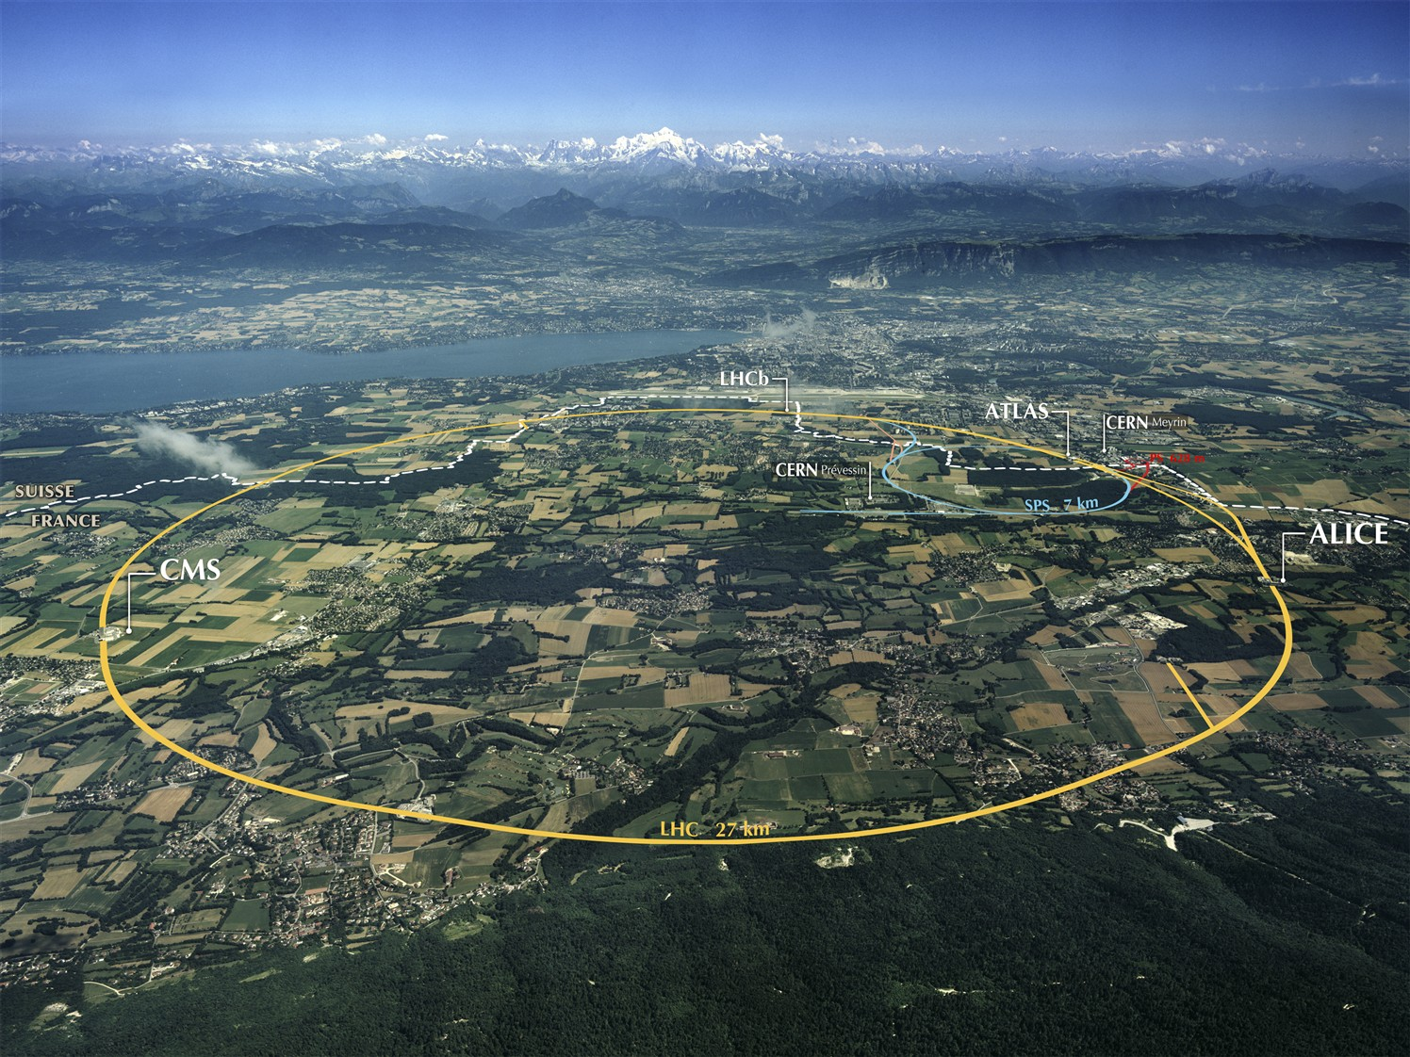
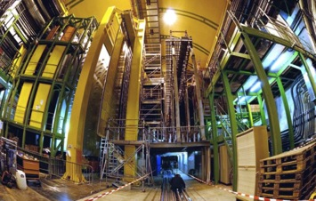
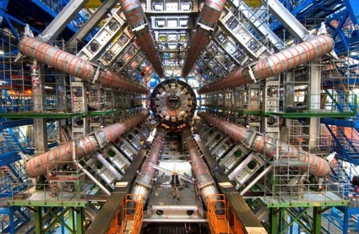
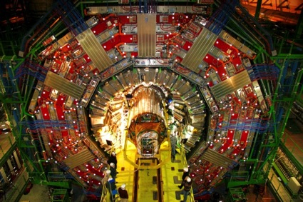
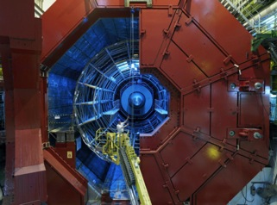
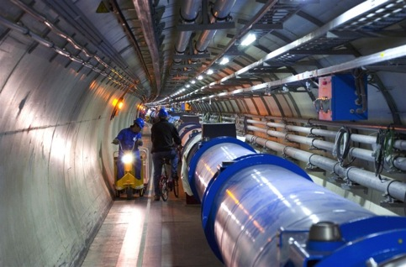

LHC and Experiments
p-p
B-Physics, CP Violation
(matter-antimatter symmetry)
LHCb
CMS
ATLAS
General purpose,
p-p, heavy ions
New physics: Higgs boson, SuperSymmetry
Exploration of a new energy frontier
in p-p and Pb-Pb collisions
ALICE
LHC:
27 km circumference
p-p, heavy ions, p-A
14TeV Center of mass energy
Bunch collision rate 40MHz
CERN: ~10000 scientists
Heavy ions, pp
Quark-Gluon Plasma
(state of matter of early universe)
Notes:
3

Slide 4
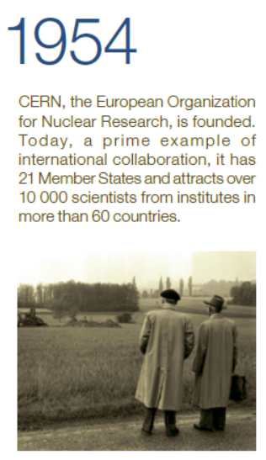
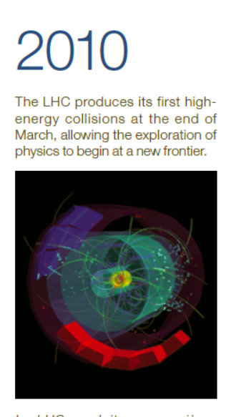


CERN celebrates 60 years

Slide 5
The challenge of the LHC computing
The physics goals - searching for rare and new processes
High luminosity and energy of the accelerator
Scale and complexity of the detectors
Unprecedented (in HEP) volumes of data
Large and worldwide community, spanning the entire globe

Slide 6
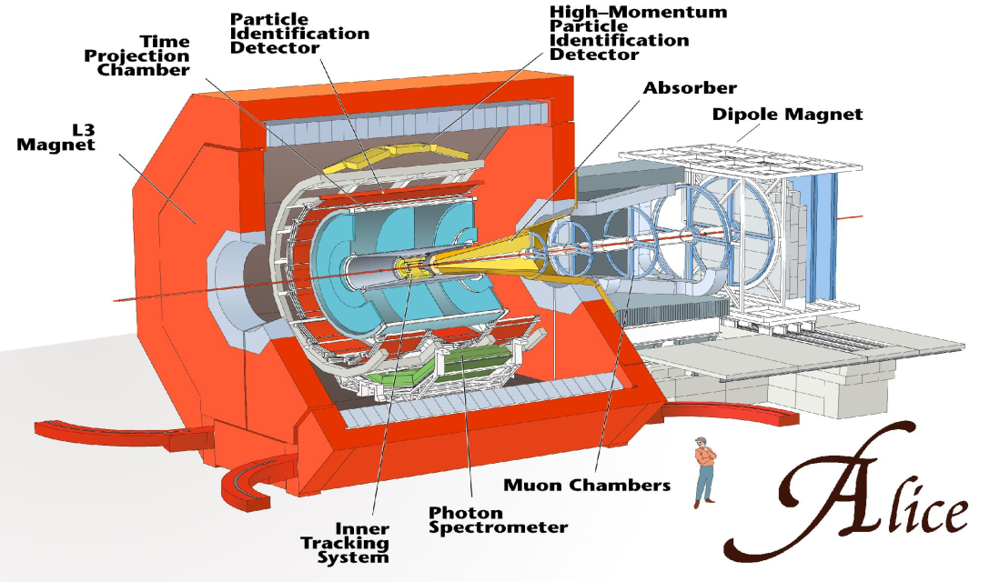
The ALICE collaboration
and data flow
~ 1/2 ATLAS, CMS, ~ 2x LHCb
1200 people, 36 countries, 131 Institutes
Total weight 10,000t
Overall diameter 16.00m
Overall length 25m
Magnetic Field 0.4Tesla
8 kHz (160 GB/sec)
level 1 - special hardware
200 Hz (4 GB/sec)
level 2 - embedded processors
50 Hz (2.5 GB/sec)
level 3 - HLT
50 Hz
(1.25 GB/sec)
data recording &
offline analysis
Notes:
Get the right numbers for ALICE

Slide 7
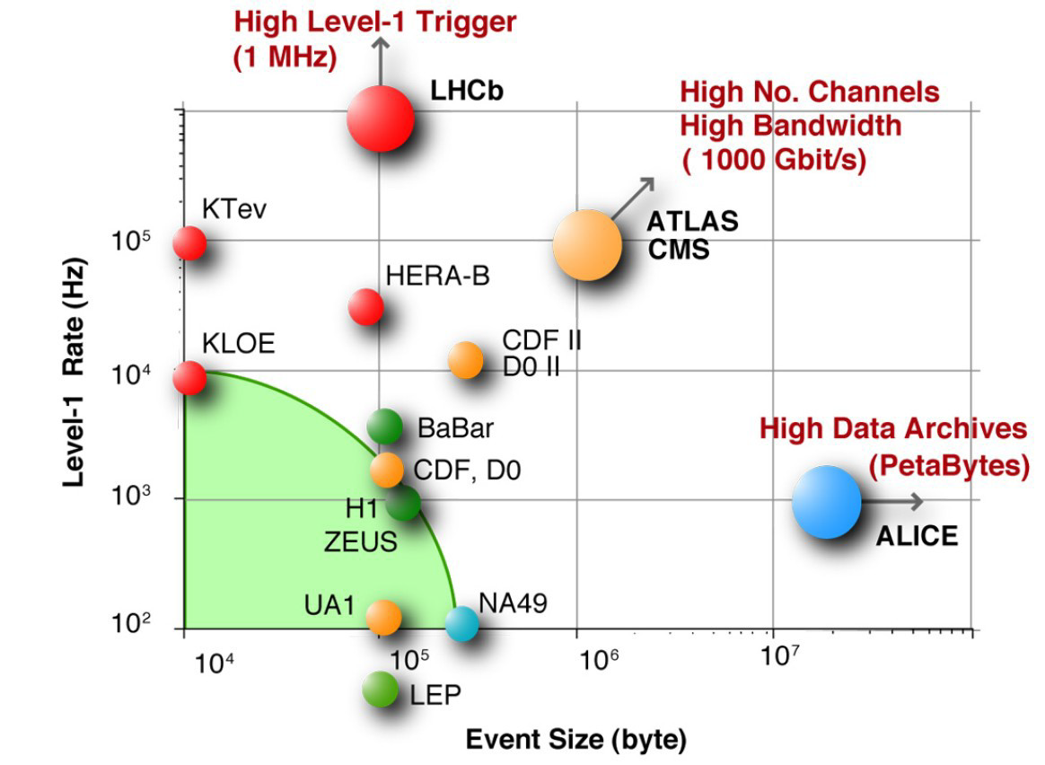
The data challenge in HEP
Today: 1 year of LHC data
Is ~25 PB

Slide 8
Why distributed computing resources
Early in the design concept for computing at LHC
  Realization that all storage and computation cannot be done locally (at CERN), as with the previous large experiments generation (i.e. LEP)
  Enter the concept of the distributed computing (the Grid) as a way to share the resources among many collaborating computing centres
  Conceptual design and start of work: 1999-2001

Slide 9











Grid projects timeline
MONARC project
CERN
Today
LHC Approval
Hoffmann Review
Computing TDRs
LHC Run 1
Run 2
1994 | 1995 | 1996 | 1997 | 1998 | 1999 | 2000 | 2001 | 2002 | 2003 | 2004 | 2005 | 2006 | 2007 | 2008 | 2009 | 2010 | 2011 | 2012 | 2013 | 2014 | 2015
PPDG+GriPhyN+iVDGL

Slide 10
Data Intensive Grid projects
GIOD - Globally Interconnected Object Databases
MONARC - Models of Networked Analysis at Regional Centres for LHC Experiments
PPDG – Particle Physics Data Grid
GriPhyN – Grid Physics Network
iVDGL – international Virtual Data Grid Laboratory
EDG – European Data Grid
OSG – Open Science Grid
NorduGrid – Nordic countries colaboration
… and other projects, all contributing to the development and operation of the
WLCG – Worldwide LHC Computing Grid (today)

Slide 11
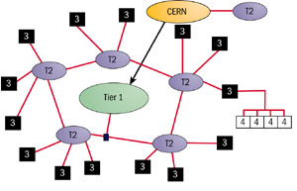
MONARC model (1999)
Models of Networked Analysis at Regional Centres for LHC Experiments
Very specific data paths
Network grows faster than
expected
Tier names remain for
historical reasons
Now the Grid looks like a cloud
CERN - Tier0
Large regional centres - Tier1s
Institute/university centres - Tier2
Smaller centres - Tier3
Red lines – data paths

Slide 12
Grid building blocks (layers)
Network connects Grid resources
Resource layer is the actual grid resources: computers and storage
Middleware provides the tools that enable the network and resources layers to participate in a Grid
Application software scientific/engineering programs running on the Grid + portals and development toolkits to support the applications

Slide 13
Grid Architecture
“Coordinating multiple resources”: ubiquitous infrastructure services, app-specific distributed services
Application
Appli-
cation
Internet Protocol Architecture
Collective
“Sharing single resources”: Negotiating access,
controlling use
Resource
“Talking to things”: Communication (Internet protocols) & security
Connectivity
Transport
“Controlling things locally”: Access to, & control of
resources
Internet
Fabric
Link
Notes:
We define Grid architecture in terms of a layered collection of protocols.
Fabric layer includes the protocols and interfaces that provide access to the resources that are being shared, including computers, storage systems, datasets, programs, and networks. This layer is a logical view rather then a physical view. For example, the view of a cluster with a local resource manager is defined by the local resource manger, and not the cluster hardware. Likewise, the fabric provided by a storage system is defined by the file system that is available on that system, not the raw disk or tapes.
The connectivity layer defines core protocols required for Grid-specific network transactions. This layer includes the IP protocol stack (system level application protocols [e.g. DNS, RSVP, Routing], transport and internet layers), as well as core Grid security protocols for authentication and authorization.
Resource layer defines protocols to initiate and control sharing of (local) resources. Services defined at this level are gatekeeper, GRIS, along with some user oriented application protocols from the Internet protocol suite, such as file-transfer.
Collective layer defines protocols that provide system oriented capabilities that are expected to be wide scale in deployment and generic in function. This includes GIIS, bandwidth brokers, resource brokers,….
Application layer defines protocols and services that are parochial in nature, targeted towards a specific application domain or class of applications. These are are are … arrgh

Slide 14
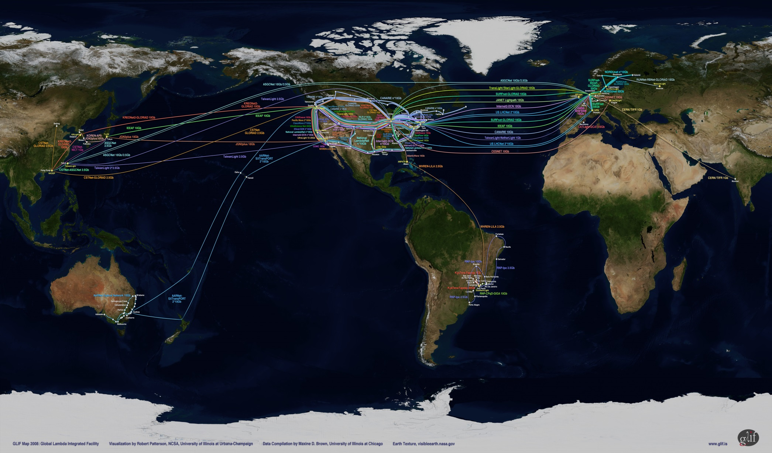
A world map
This is just the network

Slide 15
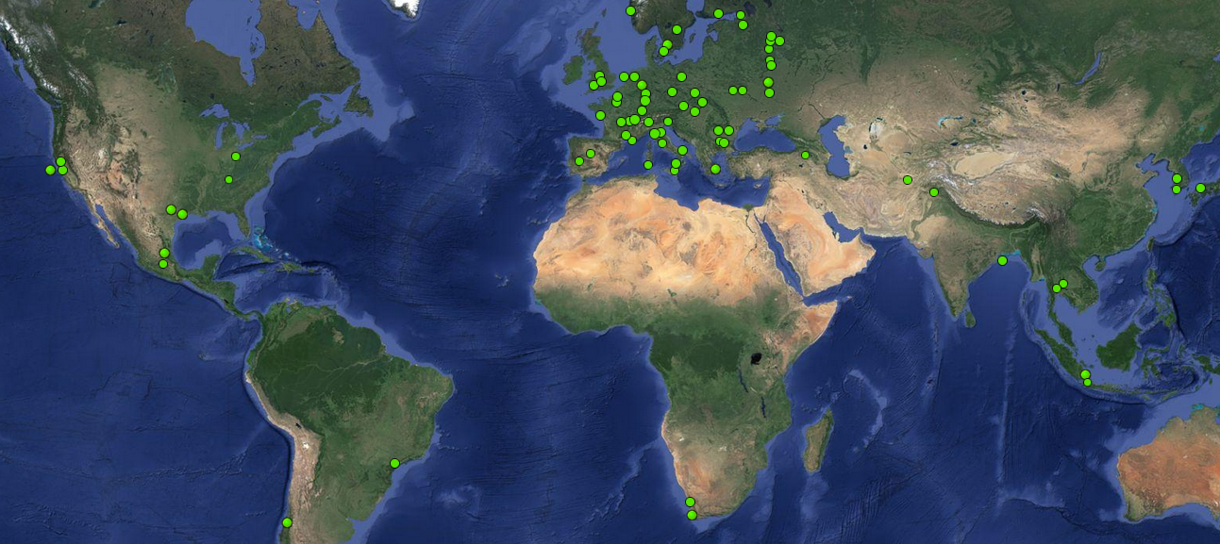
The ALICE Grid sites
8 in North America
53 in Europe
10 in Aisa
Mexico
2 in Africa
2 in South America

Slide 16
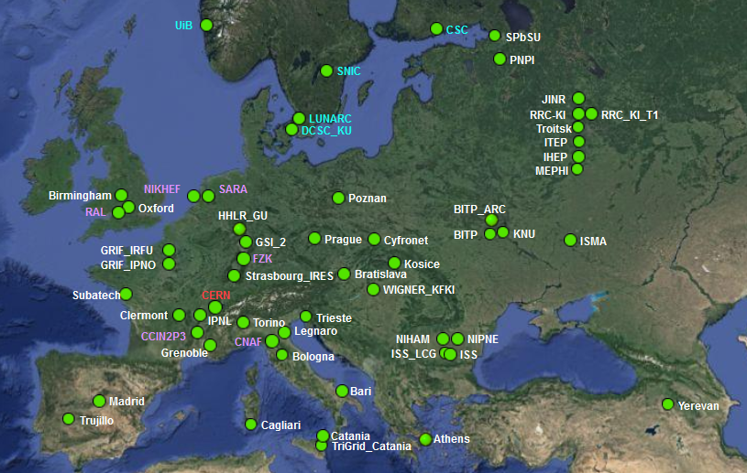
Zoom on Europe

Slide 17
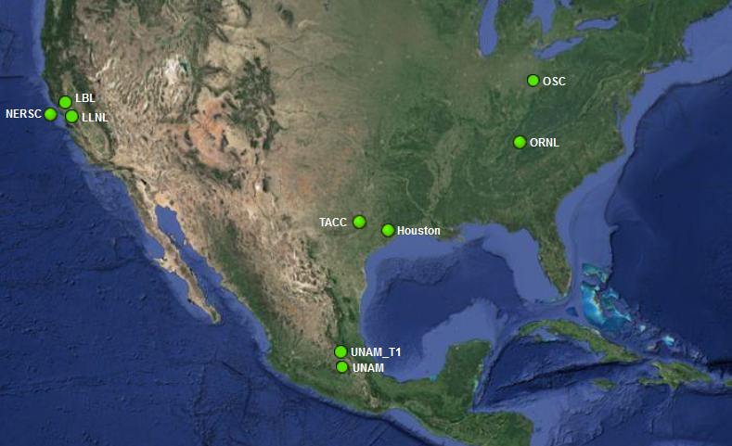
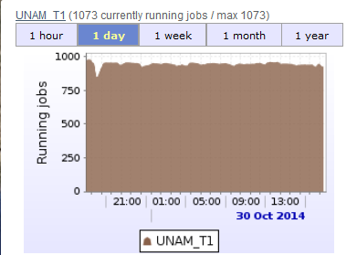
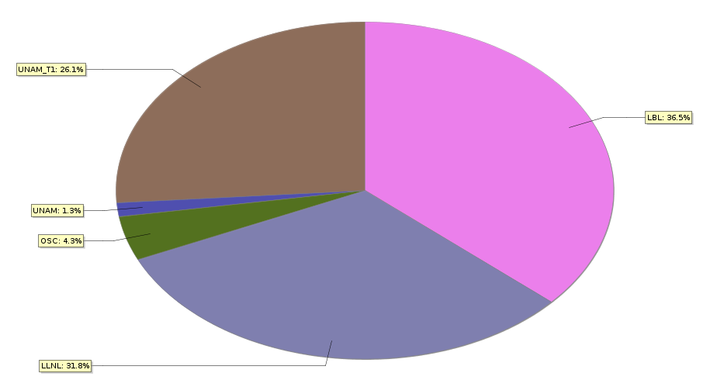
Zoom on North America
Mexico UNAM

Slide 18
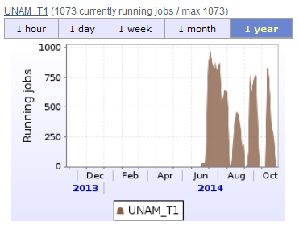
The UNAM T2 (future T1) centre
The new Grid expansion wave
Brand new hardware, fast commissioning, already in use
Typical for new Grid
centres – technology
is mature

Slide 19
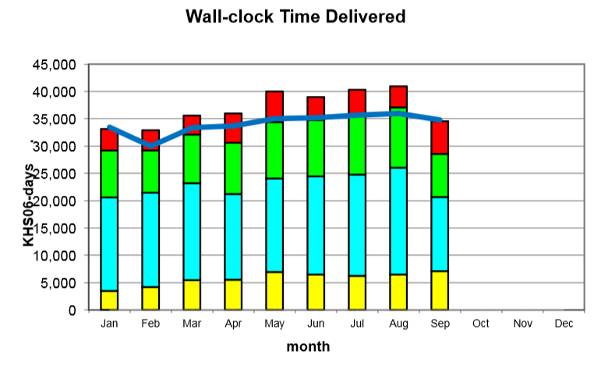
Grid sites (resources layer)
The Grid sites usually provide resources to all experiments, but there are exceptions
ATLAS and CMS have more sites and resources than ALICE and LHCb – larger collaborations
The sites use
fair-share (usually
through batch systems)
to allocate resources to
the experiments
In general –
the Grid resources
are shared
LHCb
CMS
ATLAS
ALICE

Slide 20
Use cases - Offline data processing
RAW data collection and distribution
  Unprocessed events from the detectors
Data processing
  Calibration, tracking, simulation (physics and detector)
Analysis objects
  The data containers for physics analysis
Analysis
  The analysis process, resulting in publications

Slide 21
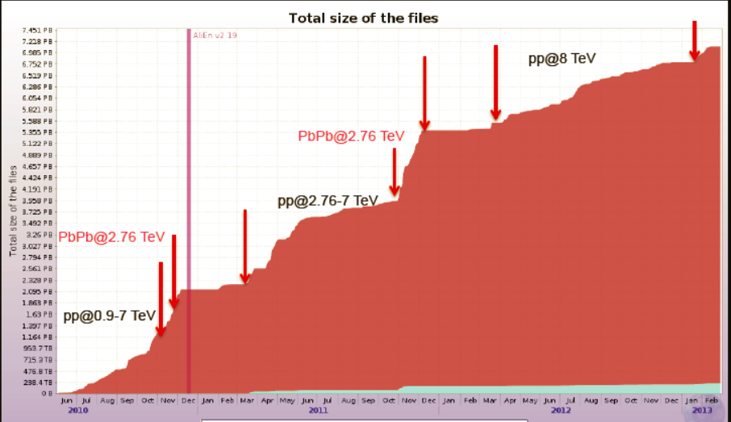
RAW data collection
RAW data from epxeriment’s DAQ/HLT, similar data
accumulation profile for other LHC experiments

Slide 22
RAW Data distribution
T1
DAQ/HLT
of the
experiment
RAW data is first collected
at the T0 centre (CERN)
One or two copies are made to
the remote T1s with custodial
storage capabilities
Custodial (MSS) usually means
tape system (reliable, cheaper
than disk media)
The RAW data is irreplaceable,
hence multiple copies
T0
MSS
MSS
T1
MSS

Slide 23
RAW data processing
RAW data is read from the
T0/T1s storage locally and
processed through the
experiment’s applications
These are complex algorithms
for tracking, momentum fitting,
particle identification, etc..
Each event takes from few secs
to minutes to process (depending
on complexity, collision type)
The results are stored for analysis
Processing
(reconstructon)
application
T1
Processing
(reconstructon)
application
T0
MSS
T1
MSS
Processing
(reconstructon)
application
MSS

Slide 24
Processing results
The RAW data processing results in analysis-ready objects
Much smaller than the original RAW, up to a factor of 100
The processing is akin to data compression

Slide 25
Monte-Carlo production
Simulation of detector response,
various physics models
Corrections of experimental
results, comparison to theoretical
predictions
MC has little input, output is the
Same type of objects (ESDs/AODs)
Processing time is far greater
Than RAW data processing
MC runs everywhere
Physics gener.+
Transport MC+
Processing
application
T2
Physics gener.+
Transport MC+
Processing
application
T0
T1
Physics gener.+
Transport MC+
Processing
application

Slide 26
Distributed analysis – data aggregation
Physicits
Input data selection
Optimization
Sub-selection 1
Sub-selection 2
Sub-selection n
Grouped by data locality
Job output
Brokering to proper location
Computing centre 1
partial analysis
Executes user code
Computing centre 1
partial analysis
Executes user code
Computing centre n
partial analysis
Executes user code
File merging

Slide 27
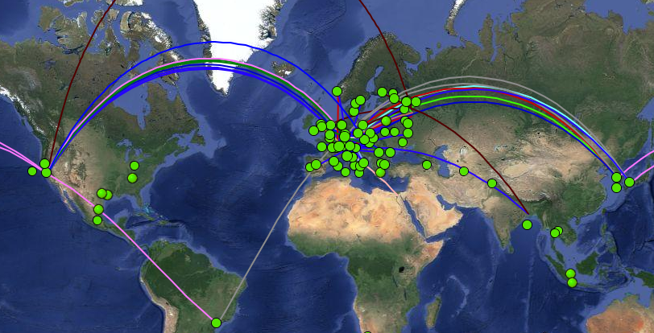
Sites interaction
Snapshot of job and network
activities

Slide 28
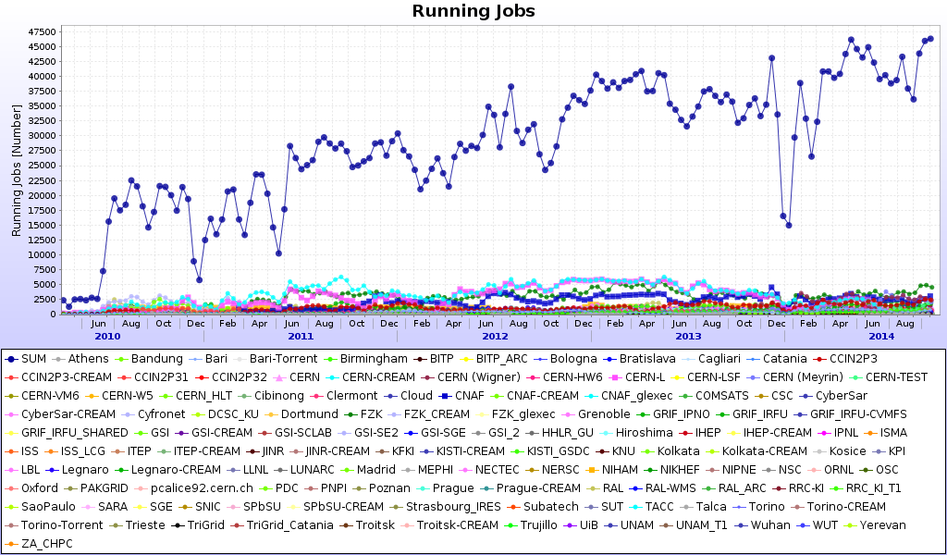
Grid resources since 2010 - ALICE
Every 4 years the power of the Grid doubles

Slide 29
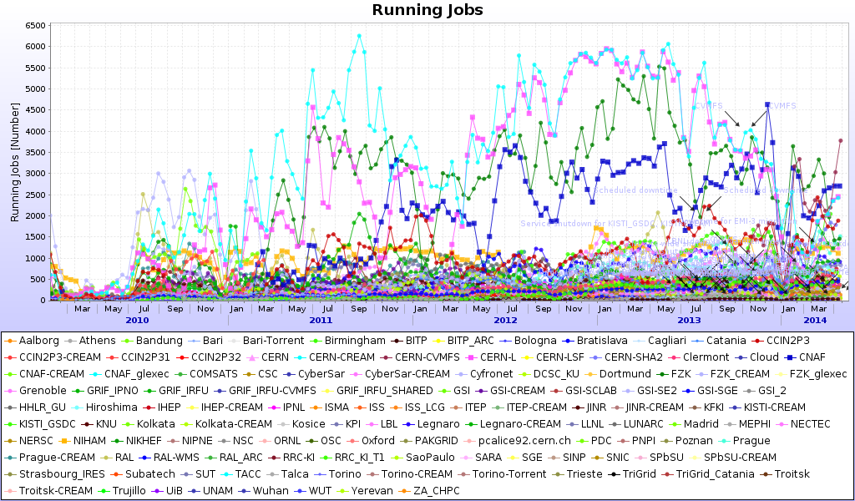
Contribution of individual sites

Slide 30
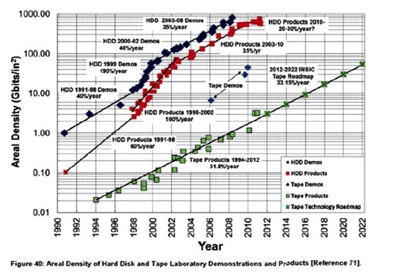
Size and evolution of the Grid
Cores per site vary from 50 to tens of thousands
~200K CPU cores in the WLCG Grid
Storage capacity per site – few tens of TBs to PBs
Grid growth is assured by technology advances: Moore’s law (CPU power, 18 months) and Kryder’s law (disk storage density, 13 months)
Grid growth is 20-25% CPU,
20% disk per year

Slide 31
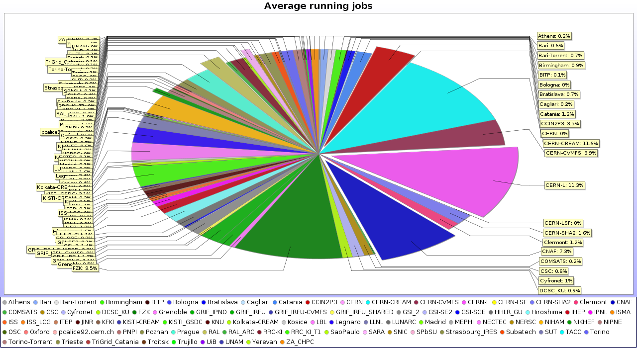
Resources distribution
Remarkable 50/50 share between large (T0/T1) and smaller computing centres

Slide 32
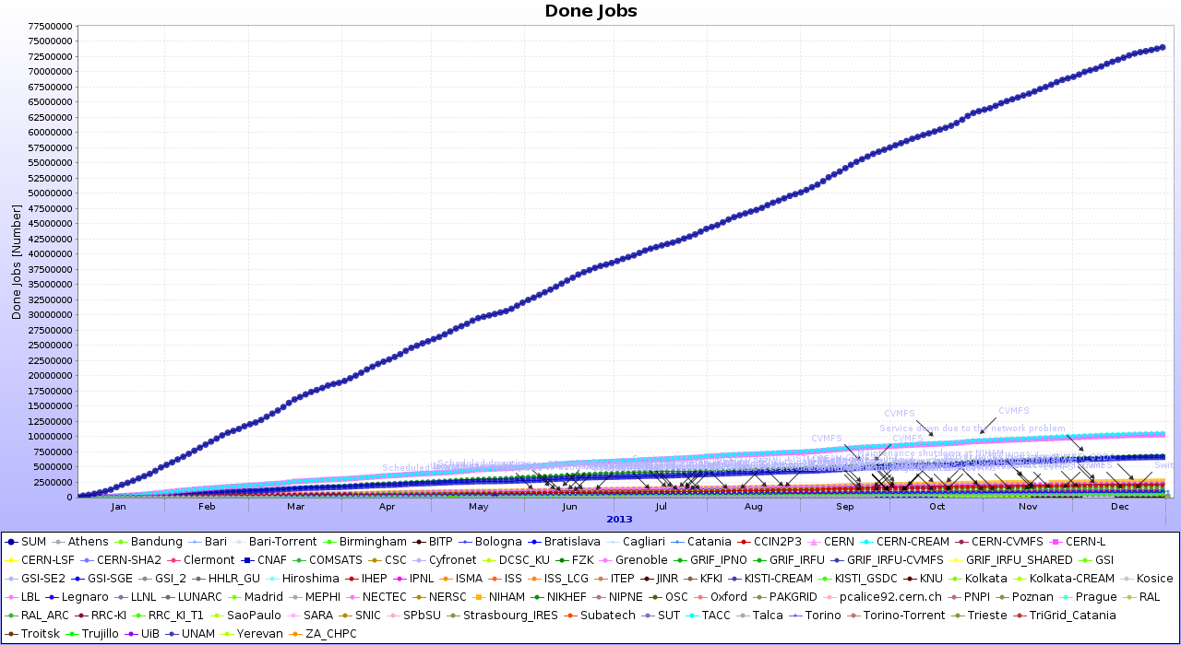
Computational tasks in numbers
~250K job per day (ALICE)
~850K completed jobs/day (ATLAS)
Jobs runs from minutes to tens of hours

Slide 33
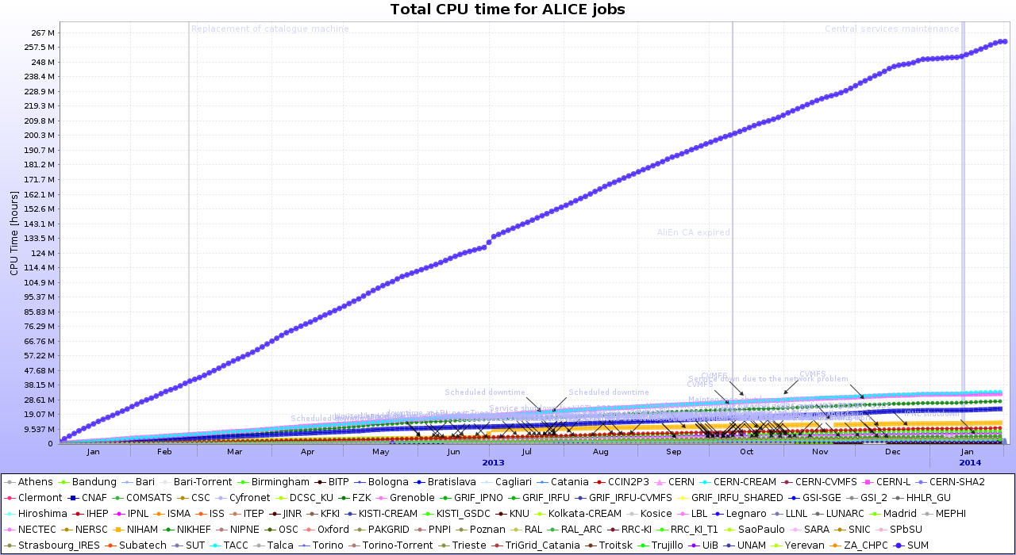
CPU time
~270M hours per year
…or 1 CPU working for 30K years

Slide 34
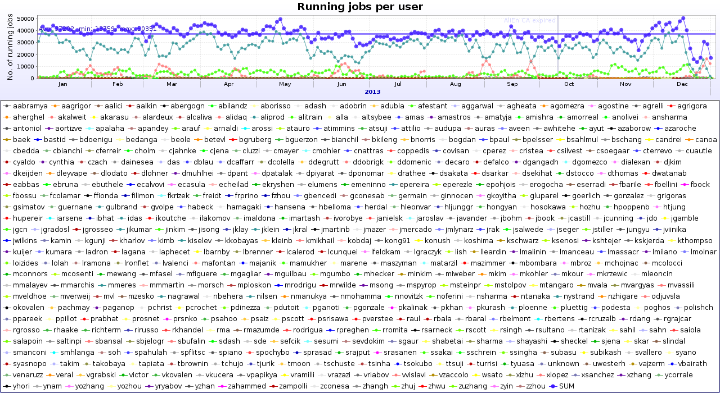
Who is on the Grid
~500 individual users (in ALICE)
Centralized activities (RAW processing, MC)

Slide 35
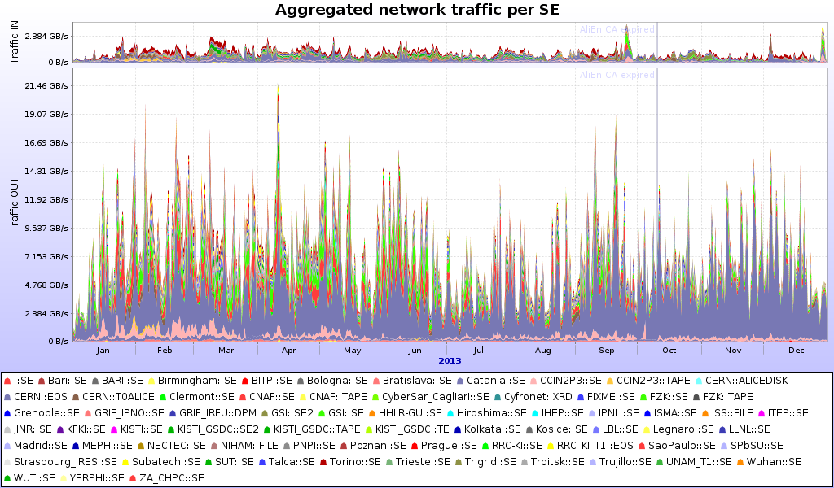
Data access (ALICE)
69 SEs, 29PB in, 240PB out, ~10/1 read/write

Slide 36
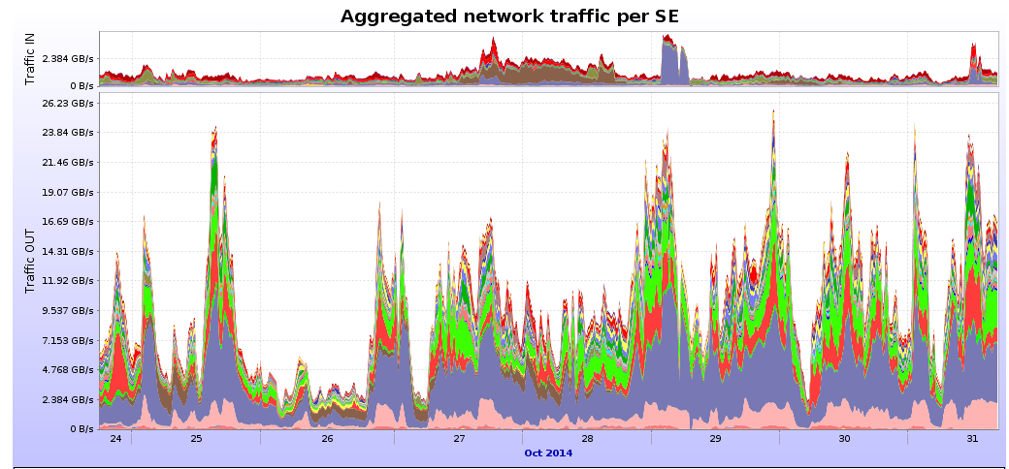
Zoom on one wek
Daily individual and orgniszed analysis activities
  Driving the bulk of data access
Data is accessed locally at the site (95% of the volume)
Sunday

Slide 37
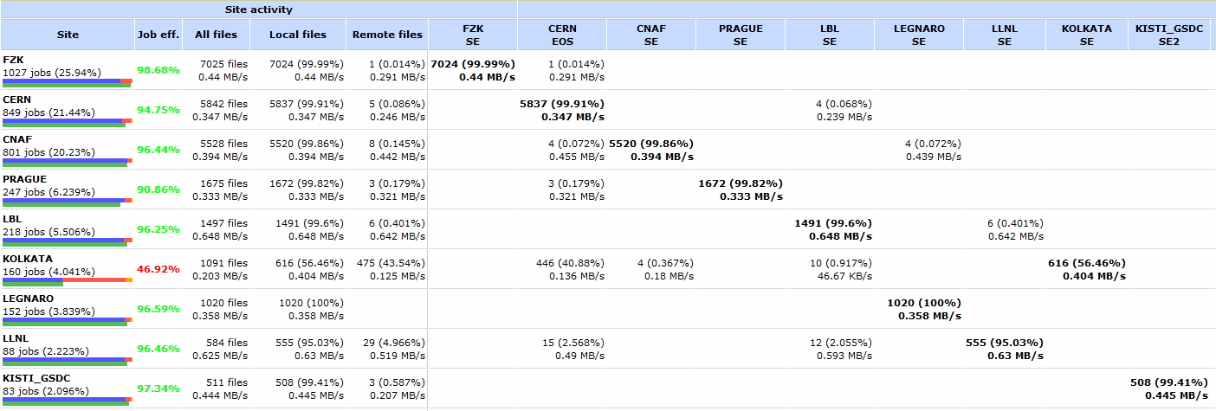
Organized analysis
Local
Remote
Typical analysis train matrix for
data access

Slide 38
Data access trivia
240 PB: ~4.8 Million BluRay movies
Netflix: 1GB/hour for streaming video => LHC analysis is ~240 Million hours or ~27 thousand years of video
2 Billion hours spent by Netflix members watching streamed video (29.2 Million subscribers)
Multiply the ALICE number by ~4… ATLAS is in Exabyte data access territory

Slide 39
Clouds
The Grid paradigm predates the Cloud
  However LHC computing is flexible, the methods and tools are constantly evolving
The Clouds (resource layer - CPU, storage) and the principles of cloud computing are actively adopted
A major difference between the early Grid days and today is the phenomenal network evolution
  With good network connectivity the Grid look like a large cloud – individual site boundaries and specific functions dissolve

Slide 40
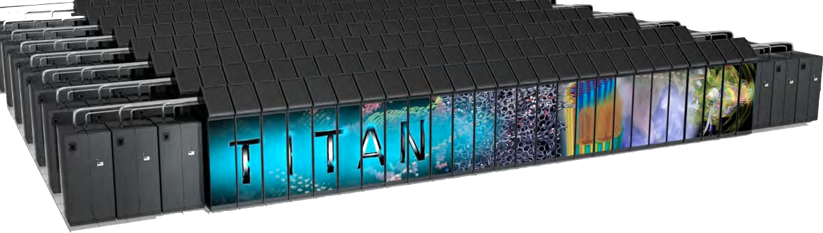
…and Supercomputers
TITAN @ORNL, USA
CRAY XK7
300K CPUs+ 18KGPUs
20PFlops
Local users running massively parallel tasks
Few percent of spare capacity – use for Grid tasks
Collaborative work of LHC experiments to modify the Grid middleware for a ‘closed’ supercomputer system
  Potentially hundreds of thousand CPU hours for simulation
Other spare supercomputer capacity around the world to be harnessed by the same system

Slide 41
Summary
The WLCG computing Grid is the primary computational tool used by the large LHC experiments for all aspects of data processing
Main features:
  Distributed – over 140 separate sites
  Well-connected – using national and international networks
  Data intensive – access to Exabytes of data for processing and analysis
  Flexible and open – addition of new resources (new ‘traditional’ and HPC centres, expansion of existing ones) is simple and ongoing
  In production since ~8 years (6 years of intensive use)
  Easy to integrate new features and platforms

Slide 42
Summary - contd
In 2015 LHC will restart with higher energy and luminosity
  The collected data volume in the next 3 years will triple, compared to the 2010-2013 run
The computing resources increase gradually to meet the demand
  New computing centres are essential for the growth and evolution of the Grid
Grid middleware (job schedulers, storage, monitoring) is undergoing constant upgrades
The Grid is a tool enabling scientists from all countries around the world to do physics data analysis
At the same time, it enables computing experts to work together and build a really unique distributed system for handling massive data and CPU-intensive tasks

Slide 43
ALICE upgrade
Upgrade timeline – LHC Run 3 – from 2019
  LHC@14TeV, 25ns bunch spacing, nominal intensity
ALICE physics progrmme with upgraded detector
  High-precision measurement of rare probes in p-p, p-A and Pb-Pb
  x100 gain in statistics over approved programme
Entirely new Online-Offline processing (the O2 project)
  x100 larger data volume

Slide 44
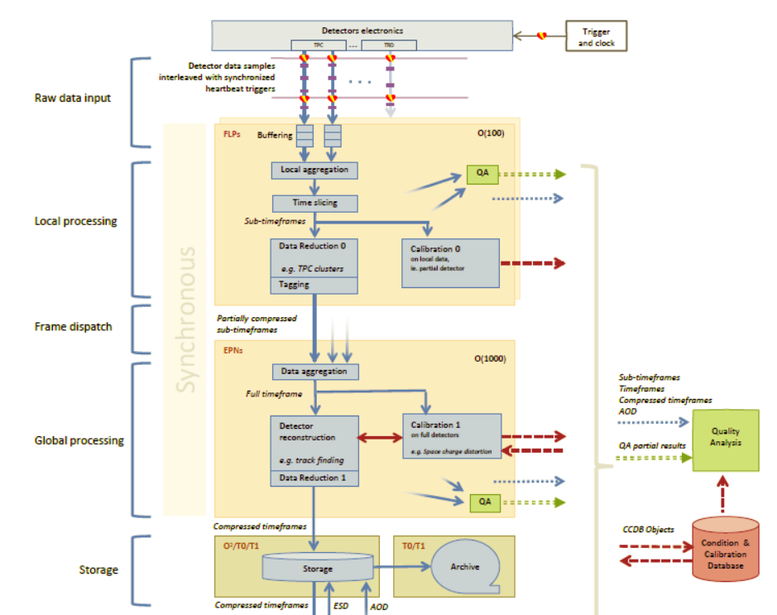
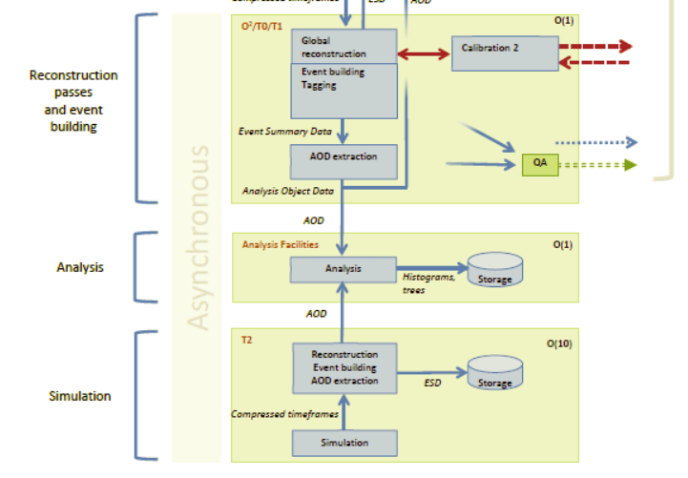
O2 facility

Slide 45
Muchas gracias!
Questions?

