Slide 1
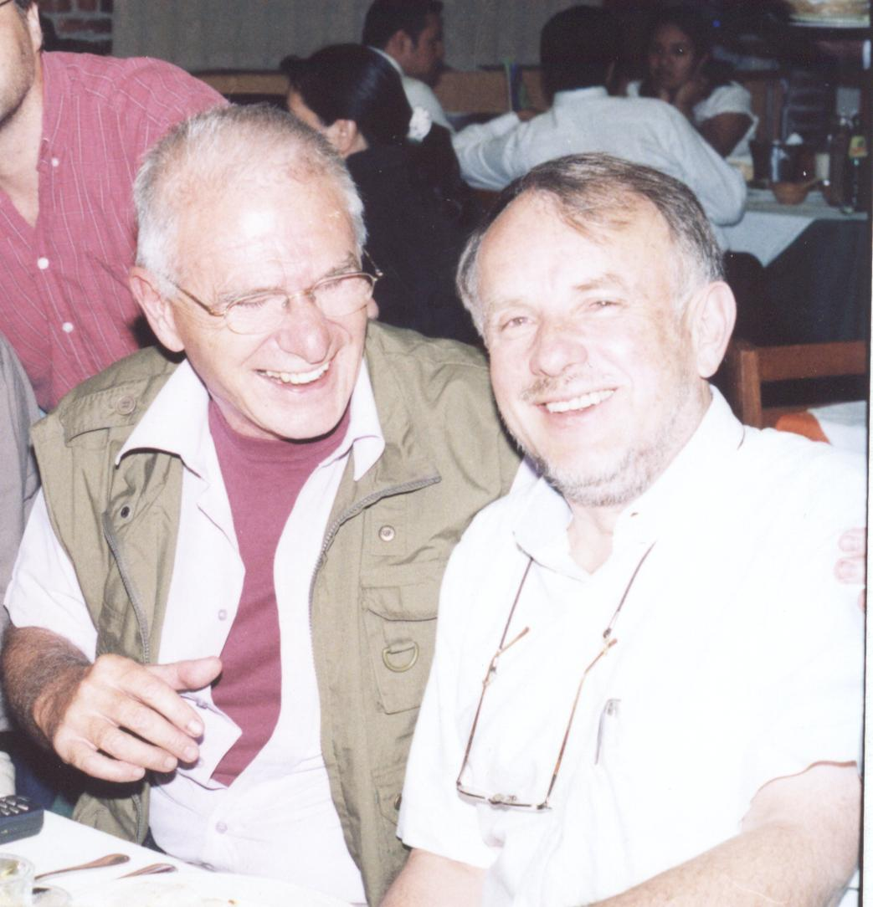
Nuclei/antinuclei production at LHC energies
A. Menchaca-Rocha
IFUNAM, Mexico
Guy-Fest, Puebla, 2/12/2011
Notes:
<number>

Slide 2
Outline
Introduction
Motivation
Why in ALICE?
Preliminary results
Open issues
  Cosmic-ray application?
  Cosmological connection?
Conclusion
<number>
Notes:
<number>

Slide 3
Light nuclei production in particle and HI collisions: a long story
Energy
-- HI’s only --
MeV/A
Evaporation
Direct reactions
Nuclear fragmentation
Fireball (pair production)
QGP-hadronization
GeV/A
TeV/A
<number>
Notes:
<number>

Slide 4
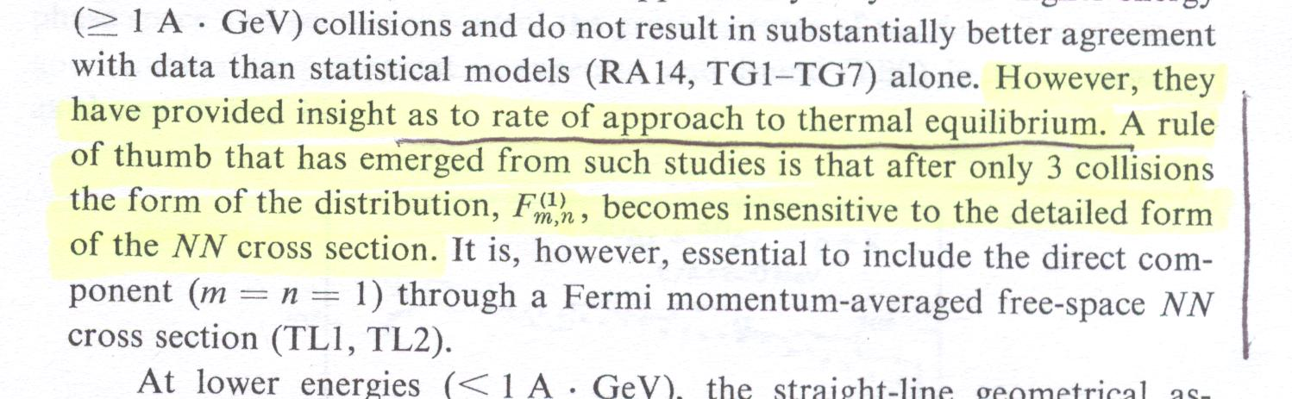
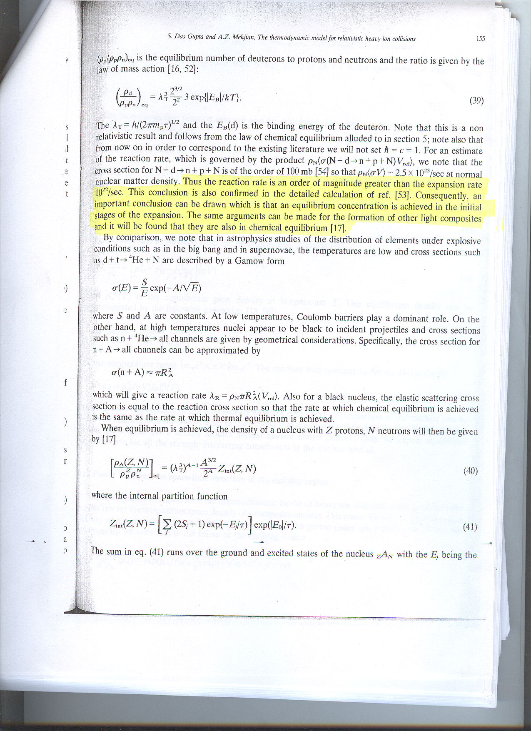
Equilibrium?
Inter-nuclear cascade calculations:
λ ~ 1.4 (ρ0/ρ) fm < R
Fm,n describes the one-particle distribution of m,n clusters
S. Nagamiya & M. Gyulassy, Adv. In Nucl. Phys, 13(1984)201
Thermodynamic calculations
S. Das Gupta and A.Z. Mekjian, Phys. Rep. 72(1981)131

Slide 5
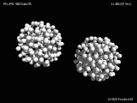
HI collision
Notes:
<number>

Slide 6

Macroscopic, central

Slide 7
Macroscopic, peripehral

Slide 8


Coalescence
pn ~ pp
n
pd ~ 2pp
d
Phase-space
p
pp
Coalescence
parameter
Coalescence parameter, BA, depends on impact parameter & pt and is affected by flow
<number>
Notes:
<number>

Slide 9
Why LHC?
p-p, p-A & A-A at higher energies
Final state of the interactions: baseline to be understood
Sensitive to collective motion
Measure BA for A ≤ 3 (pp)
Effect of N-Nbar annihilation?
Hyper/anti-hyper nuclei?
...
<number>
Notes:
<number>

Slide 10
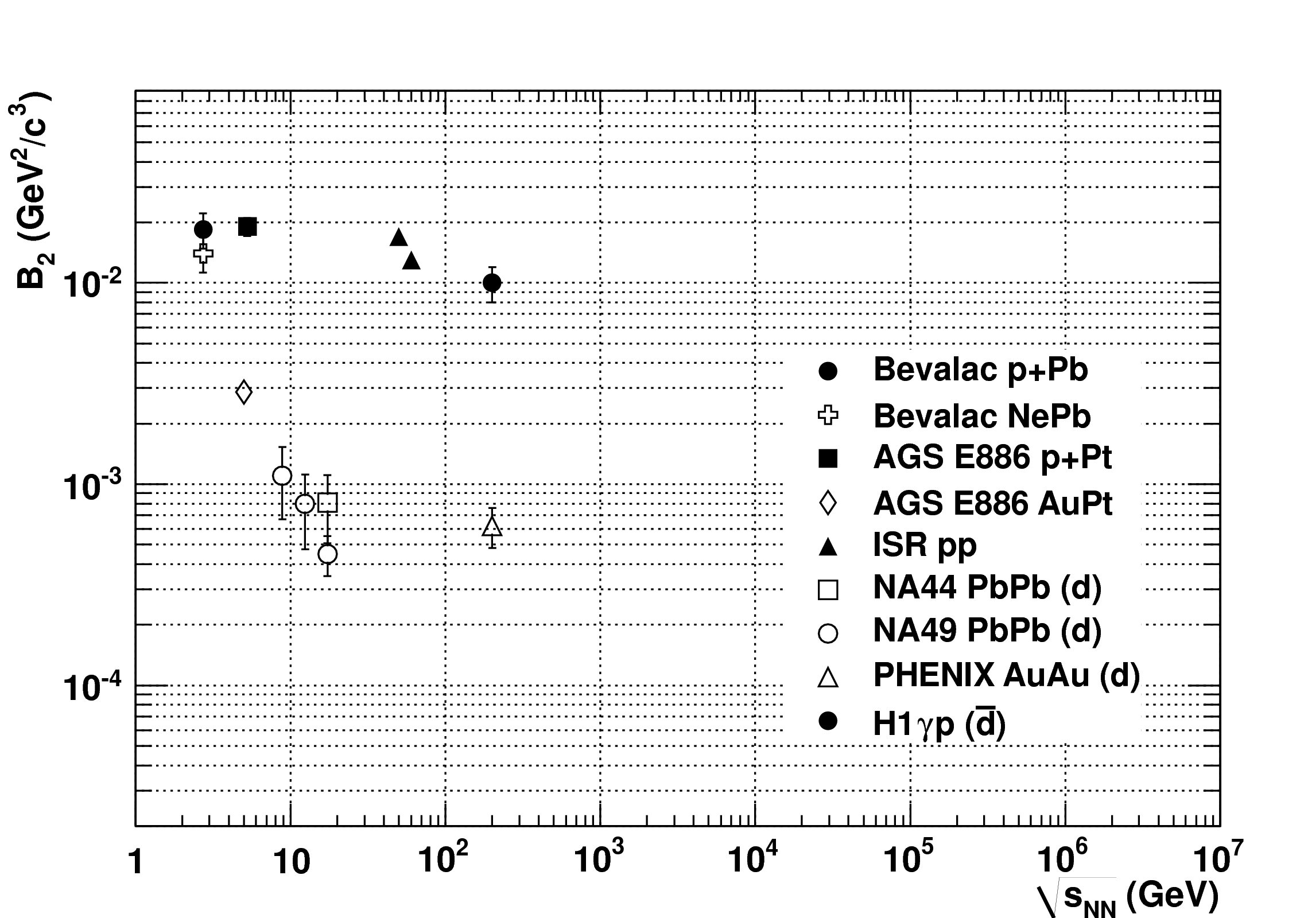
Coalescence parameter for deuterons
Particle-Particle
A-A
ALICE
ALEPH Coll. 2006
<number>
Notes:
<number>

Slide 11
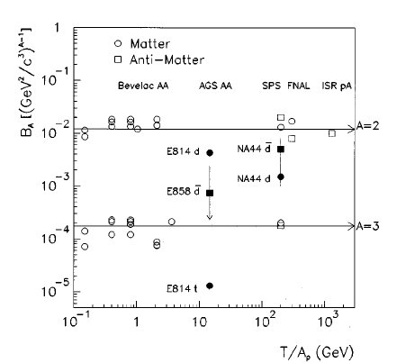
B3
Nbar/N ∝ (pbar/p)A
J.L. Nagle et al., Phys. Rev. C53(1996)367
<number>
Notes:
<number>

Slide 12
Why in LHC-ALICE?
Spectrometer (0.5 T, -0.9 <η < 0.9)
Tracking (ITS, TPC, TRD)
Timing (TOF)
dE/dx PID
Centrality (ZDC)
CP Multiplicity (ITS, TPC and V0 within 2.8 <η < 5.1)
<number>
Notes:
<number>

Slide 13
Open issues?

Slide 14
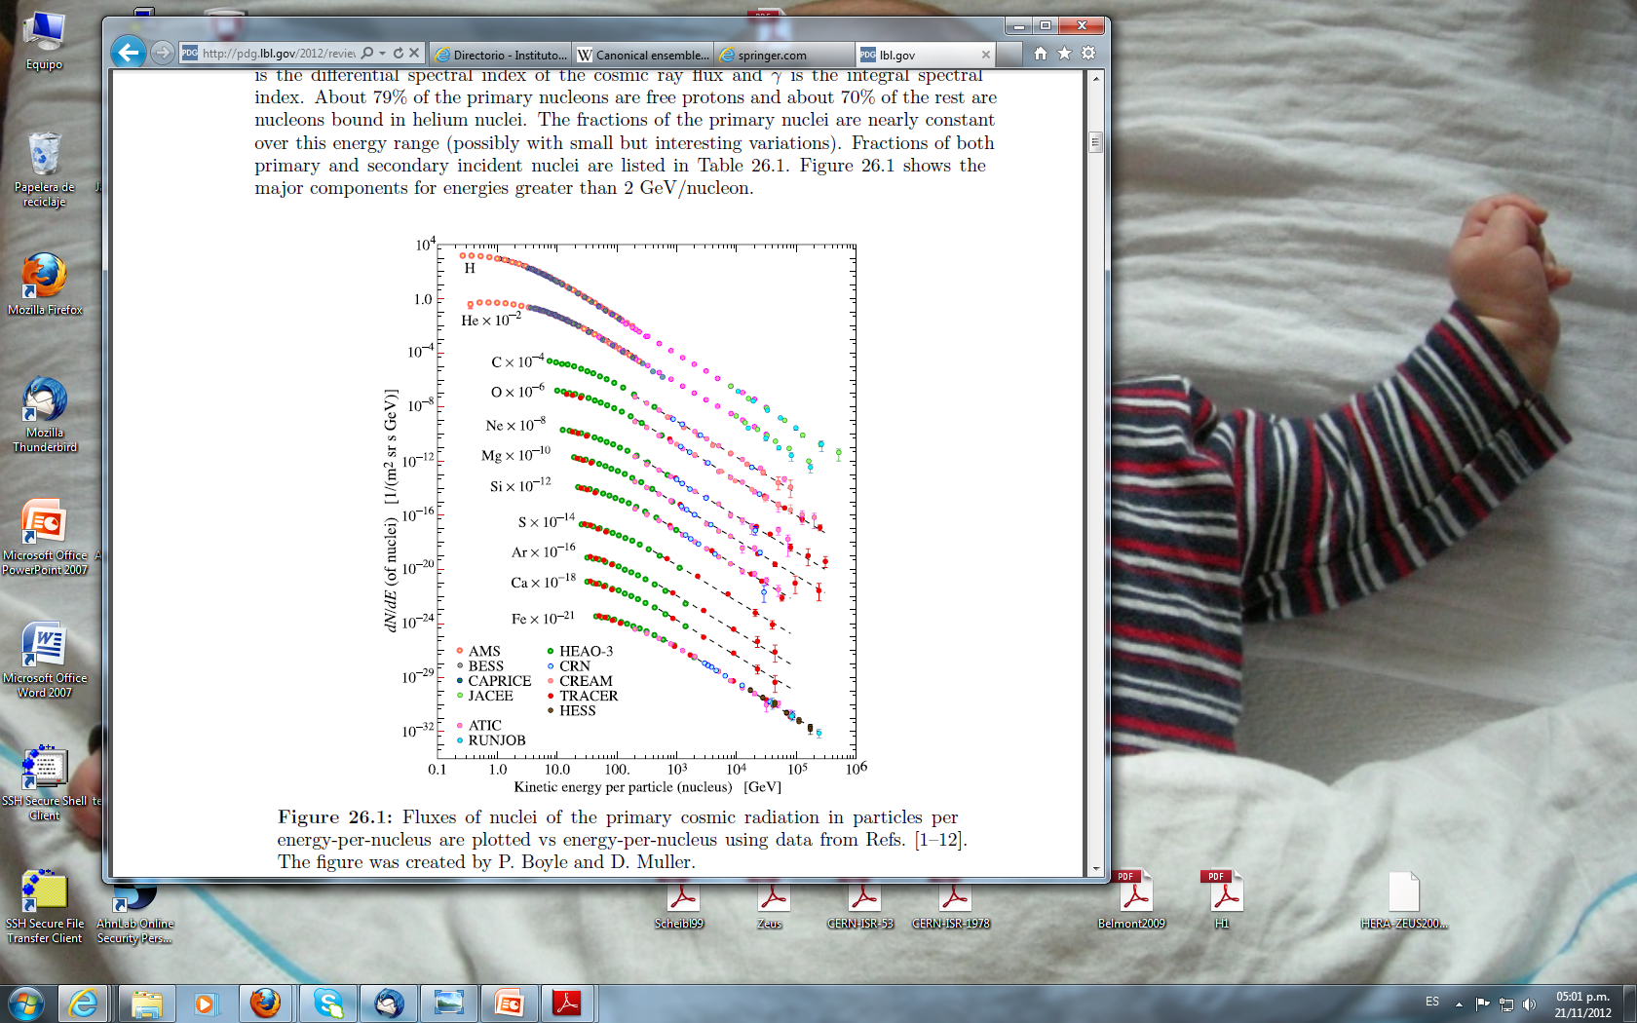
Relevant to cosmic-ray physics?
3He excess?
RPP-2012

Slide 15
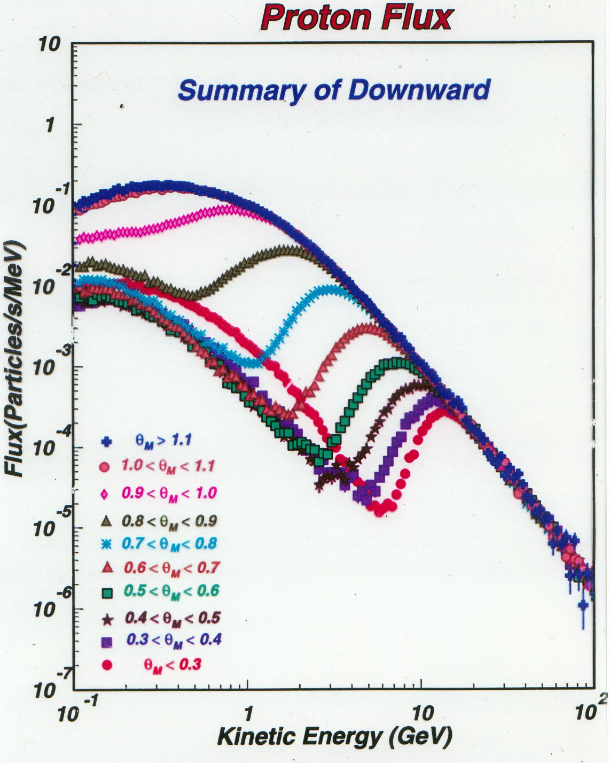
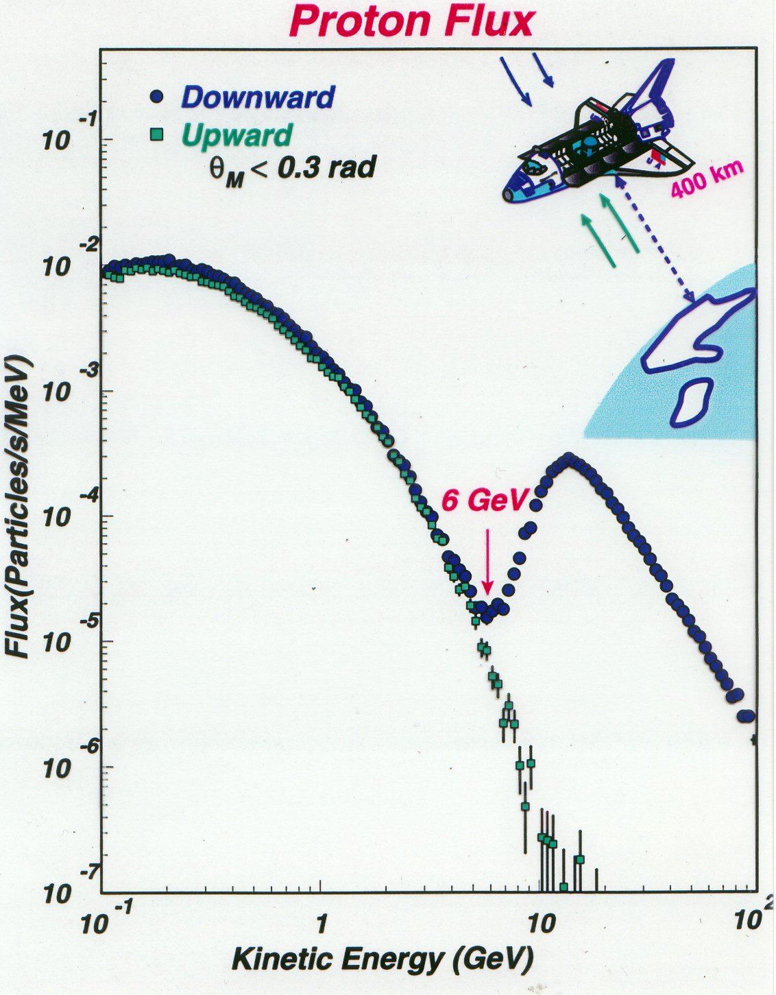
AMS-01

Slide 16
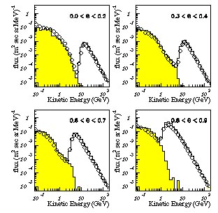
Coalescence interpretation
Phys. Lett. B489(00)1

Slide 17
Cosmic-ray measurements
p-bar/p (20 GeV) = 2*10-4
D-bar/d (1 GeV) < 2*10-4
He-bar/He < 10-7
RPP, 2012

Slide 18
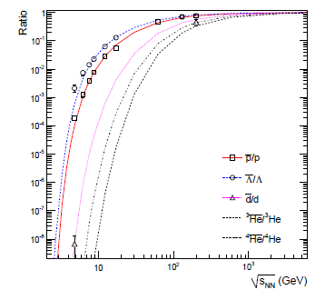
Nuclei/anti-nuclei ratios
ALICE
A. Andronic et al., Phys. Lett. B 697(2011)203

Slide 19
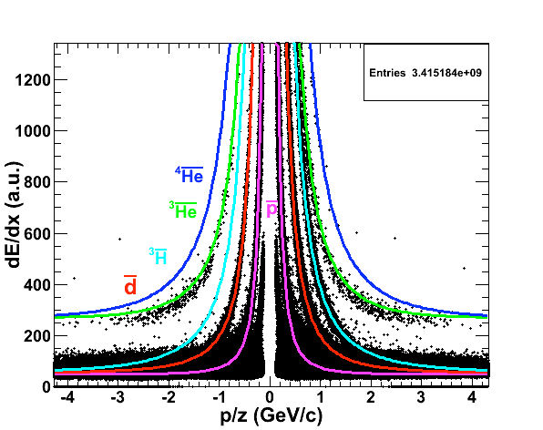
PID (AA)
Hypernuclei
feeddown?
Romana Lea

Slide 20
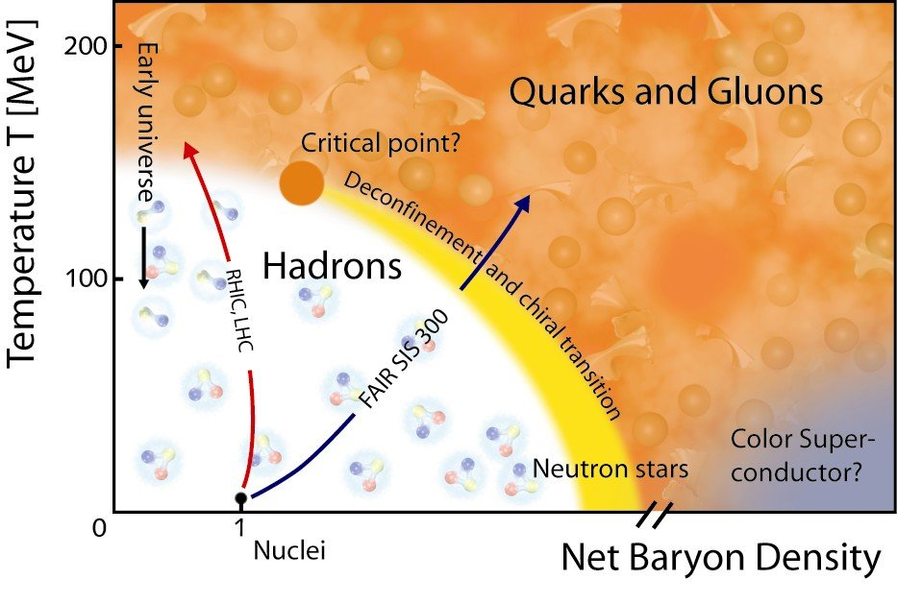
Cosmological connection?
Baryon-
Coalescence
Fusion
<number>
Notes:
<number>

Slide 21
RPP
B.D. Fields (Illinois) and S. Sarkar (Oxford):
“BBN still marks the boundary between the established and the speculative in Big Bang cosmology”
Translation: NO

Slide 22
BBNS abundance evolution
B2 = 10-2
No coalescence, 3H/3He=1,…
From Wagoner code
<number>
Notes:
<number>

Slide 23
Conclusions
N and N-bar measurements at ALICE, in progress
D and D-bar in pp @ 0.9, 2.7 and 7 TeV
  B2 ~ 10-2 trend remains
  D-bar/D ~ 1
  A>2 data: more statistics required
Relevance to cosmic rays (more data required)
Relevance to cosmology (work in progress)
<number>
Notes:
<number>
<number>

Slide 24
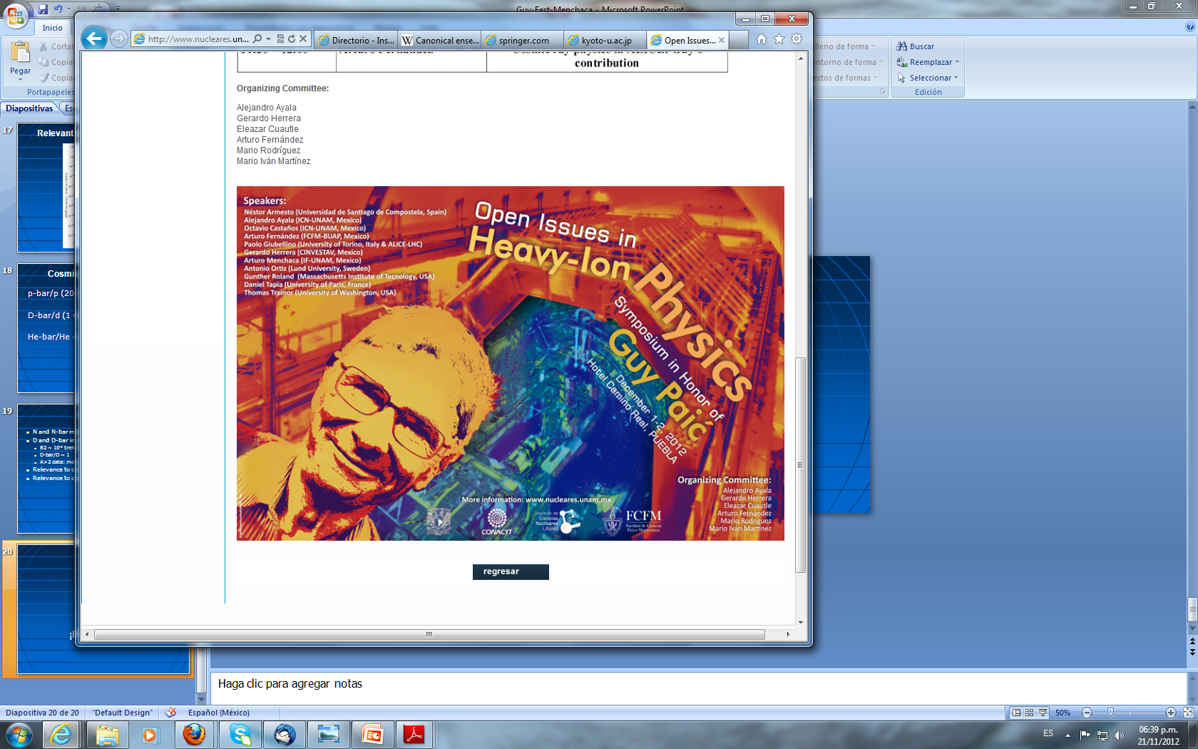
¡Felicidades!
GUY

