Slide 1
FITPix – Timepix Test
D07-0108
Mario Iván MARTÍNEZ
Eduardo MORENO

Slide 2
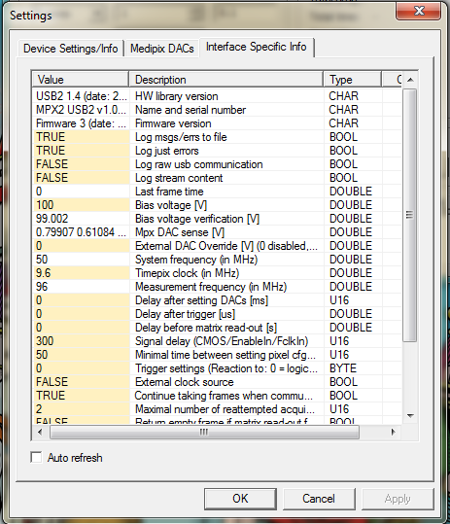

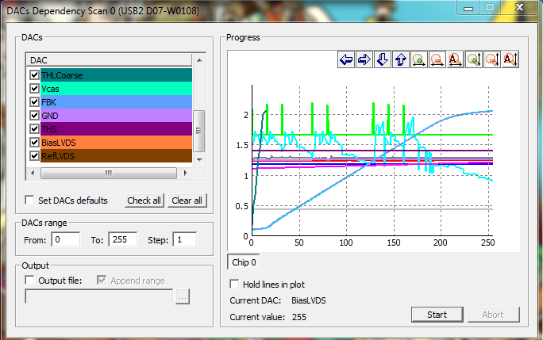
First chip settings
Bias Voltage (we used 100 V)
Digital test of pixels
DAC’s scan

Slide 3
Threshold (THL) equalization
Timepix amp. discrimination level can be chosen to filter out noise.
A single THL level can be set common to all 65,536 pixels
  One wants to put this above the noise level. Typically 40 THL counts ≈ 100 e-
Every pixel has a different noise level
  Gaussian distributed
  4-bit DAC to adjust the “noise” (actually, the amp’s output DC level) level individually
Pixelman feature exists to automatically find the noise level and adjust this DAC for each pixel

Slide 4
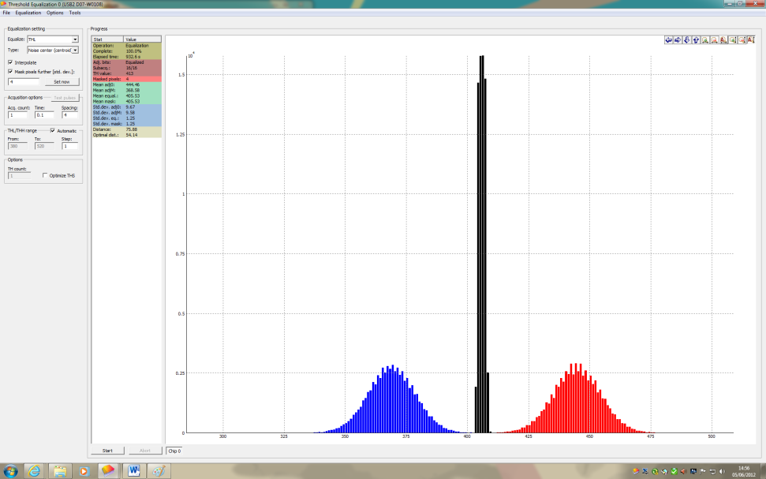
Noise distribution before and after
THL equalization
Highest DAC adjust.
mean = 444.46 THLcounts
std. dev. = 9.67
Lowest DAC adjust.
mean = 368.58 THLcounts
std. dev. = 9.58
Equalized adjust.
mean = 405.53 THLcounts
std. dev. = 1.25

Slide 5
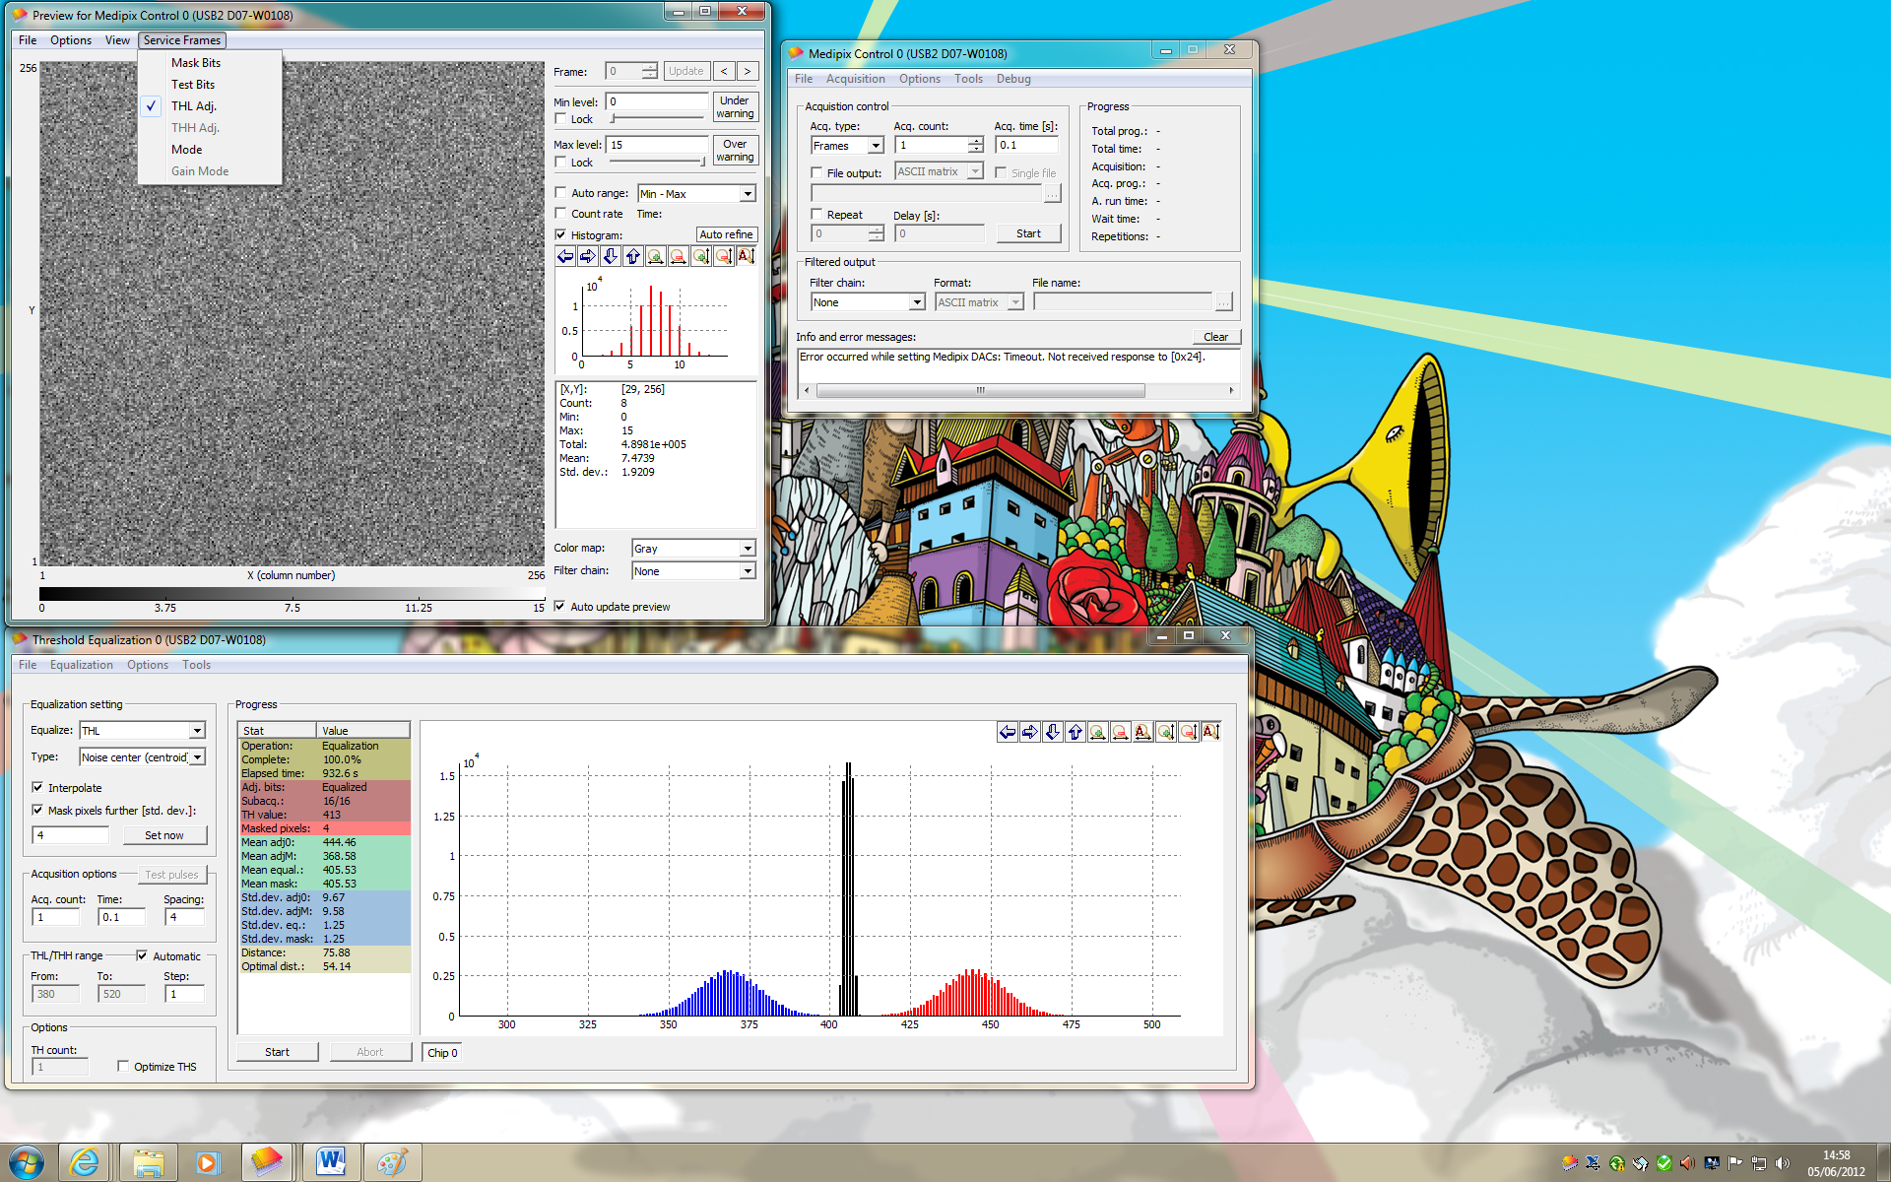
DAC’s adjustment distribution after equalization

Slide 6
Materials
Timepix chip D0-W0108
Radioactive sources
  Iron: ⁵⁵Fe
  Americium: ²⁴¹Am
  Strontium: ⁹⁰Sr
Sofware
  MAFalda v 2.1
  Pixelman 2.1.1 (7.12.2011)
Hardware
  FITPix (Medipix/TimePix USB 2.0 v.2.3, Firmware 3)
  Timepix (D07-W0108)
    300 μm thick

Slide 7
Acquisition parameters
20º C
10 milliseconds per frame
100,000 frames
Operation mode Time Over Threshold
Bias voltage 100V
Distance source-sensor 2 centimeters

Slide 8
Tested on
Desktop, Windows 7
Laptop, Windows 7
Laptop, Mac
Virtual Machine, Linux
Problems with usb connection in Mac and Virtual machine

Slide 9
Measurements

Slide 10
Contrast
To observe pixels’ noise (individuate noisy ones)
100,000 frames
Acquisition mode Time Over Threshold
Time per frame 10 milliseconds

Slide 11
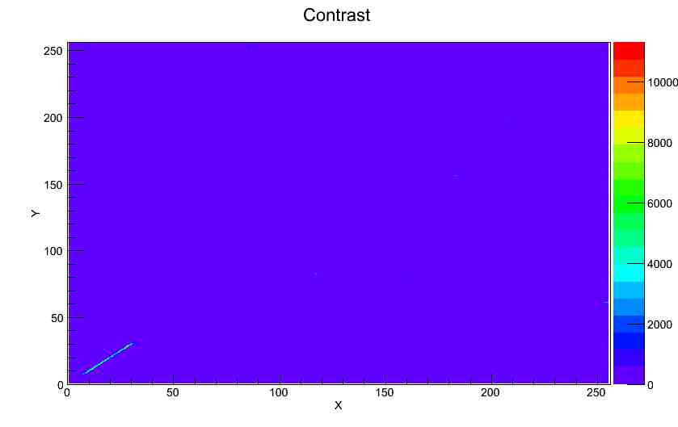
High noise (bad bonding?)

Slide 12
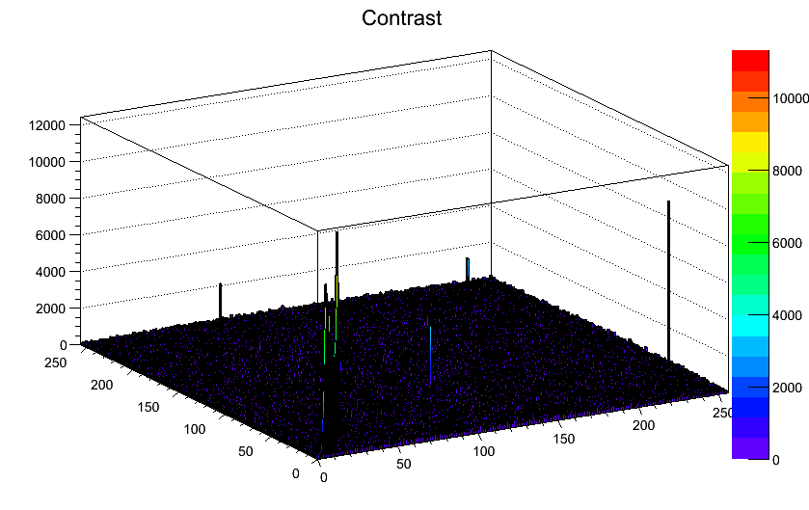
Contrast

Slide 13
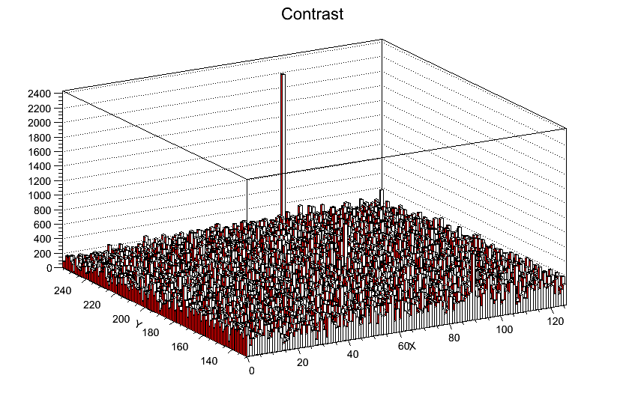
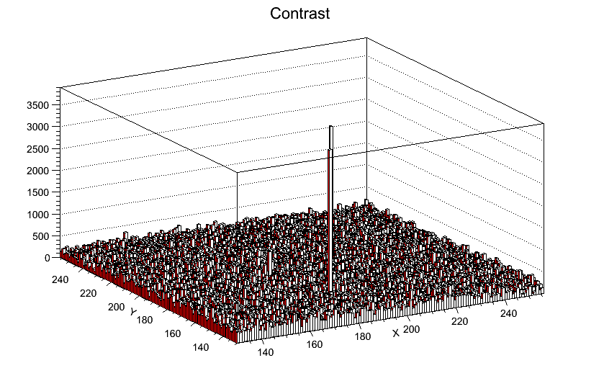
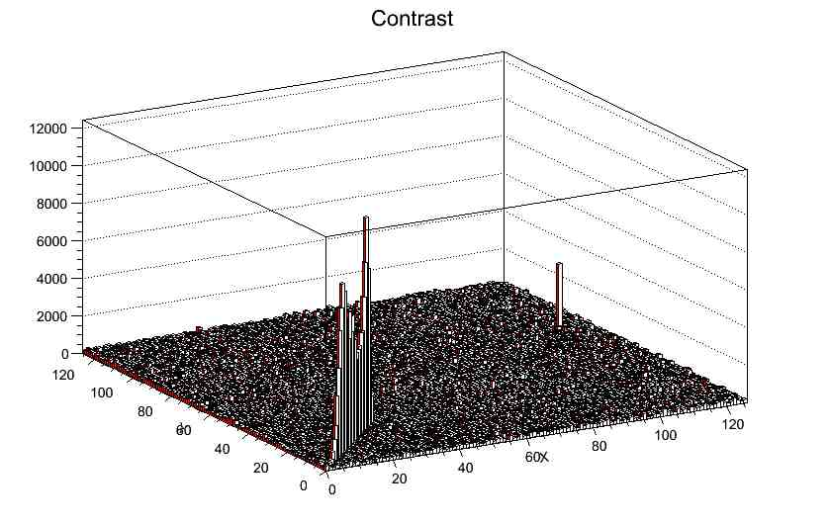
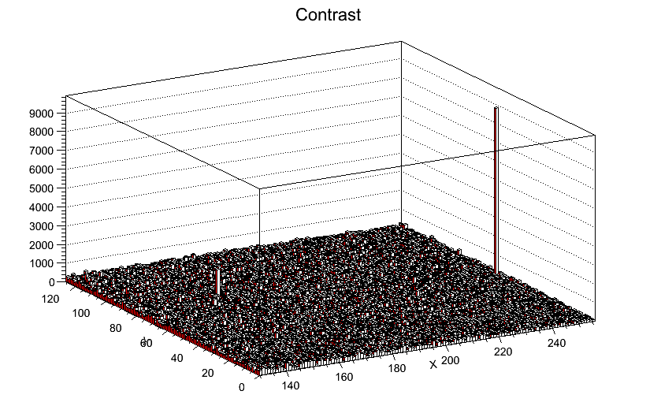
zoom for each “quadrant”

Slide 14
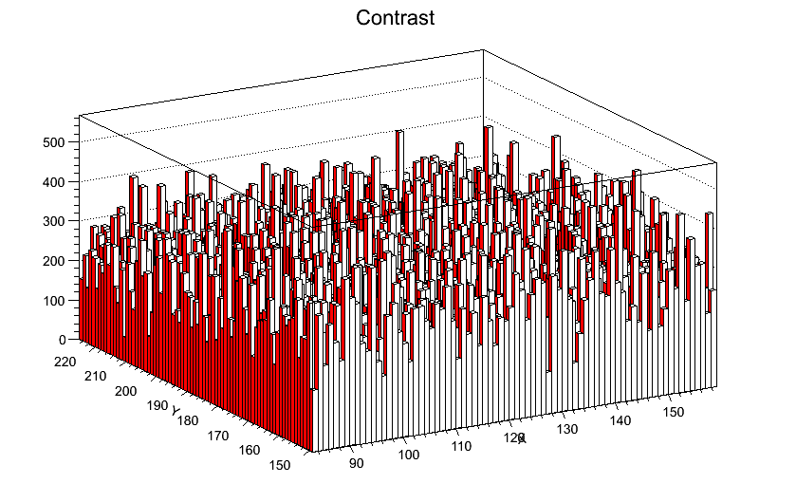
zoom to inner “good” area

Slide 15
⁹⁰Fe

Slide 16
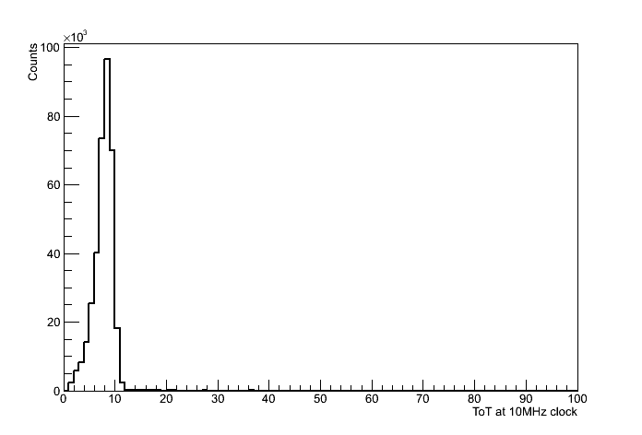
ToT distribution of single-pixel clusters

Slide 17
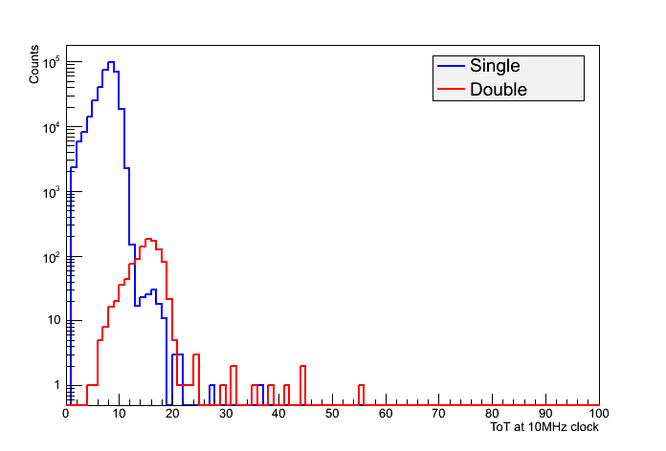
ToT distribution of single- and double-pixel clusters

Slide 18
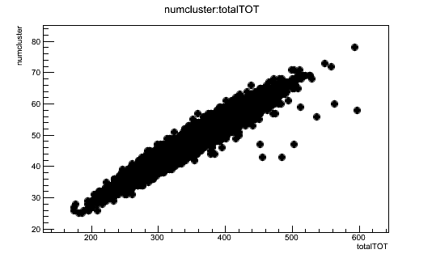
Number of clusters vs. total ToT per frame

Slide 19
²⁴¹ Am

Slide 20
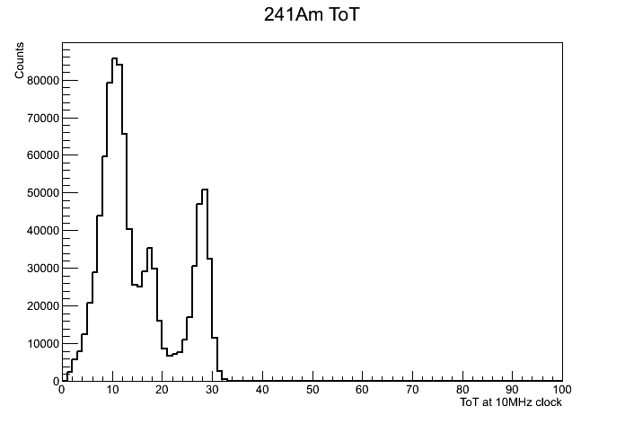
Single-pixel clusters

Slide 21
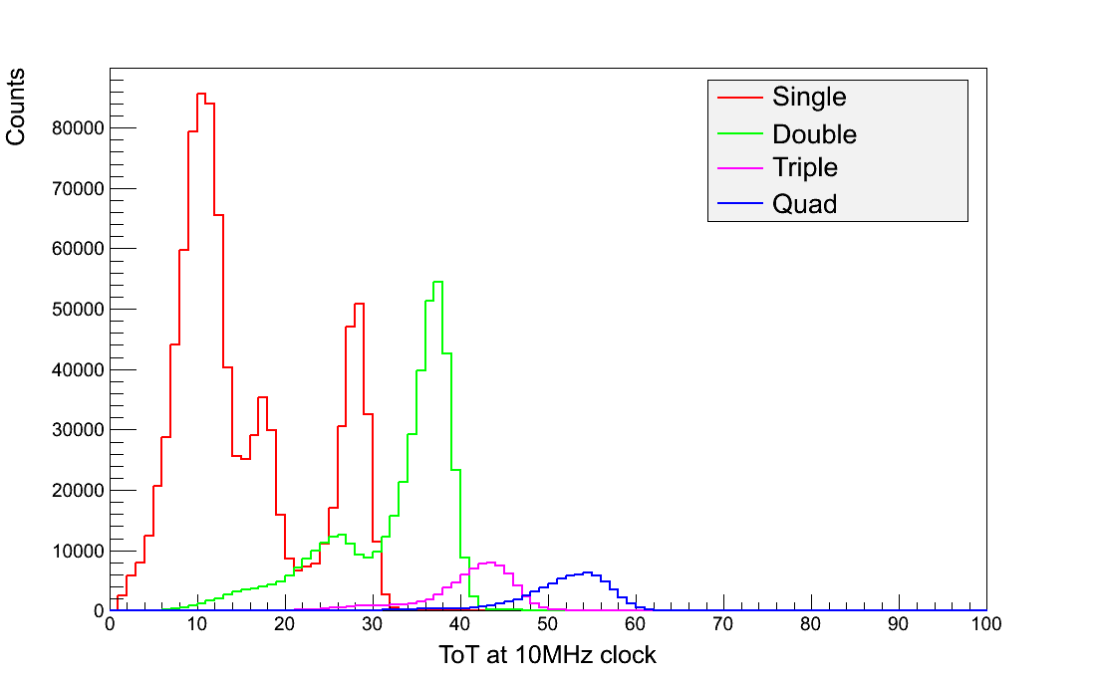
ToT distributions for different cluster sizes

Slide 22
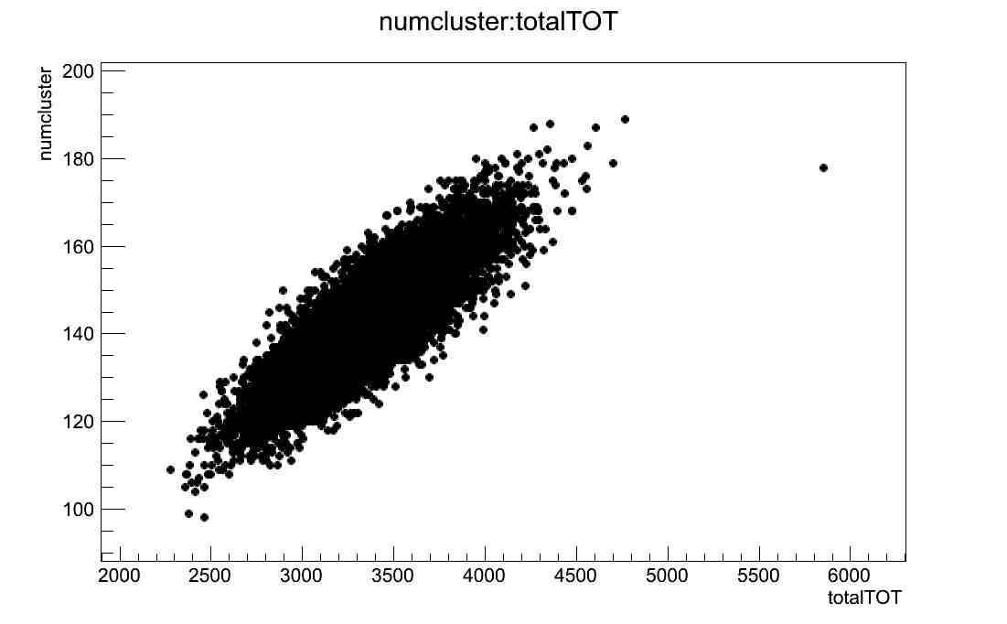
Number of clusters vs. total ToT per frame

Slide 23
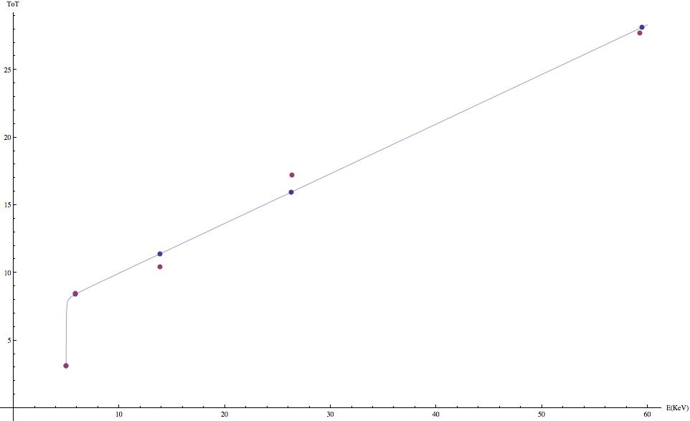
Conversion Energy to ToT

Slide 24
Aplicaciones a física médica
Imágenes bidimensionales con rayos X
Imágenes tomográficas con rayos X
Dosimetría con radiación dispersa
Estudio de fragmentación de núcleos pesados en hadroterapia

