Slide 1
Reporte de Actividades
Mario Rodríguez Cahuantzi
26 de Mayo de 2012
Contenido
UPC
Cósmicos

Slide 2

Run selection
We have analyzed 130 runs of 2011 (LHC11h period)
167806 167807 167808 167813 167814 167818 167915 167920 167921 167985 167986 167987 167988 168066 168069 168076 168107 168108 168115 168172 168173 168175 168181 168203 168205 168206 168207 168208 168212 168213 168310 168311 168318 168322 168325 168341 168342 168361 168362 168458 168460 168461 168464 168467 168511 168512 168514 168777 168826 168992 169035 169040 169044 169045 169091 169094 169099 169138 169144 169145 169148 169156 169160 169167 169236 169238 169411 169415 169417 169418 169419 169420 169475 169498 169504 169506 169512 169515 169550 169553 169554 169555 169557 169586 169587 169588 169590 169835 169837 169838 169846 169855 169858 169859 169965 169969 170027 170036 170040 170081 170083 170084 170085 170088 170089 170091 170155 170159 170163 170193 170203 170204 170207 170228 170230 170268 170269 170270 170306 170308 170309 170311 170312 170313 170387 170388 170389 170390 170572 170593
# of CMPU1-B triggers analyzed: 3161675 (~ 97.01% of the available statistic)
May 23th. 2012
UPCtf meeting
2

Slide 3
Luminosity
To compute the luminosity 3 methods were used:
VLN
1ZED
MB
For VLN and 1ZED, the values used to count the number of triggers were taken from the OCDB (values provided by Evgeny). For the MB method the scalers are not needed and the physics selection was applied.
May 23th. 2012
UPCtf meeting
3

Slide 4
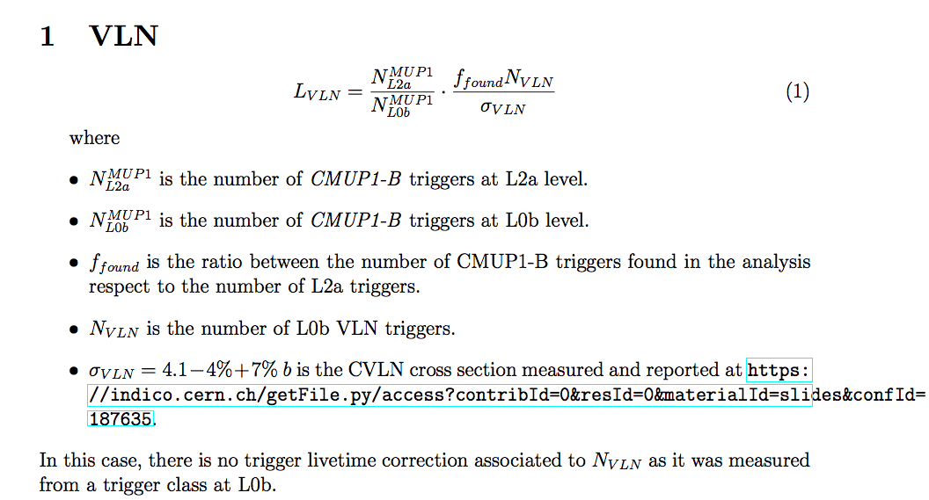
Luminosity
May 23th. 2012
UPCtf meeting
4

Slide 5
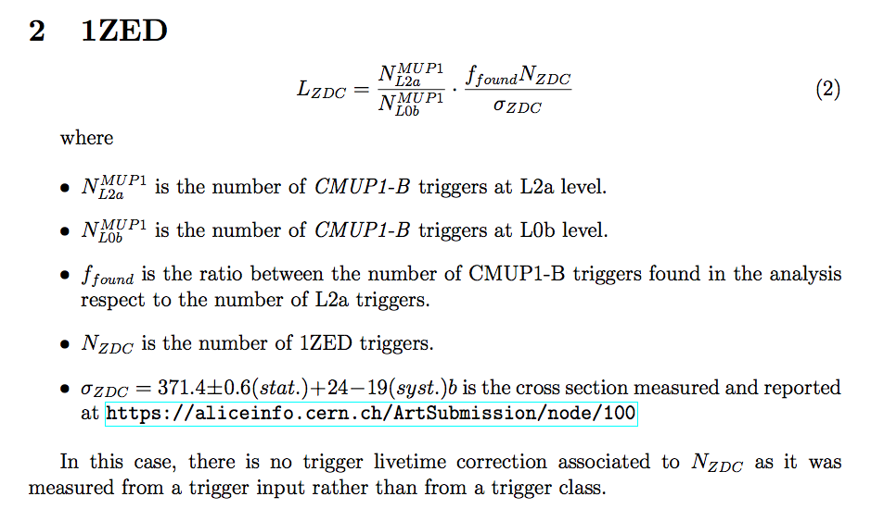
Luminosity
May 23th. 2012
UPCtf meeting
5

Slide 6
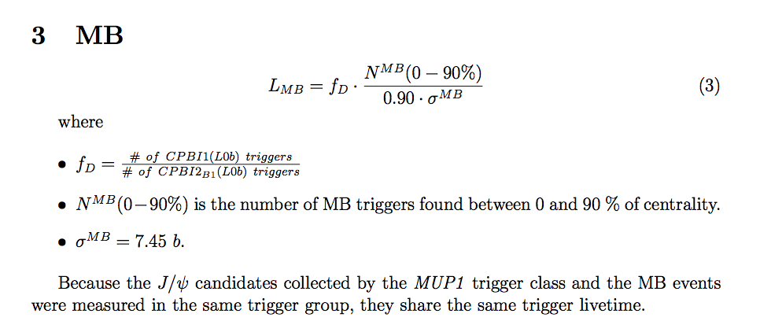
Luminosity
May 23th. 2012
UPCtf meeting
6

Slide 7
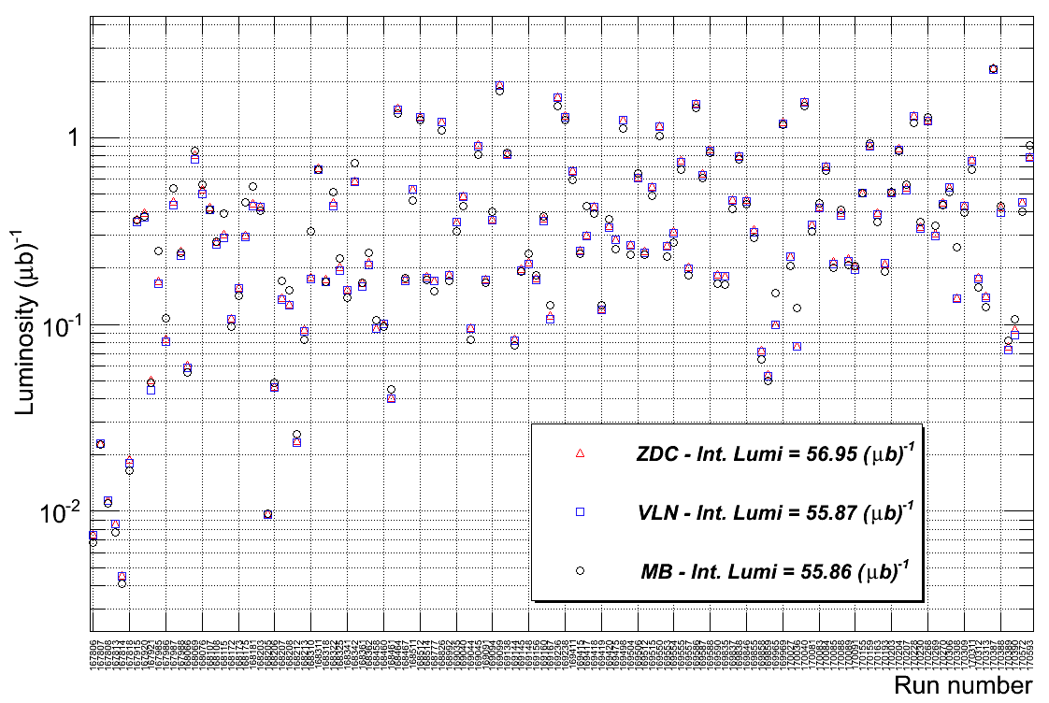
Luminosity
May 23th. 2012
UPCtf meeting
7

Slide 8
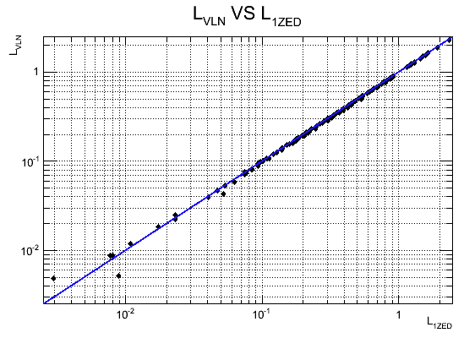
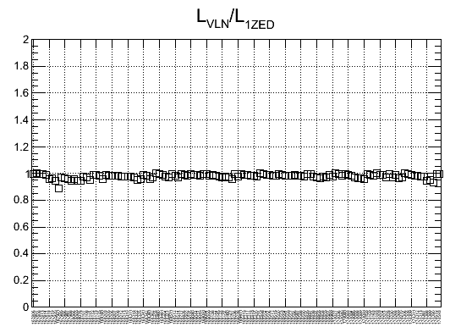
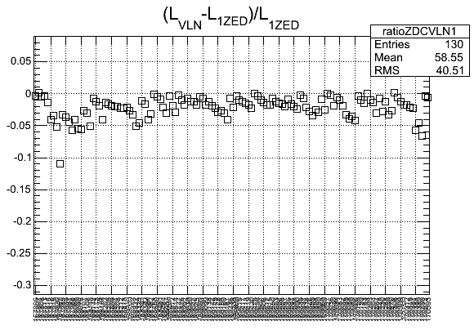
Luminosity
There is good agreement run per run between the VLN and ZDC methods.
May 23th. 2012
UPCtf meeting
8

Slide 9
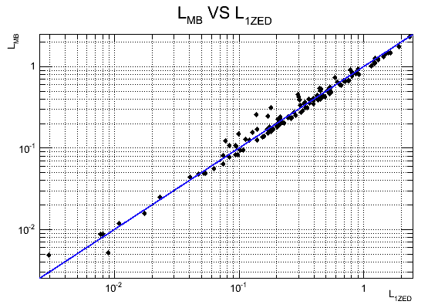
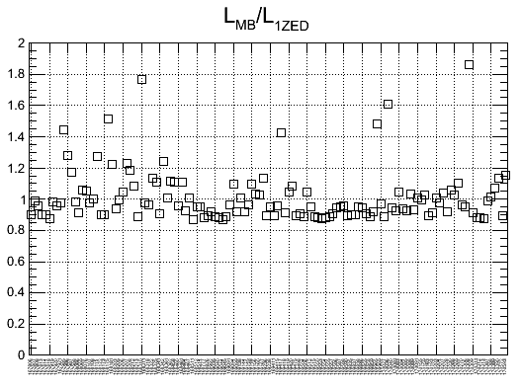
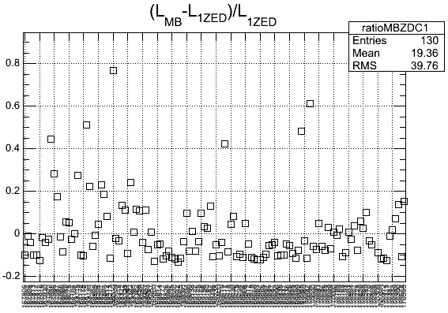
Luminosity
For the following runs, the difference between MB and ZDC methods is bigger than 20% (the luminosity is written in barns units):
Run number: 167985 MB: 246997 VLN: 165470 ZDC: 171085
Run number: 167986 MB: 107818 VLN: 81065 ZDC: 84164
Run number: 168115 MB: 389915 VLN: 290604 ZDC: 305942
Run number: 168175 MB: 452071 VLN: 293467 ZDC: 299248
Run number: 168181 MB: 546403 VLN: 429097 ZDC: 447033
Run number: 168207 MB: 170527 VLN: 135875 ZDC: 138632
Run number: 168310 MB: 316339 VLN: 175170 ZDC: 178892
Run number: 168342 MB: 731802 VLN: 579700 ZDC: 589091
Run number: 169417 MB: 429018 VLN: 297503 ZDC: 301296
Run number: 169965 MB: 147910 VLN: 98994 ZDC: 99838
Run number: 170036 MB: 122670 VLN: 76009 ZDC: 76182
Run number: 170308 MB: 258938 VLN: 138042 ZDC: 138935
These runs represents the 6.63% of the total statistic analyzed
May 23th. 2012
UPCtf meeting
9

Slide 10
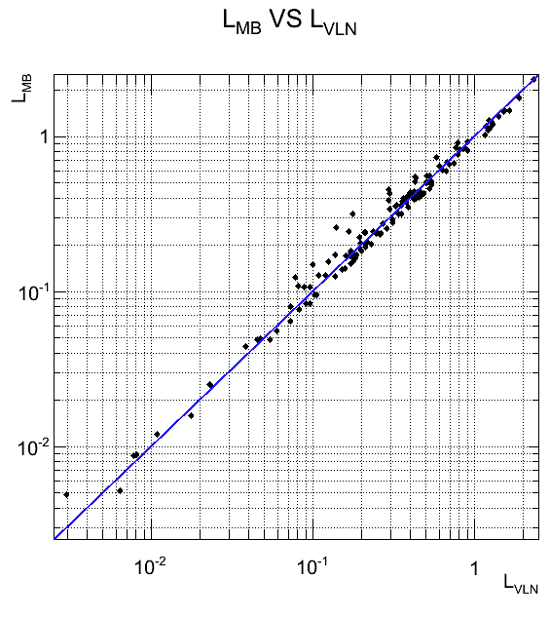
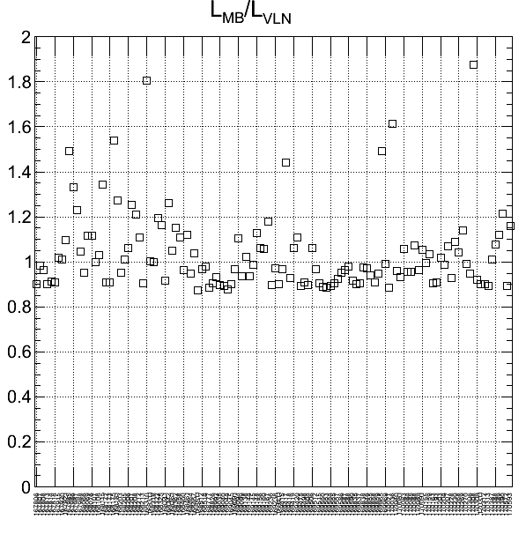
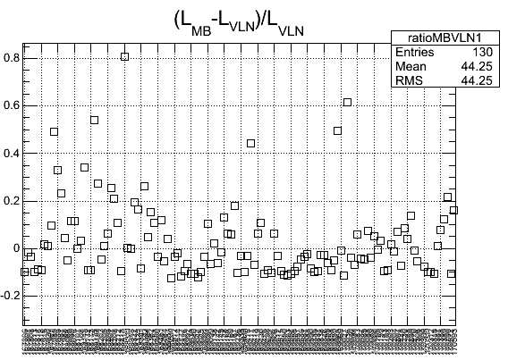
Luminosity
For the following runs, the difference between MB and VLN methods is bigger than 20% (the luminosity is written in barns units):
Run number: 167985 MB: 246997 VLN: 165470 ZDC: 171085
Run number: 167986 MB: 107818 VLN: 81065 ZDC: 84164
Run number: 167987 MB: 536215 VLN: 435721 ZDC: 456203
Run number: 168115 MB: 389915 VLN: 290604 ZDC: 305942
Run number: 168175 MB: 452071 VLN: 293467 ZDC: 299248
Run number: 168181 MB: 546403 VLN: 429097 ZDC: 447033
Run number: 168207 MB: 170527 VLN: 135875 ZDC: 138632
Run number: 168208 MB: 152921 VLN: 126294 ZDC: 128934
Run number: 168310 MB: 316339 VLN: 175170 ZDC: 178892
Run number: 168342 MB: 731802 VLN: 579700 ZDC: 589091
Run number: 169417 MB: 429018 VLN: 297503 ZDC: 301296
Run number: 169965 MB: 147910 VLN: 98994 ZDC: 99838
Run number: 170036 MB: 122670 VLN: 76009 ZDC: 76182
Run number: 170308 MB: 258938 VLN: 138042 ZDC: 138935
Run number: 170390 MB: 106908 VLN: 87936 ZDC: 94146
These runs represents the 8.9% of the total statistic analyzed.
May 23th. 2012
UPCtf meeting
10

Slide 11
Luminosity
Int. luminosity (1ZED) = 56.95 (1/μb) +/- 0.13 % (stat.)
Int. luminosity (VLN) = 55.87 (1/μb) +/- 0.13 % (stat.)
Int. luminosity (MB: 0- 90%) = 55.86 (1/μb) +/- 0.13 % (stat.)
THE DIFFERENCE BETWEEN the 3 methods for the integrated luminosity is not larger than 2%.
May 23th. 2012
UPCtf meeting
11

Slide 12
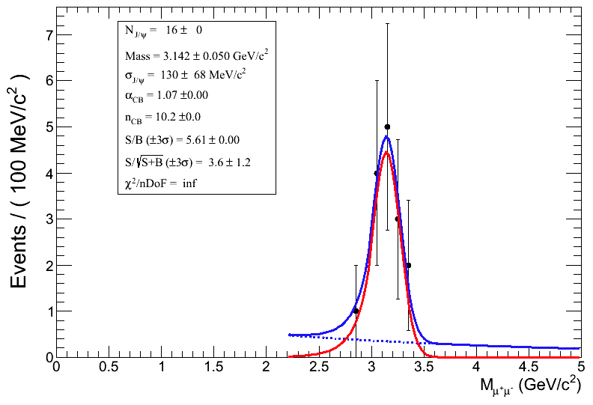
Luminosity
If the runs where the difference between the luminosity computed with the MB method is greater than 20% (respect to the VLN and 1ZED) are skipped then the luminosity decreases at most in 6.16% for ZDC, 6.10% for VLN and 8.44% for MB.
The number of J/psi that can be lost if those runs are excluded is around 16 (within the sys. errors)
Method | 130 runs (100%) | 118 runs (93.37%) | 115 runs (91.1%)
L_ZED (1/mb) | 56.95 | 54.12 (4.96%) | 53.44 (6.16%)
L_VLN(1/mb) | 55.87 | 53.11 (4.94%) | 52.46 (6.10%)
L_MB(1/mb) | 55.86 | 51.94 (7.01%) | 51.14(8.44%)
May 23th. 2012
UPCtf meeting
12

Slide 13
Luminosity
Now, we compute the luminosity with the MB method using the physics selection and different ranges of centrality:
0 – 80 % : 55.01 (1/μb)
0 – 90 % : 55.86 (1/μb)
5 – 80 % : 54.43 (1/μb)
5 – 90 % : 55.40 (1/μb)
40 – 90 % : 50.20 (1/μb)
A final crosscheck for the MB method with the new AOD101 is under progress.
April 25th. 2012
UPCtf meeting
13

Slide 14
2010 & 2011 Runs: cosmic trigger
More runs have been included in the selection of data for 2010 and 2011 (we have included those runs with TRD and EMCAL dedicated triggers for cosmic runs)
2010
No. of runs: 40
Effective live time: 5.8 days
2011
No. of runs: 185
Effective live time: 13.2 days
Thus, for 2010 and 2011 the effective live time is of 19 days
A detailed table with the information of each run is being prepared.
May 24th. 2012
PWG-UD meeting
14

Slide 15
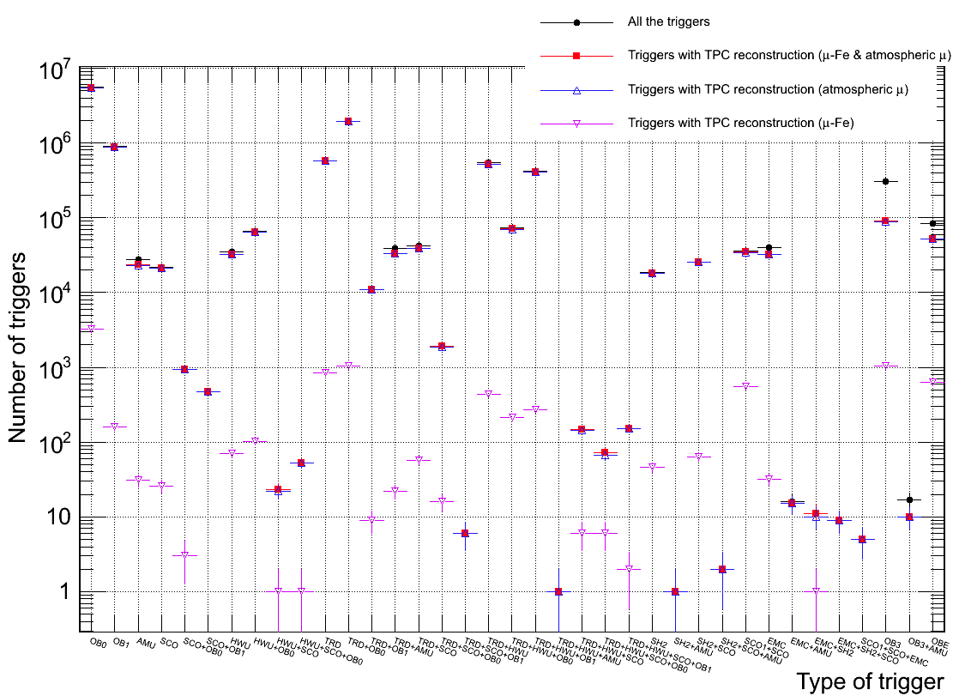
2010 & 2011 Runs: cosmic trigger
After the update in the analysis macro (which includes an improvement for the merging of cosmic pair tracks and the inclusion of cosmic triggers given by the TRD & EMCAL) we re-launched the analysis on GRID.
For 2010 and 2011 ALICE ran in cosmic data taking with 37 different triggers from the combination of the triggers given by: ACORDE, TOF, SPD, TRD and EMCAL. In total 1.083e+07 events have been analyzed.
May 24th. 2012
PWG-UD meeting
15

Slide 16
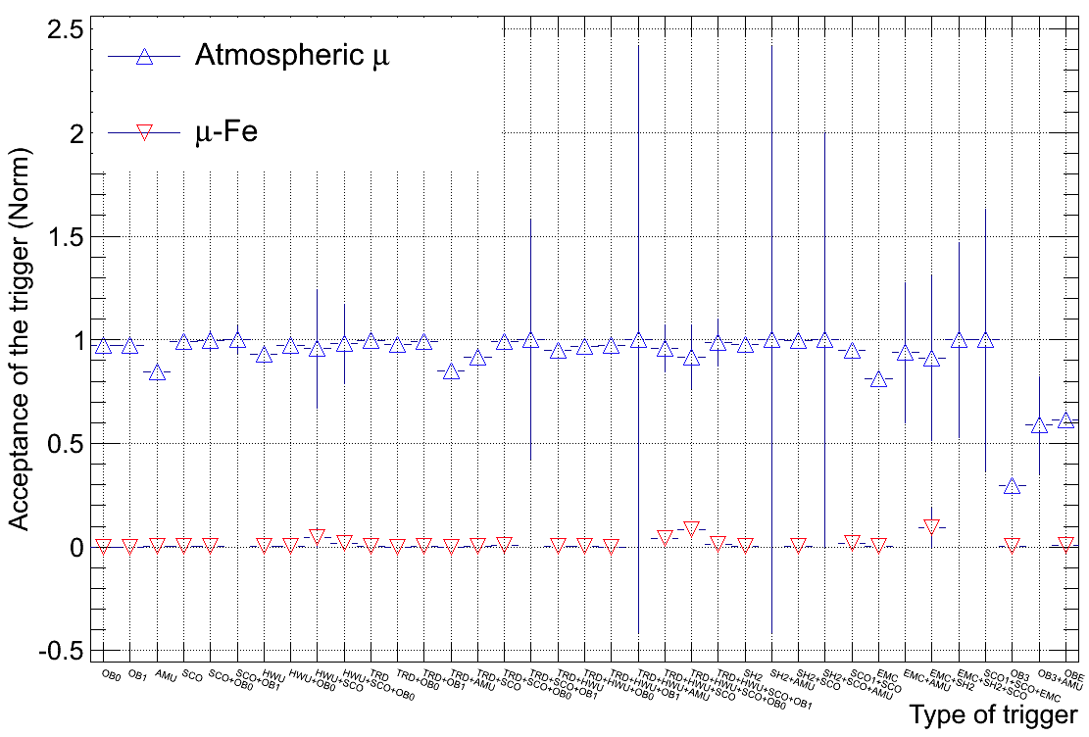
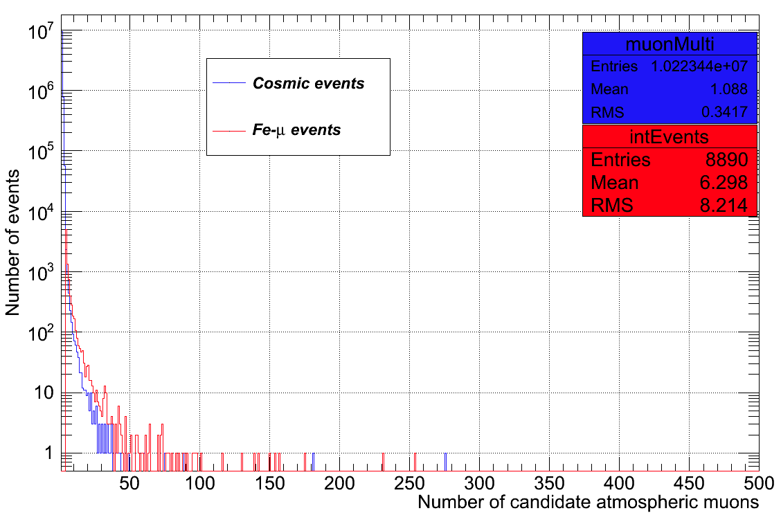
2010 & 2011 Runs: cosmic trigger
What is the fraction of mu-Fe interaction events in cosmic data?
Only the 0.086%
May 24th. 2012
PWG-UD meeting
16

Slide 17
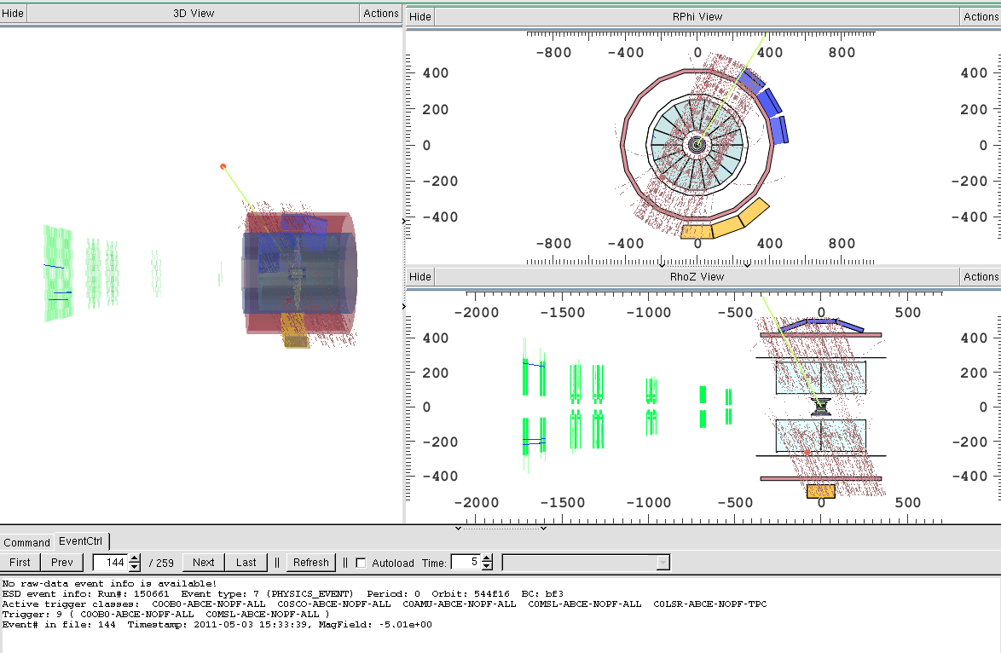
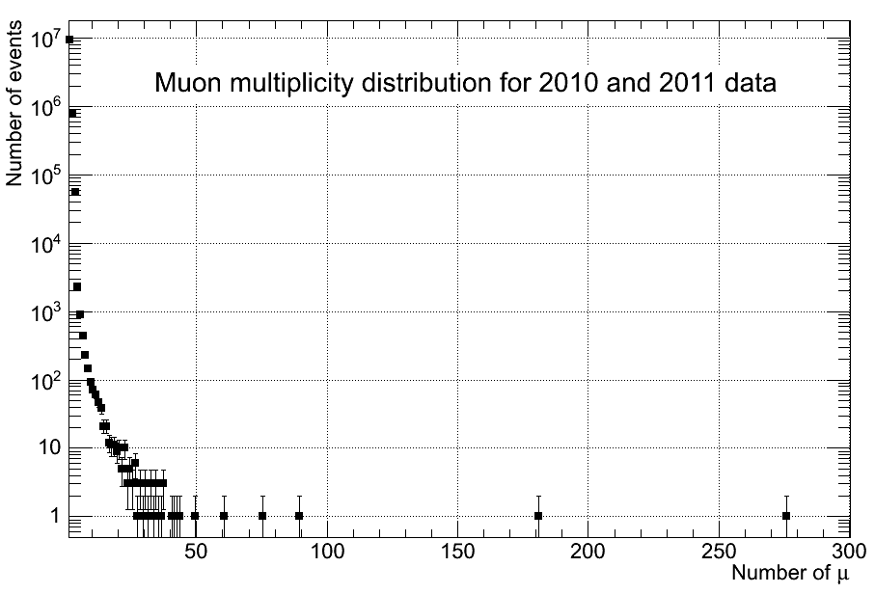
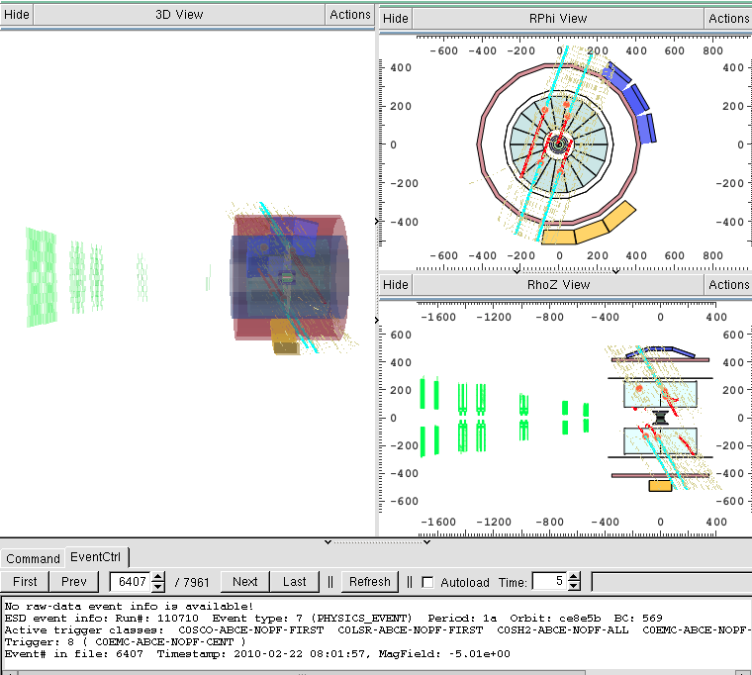
2010 & 2011 Runs: cosmic trigger
New plot for atmospheric muon multiplicity
TOF
EMCAL
We have found some more events with #mu > 50
May 24th. 2012
PWG-UD meeting
17

Slide 18
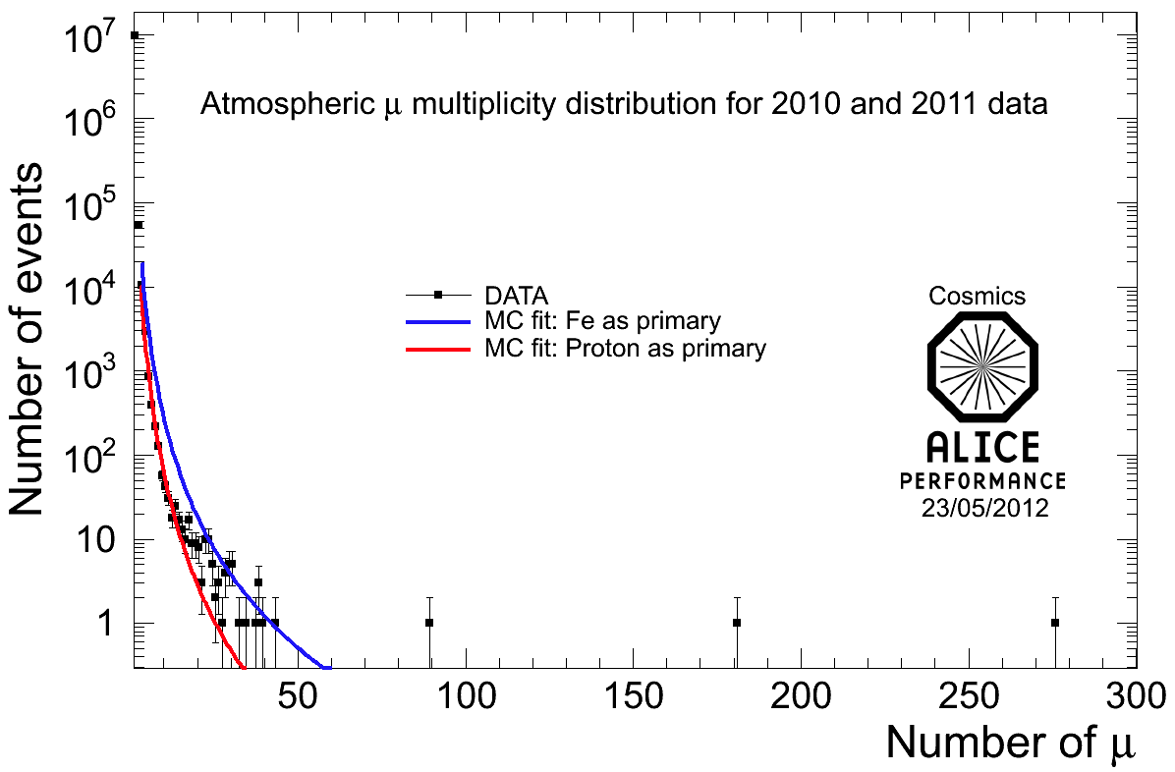
Summary
Most of the cosmic triggers implemented in 2010 & 2011 have a good acceptance.
A new MC production is needed to fit the new DATA statistic (in the meantime the performance plot remains as in the previous analysis, see plot below).
A new study on angular distributions and charge muon ratio (by each trigger) is ongoing (also the “sky map”) with the new sample analyzed during this week. Hopefully some more news the next week.
May 24th. 2012
PWG-UD meeting
18

Slide 19
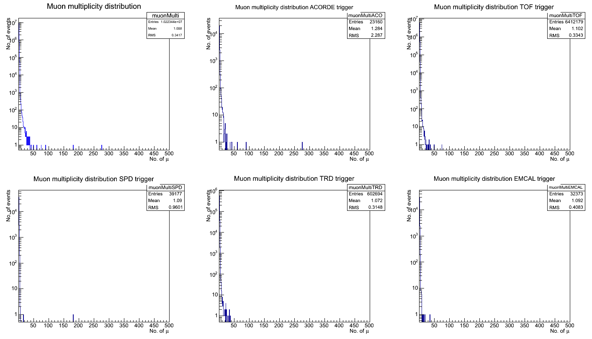
Backup
May 24th. 2012
PWG-UD meeting
19

