Slide 1
Mesoamerican Centre for Theoretical Physics Status & Prospects
Arnulfo Zepeda
Provisional Director
Elí Santos
Provisional Vice-Director
Abdel Pérez Lorenzana
Profesor, Cinvestav
Tuxtla Gutiérrez, Chiapas, México.
27 de agosto de 2012

Slide 2
Content
IDENTITY of the Mesoamerican Centre for Theoretical Phsycis
Nature
Purpose
Mission and Vision
ANTECEDENTS
The region
ICTP
Functions
Strategic 2010-2014 plan
THE PROJECT IN MEXICO
Contributions of UNACH
Starting building
MCTP
Structure
Programs

Slide 3
Nature
The Centro Mesoamericano de Física Teórica de la Universidad Autónoma de Chiapas (CEMAFIT) is created as an academic unit to integrate and consolidate UNACH functions in the areas of physics, mathematics, energy and environment. We will refer to CEMAFIT also as MCTP, for Mesoamerican Centre for Theoretical Physics.

Slide 4
Purpose
The main purpose of MCTP is to develop:
teaching
research
and extention of basic and applied science knowledge in:
PHYSICS
MATHEMATICS
ENERGY
AND ENVIRONMENT in the region of Central America, the Caribbean and Mexico

Slide 5
Mission
To contribute to the growth of education, science and technology and the extension of knowledge in the region of Mexico, Central America and the Caribbean.

Slide 6
Vision
Develop and maintain a high quality environment to promote the scientific development of young students and researches of the region.

Slide 7
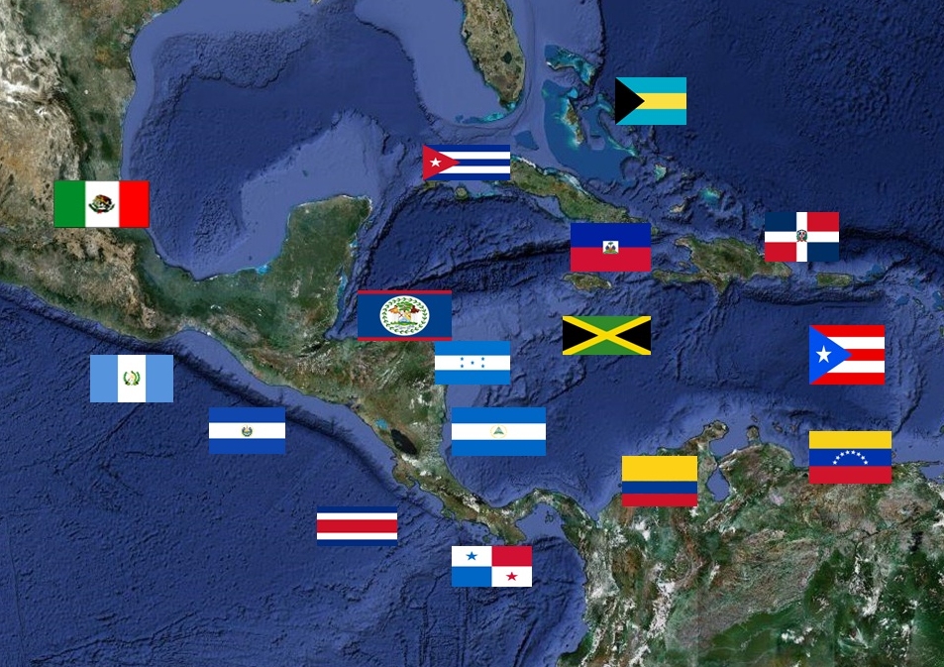
The region
Central America, the Caribbean and Mexico (CACM) are linked by an splendid Mesoamerican past and mostly also by a language.
Common problems.
Need to integrate local research efforts in science and technology development.

Slide 8
ICTP
Founded 45 years ago by Abdus Salam (Nobel Prize 1979 for the proposal, together with Sheldon Glashow and Steven Weinberg, of the Standard Model of physics at the fundamental level).
Provides resources and prestigious academic opportunities for scientists, including many from developing countries

Slide 9
Functions
ICTP functions focus on:
Research, education, exchange, and mobility.
Develops research in the following lines:
High energy, cosmology and astroparticle physics
Condensed matter and statistical physics
Mathematics
Applied physics
Physics of the Earth and environment

Slide 10
Strategic ICTP 2010-2014 plan
Expansion of the lines of research.
Incorporation of bilateral postgraduate program.
Creation of new venues, especially Mexico and Brazil, to be centers of development for the countries of Latin America and the Caribbean
Brazil opened an ICTP institute in Sao Paulo on February 2012.
In December 2011 the Memorandum of Understanding between the UNACH and ICTP for founding a similar institution in Chiapas, Mexico was signed.

Slide 11
Contributions of UNACH
First part: For the first 5 years:
Funds for operating expenses of MCTP.
Salary of the Director and Deputy Director of MCTP
5 positions of Full Professor .
Salaries for the administrations personnel: Administration Secretary, legal counselor, two bilingual assistant secretaries, computing expert and a driver.
Installations.
Furniture, computer equipment and a vehicle.

Slide 12
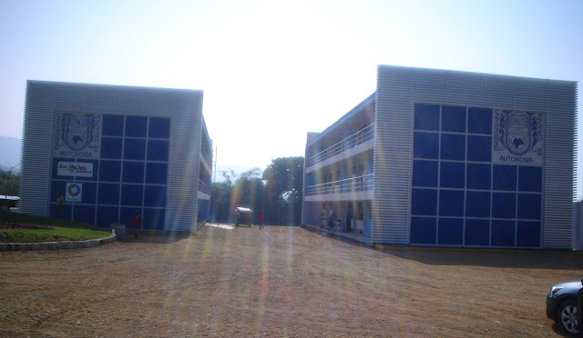
Building to start activities

Slide 13
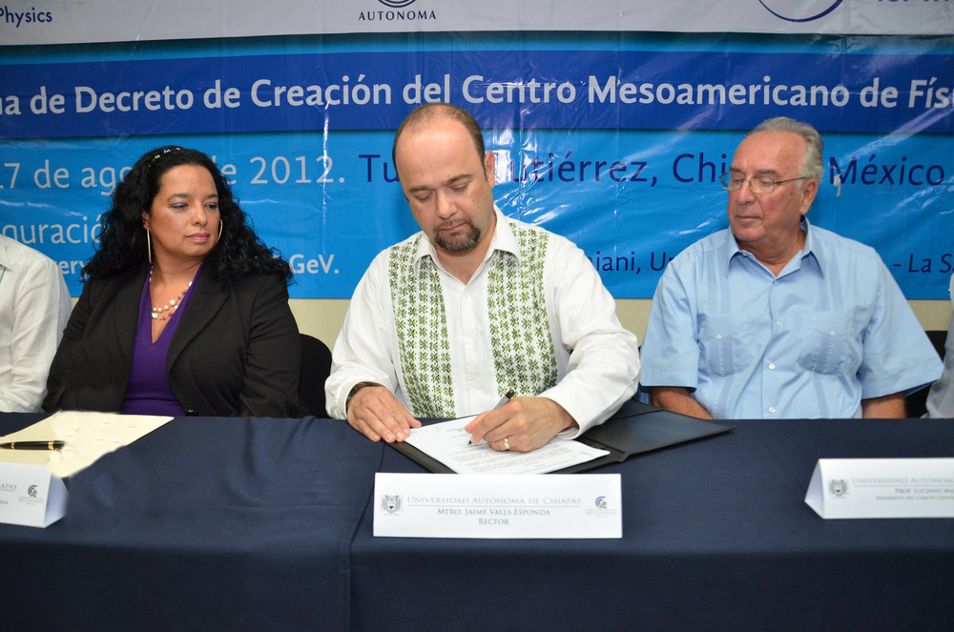
Tanks
On the 27 of August 2012 the Decree of Creation of Cemafit , MCTP, was signed by the Rector of UNACH

Slide 14
ICTP-UNACH-MAIS
Upon approval by the UNACH and UNESCO, MCTP may transmute to ICTP-UNACH-MAIS in accordance with the memorandum of understanding signed on December 20, 2011 by UNACH and ICTP (International Centre for Theoretical Physics), keeping its objectives, goals and programs.

Slide 15
Structure
Advisory Council
Scientific Council
General Coordinator
Adjunct Coordinator
Academic Staff
Administrative Staff
Guests researchers
Students

Slide 16
Advisory Council
It is the highest consultative organ of CEMAFIT.
Initially it is composed of one representative from the UNACH and a member nominated by the Director of the ICTP.
Both institutions, acting in concert, may invite other institutions or government agencies to be part of this body.
Advises on major CEMAFIT policies, regulations, plans, programs and projects, as well as on admission, retention and promotion of both staff and students.
The Advisory Board will become the Stirring Committee once CEMAFIT transmutes to the ICTP-UNACH-MAIS and its advisory faculties will become decision rights.

Slide 17
Scientific Council
It is a body of opinion and evaluation in scientific-academic matters .
It shall consist of a maximum of 10 internationally recognized scientists.
This council will include scientists from the region of Central America, the Caribbean and Mexico.
Sheldon Glashow, who shared with the Abdus Salam the 1979 Nobel Prize in Physics, accepted to serve as head of this council
Ana María Cetto, from Mexico, is part of this council.

Slide 18
Programs MCTP

Slide 19
MCTP Programs
MCTP programs seek to replicate as closely as possible, in organization, design, and operation, those of the ICTP in Trieste.

Slide 20
Central goal of the MCTP Programs
MCTP shall become an international center for scientific and academic exchange, encouraging regional mobility, and involving in its programs high level scientists.

Slide 21
Programs
Agreements on Academic Mobility and Exchange.
Permanent program of schools and scientific meetings.
Invited Scientific Meeting Program.
Research Associate Program.
Associated Groups Program .
Permanent program of visiting scientists
Diploma in Science
Postdoctoral positions program
Training and Research in Mexican Laboratories

Slide 22
Research Associate Program
The aim is to identify and support those members of the scientific community of the countries located in the region noted for its activities and scientific contributions, providing a physical space and facilities for stays.
Appointed associates will follow the same academic criteria used in ICTP in Trieste, and as far as possible, will be recognized as ICTP Associates.

Slide 23
Types of Research Associate
Young Research Associate. Up to 35 years of age, showing ability to perform high-level research, and well-defined lines of research
ii) Research Associate level I.
Between 36 and 45 years of age, who have demonstrated
ability to perform high-level research.

Slide 24
Types of Research Associate
iii) Research Associate level II.
Conducting scientific research in a systematic high-level,
with capacity to form human resources and for the
development and management of research projects.
iv) Permanent Research Fellow.
Who are involved in the organizational, academic and
research programs of MCTP.

Slide 25
Permanent Visiting Scientist Program
In order to maintain an atmosphere of continuous high academic level, MCTP will promote at all times the presence of international researchers and the interrelationship between all researchers and students.

Slide 26
Diploma in Science
Initially there will be two diploma programs in the areas of Physics and Mathematics.
These programs are designed for outstanding students with Bachelor degree in physics or mathematics from institutions in the region.
Will aim to complement the academic training of students by providing them with adequate training for efficient development in high level graduate programs at any institution in the word.
They will last one year.

Slide 27
Postdoctoral program
Aimed mainly at young researchers graduated in programs of international level.

Slide 28
Training and Research in Mexican Laboratories
MCTP will establish agreements for mobility and academic exchange with high level academic institutions and scientific laboratories of the region to promote that outstanding young researchers conduct experimental short term research projects.

Slide 29
DIPLOMADO: FASE DE ARRANQUE
Registro UNACH
Negociación: Convenios Generales y Específicos
Apertura Convocatoria
Cierre Convocatoria
Integración 1ª propuesta
Presentación a Inst. asociables
Integración Consorcio IES
Distribución cursos/prof
Inicio Programa
0
Propuesta p/Consejo Científico
Listado de Profesores
Integración paquete de Convenios Especificos
Adquisiciones: Bibliográficas.
Audiovisuales, Equipamiento instalaciones
Tramites de internación y Becas
Integración paquete de Convenios Generales
Acuerdo del Consejo Científico: Planes y programas
Registro SEP
Fin instalación Biblioteca, Computo
Audiovisuales Aulas, etc.
Listado candidatos a Profs/Colabs externos
Selección Estudiantes
Inicio negociaciones p/financiamiento de Programas

Slide 30
Thank you all. All members of the academic and scientific communities are invited to comment and make suggestions on the structure and pertinence of the programs of MCT¨P
zepeda@fis.cinvestav.mx

