Slide 1


An Introduction to Accelerator physics
Lecture 3: Longitudinal Motion & Beam Transfer
Rende Steerenberg, CERN, Switzerland

Slide 2

Contents:
Basic Synchrotron Equations
Transition Crossing
Radio Frequency Cavity
Low & High Energy Longitudinal Motion
Acceleration
Adiabatic and Non-Adiabatic Changes
What is special about Leptons ?
Transfer Lines and Transverse Matching
Single and Multi-turn Injection
Betatron and Synchrotron Injection for Leptons
Single and Multi-turn Extraction
Longitudinal Motion & Beam Transfer

Slide 3
Motion in Longitudinal Plane
What happens when particle momentum increases?
  particles follow longer orbit (fixed B field)
  particles travel faster (initially)
How does the revolution frequency change with the momentum ?
Longitudinal Motion & Beam Transfer
But
Change in velocity
Change in orbit length
Momentum compaction factor
Therefore:

Slide 4
Frequency - Momentum
but
The relativity theory says
Longitudinal Motion & Beam Transfer
varies with momentum
(E = E₀γ)
fixed by the lattice

Slide 5
Transition:
Lets look at the behaviour of a particle in a constant magnetic field.
Low momentum (β << 1, γ ⇒ 1)
  The revolution frequency increases as momentum increases
High momentum (β ≈ 1, γ >> 1)
Longitudinal Motion & Beam Transfer
  The revolution frequency decreases as momentum increases
For one particular momentum or energy we have:
This particular energy is called Transition energy

Slide 6
The Frequency Slip Factor
We found
η
Below transition → η = positive
At transition → η = zero
Longitudinal Motion & Beam Transfer
Above transition → η = negative
Transition is very important in proton machines.
  A little later we will see why….
In the CERN PS machine : γtr is at ~ 6 GeV/c
Transition does not exist in leptons machines, why?

Slide 7
Radio Frequency Systems
Hadron machines:
  Accelerate / Decelerate beams
  Beam shaping
  Beam measurements
  Increase luminosity in hadron colliders
Lepton machines:
  Accelerate beams
  Compensate for energy loss due to synchrotron radiation.
Longitudinal Motion & Beam Transfer

Slide 8
RF Cavity
To accelerate charged particles we need a longitudinal electric field.
Magnetic fields deflect particles, but do not accelerate them in absolute terms.
Vacuum chamber
Particles
Insulator
(ceramic)
Longitudinal Motion & Beam Transfer
V volts
If the voltage is DC then there is no acceleration !
  The particle will accelerate towards the gap but decelerate after the gap.
Use an Oscillating Voltage with the right Frequency

Slide 9
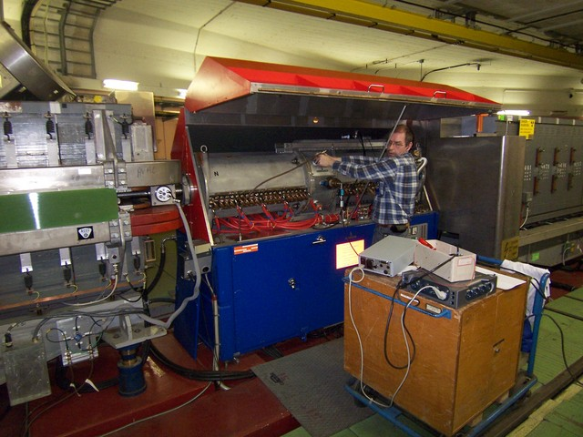
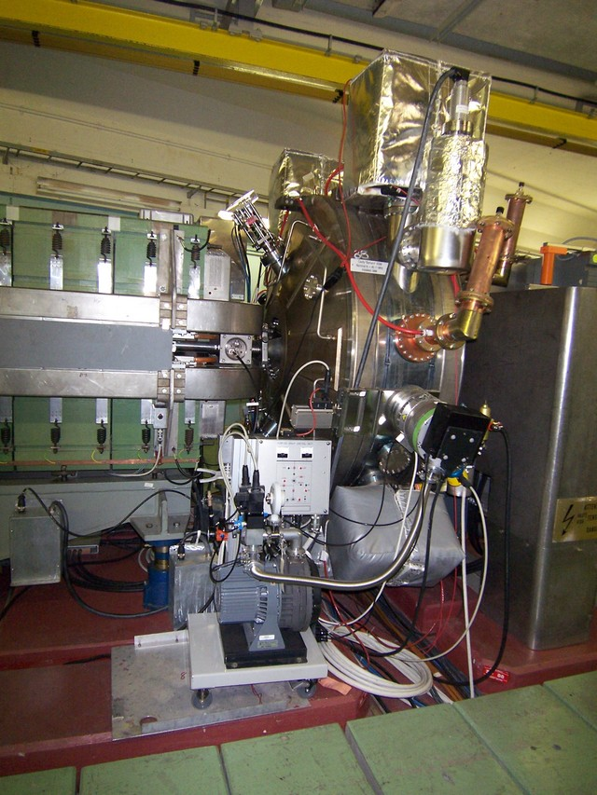
Radio Frequency Cavities
Longitudinal Motion & Beam Transfer
Variable frequency cavity
Fixed frequency cavity

Slide 10
A single particle and RF voltage
Lets see what a low energy particle does with this oscillating voltage in the cavity...
V
V
Longitudinal Motion & Beam Transfer
time
1st revolution period
2nd revolution period
Set the oscillation frequency so that the period is exactly equal to one revolution period of the particle.

Slide 11
Add a second particle
Lets see what a second low energy particle, which arrives later in the cavity, does with respect to our first particle.
A
V
A
V
time
Longitudinal Motion & Beam Transfer
B
B
1st revolution period
~ 20th revolution period
B arrives late in the cavity w.r.t. A
B sees a higher voltage than A and will therefore be accelerated
After many turns B approaches A
B is still late in the cavity w.r.t. A
B still sees a higher voltage and is still being accelerated

Slide 12
During Many Turns
A
V
Longitudinal Motion & Beam Transfer
time
B
1st revolution period

Slide 13
During Many Turns
A
V
Longitudinal Motion & Beam Transfer
time
B
100st revolution period

Slide 14
During Many Turns
A
V
Longitudinal Motion & Beam Transfer
time
B
200st revolution period

Slide 15
During Many Turns
A
V
Longitudinal Motion & Beam Transfer
time
B
400st revolution period

Slide 16
During Many Turns
A
V
Longitudinal Motion & Beam Transfer
time
B
500st revolution period

Slide 17
During Many Turns
A
V
Longitudinal Motion & Beam Transfer
time
B
600st revolution period

Slide 18
During Many Turns
A
V
Longitudinal Motion & Beam Transfer
time
B
700st revolution period

Slide 19
During Many Turns
A
V
Longitudinal Motion & Beam Transfer
time
B
800st revolution period

Slide 20
During Many Turns
A
V
Longitudinal Motion & Beam Transfer
time
B
900st revolution period

Slide 21
Synchrotron Oscillations
A
V
time
B
Longitudinal Motion & Beam Transfer
900st revolution period
Particle B has made 1 full oscillation around particle A.
The amplitude depends on the initial phase.
We call this oscillation:
Exactly like the pendulum
Synchrotron Oscillation

Slide 22
Longitudinal Phase Space
In order to be able to visualize the motion in the longitudinal plane we define the longitudinal phase space (like we did for the transverse phase space)
ΔE
Longitudinal Motion & Beam Transfer
Δt (or φ)

Slide 23
Phase Space Motion
Particle B oscillates around particle A
  This is synchrotron oscillation
When we plot this motion in our longitudinal phase space we get:
ΔE
higher energy
early arrival
Longitudinal Motion & Beam Transfer
late arrival
Δt (or φ)
lower energy

Slide 24
Phase Space Motion
Particle B oscillates around particle A
  This is synchrotron oscillation
When we plot this motion in our longitudinal phase space we get:
ΔE
higher energy
early arrival
Longitudinal Motion & Beam Transfer
late arrival
Δt (or φ)
lower energy

Slide 25
Phase Space Motion
Particle B oscillates around particle A
  This is synchrotron oscillation
When we plot this motion in our longitudinal phase space we get:
ΔE
higher energy
early arrival
Longitudinal Motion & Beam Transfer
late arrival
Δt (or φ)
lower energy

Slide 26
Phase Space Motion
Particle B oscillates around particle A
  This is synchrotron oscillation
When we plot this motion in our longitudinal phase space we get:
ΔE
higher energy
early arrival
Longitudinal Motion & Beam Transfer
late arrival
Δt (or φ)
lower energy

Slide 27
Stationary Bucket & Bunch
ΔE
Bunch
Bucket
ΔE
Δt (or φ)
Longitudinal Motion & Beam Transfer
Δt
Bucket area = longitudinal Acceptance [eVs]
Bunch area = longitudinal beam emittance = π.ΔE.Δt/4 [eVs]

Slide 28
De-bunched – Coasting beam
The emittance of an unbunched beam is just ΔET eVs
  ΔE is the energy spread [eV]
  T is the revolution time [s]
ΔE
Longitudinal Motion & Beam Transfer
ΔE
Δt (or φ)
T = revolution time

Slide 29
What Happens Beyond transition
Until now we have seen how things look like below transition.
η = positive
Higher energy  faster orbit  higher F_{rev}  next time particle will be earlier.
Lower energy  slower orbit  lower F_{rev}  next time particle will be later.
What will happen above transition ?
Longitudinal Motion & Beam Transfer
η = negative
Higher energy  longer orbit  lower F_{rev}  next time particle will be later.
Lower energy  shorter orbit  higher F_{rev}  next time particle will be earlier.
Below transition we use the rising edge, beyond transition we will use the falling edge of the oscillating voltage.

Slide 30
Motion Beyond Transition
accelerating
E
RF Voltage
V
A
time
B
Longitudinal Motion & Beam Transfer
decelerating
Imagine two particles A and B, that arrive at the same time in the accelerating cavity (when V_{rf} = 0V)
  For A the energy is such that F_{rev A} = F_{rf}.
  The energy of B is higher → F_{rev B} < F_{rev A}

Slide 31
Motion Beyond Transition
accelerating
E
RF Voltage
V
A
time
B
Longitudinal Motion & Beam Transfer
decelerating
Particle B arrives after A and experiences a decelerating voltage.
  The energy of B is still higher, but less → F_{rev B} < F_{rev A}

Slide 32
Motion Beyond Transition
accelerating
E
RF Voltage
V
A
time
time
B
Longitudinal Motion & Beam Transfer
decelerating
B has now the same energy as A, but arrives still later and experiences therefore a decelerating voltage.
  F_{rev B} = F_{rev A}

Slide 33
Motion Beyond Transition
accelerating
E
RF Voltage
V
A
time
time
B
Longitudinal Motion & Beam Transfer
decelerating
Particle B has now a lower energy as A, but arrives at the same time
  F_{rev B} > F_{rev A}

Slide 34
Motion Beyond Transition
accelerating
E
RF Voltage
V
A
time
time
B
Longitudinal Motion & Beam Transfer
decelerating
Particle B has now a lower energy as A, but B arrives before A and experiences an accelerating voltage.
  F_{rev B} > F_{rev A}

Slide 35
Motion Beyond Transition
accelerating
E
RF Voltage
V
A
time
time
B
Longitudinal Motion & Beam Transfer
decelerating
Particle B has now a higher energy as A and arrives at the same time again….
  F_{rev B} < F_{rev A}

Slide 36
Motion in the bucket
V
Phase w.r.t. RF voltage
φ
Synchronous particle
Longitudinal Motion & Beam Transfer
ΔE
RF Bucket
Δt (or φ)
Bunch

Slide 37
Motion in the bucket
V
Longitudinal Motion & Beam Transfer
ΔE
Δt (or φ)

Slide 38
Motion in the bucket
V
Longitudinal Motion & Beam Transfer
ΔE
Δt (or φ)

Slide 39
Motion in the bucket
V
Longitudinal Motion & Beam Transfer
ΔE
Δt (or φ)

Slide 40
Motion in the bucket
V
Longitudinal Motion & Beam Transfer
ΔE
Δt (or φ)

Slide 41
Motion in the bucket
V
Longitudinal Motion & Beam Transfer
ΔE
Δt (or φ)

Slide 42
Motion in the bucket
V
Longitudinal Motion & Beam Transfer
ΔE
Δt (or φ)

Slide 43
Motion in the bucket
V
Longitudinal Motion & Beam Transfer
ΔE
Δt (or φ)

Slide 44
Motion in the bucket
V
The particle now turns in the other direction w.r.t. a particle below transition.
Longitudinal Motion & Beam Transfer
ΔE
Δt (or φ)

Slide 45
Below & Above Transition
E
Below transition
Δt (or φ)
Longitudinal Motion & Beam Transfer
Stable, synchronous
position
E
Above transition
Δt (or φ)

Slide 46
RF & Harmonic Numbers
Until now we have applied an oscillating voltage with a frequency equal to the revolution frequency.
F_{rf}= F_{rev}
Longitudinal Motion & Beam Transfer
What will happen when F_{rf} is a multiple of f_{rev} ???
F_{rf}= h × F_{rev}

Slide 47
Harmonics & Buckets
Variable for
β < 1
F_{rf}= h × F_{rev}
Longitudinal Motion & Beam Transfer
Frequency of cavity voltage
Harmonic number
We will have
h buckets
1 T_{rev}

Slide 48
Synchrotron Frequency
On each turn the phase, φ, of a particle w.r.t. the RF waveform changes due to the synchrotron oscillations.
Change in revolution frequency
Harmonic number
We know that
Longitudinal Motion & Beam Transfer
Combining this with the above
This can be written as
Change of energy as a function of time

Slide 49
Synchrotron Frequency
So, we have:
Where dE is just the energy gain or loss due to the RF system during each turn
Longitudinal Motion & Beam Transfer
dE = V.sinφ
V
Synchronous particle
dE = zero
V
φ
Δt (or φ)

Slide 50
Synchrotron Tune
and
Longitudinal Motion & Beam Transfer
If φ is small then sinφ = φ
This is a SHM where the synchrotron oscillation frequency is given by:
Synchrotron tune Qs

Slide 51
Acceleration
Increase the magnetic field slightly on each turn.
The particles will follow a shorter orbit. (F_{rev} < F_{synch})
Beyond transition, early arrival in the cavity causes a gain in energy each turn.
dE = V.sinφ_{s}
V
Longitudinal Motion & Beam Transfer
Δt (or φ)
φ
We change the phase of the cavity such that the new synchronous particle is at φ_{s} and therefore always sees an accelerating voltage
V_{s} = Vsinφ_{s} = VΓ = energy gain/turn = dE

Slide 52
Accelerating Bucket
V
accelerating synchronous particle
φ_{s}
Δt (or φ)
Stationary RF bucket
Longitudinal Motion & Beam Transfer
Stationary synchronous particle
ΔE
Accelerating RF bucket
Δt (or φ)

Slide 53
Acceleration & acceptance
The modification of the RF bucket reduces the acceptance
The faster we accelerate (increasing sin φ_{s} ) the smaller the acceptance
Faster acceleration also modifies the synchrotron tune.
For a stationary bucket (φs = 0) we had:
Longitudinal Motion & Beam Transfer
For a moving bucket (φs ≠ 0) this becomes:

Slide 54
Non-Adiabatic Changes
ΔE
Matched bunch
Longitudinal Motion & Beam Transfer
Δt (or φ)
What will happen when we increase the voltage rapidly ?

Slide 55
Non-Adiabatic Changes
The bunch is now mismatched w.r.t. to the bucket
It will start rotating
ΔE
Longitudinal Motion & Beam Transfer
Δt (or φ)

Slide 56
Non-Adiabatic Changes
The frequency of this rotation is equal to the synchrotron frequency
ΔE
Longitudinal Motion & Beam Transfer
Δt (or φ)

Slide 57
Non-Adiabatic Changes
ΔE
Longitudinal Motion & Beam Transfer
Δt (or φ)

Slide 58
Non-Adiabatic Changes
ΔE
Longitudinal Motion & Beam Transfer
Δt (or φ)

Slide 59
Non-Adiabatic Changes
ΔE
Longitudinal Motion & Beam Transfer
Δt (or φ)

Slide 60
Non-Adiabatic Changes
ΔE
Longitudinal Motion & Beam Transfer
Δt (or φ)

Slide 61
Non-Adiabatic Changes
If we let it rotate for long time w.r.t. the synchrotron frequency then all the particle with smear out, we call that filamentation
ΔE
Longitudinal Motion & Beam Transfer
Δt (or φ)

Slide 62
Non-Adiabatic Changes
Filamentation will cause an increase in longitudinal emittance (blow-up)
ΔE
Longitudinal Motion & Beam Transfer
Δt (or φ)

Slide 63
Non-Adiabatic Changes
To avoid this filamentation we have to change slowly w.r.t. the synchrotron frequency.
This is called Adiabatic change.
Matched bunch
ΔE
Longitudinal Motion & Beam Transfer
Δt (or φ)

Slide 64
Adiabatic Changes
Bunch is still matched
ΔE
Longitudinal Motion & Beam Transfer
Δt (or φ)

Slide 65
Adiabatic Changes
Bunch is still matched
It gets shorter and higher
ΔE
Longitudinal Motion & Beam Transfer
Δt (or φ)

Slide 66
Adiabatic Changes
The longitudinal emittance is conserved
ΔE
Longitudinal Motion & Beam Transfer
Δt (or φ)

Slide 67
What is Special About Leptons
Since leptons are much lighter than hadrons they become relativistic very quickly during acceleration.
They emit electro magnetic waves, synchrotron radiation, under the influence of magnetic and electric forces at the following rates:
  Longitudinal proportional to the square of the energy (E²)
  Transverse proportional to the square of the magnetic field (B²)
Longitudinal Motion & Beam Transfer
P_{SR} ∝ E² B²
In our accelerators:
  Transverse force >> Longitudinal force
  Therefore we only consider radiation due to transverse acceleration (thus magnetic forces)
Every turn the leptons will lose energy due to the synchrotron radiation, which has to be made up by the RF system.

Slide 68
Synchrotron Motion for Leptons
ΔE
Δt (or φ)
Longitudinal Motion & Beam Transfer
All three particles will gain the same energy from the RF system
The blue particle will lose more energy than the red one.
This leads to a reduction in the energy spread, since u varies with E⁴.
The synchrotron oscillation can be described by the differential equation:
Extra term for energy loss

Slide 69
Betatron Motion for Leptons
Each photon emission reduces the transverse and longitudinal energy or momentum.
Emitted photon (dp)
total momentum (p)
Longitudinal Motion & Beam Transfer
momentum lost dp
ideal trajectory
particle
particle trajectory

Slide 70
Making up for lost Energy
The RF system must make up for the loss in longitudinal energy dE or momentum dp.
However, the cavity only supplies energy parallel to ideal trajectory.
ideal trajectory
Longitudinal Motion & Beam Transfer
new particle trajectory
old particle trajectory
Each passage in the cavity increases only the longitudinal energy.
This leads to a direct reduction of the amplitude of the betatron oscillation.
This results in damping in both the horizontal and vertical plane.

Slide 71
Leptons and emittances
Since leptons become very quickly relativistic, hence they emit synchrotron radiation in our accelerator mainly due to magnetic fields.
The RF system has to make up for the lost energy over every turn, resulting in a reduction of the longitudinal, horizontal and vertical emittances.
Due to several heating terms and coupling between the different planes the emittances shrink, but only to an equilibrium.
This is very useful in case of instabilities, but also when injecting leptons.
The drawback is that high energy (circular) leptons accelerators need lots of RF power.
Longitudinal Motion & Beam Transfer

Slide 72
Beam transfer, Injection & Extraction
How to get a beam into and out of circular accelerators and storage rings.
The wide range of requirements will require different solutions:
  injection into a synchrotron from a LINAC
  transfer between two synchrotrons
  extraction to an end-user facility
  accumulation of particles, to increase intensity
  dealing with different particles
Longitudinal Motion & Beam Transfer

Slide 73
Transfer Lines
Particles trajectories in transfer lines are treated the same way as in a circular machine, with the only difference that they pass only once.
We use:
  Dipoles to deflect particles
  Quadrupoles to focus particles transversely
This leads to betatron oscillations and functions
We can use the 2x2 matrices to describe the transverse motion of the particle
Longitudinal Motion & Beam Transfer

Slide 74
Transfer Line Matrix
The particles trajectories in transfer lines are not closed
This means that the
  initial lattice parameters ≠ final lattice parameters
Due to this the transfer matrix gets slightly more complicated.
Longitudinal Motion & Beam Transfer

Slide 75
Transfer Between Accelerators
1
2
A
B
Longitudinal Motion & Beam Transfer
The initial phase space ellipse will be determined by the accelerator (1), from which the beam is being extracted (point A).
Then we calculate the transport matrix that describes the transport line and we calculate the final ellipse at point B.
However, machine (2) will have it’s own predetermined transverse phase space ellipse at B.
If the phase space ellipse, which arrives from the transfer line is different then.... what will happen to the beam?

Slide 76
Transverse Mismatch
Injected beam rotates inside the new ellipse
At injection
Longitudinal Motion & Beam Transfer
“smear out” of phase space and emittance blow-up begins
emittance blow-up complete

Slide 77
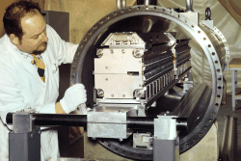

Single Turn Injection
With a single turn injection we inject one or more bunches into a synchrotron in a single turn. (revolution period of receiving machine)
Elements involved:
  Transfer line
  Septum magnet
  Fast kicker magnet
  Synchrotron (receiving machine)
Longitudinal Motion & Beam Transfer

Slide 78
Single Turn Injection
Injection trajectory
Longitudinal Motion & Beam Transfer
Injection channel
Septum thickness
βs >>
βk >>
μ(s->k) =(2n+1)π/2
Minimize δ to reduce kicker strength

Slide 79
Injection Oscillations
Error (δ)
Displacement (x)
septum
kicker
bpm1
bpm2
Longitudinal Motion & Beam Transfer
μ
π/2
π/2
π/2
Any residual transverse oscillation will lead to an emittance blow-up
Measurement methods, FFT analysis of one BPM signal, compare single-turn and closed orbit

Slide 80
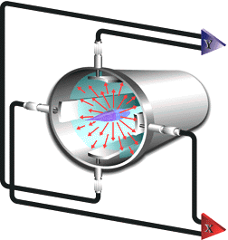
Beam Position Monitor (BPM)
A BPM works like a capacitor:
  Beam is for example formed by positive charges (protons).
  The vacuum is very good insulator.
  Then the strip lines will be charged with negative charges.
If the protons are nicely centered all strip lines contain an equal number of negative charges.
Longitudinal Motion & Beam Transfer
If the particle beam is displaced one strip line will contain more negative charges than the others.
Center of mass
position
Difference of charges on H or V strip lines
Sum of charges on H or V strip lines

Slide 81
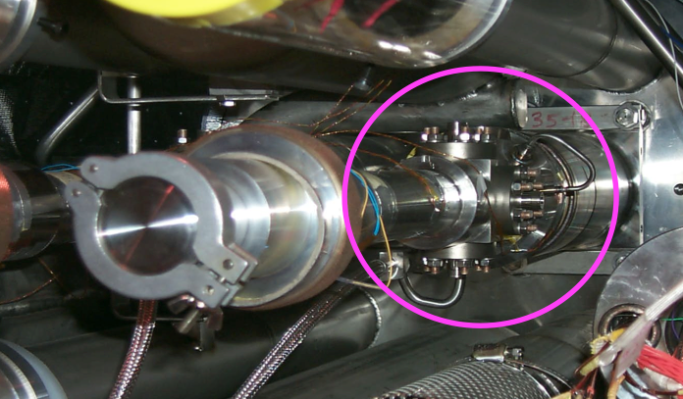
BPM in the LHC
Longitudinal Motion & Beam Transfer

Slide 82
Reason for Multi-Turn Injection:
For hadrons the beam density at injection is either limited by space charge effects or by the injector (heavy ions...)
Usually we inject from a LINAC into a synchrotron
We cannot increase charge density, so we fill the horizontal phase space to increase injected intensity.
Elements used
  Septum
  Fast beam bumpers, made out of 3 or 4 dipoles for more flexibility, to create a local beam bump
Longitudinal Motion & Beam Transfer

Slide 83
Contents:
Longitudinal Motion & Beam Transfer
Lets have a look at a real example…
Let qh = .25 (fractional tune)
Let us have a look what happens in phase space turn after turn

Slide 84
Contents:
x’
Longitudinal Motion & Beam Transfer
1
x

Slide 85
Contents:
x’
Longitudinal Motion & Beam Transfer
2
1
x

Slide 86
Contents:
x’
1
Longitudinal Motion & Beam Transfer
3
2
x

Slide 87
Contents:
x’
1
2
4
Longitudinal Motion & Beam Transfer
3
x

Slide 88
Contents:
x’
2
Longitudinal Motion & Beam Transfer
3
1
5
4
x

Slide 89
Contents:
x’
3
Longitudinal Motion & Beam Transfer
4
2
6
1
5
x

Slide 90
Contents:
x’
4
1
7
Longitudinal Motion & Beam Transfer
5
3
2
6
x

Slide 91
Contents:
x’
5
1
2
Longitudinal Motion & Beam Transfer
6
4
8
3
7
x

Slide 92
Contents:
x’
6
2
Longitudinal Motion & Beam Transfer
7
3
1
5
9
4
8

Slide 93
Contents:
x’
7
3
Longitudinal Motion & Beam Transfer
8
4
2
6
10
1
5
9
x

Slide 94
Contents:
x’
8
4
9
5
1
3
7
11
Longitudinal Motion & Beam Transfer
2
6
10
x

Slide 95
Contents:
x’
Longitudinal Motion & Beam Transfer
x

Slide 96
Contents:
x’
Longitudinal Motion & Beam Transfer
x

Slide 97
Contents:
x’
Longitudinal Motion & Beam Transfer
x

Slide 98
Contents:
x’
Longitudinal Motion & Beam Transfer
x
Now the horizontal mechanical acceptance is completely filled and acceleration can start with high intensity.

Slide 99
Multi-Turn vs. Charge Exchange Injection
Multi-turn injection:
  We need to control the tune Qh and the beam bump accurately
    in order to reduce losses
    in order to fill the horizontal phase space most efficiently
  We need a very thin septum
    in order to minimize the losses on subsequent turns
    in order to reduce phase space dilution.
Charge exchange injection:
  In order to strip the ions, but no to blow-up the beam to much we carefully need to consider the stripping foil requirements
  It has advantages over normal multi-turn proton injection
  Transport H- ions from the linac to the synchrotron
  Strip the H- ions to protons inside the ring acceptance
  It has advantages over normal multi-turn proton injection
Longitudinal Motion & Beam Transfer

Slide 100
Charge Exchange Injection
H- ions
Stripping foil
Injected protons
Longitudinal Motion & Beam Transfer
Circulating protons
beam bumpers
We paint a more uniform transverse phase space density by modifying the beam bump and by and changing the steering of the injected beam
To avoid excessive foil heating and unnecessary beam blow up the injection bump is reduced to zero as soon as the injection is finished.

Slide 101
Lepton Betatron accumulation Injection
We can apply the same fast injection as for hadrons, but use damping to our benefit.
acceptance
x_{s}
Longitudinal Motion & Beam Transfer
x_{s}
x
stored beam
injected beam
The oscillation, due to the position offset, will damp out and make place for another beam to inject.

Slide 102
Lepton Synchrotron accumulation Injection
E
stored beam
injected beam
φ
Δp < 0
      Injection 1
      Turn = N
Longitudinal Motion & Beam Transfer
E
X_{s} = D. Δp/p
φ
The oscillation, due to the energy offset, will damp out and make place for another beam to inject.
Injection 2
Turn = N + 0.5Q_{s}

Slide 103
Single Turn Extraction
With a single turn ejection we eject one or more bunches out of a synchrotron in a single turn. (revolution period)
Elements involved:
  Extraction Bump
  Septum magnet
  Fast kicker magnet
  Synchronization
Ejection trajectory
Longitudinal Motion & Beam Transfer

Slide 104
Non- Resonant Multi-Turn Extraction
machine
acceptance
x’
septum
Tune q=0.25
x’
extracted beam
x
x
beam
Turn 1
Longitudinal Motion & Beam Transfer
x’
extracted beam
extracted beam
x
x
Turn 2
Turn 3

Slide 105
Non- Resonant Multi-Turn Extraction
Particularities:
  Use a thin septum, to reduce losses
  Use two septa (electro-static, magnetic)
  First septum is moveable, position and angle
  Only gives a few turns… (>>10¹⁰ particles/turn)
  Many users need <10⁶ particles/second
For very high intensity beams the beam losses may be too important to use this method.
Hands on maintenance becomes difficult.
Longitudinal Motion & Beam Transfer

Slide 106
Resonant Extraction
Experimental physicists would prefer a continuous flux out of our accelerator.
How to extract beam over thousands of turns ?
The idea is that few particles jump to the other side of the septum every revolution period
Resonant transverse motion makes the beam size increase
Set 3Q_{h} = integer (third order resonance)
Use sextupoles to excite this resonance with correct phase.
Use a horizontal beam bump at the extraction septum, to ensure that the septum is the aperture limitation
Longitudinal Motion & Beam Transfer

Slide 107
Resonant Extraction
septum
Longitudinal Motion & Beam Transfer
This resonant extraction can generate beam spills ranging from several milliseconds up to several hours.

Slide 108
Questions ?
Longitudinal Motion & Beam Transfer

