Slide 1


An Introduction to Accelerator physics
Lecture 2: Lattices & Resonances
Rende Steerenberg, CERN, Switzerland

Slide 2
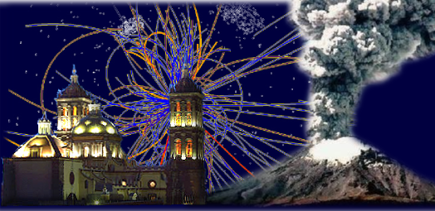
Contents:
Lattices and TWISS Parameters
Tune Calculations and Corrections
Dispersion
Momentum Compaction
Chromaticity
Sextupole Magnets
Normalized Phase Space
Dipolar, Quadrupolar and Sextupolar errors
Coupling
Tune Diagram
Lattices & Resonances

Slide 3
Matrices and Hill’s equation
We can multiply the matrices of our drift spaces and quadrupoles together to form a transport matrix that describes a larger section of our accelerator or even a complete turn around the accelerator.
Lattices & Resonances
The results of this matrix calculation should then be identical to the result obtain from Hill’s equation.

Slide 4
Matrices and Hill’s equation
Lattices & Resonances
Assume that our transport matrix describes a complete turn around the machine.
Therefore : β(s₂) = β(s₁)
Let μ be the change in betatron phase over one complete turn.
Then we get for x(s₂):

Slide 5
Matrices and Hill’s equation
So, for the position x at s2 we have…
Equating the sine terms gives:
Equating the cosine terms gives:
Lattices & Resonances
These resulting in:
and
Repeat this for c and d and use the parameters we previously defined, which are called TWISS parameters.
Resulting in:

Slide 6
Lattice parameters
This matrix describes one complete turn around our machine and will vary depending on the starting point (s).
If we start at any point and multiply all of the matrices representing each element all around the machine we can calculate α, β, γ and μ for that specific point, which then will give us β(s) and Q
Where:
Lattices & Resonances
Number of betatron oscillations per turn
If we repeat this many times for many different initial positions (s) we can calculate our Lattice Parameters for all points around the machine.

Slide 7
Matrices and Hill’s equation
Obviously μ (or Q) is not dependent on the initial position “s”, but we can calculate the change in betatron phase, dμ, from one element to the next.
Computer codes like “MAD” or “Transport” vary lengths, positions and strengths of the individual elements to obtain the desired beam dimensions or envelope β(s) and the desired Q.
Often a machine is made of many individual and identical sections (FODO cells). In that case we only calculate a single cell and not the whole machine, as the the functions β (s) and dμ will repeat themselves for each identical section.
The insertion sections have to be calculated separately
Lattices & Resonances

Slide 8
The relationship between Q and β(s)
, where μ = Δφ over a complete turn.
We also found:
Integrate over one complete turn
This leads to:
Think about the mechanical gutter
Lattices & Resonances
From this we can deduce:
  Increasing the focusing strength decreases the size of the beam envelope β and increases the betatron tune Q.
  Decreasing the focusing strength increases the size of the beam envelope β and decreases the betatron tune Q .
In practice we change de currents in the different focusing and defocusing quadrupole families to obtain the tune required.

Slide 9
Tune Corrections
What happens if we change the focusing strength slightly?
The Twiss matrix for our FODO cell is given by:
Add a small QF quadrupole, with strength dK and length ds.
This will modify the FODO lattice, and add a horizontal focusing term:
Lattices & Resonances
The new Twiss matrix of the modified lattice with the extra focusing is:

Slide 10
Tune Corrections
This extra quadrupole will modify the phase advance μ for the FODO cell.
μ₁ = μ + dμ
New phase advance
Lattices & Resonances
Change in phase advance
Provided dμ is small, we can ignore the changes in β
Therefore the new Twiss matrix is just:

Slide 11
Tune Corrections
Therefore:
Should be be equal to:
Combining and comparing the first and the fourth terms of these two matrices gives:
Lattices & Resonances
Only valid for change in β <<
μ₁ = μ + dμ and dμ is small
Therefore:

Slide 12
Tune Corrections
If we follow the same reasoning for both transverse planes for both QF and QD quadrupoles we get:
QD
QF
Let dk_{F} = dk for QF and dk_{D} = dk for QD
β_{hF}, β_{vF} = β at QF and β_{hD}, β_{vD} = β at QD
Lattices & Resonances
We get:
This matrix relates the change in the tune to the change in strength of the quadrupoles.
We can invert this matrix to calculate change in quadrupole field needed for a given change in tune

Slide 13
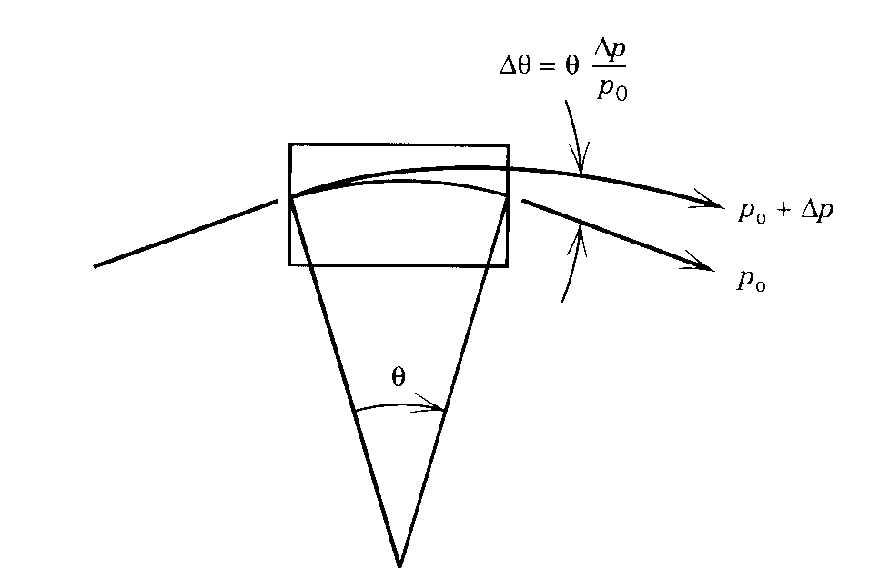
Dispersion
Until now we have assumed that our beam has no energy or momentum spread:
and
Different energy or momentum particles have different radii of curvature (ρ) in the main dipoles.
These particles no longer pass through the quadrupoles at the same radial position.
Lattices & Resonances
Quadrupoles act as dipoles for different momentum particles.
Closed orbits for different momentum particles are different.
This horizontal displacement is expressed as the dispersion function D(s)
D(s) is a function of s exactly as β(s) is a function of s

Slide 14
Dispersion
The displacement due to the change in momentum at any position (s) is given by:
Dispersion function
Local radial displacement due to momentum spread
Lattices & Resonances
D(s) the dispersion function, is calculated from the lattice, and has the unit of meters.
The beam will have a finite horizontal size due to it’s momentum spread.
In the majority of the cases we have no vertical dipoles, and so D(s)=0 in the vertical plane.

Slide 15
Momentum Compaction Factor
The change in orbit with the changing momentum means that the average length of the orbit will also depend on the beam momentum.
This is expressed as the momentum compaction factor, α _{p}, where:
Lattices & Resonances
α_{p} tells us about the change in the length of radius of the closed orbit for a change in momentum.

Slide 16
Chromaticity
The focusing strength of our quadrupoles depends on the beam momentum, p.
3.3356 p
Therefore a spread in momentum causes a spread in focusing strength
Lattices & Resonances
Q depends on the k of the quadrupoles
The constant here is called Chromaticity

Slide 17
Chromaticity Visiualized
The chromaticity relates the tune spread of the transverse motion with the momentum spread in the beam.
Focusing quadrupole in horizontal plane
A particle with a higher momentum as the central momentum will be deviated less in the quadrupole and will have a lower betatron tune
p > p₀
Lattices & Resonances
p₀
A particle with a lower momentum as the central momentum will be deviated more in the quadrupole and will have a higher betatron tune
p < p₀
QF

Slide 18
Chromaticity Calculated
Remember
and
The gradient seen by the particle depends on its momentum
Therefore
Lattices & Resonances
This term is the Chromaticity ξ
To correct this tune spread we need to increase the quadrupole focusing strength for higher momentum particles, and decrease it for lower momentum particles.
This we will obtain using a sextupole magnet

Slide 19
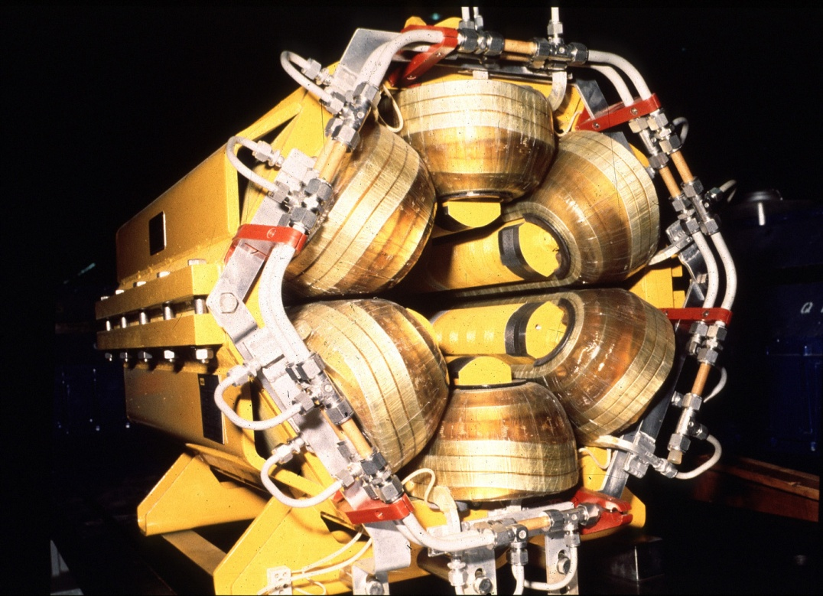
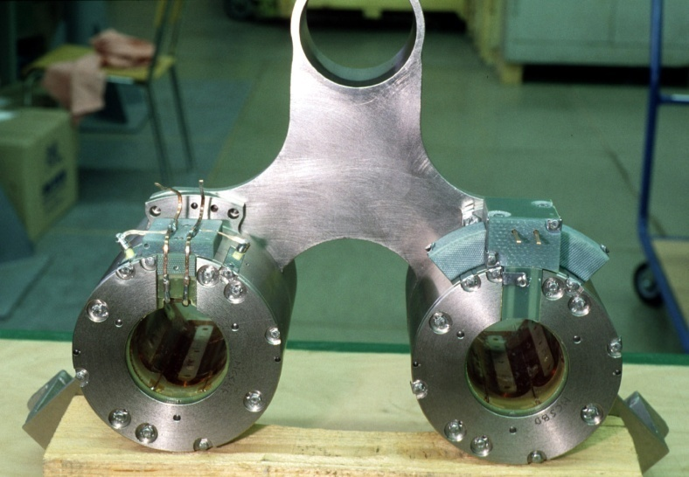
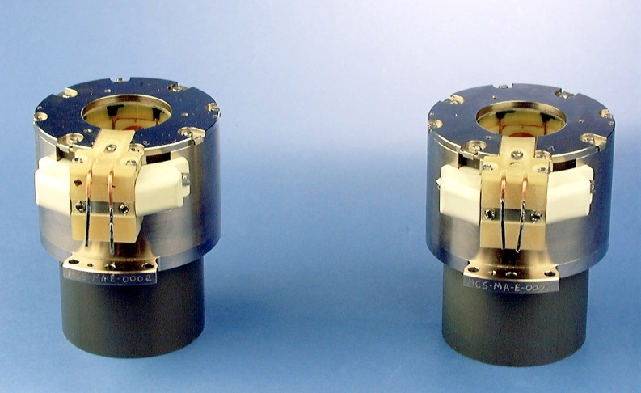
Sextupole Magnets
Conventional Sextupole from LEP, but looks similar for other “warm” machines.
~ 1 meter long and a few hundreds of kg.
Lattices & Resonances
Correction Sextupole of the LHC
11cm, 10 kg, 500A at 2K for a field of 1630 T/m²

Slide 20
Chromaticity Correction
By
By = Kq.x
Final “corrected” By
(Quadrupole)
x
(Sextupole)
Lattices & Resonances
By = Ks.x²
The effect of the sextupole field is to increase the magnetic field of the quadrupoles for the positive x particles and decrease the field for the negative x particles.
However, the dispersion function, D(s), describes how the radial position of the particles change with momentum.
Therefore the sextupoles will alter the focusing field seen by the particles as a function of their momentum.
This we can use to compensate the natural chromaticity of the machine.

Slide 21
Sextupoles & Chromaticity
In a sextupole for y = 0 we have a field By = C.x²
Now calculate k the focusing gradient as we did for a quadrupole:
Using
which after differentiating gives
Lattices & Resonances
For k we write now
We conclude that k is no longer constant, as it depends on x.
For k we write now
and we know that
Therefore

Slide 22
Chromaticity Correction
We know that the tune changes with :
Where:
and
Lattices & Resonances
with
Remember
The effect of a sextupole with length l on the particle tune Q as a function of Δp/p is given by:
If we can make this term exactly balance the natural chromaticity then we will have solved our problem.

Slide 23
Where to put Sextupoles ?
There are two chromaticities:
  horizontal → ξ_{h}
  vertical → ξ_{v}
However, the effect of a sextupole depends on β(s), which varies around the machine
Two types of sextupoles are used to correct the chromaticity.
  One (SF) is placed near QF quadrupoles where β_{h} is large and β _{v} is small, this will have a large effect on ξ_{h}
  Another (SD) placed near QD quadrupoles, where β_{v} is large and β_{h} is small, will correct ξ_{v}
Lattices & Resonances
QD
QF
QD
QF
QF
SD
SF
SD
SF
SF
Also sextupoles should be placed where D(s) is large, in order to increase their effect, since Δk is proportional to D(s)

Slide 24
Different Magnets and Imperfections
(Unfortunately) It is not possible to construct a perfect machine.
  Magnets can have imperfections
  The alignment in the de machine has non zero tolerance.
  Etc…
So, we have to ask ourselves:
  What will happen to the betatron oscillations due to the different field errors.
  Therefore we need to consider errors in dipoles, quadrupoles, sextupoles, etc…
We will have a look at the beam behaviour as a function of the tune Q
How is it influenced by these resonant conditions?
Lattices & Resonances

Slide 25
Normalized Phase Space
Phase Space
Normalized Phase Space
x’
βx’
Circle of radius
Lattices & Resonances
x
x
By multiplying the y-axis by β the transverse phase space is normalized and the ellipse turns into a circle.
This is useful to visualize who resonances work under the influence of magnet imperfections.

Slide 26
Normalized Phase Space & Betatron Tune
If we unfold a trajectory of a particle that makes one turn in our machine with a tune of Q = 3.333, we get:
x
0
2π
βy’
Lattices & Resonances
This is the same as going 3.333 time around on the circle in phase space
The net result is 0.333 times around the circular trajectory in the normalized phase space
q is the fractional part of Q
So here Q= 3.333 and q = 0.333
y
2πq

Slide 27
Classifying Resonances
After a certain number of turns around the accelerator the phase advance of the betatron oscillation is such that the oscillation repeats itself.
For example:
  If the phase advance per turn is 120º (2π/3) then the betatron oscillation will repeat itself after 3 turns.
  This could correspond to Q = 3.333 or 3Q = 10
  But also Q = 2.333 or 3Q = 7
Lattices & Resonances
The order of a resonance is defined as:
n × Q = integer
2nd turn
3rd
turn
Let’s take a look at some illustrative cases and later add the mathematics.
1st turn
2πq = 2π/3

Slide 28
A Dipole kick
For a dipole, the deflection is independent of the position in the magnet.
y’β
y’β
Q = 2.00
1st turn
Q = 2.50
2nd turn
Lattices & Resonances
y
y
3rd turn
For Q = 2.00: Oscillation induced by the dipole kick grows on each turn and the particle is lost
(1st order resonance Q = 2).
For Q = 2.50: Oscillation is cancelled out every second turn, and therefore the particle motion is stable.

Slide 29
A Quadrupolar kick
For a Quadrupole, the deflection is proportional to de displacement from the centre (deflection ∝ position).
Q = 2.50
1st turn
Q = 2.33
2nd turn
Lattices & Resonances
3rd turn
4th turn
For Q = 2.50: Oscillation induced by the quadrupole kick grows on each turn and the particle is lost
(2nd order resonance 2Q = 5)
For Q = 2.33: Oscillation is cancelled out every third turn, and therefore the particle motion is stable.

Slide 30
A Sextupolar kick
For a Sextupole, the deflection is proportional to de displacement from the centre squared (deflection ∝ position²).
Q = 2.33
1st turn
Q = 2.25
2nd turn
Lattices & Resonances
3rd turn
4th turn
5th turn
For Q = 2.33: Oscillation induced by the sextupole kick grows on each turn and the particle is lost
(3rd order resonance 3Q = 7)
For Q = 2.25: Oscillation is cancelled out every fourth turn, and therefore the particle motion is stable.

Slide 31
Amplitude Growth, a More Rigorous Approach
Let us try to find a mathematical expression for the amplitude growth in the case of a quadrupole error:
y’β
2πQ = phase angle over 1 turn = θ
Δβy’ = kick
a = old amplitude
Δa = change in amplitude
2πΔQ = change in phase
θ
a
Lattices & Resonances
y
y does not change at the kick
y = a cos(θ)
θ
Δβy’
In a quadrupole Δy’ = lky
2πΔQ
Δa
Only if 2πΔQ is small
So we have:
Δa = βΔy’ sin(θ) = lβ sin(θ) a k cos(θ)

Slide 32
Amplitude Growth
So we have:
Δa = l·β·sin(θ) a·k·cos(θ)
Each turn θ advances by 2πQ
On the n^{th} turn θ = θ + 2nπQ
Sin(θ)Cos(θ) = 1/2 Sin (2θ)
Over many turns:
Lattices & Resonances
This term will be ‘zero’ as it decomposes in Sin and Cos terms and will give a series of + and – that cancel out in all cases where the fractional tune q ≠ 0.5
So, for q = 0.5 the phase term, 2(θ + 2nπQ) is constant:
and thus:

Slide 33
Amplitude Growth for Quadrupoles
In this case the amplitude will grow continuously until the particles are lost.
Therefore we conclude as before that:
  quadrupoles excite 2nd order resonances for q=0.5
Thus for Q = 0.5, 1.5, 2.5, 3.5,…etc……
Lattices & Resonances

Slide 34
Phase, A more Rigorous Approach
If we follow the same approach, but then concentrating on the phase we will find:
Since:
we can rewrite this as:
Lattices & Resonances
, which is correct for the 1st turn
Each turn θ advances by 2πQ
On the n^{th} turn θ = θ + 2nπQ
Over many turns:
Averaging over many turns:
zero

Slide 35
Stopband
, which is the expression for the change in Q due to a quadrupole.
But note that Q changes slightly on each turn
Related to Q
Lattices & Resonances
Max variation 0 to 2
Q has a range of values varying by:
This width is called the stopband of the resonance
So even if q is not exactly 0.5, it must not be too close, or at some point it will find itself at exactly 0.5 and lock on to the resonant condition.

Slide 36
Sextupole, A more Rigorous Approach
We can apply the same arguments for a sextupole:
For a sextupole
and thus
We get :
Lattices & Resonances
Summing over many turns gives:
3rd order resonance term
1st order resonance term
Sextupole excite 1st and 3rd order resonance
q = 0
q = 0.33

Slide 37
Octupole, A more Rigorous Approach
We can apply the same arguments for an octupole:
For an octupole
and thus
We get :
4th order resonance term
2nd order resonance term
Lattices & Resonances
Summing over many turns gives:
∝ a²(cos 4(θ+2πnQ) + cos 2(θ+2πnQ))
Amplitude squared
q = 0.5
q = 0.25
Octupolar errors excite 2nd and 4th order resonance and are very important for larger amplitude particles.
Can restrict dynamic aperture

Slide 38
Resonances, a Summary
Quadrupoles excite 2nd order resonances
Sextupoles excite 1st and 3rd order resonances
Octupoles excite 2nd and 4th order resonances
This is true for small amplitude particles and low strength excitations
However, for stronger excitations sextupoles will excite higher order resonances (non-linear)
Lattices & Resonances

Slide 39
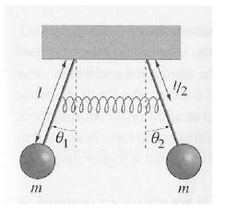
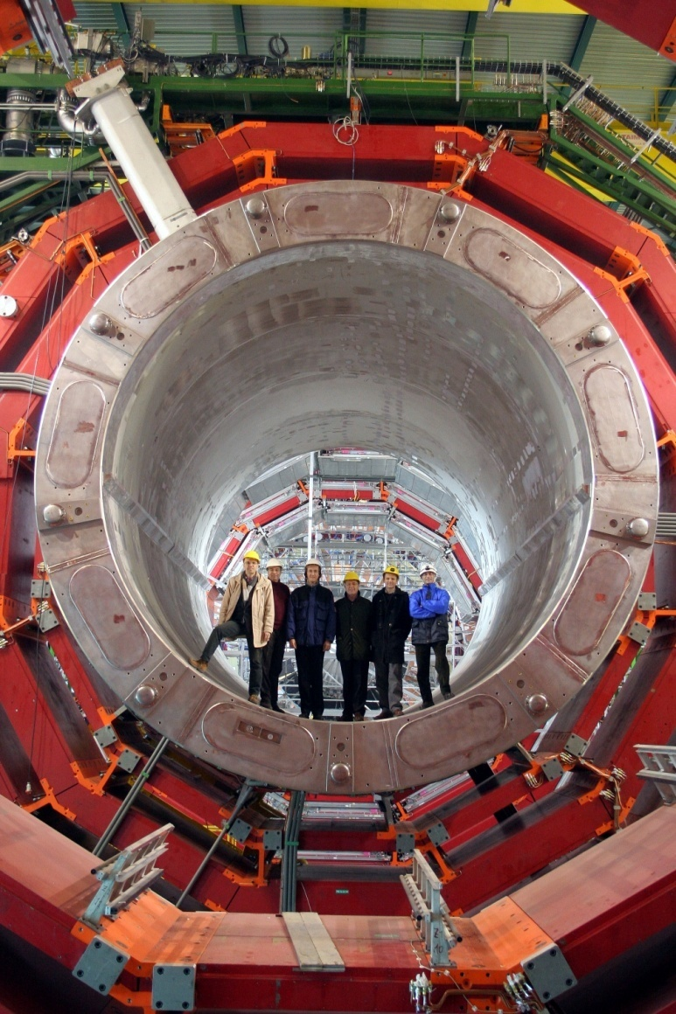
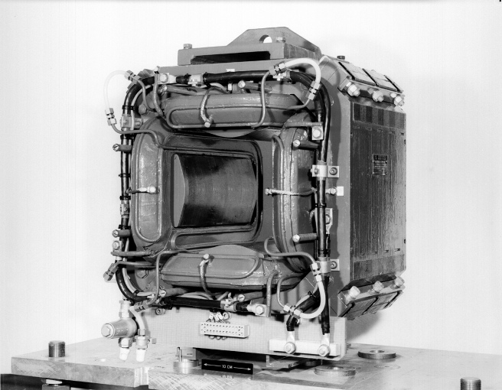
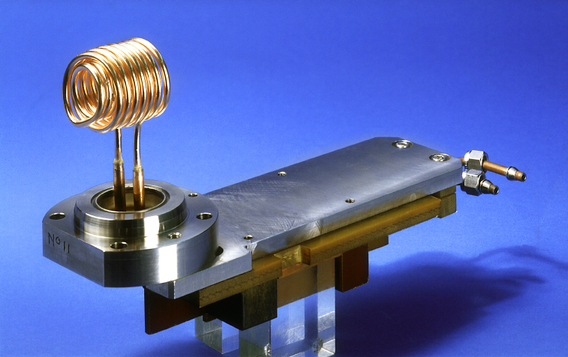
Coupling
Coupling converts betatron motion from one plane (horizontal or vertical) into motion in the other plane.
Fields that will excite coupling are:
  Skew quadrupoles, which are normal quadrupoles, but tilted by 45º about it’s longitudinal axis.
  Solenoidal (longitudinal magnetic field)
Lattices & Resonances
Magnetic field
S
N
N
Like a normal quadrupole, but then tilted by 45º
S

Slide 40
Coupling & Resonances
This coupling means that one can transfer oscillation energy from one transverse plane to the other.
Exactly as for linear resonances there are resonant conditions.
If we meet one of these conditions the transverse oscillation amplitude will again grow in an uncontrolled way.
Lattices & Resonances

Slide 41
General Tune Diagram
2Q_{v} =5
Q_{h} - Q_{v}= 0
Q_{v}
2.75
2.5
4Q_{h} =11
Lattices & Resonances
2.25
2
2 2.25 2.5 2.75
Q_{h}
2.33
2.66
During acceleration we change the horizontal and vertical tune to a place where the beam is the least influenced by resonances.

Slide 42
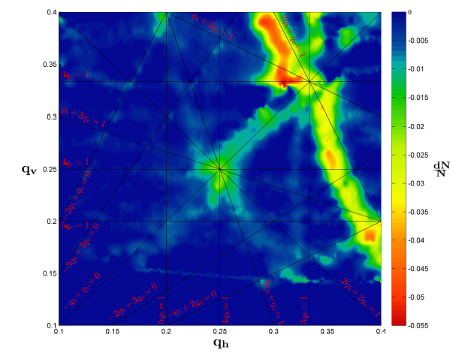
The Tune Diagram Measured
Move a large emittance beam around in this tune diagram and measure the beam losses, caused by resonances
Quantity of losses proportional to resonance strength
Not all resonance lines are harmful.
Lattices & Resonances
The challenge is to reduce and compensate these effects as much as possible and then find some point in the tune diagram where the beam is stable.

Slide 43
Questions ?
Lattices & Resonances

