Slide 1
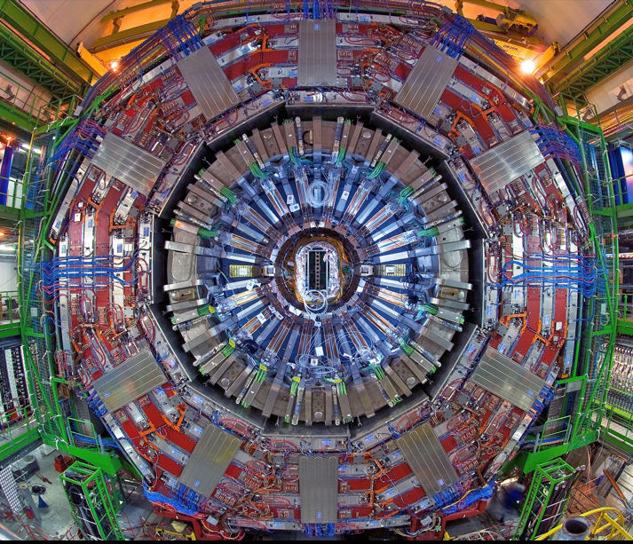

CMS: performance and highlights

Slide 2
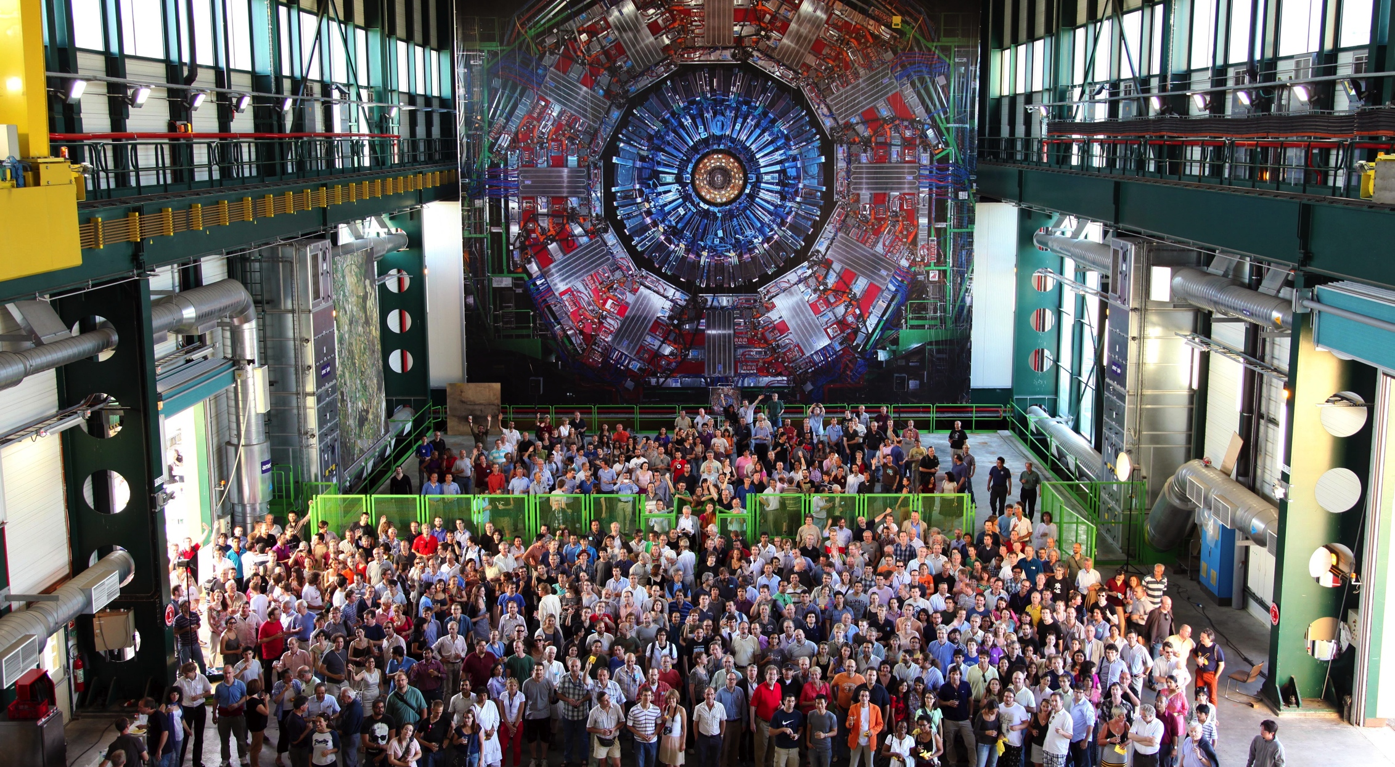
The CMS Collaboration
All of what you see out of CMS is part of a big collective effort from several generation of people

Slide 3
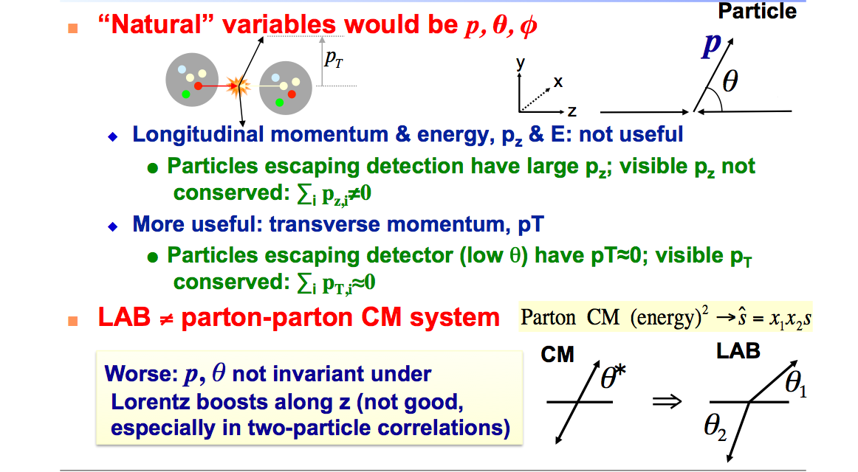
Reminder : pp kinematics

Slide 4
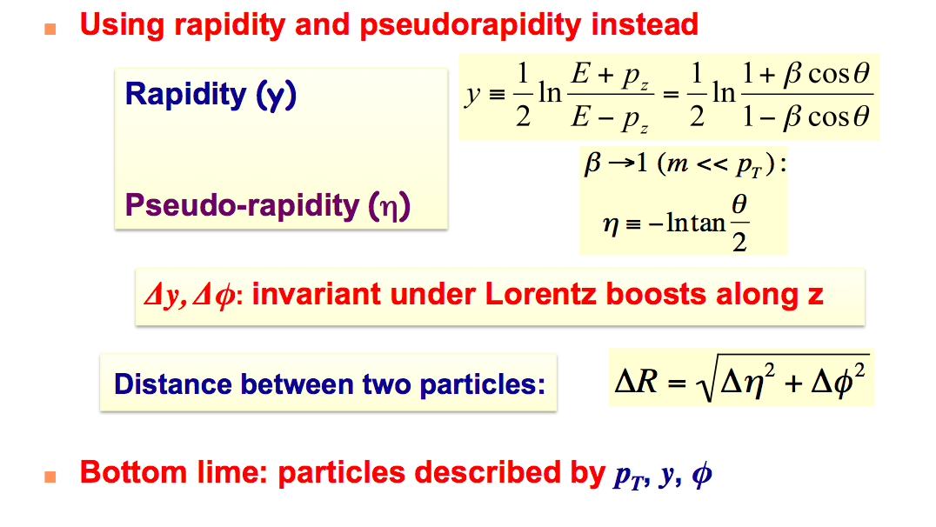
Kinematics continued

Slide 5
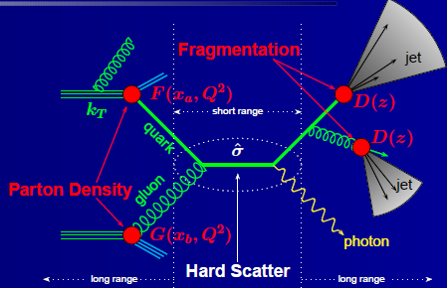

The Hard Scatter
Jet Algorithm
Anti-k_{T}, R=0.5
Typical of hard scatter
e, μ, γ : E_{T} > 20 GeV
Jets: E_{T} > 20 GeV
Isolation
E_{T},p_{T} < thresh in cone
ΔR ~ 0.3-0.4
H_{T} - scalar sum of E_{T} of all jets with e.g. P_{T} > 30 GeV/c
S_{T} - scalar sum of E_{T} of N individual objects (jets, e, μ, γ ) with e.g. E_{T} > 50 GeV/c
Notes:
Because leptons produced in the decays of low-mass particles, such as b- and c-quarks, are
63 nearly always inside jets, they can be suppressed by requiring that the lepton be isolated in
64 space from other particles that carry a substantial amount of transverse momentum.

Slide 6
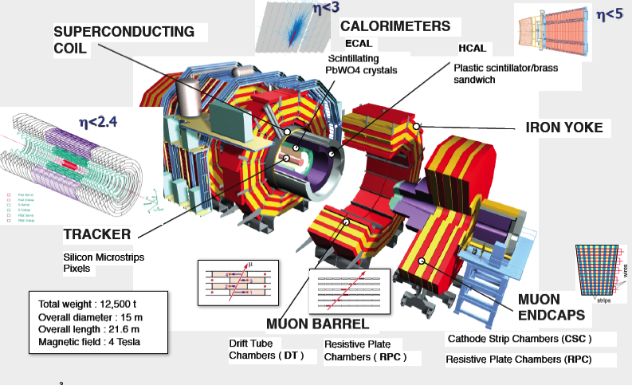
CMS

Slide 7
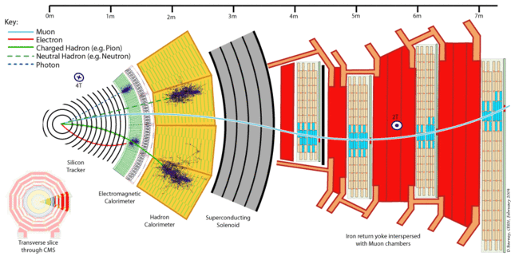
CMs is ‘simple’

Slide 8
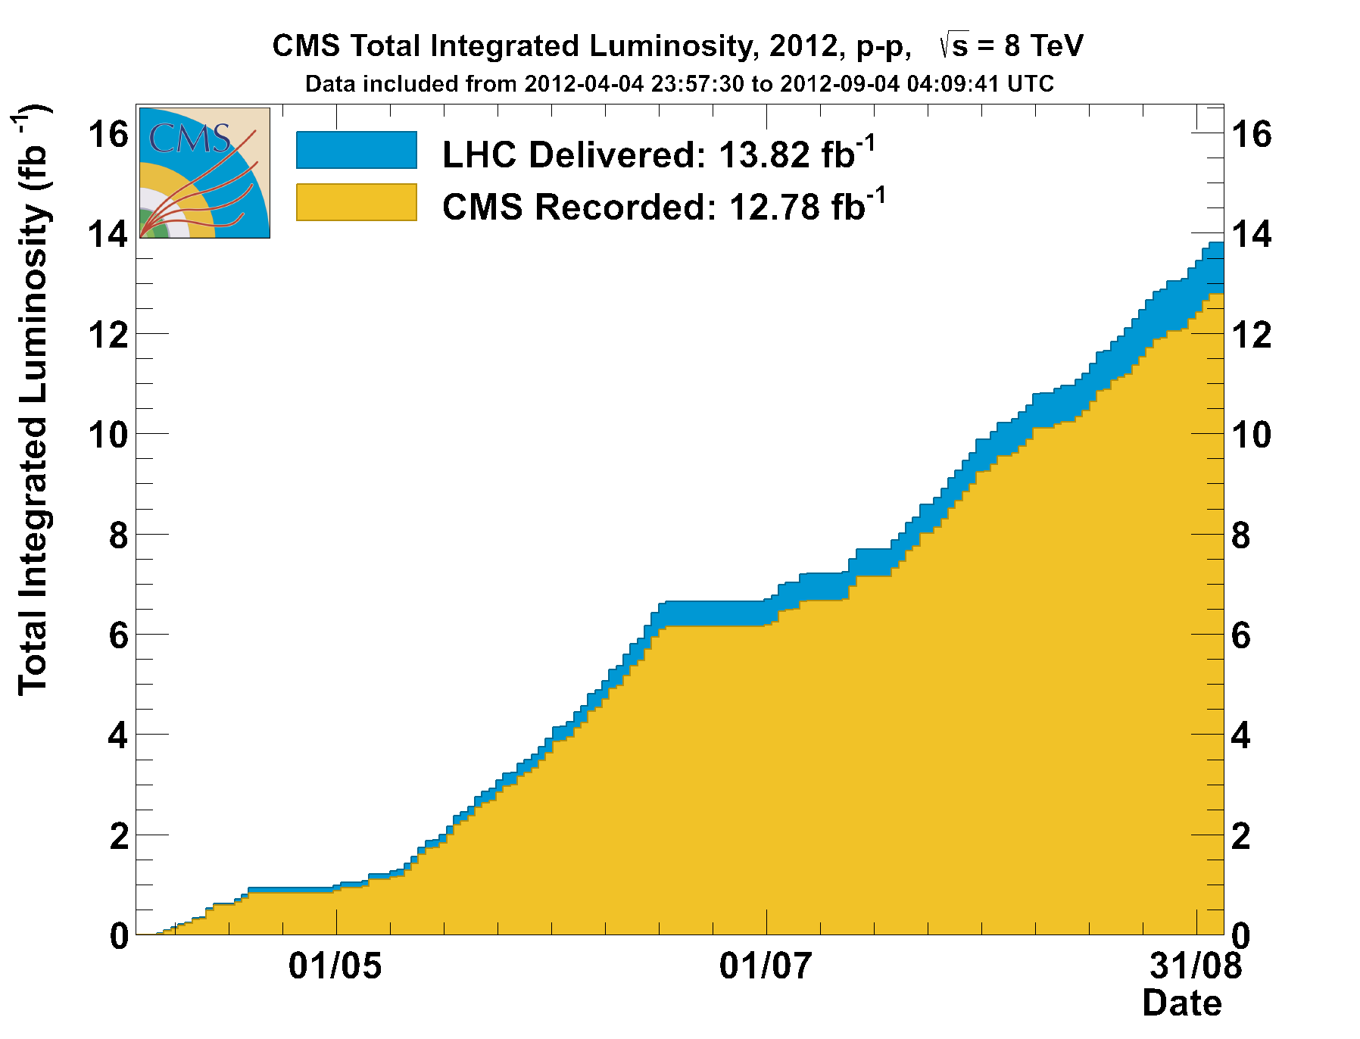
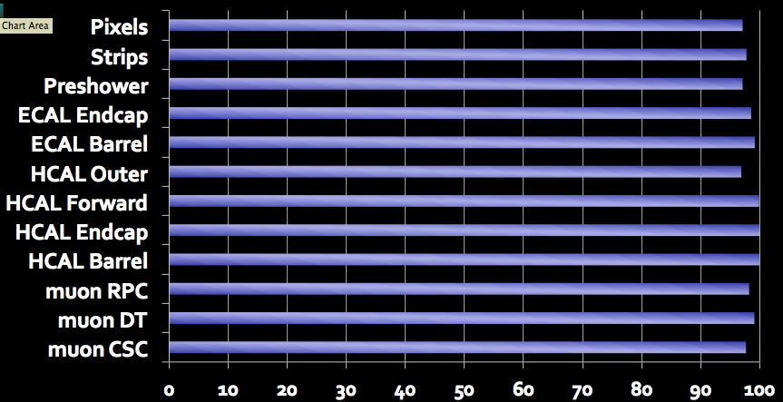
CMS and LHC in 2012
Fantastic performance
Data shown here (~6 fb⁻¹)
Fraction of working Channels > 98%

Slide 9
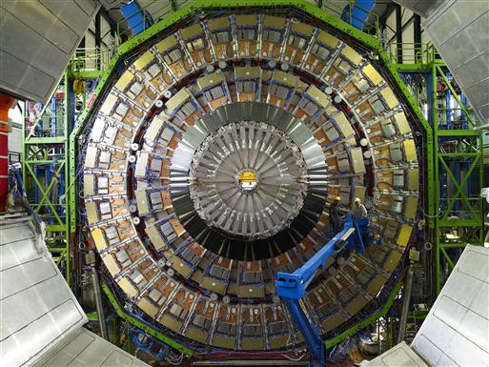
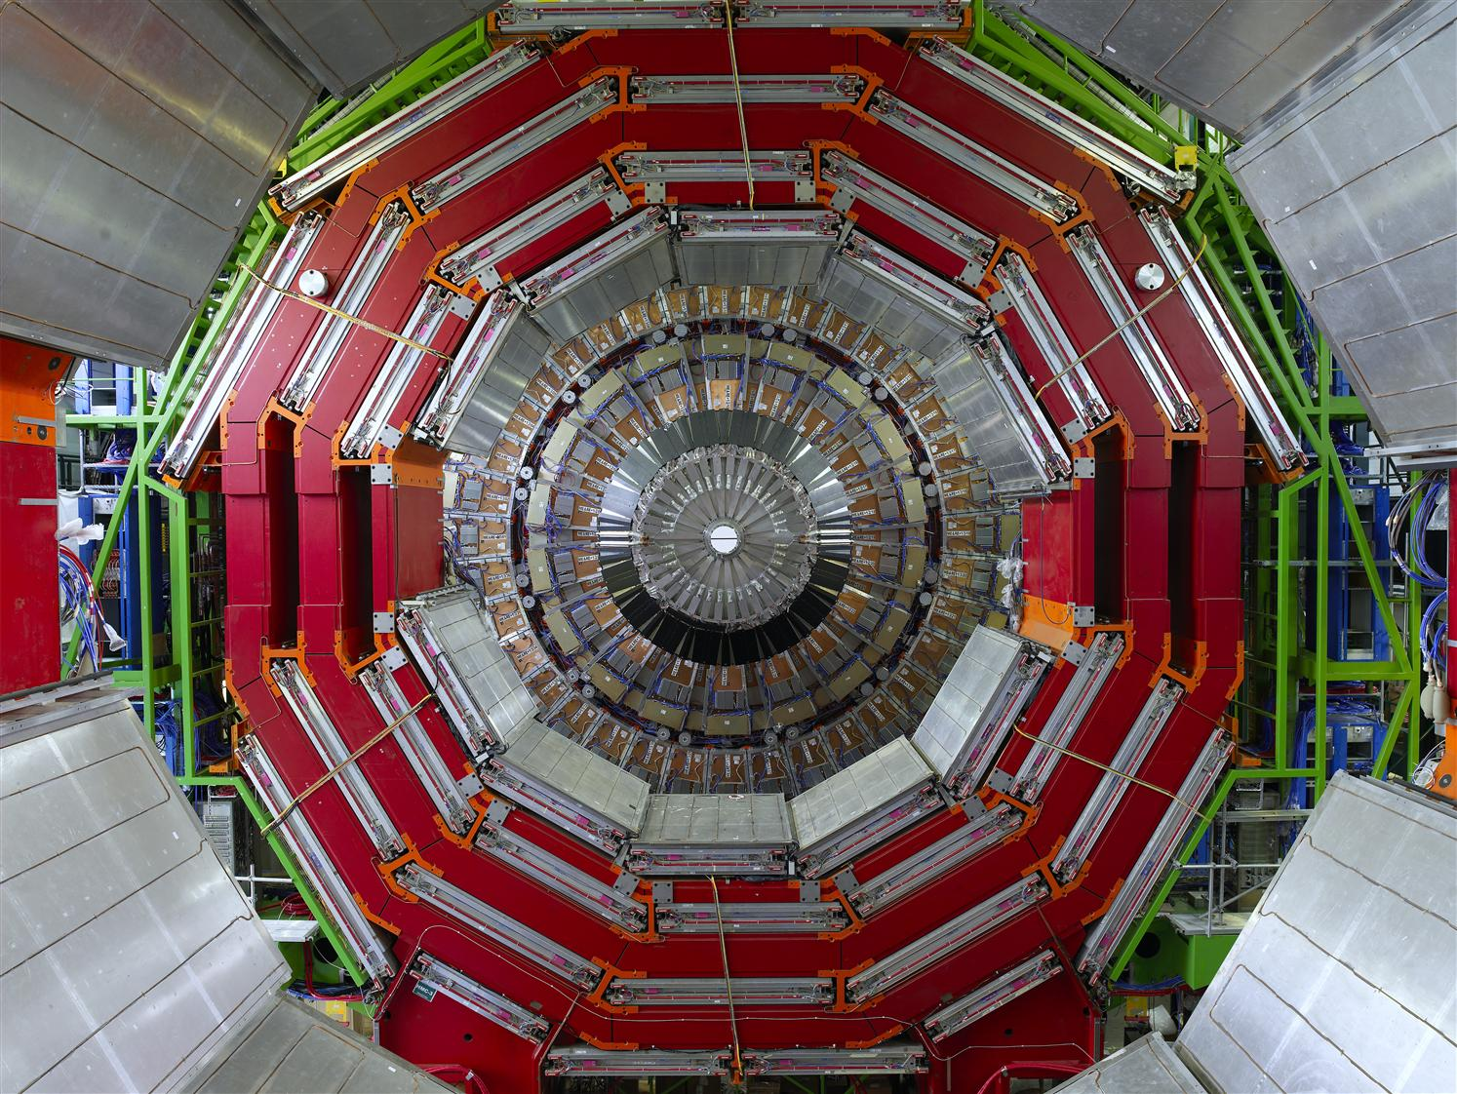
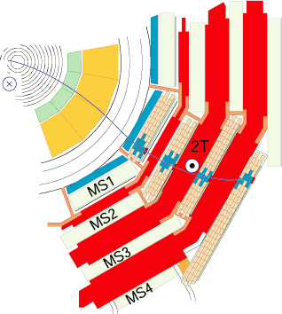
Muon system

Slide 10
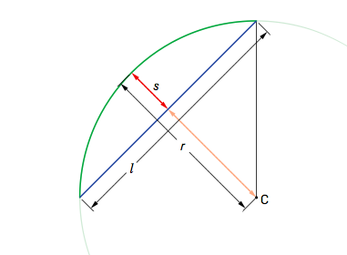
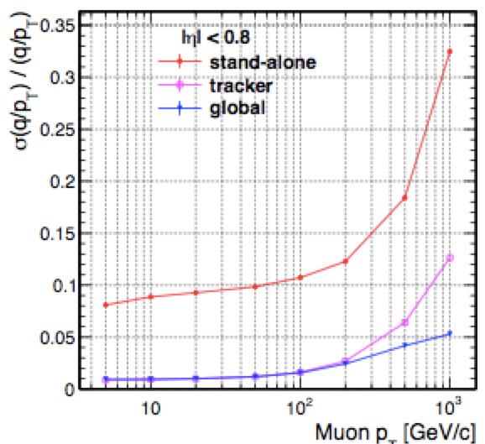
Compact MUON solenoid
B field☉
ℓ (path length in uniform B) is ~1.1 m for the Si-tracker, but more important is the first layer of the Muon chambers ( ~3m)

Slide 11
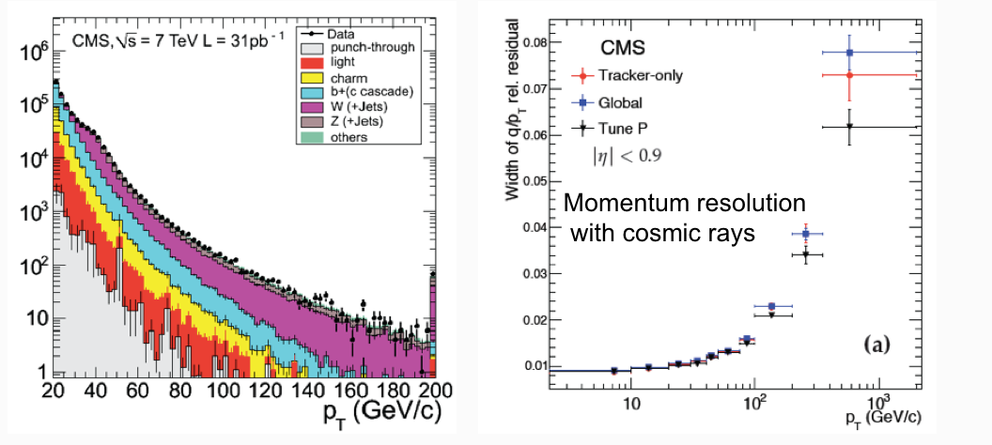
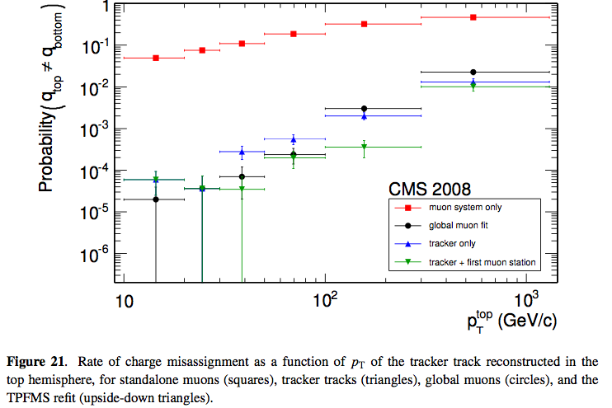
Muon performance
Muons: achieved nominal ( or better than ) performance
Charge Mis-Id~1% at 1 TeV
A μ in CMS has little chances of being ‘something else’
Design: <10% at 1 TeV

Slide 12
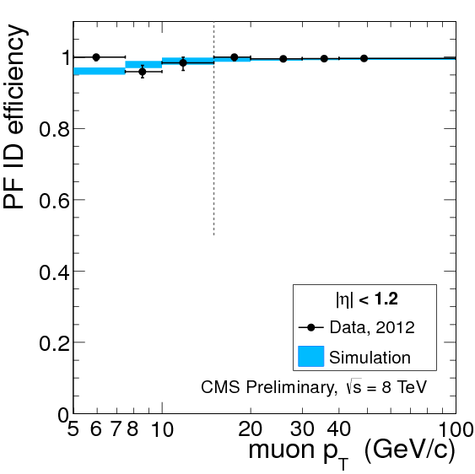
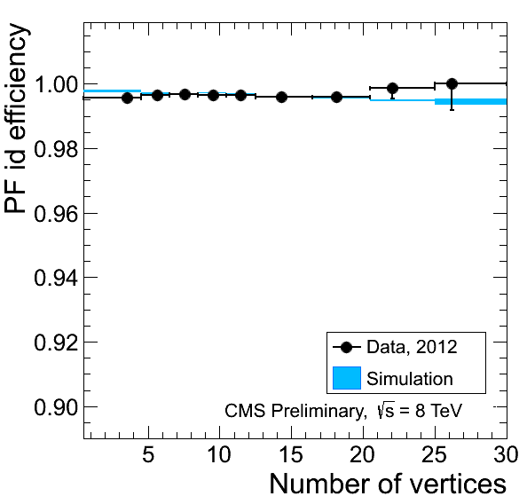
Muons
J/Ψ→μμ
T&P
Z→μμ
T&P
Efficiency is stable in high pile-up environment
High efficiency down to p_{T} = 5 GeV
  Exploit also tracker-based muon ID
  Important for H->ZZ->4l
-- Marlow

Slide 13
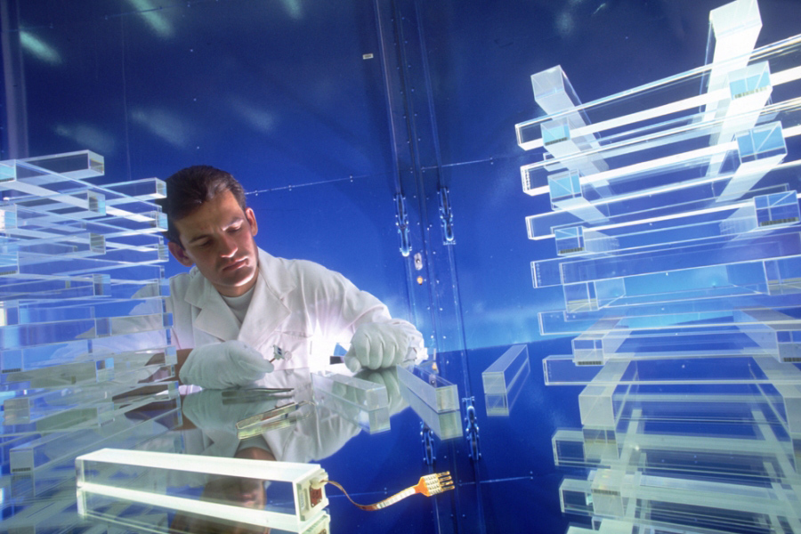
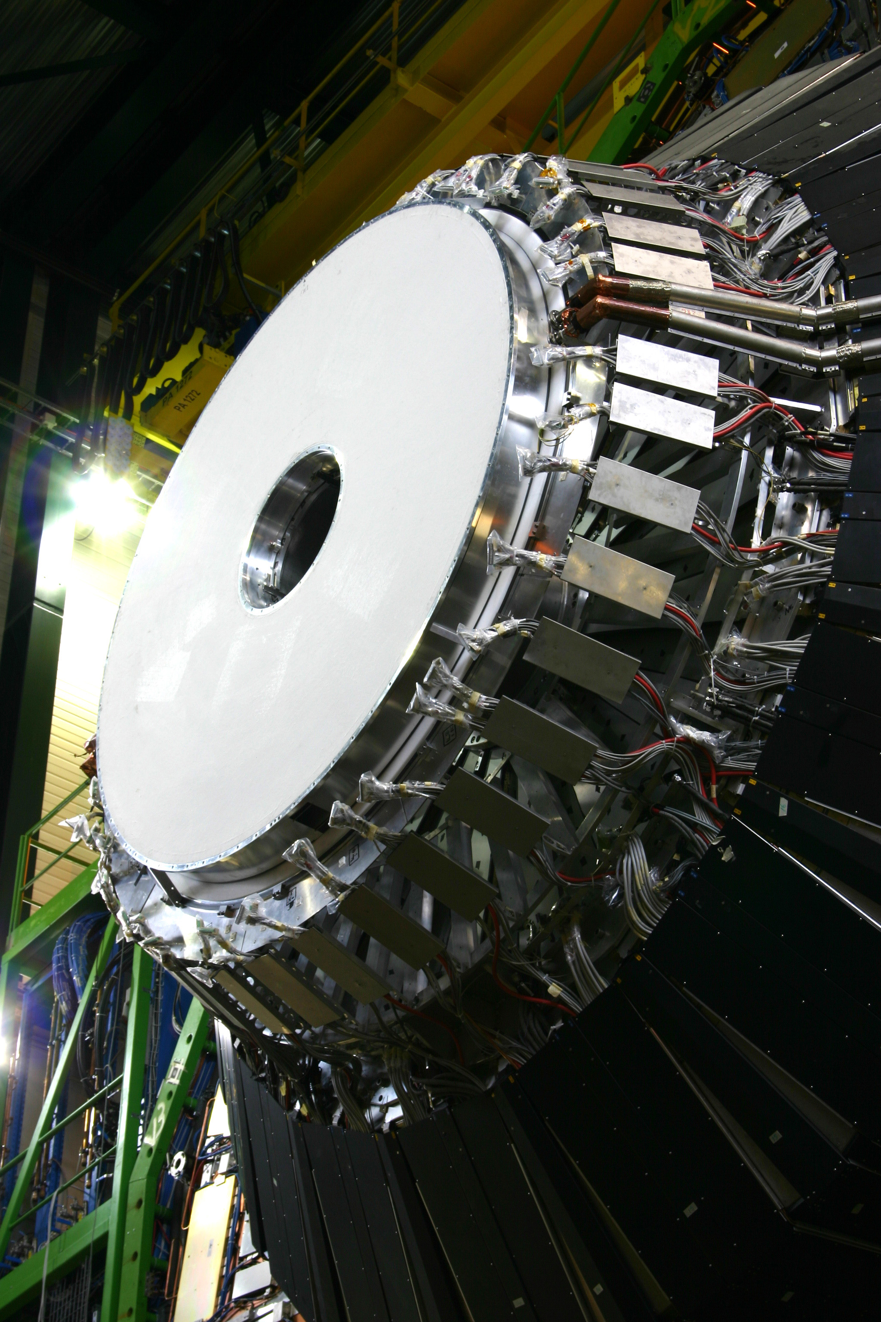
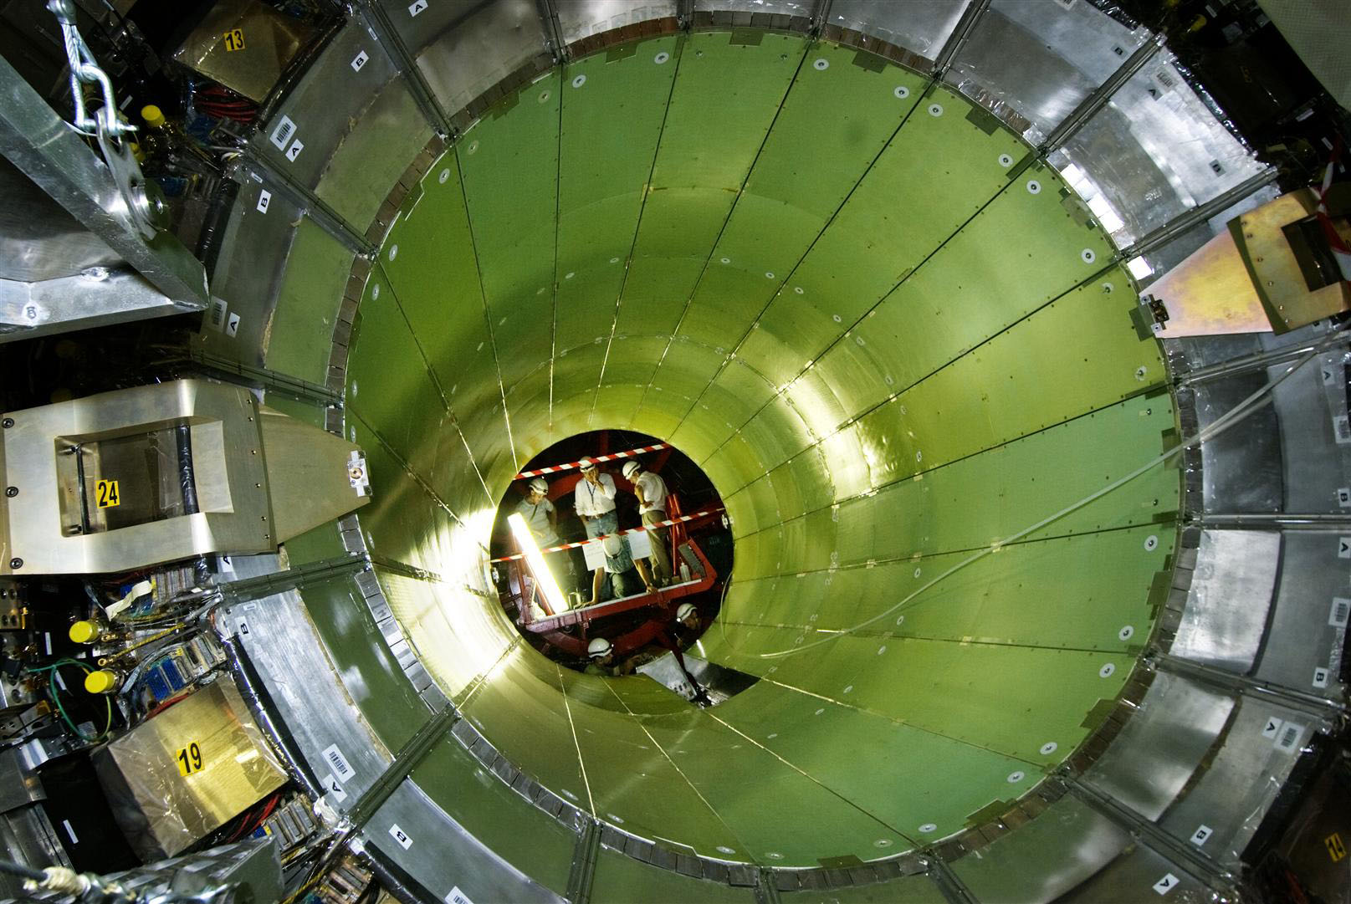
ECAL

Slide 14
EM calorimeter
Energy scale stability ~ 0.1%

Slide 15
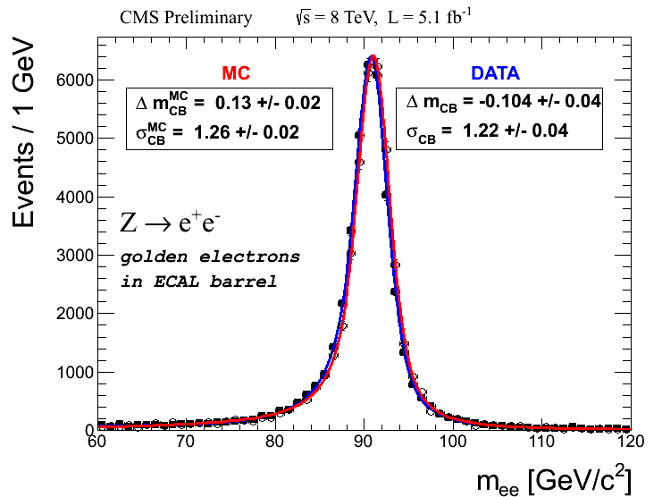
ECAL performance
Resolution on γγ resonance : for best category ( H → γγ)
σ= 1.1 GeV
Z⁰ →e⁺e⁻
m²_{γγ}= 2 E₁ E₂ (1-cosα)

Slide 16
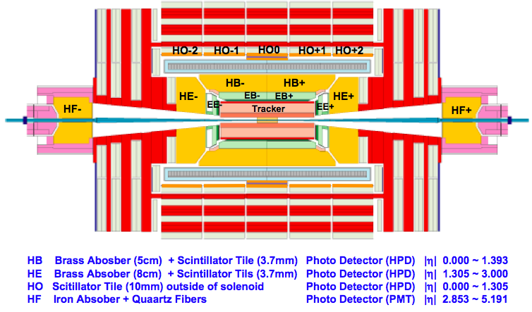
HCAL

Slide 17
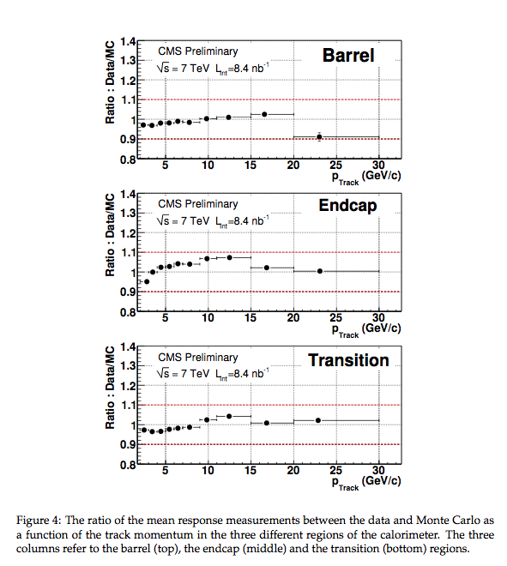
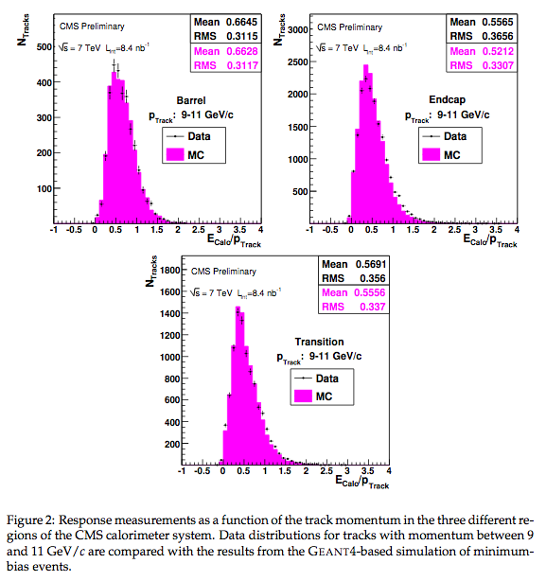
HCAL response
Single π response

Slide 18
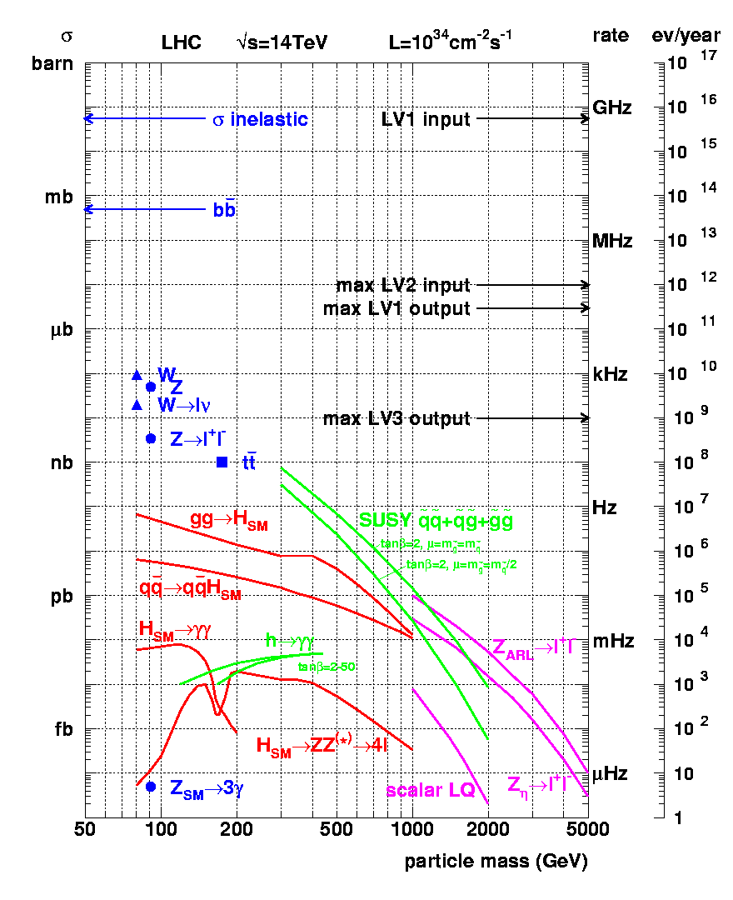
CMS triggers
LV1 Input: 1 GHz
HLT Input: 100 kHz
At LHC the collision rate is 20-40 MHz
The Event size <1 Mbyte
Band width limit ~ 200 GB→
Mass storage rate ~200-300 Hz
First step in ‘analysis’ is trigger
Mass Storage: 300 Hz
10¹⁰

Slide 19
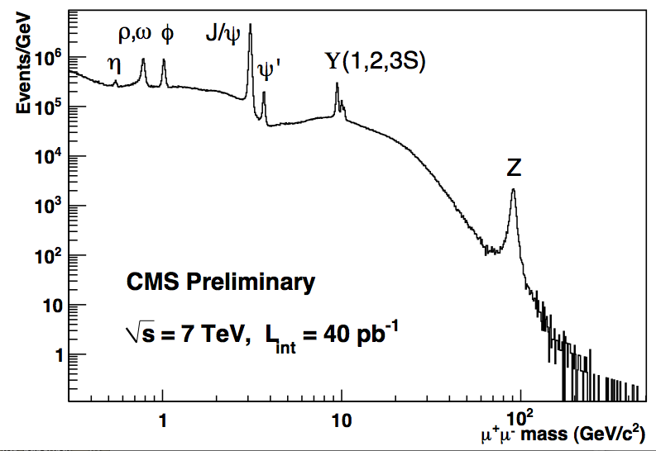
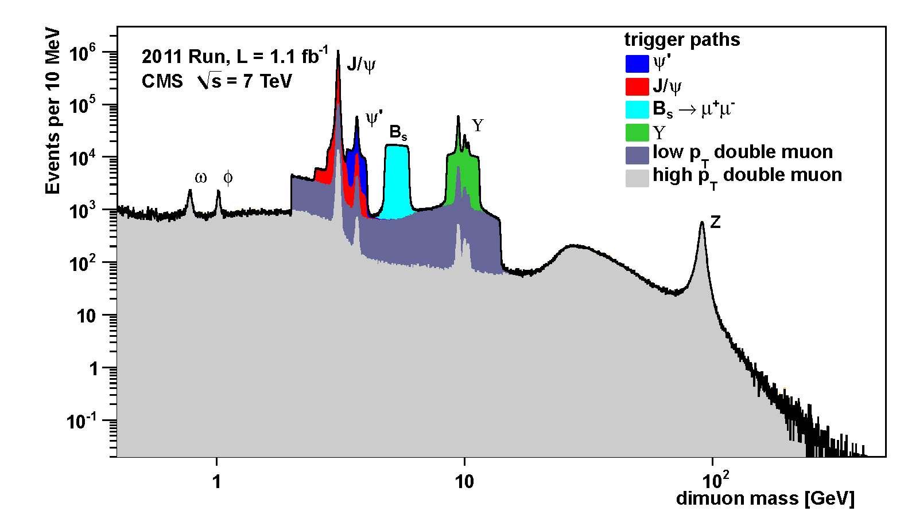
Trigger flexibility
~30 Hz reserved for b physics at HLT in 2012
Di-muons

Slide 20
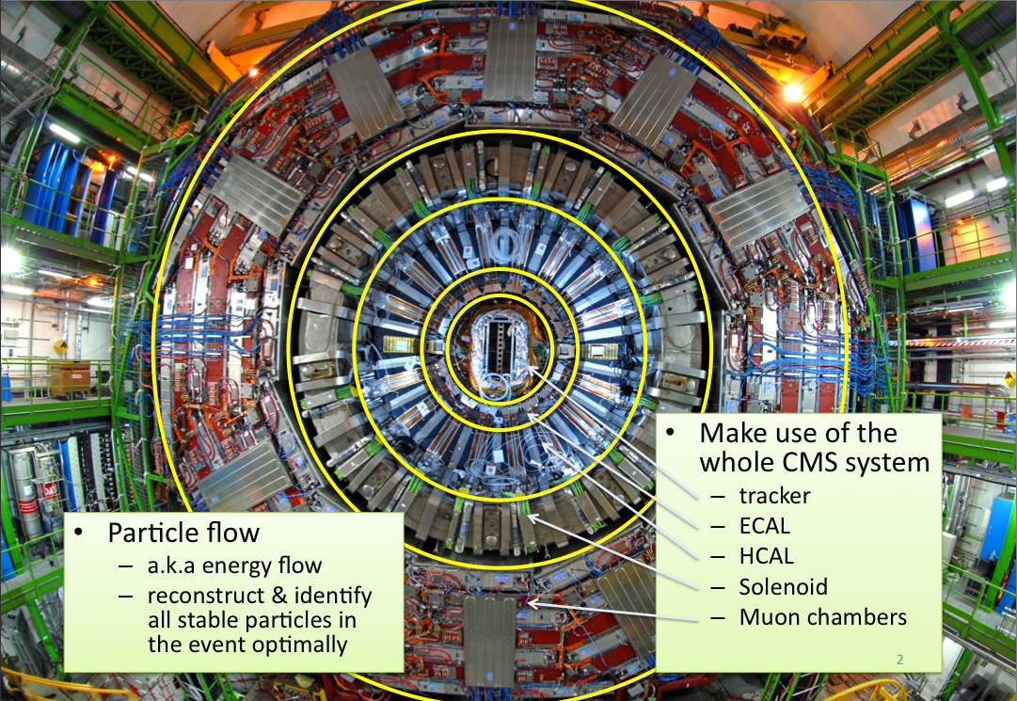
Event reconstruction

Slide 21
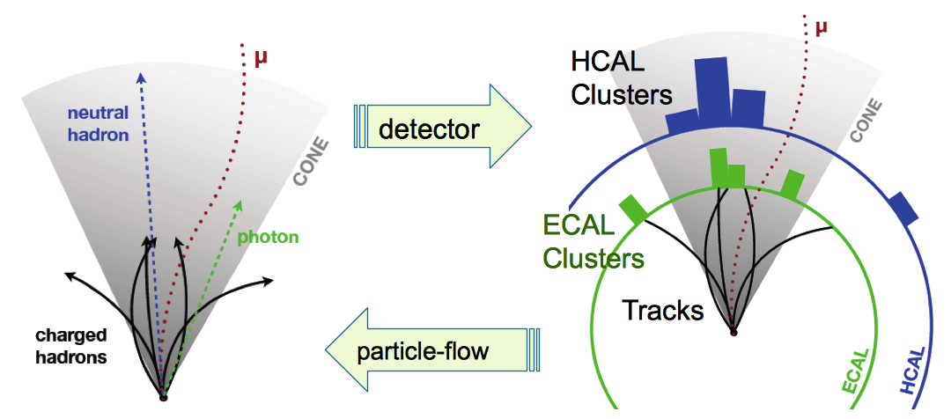
Particle flow

Slide 22
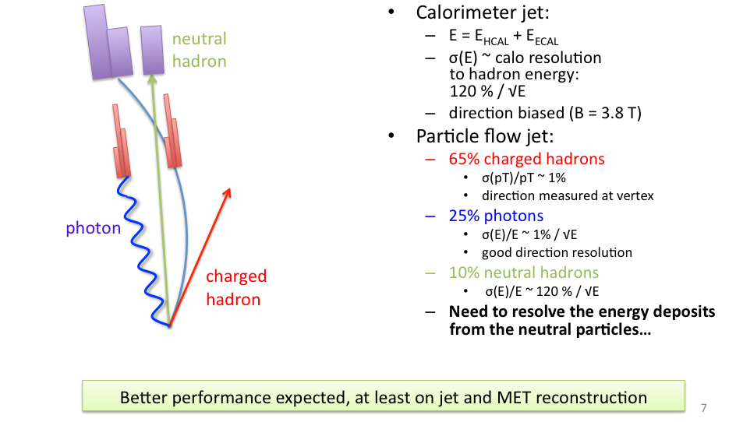
Why particle flow?

Slide 23
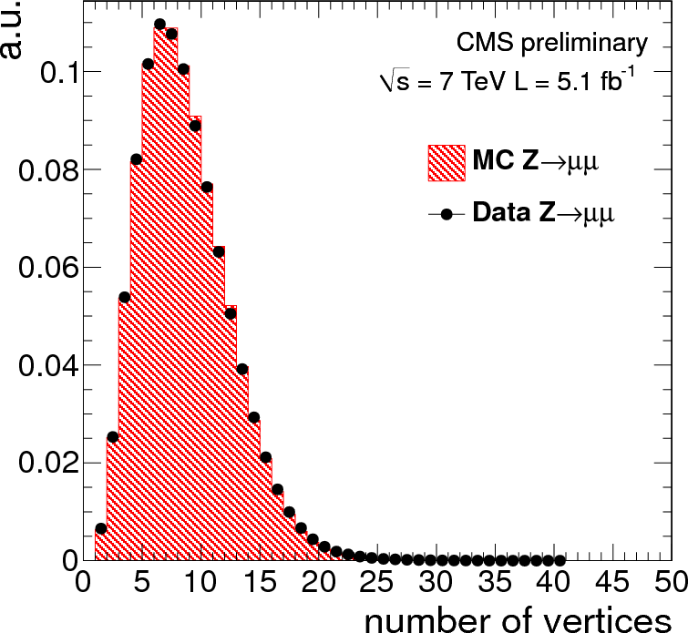
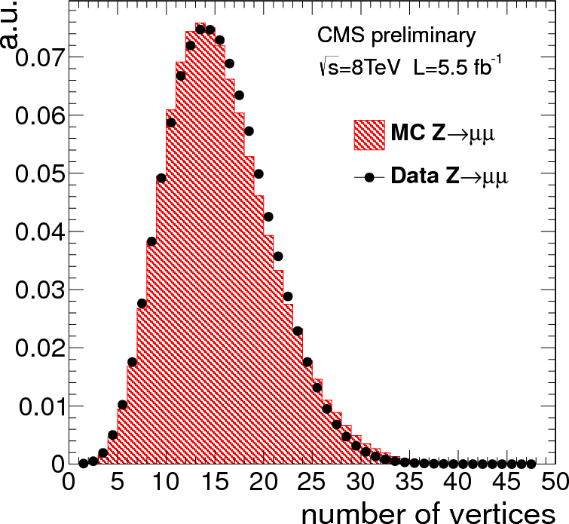
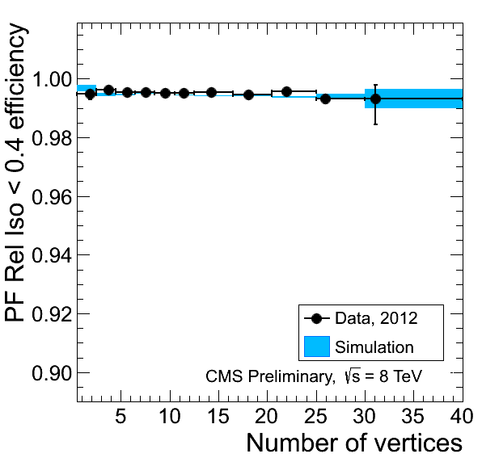
Pileup
The exceptional LHC performance has a price to pay: the luminosities achieved imply that on average per crossing we have several pp interactions:
Surprisingly the pilup turned out to be a manageable ‘nuisance’:
example of mitigating actions
  Separate vertices are reconstructed when distance >200μm and tracks not originating from primary vertex are excluded from the Pflow algorithms
FASTjet energy subtraction implemented on event by event basis( even at trigger level): calculate the momentum density per unit area ρ due to PU for each event, which is subtracted from the jet energy and lepton isolation cones based on their respective areas.
2011
2012
Pflow isolation performance: independent from Pileup up to PU >=30

Slide 24
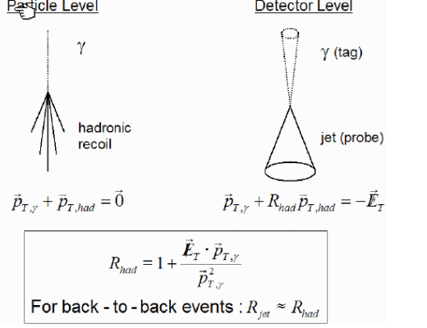
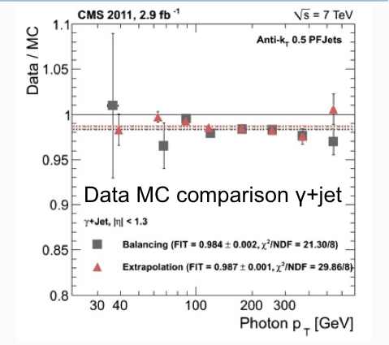
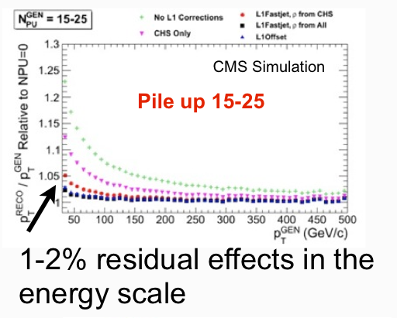
Jets

Slide 25
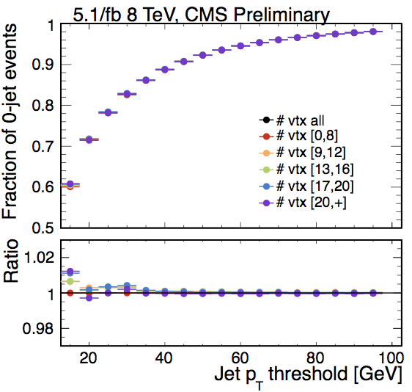
Jets and pileup

Slide 26
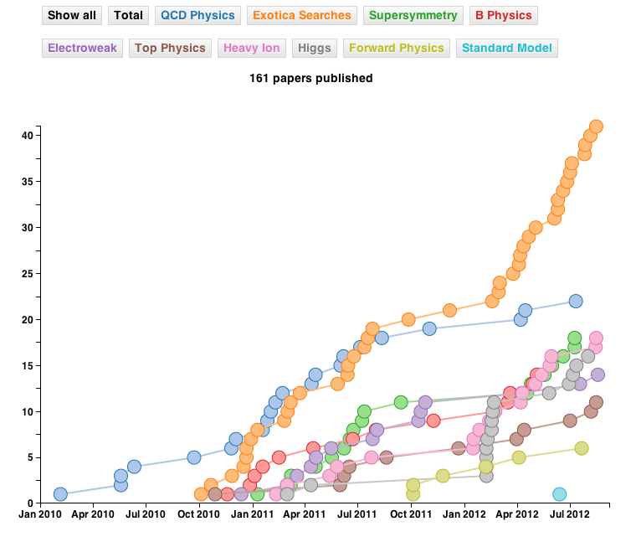
Too much
It is not humanly possible to cover all the bounty of results from the 2011-2012 data taking campaign, so in the following will give just a few key results demonstrating the performance of CMS and concentrate on
THE result of 2012

Slide 27
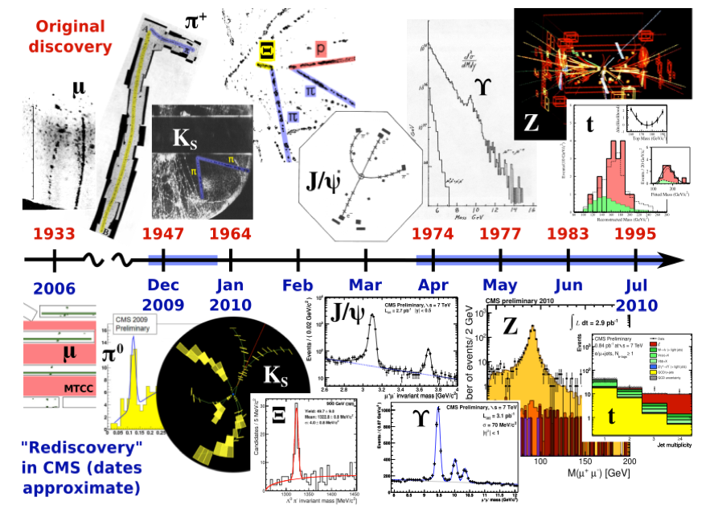
Std Model: rediscovered in 2010
Standard model particle production (π⁰, J/ψ, Z, Ws….) have become the means to calibrate and assess efficiencies and acceptance from data (tag and probe/control regions methods)without relying on MC

Slide 28
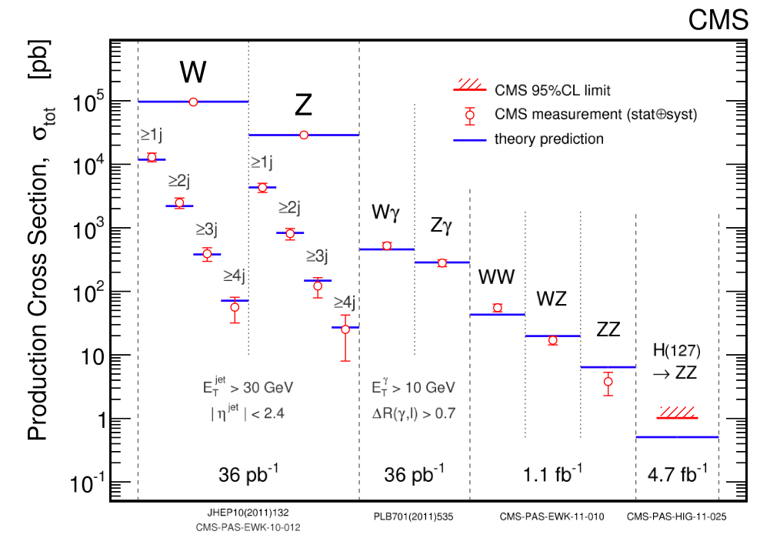
Std Model Bosons
Understanding of Boson production is a must to prepare the search of the Higgs

Slide 29
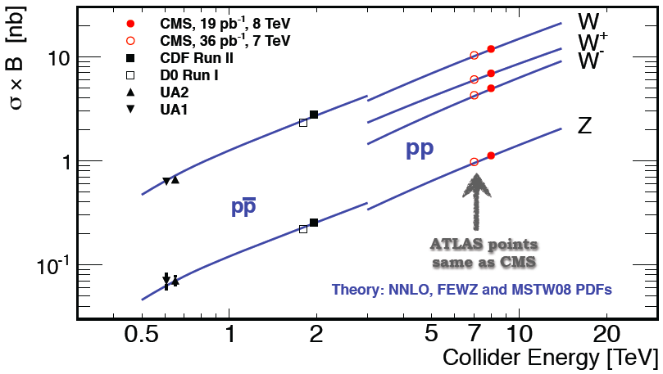
W/Z cross section

Slide 30
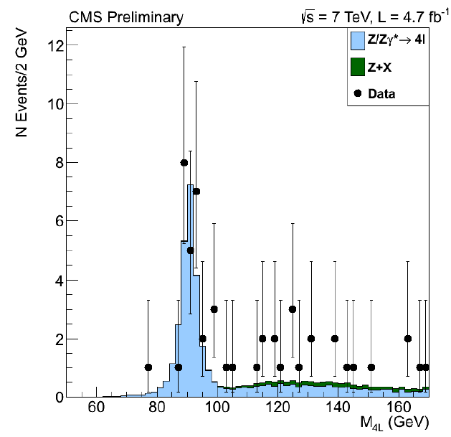
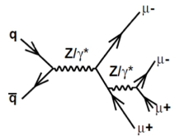
Rare events with leptons
Dalitz decay
2011
CMS and LHC are good enough to allow for the search of rare Z decays.

Slide 31
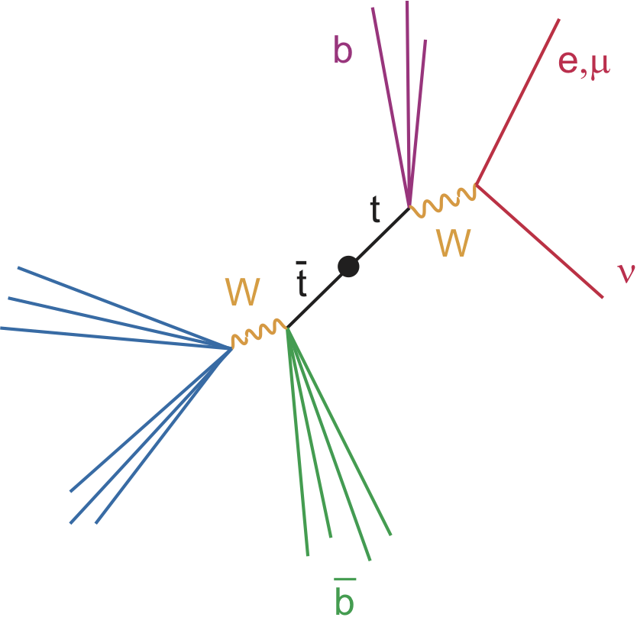
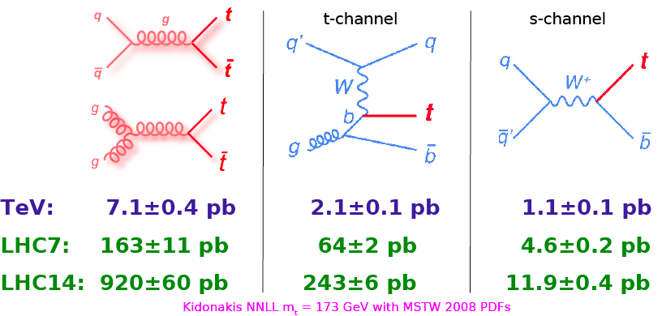
Top Production
Set of ingredients to investigate production of ttbar :
  e, μ, E_{T}^{miss}, jets, b-tag
  Good test of performance of detectors
Of interest for top analysis:
  one lepton (e or μ), E_{T}^{miss}, jjbb (37.9%)
  di-lepton (ee, μμ or eμ), E_{T}^{miss}, bb (6.46%(
LHC is a Top factory and CMS is a TOP detector

Slide 32
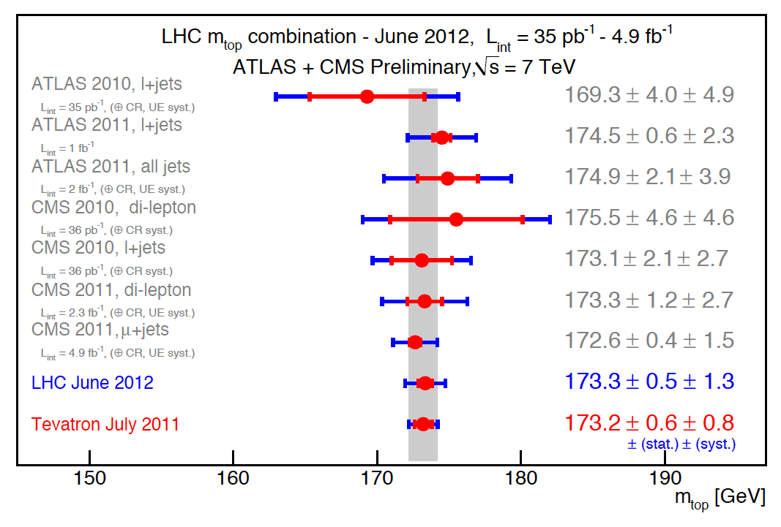
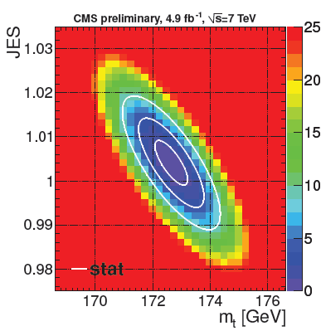
Std model : TOP mass
Simultaneous fit of top mass and Jet energy scale

Slide 33
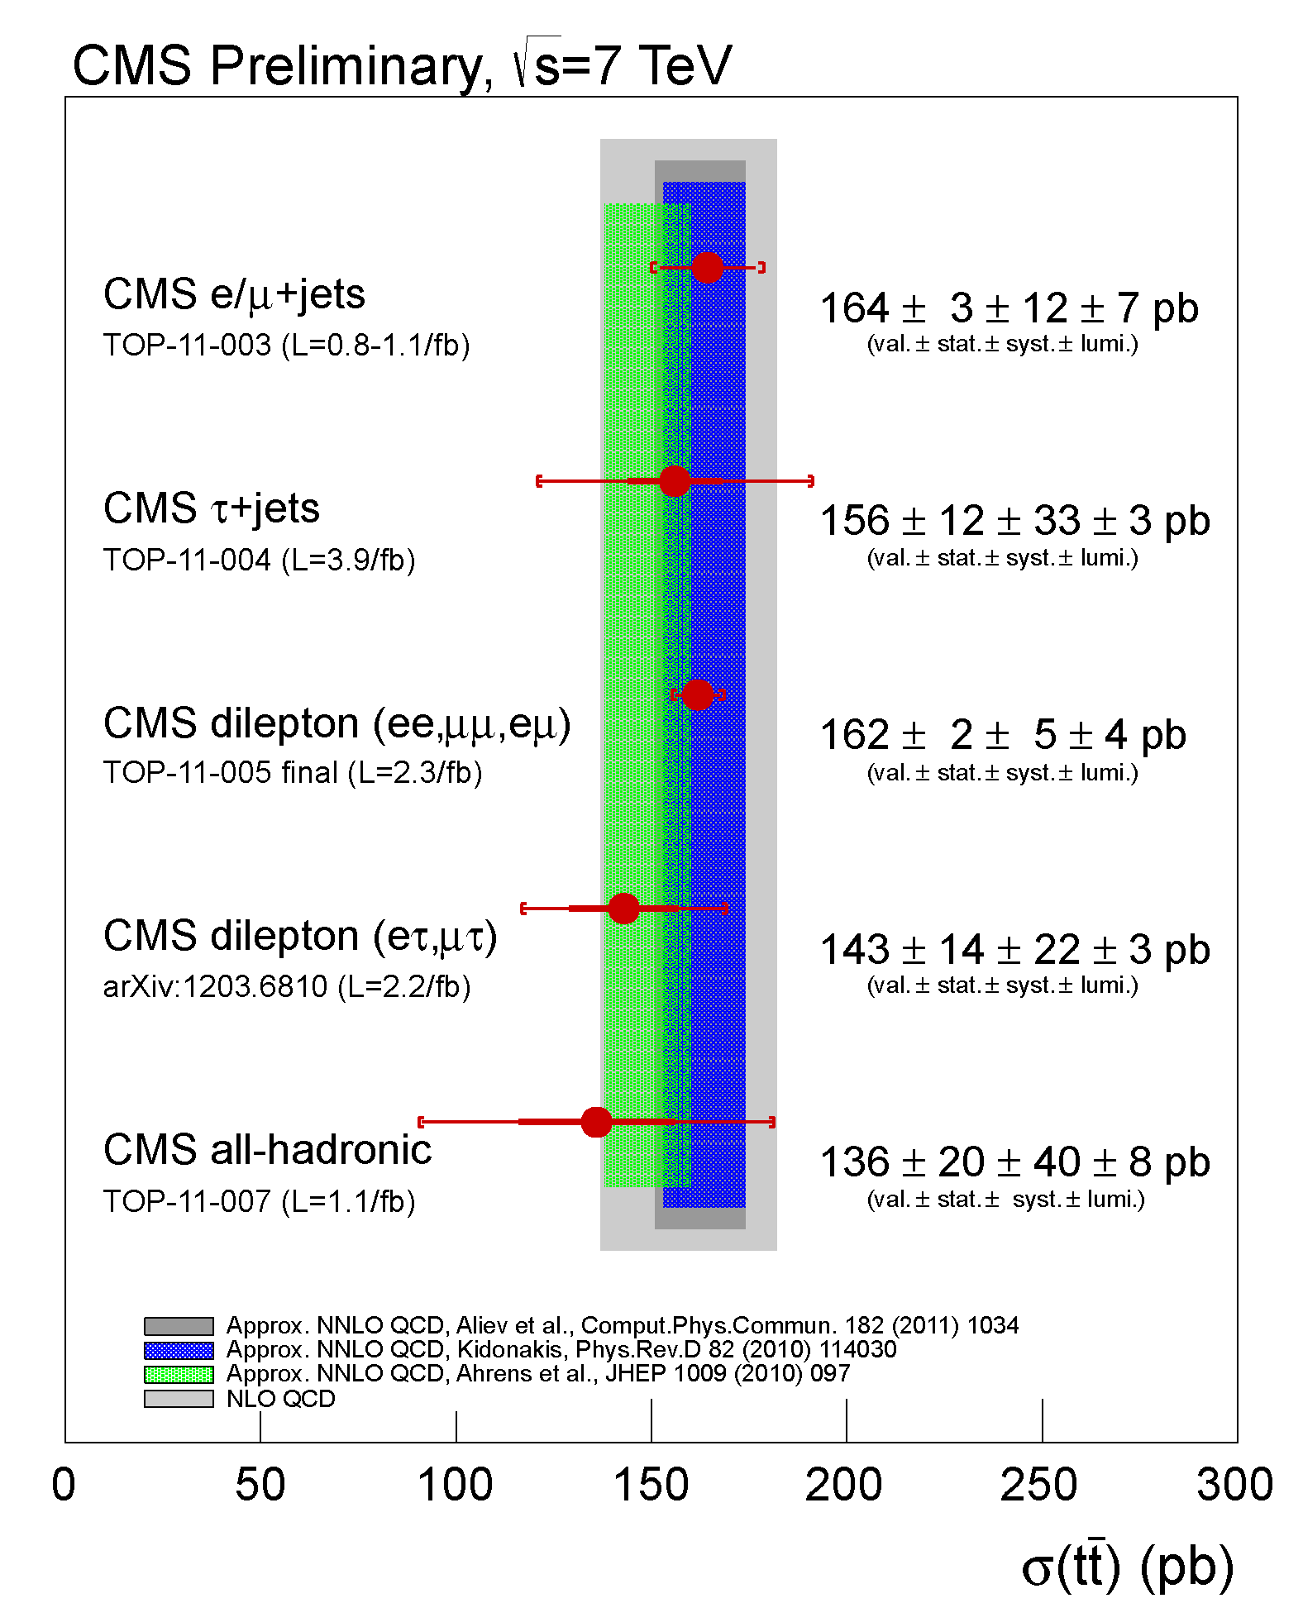
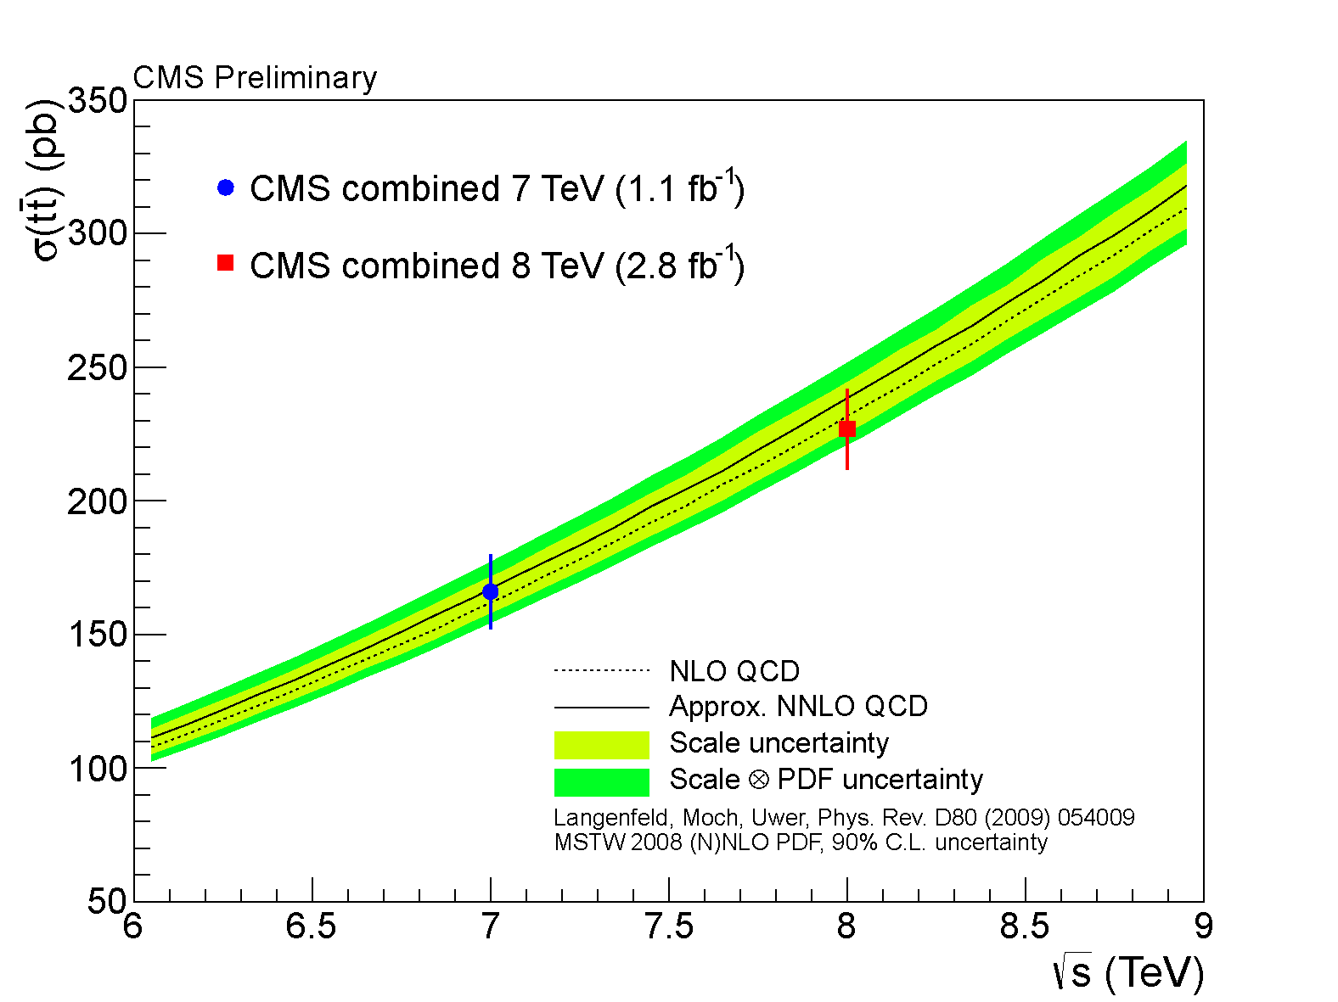
tt cross section
A precision measurement

Slide 34



Single top
cosθ∗ is defined as the angle between the lepton and the non b-tagged jet in the reconstructed top quark rest frame.

Slide 35

CPT and TOP
∆m_{t}^{measured} = −1.20 ± 1.21 (stat) ± 0.47 (syst) GeV

Slide 36
THE search

Slide 37



What we expected
prediction of the range for m_{H}
Limits from LEP , LHC and Tevatron

Slide 38
Indirect limits to M_{H}
~M_{t}²
EW radiative correction relate the precision measurements
with the top and the Higgs
The uncertainty on m_{top} (and may be m_{W)}
can still be improved:
~ln(M_{H})
α_{em} 3.1 x 10⁻⁴ 5%
M(Z) 2 x 10⁻⁵ 0.002 %
G_{F} 8.6 x 10⁻⁶ 0.0008%
+
α_{s} 2.3 x 10⁻²
sinθ_{W} 1.2 x 10⁻³ 0.5%
1/2
αem 1
√2GF sin θW √ 1−Δr
m_{W}=
f(m²_{top}, log(m_{H}))
Δm_{W} = 0.7 × 10 ^{–2} Δ m_{top}

Slide 39


The Higgs boson is a must in the SM!
Example: W_{L}W_{L} scattering
For s >> (m_{H})²thediagram with Higgs boson removes runaway s
  Conclusion: to preserve unitarity, one must switch on the H at some mass (≤1000 GeV). Something must appear by 1.0-1.2 TeV
In brief: a Higgs boson with M < TeV completes the SM
( and raises a whole set of new questions)

Slide 40

W_{L}W_{L}scattering

Slide 41




Higgs production
200 Higgs bosons (120 GeV) per hour produced with L ~3 10³³ Hz/cm²
In 10 fb⁻¹ expect a total of 25 x 10000=250000 H(125 GeV)

Slide 42
Theoretical Uncertainties
The theoretical predictions have uncertainties, mainly due to:
  the choice of the QCD scale to take into account the effect of the missing higher orders
  the PDF
  the parameters used (quark masses, W & Z parameters, couplings constants, etc )
The variation of the scale and of the PDF can cause variations of the distributions and thus variations on the Signal and Background efficiencies within the detector acceptance.

Slide 43
Gluon PDF and α_{s}
The uncertainty due to the PDF is calculated using 3 different PDF: MSTW08, CT10 and NNPDF, each of them with their preferred value of α_{s}
S.Forte, R.Thorne, J.Houston et al

Slide 44



VBF production
Yu. Dokshitzer, V. Khoze and S. Troyan, Sov.J.Nucl. Phys. 46 (1987) 712
Yu. Dokshitzer, V. Khoze and T. Sjostrand, Phys.Lett., B274 (1992) 116
Rapidity gap
φ
η
Smaller cross section, but powerful background rejection:
D. Zeppenfeld et al.
Energetic jets in the forward/backward directions:
  large Δη(jj) and large Mjj
Higgs decay products between the tagging jets
Sparse gluon radiation in the central-rapidity region,
due to colorless W/Z exchange
→ central jet veto

Slide 45







Higgs decay
bb, ττ
l
Excluded LHC + Tevatron Summer 2011
LEP
LEP
ZZ, WW
γγ
Five modes studied
  γγ, ZZ, WW, τ⁺τ⁻, bb
The branching ratio plot, however, tells only part of the story—i.e., it’s quality, not quantity.
γγ

Slide 46
For a given Higgs boson mass hypothesis,
the search sensitivity depends on:
the Higgs boson production cross section,
the decay branching fraction into the chosen final state,
the signal selection efficiency,
the Higgs boson mass resolution, and
the level of (standard model) backgrounds with the same or a similar final state.

Slide 47

CMS Higgs analyses
Shaded analyses not covered here ( not included in the Higgs discovery paper)

Slide 48
Digression: statistical estimation
The analysis leads to a distribution of invariant masses of events after selection. To interpret this distribution we need to consider the efficiencies of the selections, their systematic uncertainties and the uncertainties on the theoretical assumptions on the background and signal. These are termed ‘nuisance parameters’ indicated with θ which are characterized by a ‘estimated/measured’ value belonging to a distribution whose probability density function is coded as
We then define likelihoods and the their ratio where the ^ identifies the value which maximizes the Likelihood: the test statistics q_{μ} will be used to check against the hypothesis of Signal (scaled by μ) + background or Background only
μ=0 tests background only
μ=1 tests SM Higgs hypothesis
is the signal strength modifier

Slide 49




Stat. ( continued)
-Find the “observed” value of for a given μ under test
-Find values of the nuisance parameter best describing the experim. observed data maximising the likelihood for the 2 hypotheses (B and S+B)
-Construct (with toys) thr pdfs :
Assuming a given μ in the S+B hypoth and for μ=0 for the B only hypoth.

Slide 50

CLs
For every mass hypothesis use TOY MC (which reproduces experimental efficiencies etc.) to produce PDFs of q
Confidences are integrals of
the pdf's from the right
  CL_{b}: conf. in background
  1-CL_{b}: test significance
  CL_{s+b}: conf in sig.+bg.
  CL_{s}(μ)=CL_{s+b}/1-CL_{b}
If for μ=1, CLs < α, we would state that the SM Higgs boson is excluded
With (1−α) CLs Confidence Level

Slide 51


Limits
Ex. Moriod limit on SM higgs for a =10%,5% and 1%
95% CL Upper limit on μ obtained by varying m until we reach CLs=0.05
Expected limits/discovery sensitivities determined from toy simulation emulating the analysis performance

Slide 52


Sensitivity: exclusion
Expect to exclude up to 600 GeV
Sensitive down to 110 GeV
:Gap with Lep closed!

Slide 53
Sensitivity: discovery
At low mass most sensitivity is brought by the high resolution channels : ZZ and γγ
These are median expectations: if the signal overfluctuates we get higher significance and viceversa if the signal undefluctuates
unlucky
lucky

Slide 54

H→γγ

Slide 55


H → γγ
Signature: 2 energetic, isolated γ, in a narrow mass peak on top of a steeply falling spectrum
Relevant aspects:
Photon identification/ background rejection
Di-photon mass spectrum
Background estimation
Signal: small peak over large smoothly decreasing background
Irreducible is 2 photon QCD production
Reducible : fake photons ( gamma+jet, Drell Yan e+e-)
Background directly determined from data (no MC)
Good mass resolution( expect narrow peak) : 1-2 %
Interesting mass range : 110-150 GeV (note that largest BR is 0.2%!)

Slide 56


Slide 57


H→ γγ: new MVA
The background is estimated by fitting
a polynomial in the full mass range, of
3rd to 5th order.
•Possible bias is always less than
20% of the stat. error (more functional
forms have been tried)
•Events are first selected by requiring 2 photons
P^{t}_{γ1}> m_{γγ}/3,
P^{t}_{γ2}> m_{γγ}/4,
if there are 2 tagging jets they are classified as VBF candidates else as gluon-gluon candidates.
The events in the two categories are separated in classes based on the MVA variable: lower S/B class is rejected. In the VBF category two S/B classes are defined based on quality of Dijet tag

Slide 58






H→ γγ: BDT selection
VBF selection:
Gluon gluon selection

Slide 59


H→ γγ
For illustration only ( not used in obtaining the result) Sum over all candidates weighted with S/(S+B)
seeR.J. Barlow, J. Comp. Phys. 72 (1987) 202,
http://dx.doi.org/10.1016/0021- 66 9991(87)90078-7.
Signal
Background

Slide 60

H→ γγ: results
7 TeV and 8 TeV data consistent:
earlier fluctuation at higher mass has faded.

Slide 61

H→ZZ^{(*)}→4ℓ: the golden channel
μ⁻(Z₂) p_{T} : 15 GeV
7 TeV DATA
4-lepton Mass : 125.8 GeV
e⁺(Z₁) p_{T} : 28 GeV
μ⁺(Z₂) p_{T} : 12 GeV
e⁻(Z₁) p_{T} : 14 GeV

Slide 62

H→ ZZ^{(*)}→4 leptons
Clean channel: 2 high mass pairs of isolated electrons or muons
Narrow mass peak
Backgrounds
  Irreducible ZZ (from MC)
  Reducible: Z+jets, Zbb, tt, WZ
Most important challenge to have
good sensitivity at low masses
  Highest possible lepton id efficiency down to very low p_{T}
50 GeV < M_{Z1} < 120 GeV
12 GeV < M_{Z2} < 120 GeV
→ P_{t}(e) > 7GeV
→ P_{t}(μ) > 5GeV

Slide 63



H→ 4 ℓ: challenge
Low P_{t} leptons
Small branching ratios
Need High efficiency

Slide 64

Mass resolution

Slide 65




M.E. Discriminant
MELA uses kinematic inputs for
signal to background discrimination
{m₁,m₂,θ₁,θ₂,θ*,Φ,Φ₁}
Signal expectation ( MH=125 GeV)
Background expectation

Slide 66




MELA discrimination
SM H(125 GeV)
qqZZ

Slide 67

Z1 and Z2

Slide 68



H→ ZZ→4 leptons
With MELA >0.5

Slide 69


H→ 4 ℓ: results
2Dimensional Likelihood: M4ℓ & MELA K_{d}
7 TeV and 8 TeV data consistent

Slide 70


H→ W W→2ℓ2ν
Final state high rate in most of the M_{H} mass range:
2ℓ2ν: high BR, clean signature, no mass peak [125-500 GeV]
ℓνqq: highest rate sub-channel, closed kinematics large background [300-500 GeV]
Too high background
Non resonant background

Slide 71
H→ W W→2ℓ2ν
Signature: two high pt leptons + Missing Et
No narrow Mass peak
Main backgrounds
  WW (irreducible)
  Z+jets, WZ, ZZ,tt, W+Jets
Background estimation crucial
  W+jets: fake rate measured in QCD enriched data sample
  Z: use Z mass
  Top: b-tagging efficiency from Top control region in Data
Analysis done for separate categories:
  0/1 jet and diject ( VBF) tagged
  Final state lepton flavor
Scalar Boson +
V-A structure of W decay favors small Δφ between leptons
ℓ⁺
W⁺
ν
W⁺
ℓ⁻
H
_
W⁻
ν
W-

Slide 72

Background rejection
To minimize effect due to τ decay E^{T}_{miss}
Cross sections @7 TeV

Slide 73

Jet categories
Events are categorized on jet multiplicities (assigned to primary vertex)
0-Jets: WW dominated .
Most sensitive to gg→H
  eμ final state most pure
1-Jet: dominated by tt & tW:
apply anti-b tagging to all jets with
p^{T} > 10 GeV
2-Jets: select VBF topologies :
Δη(J₁-J₂)> 3.5, M_{j1,j2}> 450 GeV
Very good description of Jet counting
(using Z→2ℓ sample)

Slide 74




Selection
0-jet ee/eμ/μμ
1-jet ee/eμ/μμ
cut
cut
Before cut on ΔΦ(ℓℓ)
Before cut on Μ(ℓℓ)
cut
cut

Slide 75


Final sample
Background normalization uncertainties
( all from data!) :
W+jets: ≈40%
Drell-Yan: 60%
Top: 25%
WW: 15-30%
After final cuts background dominated by WW
The WW rescaled from measured WW cross section
σ_{WW} =69.9±2.8(stat)±5.6(syst)±3.1(lumi.)pb
σ^{NLO}(gg→WW +qq→WW)=57.25+2.35pb
VBF

Slide 76


H→ W W→2ℓ2ν: results
Combinining with published 7TeV MVA analysis
Expected limit: 122 < M_{H}< 450 GeV
Observed limit: 129 <M_{H} < 520 GeV
The observed excess is compatible with a Higgs boson of mass 125 as well as with a background fluctuation

Slide 77
VH→Vbb, V→ℓν, ℓℓ, νν
Large branching ratios for M_{H}< 130 GeV:
a key decay channel for the determination of the nature of the boson
BUT
σ_{bb}(QCD) ~ 10⁷ σxBR(H→bb)
WH→ℓ±νbb
Associated production with W or Z with the request to have large boost of the W/Z(*) makes the background manageable:
W/Z requirement suppress QCD background and provide clean lepton trigger paths
Boost reduces background from W/Z+jets and from tt events
Boost allows using Z→νν by requiring large MET
ZH→ℓ⁺ℓ⁻bb
(*) J. M. Butterworth, A. R. Davison, M. Rubin et al.
Phys. Rev. Lett. 100 (2008) 242001,

Slide 78
Analysis
Require High momenta Vector bosons + 2 Btagged jets
Two categories based on High and Medium Boost
Channel | Medium Boost (GeV) | High Boost (GeV)
Z(ℓℓ)H | 50<P_{T}(Z)<100 | P_{T}(Z)>100
W(ℓν)H | 120<P_{T}(W)<170 | P_{T}(W)>170
Z(νν)H | 120<ME_{T}<160 | ME_{T}>160
Larger boost to reduce tt
Backgrounds:
W/Z + jets (both udsc –’light jets’ and b –’heavy jets’
tt and single t
WW, ZZ
Boosted decision tree used to optimize discrimination between signal and background

Slide 79


Analysis
Backgrounds normalization obtained from data
Define Control regions enriched in different background components
Kinematic selection close to the one of the signal region (invert discrimination)
Background scale factors determined simultaneously for each mode from Binned Maximum Likelihood fit
Bck(Sig. Reg.)= Scale-Factor(Cntl reg.) x Bck_{MC}(Sig. Reg.)
Preselection cuts:
BDT variables:
Boost
B-Tag

Slide 80
BDT
Fit Shape of BDT output is final discriminant to extract best info regarding H content ( no cut on BDT variable)
W(μν)H
W(eν)H
Z(νν)H
Z(μμ)H
Z(ee)H

Slide 81

Systematics
Dominant uncertainties: b-tagging, background modeling,
signal cross-section

Slide 82

Results
Reconstructed Higgs mass improved using additional correction on top of JET energy Scale determined by BDT technique to improve resolution of b-jets P_{t} (technique inspired by CDF approach) : this improves Mass resolution by 15-20%
Sensititvity at 1.1σ_{SM} below 115 GeV
Mild excess between 115 and 135 GeV
→ Expect 1.6 σ_{SM} at 125 GeV, observe 2 σ_{SM}

Slide 83
H→ττ→μτ_{h},eτ_{h},eμ,μμ
Largest branching ratio at low masses
Sensitive to all production modes
  gg fusion
  VBF
  VH
BUT
Decays: requires non-trivial Pattern recognition
Challenging large background
  Drell-Yan →ττ
  W+jets
  QCD
τ⁺τ⁻

Slide 84

τ_{h} reconstruction
Charged hadrons are combined with electromagnetic objets (arranged in ‘calorimeter-strips’ or identified single photons)
ECAL
Single prong Three prongs Single Prong + Strip
τ are isolated using a MVA approach
Absolute energy sums in rings

Slide 85



τ_{h}Reco performance
τ_{h} misid in QCD enriched multijets
τ_{h} misid in W+jets enriched multijets
Ref: CMS collaboration, JINST 7, P01001

Slide 86

Di-τ mass

Slide 87

Analysis strategy
Analysis in 4 final states μτ_{h},eτ_{h},eμ,μμ
5 categories (S/B, mass resolution) defined by jet multiplicities and boost (p_{t}) of either τ_{h} (μτ_{h},eτ_{h}) or leading μ (eμ,μμ)
All categories are fit simultaneously

Slide 88




Background (0 jet)
DY→ℓℓ: taken from MC, corrected for measured ℓ→τ fake rates
DY→ττ: measured using τ embedded μμ events
e-τ_{h}
EWK: mostly W+jets measured from High M^{T} sideband
QCD: estimated from SS data
μ-μ
μ-τ_{h}
e-μ

Slide 89


Final sample
For VBF category ( the one with the best S/B)
Background can be VERY large

Slide 90





Final sample (VBF)
μ-τ_{h}
e-μ
e-τ_{h}
μ-μ
Highest sensititivity for m_{H}< 130 GeV

Slide 91

Systematics

Slide 92

Results
No significant departure from SM background-only expectation
Observed limit of 1.06 x SM at mH = 125 GeV

Slide 93



The result
Higgs excluded in 110-121.5 & 128- 600 GeV
Significant excess observed in 121.5-128 GeV range

Slide 94

Discovery!

Slide 95

5 channels

Slide 96

high res. Channels

Slide 97


Mass

Slide 98

A new boson
The new particle has to be a boson (as it decays to bosons) and cannot have spin 1 because it decays into photons.
(Landau-Yang theorem) : In the decaying particle rest frame P is conserved and as space is isotropic the two photons must be emitted in spherical waves ( space par tof the Wave Function is symmetric)
If the decaying particle has spin 1 then the two photons must be emitted in a Jtot=1 state in order to conserve angular momentum… but J=1 is formed by antisymmetric spin functions …which violate Bose statistics , hence are forbidden

Slide 99


Landau –Yang th.
An elegant derivation:

Slide 100


First checks

Slide 101
Custodial symmetry
ρ= M²_{W}/M²_{Z} cos²θ_{W} = 1 at tree level
LEP experiments have measured
ρ=1.005 ± 0.001
in perfect agreement with the theoretical value of ρ’ = 1+Δρ, when radiative corrections are correctly taken into account
The radiative corrections affect ρ mildly, because of the SU(2) symmetry of Higgs Potential, appropriately called
“Custodial Symmetry”
Measuring the W, Z coupling ratio from H decays, means measuring the ratio between boson masses, thus ρ.
^{+1.1}
^{R} _{WW/ZZ} ^{= 0.9}
^{-0.6}

Slide 102
Decays Sig. Strength
^{+1.1}
^{R} _{WW/ZZ} ^{= 0.9}
^{-0.6}

Slide 103


First checks

Slide 104



Properties :New Boson Couplings
C_{F}
C_{V}
Group the Higgs couplings into
“Vectorial” and “Fermionic” sets ( and assume the are all SM)
Attach a modifier to the SM prediction
to each of those (C_{V} and C_{F}).
In agreement with the SM within 95% CL
→ Need more data!
solid contour: 68% CL
dashed contour: 95% CL

Slide 105

What next in Higgs-land ?
How can the mass of the Higgs boson be anything “small”?
  It should “resist” itself (since it couples to mass, it should couple to itself as well)
  Its mass should be almost infinite!
Quadratic divergence in the Higgs mass
STAY Tuned : first step is to measure Higgs coupling
And continue to look for new physics
M_{H}² → M_{H}² (bare) + c Λ²
Λ is the scale of the underlying theory (could be M_{GUT} ~ 10¹⁵ GeV !)
Requires incredibly fine tuning (which is considered unnatural by most) to keep M_{H} small !!
What can happen?
The Symmetry breaking Lagrangian does not contain an elementary Higgs boson
OR
Something out there cancel quadratic divergences

Slide 106

Keep looking
We have not found any sign of new physics yet… but there is still room :e.g SUSY : there is practically no limit on the SUSY parameter space for Neutralino masses > 300-400 GeV
2012 Experimental SUSY PDG review [O.Buchmuller & P. De Jong]:
http://pdg.lbl.gov/2012/reviews/rpp2012-rev-susy-2-experiment.pdf

Slide 107

In Summary
2012 :Physics Milestone year for LHC and CMS
..and it ain’t over yet !
Stay tuned!

Slide 108

Tau isolation

Slide 109



Ellis , Espinosa,Giudice,Hoecker ,Riotto Phys Lett B 679 (2009)
LHC limit
2011 data
10¹³
Scale of new physics (TeV)
10¹¹
10⁹
10⁷
10⁵
10⁵
The funnel of reality
Upper limit on the scale of new physics
10³
10
100
150
200
250
300
350
M_{higgs} (GeV)

Slide 110
New physics hints
Ellis , Espinosa,Giudice,Hoecker ,Riotto Phys Lett B 679 (2009)
LHC limit
2011 data
2012 will be a key year : new physics evidence might be around the corner (if the Higgs will be found in the little window still allowed)
10¹³
Scale of new physics (TeV)
10¹¹
10⁹
10⁷
10⁵
10⁵
10³
LEP limit
10
100
110
120
130
140
150
M_{higgs} (GeV)

Slide 111
Backup

Slide 112

Flow chart γγ MVA

Slide 113
LHC luminosity
Energy increase yields γ² increase
in lumi
  f is the revolution frequency (11.25 kHz), γ = E/m,
  k is the number of colliding bunch pairs,
  N is the bunch population,
  F is a geometric (loss) factor (≤ 1) from the crossing angle, F ≈ 0.95 in 2011,
  ε is the normalized emittance, β* the betatron (envelope) function at the IP,
  σ is the beam size at IP:
The reach in β* depends on beam size in the triplets where we have the aperture limits:

Slide 114

Top decay

Slide 115

Parton lumi 7/14 TeV

Slide 116
Discoveries are made early
Early
discovery?
2012 guess
2011 est.
Courtesy of Joe Incandela

Slide 117

Jet response simulation

Slide 118
γ-jet balancing

