Slide 1


Neutrino Technology
Julián Félix
Laboratorio de Partículas Elementales
Departamento de Física. DCeI, Campus León
Universidad de Guanajuato

Slide 2
Neutrino Communication Technology
Julián Félix
Laboratorio de Partículas Elementales
Departamento de Física. DCeI, Campus León
Universidad de Guanajuato

Slide 3
Resume.
After Reines and Cowan neutrino detection, in 1956, physicists have proposed that neutrinos can be used to send messages, in extraordinary mediums, where electromagnetic waves cannot pass, and establish more secure communication, and global, point to point, with interstellar regions, mines, submarines, and space ships.
I present a review of the neutrino communication technology efforts done in these days, and establish a parallelism with Marconi electromagnetic wave communication technology experiments. And offer a broad view of future developments in neutrino communication technologies.

Slide 4



1. Introduction
2. Parallelism between Marconi experiments and MINERvA experiment
3. Conclusions
4. Some Remarks
5. References

Slide 5
1. Introduction
Humankind has made Technological developments for communication since ever.
Language, smoke signals, paper, press, books, post, letters are the parts of a long list.

Slide 6


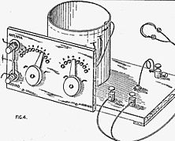
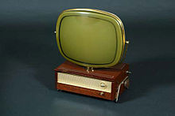
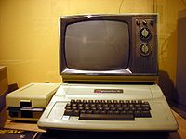
Telegraph,
teletypes,
Radio,
Television,
PC computer,

Slide 7
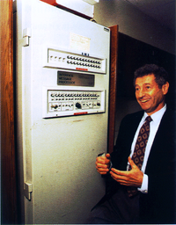
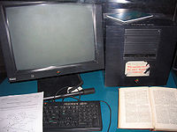
Internet,
Web,

Slide 8
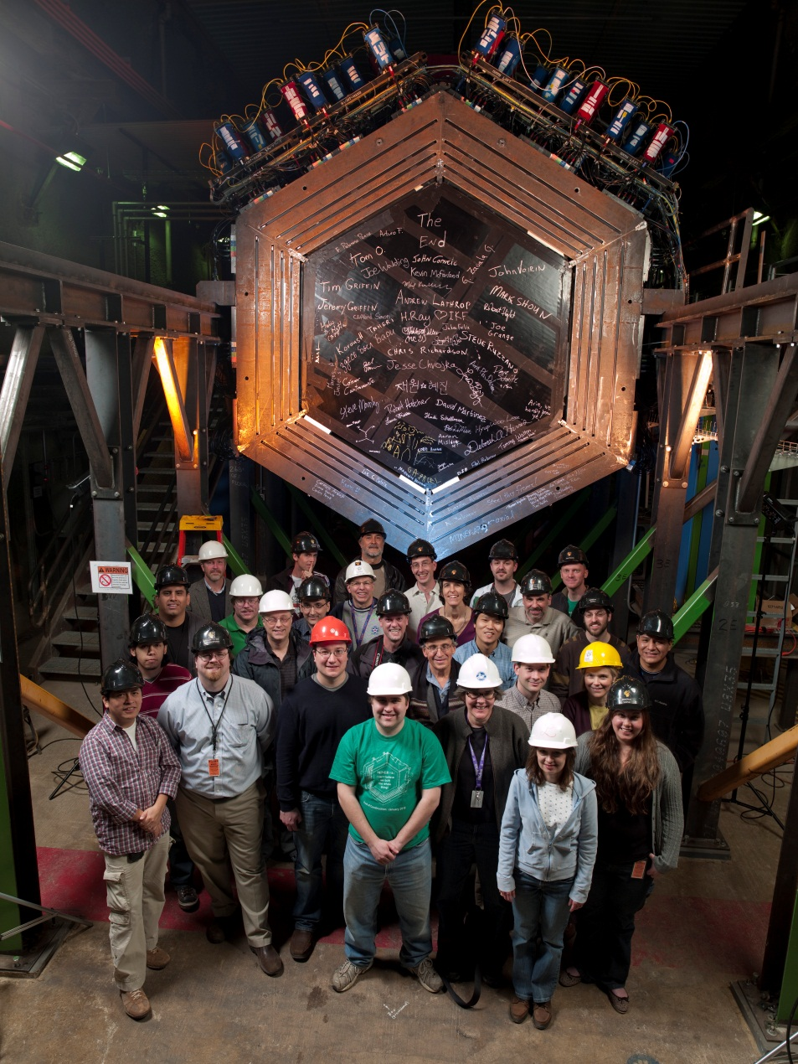
And neutrino communication technologies
MINERvA Collaboration
http://minerva.fnal.gov

Slide 9
2. Parallelism between Marconi experiments and MINERvA experiment
And short after the proposal of neutrino existence by Pauli (1930), Fermi beta decay theory (1932),
and neutrino detection by Reines y Cowan (1956),
Short after Maxwell prediction of electromagnetic waves (1865)
and its discovery –generation and detection- by Hertz (1887),

Slide 10
Parallelism between Marconi experiments and MINERvA experiment
physicists proposed that electromagnetic waves can be used to send messages or, in general, information.
This was accomplished, beside others, by Tesla and Marconi (circa 1902).
physicists proposed that neutrinos can be used to send messages or, in general, information (R. C. Arnold, Science 177, 163 (1972) and others).
This was accomplished by MINERvA collaboration (FNAL e938) (2011); published the results in 2012 (MPL A, Vol. 27, No. 12 (2012)).

Slide 11
Parallelism between Marconi experiments and MINERvA experiment
Marconi got the 1909 Physics Nobel Prize (with F. Braun "in recognition of their contributions to the development of wireless telegraphy").
MINERvA collaboration got the DOE award as the year (2011) experiment.
The award citation commended the MINERvA collaboration for its “outstanding dedication and ingenuity” and overcoming production hurdles to build a “flagship facility”.

Slide 12
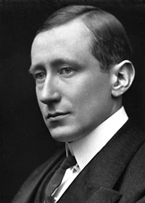
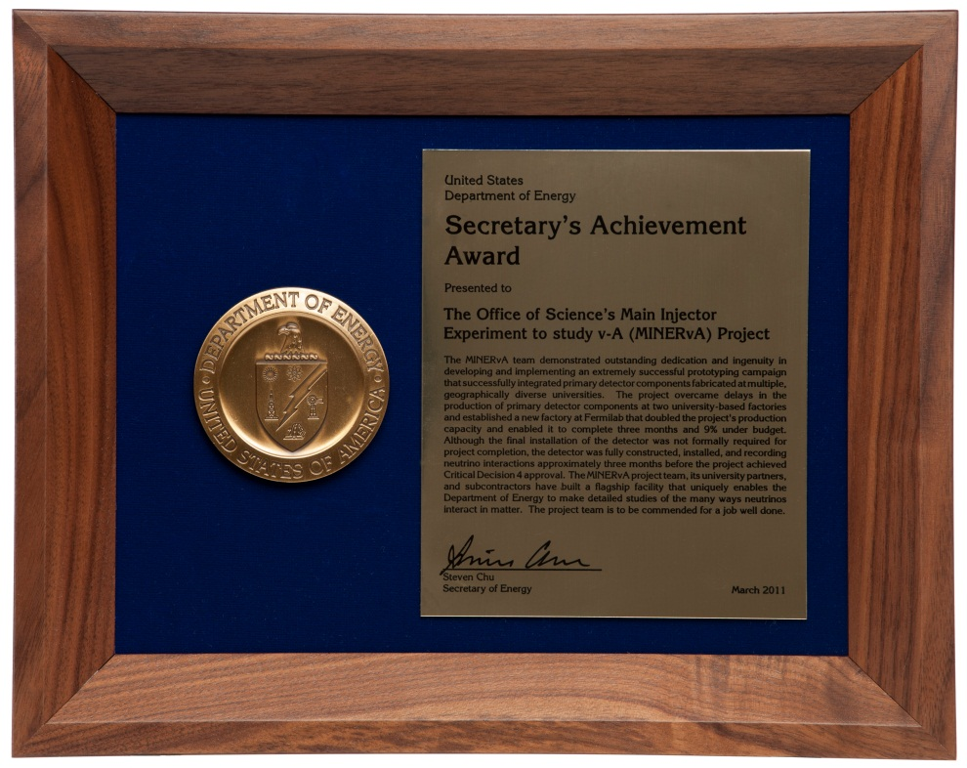
Parallelism between Marconi experiments and MINERvA experiment
GUGLIELMO MARCONI
Wireless telegraphic communication
Nobel Lecture, December 11, 1909

Slide 13
Parallelism between Marconi experiments and MINERvA experiment
La Universidad de Guanajuato, vía la DCeI, Campus León (the former IFUG) is a member of the MINERvA collaboration.

Slide 14
Parallelism between Marconi experiments and MINERvA experiment
Marconi used a monumental couple of antennas to cross an electromagnetic signal, the letter S in Morse code, through the Atlantic Ocean from Wexford England to Newfoundland Canada (3500 km apart).
MINERvA Collaboration used the NuMI beam line of Fermilab, and MINERvA detector, to cross a neutrino signal, the digitalized word NEUTRINO, from NuMI line to MINERvA detector (1035 m, including 200 m of earth).

Slide 15
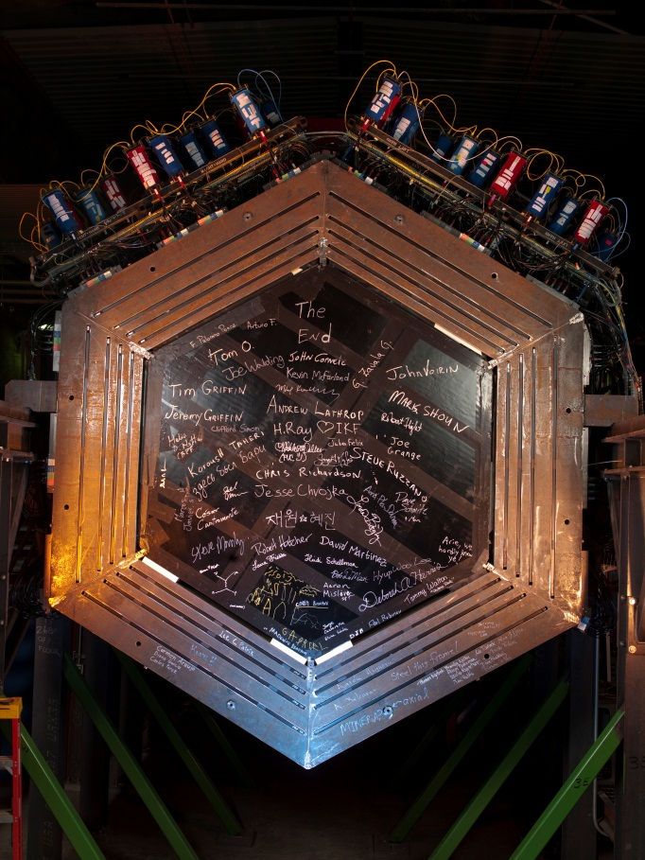
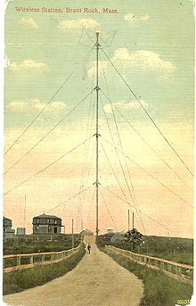
Parallelism between Marconi experiments and MINERvA experiment
MINERvA Detector
Marconi antenna

Slide 16
Parallelism between Marconi experiments and MINERvA experiment
In the 1901 experiment, at Poldhu, Cornwall. The spark-gap transmitter fed a mammoth antenna array -- four hundred wires suspended from 20 masts, each 200 feet tall, placed in a circle. A similar station was set up on the American side of the Atlantic at South Wellfleet, Cape Cod.
MINERvA collaboration accomplished the MINERvA detector in 2011, hexagonal shaped, 160 tons, 38 000 electronic channels, time resolution 3.2 ns, space resolution 2.5 mm, and will run up to 2016 collecting neutrino nucleus interactions.

Slide 17
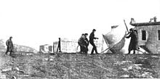
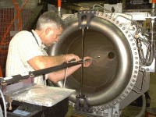
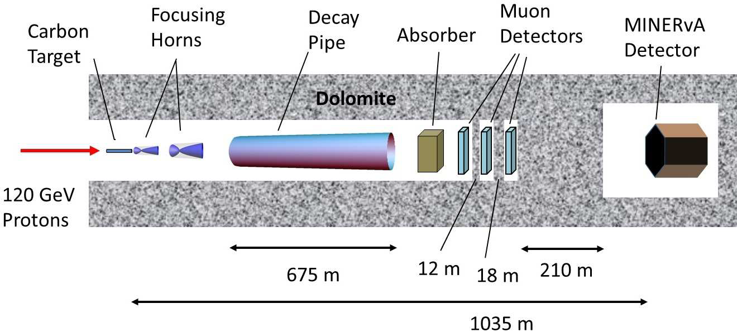
Parallelism between Marconi experiments and MINERvA experiment
Marconi experiments
MINERvA experiment

Slide 18
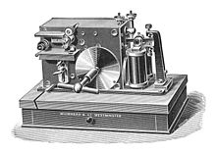
Parallelism between Marconi experiments and MINERvA experiment
The beam is composed of 88% muon neutrinos, 11% muon antineutrino, and 1% electron neutrinos.
The beam distribution energy peaks at 3.2 GeV, with a width (FWHM) of 2.8 GeV.
Marconi experiments
MINERvA experiment

Slide 19
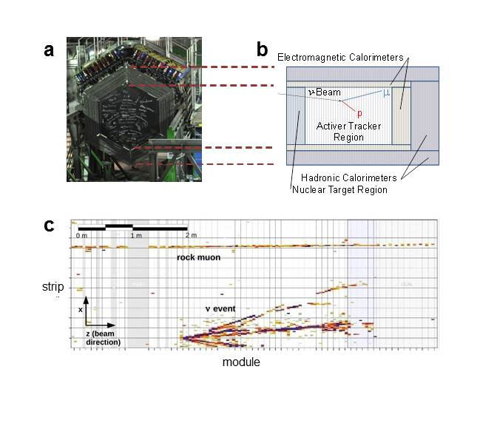
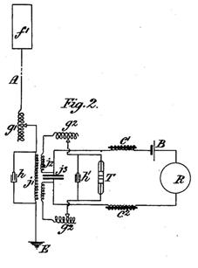

Parallelism between Marconi experiments and MINERvA experiment
Marconi experiments
MINERvA experiment

Slide 20
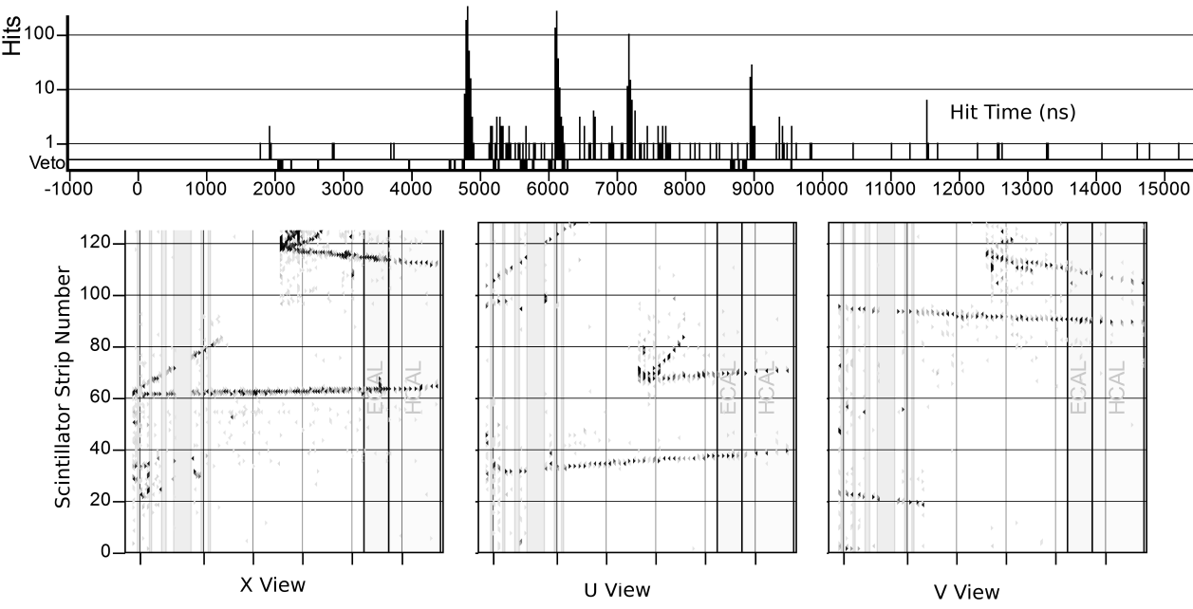
Parallelism between Marconi experiments and MINERvA experiment
Marconi experiments
MINERvA experiment

Slide 21
Parallelism between Marconi experiments and MINERvA experiment
MINERvA experiment digitalized the signal and applied an on-off key (OOK) for encoding the message.
Marconi experiment used Morse Code.
Marconi experiments
MINERvA experiment

Slide 22
Parallelism between Marconi experiments and MINERvA experiment
Lines and dots. (three dots for the S letter).
(S • • •)
MINERvA bits were
1 (beam);
0, no beam.
Marconi experiments
MINERvA experiment

Slide 23
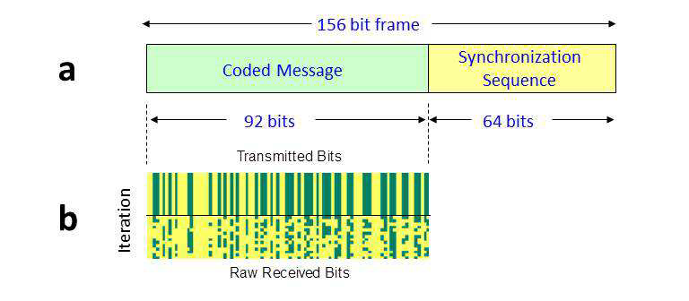
Parallelism between Marconi experiments and MINERvA experiment
Marconi, and helper, detected by ear the three dots.
MINERvA codified and digitalized the word NEUTRINO.
Marconi experiments
MINERvA experiment

Slide 24
Parallelism between Marconi experiments and MINERvA experiment
From the analysis, it is shown that the rate of transmission of information is (0.100±0.001) bit/s.
The error is statistical, and the systematic error is small compared with the statistical one.
Apparently, Marconi had no errors. The message was received cleanly.
Marconi experiments
MINERvA experiment

Slide 25
Parallelism between Marconi experiments and MINERvA experiment
More information about MINERvA experiment in http://minerva.fnal.gov
And Modern Physics Letters A
Vol. 27, No. 12 (2012) 1250077 (10 pages). World Scientific Publishing Company
DOI: 10.1142/S0217732312500770
DEMONSTRATION OF COMMUNICATION USING NEUTRINOS
More information about Marconi experiment is in http://www.nobelprize.org/nobel_prizes/physics/laureates/1909/.
Marconi experiments
MINERvA experiment

Slide 26
Parallelism between Marconi experiments and MINERvA experiment
MINERvA experiment proved the possibility of sending messages using neutrino beams.
Marconi experiment proved the possibility of sending messages using electromagnetic waves.
Marconi experiments
MINERvA experiment

Slide 27
3. Conclusions
MINERvA experiment proved the possibility of sending messages using neutrino beams.
The demonstration is based on the establishment of a low rate (0.100±0.001 bit/s) communication link using the NuMI beam line and the MINERvA detector at Fermilab, over a distance of 1035 m, including 240 m of earth.

Slide 28
4. Some Remarks
There are many applications and implications of this technology, as follows:
1. Point-to point global communication.
2. Space communications.
3. Retirement of satellites.
4. Communication with submarines.
5. Communication with mines.
6. Spacecraft communication.
7. Distribution of encryption code.
8. Search for extraterrestrial and intelligent, and technological advanced, beings.
9. This is a landmark in the history of humankind of telecommunications.

Slide 29
Further steps are as follows:
1. Make this technology more efficient.
2. Reduce the size and weight of the equipment to generate and receive neutrino messages.
3. Search for more applications.

Slide 30
5. References
http://www.nobelprize.org/nobel_prizes/physics/laureates/1909/.
http://minerva.fnal.gov
And Modern Physics Letters A
Vol. 27, No. 12 (2012) 1250077 (10 pages). World Scientific Publishing Company
DOI: 10.1142/S0217732312500770
DEMONSTRATION OF COMMUNICATION USING NEUTRINOS

