Slide 1


An Introduction to Accelerator physics
Lecture 1: Introduction & Transverse motion
Rende Steerenberg, CERN, Switzerland

Slide 2

Contents:
Overview of the Lectures
A Brief History on Particle Accelerators
The Mathematics we Need
Overview of the CERN Accelerator Complex
Relativity, Energy and Units
Accelerator Coordinates
Magnetic Rigidity
The Magnets we Need
Hill’s Equation
Phase Space, Emittance and Acceptance
The Matrix Formalism
Introduction & Transverse Motion

Slide 3
Overview of the Lectures:
4 Lectures of 1 ½ hours each.
Lecture | Date | Subject(s)
1 | Thu. 6 Sep. 09:00 | Introduction & Transverse Motion
2 | Thu. 6 Sep. 17:30 | Lattices & Resonances
3 | Fri. 7 Sep. 09:00 | Longitudinal Motion & Beam Transfer
4 | Sat. 8 Sep 09:00 | Instabilities & Collective Effects
Introduction & Transverse Motion
Most of the examples or material in these lectures are based on the CERN accelerator complex.
Useful books/material:
  An Introduction to Particle Accelerators, by Edmund Wilson
  Particle Accelerator Physics, by Helmut Wiedermann
  CAS (CERN Accelerator School) proceedings
    http://cas.web.cern.ch/cas/welcome.html

Slide 4
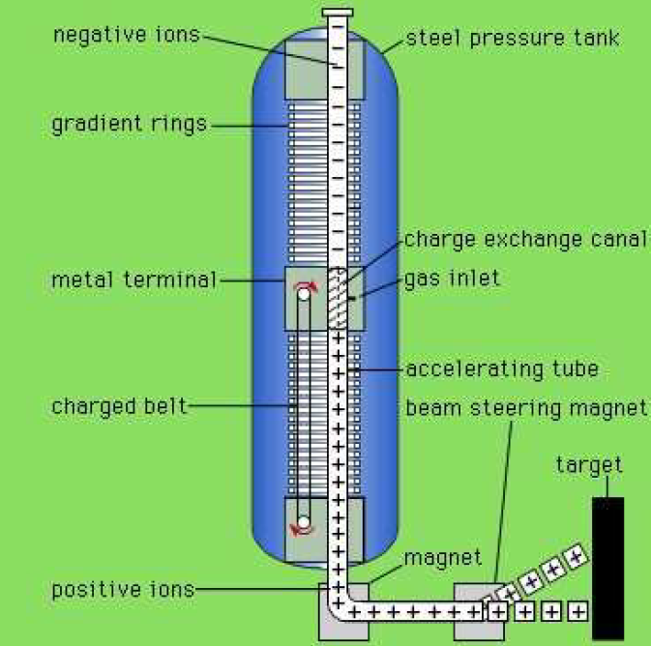
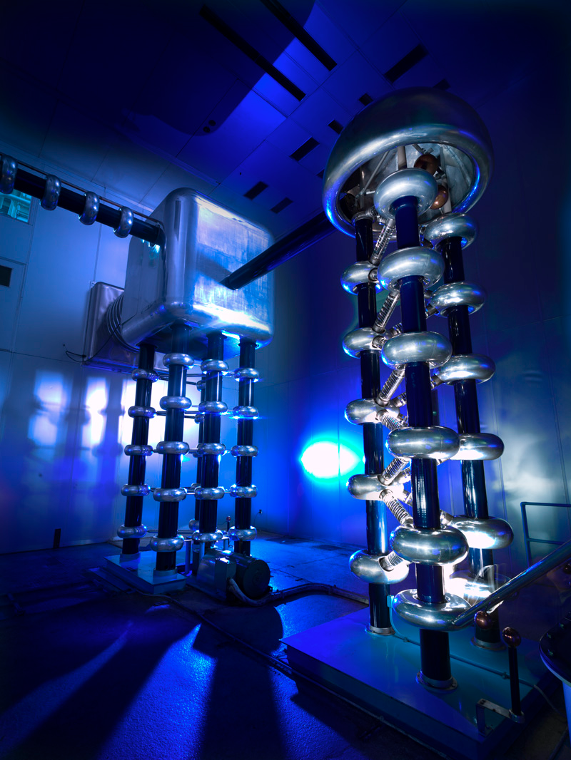
Brief historic overview
Cockroft, Walton & Van de Graaff:
  1932: First accelerator – single passage 160 keV
  Limited by the high voltage needed.
Introduction & Transverse Motion

Slide 5
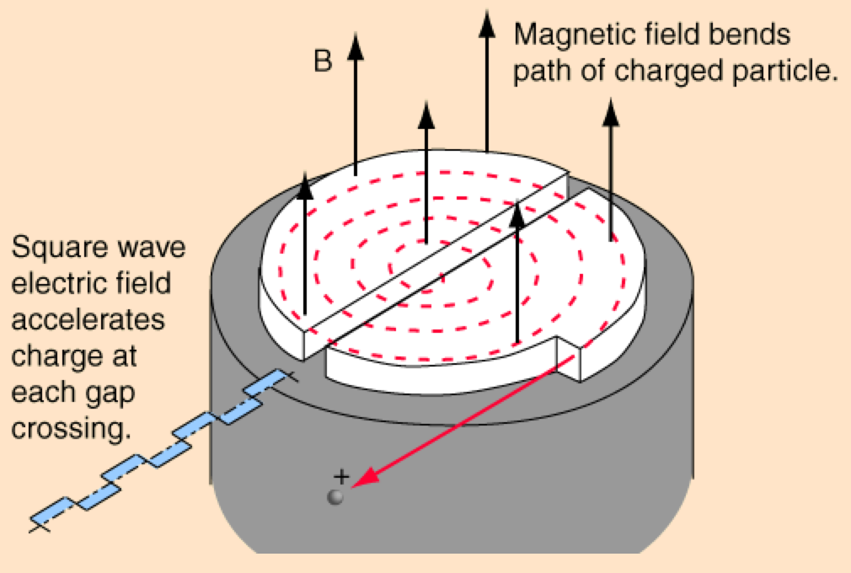
Brief historic overview
Cyclotron (E.O. Lawrence, M.S. Livingston)
  1932: 1.2 MeV – 1940: 20 MeV
  Constant magnetic field
  Alternating voltage between gap is easier than DC.
  Increasing particle trajectory radius.
  Later development lead to the synchro-cyclotron in order to cope with the relativistic effects.
Introduction & Transverse Motion
In 1939 Lawrence received the Noble prize for his work.

Slide 6
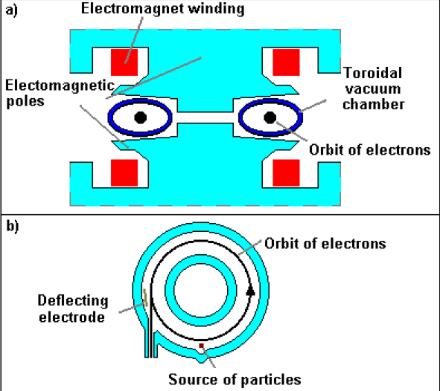
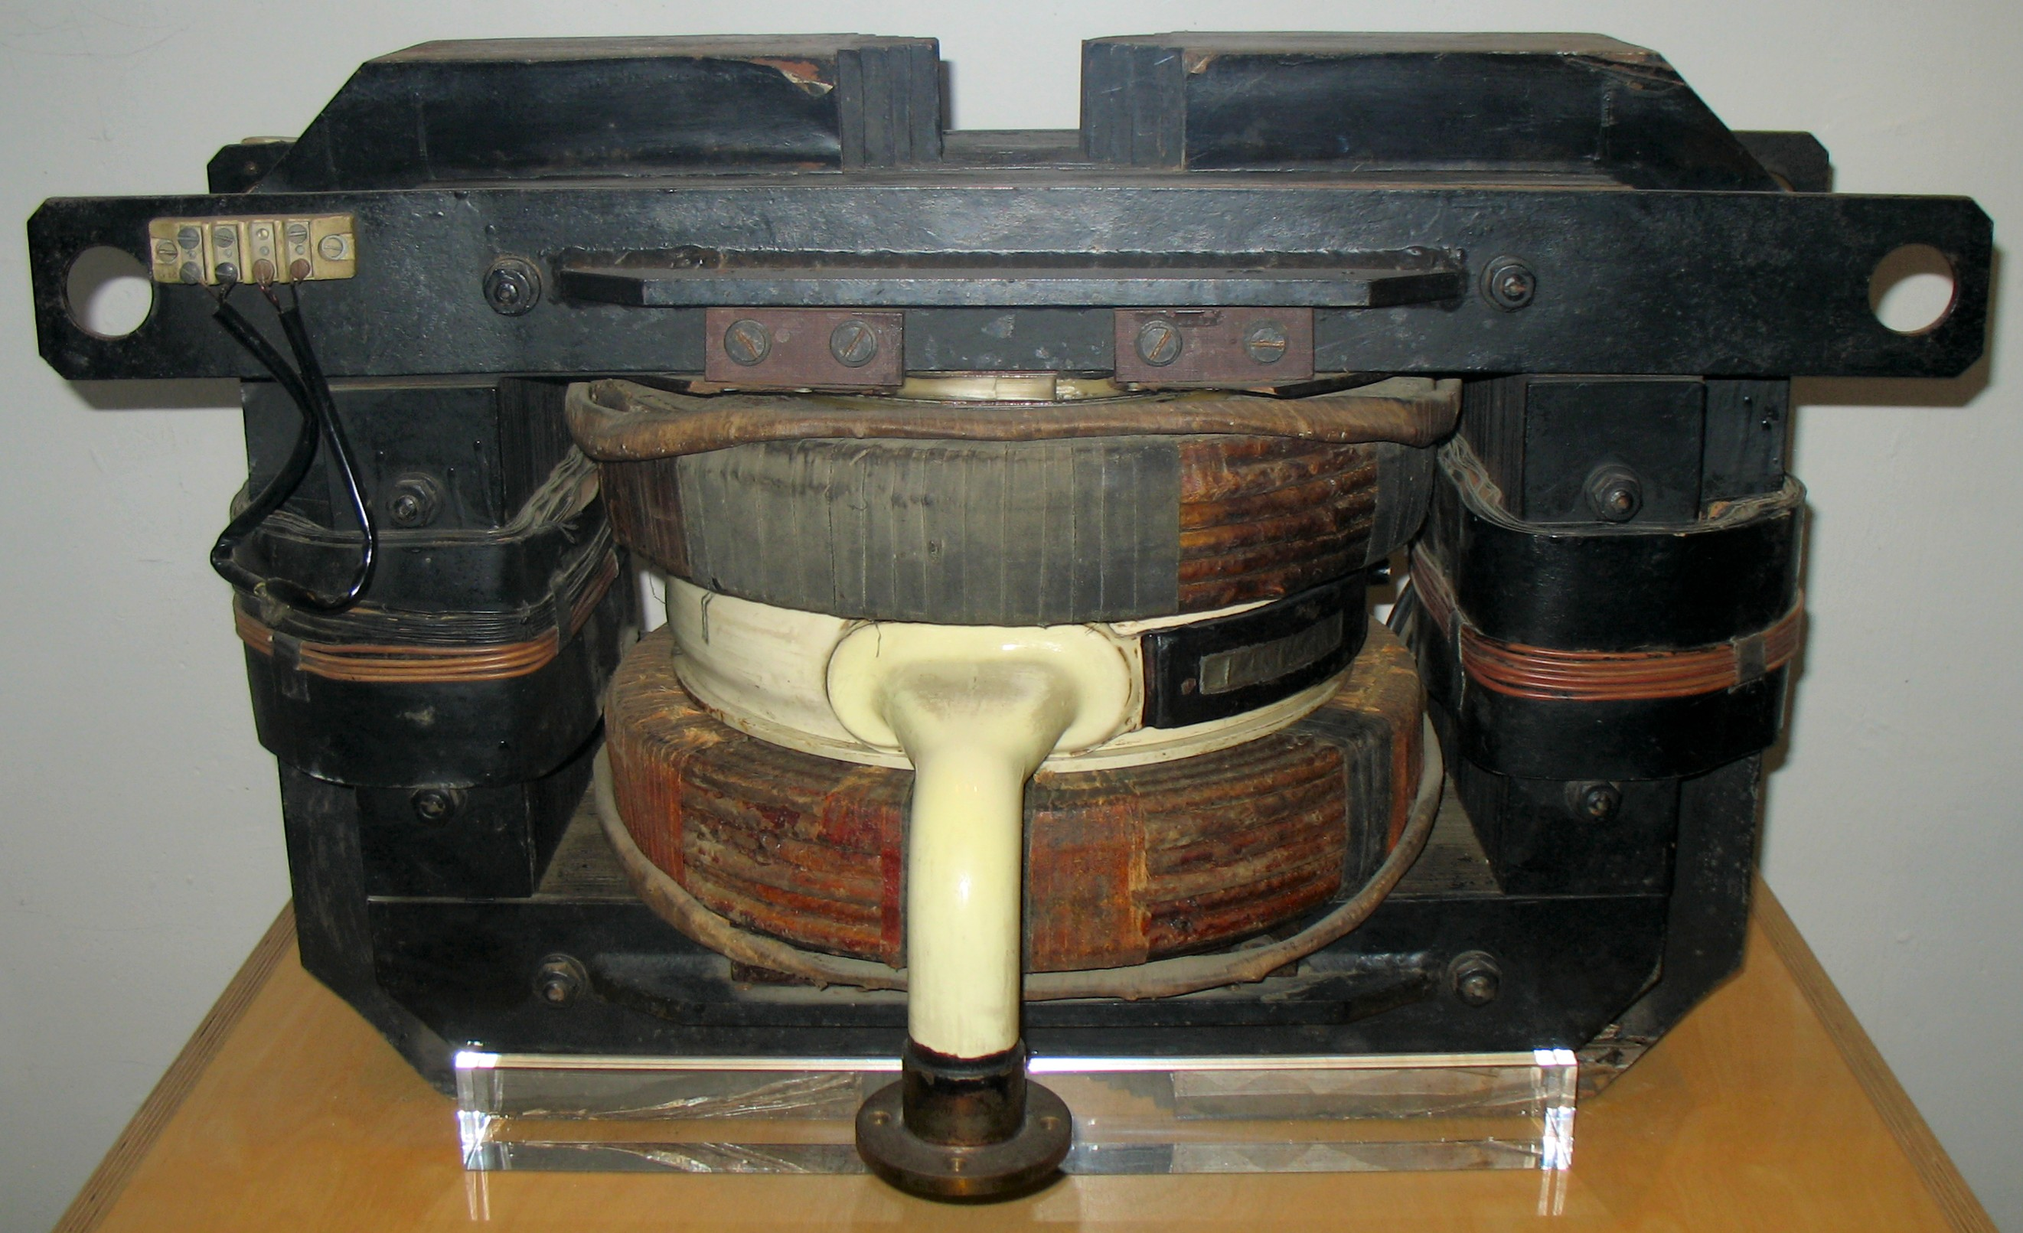
Brief historic overview
Betatron
  1940: Kerst 2.3 MeV and very quickly 300 MeV
  It is actually a transformer with a beam of electrons as secondary winding.
  The magnetic field is used to bend the electrons in a circle, but also to accelerate them.
  A deflecting electrode is use to deflect the particle for extraction.
Introduction & Transverse Motion

Slide 7
Brief historic overview
Linear accelerator
Source of particles
l₁
l₂
l₃
l₄
l₅
l₆
l₇
Introduction & Transverse Motion
RF generator with fixed frequency
Metallic drift tubes
~
Many people involved: Wideroe, Sloan, Lawrence, Alvarez,….
Main development took place between 1931 and 1946.
Development was also helped by the progress made on high power high frequency power supplies for radar technology.
Today still first stage in all accelerator complexes.
Limited by energy due to length and single pass.

Slide 8
Brief historic overview
Synchrotron (1959: CERN PS and BNL AGS)
  Fixed radius for particle orbit
  Varying magnetic field
  Varying radio frequency
  Important focusing of particle beams
  Providing beam for fixed target physics
  Paved the way to colliders
These lectures will predominantly deal with synchrotron accelerators.
Introduction & Transverse Motion

Slide 9
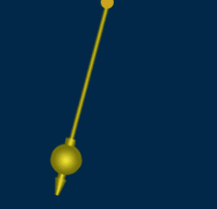
The Mathematics we Need
Differential equations:
  Distance from center =
  , θ <<
L
θ
  Velocity of mass M:
M
M
F
Introduction & Transverse Motion
  Acceleration of mass M:
Mg
  Newton: F = m × a :
  2nd order differential equation:
  L is constant
  and θ is small.

Slide 10
The Mathematics we Need
Solving the differential equation:
  Educated guess:
  Differentiate twice:
Introduction & Transverse Motion
  Valid for:
Oscillation amplitude
Oscillation frequency
  Final solution for pendulum:

Slide 11
The Mathematics we Need
The differential equation used to describe transverse motion in our accelerator:
Introduction & Transverse Motion
The 2nd order differential equation describes simple harmonic motion and is valid for any system where the restoring force is proportional to the displacement.
Particles in our accelerator follow an oscillatory trajectory when they go around in the accelerator and the forces acting upon them are restoring forces that are proportional to their displacement.

Slide 12
The Mathematics we Need
The other important mathematical ingredient to describe transverse motion are matrices
Introduction & Transverse Motion
Matrices are used to describe the various magnetic elements in our accelerator:
  The x and y coordinates are the position and angle of each individual particle.
  If we know the position and angle of any particle at one point, then to calculate its position and angle at another point, we multiply all the matrices describing the magnetic elements between the two points to give a single matrix.

Slide 13
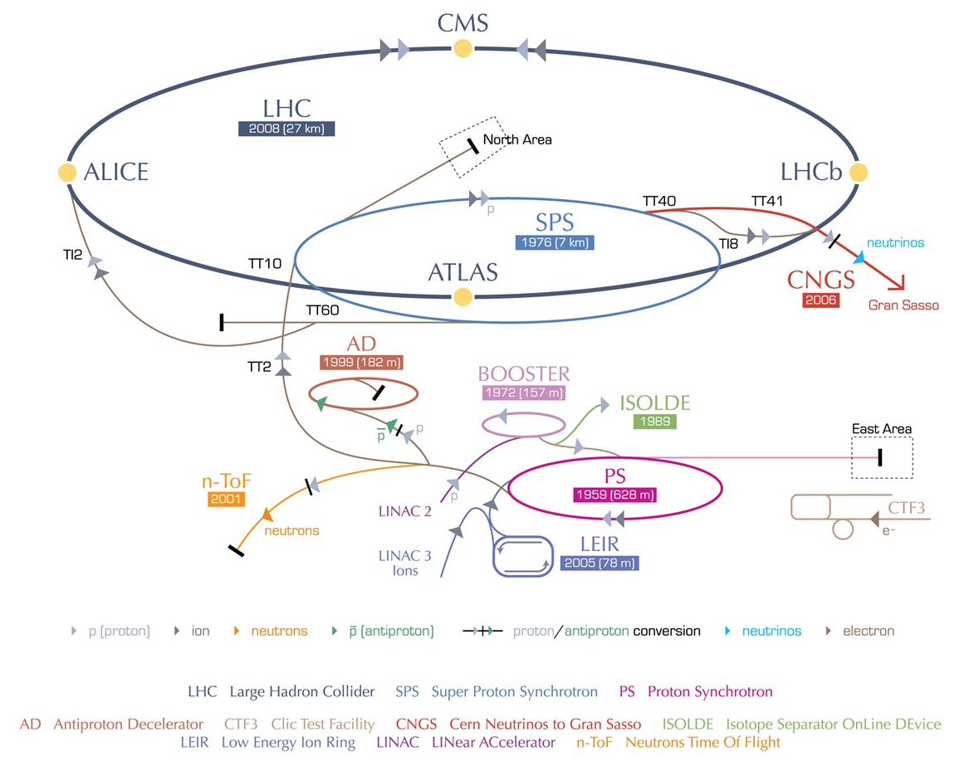
The CERN Accelerator Complex
From several keV to several TeV using 5 different accelerators
Fixed target physics.
Collider physics.
Different particle species.
Introduction & Transverse Motion

Slide 14
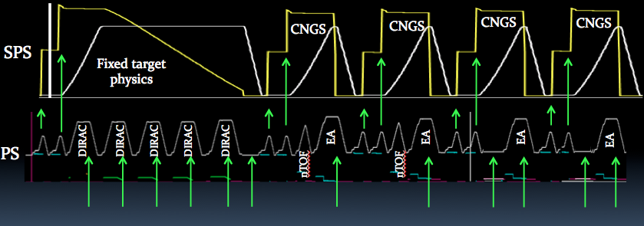
The CERN Accelerator Complex
Introduction & Transverse Motion
Time sharing to serve all experiments and accelerators.

Slide 15
Relativity in Accelerators
velocity
CERN PS
c
Introduction & Transverse Motion
SPS / LHC
}
Einstein:
energy increases
not velocity
energy
Newton:
PS Booster

Slide 16
Energy and Momentum
Einstein’s relativity formula:
Rest mass
For a mass at rest this will be:
Rest energy
As being the ratio between the total energy and the rest energy
Define:
Introduction & Transverse Motion
Then the mass of a moving particle is:
Define:
,then we can write:
,which is always true and gives:

Slide 17
Units
The energy acquired by an electron accelerated in a potential of 1 Volt is defined as being 1 eV
1 eV is energy gained by 1 elementary charge accelerated by 1 Volt.
Thus : 1 eV = 1.6 x 10⁻¹⁹ Joules
The unit eV is too small to be used currently, we use:
  1 keV = 10³ eV; 1 MeV = 10⁶ eV; 1 GeV=10⁹; 1 TeV=10¹²,………
Introduction & Transverse Motion
Therefore the units of momentum are GeV/c,..,etc.
Momentum
Energy
when β = 1 energy and momentum are equal
when β < 1 the energy and momentum are not equal

Slide 18
Accelerator Coordinate System
Vertical
Horizontal
It travels on the central orbit
Longitudinal
Introduction & Transverse Motion
y
θ
s or z
x
We can speak about a:
  Rotating Cartesian Co-ordinate System

Slide 19
Bending a Beam & Magnetic Rigidity
The force ev×B on a charged particle moving with velocity v in a dipole field of strength B is equal to it’s mass multiplied by it’s acceleration towards the center of it’s circular path.
Like for a stone attached to a rotating rope
A vertical magnetic field and a particle travelling horizontally with velocity v.
Introduction & Transverse Motion
Radius of curvature
mv
As a formula this is:
F
=
ev ×B
=
2
ρ
Which can be written as:
ρ
=
mv
=
p
B
Momentum
P = mv
e
e
Bρ is called the magnetic rigidity, and if we put in all the correct units we get:
Bρ = 33.356·p [KG·m] = 3.3356·p [T·m] (if p is in [GeV/c])

Slide 20
Radius Versus Radius of Curvature
LHC circumference = 26658.883 m
  Therefore the radius r = 4242.9 m
There are 1232 main dipoles to make 360˚
  This means that each dipole deviates the beam by only 0.29 ˚
The dipole length = 14.3 m
  The total dipole length is thus 17617.6 m, which occupies 66.09 % of the total circumference
The bending radius ρ is therefore
  ρ = 0.6609 x 4242.9 m → ρ = 2804 m
Apart from dipole magnets there are also empty straight sections in our accelerator.
  These are used to house RF cavities, diagnostics equipment, special magnets for injection, extraction etc.
Introduction & Transverse Motion

Slide 21
The Dipole Magnet
A dipole with a uniform dipolar field deviates a particle by an angle θ.
The deviation angle θ depends on the length L and the magnetic field B.
The angle θ can be calculated:
Introduction & Transverse Motion
If angle θ is small:
Therefore we can write:

Slide 22
Two Particles in a Dipole Field
What happens with two particles that travel in a dipole field with different initial angles, but with equal initial position and equal momentum ?
Assume Βρ identical for both particles
Particle B
Particle A
Particle A
Particle B
Introduction & Transverse Motion
displacement
0
2π
Particle B oscillates around particle A.
This type of oscillation forms the basis of all transverse motion in an accelerator.
It is called “Betatron Oscillation”

Slide 23
Stable or Unstable Motion ?
Since the horizontal trajectories close we can say that the horizontal motion in our simplified accelerator with only a horizontal dipole field is stable.
What can we say about the vertical motion in the same simplified accelerator ?
    Is it stable or unstable and why ?
    What can we do to make this motion stable ?
We need some element that focuses the particles back to the reference trajectory.
This focusing is provided by Quadrupole magnets
Introduction & Transverse Motion

Slide 24
Quadrupoles
y
A quadrupole has 4 poles, 2 North and 2 South
The poles are symmetrically arranged around the center.
All magnetic fields cancel-out in the center.
N
S
Force on particles
x
Introduction & Transverse Motion
On the x-axis (horizontal) the field is vertical and given by:
B_{y} ∝ x
S
N
On the y-axis (vertical) the field is horizontal and given by:
B_{x} ∝ y
The field gradient, K is defined as:
The “normalized gradient”, k is defined as:
This is a focusing quadrupole, rotating 90˚ gives a defocusing quadrupole.

Slide 25
Focusing and Stable Motion
Using a combination of focusing (QF) and defocusing (QD) quadrupoles solves our problem of “unstable” vertical motion.
It will keep the beams focused in both planes when the position in the accelerator, type and strength of the quadrupoles are well chosen.
By now our accelerator is composed of:
  Dipoles, constrain the beam to some closed path (orbit).
  Focusing and Defocusing Quadrupoles, provide horizontal and vertical focusing in order to constrain the beam in transverse directions.
Introduction & Transverse Motion
A combination of focusing and defocusing sections that is very often used is the so called: FODO lattice.
This is a configuration of magnets where focusing and defocusing magnets alternate and are separated by non-focusing drift spaces.
QF
QD
QF
L1
L2
‘FODO’ cell
Or like this……
Centre of
first QF
Centre of
second QF

Slide 26
Particle Oscillation
A particle during its transverse motion in our accelerator is characterized by:
  Position or displacement from the central orbit.
  Angle with respect to the central orbit.
x = displacement
x’ = angle = dx/ds
x’
Introduction & Transverse Motion
x
x
s
ds
dx
This is a motion with a constant restoring force, like the pendulum, resulting in a differential equations.

Slide 27
Hill’s Equation
These betatron oscillations exist in both horizontal and vertical planes.
The number of betatron oscillations per turn is called the betatron tune and is defined as Qx and Qy.
Hill’s equation describes this motion mathematically
Introduction & Transverse Motion
If the restoring force, K is constant in ‘s’ then this is just a Simple harmonic motion.
‘s’ is the longitudinal displacement around the accelerator.
In an accelerator K varies strongly with ‘s’.
Therefore we need to solve Hill’s equation for K as a function of ‘s’.

Slide 28
The Mechanical Equivalent
The gutter below illustrates how the particles in our accelerator behave due to the quadrupolar fields.
Whenever a particle beam diverges too far away from the central orbit the quadrupoles focus them back towards the central orbit.
Introduction & Transverse Motion
How can we represent the focusing gradient of a quadrupole in this mechanical equivalent ?
The phase advance and the amplitude modulation of the oscillation are determined by the shape of the gutter.
The overall oscillation amplitude will depend on the initial conditions, i.e. how the motion of the ball started.

Slide 29
Solving Hill’s Equation (1)
In order to solve it we make an educated guess for a solution:
Introduction & Transverse Motion
ε and φ₀ are constants, which depend on the initial conditions.
β(s) = the amplitude modulation due to the changing focusing strength.
φ(s) = the phase advance, which also depends on focusing strength.
Define some parameters:
…and let
Remember φ is still a function of s

Slide 30
Solving Hill’s Equation (2)
Differentiate our guess twice:
Substitute these results in Hill’s equation:
Introduction & Transverse Motion
Sine and Cosine are orthogonal and will never be 0 at the same time
The sum of the coefficients must vanish separately to make our guess valid for all phases
The sine terms will give particle motion and the cosine terms will give the envelope function

Slide 31
Solving Hill’s Equation (3)
Taking the sine terms:
We defined
, which after differentiating gives
Introduction & Transverse Motion
and
gives:
Combining
Which is the case as:
since
So our guess seems to be correct

Slide 32
The Phase Space Ellipse
So now we have an expression for x and x’
and
If we plot x’ versus x as φ goes from 0 to 2π we get an ellipse, which is called the phase space ellipse.
Introduction & Transverse Motion
φ = 3π/2
x’
φ = 0 = 2π
x

Slide 33
The Phase Space Ellipse
As we move around the machine the shape of the ellipse will change as β changes under the influence of the quadrupoles
x’
However the area of the ellipse (πε) does not change
x’
Area = π· r₁· r₂
Introduction & Transverse Motion
x
x
ε is called the transverse emittance and is determined by the initial beam conditions.
The units are meter·radians, but in practice we use more often mm·mrad.

Slide 34
Phase space ellipse orientation
x’
QF
QD
QF
x’
x’
x’
x’
x’
x
x
x
Introduction & Transverse Motion
For each point along the machine the ellipse has a particular orientation, but the area remains the same
The projection of the ellipse on the x-axis gives the Physical transverse beam size.
Therefore the variation of β(s) around the machine will tell us how the transverse beam size will vary.
x’
x

Slide 35
Emittance & Acceptance
To be a bit more rigorous we should define the emittance slightly differently.
  Observe all the particles at a single position on one turn and measure both their position and angle.
  This will give a large number of points in our phase space plot, each point representing a particle with its co-ordinates x, x’.
x’
Introduction & Transverse Motion
emittance
beam
x
acceptance
The emittance is the area of the ellipse, which contains all, or a defined percentage, of the particles. (1, 2, 3, … σ)
The acceptance is the maximum area of the ellipse, which the emittance can attain without losing particles.

Slide 36
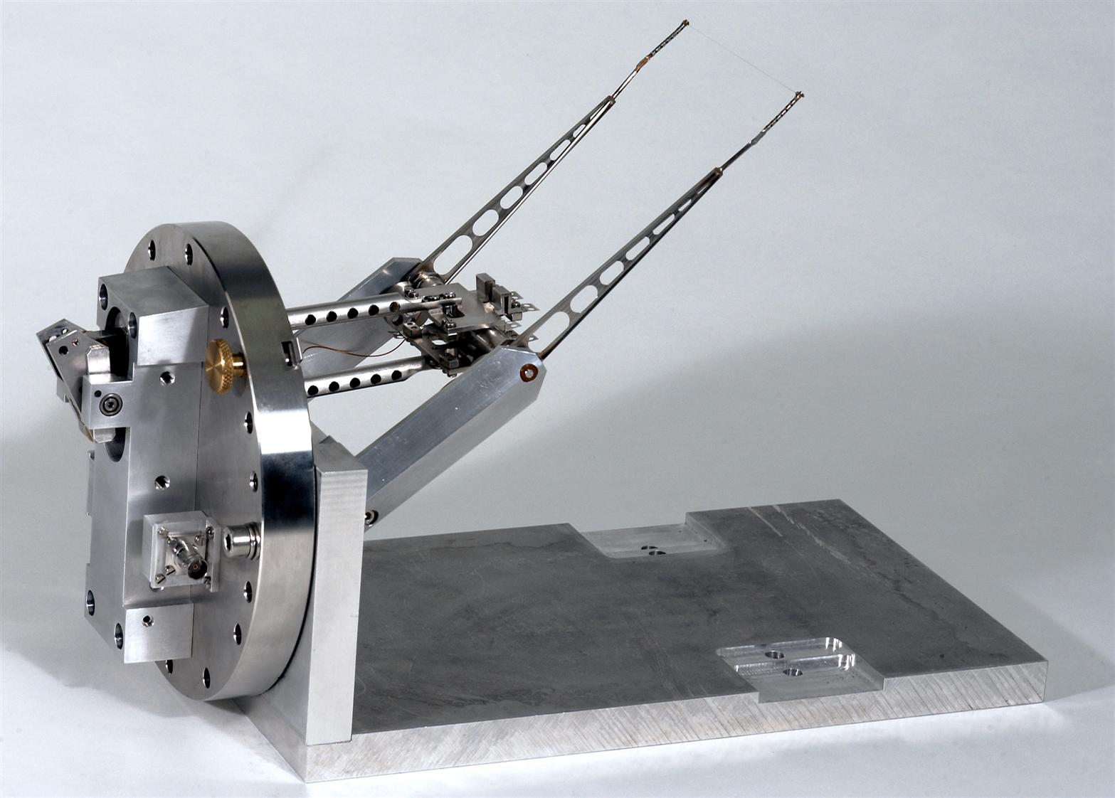
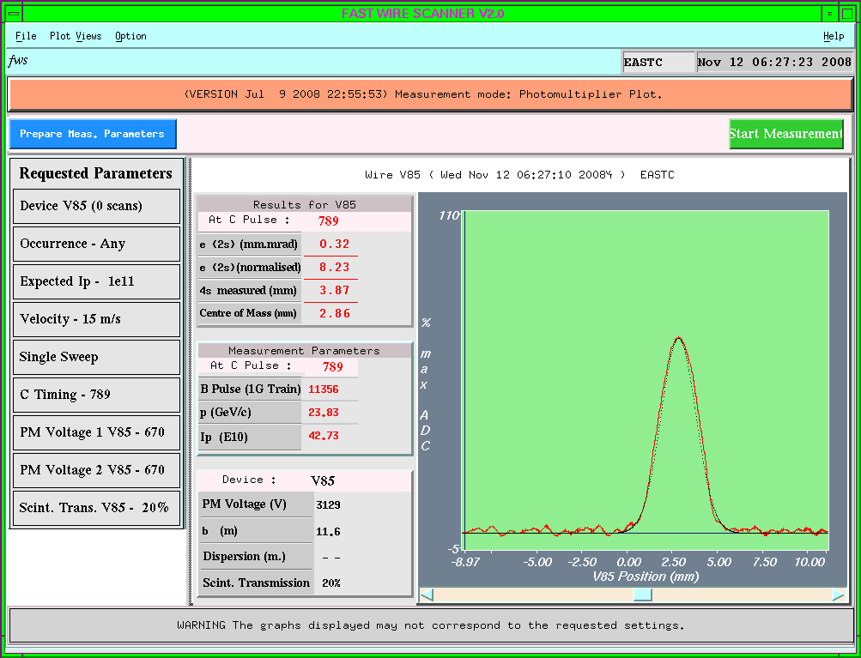
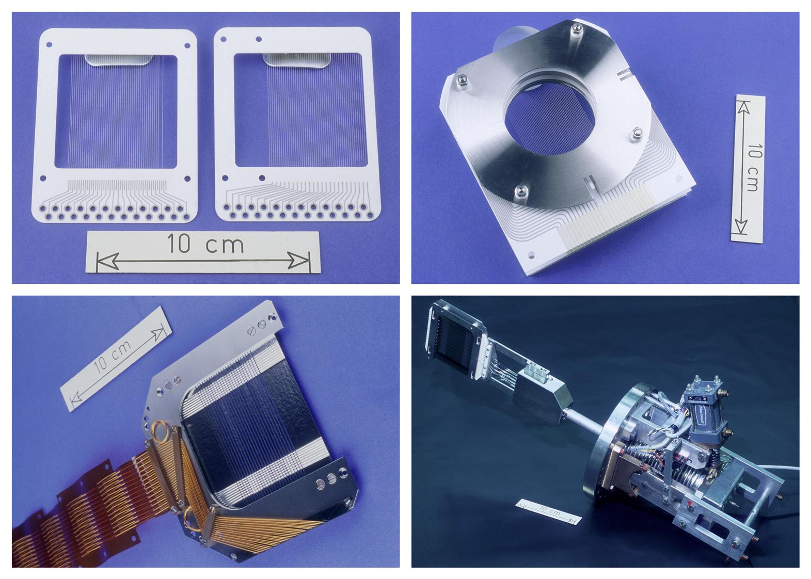
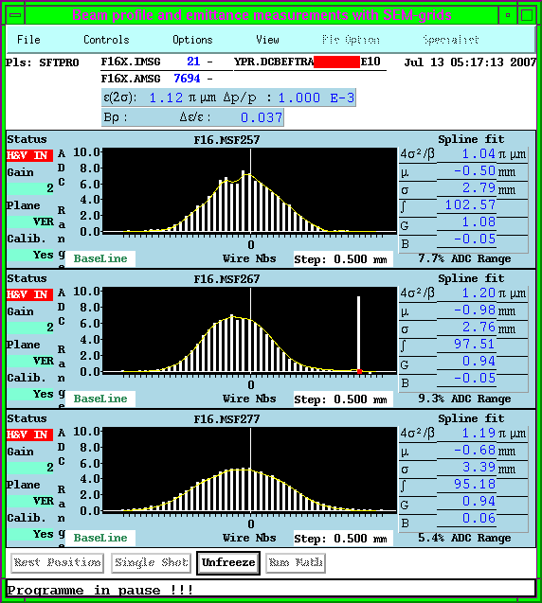
Emittance Measurement tools
are also empty straight sections in our accelerator.
Introduction & Transverse Motion

Slide 37
Matrix Formalism & Particle Motion
Lets represent the particles transverse position and angle by a column matrix.
As the particle moves around the machine the values for x and x’ will vary under influence of the dipoles, quadrupoles and drift spaces.
These modifications due to the different types of magnets can be expressed by a Transport Matrix M
If we know x₁ and x₁’ at some point s₁ then we can calculate its position and angle after the next magnet at position s₂ using:
Introduction & Transverse Motion

Slide 38
Matrices
If we want to know how a particle behaves in our machine, as it moves around, using the matrix formalism, we need to:
  Split our machine into separate elements as dipoles, focusing and defocusing quadrupoles, and drift spaces.
  Find the matrices for all of these components
  Multiply them all together
  Calculate what happens to an individual particle as it makes one or more turns around the machine
Introduction & Transverse Motion

Slide 39
The Drift Space Matrix
A drift space contains no magnetic field.
A drift space has length L.
x₂ = x₁ + L.x₁’
Introduction & Transverse Motion
x₁’
x₁
x₁’ small
L
}

Slide 40
The Quadrupole Matrix
deflection
A quadrupole of length L.
x₁
x₂
x₁’
Remember B_{y} ∝ x and the deflection due to the magnetic field is:
x₂’
Introduction & Transverse Motion
Provided L is small
}

Slide 41
What next
We can multiply the matrices of our drift spaces and quadrupoles together to form a transport matrix that describes a larger section of our accelerator or even a complete turn around the accelerator.
Introduction & Transverse Motion
The results of this matrix calculation should then be identical to the result obtain from Hill’s equation.
This together with other subjects we will look at this afternoon.

Slide 42
Questions ?
Introduction & Transverse Motion

