Slide 1
Effective SUSY and N_{PQ}MSSM
Jihn E. Kim
Seoul National University
Gwangju Institute of Science and Technology
PASCOS 2012 at Merida, Mexico, 4 June 12

Slide 2
What can be there beyond SM?
New CP? Axions? SUSY? String?
1. The effective SUSY
2. Strong CP and axions
3. New pseudoscalar boson at EW scale ?
J E Kim EffSUSY and N_{PQ}MSSM, PASCOS12, Merida, Mexico, 4 Jun. 2012
2/64

Slide 3
1. The effective
SUSY
J E Kim EffSUSY and N_{PQ}MSSM, PASCOS12, Merida, Mexico, 4 Jun. 2012
3/64

Slide 4
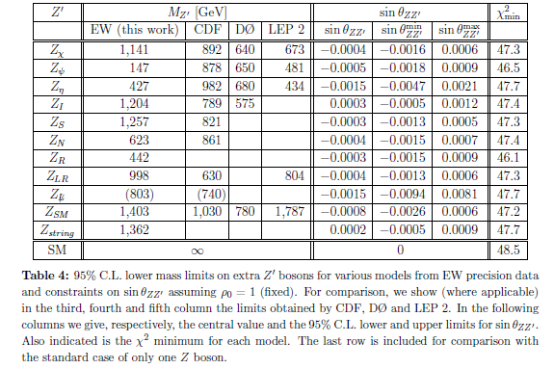
If there exists a new force around the electroweak scale, an extra Z’ is expected at the TeV scale. As done for the Z boson [Glashow, NPB 22, 579 (1961)], the indirect limits for the extra Z’ boson has been studied for a long time [Erler et al., 0906.2435[hep-ph]].
J E Kim EffSUSY and N_{PQ}MSSM, PASCOS12, Merida, Mexico, 4 Jun. 2012
4/64

Slide 5
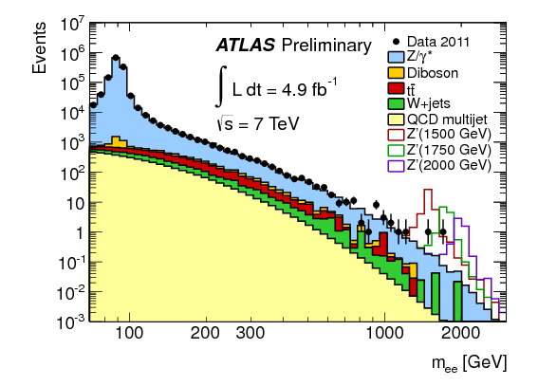
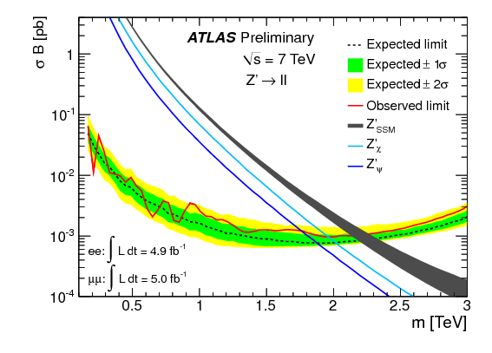
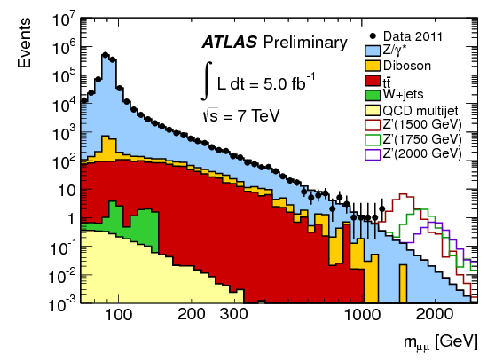
Search for Z’ boson in di-leptons (ee or 𝜇𝜇)
ATLAS-CONF-2012-007
CMS PAS EXO-11-019
simple/robust analysis : search a peak in a di-lepton invariant mass spectrum
e⁺e⁻ channel
model independent upper limits on 𝜎 x Br
as a function of the mass of the new vector boson
𝝈 x Br [pb]
𝜇⁺𝜇⁻ channel
m_{ee} [GeV]
model dependent lower limits on the Z’ mass:@95CL
ATLAS (ee: 4.9fb⁻¹ 𝜇⁺𝜇⁻ : 5.0fb⁻¹) CMS (1.1 fb⁻¹)
SSM: m(Z’) > 2.21 TeV, >1.94 TeV
RS graviton: m(G*) > 2.16 TeV, >1.98 TeV coupling k/M_{pl}=0.1
ATLAS-CONF-2012-007
m_{𝜇𝜇} [GeV]
J E Kim EffSUSY and N_{PQ}MSSM, PASCOS12, Merida, Mexico, 4 Jun. 2012
5/64
Notes:
This is a resonance search in the di-lepton invariant mass, here the lepton means either electron or muons
this is relatively simple and robust analysis, just looking for a peak in the mass distribution
Left top plot is the ee channel with full statistics from 2011, if you have signals
you would see narrow resonance in the high mass tail as you see in the figure
due to the good EM calorimeter resolution in high energy
Left bottom plot is the mumu channel where QCD background is highly suppressed
compared to ee channel.
Right plot is the model independent upper limit on cross section times branching ratio
as a function of the new vector boson mass which is expressed by red line as an observed limit
and the dashed line for expected limit.
Model dependent limits are also obtained as a Z’ mass for sequential standard model
and graviton mass for the randall sandrum model (NEED TO MENTION coupling?)

Slide 6
D. H. Kim (for CMS), talk presented at GIST mini-Workshop, 3 Dec. 2011
J E Kim EffSUSY and N_{PQ}MSSM, PASCOS12, Merida, Mexico, 4 Jun. 2012
6/64

Slide 7
The Z’ limit in SSM is 2.2 TeV from ATLAS. It is
for the extra Z’, the first guess is whether it can arise from a GUT or not.
Many interesting GUT groups are subgroups of E6:
SU(5), SO(10), SU(6), trinification SU(3)³
For the study of Z’ of the subgroup of E6, the study of diagonal generators of E6 is sufficient, because any Cartan subalgebra generator can be expressed as a linear combination of E6 diagonal generators.
J E Kim EffSUSY and N_{PQ}MSSM, PASCOS12, Merida, Mexico, 4 Jun. 2012
7/64

Slide 8
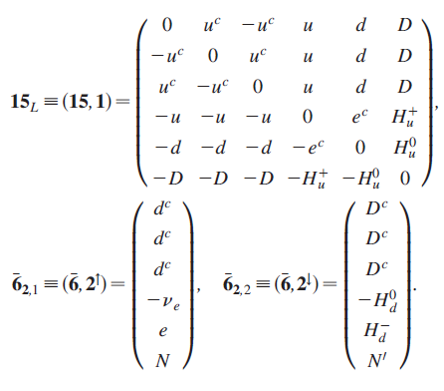
Now, the vertical and horizontal directions of the rep 15 and 6-bars introduce 6 diagonal generators of E6.
J E Kim EffSUSY and N_{PQ}MSSM, PASCOS12, Merida, Mexico, 4 Jun. 2012
8/64

Slide 9
Baryon number U(1)’_{B} cannot be from E6.
Leptophobic U(1)’
Even if it is not baryon number, this
U(1)’ is such that Z’ does not couple to
leptons. Higgs doublet H_{u} may be
nontrivial under this U(1)’. It is
leptophobic U(1)’. Considering Z’ from
E6 subgroups, the rho parameter
of LEP II does not allow the Z’ mass
below 10 TeV.
J E Kim EffSUSY and N_{PQ}MSSM, PASCOS12, Merida, Mexico, 4 Jun. 2012
9/64

Slide 10
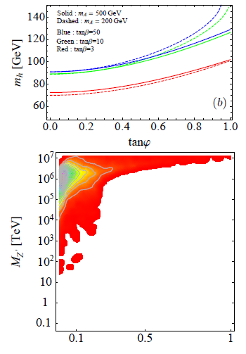
The Z’ mass and the CP even Higgs mass are studied in the SSM.
If Z’ descends down from E6,
It is not likely that it is near
TeV.
J E Kim EffSUSY and N_{PQ}MSSM, PASCOS12, Merida, Mexico, 4 Jun. 2012
10/64

Slide 11
But if we do not restrict to a subgroup of E6, a TeV scale Z’ is perfectly allowed.
The SSM from string: basically from E8, but not from E6.
J E Kim EffSUSY and N_{PQ}MSSM, PASCOS12, Merida, Mexico, 4 Jun. 2012
11/64

Slide 12
Still the extra Z’ with a large Z’ mass from E6 CAN contribute to low energy physics. In SUSY models, they can work as the messengers of SUSY breaking sector to the SSM physics.
And also, they contribute to the quartic couplings of scalar fields, by fine-tuning.
J E Kim EffSUSY and N_{PQ}MSSM, PASCOS12, Merida, Mexico, 4 Jun. 2012
12/64

Slide 13
Effective SUSY
Has been proposed in the middle of 90s. The third generation and Higgs doublets are the necessary ingredient of the gauge hierarchy solution through SUSY.
Dimopoulos-Giudice, PLB357, 573 [hep-ph/9507282];
Pomarol-Tommasini, NPB466, 3 [hep-ph/9507462];
Cohen-Kaplan-Nelson, PLB388, 588 [hep-ph/9607394]; recently
Giudice-Nardecchia-Romanino, NPB813, 156 [0812.3610 [hep-ph] ]
J E Kim EffSUSY and N_{PQ}MSSM, PASCOS12, Merida, Mexico, 4 Jun. 2012
13/64

Slide 14
To raise the 1st and 2nd family squark masses a little bit, from FCNC effects one needs a symmetry of the first two family squarks. Probably U(2).
But, if the 1st and 2nd family squark masses are raised above 10⁵ – 10⁶ GeV, one does not need such a light family symmetry.
Maybe a tachionic problem at two loop
[N. Arkani-Hamed and H. Murayama, PRD56, 6733
(1997) [ hep-ph/9703259]; C. Tamarit, 1204.2645
[hep-ph].], but will neglect it here.
J E Kim EffSUSY and N_{PQ}MSSM, PASCOS12, Merida, Mexico, 4 Jun. 2012
14/64

Slide 15
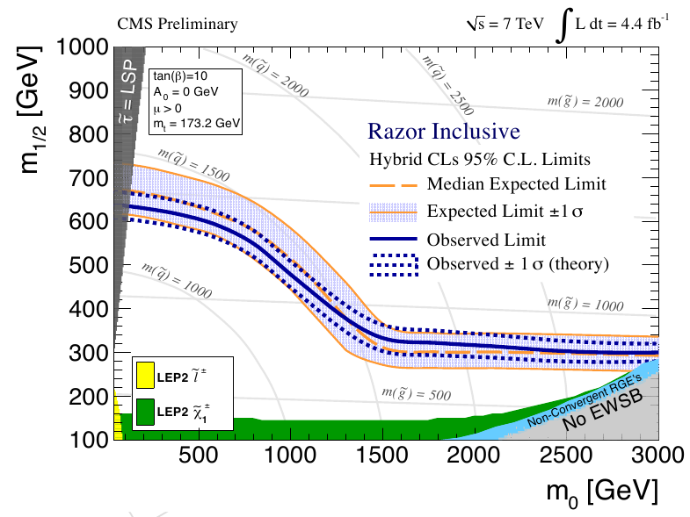
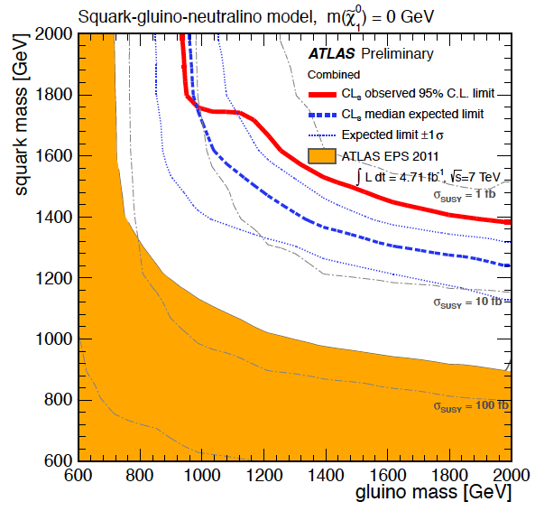
Interpretation in CMSSM & simplified model
CMS SUS-12-005
ATLAS-CONF-2012-033
ATLAS-CONF-2012-037
latest CMS results from Razor analysis (4.4 fb⁻¹) exclude squark
and gluino masses up to 1.35TeV (CMS SUS-12-005)
latest ATLAS results from m_{eff} on 0-lepton (4.7fb⁻¹) is mapped on simplified model
with the massless LSP assumption
m_{gl}<940GeV, m_{sq}<1380GeV are excluded (ATLAS-CONF-2012-033)
In 0-lepton + high multiplicity jets (≥6 to ≥9) m_{gl}<880GeV (ATLAS-CONF-2012-037)
Both experiments increased the exclusion reach since last summer
J E Kim EffSUSY and N_{PQ}MSSM, PASCOS12, Merida, Mexico, 4 Jun. 2012
15/64
Notes:
Here is a summary of the strong production SUSY search
Plot on the left is the latest CMS results from Razor analysis (from 4.4 fb⁻¹) shown earlier, which exclude squark
and gluino masses up to 1.35TeV
Plot on the right is the latest ATLAS results from m_{eff} on 0-lepton analysis (from 4.7fb⁻¹) which is mapped on simplified model interpretation
with the massless LSP assumption
m_{gl}<940GeV, m_{sq}<1380GeV are excluded
Both experiments increased the exclusion reach since last summer which can be confirmed on the right ATLAS plot
where orange area is the one from EPS in 2011 and current limit is the red line
[JUST for RECORD]
Simplifying assumptions to map limits onto 2-dim space
only gulino & 1st gen. squarks production
other sparticles mass = 5TeV, m (LSP)=0
allow only one step decay

Slide 16
Z’ mediation:
SUSY breaking at the hidden sector is manifested in the visible sector (SM) by the Z’ charged sector.
It is not just saying effSUSY, but
realizing such a model explicitly.
J E Kim EffSUSY and N_{PQ}MSSM, PASCOS12, Merida, Mexico, 4 Jun. 2012
16/64

Slide 17
● Gravity mediation:
Needs a SUGRA model distinguishing families.
At present, there has not appeared a serious model.
● GMSB
If the SSM is obtained from string, the group nature is well worked
out from E8xE8 heterotic string.
Suppose that the hidden sector is SU(4)’ or SU(5)’. Then, we need
SU(5)’ representations for SUSY breaking, for example one
10’+5’-bar’or six pairs of 5’ and 5’-bar. These count 45 visible
sector fermions and (15 or 60 hidden sector fermions). These need
at least 60 or 105 chiral fermions. In addition, we need the
messenger sector fermions(GM) also. The messen. sector must carry
color, etc, and hidden sector gauge charges. These add much more
chiral fermions. In the string compactification, roughly 150 fermions
appear. There seems to be some conflict, but not definitive.
● Z’ mediation
J E Kim EffSUSY and N_{PQ}MSSM, PASCOS12, Merida, Mexico, 4 Jun. 2012
17/64

Slide 18
● Z’ mediation
The Z’ mediation has been studied relatively recently.
P. Langacker, G. Paz, L.-T. Wang, and I. Yavin, PRL100, 041802 (2008);
R. N. Mohapatra and S. Nandi, PRL 79, 181 (1997);
T. Kikuchi and T. Kubo, PLB 666, 262 (2008).
Langacker et al discusses one Z’ and MN discusses Z’ and Z. In the latter case, it is proper for it to be called the mixed mediation (MM).
The MM needs a fine-tuning of parameters. So, we discuss the Z’ mediation only.
The U(1)’ charge is carried by the mediators, but
NOT by the 3rd family members and Higgs doublets.
At least, it is a CALCULABLE MODEL with only a SUSY gauge theory knowledge.
J E Kim EffSUSY and N_{PQ}MSSM, PASCOS12, Merida, Mexico, 4 Jun. 2012
18/64

Slide 19
For the SUSY hierarchy solution, we need a light Higgs.
The large top mass (or Yukawa couplings) at TeV scale
and also its superpartner mass needed at TeV scale
(for gauge hierarchy solution) and it supports
the SU(2) x U(1) breaking radiatively
[Ibanez-Ross, Inoue et al., Ellis et al.]
H_{u} and H_{d} light and the 3rd family members
light = effSUSY
J E Kim EffSUSY and N_{PQ}MSSM, PASCOS12, Merida, Mexico, 4 Jun. 2012
19/64

Slide 20
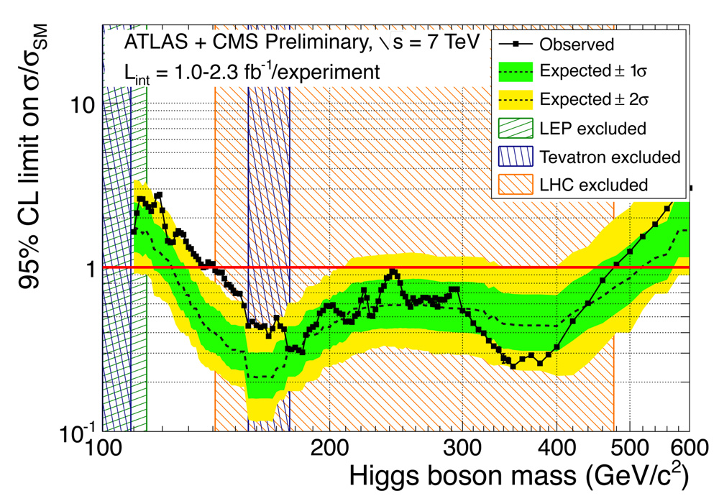
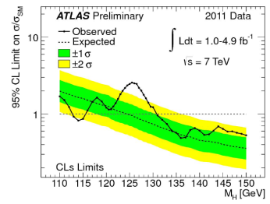
Experimental Higgs boson exclusion limits for combined ATLAS and CMS data.
J E Kim EffSUSY and N_{PQ}MSSM, PASCOS12, Merida, Mexico, 4 Jun. 2012
20/64

Slide 21
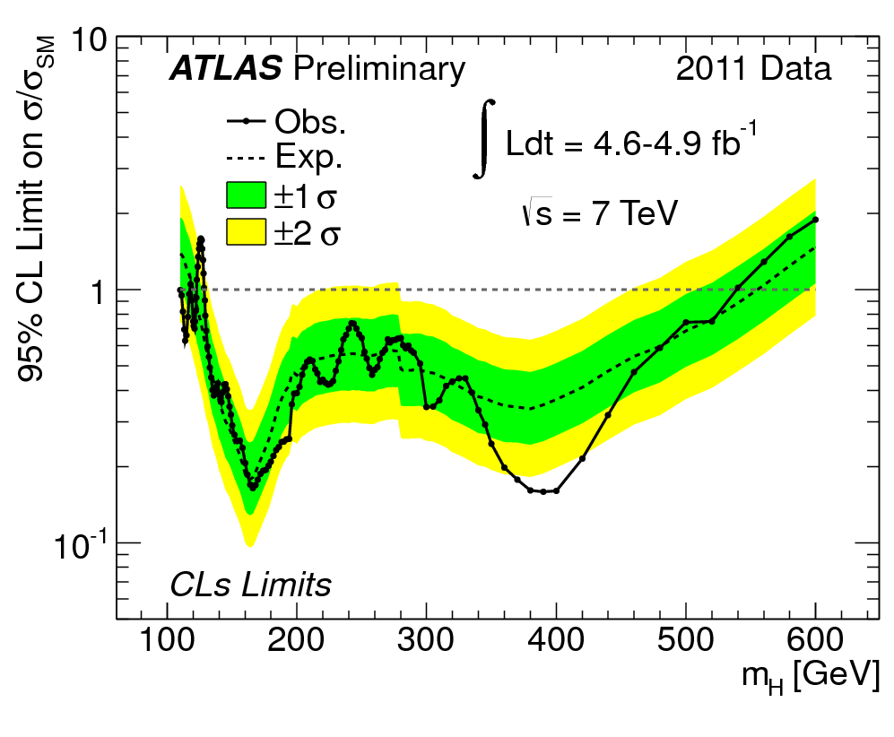
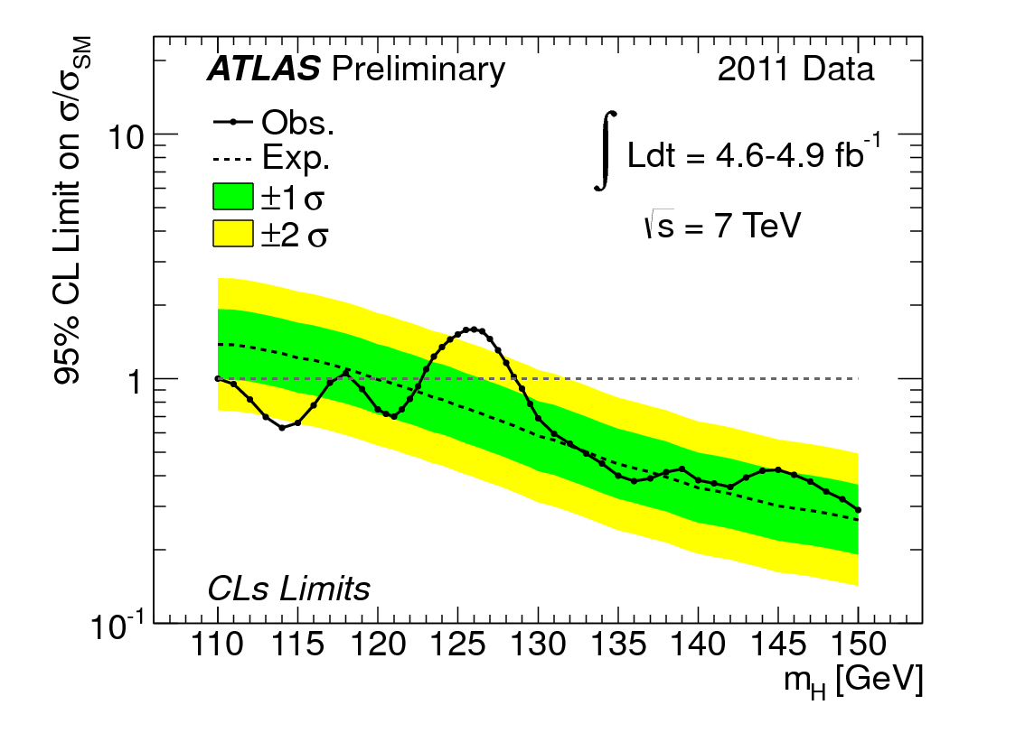
Channel Combined Constraints (ATLAS) by JINNOUCHI 16.03.2012 Kyoto
ATLAS: CONF-2012-019
95% C.L. limit on 𝜇 for all channels (including channels not shown)
low mass
zoom in
LEP limit
m_{H} [GeV]
m_{H} [GeV]
expected sensitivity : m_{H} = 120 – 555 GeV
excluded at 95% CL: 110.0 < m_{H} < 117.5 GeV (extended LEP limit)
118.5 < m_{H} < 122.5 GeV 129 < m_{H} < 539 GeV
J E Kim EffSUSY and N_{PQ}MSSM, PASCOS12, Merida, Mexico, 4 Jun. 2012
2/164
Notes:
Plot on the left is the ATLAS combined exclusion plot for wide higgs mass range
and now we have sensitivity from 120 to 555 GeV.
on the right is the zoom in of the same plot
two very narrow regions are left un-excluded, namely
117.5 to 118.5 GeV and 122.5 to 129GeV
lower limit actually extended the LEP limit of 114.4 GeV

Slide 22
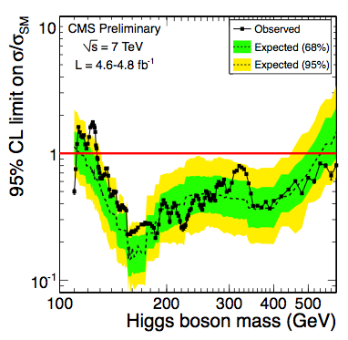
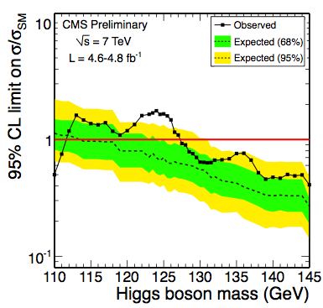
Channel Combined Constraints (CMS) ) by JINNOUCHI 16.03.2012 Kyoto
CMS: HIG-12-008
full mass range
low mass range
low mass zoom in
LEP limit
expected sensitivity : m_{H} = 114.5 – 543 GeV
excluded at 95% CL: 127.5 < m_{H} < 600 GeV
J E Kim EffSUSY and N_{PQ}MSSM, PASCOS12, Merida, Mexico, 4 Jun. 2012
22/64
Notes:
Now let’s see what CMS reports
plot on the left is the 95% confidence level in full mass range and on the right is its zoom in
CMS has the sensitivity from 114.5 to 543 GeV
and now excluded the region 127.5 to 600GeV

Slide 23
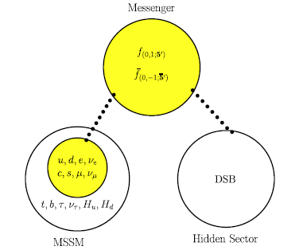
Superpartner
Zprimino is effec.
in the mediation.
(2) The SUSY
breaking source
DSB does not
carry the weak
hypercharge Y.
The messenger
sector carries the
Z’ charge but no
weak hypercharge Y.
(3) The third family
does not carry
the Z’ charge.
(4) The Higgs do not
carry the Z’ charge.
This scenario can be generic, compared to the family universal Z’ charge.
J E Kim EffSUSY and N_{PQ}MSSM, PASCOS12, Merida, Mexico, 4 Jun. 2012
23/64

Slide 24
To obtain this kind, we assign different quantum
numbers to the third family members. The mediation
mechanism is Z’ meditation.
It is different from the
E6 GUT.
Jeong+JEK+Seo,
PRD 84, 075008
1107.5613
J E Kim EffSUSY and N_{PQ}MSSM, PASCOS12, Merida, Mexico, 4 Jun. 2012
24/64

Slide 25
The largest SUSY partner mass is added to SUSY mass as
This is the largest SUSY splitting.
J E Kim EffSUSY and N_{PQ}MSSM, PASCOS12, Merida, Mexico, 4 Jun. 2012
25/64

Slide 26
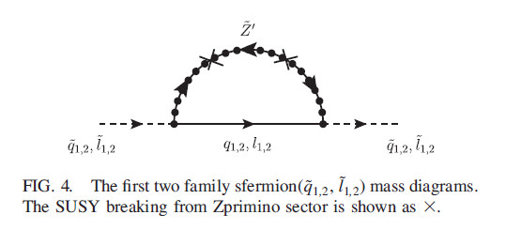
On the other hand, the first two family sfermions are heavy appearing at one-loop with ΔZ’~
J E Kim EffSUSY and N_{PQ}MSSM, PASCOS12, Merida, Mexico, 4 Jun. 2012
26/64

Slide 27
Since the messengers are not charged under the SM gauge group, the MSSM gaugino masses are induced only through RG running from the loops shown here (two-loop):
J E Kim EffSUSY and N_{PQ}MSSM, PASCOS12, Merida, Mexico, 4 Jun. 2012
27/64

Slide 28
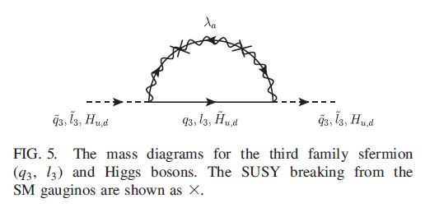
The smallest is the third family members and the Higgs doublet pair. They are one more loop beyond the gaugino masses (three loop). This is the effective SUSY scenario, through Z’ mediation.
Langacker et al. Z’ mediation, PRL100, 041802 (2008) family universal Z’ med
Jeong+JEK+Seo, PRD 84, 075008 (2011) family dependent Z’ med→ effSUSY
J E Kim EffSUSY and N_{PQ}MSSM, PASCOS12, Merida, Mexico, 4 Jun. 2012
28/64

Slide 29
Jeong+JEK+Seo, PRD 84, 075008 (2011)
Realistic string models may give a bit different spectra.
J E Kim EffSUSY and N_{PQ}MSSM, PASCOS12, Merida, Mexico, 4 Jun. 2012
29/64

Slide 30
In this Z’ mediation, the LSP is most
probably the gravitino.
So, CDM may be cold axions and/or axinos.
Axion seems needed also for a solution of
the strong CP problem.
J E Kim EffSUSY and N_{PQ}MSSM, PASCOS12, Merida, Mexico, 4 Jun. 2012
30/64

Slide 31
2. Axions and
dark matter
J E Kim EffSUSY and N_{PQ}MSSM, PASCOS12, Merida, Mexico, 4 Jun. 2012
31/64

Slide 32
A brief history of
QCD
J E Kim EffSUSY and N_{PQ}MSSM, PASCOS12, Merida, Mexico, 4 Jun. 2012
32/64

Slide 33
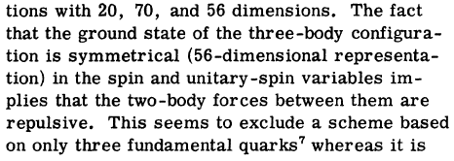
Ω⁻
Ω⁻
= spin 3/2 predicted from SU(3)
belong to 56 of SU(6)
u, d, s
(↑,↓)
S. Okubo, Prog. Theor. Phys. 27 (1962) 949 [Rec. 06.12.61]
s↑
s↑
s↑
Completely symmetric under
exchange of s↑
Guersey+ Radicati, Phys. Rev. Lett. 13 (1964) 173 [Rec. 15.07.64]
M. Gell-Mann’s SU(3), Phys. Rev. 125 (1962) 1067 [Rec. 27.03.61]
M. Gell-Mann’s quark, Phys. Lett. 8 (1964) 214 [Rec. 04.01.64]
G. Zweig, unpublished CERN preprint [CERN TH-401, 412 (1964)]
J E Kim EffSUSY and N_{PQ}MSSM, PASCOS12, Merida, Mexico, 4 Jun. 2012
33/64

Slide 34
Shoichi Hori, Prog. Theor. Phys. 36, 131 (1966) [Rec. 10.02.66]
W. A. Bardeen, H. Fritszch, M. Gell-Mann, 1972, in Scale
and Conformal Symmetry in Hadron Physics, edited by R. Gatto
(Wiley-Interscience, New York, 1973), p. 139. π⁰→2γ
SU(3)-color degree introduced:
M .-Y. Han and Y. Nambu, PR 139 (1965)B1006 [Rec. 12.04.65]
O. W. Greenberg, PRL 13 (1964) 598 [Rec 27.10.64]
M .-Y. Han and Y. Nambu, PR 139 (1965)B1006 [Rec. 12.04.65]
D. Gross, F. Wilczek, PRL30 (1973) 1343 [Rec. 27.04.73]
H. D. Politzer, PRL30 (1973) 1346 [Rec. 03.05.73]
S. Weinberg, PRL31 (1973) 494 [Rec. 30.05.73]
H. Fritzsh, M. Gell-Mann, H. Lewtwyler, PLB47 (1973) 365
[Rec. 01.10.73]
H. Fritzsch, Gell-Mann, in Proc. XVI Intern. Conf. on High energy
physics, Chicago, Vol. 2 (1972), p. 135
M.-Y. Han and Y. Nambu, PRD 10 (1974) 674 [Rec. 24.10.73]
J E Kim EffSUSY and N_{PQ}MSSM, PASCOS12, Merida, Mexico, 4 Jun. 2012
34/64

Slide 35
This has led to the consideration of 8 gluons interacting
strongly with color triplet quarks. The mass of quarks were
first estimated by, the current quark masses,
M. Gell-Mann, Oakes, Renner PR175 (1968) 2195 [Rec. 22.07.68]
After, QCD has been known for strong interaction theory,
P. Langacker, H. Pagels, 1973, Phys. Rev. D8 (1973) 4595 [Rec. 11.06.73]
But, QCD with MeV order quark masses gives a light η’,
Weinberg’s U(1) problem:
S. Weinberg, Phys. Rev. D11 (1976) 3583 [Rec. 08.09.75]
J E Kim EffSUSY and N_{PQ}MSSM, PASCOS12, Merida, Mexico, 4 Jun. 2012
35/64

Slide 36
And, gluons give an effective interaction,
Even though this is a total derivative, it cannot be
neglected due to contributions at infinity surface (due
to instanton solutions). For QED, it does not apply.
If it is present, the U(1) problem is solved since this term
is flavor diagonal.
G. ‘t Hooft, Phys. Rep. 142 (1986) 357 [Rec. 18.04.86]
J E Kim EffSUSY and N_{PQ}MSSM, PASCOS12, Merida, Mexico, 4 Jun. 2012
36/64

Slide 37
This suggest the vacuum angle term is
working. Otherwise, the U(1) problem
is not solved.
This is the QCD history, with good understanding
of hadron spectrum and high energy collision rates.
J E Kim EffSUSY and N_{PQ}MSSM, PASCOS12, Merida, Mexico, 4 Jun. 2012
37/64

Slide 38
For QED, we need not consider it:
The surface term at
infinity is neglected.
J E Kim EffSUSY and N_{PQ}MSSM, PASCOS12, Merida, Mexico, 4 Jun. 2012
38/64

Slide 39
For QCD, we consider :
E_{a}²-B_{a}² E_{a}·B_{a}
The surface term violates CP symmetry
J E Kim EffSUSY and N_{PQ}MSSM, PASCOS12, Merida, Mexico, 4 Jun. 2012
39/64

Slide 40
QCD break CP. If so,
It can be looked in static properties of hadrons. NEDM is the best place, and we limit the vacuum angle to
Semertzidis will
look for p EDM
Strong CP problem
J E Kim EffSUSY and N_{PQ}MSSM, PASCOS12, Merida, Mexico, 4 Jun. 2012
40/64

Slide 41
Strong CP problem solved:
1. Massless up quark (1975)
2. Peccei-Quinn symmetry (1977)
3. Calculable models (1978)
4. Invisible axion (1979)
5. Cosmological axion (1983)
6. Invisible axion detection (1988)
J E Kim EffSUSY and N_{PQ}MSSM, PASCOS12, Merida, Mexico, 4 Jun. 2012
41/64

Slide 42
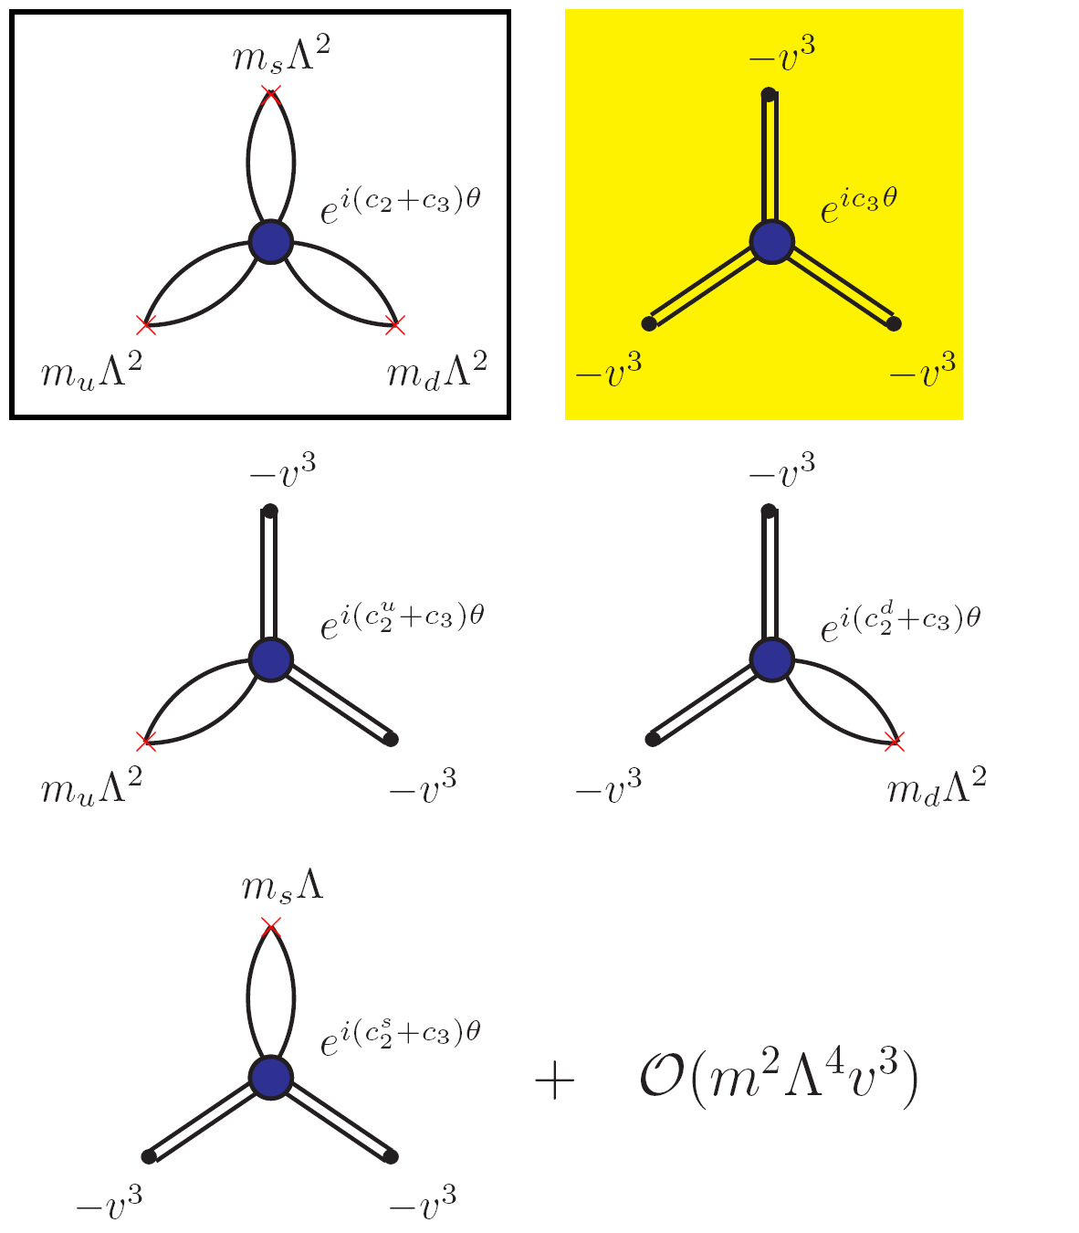
J E Kim EffSUSY and N_{PQ}MSSM, PASCOS12, Merida, Mexico, 4 Jun. 2012
42/64

Slide 43
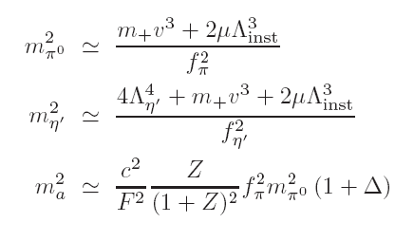
J E Kim EffSUSY and N_{PQ}MSSM, PASCOS12, Merida, Mexico, 4 Jun. 2012
43/64

Slide 44
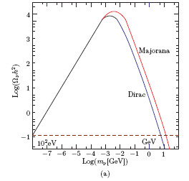
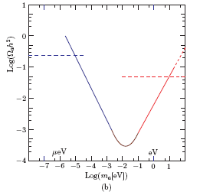
Dark matter in the universe is the most looked-for particle(s)
in cosmology and at LHC, and also at low temperature labs.
The 100 GeV scale DM and the10-1000 micro eV axion are
the most promising candidates.
Neutrinos Light bosons
J E Kim EffSUSY and N_{PQ}MSSM, PASCOS12, Merida, Mexico, 4 Jun. 2012
44/64

Slide 45
It is very flat if the axion decay constant is large,
CP conserving point
In the evolving universe, at some temperature, say T₁, a
starts to roll down to end at the CP conserving point
sufficiently closely. This analysis constrains the axion decay
constant (upper bound) and the initial VEV of a at T₁.
J E Kim EffSUSY and N_{PQ}MSSM, PASCOS12, Merida, Mexico, 4 Jun. 2012
45/64

Slide 46
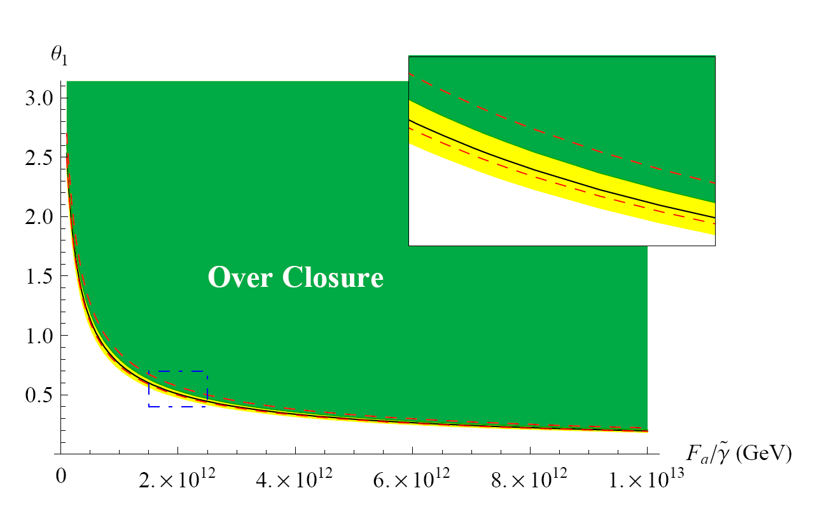
Bae-Huh-Kim, JCAP0809, 005
m_{q}
Λ_{QCD}
J E Kim EffSUSY and N_{PQ}MSSM, PASCOS12, Merida, Mexico, 4 Jun. 2012
46/64

Slide 47
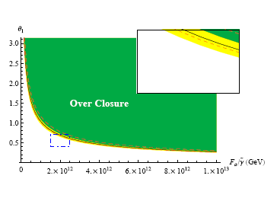
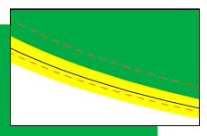
If we do not take into account the overshoot factor
and the anharmonic correction,
Inclusion of these
showed the region,
prev. figure
J E Kim EffSUSY and N_{PQ}MSSM, PASCOS12, Merida, Mexico, 4 Jun. 2012
47/64

Slide 48
The relevant axion interactions are presnt,
The Primakoff term is always present, but the electron term
is present only when the Higgs coupling to leptons carry the
PQ charge.
In a full theory, one must look into all the PQ charges of
fermions.
J E Kim EffSUSY and N_{PQ}MSSM, PASCOS12, Merida, Mexico, 4 Jun. 2012
48/64

Slide 49
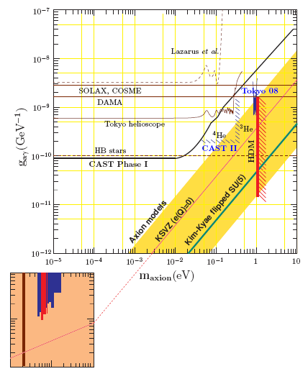
It depends on models.
There are not many calculations in string models.
J E Kim EffSUSY and N_{PQ}MSSM, PASCOS12, Merida, Mexico, 4 Jun. 2012
49/64

Slide 50
White dwarf bound
(1st hint at the center of the axion window)
J E Kim EffSUSY and N_{PQ}MSSM, PASCOS12, Merida, Mexico, 4 Jun. 2012
50/64

Slide 51
By discovering the axion, QCD is completed satisfactorily.
If the axion is ruled out at the window,
Either, its mass is too small to be detected, or the small-θ problem remains as a fine-tuning.
J E Kim EffSUSY and N_{PQ}MSSM, PASCOS12, Merida, Mexico, 4 Jun. 2012
51/64

Slide 52
3. Higgs boson
at 125 GeV ?
J E Kim EffSUSY and N_{PQ}MSSM, PASCOS12, Merida, Mexico, 4 Jun. 2012
52/64

Slide 53
It seems that there is something new particle is present around 125 GeV.
Most probably, it looks like a Higgs boson.
The SM Higgs boson or the lightest or the next lightest scalar Higgs boson, or something else?
It has to be determined. In SUSY models,
a singlet X is introduced.
J E Kim EffSUSY and N_{PQ}MSSM, PASCOS12, Merida, Mexico, 4 Jun. 2012
53/64

Slide 54
We point out that a pseudoscalar boson with a singlet X is of general phenomenon. The pseudoscalar possibility of the 125 GeV two photon mode is discussed.
In addition, the strong CP problem must be solved. The MSSM cannot do it because μH_{u}H_{d} breaks the PQ symmetry.
Strong CP solution in NMSSM pseudoscalar at EW
JEK+Nilles+Seo, arXiv:1201.6547.
J E Kim EffSUSY and N_{PQ}MSSM, PASCOS12, Merida, Mexico, 4 Jun. 2012
54/64

Slide 55
We introduce the PQ symmetry, with the invisible
(very light) axion idea.
Suvives down to the EW scale
J E Kim EffSUSY and N_{PQ}MSSM, PASCOS12, Merida, Mexico, 4 Jun. 2012
55/64

Slide 56
Neglecting the second term(the 2nd term is in
consideration, but the conclusion not much
different), we introduce an extra U(1)’, surviving
to multi TeV scale.
So, we treat λ as a parameter to see how the
spectrum goes.
V contains λ(ϕ*ϕ)² .
J E Kim EffSUSY and N_{PQ}MSSM, PASCOS12, Merida, Mexico, 4 Jun. 2012
56/64

Slide 57
This is a typical example, leading to the EW scale
singlet, starting with the PQ symmetry. After the PQ
symmetry is broken at the intermediate scale of
10¹⁰ – 10¹² GeV, there exist the invisible axion.
At the electroweak scale, the mu term is generated, and
also the H_{u}H_{d} renormalizable term. So we treat mu as
a parameter at the electroweak scale. The important thing
is that X_{ew} survives down to the TeV scale.
J E Kim EffSUSY and N_{PQ}MSSM, PASCOS12, Merida, Mexico, 4 Jun. 2012
57/64

Slide 58
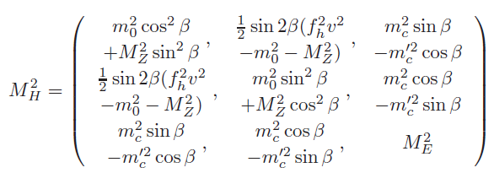
With a singlet X, the scalars take the following mass matrix.
With the off-diagonal term, the lightest Higgs boson mass
can be raised:
Without the off-diagonal term, the maximum value of the
lightest scalar mass is smaller than that of the MSSM
limit M_{Z} (Weinberg’s limit). M. Drees, IJMP A4, 3635 (1989)
J E Kim EffSUSY and N_{PQ}MSSM, PASCOS12, Merida, Mexico, 4 Jun. 2012
58/64

Slide 59
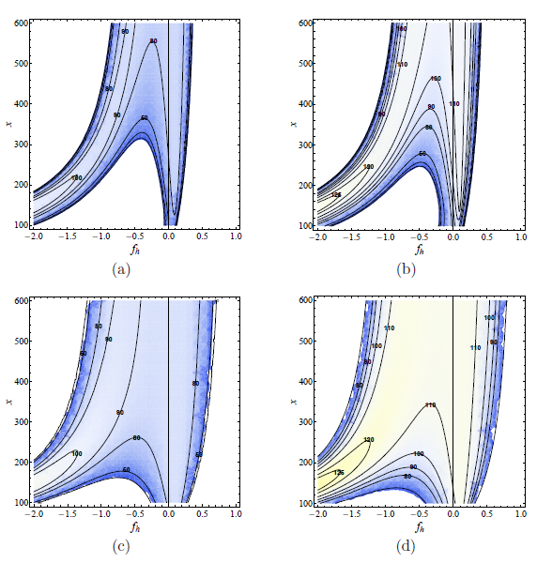
With the off-diagonal term, the lightest Higgs boson mass
can be raised:
J E Kim EffSUSY and N_{PQ}MSSM, PASCOS12, Merida, Mexico, 4 Jun. 2012
59/64

Slide 60
Now, the EW scale Lagrangian has an additional
symmetry,
Treat perturbatively
Suvives down to the EW scale
Treating mu’s as a perturbation, there exists a symmetry
J E Kim EffSUSY and N_{PQ}MSSM, PASCOS12, Merida, Mexico, 4 Jun. 2012
60/64

Slide 61
The chargino (more generally the Higgsino pair) has the anomaly current ,
KNS symmetry from the PQ symmetry: An EW
scale light pseudoscalar
J E Kim EffSUSY and N_{PQ}MSSM, PASCOS12, Merida, Mexico, 4 Jun. 2012
61/64

Slide 62
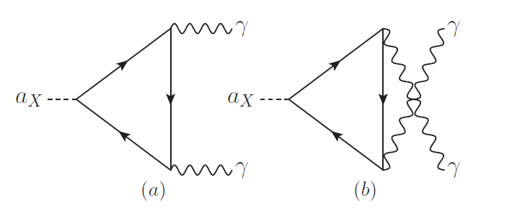
The weak gauge boson fusion gives a correct order of the two photon mode.
Still solves the strong CP problem by the invisible axion discussed earlier.
J E Kim EffSUSY and N_{PQ}MSSM, PASCOS12, Merida, Mexico, 4 Jun. 2012
62/64

Slide 63
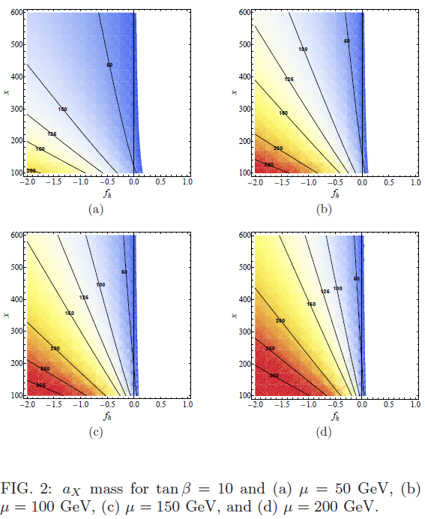
J E Kim EffSUSY and N_{PQ}MSSM, PASCOS12, Merida, Mexico, 4 Jun. 2012
63/64

Slide 64
Conclusion
1. A brief history of QCD.
2. Strong CP solution completes its theoretical ends.
3. Invisible axion, working for DM and can be detected.
4. Some comments on the LHC physics, and set the axion to the recent LHC finding.
5. A new approximate anomalous symmetry at the EW scale: Higgsino symmetry
An EW scale light pseudoscalar for LHC,
not necessarily for 125 GeV. Watch this!!!
J E Kim EffSUSY and N_{PQ}MSSM, PASCOS12, Merida, Mexico, 4 Jun. 2012
64/64

Slide 65
More on Weak CP
with the CKM matrix
J E Kim EffSUSY and N_{PQ}MSSM, PASCOS12, Merida, Mexico, 4 Jun. 2012
a/64

Slide 66
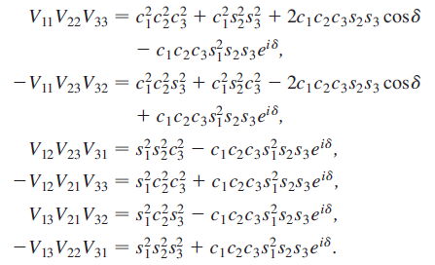
Flavor physics
on maximal CP
JEK-Seo, PRD84, 037303 (2011) [arXiv:1105.3304[hep-ph]]
J E Kim EffSUSY and N_{PQ}MSSM, PASCOS12, Merida, Mexico, 4 Jun. 2012
b/64

Slide 67
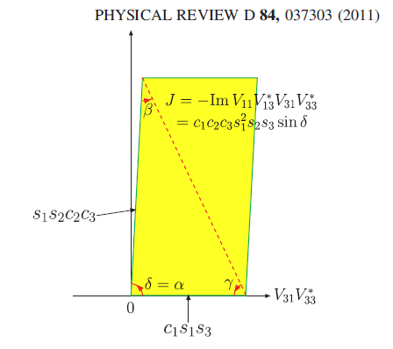
Jarlskog
determinant
Maximal CP
violation
J E Kim EffSUSY and N_{PQ}MSSM, PASCOS12, Merida, Mexico, 4 Jun. 2012
c/64

Slide 68
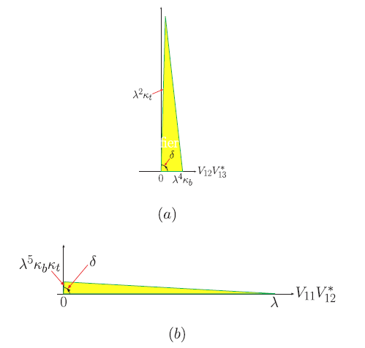
Jarlskog
Determinant
Area the same
Maximal CP
violation
J E Kim EffSUSY and N_{PQ}MSSM, PASCOS12, Merida, Mexico, 4 Jun. 2012
d/64

Slide 69
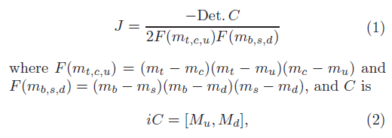
JEK+Seo proved it recently. J det consists of two lelements
of V and two elements of V*. But det consists of three
elements of V. It is not obvious at the outset.
The Jarlskog det is
J= V₁₁ V₃₃ V*₁₃ V*₃₁
J E Kim EffSUSY and N_{PQ}MSSM, PASCOS12, Merida, Mexico, 4 Jun. 2012
e/64

Slide 70
The determinant is real. If it is not real, we can change
the quark phases to make it real. This process changes
the coefficint of the gluon anomaly term, i.e. the θ term.
So, it is reasonable to work in this basis.
Multiplying V*₁₃ V*₂₂ V*₃₁, we have
J E Kim EffSUSY and N_{PQ}MSSM, PASCOS12, Merida, Mexico, 4 Jun. 2012
f/64

Slide 71
In the same way, the 4th term can be written with two terms
And one of them combine with the 3rd term to make
(1- |V*₁₁ |²) V₁₂ V₂₃ V*₁₃ V*₂₂.
So we have
The Jarlskog det
J= V₁₁ V₃₃ V*₁₃ V*₃₁
ImV*₃₁V*₂₂V*₁₃ =
J E Kim EffSUSY and N_{PQ}MSSM, PASCOS12, Merida, Mexico, 4 Jun. 2012
g/64

Slide 72
So the essence of the weak CP violation can be
looked upon by scrutinizing the CKM matrix.
We can also say that the weak CP violation is
maximal. PDG gives
J E Kim EffSUSY and N_{PQ}MSSM, PASCOS12, Merida, Mexico, 4 Jun. 2012
h/64

Slide 73
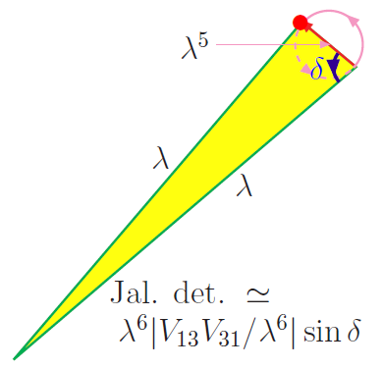
Since the area of the J det is the same, we look for
two long sides triangles. For example,
The area is maximum when δ=π/2. So, we observed the maximal CP violation.
The CP violation is modeled in
JEK, PLB704 (2011) 360 [1109.0995].
J E Kim EffSUSY and N_{PQ}MSSM, PASCOS12, Merida, Mexico, 4 Jun. 2012
i/64

Slide 74
The angular momentum of

