Slide 1
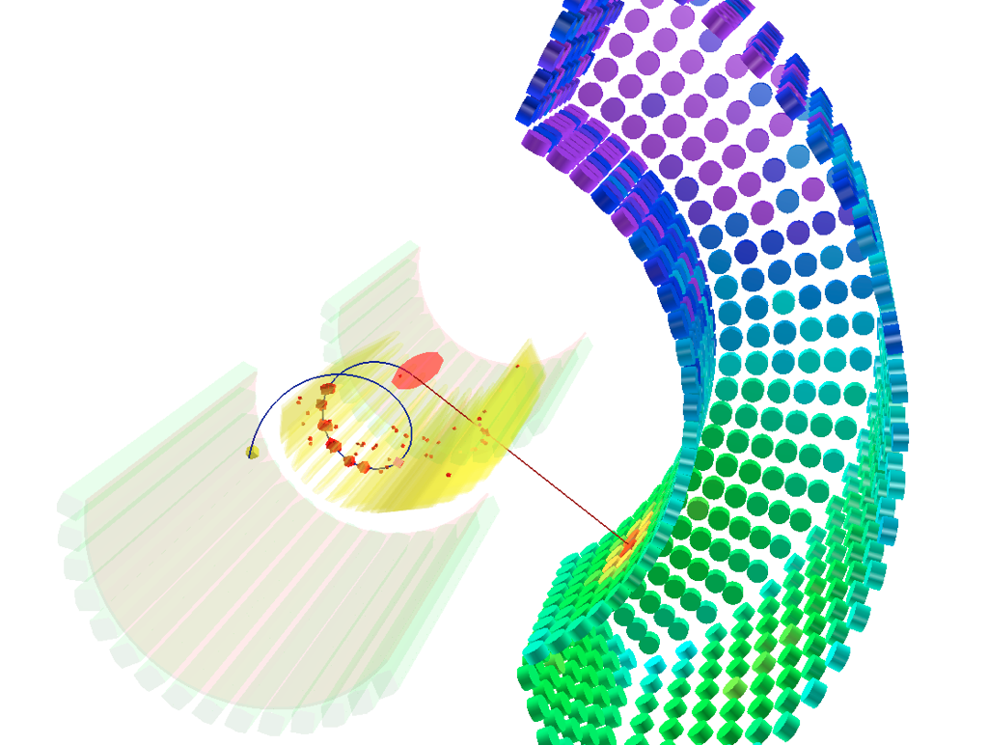


Search for lepton flavor violation: Latest results from the MEG experiment
Gordon Lim

Slide 2
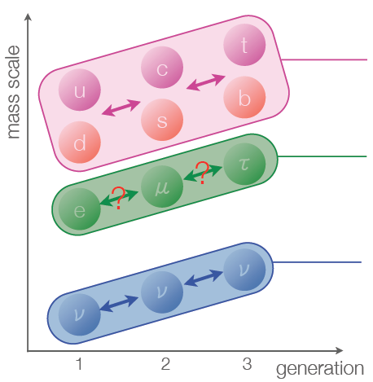
Flavor violation
Motivation Experiment Performance Results Conclusions
Quarks
  Quark mixing observed by various accelerator experiments
  Standard Model: CKM mixing matrix
Neutrinos
  Neutrino oscillations observed by various neutrino experiments
  Standard Model: PMNS mixing matrix
Charged lepton flavor violation
  Not observed
?

Slide 3
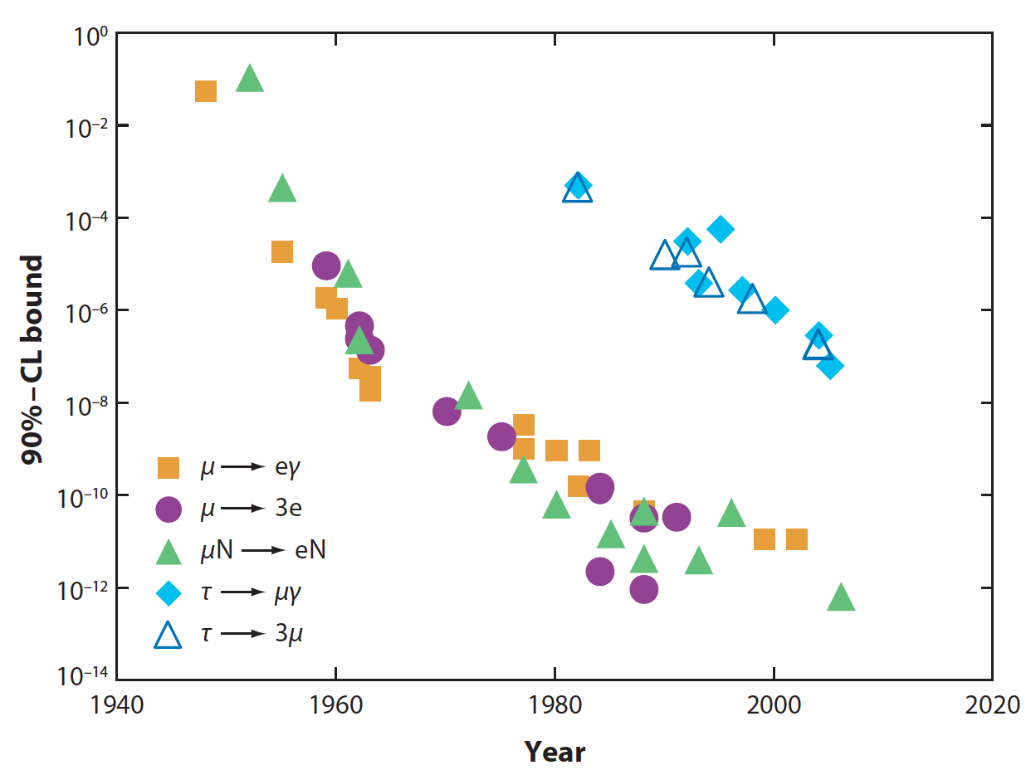
Search for charged lepton flavor violation
Motivation Experiment Performance Results Conclusions
Historical overview of selected charged lepton flavor violation searches:
Marciano, Mori & Roney,
Annu. Rev. Nucl. Part. Sci. 2008 58:315–41
B-factories (Babar, Belle)
MEGA @ LAMPF
SINDRUM I & II @ PSI
Processes involving muons are best constrained: Muons are copiously produced at high-intensity proton accelerators and have precisely measurable final states

Slide 4

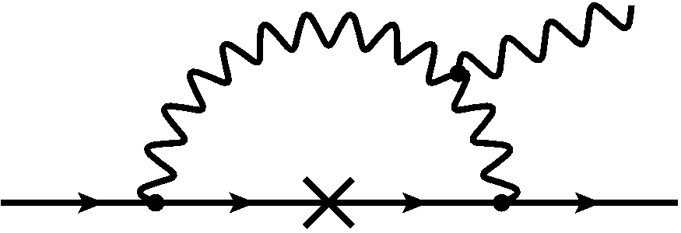
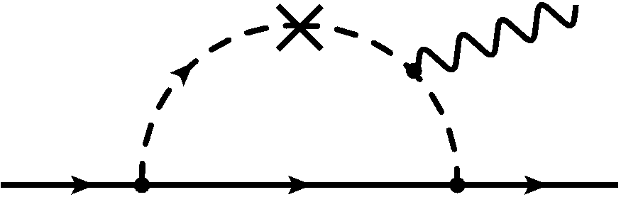




Motivation Experiment Performance Results Conclusions
Standard Model:
Beyond the Standard Model,
e.g. SUSY-GUT scenarios:
impossible to detect
very small but not impossible
Observation of is clear sign of new physics!

Slide 5
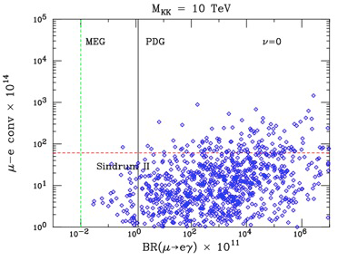
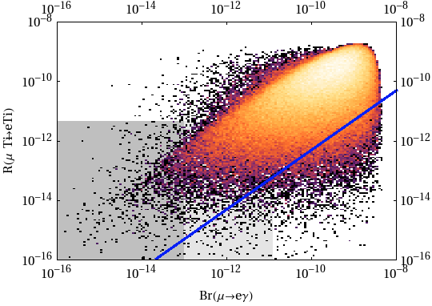




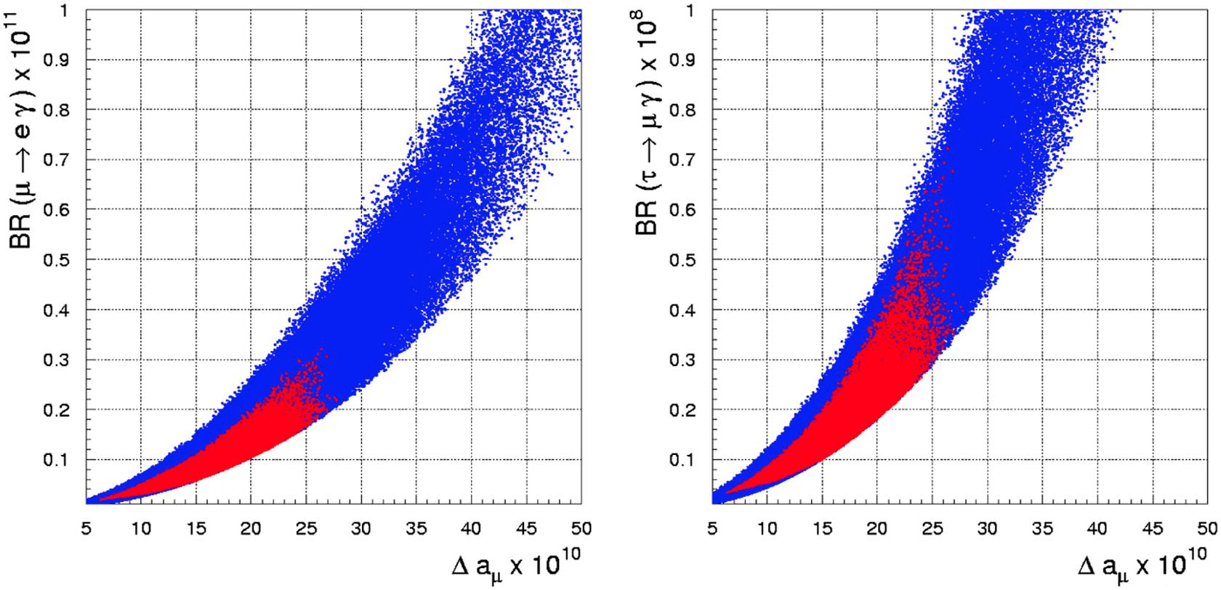
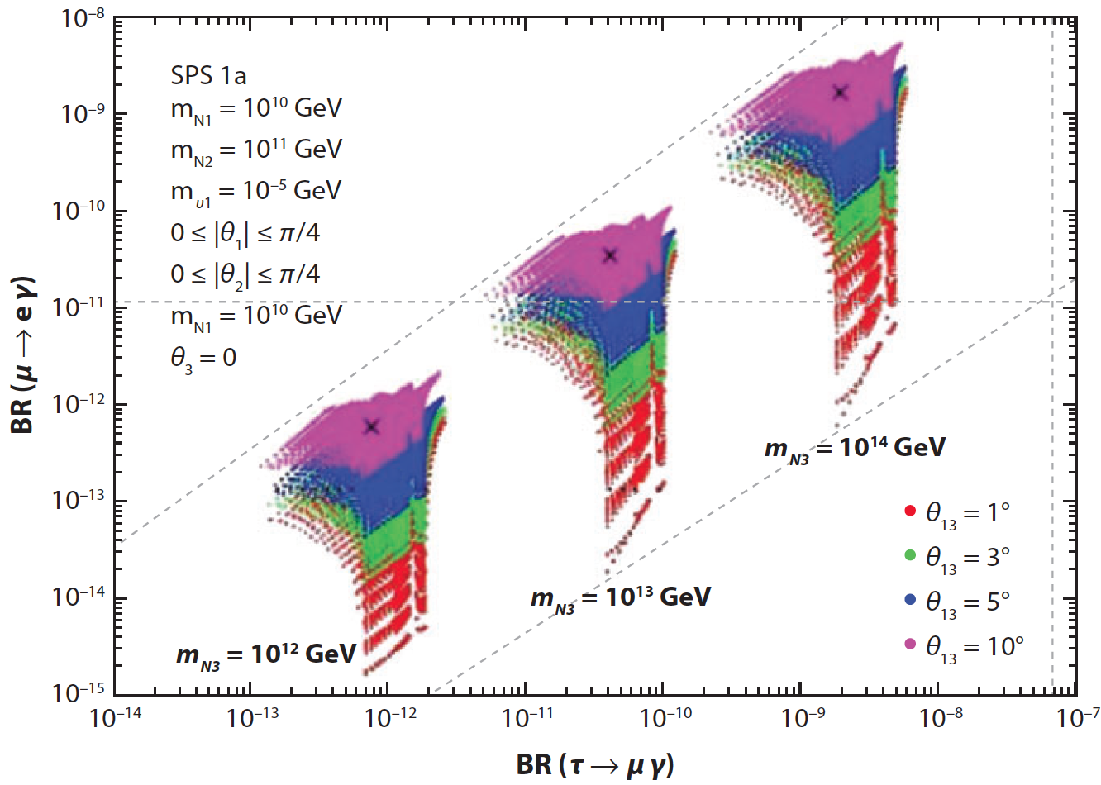


in new physics
5
Motivation Experiment Performance Results Conclusions
Extra
dimensions
Little
Higgs
M.Blanke et al., Acta Phys.
Polon. B41 (2010) 657
K.Agashe et al., PRD 74 (2006) 053011
S. Antusch et al., JHEP 11 (2006) 090
SUSY –
GUT
SUSY –
Seesaw
G.Isidori et al., PRD 75 (2007) 115019
b-physics constraints
favored by recent reactor & accelerator neutrino experiments

Slide 6
in new physics
6
Motivation Experiment Performance Results Conclusions
Extra
Dimensions
Little
Higgs
SINDRUM II
SINDRUM II
MEGA
MEGA
M.Blanke et al., Acta Phys.
Polon. B41 (2010) 657
K.Agashe et al., PRD 74 (2006) 053011
S. Antusch et al., JHEP 11 (2006) 090
SUSY –
GUT
SUSY –
Seesaw
MEGA
(g-2)_{μ}
(g-2)_{μ}
Babar, Belle
G.Isidori et al., PRD 75 (2007) 115019
b-physics constraints
favored by recent reactor & accelerator neutrino experiments

Slide 7
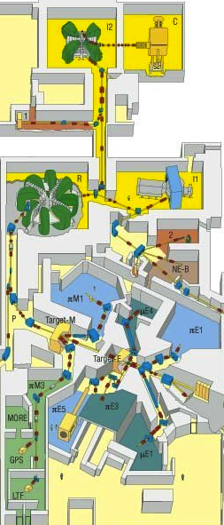






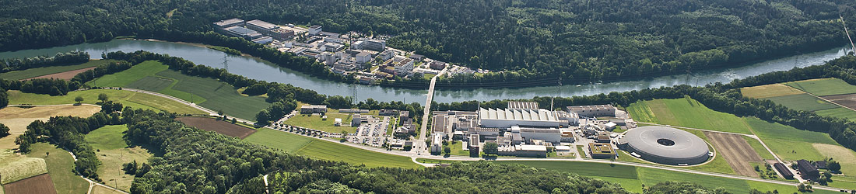

The MEG experiment
Motivation Experiment Performance Results Conclusions
The MEG Collaboration: 60 physicists, 12 institutes,
from
Detector location: The Paul Scherrer Institut near Zürich, Switzerland
The world’s most intense continuous low momentum positive muon beam

Slide 8













Detection principle
Motivation Experiment Performance Results Conclusions
Signal:
Backgrounds:
1) Radiative muon decay (Br_{RMD} ≈ 1.4%)
2) Accidental overlap
Photon can come from:
Radiative muon decay
Positron annihilation in flight
Brehmstralung
Acc. background dominant, detector resolutions crucial!

Slide 9
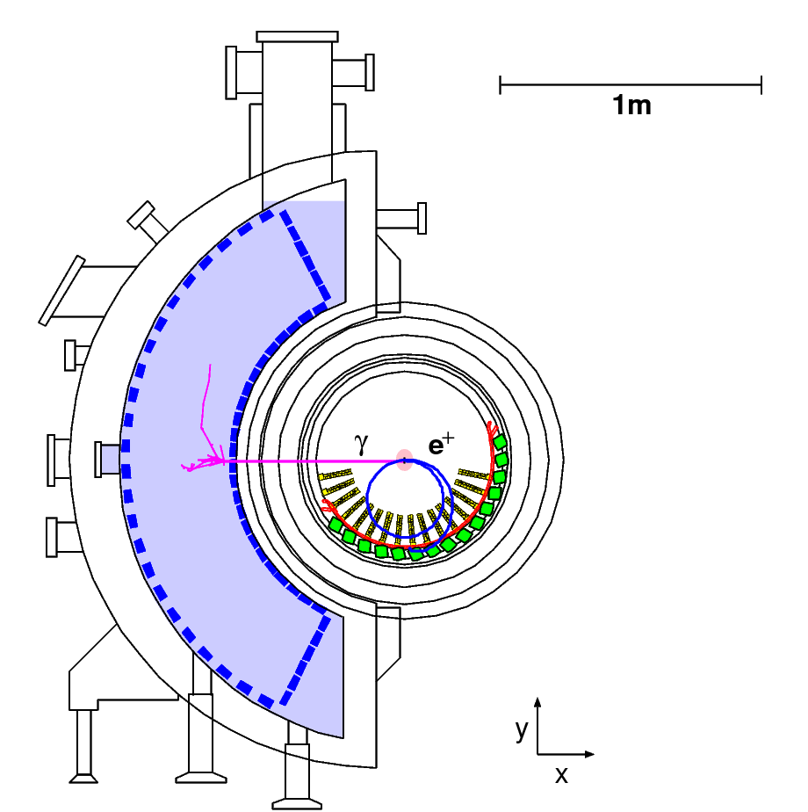
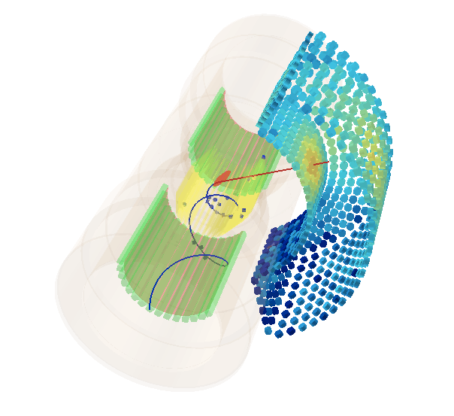
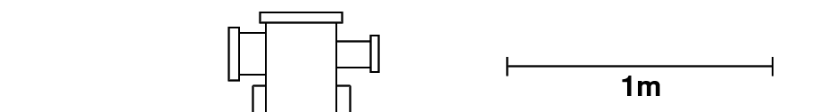
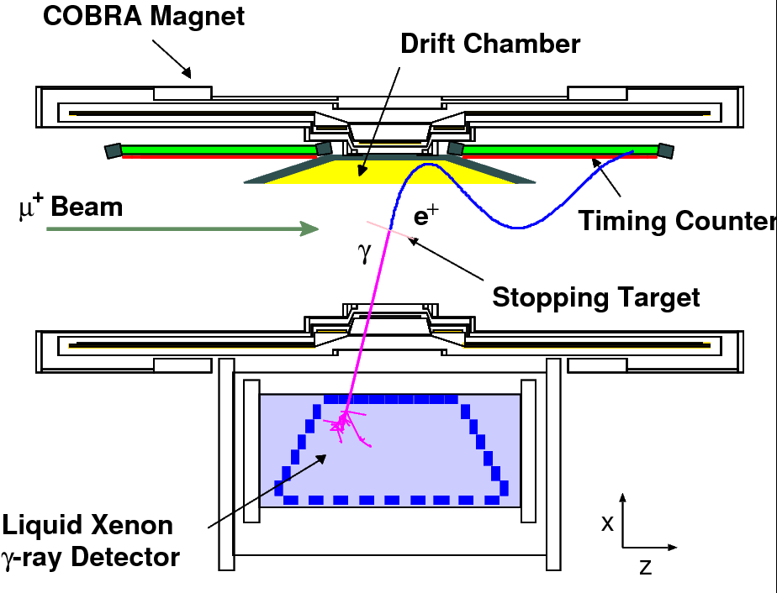
The MEG detector
Motivation Experiment Performance Results Conclusions
3D view:
Lateral view:
Front view:
er
Dedicated detector with non-symmetric coverage (Ω_{MEG}/4π = 11%):
Photon detector with excellent spatial, temporal & energy resolutions
Positron spectrometer with excellent energy & timing capabilities
Stable and well monitored & calibrated detector (arsenal of calibration & monitoring tools)
High performance DAQ system (multi-GHz waveform digitization of nearly all 3k channels)

Slide 10
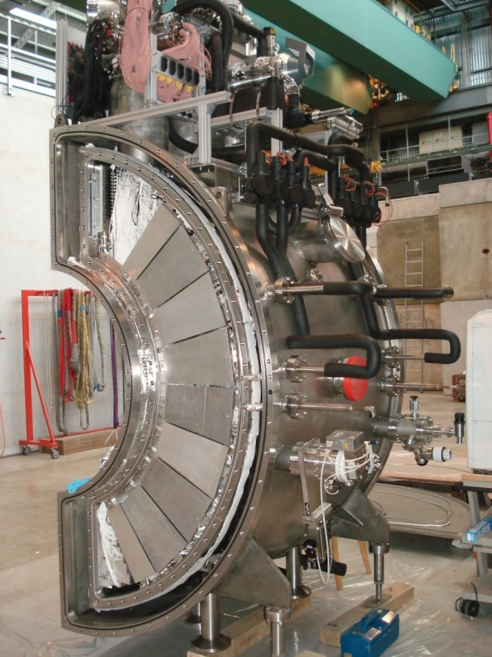
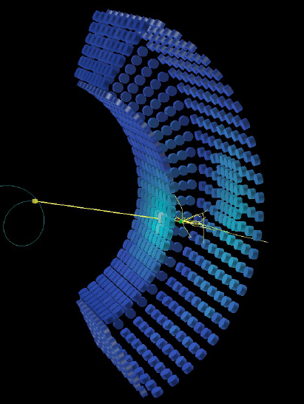
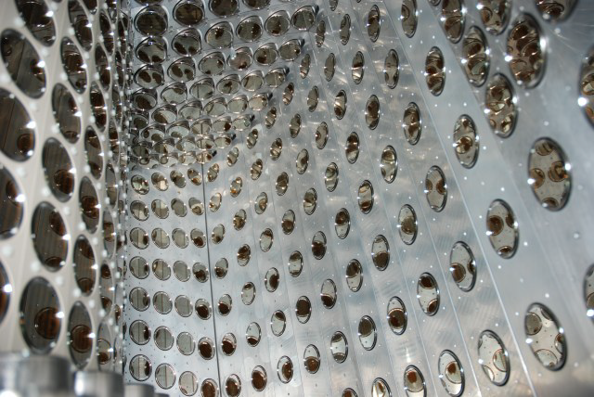
The photon calorimeter
Motivation Experiment Performance Results Conclusions
Liquid Xenon scintillation:
High light yield: 40k photons/MeV
Fast response: τ_{decay} = 45 ns
High stopping power: X₀ = 2.8 cm
No self-absorption: λ_{abs} > 1 m
Detector:
Fiducial volume: 800 liter (largest in the world)
Homogeneous volume
Solid angle coverage ≈ 11 %
Total stopping power ≈ 14 X₀
Read-out by 846 wall-mounted PMTs, digitized @ 1.6 GHz
Cathode area coverage ≈ 40 %

Slide 11
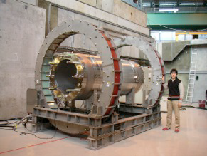
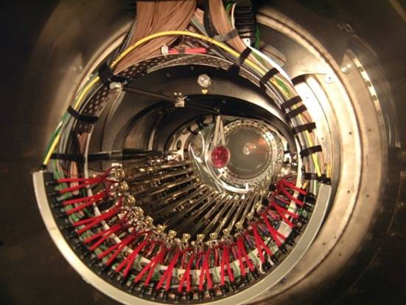
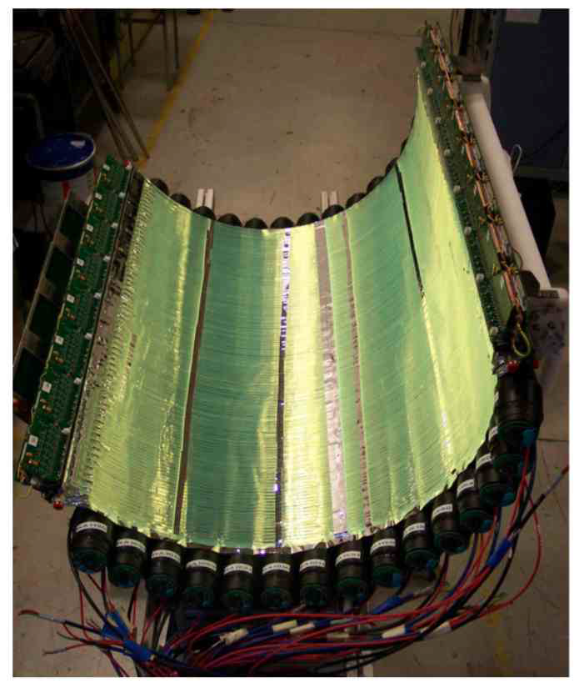
The positron spectrometer
Motivation Experiment Performance Results Conclusions
Superconducting COBRA magnet:
Solenoidal gradient B-field: 0.5 - 1.3 T (COnstant Bending RAdius, quick sweep out)
0.2 X₀ fiducial thickness
Helium environment
Drift chambers:
16 radially staggered double-layered modules
Each layer contains 9 axial drift cells equipped with very thin Vernier cathode pads
Open-frame module design (total radiation length along e⁺ trajectory ≈ 2x10⁻³ X₀)
Counting gas: He (50%) + C₂H₆ (50%)
Timing Counters (x2):
15 axial scintillation bars, PMT read-out
128 semi-circular scintillation fibers, APD read-out

Slide 12
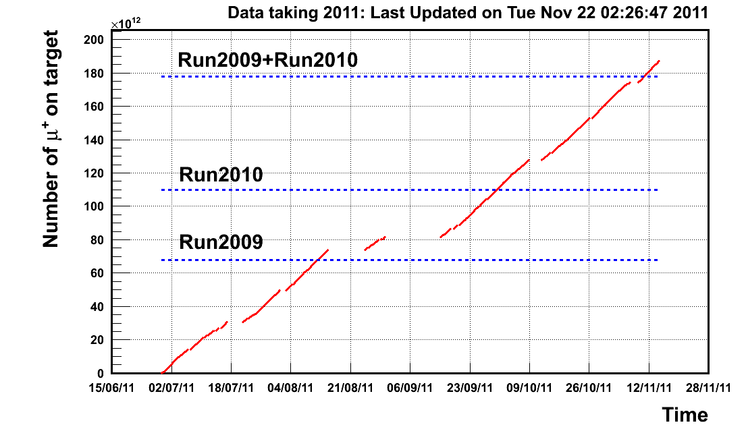
History
Motivation Experiment Performance Results Conclusions
Timeline:
: LOI submitted to PSI
: Detector R&D and construction
: Engineering run
: Physics run I
Tracker discharge problem
: Physics run II
  Total physics DAQ time: 35.2 days
: Physics run III
  Total physics DAQ time: 56.3 days
: Physics run IV
  Total physics DAQ time: 81.1 days
: Physics run V
Expected total physics DAQ time equal to 2011
1998
‘99 - ‘06
2007
2008
2009
2010
2011
2012
Run 2011
Published 2008 analysis results in Nucl. Phys. B 834 (2010) 1-12
Preliminary 2009 analysis results presented at ICHEP 2010
Published 2009 + 2010 analysis results in Phys. Rev. Lett. 107 (2011) 171801
(this presentation)

Slide 13
Detector performance
Motivation Experiment Performance Results Conclusions
 | 2009 | 2010 | 2011 (preliminary)
γ energy | 1.9% (w>2cm) | 1.9% (w>2cm) | 1.7% (w>2cm)
γ position | 5 mm (u,v), 6 mm (w) | 5 mm (u,v), 6 mm (w) | 5 mm (u,v), 6 mm (w)
e⁺ momentum | 0.31 MeV (80% core) | 0.32 MeV (80% core) | 0.32 MeV (86% core)
e⁺ angle | 9.4 mrad (θ), 6.7 mrad (ϕ) | 11.0 mrad (θ), 7.2 mrad (ϕ) | 10.8 mrad (θ), 6.5 mrad (ϕ)
Vertex position | 1.5 mm (Z), 1.1 mm (Y) | 2.0 mm (Z), 1.1 mm (Y) | 1.9 mm (Z), 1.0 mm (Y)
e⁺-γ timing | 146 ps | 122 ps | 133 ps
Trigger efficiency | 91% | 92% | 95%
Total # of muons stopped on target | 0.7x10¹⁴ | 1.1x10¹⁴ | 1.9x10¹⁴

Slide 14
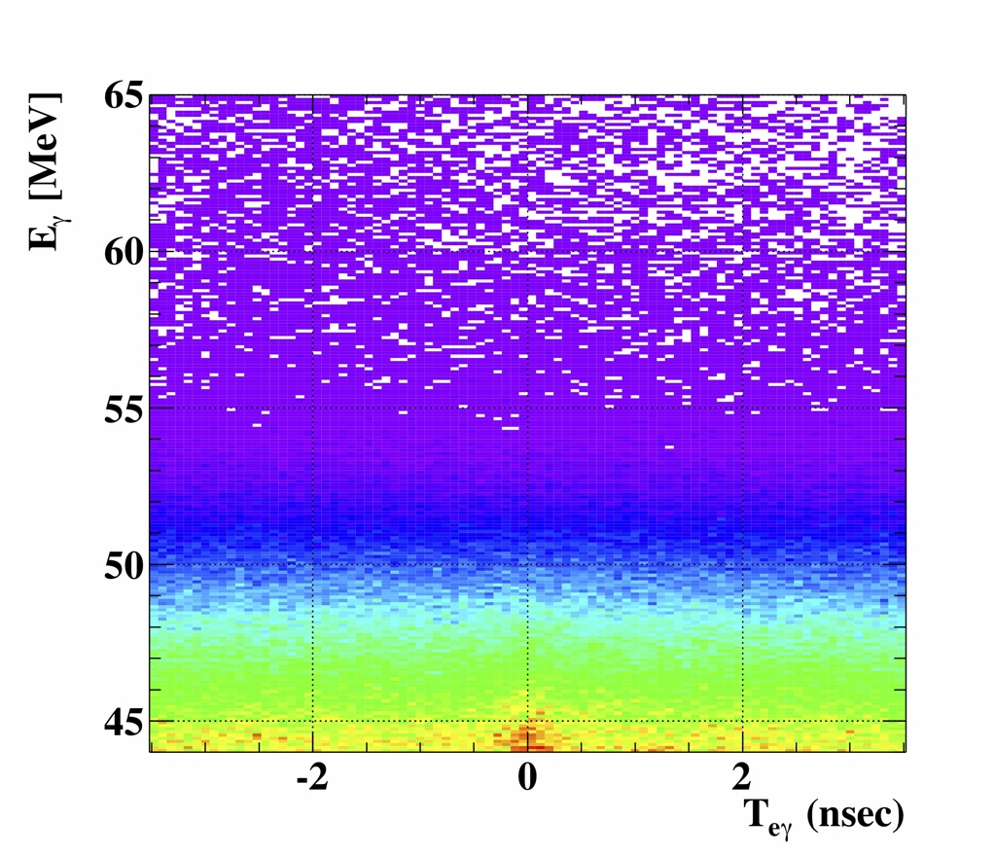


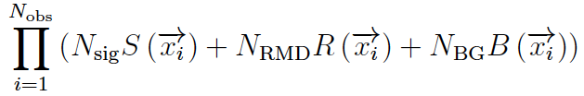

Data analysis
Motivation Experiment Performance Results Conclusions
Analysis technique:
Events characterized by 5 observables:
Blindness policy: Blind box defined by E_{γ} and T_{eγ} . Events inside this box are not used in the development of the analysis.
Search method: The number of signal, radiative muon decay and accidental background events in the data sample (N_{sig}, N_{RMD}, N_{BG}) are determined using an extended unbinned max. likelihood fit:
Fit ingredients:
Left T_{eγ}
sideband
Blinding &
Analysis-box
Right T_{eγ}
sideband
E_{γ} sideband
The PDFs (S, R and B) are considered event-by-event and are extracted from the detector response and sideband data as much as possible. The Gaussian background constraints are measured in the time sidebands.

Slide 15
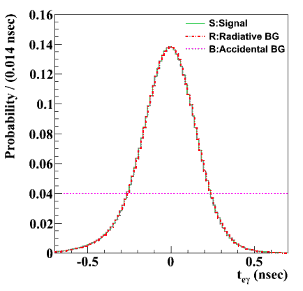
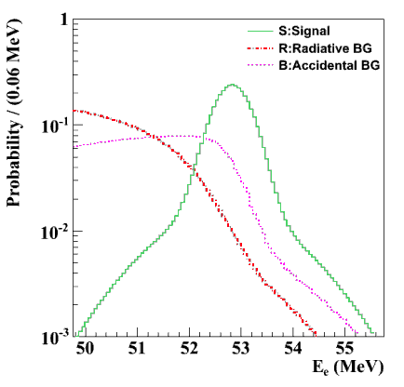
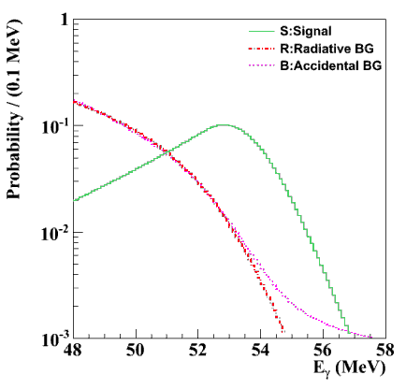



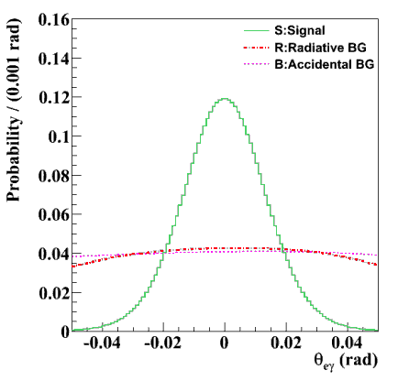



PDFs
Motivation Experiment Performance Results Conclusions
Signal: E_{γ} sideband data
RMD: E_{γ} sideband data
Acc. BG: Flat
Signal: Michel data
RMD: SM + detector response
Acc. BG: T_{eγ} sideband data
Signal: CEX data
RMD: SM + detector response
Acc. BG: T_{eγ} sideband data
Signal: CEX + Michel 2-turn data
RMD: SM + detector response
Acc. BG: T_{eγ} sideband data
Signal: CEX + Michel 2-turn data
RMD: SM + detector response
Acc. BG: T_{eγ} sideband data
(PDFs averaged w.r.t. the other kinematic variables)

Slide 16
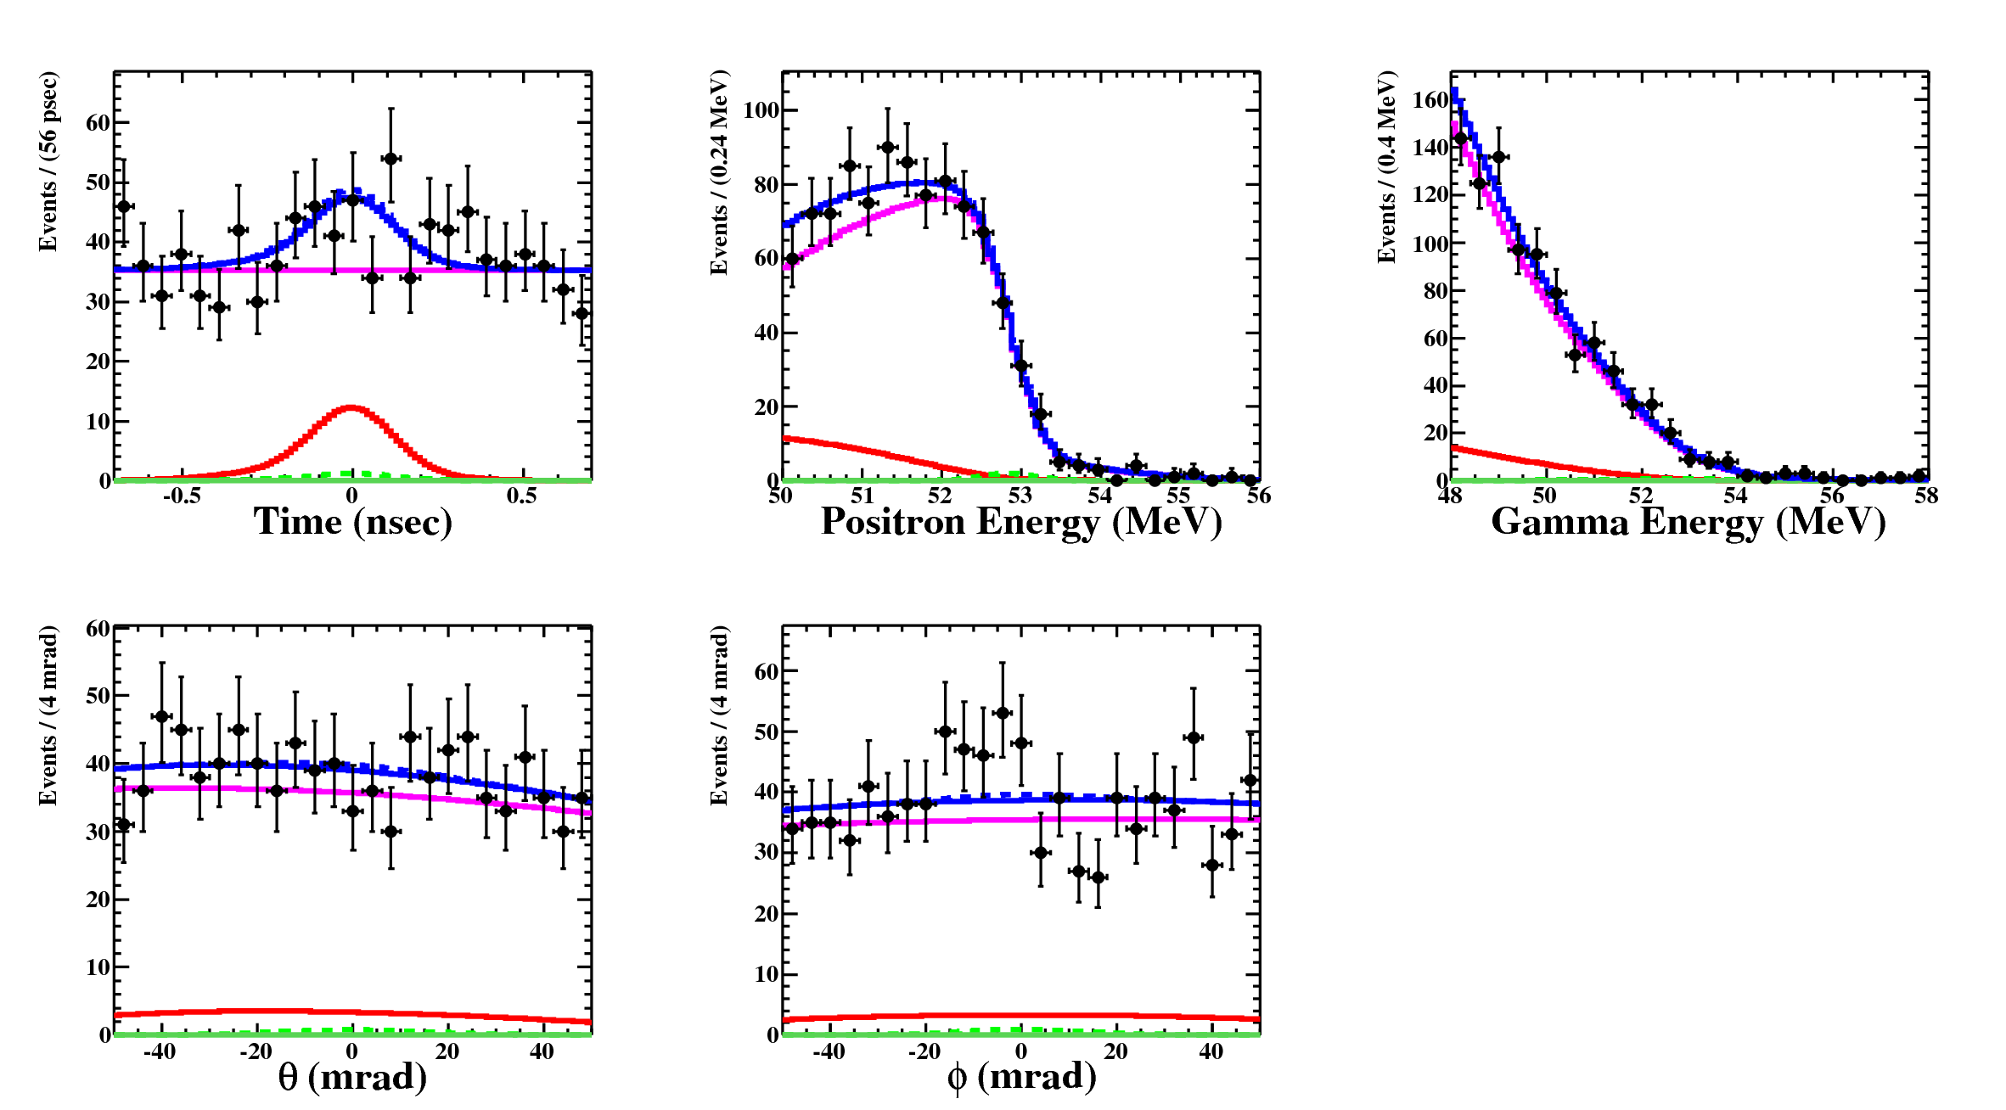
Fit result of 2009 + 2010 data
Motivation Experiment Performance Results Conclusions
(Signal, RMD, Accidental BG, Total)
N_{obs} = 956
N_{sig} = -0.5 ^{+7.9}_{-4.7}
N_{RMD} = 76.5 ± 12
N_{BG} = 882 ± 22
(MINOS 1.645 σ errors)

Slide 17

Branching ratio normalization
Motivation Experiment Performance Results Conclusions
Procedure:
The number of signal events in the analysis region is normalized to the number of Michel decays measured with an unbiassed trigger during data-taking (after applying the same analysis selection criteria):
Insensitive to variations in beam rate or detector conditions. Cross-checked with the number of radiative muon decays measured in the E_{γ} sideband.
Results:
# of Michel events
Efficiencies and detector acceptence
Normalization factor
k₂₀₀₉ = (1.08 ± 0.07) x 10¹²
k₂₀₁₀ = (2.23 ± 0.16) x 10¹²
k₂₀₁₁ = 3.4 x 10¹² (preliminary)

Slide 18
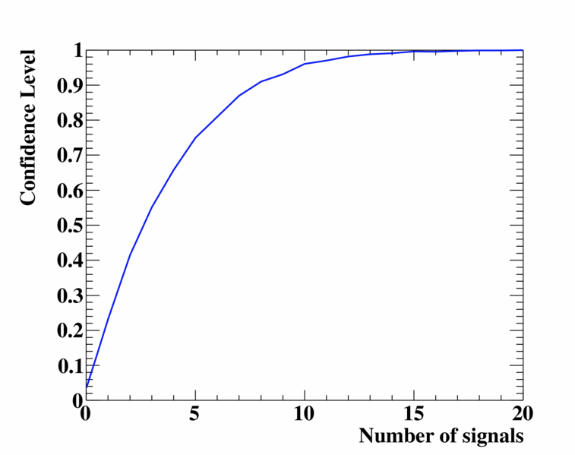
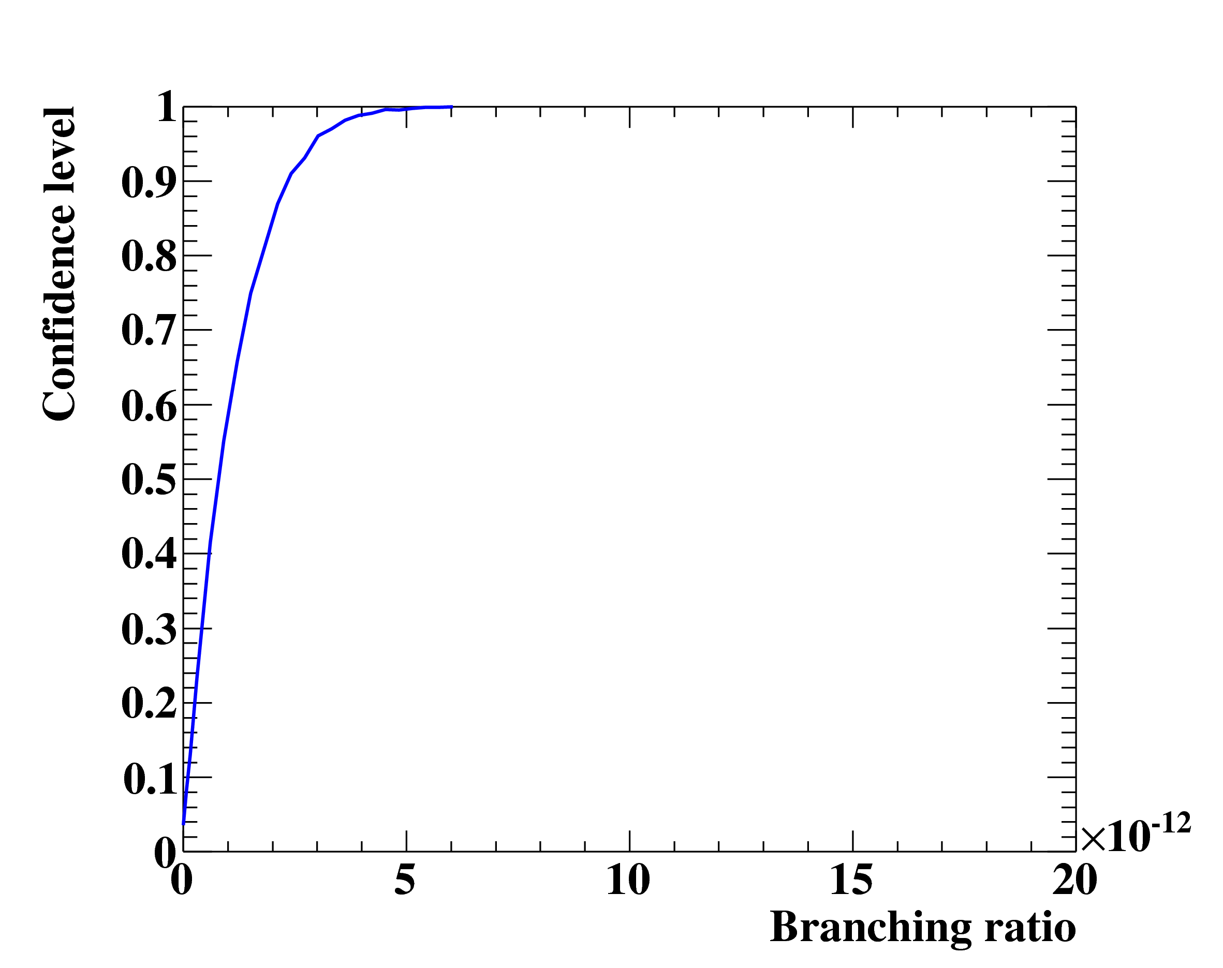
Combined 2009+2010 result
Motivation Experiment Performance Results Conclusions
Confidence level:
The calculation of the confidence interval follows a frequentist approach using profile likelihood ratio ordering (Feldman-Cousins). Systematic uncertainties of PDF parameters are taken into account by fluctuating the PDFs according to their uncertainties.
Result:
Factor 5 improvement over the
previous best upper limit

Slide 19
in new physics
19
Motivation Experiment Performance Results Conclusions
Extra
dimensions
Little
Higgs
SINDRUM II
SINDRUM II
MEGA
MEGA
M.Blanke et al., Acta Phys.
Polon. B41 (2010) 657
K.Agashe et al., PRD 74 (2006) 053011
S. Antusch et al., JHEP 11 (2006) 090
SUSY –
GUT
SUSY –
Seesaw
MEGA
(g-2)_{μ}
(g-2)_{μ}
Babar, Belle
G.Isidori et al., PRD 75 (2007) 115019
b-physics constraints
favored by recent reactor & accelerator neutrino experiments

Slide 20
in new physics
20
Motivation Experiment Performance Results Conclusions
Extra
dimensions
Little
Higgs
MEG
SINDRUM II
SINDRUM II
MEG
M.Blanke et al., Acta Phys.
Polon. B41 (2010) 657
K.Agashe et al., PRD 74 (2006) 053011
S. Antusch et al., JHEP 11 (2006) 090
SUSY –
GUT
MEG
SUSY –
Seesaw
MEG
(g-2)_{μ}
(g-2)_{μ}
Babar, Belle
G.Isidori et al., PRD 75 (2007) 115019
b-physics constraints
favored by recent reactor & accelerator neutrino experiments

Slide 21

Conclusions & Outlook
Motivation Experiment Performance Results Conclusions
Conclusions:
Combined 2009+2010 analysis result consistent with null signal, resulting in a factor 5 improvement of the world’s most stringent upper limit on μ⁺→e⁺γ :
Outlook:
Analysis of 2011 data almost ready for unblinding
Physics data taking will resume next month
MEG is aiming for an upper limit at 90% CL of O(10⁻¹³) after 2012
Possible future improvements (2013+):
Active target
Thin silicon vertex tracker
New positron tracker: Single-volume driftchamber, thin scintillator tiles, etc.
Smaller photo-sensors on inner face of LXe detector
?
2009
2010
2011
2012
(expected)
2013
(?)

Slide 22
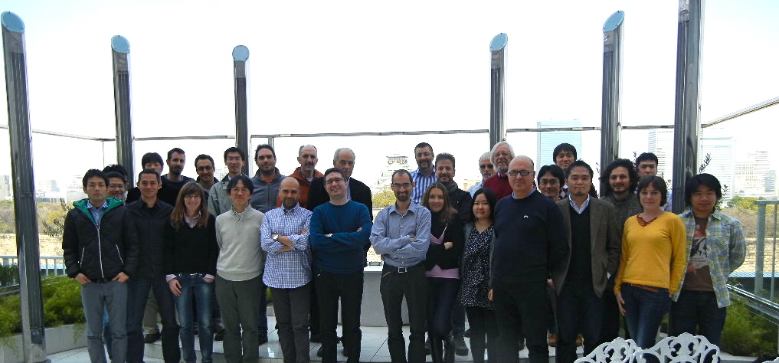
Muchos gracias por su atención!
Motivation Experiment Performance Results Conclusions
On behalf of the MEG Collaboration

Slide 23
Back up
Motivation Experiment Performance Results Conclusions Backup

Slide 24
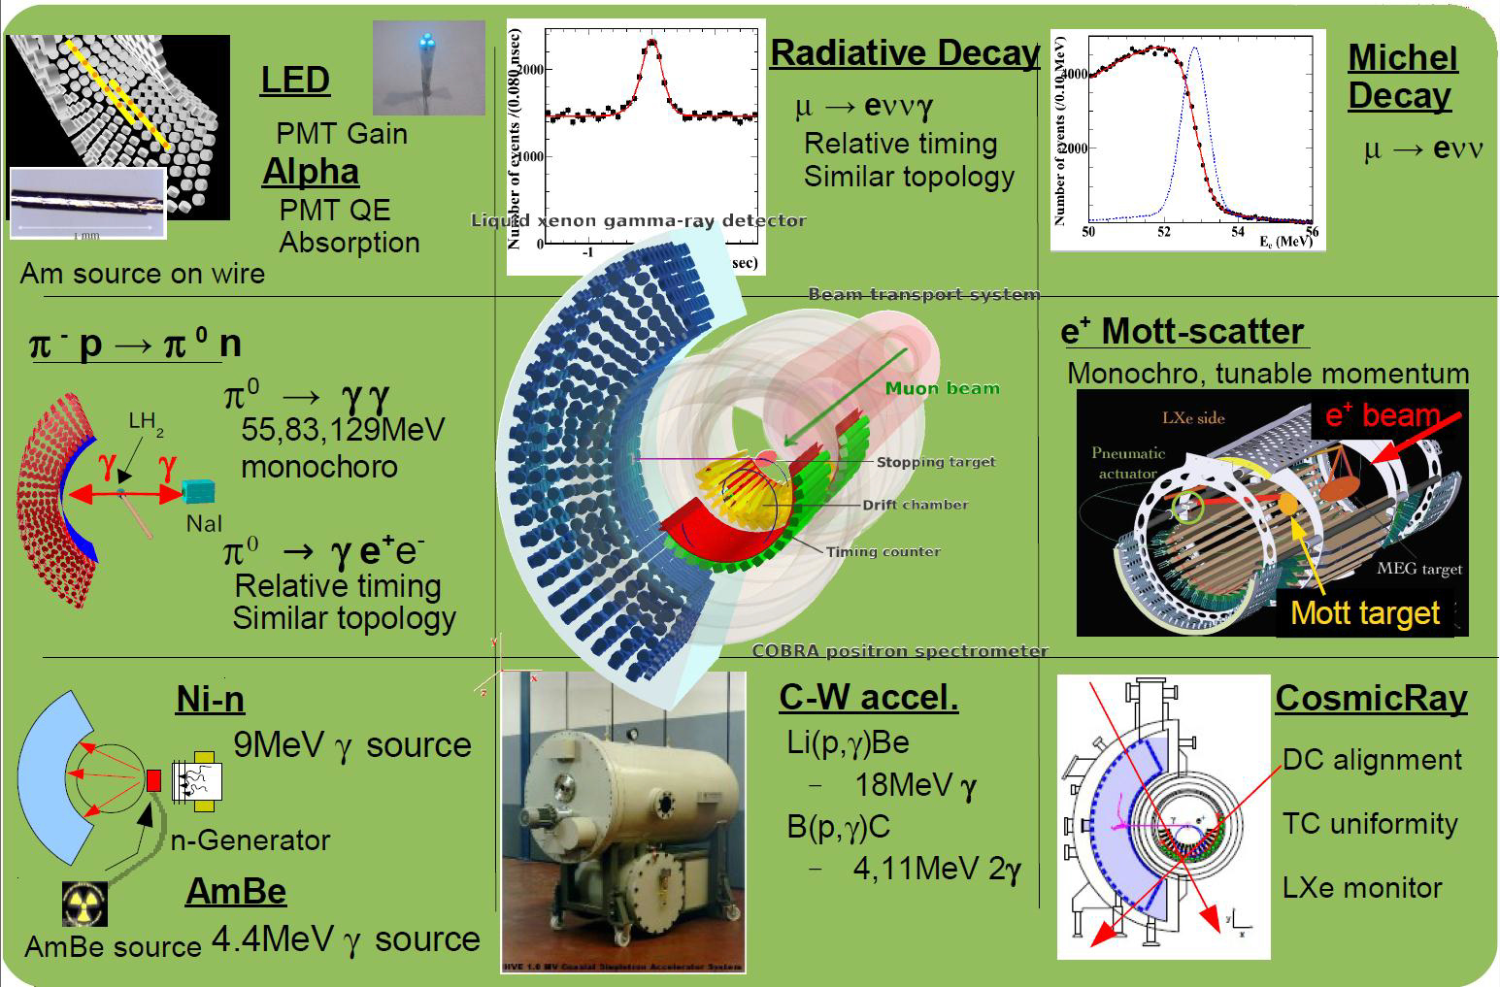
Calibrations
Motivation Experiment Performance Results Conclusions Backup

Slide 25
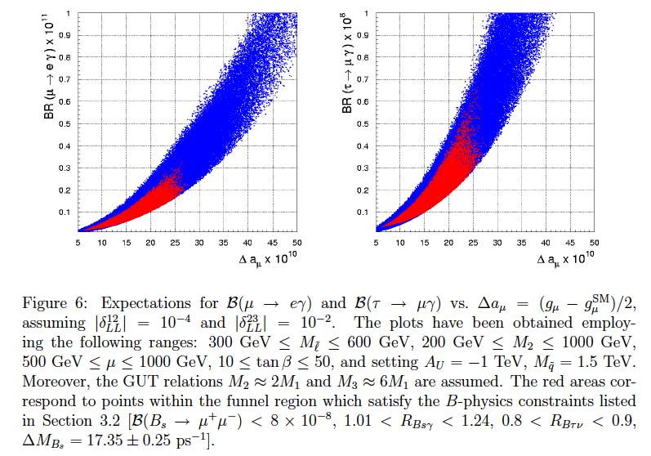
SUSY-GUT example
Motivation Experiment Performance Results Conclusions Backup
G.Isidori et al., PRD 75 (2007) 115019

Slide 26
SUSY-GUT + ν_{R} example
Motivation Experiment Performance Results Conclusions Backup
SPS 1a:
M₀ = 100 GeV
M_{1/2} = 250 GeV
A₀ = -100 GeV
tan(β) = 10
sign(μ) = +
S. Antusch et al., JHEP 11 (2006) 090

