Slide 1
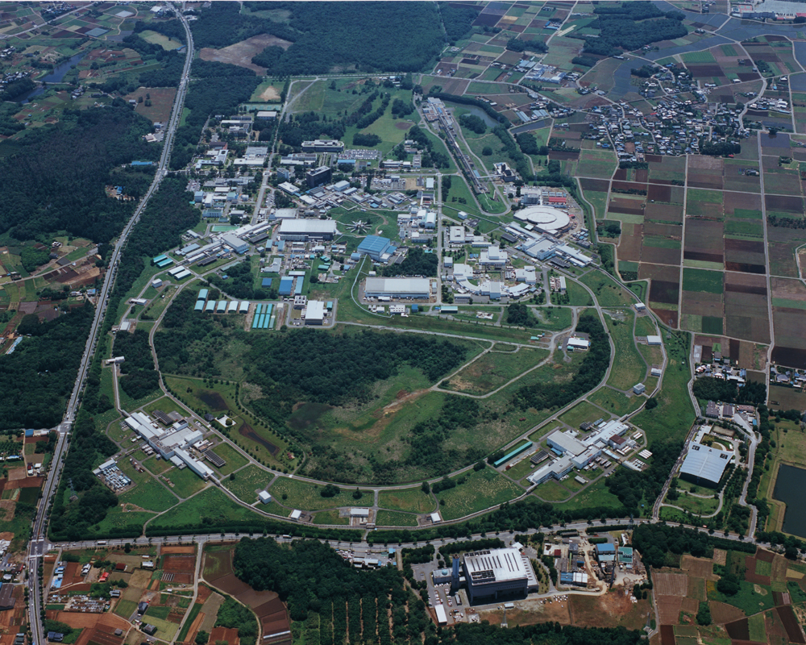
Probing new physics at SuperKEKB
October 22, 2011
Talk given at XIII Mexican Workshop on Particles and Fields
M.Yamauchi
KEK

Slide 2
Outline
Introduction – testing CKM scheme in B decays
Achievement of the B factories
Physics case of higher luminosity B factories
SuperKEKB and Belle-II
Summary
(Research program at KEK)

Slide 3
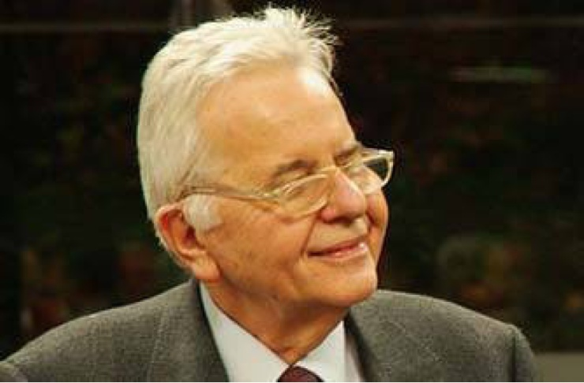

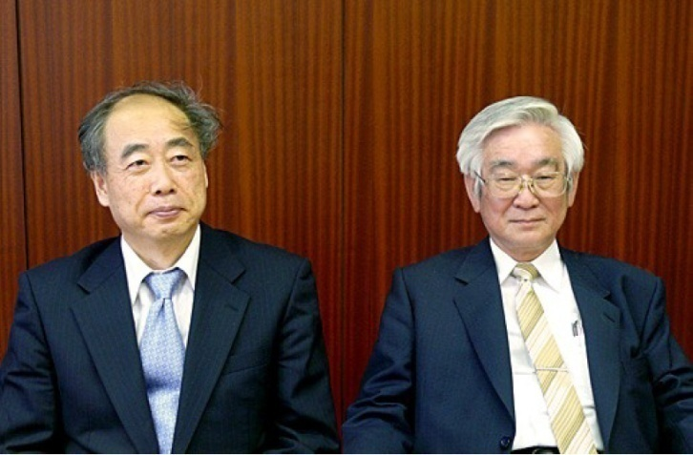
Cabibbo-Kobayashi-Maskawa model (1973)
Charged-current weak interaction
in the Standard Model (SM)
Quark mass eigenstates differ from
weak eigenstates
Cabibbo-Kobayashi-Maskawa
(CKM) quark mixing matrix

Slide 4
Unitarity of CKM matrix
CKM quark mixing matrix
Unitarity
Unitarity triangle
*
−V_{tb}V_{td}
−V_{cb}V_{cd}
φ₁≡π−arg( )
*
V_{tb}V_{td}
−V_{ub}V_{ud}
*
φ₂≡arg( )
*

Slide 5
Testing CKM scheme in B decays
_ _
(ρ, η)
B⁰ g π⁺π⁻
b g ulν
with several
approaches
(excl. & incl.)
Bg ρπ
Bg ρρ
φ₂(α)
_
BB mixing (Δm_{d})
Bg DK
Bg D⁽*⁾π
φ₃(γ)
φ₁(β)
(0,1)
(0,0)
B⁰ g J/ψ K_{S(L)}, ψ(2S) K_{S},
χ_{c1} K_{S}, η_{c} K_{S}
B g D⁽*⁾lν

Slide 6
Time dependent CP violation in B meson system
=A_{f} cos(Δmt)+S_{f} sin(Δmt)
Standard model predictions
| λ_{f} |² - 1
A_{f} =
| λ_{f} |² + 1
2Im( λ_{f} )
S_{f} =
| λ_{f} |² + 1
A( Bgf )
λ_{f} ≡e^{-2iφ}M
A( Bgf )
Note: A_{f} = 0 a Γ(Bgf ) = Γ(Bgf ) a direct CP violation.

Slide 7
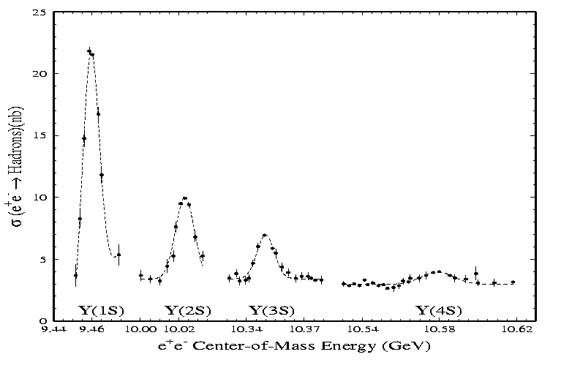
“10Hz for L=10³⁴cm⁻²s⁻¹”
Y(4S) _
g B⁰B⁰ (~50%)
g B⁺B⁻ (~50%)
10.58GeV/c²
5.28 × 2 = 10.56GeV/c²

Slide 8
Principle of the measurement
ϒ
Γ(Bgf_{CP};t ) can be measured.
Large data sample
A_{f} and S_{f}

Slide 9
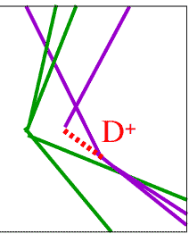
electron
positron
B
B

Slide 10

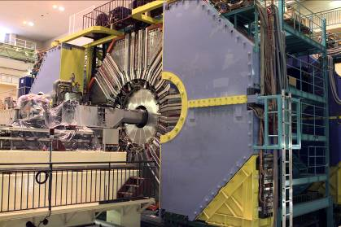
KEKB and Belle

Slide 11

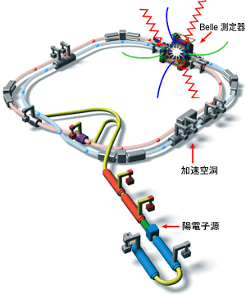
KEKB accelerator

Slide 12

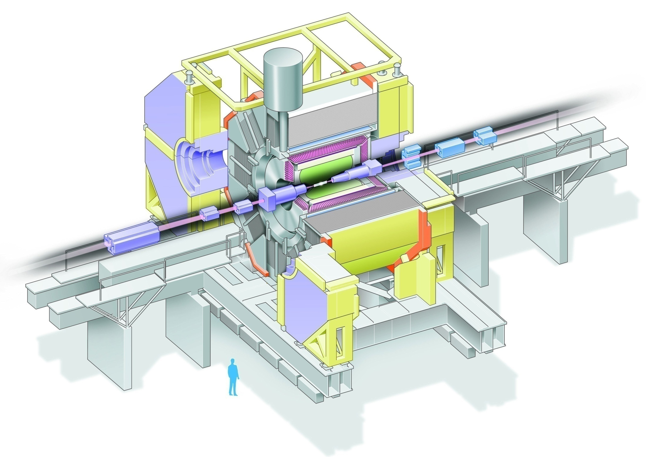
Belle Detector
Aerogel Cherenkov cnt.
n=1.015~1.030
SC solenoid
1.5T
3.5GeV e⁺
CsI(Tl) 16X₀
TOF counter
8GeV e⁻
Tracking + dE/dx
small cell + He/C₂H₆
m / K_{L} detection
14/15 lyr. RPC+Fe
Si vtx. det.
4 lyr. DSSD

Slide 13
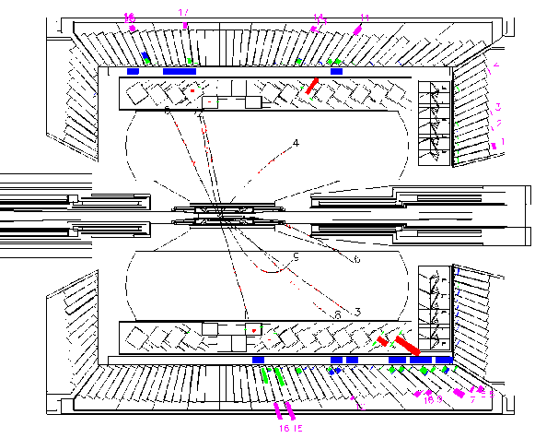
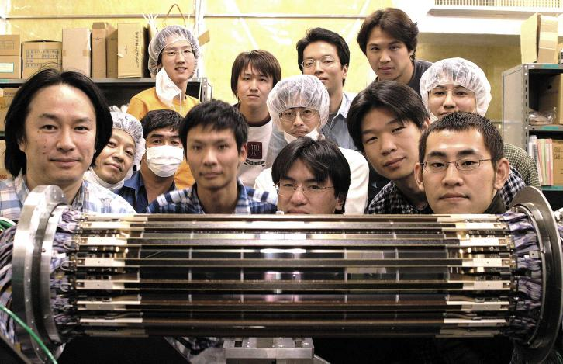
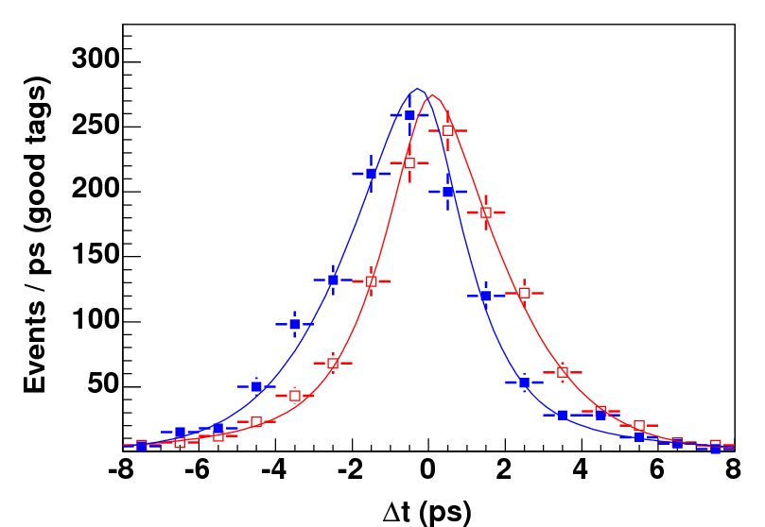
Measurement at B factory
Si detector
Δt
B⁰(B⁰)
8GeV e⁻
ϒ(4S)
3.5GeV e⁺
B⁰(B⁰)
Be vacuum pipe
シリコン測定器上の粒子通過点
の測定によってBの崩壊点を測定、
Δtの分布をB⁰、B⁰についてプロット
B⁰
B⁰

Slide 14
Belle Collaboration
Krakow Inst. of Nucl. Phys.
Kyoto
Kyungpook National U.
Lausanne
Jozef Stefan Inst.
MPI, Munich
Melbourne
Nagoya
Nara Women’s U.
National Central U.
National United U.
National Taiwan U.
Nihon Dental College
Niigata
Nova Gorica
Osaka
Osaka City U.
Panjab
Peking
Princeton
Illinois U. - Riken
Saga
USTC
Seoul National U.
Shinshu
Sungkyunkwan
Sydney
TIFR
Toho
Tohoku
Tohuku Gakuin
U. of Tokyo
Tokyo Inst. of Tech.
Tokyo Metropolitan U.
Tokyo U. of A and T.
Toyama Nat’l College
Tsukuba
VPI
Yonsei
BINP
Chennai
Chiba
Hanyang
Cincinnati
Fu-Jen
Giessen
Gyeongsang Nat’l U.
U. of Hawaii
Hiroshima Tech.
HEPHY, Vienna
IHEP, Protvino
IHEP, Beijing
INFN, Torino
ITEP
Kanagawa
Karlsruhe
KEK
Korea U.
w
w
w
w
w
w
w
w
w
w
w
w
w
w
w
w
w
w
w
w
w
w
w
w
w
w
w
w
w

Slide 15
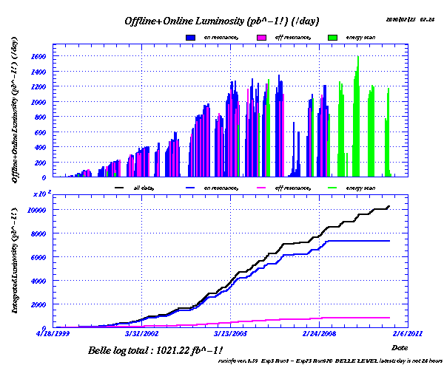
Luminosity
1 fb⁻¹/day
1000 fb⁻¹ = 1 ab⁻¹
Υ(1,2,3,5s)
Υ(4s)
off resonance

Slide 16
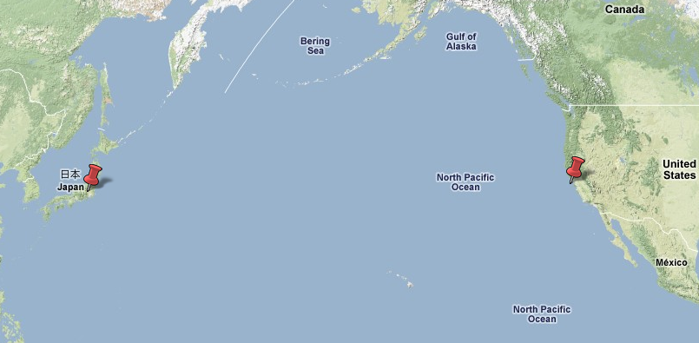

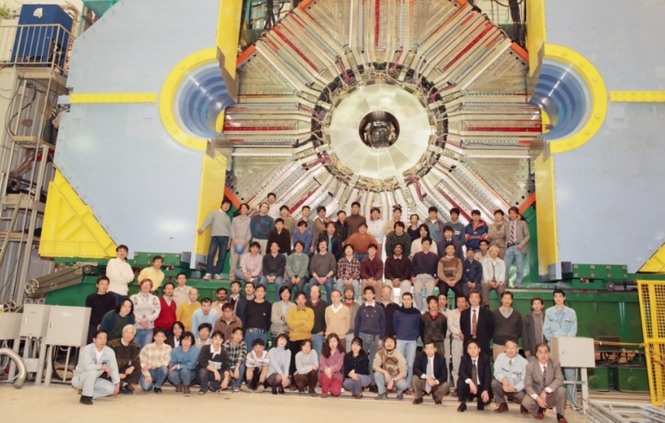
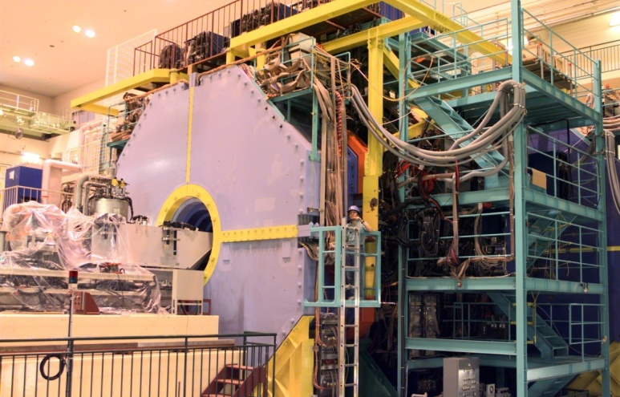

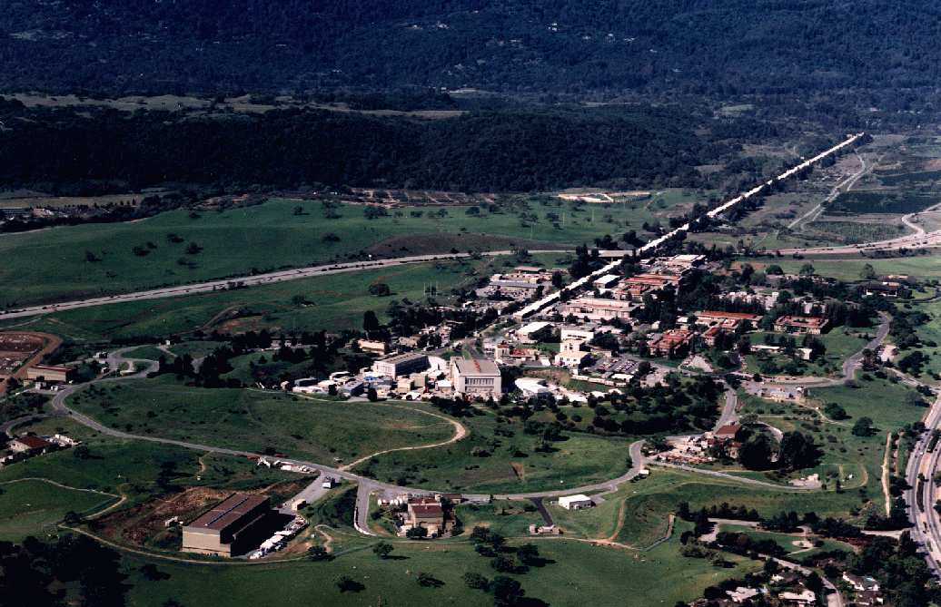
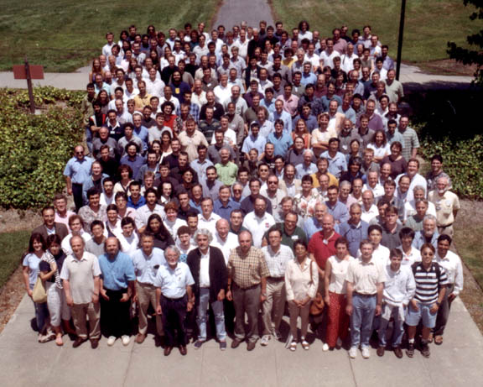
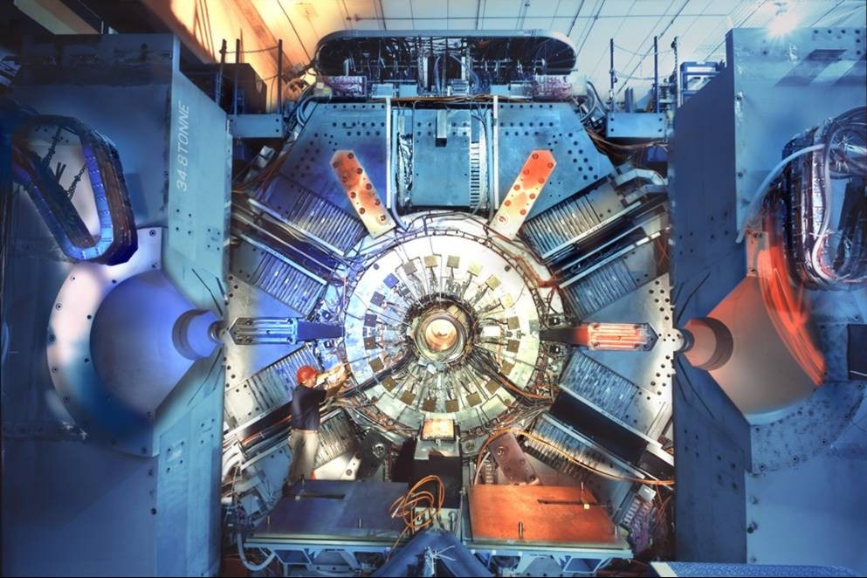
B-Factories in the World
Accelerator
Collaboration
Detector
~400 researchers
from 14 countries/
regions.
Belle
(Japan)
Belle
(Japan)
Belle in Japan
BaBar in US
~600 researchers
from 10 countries/
regions.
BaBar
(US)
BaBar
(US)

Slide 17
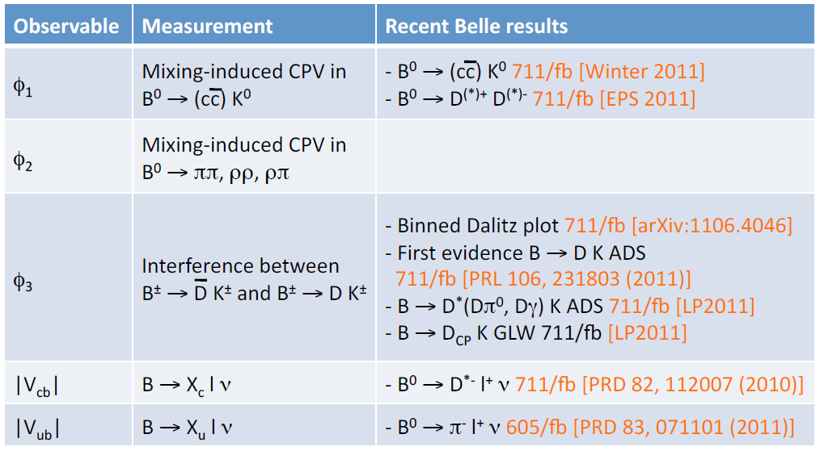
Unitarity triangle measurements

Slide 18
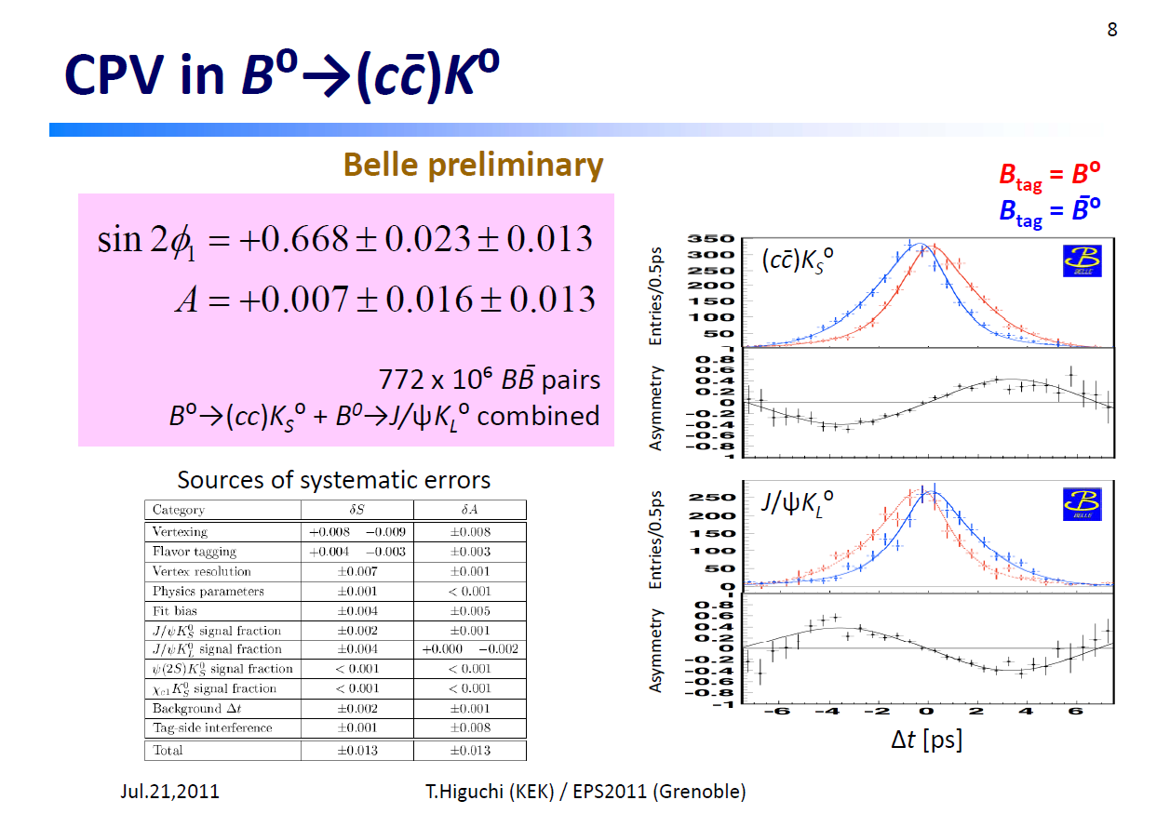
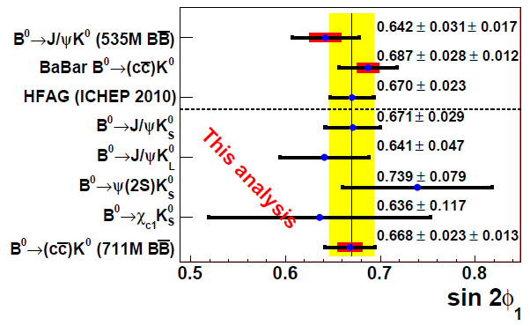

Slide 19
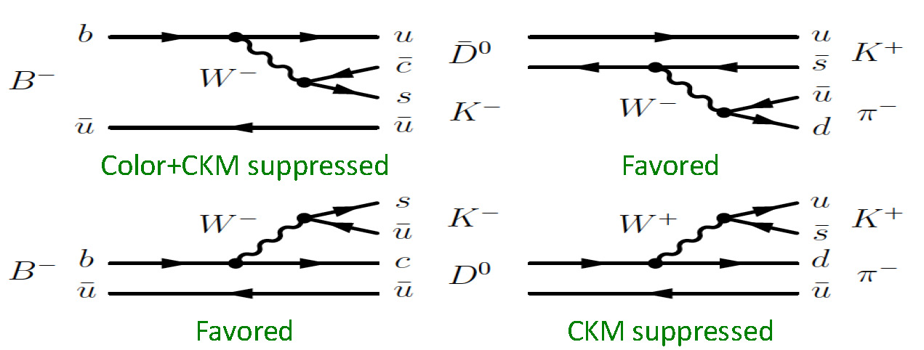
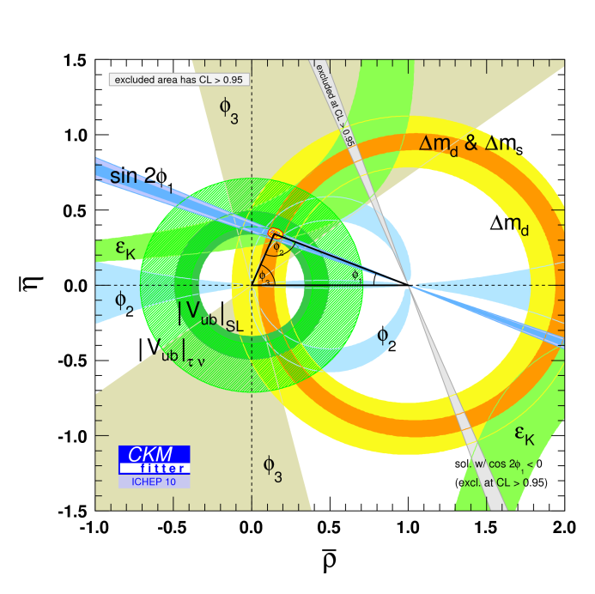
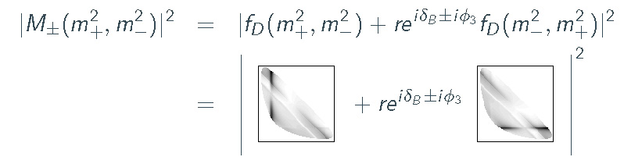
φ₃ (=γ) with Dalitz analysis
GGSZ method:
The best way to
measure φ₃
model dependent description of f_{D}
using continuum D* data ⇒
systematic uncertainty
A. Giri et al., PRD68, 054018 (2003)
( )
D⁰ → K_{S}π⁺π⁻
3-body D⁰ → K_{S}π⁺π⁻ Dalitz amplitude
φ₃=(78 ± 12 ± 4 ± 9)º
φ₃=(68 ± 14 ± 4 ± 3)º
Belle, PRD81, 112002, (2010), 605 fb⁻¹
BaBar, PRL 105, 121801, (2010)

Slide 20
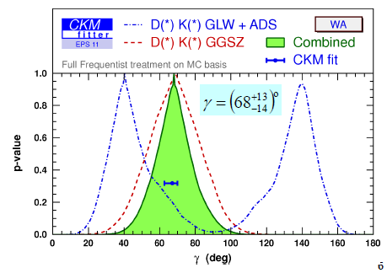
φ₃ measurement
Combined φ₃ value:
Note that B factories were not built to measure φ₃
It turned out much better than planned!
φ₃ =(68 ⁺¹³₋₁₄ ) degrees
This is not the last word from B factories, analyses still to be finalized...

Slide 21
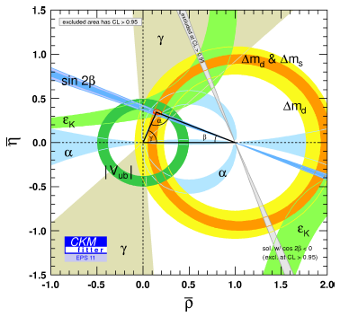
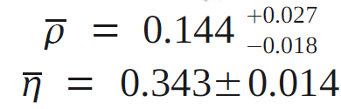

Test of CKM scheme (as of 2011)

Slide 22
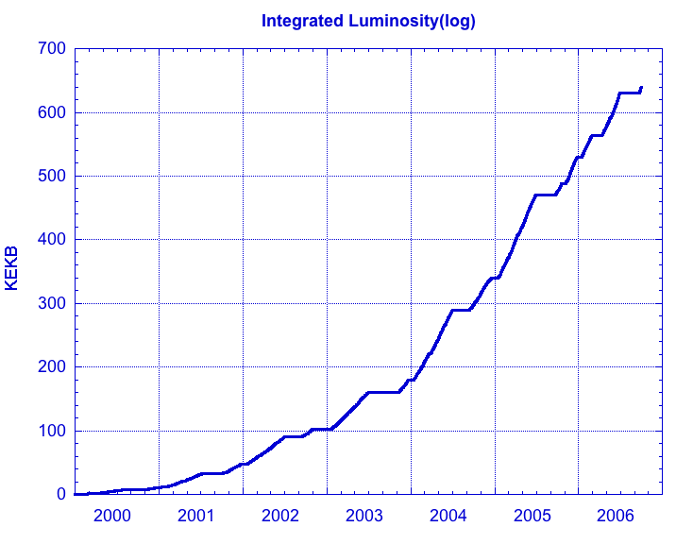
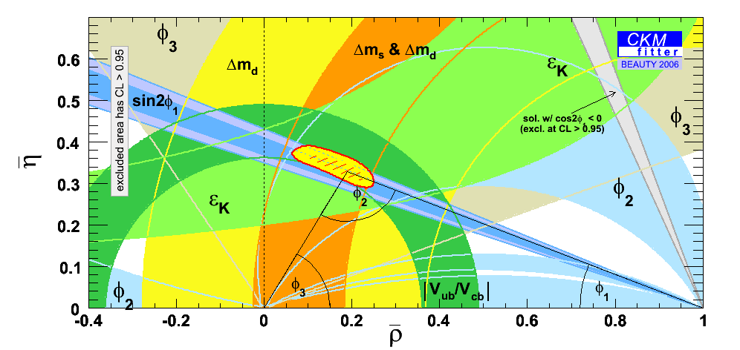
Major achievements at Belle
Evidence for D⁰ mixing
Observation of direct CP
violation in B g π⁺π⁻
Evidence for B g τν
Observation of b g dγ
Decisive confirmation of
Kobayashi-Maskawa model
Evidence for direct CP
violation in B g K⁺π⁻
Measurements of
CP violation in B g φKs, η’Ks etc.
Observation of CP
violation in B meson
system
Discovery
of X(3872)
Observation of B g K^{(*)}ll

Slide 23
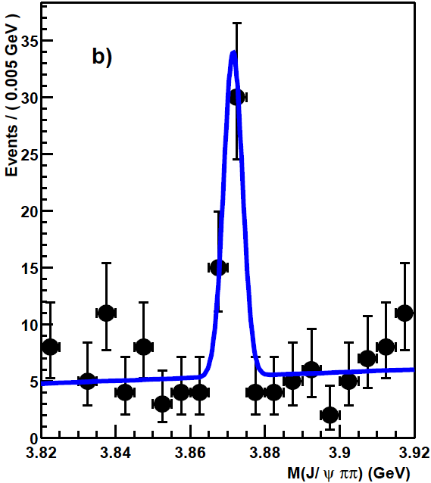
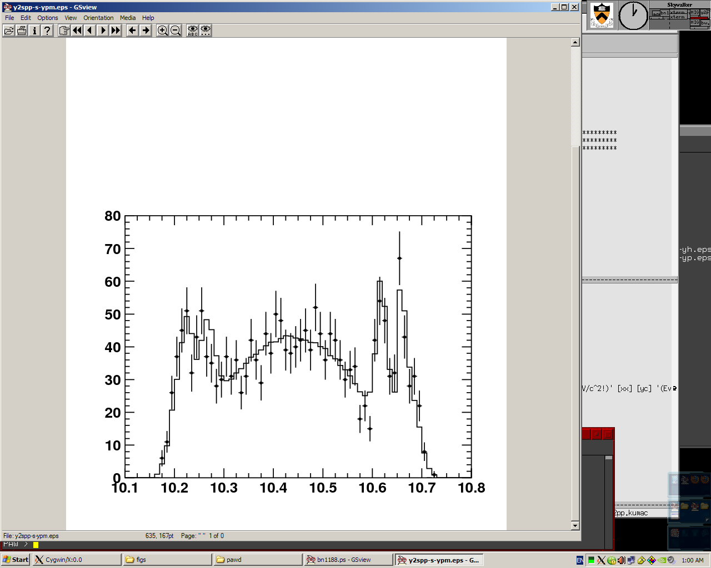
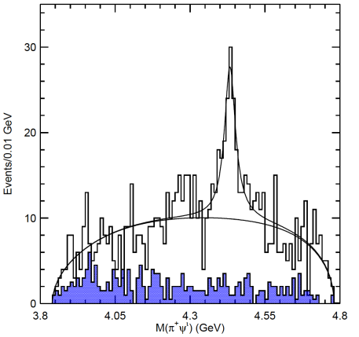
New Hadrons
X(3872)
B⁺ → X(3872) K⁺
X(3872) → J/ψπ⁺π–
A new particle, which
can never be cc
resonances.
Z_{b}⁺
Υ(5s)→Z_{b}⁺π⁻
Z_{b}⁺→Υ(1,2s)π⁺
_
signals
χ2 = 57.7/52
Z_{b}(10610)
Z_{b}(10650)
reflections
Z(4430)⁺
B⁰ → Z(4430) K–
Z(4430)⁺ → ψ(2S)π⁺
A new particle with
charge, which can
never be cc resonance
Bound state of 4
quark resonance?
M(ϒ(2S)π⁺), GeV
Many other new particles are
being discovered:
Y(4260), X(3940), Y(3940),
Y(4325), X(4160), Y(4008) …
_

Slide 24
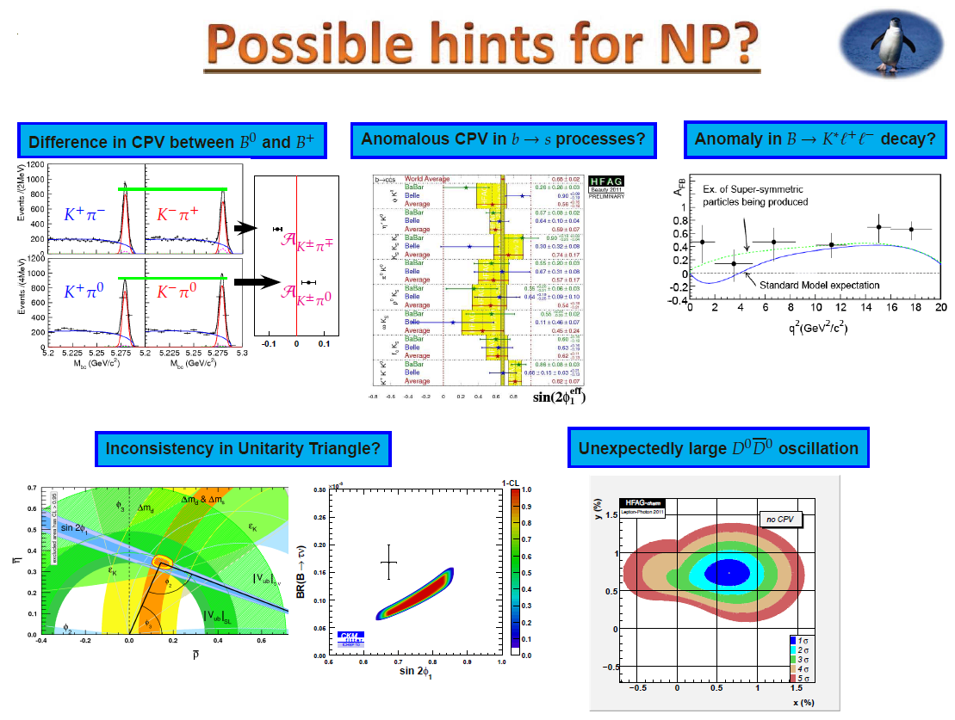

Slide 25
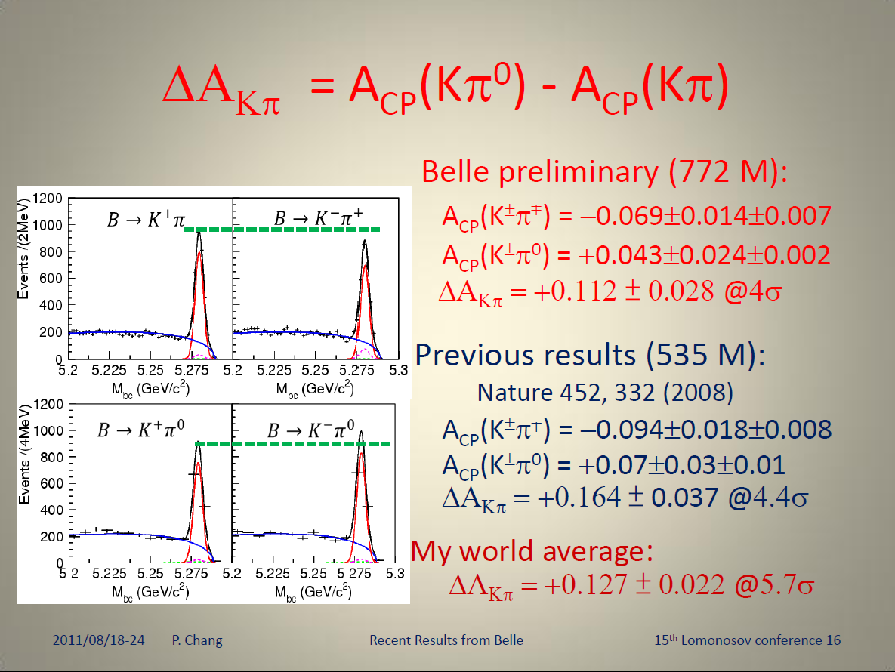

Slide 26
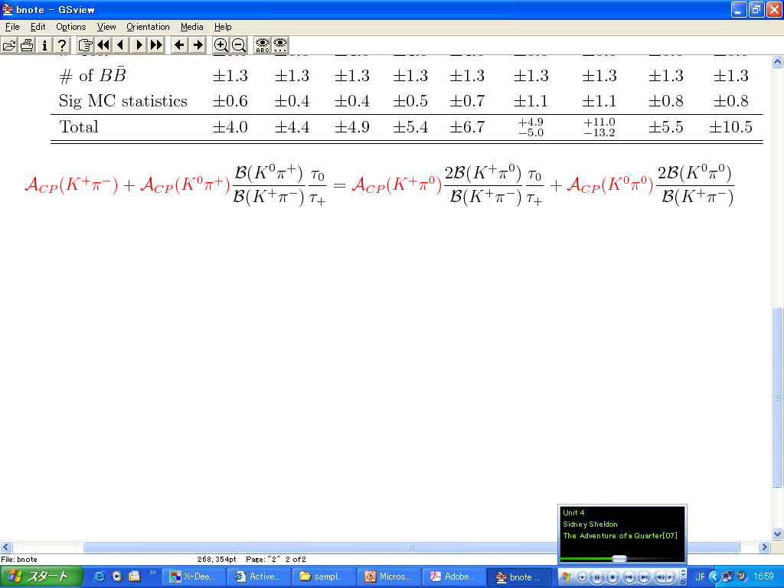

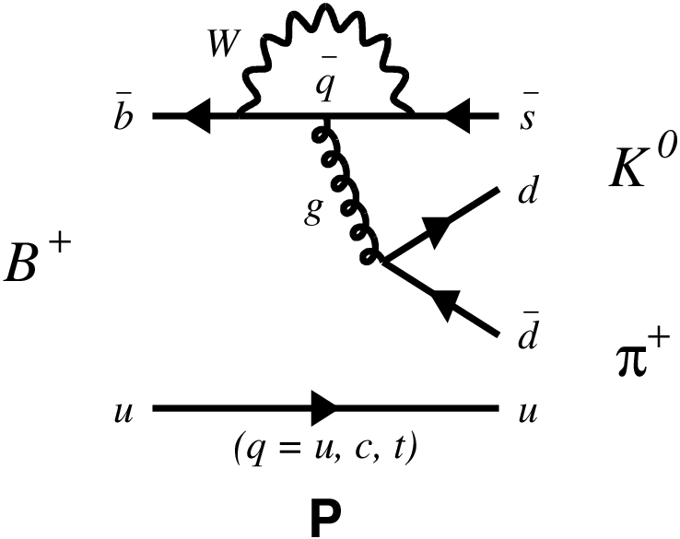
Model independent test of ΔA_{Kπ} Puzzle
M. Gronau, PLB 627, 82 (2005); D. Atwood & A. Soni, Phys. Rev. D 58, 036005(1998).
B⁺→ K⁰ p⁺
B⁰→ K⁰ p⁰
New
A_{cp}(K⁰ p⁰)
A = -0.13 ± 0.13 ± 0.03
Sum rule
A = +0.14 ± 0.13 ± 0.06
•
DA(Kp)
HFAG AVG: -0.01 ± 0.10
P dominants. ⇒A_{cp}(K⁰p⁺)~ 0
World Average
Important topic for Super B factory
Sum rule predicts A_{cp}(K⁰p⁰) = -0.151±0.043
A_{cp}(K⁰p⁺)= 0.009±0.025

Slide 27
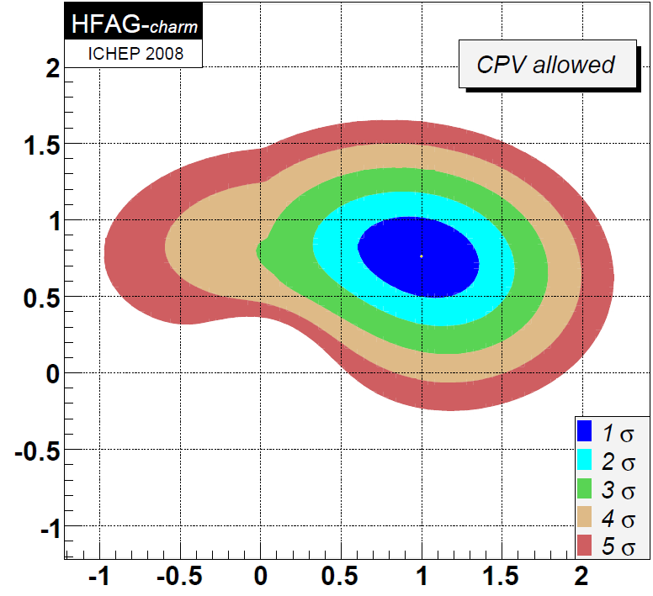
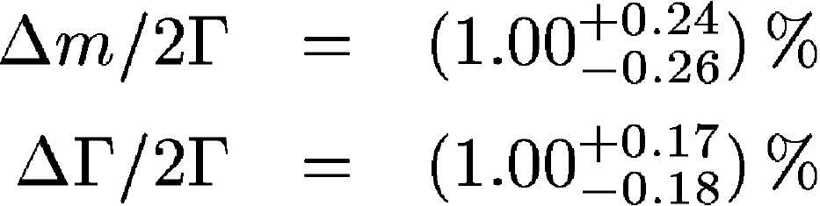
Unexpectedly Large D⁰-D⁰ Mixing
_
_
Unexpectedly large D⁰-D⁰ was found
from the lifetime difference between
D⁰ → K⁺K– and D⁰ → K⁺π–.
(2008 W.A.)
ΔΓ/2Γ
Δm/2Γ

Slide 28
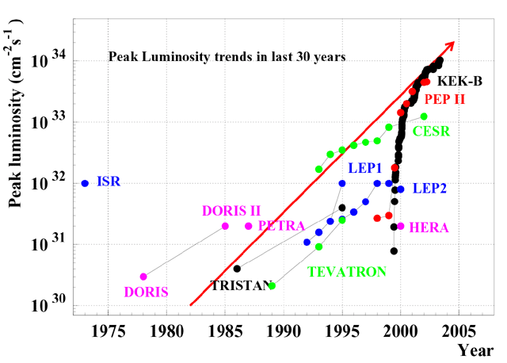
Target luminosity：8×10³⁵cm⁻²s⁻¹
Peak luminosity trends
in the last 30 years
US
Germany
CERN
Will lead to 50ab⁻¹ before 2020.

Slide 29
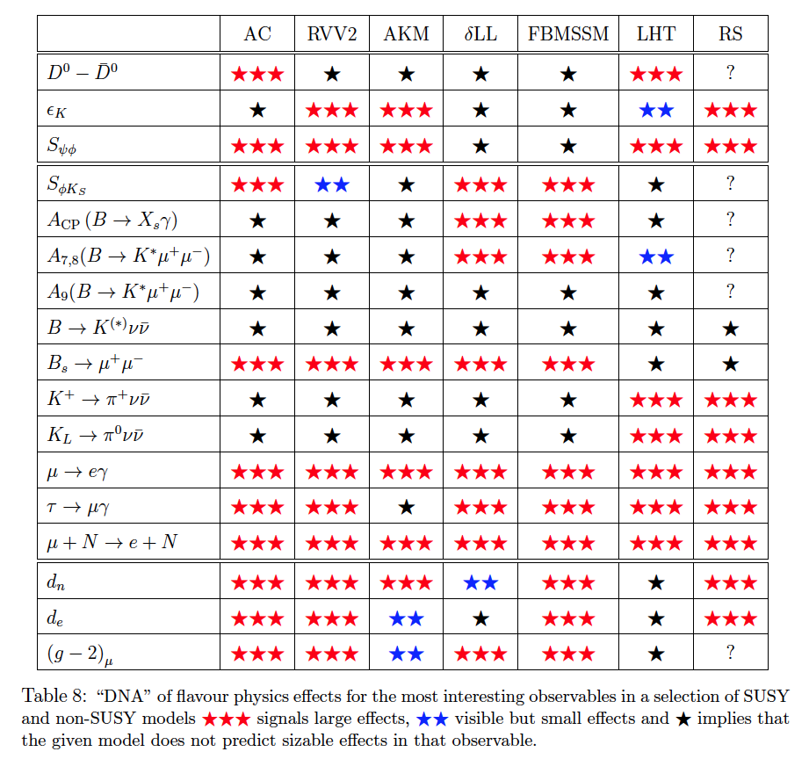
What is next with flavour physics?
LHC will start soon to explore the TeV region, which is the scale of the electroweak symmetry breaking, and most probably related to the “New Physics” scale.
  It is natural to assume that the NP
  effects are seen in B/D/τ decays.
  Flavour structure of new physics?
  CP violation in new physics?
  These studies will be useful to
  identify mechanism of SUSY
  breaking, if NP=SUSY.
Otherwise…
  Search for deviations from SM in
  flavor physics will be one of the
  best ways to find new physics.
In order for the flavor physics to be useful in
the coming LHC era, the precision of various
flavor measurements must be significantly
improved, both in terms of experimental reach
and understanding of theoretical uncertainty.
W. Altmannshofer, A. J. Buras, S. Gori, P. Paradisi, D. M. Straub, Nucl. Phys. B830, 17-94, 2010.

Slide 30
Synergy between flavor and energy frontier experiments
Discoveries in flavor physics
Discoveries in energy frontier
K-K mixing
Charm quark
CP violation in K system
Bottom quark and τ lepton
B-B mixing
Top quark
CP violation in B system
??
New physics, SUSY??

Slide 31
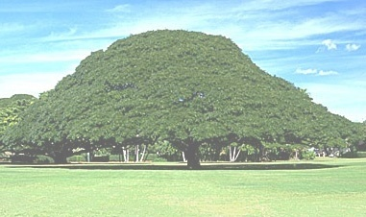
Physics at SuperKEKB
New source of
CP violation
New source of flavor mixing
Precision test of KM scheme
LFV τ decays
SUSY breaking mechanism
Charm physics
New resonances,
D⁰D⁰ mixing…
Super-high statistics
measurements:
α_{S}, sin²θ_{W}, etc.
Notes:
その具体的内容は以下のとおり。

Slide 32
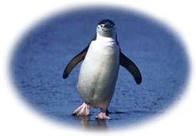
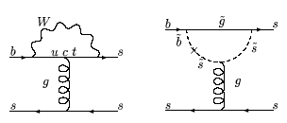
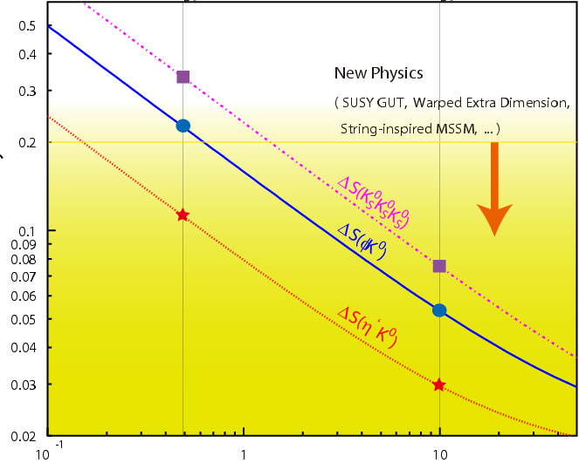
CPV in b→s penguin
In general, new physics contains new sources of flavor
mixing and CP violation.
4In SUSY models, for example, SUSY particles contribute to the b→s transition, and their CP phases change CPV observed in B→φK, η’K etc.
SM
SUSY contribution
Present upper
limits
Deviation from SM
Measurements
at SuperKEKB
（ ab⁻¹ ）
Present B factories
SuperKEKB

Slide 33
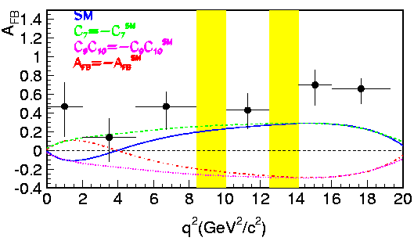
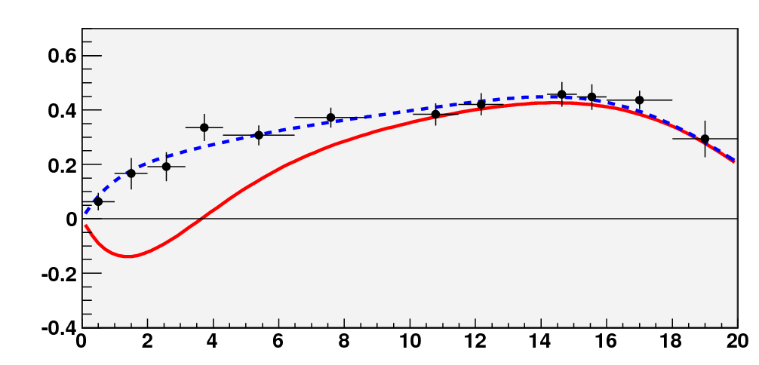
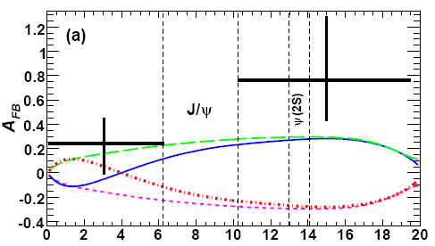

Probing b→ s transition with l ⁺ l ⁻
l ⁺
l ⁻
: Probe the flavor changing
process with the “EW probe”.
γ, Z⁰
This measurement is especially sensitive to new
physics such as SUSY, heavy Higgs and extra dim.
b quark
s quark
?
L⁻
The F/B asymmetry is a consequence
of γ-Z⁰ interference.
B
θ
K*
L⁺
A_{FB}
MC with 50ab⁻¹
q²(GeV²/c²)

Slide 34
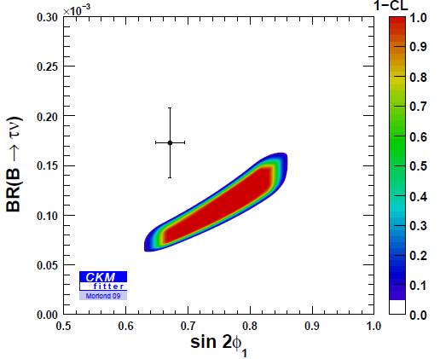
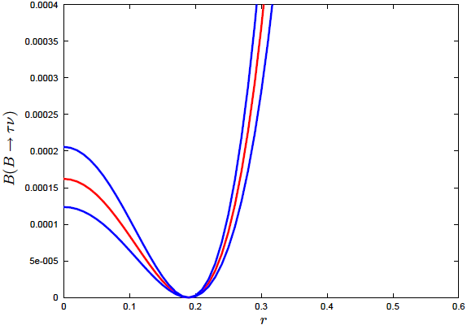

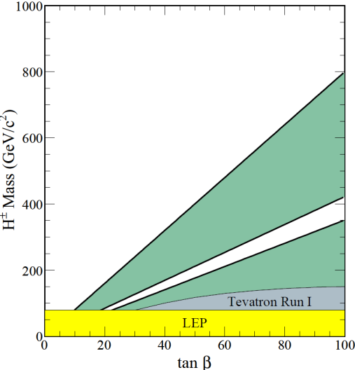



H±search in B to τ decays
ν
B (Β→τν) = (1.73± 0.35 )x10⁻⁴
B
B
e⁻
Υ
e⁺
H⁺/W⁺
τ ⁺
B
π
2.1σ deviation
D
full reconstruction
0.2~0.3% for B⁺
B->τν: H-b-u coupling
B->Dτν : H-b-c coupling
gb->tH: H-b-t coupling
Belle, 2008
b
ν
H⁻
u
B→τν
τ
τ
H
ν
b
c
B→Dτν

Slide 35


Search for LFV τ decays
Upper limits
τ−>μγ
μ->eγ
τ−>eγ
Reach of B factories
T.Goto et al., 2007
SuperKEKB

Slide 36










Colliding bunches
Belle II
New IR
e- 2.3 A
New superconducting /permanent final focusing quads near the IP
SuperKEKB
New beam pipe
& bellows
e+ 4.0 A
Replace long TRISTAN dipoles with shorter ones (HER)
Add / modify RF systems for higher beam current
Low emittance positrons to inject
Positron source
Redesign the HER arcs to squeeze the emittance
Damping ring
New positron target / capture section
TiN-coated beam pipe with antechambers
Low emittance gun
Low emittance electrons to inject
x 40 Gain in Luminosity

Slide 37

SuperKEKB – Machine parameters
Parameter | Units | KEKB |  | SuperKEKB
 |  | HER (e⁻) | LER (e⁺) | HER (e⁻) | LER (e⁺)
Circumference | m | 3016.3 |  | 3016.3
Energy | GeV | 8 | 3.5 | 7 | 4
Crossing angle | mrad | 22 |  | 83
β_{x} at IP | cm |  |  | 2.5 | 3.2
β_{y} at IP | mm | 5.9 | 5.9 | 0.30 | 0.27
ε_{x} (emittance) | 10⁻⁹ m | 24 | 18 | 5.3 | 3.2
Emittance ratio | % |  |  | 0.35 | 0.40
σ_{z} | mm | 6 | 6 | 5 | 6
Beam current | mA | 1190 | 1640 | 2620 | 3600
σ_{x} at IP | 10⁻⁶ m |  |  | 7.75 | 10.2
σ_{y} at IP | 10⁻⁹ m | 940 | 940 | 59 | 59
ξ_{x} (tune shift) |  |  |  | 0.0028 | 0.0028
ξ_{y} |  | 0.090 | 0.129 | 0.0875 | 0.09
Luminosity | cm⁻² s⁻¹ | 2 x 10³⁴ |  | 8 x 10³⁵
High
beam current
Nanobeam
x40

Slide 38

Strategy: Nano-Beam Option
(1) Smaller β_{y}*
5.9(LER)/5.9(HER) mm→0.27/0.30 mm
(2)Increase beam currents
1.6 A (LER) / 1.2A (HER) → 3.6 A (LER) / 2.6 A (HER)
  Close to original KEKB design
(3) Increase ξ_{y}
0.13(LER)/0.09(HER) → 0.09/0.09
Proposed by P. Raimondi et al., along with Crab Waist, for use at Italian Super B Factory

Slide 39


The Problem of Electron Clouds
Photo-electrons produced at the beam pipe wall by synchrotron radiation are trapped in the region of the beam orbit in the positron ring, which blow up the beam.

Slide 40




Beam duct for SuperKEKB
Copper beam duct with ante-chambers
  Copper is required to withstand intense SR power
Features (compared to simple pipe):
  Low SR power density
  Low photoelectrons in beam pipe
  Low beam impedance
Pump
Beam
SR
LER
HER
Y.Suetsugu

Slide 41



Design of main components_5
41
Y. Suetsugu
Bellows and gate valves with comb-type RF-shield
  Sure RF shielding, thermally strong
  applicable to ante-chamber scheme
  Finger-type for some cases, if flexibility is required.
Trial models have been installed into the ring and tested.
  Reduction in the temperature of bellows has been demonstrated.
Copper RF shield will be used even for
aluminum-alloy beam ducts.
Gate valve
Bellows chamber
RF-shield (gate valve)
2010/2/17

Slide 42


And more on suppressing photoelectrons
Clearing Electrode
Can be used inside magnet, where solenoid fields are ineffective.
Grooved Surface (M. Pivi, SLAC)
Can also be used inside magnet.
Mechanically traps photoelectrons.
Clearing Electrode
Grooved Surface
TiN~50 nm
Effectiveness of both designs in reducing electron clouds has been demonstrated at KEKB LER.
R&D continuing in collaboration with Cornell (CesrTA) and SLAC.
Y.Suetsugu

Slide 43


Vibration Measurements
43
M. Masuzawa
QC1RE
KEKB tunnel at the IP vibrates at
  ~ 0.3 Hz in the horizontal direction (micro-seismic)
  ~3 Hz in the vertical direction & horizontal direction (resonance of the “Kanto loam” soil around KEK)
  In addition, magnets, QCS boat and the table vibrate at ~ 8Hz.
QCS-boat
Movable table
KEKB tunnel floor
Belle-stand
B4 floor
The vibration amplitude of the IR magnets are much smaller
than the size of the colliding beams (~2μm vertically & ~100μm
horizontally) for KEKB but comparable for SuperKEKB.

Slide 44


Slide 45
Requirements for the Belle II detector
Critical issues at L= 8 x 10³⁵/cm²/sec
4 Higher background ( ×10-20)
4 Higher event rate ( ×10)
4 Special features required
radiation damage and occupancy
fake hits and pile-up noise in the EM Calorimeter
- higher rate trigger, DAQ and computing
low p m identification f smm recon. eff.
hermeticity f n “reconstruction”
Result: significant upgrade

Slide 46

Belle II detector upgrade
CsI(Tl) EM calorimeter:
waveform sampling
electronics, pure CsI
for end-caps
7.4 m
RPC m & K_{L} counter:
scintillator + Si-PM
for end-caps
4 layers DS Si Vertex
Detector →
2 layers PXD (DEPFET),
4 layers DSSD
5.0 m
Time-of-Flight, Aerogel
Cherenkov Counter →
Time-of-Propagation counter
(barrel),
prox. focusing Aerogel RICH
(forward)
Central Drift Chamber:
smaller cell size,
long lever arm

Slide 47

Interaction Region Design

Slide 48

Vertex Detector
Nano beam option: 1 cm radius of beam pipe
„PXD“
2 layer Si pixel detector (DEPFET technology)
(R = 1.3, 2.2 cm) monolithic sensor
thickness 50 µm (!), pixel size ~50 x 50 µm²
PXD
4 layer Si strip detector (DSSD)
(R = 3.8, 8.0, 11.5, 14.0 cm)
„SVD“
Significant improvement in z-vertex resolution
SVD
σ [µm]
PXD+SVD
PXD
100
Belle
50
Belle II:
30μm
20
Belle II
15μm
0
0.4
0.8
1.2
1.6
2.0
4.4 cm
pβsin(θ) [GeV/c]

Slide 49



DEPFET pixels for Belle II
radius pixel thickness
Layer 1 r = 14mm 50x50μm² 75μm(0.18%X0)
Layer 2 r = 22mm 50x75μm² 75μm
total of 8 M pixels
Mechanical mockup
Power consumption in sensitive area: 0.1W/cm² => air-cooling sufficient

Slide 50



Particle ID
Ring Imaging Cherenkov Detectors
>4σ K/π separation up to 4GeV/c
Aerogel radiator
n1=1.045
n2=1.055
photodetector
endcap
Aerogel RICH
barrel
TOP（Time-Of-Propagation）Counter

Slide 51





Barrel PID
Cherenkov ring imaging detector with precise timing information
  Quartz radiator
    2cm^{T}x~40cm^{W}x~2.5m^{L}
    Possible configurations
      1-bar or 2-bar
      Small stand-off box or not
  MCP-PMT
    Two candidates
      Hamamatsu SL10 or Photonis 85015
    Excellent time resolution (<40ps) required for
    good K/π separation; confirmed on laser bench
  Electronics
    Fast waveform sampling
      New ASIC chip ready soon
Hamamatsu SL10
Laser test
σ=34.2±0.4ps
TDC [1count/25ps]

Slide 52






Aerogel RICH for endcap PID
“Focusing” Aerogel radiator
N_{pe} = 9.1, σ(track) = 4.2 mrad achieved
~5.5σ separation for 4 GeV/c K/π
1.045
1.055
1.050
1.062
Photon Sensors
  Sensitive to single photon
    High QE >~ 20 %
    High gain
  Position detection accuracy: ~5x5 mm²
  Large effective area: >~ 70 %
  Operational with 1.5 Tesla magnetic field
Hybrid (Avalanche) Photon Detector
MCP (Micro Channel Plate) PMT
Si-PM/MPPC

Slide 53




Expected PID improvement
K efficiency
2 GeV/c
3 GeV/c
4 GeV/c
2 GeV/c
3 GeV/c
4 GeV/c
p fake rate
Belle PID
iTOP only (no dE/dx)

Slide 54

Expected Performance
(Luminosity gain)
No upgrade
BAD
Upgrade
GOOD
No upgrade
BAD
Upgrade
GOOD
FWD BRL | ACC only | dE/dx only | As good as Belle | A-RICH
TOF, dE/dx NA | –74% | –69% | –68% | –62%
TOF NA | –41% | –35% | –32% | –22%
As good as Belle | –10% | –4% | 0% (definition) | +12%
iTOP | +45% | +51% | +60% | +83%
Completely different game with excellent PID detectors
Example mode:
B⁰gρ⁰γ

Slide 55



KLM Upgrade
Scintillator-based KLM (endcap)
y-strip plane
~120 strips in one 90º sector
(max L=280cm, w=25mm)
Readout by WLS fiber couple to Geiger mode APD (GAPD)
~30000 read out channels
Iron plate
x-strip plane
CPTA MRS APD
796 40um pixels, 1.28 mm inscribed circle
Aluminium frame
Fermilab (USA)
(used in T2K near detector)
D1.2
10
40

Slide 56


— ITEP scintillator 1m×1m test module (96 readout ch.)
These modules will be installed in Oho side

Slide 57


Early November 2010: extracted the SVD2 – vertex detector
Deconstructing to start Belle II upgrade
Belle Detector Roll-out: Dec. 9, 2010
End-caps, CDC, B-ACC, TOF extraction: by end of Jan. 2011
Ready for new construction to start…

Slide 58


The Earthquake
M22 bolts!!
As is well known, Japan suffered a terrible earthquake and tsunami on March 11, which has caused tremendous damage, especially in the Tohoku area. Fortunately, all KEK personnel and users were safe. The injection linac did suffer significant but manageable damage, and repairs are underway. The damage to the KEKB main rings appears to be less serious, though non-negligible. No serious damage has been reported so far at Belle. Further investigation is necessary. We would like to convey our deep appreciation to everyone for your generous expressions of concern and encouragement.

Slide 59

KEKB/Belle status
Fortunately enough:
KEKB stopped operation in July 2010, and the low energy ring was to a large extent disassembled
Belle was rolled out its parked position
The 1400 tons of Belle moved by ~6cm
(most probably by 20cm in one direction,
and 14cm back)...
We are checking the functionality of the Belle spectrometer (in particular the CsI calorimeter), so far checks out OK in LED and cosmic ray tests
The lab (Tsukuba campus) has to a large extent recovered from the earthquake, back to normal operation – very little impact on the upgrade schedule

Slide 60


Belle II Collaboration
15 countries, ~60 institutions
~400 collaborators
Belle II web page: http://b2comp.kek.jp/~twiki/pub/Organization/B2TDR/B2TDR.pdf
TDR

Slide 61


Belle-II Collaboration has been formed
2004.06 SuperKEKB LoI
2008.01 KEK Roadmap
2008.03 1st Proto collaboration meeting
2008.10 Detector study report
2008.12 New collaboration, Belle-II, started
2010.11 Technical Design Report published
~2011.7 Open collaboration meetings

Slide 62
SuperKEKB construction schedule
Revised on Sep. 10, 2011
FY2010
FY2011
FY2012
FY2013
FY2014
Dismantle KEKB
Fabrication
Beam pipes and vacuum components
Baking, TiN coating
Install, system check
Fabrication
Magnets and power supplies
Field measurement
Install, alignment, system check
RF system
Reinforce and rearrange
SuperKEKB
commissioning
Monitor & control,
Beam transport
R&D
Fabrication
Optics and hardware design, R&D
QCS and IR hardware
Fabrication
MR buildings construction
Install, system check,
field measure
+ IR assembly
MR infrastructure
Cooling system reinforcement
Damping Ring
Components Fabrication
DR tunnel construction
Install, alignment, system check
DR buildings construction
e+e- Injector
Upgrade and operation for PF/PF-AR
Injector commissioning

Slide 63
Summary
KEKB/Belle provided quantitative confirmation to Kobayashi-Maskawa theory.
Next generation e⁺e⁻ B factory with L~10³⁶ is very useful to study the new sources of flavor mixing and CP violation, which is anticipated to be present at O(1TeV) energy scale.
SuperKEKB : Nano-beam scheme with the goal L~8x10³⁵.
Belle-II : Detector upgrade to improve its performance and BKG/rate immunity.
New collaboration, Belle-II, has been formed.
We hope to have another friendly competition with SuperB at Cabibbo Lab.
KEK conducts diverse research program using electron and proton accelerators.

Slide 64




KEK : High Energy Accelerator Research Organization
J-PARC
Tokai
Tsukuba
B-Factory
LC-Test Facility
Photon-Factory

Slide 65













KEK Current Core Activities
J-PARC in Tokai
KEKB-Factory
Photon Factory
ILC Test Facility
STF
LHC at CERN
ATF

Slide 66

J-PARC
Neutrino Beam
in 2009
Material & Life science Facility
:
Neutron and Muon Beams
in 2008
Hadron Facility
:
Kaon Beam
in 2009
Notes:
以上、加速器の現状を述べましたが、それでは，この施設を用いてどんな研究を展開するのかという話題に移りたいと思います。
この写真はさっきの写真とよく似ておりますが、実験室がよく見えるように、逆方向の南から北方向を眺めたものです。
本年度末には、物質生命科学実験施設とハドロン実験施設において実験が始まります。そして、来年度早々には、ニュートリノビームを神岡の方に送ることにしております。
実験室としては３つありますので、それぞれでどんな科学が展開されるのかをザッと眺めたいと思います。

Slide 67





T2K : Long Baseline Neutrino Experiment
Tokai
Kamioka
T2K
J-PARC
Super-Kamiokande
Solar exps. + KamLAND
Super-Kamiokande
K2K
  ~400 members from 12 Countries:
  Japan(66), US(58), Canada(50),France(38), UK(37) Switzerland(31),
  Poland(22), Korea(13), Russia(12),
  Spain(11), Italy(9), Germany(2)
T2K

Slide 68





Photon Factory
PF：2.5GeV, 450mA e⁻
PF-AR:6.5GeV, 50mA e⁻
: Single Bunch
60 stations : active

Slide 69







atomic & molecular structures,
electron properties of nano-materials,
biological science, protein crystallography,
environmental science, ・・・・・

Slide 70


Future Light Source : Energy Recovery Linac
ERL: 5 GeV
Compact ERL: 60 ~ 200 MeV
ERL : Energy Recovery Linac
 | average brilliance | peak brilliance | repetition rate (Hz) | coherent fraction | bunch width (ps) | # of BLs
ERL | ~10²³ | ~10²⁶ | 1.3G | ~20% | 0.1~1 | ~30
XFEL | 10²²~10²³ | ~10³³ | 100~1K | 100% | 0.1 | ~1
(brilliance : photons/mm²/mrad²/0.1%/s @ 10 keV)

Slide 71












ATF : Accelerator Test Facility (KEK)
ATF2: Realization of the nanobeam
(beam commissioning : October 2008)
Diagnostic line for
the extracted low emittance beam
ATF DR
ATF Linac
Construction started in 1993
Achieved world smallest emitance ~2pm
World-wide collaboration going-on

Slide 72







Superconducting Accelerator
Test Facility (KEK)

