Slide 1
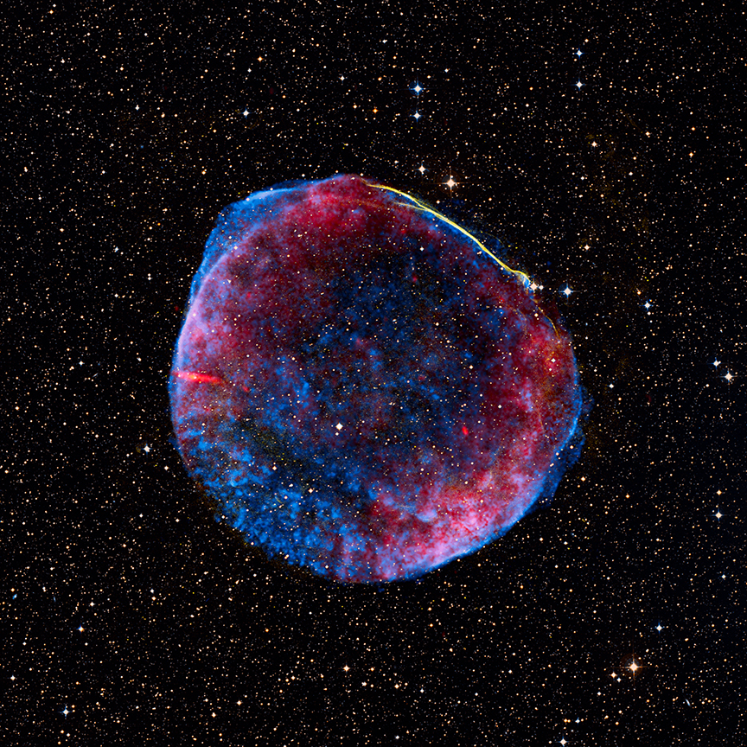
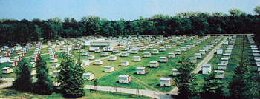
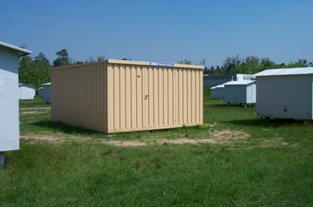
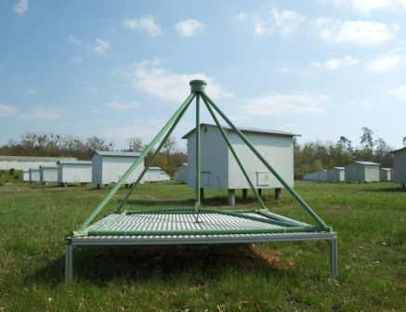
Exploring the light and heavy composition of cosmic rays with KASCADE-Grande
J.C. Arteaga-Velázquez for the KASCADE-Grande Collaboration
IFM, Universidad Michoacana
Morelia, Michoacan, Mexico
Kascade-Grande ,J.C. Arteaga, U. Michoacana XIII MWPF, October, Guanajuato

Slide 2
Exploring the light and heavy composition of cosmic rays with KASCADE-Grande
J.C. Arteaga-Velázquez for the KASCADE-Grande Collaboration
IFM, Universidad Michoacana
Morelia, Michoacan, Mexico
Content
Introduction
Experiments around E~10¹⁵ eV
The KASCADE-Grande detector
Results about composition
Summary
Kascade-Grande ,J.C. Arteaga, U. Michoacana XIII MWPF, October, Guanajuato

Slide 3
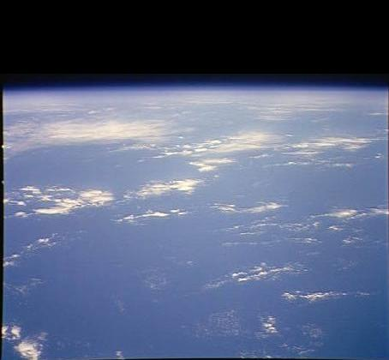
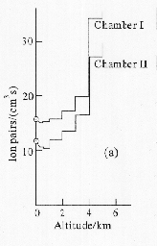
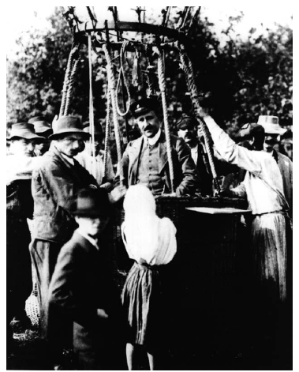
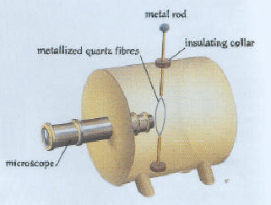
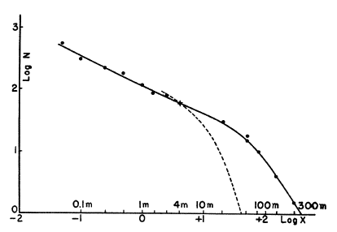
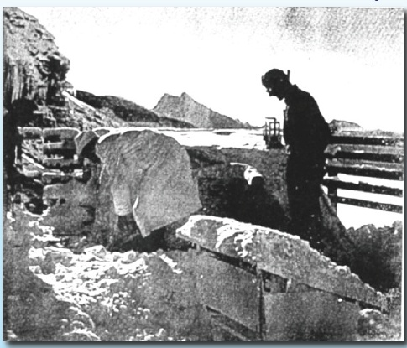
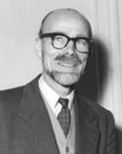
Introduction
1911-1912. V. F. Hess
Balloon flights up to 5 km a.s.l.
Ionization increases with altitude
“a radiation of very high penetrating power
enters our atmosphere from above”
Hess, V.F., 1912, Phys.. Z, 13 1084.
1930´s. P. Auger and collaborators
Jungfraujoch, Switzerland, 3500 m a.s.l.
Geiger-Müller counters: Long distance
coincidences, up to 300 m (Δt ∼ 1 μs) .
“end effects of showers that the primary
particles…which enter the high atmosphere
produced there” (Ne ∼ 10⁶ => E ∼ 10¹⁵ eV)
Coincidences
Auger, P., Maze, R. and Robley, C.R., 1938, Compt. Rend., 208 1641; Auger et al., Rev. Mod. Phys. 11, 288 (1939).

Slide 4
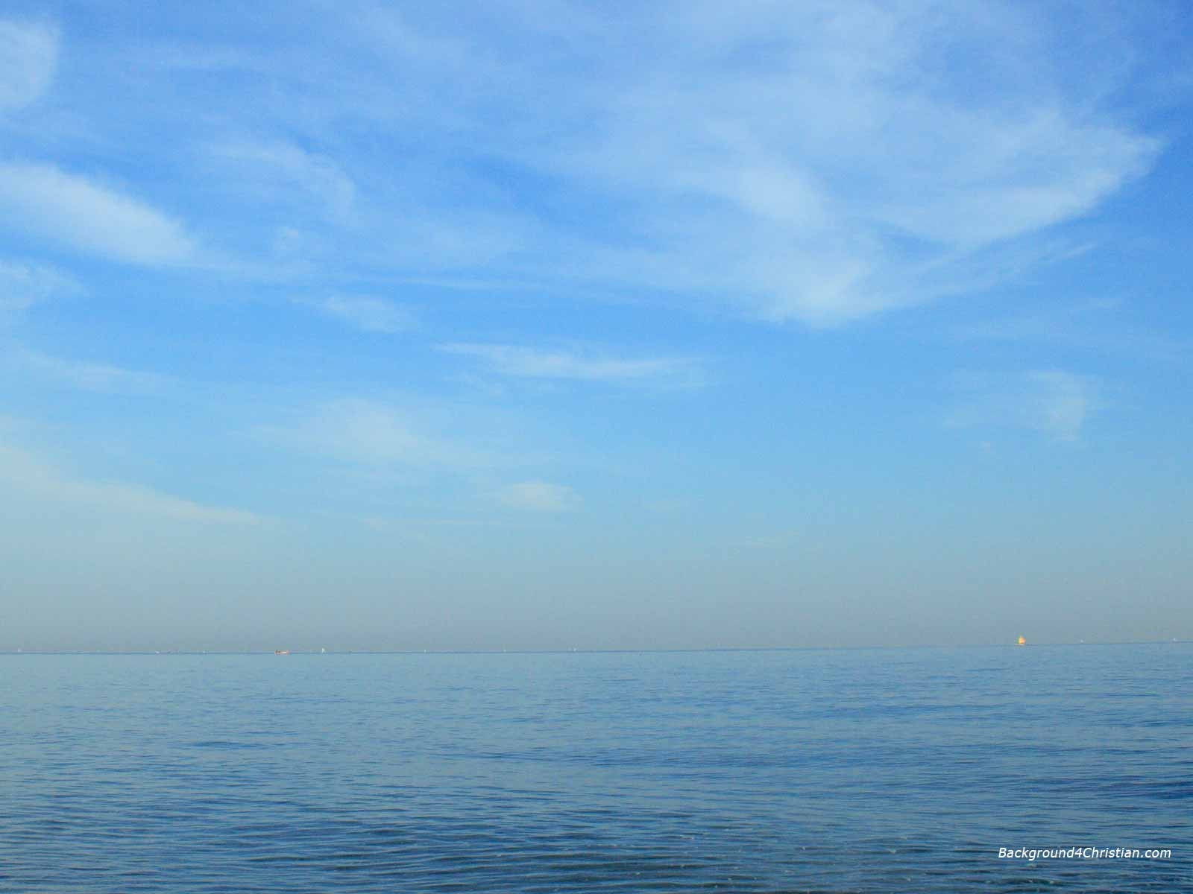
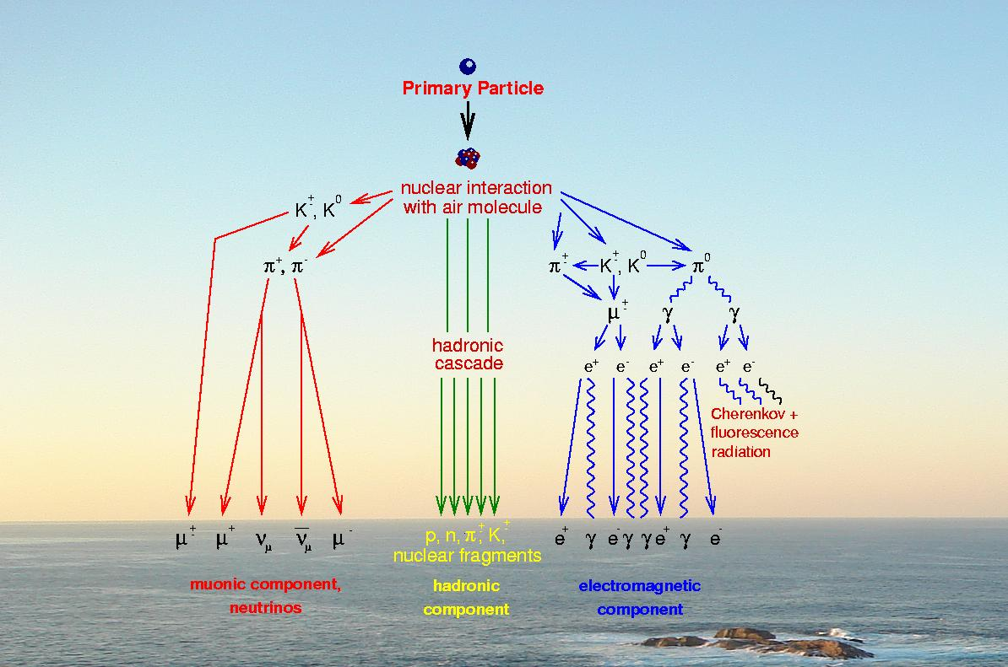
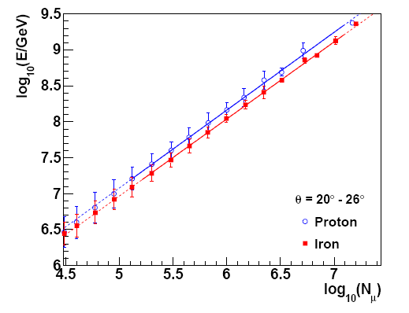
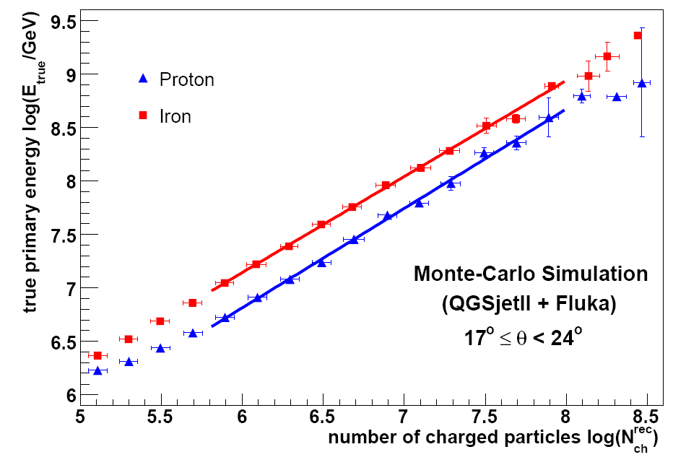
Introduction
Extensive air shower
Kascade-Grande ,J.C. Arteaga, U. Michoacana XIII MWPF, October, Guanajuato

Slide 5
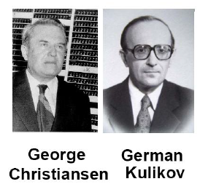
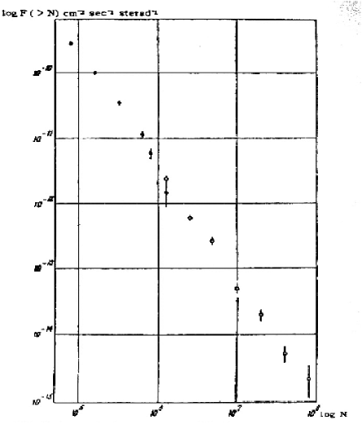
Introduction
1958. G. Christiansen y G. Kulikov
Group from Moscow University
Measured the flux of events vs
Numb. of charged particles (N_{ch} ∝ E^{β})
“the observed spectrum is a
superposition of the spectra
of particles of galactic and
metagalactic origin”
Discovery of the “Knee”
Kulikov and Khristiansen , On the size distribution of extensive atmospheric showers, J. Exper. Theor. Phys. 35, 635, (1958).

Slide 6
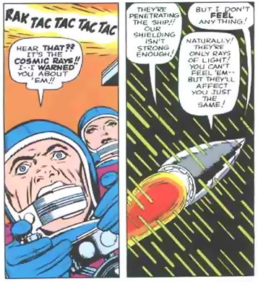
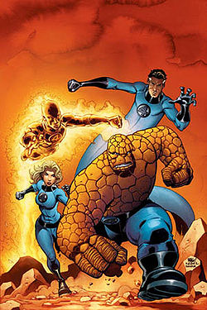
Introduction
1961. Fantastic Four get powers from cosmic rays
Kascade-Grande ,J.C. Arteaga, U. Michoacana XIII MWPF, October, Guanajuato

Slide 7
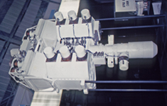
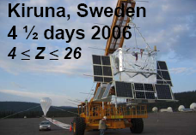
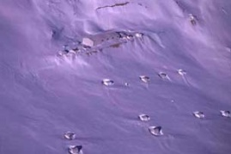
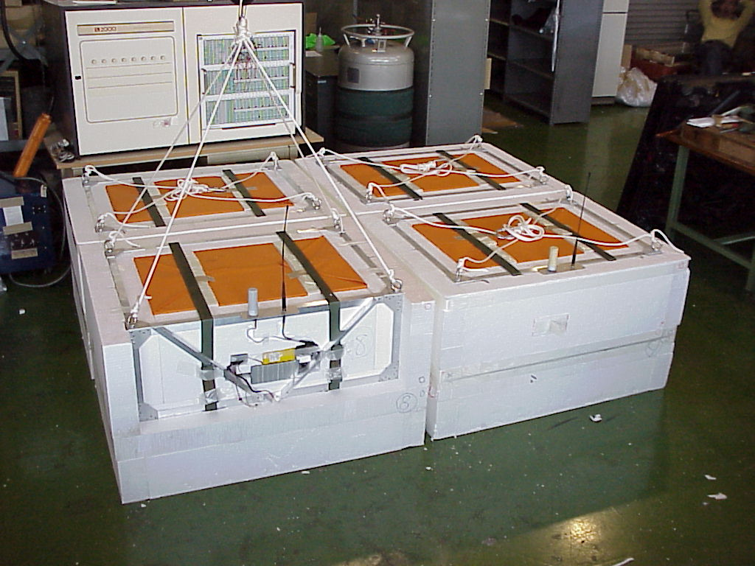
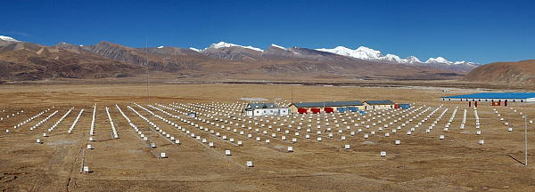
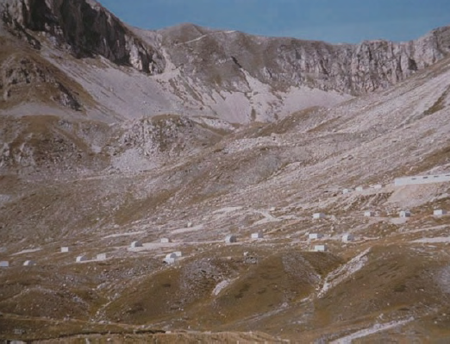
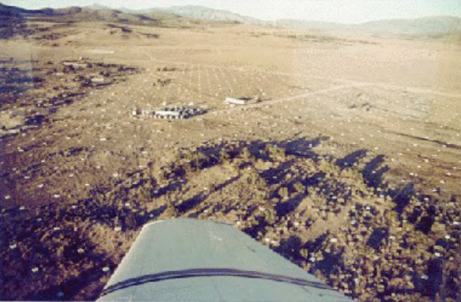
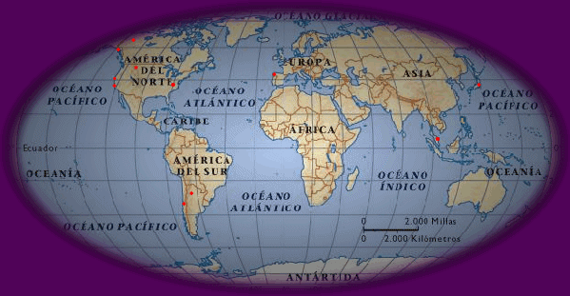
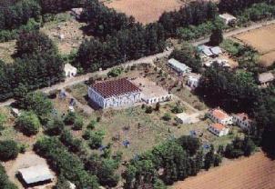
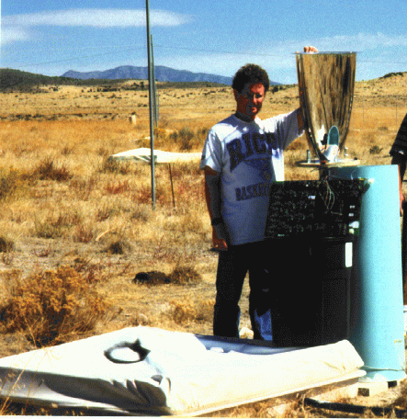
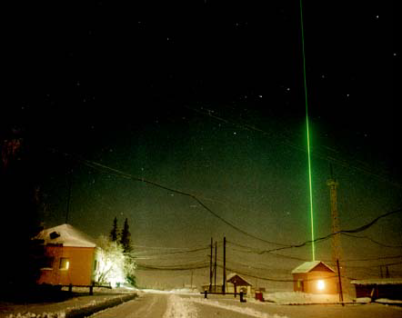
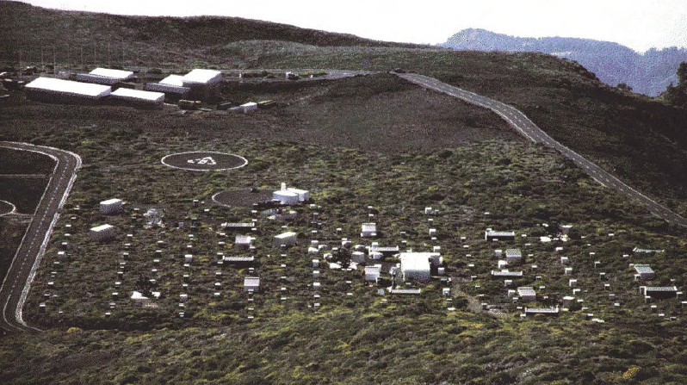
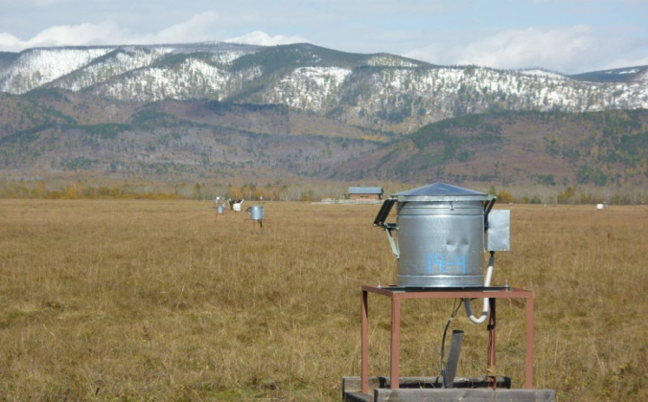
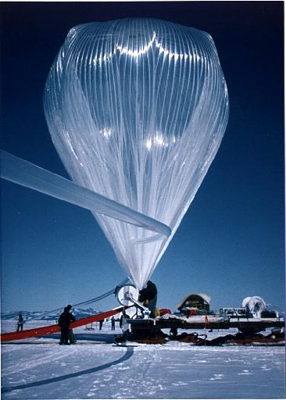
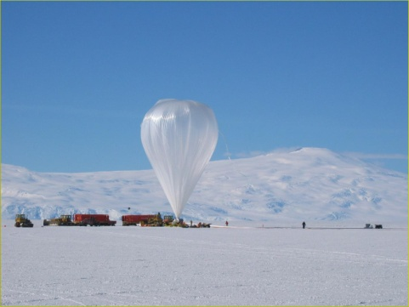
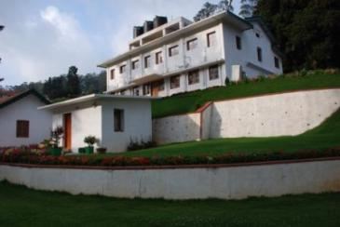
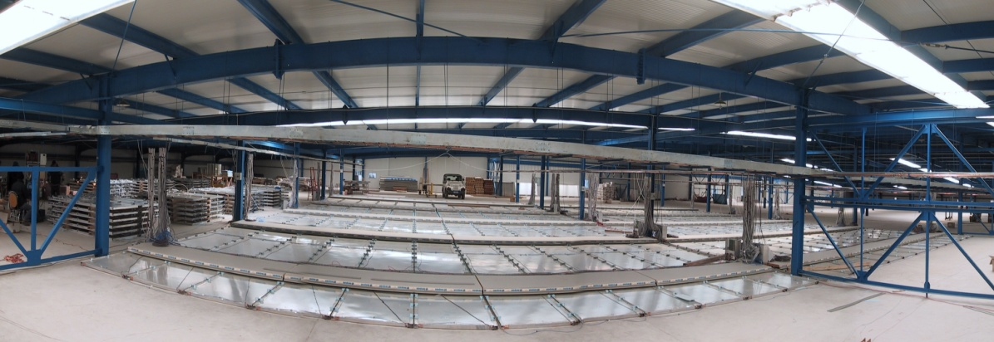
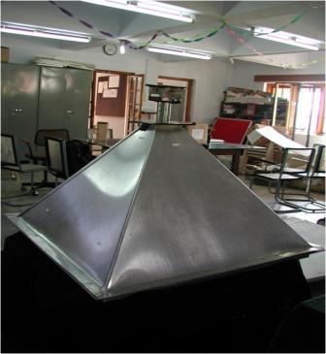
2) Experiments around E ∼ 10¹⁵ eV
Different models, depths and observables
Sokol, Kosmos1713 Satellite
TRACER, Hemis. (1999- 2006)
EAS-TOP, Gran Sasso
RunJob, over Russia (1996-2011)
Tibet AS-Gamma, Tibet
CASA-MIA, Utah
(1990-1998)
Akeno, Japan
Blanca Utah
Yakutsk, Russia
HEGRA, La Palma, Canarias
Tunka 25, Russia
JACEE, Antartic (1979-1996)
CREAM, Antartic
(2004-2006)
Grapes, India
ARGO-YBJ, Tibet

Slide 8
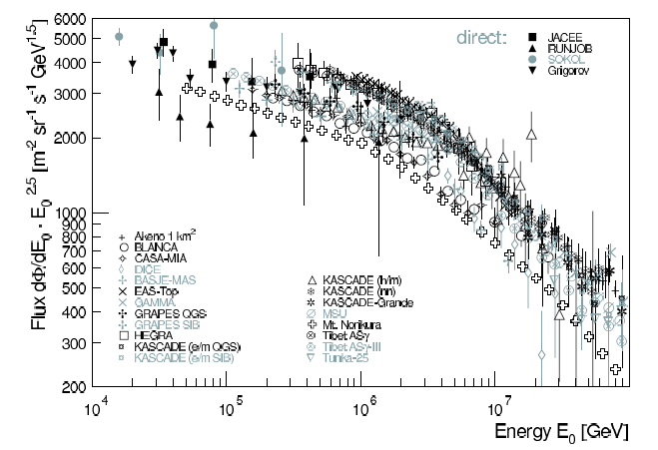
2) Experiments around E ∼ 10¹⁵ eV
Energy spectrum
A similar behaviour
is observed: “knee”
around 4 PeV.
Agreement within
a factor of two.
Agreement between
direct and indirect
experiments.
Systematic errors:
ΔE/E = 15-25 %
Kascade-Grande ,J.C. Arteaga, U. Michoacana XIII MWPF, October, Guanajuato

Slide 9
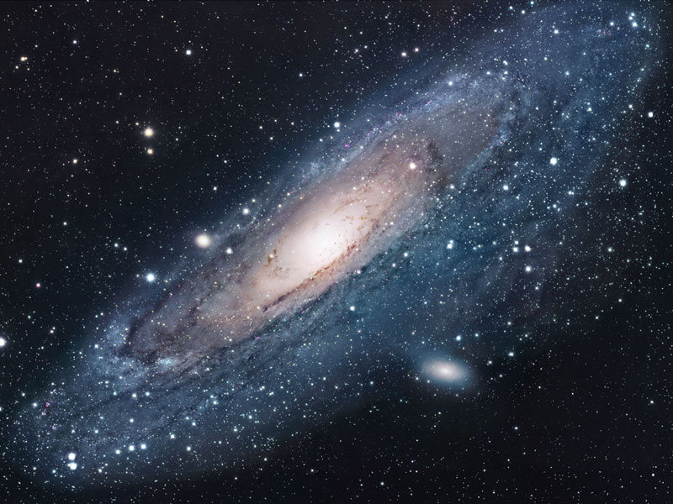
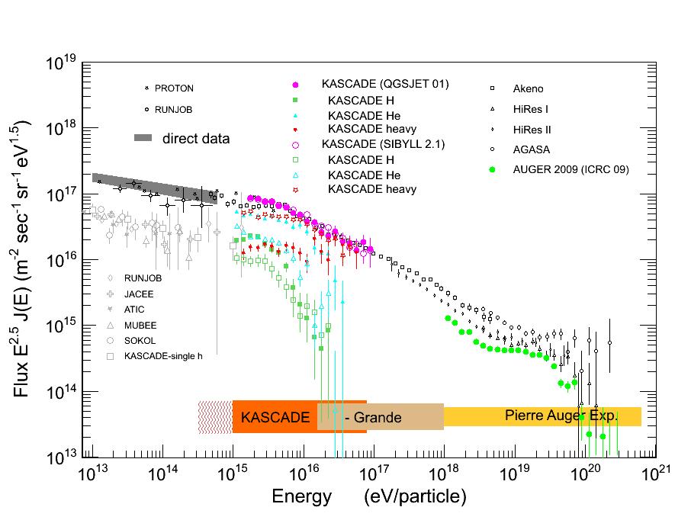
2) Experimentos: E ∼ 10¹⁵ eV
Questions
Knee origin
Second knee?
-Iron knee?
Galactic to
extragalactic
transition
-Sources
-Propagation
-Acceleration
Data
Spectrum
Composition
Arrival direction
γ/ν
Kascade-Grande ,J.C. Arteaga, U. Michoacana XIII MWPF, October, Guanajuato

Slide 10
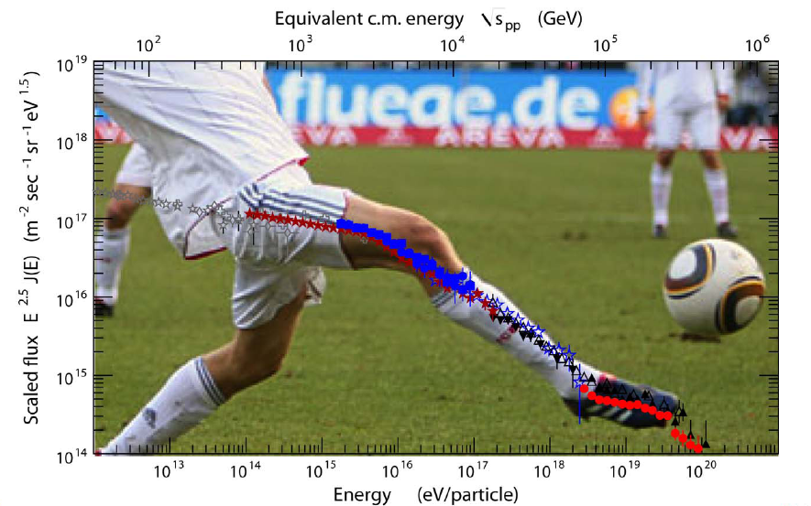
2) Experimentos: E ∼ 10¹⁵ eV
Courtesy A. Haungs
Kascade-Grande ,J.C. Arteaga, U. Michoacana XIII MWPF, October, Guanajuato

Slide 11
Problem of galaxy confinement:
E_{max} ~ Ze x B x R
~ H: 10¹⁵ eV - Fe: 10¹⁷ eV
Lcr ~ 10⁴⁰ erg/s = 1% L _{SNR}
Problem with efficiency of accelerators (Fermi mechanism):
E^{H}_{max} = 4 x 10¹⁵ eV & E^{Fe}_{max} = 10¹⁷ eV
J. Hörandel, Astrop. Phys. 21 (2004) 241

Slide 12
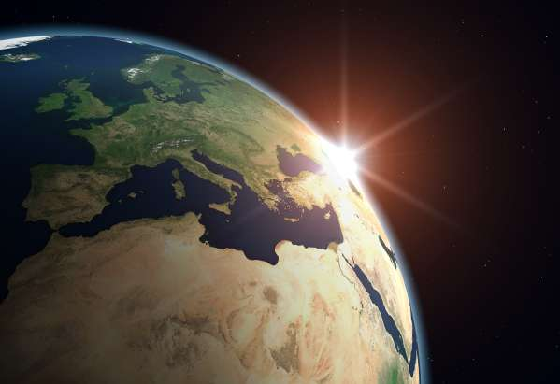
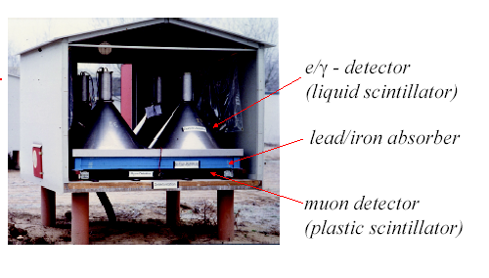
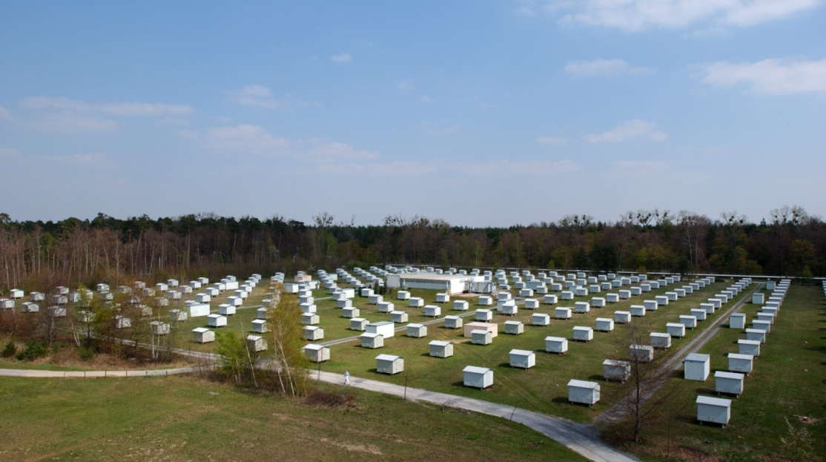
2) Experiments around E ∼ 10¹⁵ eV
Karlsruhe Shower Core and Array Detector
Components:
- Ground array with 252 e/γ and μ
scintillator detectors
- Central detector (Calorimeter, μ detectors)
- Muon tracking detector
Observables:
N_{e}, N_{μ}, H_{hadron}
E = 10¹⁴ – 10¹⁷ eV
Kascade-Grande ,J.C. Arteaga, U. Michoacana XIII MWPF, October, Guanajuato

Slide 13
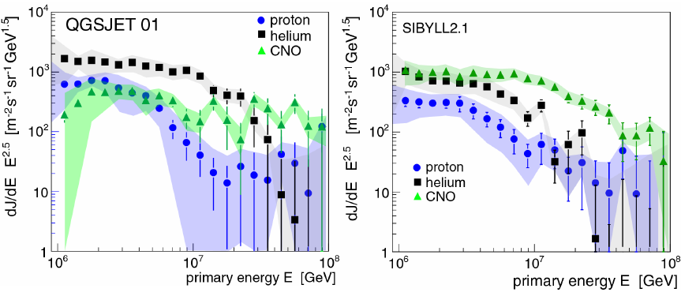
2) Experiments around E ∼ 10¹⁵ eV
Astro.Phys. 24 (2005)
Results
Knee produced by light component
Relative abundances show dependence with hadronic interaction model
Results
Knee produced by light component
Relative abundances show dependence with hadronic interaction model
Kascade-Grande ,J.C. Arteaga, U. Michoacana XIII MWPF, October, Guanajuato

Slide 14
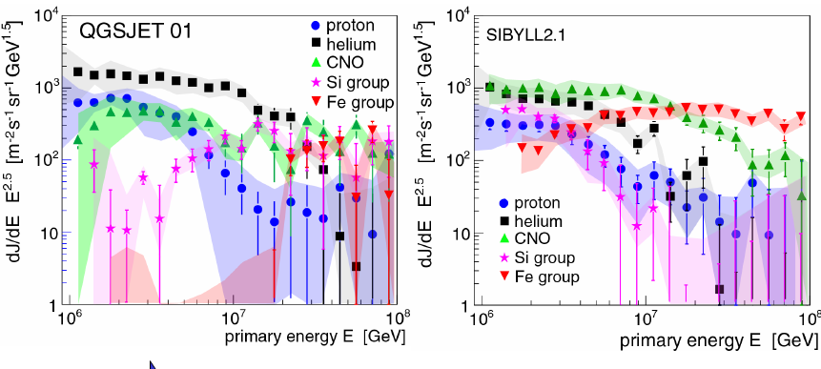
2) Experiments around E ∼ 10¹⁵ eV
Astro.Phys. 24 (2005)
Results
Knee produced by light component
Relative abundances show dependence with hadronic interaction model
Knee position change with composition (E_{knee} α Z or A?)
Results
Knee produced by light component
Relative abundances show dependence with hadronic interaction model
Knee position change with composition (E_{knee} α Z or A?)
E^{Fe}_{knee} ~ 10¹⁷ eV?
Kascade-Grande ,J.C. Arteaga, U. Michoacana XIII MWPF, October, Guanajuato

Slide 15
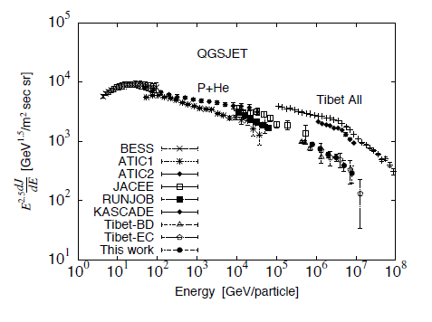
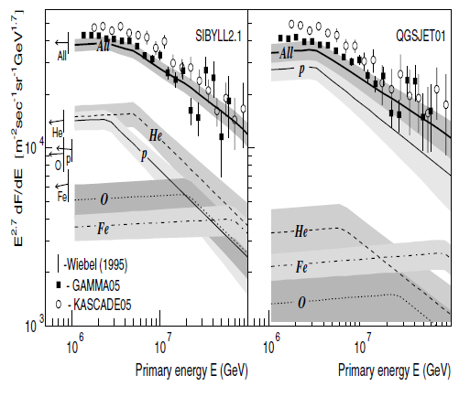
2) Experiments around E ∼ 10¹⁵ eV
Tibet results
GAMMA results
Kascade-Grande ,J.C. Arteaga, U. Michoacana XIII MWPF, October, Guanajuato

Slide 16
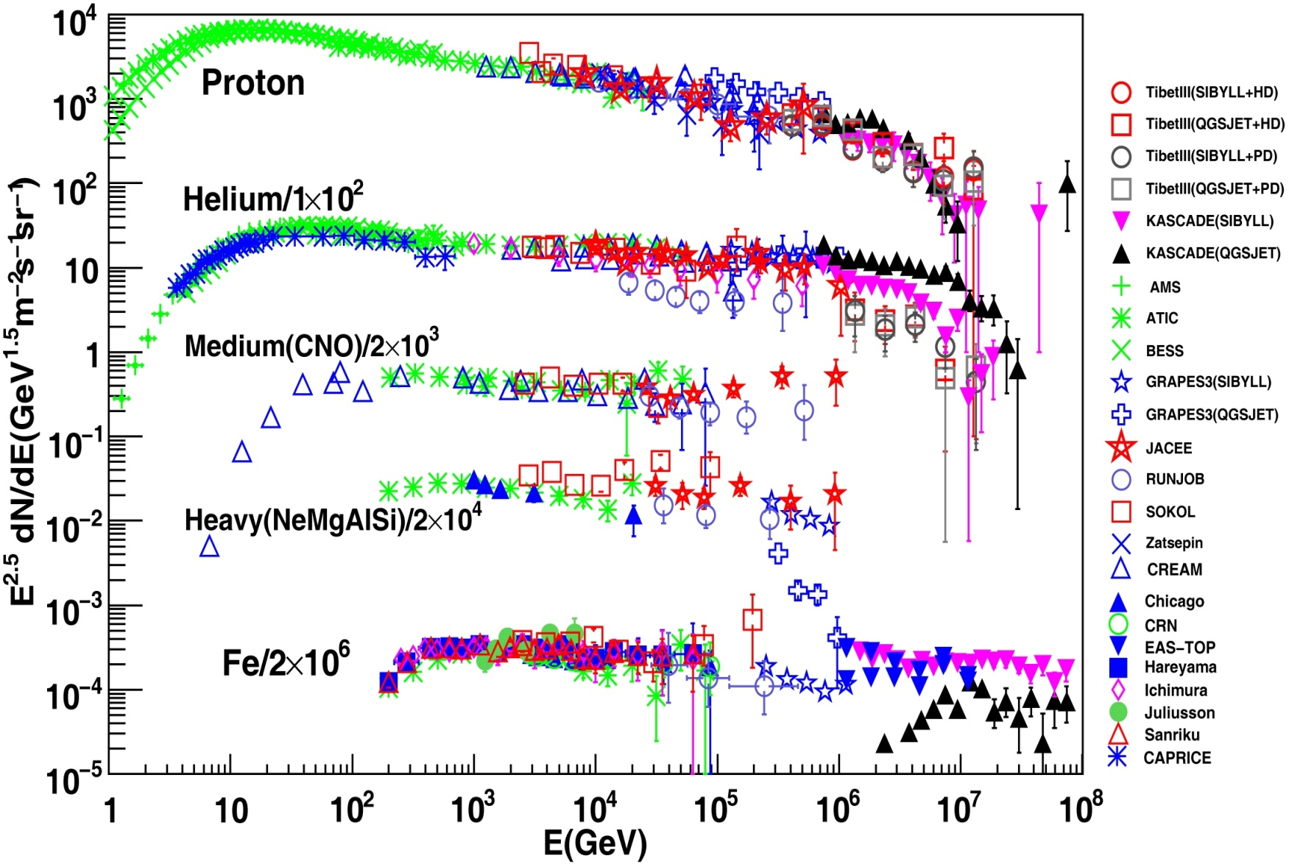
2) Experiments around E ∼ 10¹⁵ eV
Kascade-Grande ,J.C. Arteaga, U. Michoacana XIII MWPF, October, Guanajuato

Slide 17
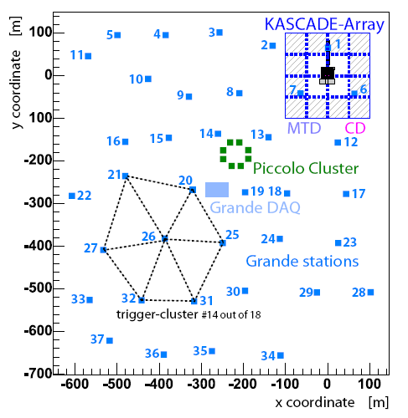
3) The KASCADE-Grande detector
KASCADE
Observables
-N_{e}
-N_{μ}, ρ_{μ}, τ_{μ}
-N_{ch}, ρ_{ch}, τ_{ch}
-N_{h}, ΣE_{h}
-H_{μ}, η
E = 10¹⁶-10¹⁸ eV
W. D. Apel, NIMA620, 202 (2010).
Grande station
Area: 0.5 km²
37x10 m² Scintillator Detec.
Distance: 140 m
MTD
Calorimeter
Kascade-Grande ,J.C. Arteaga, U. Michoacana XIII MWPF, October, Guanajuato

Slide 18
3) The KASCADE-Grande detector
Data acquisition
Efficiency
E ≥ 10⁷ GeV
Stable since December 2003
Trigger: Hexagon + central
detector
- Rate = 0.5 Hz
W. D. Apel, NIMA620, 202 (2010).
Kascade-Grande ,J.C. Arteaga, U. Michoacana XIII MWPF, October, Guanajuato

Slide 19
3) The KASCADE-Grande detector
KASCADE Muon
Detectors (ρ^{μ}_{k})
Lateral fit (Lagutin)
N_{μ}
Grande array
(ρ^{ch}_{j}, Δt_{j})
NKG
N_{ch}
Lateral E correction function
χ2
Core position
Lateral
fits
Age
χ2
Incidence angle
Linsley
S(500)

Slide 20
3) The KASCADE-Grande detector
KASCADE Muon
Detectors (ρ^{μ}_{k})
Lateral fit (Lagutin)
N_{μ}
N_{e}
Grande array
(ρ^{ch}_{j}, Δt_{j})
NKG
N_{ch}
Lateral E correction function
χ2
Core position
Age
χ2
Incidence angle
Linsley
S(500)

Slide 21
3) The KASCADE-Grande detector
Event reconstruction
Recorded on July 8 2005 at 12:11 UTC
Core: (-155, -401) m
log₁₀(N_{ch}) = 7.0
log₁₀(N_{μ}) = 5.7
Zenith : 24.2°
Azimuth: 28.4°
Data points:
ρ_{μ}(r_{i}) = n(r_{i}) /(A_{i}⋅cosθ)
Fit:
ρ_{μ}(r) = N_{μ} ⋅ f(r)

Slide 22
3) The KASCADE-Grande detector
Arrival direction from Chi² minimization of arrival times:
χ² = Σ (Ti^{data} – Ti^{model} (θ, ϕ)- ΔTi)²/ σi²
i
Ti^{model} = (r_{i} - r_{o})• n/c
Kascade-Grande ,J.C. Arteaga, U. Michoacana XIII MWPF, October, Guanajuato

Slide 23
3) The KASCADE-Grande detector
KASCADE-Grande Accuracy: Direct comparison with KASCADE
W. D. Apel, NIMA620, 202 (2010).
Kascade-Grande ,J.C. Arteaga, U. Michoacana XIII MWPF, October, Guanajuato

Slide 24
3) The KASCADE-Grande detector
Energy spectrum
Experimental data set:
1173 days of effective DAQ time.
Performance of reconstruction and
detector is stable.
θ < 40°
Exposure: 2 ∙10¹⁷ cm² ∙ s ∙ sr
N_{μ}: Correction for systematics

Slide 25
3) The KASCADE-Grande detector
For each zenith angle bin
Consideration of N_{ch}-N_{μ} correlation
k = 0 (p), 1(Fe)
QGSJET II/FLUKA
Calibration function according to primary
W.D.Apel, sent to Astrop. Phys.
astro-ph/1009.4716
QGSJET II/FLUKA
Kascade-Grande ,J.C. Arteaga, U. Michoacana XIII MWPF, October, Guanajuato

Slide 26
3) The KASCADE-Grande detector
Energy spectrum
After unfolding
@10¹⁷ eV
Flux Syst ∼10 %
ΔE ∼ 20 %
@10¹⁷ eV
Flux Syst ∼14 %
ΔE ∼ 20 %
Φ= n/[Δt ΔA ΔΩ ΔE]
QGSJET II/FLUKA
W.D.Apel, sent to Astrop. Phys.
astro-ph/1009.4716
Kascade-Grande ,J.C. Arteaga, U. Michoacana XIII MWPF, October, Guanajuato

Slide 27
3) The KASCADE-Grande detector
QGSJET II/FLUKA
Concave
spectrum
Possible structure: Iron knee??
QGSJET II: Spectrum is not described by a single power law
W.D.Apel, sent to Astrop. Phys.
astro-ph/1009.4716
Kascade-Grande ,J.C. Arteaga, U. Michoacana XIII MWPF, October, Guanajuato

Slide 28
Concavity
Gap CON-Fe
T. Antoni, Astro.Phys. 24 (2005)
MILAGRO
A.A.Abdo, Phys. Rev. Lett..101 (2008)
E ~ TeV
ICECUBE-40
R.Abbasi et al., ApJ (2011)
Close source
Kascade-Grande ,J.C. Arteaga, U. Michoacana XIII MWPF, October, Guanajuato

Slide 29
CREAM Coll., ApJ 714 L89 (2010)
CREAM, BESS, AMS, JACEE, ATIC
Non-lineal effects in SNR
Nature 460, 701 (2009)
Superbubble
Reacceleration in galaxy

Slide 30
3) The KASCADE-Grande detector
Observations by other experiments
L.A. Kuzmichev [Tunka Coll.], icrc250, 2011
R.M. Martirosov [GAMMA Coll.], icrc134, 2011
Kascade-Grande ,J.C. Arteaga, U. Michoacana XIII MWPF, October, Guanajuato

Slide 31
4) Results about composition
Kascade-Grande ,J.C. Arteaga, U. Michoacana XIII MWPF, October, Guanajuato

Slide 32
4) Results about composition
Constant intensity cut method: * Correct Nch, Ne, Nμ for atmospheric attenuation.
* Summe up data from different zenith angles.
1 atm
(10³ g/cm²)
J(E)
J(E)
e/γ
μ
μ
μ
1500 g/cm²
μ
e/γ
J_{μ}(N_{μ2}, θ₂)
J_{μ}(N_{μ1}, θ₁)
Isotropy:
J(>E) independent of θ → J_{μ} used as an energy scale
Kascade-Grande ,J.C. Arteaga, U. Michoacana XIII MWPF, October24, Leon

Slide 33
4) Results about composition
Constant intensity cut method
Shower size normalized to a certain zenith angle
Kascade-Grande ,J.C. Arteaga, U. Michoacana XIII MWPF, October, Guanajuato

Slide 34
4) Results about composition
Knee in heavy component:
KASCADE-Grande Coll, PRL 107, 171104 (2011)
J.C. Arteaga, ICRC Proc., (2011)

Slide 35
4) Results about composition
Knee in heavy component:
Independent of Y^{CIC} cut
KASCADE-Grande Coll, PRL 107, 171104 (2011)
Kascade-Grande ,J.C. Arteaga, U. Michoacana XIII MWPF, October, Guanajuato

Slide 36
4) Results about composition
KASCADE-Grande Coll, PRL 107, 171104 (2011)
Confirmed by independent analyses
Kascade-Grande ,J.C. Arteaga, U. Michoacana XIII MWPF, October, Guanajuato

Slide 37
4) Results about composition
Problem: Find primary flux and A from N_{e} y N_{μ}.
Reconstruction accuracy
Efficiency
Shower fluctuations
D. Fuhrmann, ICRC Proc., (2011)
Kascade-Grande ,J.C. Arteaga, U. Michoacana XIII MWPF, October, Guanajuato

Slide 38
4) Results about composition
Problem: Find primary flux and A from N_{e} y N_{μ}.
D. Fuhrmann, ICRC Proc., (2011)
Kascade-Grande ,J.C. Arteaga, U. Michoacana XIII MWPF, October, Guanajuato

Slide 39
4) Results about composition
Dependence with Z is more probable
D. Fuhrmann, ICRC Proc., (2011)
This work
Expected if E_{k} ∝A
Expected from KASCADE if E_{k} ∝Z
Kascade-Grande ,J.C. Arteaga, U. Michoacana XIII MWPF, October, Guanajuato

Slide 40
4) Results about composition
A. Haungs, ICRC Proc., (2011)
Agreement with other experiments
Kascade-Grande ,J.C. Arteaga, U. Michoacana XIII MWPF, October, Guanajuato

Slide 41
5) Summary
Our knowledge about the origin, acceleration mechanism and propagation of galactic cosmic rays is still incomplete.
KASCADE-Grande has found two new structures: a concavity (~ 10¹⁶ eV) and a new knee (~ 10¹⁷ eV).
A knee in the heavy component of cosmic rays has been found around ~ 10¹⁷ eV .
Possible Z dependence of the knees of the light and heavy components.
¿What astrophysical models describe at best the data?
Kascade-Grande ,J.C. Arteaga, U. Michoacana XIII MWPF, October, Guanajuato

Slide 43
Abstract:
KASCADE-Grande is an air-shower observatory devoted to the detection of cosmic rays with energies in the range of $10^{16}$ and $10^{18}$ eV. This energy region is of particular interest for the cosmic ray astrophysics, since it is the place where several models predict the existence of a galactic- extragalactic transition in the cosmic ray spectrum and the presence of a break in the flux of its heavy component. The detection of these features requires detailed and simultaneous measurements of the energy and composition of cosmic rays with sufficient statistics. This kind of studies are possible for the first time in KASCADE-Grande due to the accurate measurements of several air-shower observables, i.e., the number of charged particle, electrons and muons in the shower, using the different detector systems of the observatory. In this contribution, a detailed look into the composition of $10^{16}-10^{18}$ eV cosmic rays with KASCADE-Grande is presented.

