Slide 1

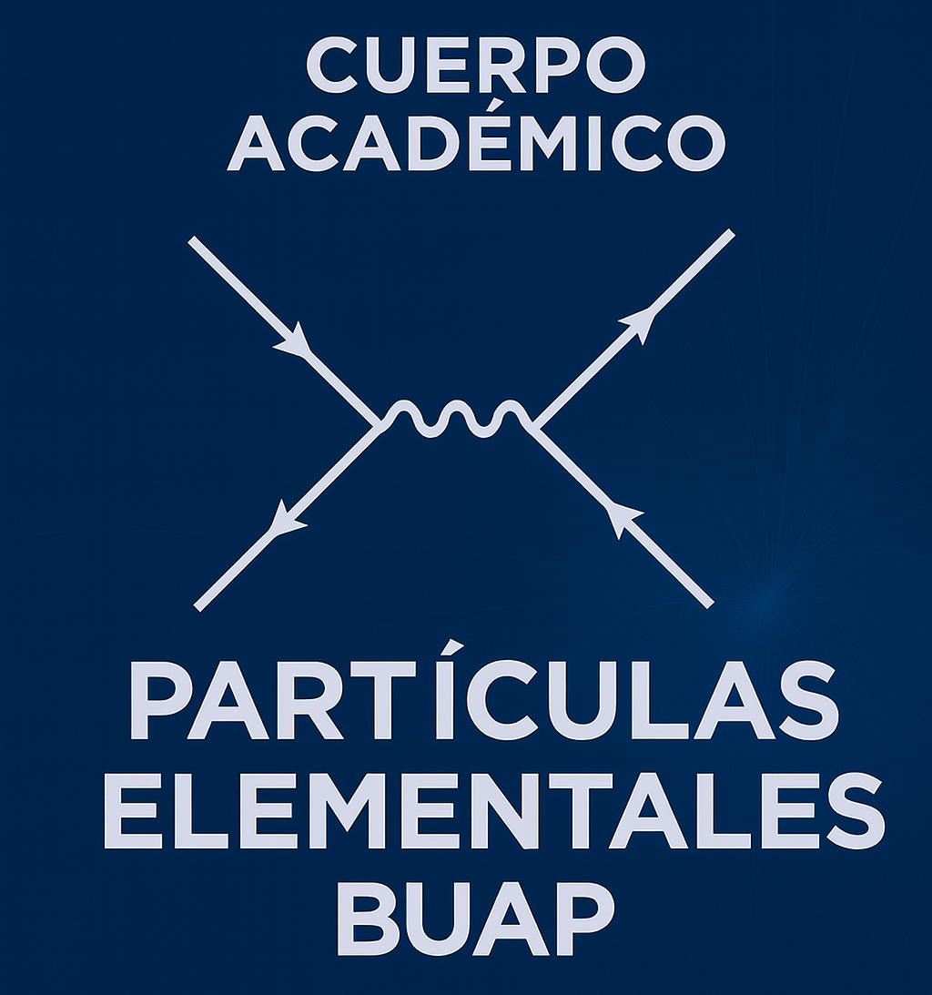
Geometrical Optimization of the Muon Identification (MID) for Maximum Particle Acceptance
Francisco Emmanuel Perez Mejia
XXI Mexican School on Particles and Fields 2026

Slide 2
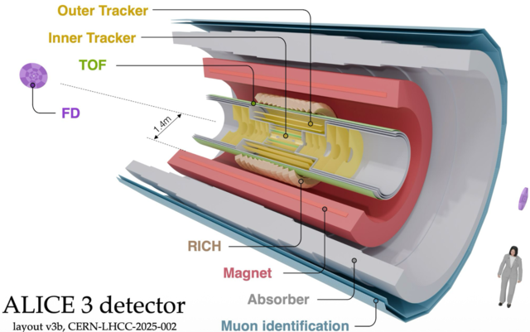
Muon Identification

Slide 3
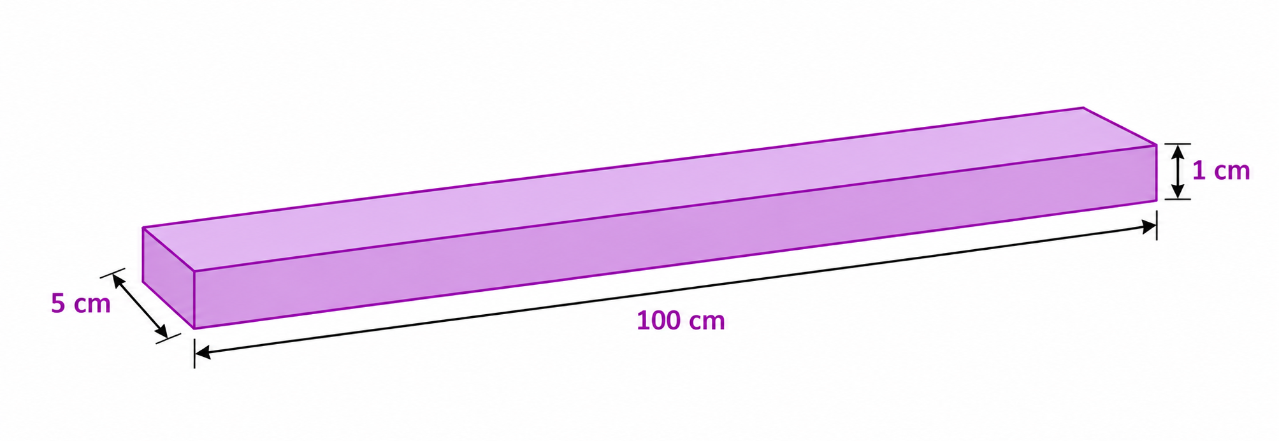
Plastic Scintillator Bar
Length: 100 cm
Width: 5 cm
Height: 1 cm

Slide 4
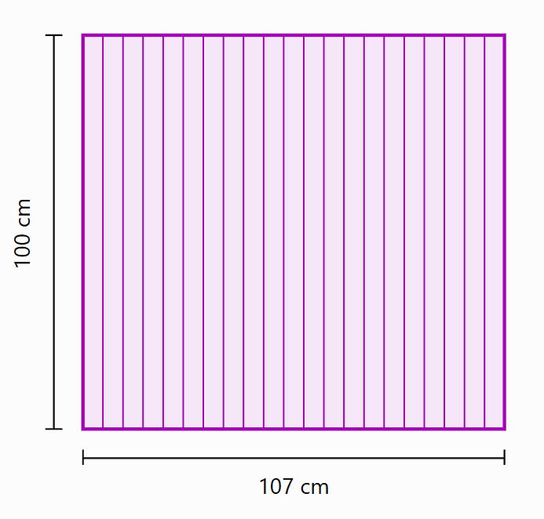
Scintillator Element
One element are 21 Scintillator Bars
0.1 cm of separation between bars
Length: 100 cm
Width: 107 cm
Height: 1 cm

Slide 5
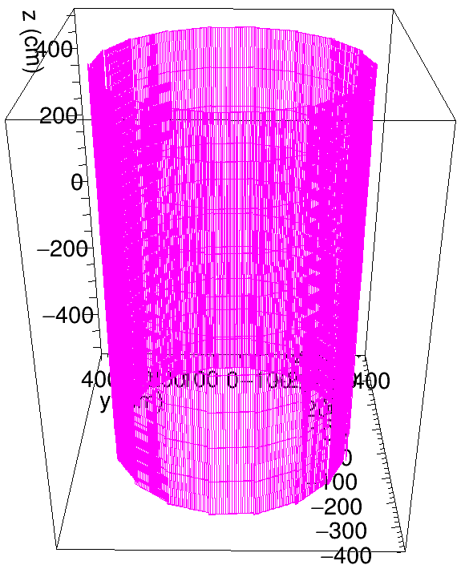
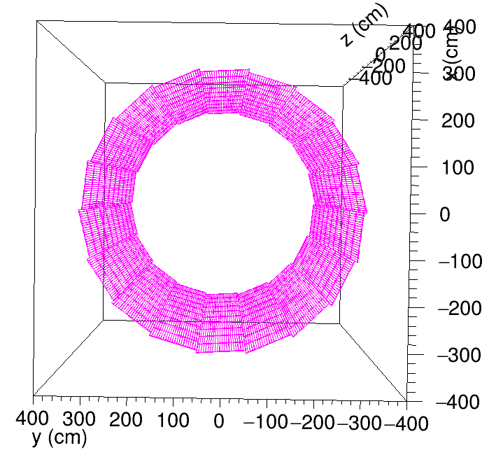
Full Simulated Geometry:
One ring is made by 18 elements
The cylinder is made by 10 rings
21 bars x 18 elements x 10 rings = 3780 simulated bars

Slide 6
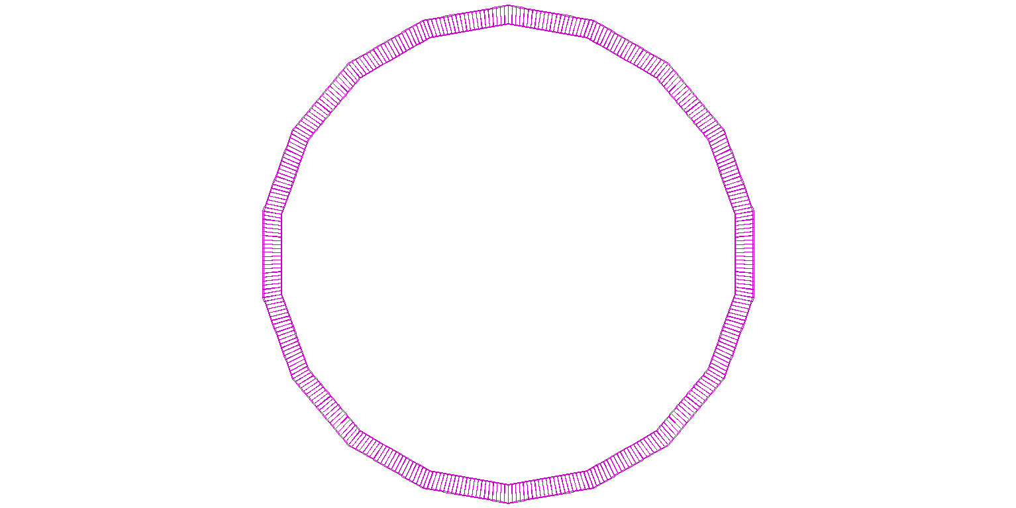
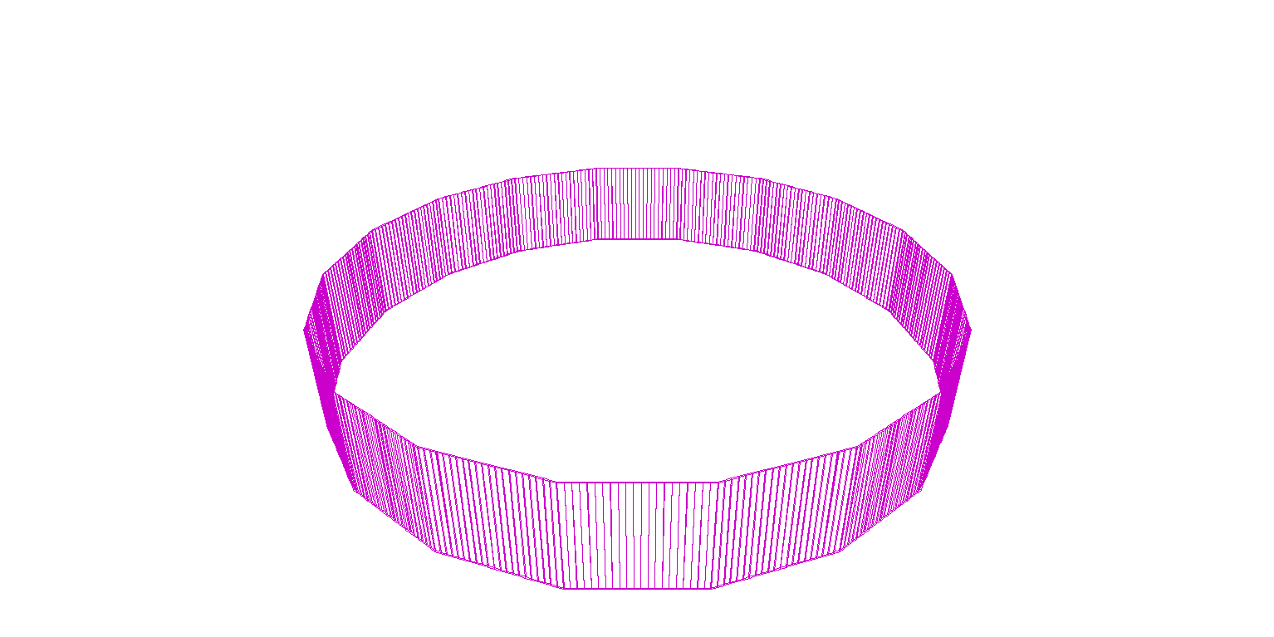
Parameter: TiltDeg
Rotation in the transverse (XY) plane
Changes the angular orientation of the scintillator arrays within each ring.
Affects geometrical coverage and particle acceptance.

Slide 7
Parameter: zTiltDeg
Inclination relative to the longitudinal Z-axis
Modifies the longitudinal inclination of the scintillator arrays.
Affects the spatial arrangement and geometrical overlaps.

Slide 8
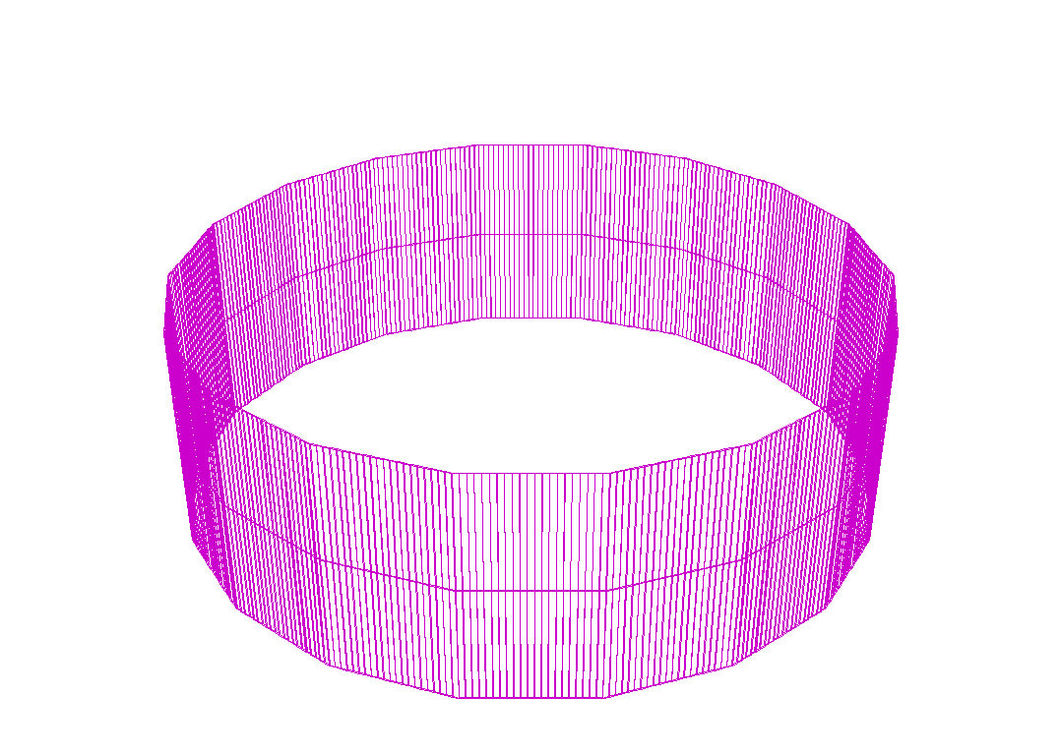
Parameter: dzCenters
Distance between consecutive ring centers along the Z-axis
Controls the longitudinal spacing between consecutive detector rings.
Modifies the gaps or overlaps between adjacent scintillator arrays.
Influences geometrical continuity and particle acceptance.

Slide 9
Combined Effect of tiltDeg and zTiltDeg
The combination of tiltDeg and zTiltDeg modifies the spatial orientation of the scintillator arrays.
Their combined effect influences geometrical coverage, overlaps, and particle acceptance.

Slide 10
Motivation and Objectives
Motivation
The geometrical arrangement of scintillator bars can affect particle acceptance.
Gaps and overlaps between detector elements may limit effective geometrical coverage.
Objectives
Maximize geometrical particle acceptance by optimizing tiltDeg, zTiltDeg, and dzCenters.
Identify overlap-free configurations while minimizing acceptance losses, particularly at the transitions between rings.

Slide 11
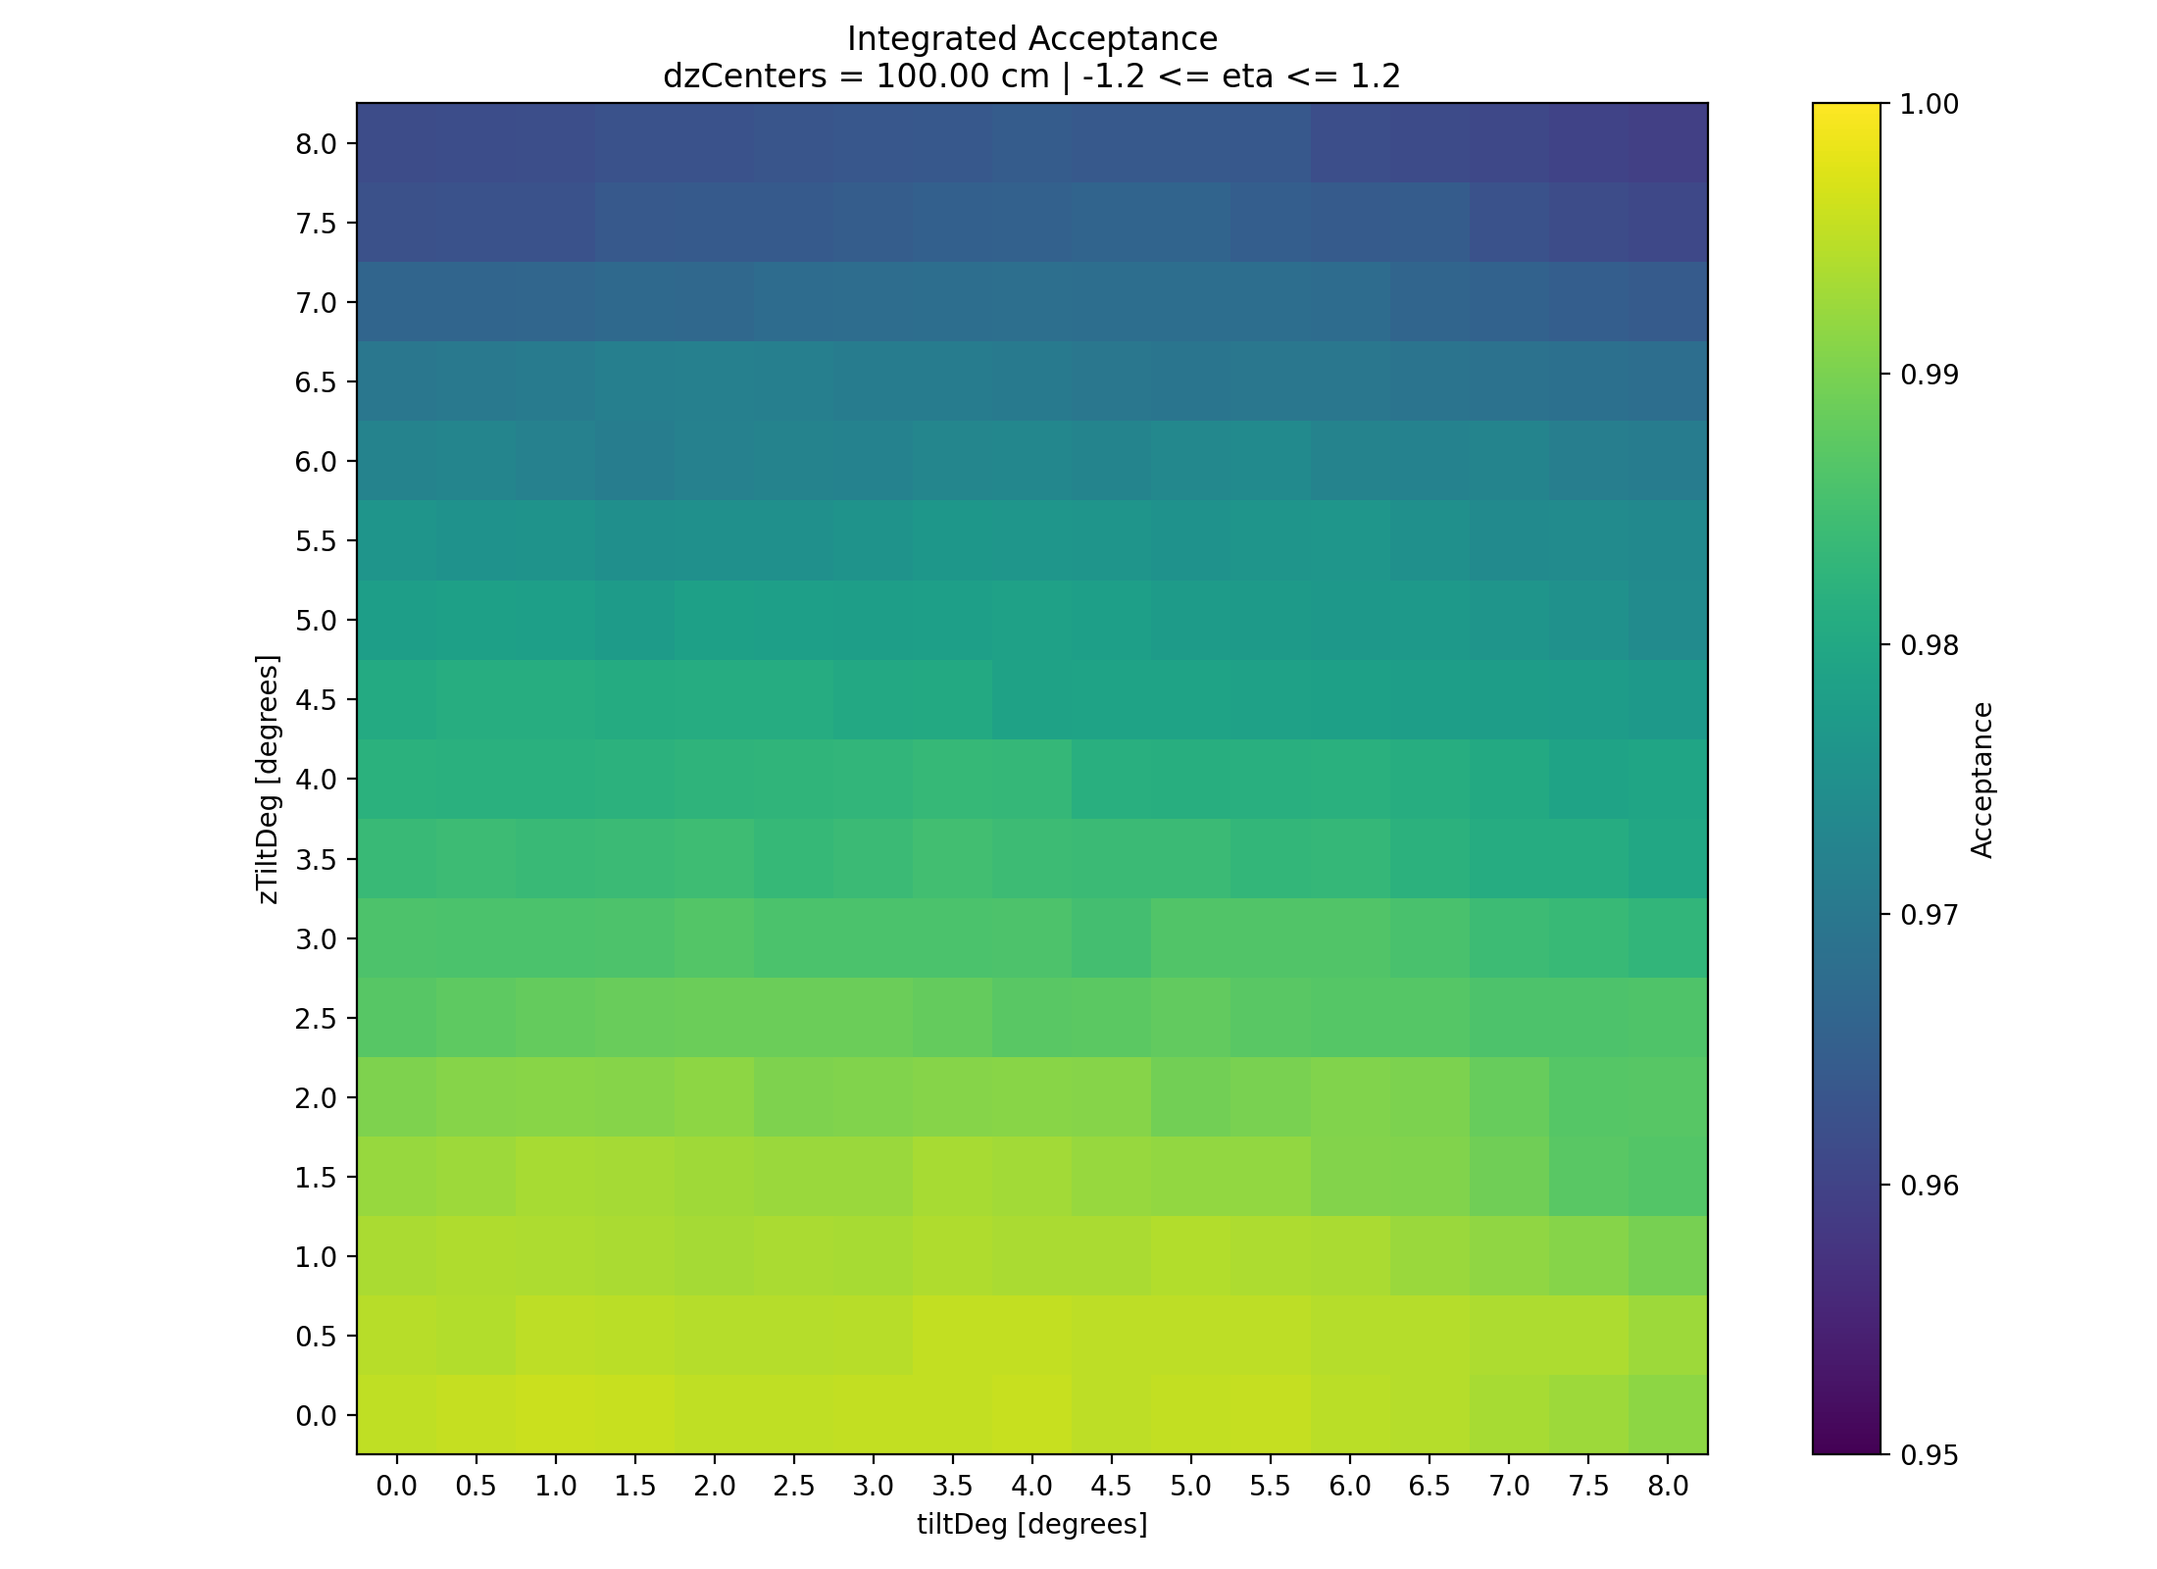

Slide 12
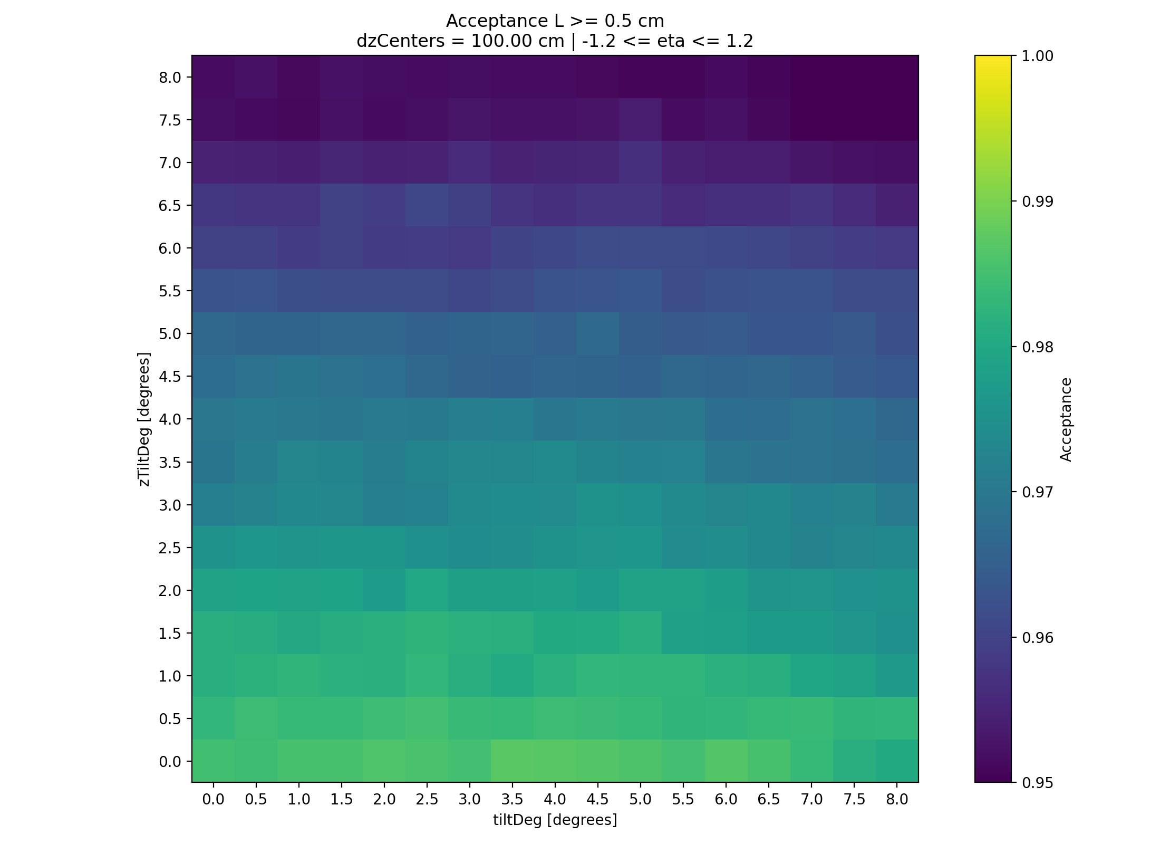

Slide 13
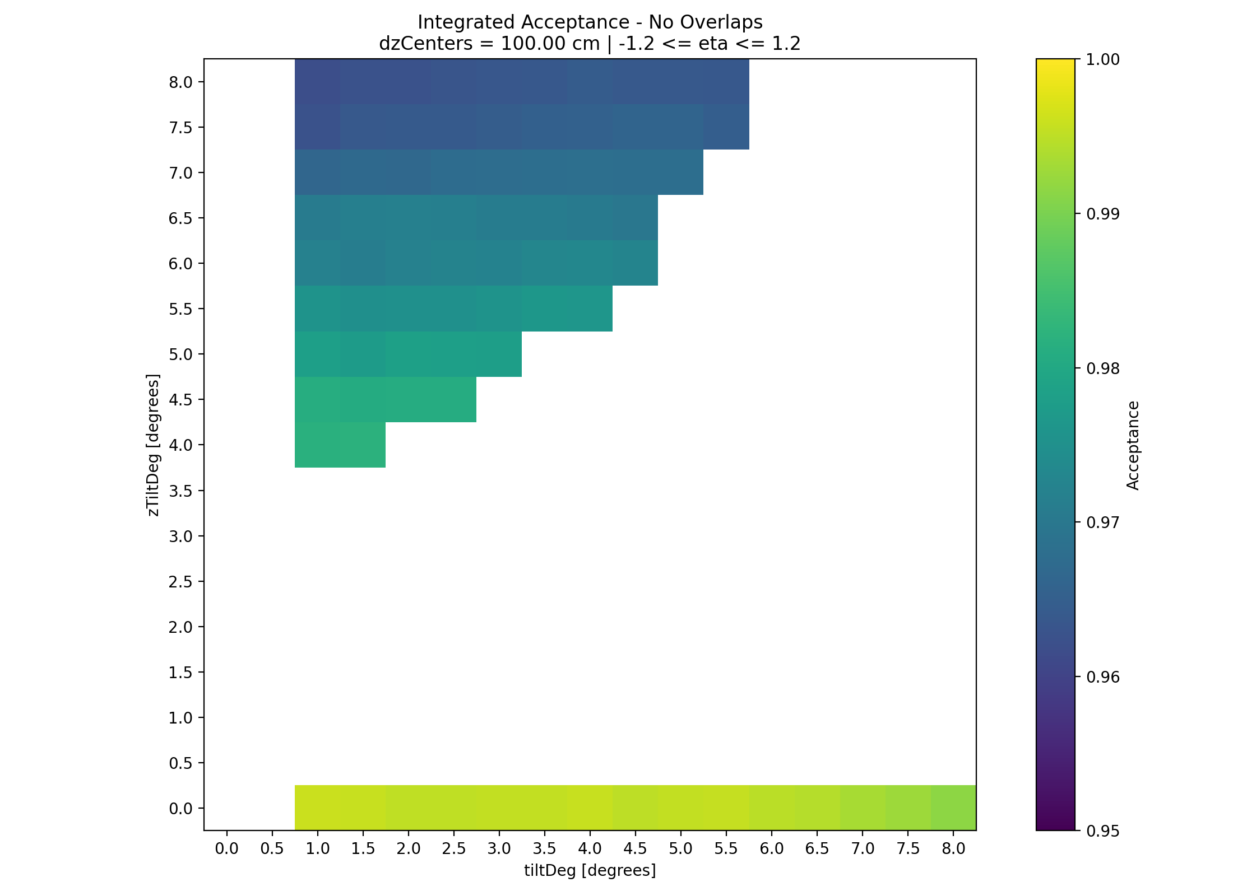

Slide 14
Geometrical Overlap Constraints on MID Acceptance
White regions indicate geometrical configurations excluded due to detected overlaps.
At dzCenters = 100 cm, overlap-free configurations occur mainly at zTiltDeg = 0° and within a second region at larger zTiltDeg.
The highest integrated acceptance among overlap-free configurations is 99.59%, at tiltDeg = 1° and zTiltDeg = 0°.
Increasing zTiltDeg generally reduces acceptance, even in geometrically valid regions.

Slide 15
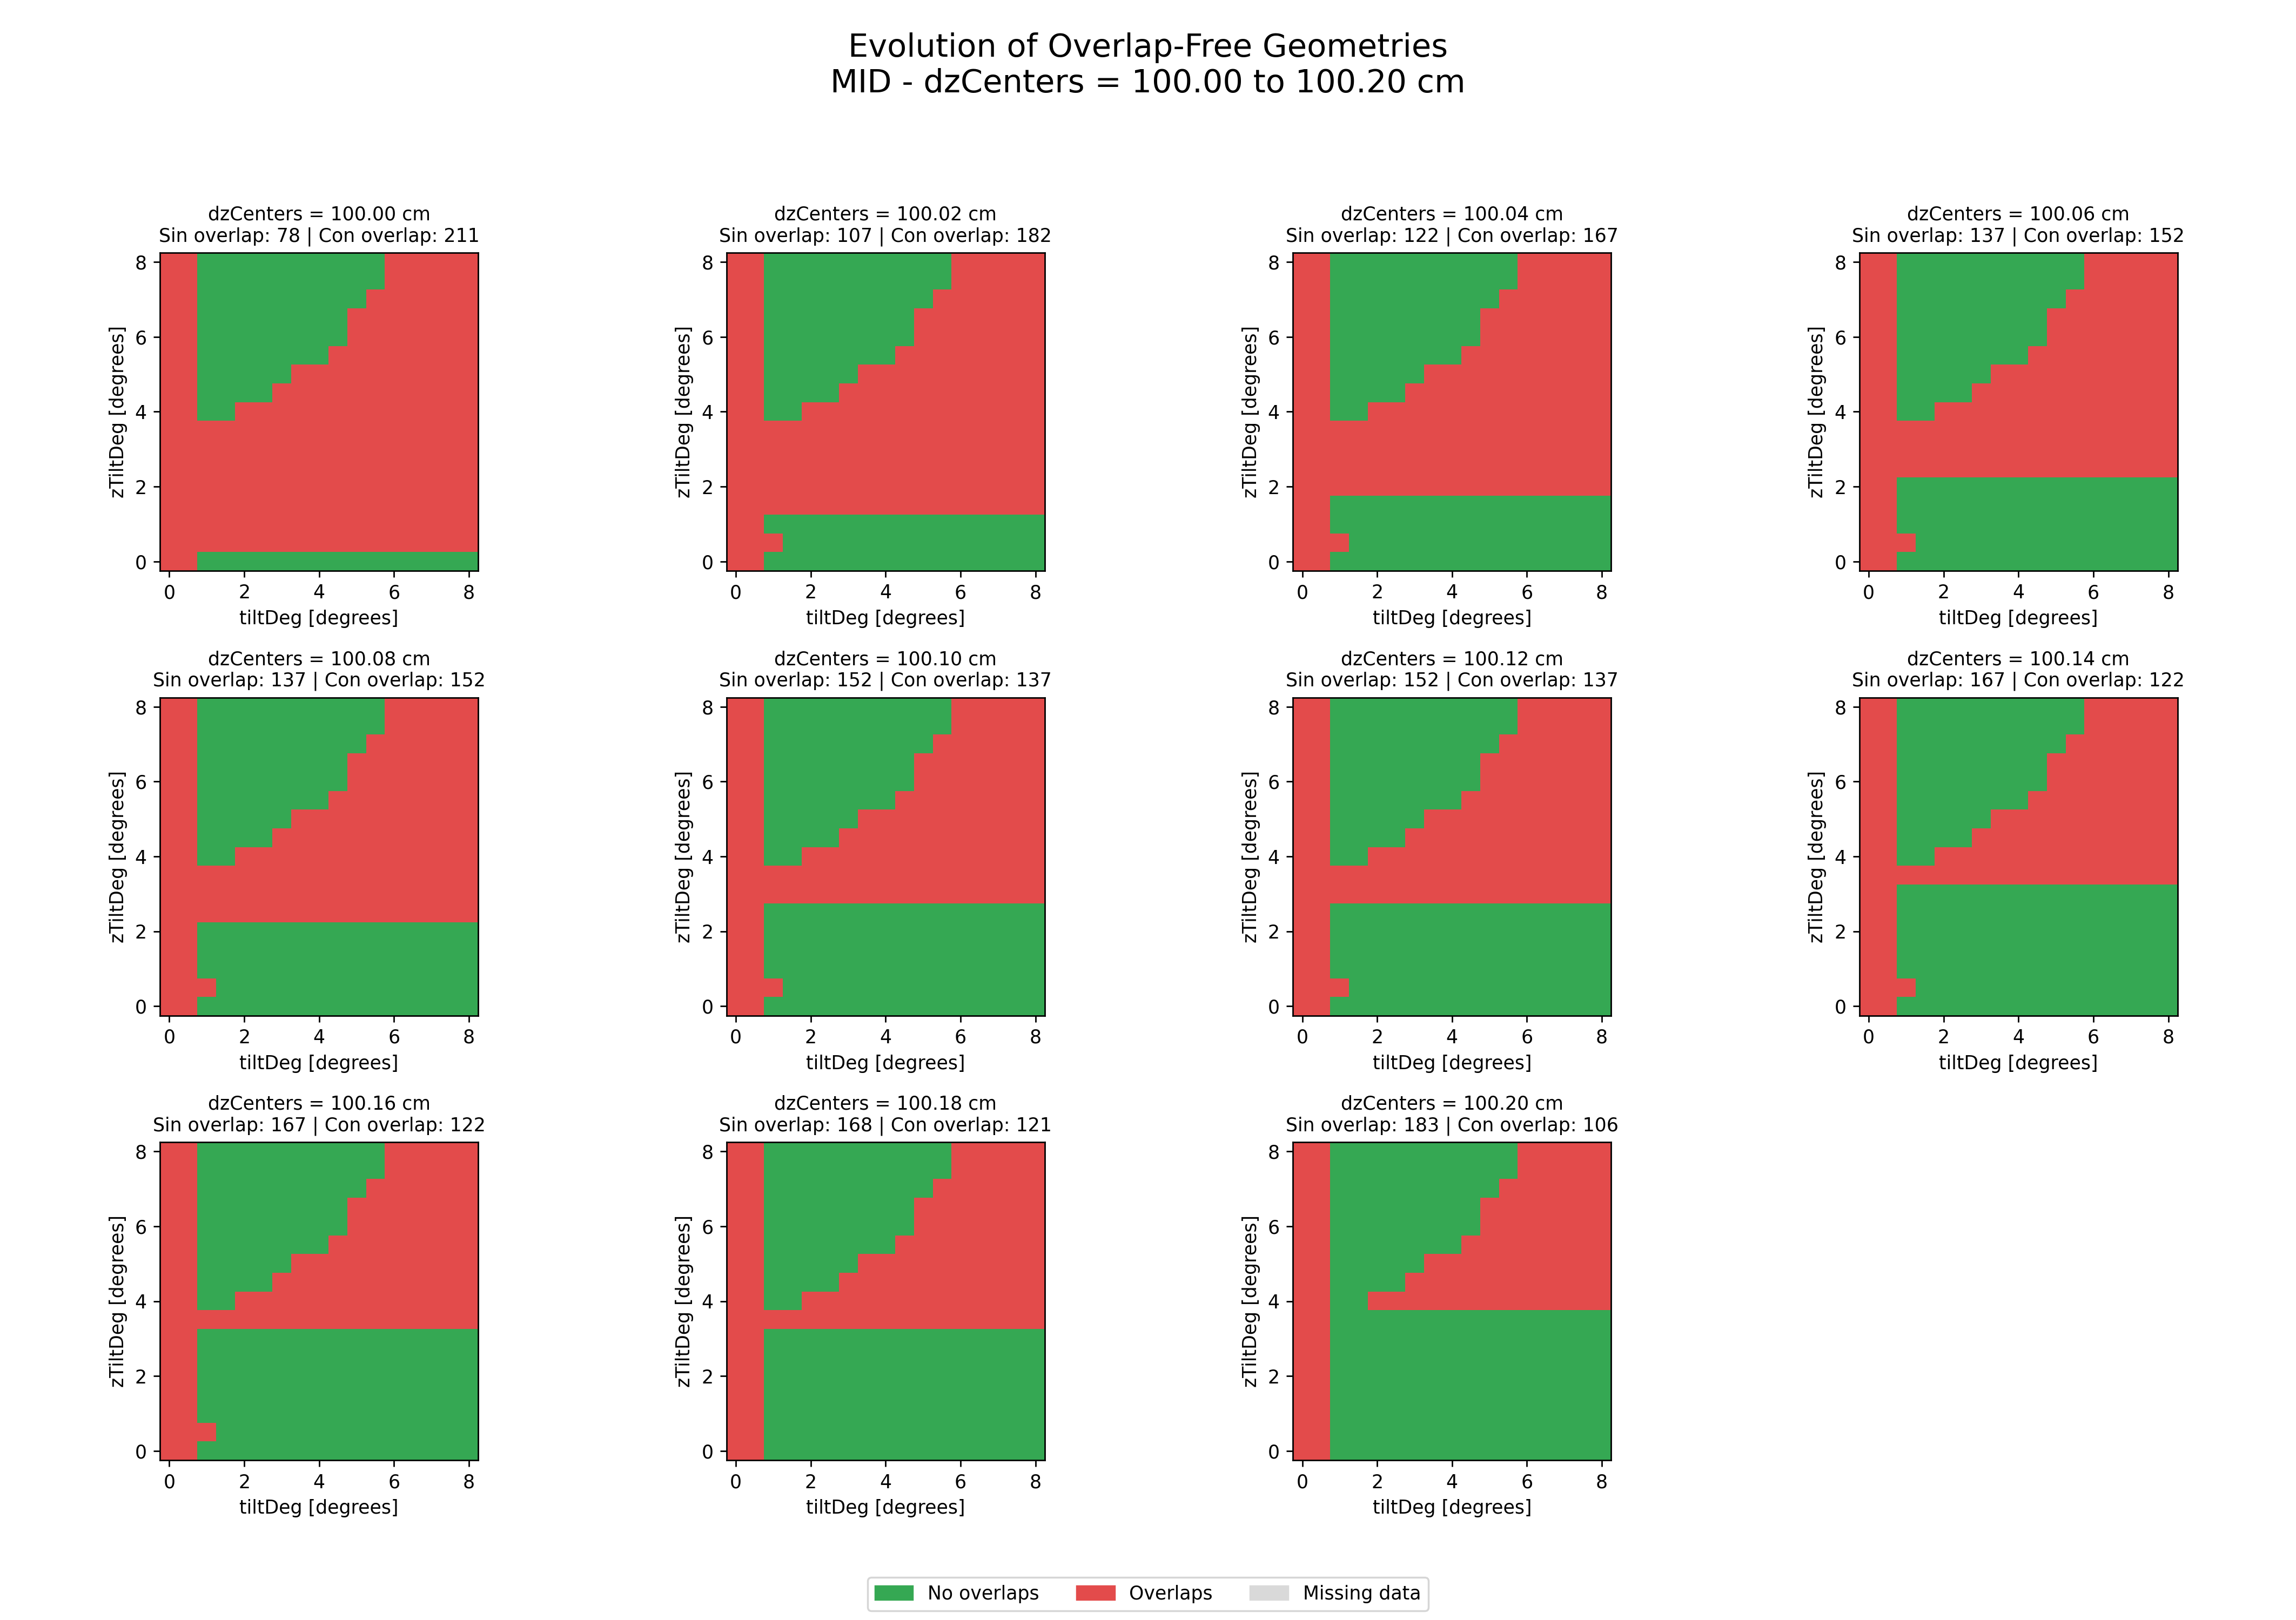

Slide 16
Evolution of Overlap-Free Geometries
Green regions: geometrical configurations without overlaps.
Red regions: configurations where overlapping detector elements are detected.
Increasing dzCenters from 100.00 to 100.20 cm increases the number of overlap-free configurations from 78 to 183 out of 289.
Larger longitudinal separations progressively expand the valid region at low zTiltDeg, while some configurations remain invalid.

Slide 17
Conclusion
High geometrical acceptance
An integrated acceptance of 99.59% was achieved for an overlap-free configuration at tiltDeg = 1° and zTiltDeg = 0°, with dzCenters = 100 cm.
Longitudinal separation matters
Increasing dzCenters from 100.00 to 100.20 cm expanded the number of overlap-free configurations from 78 to 183.
Geometry optimization requires a balance
Maximizing particle acceptance requires controlling geometrical overlaps and the spacing between detector rings.

Slide 18
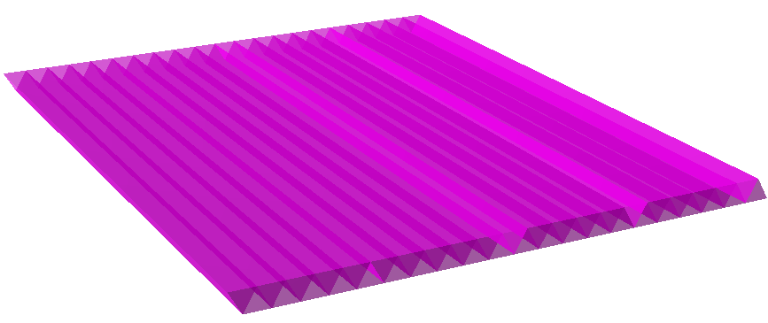
Work in Progress
Equilateral triangular bars
52 bars make a module
52 bars x 18 modules x 10 rings = 9360 triangular bars

Slide 19
Thank you

