Slide 1


Construction and Development of RPC Gas Detectors
Juan Pablo Salvador Garcia
Benemérita Universidad Autónoma de Puebla
XXI Mexican School on Particles and Fields

Slide 2
Motivation and Objectives
Develop fast detectors for high-energy physics experiments.
Resistive Plate Chambers (RPCs):
  Good timing resolution
  Low construction cost
  Large-area coverage
  Planar geometry → flexible design and gap optimization
Objective: Construct and characterize low-cost MRPC detectors with two 0.3 mm gas gaps, evaluating their detection efficiency, timing resolution, and charge response.

Slide 3

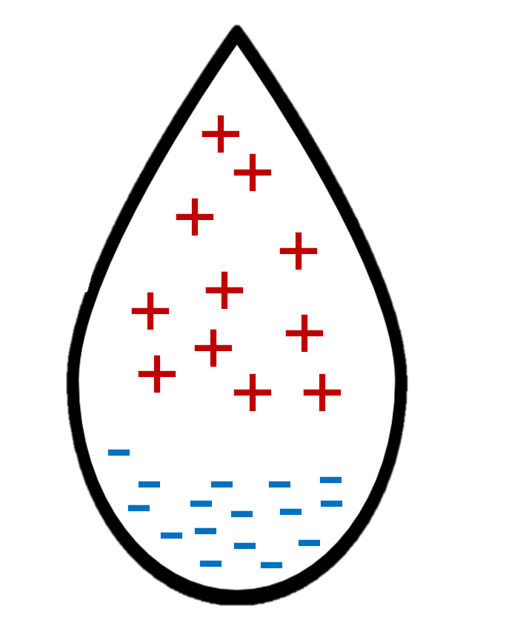


Working Principle
General RPC Design
Multigap RPCs (MRPCs)
Gas ionization by charged particles
Electron avalanche formation
Induced signals from moving charges
Readout electrode
$$μ$$
Readout system
Floating internal electrodes
Combined signal contributions
Potential for improved timing resolution and rate capability
Resistive plate (-)
-10 V
Cathode -
$$\vec{E}$$
HV
-5 V
Resistive plate (+)
Anode +
0 V

Slide 4
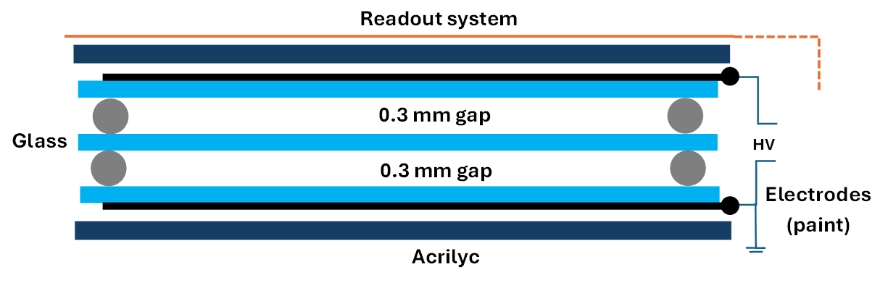
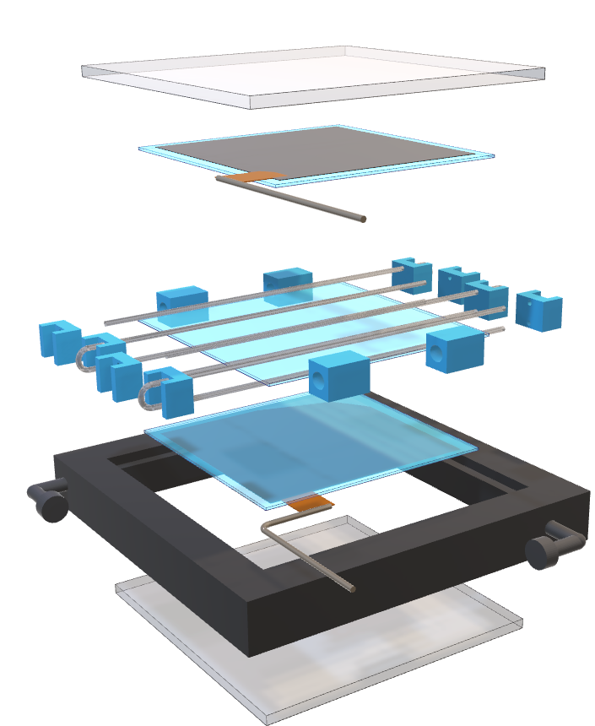
Detector Design
Acrylic cover
Resistive electrode
Two gas gaps of 0.3 mm each
Two MRPC prototypes were constructed
Gap spacers
Floating electrode
Lower resistive electrode
3D Frame
Acrylic cover

Slide 5
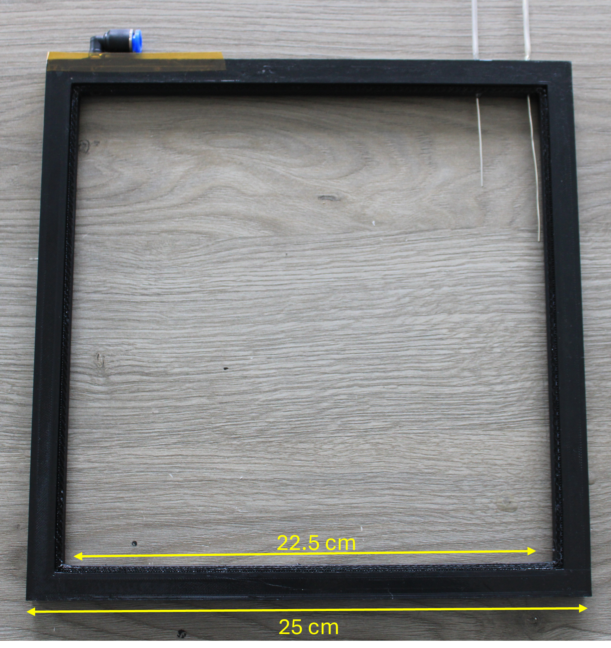
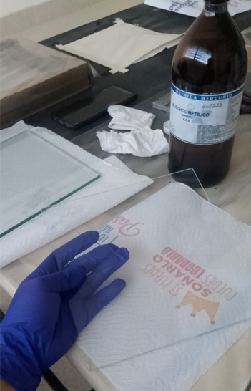
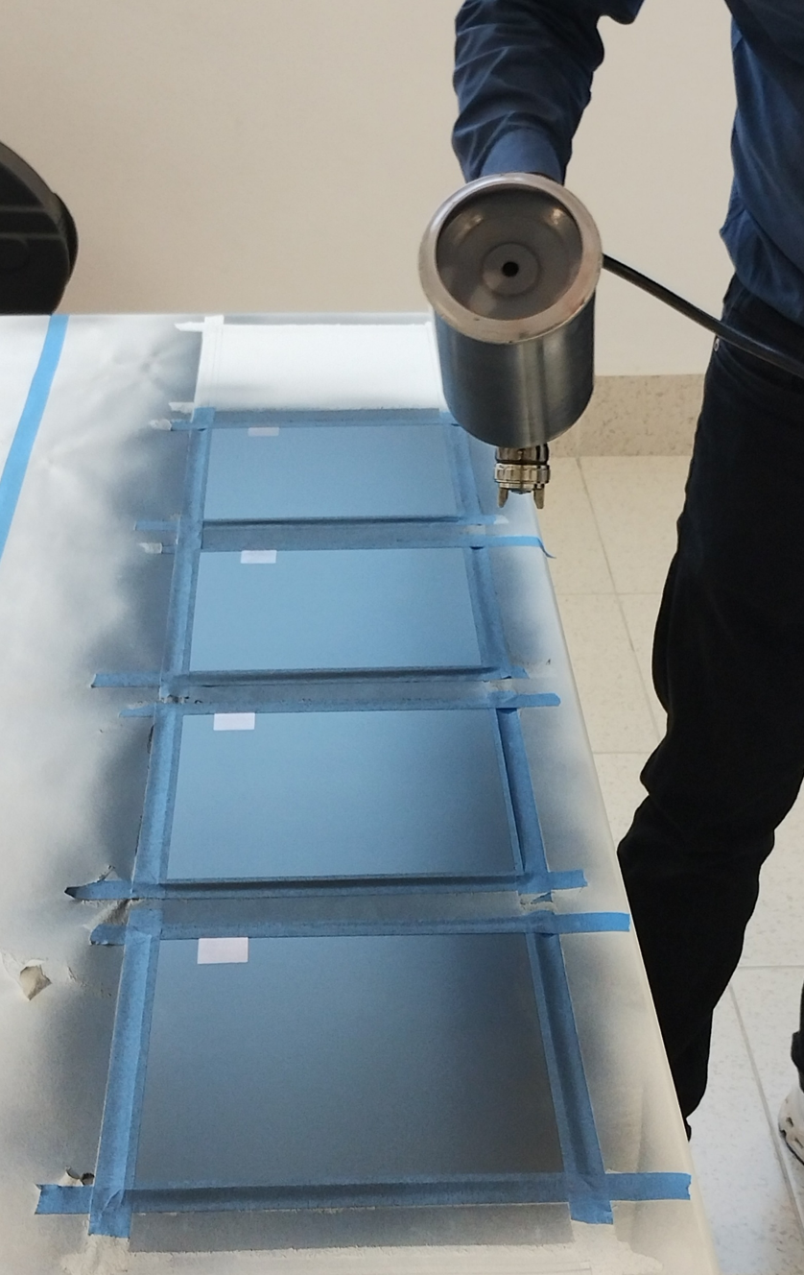
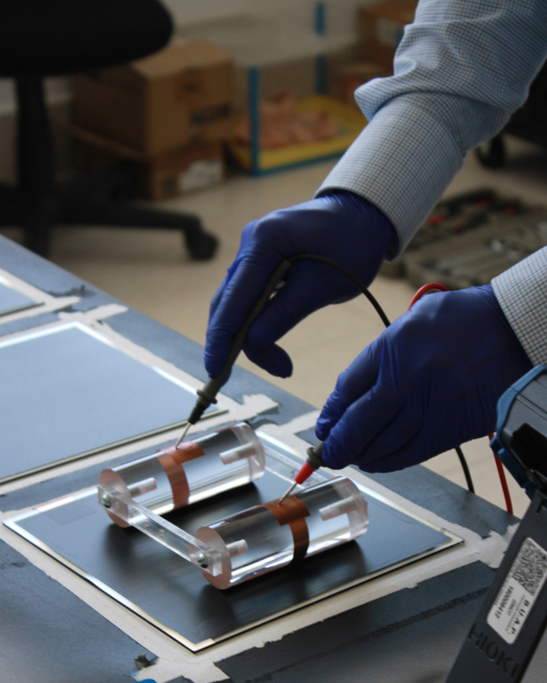
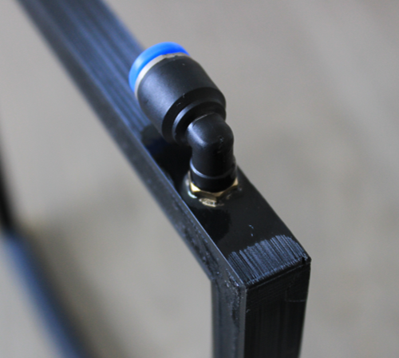
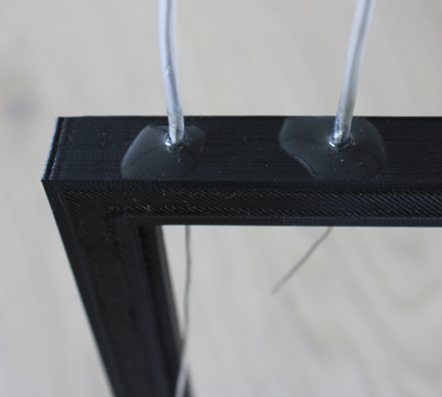
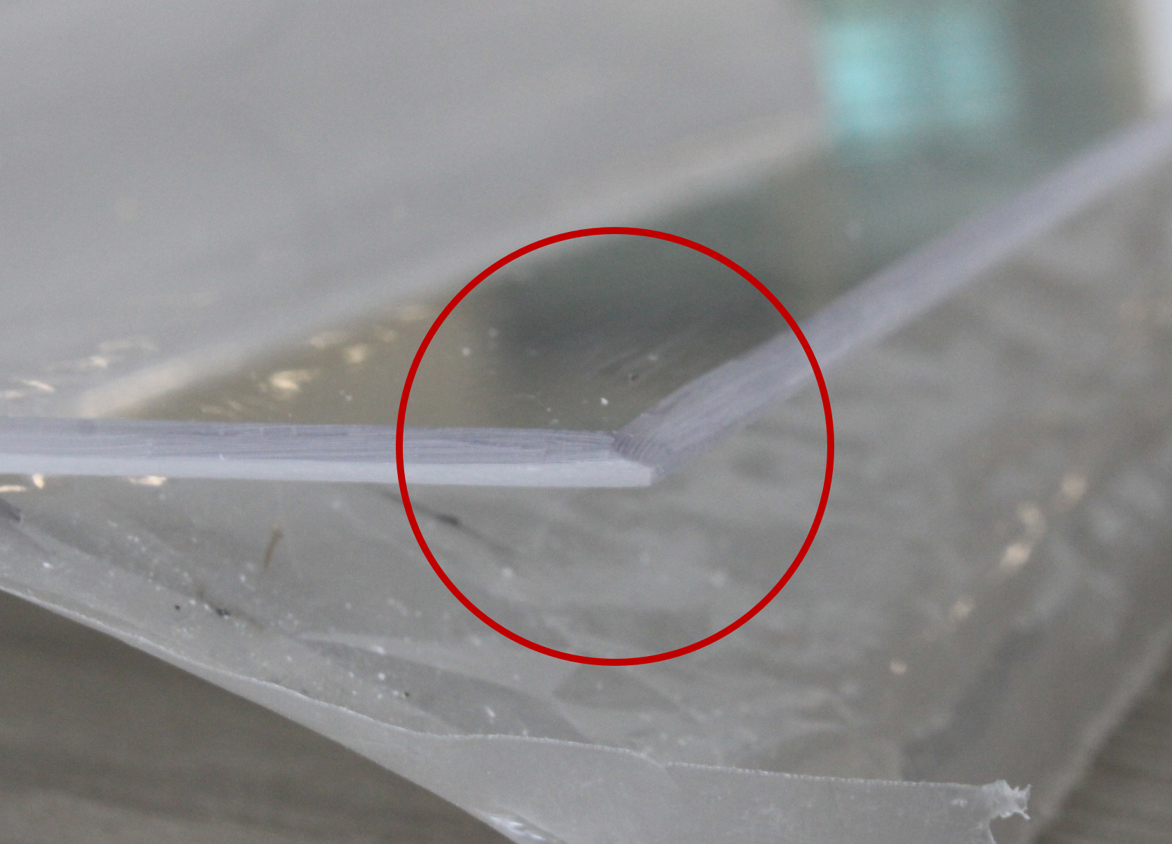
Assembly Process I: Materials and Coating
Glass electrodes and acrylic treatment
Resistive paint process
Resistivity measurments
3D-printed frame and components

Slide 6
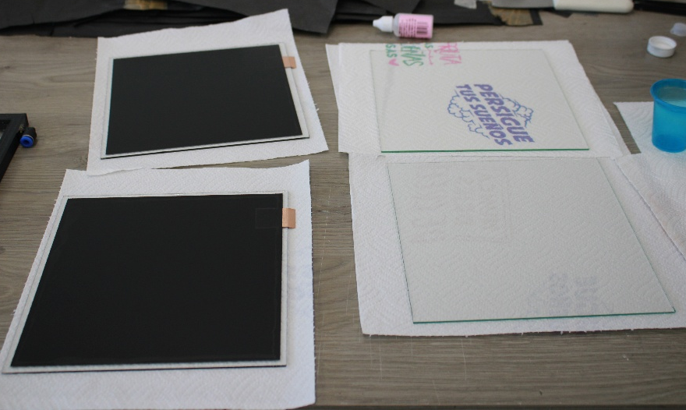
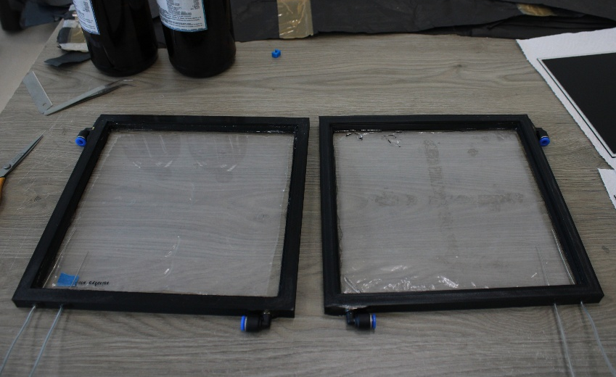
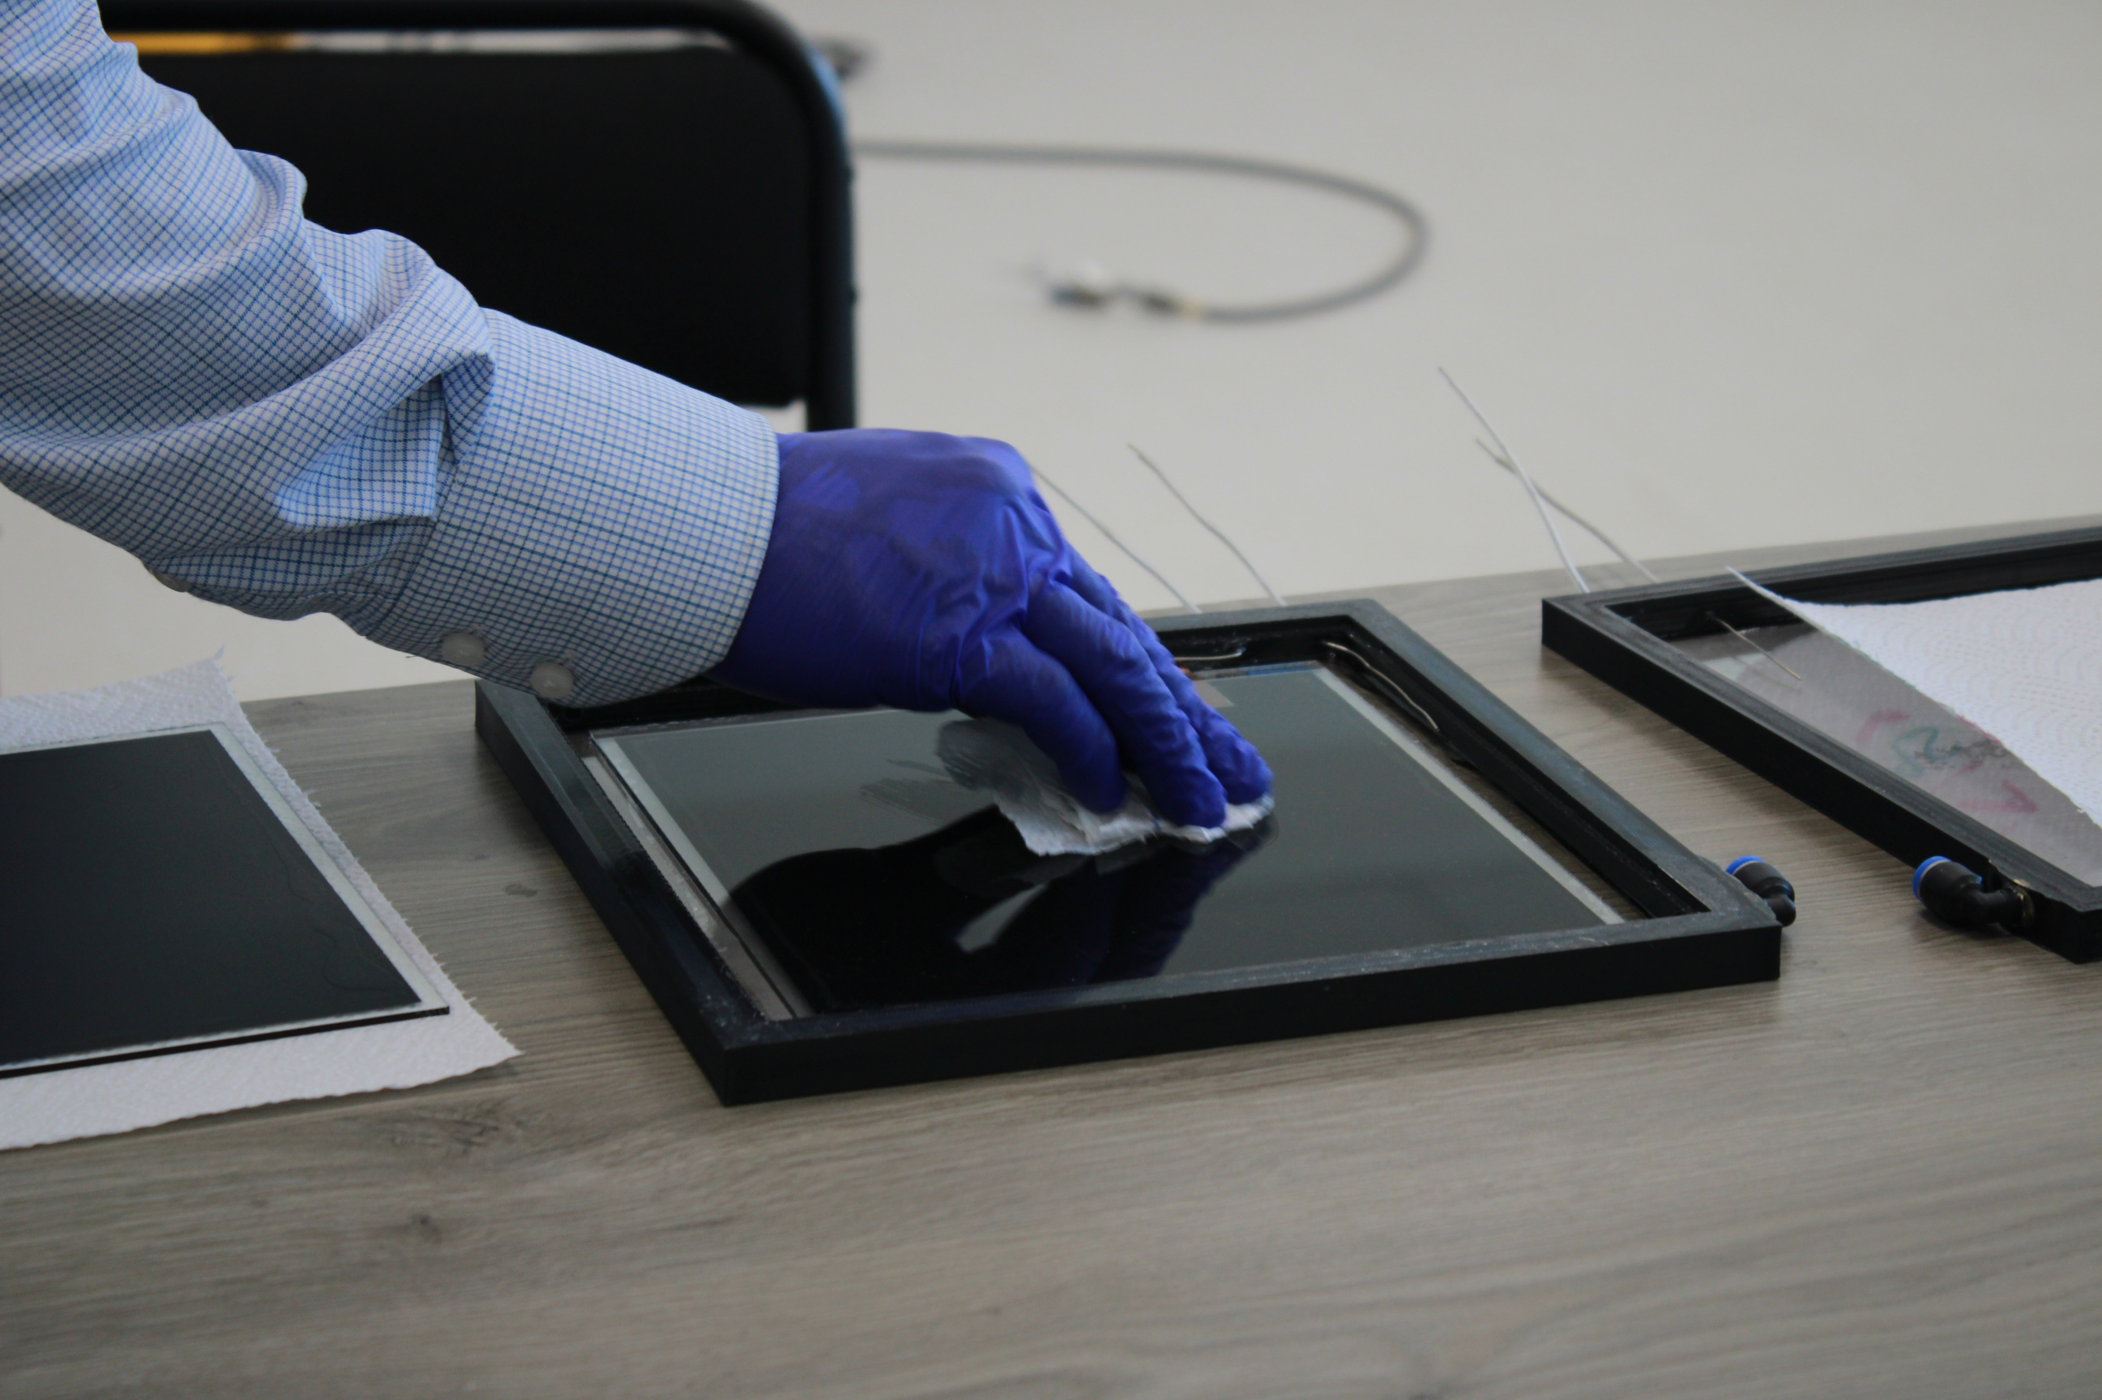
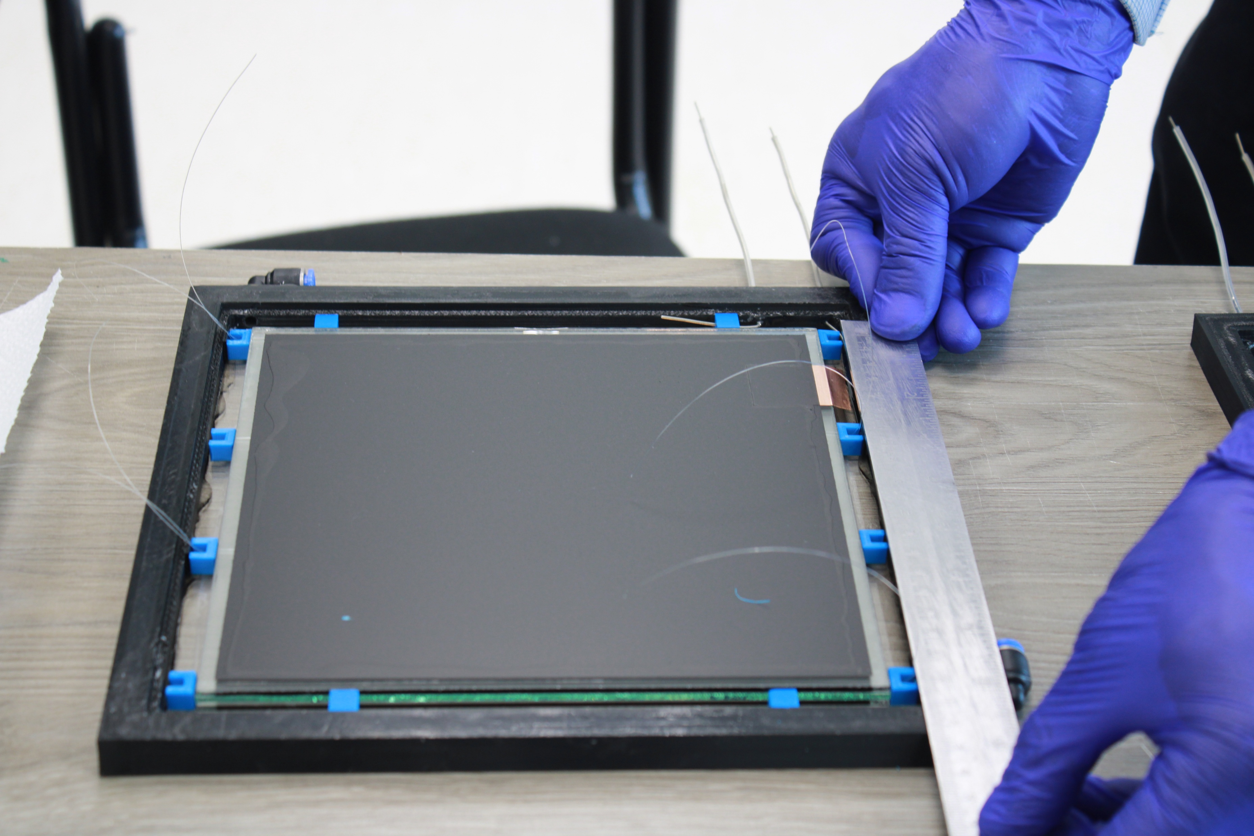
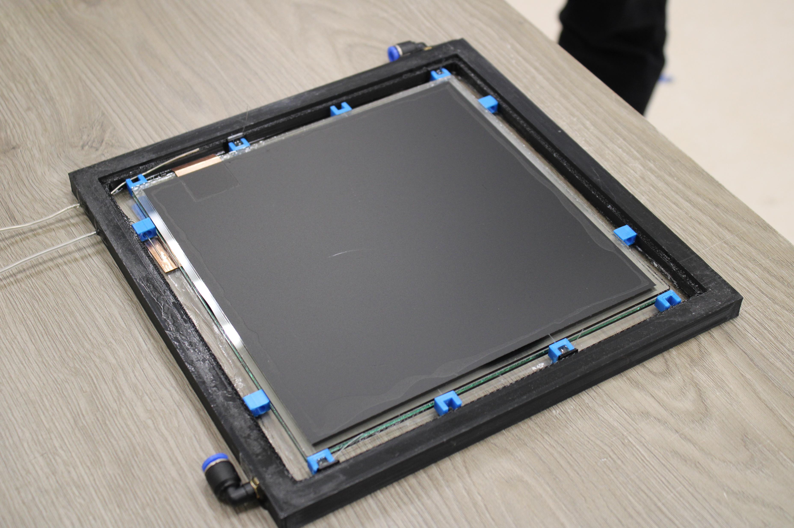
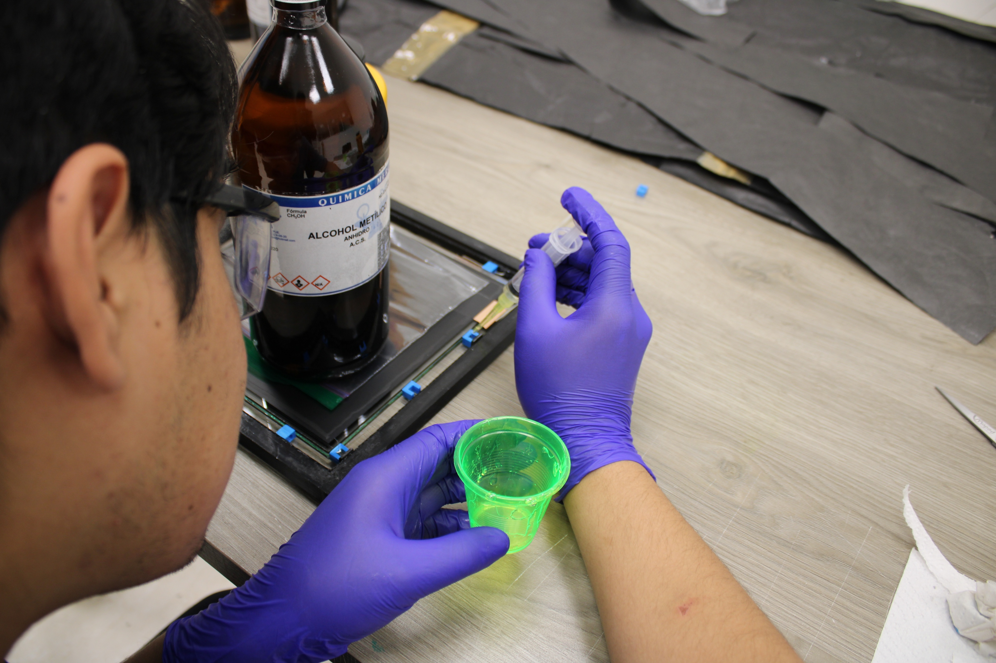
Assembly Process II
1
3
2
4
5
6

Slide 7
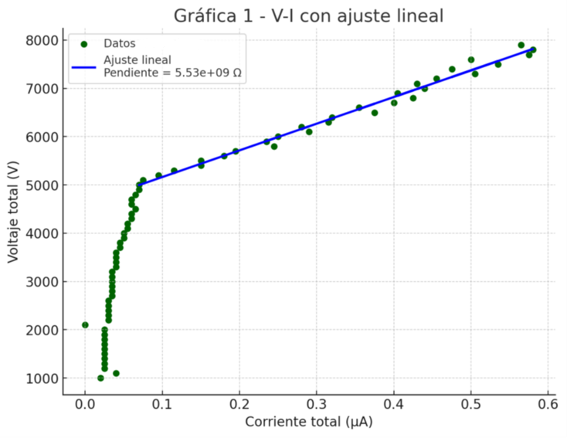
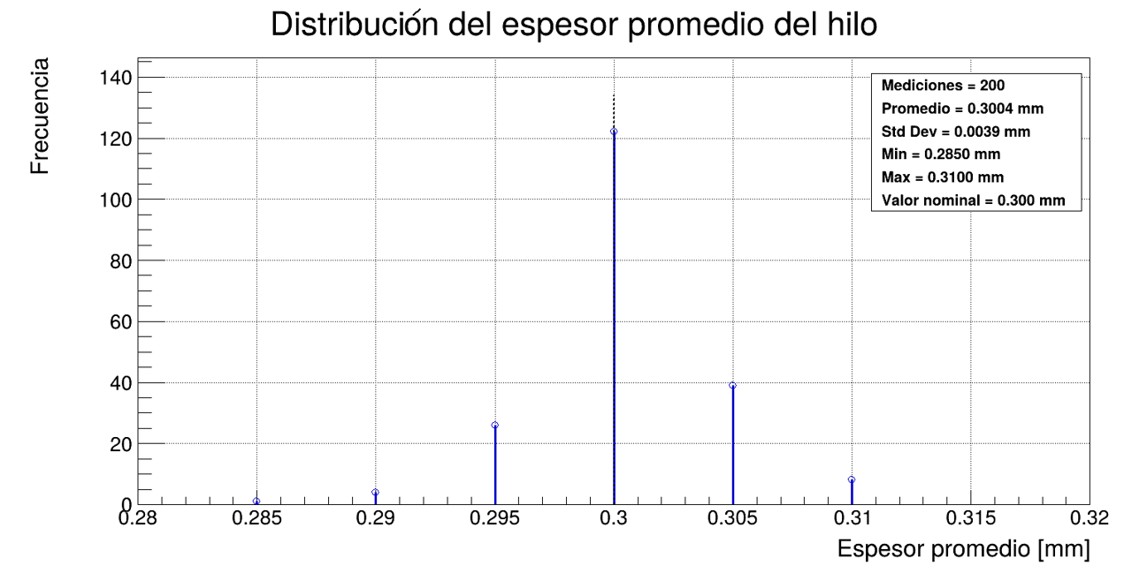
Material Characterization
Electrode Volume Resistivity
Gap Thickness Verification
RPC₁ = 3.02 x 10¹⁰ Ωm
RPC₂ = 2.90 x 10¹⁰ Ωm
Measured fishing-line diameter: 0.3004 ± 0.004 mm.

Slide 8
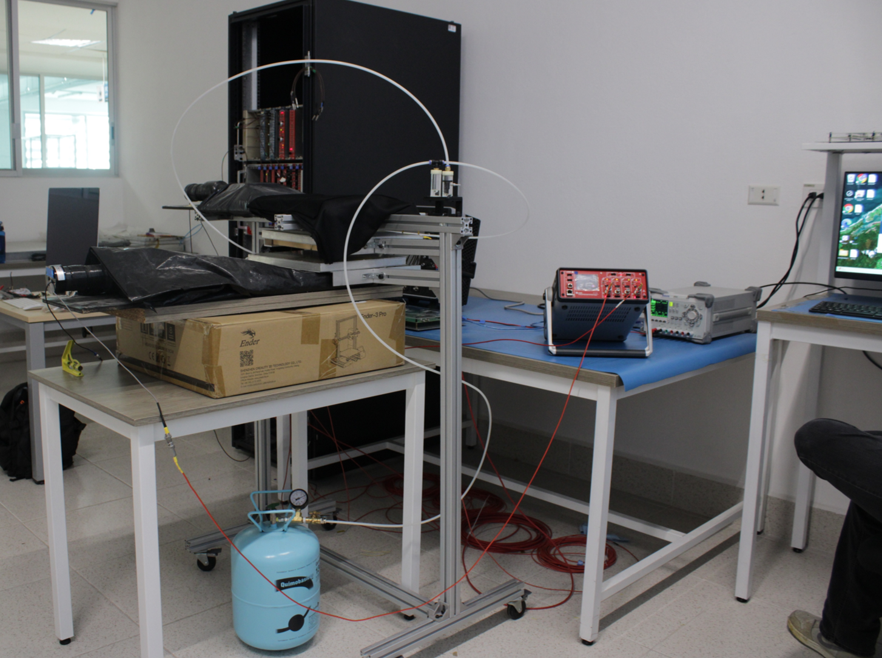
Experimental Setup
Coincidence setup using two scintillator–PMT detectors as references
Electronic modules for signal discrimination and coincidence triggering
Readout system based on the Petiroc 2A ASIC
Electronic modules
Gas system
Detectors setup
ASIC power supply
Trigger electronics
PMT power suply
PMT
Readout ASIC
RPC
RPC
Trigger
Freon
PMT
Petiroc 2A
10 ch

Slide 9
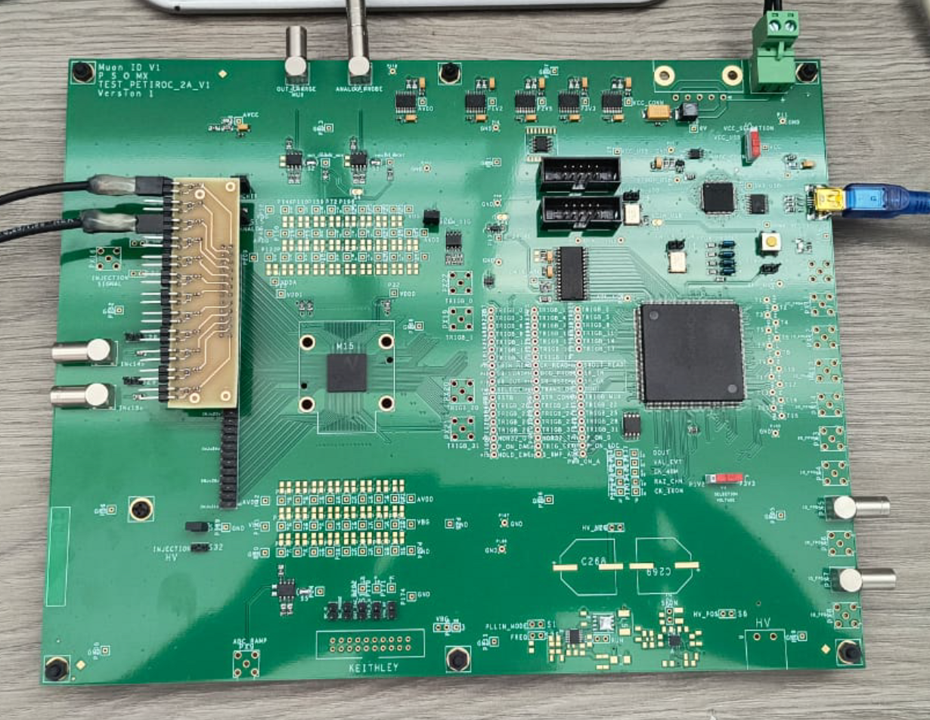
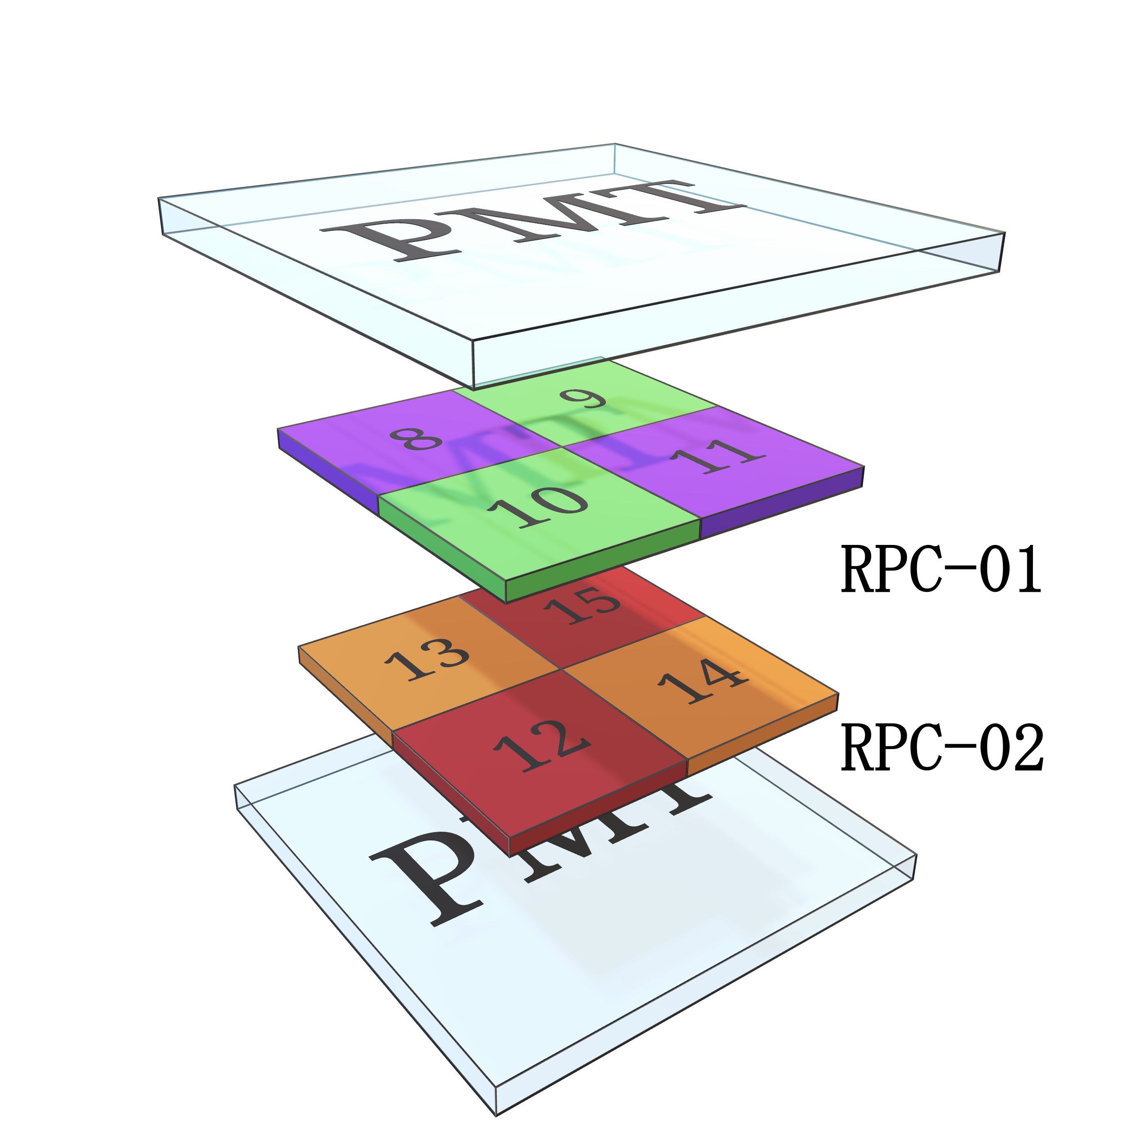
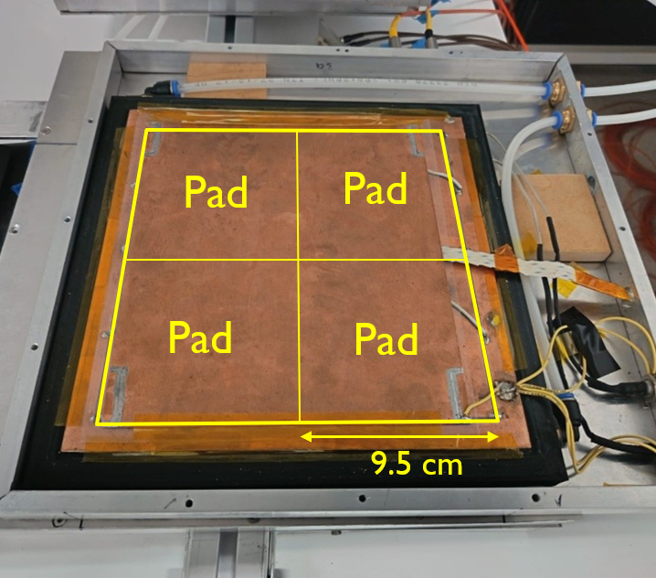
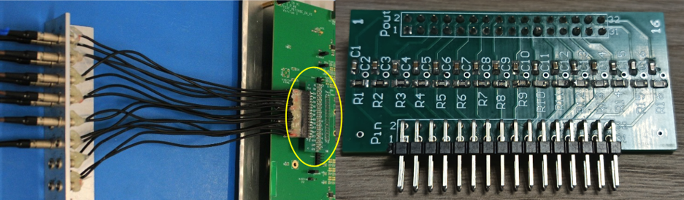
Signal Readout and Data Acquisition
Adaptation of the Petiroc 2A readout system for MRPC signals.
Signal processing through two independent paths:
  Fast timing path
  Charge measurement path
Four readout pads per MRPC detector
One-hour data acquisition runs at different applied voltages (6.0–10.2 kV).
SiPM readout PCB
Patch panel for MRPC signal coupling

Slide 10
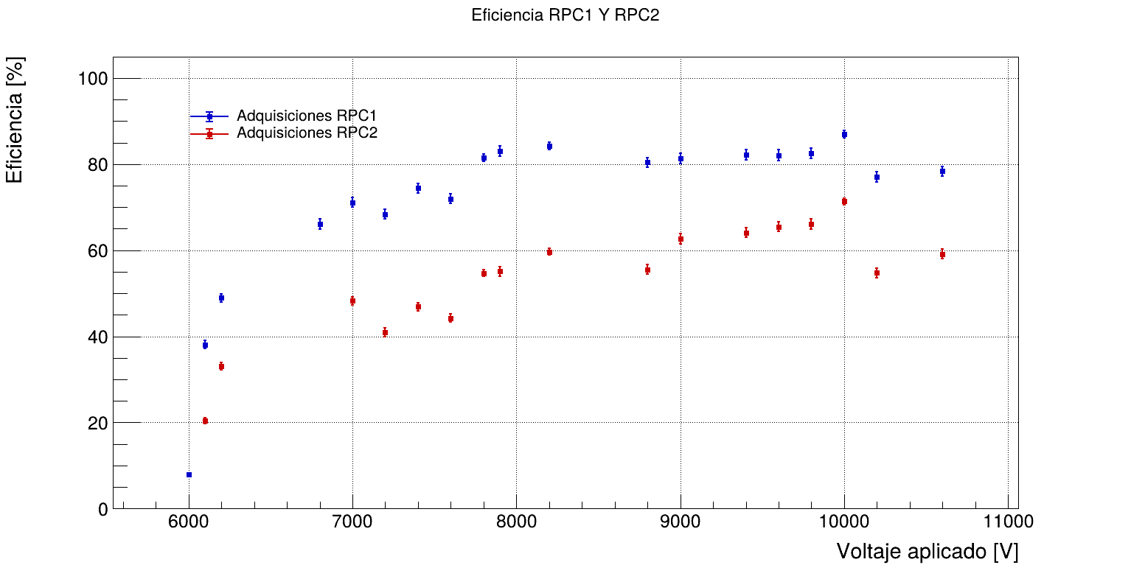
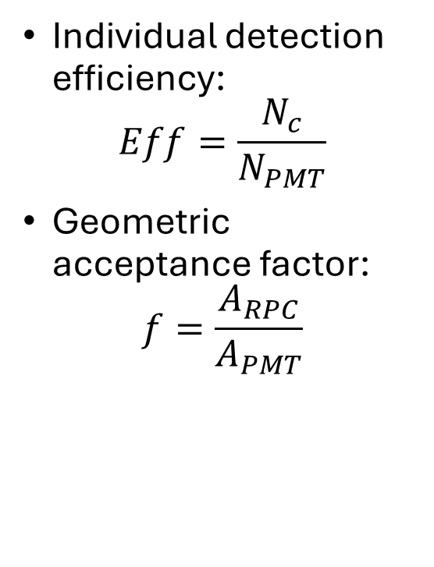
Detection Efficiency
Individual detection efficiency$\text{:}$
$$Eff=\frac{N_{c}}{N_{PMT}}$$
Geometric acceptance factor:
$$f=\frac{A_{RPC}}{A_{PMT}}$$

Slide 11
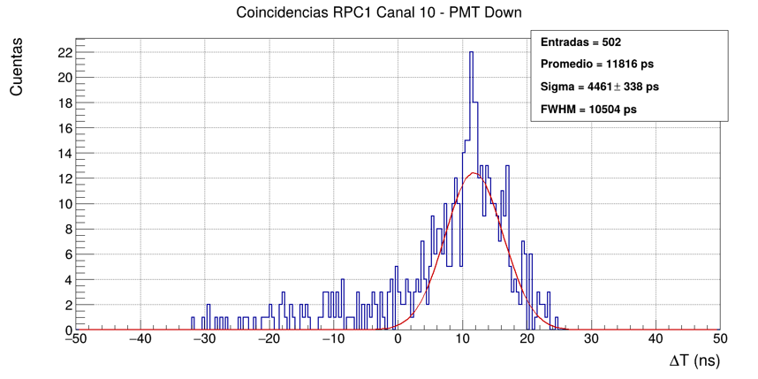
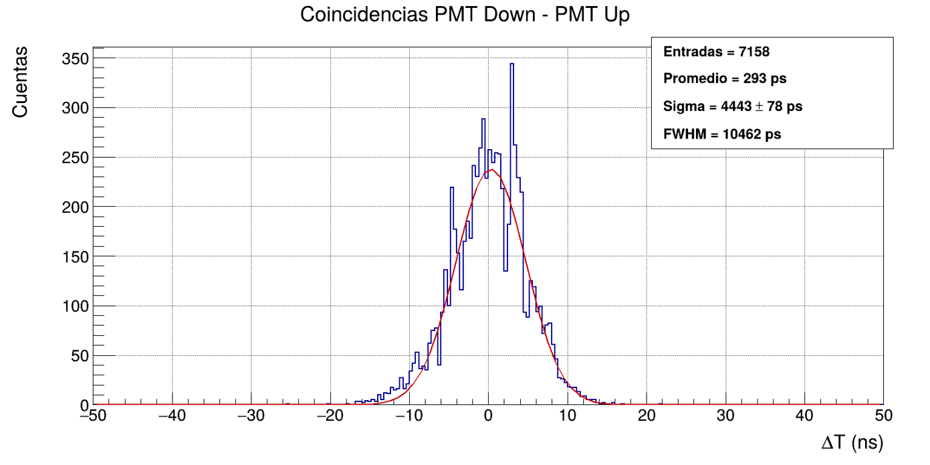
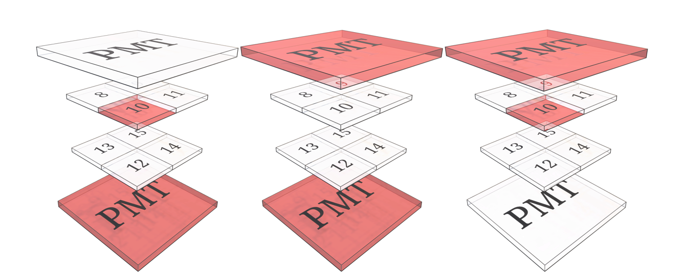
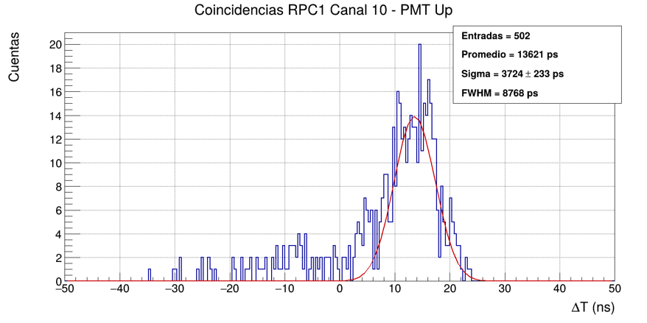
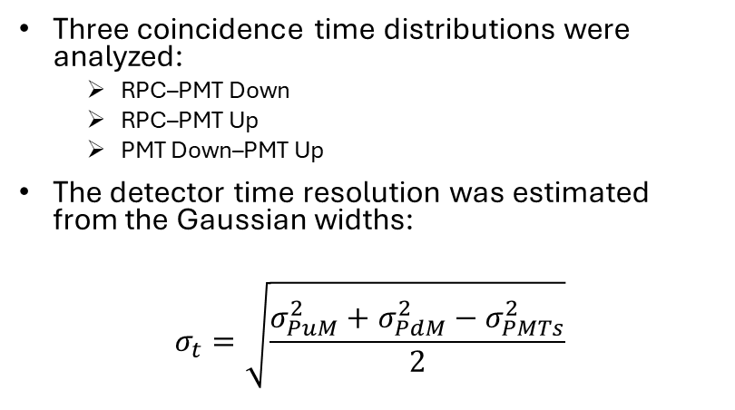
Timing Performance
Three coincidence time distributions were analyzed:
  RPC–PMT Down
  RPC–PMT Up
  PMT Down–PMT Up
The detector time resolution was estimated from the Gaussian widths:
$$σ_{t}=\sqrt{\frac{σ_{PuM}^{2}+σ_{PdM}^{2}−σ_{PMTs}^{2}}{2}}$$

Slide 12
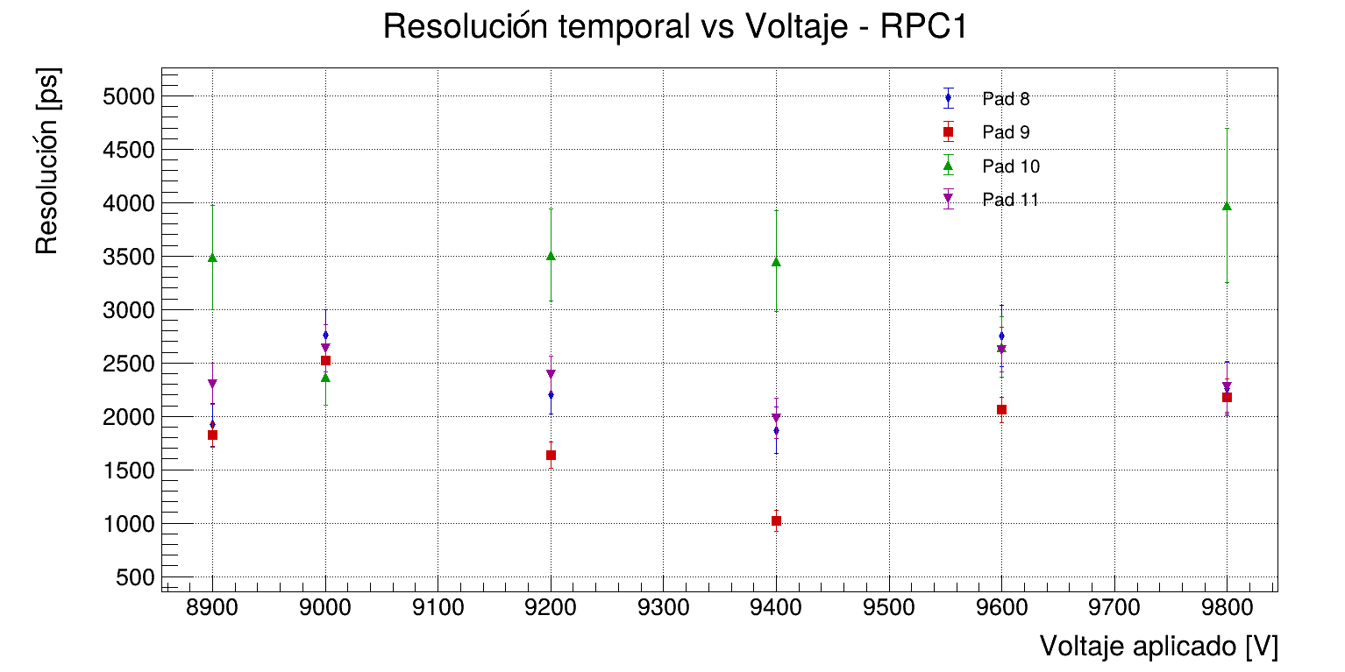
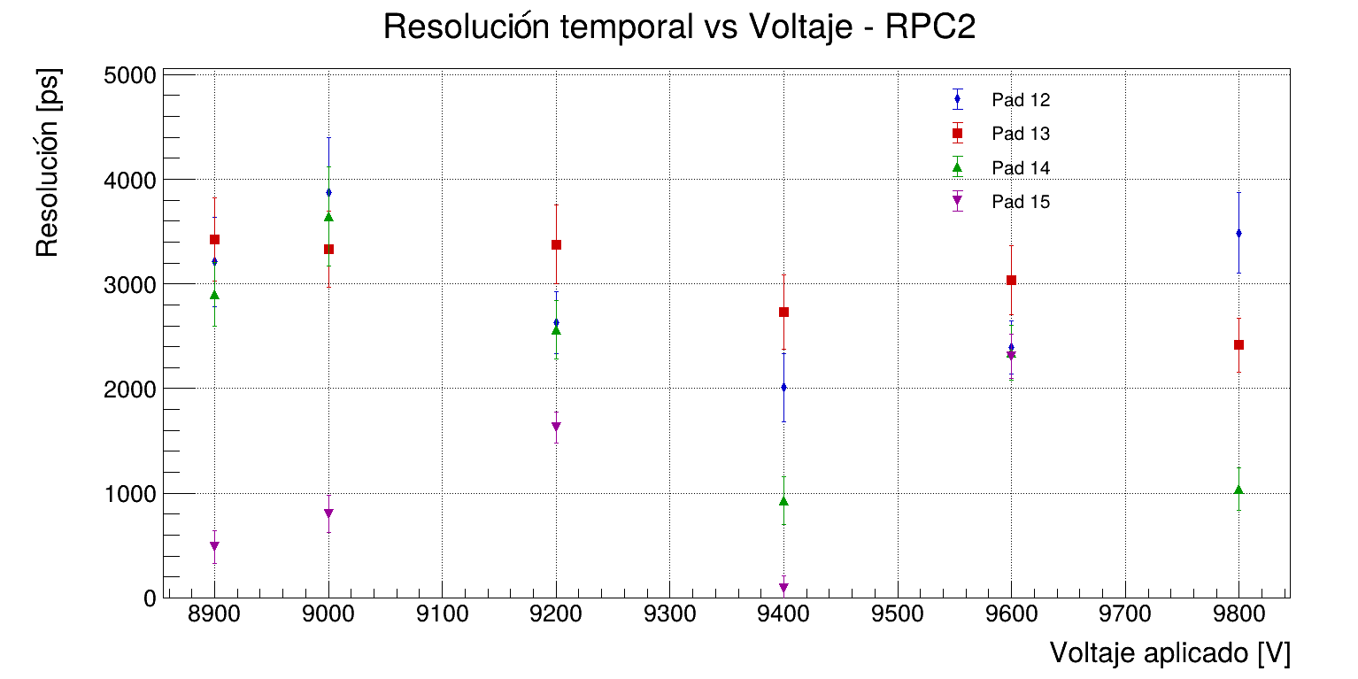
Time Resolution for Different Applied Voltages

Slide 13
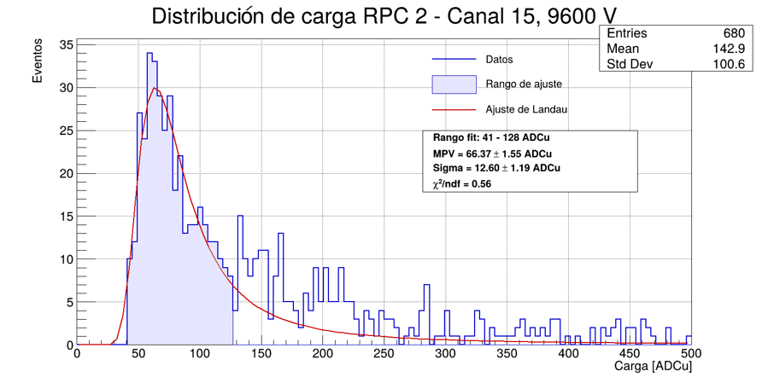
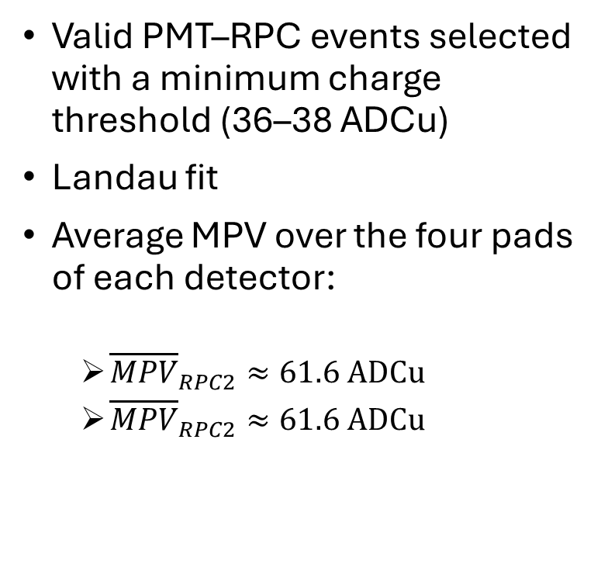
Charge Measurements
Valid PMT–RPC events selected with a minimum charge threshold (36–38 ADCu)
Landau fit
Average MPV over the four pads of each detector:
  ${\overline{MPV}}_{RPC2}≈61.6 ADCu$
  ${\overline{MPV}}_{RPC2}≈61.6 ADCu$

Slide 14
Conclusions
Two MRPC prototypes with two 0.3 mm gas gaps were successfully constructed.
Electrode resistivity and gap thickness were characterized during the construction process.
The Petiroc 2A readout system was adapted for MRPC signal acquisition, enabling experimental measurements of detection efficiency, timing resolution, and charge response.
Outlook
Further studies will focus on improving detector stability, optimizing construction procedures, and refining the experimental characterization.

