Slide 1
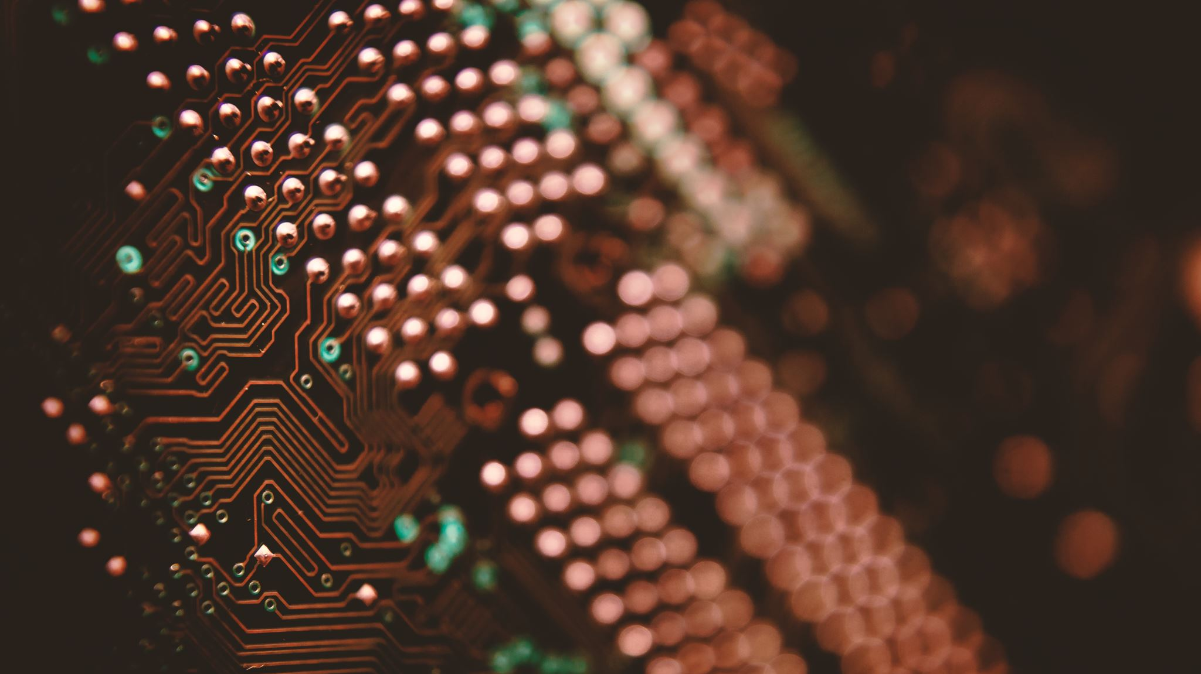
MID FEC: plastic scintillator option
(WP3)
ALICE Mexico MID meeting
April 15, 2026
Guillermo Tejeda, for the MID-Mexico electronics group

Slide 2
Outline
Introduction (MID detector)
FEC V1
Data from Beam Test
FEC Version 2 and LpGBT
Organization
Summary

Slide 3
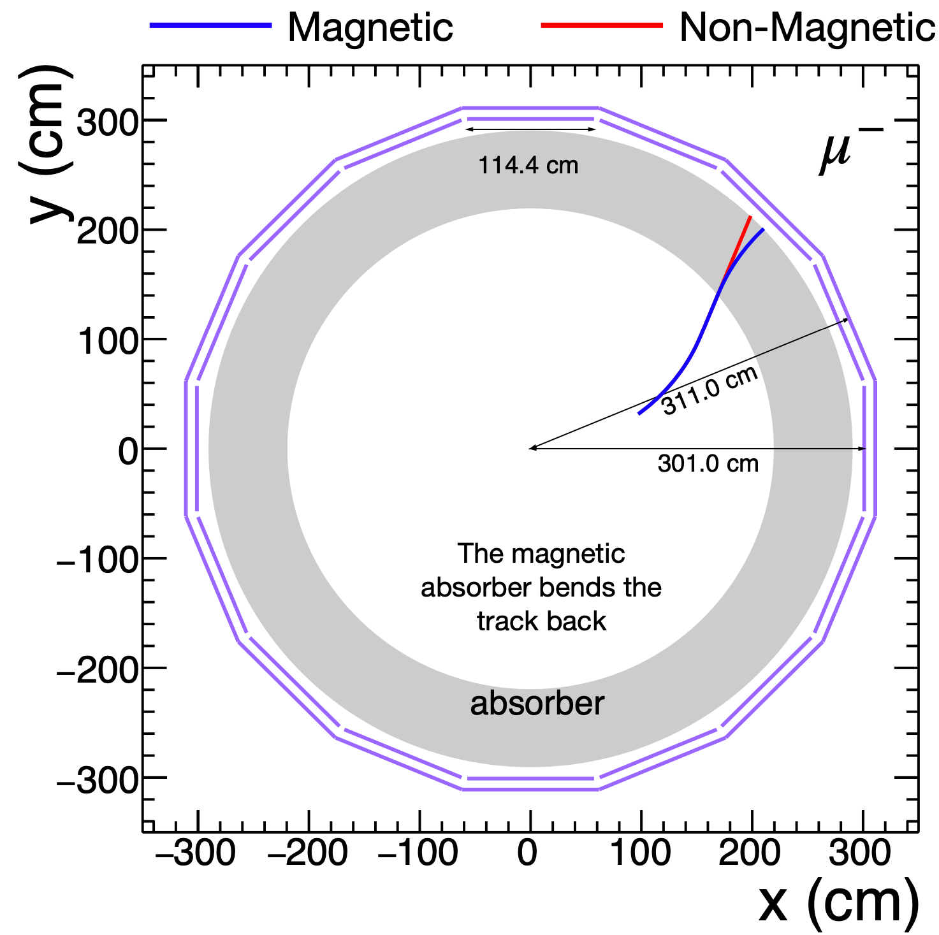
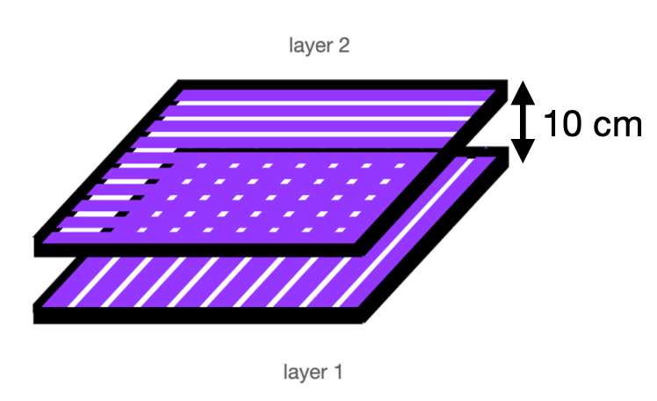
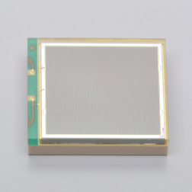
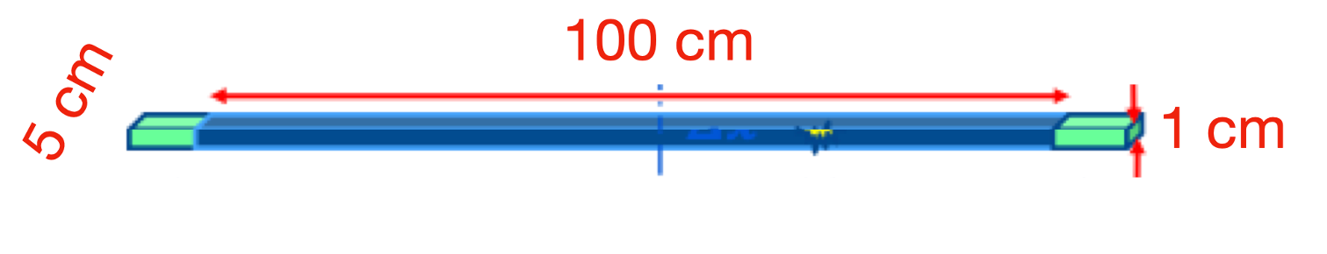
MuonID Detector
Plastic Scintillator Option
Assumptions:
  10 rings
  18 segments per ring
  1 chamber per segment
  40 channels per chamber
  1 SiPM per channel

Slide 4
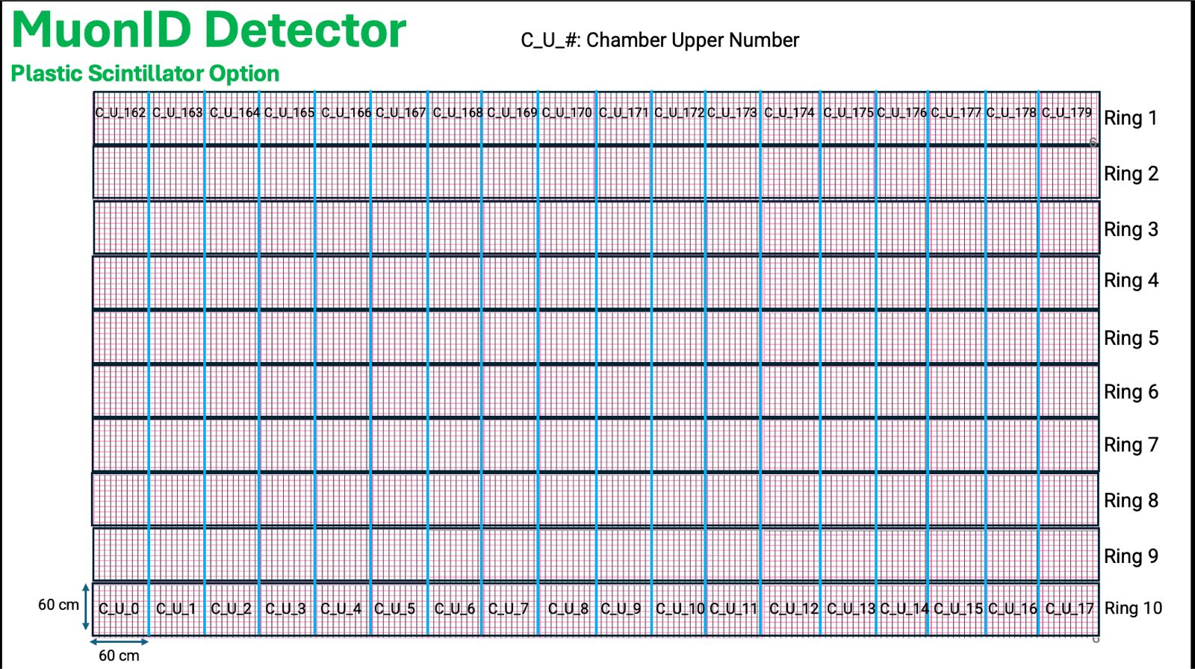
100cm
100cm

Slide 5
MuonID FEC details (Version 1)
Designed to test PETIROC 2A with the MID module prototype.
1 Erni connectors with 32 ch
1 ASIC Petiroc 2A designed for SiPM
1 Cyclone FPGA
Power supply regulators for FEC and SiPM
Analog and digital outputs for debugging
USB communications
EPCQ16
JTAG
Clk
40MHz
Clk
12MHz
32 CH Input
Petiroc 2A
Control
FPGA
Uplink
Trigger
USB
Data
Downlink
Power_Reg (3.3V, 2.5V, 1.2V)
Ch14/Ch15
Test inputs
Analog and Digital
Output Probes
Ext_Trigger
11
I/O

Slide 6
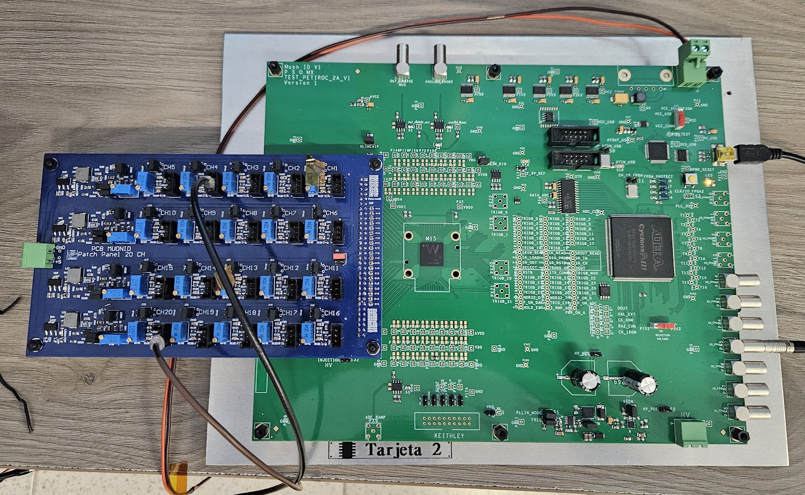
FEC + PP
Communication
Power consumption
Internal trigger
External trigger
PP (reduce components)

Slide 7
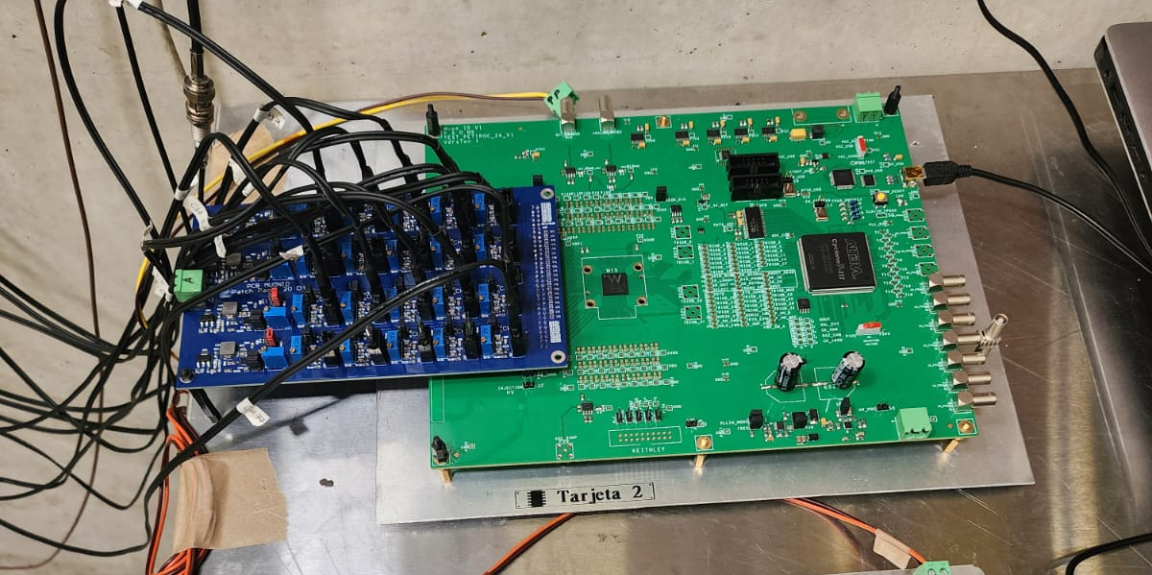
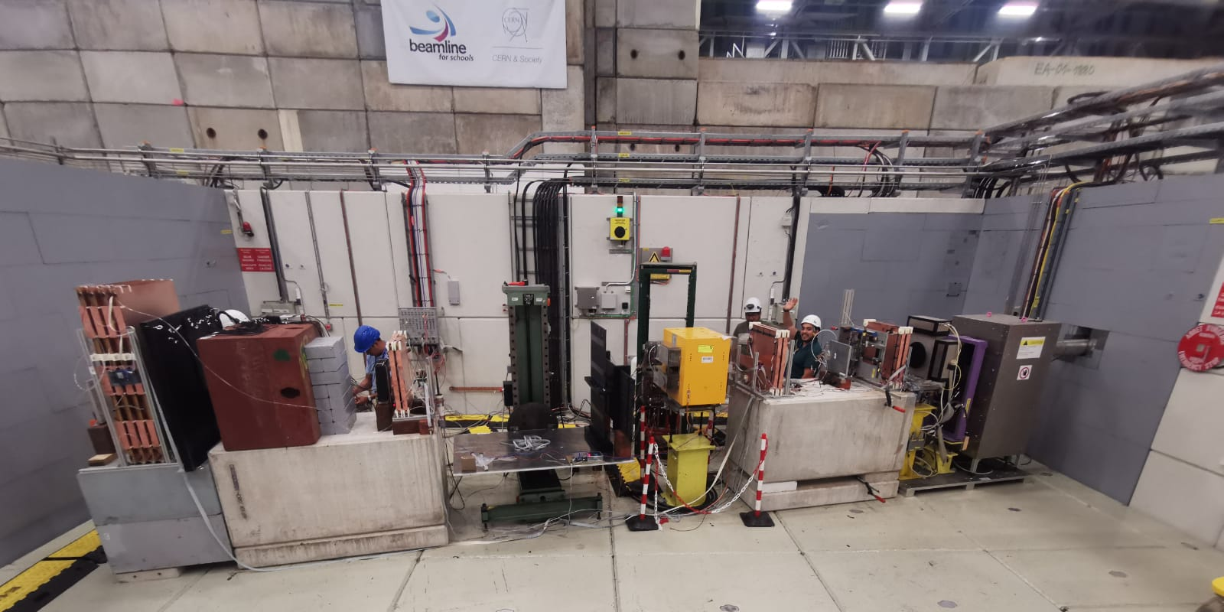
FEC + RPCs
Beam Test August 2025
RPC 3 RPC 1

Slide 8
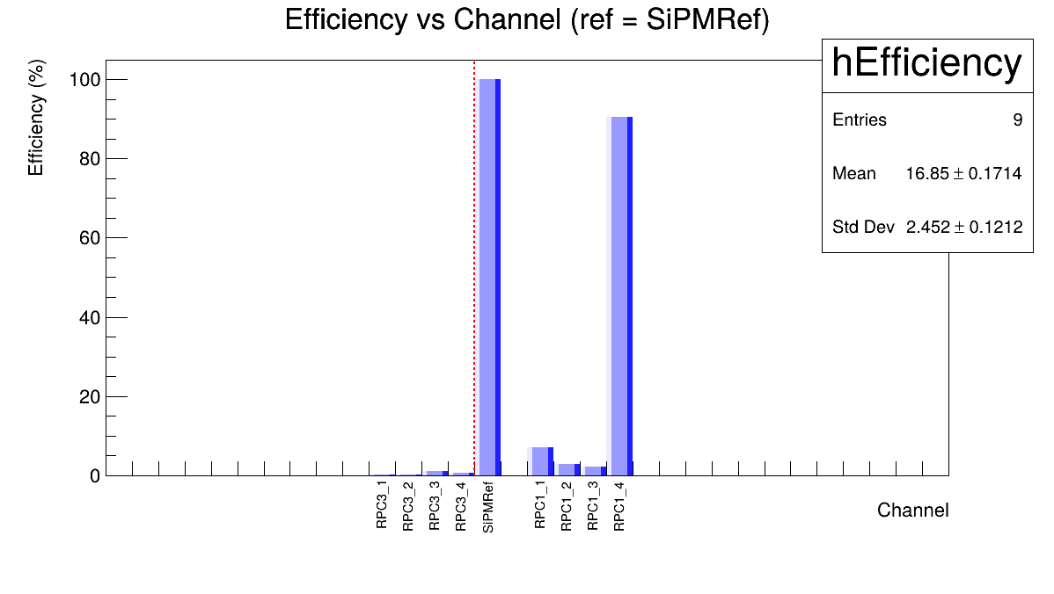
Beam Test 2025
2 GeV/c Muons
RPCs = 7500 V
RPC1 Eff = 92.78%
RPC 3_2
RPC 3_3
RPC 3_1
RPC 3_4
RPC 1_2
RPC 1_3
RPC 1_1
RPC 1_4

Slide 9
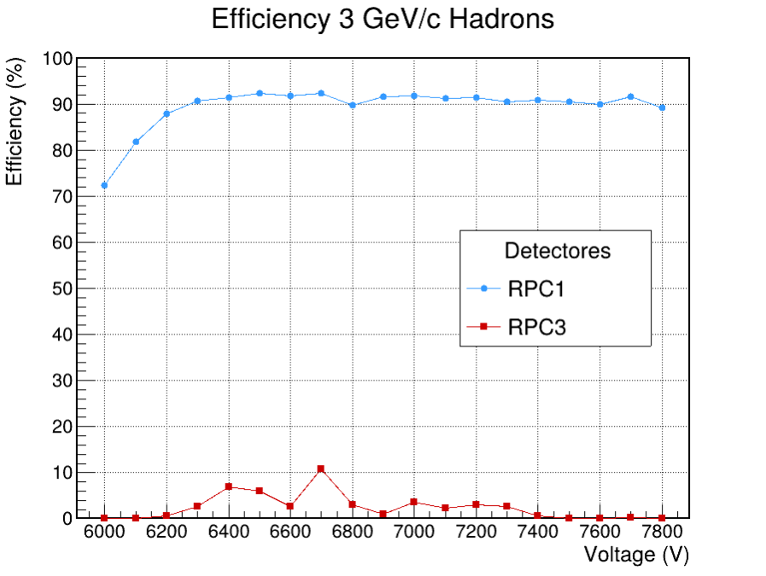
Beam Test 2025

Slide 10
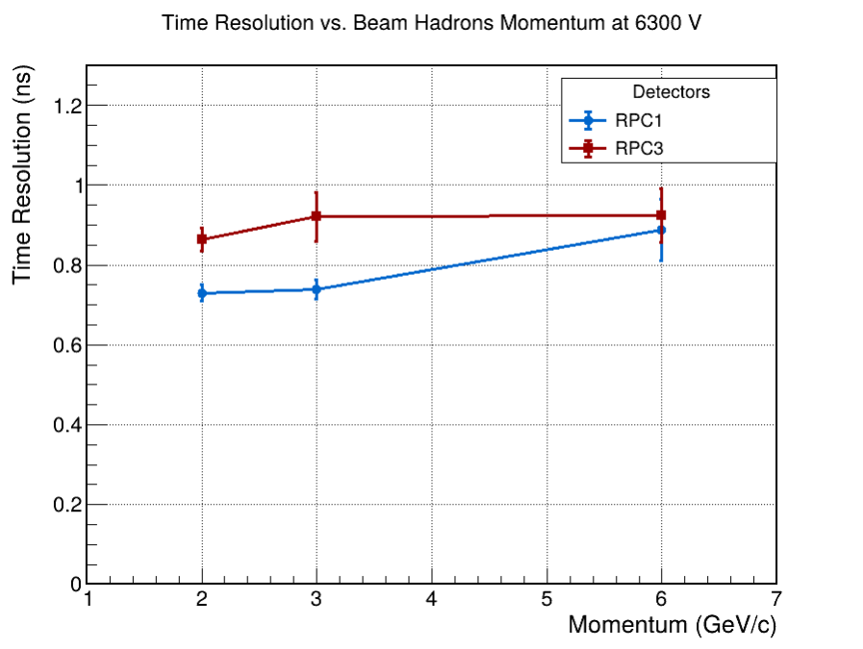
Beam Test 2025

Slide 11
MuonID FEC details (Version 2)
Designed to test Temporoc with the Final MID module prototype.
2 Erni connectors with 32 ch
64 ch input
1 ASIC Temporoc 3 designed for SiPM
1 FPGA CycloneVI
Power supply regulators for FEC and SiPM
Analog and digital outputs for debugging
LpGBT – VTRx
USB
Ethernet
EPCQ16
JTAG
Clk
40MHz
32 CH Input
Uplink
Temporoc 3
(64 ch)
LpGBT
VTRx+
Control 1
Downlink
Trigger
FPGA
Data 1
32 CH Input
Control 2
Trigger
USB
Data 2
Ethernet
Ch14/Ch15
Test inputs
Analog and Digital
Output Probes
Ext_Trigger
11
I/O
Power_Reg
(5V, 3.3V, 2.5V, 1.2V)

Slide 12
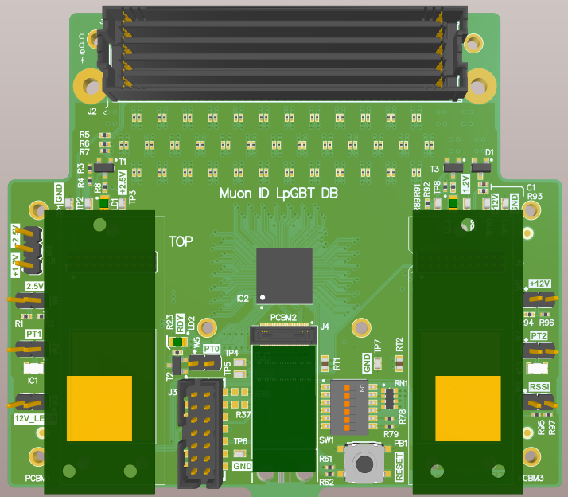
LpGBT V3
FMC
MuonID DB from LpGBT group
  Version 3
First PCB components for prototypes
  4 bPol12V (36 CHF)
  4 bPol2V5 (56 CHF)
  4 LpGBT (100 CHF)
  VtRX+
LpGBT
bPol 2.5V
bPol 12V
VtRX+

Slide 13
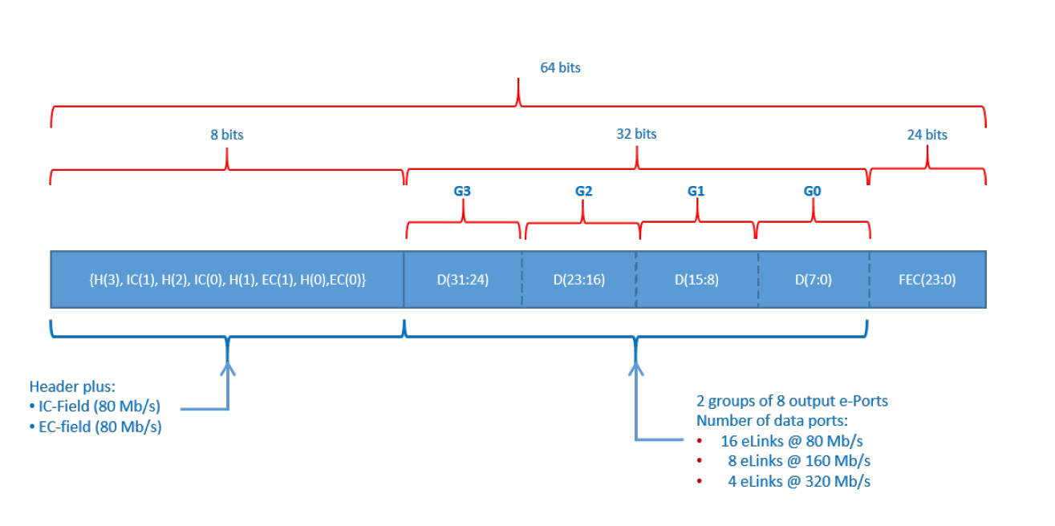
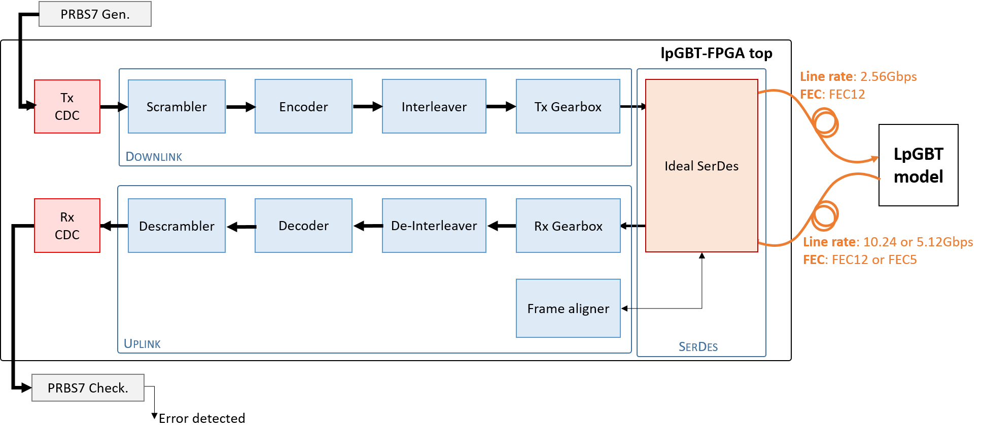
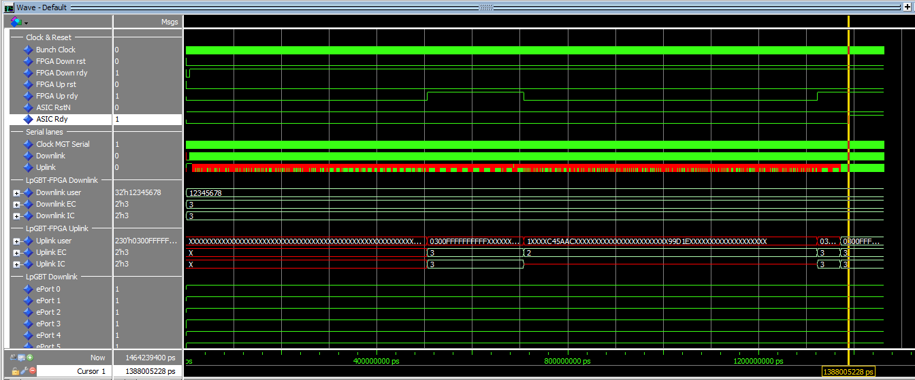
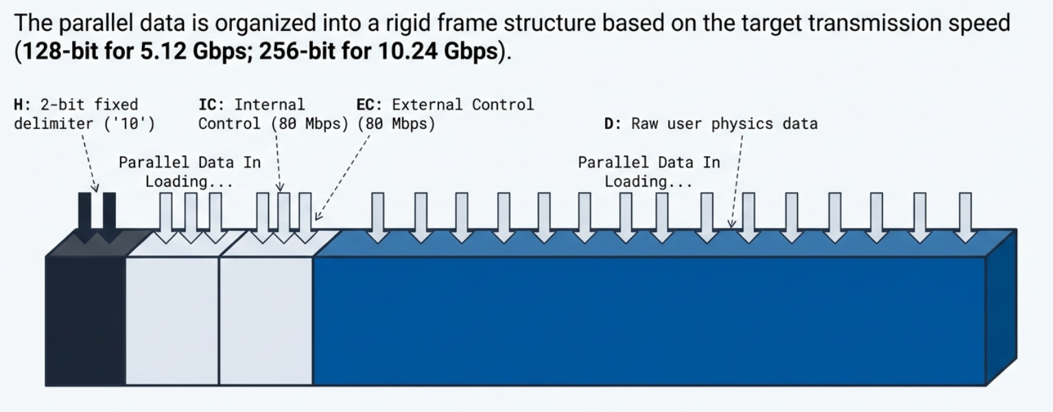
Simulation LPGBT - FPGA
Simulation process diagram.
Downlink Frame: 64‑bit bus @ 40 MHz → Reed‑Solomon encoded → serial link at 2.56 Gbps.
Uplink Frame
Original simulation without modifying files.

Slide 14
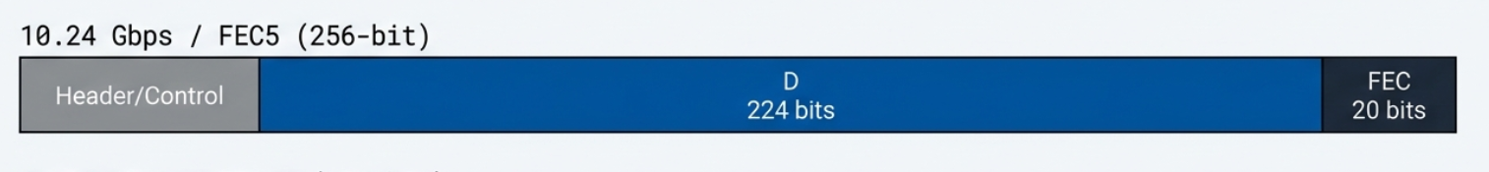
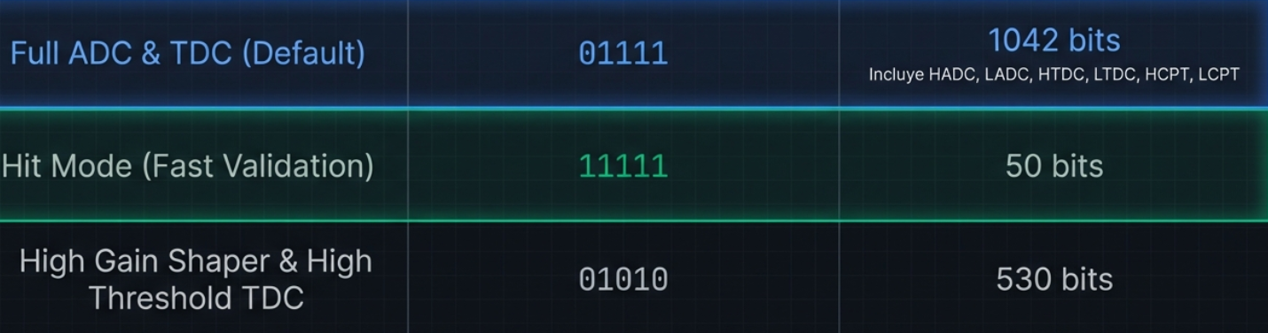
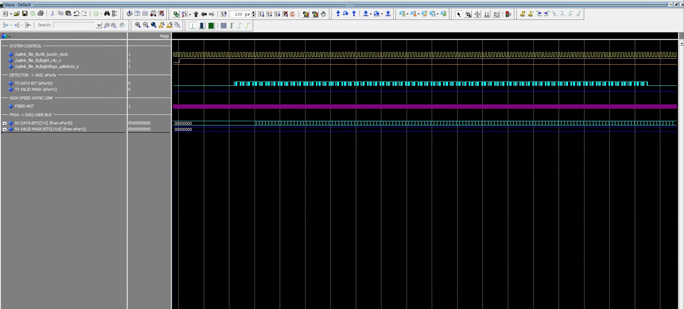
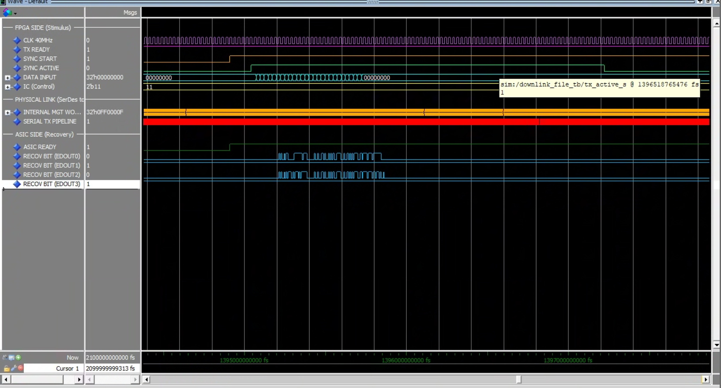
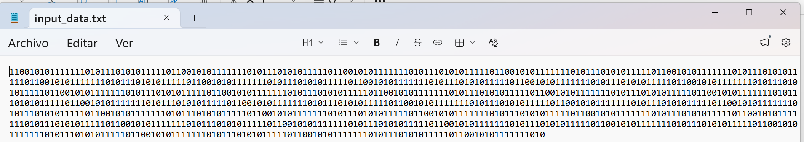
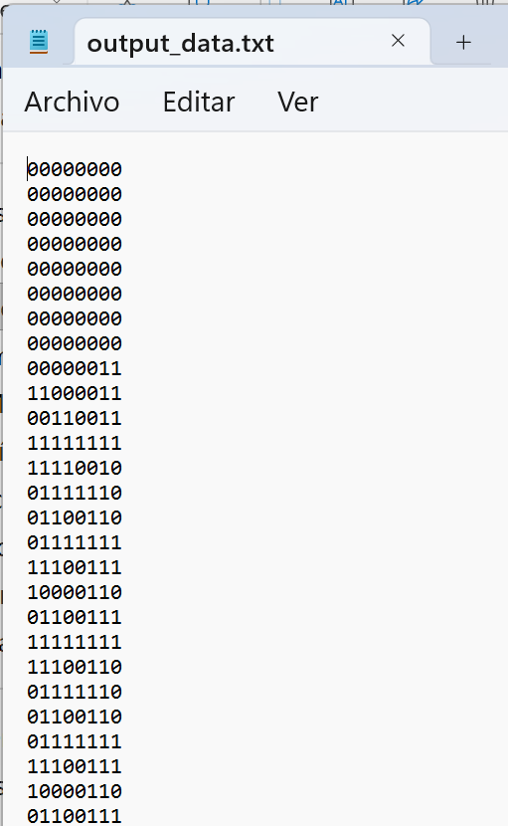
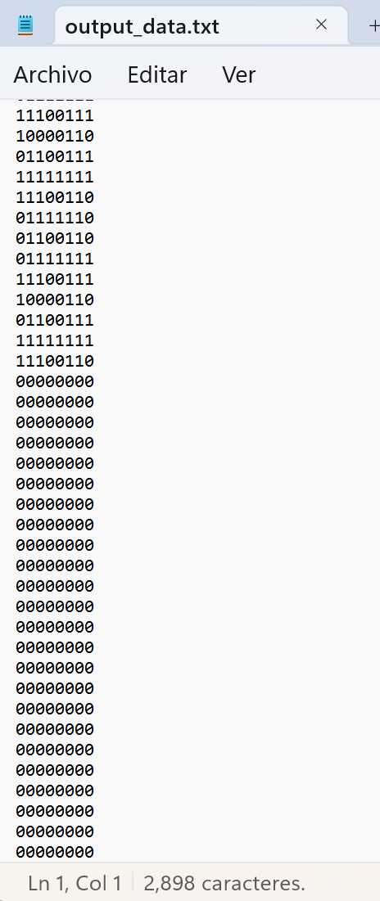
Simulation Uplink and Downlink
Data frame: data frame generated by the Temporoc ASIC chip, comprising a header, data per channel and a footer.
Data frame sent for use in the uplink simulation.
Simulation of the downlink by injecting a data file with the same structure as the data sent by the Temporoc
Simulation of the Slow Control transmission for LPGBT programming.

Slide 15
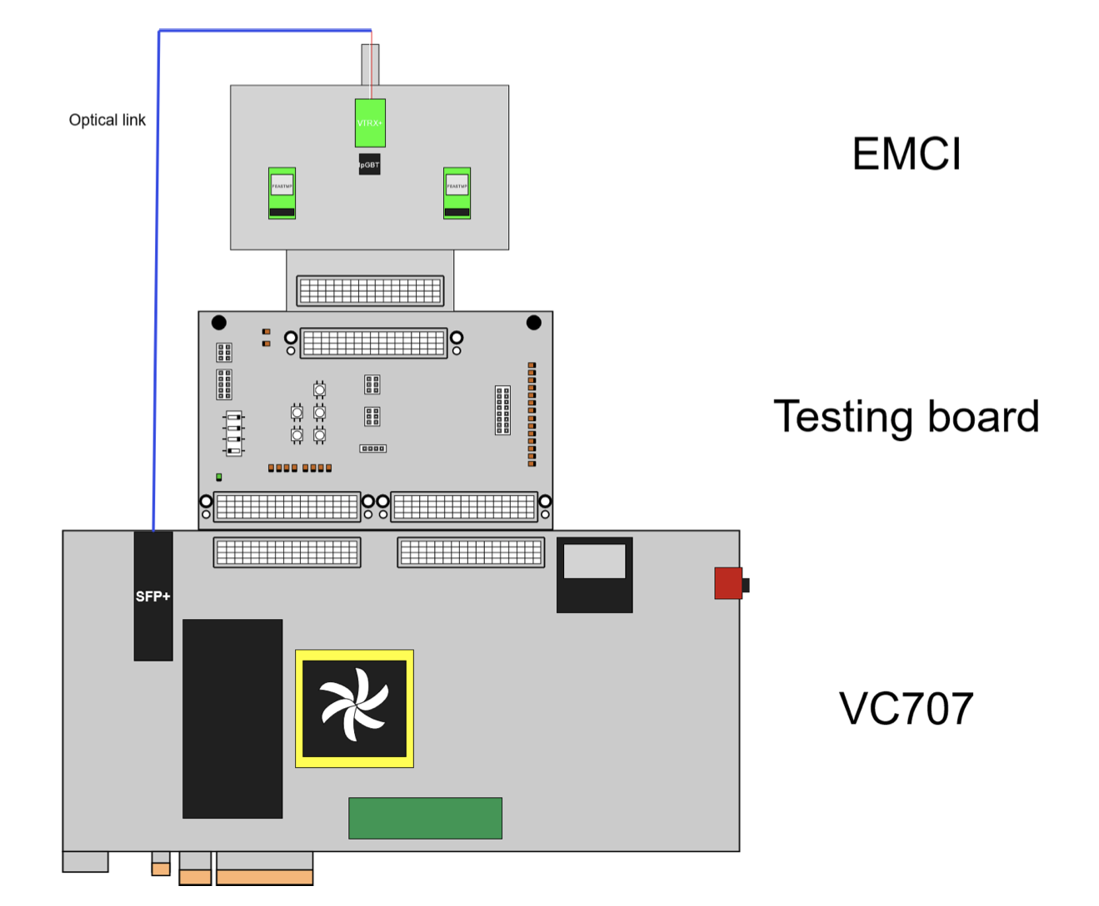
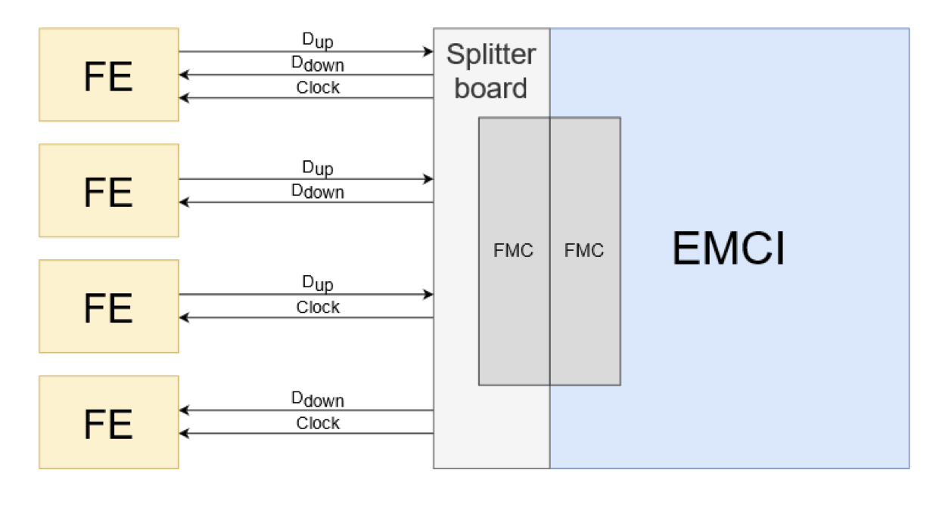
Plan for LpGBT
LpGBT card
LpGBT card

Slide 16
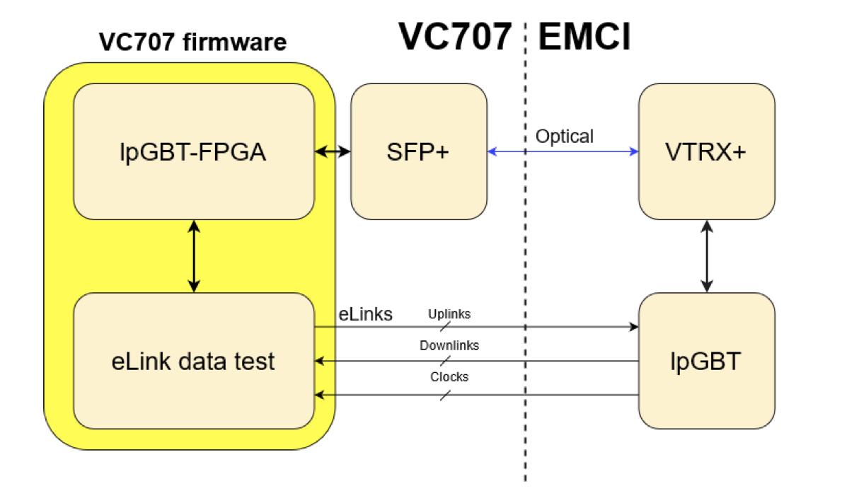
Simulation and test of the complete communications ALICE 3 System (1)
LpGBT card

Slide 17
Simulation and test of the complete communications ALICE 3 System (2)
LpGBT card
MID Electronics
DCS

Slide 18
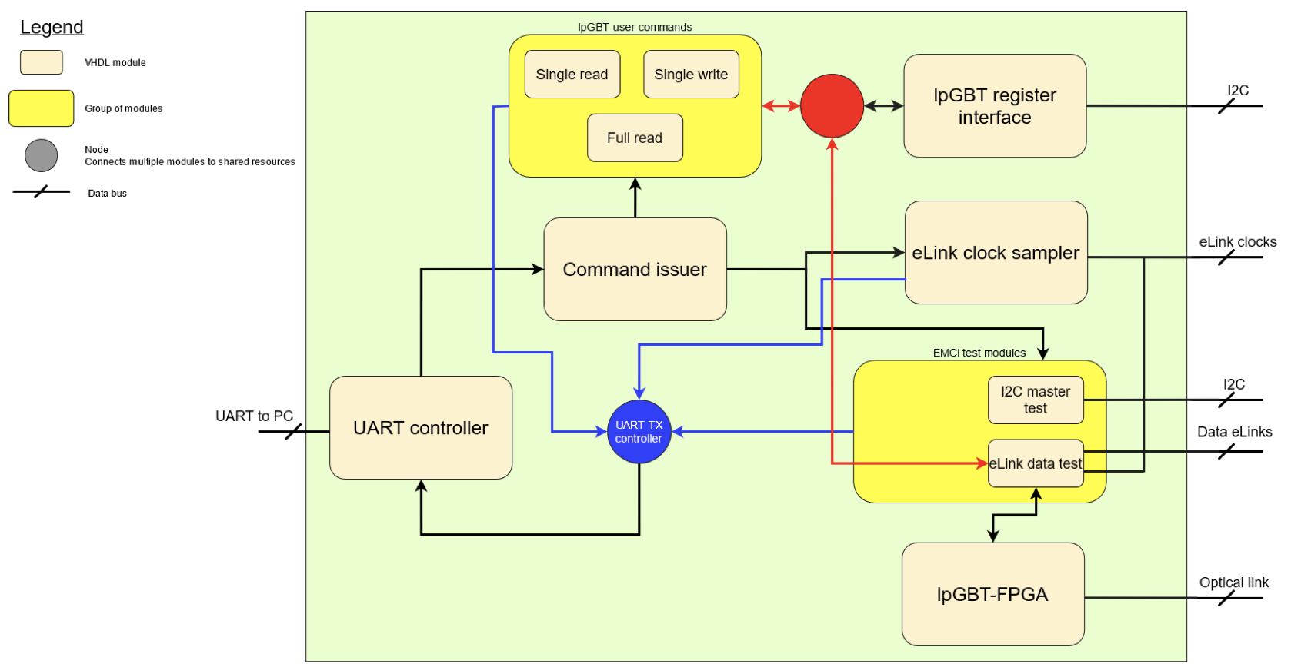
VC707 firmware

Slide 19
Muon ID Electronics Organization
Sinaloa
  Carlos Duarte Galvan
  Juan Manuel Mejia Camacho
  Cesar Regalado Elenes
  Juan Carlos Cabanillas
UNAM
  Enrique Patiño Salazar
  Saul Aguilar
Puebla
  Emigdio Jimenez Dominguez
  Yael Antonio Vazquez Beltrán
  Guillermo Tejeda Muñoz
  Beymar Mamani Mamani
External member
  Luis A. Pérez Moreno
  Salvador ventura
FEE
Grafic Interface
SiPM
- Bi weekly meeting.
FEC-PCB
FEC-Firmware
Communication protocols

Slide 20
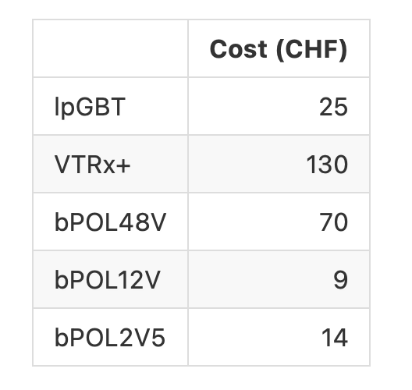
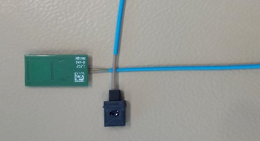
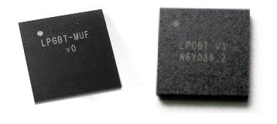
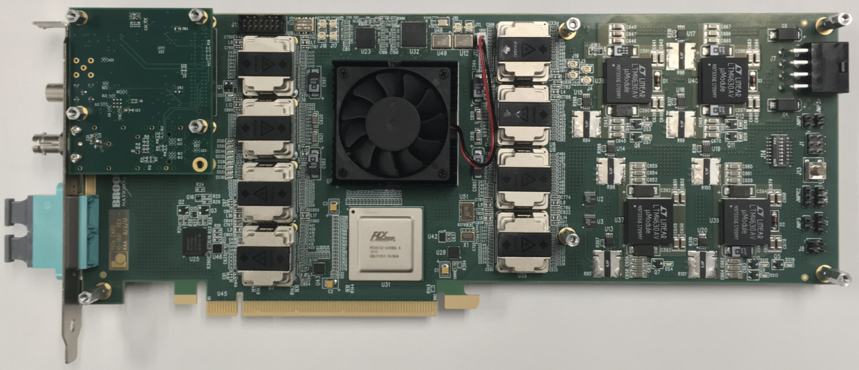
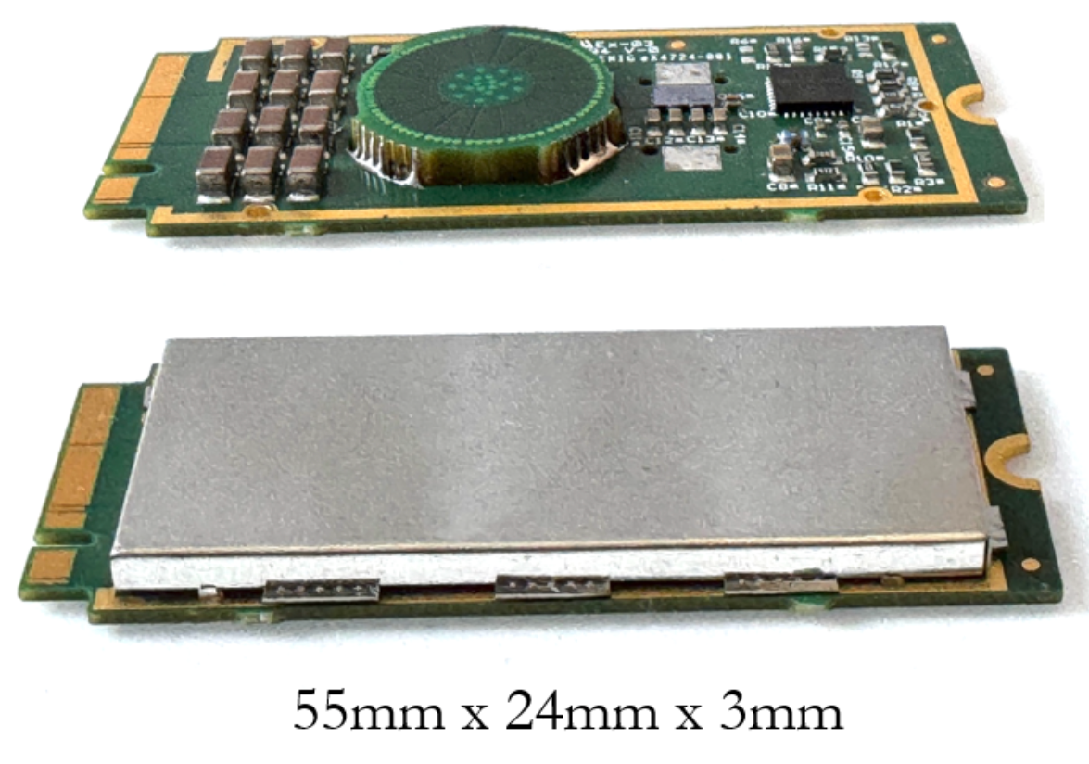
Cost approximations FEC
Pigtail
Lenght : 25 cm
180 for detector
20 for spare
5 for lab use
LpGBT:
180 for detector
20 for spare
5 for lab use
VTRx+:
180 for detector
20 for spare
5 for lab use
Felix card:
3 for detector
1 for spare and lab use
bPOL2V5:
180 for detector
20 for spare
5 for lab use
bPOL12V:
180 for detector
20 for spare
5 for lab use
FEC V2 costs
Temporoc 3 -> 133 KCHF
FPGA -> 82 KCHF
PCB FEC -> 20 KCHF
Components
And connectors -> 50 KCHF
Assembling -> 20 KCHF
TOTAL = 341 KCHF
lpGBT -> 205
5125 CHF
VTRx -> 205
26650 CHF
bPOL2V5 -> 205
2870 CHF
bPOL12V -> 205
1845 CHF

Slide 21
Summary
FEC V1 prototype completed
-> SiPM and RPCs
Development of the FEC version 2
-> working on schematic and PCB
LpGBT communication protocol and VtRX+
-> working on simulation and Hardware

Slide 22
Next activities
Capturing schematic for FEC V2
  (PCB July ∼ 2026)
Review of LpGBT and VtRx+ documentation (hardware)
Analysing data of Beam Test 2025
Continue with data taking to improve parameters configurations
LpGBT PCB -> Ok
Test Board - > Ok
Simulation -> LpGBT model OK

Slide 23

Thank You for your attention

Slide 24
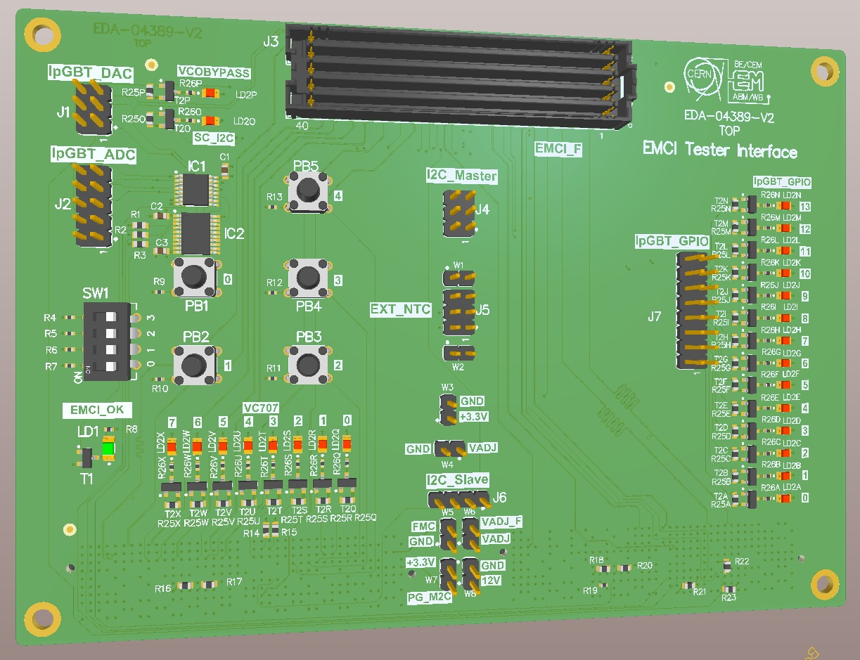
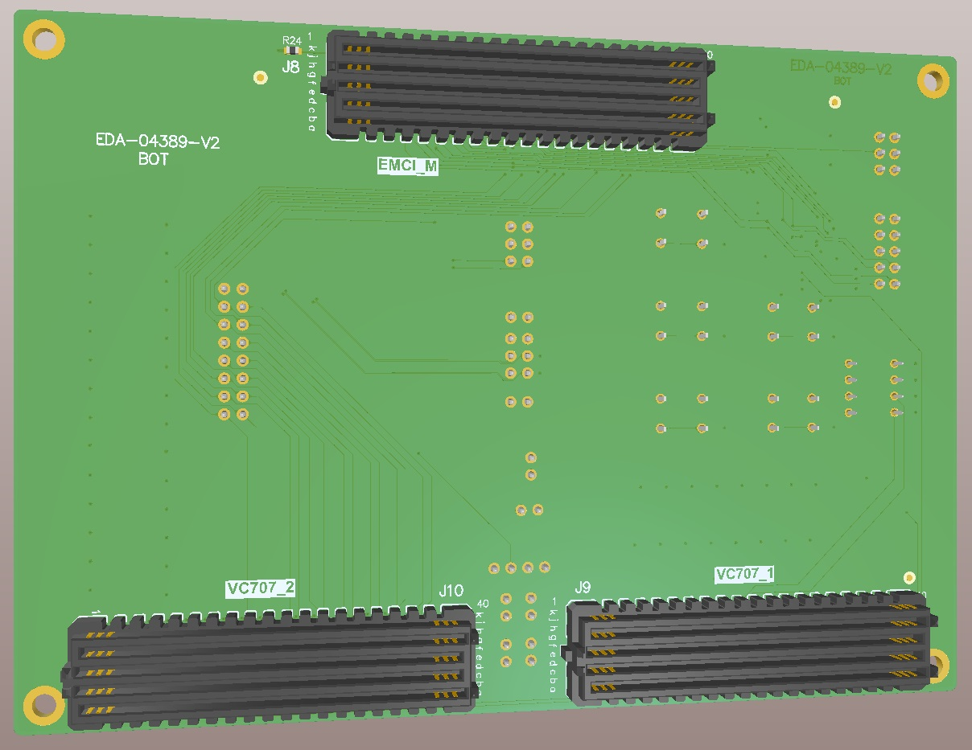
3D View Adapt board

Slide 25
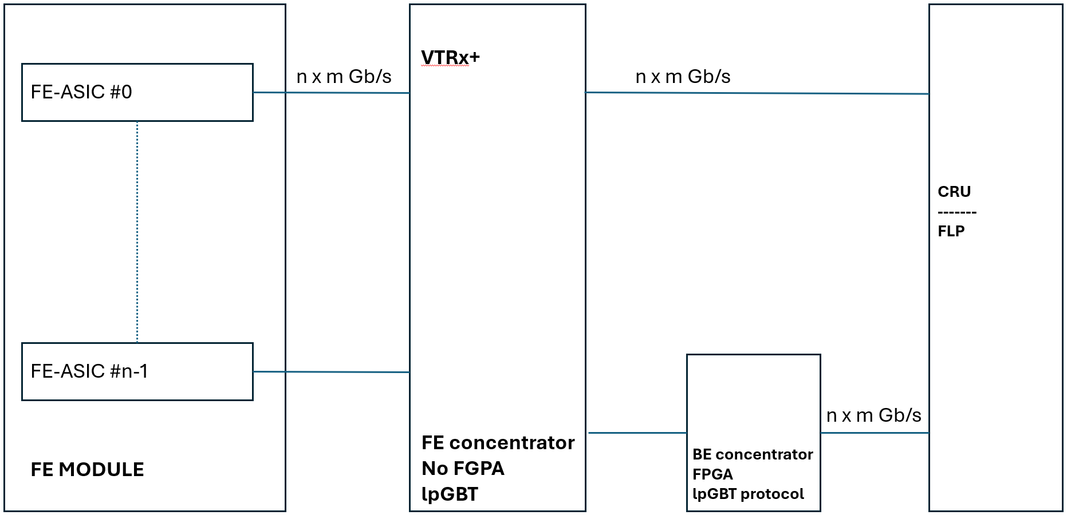
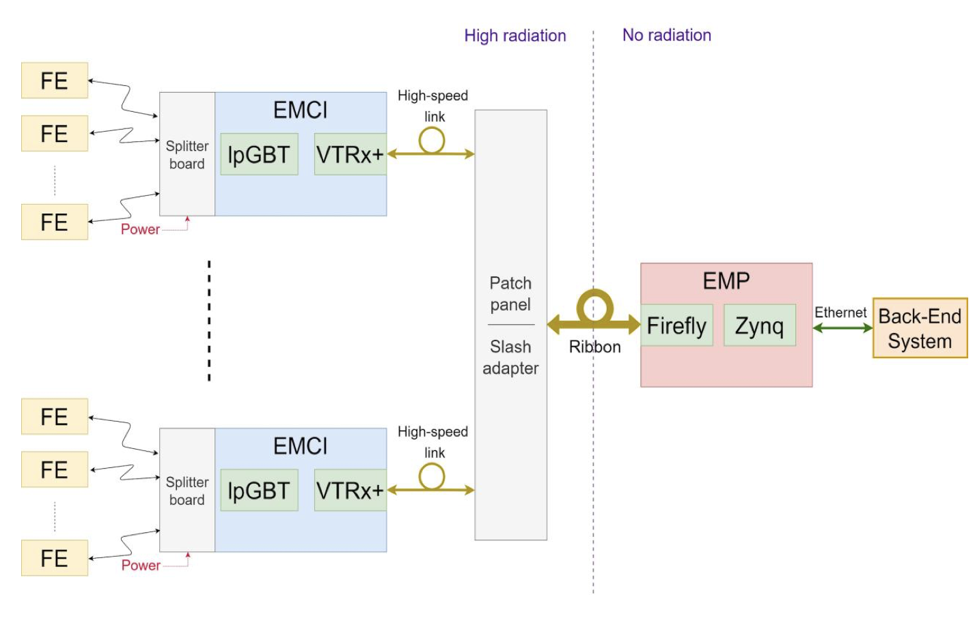
MID Proposal
EPCQ16
Power_Reg
(5V, 3.3V, 2.5V, 1.2V)
CRU
ASIC 1
32 CH Input
Petiroc 2A
1
JTAG
Clk
40MHz
Control 1
LpGBT
Uplink
CRU
1 x 0.5 Gb/s
Trigger
FPGA
VTRx+
Data 1
Downlink
ASIC 1
32 CH Input
Petiroc 2A
2
Control 2
Trigger
USB
Data 2
Ethernet
1 x 0.5 Gb/s
Ch14/Ch15
Test inputs
Analog and Digital
Output Probes
Ext_Trigger
11
I/O
lpGBT
VTRx+

Slide 26
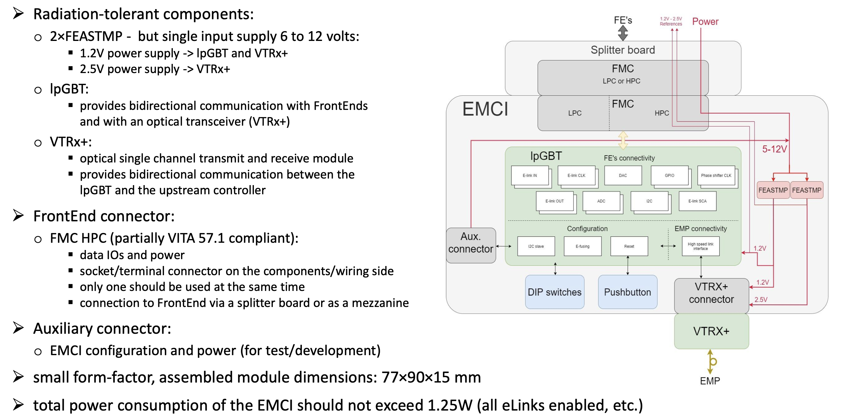
LpGBT DC

Slide 27
lpGBT VTRX+ and bPol components
Pigtail
Lenght : 25 cm
180 for detector
20 for spare
5 for lab use
LpGBT:
180 for detector
20 for spare
5 for lab use
VTRx+:
180 for detector
20 for spare
5 for lab use
Felix card:
3 for detector
1 for spare and lab use
bPOL2V5:
180 for detector
20 for spare
5 for lab use
bPOL12V:
180 for detector
20 for spare
5 for lab use
lpGBT -> 205
5125 CHF
VTRx -> 205
26650 CHF
bPOL2V5 -> 205
2870 CHF
bPOL12V -> 205
1845 CHF

Slide 28
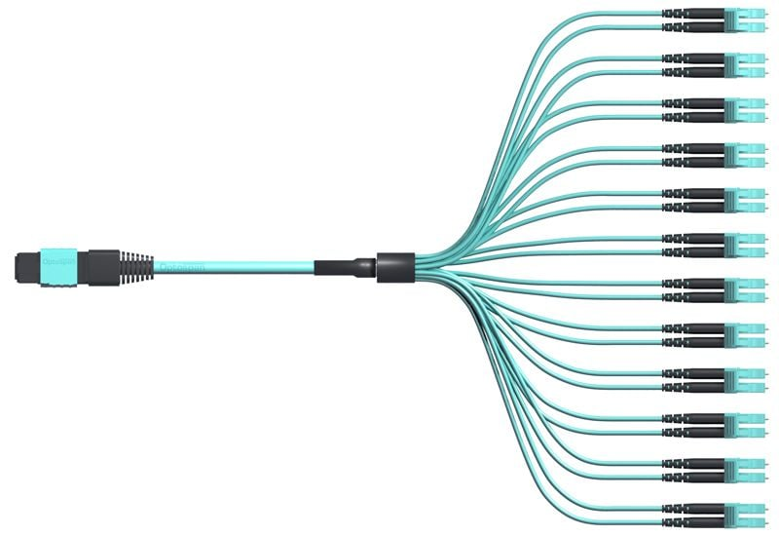
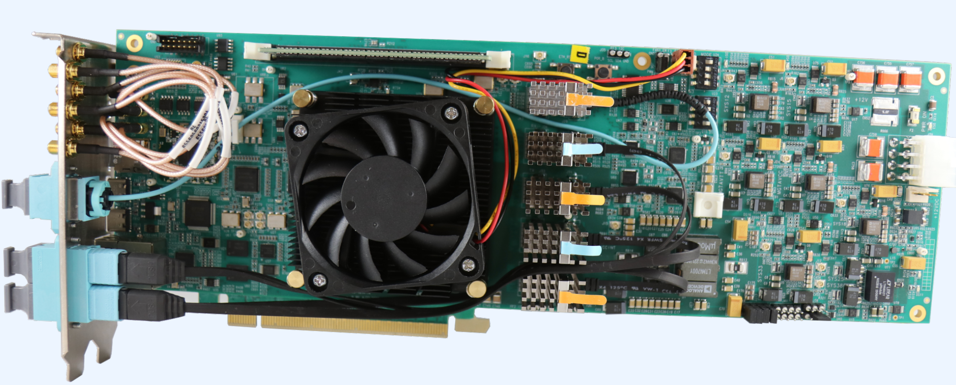
Channels Distribution (proposal)
180 FECs in total
40 channels/FEC
Energy & Time measuremnt
Required 180 PigTails
3 Break Out Box
10 Optical links from Break Out Box to Felix Cards
9 Gb/s required for each MID Ring
3 Felix Card -> 24 links up to 10 Gb/s
Compatible with MWPC
10 m (10 rings)
MID Module
18 FEC per ring
FEC
Distance from MuonID module to break out Box -> 12m
MuonID Break Out box to Felix Card Rack
Break Out box 1
Break Out box 2
Break Out box 3
Felix Card 1
MID ring 1 to 3
Felix Card 2
MID ring 4 to 6
Felix Card 3
MID ring 7 to 10

Slide 29
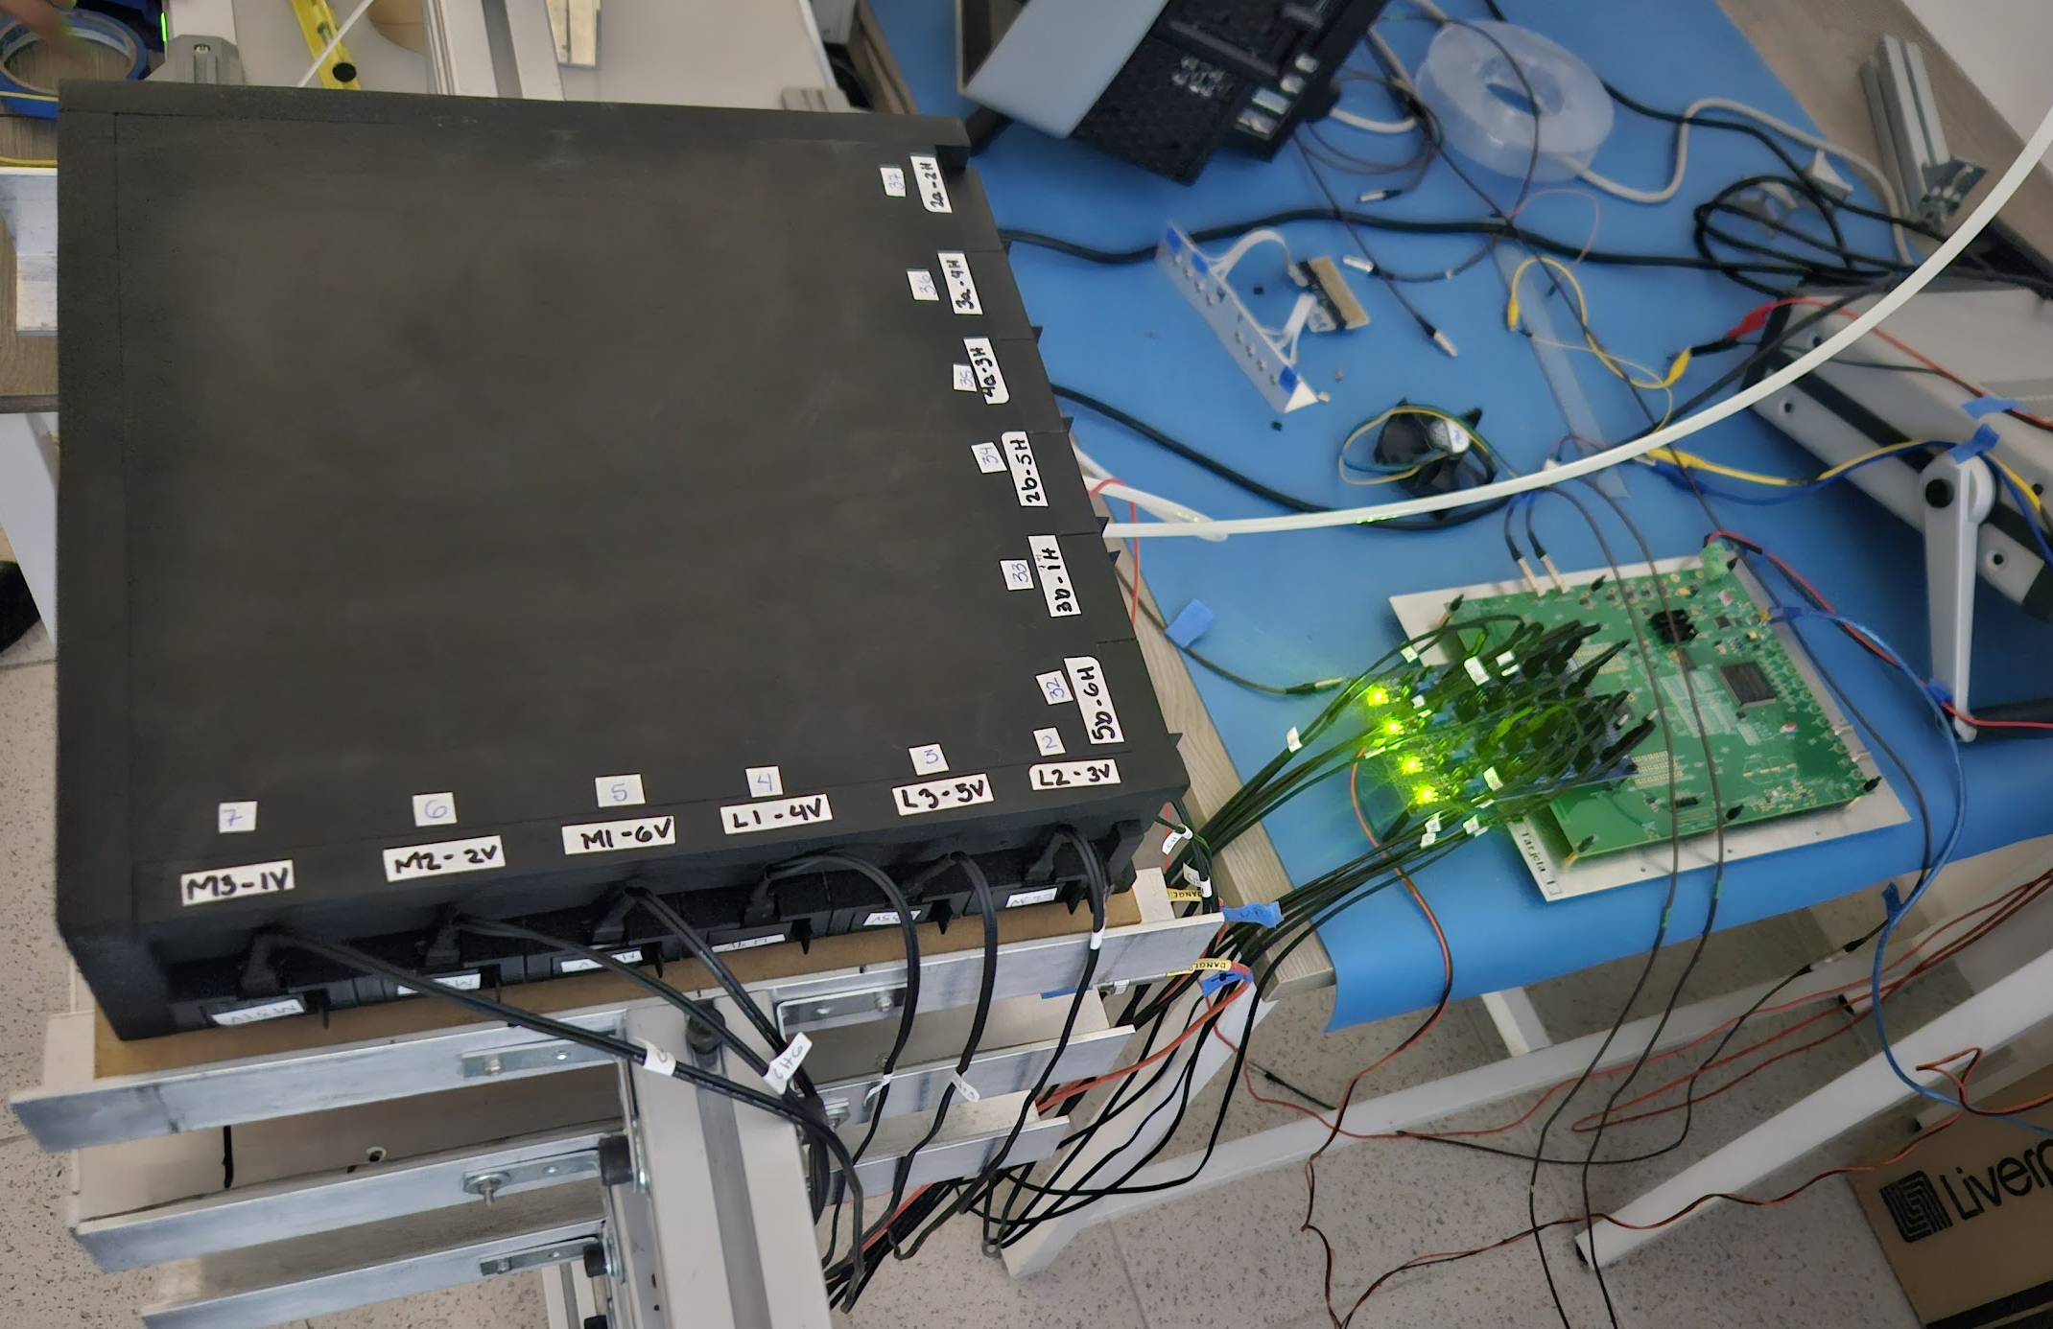
MID Charge
(Data from coincidence between layers, Cosmics)

Slide 30
Using 2 PMTs for external trigger

Slide 31
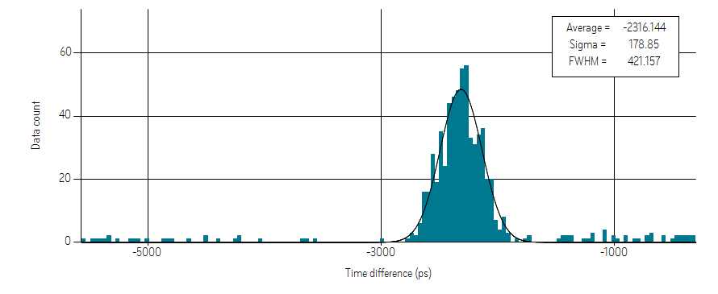
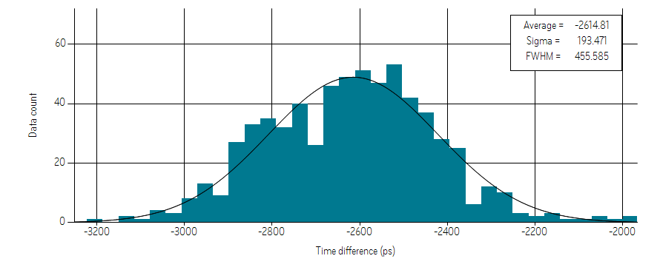
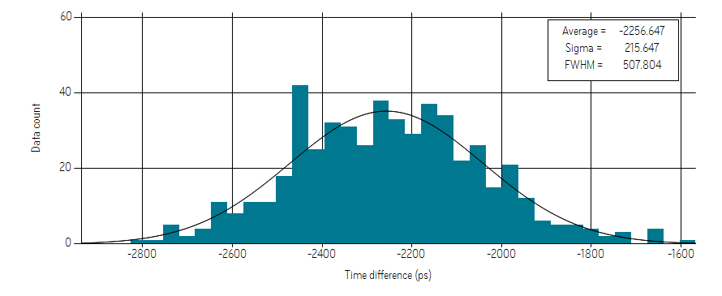
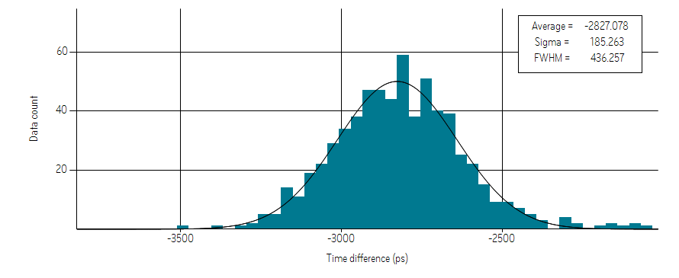
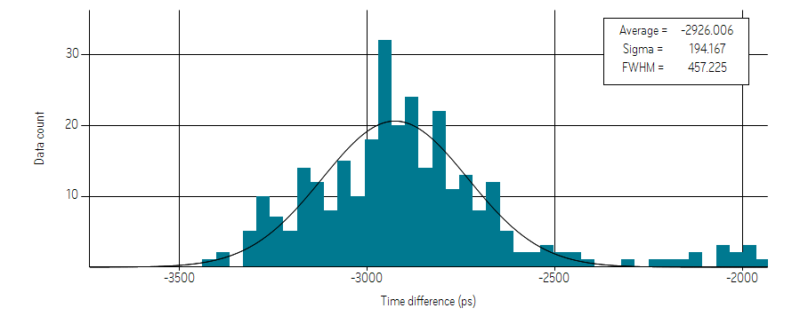
Time difference (SiPM)
CH9 & Ch16
CH9 & CH17
CH9 & CH18
CH9 & CH 20
CH9 & CH 21

Slide 32
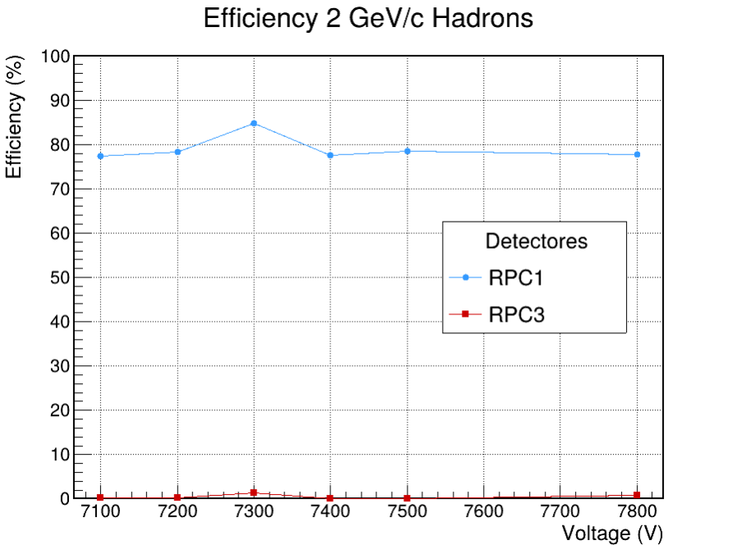
Beam Test 2025

Slide 33
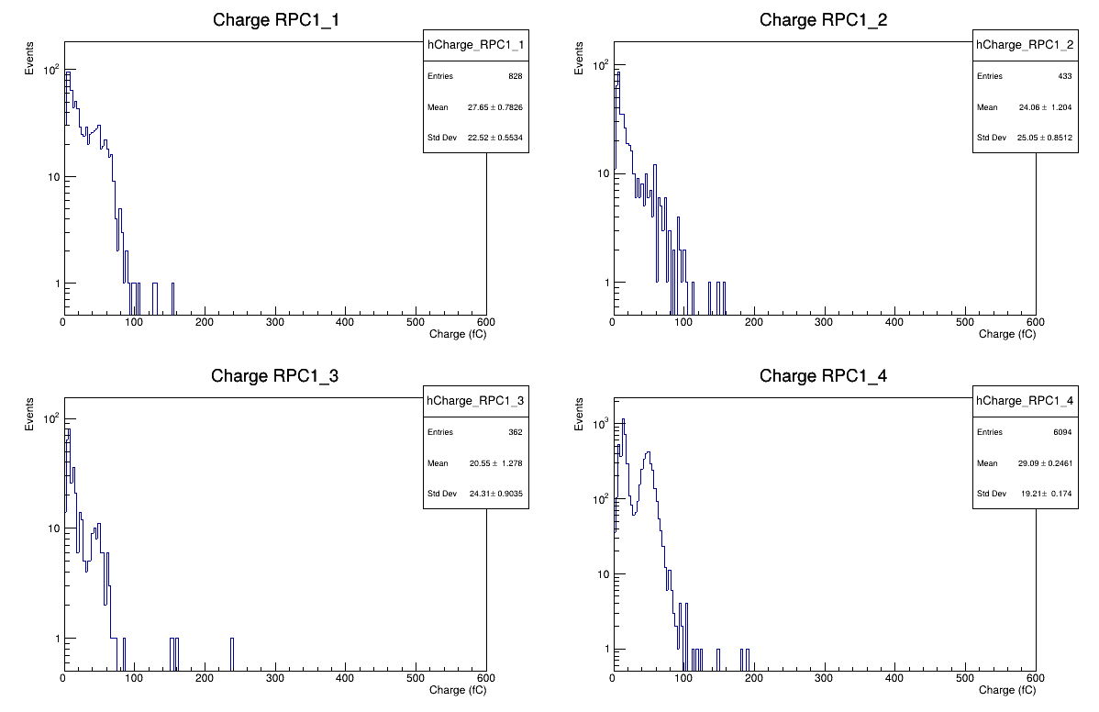
Beam Test 2025
2 GeV/c Muons
RPCs = 7500 V
RPC1 Eff = 92.78%

Slide 34
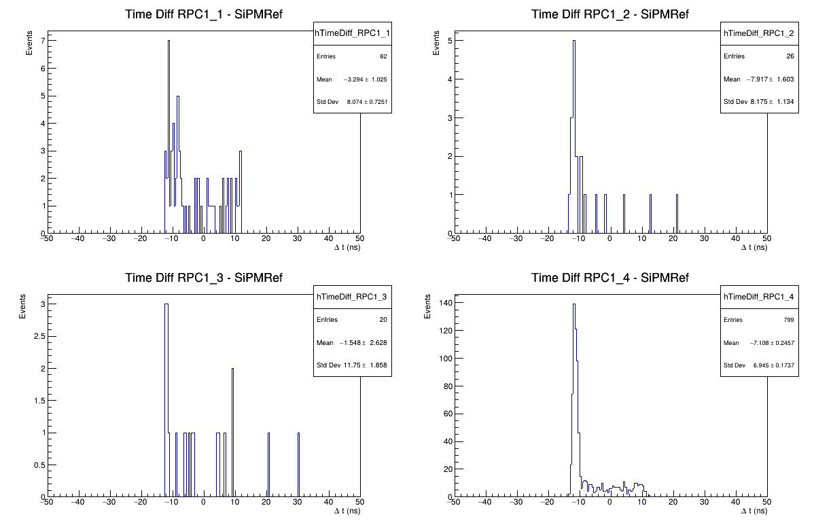
Beam Test 2025
2 GeV/c Muons
RPCs = 7500 V
RPC1 Eff = 92.78%
RPC3 Eff = 21.94%

Slide 35
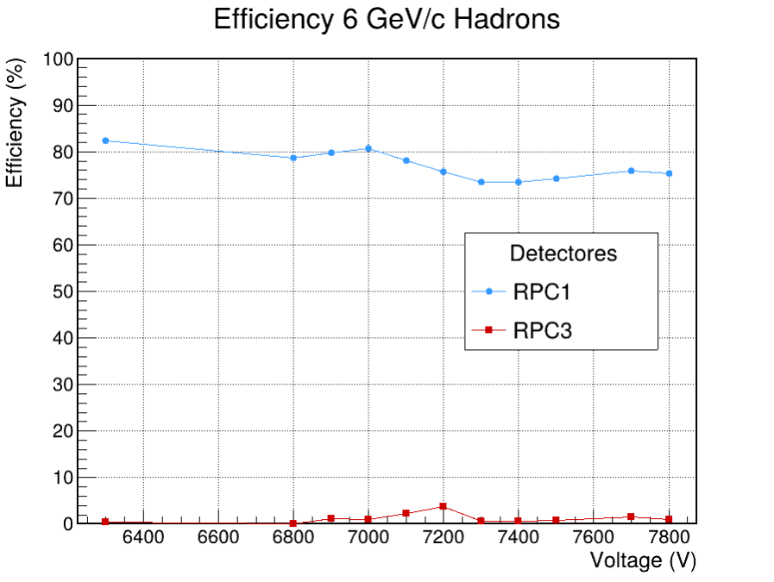
Beam Test 2025

