Slide 1


DCS and absorber design for ALICE-3 MID
Juan Carlos Cabanillas Noris
ALICE Mexico MID meeting
April 15, 2026
Notes:
My name is Juan Carlos Cabanillas Noris, and I am professor at the National Technological Institute of Mexico (TecNM), Campus Culiacán
I would like to present our institution's interests and plans for the ALICE collaboration.

Slide 2
Participation history
The participation of TecNM members in the ALICE Collaboration dates back more than 10 years.
    AD Detector (Run-2) → 2015-2018
    FDD Detector (FIT) (Run-3) → 2019-2016
    MID Detector (Run-5) → From 2022

Slide 3
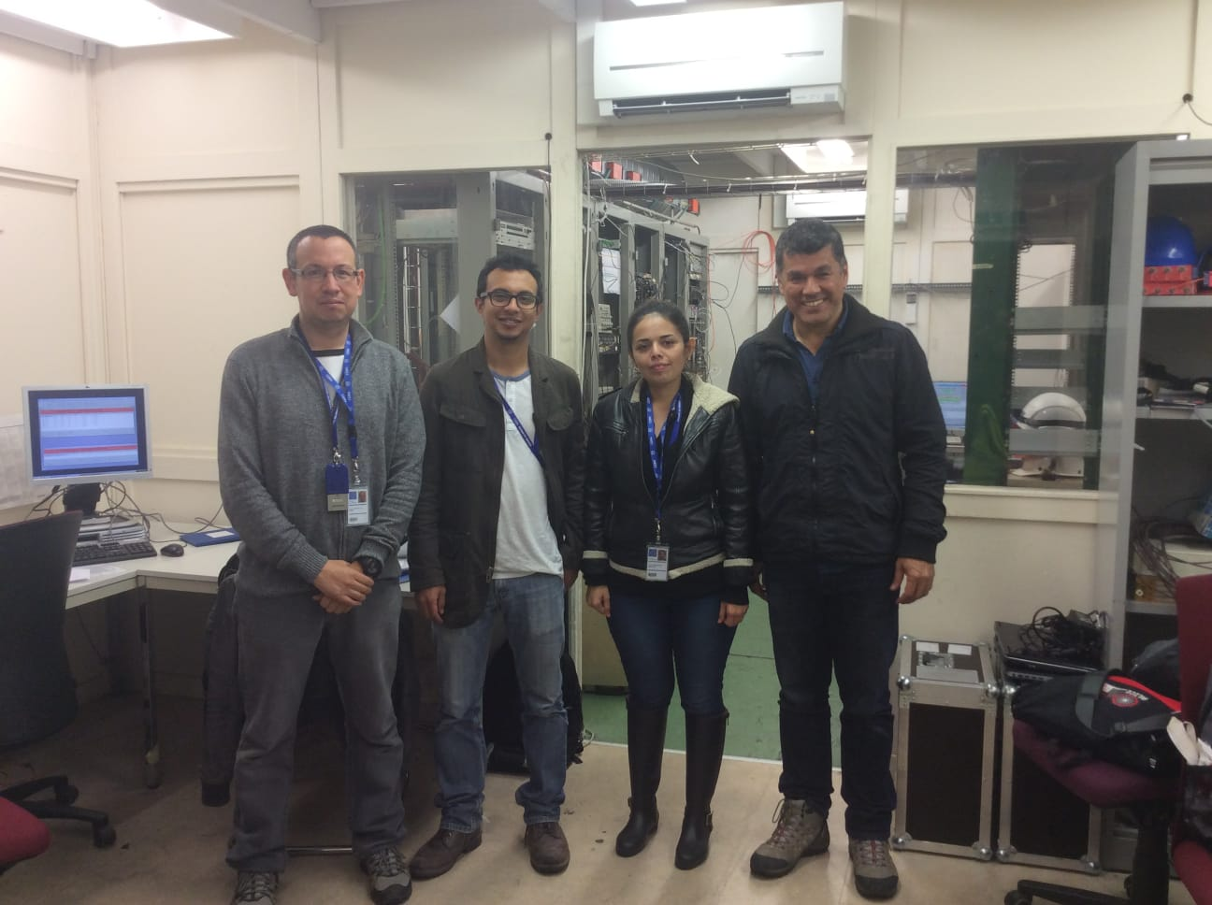
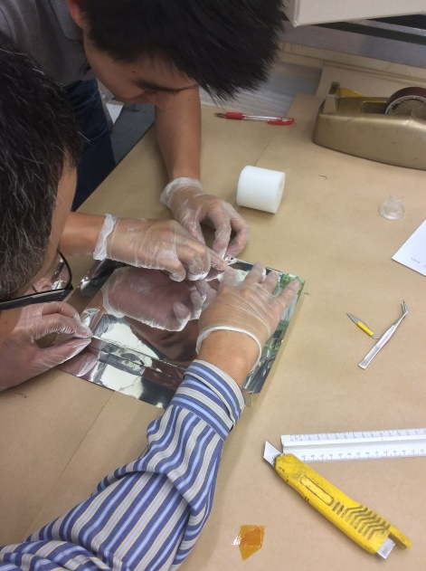
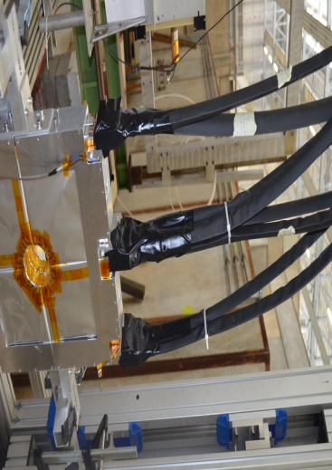
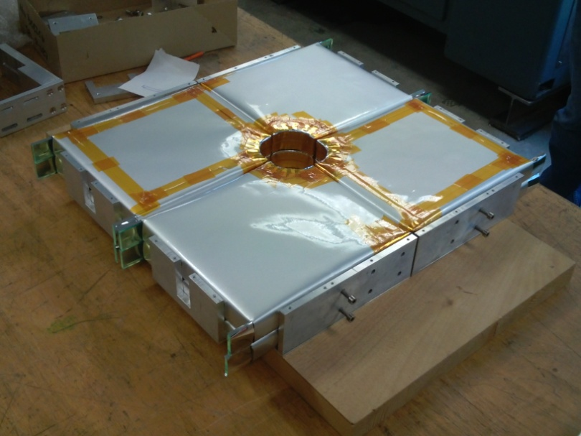
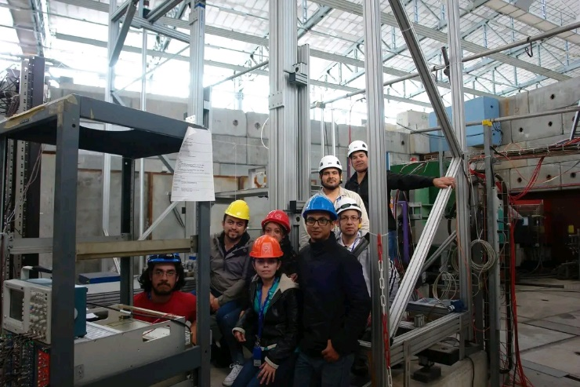
Participation history
1. ALICE Diffractive (AD) → 2015-2018
In this project we participated in:
Development, commissioning and operation of Detector Control System (DCS) for ADA y ADC subdetector during LHC Run-2 (2015-2018).
Detector Construction.
Beam tests.
Notes:
TecNM members have been involved in ALICE Collaboration projects for over 10 years.
In my case, I began participating in the development of the AD detector during my doctoral studies.
I collaborated in the development, commissioning and operation of the AD-DCS during Run-2 from 2015-2018 (two thousand fifteen to two thousand eighteen)
Also I participated in the detector construction and different beam tests.

Slide 4
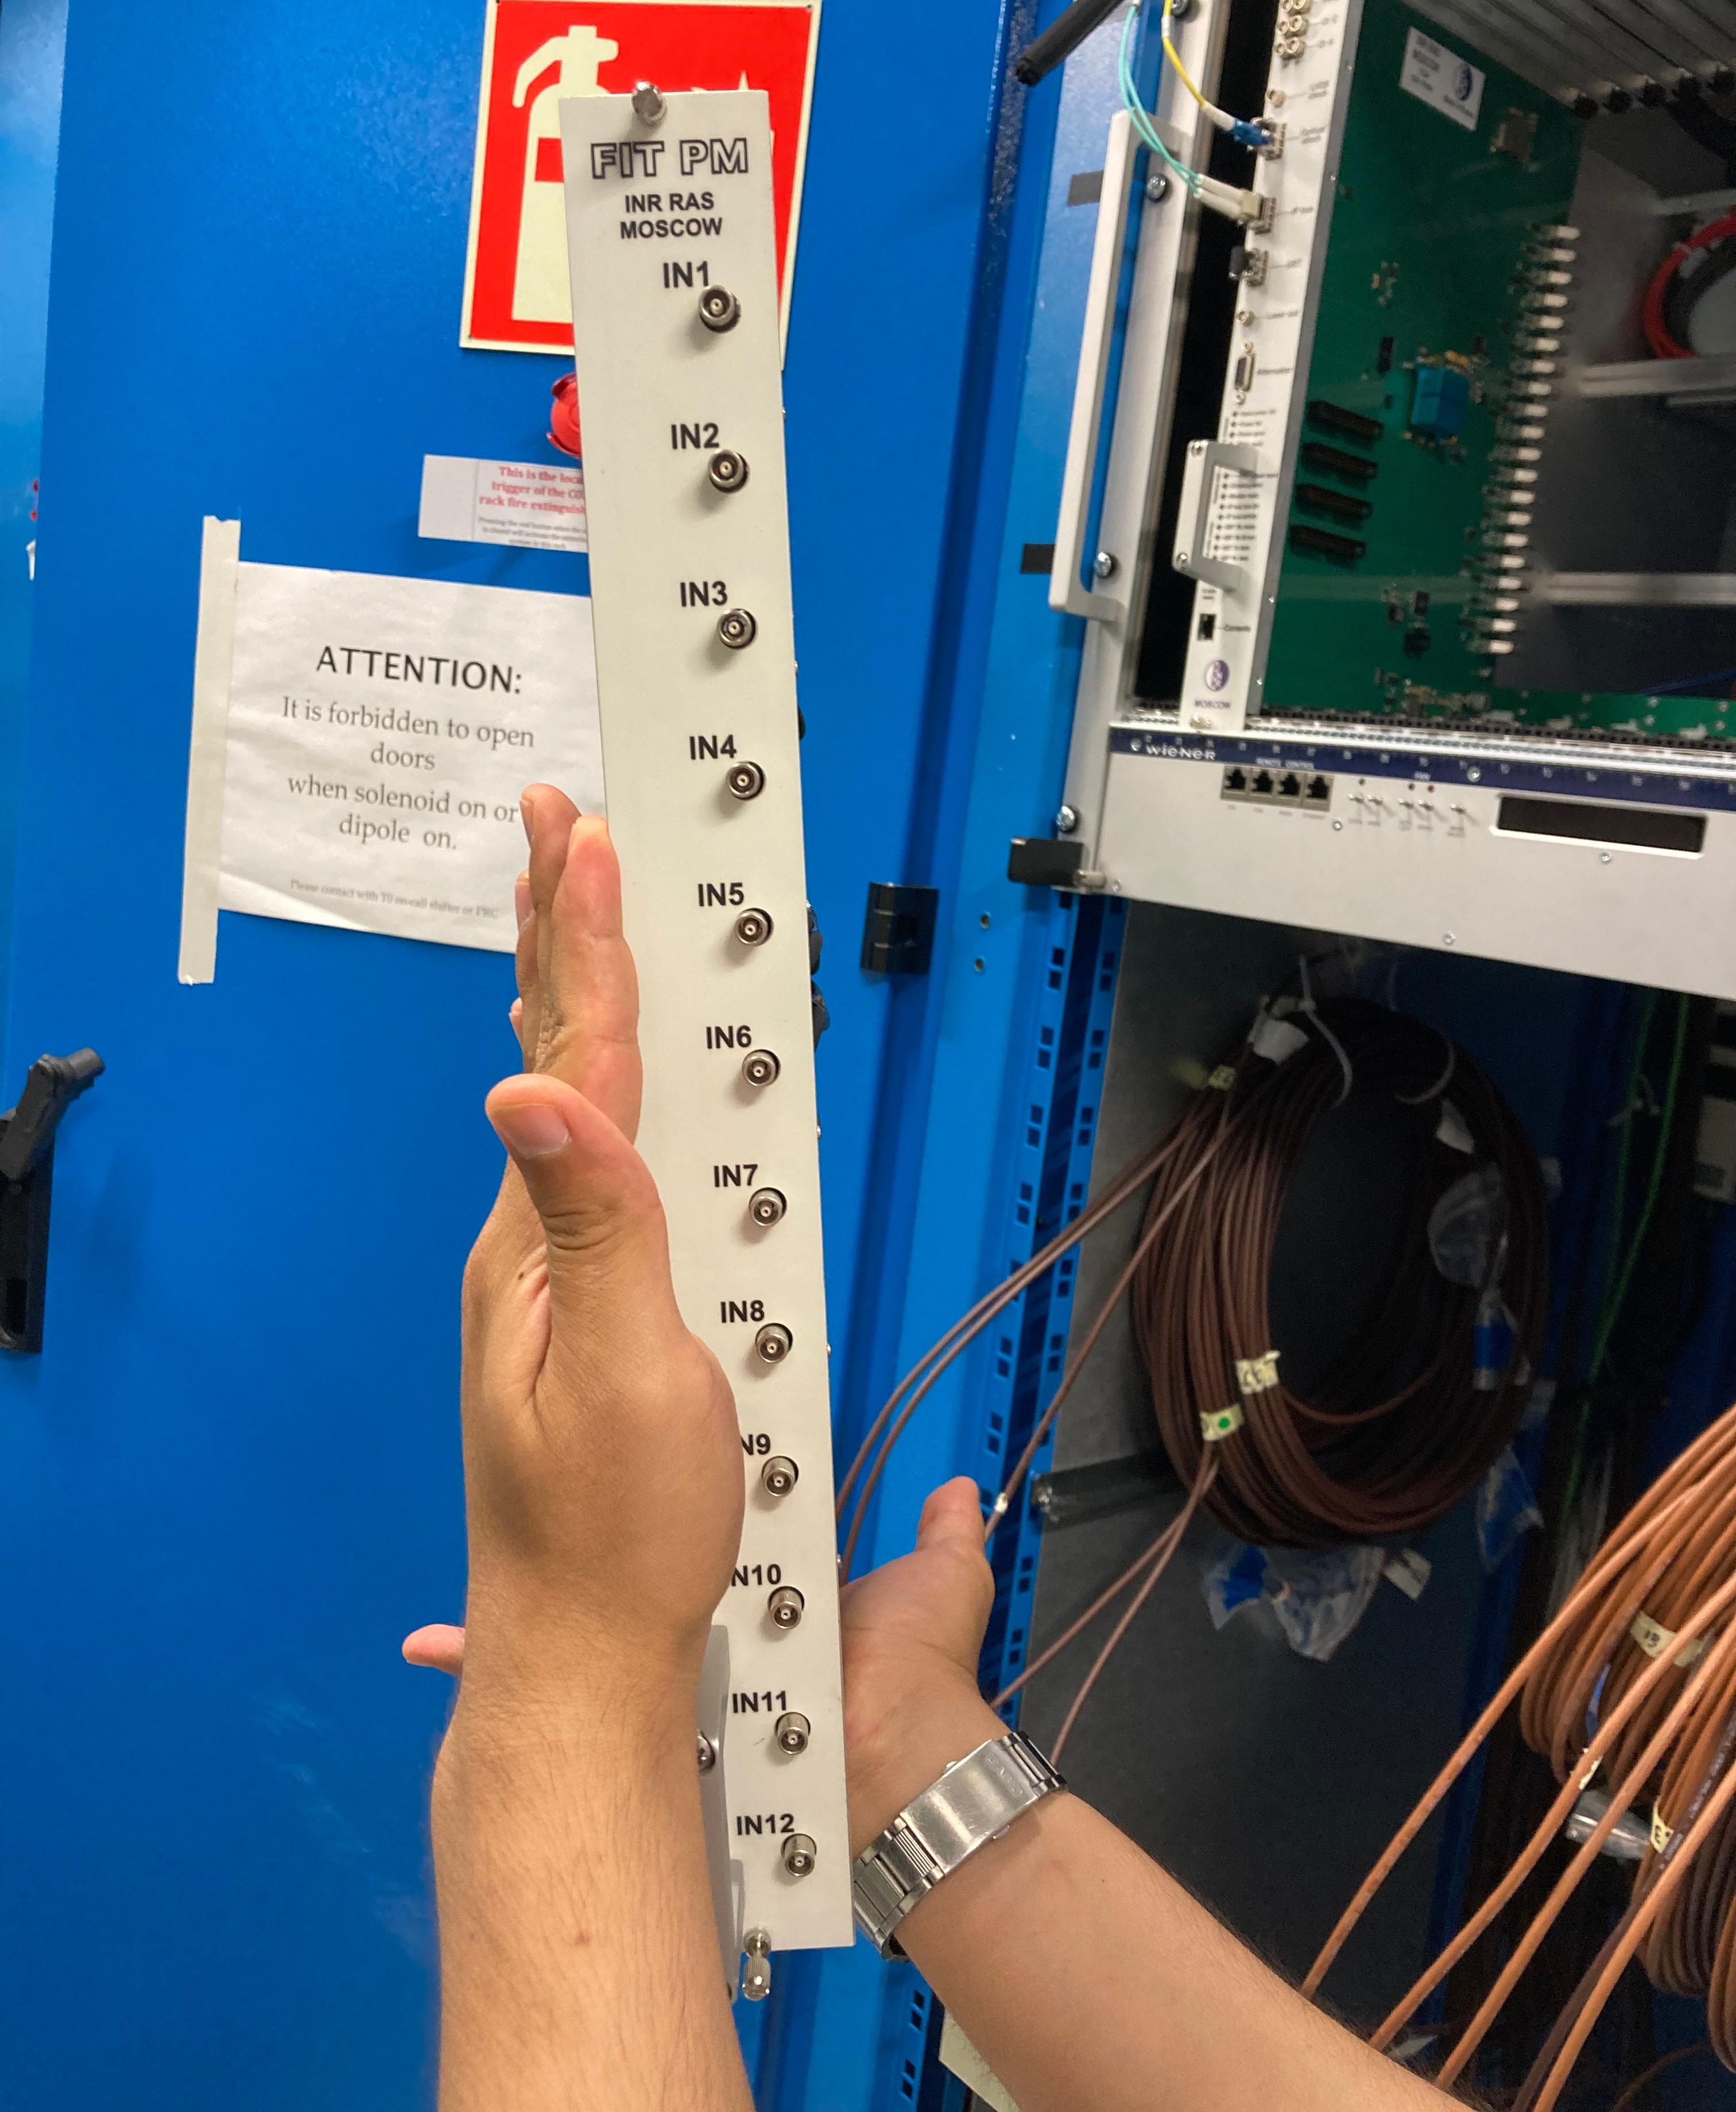
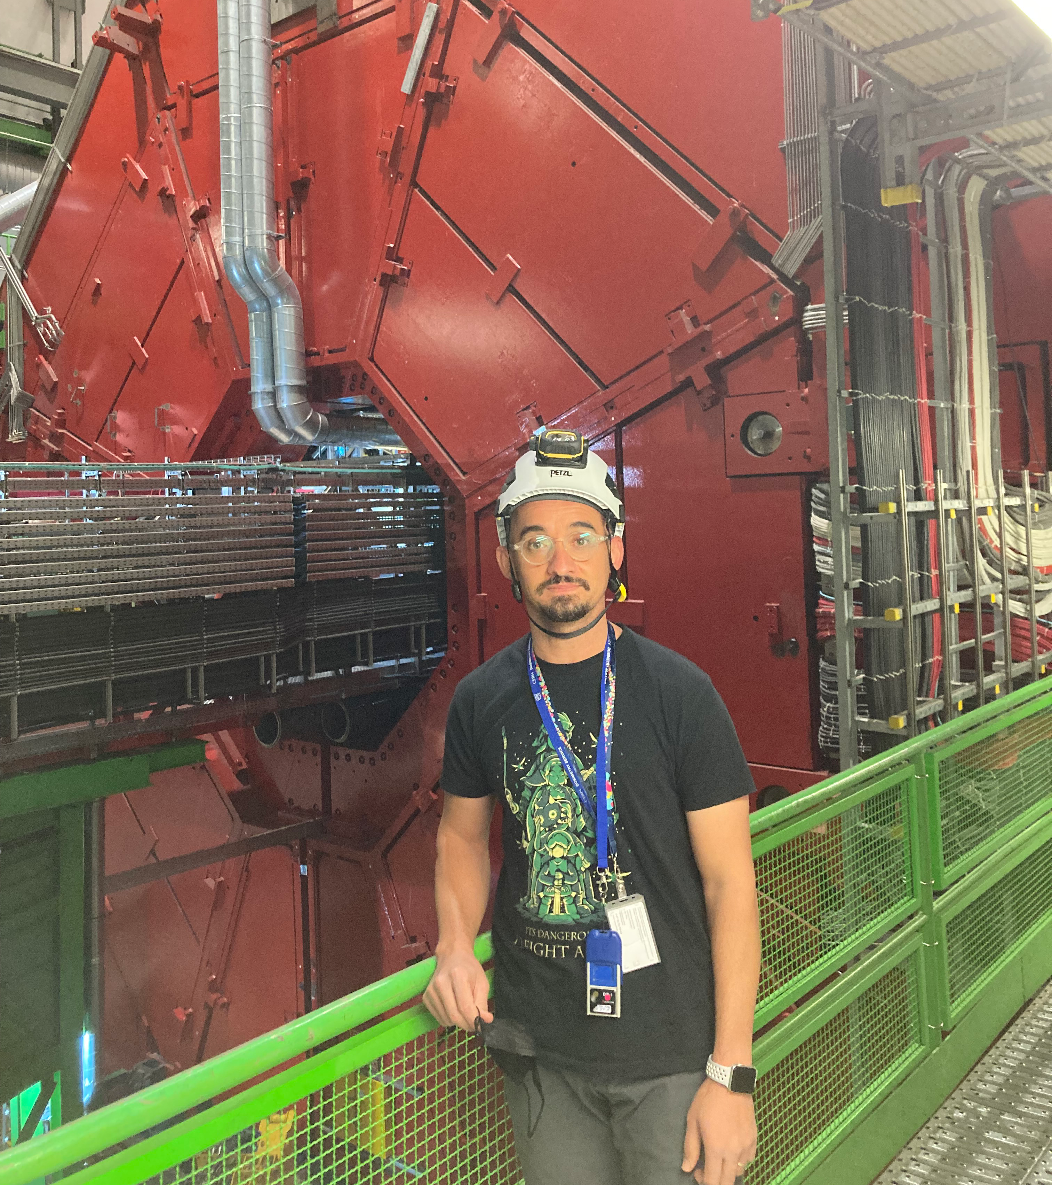
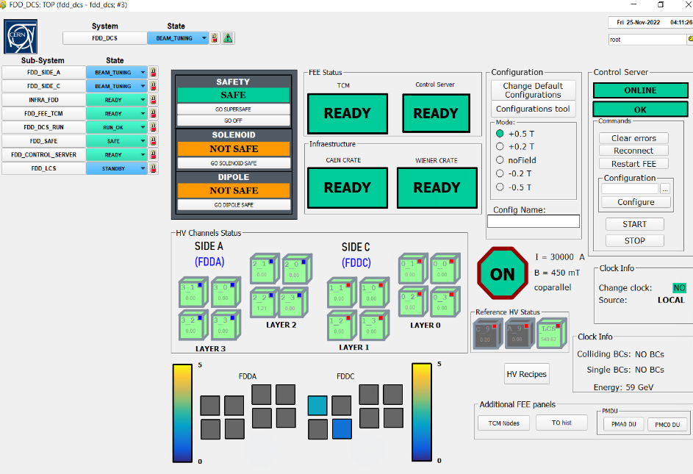
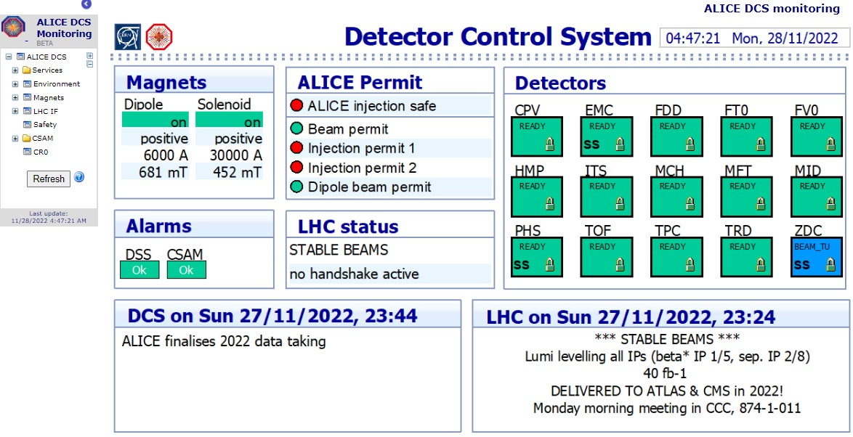
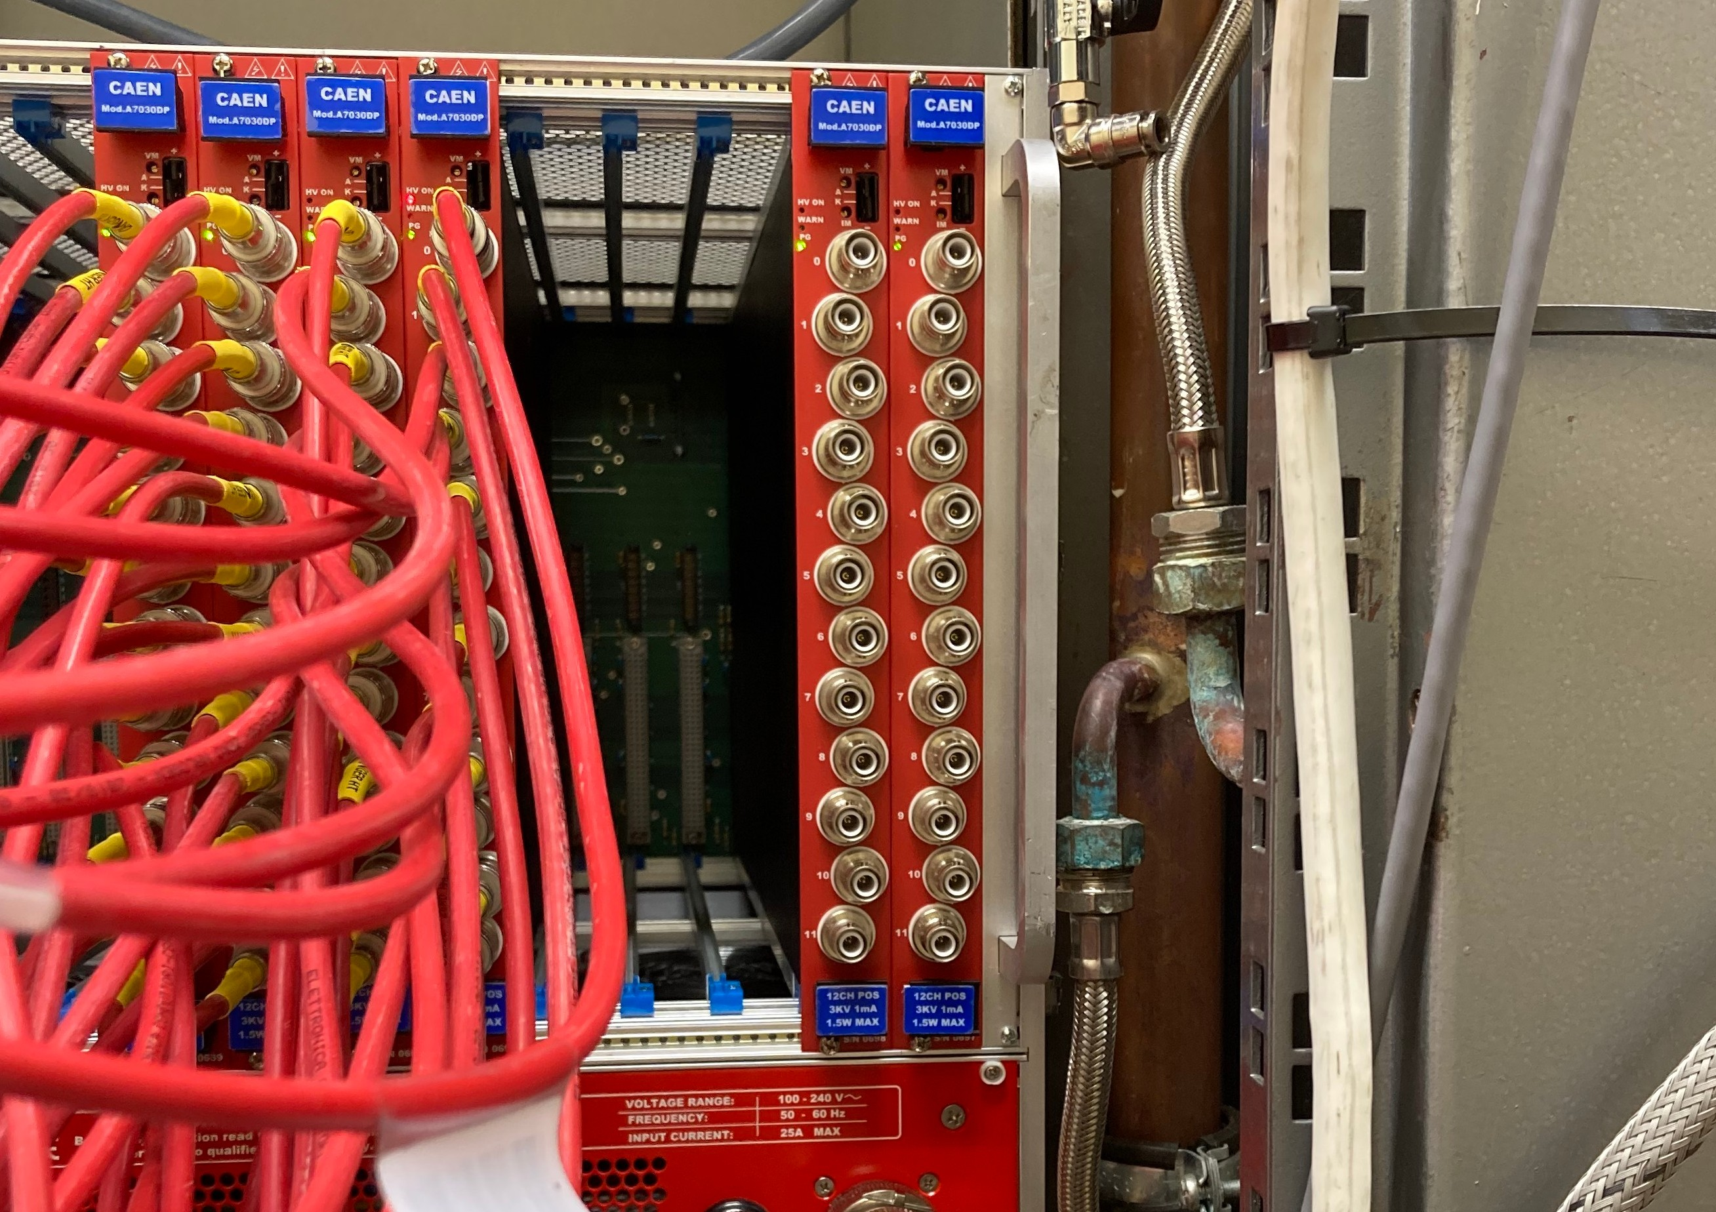

Participation history
2. Detector FDD (FIT Project) → 2019 - 2026
In this project we are participating in:
Development, commissioning and operation of FDD-DCS during LHC Run-3.
Instalation of Electronics (FEE) and High Voltage.
Detector materials
Notes:
In this project we are participating in:
--Development, commissioning and operation of FDD-DCS during LHC Run-3.
--Installation of the crates and boards for Electronics (FEE) and High Voltage.
--And acquisition of detector materials.
A student of our PhD program, Juan M. Mejía Camacho, graduated with this project.

Slide 5
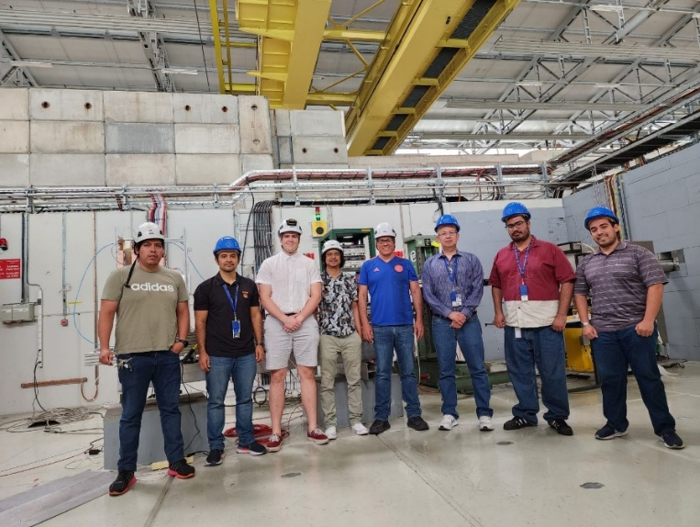
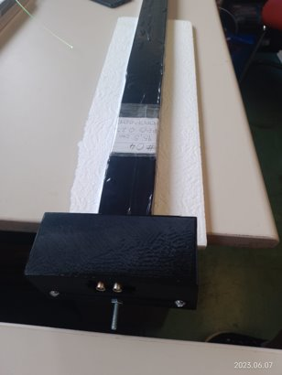
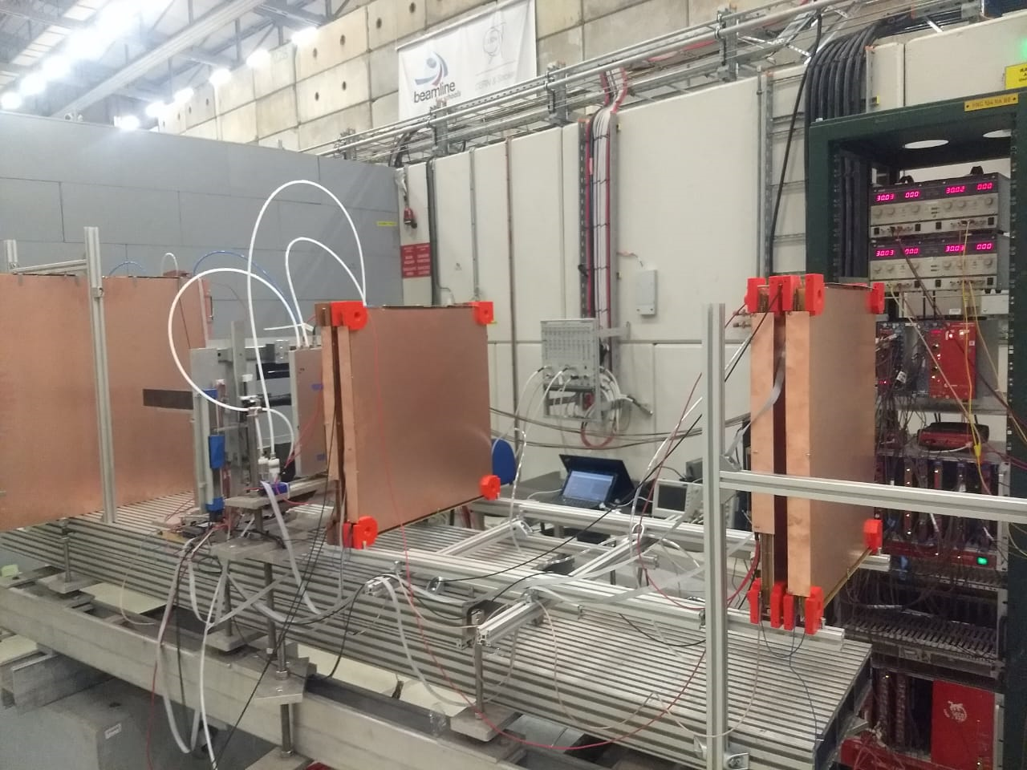
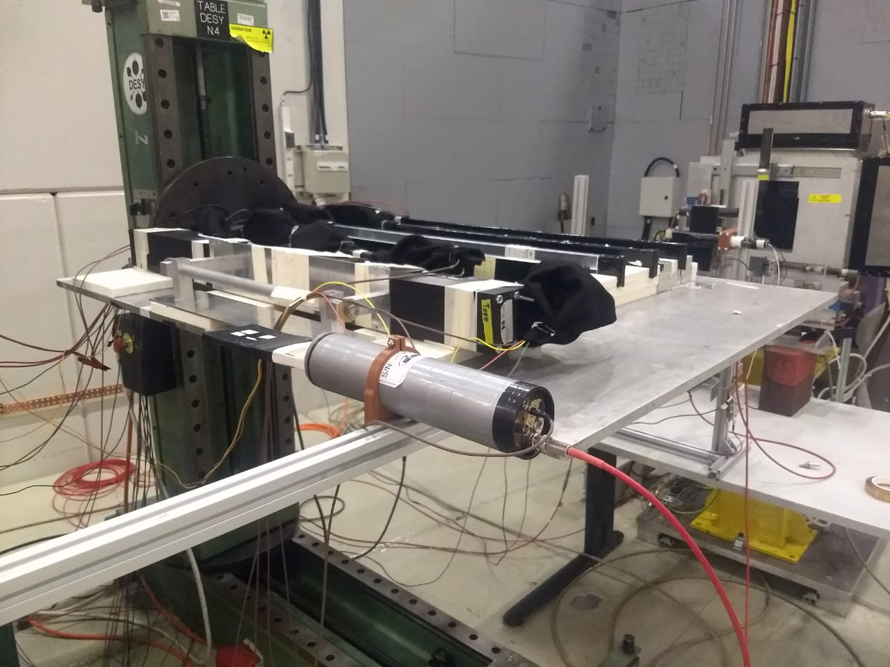
Participation history
3. First MID Beam Test → June 2023
For this test we participated in:
Installation of a prototype of scintillator plastic developed by the Sinaloa working group.
Shifts for data taking.
Notes:
In 2023 (two thousand twenty three), we participated in the first MID beam test.
Specifically, with:
The installation and test of a prototype of scintillator plastic developed by the Sinaloa working group.
And doing shifts for data taking.
A doctoral student and I were present.

Slide 6
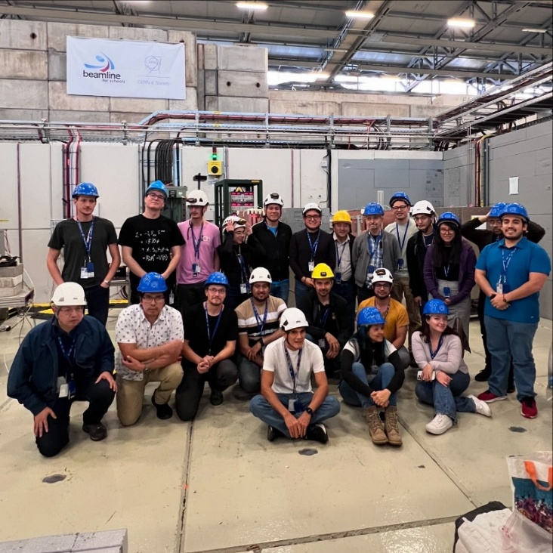
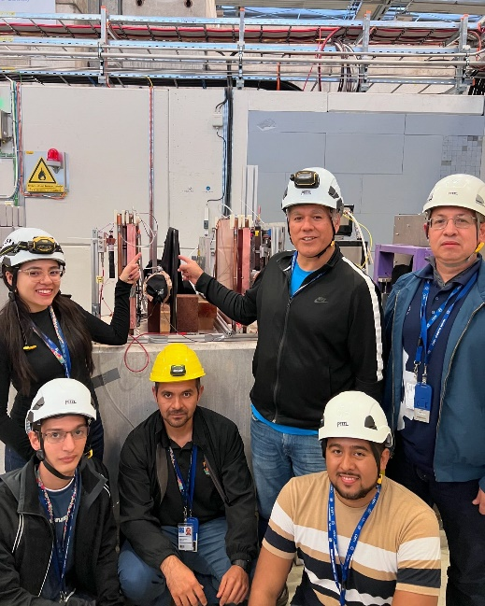
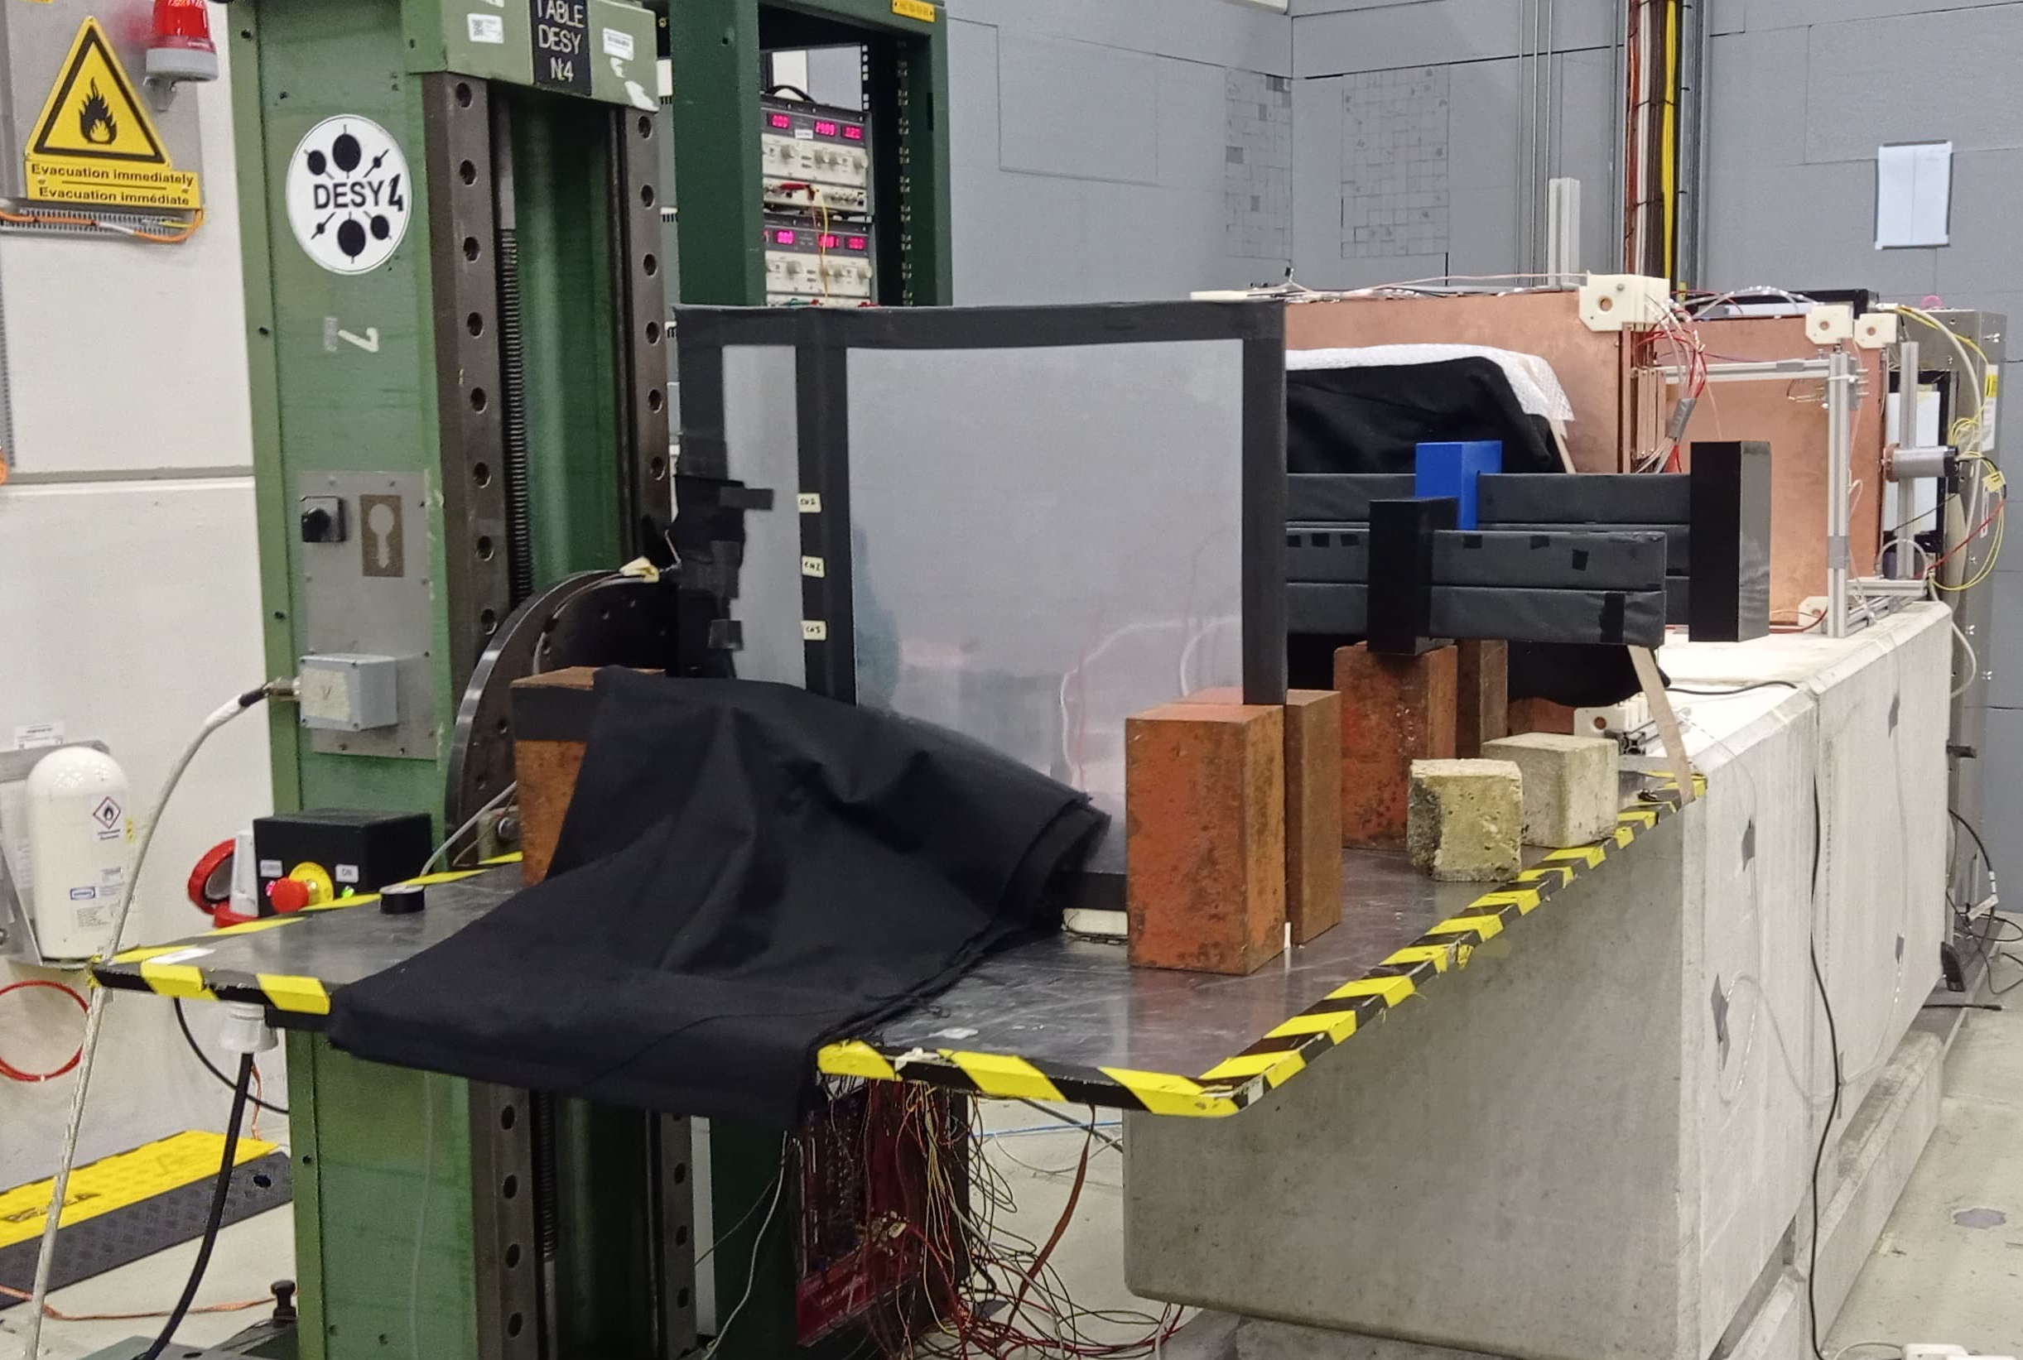
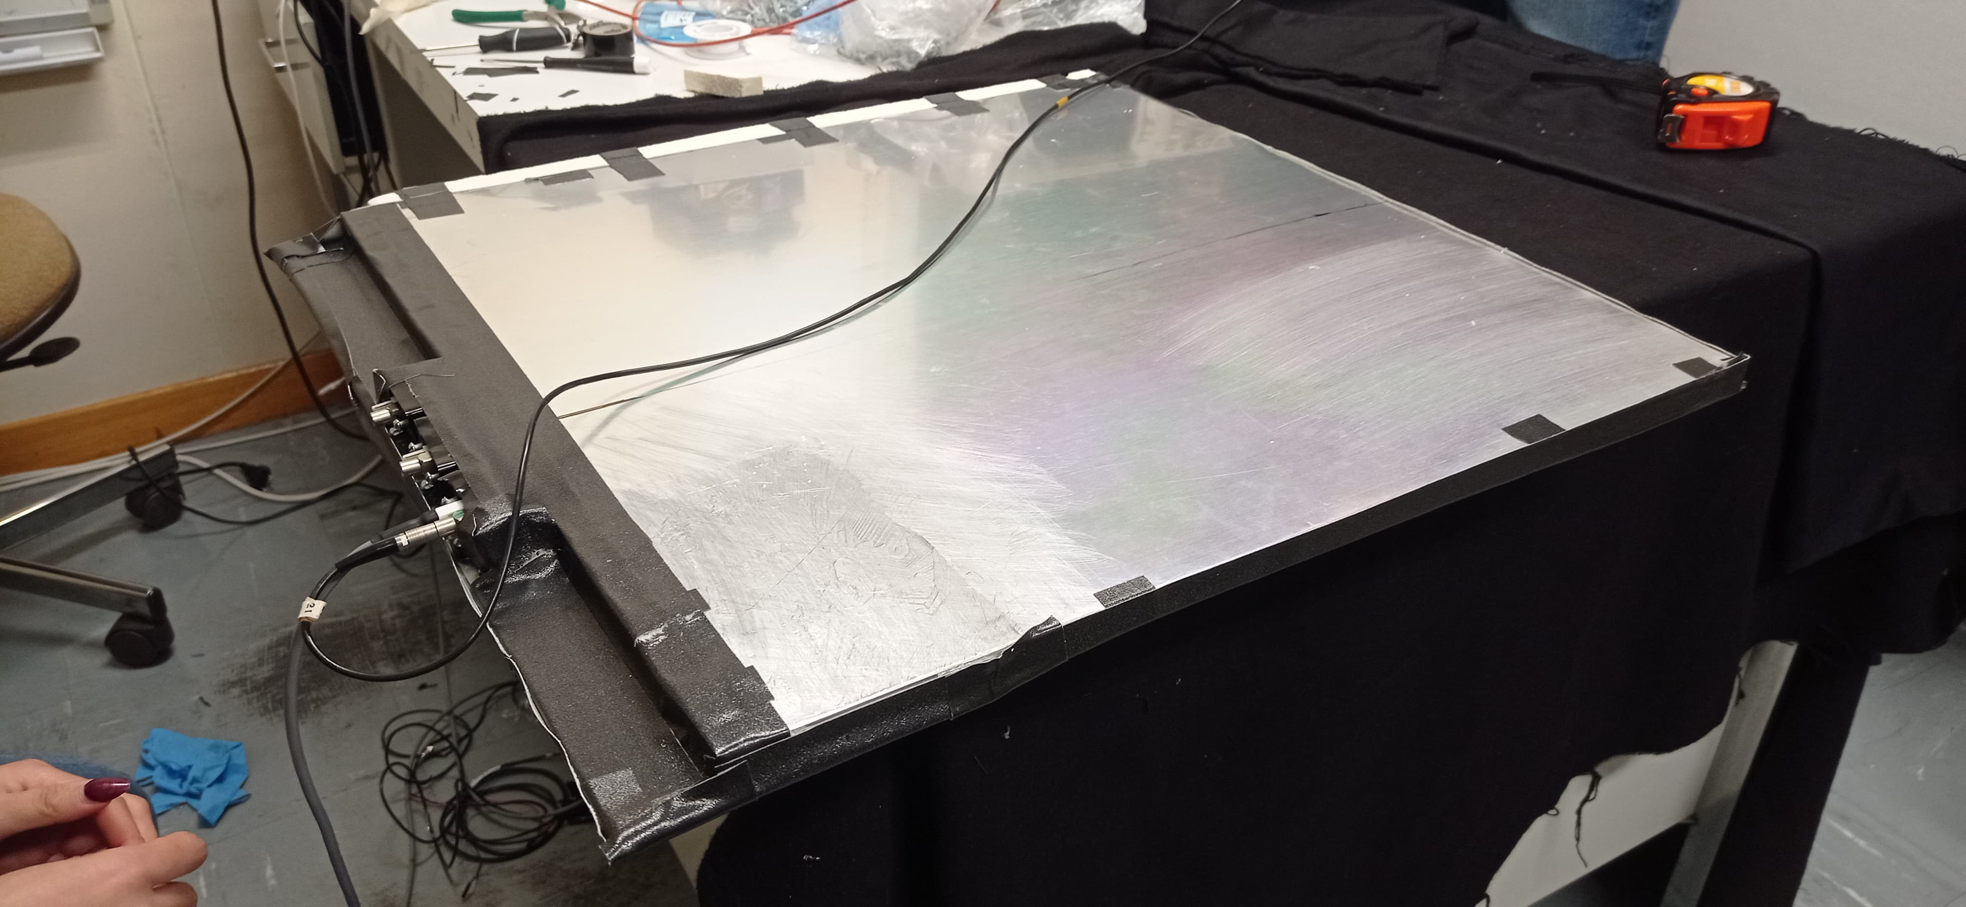
Participation history
4. Second MID Beam Test → Octuber 2024
For this test we participated in:
Installation of a new plastic scintillator prototype developed by Sinaloa working group.
Shifts for data taking.
Notes:
For this second beam test we participated in:
- A new prototype of scintillator plastic developed by Sinaloa working group was tested.
- Doing shifts for data taking.
A student of the master in science of our institution participated directly, Kevin Núñez, and who recently graduated (september 2025).
And the student Narcio Laveaga participated remotely.

Slide 7
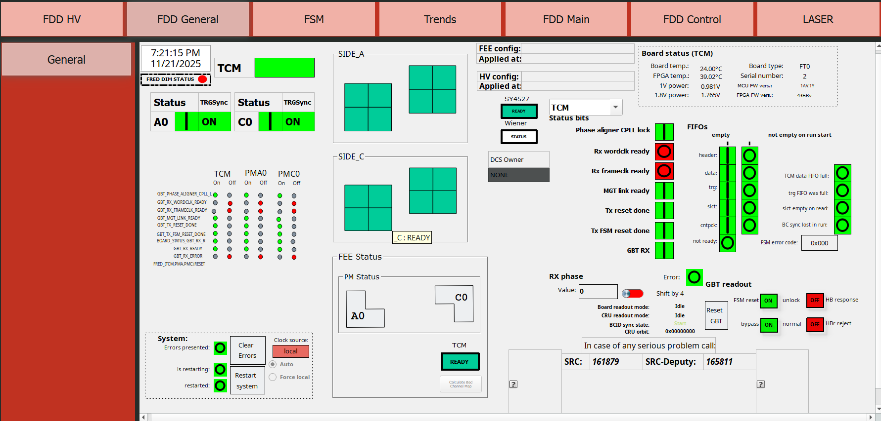
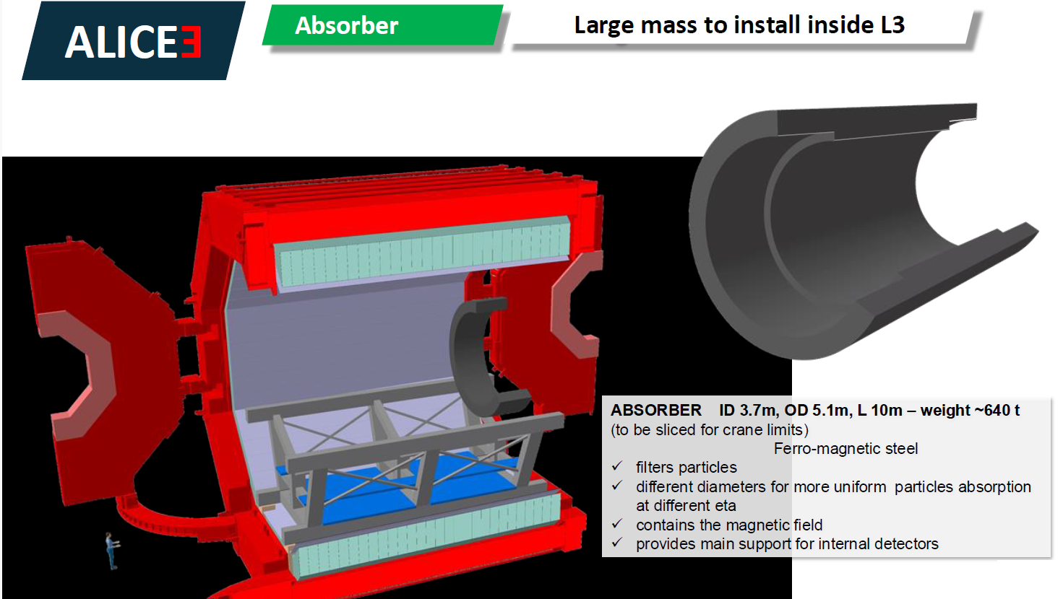
Plans for Run4 & ALICE 3
Updating, standardizing and preparing the FDD-DCS for integration into the LHC-Run4 from the FIT Project.
Development of materials for MID in ALICE 3.
Development of the MID-DCS in ALICE 3.
Absorber structure design that will be used for the MID detector in ALICE-3.
    Integrate at least one member who is a specialist in the subject.
    Collaborate with Pakistani group on this project.

Slide 8
Students and graduated of TecNM
# | Student name | Grade | % of progress | Status | Topic of thesis
1 | Juan Manuel Mejía Camacho | PhD | 100 | Graduated | DCS of FDD/FIT
2 | Kevin Fernando Núñez Aguilar | MSc | 100 | Graduated | FDD Aging
3 | Rafael Angel Narcio Laveaga | PhD | 88 | Ongoing | Developing of plastics centillators
4 | Salvador Beltrán Rivera | PhD | 25 | Ongoing | IPBus – ALFRED of FDD-DCS
5 | Jesús Manuel Lafarga | MSc | 25 | Begining tesis | Radiation of materials
6 | Armando Payán Ángulo | MSc | 25 | Begining thesis | Interfaces of control system
7 | José Manuel Pardo Cruz | PosDoc | 10 | Began on October | IA for DCS data in FIT
8 | César Regalado Elenes* | PhD | 0 | Begining this year | MID Electronics

Slide 9
Recent student activities
@ Salvador Beltrán (doctoral student)
  Just finished a stay a CERN for 3 months (January to April 2025)
  Stardardization of FDD-DCS (Similar to FV0 & FT0) → Colaboration with Poland group (Thanks)
  Diferent type of shifts (QC, DCS, ECS and leader)
@ Rafael Narcio (doctoral student)
  Writing a paper related to his thesis (last step)
  Writing his thesis → To concluded next august month
  Last year participated in different type of shifts (including Run Manager)
@ Jesus Lafarga (master student)
  Manufacturing and characterazing samples of scillator plastics proposal by Sinaloa grup (UAS, TecNM and CINVESTAV)
  A stay at CERN next month to submit to radiation test some samples In coordination with Praga group.
@ Manuel Pardo (postdoc)
  Doing a predictable analysis of conditional data (DCS) using IA → In collaboration with Manuel Mejía
  Writing a paper

Slide 10
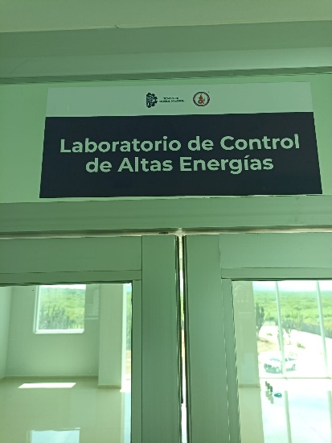
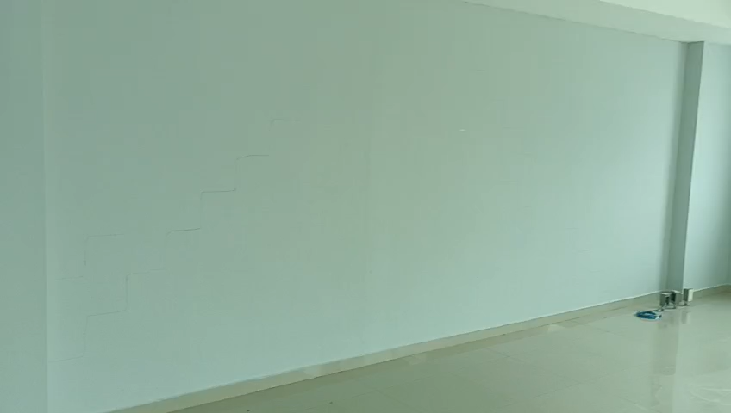
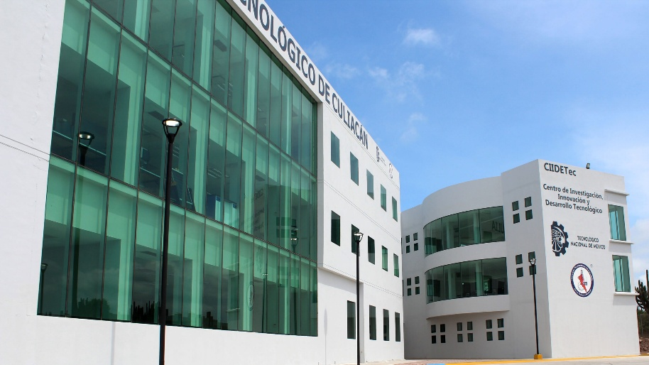
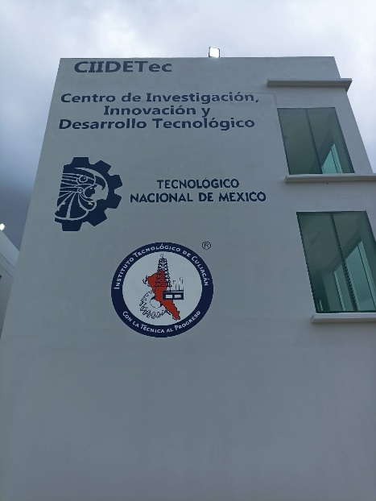
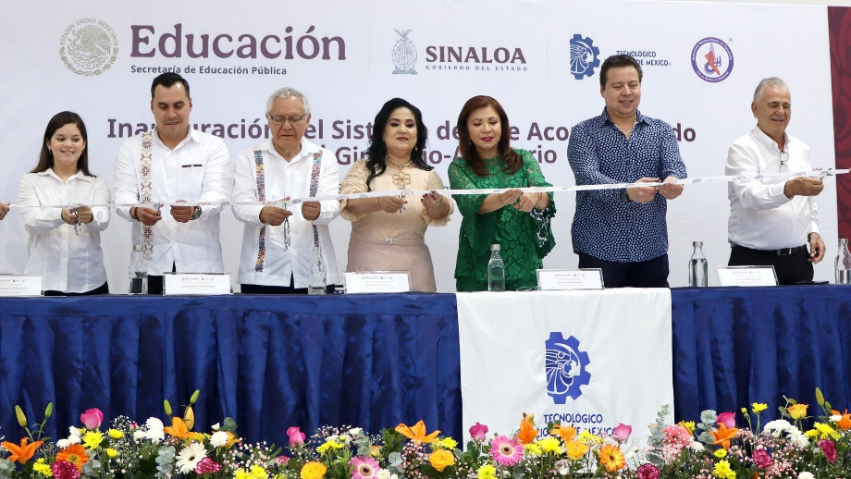
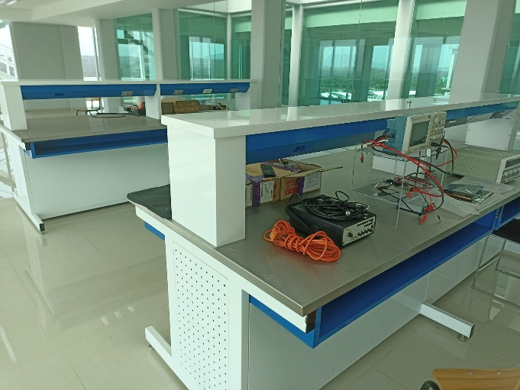
New research center / (TecNM – IT Culiacan)
CIIDETec

Slide 11
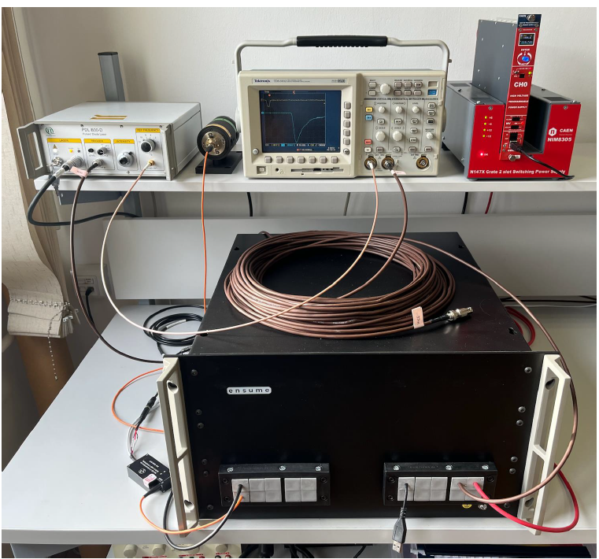
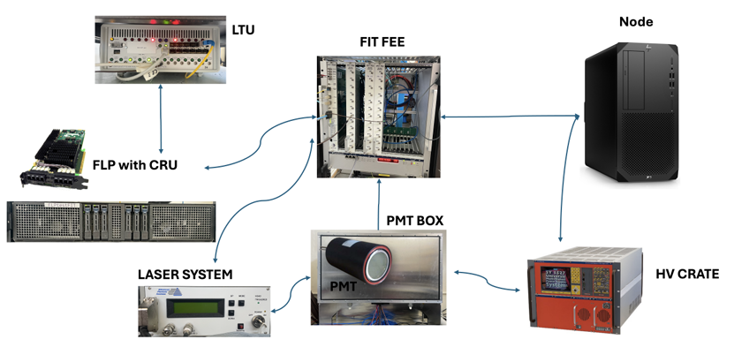
Future Projects (in management)
a) DCS Laboratory
Training and development center.
Update and development for FDD-DCS during Run-4.
Design and development of MID-DCS for Run-5.
Like FIT-Lab

Slide 12
Future Projects (in management)
a) Computer cluster for IA and massive data analysis for ALICE collaboration
Process real LHC data
Develop and train AI models for ALICE
Publish in high-impact scientific journals
Train graduate students in HPC + ML + Physics + Engineering
Other types of applications: Agriculture, aquaculture, economic strategy, logistics, etc.

Slide 13
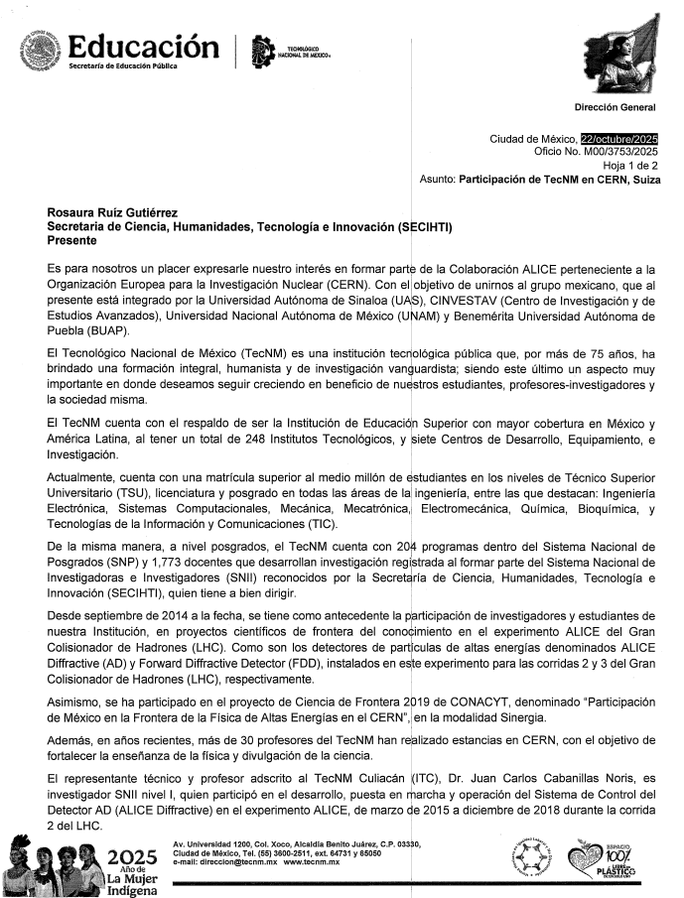
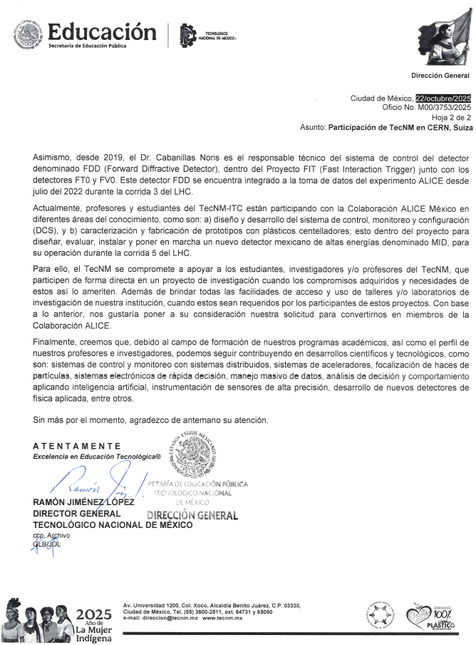
TecNM request to SECIHTI

Slide 14
ALICE Mexico MID meeting
THANKS!

