Slide 1

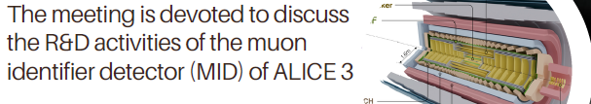



Participation of Mexico in the Absorber design
Ismael Diaz Peña
Tecnológico Nacional de México - Culiacán

Slide 2
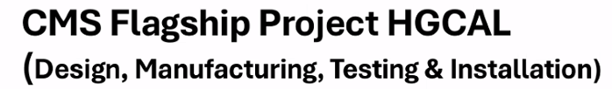
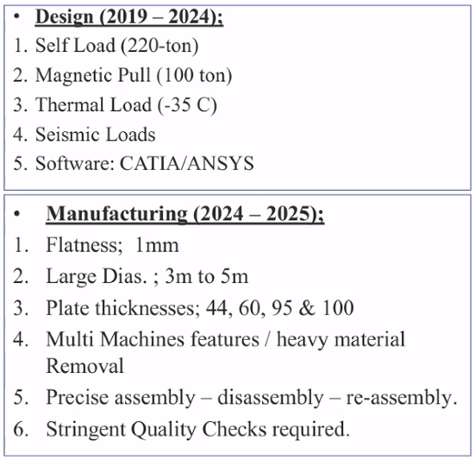
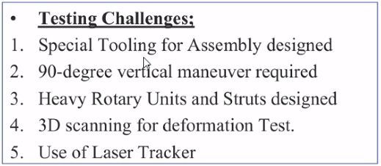
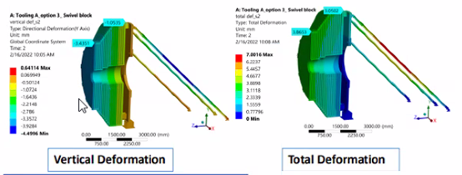
HMC-3
Testing and experimentation
Working conditions
Manufacturing scope

Slide 3
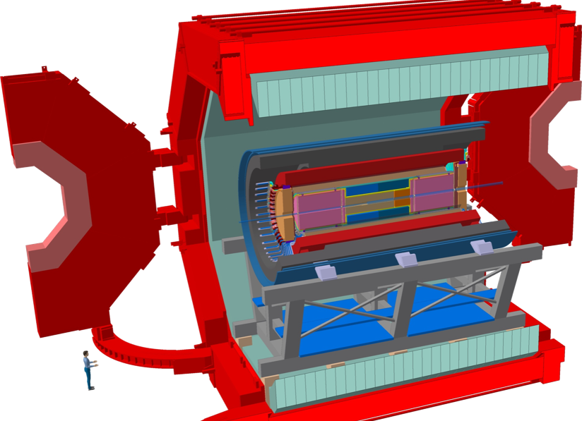
Concepts and planning for early-stage development
Finite element simulation for structural and load analysis: Entire System, Section by Section
Evaluate the structural behavior and stress–strain response of all components.
Determine mechanical properties, including compressive strength, tensile strength, flexural strength, modulus of elasticity, stress–strain curves.
Assess the impact of geometric design modifications through simulation.
Implement machine learning algorithms to analyze and predict combined stress states.

Slide 4
Concepts and planning for early-stage development
Study the working atmospheres within the system and evaluate the conditions to which the structure and materials are subjected. Assessment of the effects of working conditions such as temperature, radiation, vibration, and mechanical stresses.
Evaluate wear, degradation, service life, loss of design properties (mechanical, thermal, corrosive, etc.), and the long-term effect on the structural integrity.
Design of moving mechanisms.
-Design physical prototypes for mechanical testing under extreme working conditions similar to real conditions.

Slide 5
Concepts and planning for early-stage development
-Evaluation of plans, engineering drawings, and preliminary designs.
-Collaboration with other teams to implement real-time modifications.
Collaboration with the Autonomous University of Nuevo León.
Collaboration with other Technological Institutes.

Slide 6
Concepts and planning for early-stage development
Evaluation of the Mechanical Characteristics of Scintillators
Effect of doping on the mechanical properties of the bars.
Root-cause evaluation of microfractures and their effect on the physical properties of the scintillators.
Evaluation of the supporting structure of the bars.
Assessment of the effects of working conditions such as temperature, radiation, vibration, and mechanical stresses on the bars.
Work collaboratively with teams from other institutions to adapt prototypes in real time to the simulation and test results.

Slide 7
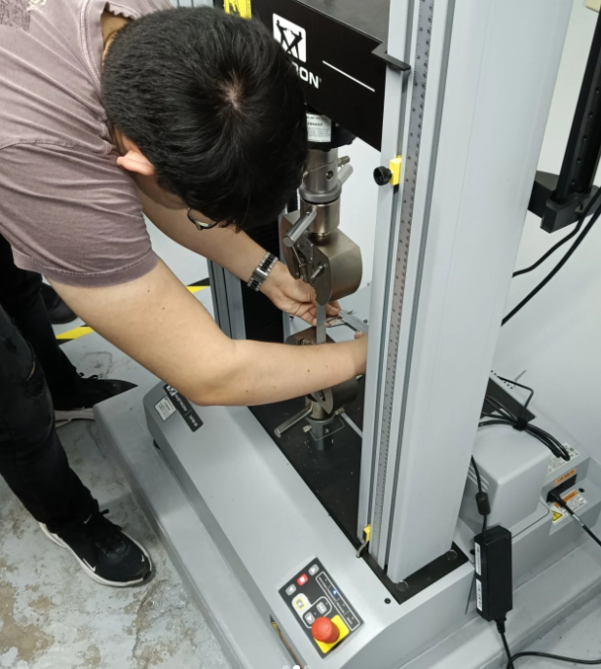
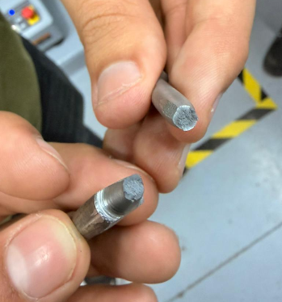
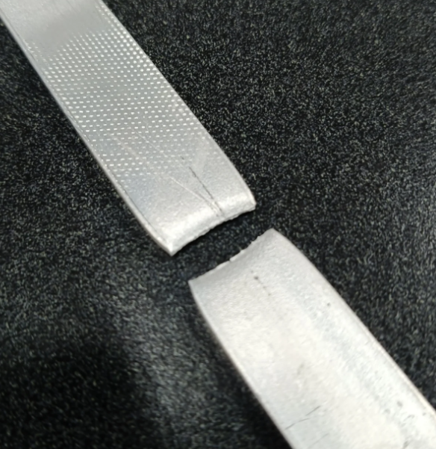
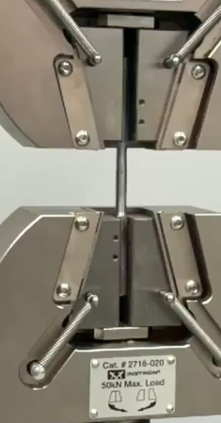
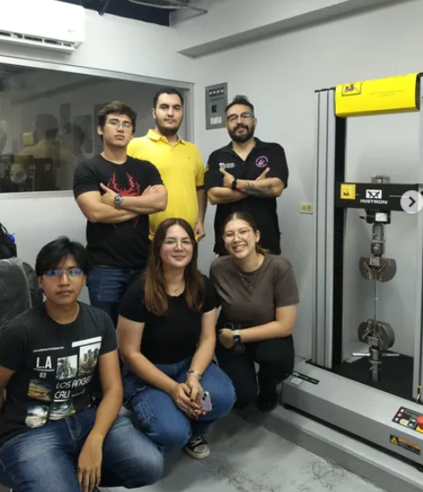
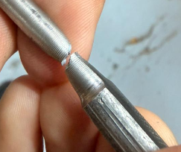
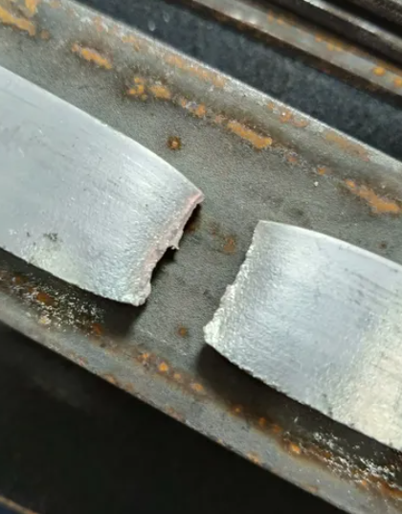
Students, Laboratory and Tests

Slide 8
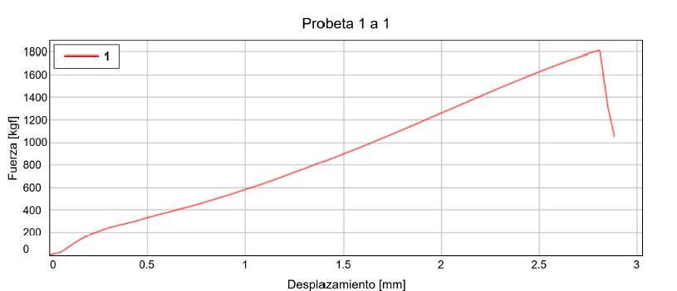
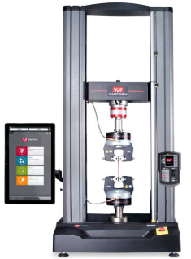
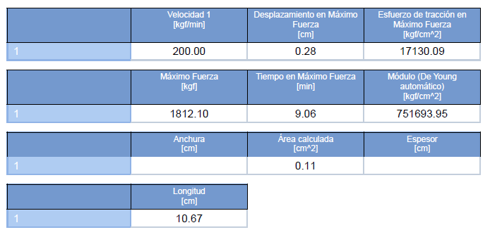
Universal Testing Machine
Strain-Stress Curve
Tensile Testing Report

Slide 9
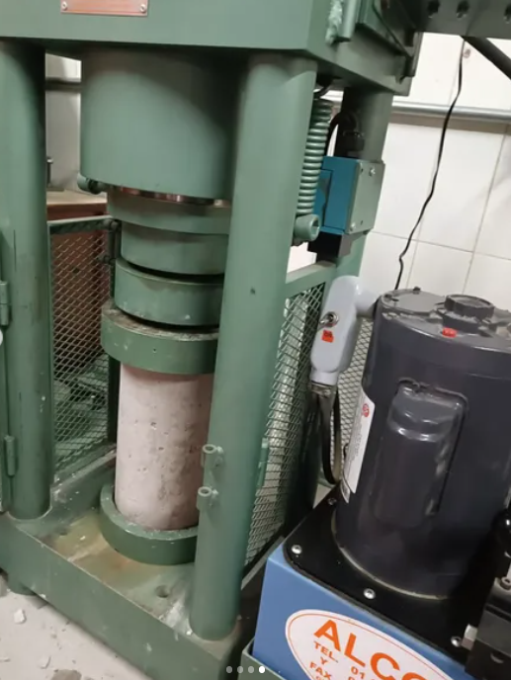
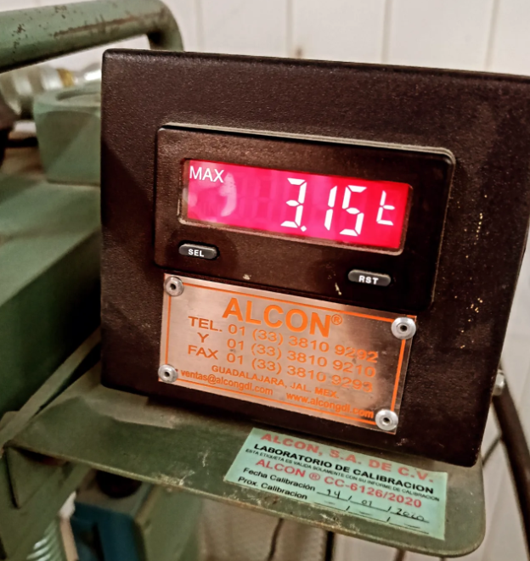
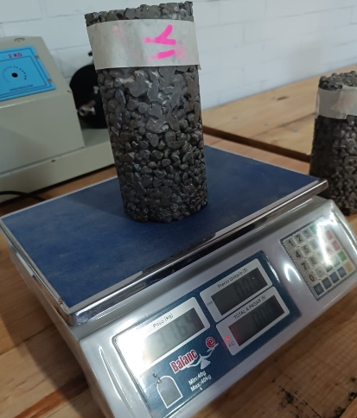
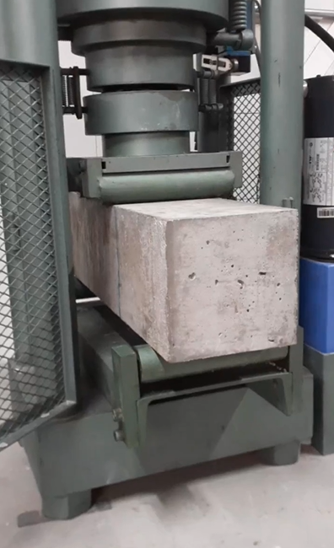
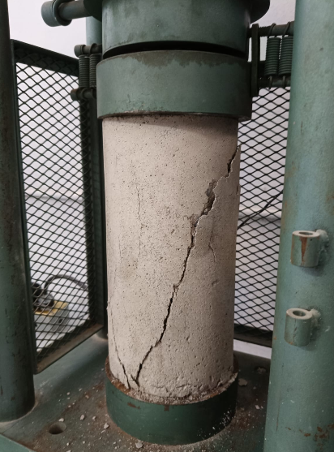
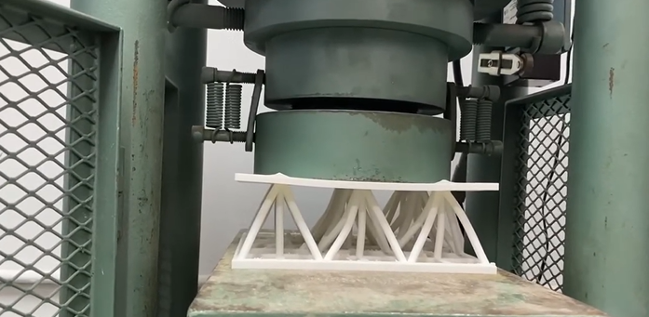
Compressive Test
Flexural Test

Slide 10
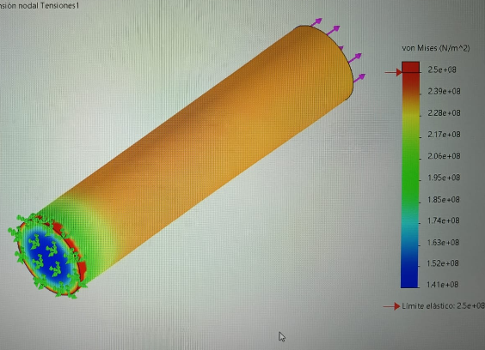
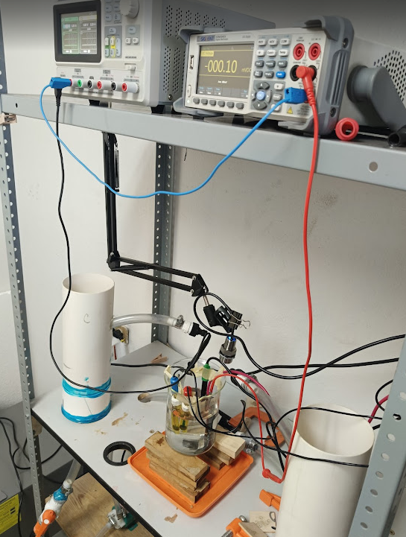
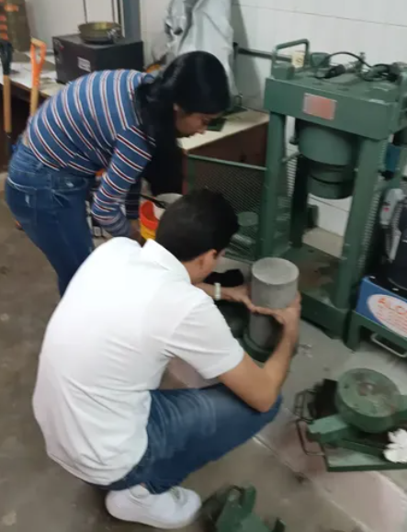
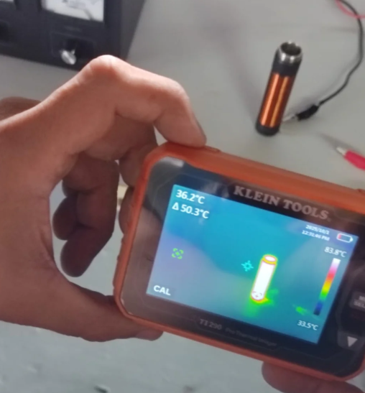
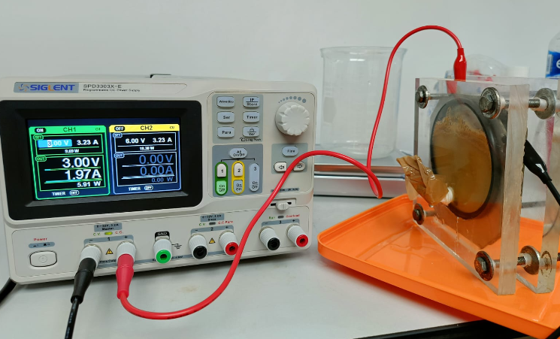
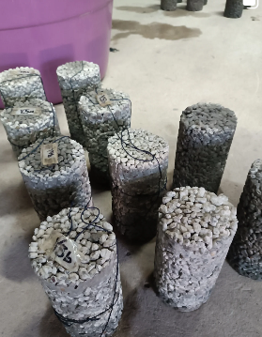
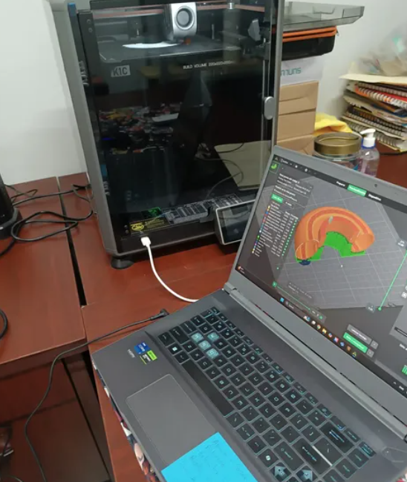
Electrochemical Properties
Therma Analysis
Finite Element Analysis
Steel Corrosion Resistance
Ceramic Materials
CAD – 3D Print

Slide 11
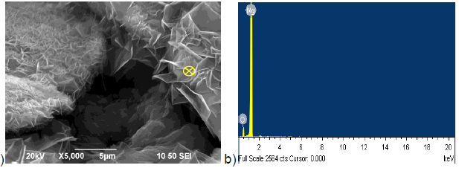
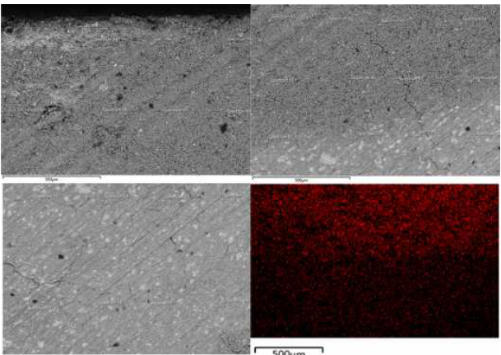
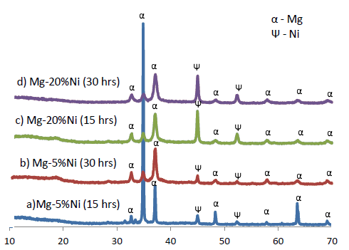
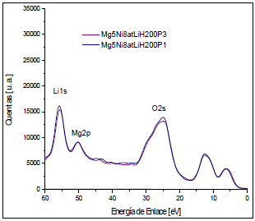
Advanced Characterization of Materials
Scanning Electron Microscopy (Secondary and Backscattering)
X-Ray Difraction analysis
Energy Dispersive Spectroscopy for Mapping
X-Ray Photoelectron Spectroscopy

Slide 12







First steps
Training and instruction of undergraduate students, graduate students, and collaborators in design and simulation software.
Software:
SolidWorks (Paid, Student version)
Fusion360 (Free for students)
ANSYS (Free for students)
STAAD.pro (Paid, Steel Structural análisis)
CATIA (Paid, Computer-Aided Design),
Solid Edge (Free for students). ALL used by HMC-3

Slide 13
Thank you!

