Slide 1

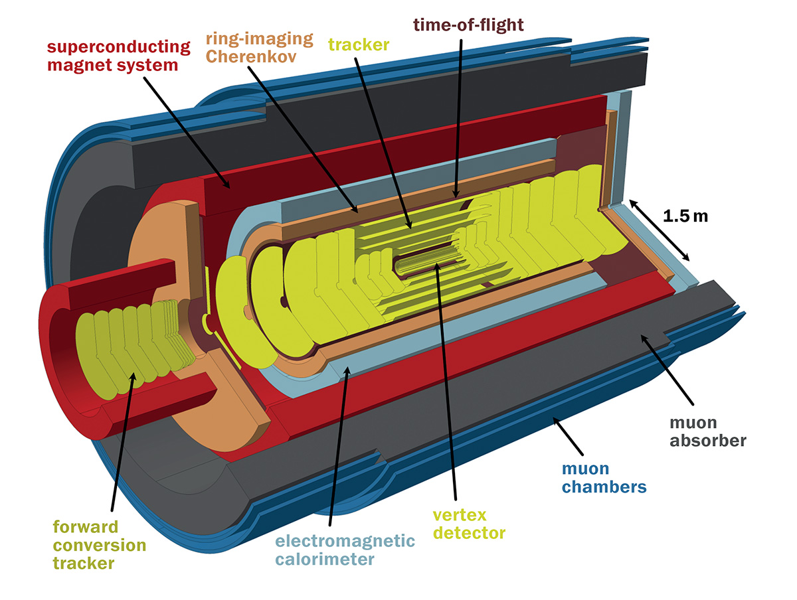



Design of the first large area scintillator-based chamber for the MID detector
Laura Helena González Trueba
Varlen Grabski

Slide 2
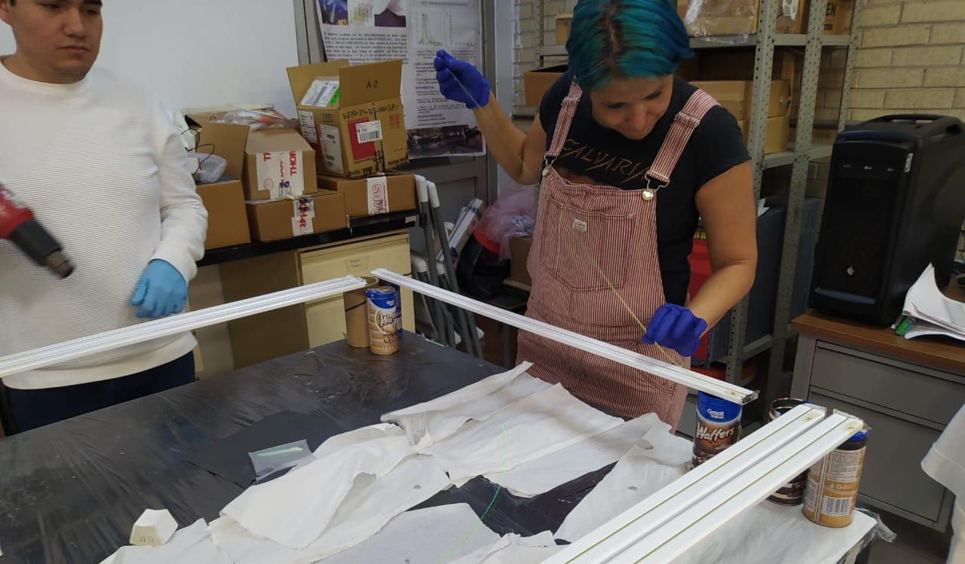
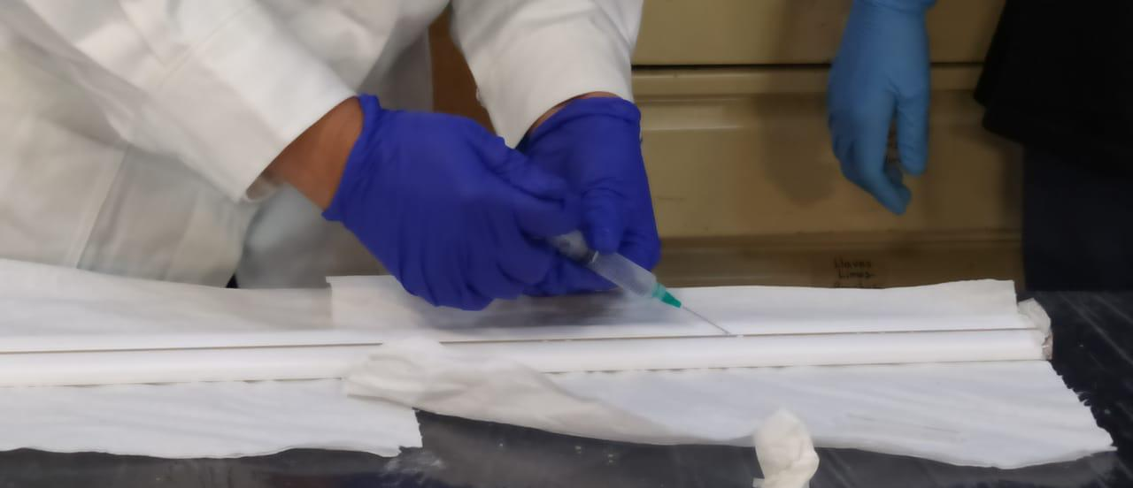
FNAL-NICADD Extruded scintillator bars
1 m length, 4 cm width, 1 cm thickness
Reduced prototype has a length of 25 cm
Optical cement was injected into the groove to adapt a WLSF.
It was wrapped with aluminium tape.

Slide 3

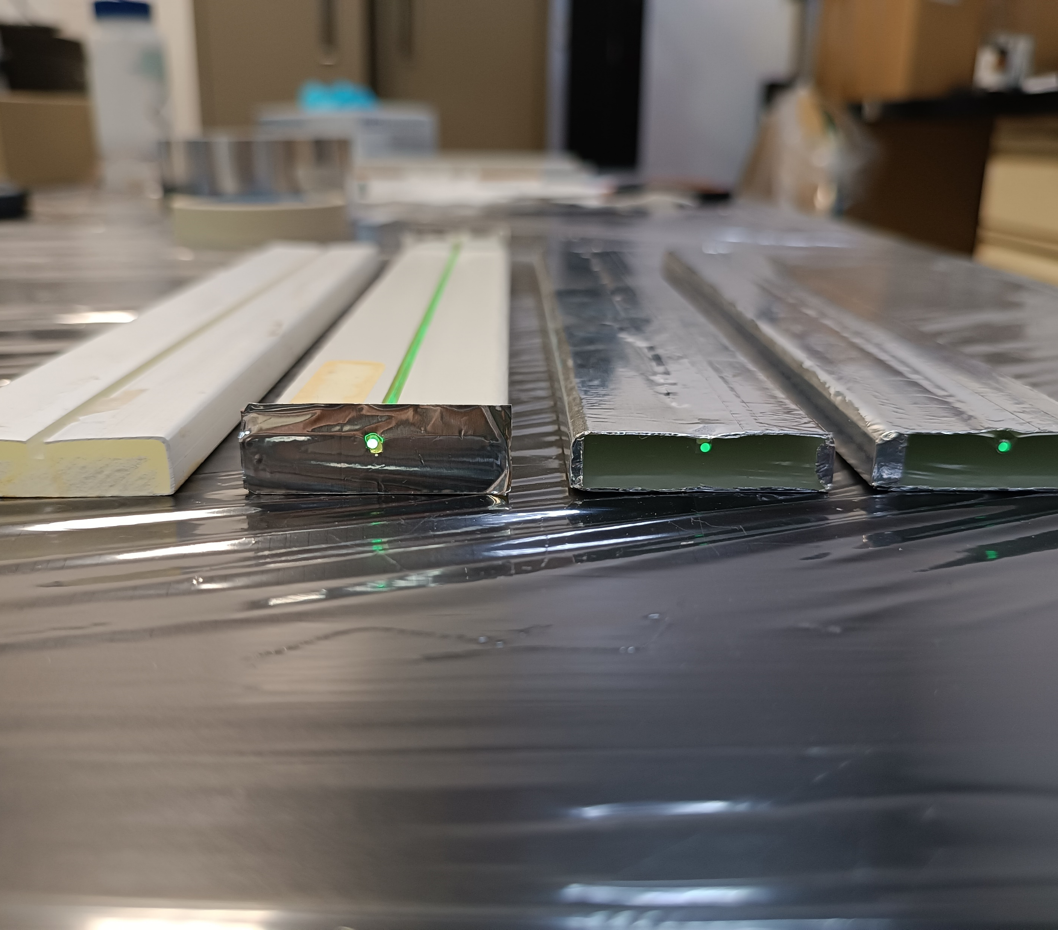


Assembly steps

Slide 4
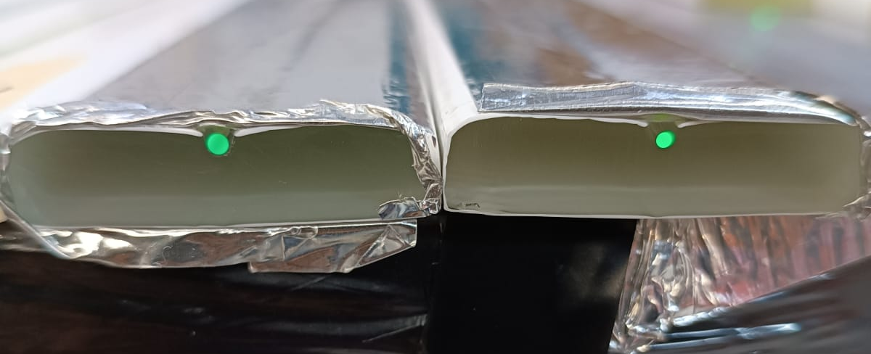
Wavelength Shifter Fiber- Kuraray Y-11-200MJ 1.5 and 2 mm of diameter.
2 mm
1.5 mm

Slide 5
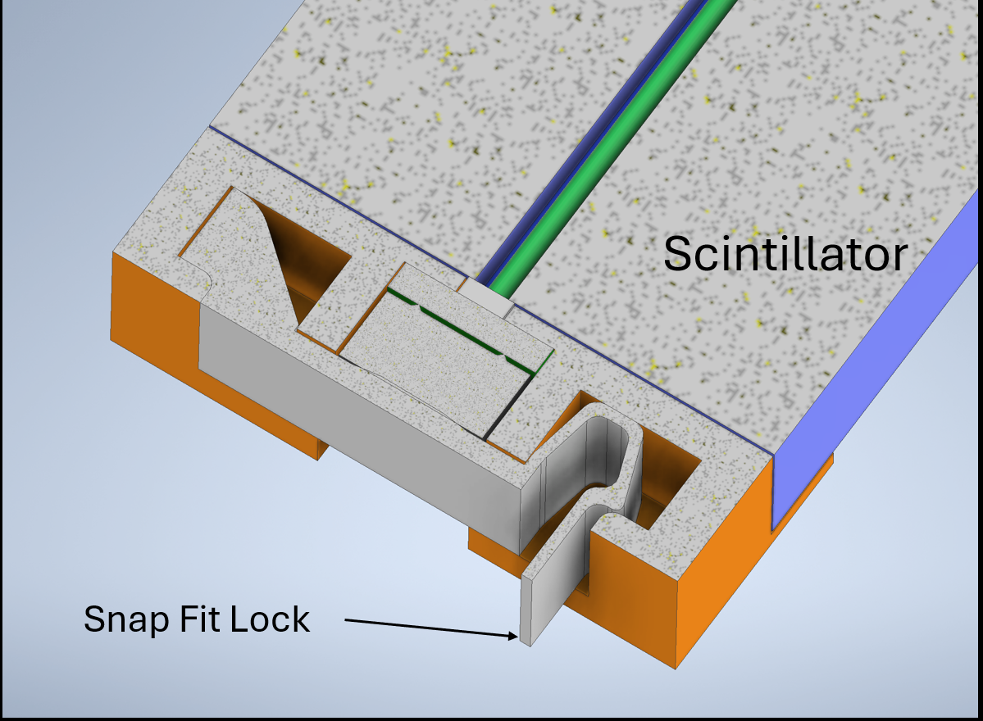
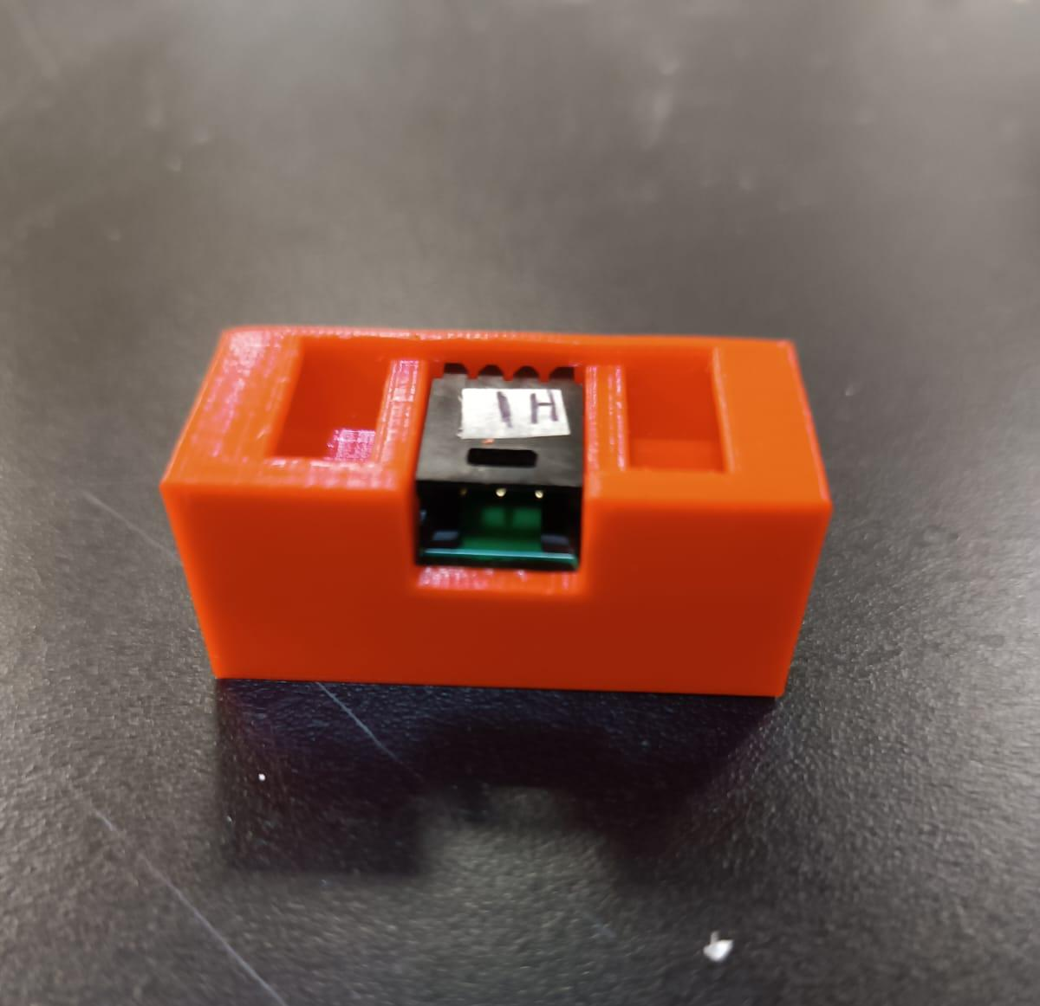
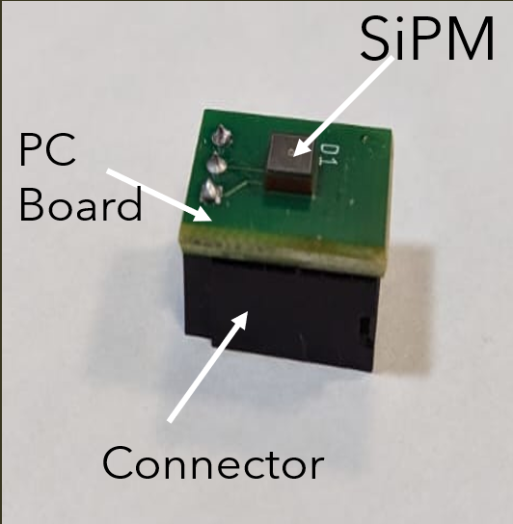
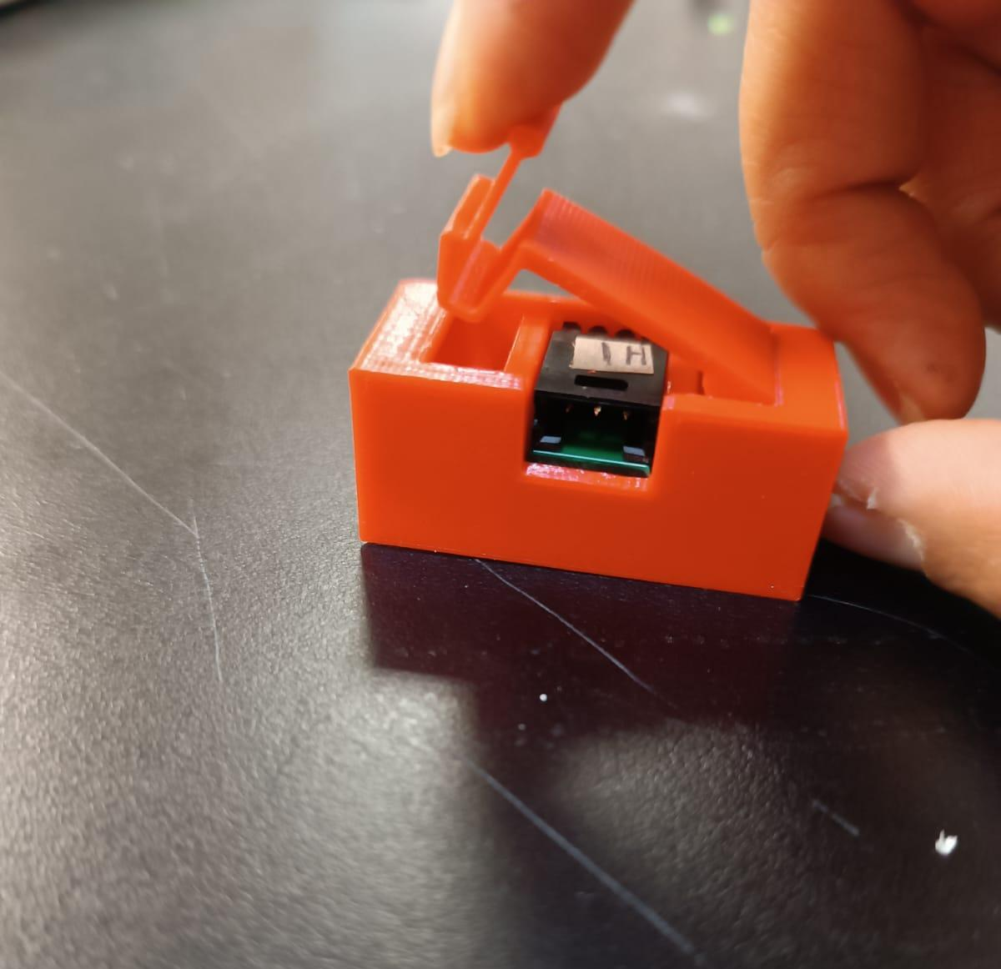
SiPM-Hamamatsu 4160-3050HS , 3X3 mm²
Snap Fit holder for the SiPMs

Slide 6
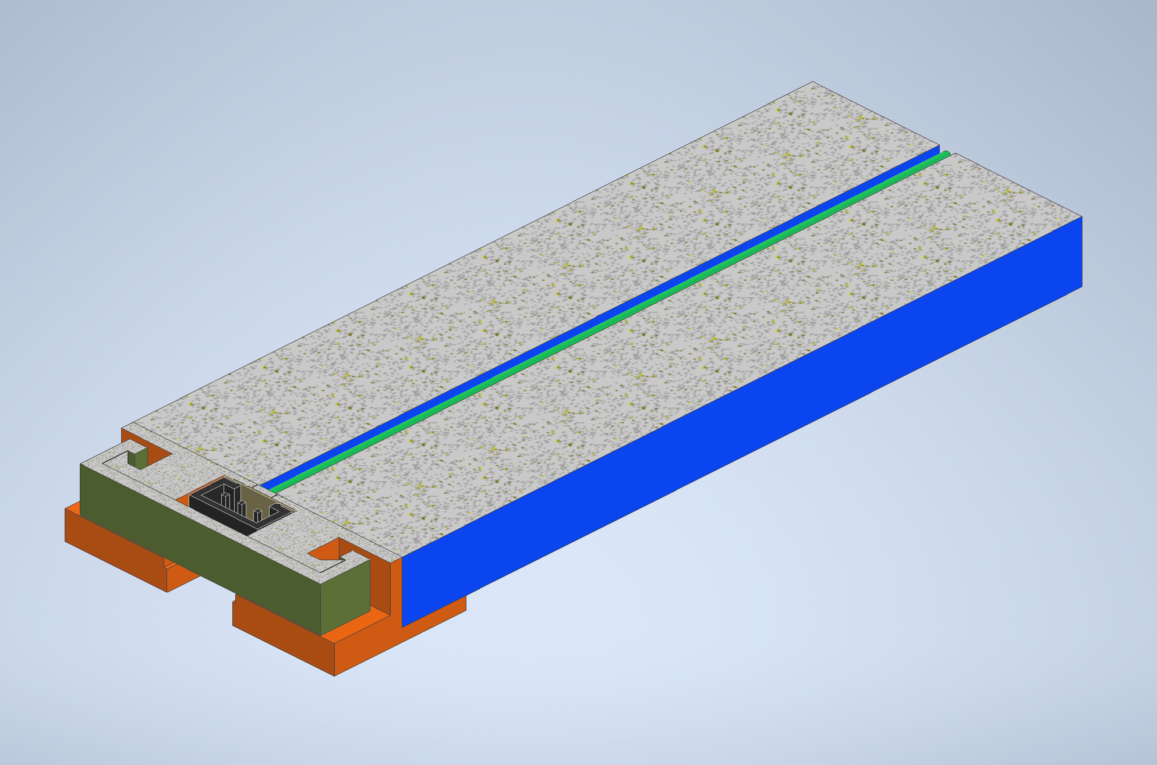
Total assembling of each bar
WLSF
Connector
SiPM
Plastic Scintillator
PC Board
Snap Fit Holder

Slide 7
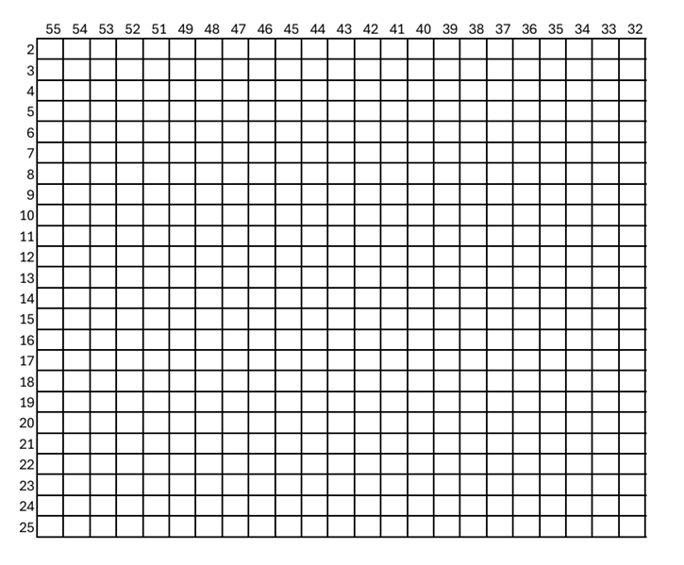
WLS Fiber of 2 mm:
Upper layer channel 15
Bottom layer channels 41 to 461

Slide 8
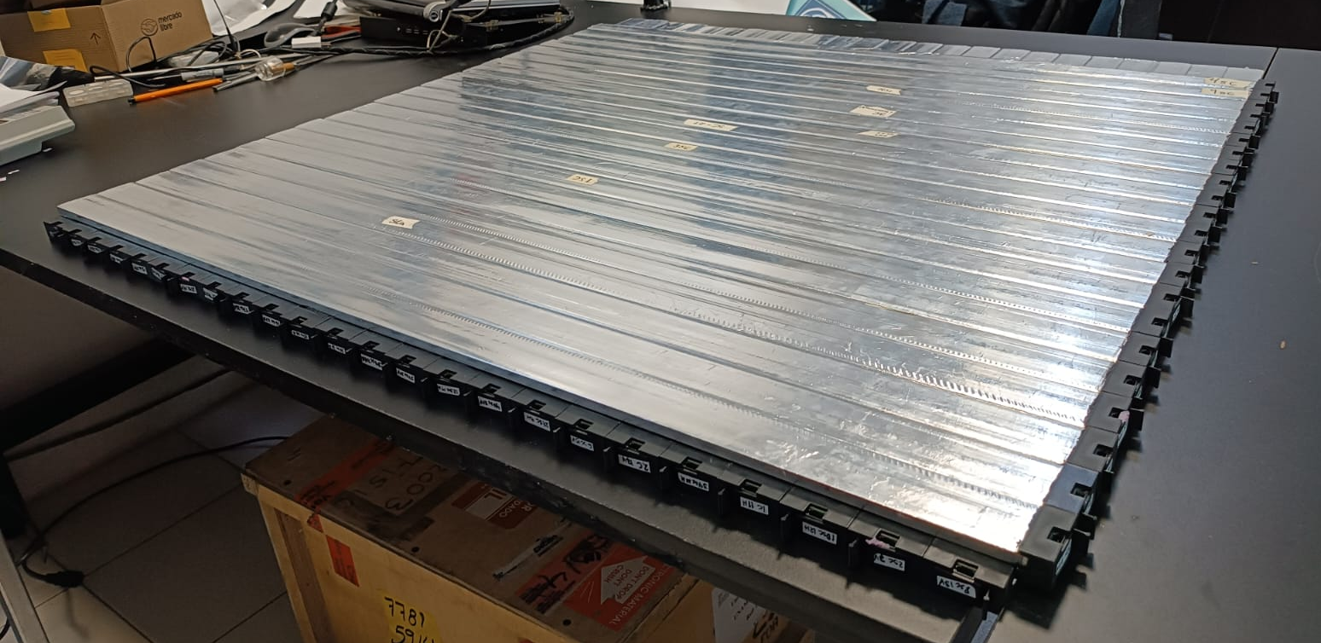
Scintillator Chamber without its mechanical structure

Slide 9
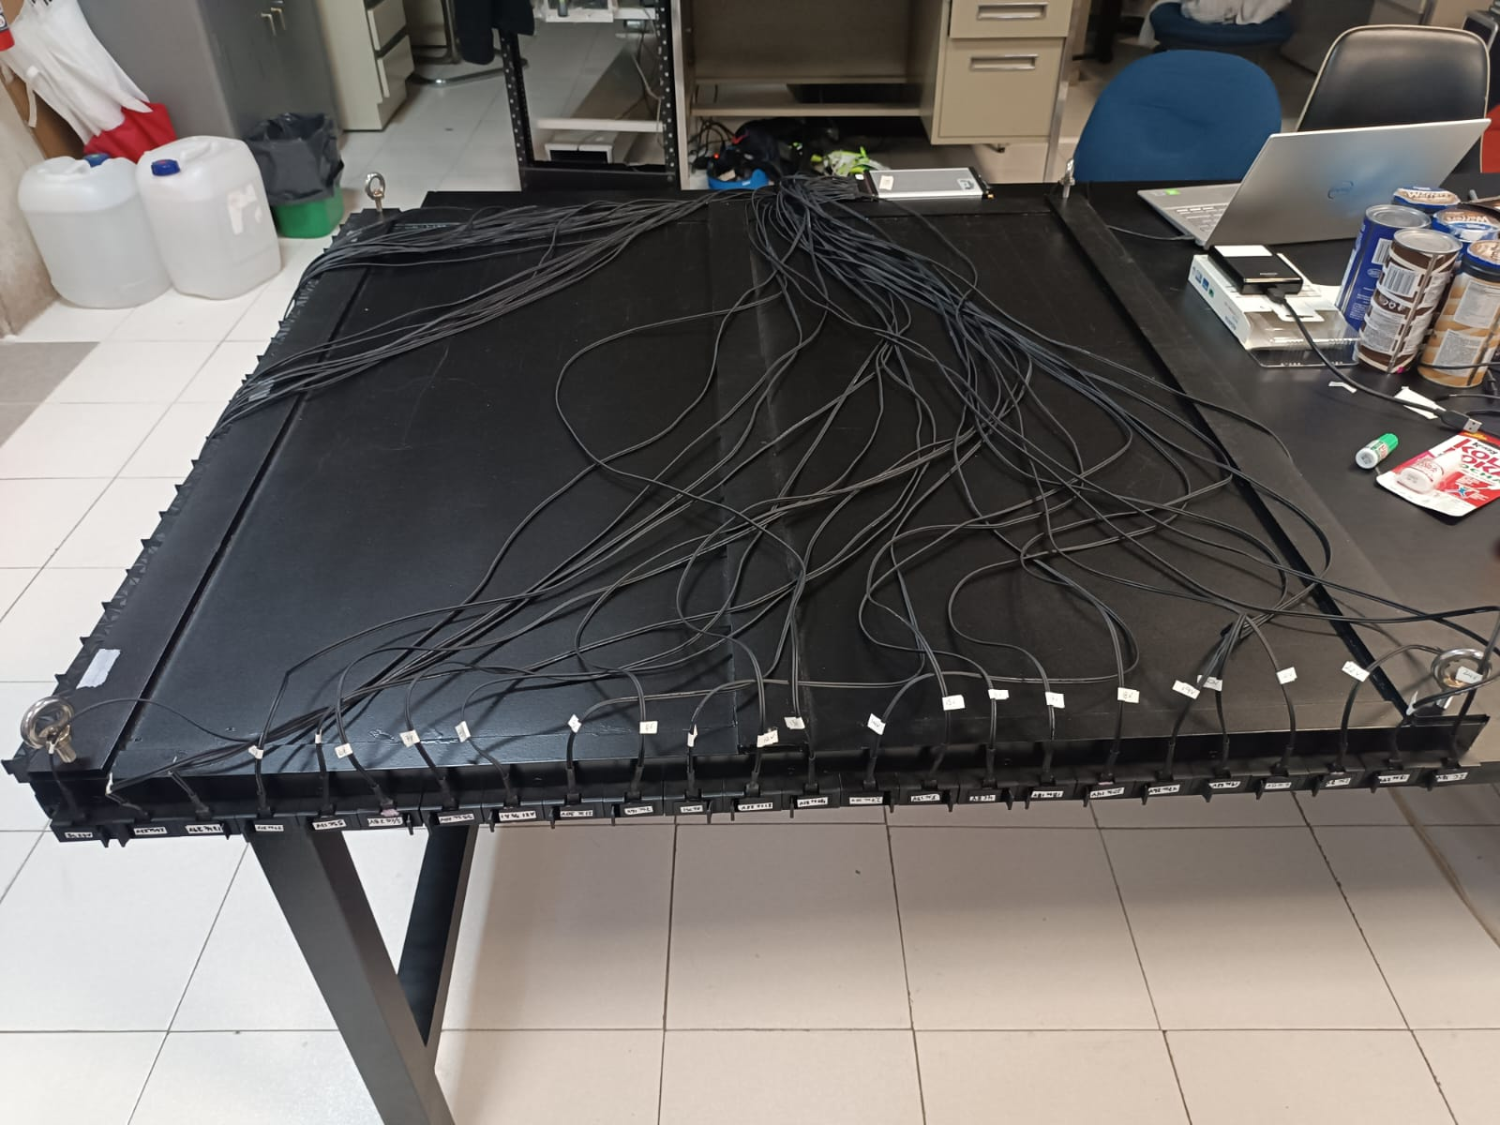
SiPMs Holders

Slide 10
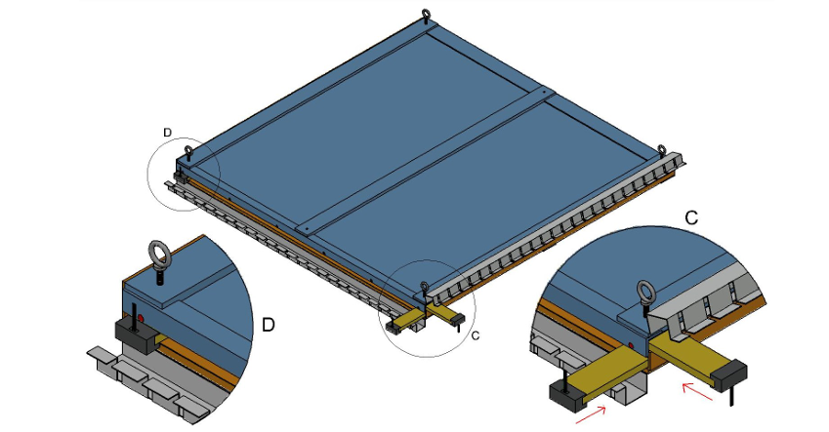
MID Chamber 1x1 m²

Slide 11
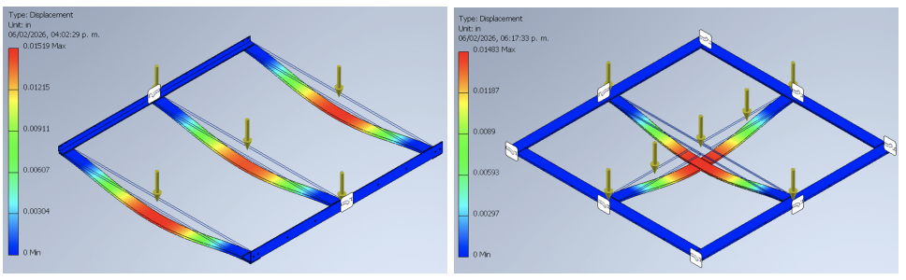
Simulation for mechanical stress on the mechanical structure

Slide 12

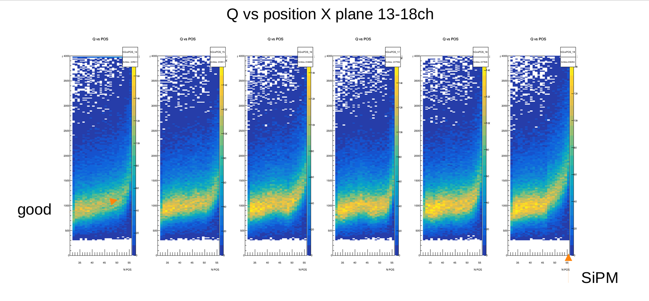
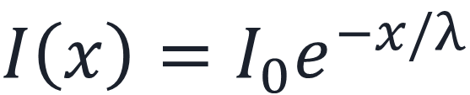
Attenuation Length
SiPM
3.60±1.15 m
$$I\left(x\right)=I_{0}e^{−x/λ}$$

Slide 13
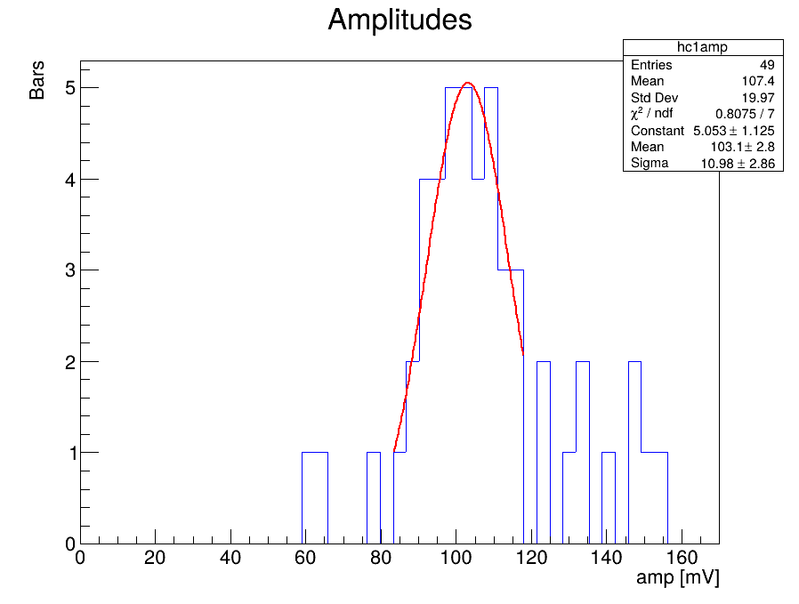
Fibers of 1.5 mm
Fibers of 2 mm
41%

Slide 14
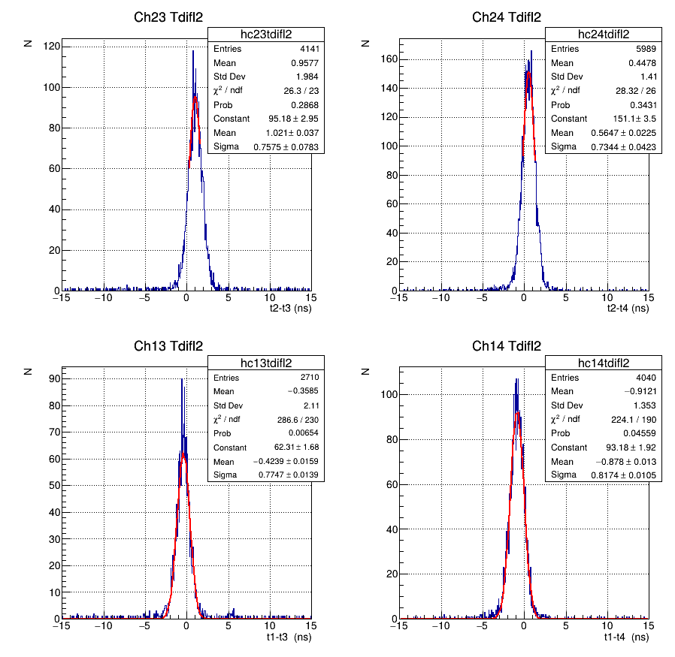
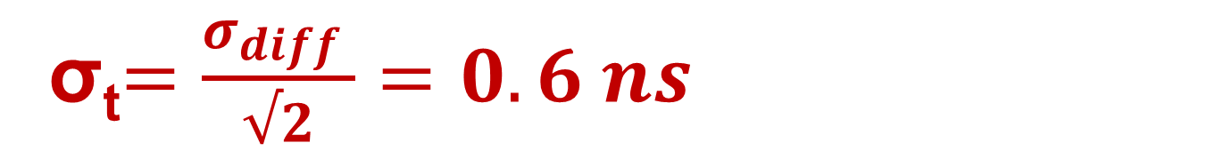
σ_{t}$=\frac{σ_{diff} }{√2}=0.6 ns$

Slide 15
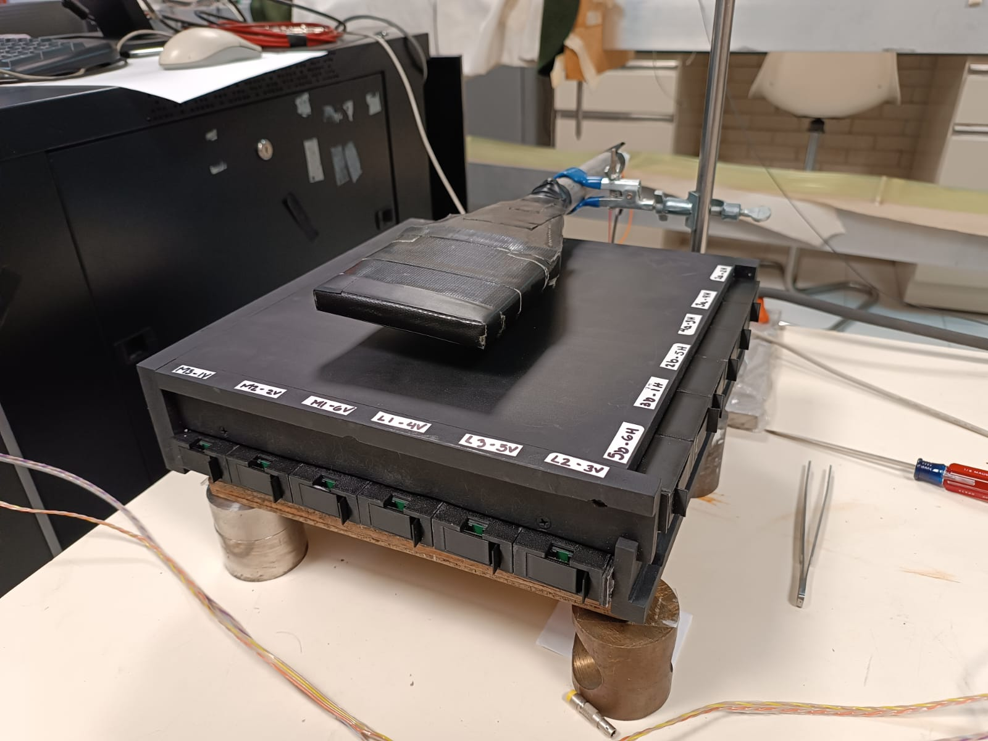
Reduce Prototype 25 x 25 cm2

Slide 16
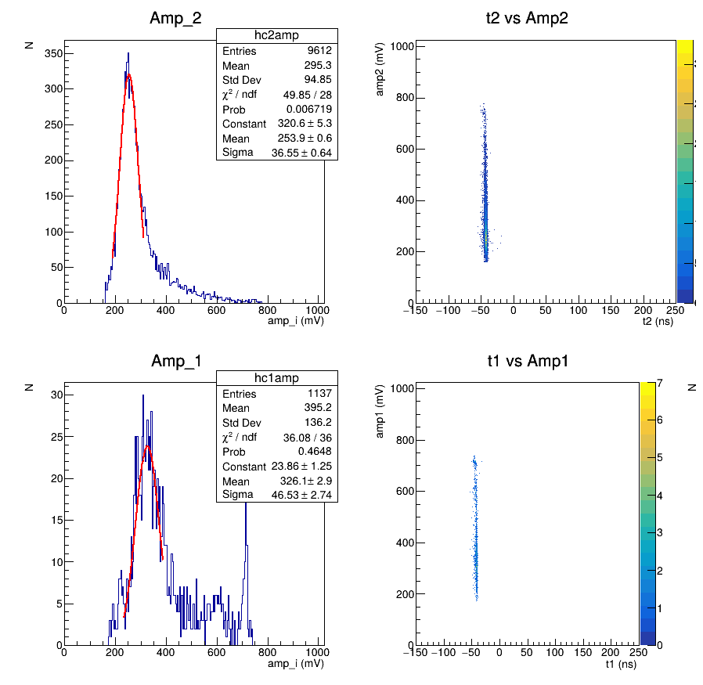
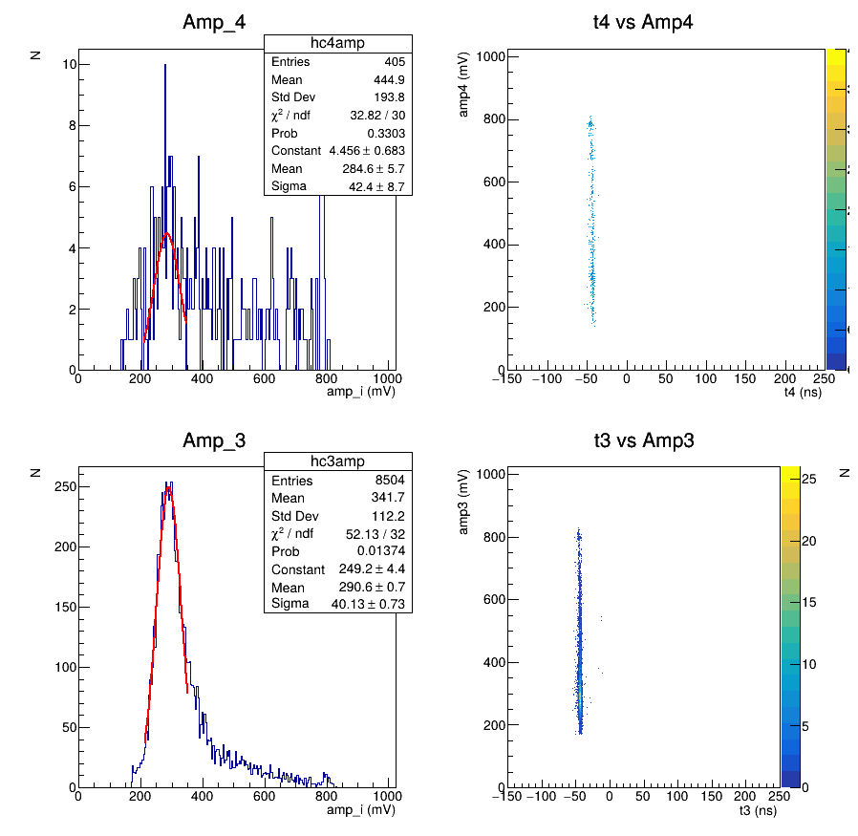

Efficiency 98.2%
$$ƞ=\frac{\sum{Entries}}{\# Triggers}= \frac{19658}{20000}$$

Slide 17
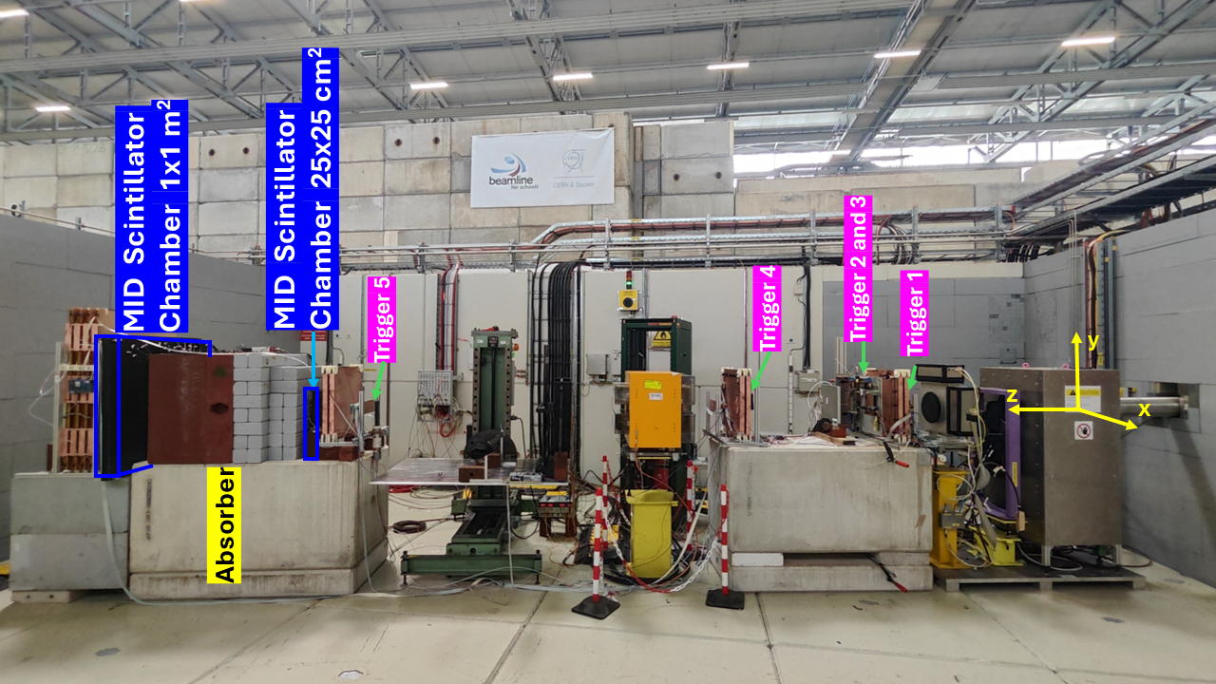
Test beam 2025 for 1x1 m² MID chamber.

Slide 18
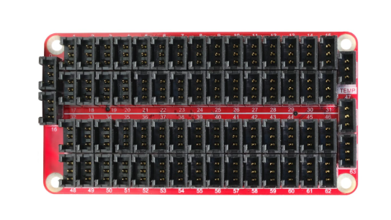
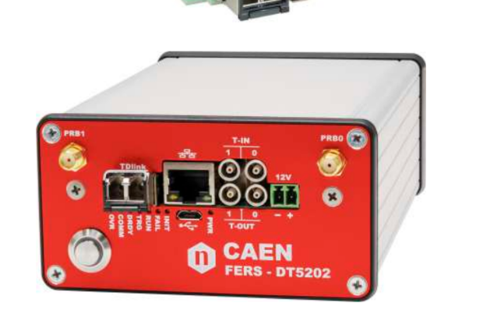
CAEN DT5202 Module
Janus Softeware for data acquisition.
First Layer
First Layer
Second Layer
Second Layer

Slide 19
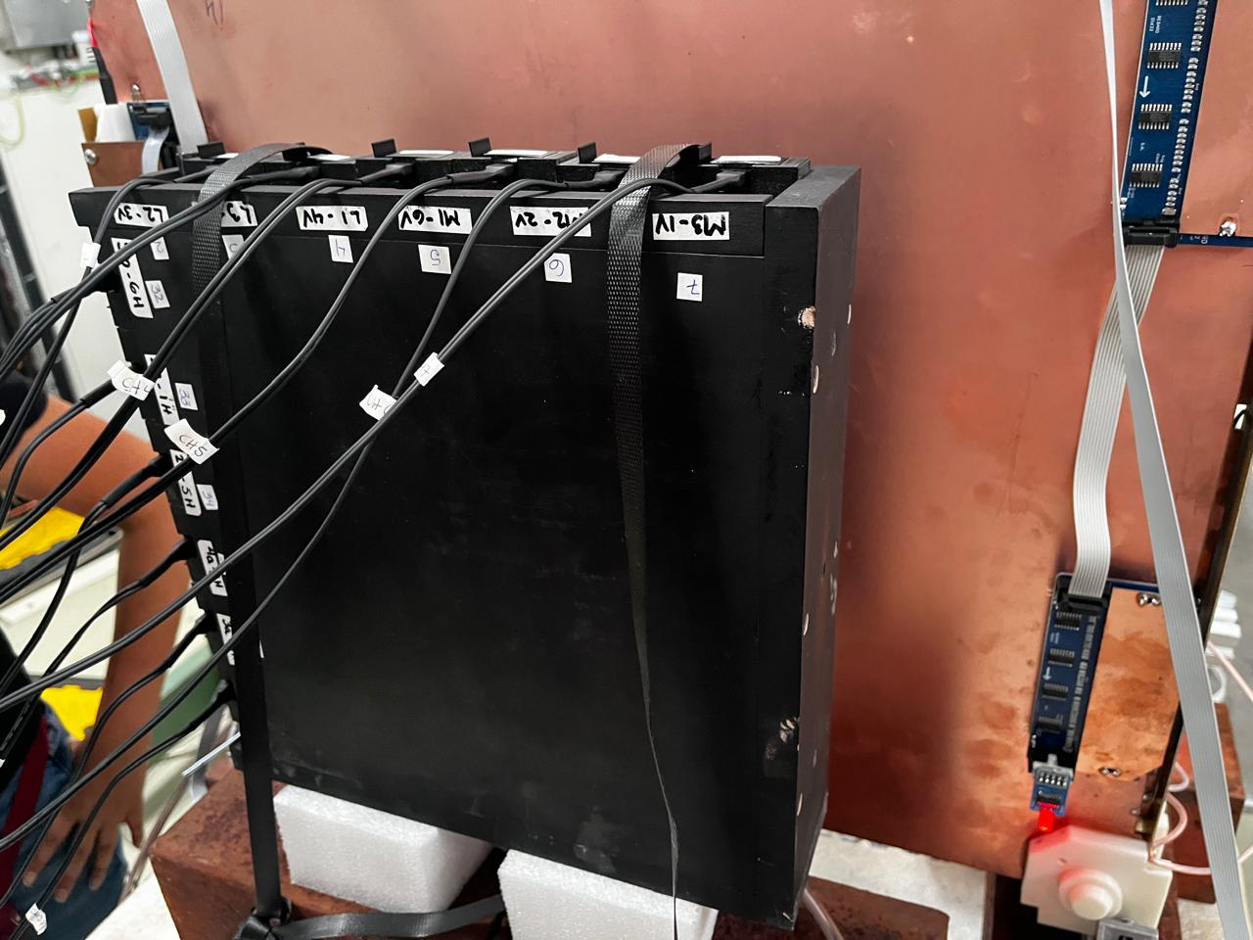
Reduce MID Scintillator chamber 25x25 cm2

Slide 20
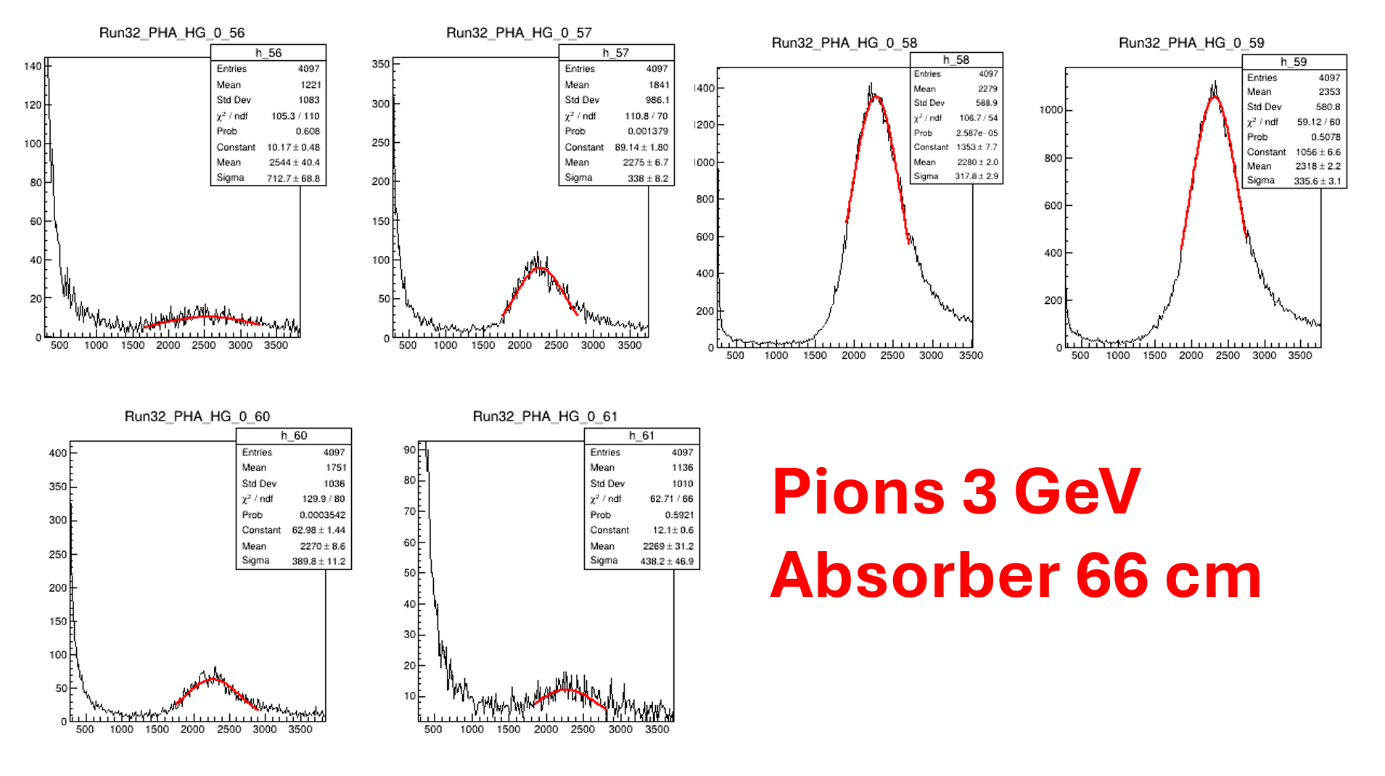
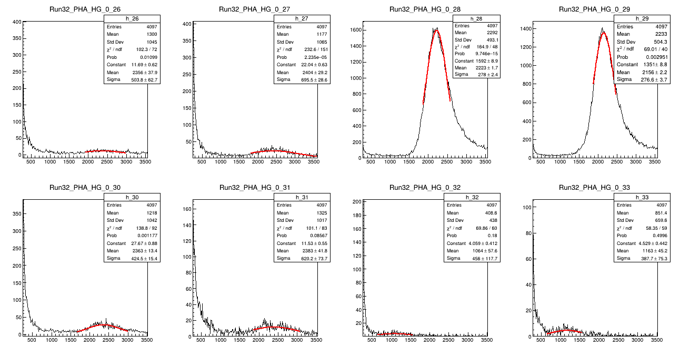

Reduce Prototype Chamber 25 X 25 cm2
25 cm
25 cm

Slide 21
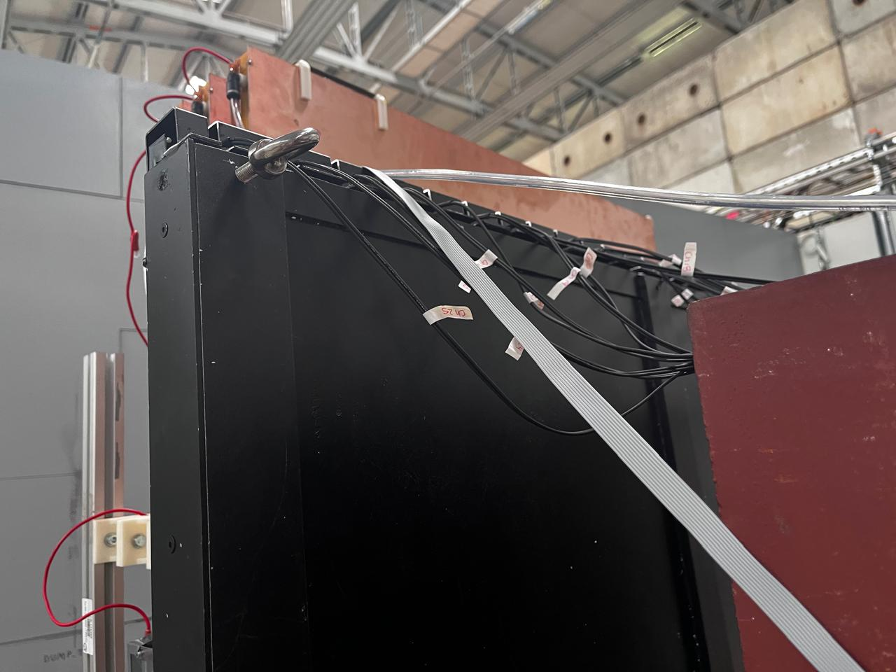
MID Scintillator chamber 1x1 m2

Slide 22
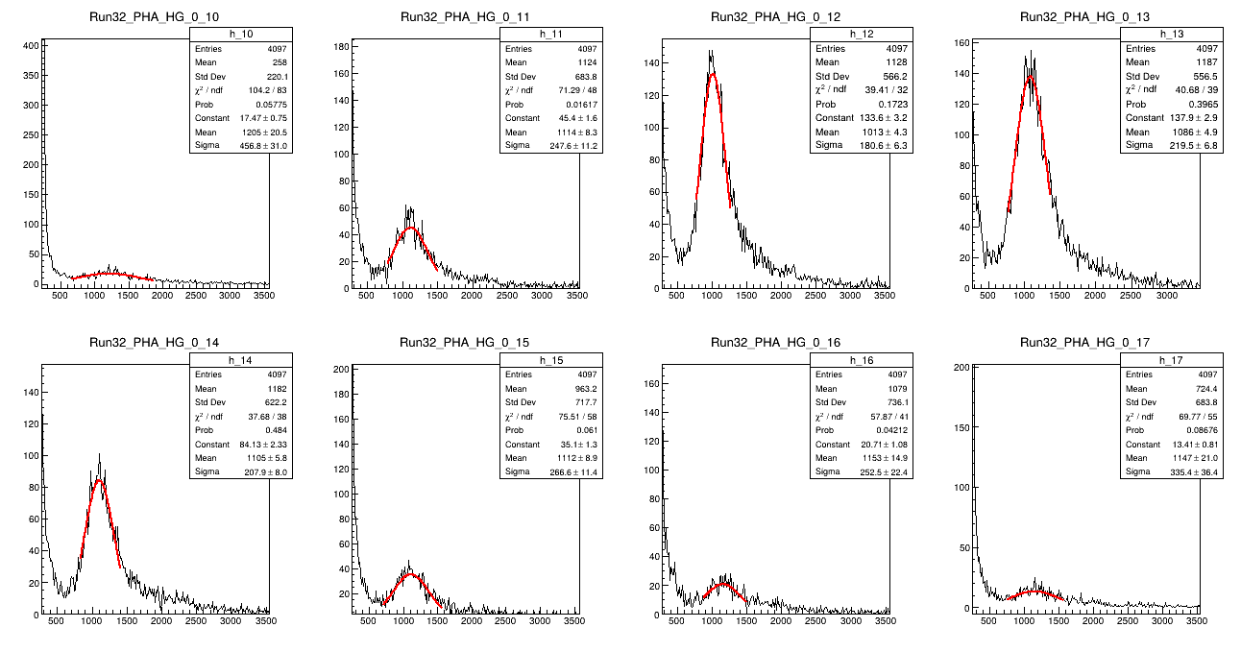
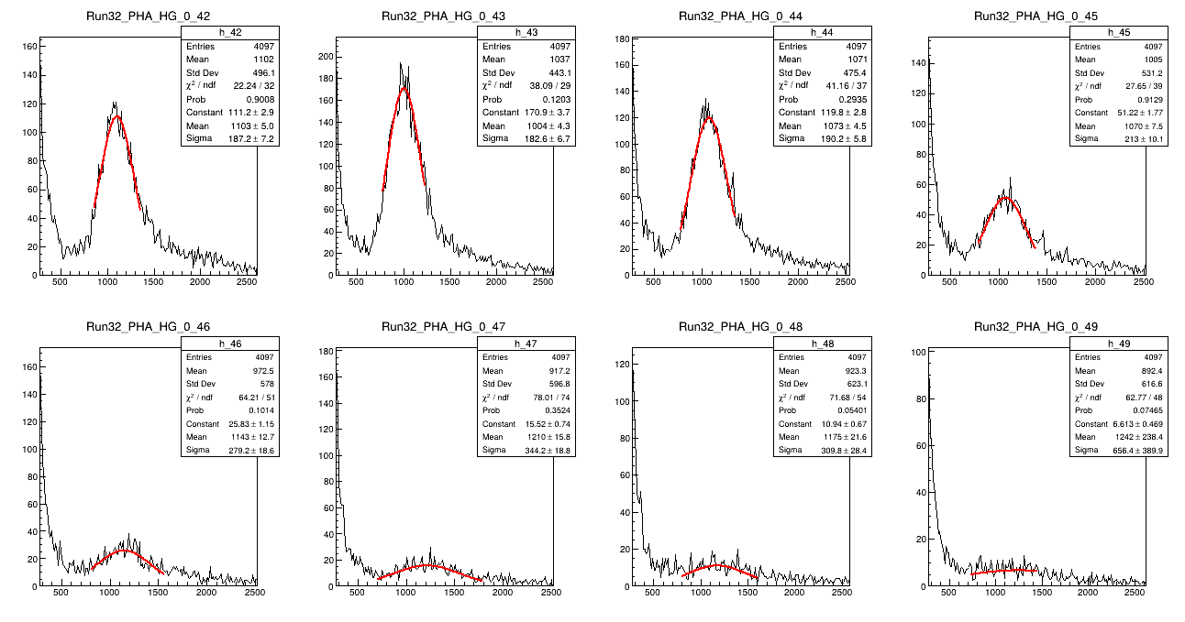
1 X 1 m2 Prototype
1 m
1 m

Slide 23
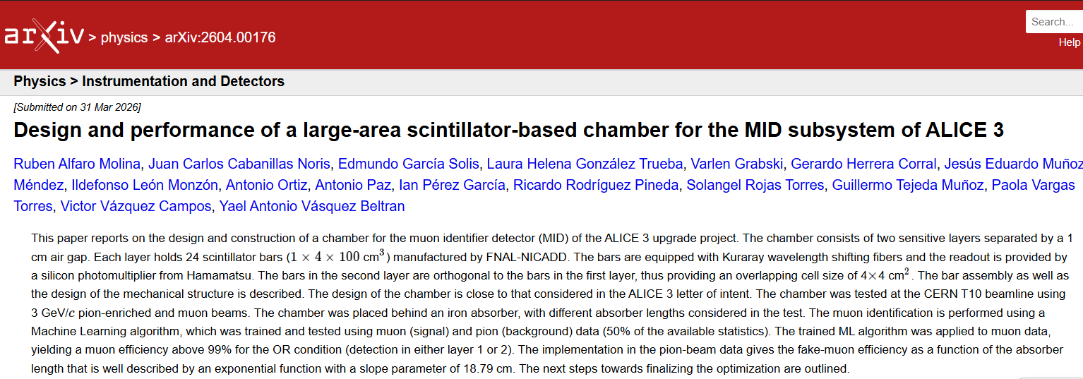
Paper for the test beam 2025 of the MID chamber prototype
15/04/2026
ALICE Mexico Annual Meeting

Slide 24
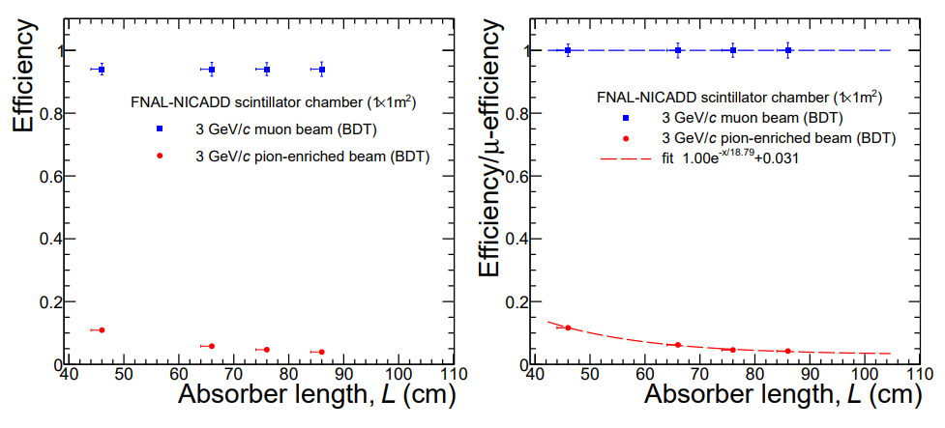
Identified muons as a function of absorber length.

Slide 25
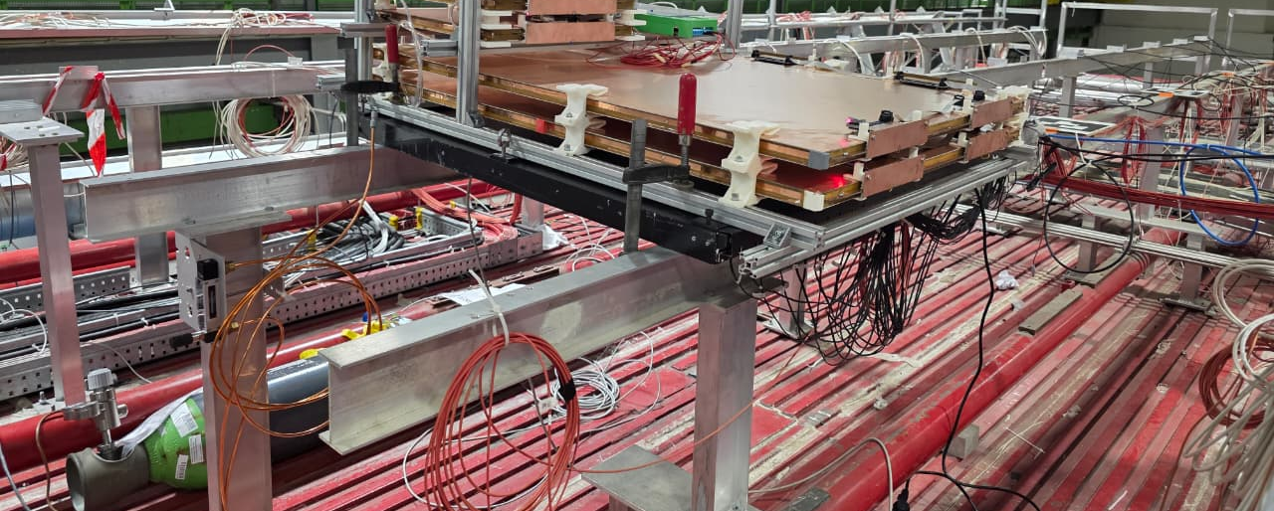
Installation of MID Prototype 1x1 m² at the roof of L3 ALICE YOKE

Slide 26
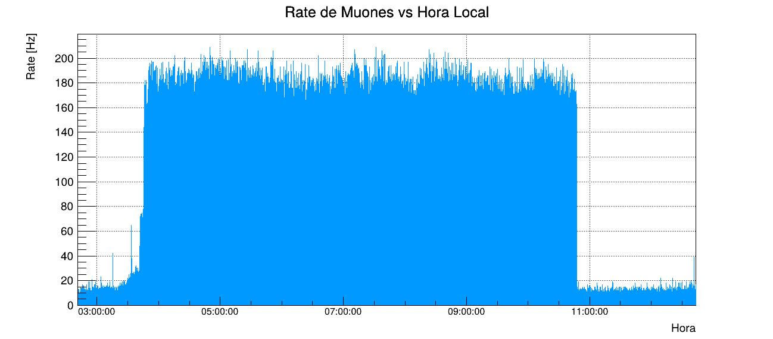
All Cycle
Rate all cycle vs Local Time
Dump and Ramp Down
Stable Beam
Ramp
Injection

Slide 27
GOALS for the installation
Before and after de beam injection take data to analize the background and compering them with simulation on FLUKA.
For collision on p-p, during stable beam take data and also compere the results with GEANT 4 and Pythia.
15/04/2026
ALICE Mexico Annual Meeting

Slide 28
Summary
MID 1x1 m² prototype
The geometrical efficiency of the 2nd reduced prototype is about 98.2%
An estimation of the attenuation length was obtained, λ=3.6m.
The fibers of 2mm transmitted 41% more than 1.5 mm.
For the 1x1 m² prototype, a muon efficiency of 94% would be sufficient to give a fake-muon efficiency of 2.7% a 70 cm-thick absorber.
Installation
In February, the MID 1x1 m² chamber prototype was installed at the ALICE cavern; now it is working in the data acquisition and in the análisis as well as in the simulations.

Slide 29


Slide 30
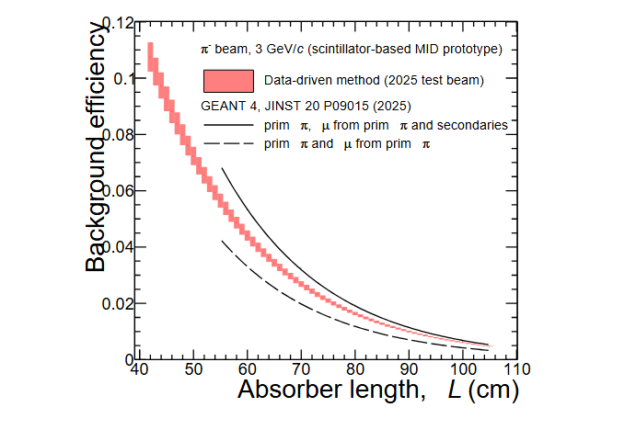
Data-driven background efficiency as a function of absorber length
15/04/2026
ALICE Mexico Annual Meeting

