Slide 1
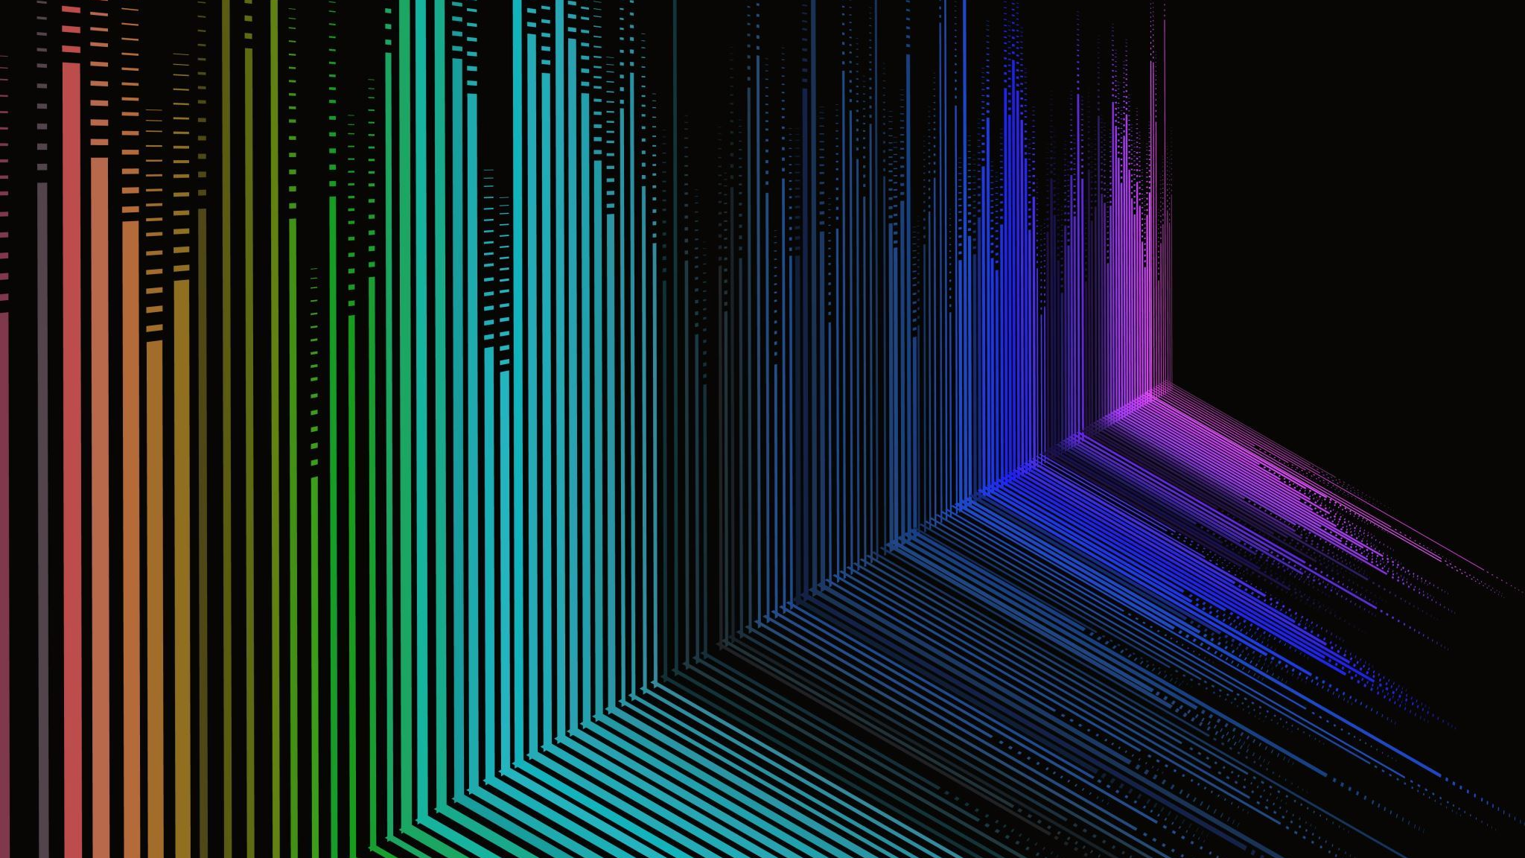



Mexican Scintillators for the ALICE-3 MID
Ildefonso León Monzón
Universidad Autónoma de Sinaloa
On Behalf of the UAS-TECNM-CINVESTAV Group
April 15, 2026

Slide 2
Outline
Materials for the MID: PPO + POPOP + Matrix
Synthesis of scintillators: First samples from Canadian materials
  Optimal performance
  Production of the first urethane bars
Samples with materials from the USA
  Results

Slide 3
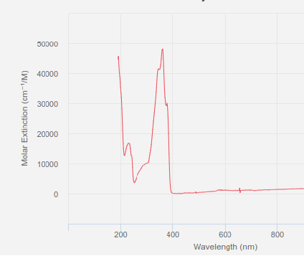
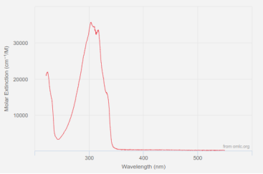
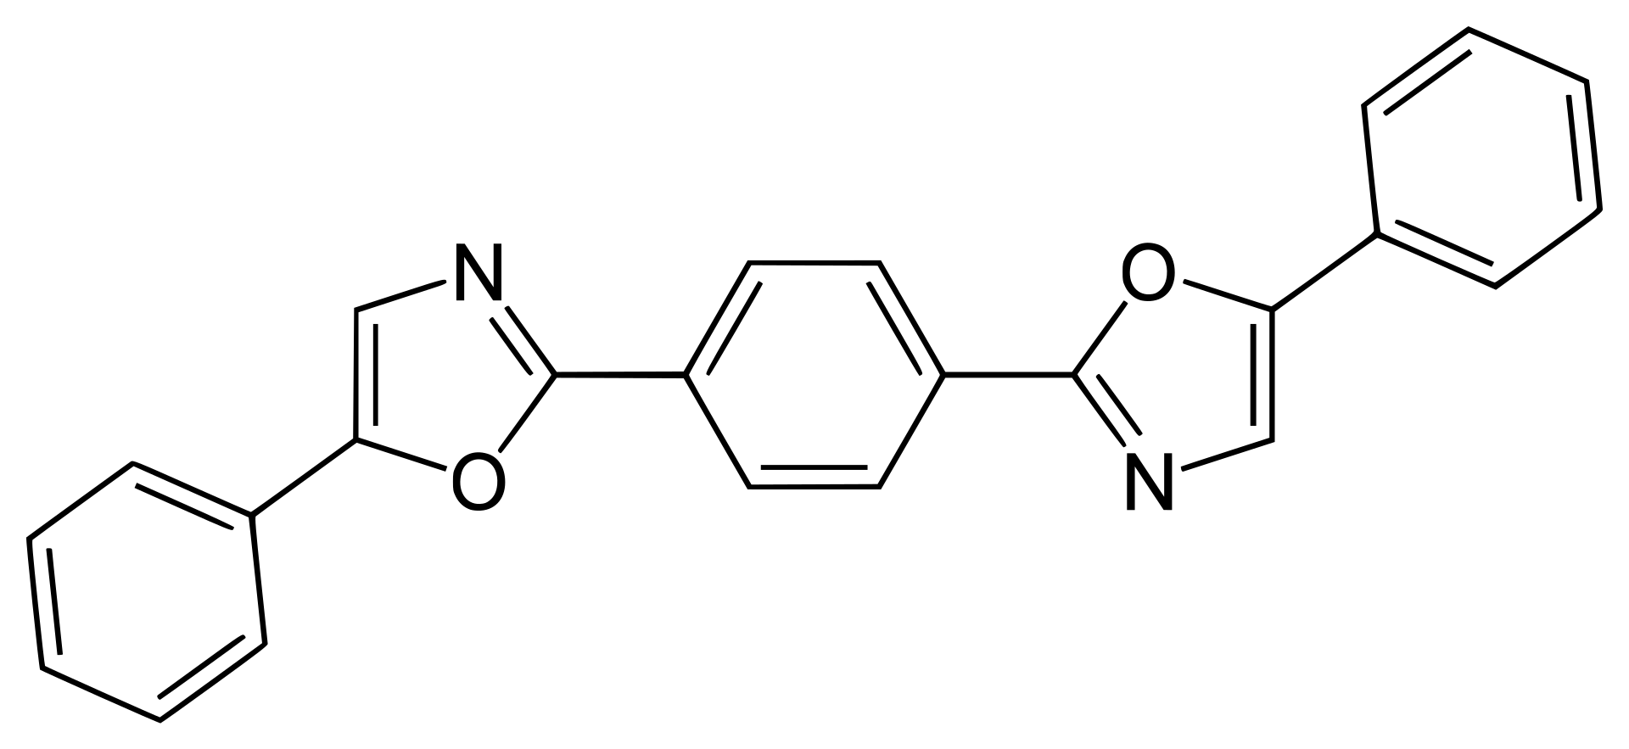
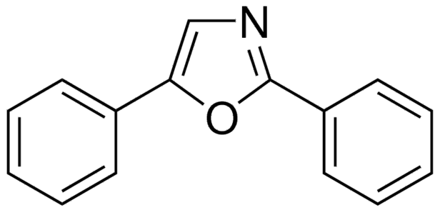
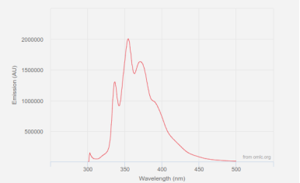
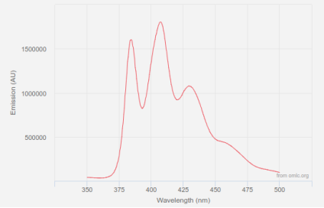
Fluorescent organic compounds for the MID
PPO
POPOP

Slide 4
Previous Work
In 2023, we designed and produced a prototype for the MID detector.
This prototype was successfully tested at CERN with proton and pion beams.
The prototype was a non-aliphatic compound, and this can be an issue.
The matrix currently under test is urethane-based (polyurethane).
Polyurethanes can offer improved radiation hardness and humidity resistance compared to traditional polystyrene (PS) or polyvinyltoluene (PVT), depending on the specific formulation.

Slide 5
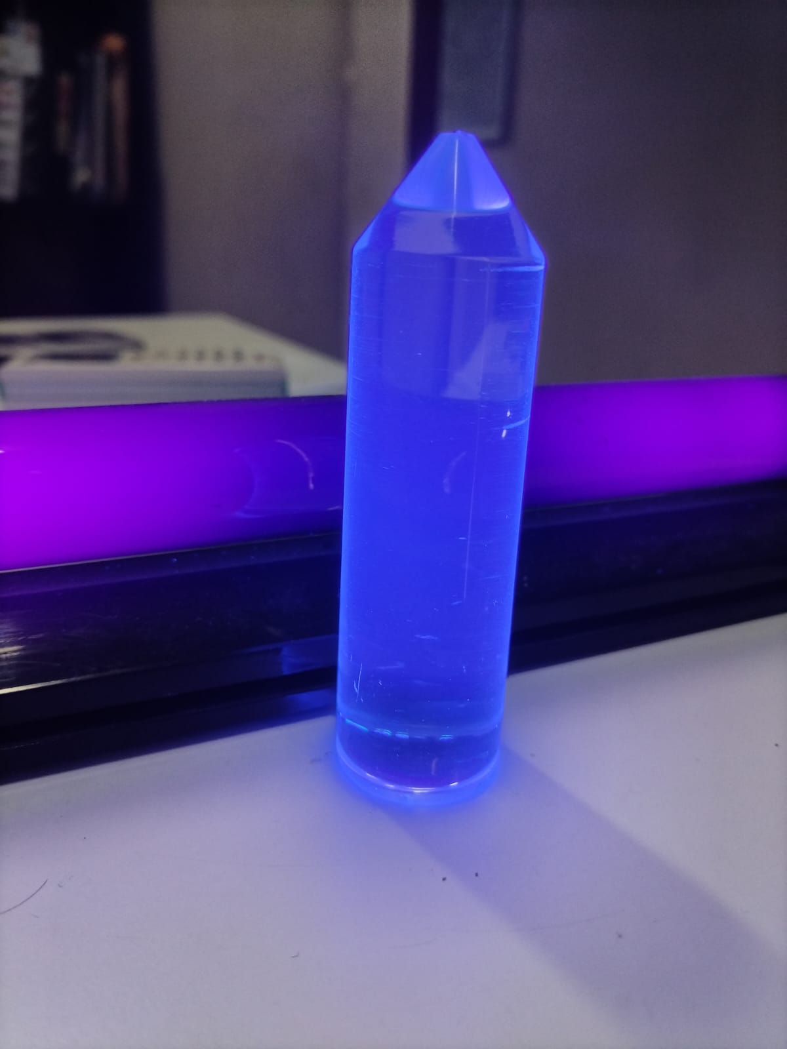
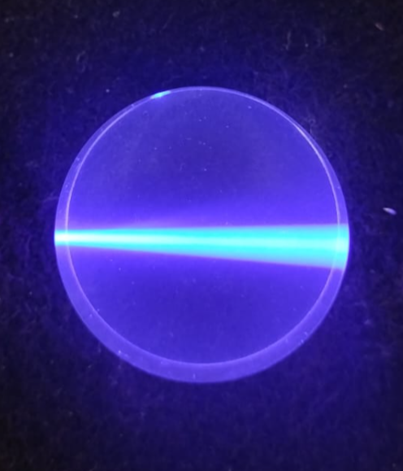
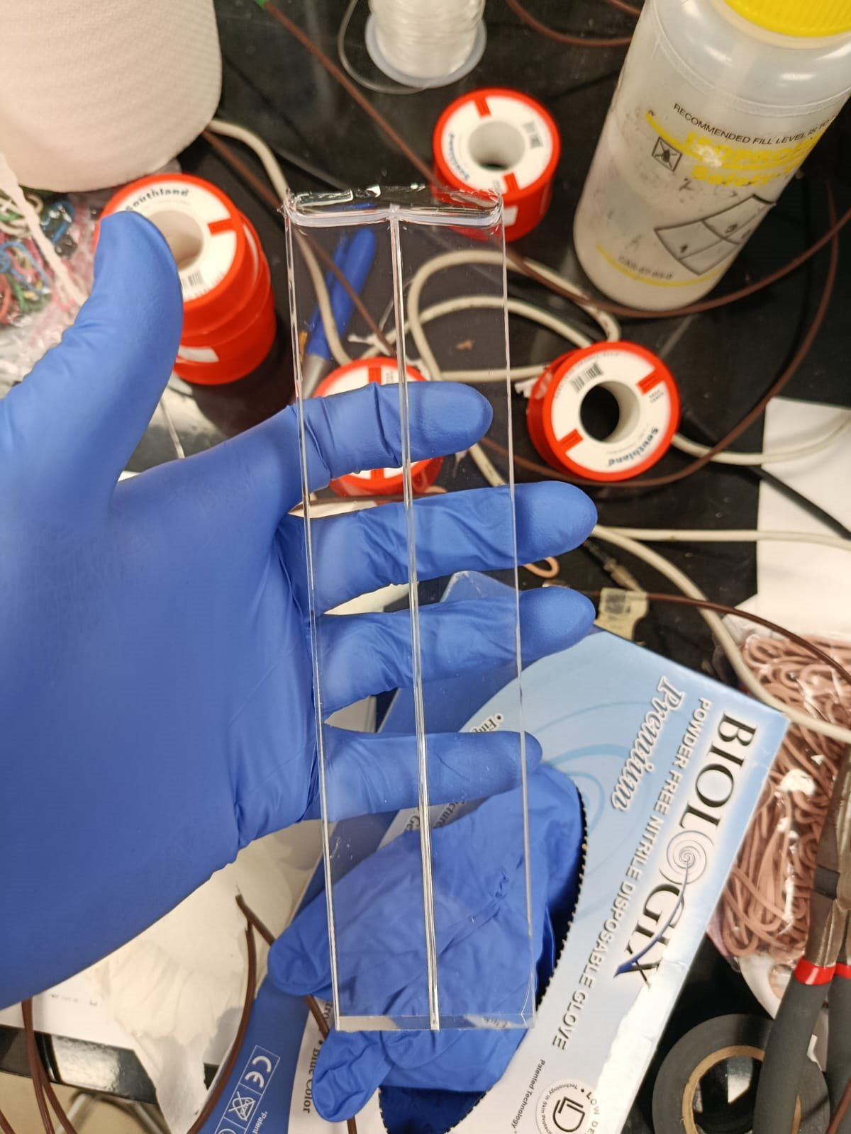
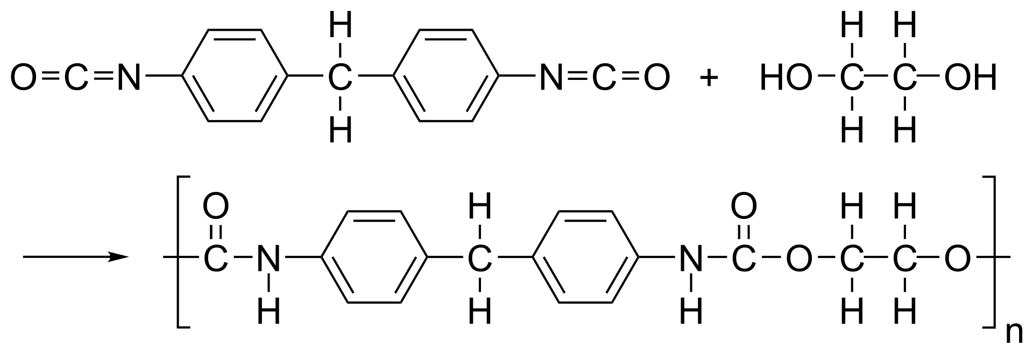
Polyurethane samples: Canadian materials

Slide 6
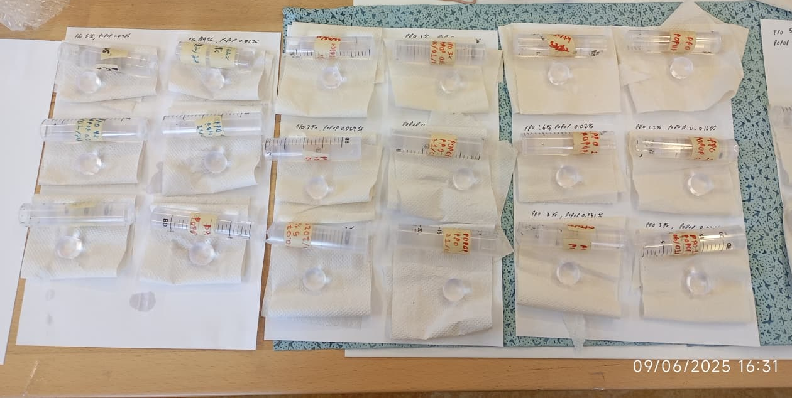
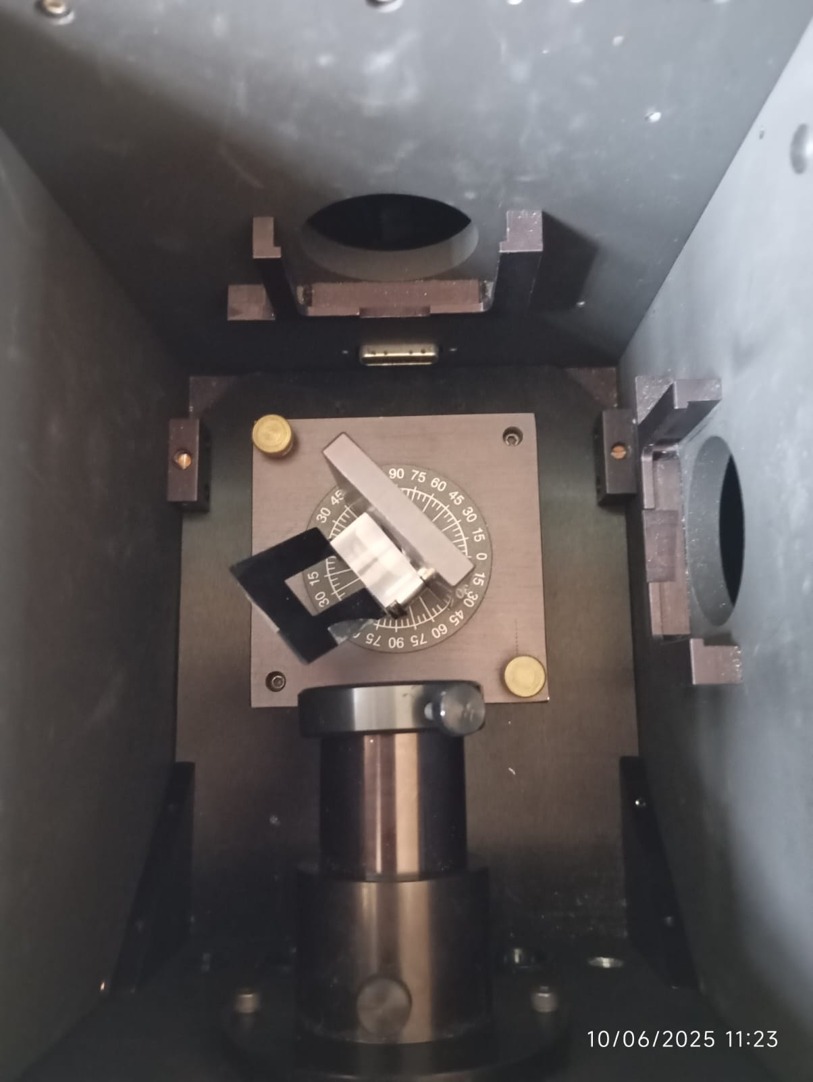
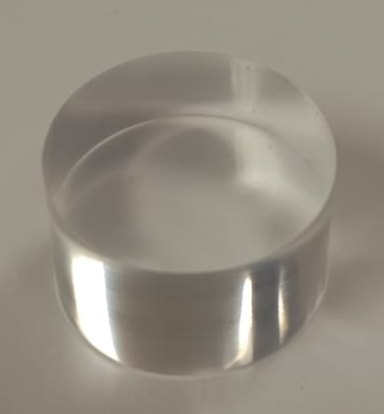
Samples and results: transmittance and time decay
The spectrum emission and absorption were measured using the Fluoromax R928P equipment.
For the time decay, we use the Spectrofluorometer 5000M (Horiba).

Slide 7
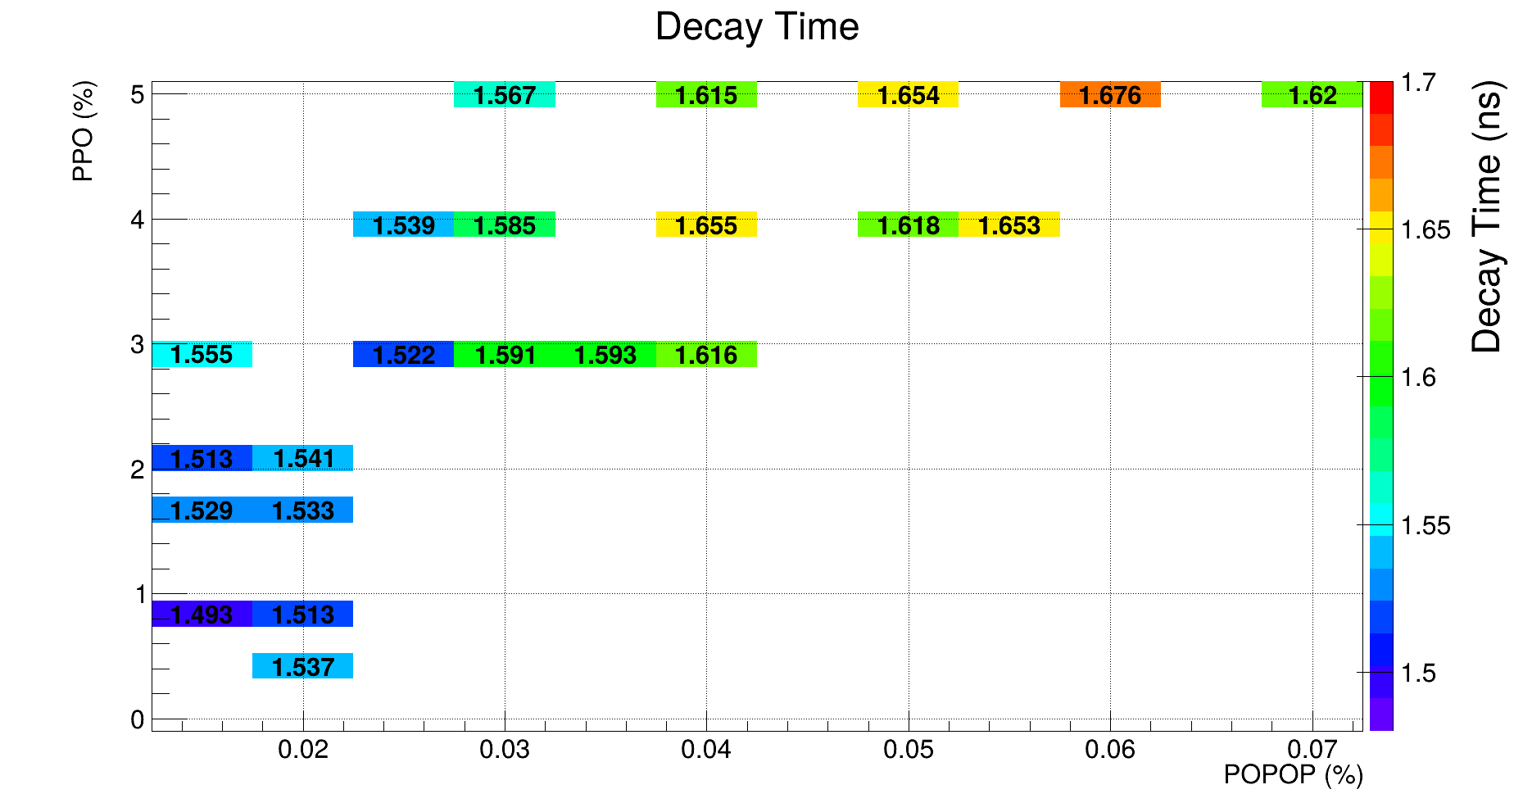
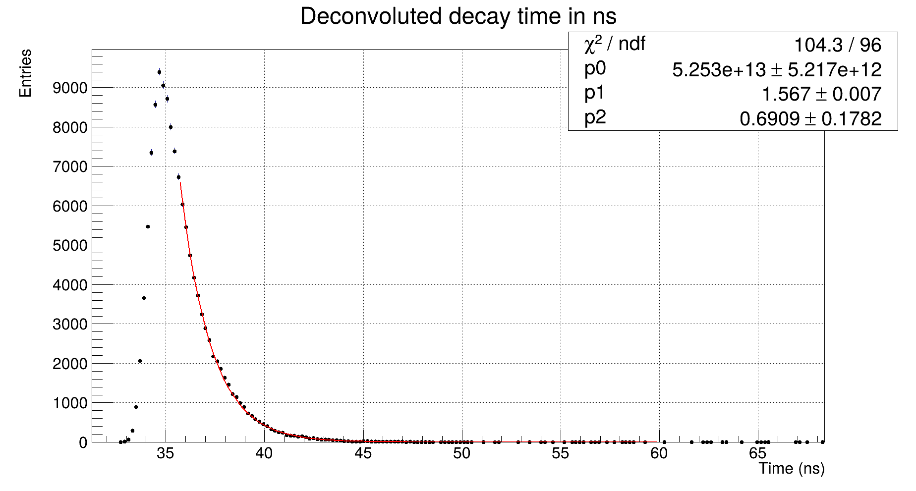
Time response from samples
Time decay - PPO 5% - POPOP 0.03%
Time decay vs dopants concentration

Slide 8
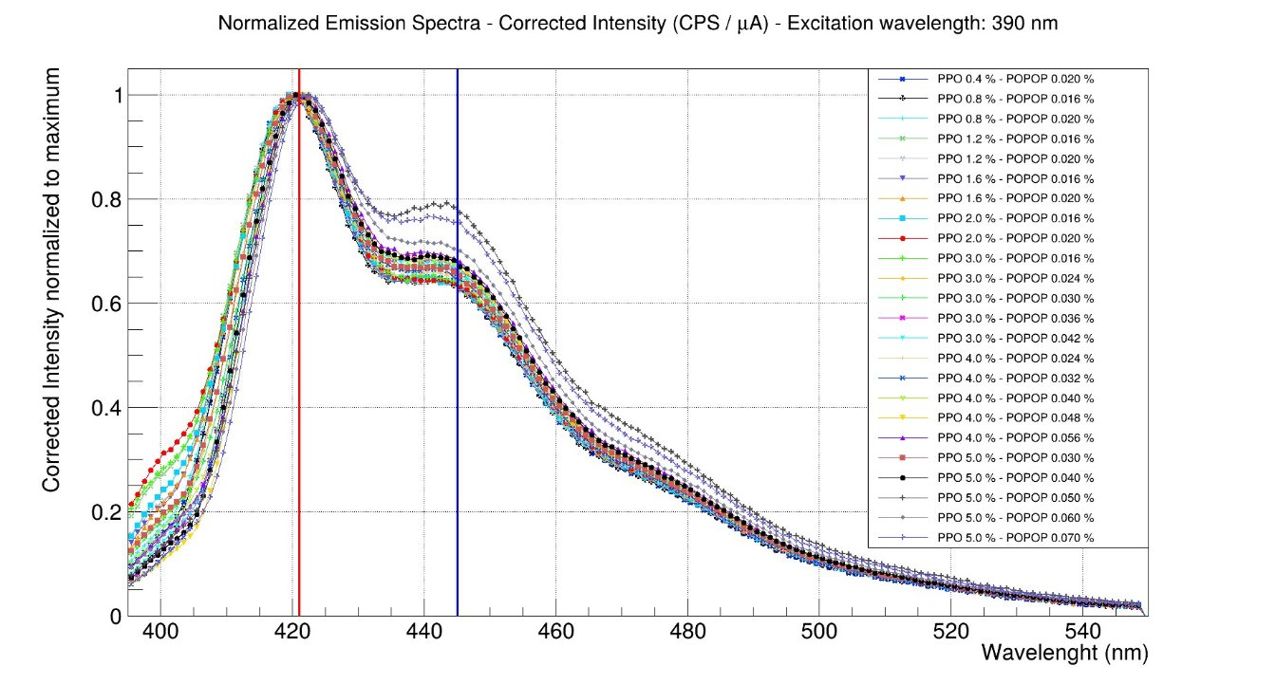
Emission spectra for the different samples

Slide 9
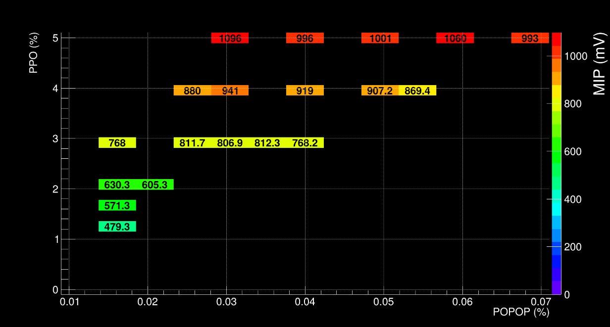
Pulse amplitude for MIPS in mV

Slide 10
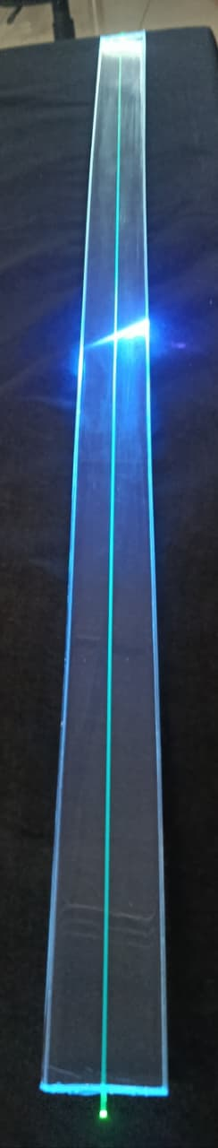
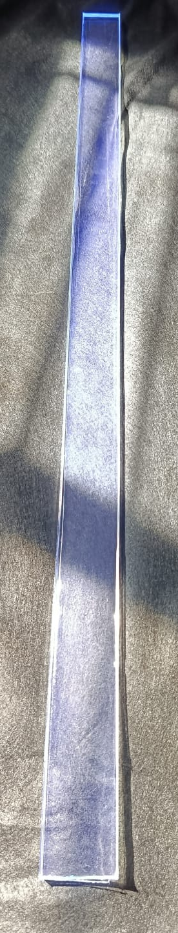
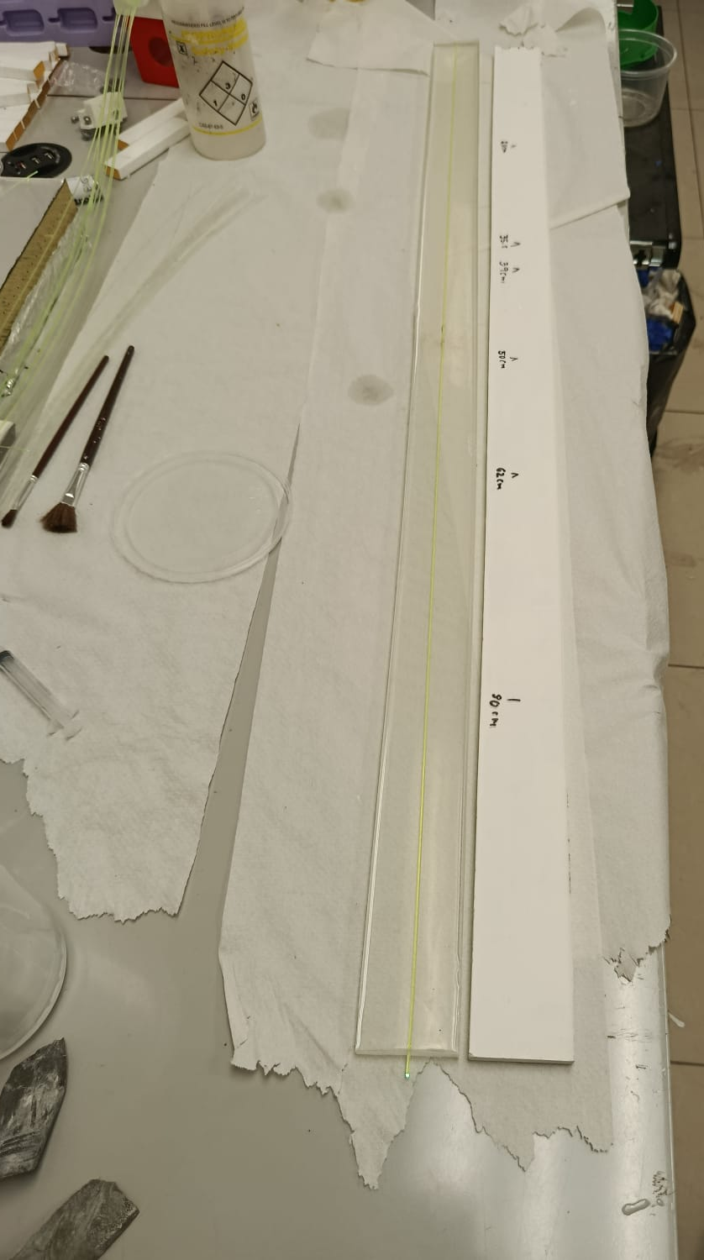
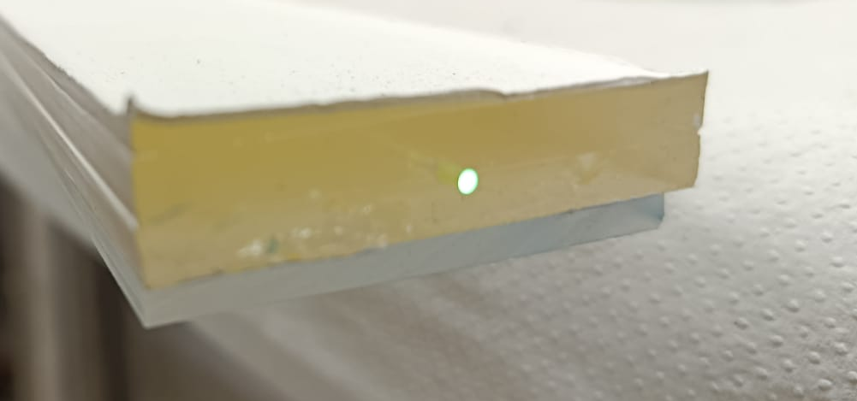
Bars produced with best concentration
Scintillator with Kuraray fibre, 1.5 mm diameter model Y11 (200).
BEHR paint ULTRA PURE WHITE with 94% reflectivity.

Slide 11
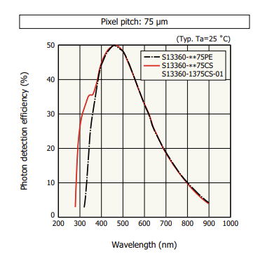
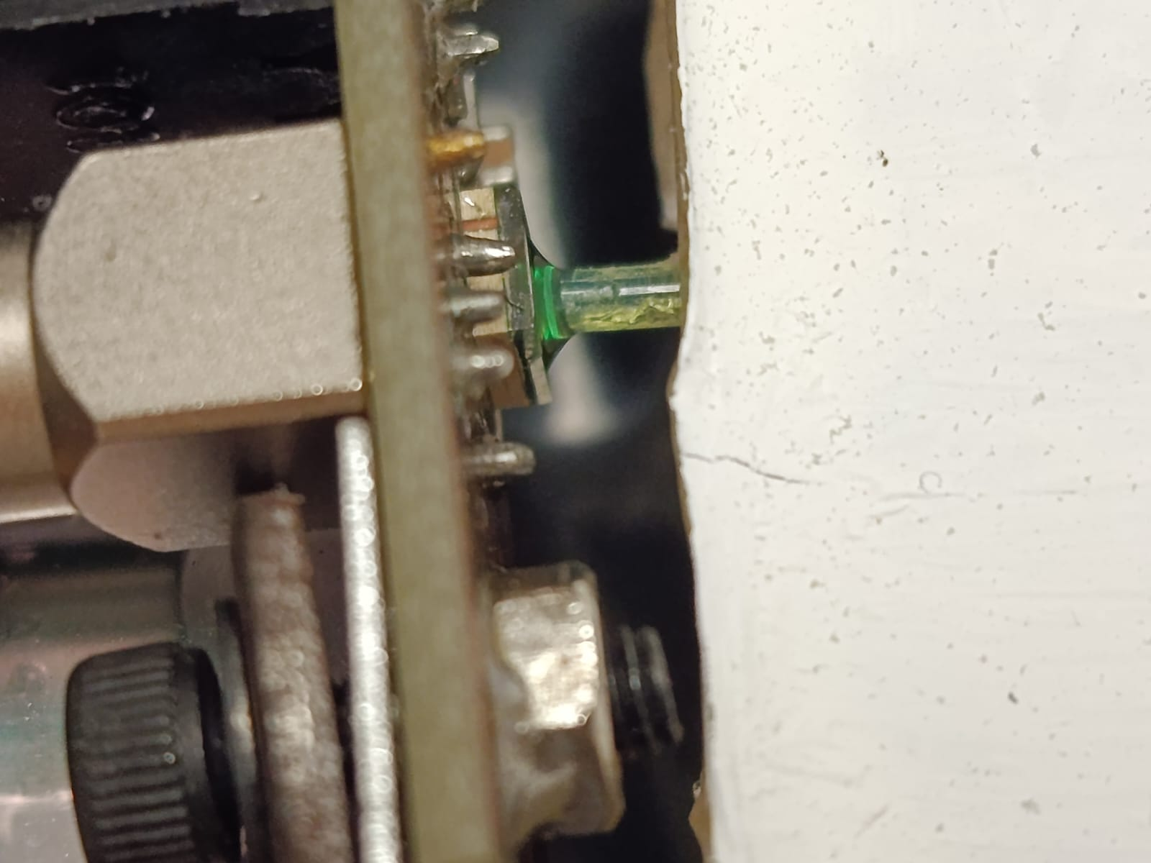
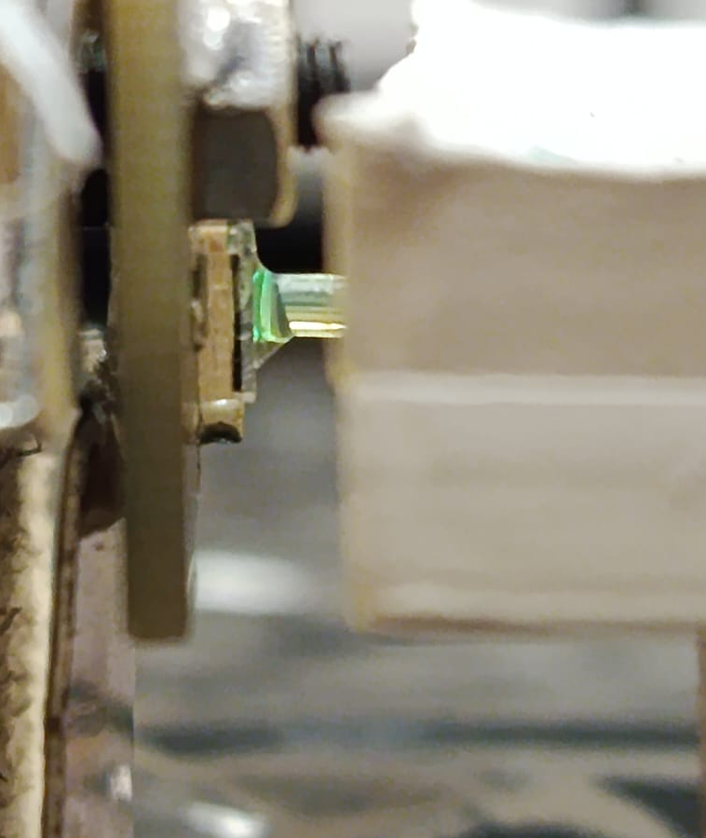
Cosmic run with silicon detector and WLS
Fiber Y11: Peak absorption 430 nm
Peak emission 476 nm
Attenuation length 3.5 m

Slide 12
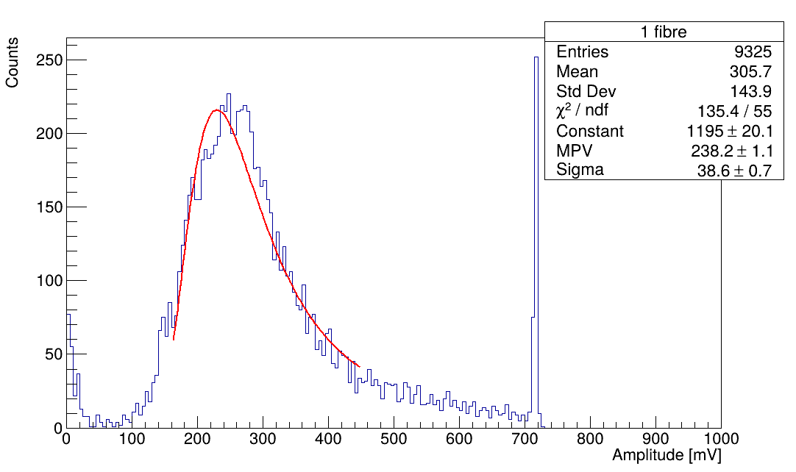
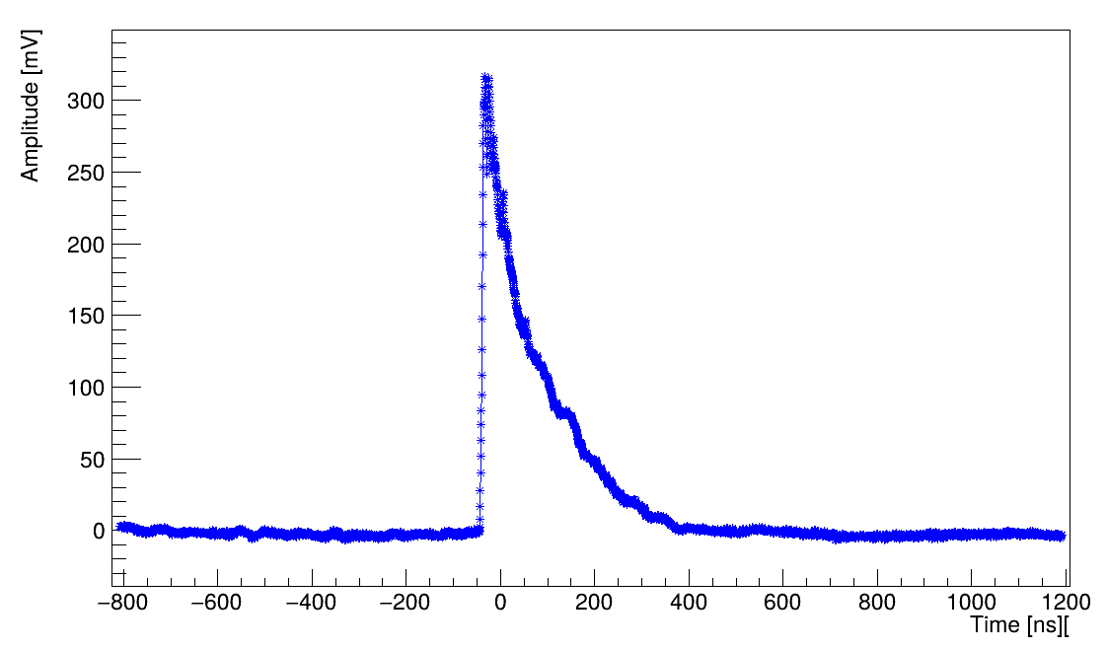
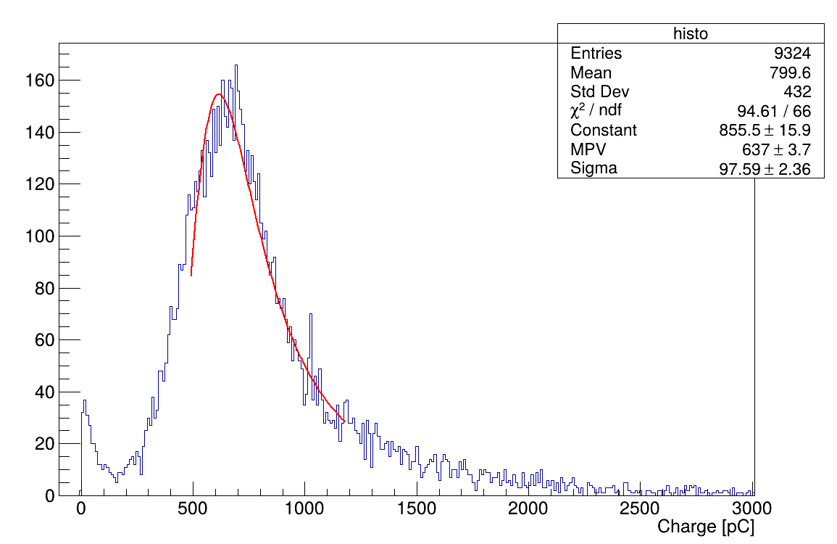
Cosmic run results

Slide 13
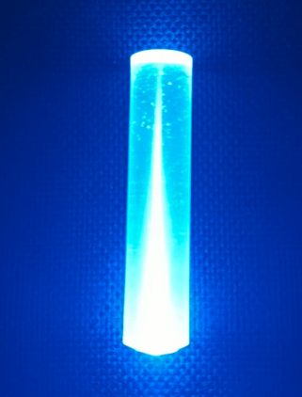
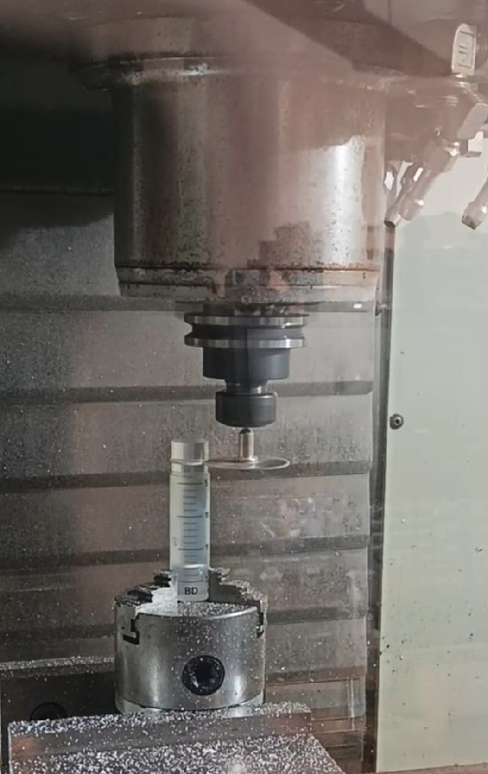
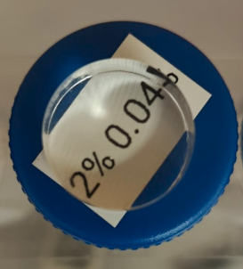
Polyurethane samples: Materials from theUSA

Slide 14
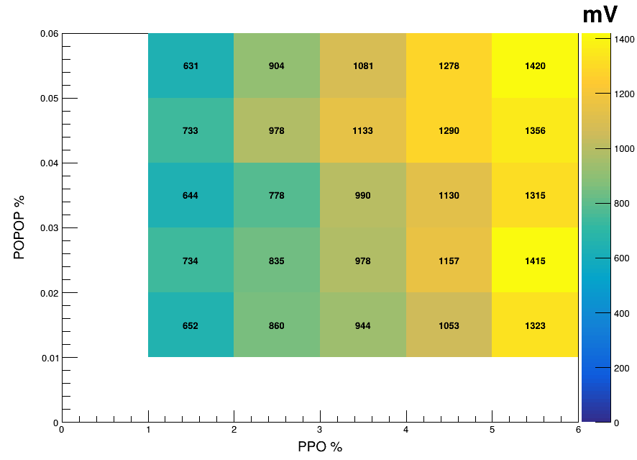
Results from cosmic runs

Slide 15
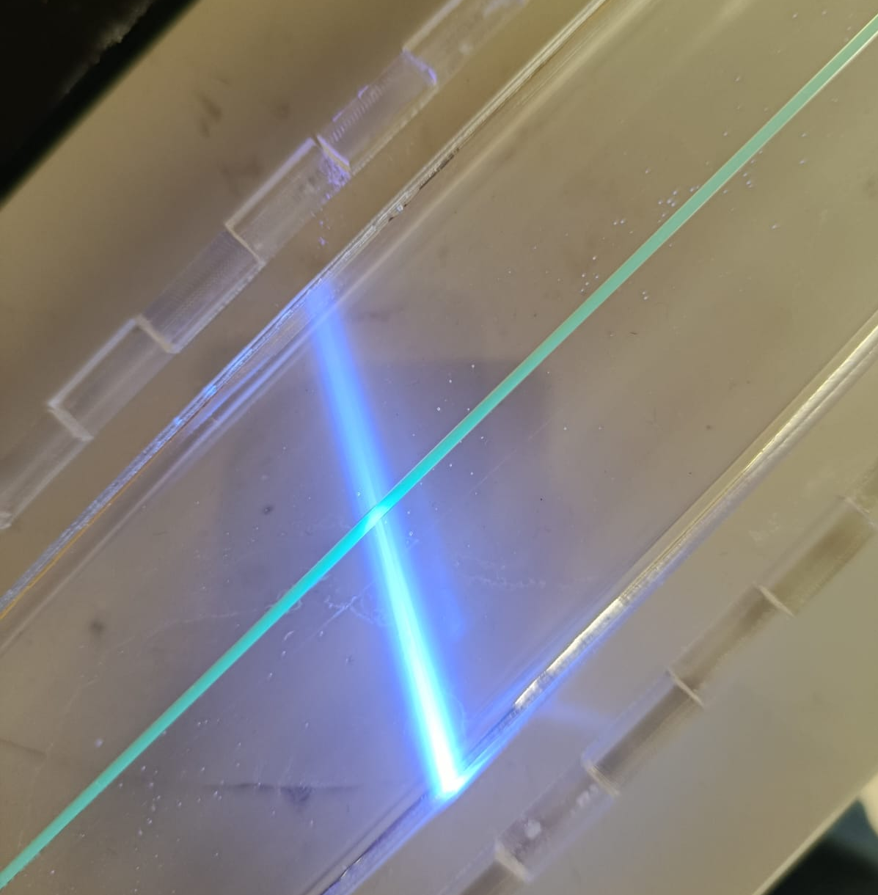
First bar produced PPO 5%, POPOP 0.02%

Slide 16
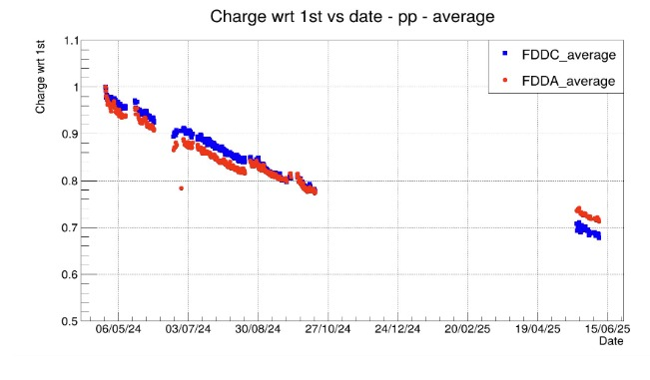
Aging in FDD: Data from proton-proton collisions

Slide 17
Plans
For the new bar we will start a cosmic run to measure the number of photoelectrons per MIP.
In June, there is a campaign to irradiate the best samples at 10, 100 and 300 krad and at 1, 5 and 10 Mrad. This irradiation will take place at CERN IRRAD proton irradiation facility
We will start producing 2 modules for the MID.

Slide 18
Thank you

