Slide 1

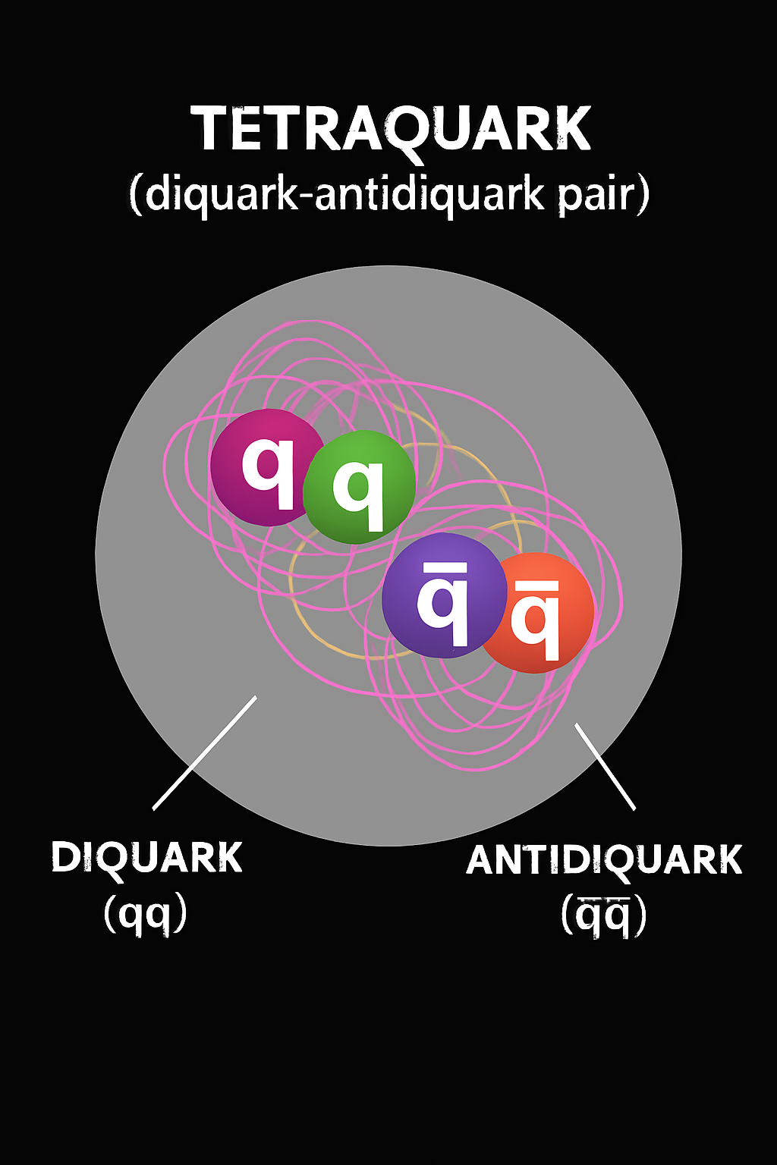

Tetraquarks insights from a contact interaction: The diquark approach
XIX Workshop on Particles and Fields
Leon, Guanajuato
Marco Antonio Bedolla Hernández
marco.bedolla@unach.mx
October 23, 2025

Slide 2
What is a tetrquark?
Is it forbidden by the theory?

Slide 3
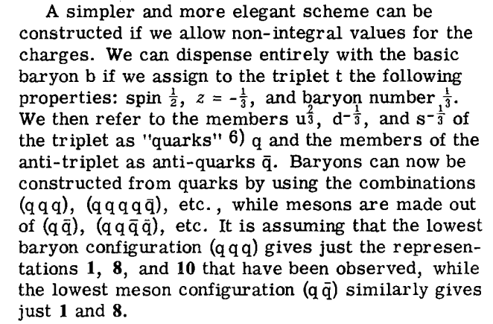
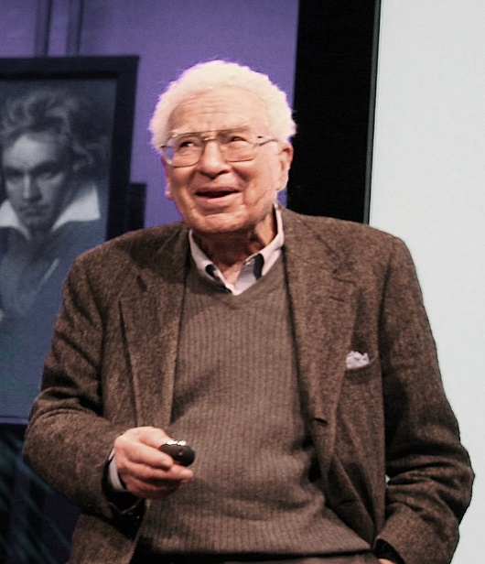
Quark Model
Providing spin and baryon number to quarks, it is possible to build mesons and baryons.
In 1964, M. Gell-Mann described the rules on how quarks could combine.
Murray Gell-Mann in 2007
Gell-Mann, M. (4 January 1964). "A Schematic Model of Baryons and Mesons". Physics Letters. 8 (3): 214–215.
There is not any mechanism that forbids the existence of hadrons with four or more quarks… just the experimental evidence…

Slide 4
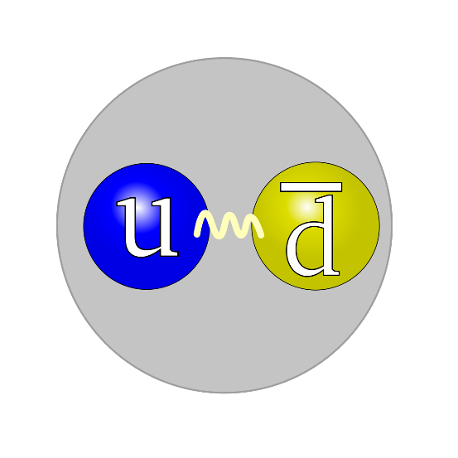
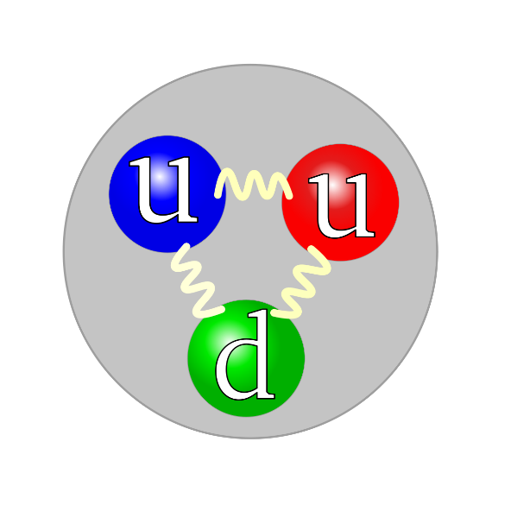
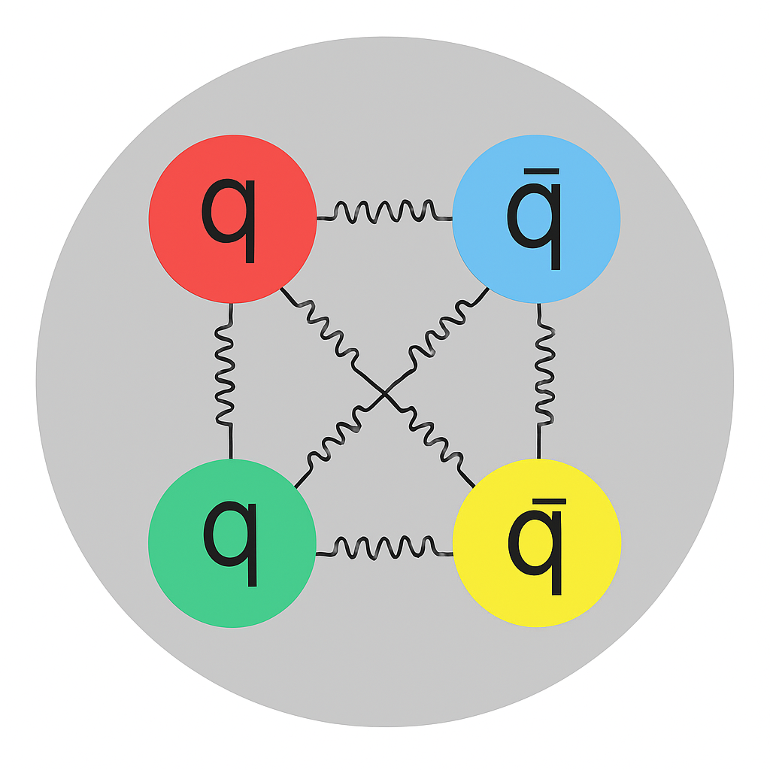
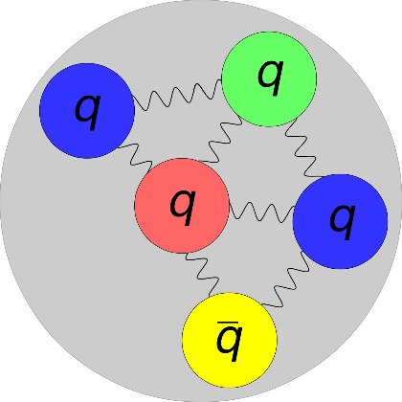
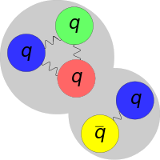
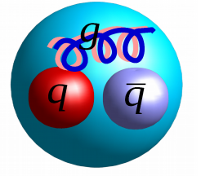
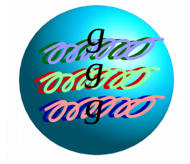
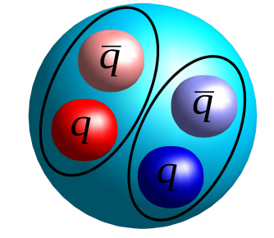
In hadron physics, we study strong interactions and their bound-states. Up to date we have
Mesons and barions
Pentaquarks
Tetraquarks
Hybrids & glueballs
Mesonic Molecule
Baryon-Meson Molecule

Slide 5
A really short history of tetraquarks
The first mention of a multiquark (tetraquark) state was in 1976.
R.L. Jaffe Phys. Rev. D15, 267 (1977);
R.L. Jaffe Phys. Rev. D15, 281 (1977);
Here, Jaffe used a modified version of the MIT Bag Model to study a meson-meson molecule bound-state
In 2004, Maiani et al. saw the possibility that scalar mesons might be tetraquarks candidates.
L. Maiani et. al. Phys. Rev. Lett. 93, 212002 (2004);
L. Maiani et. al. Phys. Rev. D71, 014028 (2005);
They use a diquark-antidiquark approach a study a possible quarks decay that could lead to a meson-meson molecular bound-state.
Have tetraquarks ever been detected?
Notes:
Lamentablemente, estos fenómenos no son obvios de lagrangiano de QCD. Sin estos QCD sería igual que QED, pero las interacciones entre tres y cuatro gluones estos fenómenos bastante interesantes

Slide 6
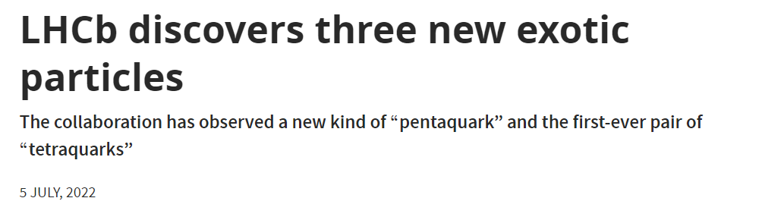
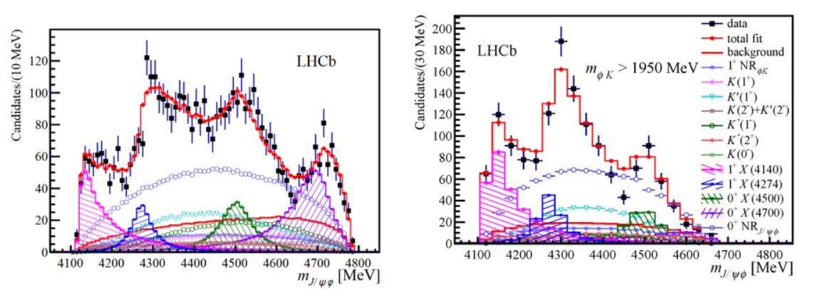
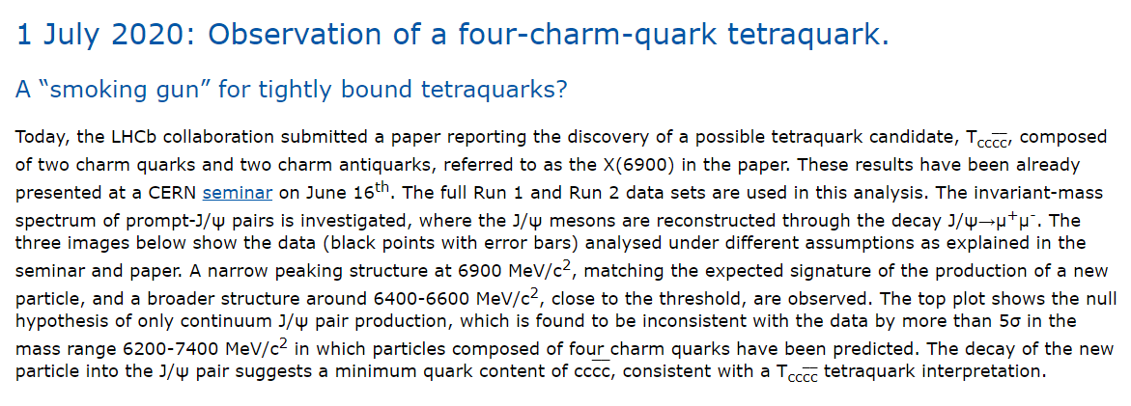

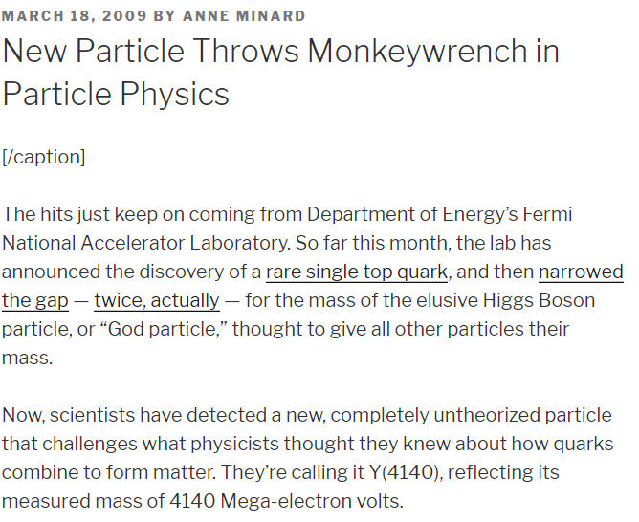
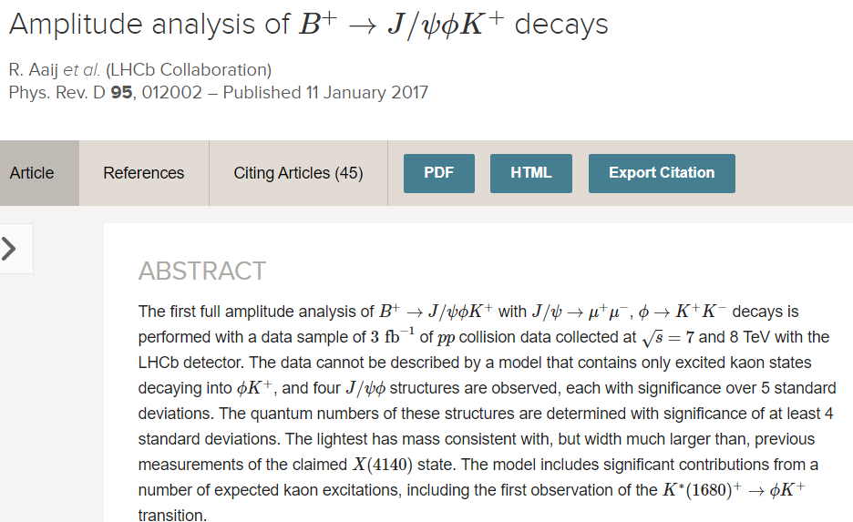
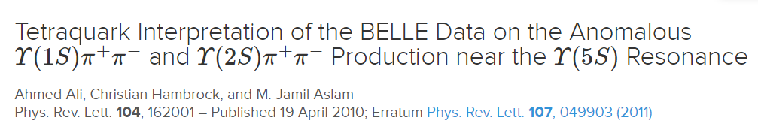
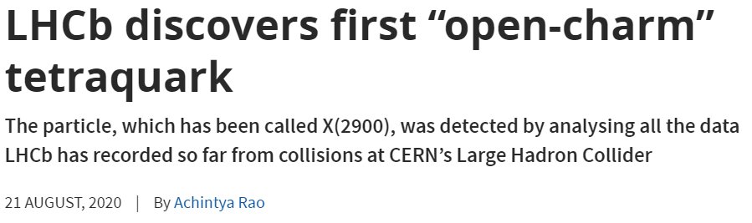

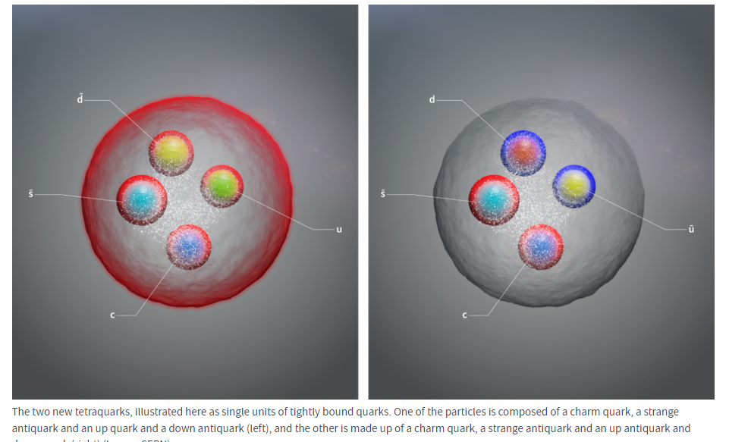
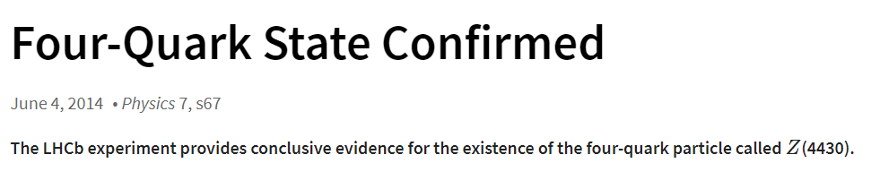
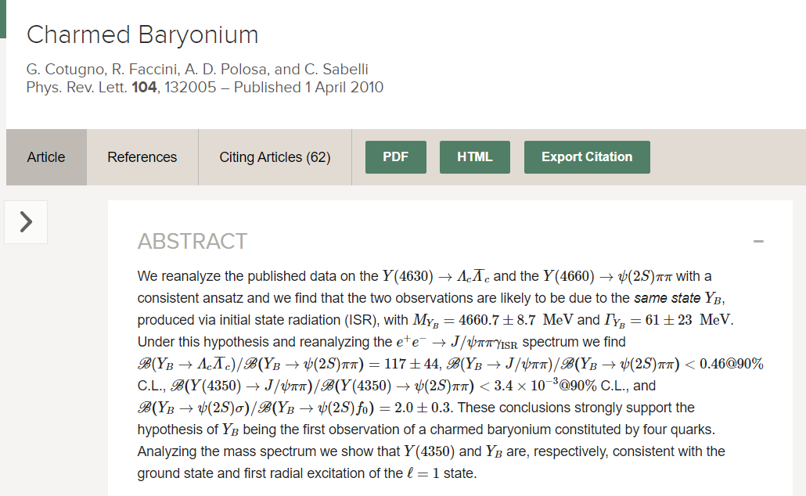
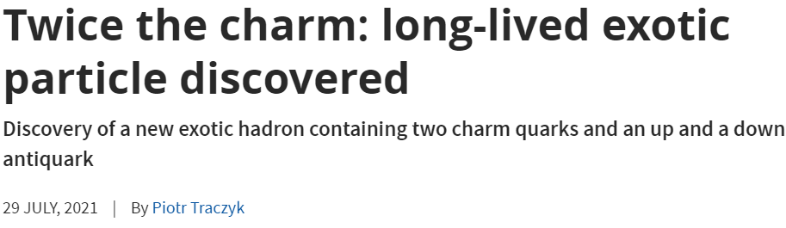
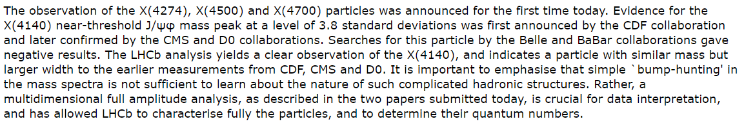
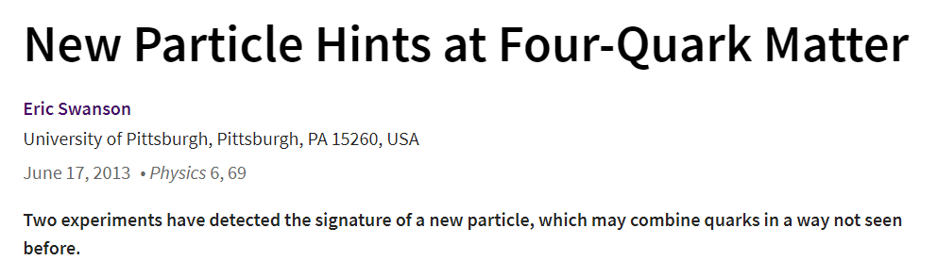

Slide 7
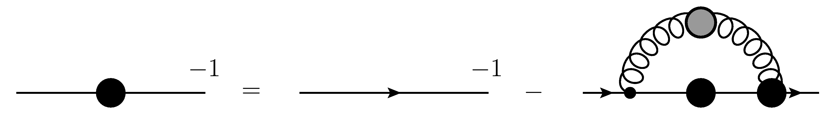

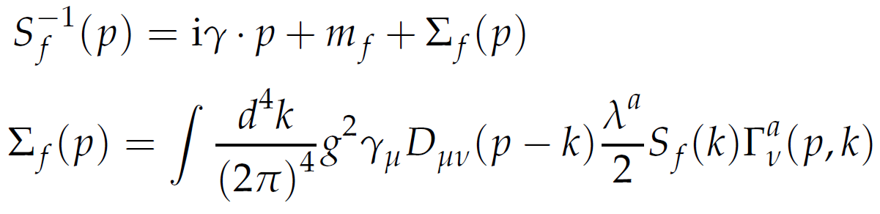
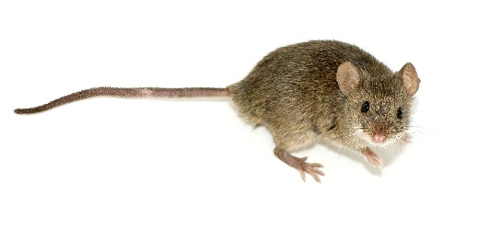
The Framework: Dyson-Schwinger Equations
Quark SDE:
Mathematical expression:
Notes:
El propagador vestido del quark se escribe como el propagador desnudo más los términos de autointeracción. Aquí tenemos las correcciones al propagador del quark, las correcciones al vértice y las correccones al propagador del gluón

Slide 8
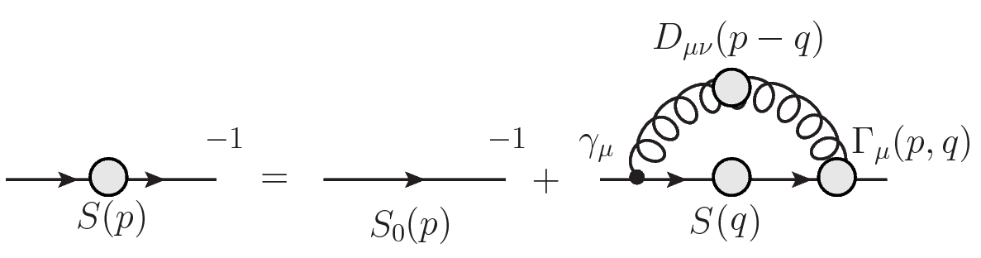
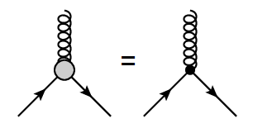
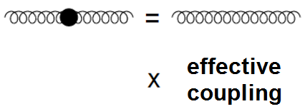
The Framework: Dyson-Schwinger Equations
In order to solve the SDE, we employ a truncation scheme:
Rainbow truncation:
Notes:
La ecuación de Schwinger-Dyson no se puede resolver hasta que se define un problema manejable. Para ello se hace un modelo para el gluón, donde por lo general se considera el gluón libre multiplicado por un acoplamiento efectivo que reuna las propiedades de QCD. Al mismo tiempo para el vértice, donde usualmente se toma el vértice desnudo. Nosotros las truncamos a primer orden. Y los efectos de QCD se incluyen en el acoplamiento efectivo.

Slide 9
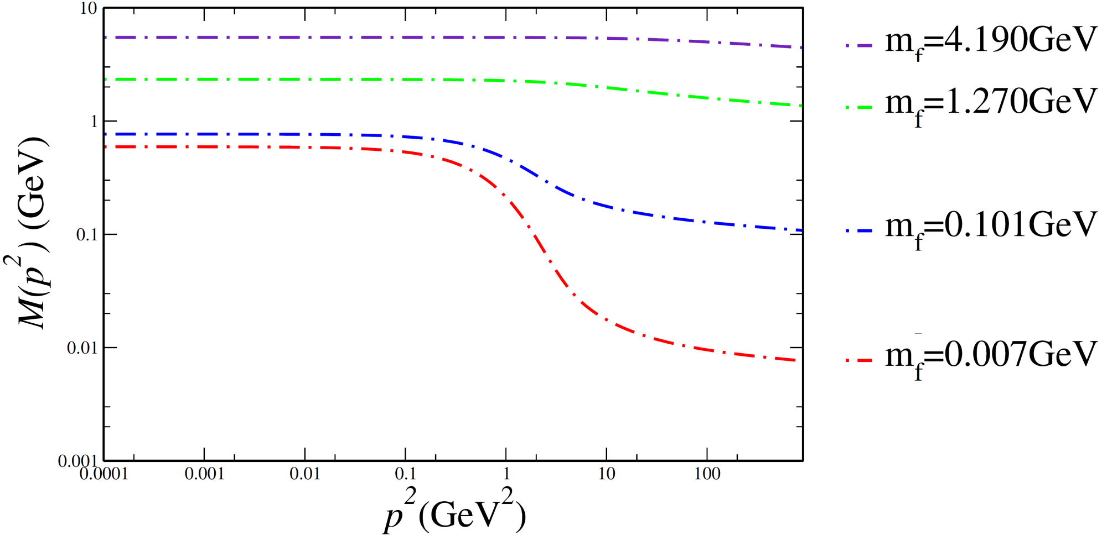
The Framework: Dyson-Schwinger Equations
P. Maris and P. C. Tandy Phys. Rev. C60, 055214 (1999)
Notes:
Mientras más pequeña es la masa, los efectos de las autointeracciones influyen más en la adquisición de masa dinámica del quark, los quarks pesados no sienten tanta influencia. Dicho de otra manera, los quarks pesados no se ven afectados por la masa del gluón

Slide 10
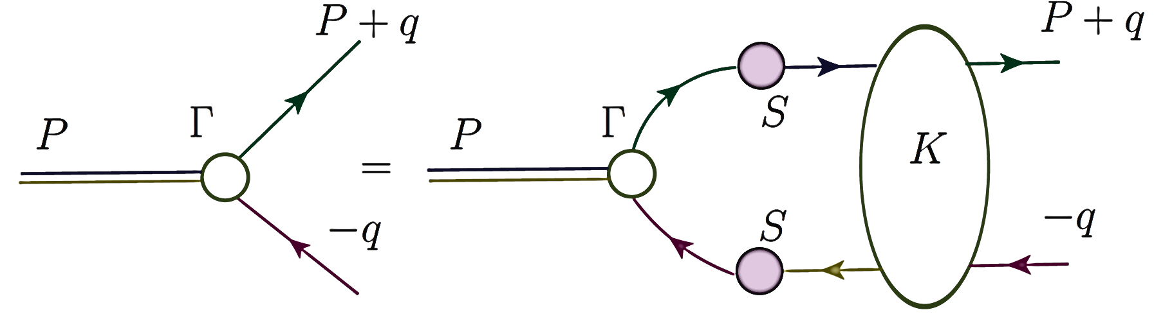
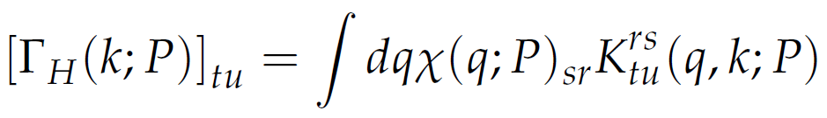
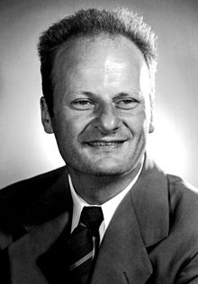


The Framework: Bethe-Salpeter Equation
A meson (diquark) appears as a pole in the quark-antiquark (quark-quark) Green function → Bethe-Salpeter Equation. In order to compute diquark mass, there is a factor a ½ due to the color factors.
E. E. Salpeter Phys. Rev. 84, 1226 (1951)
E. E. Salpeter and H. A. Bethe Phys. Rev. 84, 1232 (1951)
Notes:
Quarks and gluons are not free– This makes QCD unique: the elementary constituents are not the asymptotic states of the theory.

Slide 11
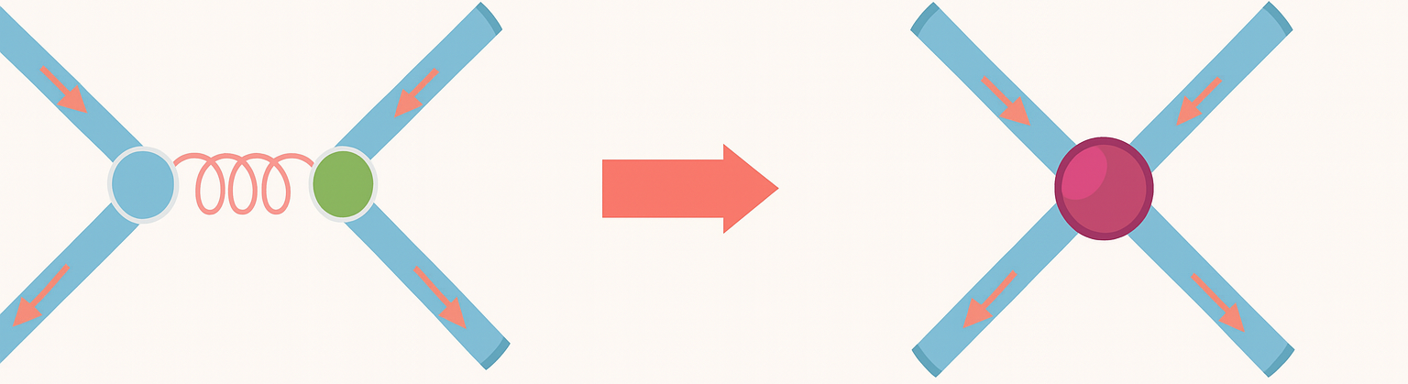
How do we implement a contact interaction in this framework?
We use a contact interaction model mediated by a vector-vector interaction employed in:
L. Xiomara Gutiérrez, et. al., Phys. Rev. C81, 065202 (2010);
H.L.L Roberts, et. al. Phys. Rev. C82, 065202 (2010);
Phys. Rev. C83, 065206 (2011).
This model provides a simple scheme to exploratory studies of the spontaneous chiral symmetry breaking and its consequences like:
  Dynamical mass generation.
  Quark condensate.
  Goldstone bosons in chiral limit.
  Confinement.
Notes:
It a model which is independent of relative momentum
En el segundo se calcula para el meson rho

Slide 12
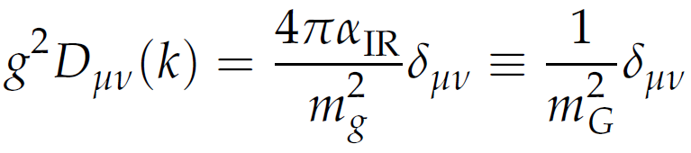


How do we implement a contact interaction in this framework?
We use a contact interaction model mediated by a vector-vector interaction employed in:
This model provides a simple scheme to exploratory studies of the spontaneous chiral symmetry breaking and its consequences like:
  Dynamical mass generation.
  Quark condensate.
  Goldstone bosons in chiral limit.
  Confinement.
Notes:
It a model which is independent of relative momentum
En el segundo se calcula para el meson rho

Slide 13
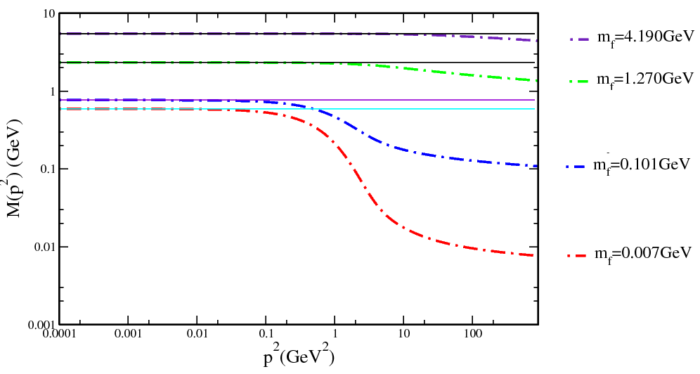
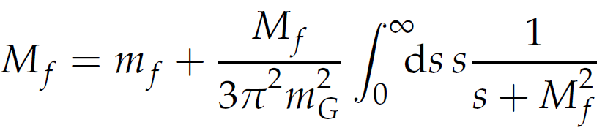
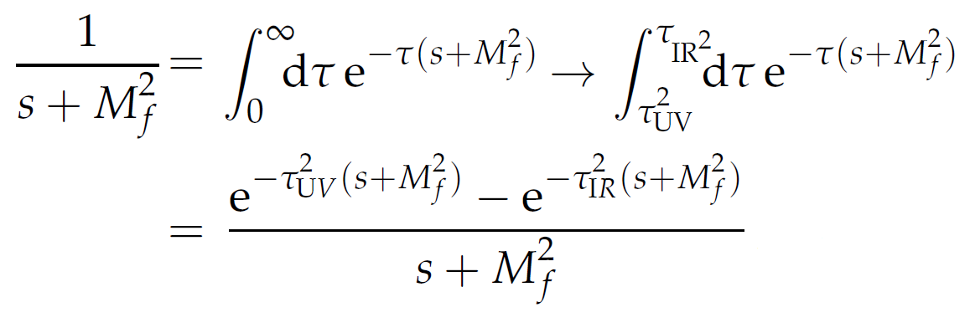
How do we implement a contact interaction in this framework?
Mass function:
Proper time
regularization:
The constant τ_{UV} is the regulator since the model is not renormalizable and cannot been removed. This regulator plays a dynamical role and sets the scale of dimensioned quantities.
A non zero value of τ_{IR} implements confinement by ensuring the absence of quark production threshold at s=-M²_{f} .
Notes:
Tau ir diferente de cero implementa confinamiento al eliminar el polo, tau uv es el regulador, no puede ser eliminado pero juega un rol dinámico y ajusta la escala para nuestras dimensiones

Slide 14
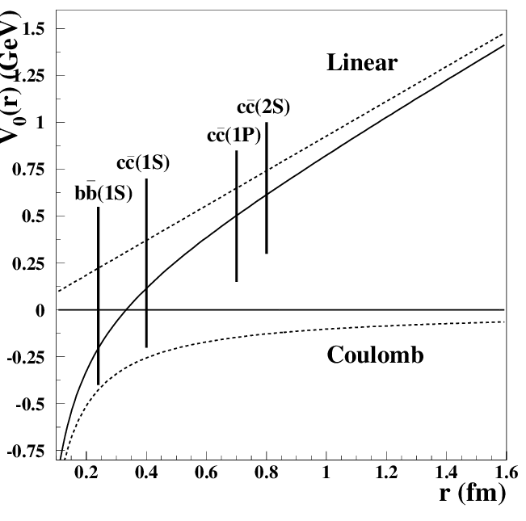
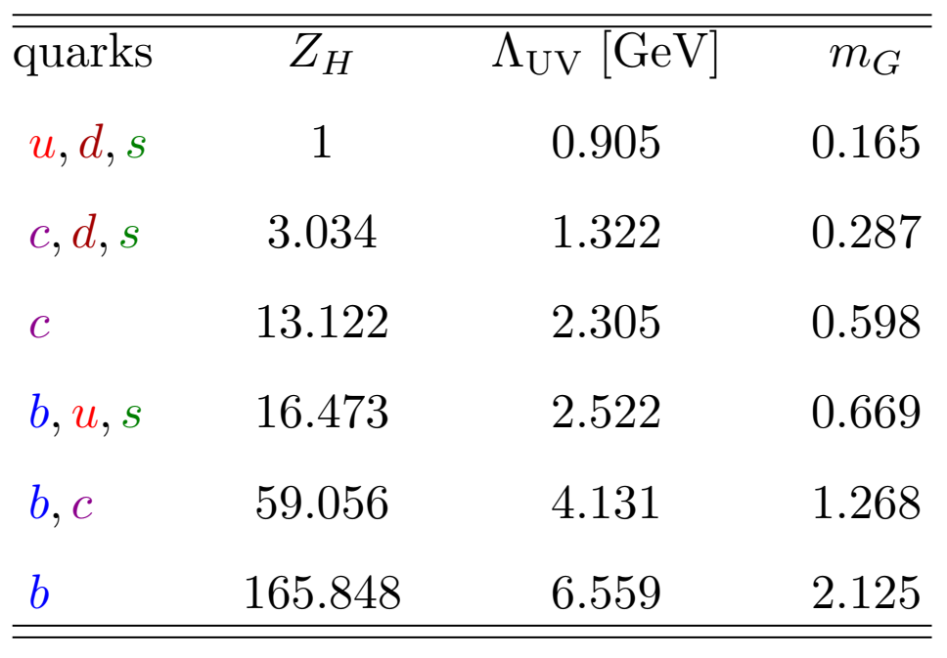

How do we implement a contact interaction in this formalism?
E. Eichten, K. Gottfried, T. Kinoshita, J. B. Kogut, K. D. Lane and T. M. Yan,
Phys. Rev. Lett. 34, 369-372 (1975).
We adjust the parameters fitting to the pseudoscalar meson for each set of quarks.
S Kamal,
10.1051/epjconf/20100307006
Notes:
Tau ir diferente de cero implementa confinamiento al eliminar el polo, tau uv es el regulador, no puede ser eliminado pero juega un rol dinámico y ajusta la escala para nuestras dimensiones

Slide 15
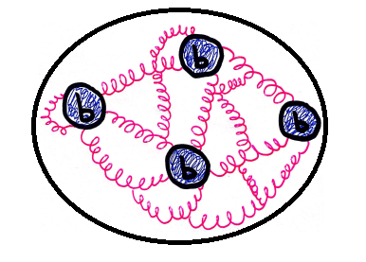
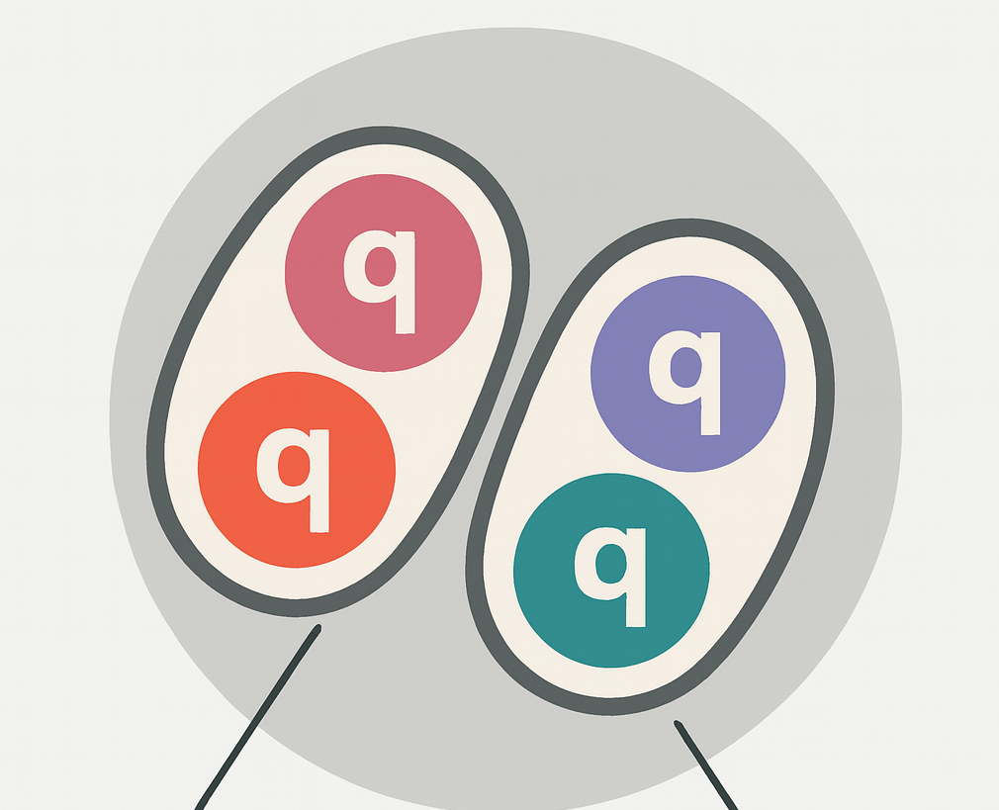




How we study tetraquarks
Some studies treat tetraquarks via a quark-exchange model interaction.
However, this kind of interaction promotes the mesonic molecule bound-state interpretation.
We should not forget that a quark-quark(diquark) bound-state has color too…
And then we can bound a diquark and an antidiquark to form a tetraquark via gluon exchanges… in the same way we form mesons as a quark-antiquark pair.
Today, there are several theoretical studies to predict the main quantum numbers of tetraquarks, this helps to guide the energy region where they could be.
Notes:
It a model which is independent of relative momentum
En el segundo se calcula para el meson rho

Slide 16


Tetraquarks in the Diquark model
M.A. Bedolla, C.D. Roberts, E. Santopinto and J. Ferretti Eur.Phys.J.C 80 (2020) 11, 1004
M.A. Bedolla, Few-Body Syst (2019) 60: 24.
In this model, a tetraquark is seen as a point-diquarks bounded with a point-antiquark.
Because diquarks have color, they are confined particles.
Two diquarks can couple in a color-antisymmetric-triplet, or in a color-symmetric sextet
Color sextet lead to repulsive interactions. Thus, color-antitriplet diquarks are the only possibility to form bound-states
A diquark in its bound state is S-wave, so it spin is 0 or 1 .
To study scalar tetraquarks, Fermi-Dirac statistics only allows spin-1 diquarks couple to form flavor-singlet tetraquarks
Notes:
It a model which is independent of relative momentum
En el segundo se calcula para el meson rho

Slide 17
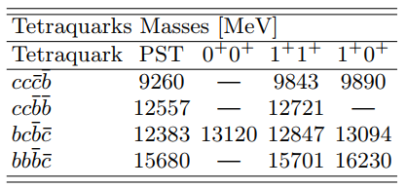
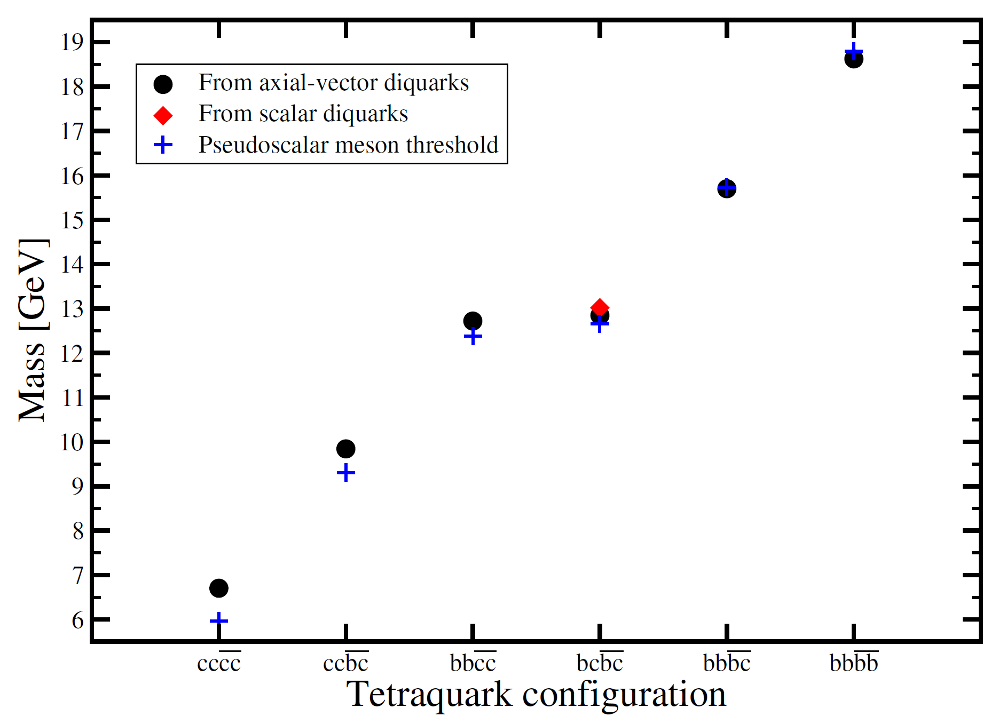
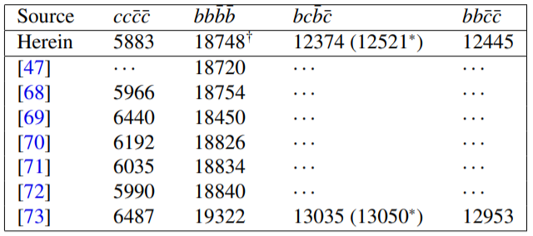
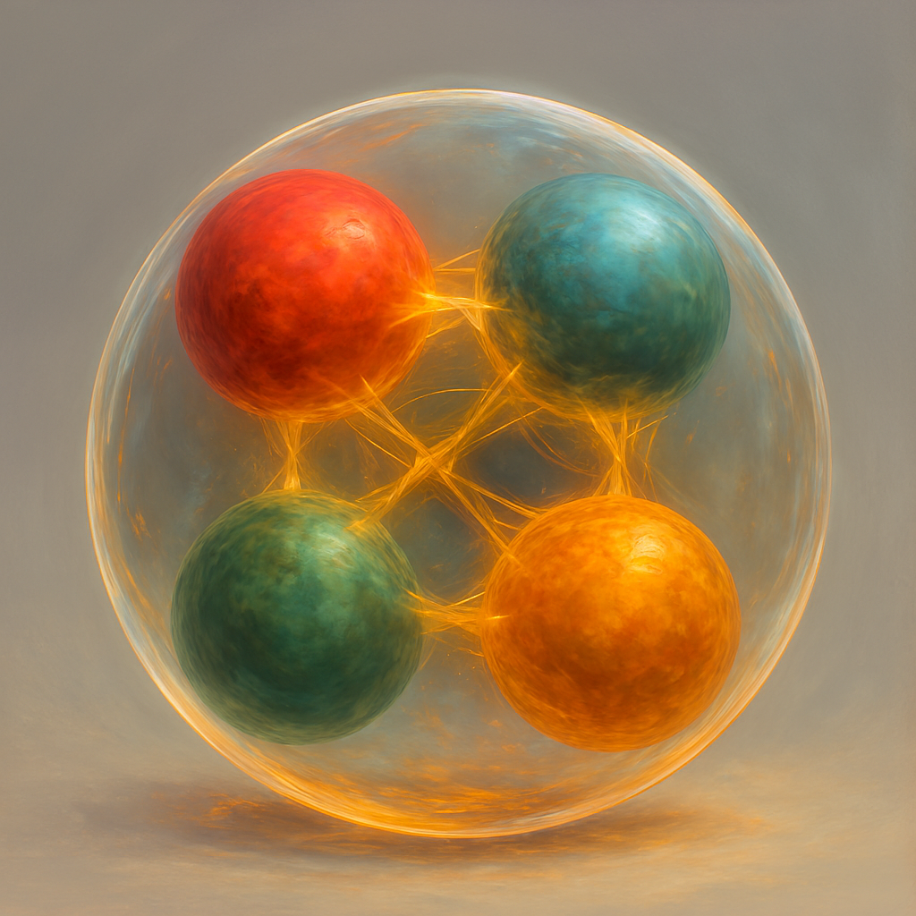
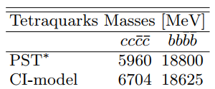
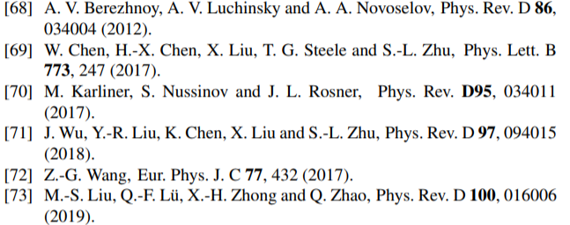
Tetraquarks in the contact interaction
M.A. Bedolla, E. Santopinto and J. Ferretti, in preparation
M.A. Bedolla, C.D. Roberts, E. Santopinto and J. Ferretti
Eur.Phys.J.C 80 (2020) 11, 1004
M.A. Bedolla, Few-Body Syst (2019) 60: 24.
Notes:
It a model which is independent of relative momentum
En el segundo se calcula para el meson rho

Slide 18
Final Remarks
Since 2004, there have been some tetraquarks candidates, most of them in the last three years.
We consider that more tetraquarks will be detected as the energy of accelerators increases.
In particular, the recent LHCb upgrade to 13.6 TeV (July this year) increases the possibility of creating and detecting new particles.
We study tetraquarks by considering a diquark-antidiquark picture via gluon exchange… in the same way mesons can be studied.
We expect our results to be close to the future detected heavy tetraquarks-particles
We are developing an scheme to study tetraquarks in the Bethe-Salpeter Schwinger-Dyson equation approach to study heavy-light tetraquarks.

Slide 19


