Slide 1
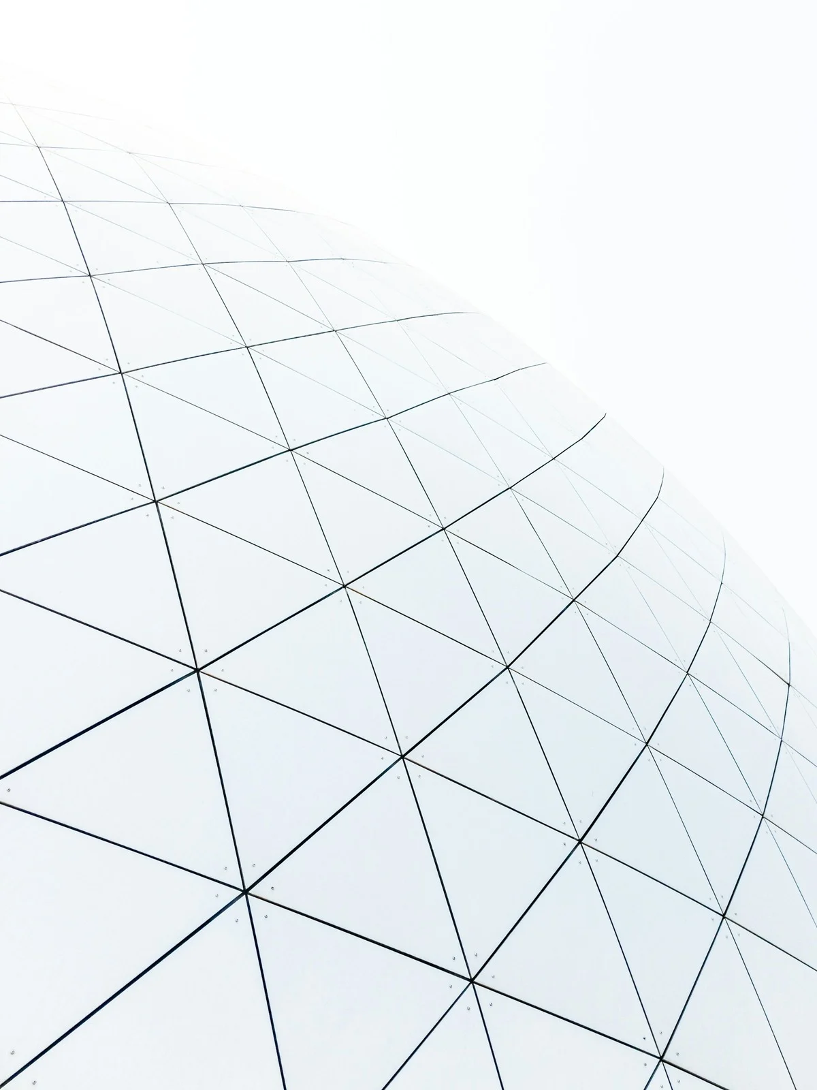


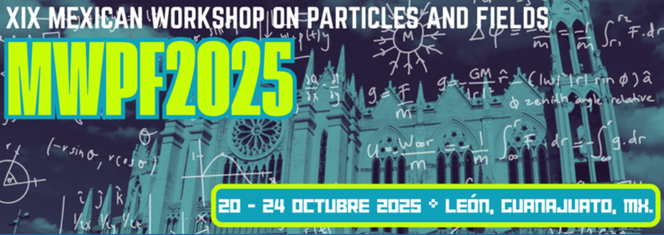

Science Without Borders:
The Mexican Contribution to Global Particle Accelerator Initiatives
Karla Beatriz Cantún Avila

Slide 2
Outline
Introduction
Beginning
International presence
Closing with: Members opinions

Slide 3
A particle accelerator physicist
is a scientist who specializes in designing, operating, and studying particle accelerators—machines that accelerate charged particles (like electrons, protons, or ions) to very high speeds for research and practical applications.

Slide 4
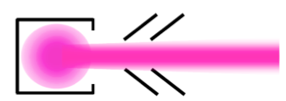
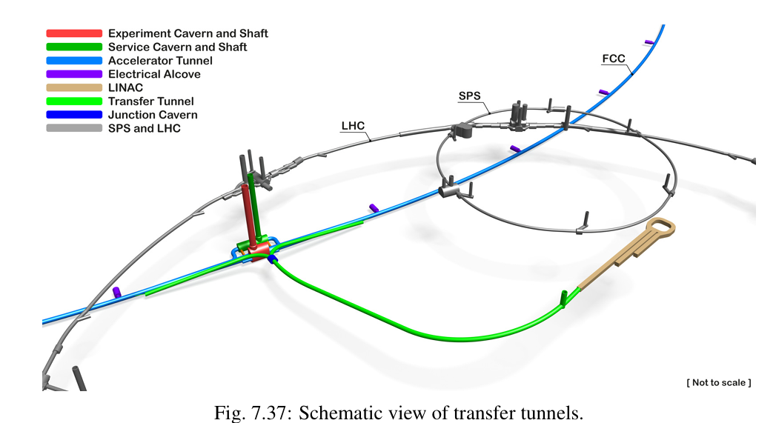
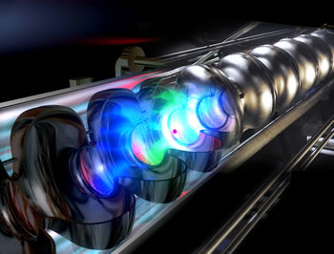
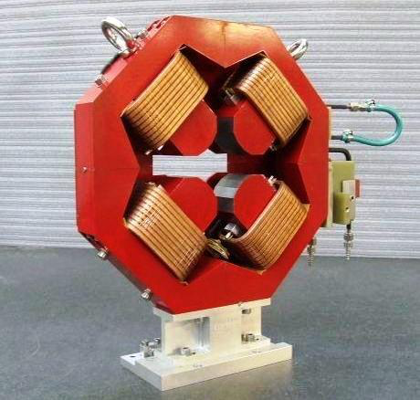
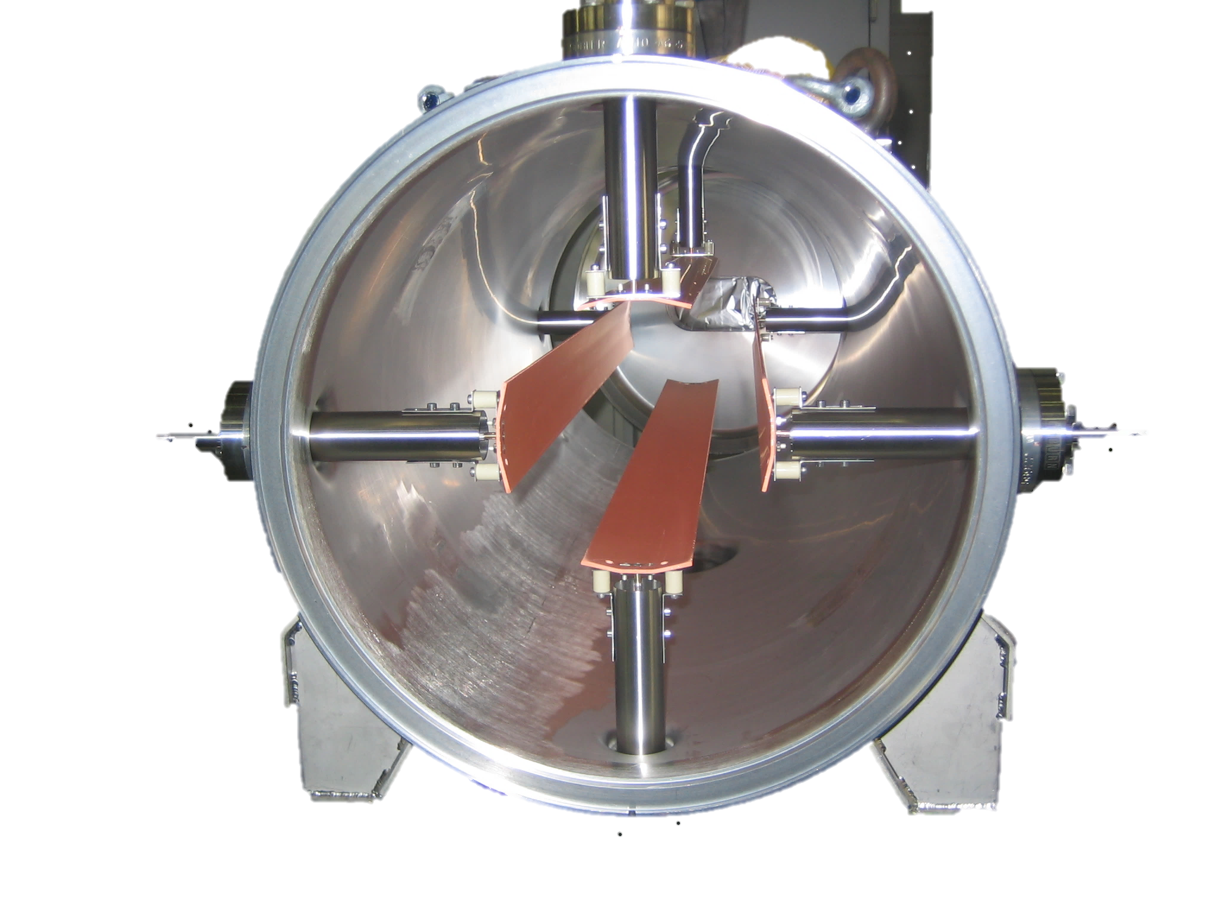
Particle accelerators
Beam source
Accelerator structures
Magnets
Vaccum Chamber
Instrumentation
FCC Feasibility Study Report, Vol 2, 2025

Slide 5







FCC-ee Injector Complex
Lepton transfer
line:
Source
LINAC
Damping ring
HE LINAC
injector tunel
booster
collider
FCC Feasibility Study Report, Vol 2, 2025

Slide 6
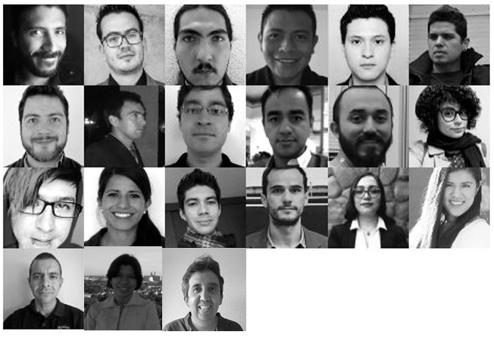
Mexican Community for Particle
Accelerators CMAP
To promote and develop the area of particle accelerators in México and around the world.

Slide 7
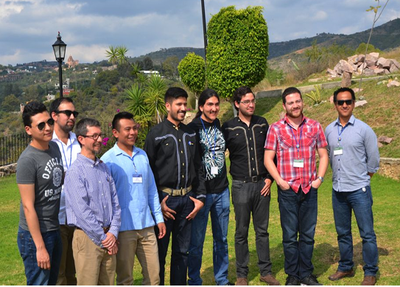
2015
Founded ten years ago by nine visionary individuals who understood the importance of building collaborative ties to ensure a promising future for our country.

Slide 8
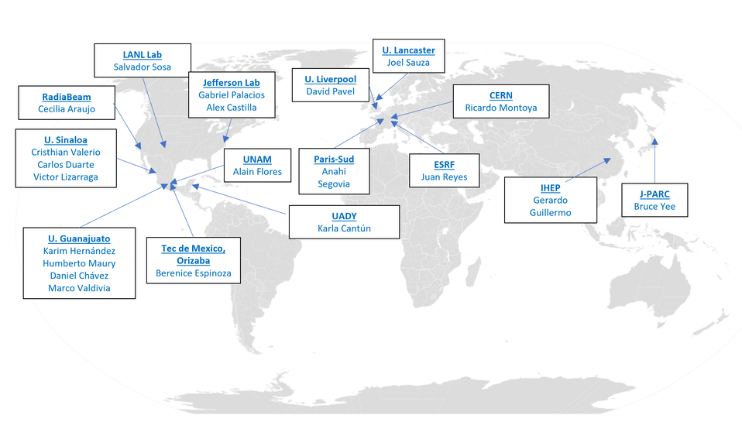
International presence
Today, that vision has become a reality strengthening national and inter-institutional collaborations with a presence in 15 institutions:
  8 in the Americas,
  5 in Europe,
  2 in Asia.

Slide 9
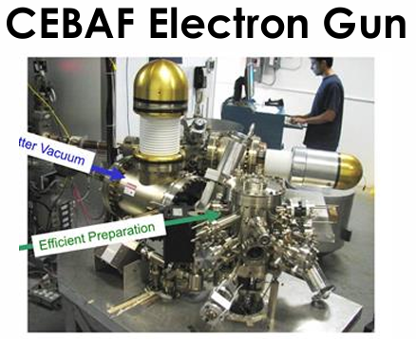
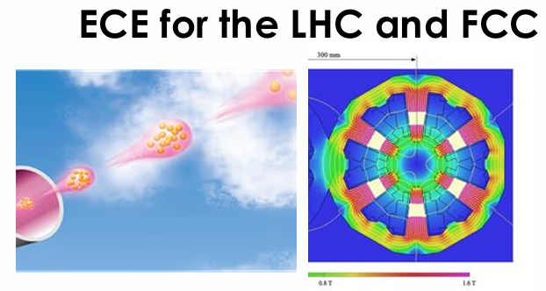
Members expertise
Working groups, academic networks, and training programs have been established through the years.
Our community has diversified its research lines, design and operation of accelerators at several institutions and developing technologies in:
Electron guns
Synchrotron radiation, X-ray optics
Superconducting systems
Beam dynamics and RF cavities design
Development and simulation of RF systems
Studies to mitigate the electron cloud

Slide 10
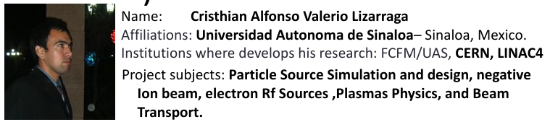
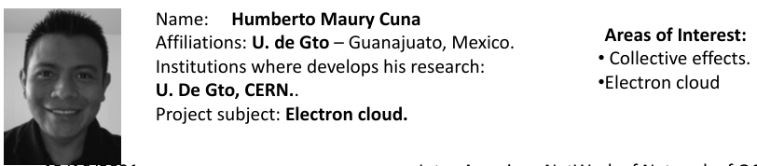
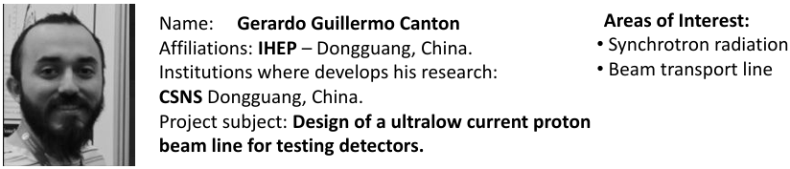
Members expertise over the time
Circular and linear colliders

Slide 11
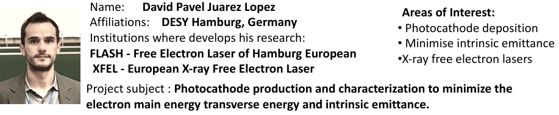
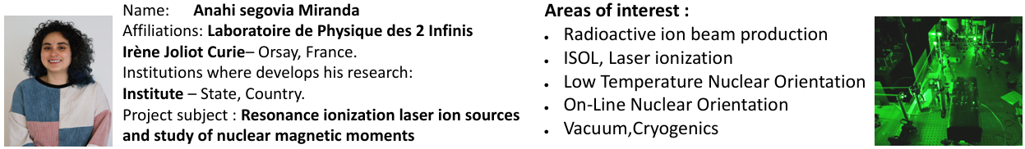
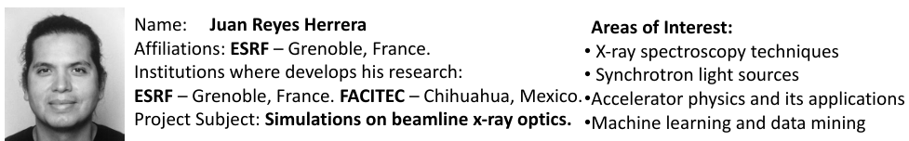
Source and electron accelerators

Slide 12
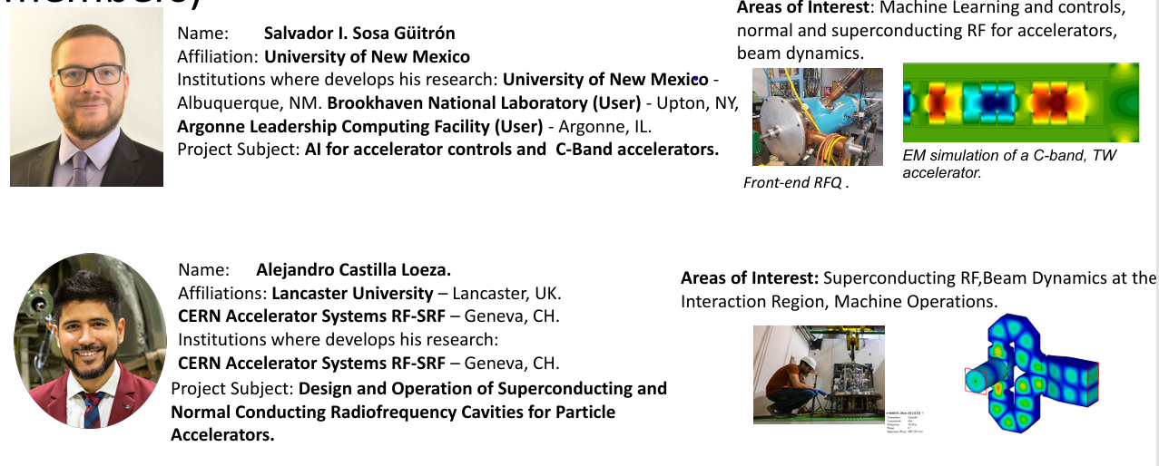
Accelerator technology

Slide 13
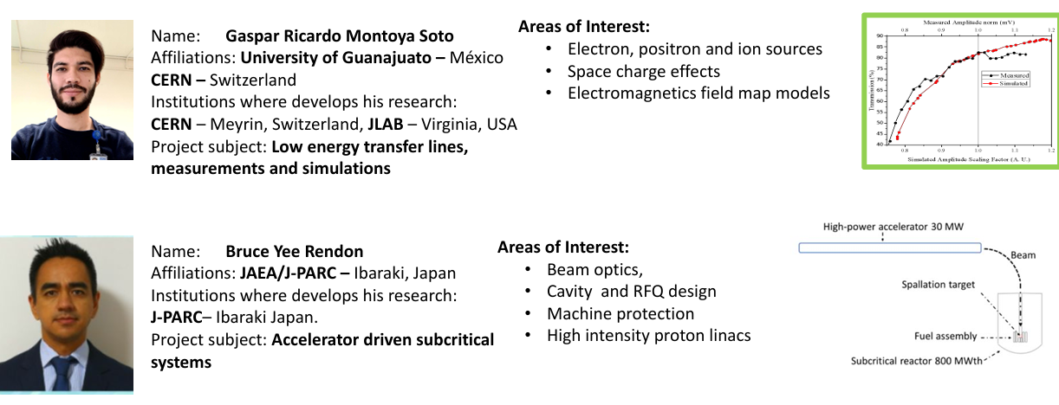
Beam dynamics and EM field

Slide 14
Gerardo Palacios: whith Carlos Hernández García, designed and commissioned the 200 kV polarized electron gun for the CEBAF at the Thomas Jefferson National Accelerator Facility, along with two corresponding 200 keV Wien spin rotors. They were the first in the world to build a feed-through capable of delivering 500 kV to a test electrode.
Juan Reyes: who participated in a project in which we developed a model that can accurately simulate the radiation produced by synchrotron sources (Undulators) for use in ray tracing applications. This model includes several important effects in fourth-generation synchrotron sources, such as electron emittance, energy spread, and diffraction-limited beam size. DOI: https://doi.org/10.1107/S1600577525000190

Slide 15
Alejandro Castilla: Plans for a food irradiation plant in Michoacan. Efforts to install an electron linac for educational purposes at UGTO. MEPAS in all its editions.
Ricardo Montoya: Photo Injector Test Facility at DESY, and for European Organization for Nuclear Research (CERN). Laboratório Nacional de Luz Síncrotron (LNLS), Brazil, and a research stay, Jefferson Lab National Laboratory (JLAB), United States.
Bruce Gee: Professor at J-PARC and ADS in JAEA.
Jesús Jimenes: participated in a project at the KEK lab, where he worked on optimizing the ARES cavity tuning system and developing an automated bead-pull measurement system using a Raspberry Pi. Currently participating in the development of a 1.6-cell cryogenic electron gun, a collaborative project between UCLA and LANL.

Slide 16
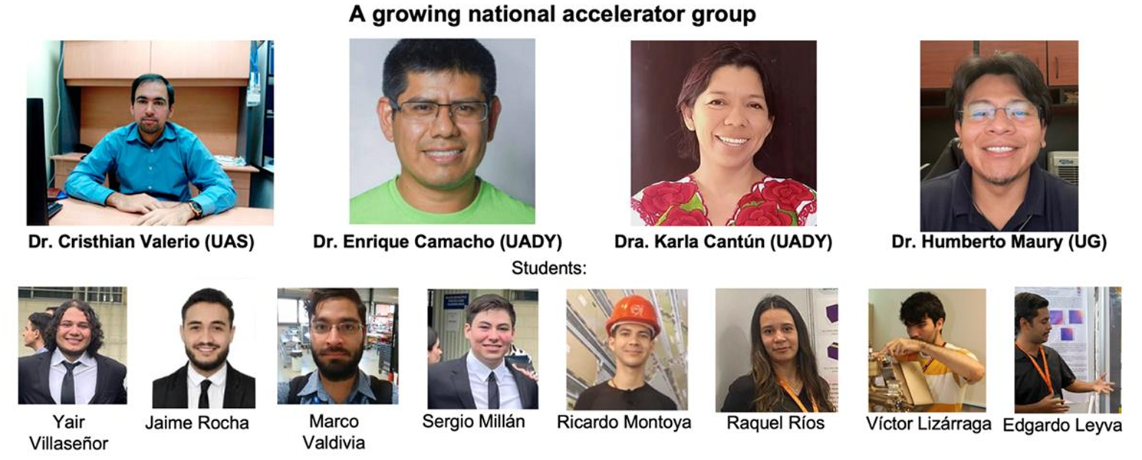
Members residing in the country

Slide 17
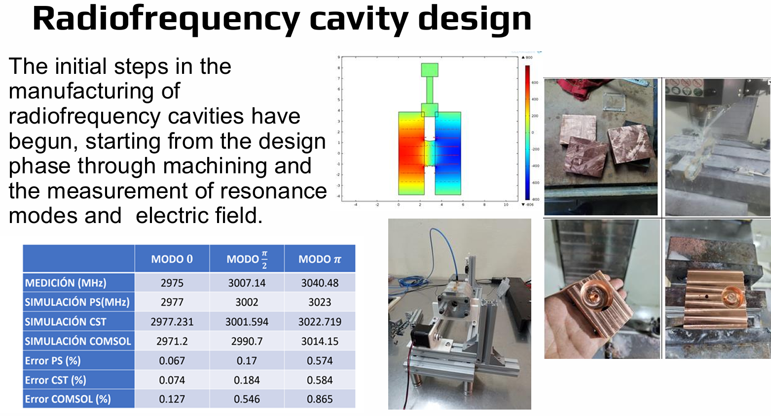

Slide 18
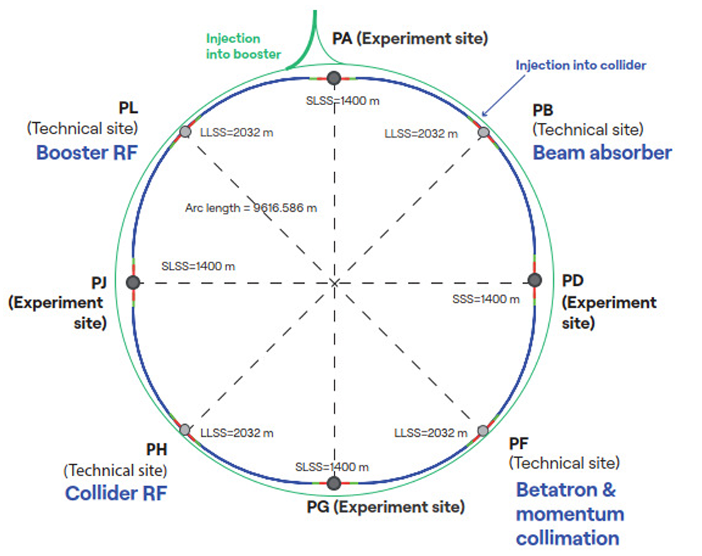
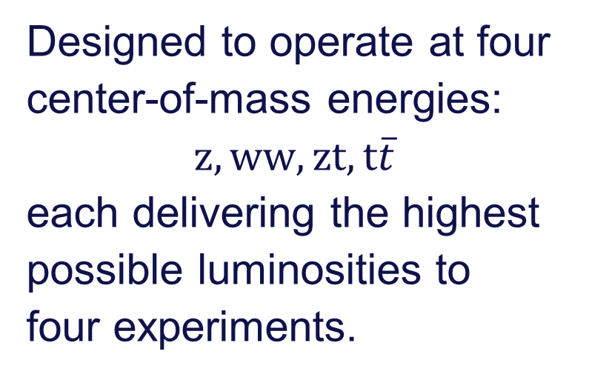
Future Circular Collider
Integrate program:
FCC-ee
Designed to operate at four center-of-mass energies:
$z,ww,zt, t\overline{t}$
each delivering the highest possible luminosities to four experiments.
FCC Feasibility Study Report, Vol 2, 2025
Notes:
The FCC-ee is designed to operate at four key centre-of-mass energies: the Z pole, the WW pair production threshold, the ZH production peak, and the top/anti-top production threshold—each delivering the highest possible luminosities to four experiments

Slide 19
FCC-ee Injector Complex
People in charge of electron cloud studies :
Damping ring - Ozgur Etisken
Booster - Karla Cantún
Collider – Luca Sabato
Collider – Humberto Maury
Lepton transfer
line:
Source
LINAC
Damping ring
HE LINAC
injector tunel
booster
collider
FCC Feasibility Study Report, Vol 2, 2025

Slide 20




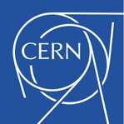

Collaboration Institutes
Brasil:
EE.UU.:
Suiza:

Slide 21
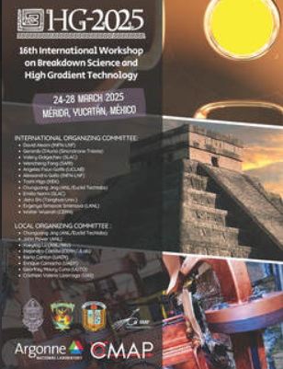

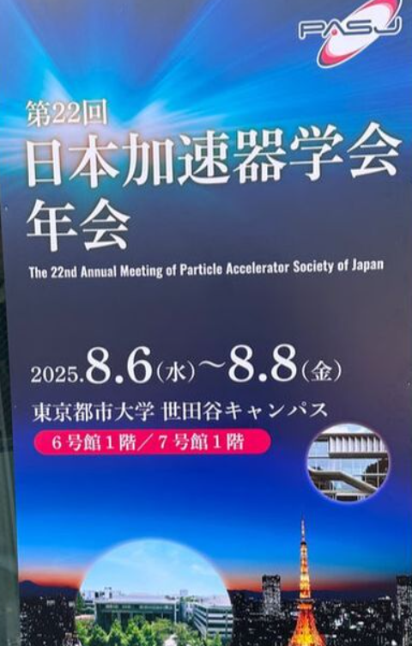
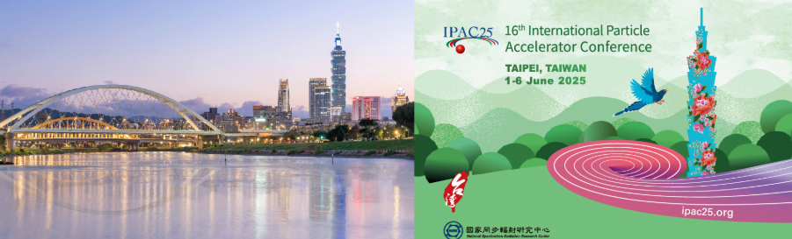
International
Events Participations

Slide 22
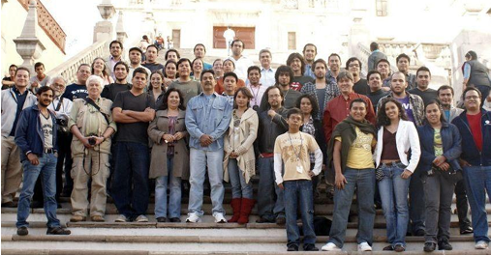
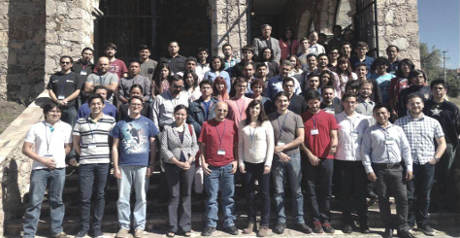
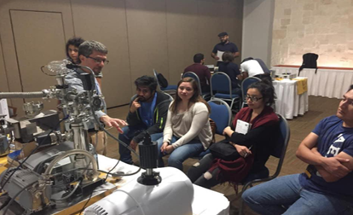
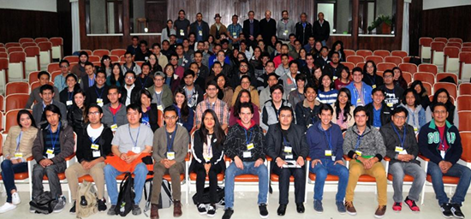
Training the future generations
Mexican Particle Acceleration Schools (MePAs)
  MePAs I (2011) laid the groundwork with strong theoretical lectures
  MePSs II (2015) expanded into diagnostic and machine protection
  MePAs III (2018) targeting a broader students audience with structured evaluations
CMAP – ININ Workshop (2017)
Lectures on theory and principles
Lab visits and practical activities
Hands-on focus: Ion Beam Analysis techniques

Slide 23
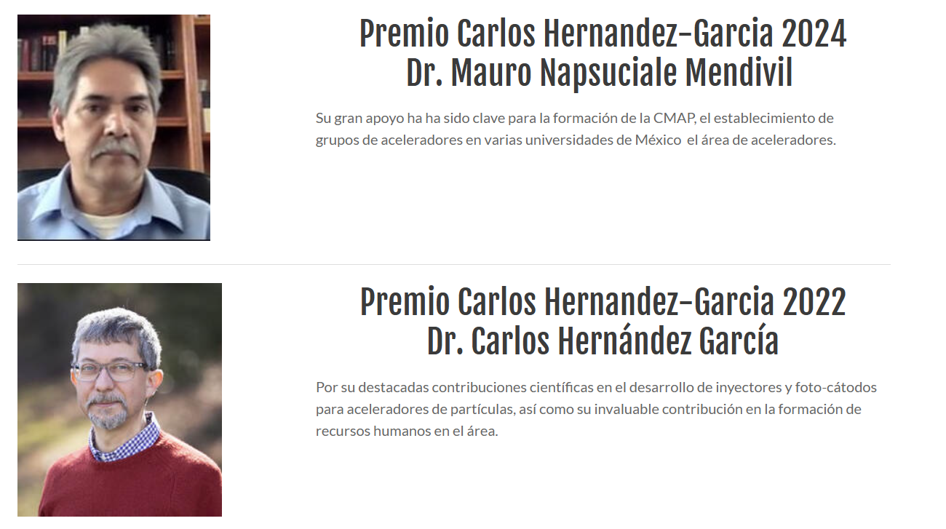
Carlos García Hernández Award
Created to publicly recognize and express our gratitude to those who, throughout their careers, have believed in, supported, and promoted the development of Mexican talent in the field of particle accelerators.
Their contributions have played a vital role in advancing and strengthening this area, both in Mexico and internationally.

Slide 24
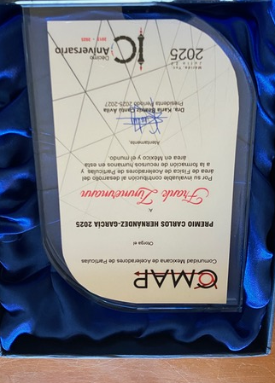
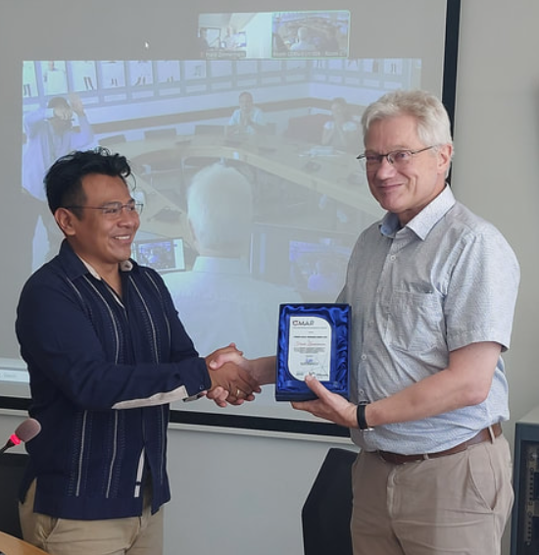

Slide 25
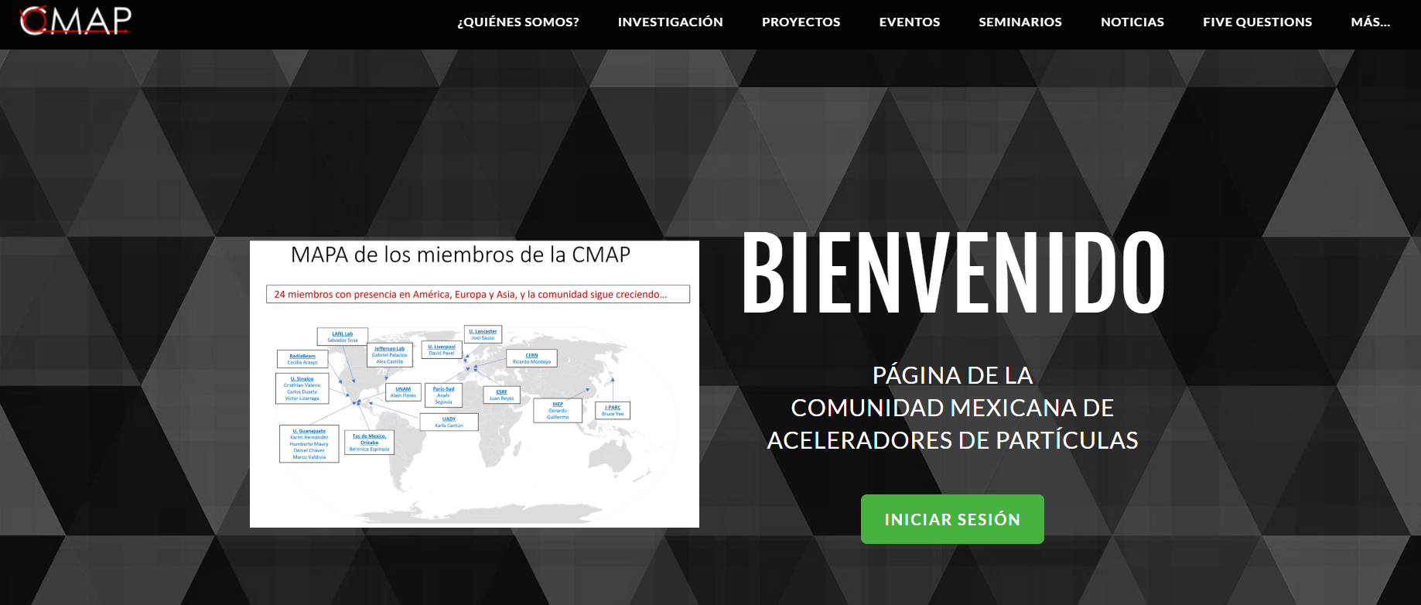
https://www.cmapmx.org/
You can find us at

Slide 26
Closing thoughts: What our colleagues think
“The creation and activities of CMAP have allowed me to establish contacts in the field, both in Mexico and abroad“
“Thanks to the community, the outreach to students at different levels in Mexico is considerably greater than any independent effort any of its members could achieve”
“Demonstrating a united front in support of the field conveys a greater level of commitment than that of any individual member”

Slide 27
… second part
“Throughout CMAP conferences, workshops, and meetings, I've had the opportunity to interact with other members, many of whom hold prominent positions in prestigious laboratories”
“This has opened the doors for more Mexicans to access these positions. Their careers inspire me to continue developing and fill me with pride”
“It's very enriching to hear how the international community recognizes the work of Mexican scientists”
“It has put me in contact with various experts in the field of accelerators”

Slide 28
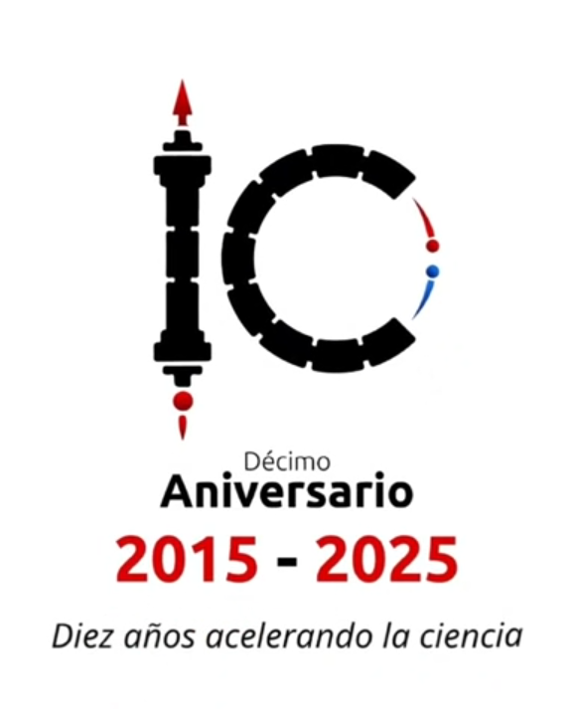
Thank you for your Attention!

