Slide 1

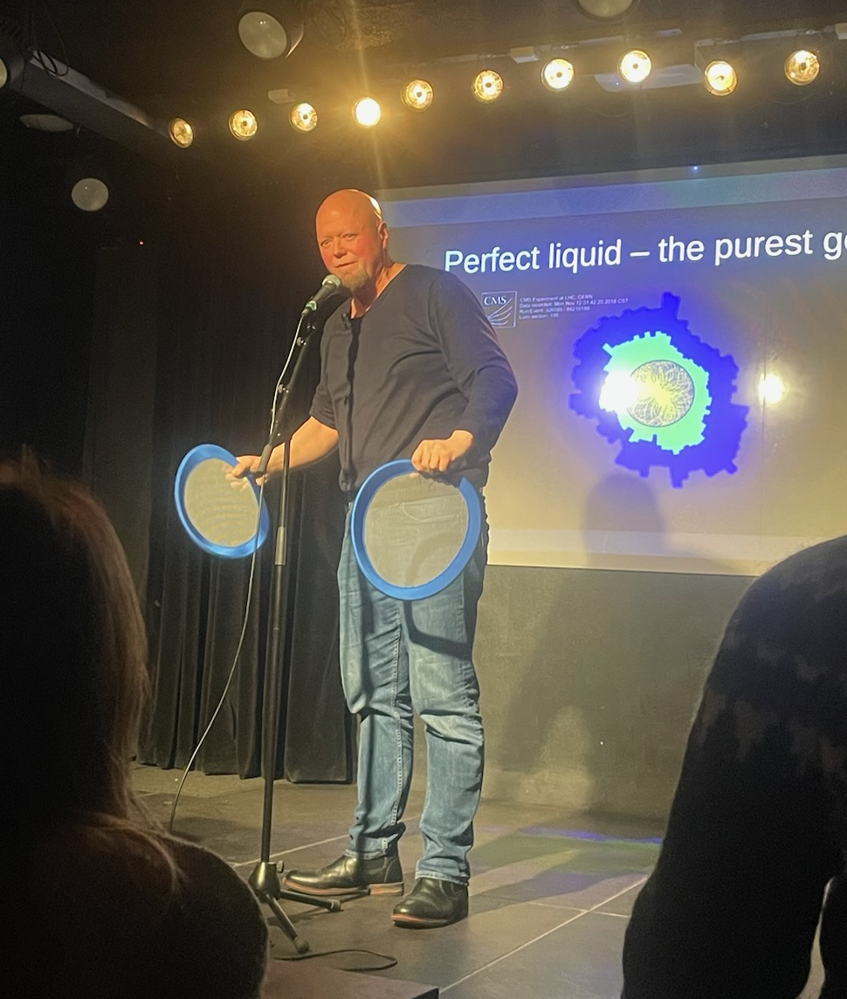
An introduction to Heavy Ion Physics and CLASH
P. Christiansen
(Lund University)
UNAM Seminar
June 20, 2024

Slide 2
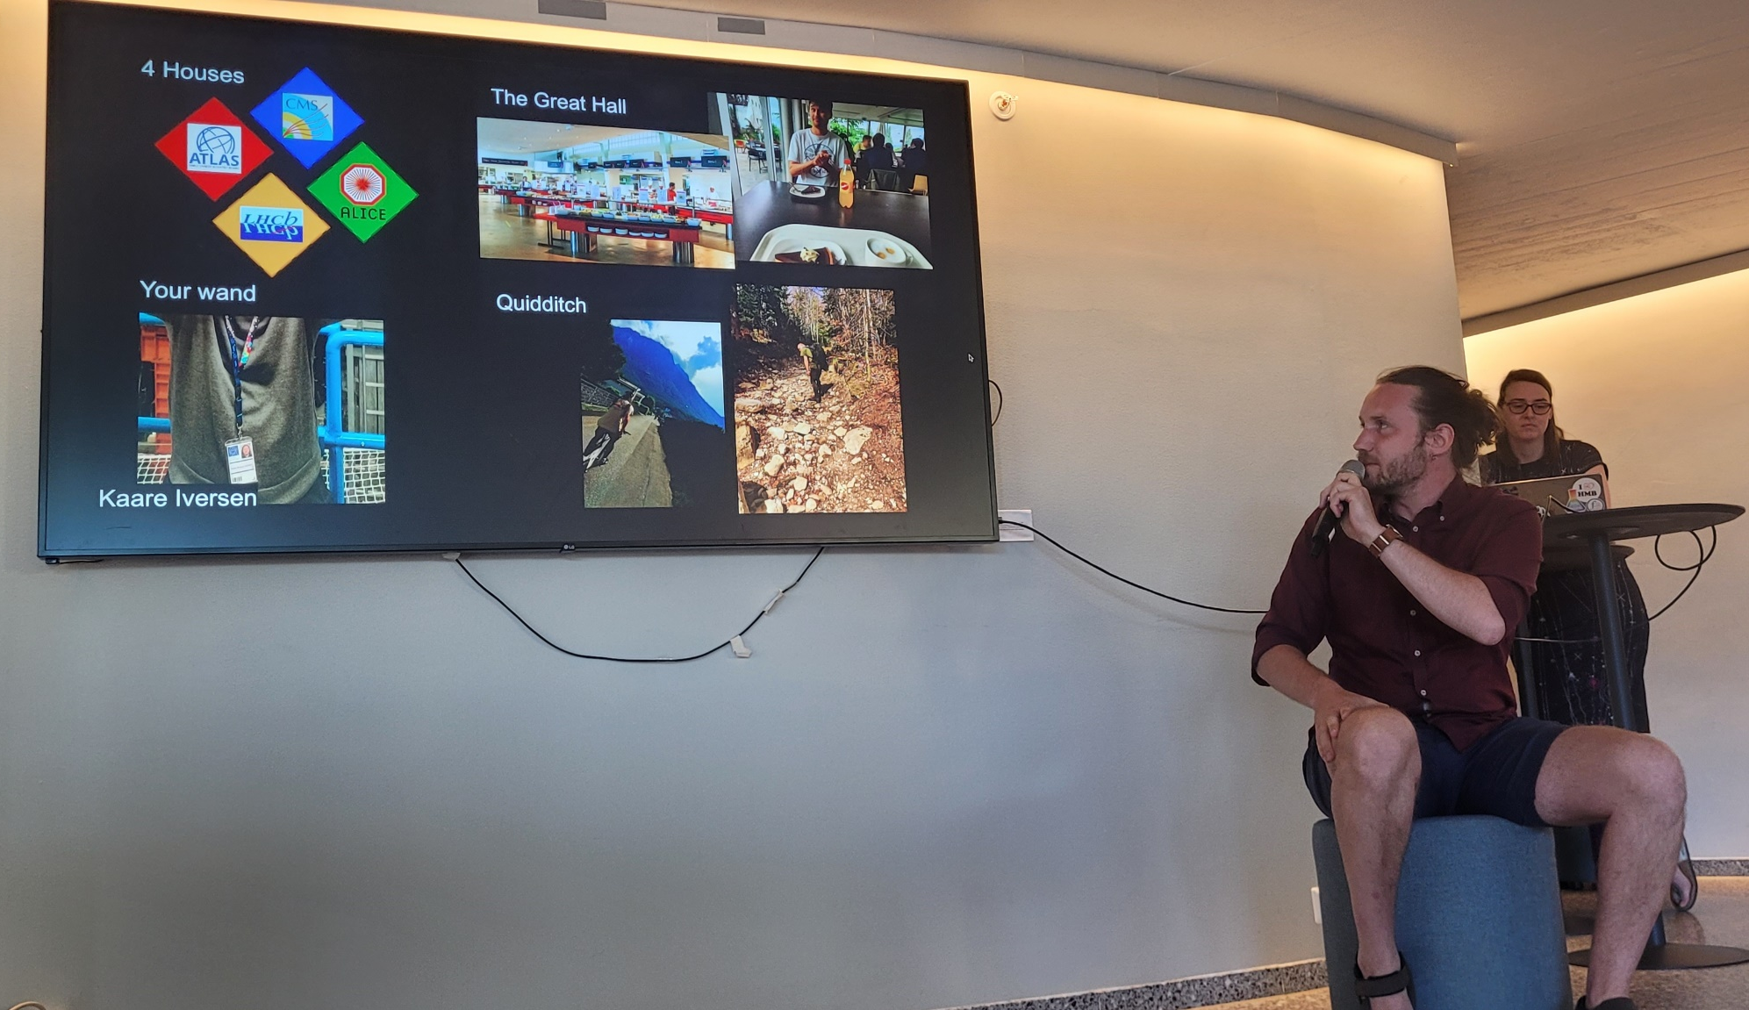
or “Why are heavy-ion physicists the Slytherins of particle physics!”

Slide 3
Outline
A brief introduction to QCD and the Quark Gluon Plasma (QGP)
The good: quarkonium
The bad (?): the perfect liquid
The ugly (?): QGP in small systems
The CLASH
The crazy (?): perfect QCD

Slide 4
Outline
A brief introduction to QCD and the Quark Gluon Plasma (QGP)
The good: quarkonium
The bad (?): the perfect liquid
The ugly (?): QGP in small systems
The CLASH
The crazy (?): perfect QCD
  No time! Read it on arXiv:2301.13467 ☺

Slide 5
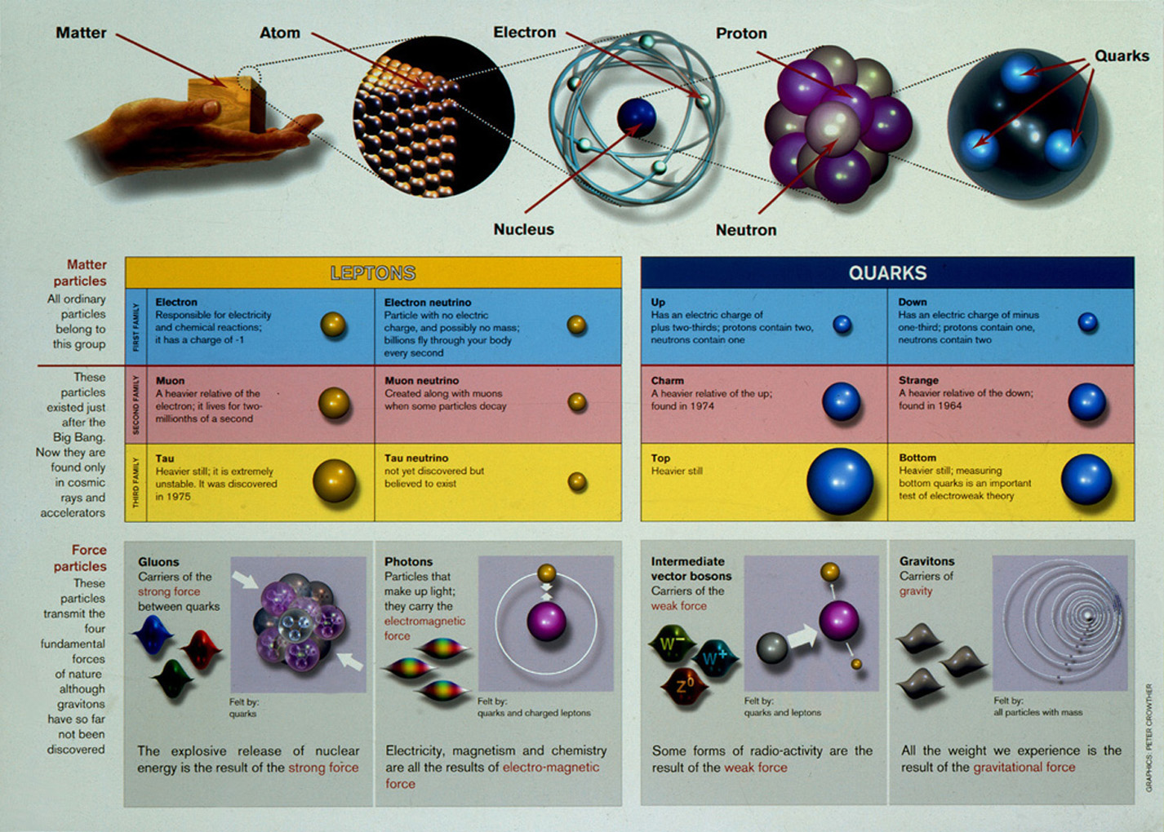

Slide 6
QED vs QCD
QED: superposition principle
QCD: color fields interact (form flux tube at long distance)
Basis of Lund string model

Slide 7
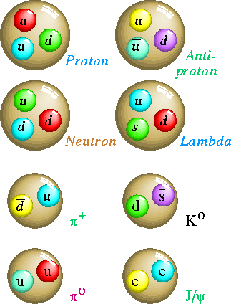
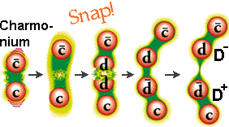

The strong interaction:
Quantum Chromo Dynamics (QCD)
3 strong charges (red, green, blue)
Particles in nature are color neutral
Quarks are “confined”
Hadrons
Baryons
(Force ~ 1 GeV/fm)
Mesons
10ton

Slide 8
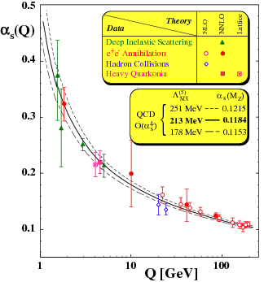
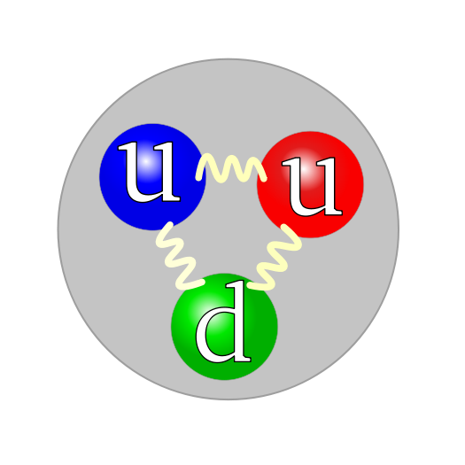
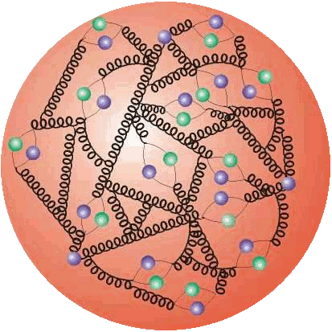
The first challenge: the two limits of QCD
2 limits
SOFT
HARD
Non-perturbative physics
(knows the equations but not how to
solve them)
Bulk properties (=QGP)
Perturbative physics
(theoretical predictions)
Rare jets (=probes)

Slide 9
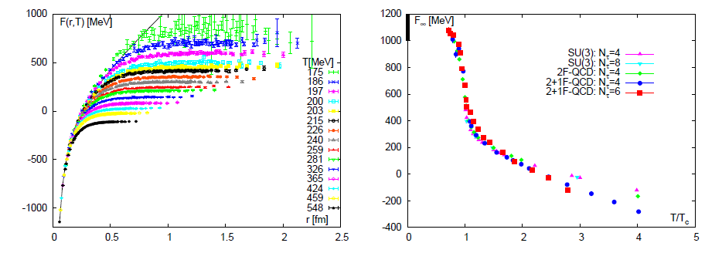
Solution (?): use lattice QCD
First question we will ask:
What happens to the heavy-quark potential when we heat up the system
Lattice QCD results for the heavy quark potential (free energy): arXiv:0710.0498
The long-range force will be screened in the plasma.
This should lead to deconfinement!

Slide 10
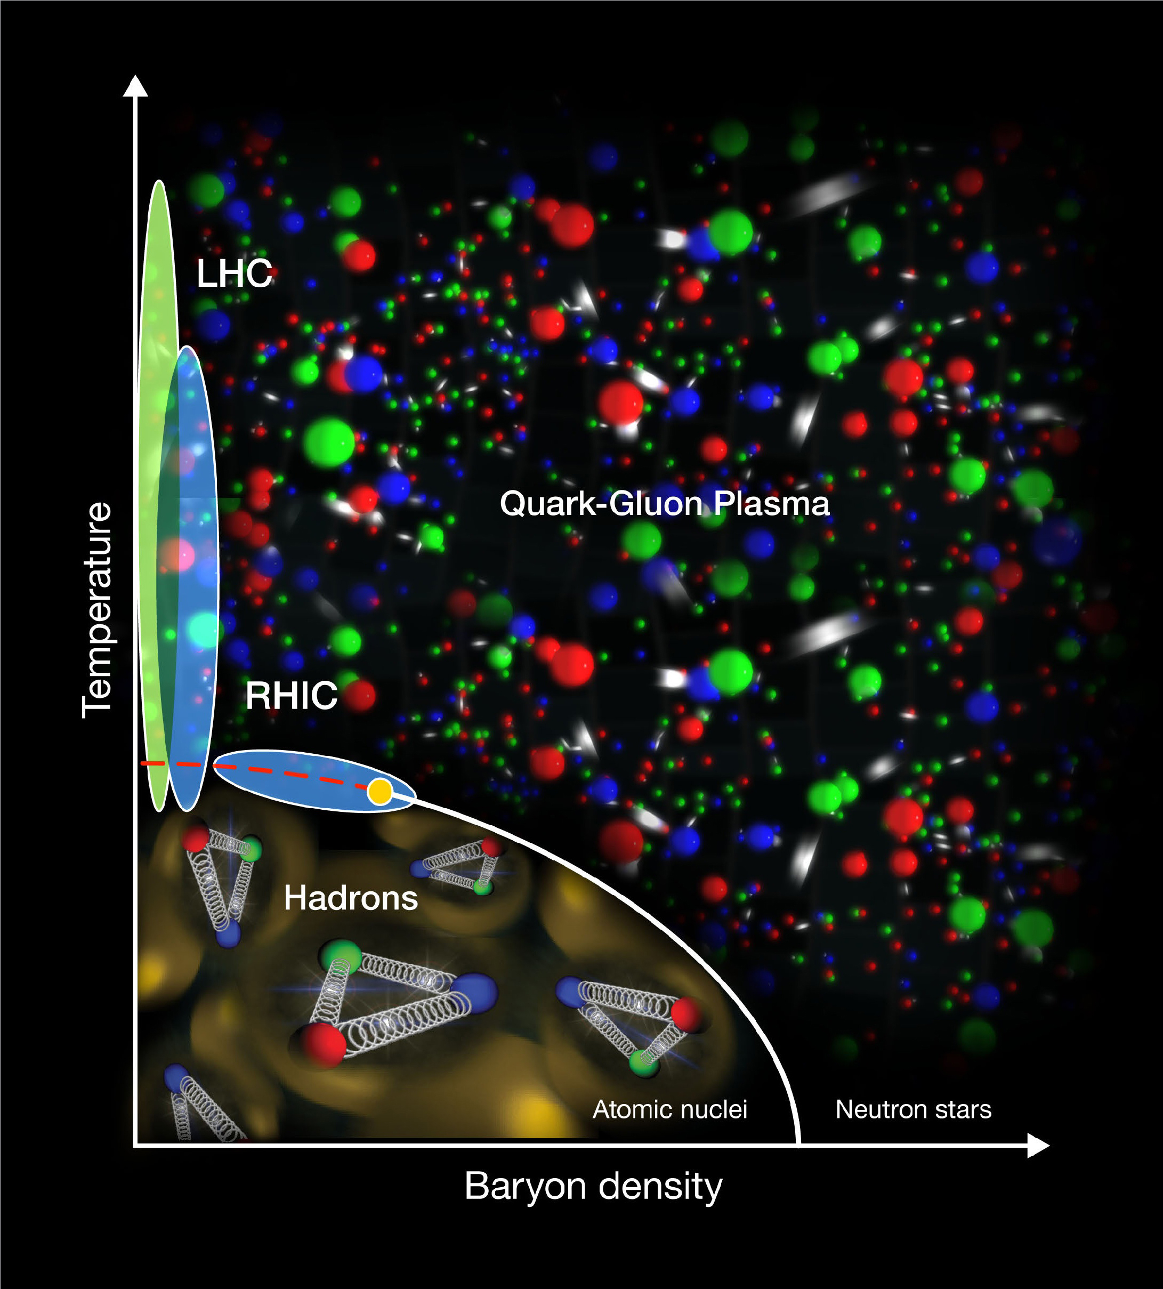
Deconfinement at high energy densities
Tc ~ 160 MeV
(~2.000.000.000.000 K)
At high energy densities a new form of matter exists:
Quark-Gluon Plasma, where quarks&gluons are deconfined
I will only talk about the high temperature transition which is what we probe in heavy-ion collisions

Slide 11
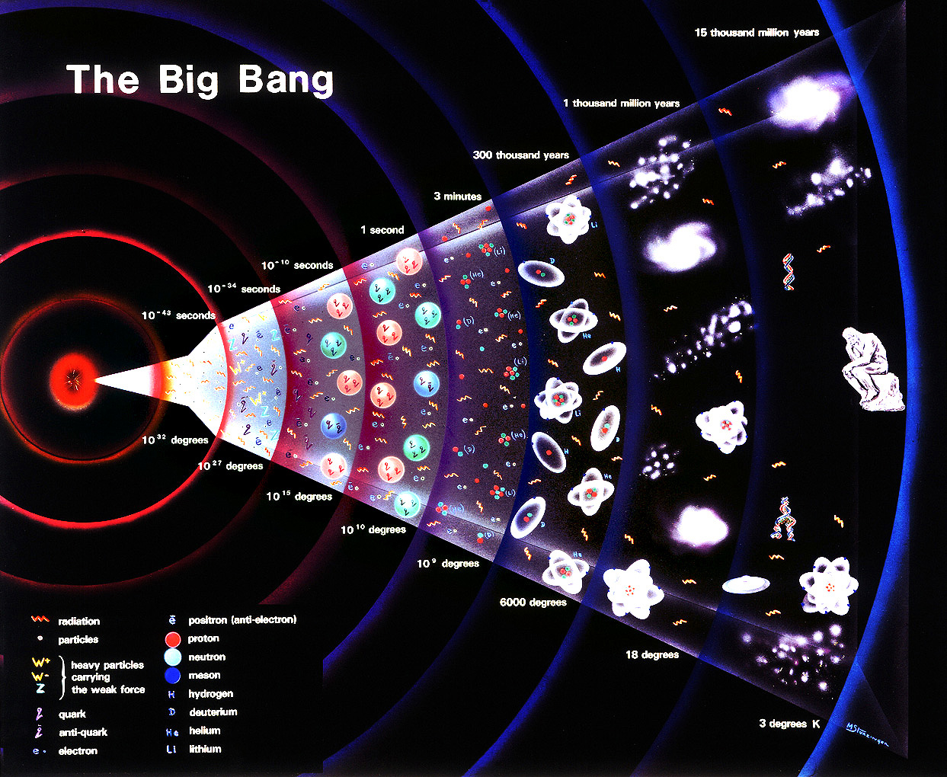

Probing the early universe
+ animation
QGP – the phase of the universe a few micro seconds after
QGP and
hydrodynamic expansion
hadronic phase
and freeze-out
initial state
pre-equilibrium
hadronization

Slide 12
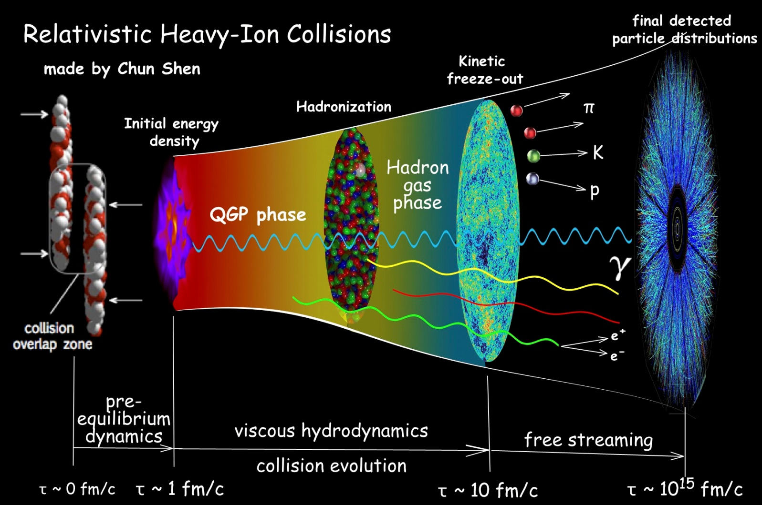
The second challenge: we cannot easily directly observe the QGP

Slide 13
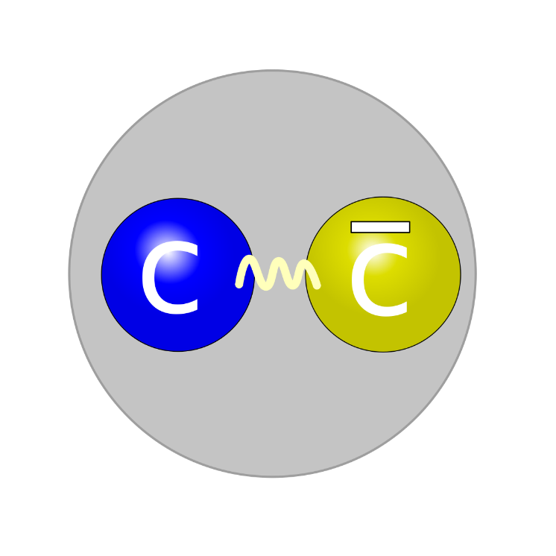
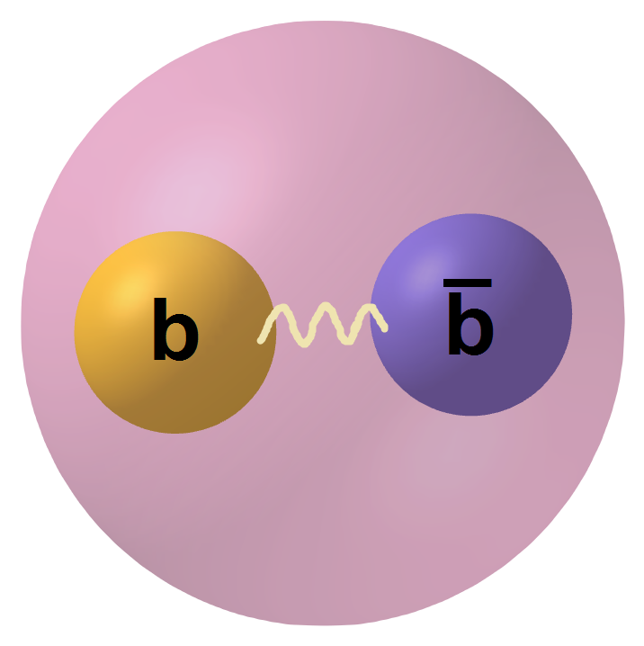
The good: quarkonium
J/ψ: 1S, (ψ’: 2S)
ϒ: 1S, 2S, 3S

Slide 14
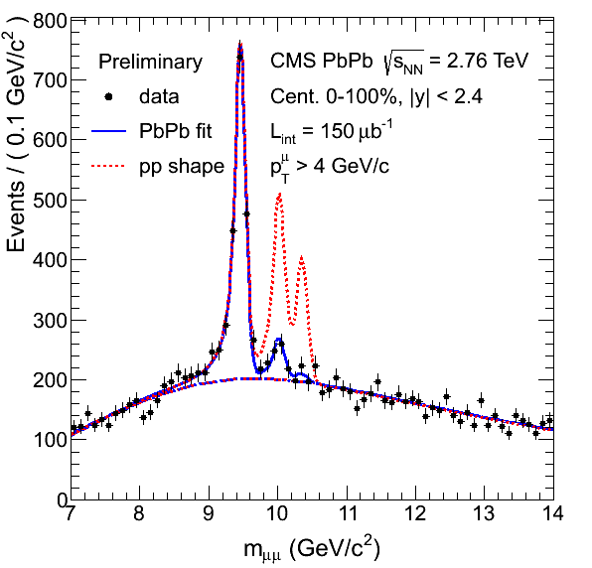
LHC has delivered
Published in PRL
107, 052302
ϒ: 1S 2S 3S
CMS has proven to be a marvelous detector for bottomonium
ALICE can complement by going to lower p_{T} for charmonium

Slide 15
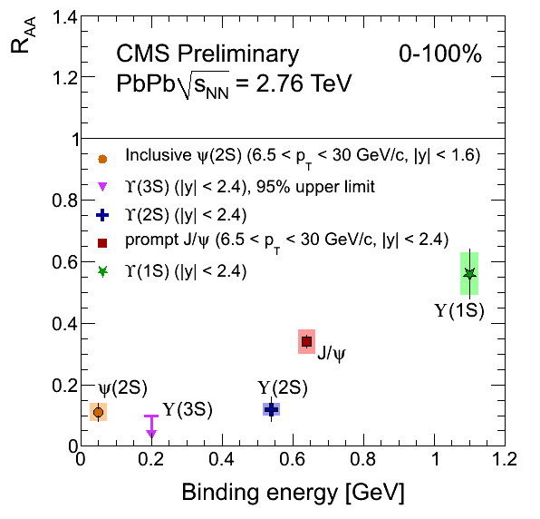
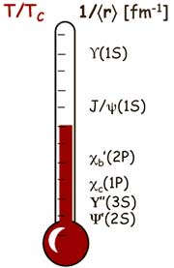
Suppression of heavy quarkonia can work as a thermometer
Note: 6.5<p_{T}<30 GeV for J/ψ and ψ(2s)
Suppression qualitatively depends on binding energy as predicted
A lot of devils in the details that I skip.

Slide 16

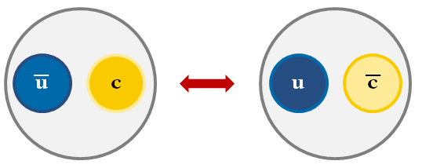
J/ψ in the QGP at high energies
Survive
Break up
Recombine
Requires high charm denisty

Slide 17
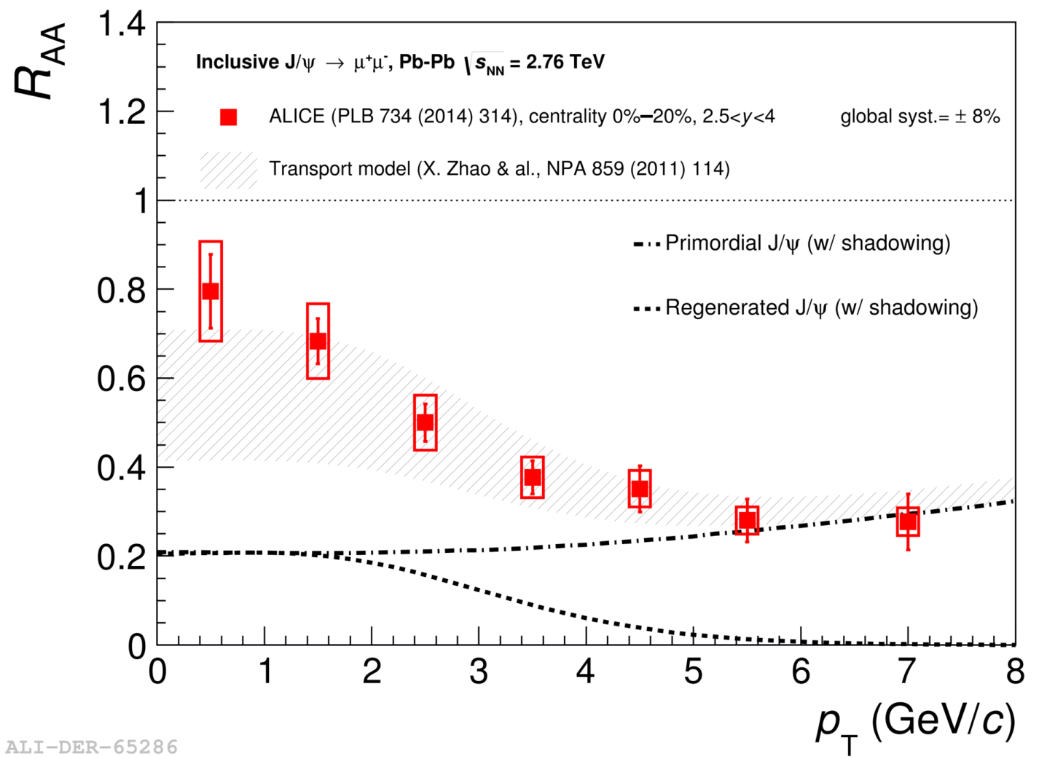
J/ψ recombination
One needs to include recombination/regeneration to explain the data.

Slide 18
The bad (?): the perfect liquid

Slide 19
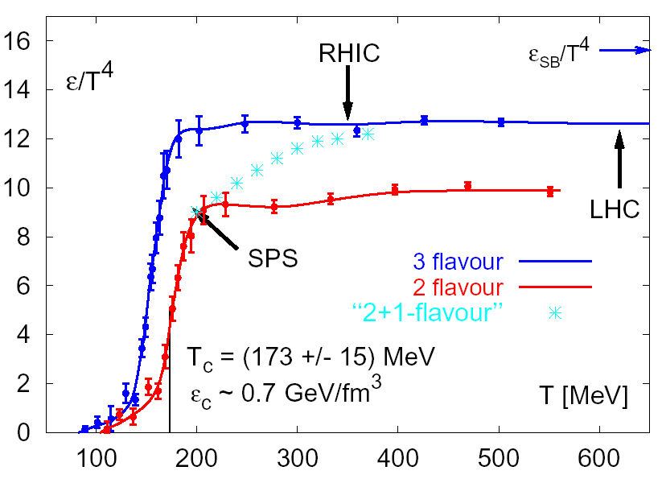
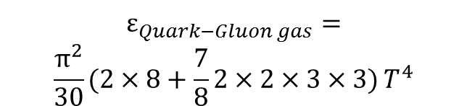
Lattice QCD calculation of the energy density
$$ε_{Quark−Gluon gas}=$$
$$\frac{π^{2}}{30}\left.(2×8+\frac{7}{8}2×2×3×3)\right.T^{4}$$
Gluon spin and color
(Anti+)quark spin, color and flavor
Several things pointed to that the QGP should behave more like a gas:
The energy density found in lattice QCD calculations
The screening of the long-range force
The running of the coupling constant
Ideas inspired by bag models

Slide 20
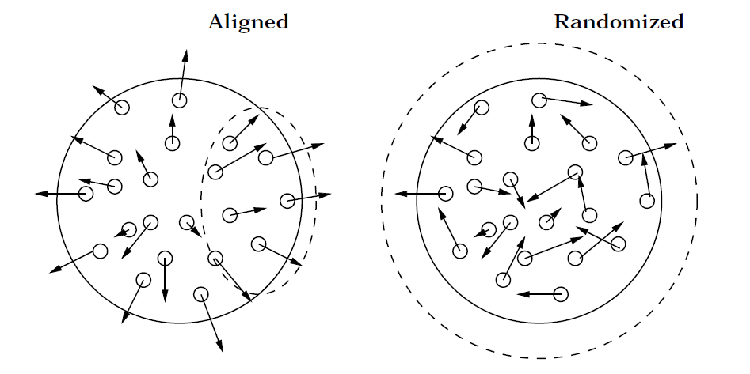
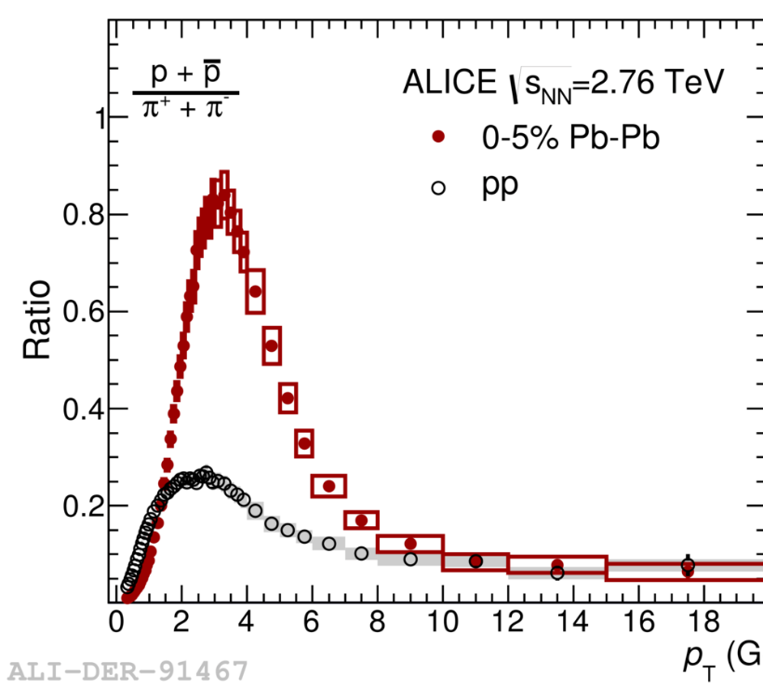

Radial flow
Flow in general plays a very
important role in heavy-ion
collisions.
We believe that flow in the partonic phase is imprinted on the final state hadrons at freeze out.
p_{T} (GeV/c)
Flow velocity β_{r} → mass dependent
boost:
p_{T} ~ γβ_{r}m (for particle initially at rest)

Slide 21
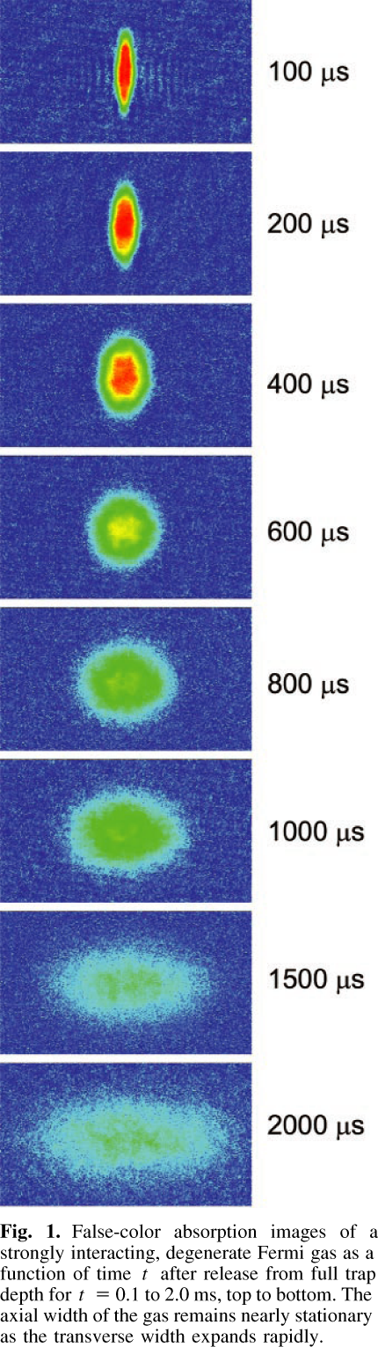
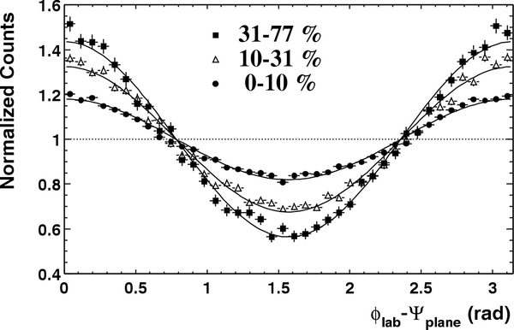
Elliptic flow (v₂)
Z
Fourier decomposition:
dN/dΔφ = 1 + 2 v₂cos(2 Δφ)
Y
X
Reaction plane
P_{y}
P_{z}
P_{x}
Initial
spatial
anisotropy
Strong
pressure
gradients
v₂
Azimuthal
anisotropy
Sensitivity to
early expansion

Slide 22
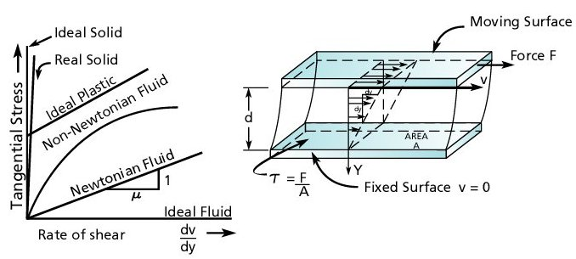
Shear viscosity
Figure taken from http://www.pumpfundamentals.com/about_fluids.htm
The shear force is given as F=ηAv/d
The shear vicosity-to-entropy density ratio, η/s, is a unitless quantity for characterizing fluids.

Slide 23
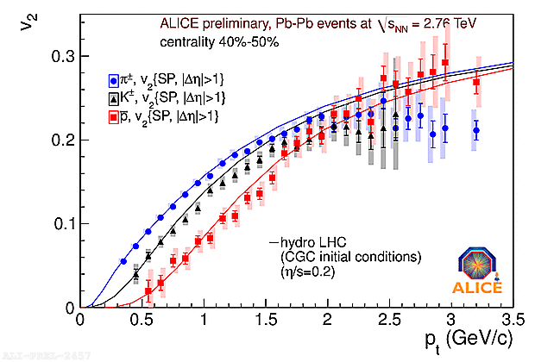
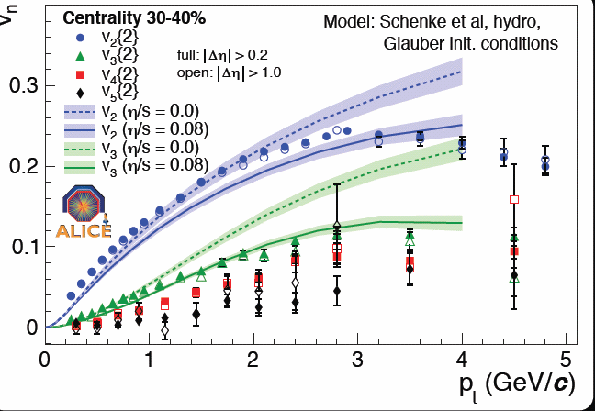
Elliptic flow and triangular flow is almost ideal!
Huge flow at intermediate p_{T}:
  2 times more particles in plane than out
  Nearly ideal fluid
Significant higher order flow caused by fluctuations – also described by nearly ideal hydro + initial state

Slide 24
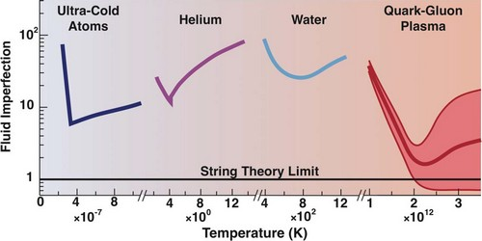
The QGP fluid compared to other fluids

Slide 25
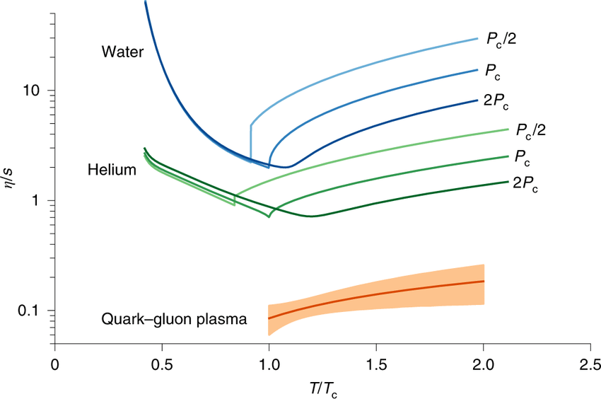
Recent comparison
J. E. Bernhard,
J. S. Moreland,
S. A. Bass
Nature Phys. 15 (2019)
11, 1113
Because of the very low η/s (shear viscosity-to-entropy density) we think the QGP is a perfect liquid!

Slide 26
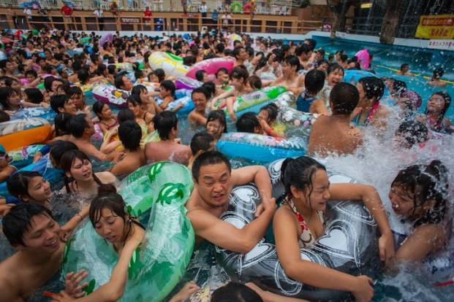
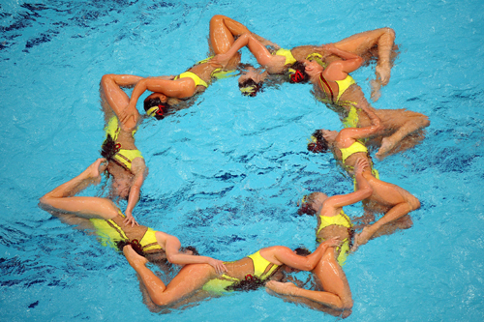
The QGP is less like a crowd and more like a synchro team
The QGP is less like a crowd
and more like a synchro team
We went looking for a gas, but we found the strongest interacting liquid known to mankind

Slide 27
Third challenge
We have no precise idea of what a
Quark-Gluon Plasma should look like
That is IMO why we are the Slytherins of the LHC experiments: we do not have a solid theoretical foundation
New paradigm (?) for why we study the QGP
  Circumvent traditional problem that while quarks and gluons are the fundamental degrees of freedom we observe hadrons to directly study the QCD dynamics of quarks and gluons

Slide 28
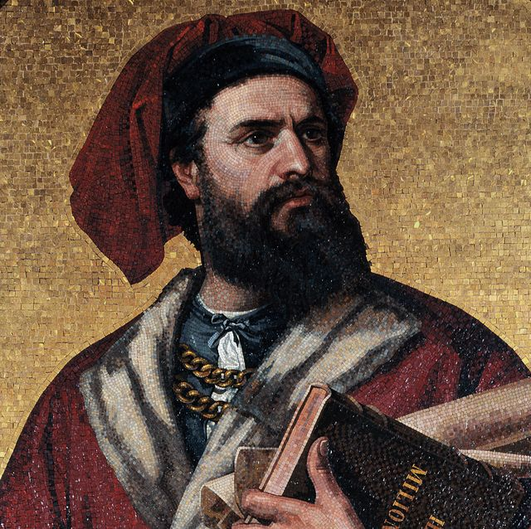
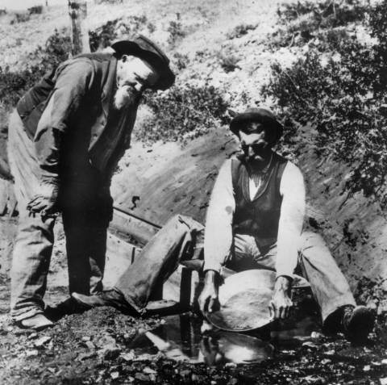
We are a mix of explorers…
...and gold diggers!
We are a mix of explorers…
...and gold diggers!

Slide 29
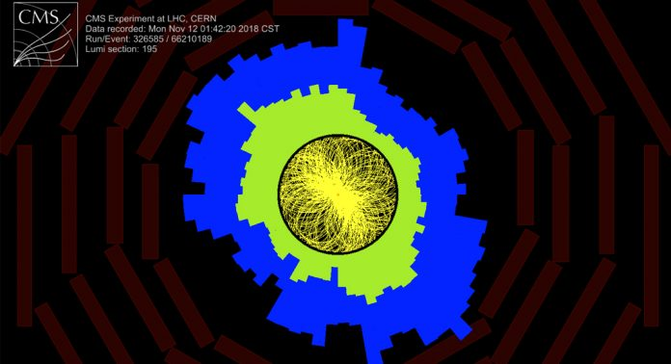
Perfect liquid – the purest gold!
Perfect liquid expansion is almost reversible
Almost no entropy production!?
We can “photograph” the initial overlap

Slide 30
The ugly (?): QGP in small systems

Slide 31
Now we keep exploring and digging!

Slide 32
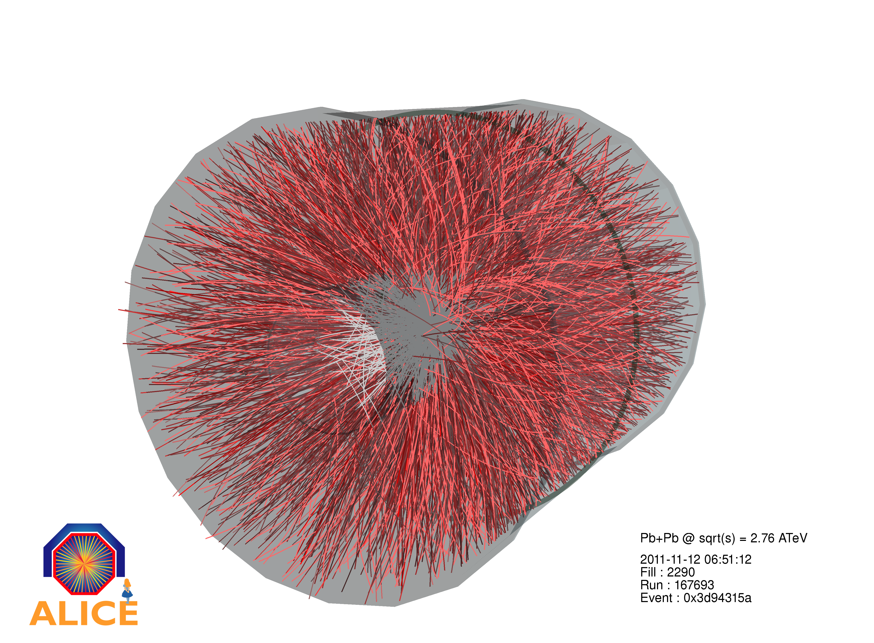
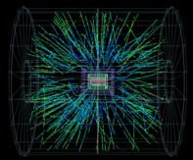
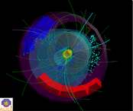
The effect of system size:
Macroscopic effects in small systems?
Pb-Pb
Hot nuclear
matter
p-Pb
Cold nuclear
matter
pp
QCD baseline

Slide 33
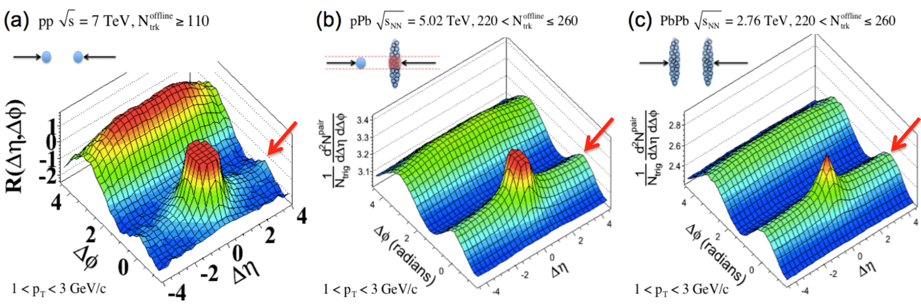
The ridge: a fingerprint of the macroscopic QGP
Z
Y
X
Reaction plane
P_{y}
P_{z}
P_{x}
Initial
spatial
anisotropy
Strong
pressure
gradients
v₂
Azimuthal
anisotropy
Sensitivity to
early expansion

Slide 34
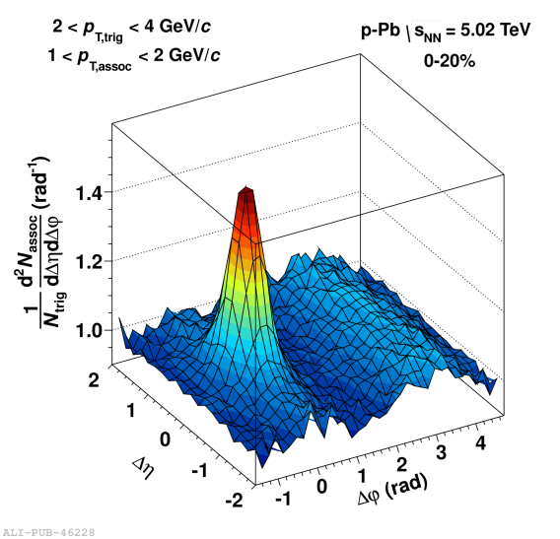
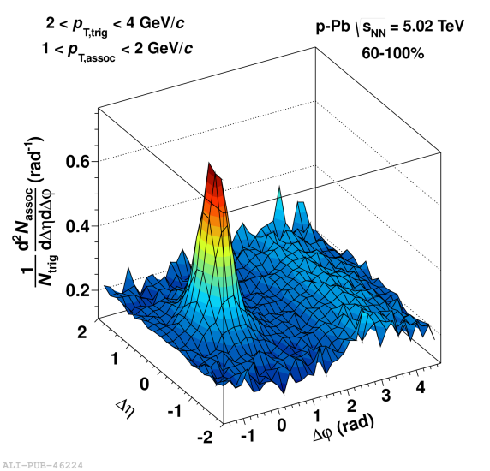
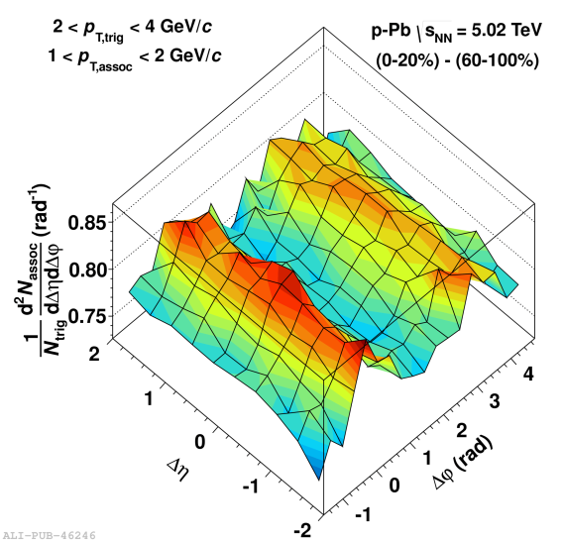
The rise of the double ridge
-
=
ALICE: Physics Letters B 719 (2013)
Double ridge structure reminiscent of azimuthal flow in Pb-Pb collisions

Slide 35
Ridges in all systems
The perfect liquid is produced in all systems suggesting that small QCD systems produce “macroscopic” matter

Slide 36
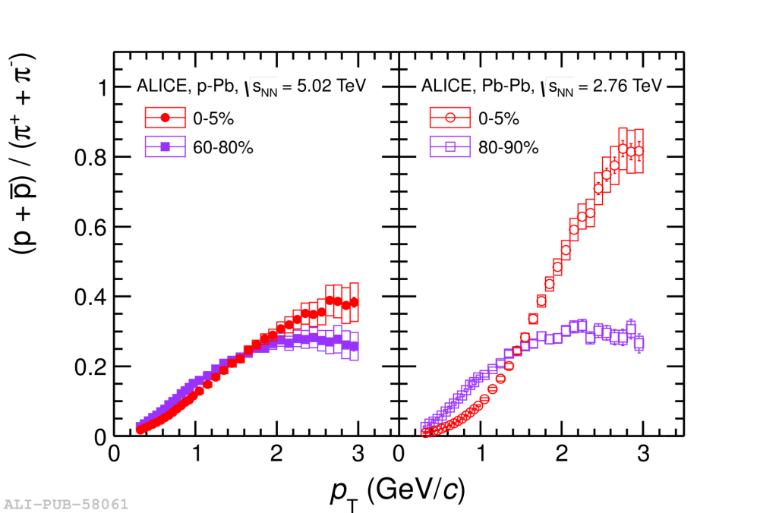
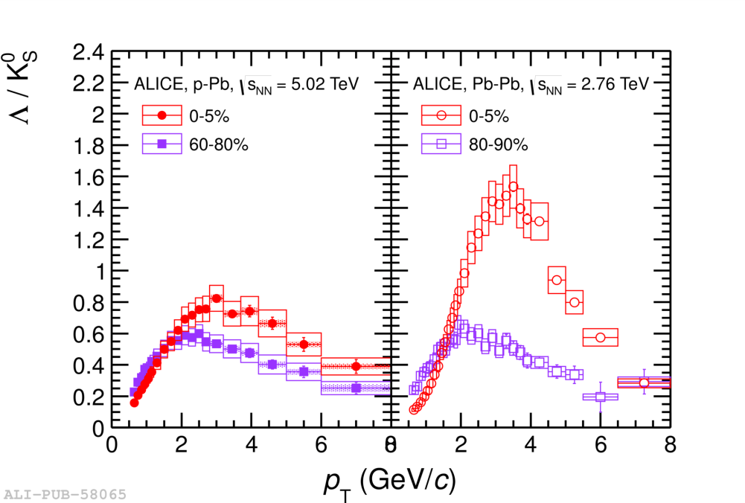
Particle ratios in p-Pb and Pb-Pb show similar radial flow features
p-Pb
Pb-Pb
p-Pb
Pb-Pb
Phys. Lett. B 728 (2014) 25
Characteristic evolution of p/π and Λ/ K⁰_{S} with multiplicity is reminiscent of Pb-Pb where it is believed to be due to radial flow

Slide 37

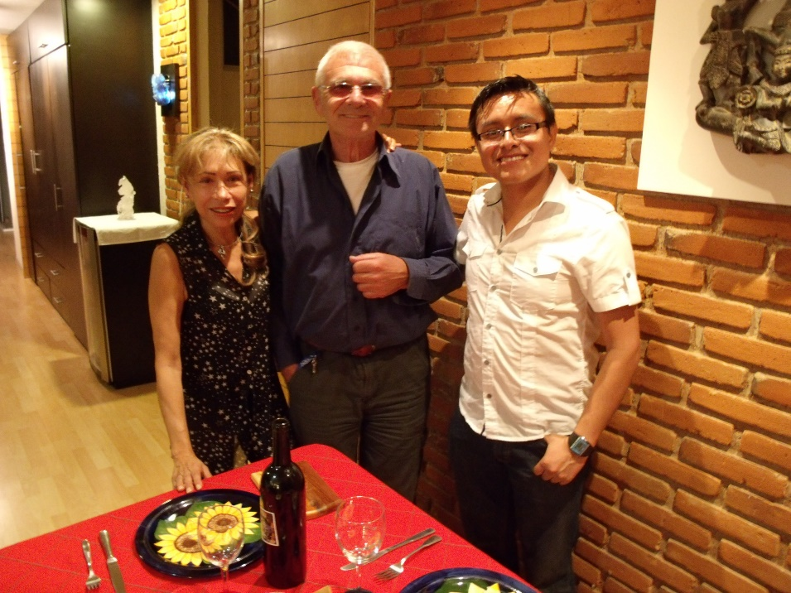
The Mexican angle
Visited UNAM 1 month in 2011 (EPLANET)
  Ongoing collaboration since then
  Common workshops: QCD challenges from pp to AA collisions, Taxco (2016), Puebla (2017), Lund (2019), Padova (2023), Muenster (2024)

Slide 38
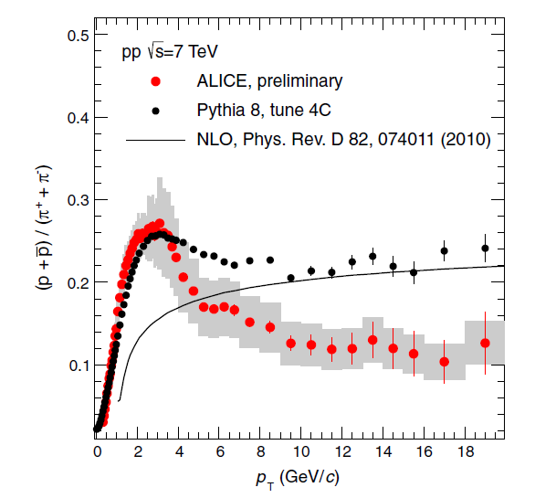
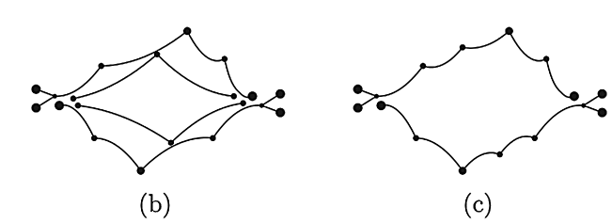
The “flow peak” in pp
Realized that Color Reconnection (CR) in PYTHIA gives rise to flow like boosts
Antonio Ortiz Velasquez, Peter Christiansen, Eleazar Cuautle Flores, Ivonne Maldonado Cervantes, Guy Paić, PRL 111, 042001 (2013).
For details, see T. Sjöstrand, arXiv:1310.8073.
CR can be a microscopic model of flow
→ Renewed interest in CR
Alternative to hydrodynamics
Common
boost

Slide 39
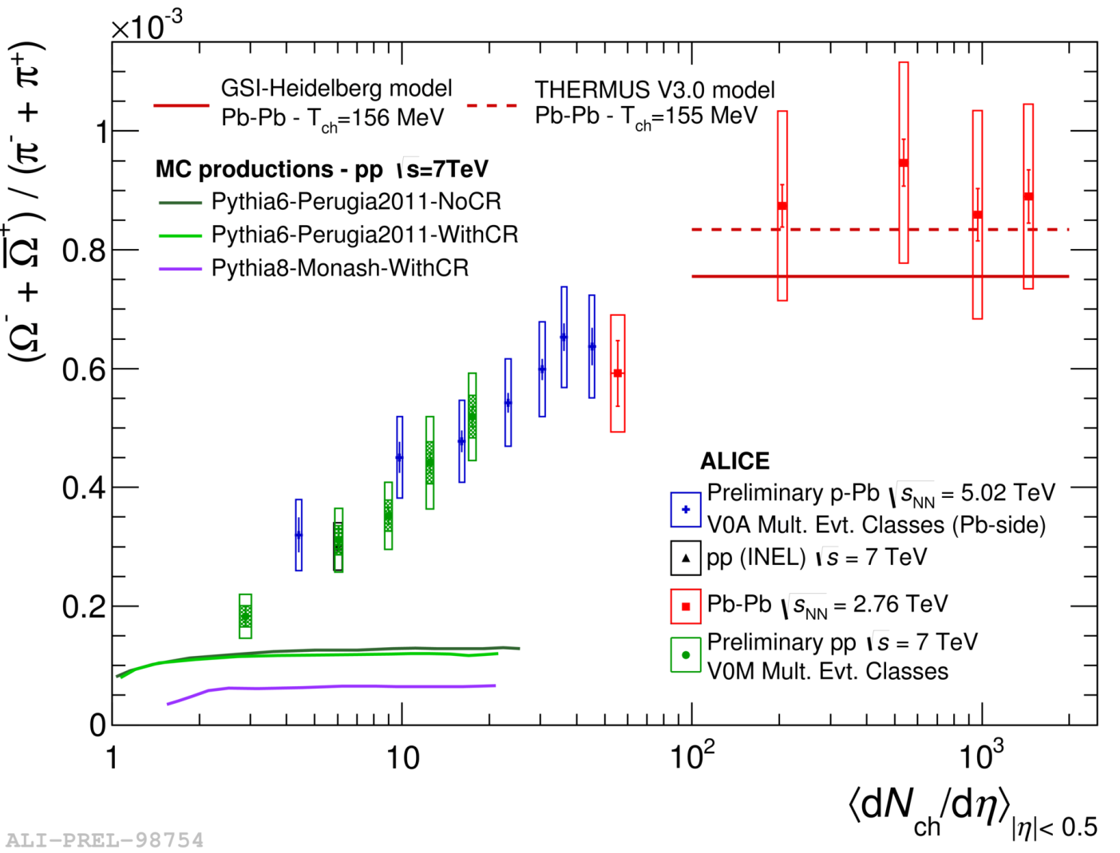
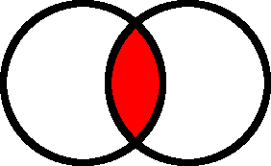
pp phenomenologists’ favorite figure from ICHEP 2016
Nature Physics 13 (2017) 535
AA limit
(sss)
e⁺+e—like
(“more of
the same”)
Need new physics mechanisms to describe increase!

Slide 40
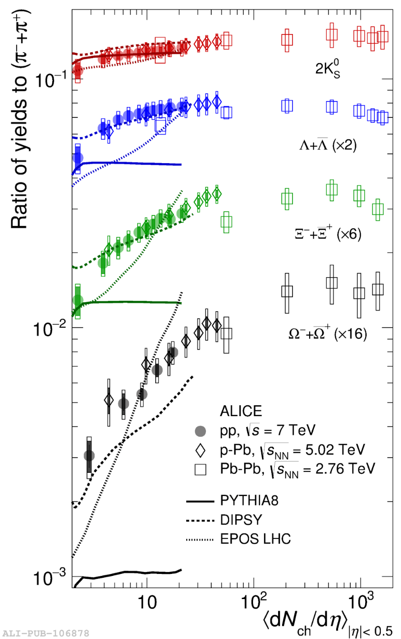
Integrated particle ratios
DIPSY Color rope model:
C. Bierlich, G. Gustafson, L. Lönnblad, A. Tarasov (Jefferson Lab), JHEP 1503 (2015) 148
Nature Physics 13 (2017) 535

Slide 41


The CLASH:
Macroscopic (top-down) vs microscopic (bottom up) models
Stat. thermal model
  Canonical
  Grand-canonical
Hydrodynamics
  Radial flow
  Azimuthal anisotropic
Tunneling of qq̅-pairs
  Strings
  Ropes
String interactions
  Color reconnection
  Shoving

Slide 42

CLASH experimental angle:
“Event Engineering”
A proton-proton collision in Pythia
Pythia Manual,
SciPost Phys.Codeb. 2022 (2022) 8
Discovery → Control/Isolation
Question: can we control strangeness enhancement? E.g., switch on and off strangeness enhancement for a fixed multiplicity

Slide 43


Two ideas tested in CLASH
No time to show: Relative Transverse Activity (R_{T})
  PhD thesis: Omar Vazquez Rueda
  (UNAM → Lund → University of Houston)
    ALICE, JHEP 06 (2023) 027 (π, K, p)
  PhD thesis: Oliver Matonoha
    To be published ($K_{s}^{0}$, φ, Λ, Ξ)
Transverse Spherocity (S_{O})
  Extension (N_{ch} → Particle identification) of ideas and work proposed by Antonio Ortiz (see later)
  PhD thesis: Adrian Nassirpour
    ALICE, JHEP 05 (2024) 184

Slide 44


Transverse Spherocity S_{O}
Define the unweighted transverse spherocity:
$S_{O}^{pT=1}=$ $\frac{π2}{4}\min_{\hat{n}}{{\left(\frac{\sum_{tracks}{\left|\hat{p}T×\hat{n}\right|}}{N_{tracks}}\right)}^{2}}$
Most other ALICE results were for the p_{T}-weighted S_{O}
  We need this change because we study shortlived and neutral particles
  Will call it S_{O} in the following

Slide 45


The effect of S_{O} selection for different multiplicity estimators
Forward estimator
Different region than where we measure S_{O}
Shown for top 10%.
(typically used in ALICE to avoid autocorrelations)
Mid-rapidity estimator
Same region where we measure S_{O}
Physics we can address with S_{O} depends on where we select the multiplicity
The following results are all done with the mid-rapidity estimator
  This ensures that multiplicity is almost constant so that we mainly select harder or softer events

Slide 46


Results top 1% multiplicity and top 1% S_{O} (0.01% of events)
Large differences between jetty and isotropic ratios ✓
Events without S_{O} selection are similar to isotropic
  QGP-like effects dominates
    Perfect liquid?
  Hard physics is outlier
Jet-like events
  Radial-flow “peaks” are reduced
  Strangeness is significantly reduced at high p_{T}
ALICE,
JHEP 05
(2024)
184

Slide 47


Results top 1% multiplicity and top 10% S_{O} (0.1% of events)
ALICE,
JHEP 05 (2024) 184
For top 10% we also have resonances (φ and K^{*0})
  Require more statistics due to event mixing background
Vs top 1%: effects are reduced but trends are the same

Slide 48

Strangeness enhancement vs S_{O}
(top 1% multiplicity)
Jetty
Isotropic
We can control the strangeness enhancement with S_{O} ✓
  The effect is bigger for Ξ (S=2) than for Λ (S=1)
Pythia ropes can describe the enhancement qualitatively

Slide 49

Strangeness enhancement vs S_{O}
(top 1% multiplicity)
Jetty
Isotropic
EPOS LHC captures the trend
  The QGP core is reduced in jetty events
HERWIG has opposite trend?! (next slide)

Slide 50

Why Herwig is wrong
S. Gieseke,
P. Kirchgaeßer, S. Plätzer
Eur.Phys.J.C 78 (2018) 2, 99
Herwig produces a baryon enhancement by allowing 3 mesons close in phase space to form a baryon-antibaryon pair
  But this will be more likely to happen in pencil-like events!
  What about quark coalescence models?

Slide 51

Strangeness enhancement vs S_{O}
(top 10% multiplicity)
Jetty
Isotropic
φ $(\text{}s\overline{s})$ and Ξ $(ssd)$ follows different trends
Data and models agree
  Surprising for Pythia where φ is produced via 2 $s\overline{s}$ breakings
    Suggests that the effect is mostly due to junctions
How can we differentiate between EPOS and Pythia Ropes?

Slide 52






Answer: look at the how the strange quarks are balanced
Ξ (Xi) baryon
QGP:
We naively expect that in a QGP the quarks will be deconfined and so eventually the quark pairs will drift apart in phase space.
Lund string:
Most quarks and antiquarks are produced together during hadronization.
$$\overline{s}$$
$$\overline{s}$$
$$s$$
$$s$$
$$d$$
$$\overline{d}$$

Slide 53






The easiest case:
Ξ balanced by antiproton
$$s$$
$$s$$
$$\overline{u}$$
$$\overline{u}$$
$$d$$
$$\overline{d}$$
QGP:
We expect that the balancing occurs on a statistical basis so this can happen.

Slide 54
The easiest case:
Ξ balanced by antiproton
$$s$$
$$s$$
$$\overline{u}$$
$$\overline{u}$$
$$d$$
$$\overline{d}$$
Normal Lund string and ropes:
Ξ almost never balanced by antiproton but instead typically by antistrange baryons and even anti-Ξ!
Idea from CLASH workshop write up: J. Adolfsson et al, Eur. Phys. J. A 56 (2020) 11, 288,
“QCD challenges from pp to A–A collisions”

Slide 55
The easiest case:
Ξ balanced by antiproton
$$s$$
$$s$$
$$\overline{u}$$
$$\overline{u}$$
$$d$$
$$\overline{d}$$
Junction:
Ξ balanced more by kaons and less by antistrange baryons. Broader correlations in rapidity.
Idea from CLASH workshop write up: J. Adolfsson et al, Eur. Phys. J. A 56 (2020) 11, 288,
“QCD challenges from pp to A–A collisions”

Slide 56

Microscopic balance of Ξ by antiprotons: MB results
arXiv:2308.16706
EPOS (QGP) model: no structure due to extreme assumption of grand-canonical ensemble
Pythia8 Monash: fails since this almost never happens
Pythia8 Junctions: describes well the data

Slide 57

Microscopic balance of Ξ by antiprotons: low mult results
arXiv:2308.16706
Pythia8 Junctions: fails to describe the data since in the low multiplicity limit it must agree with Monash (no CR)
But why does nature prefer such a complicated process where strangeness is balanced by two mesons?

Slide 58



Part of the work of Jonatan Adolfsson’s PhD Thesis
Ξ-K
Ξ-p
Jonatan Adolfsson (LU)
https://home.cern/news/news/cern/alice-congratulates-its-phd-thesis-award-winner
Ξ-Λ
Ξ-Ξ
He studied many more combinations, see arXiv:2308.16706

Slide 59

Future outlook
The study of the microscopic balance is something we want to keep pursuing
  Xi (ssd) → Omega (sss)
  2 particles →
  3 particles
  ssbar → ccbar
Thank You!

