Slide 1
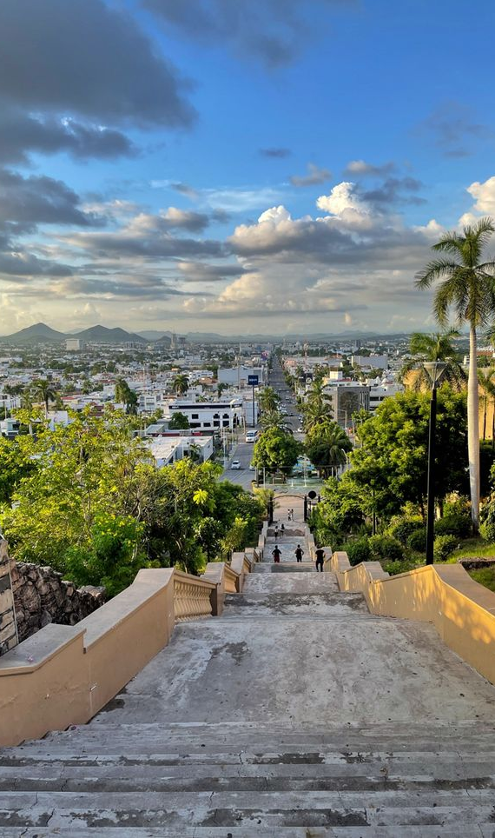









Accelerating High-Energy collisions calculations using analytic models to describe effective PDFs
Salvador A. Ochoa Oregon
in colaboration with D. F. Rentería-Estrada,
R. J. Hernández-Pinto, G. F. R. Sborlini and Pia Zurita.
XV American Symposium on High Enery Physics (SILAFAE)
CDMX, - 05.11.2024

Slide 2
Outlook
1. Parton Distribution Functions
1.1 Some history
1.2 How to compute them
2. Motivation
3. Machine Learning for PDFs
4. Results
5. Conclusions
Based on:
S. A. Ochoa-Oregon, D. F. Rentería-Estrada, R. J. Hernández-Pinto, G. F. R. Sborlini and Pia Zurita, “Using analytic models to describe effective PDFs”, Phys. Rev. D 110, 036019
2

Slide 3
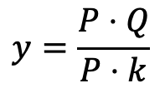
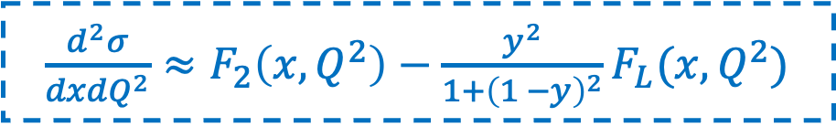
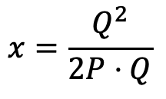


Parton Distribution Functions
Deep Inelastic Scattering
Parton distributions are present since 1960 when the determination of the cross section depends on the structure functions $F_{2}$ and $F_{L}$.
Kinematical variables
$$Q^{2}=−{\left(k−k^{′}\right)}^{2}$$
$$x=\frac{Q^{2}}{2P⋅Q}$$
$$y=\frac{P⋅Q}{P⋅k}$$
$\frac{d^{2}σ}{dxdQ^{2}}≈F_{2}\left(x,Q^{2}\right)−\frac{y^{2}}{1+{\left(1 −y\right)}^{2}}F_{L}(x, Q^{2})$
3

Slide 4
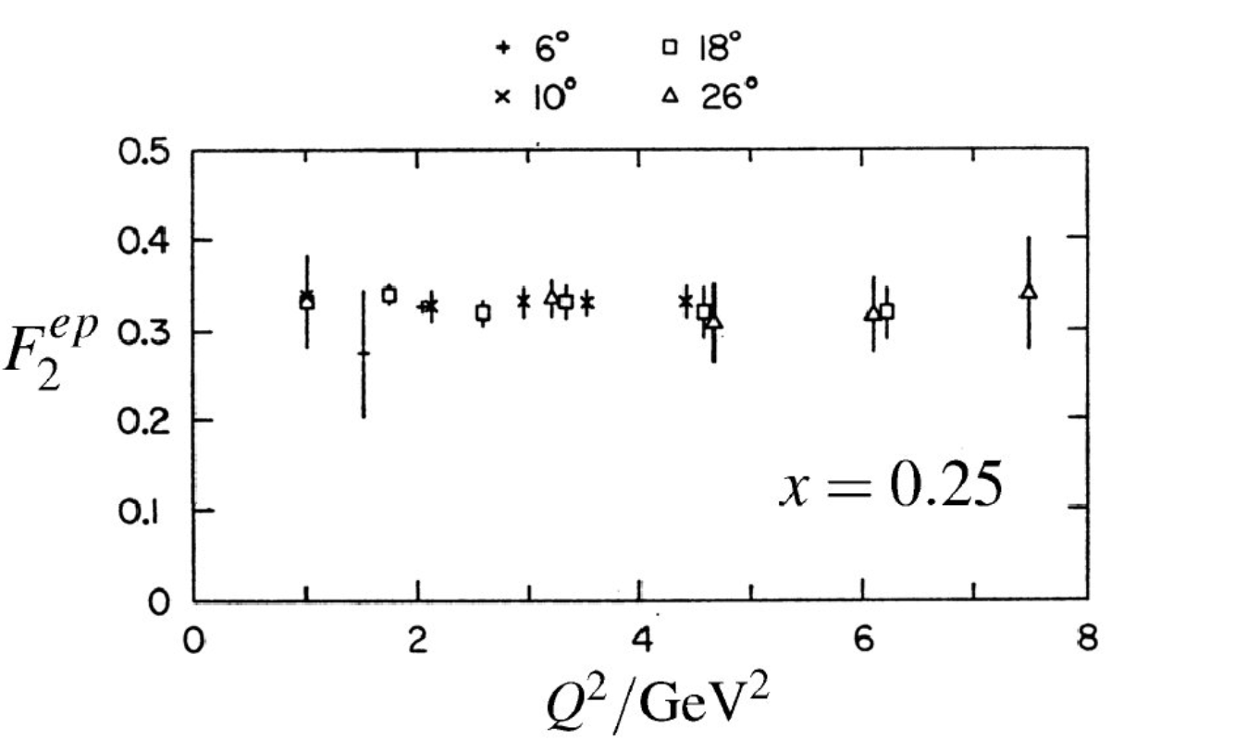
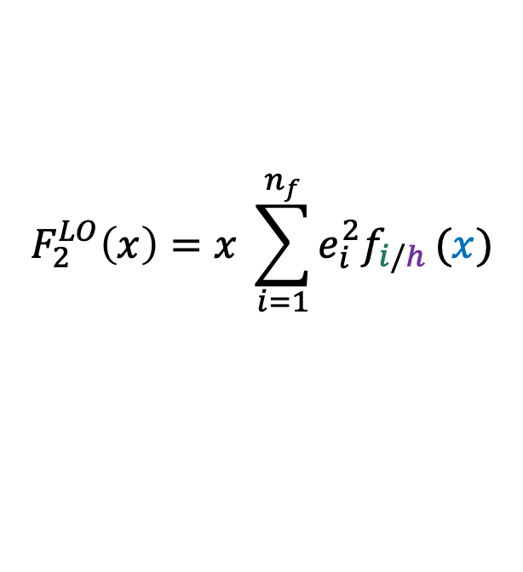
Parton Distribution Functions
Experimental results of structure functions were
Then, a scaling was expected as
$$F_{2}^{LO}\left(x\right)=x \sum_{i=1}^{n_{f}}{e_{i}^{2}f_{i/h}}(x)$$
J.T. Friedman and H.W. Kendall, Ann.Rev.Nucl.sci. 22(1972) 2013
4

Slide 5

Parton Distribution Functions
Where $f_{i/h}$ is the probability density of finding the parton $i$ inside the hadron $h$with a fraction of momentum $x$. They are called Parton Distribution Functions (PDFs).
5

Slide 6
Parton Distribution Functions
Where $f_{i/h}$ is the probability density of finding the parton $i$ inside the hadron $h$with a fraction of momentum $x$. They are called Parton Distribution Functions (PDFs).
Idea only true at LO
At higher orders in the expansion the scaling breaks down and a dependece on the renormalization scale $μ$ appears.
5

Slide 7
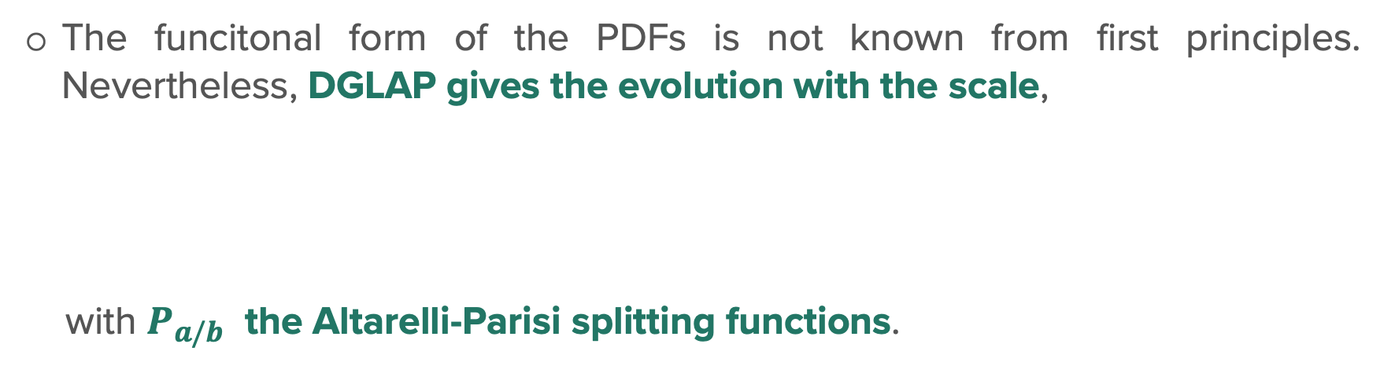
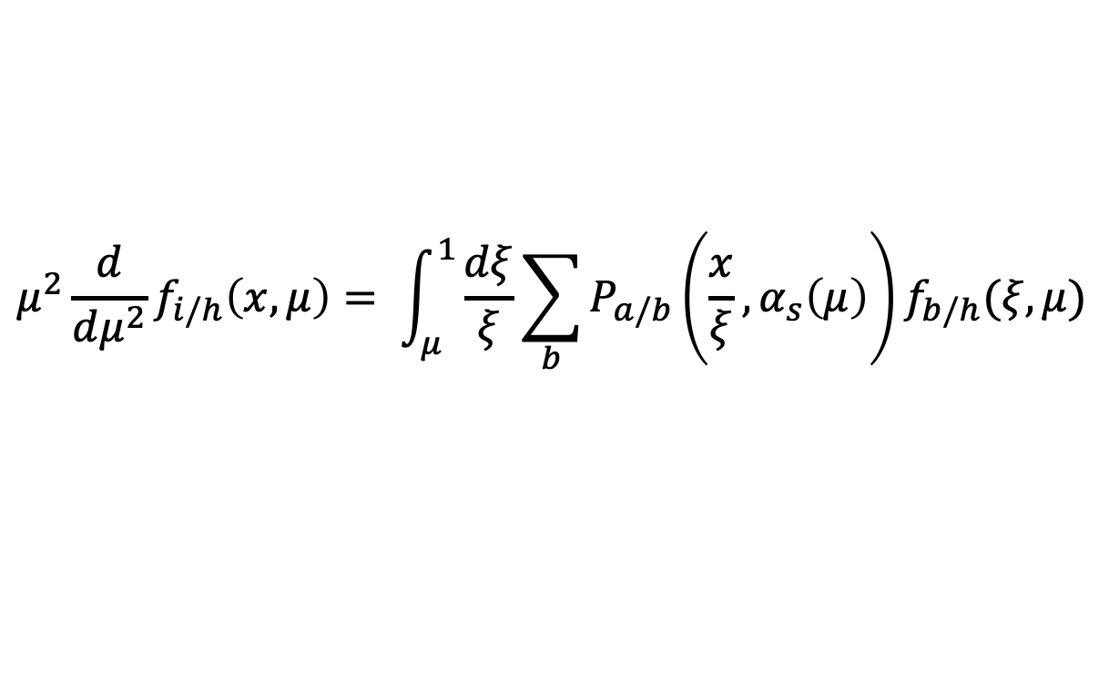
Parton Distribution Functions
Where $f_{i/h}$ is the probability density of finding the parton $i$ inside the hadron $h$with a fraction of momentum $x$. They are called Parton Distribution Functions (PDFs).
Idea only true at LO
At higher orders in the expansion the scaling breaks down and a dependece on the renormalization scale $μ$ appears.
The funcitonal form of the PDFs is not known from first principles. Nevertheless, DGLAP gives the evolution with the scale,
with $P_{a/b}$ the Altarelli-Parisi splitting functions.
$$μ^{2}\frac{d}{dμ^{2}}f_{i/h}\left(x,μ\right)= \int_{μ}^{1}{\frac{dξ}{ξ}\sum_{b}{P_{a/b}\left(\frac{x}{ξ}, α_{s}\left(μ\right)\right)f_{b/h}(ξ,μ)}}$$
5
Altarelli, G., & Parisi, G. (1977). Asymptotic freedom in parton language. Nuclear Physics B, 126(2), 298-318

Slide 8
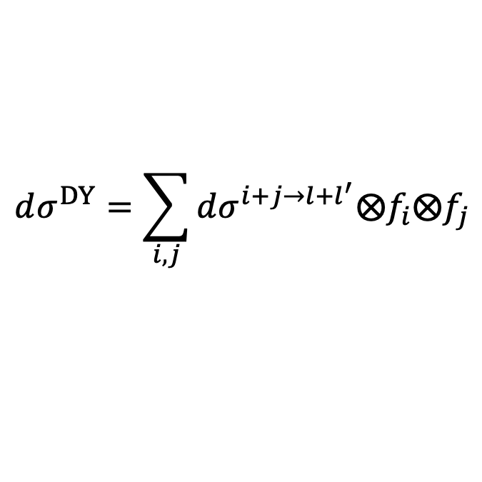
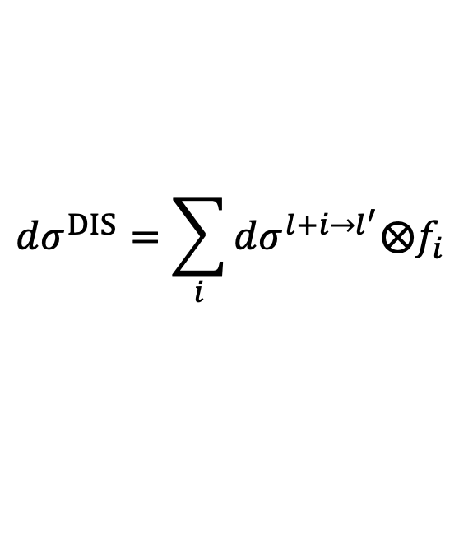
Parton Distribution Functions
One big asumption…
Universality holds for the PDFs, therefore, any process that is an inclusive hard scattering can be written as,
$$dσ^{DIS}=\sum_{i}{dσ^{l+i→l^{′}}⨂f_{i}}$$
$$dσ^{DY}=\sum_{i,j}{dσ^{i+j→l+l^{′}}⨂f_{i}⨂f_{j}}$$
Factorization scheme and fixed order calculations
and
with the same PDFs. Also, the PDFs contains the long distance structure of hadrons.
We need global Fits
6

Slide 9
Parton Distribution Functions
One big asumption…
Universality holds for the PDFs, therefore, any process that is an inclusive hard scattering can be written as,
$$dσ^{DIS}=\sum_{i}{dσ^{l+i→l^{′}}⨂f_{i}}$$
$$dσ^{DY}=\sum_{i,j}{dσ^{i+j→l+l^{′}}⨂f_{i}⨂f_{j}}$$
Factorization scheme and fixed order calculations
and
with the same PDFs. Also, the PDFs contains the long distance structure of hadrons.
We need global Fits
Without PDFs there are no theorical predictions!
6

Slide 10
Parton Distribution Functions
Global Fits
Steps in general. Choose: i) a factorization scheme, ii) an order in pQCD, iii) a starting scale $Q_{0}$, iv) the data to be fitted, v) the heavy flavor scheme.
7

Slide 11

Parton Distribution Functions
Global Fits
Steps in general. Choose: i) a factorization scheme, ii) an order in pQCD, iii) a starting scale $Q_{0}$, iv) the data to be fitted, v) the heavy flavor scheme.
Parametrize partonic distributions, in general,
$$xf_{i}\left(x, Q_{0}^{2}\right)=A_{i}x^{α_{i}}{\left(1 −x\right)}^{β_{i}}P(x, c_{i})$$
7

Slide 12
Parton Distribution Functions
Global Fits
Steps in general. Choose: i) a factorization scheme, ii) an order in pQCD, iii) a starting scale $Q_{0}$, iv) the data to be fitted, v) the heavy flavor scheme.
Parametrize partonic distributions, in general,
$$xf_{i}\left(x, Q_{0}^{2}\right)=A_{i}x^{α_{i}}{\left(1 −x\right)}^{β_{i}}P(x, c_{i})$$
Solve the DGLAP equations for the measured kinematics.
Convolute PDFS and partonic Cross-sections.
7

Slide 13
Parton Distribution Functions
Global Fits
Steps in general. Choose: i) a factorization scheme, ii) an order in pQCD, iii) a starting scale $Q_{0}$, iv) the data to be fitted, v) the heavy flavor scheme.
Parametrize partonic distributions, in general,
$$xf_{i}\left(x, Q_{0}^{2}\right)=A_{i}x^{α_{i}}{\left(1 −x\right)}^{β_{i}}P(x, c_{i})$$
Solve the DGLAP equations for the measured kinematics.
Convolute PDFS and partonic Cross-sections.
Minimize distance between theorical predictions and experimental values.
Use a method to estimate theorical error bands.
Create grids in $x$ and $Q^{2}$, and provide an interpolator for the grid.
7

Slide 14
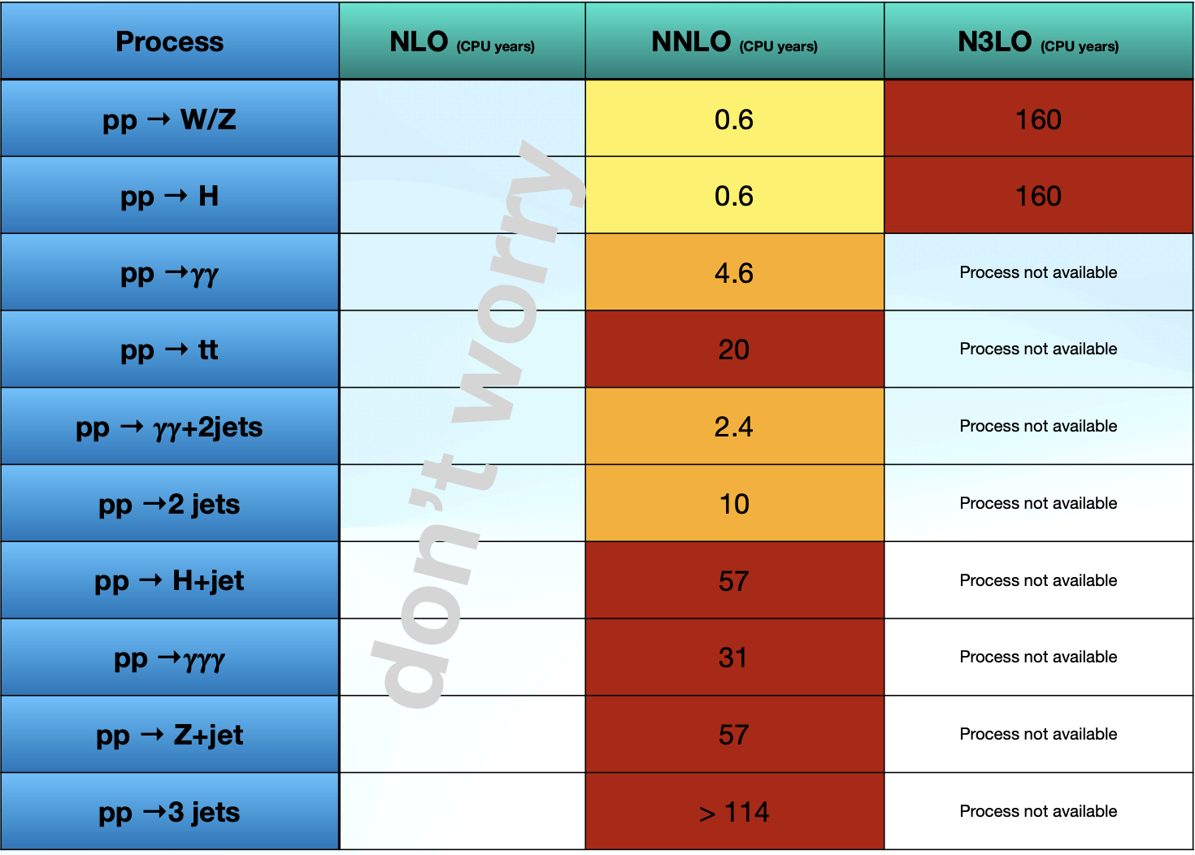
Motivation
All the running of MC codes take a long time to reach good precision.
They carry a significant environmental impact (and to our pockets given the cost of the CPU and then the electricity)
Cieri, L. (2024, june 19). Precise theoretical predictions at colliders. LHCPHENO 2024, IFIC, Valencia, España.
* One CPU year is equivalent to run the code in 1000 cores continuosly 9 hours.
8

Slide 15
Motivation
All the running of MC codes take a long time to reach good precision.
They carry a significant environmental impact (and to our pockets given the cost of the CPU and then the electricity).
Can we speed up the running time without touching the code?
Cieri, L. (2024, june 19). Precise theoretical predictions at colliders. LHCPHENO 2024, IFIC, Valencia, España.
* One CPU year is equivalent to run the code in 1000 cores continuosly 9 hours.
8

Slide 16
Motivation
All the running of MC codes take a long time to reach good precision.
They carry a significant environmental impact (and to our pockets given the cost of the CPU and then the electricity)
Can we speed up the running time without touching the code?
Most codes require non perturbative inputs (e.g. PDFs) and most of them are provided as grids and interpolate over them.
Cieri, L. (2024, june 19). Precise theoretical predictions at colliders. LHCPHENO 2024, IFIC, Valencia, España.
* One CPU year is equivalent to run the code in 1000 cores continuosly 9 hours.
8

Slide 17
Motivation
All the running of MC codes take a long time to reach good precision.
They carry a significant environmental impact (and to our pockets given the cost of the CPU and then the electricity)
Can we speed up the running time without touching the code?
Most codes require non perturbative inputs (e.g. PDFs) and most of them are provided as grids and interpolate over them.
A quick exploration shows that interpolation time could be reduced 40-50% if we had analytical expressions for the PDFs.
Cieri, L. (2024, june 19). Precise theoretical predictions at colliders. LHCPHENO 2024, IFIC, Valencia, España.
* One CPU year is equivalent to run the code in 1000 cores continuosly 9 hours.
8

Slide 18

Machine Learning for PDFs
Goal: Find an analytical $x$ and $Q^{2}$ form for a set of proton PDFs.
9

Slide 19
Machine Learning for PDFs
Goal: Find an analytical $x$ and $Q^{2}$ form for a set of proton PDFs.
How? Inpired by functional form of HERAPDF, we propose a general functional form
$$xf_{i}\left(x, Q^{2}\right)=A_{i}\left(Q^{2}\right)x^{α_{i}\left(Q^{2}\right)}{\left(1 −x\right)}^{β_{i}\left(Q^{2}\right)}P\left(x, c_{i}\left(Q^{2}\right)\right)$$
$$−Θ(x_{c,i}−x)A_{i}^{′}\left(Q^{2}\right)x^{α_{i}^{′}\left(Q^{2}\right)}{\left(1 −x\right)}^{β_{i}^{′}\left(Q^{2}\right)}P\left(x, c_{i}^{′}\left(Q^{2}\right)\right)$$
More details in: Phys. Rev. D 110, 036019 [hep-ph]
9

Slide 20
Machine Learning for PDFs
Goal: Find an analytical $x$ and $Q^{2}$ form for a set of proton PDFs.
How? Inpired by functional form of HERAPDF, we propose a general functional form
$$xf_{i}\left(x, Q^{2}\right)=A_{i}\left(Q^{2}\right)x^{α_{i}\left(Q^{2}\right)}{\left(1 −x\right)}^{β_{i}\left(Q^{2}\right)}P\left(x, c_{i}\left(Q^{2}\right)\right)$$
$$−Θ(x_{c,i}−x)A_{i}^{′}\left(Q^{2}\right)x^{α_{i}^{′}\left(Q^{2}\right)}{\left(1 −x\right)}^{β_{i}^{′}\left(Q^{2}\right)}P\left(x, c_{i}^{′}\left(Q^{2}\right)\right)$$
Our hypotesis is that the $Q^{2}$-dependence of the PDFs is given by the parameters.
The heavyside function is used to give more flexibility at low $x$. (Inspired by HERAPDF and gradient boosting algorithm)
Fitted using Machine Learning tools and techniques.
More details in: Phys. Rev. D 110, 036019 [hep-ph]
9

Slide 21
Machine Learning for PDFs
Fitting procedure
We generate a grid of 5,000-10,000 random points in {$x, Q^{2}$} using HERAPDF20_NLO_EIG (HERAPDF 2.0)
The range was chosen in accordance to HERAPDF
Furthermore, we use for light quarks and gluons $Q_{Min}=Q_{0}≈1.37 GeV$, whilst $Q_{0}=1.5 GeV$ and $Q_{0}=4.5 GeV$ for the charm and bottom quarks, respectively
Note: We are fitting the results of an existing fit.
More details in: Phys. Rev. D 110, 036019 [hep-ph]
9

Slide 22
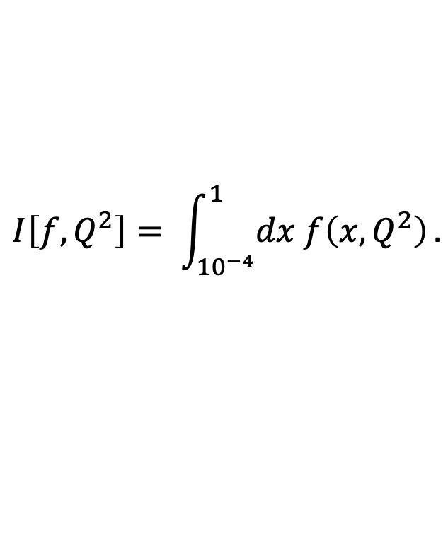
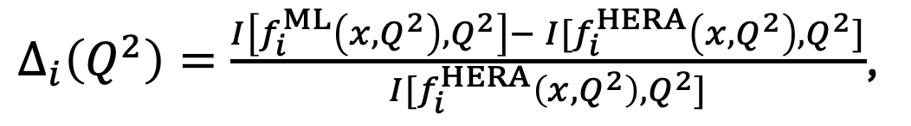
Machine Learning for PDFs
Finding the best fit: cost function
Since HEP phenomenology is not only interested in the central value of the PDF, we rather define the best fitting parameters through the cost function,
$Δ_{i}\left(Q^{2}\right)=\frac{I\left[f_{i}^{ML}\left(x, Q^{2}\right), Q^{2}\right]− I[f_{i}^{HERA}\left(x, Q^{2}\right), Q^{2}]}{I[f_{i}^{HERA}\left(x, Q^{2}\right), Q^{2}]}$,
Inspired by Factorizaction Theorem
which takes care of the integral error of the determination of the PDFs, through the integration operator,
$$I\left[f, Q^{2}\right]= \int_{{10}^{−4}}^{1}{dx f\left(x, Q^{2}\right)}.$$
More details in: Phys. Rev. D 110, 036019 [hep-ph]
10

Slide 23
Machine Learning for PDFs
${xu}_{v}$ distribuction coefficients
More details in: Phys. Rev. D 110, 036019 [hep-ph]
We use ML to find all coefficients.
For this particular case, a polynomial function was sufficient. In many cases it was necessary to propose a more complicated basis.
10

Slide 24
Machine Learning for PDFs
Up quark distributions
We found a good agreement and only use one region to $x\overline{u}$ and two regions to $xu_{v}$.
We can obtain $u$-quark distribution by: $xu=x\overline{u}+xu_{v}$
11

Slide 25
Machine Learning for PDFs
Down quark distributions
Similar to the $u$-quark, we found a good agreement and in this case we only use one region to both distributions.
Similarly, $d$-quark distribution by: $xd=x\overline{d}+xd_{v}$
12

Slide 26
Machine Learning for PDFs
Strange and Charm quark distributions
For $s$-quark and $c$-quark we used two regions.
Only small discrepancies for $x<{10}^{−3}$ at $Q=10 GeV$ in $s$-quark distribution are present.
13

Slide 27
Machine Learning for PDFs
Bottom quark and Gluon distributions
For the 𝑏-quark we split into two regions and for the gluon we split into four regions.
Small deviations of the central value for $x<{10}^{−3}$ in 𝑏-quark were found.
14

Slide 28
Results
How good is good ?
The estimator $Δ_{i}(Q^{2})$ shows small integral error (maximum of 1.5% for all partons)
S. A. Ochoa-Oregon et al., Phys. Rev. D 110, 036019 [hep-ph].
15

Slide 29
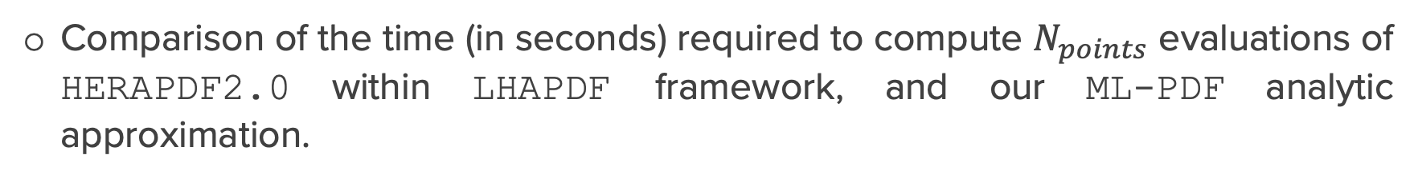

Results
$$Gain\left(\%\right)=100×\frac{time_{LHAPDF} −{time}_{ML−PDF}}{time_{LHAPDF}}$$
How fast is fast?
Comparison of the time (in seconds) required to compute $N_{points}$ evaluations of HERAPDF2.0 within LHAPDF framework, and our ML-PDF analytic approximation.
The gains seems to approach a plateau around 50%.
16
S. A. Ochoa-Oregon et al., Phys. Rev. D 110, 036019 [hep-ph].

Slide 30
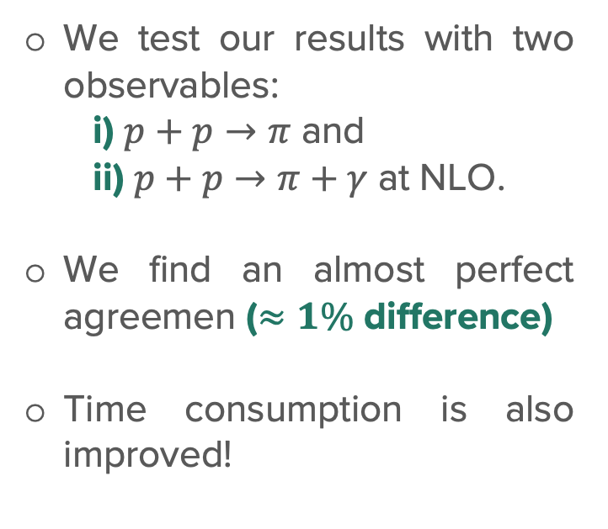
Results
The final test …
We test our results with two observables:
i) $p+p→π$ and
ii) $p+p→π+γ$ at NLO.
We find an almost perfect agreemen ($≈1\%$ difference)
Time consumption is also improved!
S. A. Ochoa-Oregon et al., Phys. Rev. D 110, 036019 [hep-ph].
FF: DEHSS2014
17

Slide 31
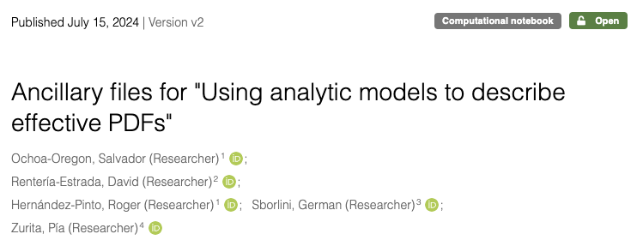

Results
The final test …
We test our results with two observables:
i) $p+p→π$ and
ii) $p+p→π+γ$ at NLO.
We find an almost perfect agreemen ($≈1\%$ difference)
Time consumption is also improved!
S. A. Ochoa-Oregon et al arXiv:2404.15175 [hep-ph].
FF: DEHSS2014
17

Slide 32
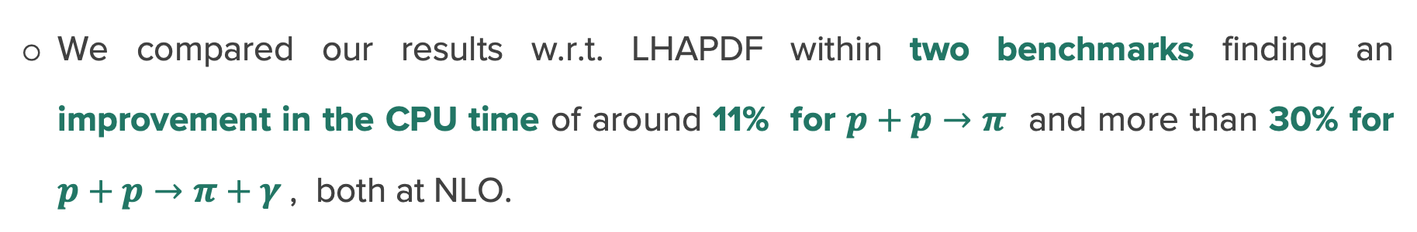
Conclusions
PDFs are key ingredients for any phenomenological theoretical predictions.
Since MC simulations are taking the CPU cost to the extreme, we exploited ML to extract analytical PDFs to avoid running interpolations techniques.
We compared our results w.r.t. LHAPDF within two benchmarks finding an improvement in the CPU time of around 11% for $p+p→π$ and more than 30% for $p+p→π+γ$, both at NLO.
The code (FORTRAN) with the PDFs can be found at https://zenodo.org/records/12745978.
18

Slide 33
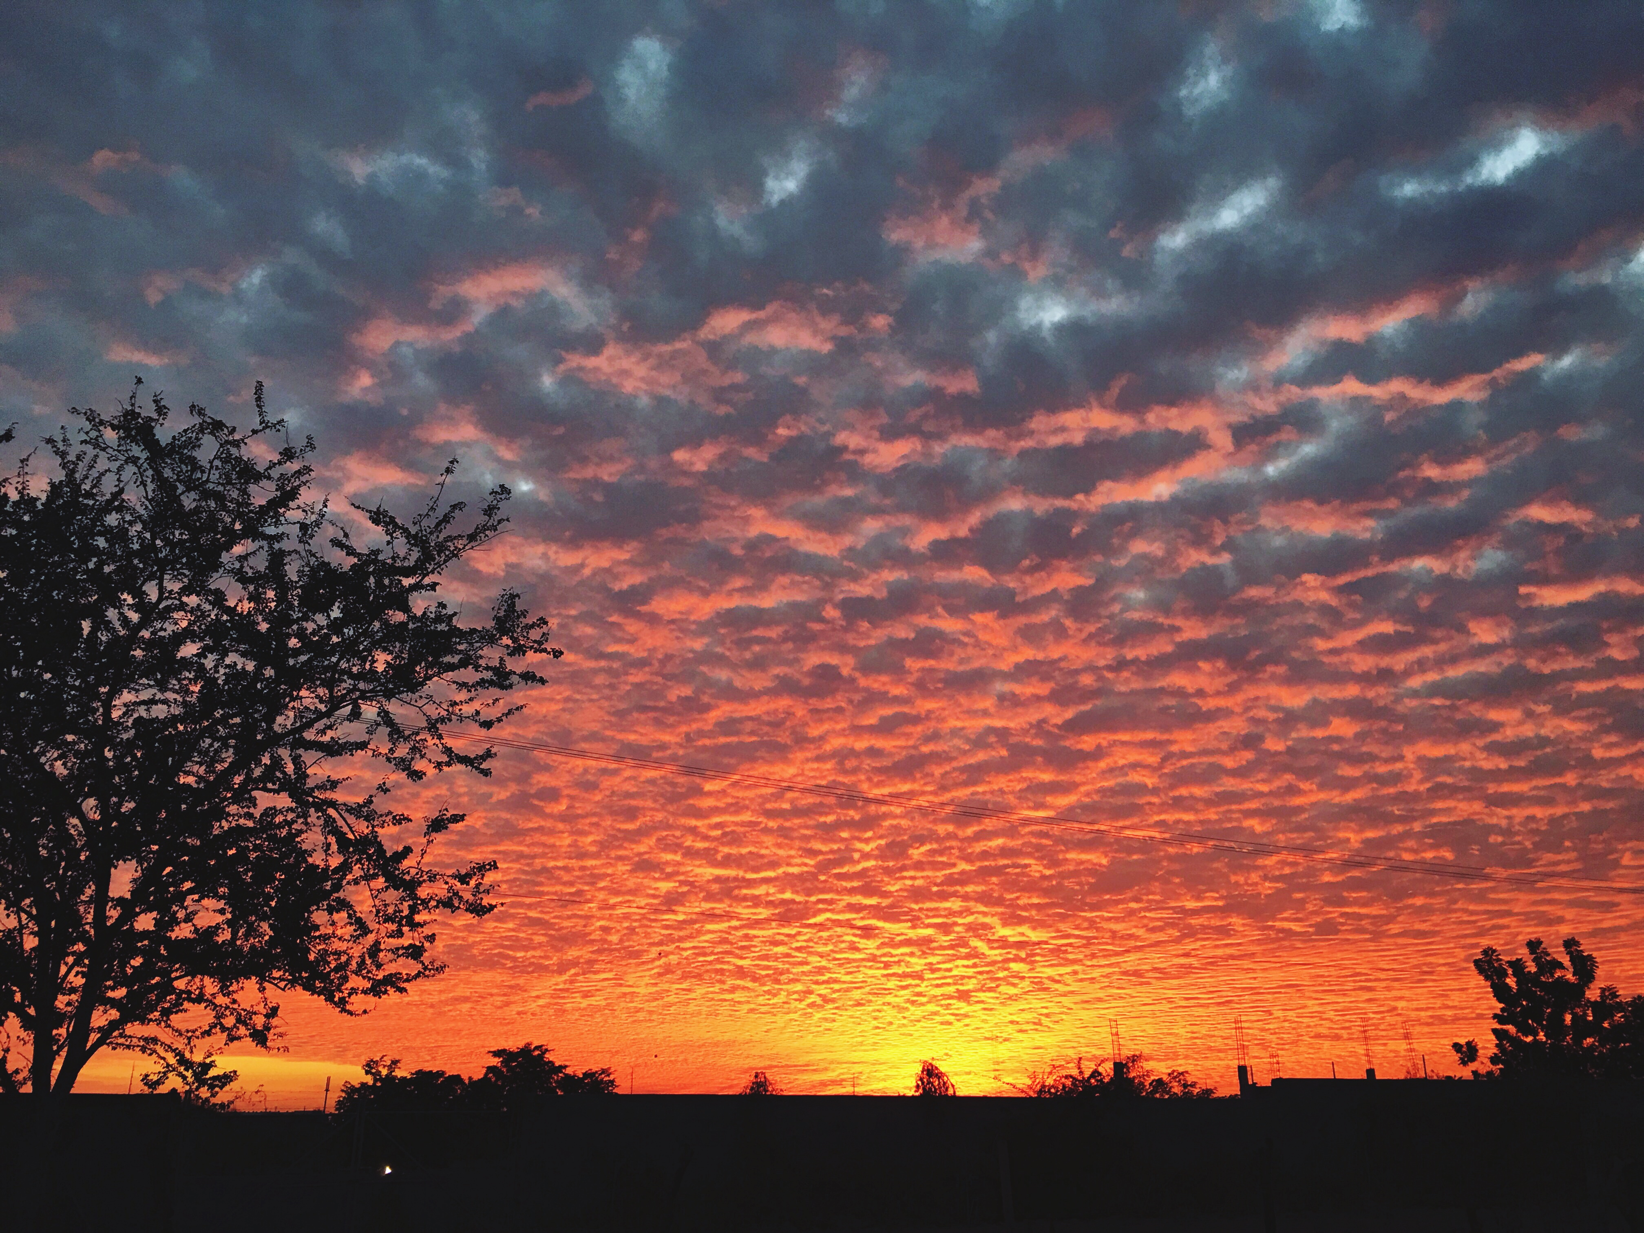
THANKS!

Slide 34
BACKUP SLIDES

Slide 35

















Regions
$xu_{v}$ distribution
$xs$ distribution
$$R_{1}=\{Q_{0}≤Q≤10 GeV\}$$
$$R_{1}=\{Q_{0}≤Q≤4.5 GeV\}$$
$$R_{2}=\{10GeV≤Q≤1000 GeV\}$$
$$R_{2}=\{4.5 GeV≤Q≤1000 GeV\}$$
$xb$ distribution
$xc$ distribution
$$R_{1}=\{4.5≤Q≤15 GeV\}$$
$$R_{1}=\{1.47≤Q≤3 GeV\}$$
$$R_{2}=\{15 GeV≤Q≤1000 GeV\}$$
$$R_{2}=\{3 GeV≤Q≤1000 GeV\}$$
$xg$ distribution
$$R_{1}=\{Q_{0}≤Q≤2.5 GeV\}$$
$$R_{3}=\{5 GeV≤Q≤5 GeV\}$$
$$R_{2}=\{2.5 GeV≤Q≤5 GeV\}$$
$$R_{4}=\{150 GeV≤Q≤1000 GeV\}$$
19
S. A. Ochoa-Oregon et al., Phys. Rev. D 110, 036019 [hep-ph].

Slide 36



Functional Forms
Up distributions
Down distributions
For $R_{1}$:
For $R_{2}$:
20
S. A. Ochoa-Oregon et al., Phys. Rev. D 110, 036019 [hep-ph].

Slide 37






Functional Forms
Strange distribution
Charm distribution
For $R_{1}$:
For $R_{1}$:
For $R_{1}$, $R_{2}$:
For $R_{2}$:
21
S. A. Ochoa-Oregon et al., Phys. Rev. D 110, 036019 [hep-ph].

Slide 38


Functional Forms
Bottom distribution
Gluon distribution
For $R_{1}$:
For $R_{1}$:
For $R_{2}$:
For $R_{1}$, $R_{2}$and $R_{3}$:
21
S. A. Ochoa-Oregon et al., Phys. Rev. D 110, 036019 [hep-ph].

Slide 39

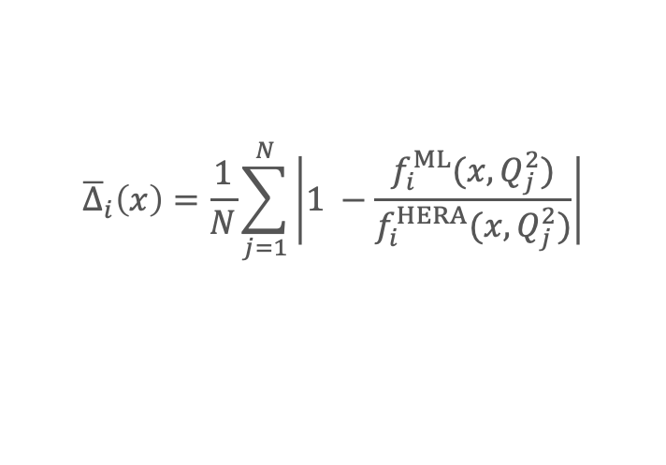
Another Cost-Function
Error Shape
$${\overline{Δ}}_{i}\left(x\right)=\frac{1}{N}\sum_{j=1}^{N}{\left|1 −\frac{f_{i}^{ML}(x, Q_{j}^{2})}{f_{i}^{HERA}(x, Q_{j}^{2})}\right|}$$
$N=50,000$ and $Q∈ \{10 GeV, 1000 GeV\}$
22
S. A. Ochoa-Oregon et al., Phys. Rev. D 110, 036019 [hep-ph].

Slide 40
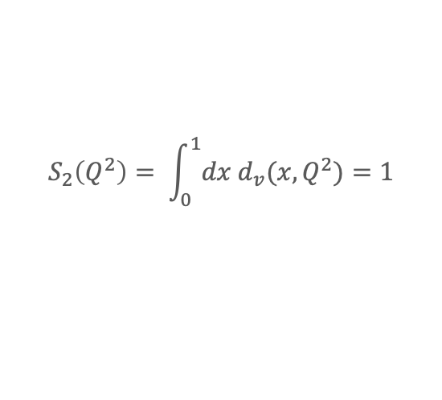


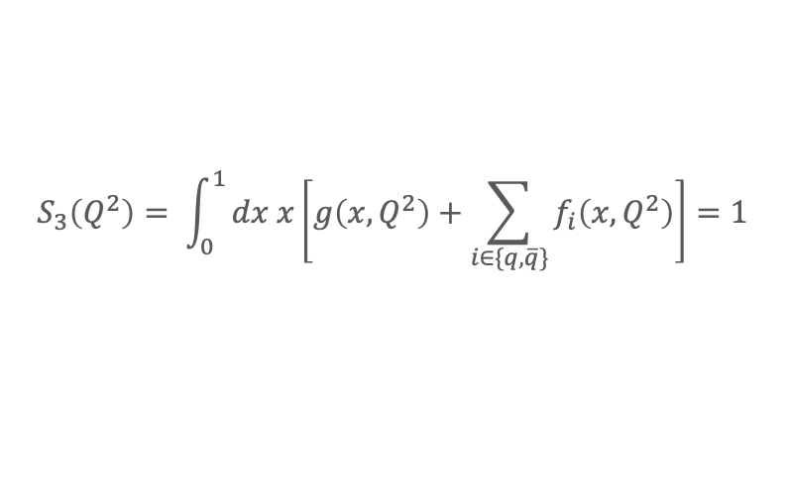
Validity of the sum rules
Sume rules for any energy scale $Q$
$$S_{1}\left(Q^{2}\right)= \int_{0}^{1}{dx u_{v}(x,Q^{2})}=2$$
$$S_{2}\left(Q^{2}\right)= \int_{0}^{1}{dx d_{v}(x,Q^{2})}=1$$
$$S_{3}\left(Q^{2}\right)= \int_{0}^{1}{dx x\left[g\left(x,Q^{2}\right)+\sum_{i∈\{q, \overline{q}\}}{f_{i}\left(x, Q^{2}\right)}\right]=1}$$
23
S. A. Ochoa-Oregon et al., Phys. Rev. D 110, 036019 [hep-ph].

Slide 41
Validity of the sum rules
Sume rules for any energy scale $Q$
24
S. A. Ochoa-Oregon et al., Phys. Rev. D 110, 036019 [hep-ph].

