Slide 1
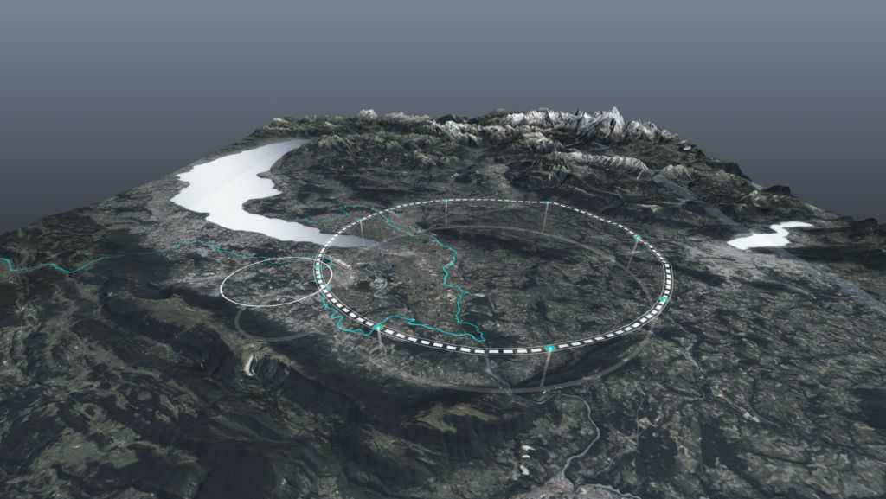









Special Session on the FCC
General Introduction
Emmanuel Tsesmelis (CERN)
Head of Associate Member State and Non-Member State Relations
Convenor of FCC Global Collaboration Working Group
XV Latin American Symposium on High Energy Physics (SILAFAE)
CINVESTAV, Mexico City
4-8 November 2024
http://cern.ch/fcc
Work supported by the European Commission under the HORIZON 2020 projects EuroCirCol, grant agreement 654305; EASITrain, grant agreement no. 764879; iFAST, grant agreement 101004730, FCCIS, grant agreement 951754; E-JADE, contract no. 645479; EAJADE, contract number 101086276; and by the Swiss CHART program
photo: J. Wenninger

Slide 2
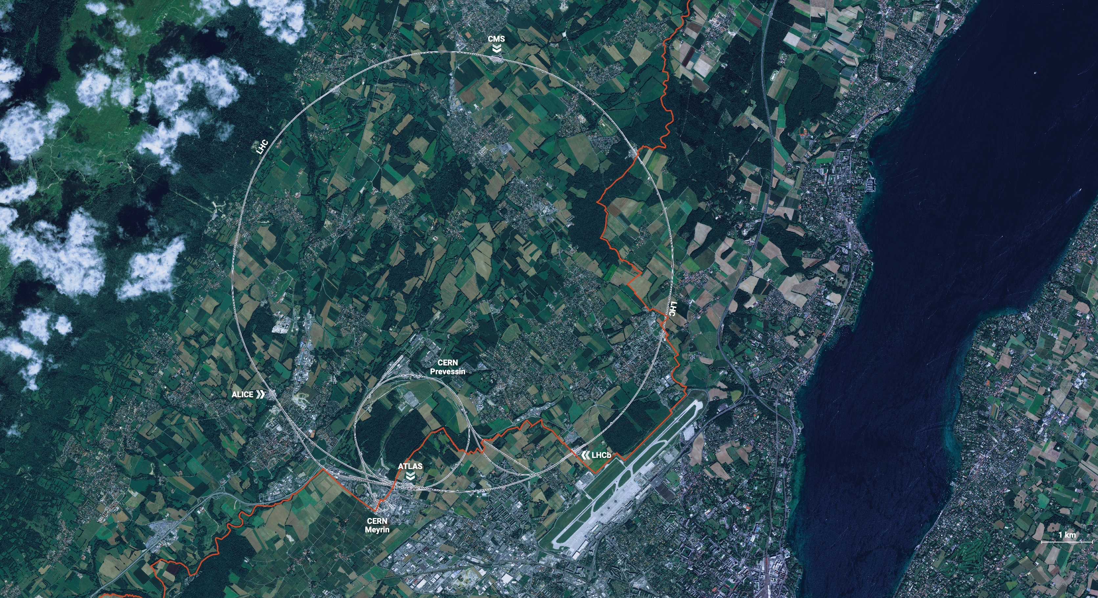
CERN is the world’s biggest laboratory
for particle physics.
Our goal is to understand the most fundamental particles and laws
of the universe.

Slide 3
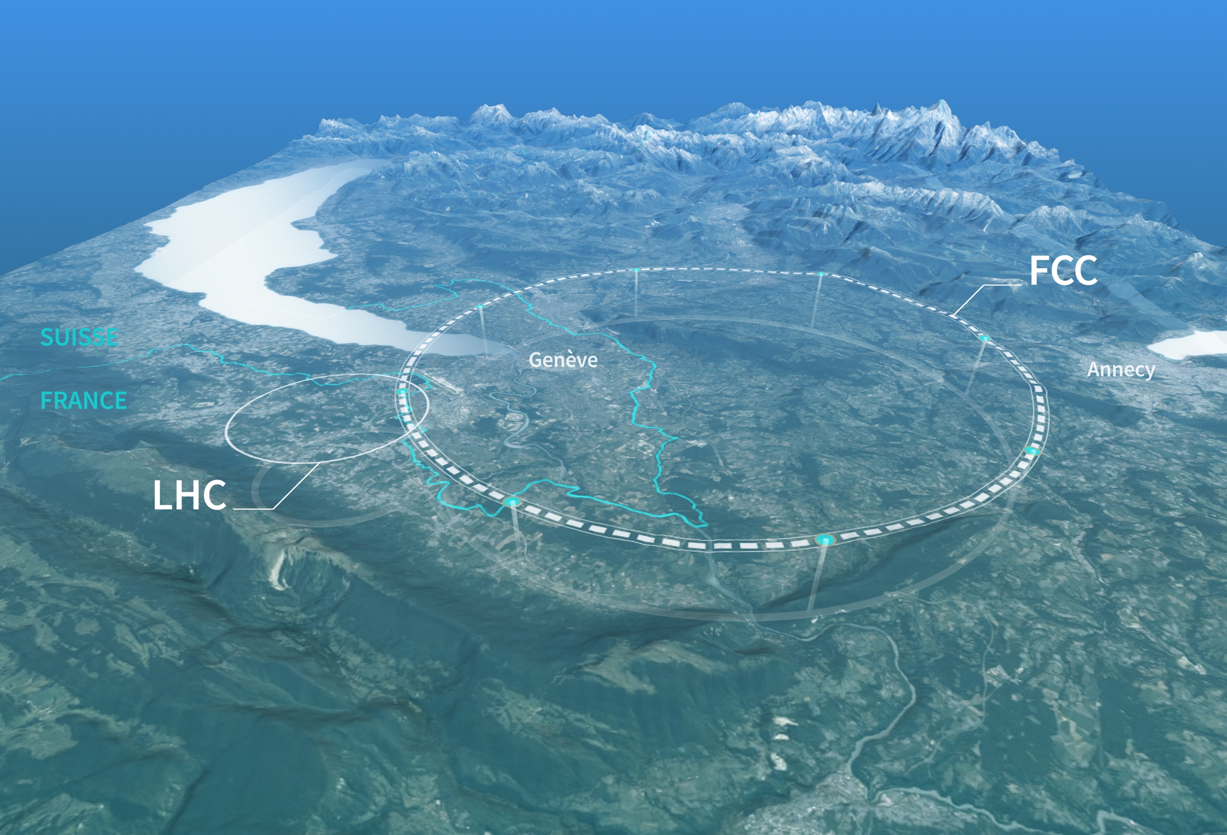
Preparing CERN’s Future
Driven by the 2020 Update of the European Strategy for Particle Physics
Technical and financial feasibility study of a Future Circular Collider (Spring 2025)
Accelerator R&D to develop technologies for FCC and for alternative options
Detector and computing R&D
Maintain and expand a compelling scientific diversity programme
Continue to support other projects around
the world
The third update of the European Strategy for Particle Physics was launched by the CERN Council in June 2024 and is expected to conclude in January 2026.

Slide 4
CERN Research Infrastructure
LHC
PS Complex
SPS
FCC
photo: J. Wenninger

Slide 5

Science for peace
CERN was founded in 1954 with 12 European Member States
CERN’s annual budget
is 1200 MCHF (equivalent
to a medium-sized European university)
24 Member States
Austria – Belgium – Bulgaria – Czech Republic
Denmark – Estonia – Finland – France – Germany
Greece – Hungary – Israel – Italy – Netherlands
Norway – Poland – Portugal – Romania – Serbia
Slovakia – Spain – Sweden – Switzerland – United Kingdom
As of 31 December 2023
Employees:
2666 staff, 1002 graduates
Associates:
12 370 users, 1513 others
2 Associate Member States
in the pre-stage to membership
Cyprus – Slovenia
8 Associate Member States
Brazil – Croatia – India – Latvia – Lithuania – Pakistan
Türkiye – Ukraine
6 Observers
Japan – Russia (suspended) – USA
European Union – JINR (suspended) – UNESCO
Around 50 Cooperation Agreements
with non-Member States and Territories
Albania – Algeria – Argentina – Armenia – Australia – Azerbaijan – Bangladesh – Bolivia – Bosnia and Herzegovina
Canada – Chile – Colombia – Costa Rica – Ecuador – Egypt – Georgia – Honduras – Iceland – Iran – Jordan
Kazakhstan – Lebanon – Malta – Mexico – Mongolia – Montenegro – Morocco – Nepal – New Zealand
North Macedonia – Palestine – Paraguay – People's Republic of China – Peru – Philippines – Qatar – Republic of Korea
Saudi Arabia – Sri Lanka – South Africa – Thailand – Tunisia – United Arab Emirates – Vietnam
Notes:
The speaker can highlight CERN’s second mission as stated when it was established: to foster peaceful collaborations between nations that had recently been at war.
Additional information (OPTIONAL)
More than 40% of CERN’s budget is returned to industry through materials, utilities and services

Slide 6
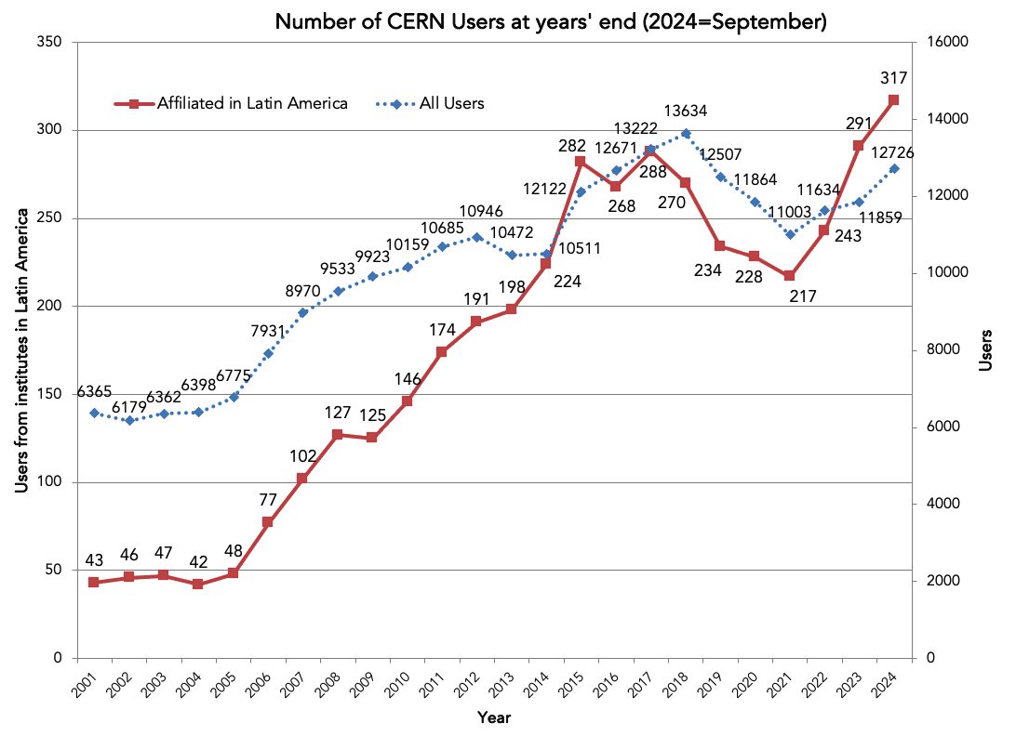
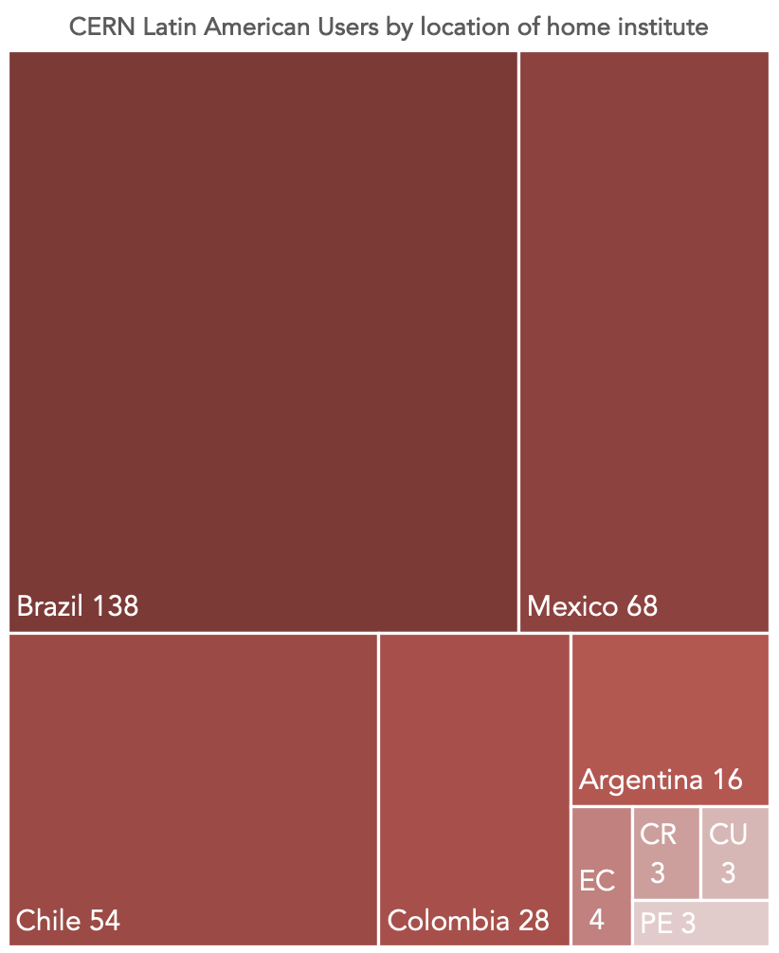
CERN Users (from Latin American institutes)
Students, Researchers & Technologists visiting for >5% of their working time over a 5-year window.
Local communities (Especially in Latin America) ~3-5 times larger: (under-)graduate students, engineers participating remotely/locally
S. Mele, SILAFAE, Nov. 2024

Slide 7

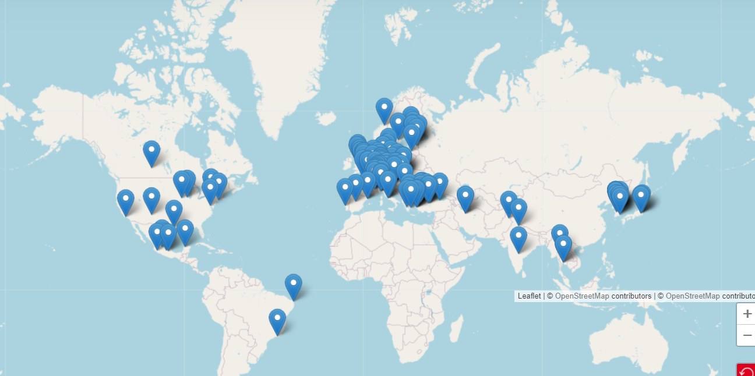


Status of FCC Global Collaboration
Increasing international collaboration as a prerequisite for success:
→links with science, research & development and high-tech industry will be essential to further advance and prepare the implementation of FCC
FCC Feasibility Study:
Aim is to increase further the collaboration,
on all aspects, in particular on
Accelerator and Particle/Experiments/Detectors
141 Institutes
32 countries
+
CERN

Slide 8
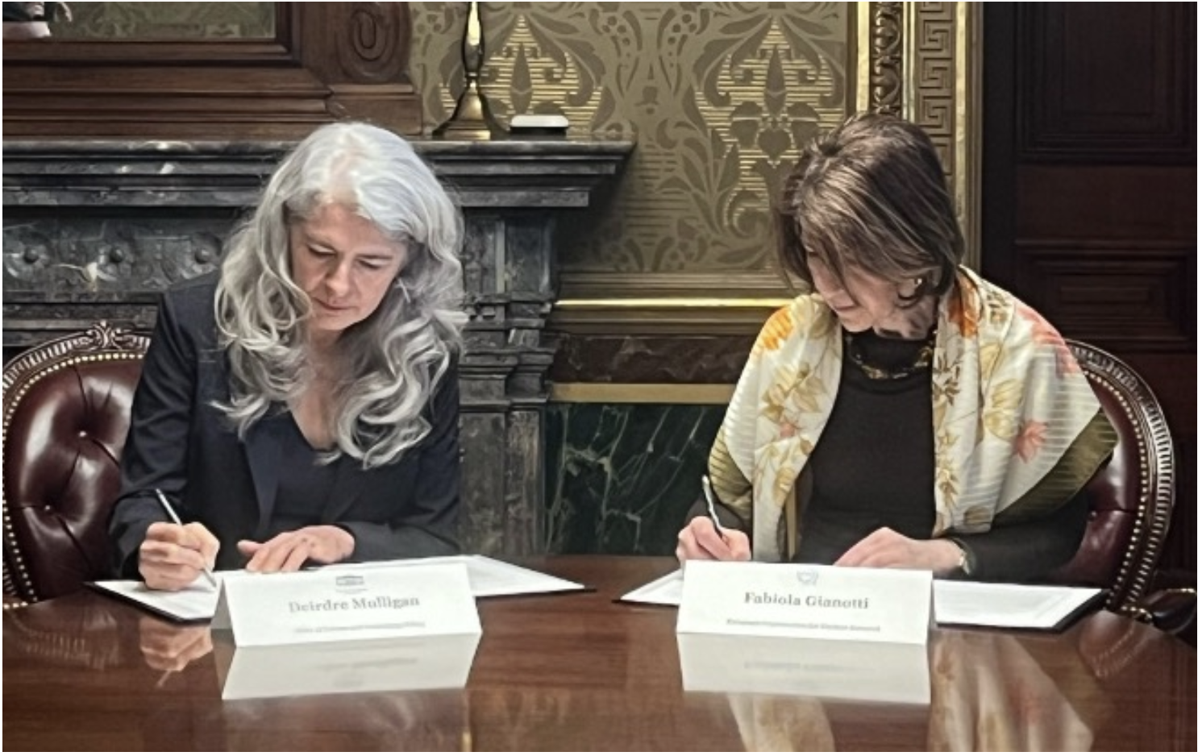
Statement of Intent – CERN & USA
CERN and the US government have released a joint statement concerning future planning for large research infrastructures, advanced scientific computing and open science.
CERN and the US intend to enhance collaboration in planning activities for large-scale, resource-intensive facilities with the goal of providing a sustainable and responsible pathway for the peaceful use of future accelerator technologies.
“Should the CERN Member States determine the FCC-ee is likely to be CERN’s next world-leading research facility following the high-luminosity Large Hadron Collider, the United States intends to collaborate on its construction and physics exploitation, subject to appropriate domestic approvals.”
CERN Director-General, Fabiola Gianotti (right), and Principal Deputy US Chief Technology Officer,
Deirdre Mulligan, of the White House Office of Science and Technology (left) at the signing ceremony.
(Image:US Department of State, Bureau of Oceans & International Environmental & Scientific Affairs)
Washington, D.C., 26 April 2024

Slide 9
Latin American Institutes Participating in the
FCC Feasibility Study
Institute | Country | MoU Status
CBPF, Brazilian Center for Physics Research | Brazil | Fully Signed
UFRN, Federal University of Rio Grande do Norte | Brazil | Fully Signed
PUC, Pontificia Universidad Católica de Chile | Chile | Fully Signed
Millenium Institute SAPHIR | Chile | Fully Signed
UNAL - Universidad Nacional de Colombia | Colombia | Sent to Institute
CINVESTAV, Centro de Investigación y de Estudios Avanzados del IPN | Mexico | Fully Signed
UADY, Autonomous University of Yucatan | Mexico | Fully Signed
UGTO, Universidad de Guanajuato | Mexico | Fully Signed
BUAP, Benemérita Universidad Autónoma de Puebla | Mexico | Fully Signed
UCOL, University of Colima | Mexico | Sent to Institute
UAS, Universidad Autonoma de Sinaloa | Mexico | To be contacted

Slide 10


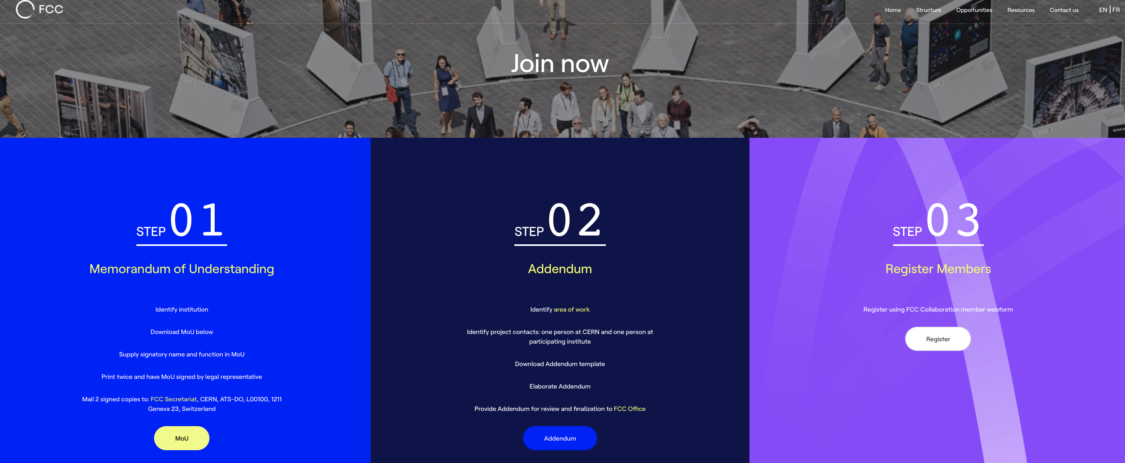
FCC Feasibility Study Collaboration Membership
Participation in FCC through MoU and Addenda.
The FCC MoU for the first phase of the study (Conceptual Design) is updated to cover the Feasibility Study.
The current participating institutes who wish to take part in the Feasibility Study can continue to participate on the basis of the previously signed MoU until the updated MoU is signed.
https://fccis.web.cern.ch/join-now

Slide 11
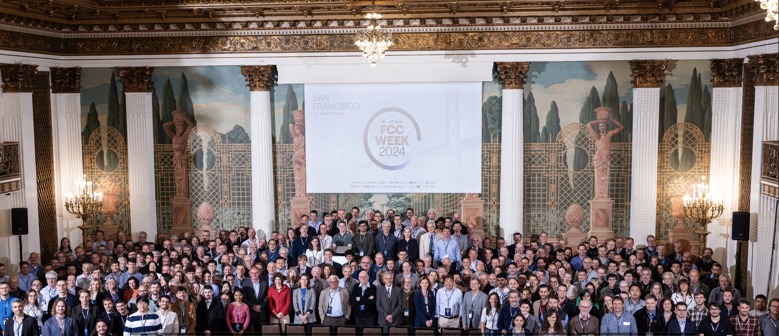
FCC Week 2024 San Francisco, USA
449 participants
374 in person and 75 remote
Next: FCC Week 2025
Vienna, Austria
19-23 May 2025

Slide 12
CERN, the FCC and International Collaboration
We now know much about the Universe, using increasingly larger and more complex machines. There remain many very interesting and unanswered questions in particle physics to be solved.
CERN is the right place for the next large accelerator.
The first stage of FCC could be approved within a few years after the next European Strategy Update, if the latter is supportive. Following approval by the CERN Council, tunnel construction could then start in the early 2030s and FCC-ee physics programme could begin in the second half of the 2040s, a few years after completion of the HL-LHC physics runs, expected by around 2040.
Long-term goal: world-leading HEP infrastructure for 21st century to push particle-physics precision and energy frontiers far beyond present limits.
We are counting on the scientists and engineers of the future to make the project a success for the exploration of the fundamental laws and building blocks of the Universe.
Strong collaboration with international partners is essential for success!
Video

Slide 13


