Slide 1

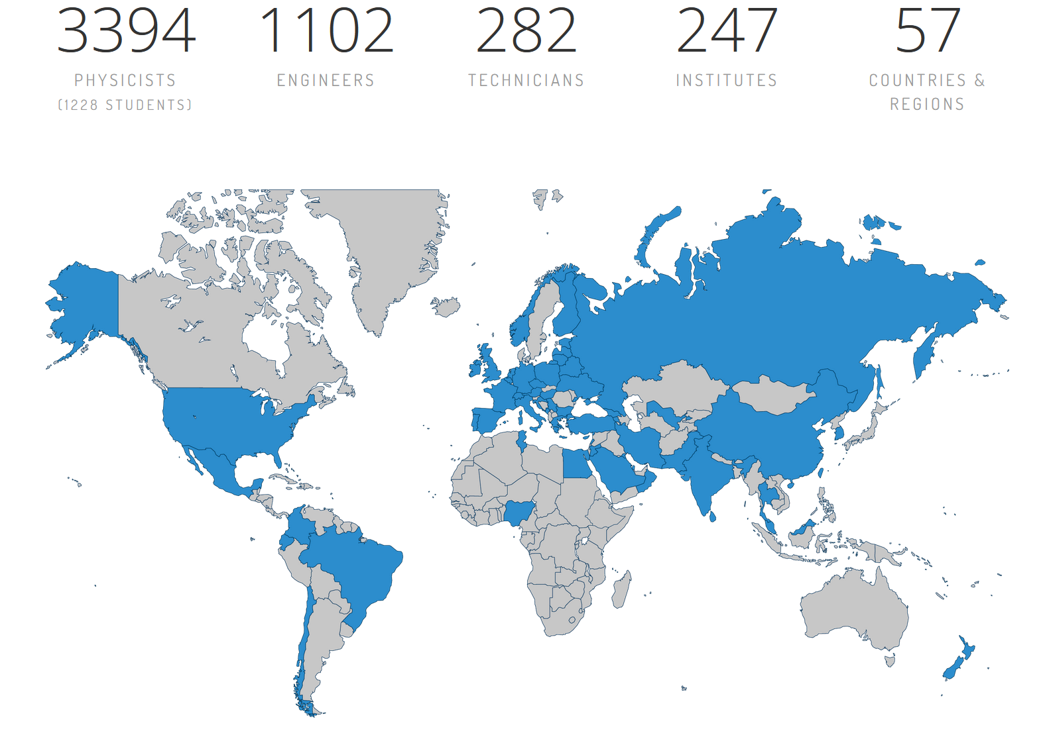
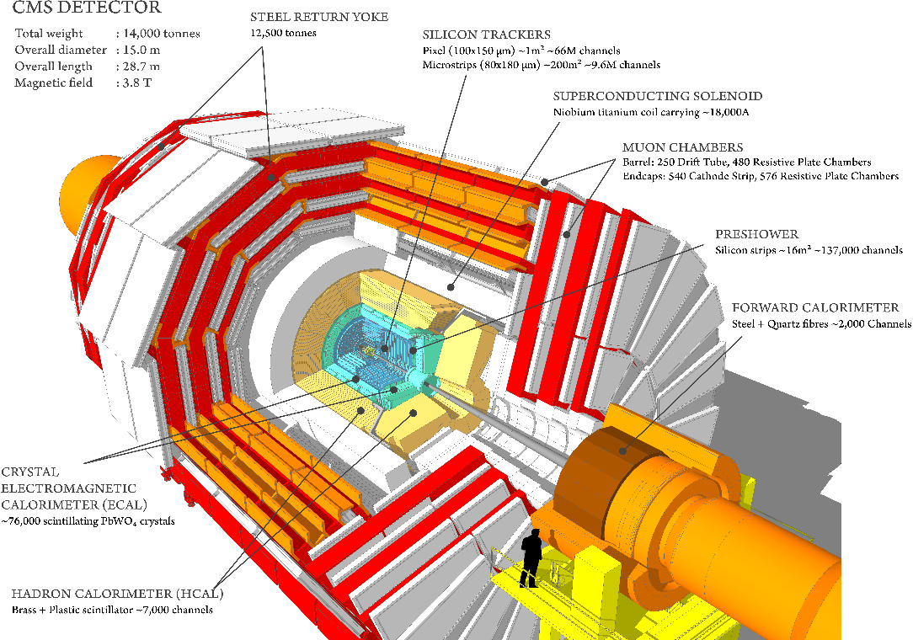
Overview of the Physics beyond the Standard Model
@ CMS Experiment (LHC)
Sergei Shmatov (JINR, Dubna)
shmatov@cern.ch shmatov@jinr.ru
https://cms.cern/ https://cms-info.web.cern.ch/
XV Latin American Symposium on High Energy Physics, November 4-8, 2024, Cinvestav, Mexico

Slide 2
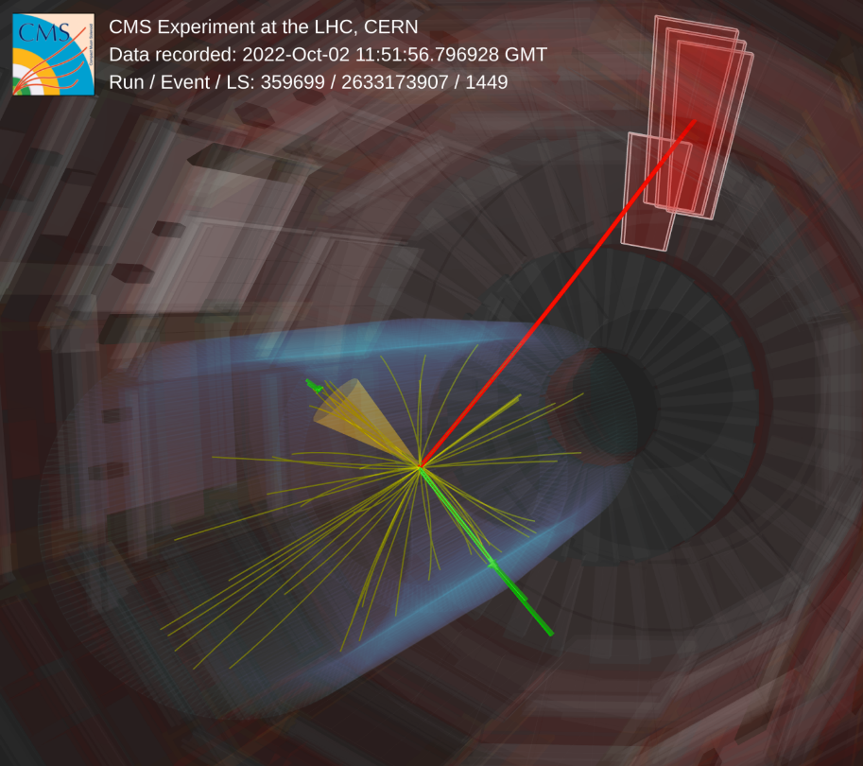
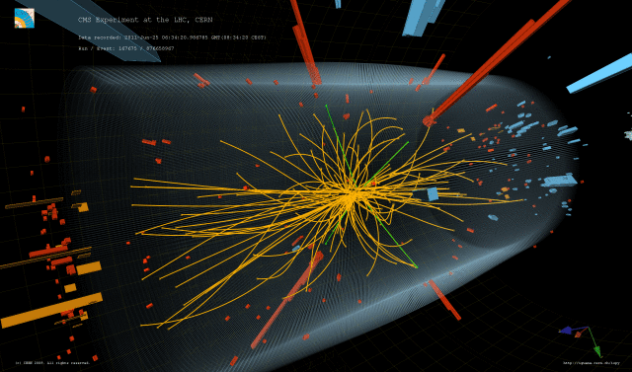
Content
Standard Model after over 10 Years of LHC Operations
Why we are still expecting the New Physics?
Conventional Signals (“standard candles”)
Higgs Boson as a Tool to Search for the New Physics
LLP Non-conventional Signals
Summary

Slide 3
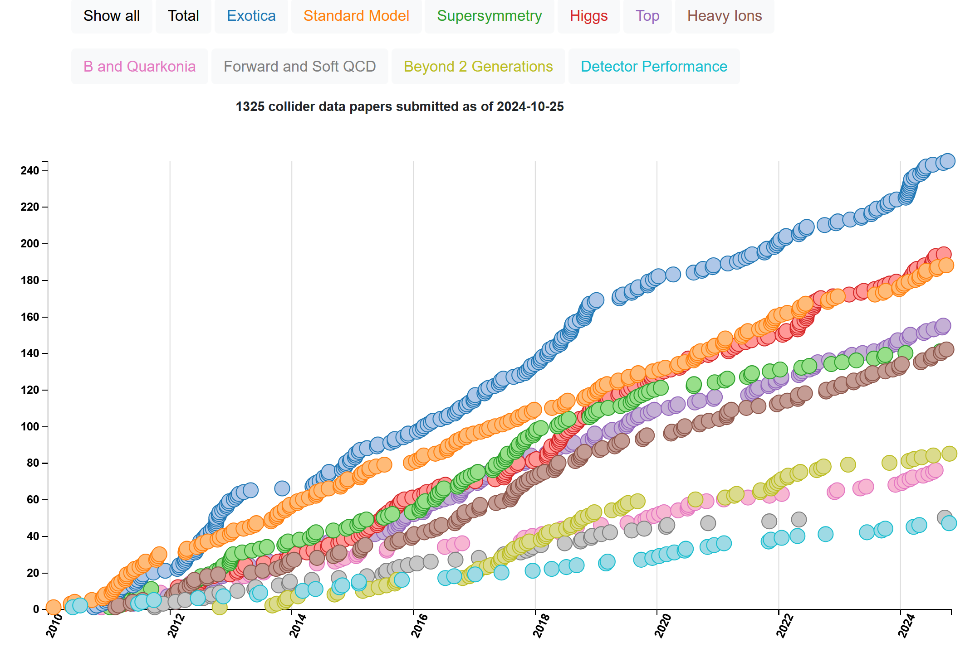

Some Statistics from CMS
This talk are summarized the selected (by me) the recent CMS results on Physics beyond the SM (mainly LPP and Higgs sector, i.g. many nice results with top are omitted, see talk by M. Pinamonti)
  Moriond/EW2024, 24-31 Mar 2024, La Thuile (Italy)
  Moriond/QCD2024, 31 Mar-7 Apr 2024, La Thuile (Italy)
  LHCP2024, 3-7 Jun 2024, Northeastern Univ., Boston (US)
  CHEP2024, 18-24 Jul 2024, Prague (Czech Republic)
  Recent CMS Briefings
1272 papers based on
collision data
(+25 on cosmic data)
http://cern.ch/cms-results/public-results/publications-vs-time/
Exotica – 245
SUSY – 141
B2G – 85
Higgs – 194
Standard Model/Top/B and Quarkonia - 419
Forward and Soft QCD – 50
Heavy Ion – 142
Detector Performance – 47
CMS Publications Page
https://cms-results.web.cern.ch/cms-results/public-results/publications/
CMS Public Results (newest)
https://cms-results-search.web.cern.ch/

Slide 4
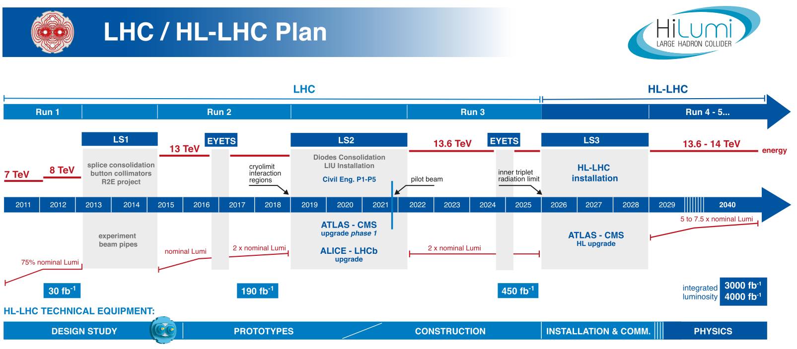
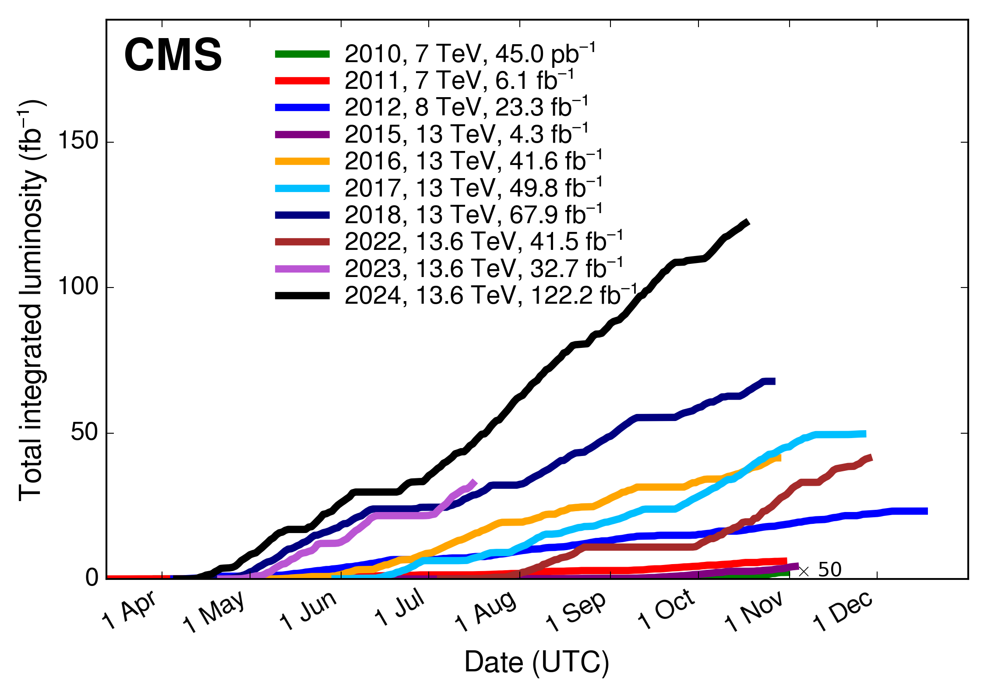
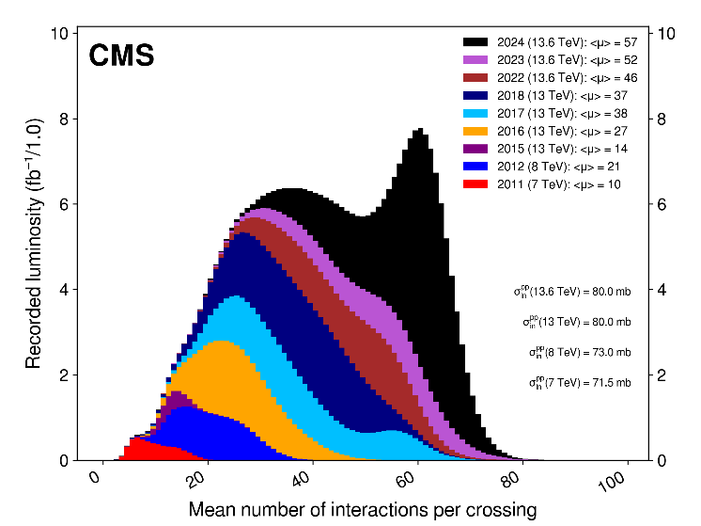
LHC Timeline and Data That We Have
CMS Luminosity Information
https://twiki.cern.ch/twiki/bin/view/CMSPublic/LumiPublicResults
Σ ≈ 390 fb⁻¹
L_{inst} = 2.1×10³⁴ cm⁻²s⁻¹
L_{iinst} = 7.5×10³⁴ cm⁻²s⁻¹
We are here
CMS Dataset RUN2
  ~163 fb⁻¹ of proton-proton collisions @ 13 TeV is delivered
  151.78 fb⁻¹ is recorded by CMS (data-taking efficiency ~93% )
CMS Dataset RUN3
  196.35 fb⁻¹ is already delivered @ 13.6 TeV during the RUN3
  180.84 fb⁻¹ is recorded by CMS (data-taking efficiency ~92% )
  ~93% of collected data “good for physics” in 2023 (91% in 2022)
  number of pp interactions per beam crossing (PU): ⟨μ⟩ = 57 for 2024
  ~260 fb⁻¹ it is expected @ 13.6 TeV for the end of the RUN3 (450 fb⁻¹, in total
  for RUN1/2/3)
  pPb and PbPb Runs
CMS Data Quality Information
https://twiki.cern.ch/twiki/bin/view/CMSPublic/DataQuality

Slide 5
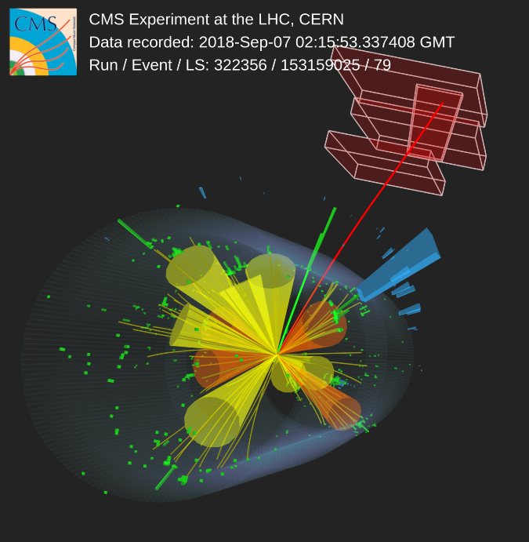
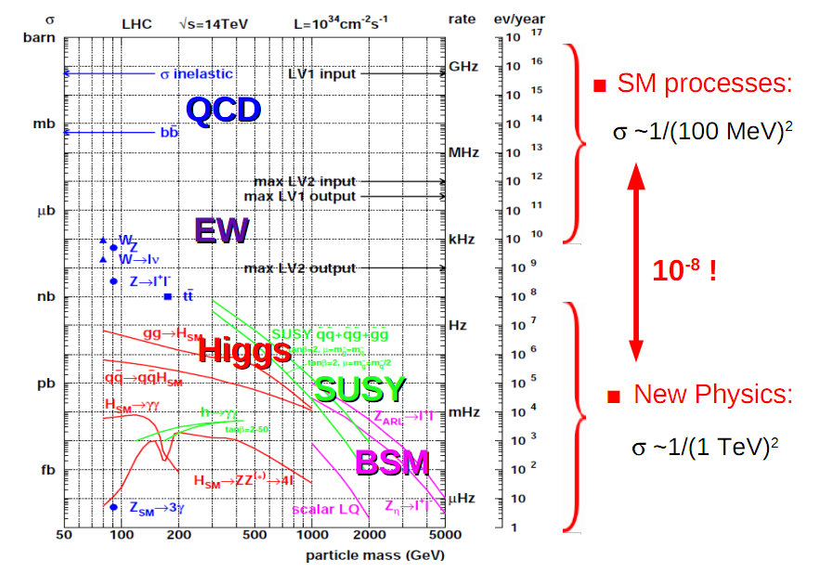
What do we know today about the Standard Model from LHC?

Slide 6
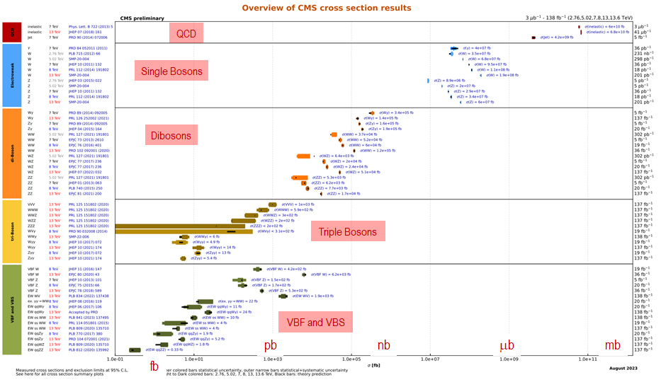
Summary of Standard Model Tests with EWK Bosons
Summaries of CMS cross section measurements
https://twiki.cern.ch/twiki/bin/view/CMSPublic/PhysicsResultsCombined
Agree with the Standard Model predictions!
see talk by M. Velasco

Slide 7
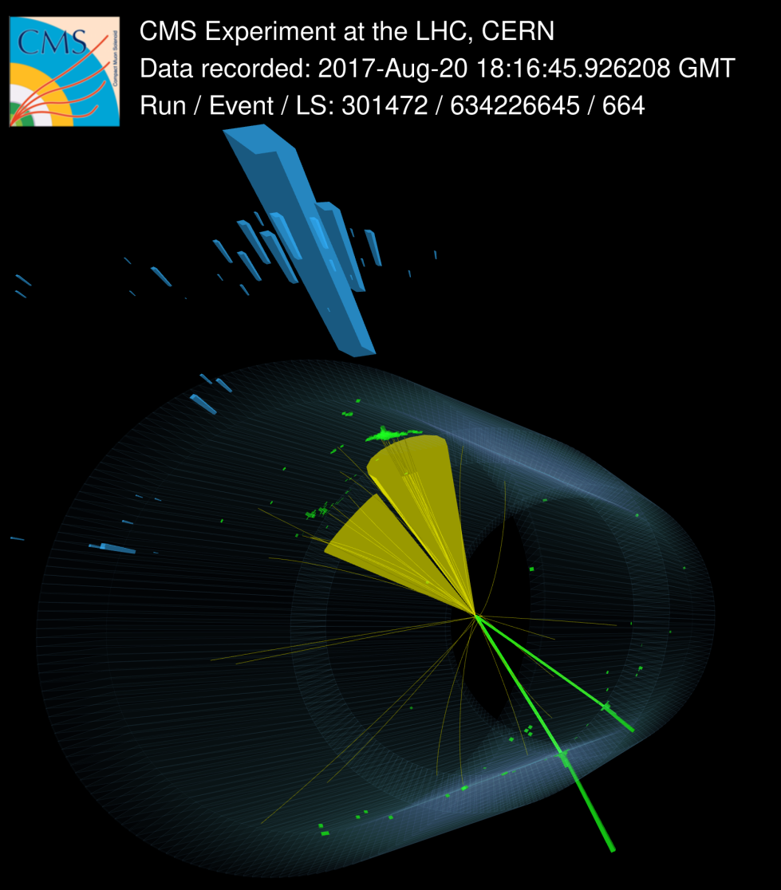
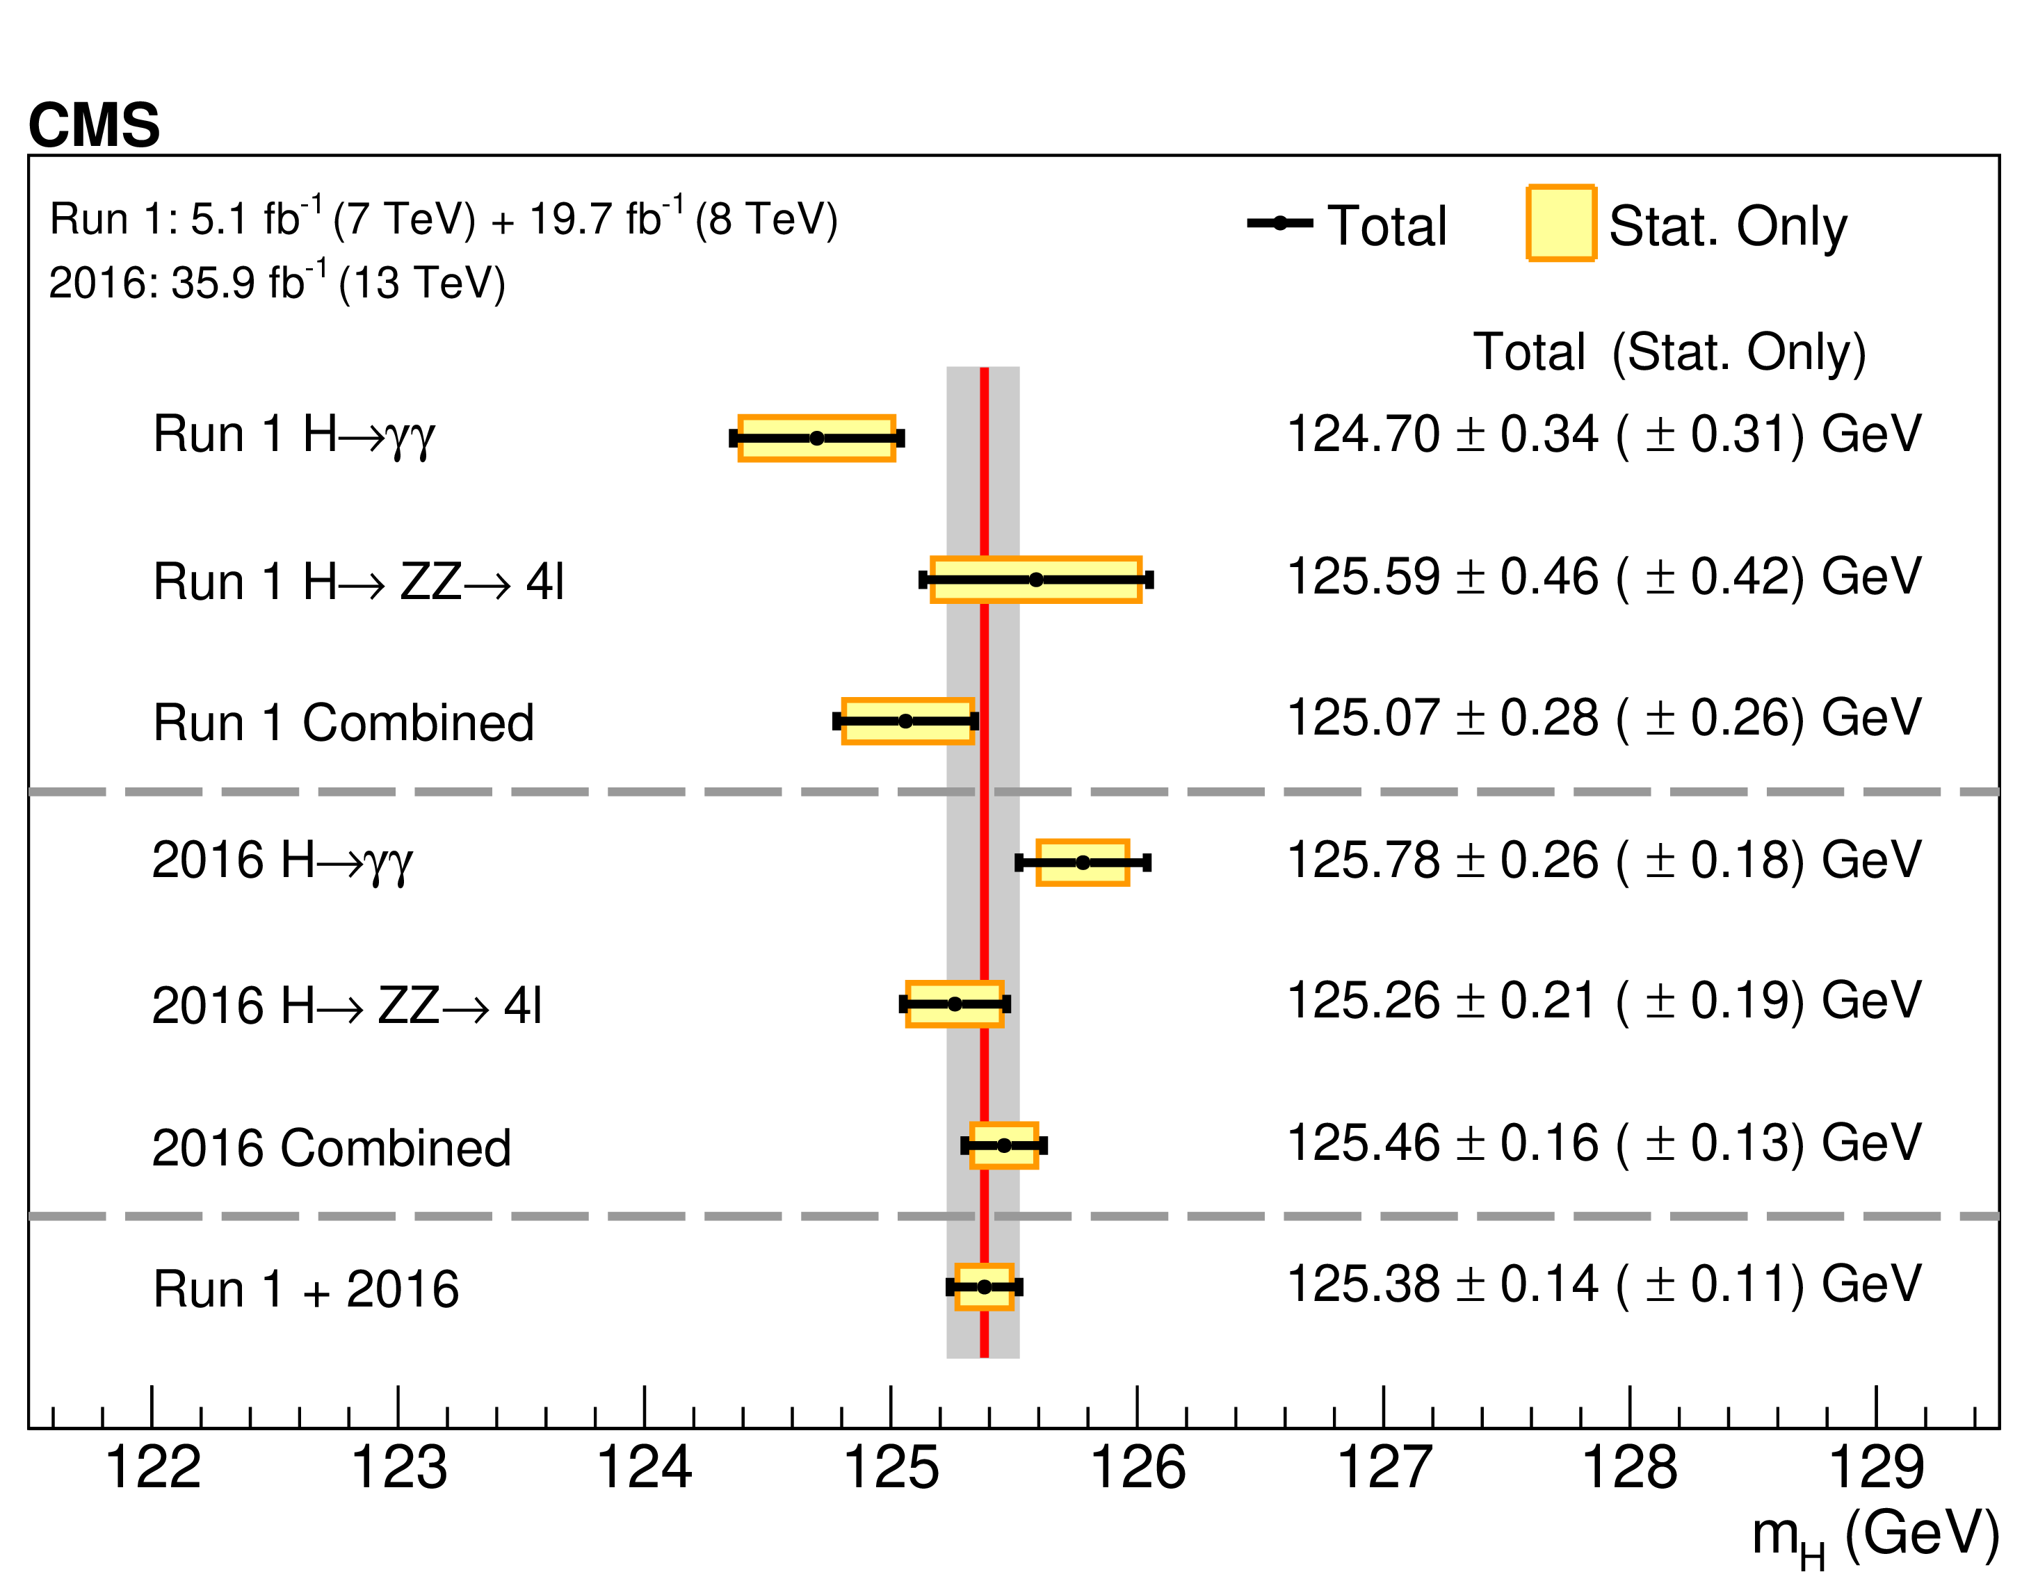
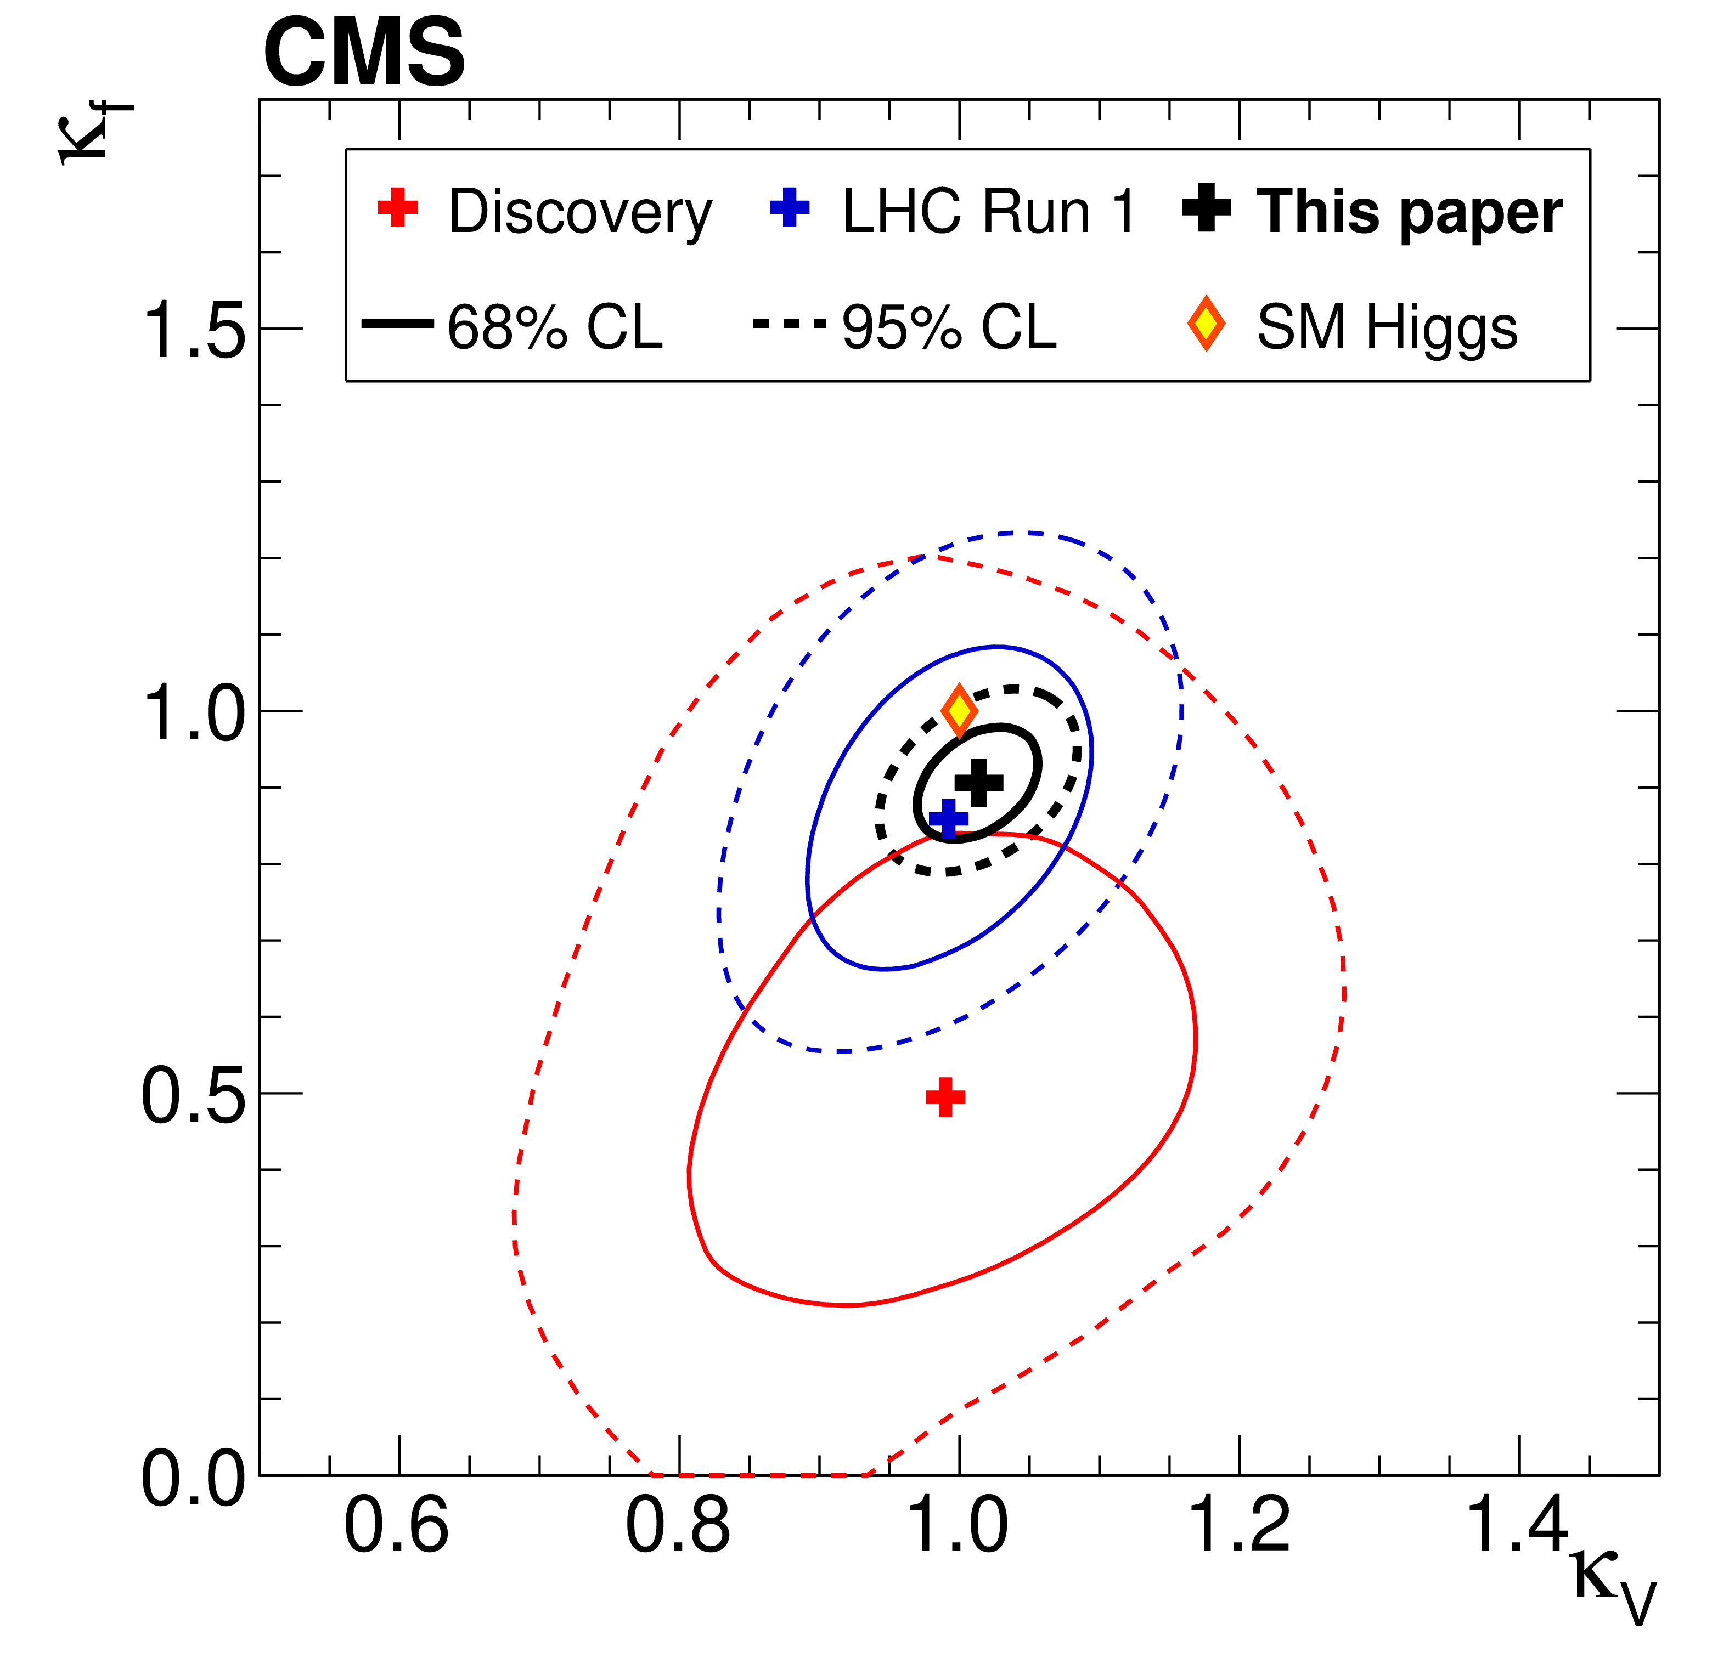

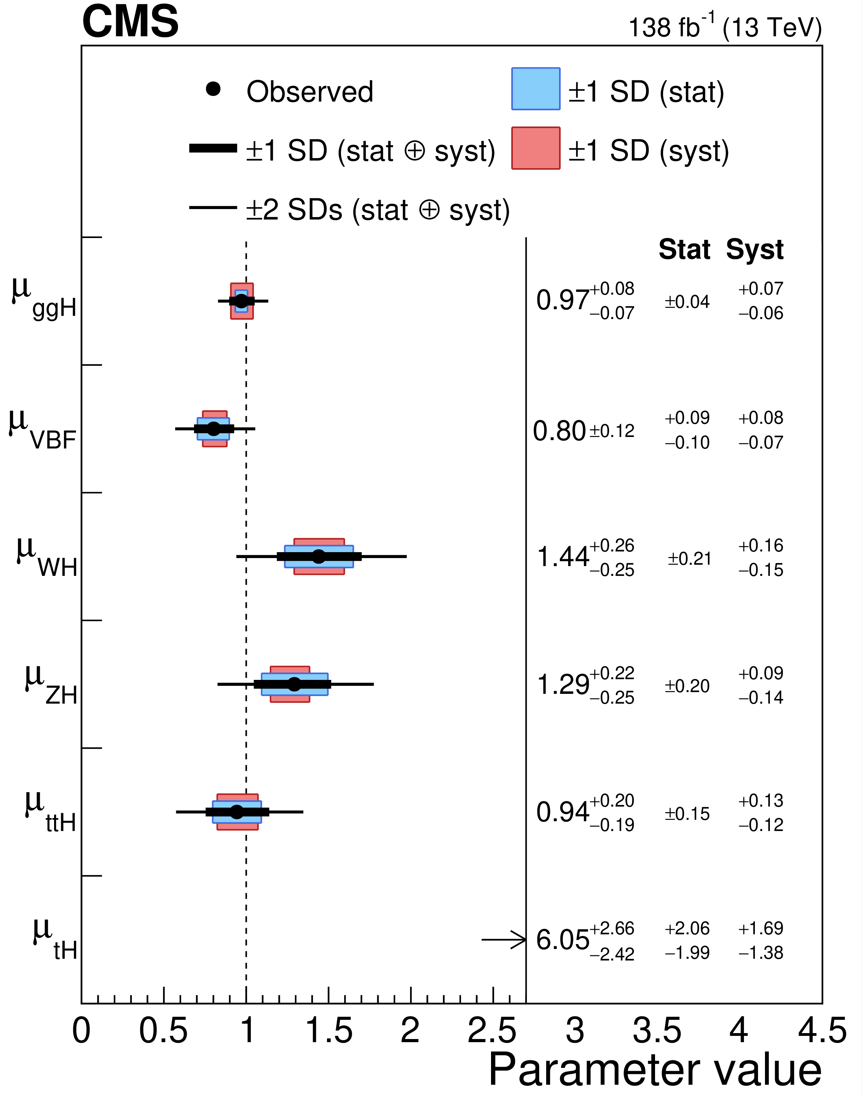


Higgs Portrait after 10 Years
During Run 2 of the LHC the experimental collaborations started to employ the combined data for precision measurements of Higgs properties (mass, width, couplings, CP, rare decays)
All main production mechanisms are observed, including h → bbar, ttH, VH
Mass of Higgs boson m_{h} is measured with an accuracy of 0.1% (!)
Precisions of cross section and branching ratio measurements in combined channel are down to 8.5% level
We have ~6-30% accuracy for measurements of couplings
The absolute value of a width is getting closer to the SM expectations (4.1 MeV). We still need to improve an accuracy.
Spin, parity, differential distributions do not contradict the SM
see talk by Reina Camacho Toro
Nature 607 (2022) 60

Slide 8
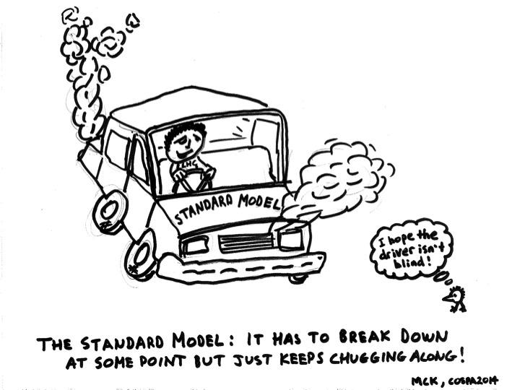
What do we have as a result?

Slide 9
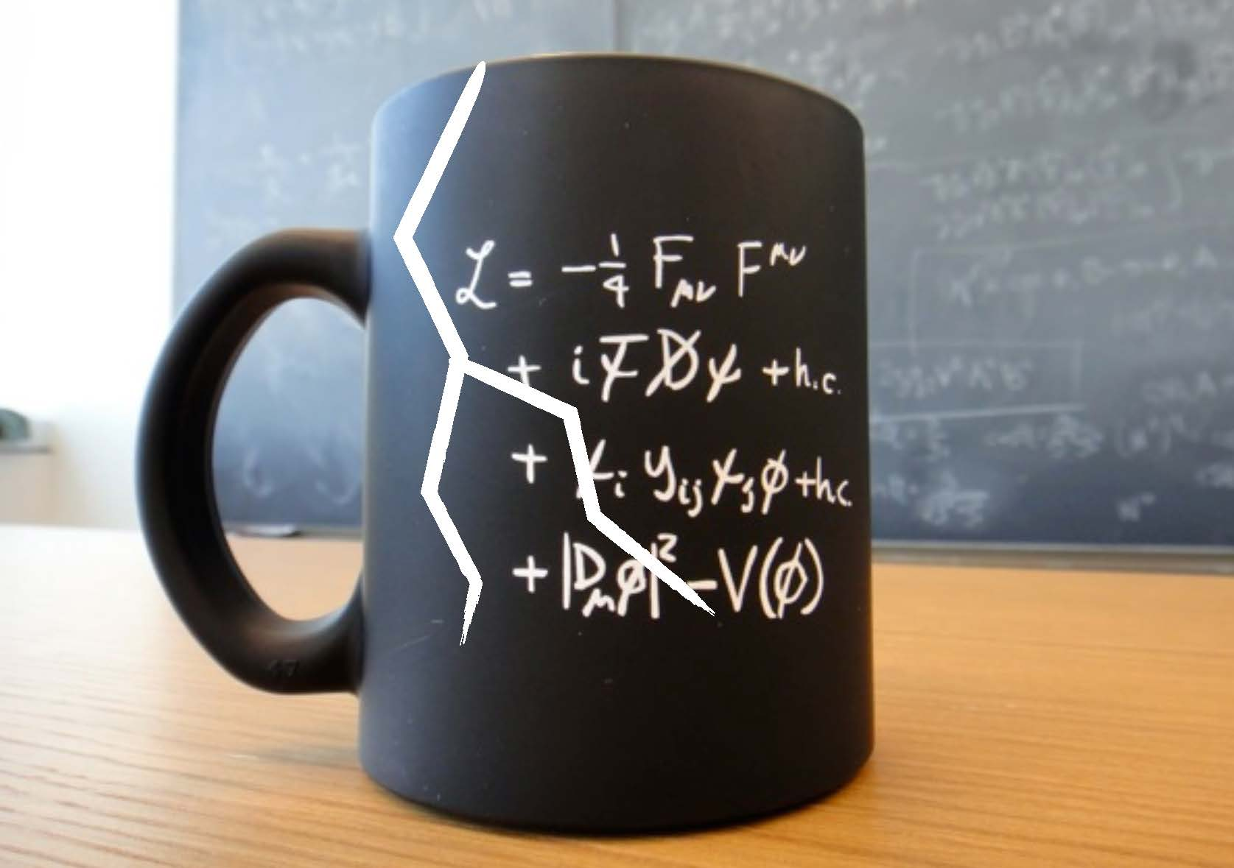
Why we are still expecting the New Physics?

Slide 10
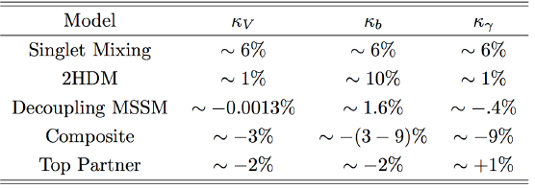
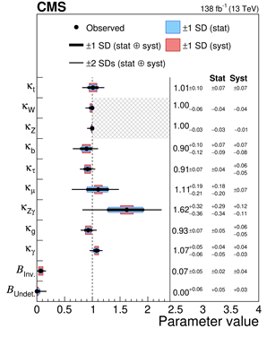
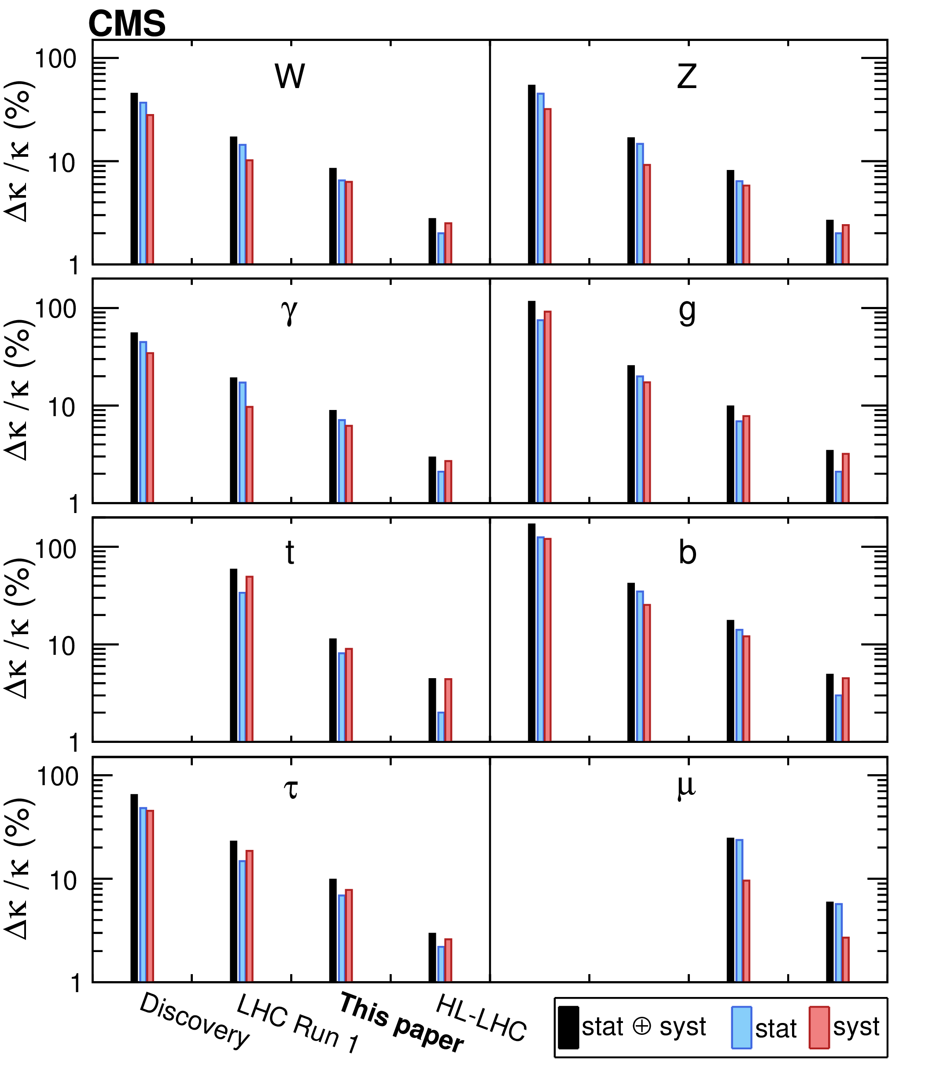
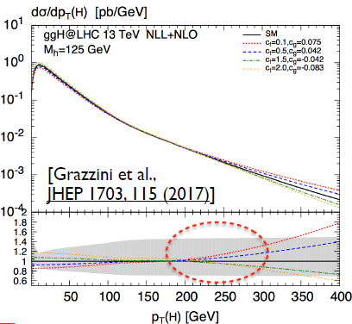
A room in Higgs Sector
… but the current accuracy of Higgs coupling measurements is still insufficient to reject BSM Higgs hypothesis
EPJC 79 (2019) 421
Summary of Higgs Couplings Measurements
Measurements precision continuous increasing
Search for new higgs states and other BSM
  BSM effects on in the differential distributions

Slide 11
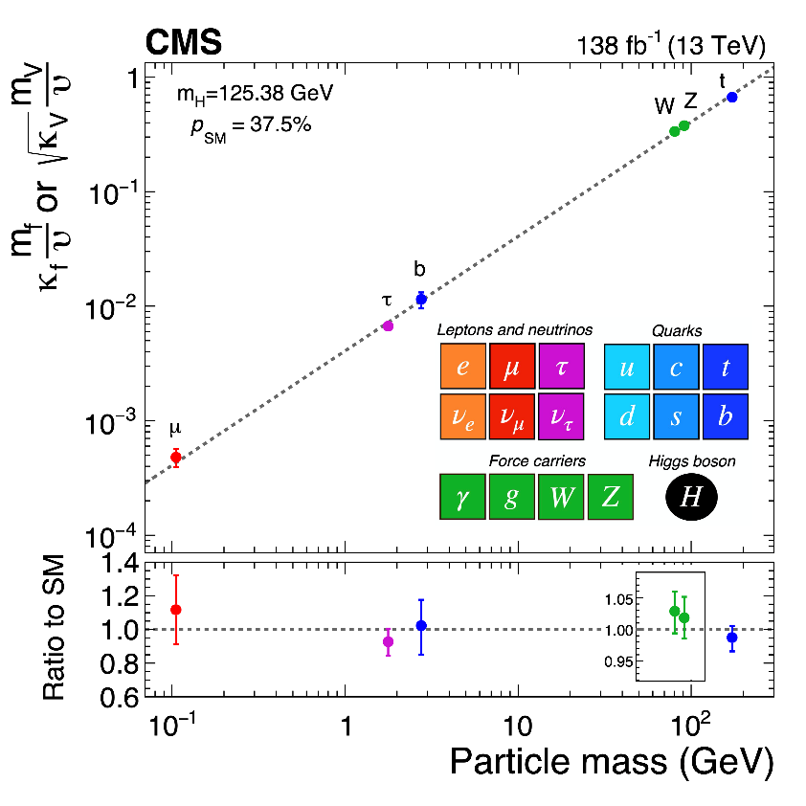
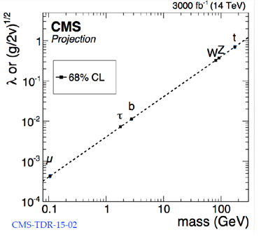
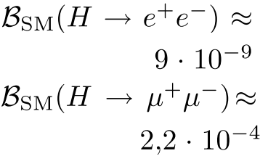


Another Hint from the Higgs: Flavor Universality
The properties of the Higgs h₁₂₅ agree fully with SM in decay into
gauge bosons
3rd generation fermions (t/b/τ)
and do not conflict with results for the 2nd generation (no deviations in cc/μμ decays after RUN2)
μμ: 3σ
CMS HL-LHC Projection
JHEP 01 (2021) 148
We do not know and will not know until the end of the LHC whether the coupling of the Higgs h₁₂₅ to 1st generation fermions is in a “standard” way or not.
If we have no Extra Higgses! (rare decays are enhanced within Extended Higgs Sectors)

Slide 12
Lepton universality in beauty-quark decays
SM
NP
arXiv:2103.11769 Nature 18, 277 (2022)
3.1 σ

Slide 13
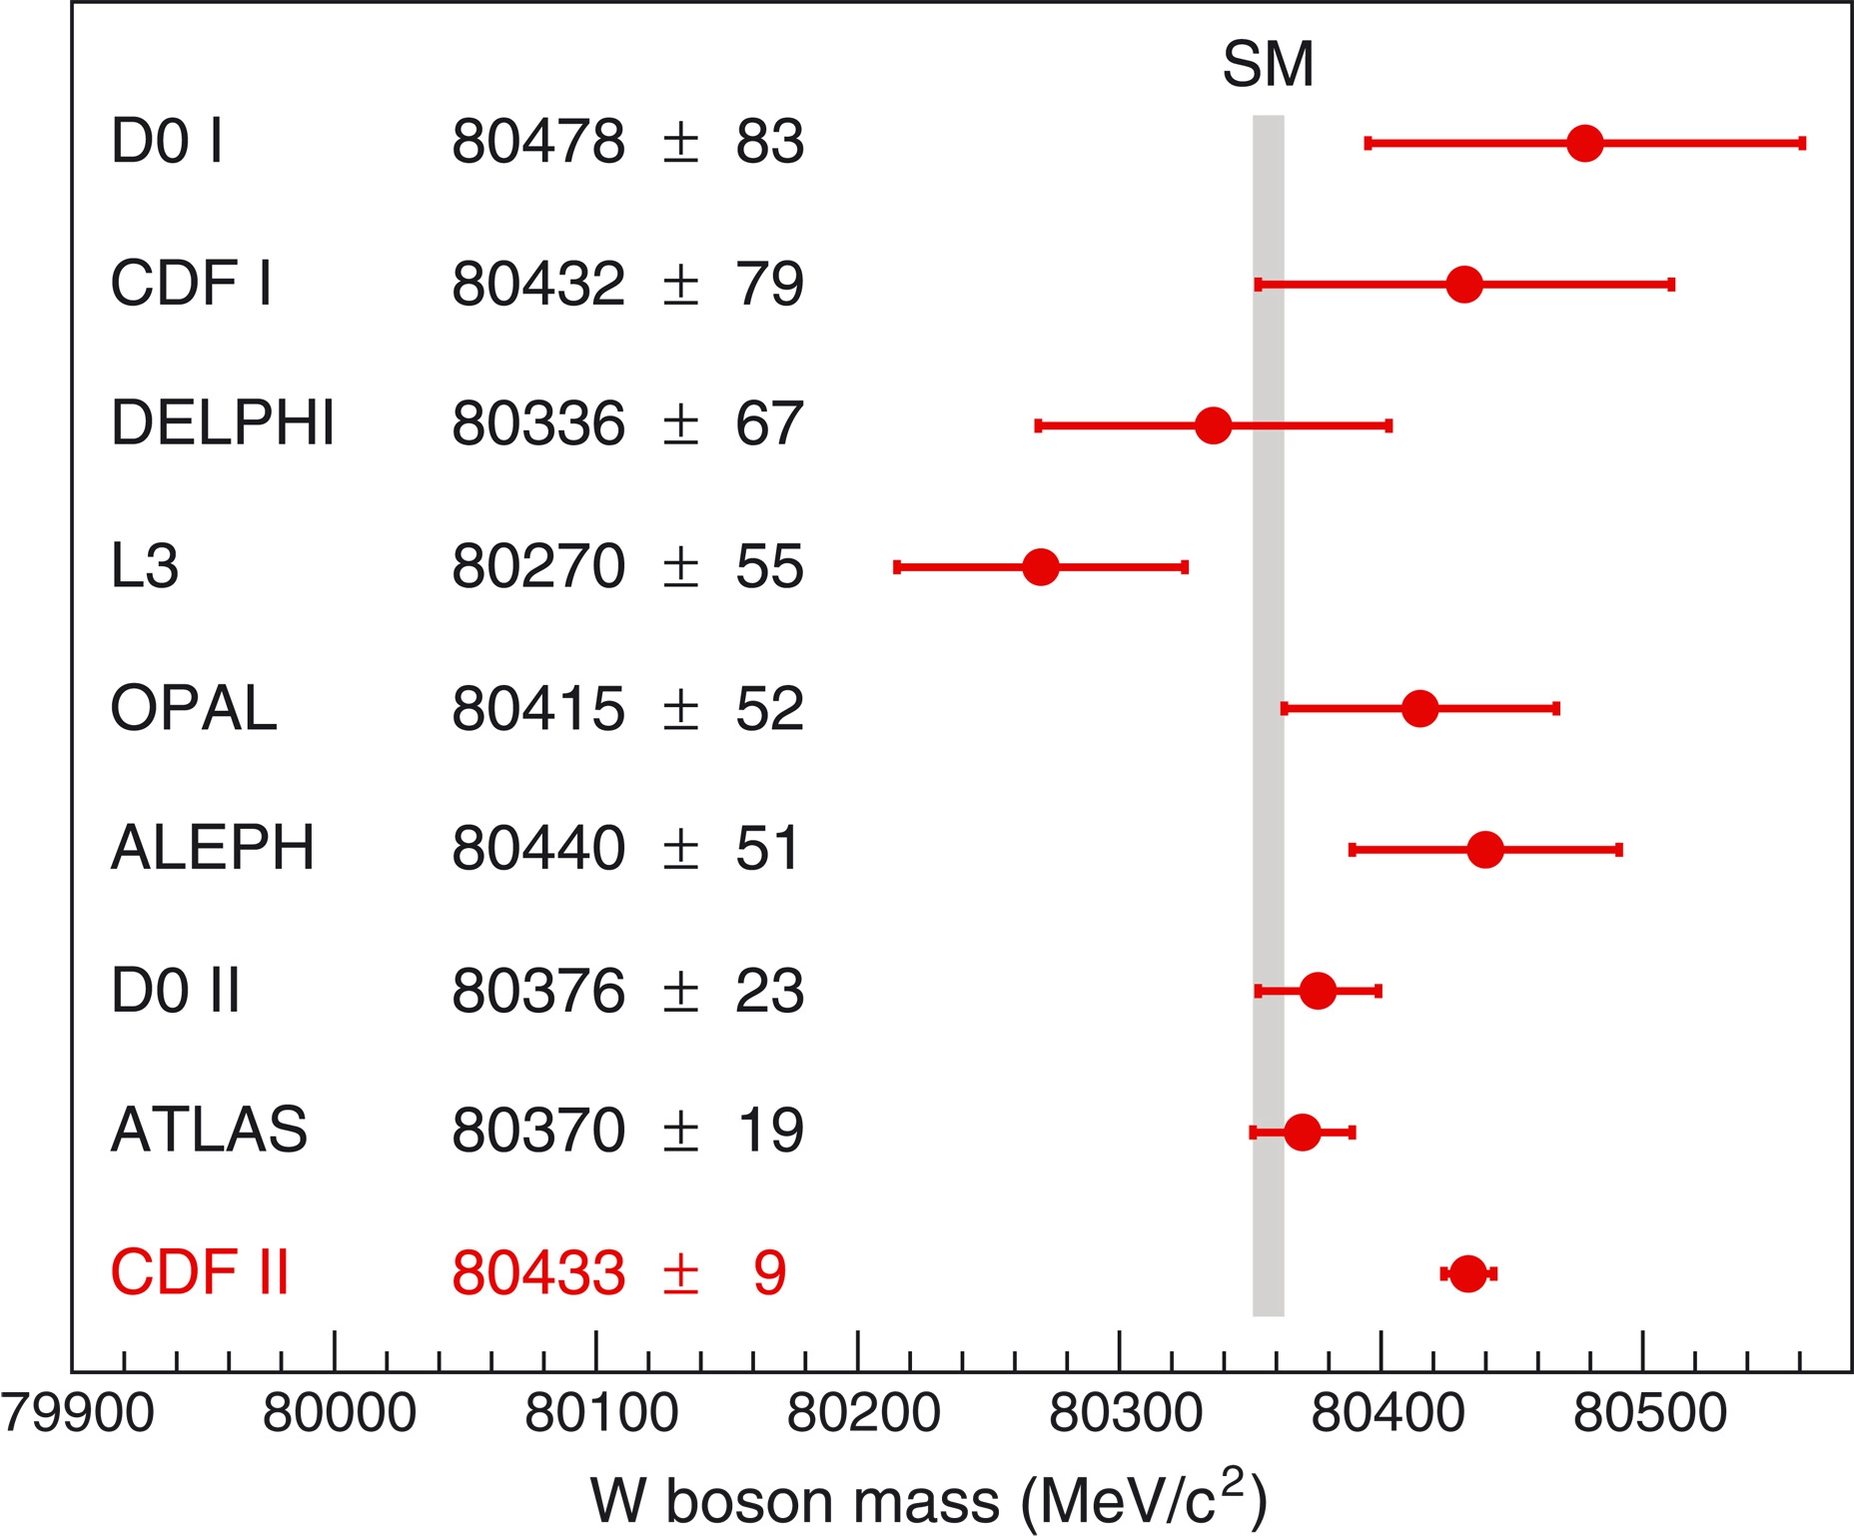
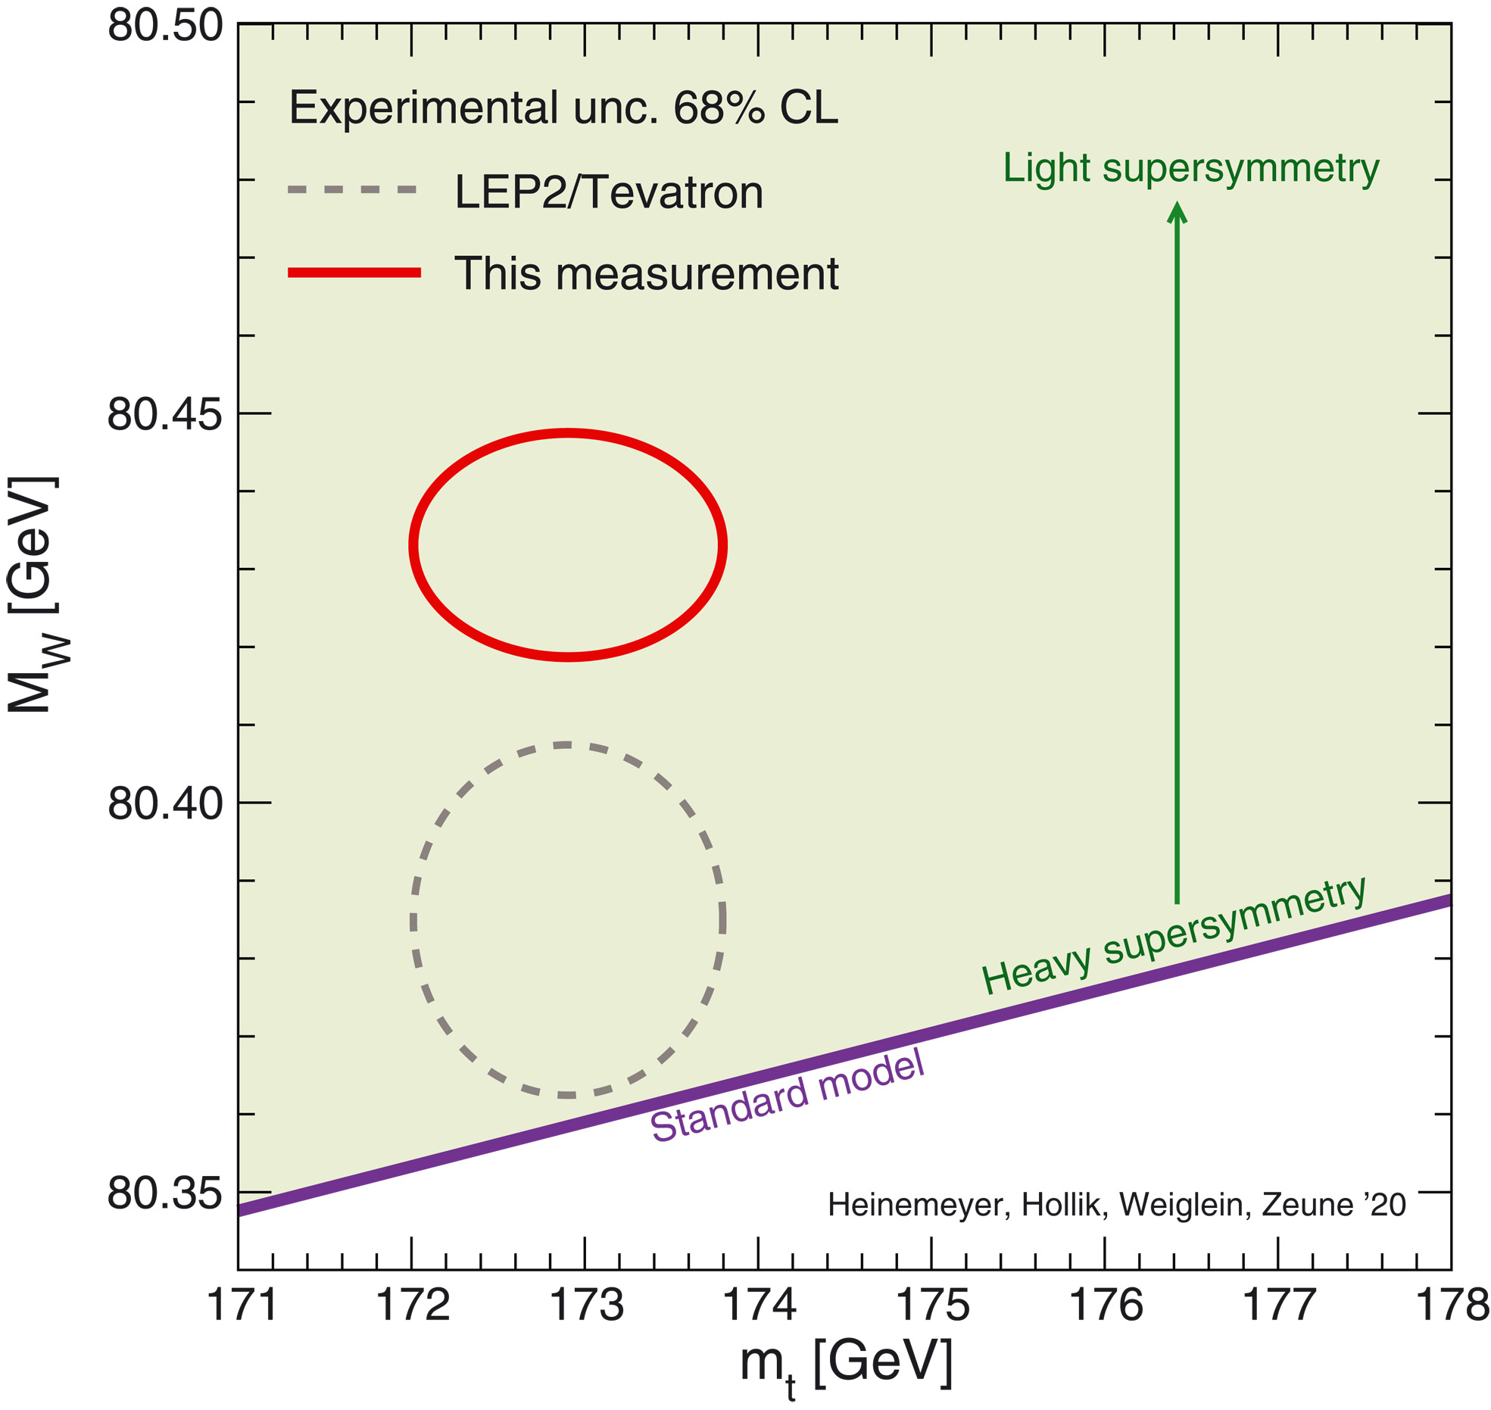
W boson mass with the CDF II detector
7 σ, 8.8 fb⁻¹
Science Vol 376, 170-176 (2022)

Slide 14
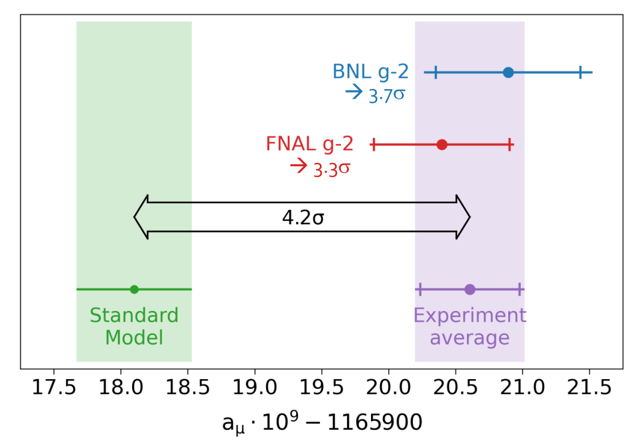
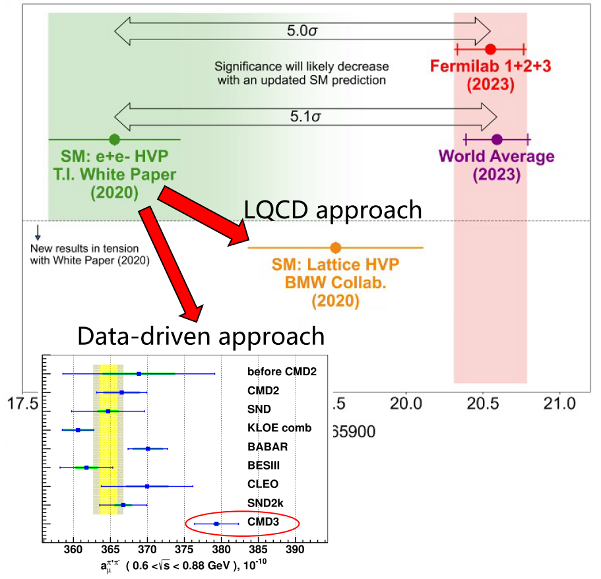
Fermilab Muon g − 2 Experiment
for J=1/2
at the beginning of 2023…
5,0σ.
5,1σ.
PRD110, 032009 (2024)
The new experimental result is:
a_{μ} = 116592055(24)×10⁻¹¹ 0.2 ppm

Slide 15
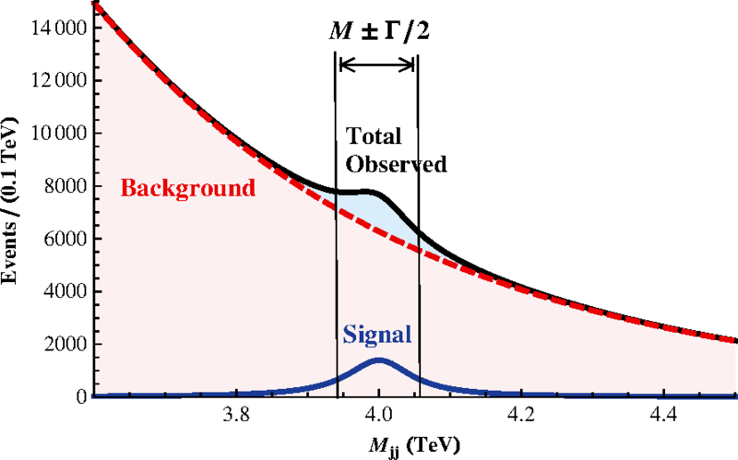
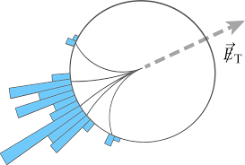
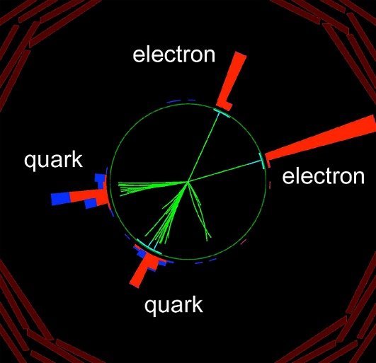
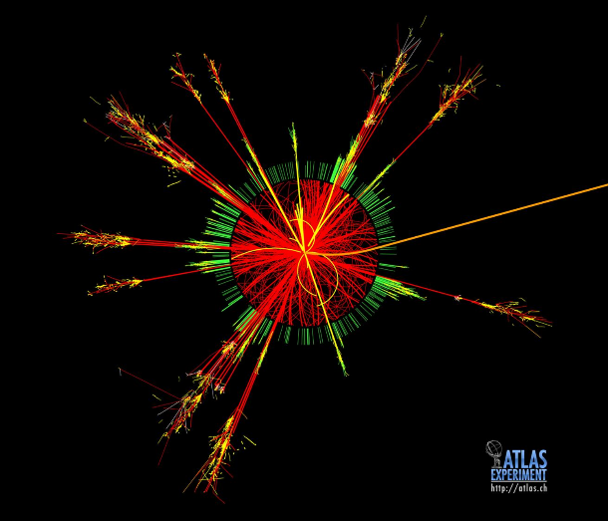
Conventional Signals
Heavy Resonances (extended gauge models, extra dimensions, technicolor) ⇒ dileptons, dijets, diphotons, ttbar, WZ
Non-Resonant Signals
Mono-particle + Missing ET (extended gauge models, extra dimensions, technicolor, SUSY) ⇒ mono-jet + MET, mono-photon + MET, mono-lepton + MET
Microscopic Black Holes (extra dimensions) ⇒ high-multiplicity events
Leptoquarks ⇒ lepton + jet
4th Generation ⇒ leptons/jets, dilepton

Slide 16
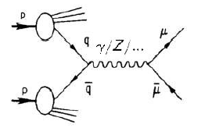

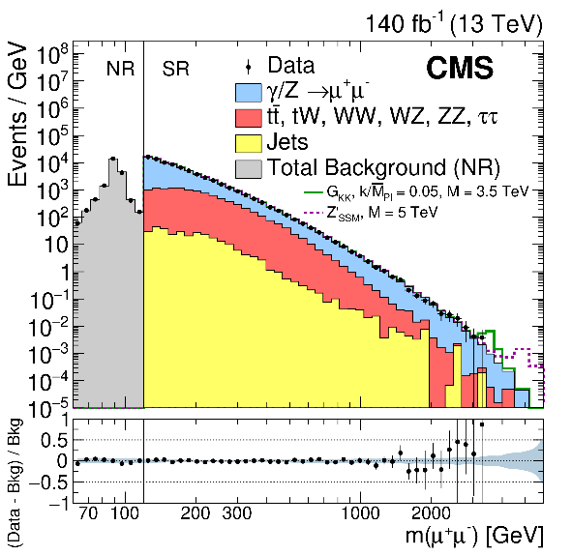
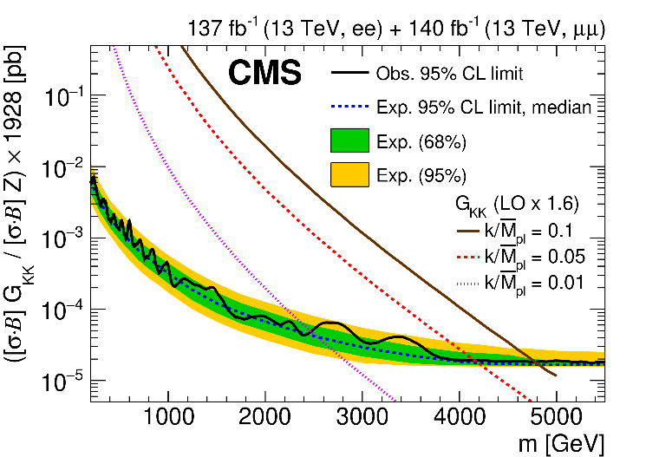
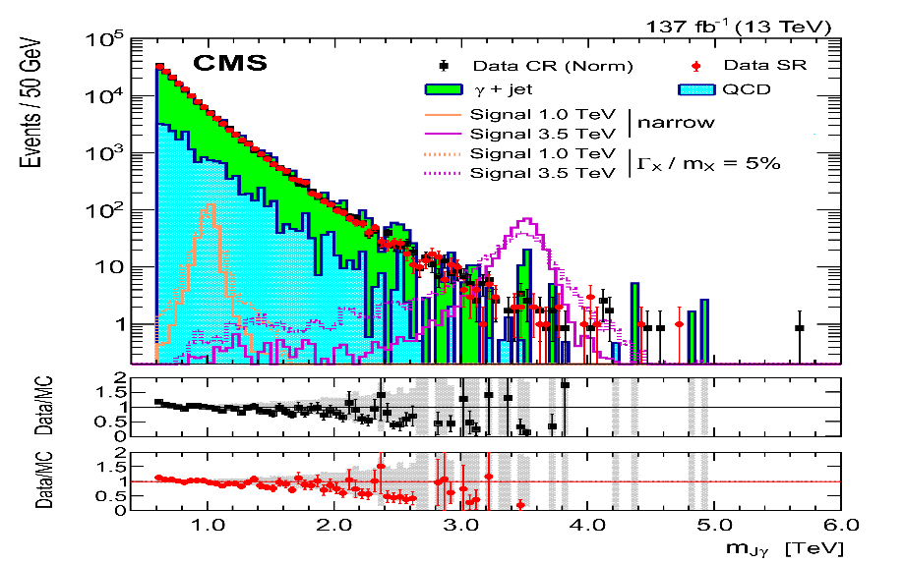
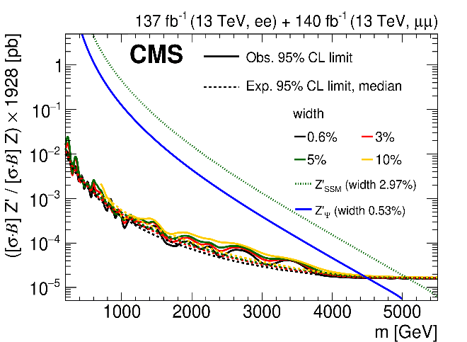
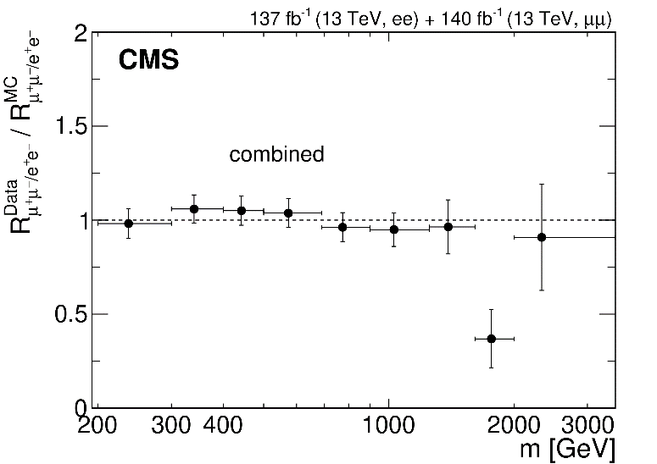
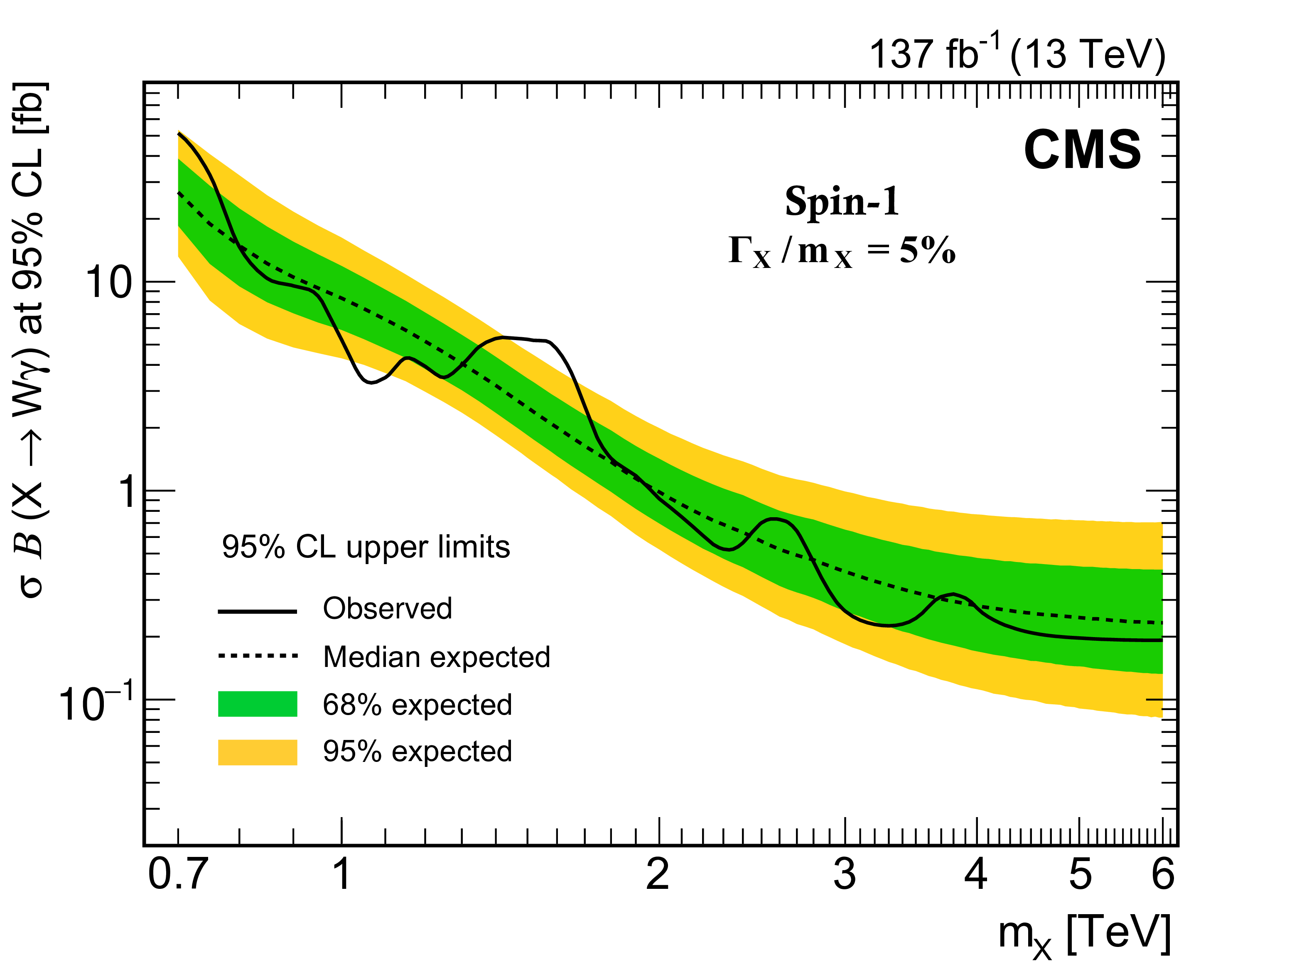
Searches for Heavy Resonances
New Physics (Z′/Z_{KK}/G_{KK}) contributions to SM processes
Dileptons, full RUN2 data
JHEP 07 (2021) 208
Wγ, full RUN2 data
PLB 826 (2022) 136888
RS1 graviton
Lepton flavor universality
Z’ boson
benchmark heavy scalar (vector) triplet bosons with masses between 0.75 (1.15) and 1.40 (1.36) TeV are excluded at 95% CL

Slide 17
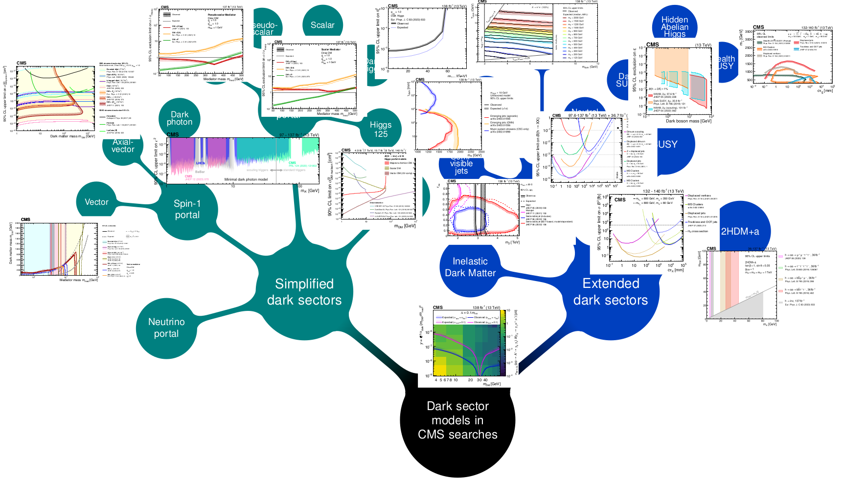
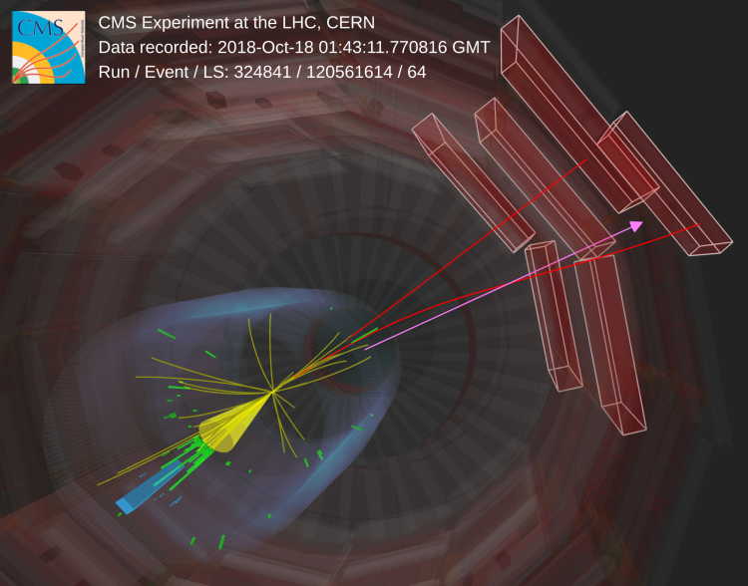
Dark Matter Results
~40 papers are released
CMS Physics Briefings
Mono-particle + Missing ET

Slide 18
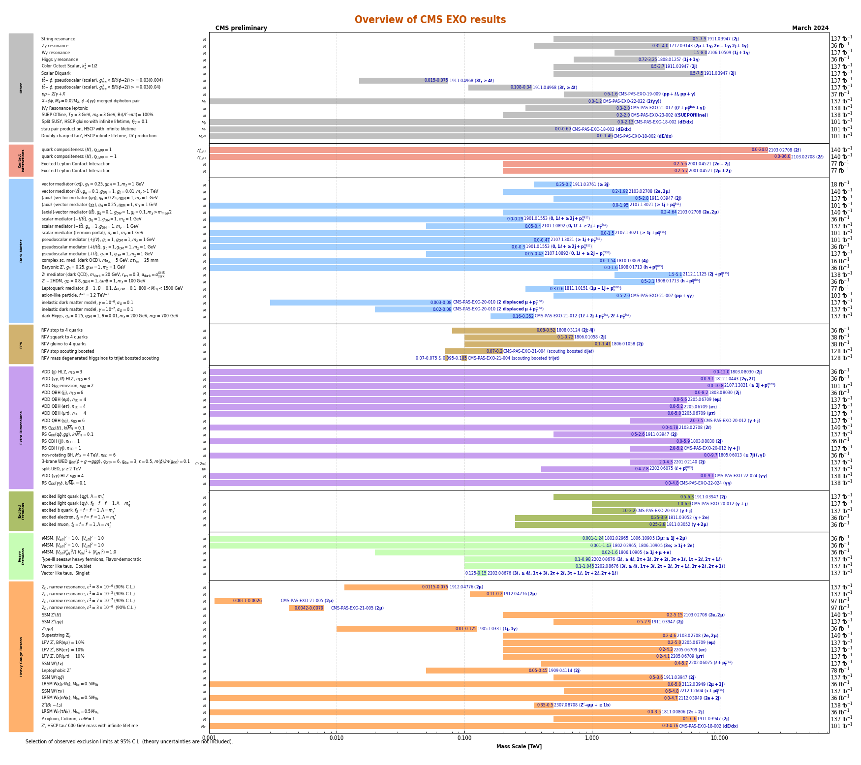
Direct Search for BSM: Conventional Signals
plots are updated for Moriond 2024
CI
Dark Matter
RPV SUSY
Extra Dimensions
Excited Fermions
Heavy Fermions
Heavy Gauge Bosons
1 TeV
10 TeV
40 TeV
https://twiki.cern.ch/twiki/bin/view/CMSPublic/SummaryPlotsEXO13TeV

Slide 19
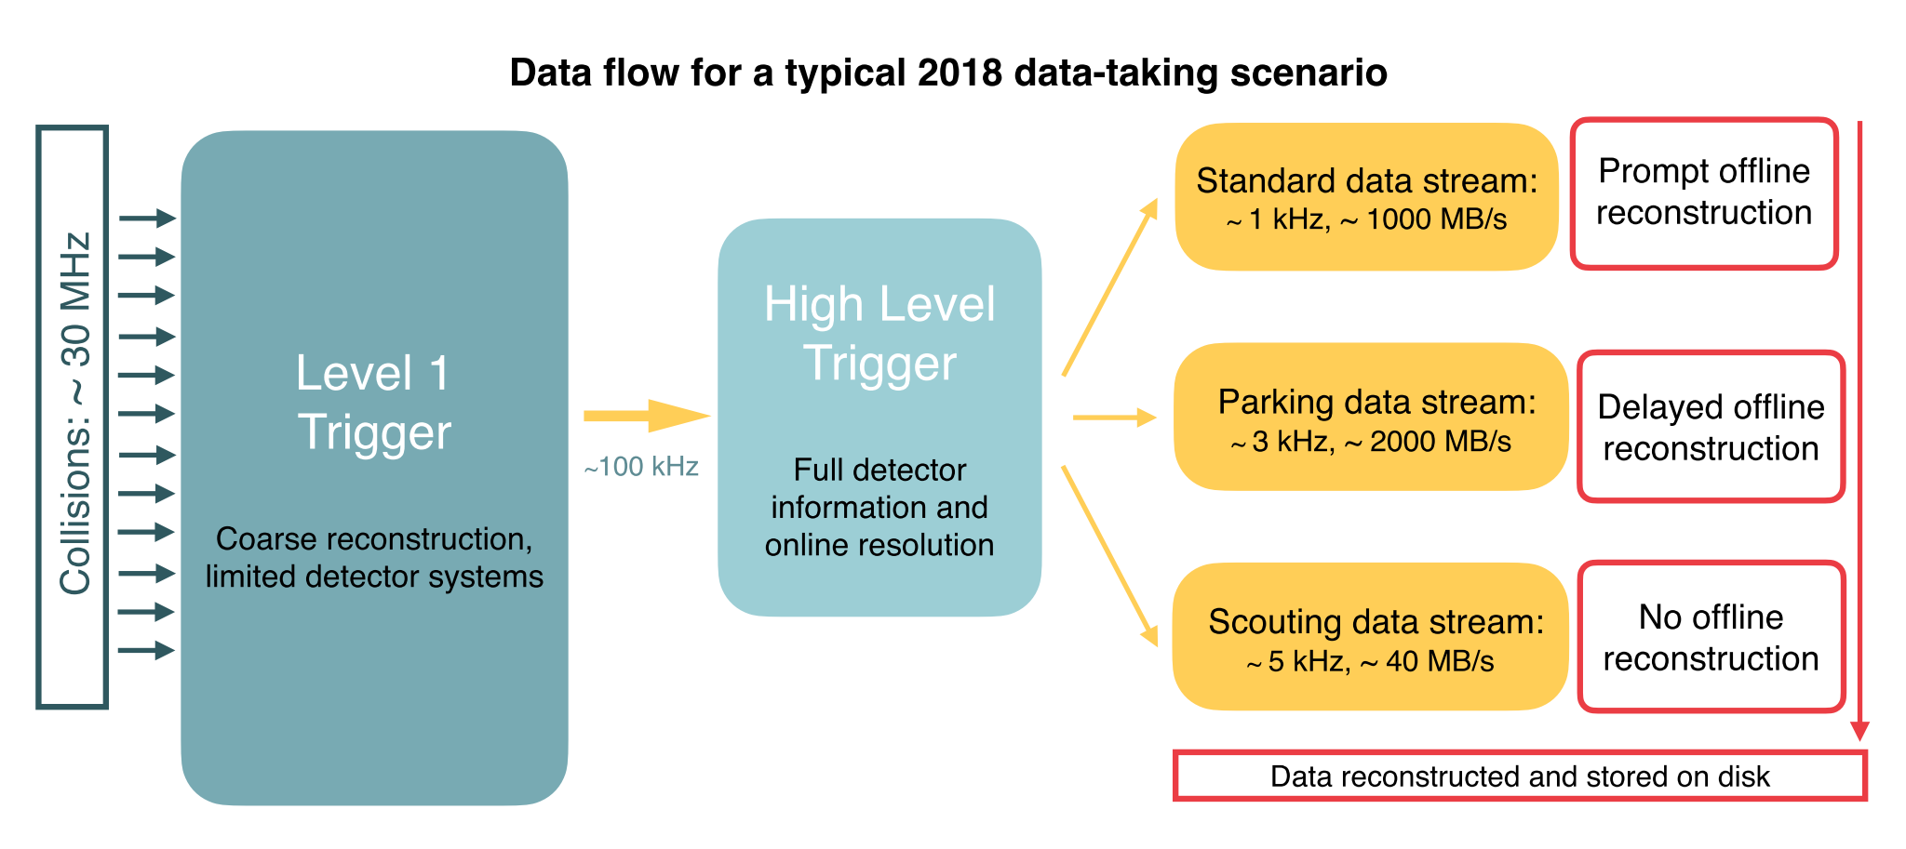
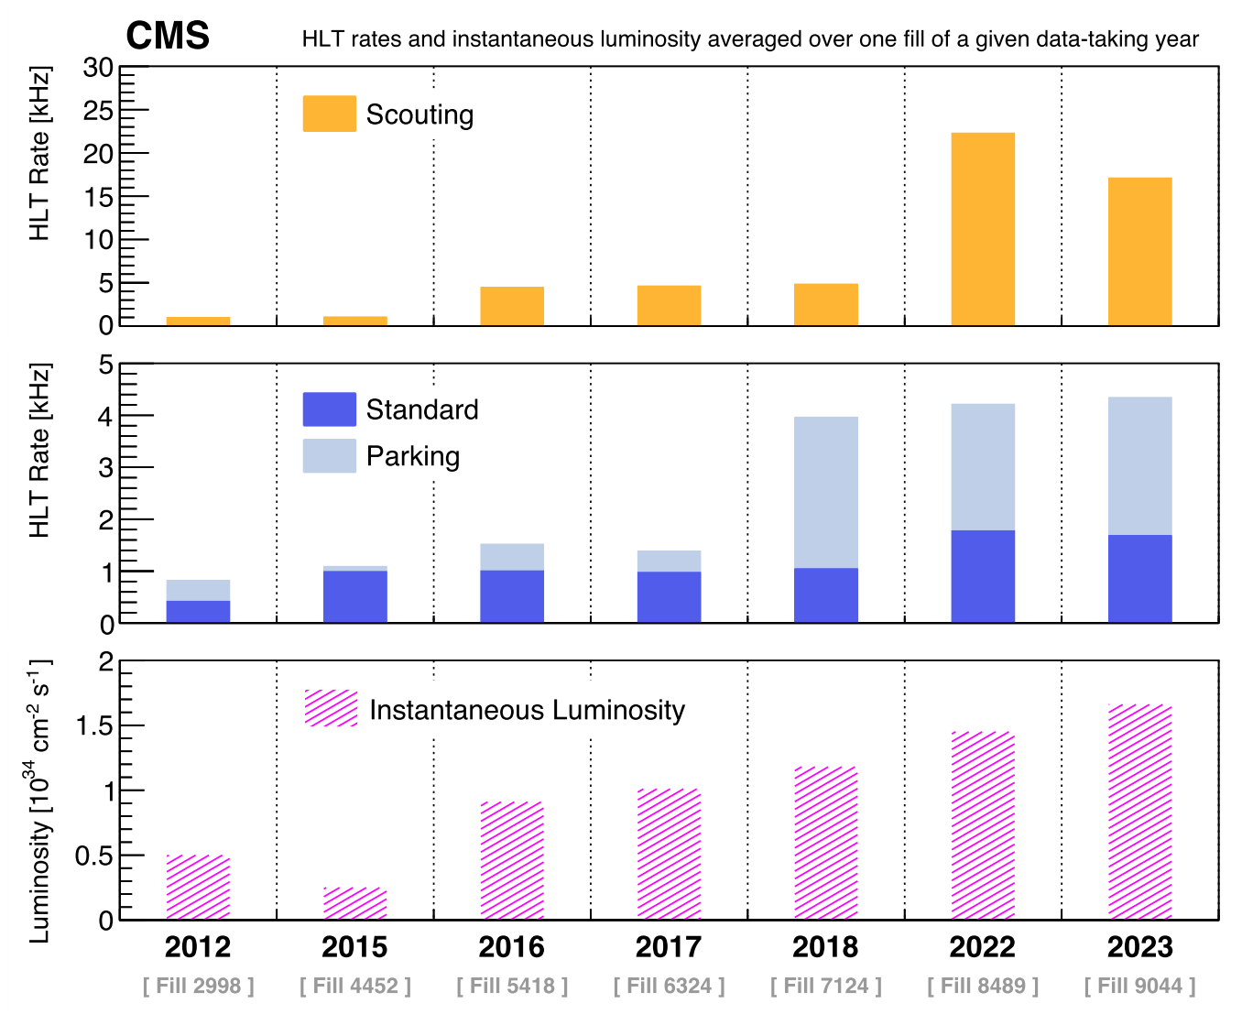
Enriching the physics program of the CMS experiment
Physics motivations
  NP scenarios where hypothetical particles have low masses and feeble couplings
  such particles are difficult to detect, given the large rate of SM backgrounds
  traditional data acquisition protocols frequently necessitate relatively high thresholds to mitigate SM backgrounds
Solutions
  parking data (significantly lowering the HLT thresholds)
  scouting data (significantly lowering the HLT thresholds and storing a reduced event content on disk, HLT reconstruction only)

Slide 20
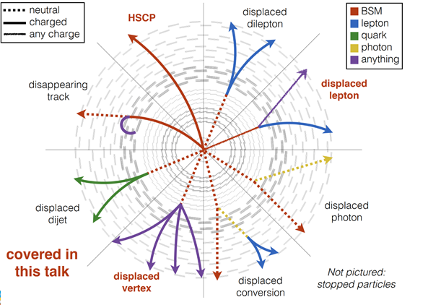
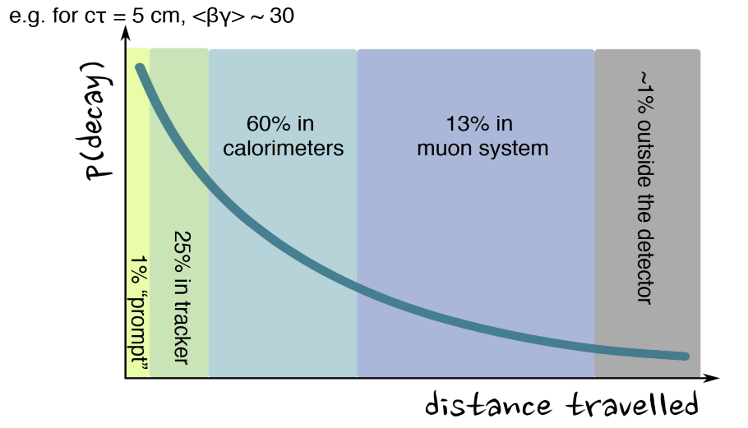
Direct Search for BSM: LLP Non-conventional Signals
a proper lifetime cτ₀ is greater than or comparable to the characteristic size of the (sub)detectors
small cτ₀ that comparable to the inner tracker size, no displaced tracks → “standard” prompt decay
intermediate cτ₀ → LLP
very large/infinite large cτ₀ → stable particles, “standard” MET signatures
LLPs may have decay lengths up to several meters, hence traveling through the inner detector layers without leaving any trace

Slide 21
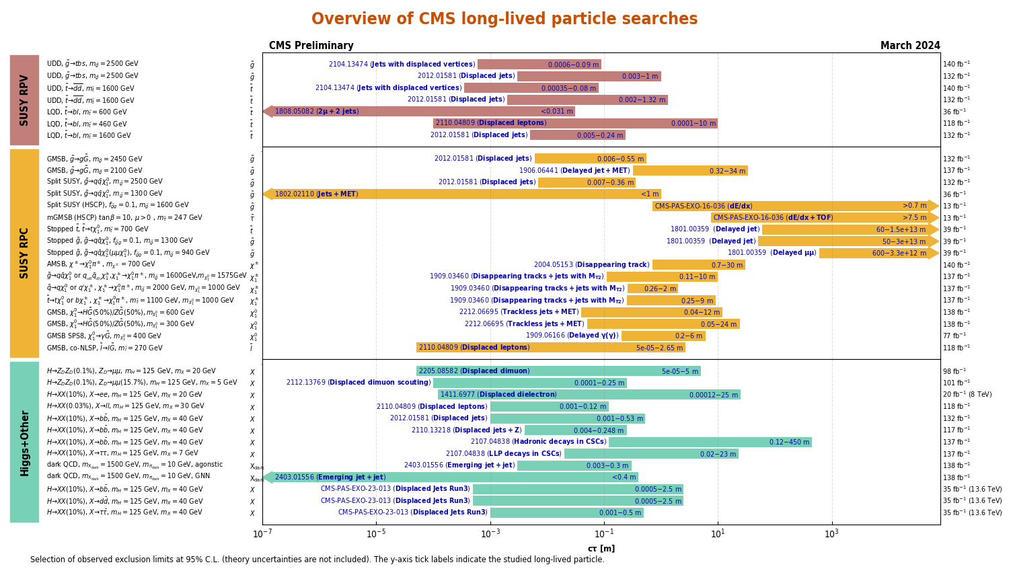
Overview of CMS Exotica LLP Searches
plots are updated for Moriond 2024
RPV SUSY
RPC SUSY
RPV RPC
to be presented
today!
Higgs+ Other
http://cms-results.web.cern.ch/cms-results/public-results/publications/EXO/LLP.html

Slide 22
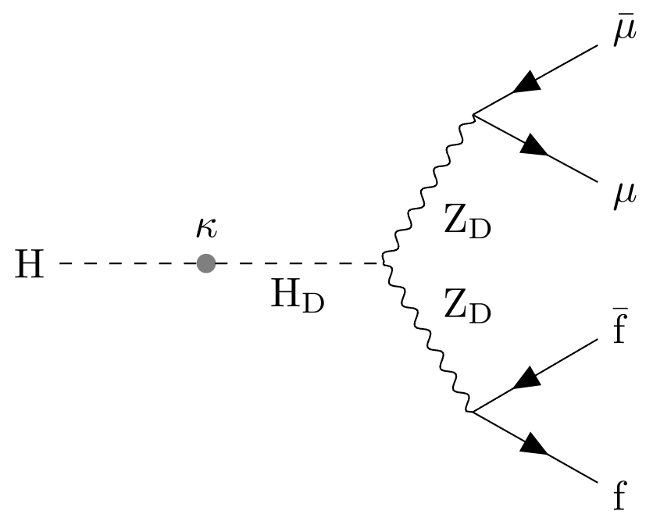
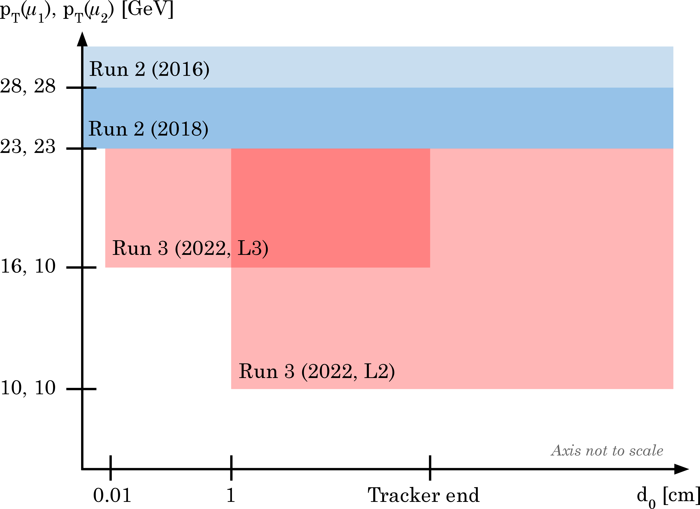
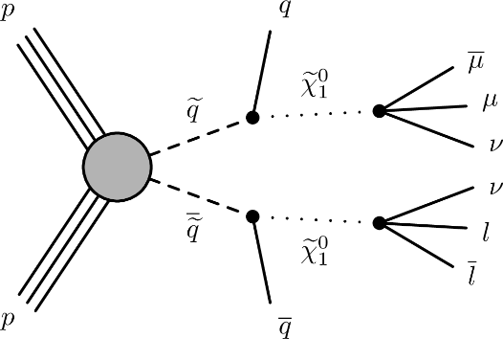




LLP with Displaced Dimuons
Dark photon and long-lived neutralinos decays
the first EXO results of RUN3 data @ 13.6 TeV with 36.7 fb⁻¹
LLP neutralinos decays
Dark photon
RPV
SM Higgs boson mixes with the dark-sector Higgs boson
Three categories of events:
STA-STA, TMS-TMS, and STA-TMS
JHEP05 (2024) 047
  No significant excess of events above the standard model background is observed. The results are interpreted in the frameworks of the hidden Abelian Higgs model, in which the Higgs boson decays to a pair of long-lived dark photons; and of an R- parity violating supersymmetry model

Slide 23






LLP with Displaced Jets (Showers in Muon System)
the scalar particle (a twin version of the Higgs boson) is likely to be one of the candidates for a messenger role between SM fields (“visible sector”) and DM sector (invisible “hidden sector”)
they decay into SM particles only when they reach the outermost part of the CMS detector (the muon system)
a signal is a shower of secondary particles that ionize the gas in the muon detectors (large multiplicity of hits that cluster together)
$$h →SS→4l or 4q$$
PRD 110 (2024) 012004
CMS Physics Briefings
arXiv:2409.10806
Submitted to Reports on Progress in Physics
“muon” displaced jets
the most stringent limit for proper decay lengths in the range 0.04-0.4 (0.3-0.9) m and above 4 (3) m for an LLP mass of 15 (40) GeV

Slide 24


Higgs Boson as a Tool to Search for the New Physics

Slide 25








Higgs Invisible Decays
The expected in SM h₁₂₅ the branching fraction h₁₂₅ → inv
$$ℬ(h_{125}{ZZ}^{∗}4)=0.12\%$$
Several BSM scenario anomalous and sizeable values, ℬ is significantly enhanced
a simple extension of the SM to provide a Dark Matter (DM) candidate and are able to predict the observed relic DM density vis s-channel $χχ→f\overline{f}$
Eur. Phys. J. C 83 (2023) 933
ttH
VH
0.15
Low-mass region in the spin-independent dark-matter-nucleon scattering cross section

Slide 26












Lepton Flavour Violation Higgs Decays (1)
PRD 108 (2023) 072004
The decays $H$ $eμ/μτ/eτ$ trough the LFV Yukawa couplings arising in two Higgs doublet models, extra dimensions, models with flavor symmetries, models of compositeness, etc
  to verify h₁₂₅ hypothesis, $m_{ll}= m_{h_{125}}$ (type 1)
  to search for new higgs states, $m_{ll}≠m_{h_{125}}$ ⇒ broad invariant mass region (type 2)
$ℬ\left(H→eμ\right)<4.4×{10}^{−5}$
type 1, ggH, VBF
PRD 108 (2023) 072004
eμ, eτ_{h}, eτ_{μ}, μτ_{h}, μτ_{e}
jet categories: 0-3j (ggH), 0-2j (VBF),
$m_{ll}≠m_{h_{125}}$ ⇒ broad invariant mass region (type 2)
BDT discriminant signal
PRD 104 (2021) 032013

Slide 27







Lepton Flavour Violation Higgs Decays (2)
The ﬁrst direct search for LFV $H→μτ/eτ$ decays for an Extra Higgs mass in the range $200 GeV<m_{H}$< 900 GeV (neutral heavy Higgs boson)
type 2, ggH, τ lepton decay products are highly boosted
ε_{τ} ≈ 70% (DNN)
The observed (expected) upper
limits (95% CL) is
µτ: 51.9 (57.4) fb to 1.6 (2.1) fb
eτ: 94.1 (91.6) fb to 2.3 (2.3) fb
JHEP 03 (2020) 103

Slide 28





Searches for Low-Mass BSM Higgses/DM in h₁₂₅ Decays
If m_{H} > 2m_{X}, some BSM scenarios allow Higgs bosons decays via one or two hypothetical on-shell new (pseudo)scalar(s) decaying to a pair of SM particles.
$$h_{125}→ZZD/ZDZD/ss/aa→4l$$
$$h_{125}→AA→4γ$$
EPJ C 82 (2022) 290
PRL 131 (2023) 101801
ex. 2HDM, 2HDM+

Slide 29
BSM Higgs/V′ in Decays into h₁₂₅(+X)
If m_{H} < 2m_{X} , the finals states are possible with h₁₂₅ and SM gauge bosons
PRD 105 (2022) 032008
EPJ C 81 (2021) 688

Slide 30


BSM Higgs/X in Decays into SM Particles
VBF tag, Charged Higgs boson mass explored: 200 – 3000 GeV
EPJC 81 (2021) 723

Slide 31






BSM Higgs/X in Decays into BSM Particles
$$X→aa→4b$$
PLB 835 (2022) 137566
A $→a\left(→χ\overline{χ}\right)h125→MET+$ $h125$
EPJC 79 (2019) 280
JHEP 03 (2020) 25
2HDM+a
h→ $b\overline{b},$new pseudoscalar in
invisible mode
Free parameters: m_{A}, m_{H}, m_{S}, mixing angle between a and A $sinθ$, VEV ratio for two higgs doublets $tanβ$, couplings to SM and DM particles
The analysis is restricted to the mass ranges m_{a} from 25 to 100 GeV and m_{X} from 1 to 3 TeV.

Slide 32



Some Selected Recent Excitements from LHC
X →ΥH
σ_{local}=4.1 (2.8) @ X and Y masses of 700 GeV and 400 GeV
RUN3 is a perfect judge for these challenges!
CMS-PAS-HIG-20-012

Slide 33


Summary
Extensive searches for the New Physics are performed with CMS experiment on RUN1 and RUN2 data
  245 of EXO analyses, 194 of Higgs analyses, 85 of B2G, 141 of SUSY
The tricks of the RUN2/3 are (procedure was updated during LS2 and will be improved further)
  higgs boson is intensively involved in searches
  non-conventional signals (displaced vertices, highly-boosted objects produced emerging jets/leptons)
  the data-scouting and data-parking strategies are used
Many new analyses made public
  for Summer Conferences, http://cms-results.web.cern.ch/cms-results/public-results/preliminary-results/CMS/index.html
  Physics Briefings at: https://cms.cern/tags/physics-briefing
The first RUN3 results are already available

Slide 34

THANK YOU FOR YOUR ATTENTION!

Slide 35



Analyses in the LHC Collaborations
Direct Searches for the Physics Beyond the SM
  Conventional Signals, such as new resonances in dileptons/diphotons/ dijets spectra or non-resonant signals, combinations of physics objects (leptons/photons/jets) and MET/ b/t-jets tags, high-multiplicity events, etc
SUSY
Extra Dimensions
Extended Gauge Sector
LQ/CI/Excited Fermions/B3G
  on-conventional Signals, for example displaced vertices/leptons/lepton-jets/dileptons from Long-Lived Particles or emerging jets/leptons from boosted heavy objects, $m≪p_{T}$ (i.e. high-p_{T} Z/W/h₁₂₅ bosons)
BSM-Higgs Physics
  Searches for the new Higgs states (from extended Higgs sector including SUSY)
  Probes for the New Physics with h₁₂₅ (Higgs as a tool for new discovery)
Check for discrepancies with data and search for new physics via Effective Field Theory
Precision Tests of SM
  Measurements of the W/Z, Drell-Yan (+ n jets) x-sections and angular characteristics
  Search for rare decays of B-mesons
  Observations of other rare process in top sector within SM (Wtb couplings, CP violating top quark couplings, flavor-changing neutral current interactions of the t-quark and h₁₂₅)
Long-Lived Particles (Dark Matter/Non-standard SUSY/Neutrino Masses/etc)
Extended Higgs and Dark Matter Sectors
Extra Higgses, Dark Matter, Flavour Universality Violation
Sergei Shmatov, Lomonosov 2023
04.11.2024

Slide 36





Example of Dark Matter Searches in Dijets+Dileptons
We consider a model that assumes the existence of a single DM particle that interacts with the SM particles through a spin-1 mediator, which can be either a vector or axial-vector boson.
V/VA
vector mediator with small couplings to leptons, g_{DM} = 1.0, g_{q} = 0.1, g_{l} = 0.01
axial-vector mediator with equal couplings to quark and leptons: g_{DM} = 1.0, g_{q} = g_{l}= 0.1
g_{q}
g_{q}
5 parameters:
m_{DM}, m_{Med}, g_{DM}, g_{l}, g_{q}
DM-nucleon upper limits on the cross section

Slide 37

Mapping Dark Matter Searches

Slide 38



Inelastic Dark Matter at the LHC/LLP
inelastic dark matter: relic particles that cannot scatter elastically oﬀ of nuclei the dark sector
particles continue traveling for a long time and traverse several meters (Long-Lived Particles) before tunneling back into our visible universe (quarks or leptons)
https://arxiv.org/abs/1901.04040

Slide 39










Vector-like quarks
Search for a pair of bottom-type vector-like quarks
VLQ → b + H/Z, t + W
both fully hadronic final states and those containing a lepton pair from a Z boson decay
hadronic decays can be resolved as two distinct jets or merged into a single jet
Search for a single vector-like quark T
T VLQ → t + H/W
all-hadronic final state
CMS-PAS-B2G-19-001
The limits on the B VLQ mass have been increased
  1570 GeV for 100% B → bH
  1540 GeV for 100% B → bZ
For many cases, they exceed by 100 GeV or more those of previous results.
CMS-PAS-B2G-20-014, Submitted to Phys. Rev. D

Slide 40

Summary of HLO Strinjent Tests
Summary of the cross sections standard model particles produced in association with jets
https://twiki.cern.ch/twiki/bin/view/CMSPublic/PhysicsResultsCombined
V+jets VV+jets
tt + jets
h + jets
up to 4 jets
Agree with the Standard Model predictions!

Slide 41




What does Brazilian Flag mean?
Dimuon example
Extended gauge models
Models of low-energy gravity (RS1-type scenario of ED)
SM predictions
BSM predictions
SM predictions
Mass limit
Model-independent limits on cross section (in narrow width approximation, NWA)

Slide 42








Production of SM Higgs boson
N(N)LO QCD + NLO EWK
ggH
43.9 pb⁻¹, ggH, 7M
3.77 pb⁻¹, VBF, 600K
1.36 pb⁻¹, WH, 200K
0.88 pb⁻¹, ZH, 140K
0.5 pb⁻¹, ttH, 80K
0.48 pb⁻¹, bbH, 77K
0.08 pb⁻¹, tH, 13K
@ m_{H} =125.38 GeV
VBF
tt/bbH
https://twiki.cern.ch/twiki/bin/view/LHCPhysics/CERNYellowReportPageBR
VH
tH

Slide 43







Higgs Width
On-shell measurements in γγ and ZZ (4l)
  total Higgs width of 4.1 MeV unmeasurably small, limited by
  detector resolution
  in assumption the lack of signal-background interference
  Γ_{H} < 1.1 GeV @ 95% CL in 4l
Off-shell measurements in ZZ for gg-production
  for
    on-shell (NWA) depends on Γ_{H}
    off-shell does not depend
PRD 99 (2019) 112003

Slide 44

Summary of 2HDM+S searches at 13 TeV
https://twiki.cern.ch/twiki/bin/view/CMSPublic/Summary2HDMSRun2

Slide 45

Displaced Leptons + Jets
EPJC 82 (2022) 153
RPV SUSY, GMSB, and BSM Scalar Higgs
Leptons could have common or different vertexes
μμ, ee and eμ final states were used
Trigger and event selection exclusively on displaced leptons
leptons |d0| is the main discriminating variable (up to 10 cm)
Data driven background estimation
DL+b-jets
DL+jets
DL+MET
DL+DL
RPV SUSY
GMSB
BSM Scalar Higgs

Slide 46






LPP + Z bosons
JHEP 03 (2022) 160
Used as a spectator in the event
The multiplicity of displaced jets $N_{j}^{dis}$ is the the main discriminator variable. Signal region is $N_{j}^{dis}$≥ 2
No excess over the expected SM event rate is observed.
New limits on branching Higgs to LLP scalar particles (S) are reached

Slide 47



LHC Satellite Experiments
CMS/ATLAS
CMS
Phys. Rev. D 99 (2019) 015021
https://arxiv.org/abs/1901.04040
LHCb
ATLAS

Slide 48
LLP Lifetime

Slide 49

MAssive Timing Hodoscope for Ultra-Stable neutraLpArticles
The full-scale detector could then become
operational by 2025-26.
CMS
https://arxiv.org/abs/1901.04040

