Slide 1
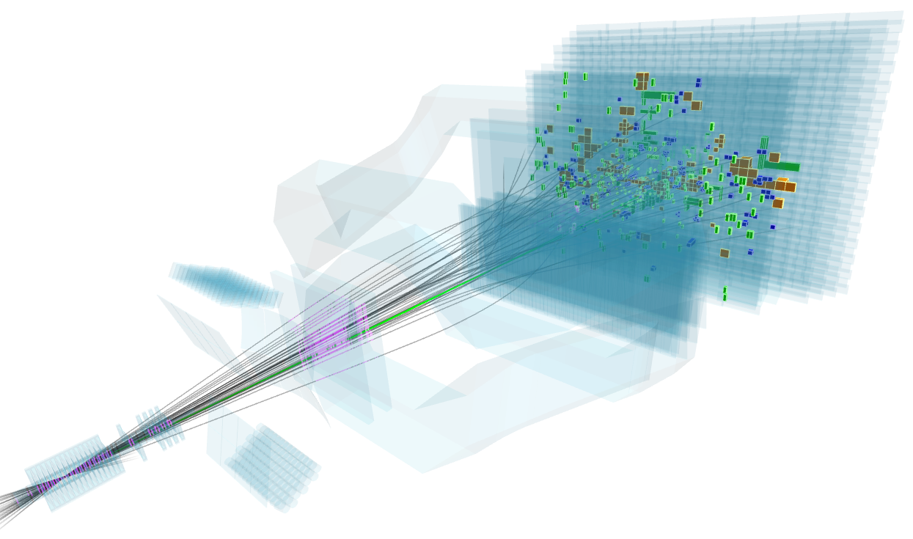


LHCb: performance, results and upgrade
XV Latin American Symposium on
High Energy Physics (SILAFAE),
Mexico City, November 6, 2024
Mick Mulder on behalf of the LHCb collaboration
(e-mail: mick.mulder@cern.ch)

Slide 2
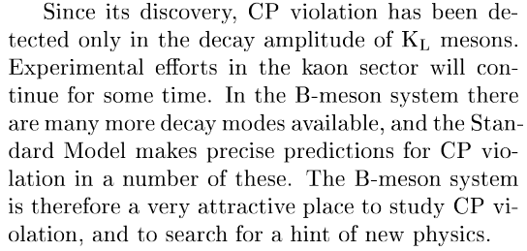
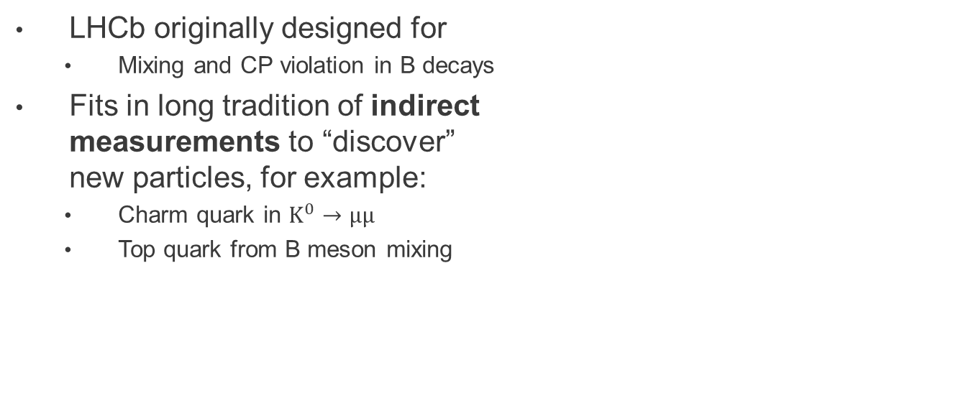
LHCb physics programme
LHCb technical proposal (1998)
LHCb originally designed for
  Mixing and CP violation in B decays
Fits in long tradition of indirect
measurements to “discover”
new particles, for example:
  Charm quark in $K^{0}→μμ$
  Top quark from B meson mixing
Notes:
“We have been able to do much more”
Watch time

Slide 3
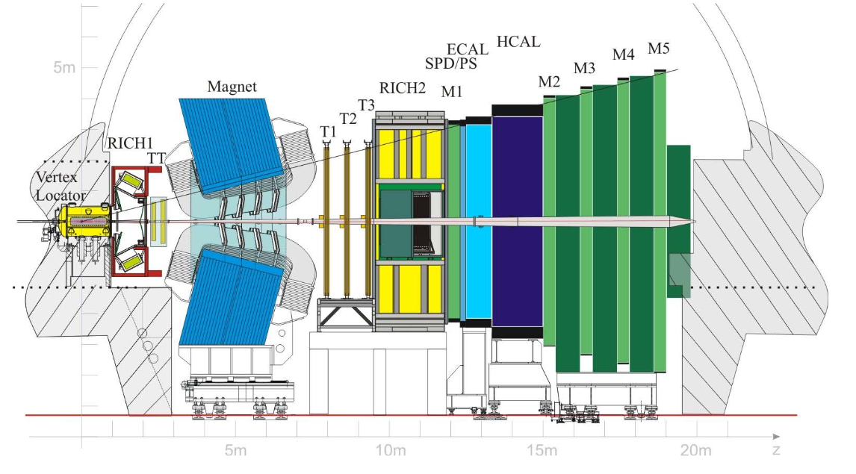

LHCb experiment
Forward spectrometer at the LHC, optimised for $b$-hadrons
$b\overline{b}$cross section $=154.3±1.5 μb$ at $\sqrt{s}=$13 TeV in acceptance $2<η<5$
$O({10}^{5})$ $b\overline{b}$ pairs/s in LHC Run 1 & 2 (and 20 x more $c\overline{c}$)
Notes:
Optimised for b-hadrons

Slide 4
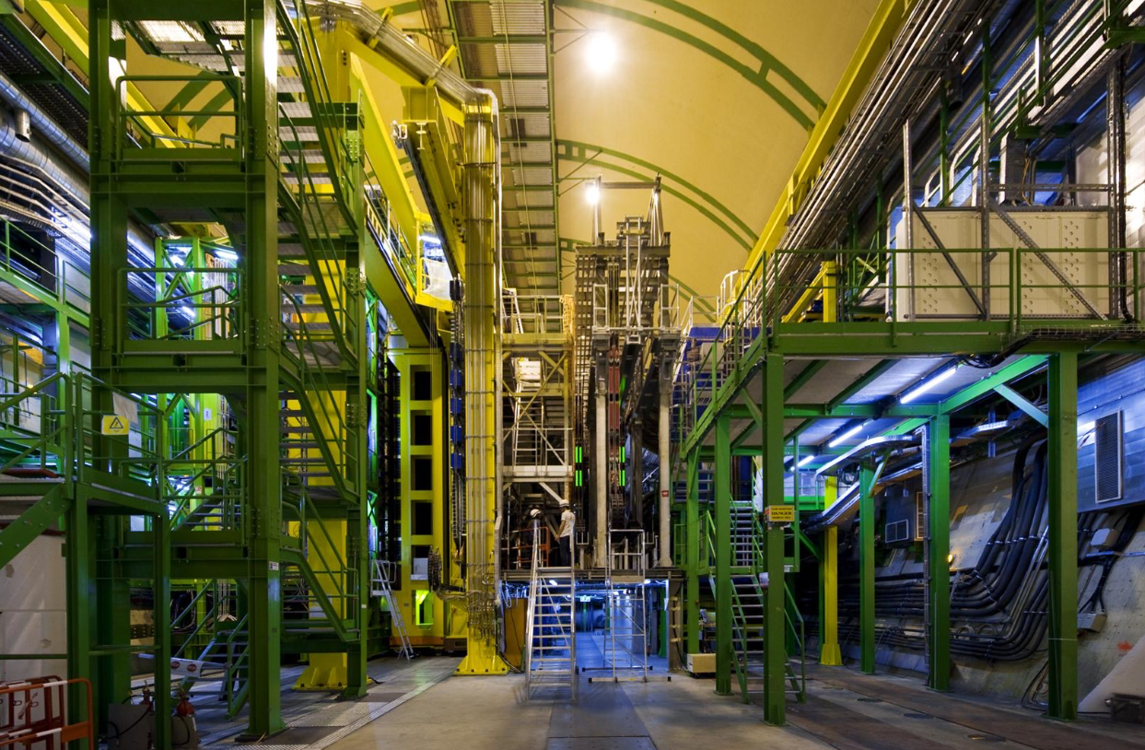
LHCb detector

Slide 5
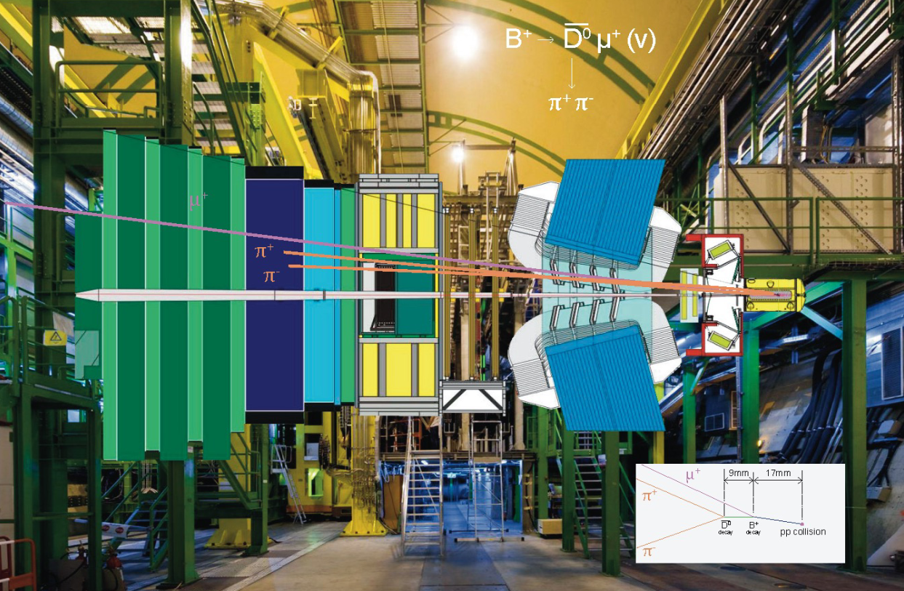
LHCb detector
Notes:
Potentially cut time

Slide 6
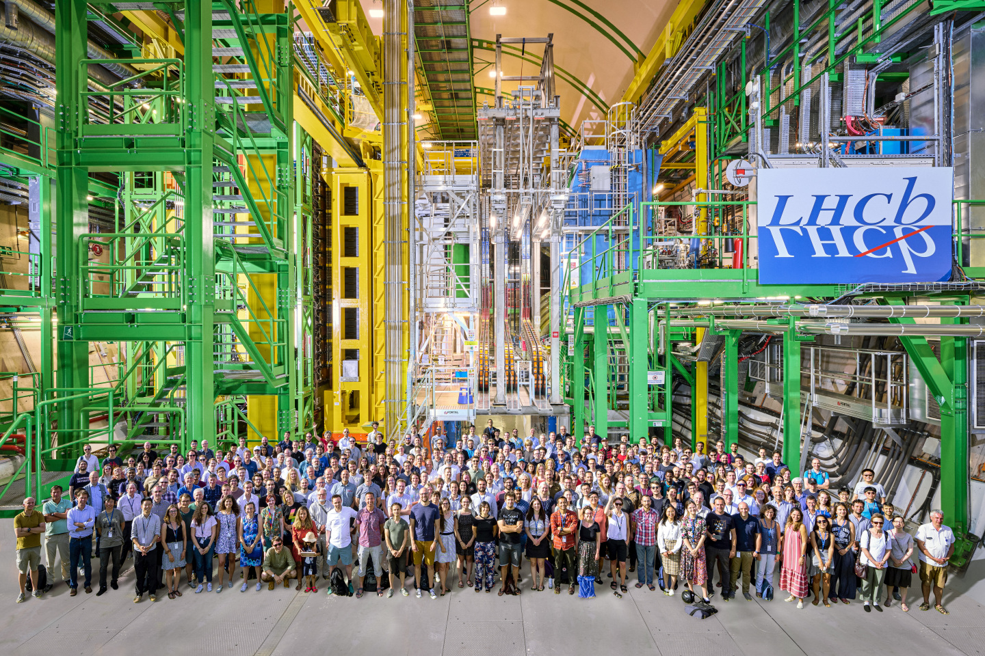
LHCb collaboration
Notes:
Watch time

Slide 7
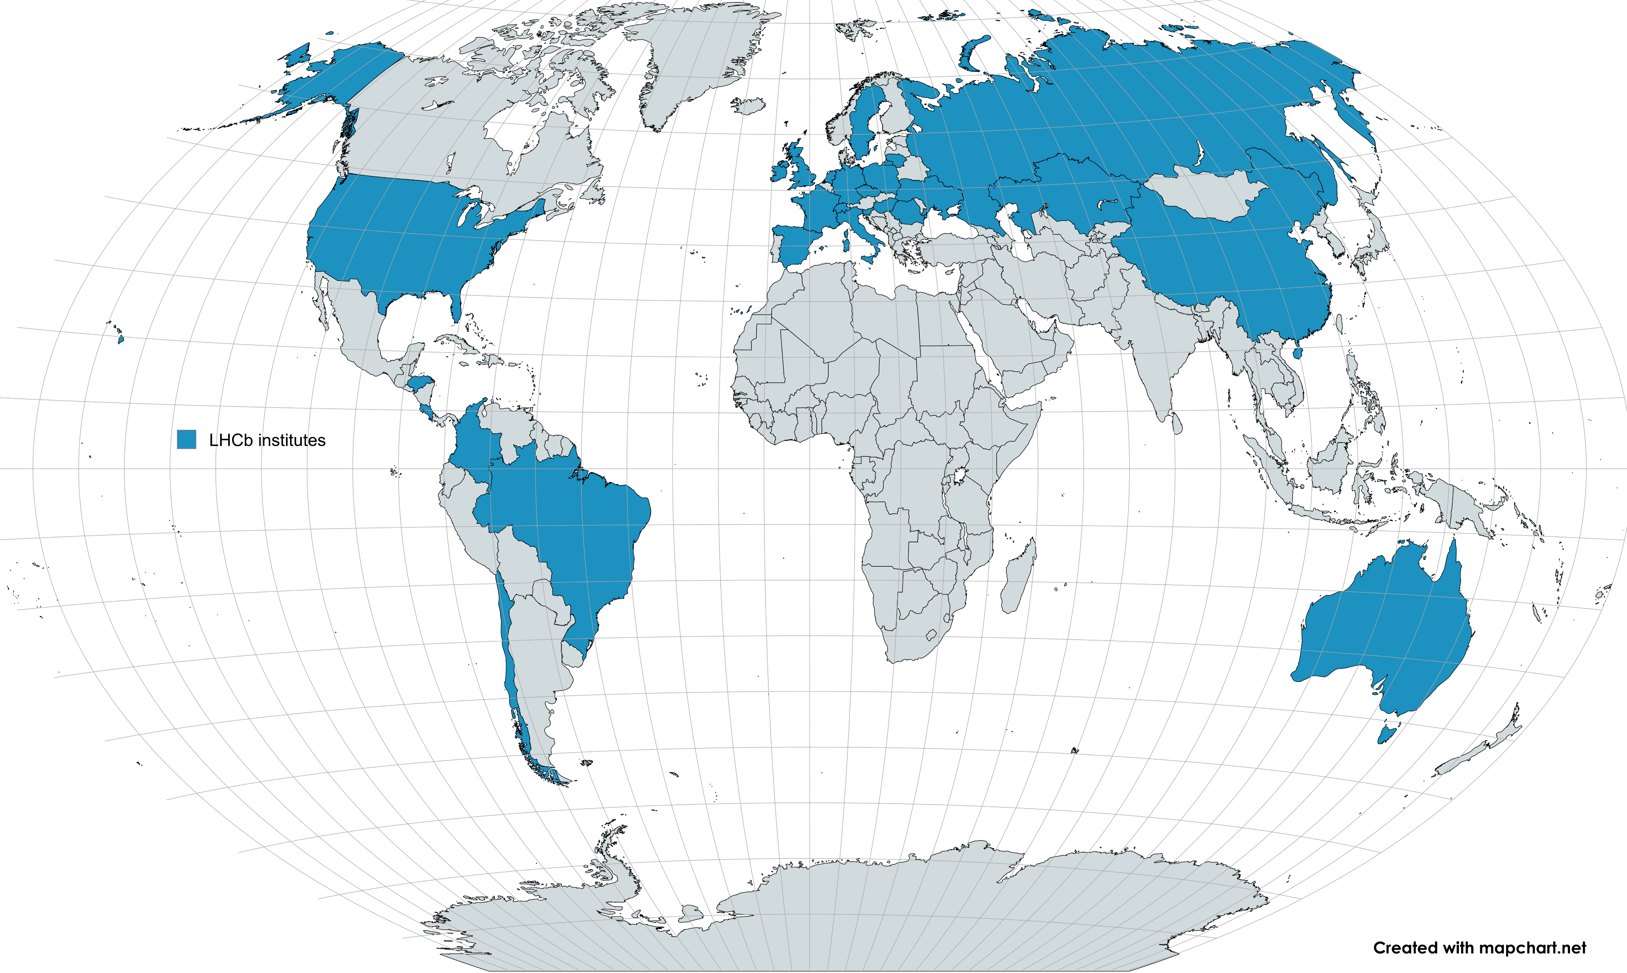
LHCb collaboration
Notes:
LHCb originally very European, but we are expanding, including in Latinoamerica
Watch time

Slide 8
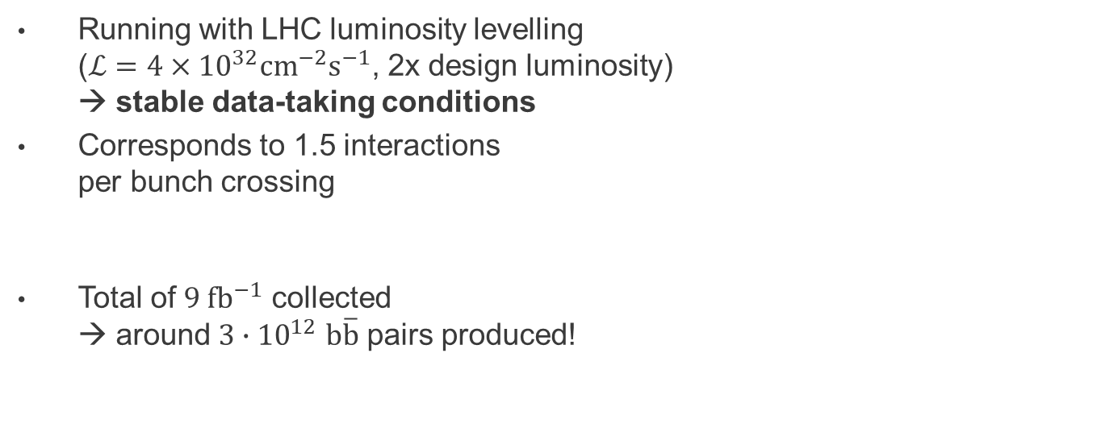
LHCb Run 1 & 2 data taking
Running with LHC luminosity levelling
($ℒ=4×{10}^{32}cm^{−2}s^{−1}$, 2x design luminosity)
→ stable data-taking conditions
Corresponds to 1.5 interactions
per bunch crossing
Total of $9 fb^{−1}$ collected
→ around $3∙{10}^{12}$ $b\overline{b}$ pairs produced!
Notes:
Update plot

Slide 9
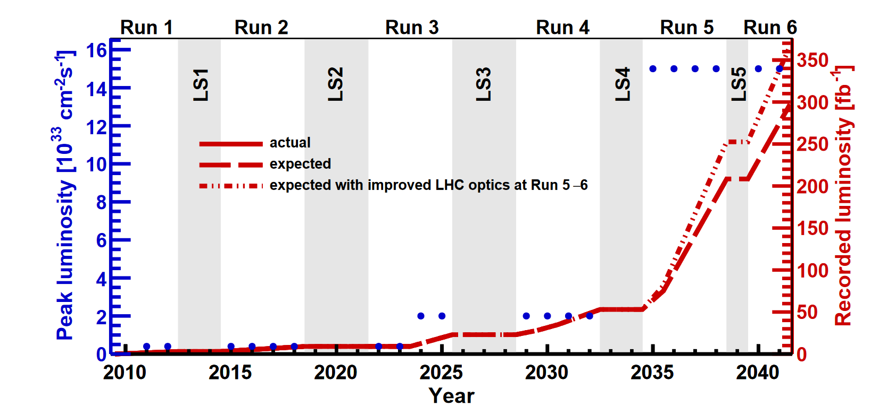

LHCb Run 1 & 2 data taking
Running with LHC luminosity levelling
($ℒ=4×{10}^{32}cm^{−2}s^{−1}$, 2x design luminosity)
→ stable data-taking conditions
Corresponds to 1.5 interactions
per bunch crossing
Total of $9 fb^{−1}$ collected
→ around $3∙{10}^{12}$ $b\overline{b}$ pairs produced!
Only the beginning!
Notes:
Fix position plot

Slide 10
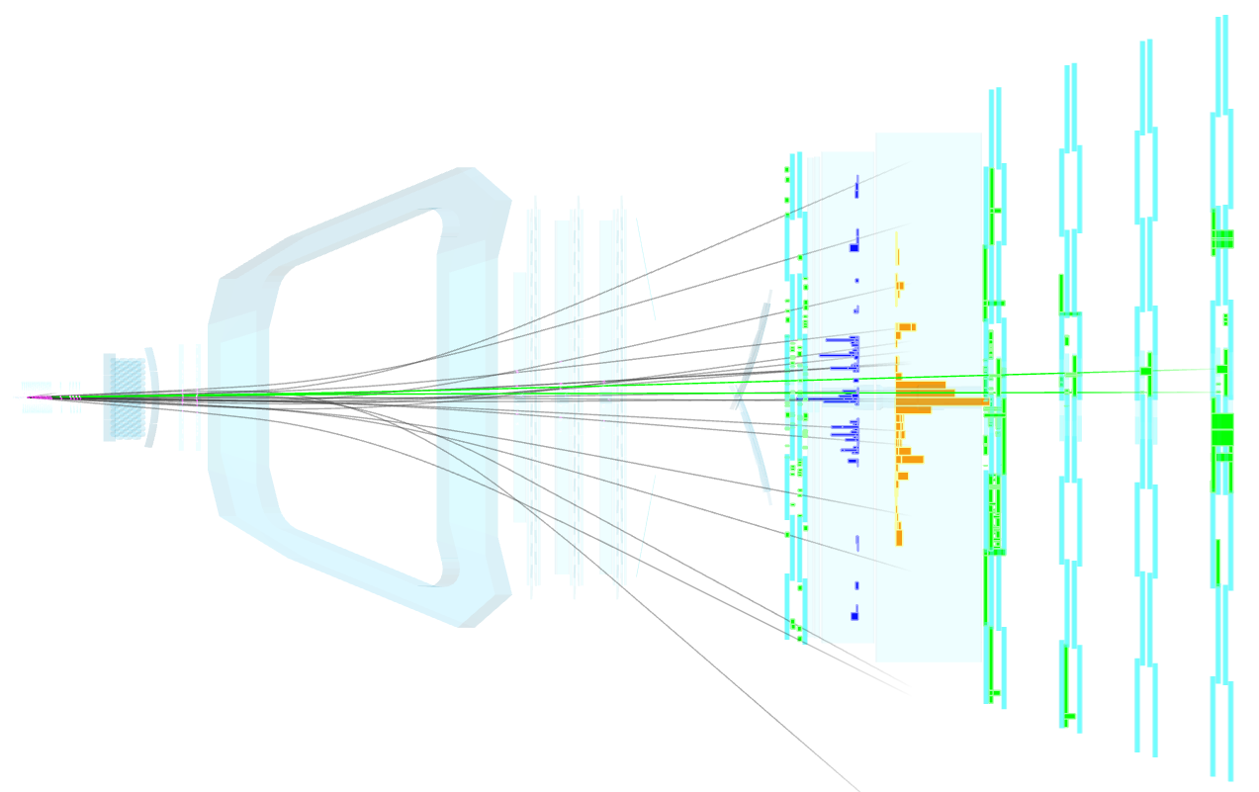
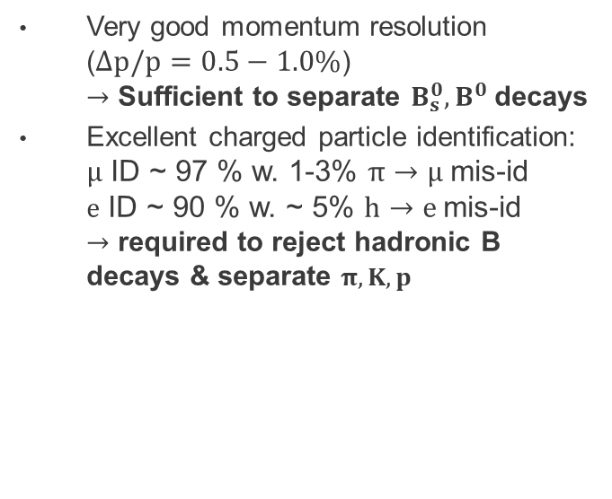
LHCb performance
Very good momentum resolution
($Δp/p=0.5−1.0\%$)
$→$ Sufficient to separate $B_{s}^{0},B^{0}$ decays
Excellent charged particle identification:
$μ$ ID ~ 97 % w. 1-3% $π→μ$mis-id
$e$ ID ~ 90 % w. ~ 5% $h→e$mis-id
$→$ required to reject hadronic B decays & separate $π,K,p$

Slide 11
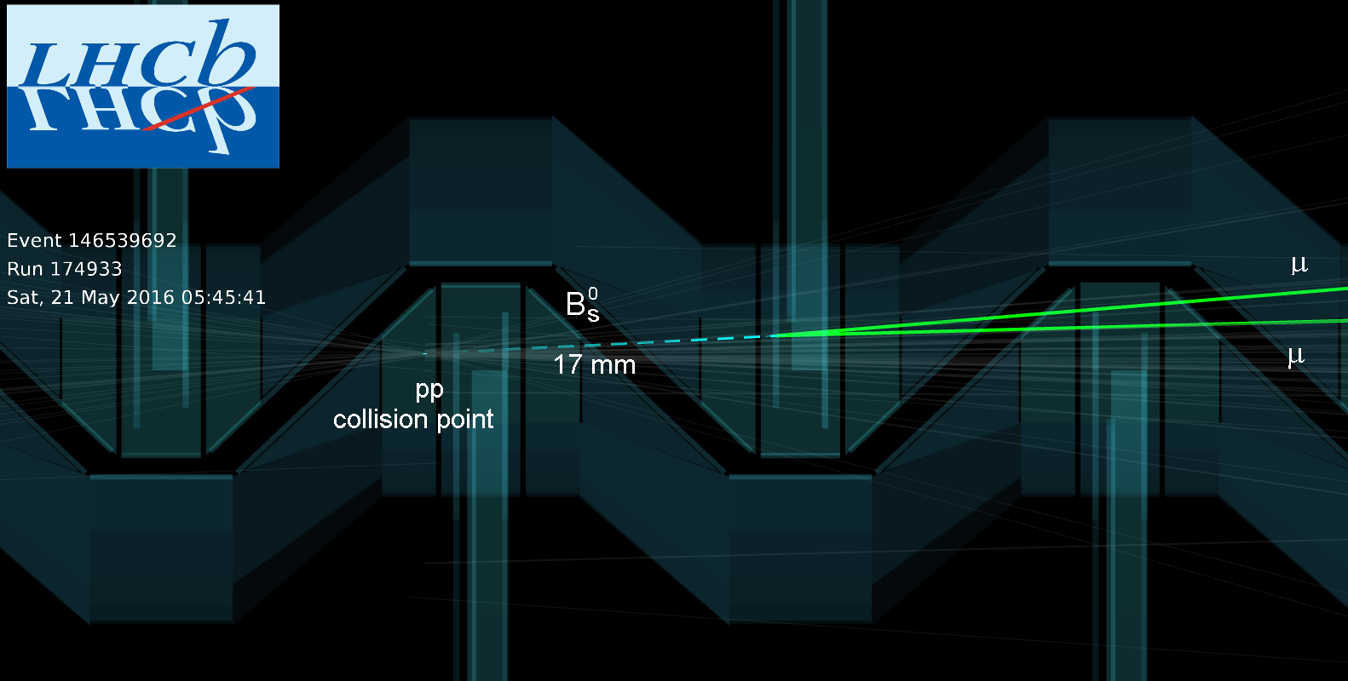
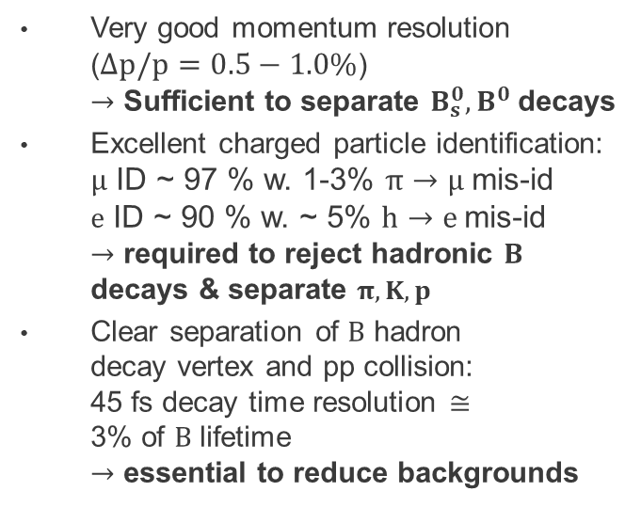
LHCb performance
Very good momentum resolution
($Δp/p=0.5−1.0\%$)
$→$ Sufficient to separate $B_{s}^{0},B^{0}$ decays
Excellent charged particle identification:
$μ$ ID ~ 97 % w. 1-3% $π→μ$mis-id
$e$ ID ~ 90 % w. ~ 5% $h→e$mis-id
$→$ required to reject hadronic $B$ decays & separate $π,K,p$
Clear separation of $B$ hadron
decay vertex and pp collision:
45 fs decay time resolution $≅$
3% of $B$ lifetime
$→$ essential to reduce backgrounds
Notes:
Watch time

Slide 12
LHCb physics programme
LHCb technical proposal (1998)
LHCb originally designed for:
  Mixing and CP violation in B decays

Slide 13
LHCb physics programme
Check out the
LHCb publication page!
LHCb originally designed for:
  Mixing and CP violation in B decays
But LHCb has found general purpose:
  Rare B decays
  Charm decays
  Semileptonic B decays
  Spectroscopy and exotic hadrons
  Hadron production (B and quarkonia)
  Heavy ion physics, fixed target
  Electroweak physics, QCD
  Exotics (dark matter, long-lived particles)

Slide 14
LHCb physics programme
Check out the
LHCb publication page!
LHCb originally designed for:
  Mixing and CP violation in B decays
But LHCb has found general purpose:
  Charm decays
  Rare B decays
  Semileptonic B decays
  Spectroscopy and exotic hadrons
  Hadron production (B and quarkonia)
  Heavy ion physics, fixed target
  Electroweak physics, QCD
  Exotics (dark matter, long-lived particles)
Today: selected results from LHCb Run 1 and 2
Many more interesting results, just a small flavour!

Slide 15
Mixing and CP violation

Slide 16
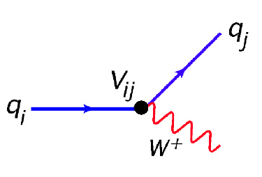
CKM matrix
Mass and flavour eigenstates of quarks are not equal → W boson transforms quarks
Notes:
Coupling plot

Slide 17
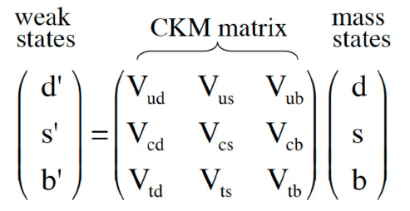
CKM matrix
Mass and flavour eigenstates of quarks are not equal → W boson transforms quarks
Probabilities described with 3x3 unitary CKM matrix (almost diagonal, almost real)

Slide 18
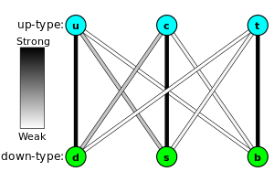
CKM matrix
Mass and flavour eigenstates of quarks are not equal → W boson transforms quarks
Probabilities described with 3x3 unitary CKM matrix (almost diagonal, almost real)
Only three real, one imaginary parameter remain in SM (due to unitarity)
Imaginary element causes CP violation
(opposite phase for particle, anti-particle)
Before LHCb, only 1st and 2nd generation were well constrained

Slide 19
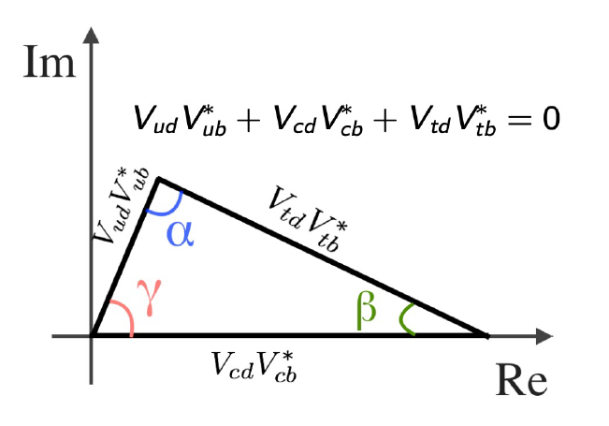

Unitarity triangle
Unitarity of CKM matrix leads to two types of conditions:
real, $Σ_{i}V_{ij}V_{ij}^{∗}=1$, orthogonal, $Σ_{i}V_{ij}V_{ik}^{∗}=0$
Unitarity triangles formed
with orthogonal relations
In case of New Physics,
unitarity conditions are broken!
→ test consistency of unitary
triangles with measurements
testing each angle and side

Slide 20
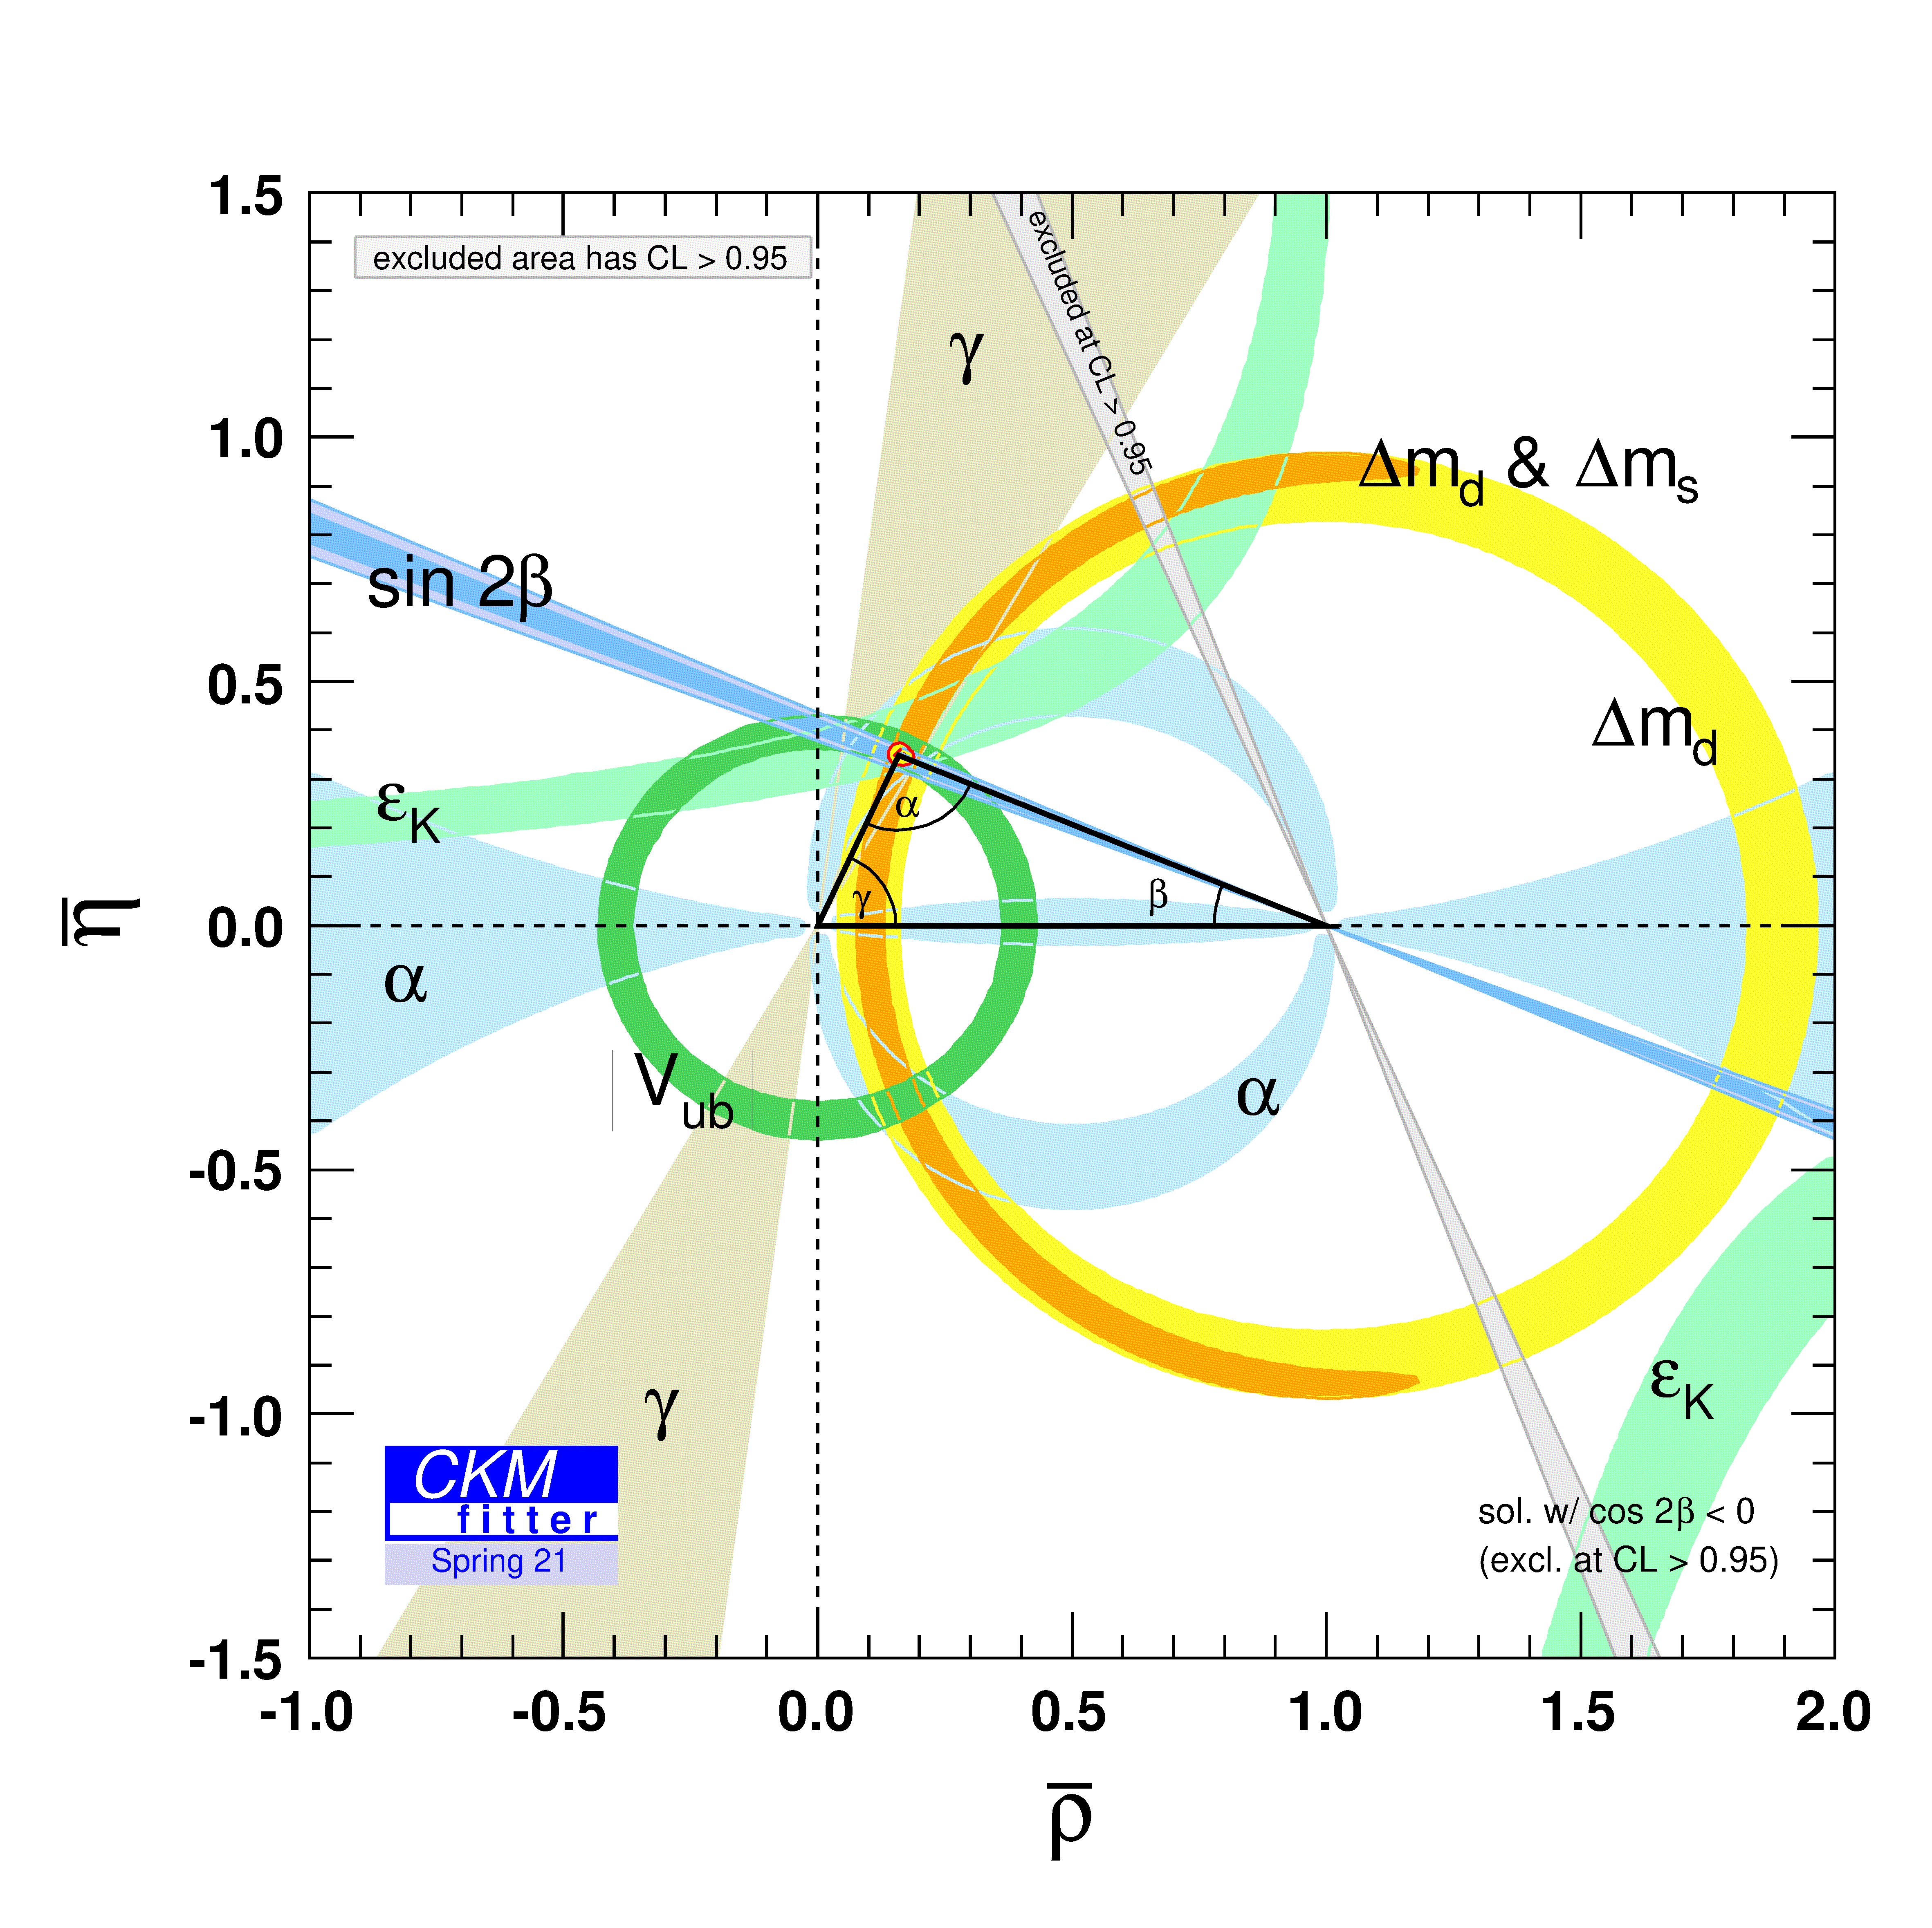
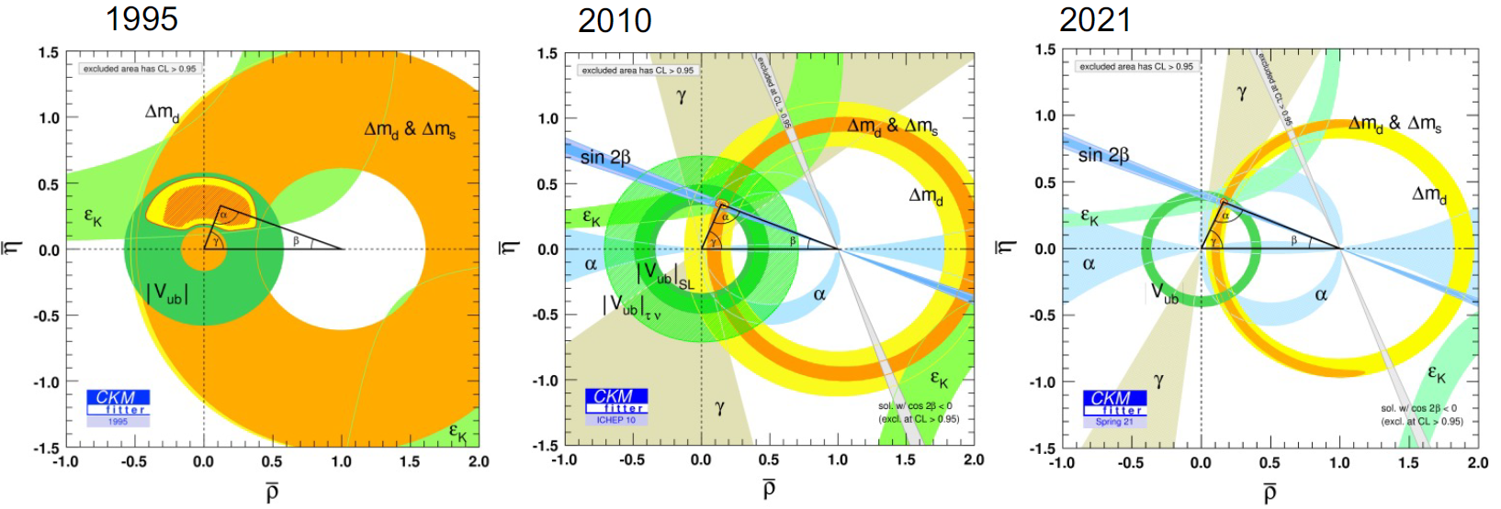
Constraining the unitarity triangle
Significant progress over last decades with crucial role for LHCb (since 2011)
2021
Any sign of inconsistency could point to New Physics
CKMfitter.in2p3.fr
Notes:
CROP THE IMAGE

Slide 21
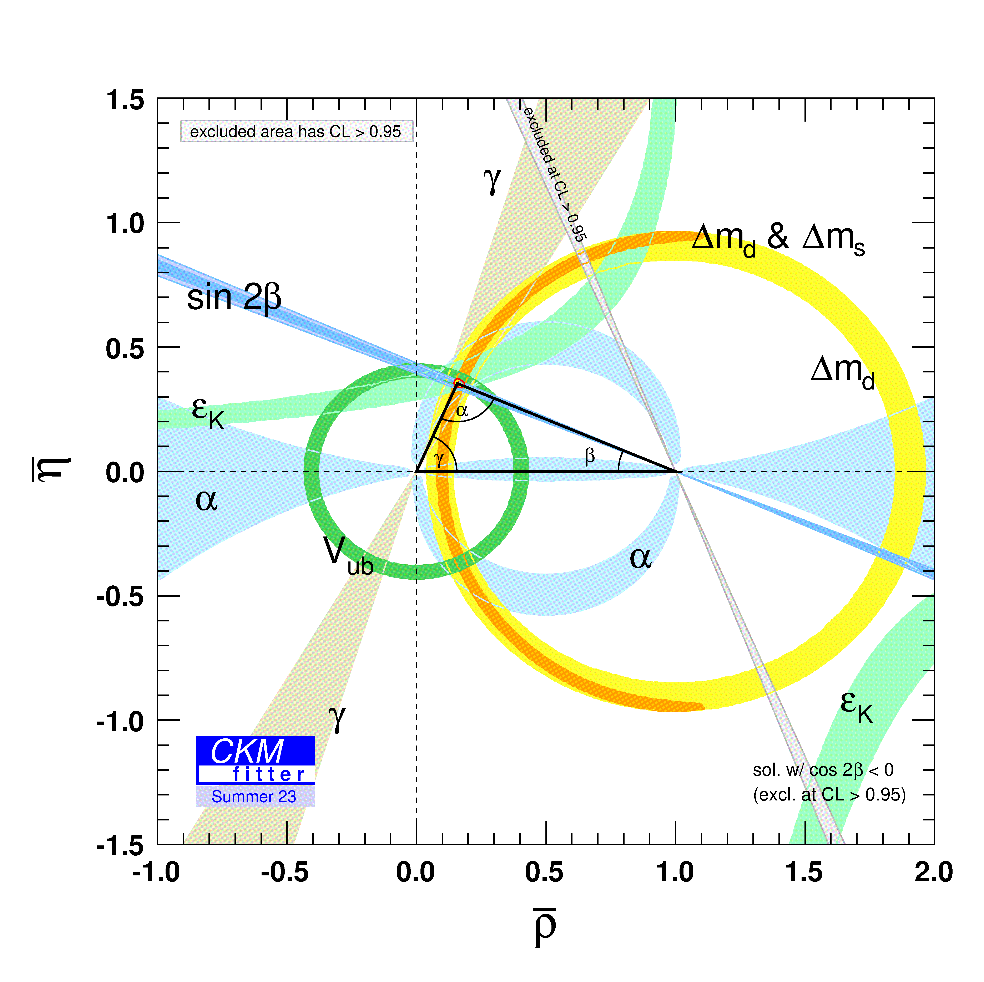
Constraining the unitarity triangle
Significant progress over last decades with crucial role for LHCb (since 2011)
2023
Any sign of inconsistency could point to New Physics
CKMfitter.in2p3.fr
Notes:
CROP THE IMAGE, replace 95 and 2010 plots

Slide 22
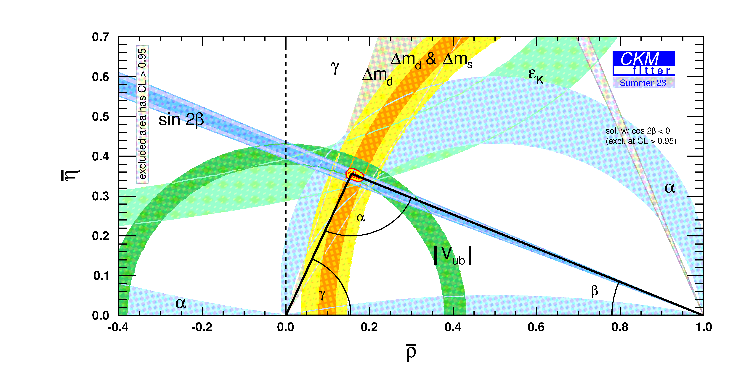


CKM angle $γ$
$$γ=\arg\left(−\frac{V_{ub}^{∗}V_{ud}}{V_{cb}^{∗}V_{cd}}\right)$$
Only angle accessible in tree-level decays
Theoretically clean
2023
Notes:
Highlight gamma

Slide 23
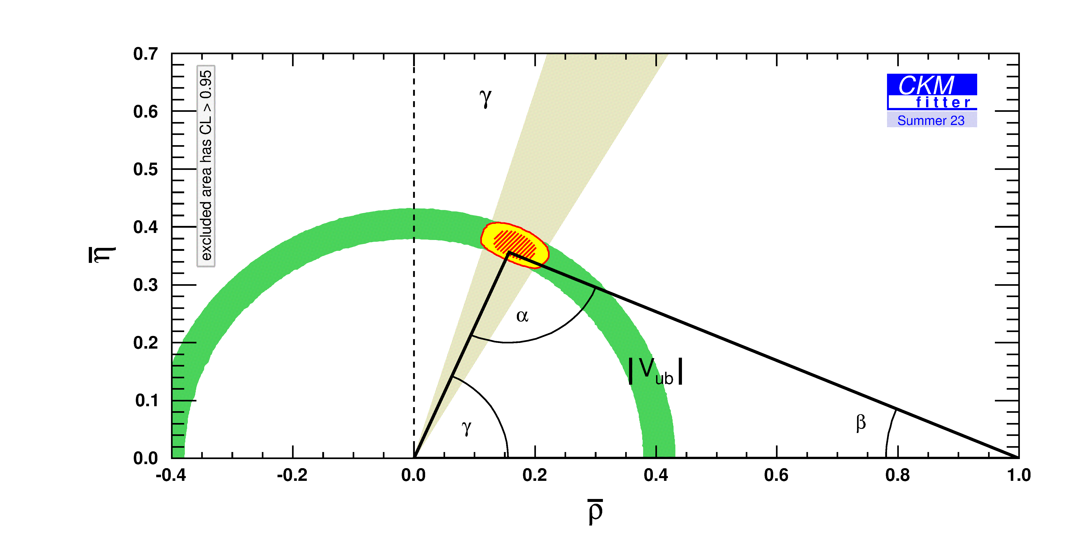

CKM angle $γ$
$$γ=\arg\left(−\frac{V_{ub}^{∗}V_{ud}}{V_{cb}^{∗}V_{cd}}\right)$$
Only angle accessible in tree-level decays
Theoretically clean
World Average from direct
measurements: $γ=\text{(}{66.4}_{−3.0}^{+2.8})\text{°}$
2023
Notes:
Highlight gamma

Slide 24
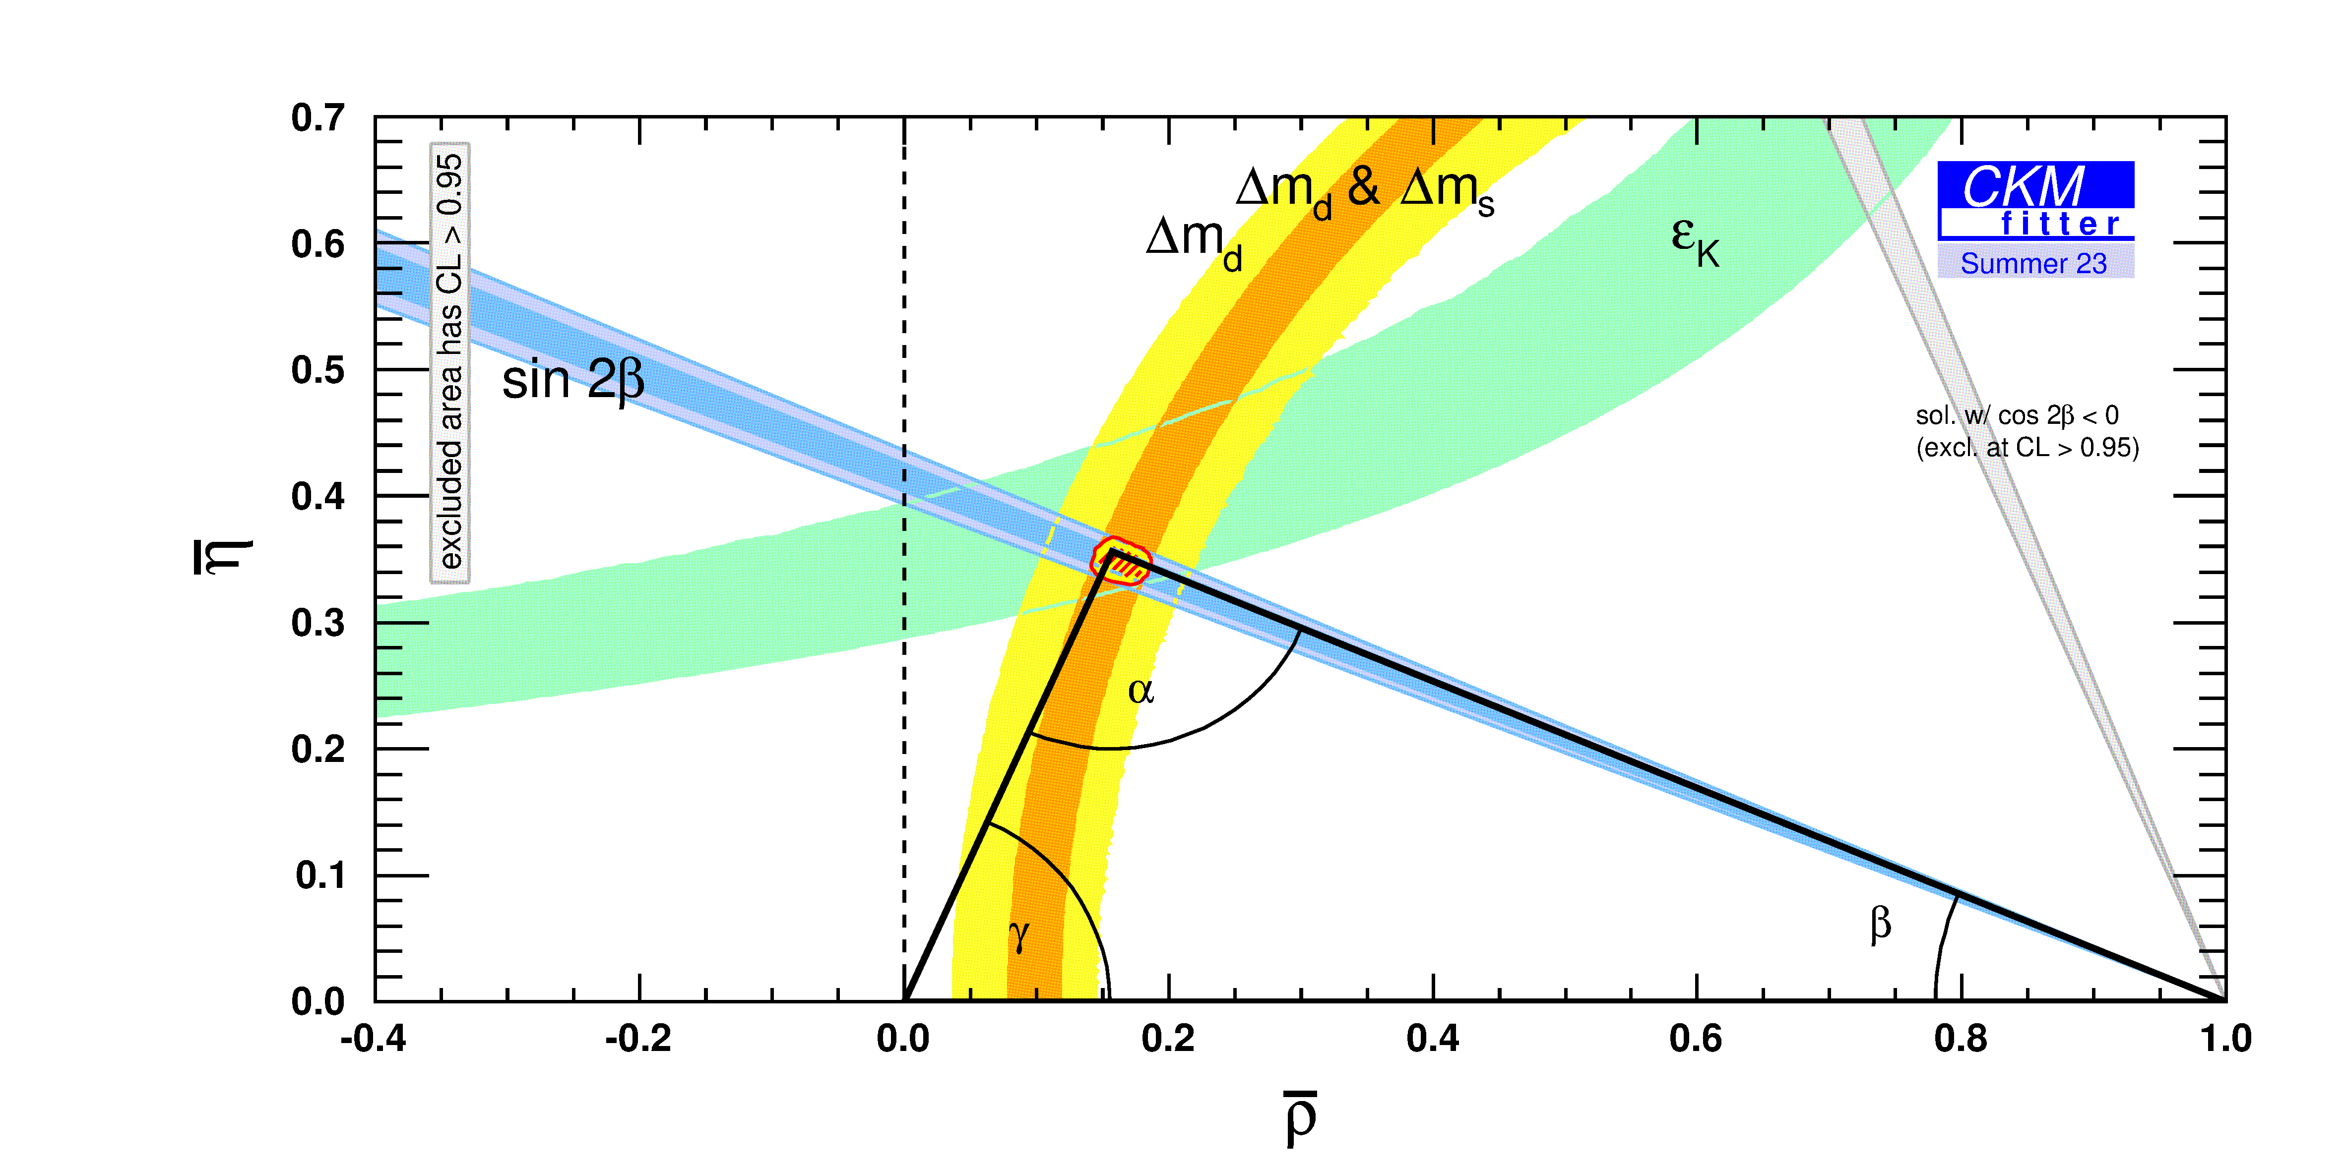

CKM angle $γ$
$$γ=\arg\left(−\frac{V_{ub}^{∗}V_{ud}}{V_{cb}^{∗}V_{cd}}\right)$$
Only angle accessible in tree-level decays
Theoretically clean
World Average from direct
measurements: $γ=\text{(}{66.4}_{−3.0}^{+2.8})\text{°}$
World Average from indirect
measurements (CKMFitter 2023):
$γ=\text{(}{66.3}_{−1.9}^{+0.7})\text{°}$
LHCb’s goal: bring uncertainty
from direct measurements of $γ$ down to
uncertainty from indirect measurements
2023
Notes:
Highlight gamma

Slide 25


Measuring CKM angle $γ$
$$γ=\arg\left(−\frac{V_{ub}^{∗}V_{ud}}{V_{cb}^{∗}V_{cd}}\right)$$
Use interference of $b→c$ and $b→u$ diagrams
Interference only possible when $D^{0},{\overline{D}}^{0}$ decay to same final state
Extract $γ$ from combination of $B→D^{(∗)}h^{+},B→D^{(∗)}h^{+}π^{+}π^{−}$ measurements (where $h=K$ or $π$)

Slide 26
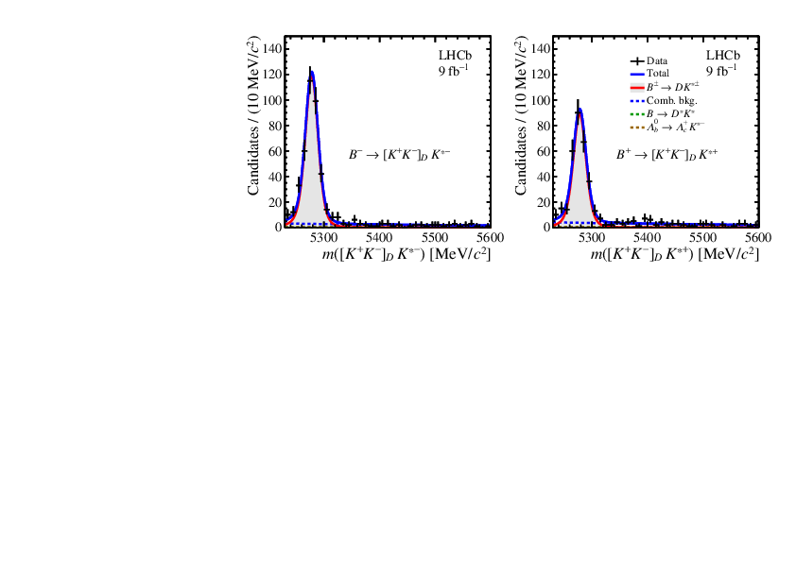
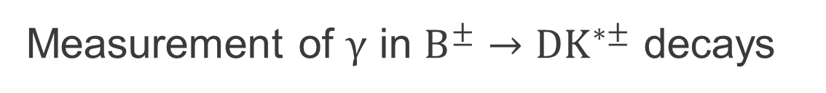

Measurement of $γ$ in $B^{±}→DK^{∗±}$ decays
D meson reconstructed in many possible final states:
$D→Kπ,K^{+}K^{−},π^{+}π^{−},K^{+}ππ^{+}π^{−},π^{+}π^{−}π^{+}π^{−},K_{S}^{0}π^{+}π^{−},K_{S}^{0}K^{+}K^{−}$
Relatively challenging mode due to $K^{∗±}→K_{S}^{0}π^{±}$ decay,
low $K_{S}^{0}$reconstruction efficiency
Result: $γ=\left(63±13\right)° →$
illustrative of measuring $γ:$
many modes required
to reach ultimate precision
[arXiv:2410.21115]
Direct CPV: more $B^{−}$ decays than $B^{+}$ decays!
Notes:
Fix plot

Slide 27


New $γ$ combination
LHCb-CONF-2024-004;
update of [JHEP 12(2021)141]
Combination of 198 observables
to determine 53 free parameters
Simultaneous determination of
$γ$and charm mixing parameters
External inputs from BESIII, CLEO-c

Slide 28
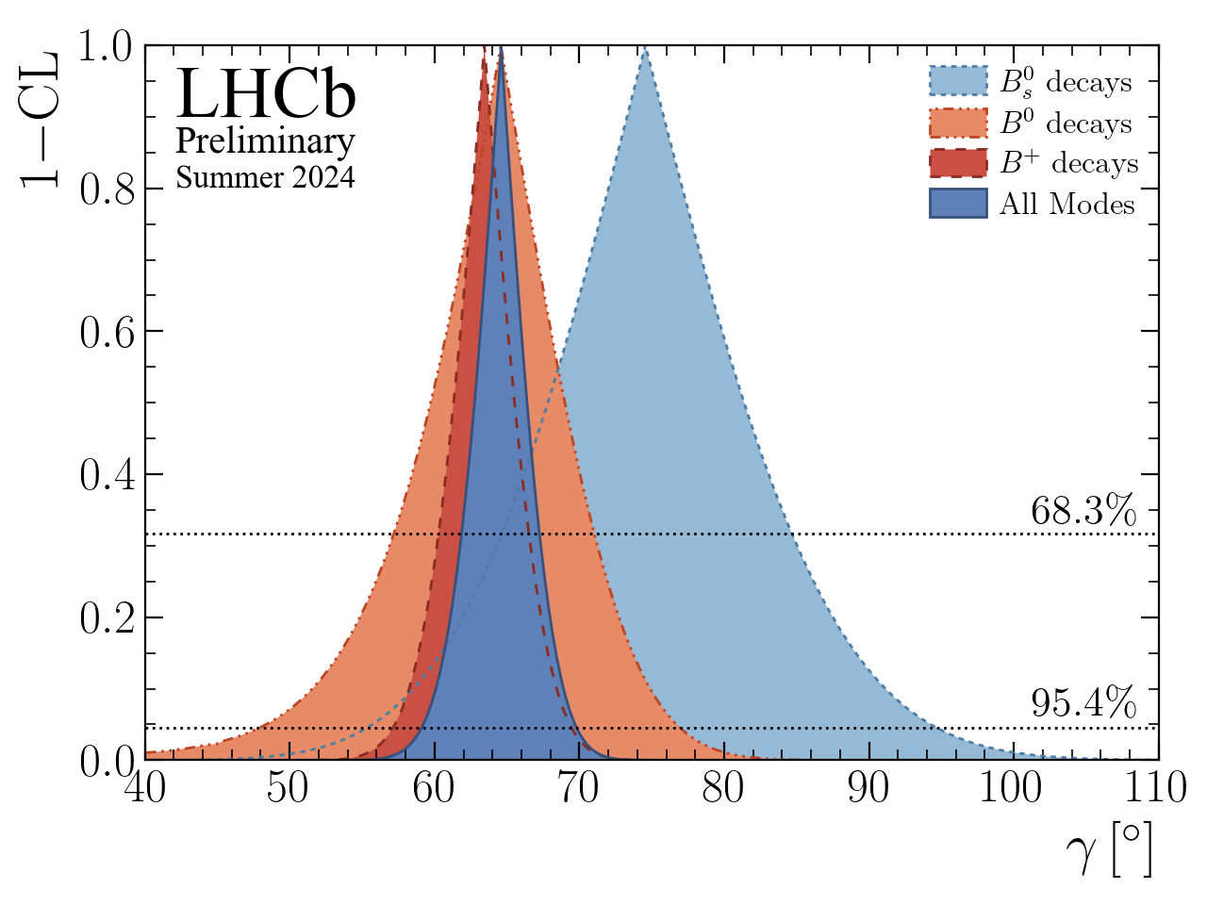
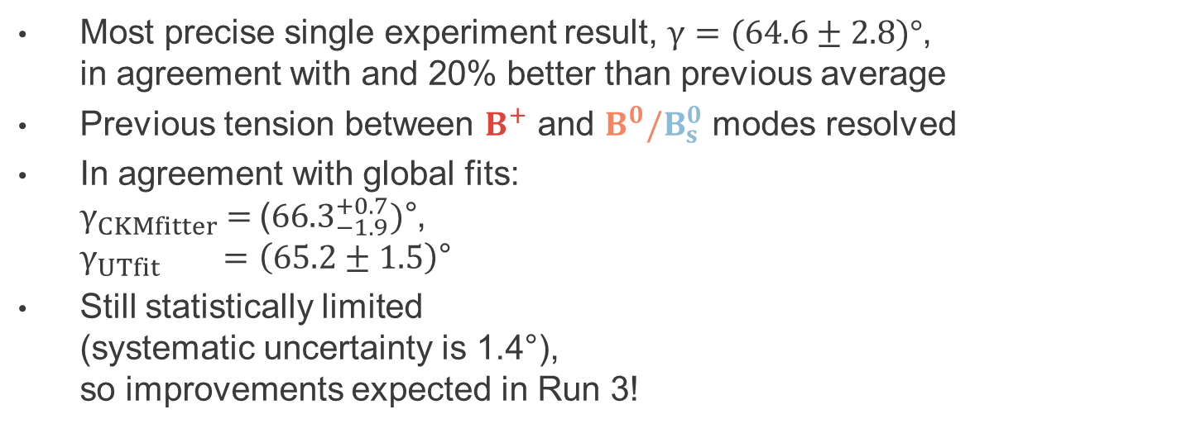
New $γ$ combination
LHCb-CONF-2024-004;
update to [JHEP 12(2021)141]
Most precise single experiment result, $γ=(64.6±2.8)°$,
in agreement with and 20% better than previous average
Previous tension between $B^{+}$ and $B^{0}/B_{s}^{0}$ modes resolved
In agreement with global fits:
$γ_{CKMfitter}\text{ = }\text{(}{66.3}_{−1.9}^{+0.7})\text{°}$,
$γ_{UTfit} =\left(65.2±1.5\right)\text{°}$
Still statistically limited
(systematic uncertainty is 1.4$\text{°}$),
so improvements expected in Run 3!
Notes:
Replace figure

Slide 29

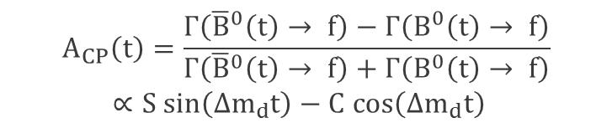
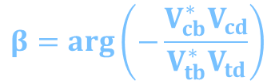


CKM angle $β$
$$β=\arg\left(−\frac{V_{cb}^{∗}V_{cd}}{V_{tb}^{∗}V_{td}}\right)$$
The angle $β$ is sensitive to top-quark interactions;
therefore only sensitive to loop diagrams,
in this case B-meson oscillation
Use interference of $B^{0}$ and ${\overline{B}}^{0}$ meson
decay to same final state, resulting in
(ignoring lifetime difference in $B^{0}$- ${\overline{B}}^{0}$ system)
$B^{0}→ψK_{S}^{0}$-type decays excellent to measure $β≈22.5°$:
for these decays $S=sin\left(2β+Δϕ_{d}+Δϕ_{d}^{NP}\right)$,
where $Δϕ_{d}≈0.5°$ due to non-tree decays is correction of ~1%
$$A_{CP}\left(t\right)=\frac{Γ\left({\overline{B}}^{0}\left(t\right)→ f\right)−Γ\left(B^{0}\left(t\right)→ f\right)}{Γ\left({\overline{B}}^{0}\left(t\right)→ f\right)+Γ\left(B^{0}\left(t\right)→ f\right)}$$
$∝S sin\left(Δm_{d}t\right)−C cos\left(Δm_{d}t\right)$
Notes:
Highlight beta
Split slides?

Slide 30
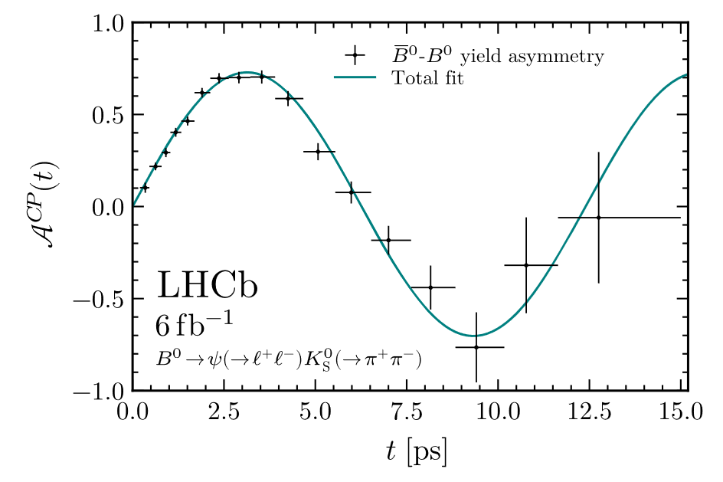
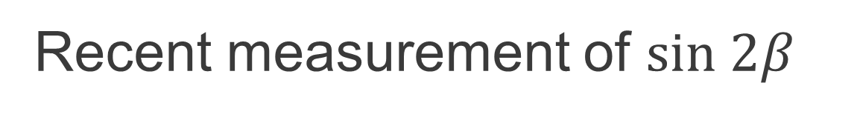
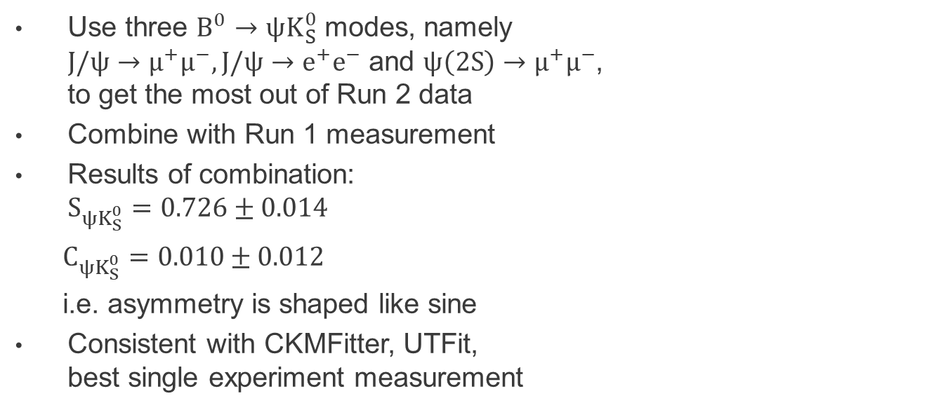
Recent measurement of $sin 2β$
Use three $B^{0}→ψK_{S}^{0}$ modes, namely
$J/ψ→μ^{+}μ^{−},J/ψ→e^{+}e^{−}$ and $ψ\left(2S\right)→μ^{+}μ^{−}$,
to get the most out of Run 2 data
Combine with Run 1 measurement
Results of combination:
$S_{ψK_{S}^{0}}=0.726±0.014$
  $C_{ψK_{S}^{0}}=0.010±0.012$
  i.e. asymmetry is shaped like sine
Consistent with CKMFitter, UTFit,
best single experiment measurement
[Phys. Rev. Lett. 132 (2024) 021801]
Notes:
Update values

Slide 31
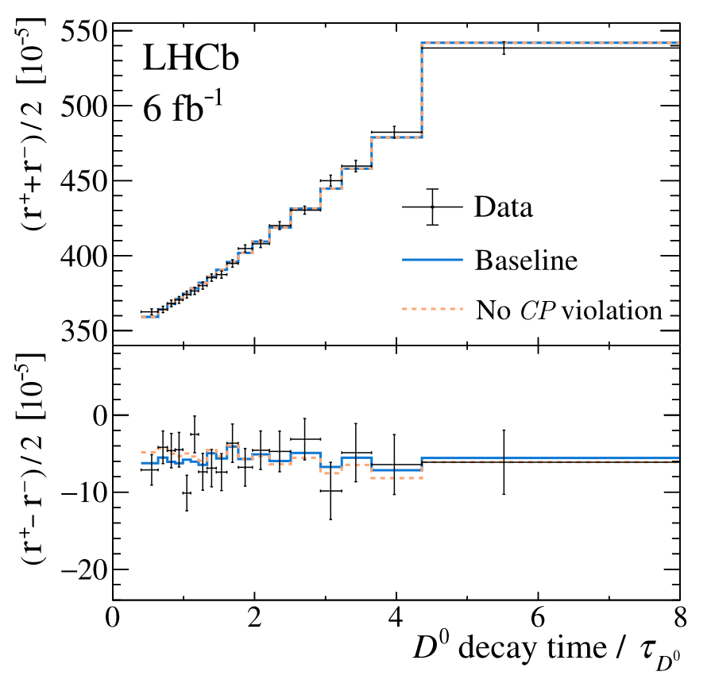
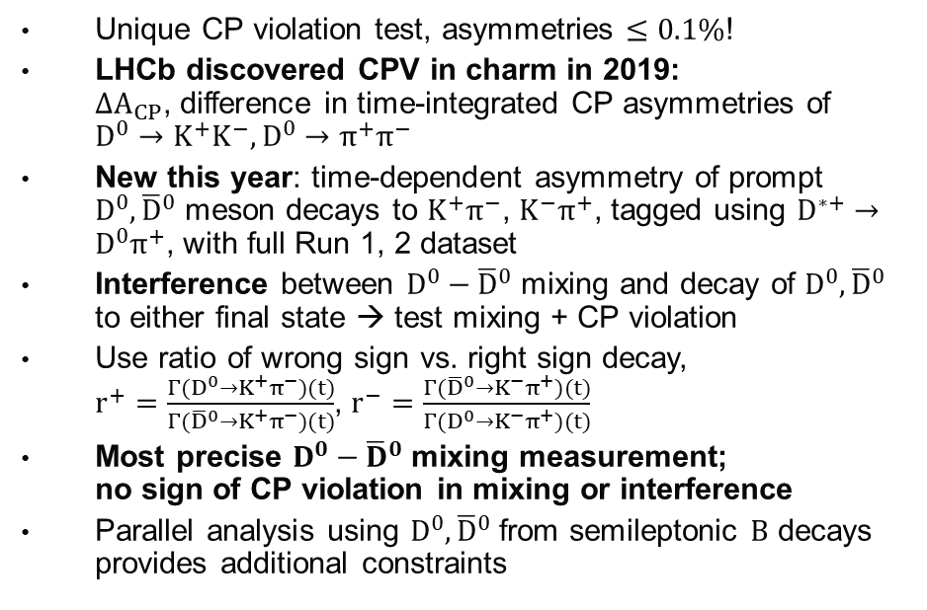
Charm mixing and CPV
[PRL 122 (2019) 211803]; [arXiv:2407.18001]
Unique CP violation test, asymmetries $≤0.1\%$!
LHCb discovered CPV in charm in 2019:
$ΔA_{CP}$, difference in time-integrated CP asymmetries of $D^{0}→K^{+}K^{−},D^{0}→π^{+}π^{−}$
New this year: time-dependent asymmetry of prompt $D^{0},{\overline{D}}^{0}$ meson decays to $K^{+}π^{−}$, $K^{−}π^{+}$, tagged using $D^{∗+}→D^{0}π^{+}$, with full Run 1, 2 dataset
Interference between $D^{0}−{\overline{D}}^{0}$ mixing and decay of $D^{0},{\overline{D}}^{0}$ to either final state → test mixing + CP violation
Use ratio of wrong sign vs. right sign decay,
$r^{+}=\frac{Γ(D^{0}→K^{+}π^{−})(t)}{Γ({\overline{D}}^{0}{→K}^{+}π^{−})(t)}$, $r^{−}=\frac{Γ({\overline{D}}^{0}→K^{−}π^{+})(t)}{Γ(D^{0}{→K}^{−}π^{+})(t)}$
Most precise $D^{0}−{\overline{D}}^{0}$ mixing measurement;
no sign of CP violation in mixing or interference
Parallel analysis using $D^{0},{\overline{D}}^{0}$ from semileptonic $B$ decays provides additional constraints
[LHCb-PAPER-2024-044, in preparation]

Slide 32
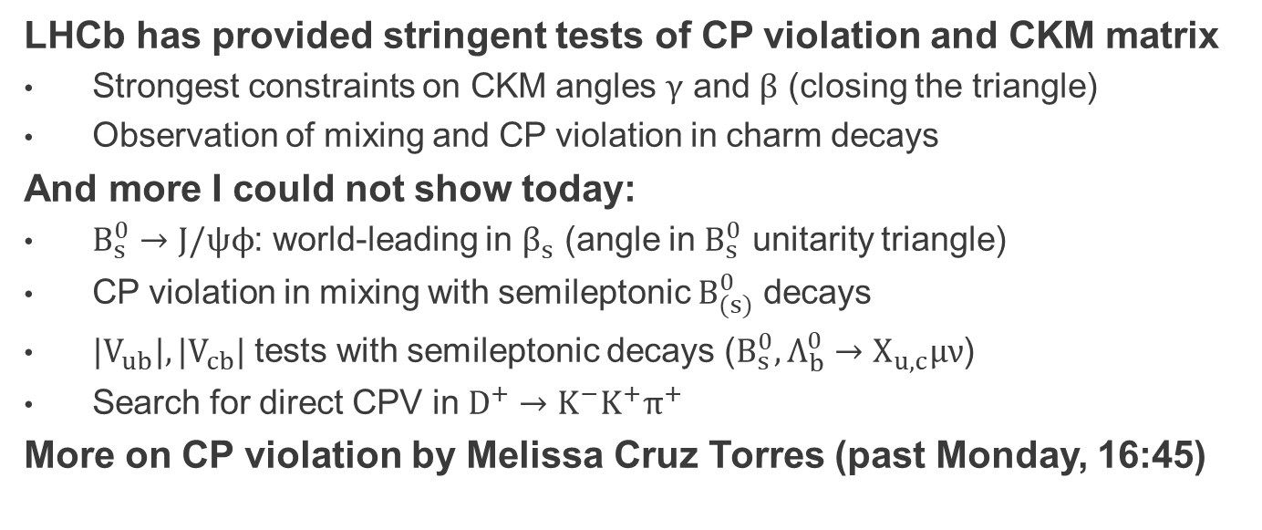
CP violation: summary
LHCb has provided stringent tests of CP violation and CKM matrix
Strongest constraints on CKM angles $γ$ and $β$ (closing the triangle)
Observation of mixing and CP violation in charm decays
And more I could not show today:
$B_{s}^{0}→J/ψϕ$: world-leading in $β_{s}$ (angle in $B_{s}^{0}$ unitarity triangle)
CP violation in mixing with semileptonic $B_{(s)}^{0}$ decays
$|V_{ub}|,|V_{cb}|$ tests with semileptonic decays ($B_{s}^{0},Λ_{b}^{0}→X_{u,c}μν$)
Search for direct CPV in $D^{+}→K^{−}K^{+}π^{+}$
More on CP violation by Melissa Cruz Torres (past Monday, 16:45)
[PRL 132 (2024) 051802]
[PRL 114 (2015) 041601,
PRL 117 (2016) 061803]
[PRL. 126 (2021) 081804, PRD101 (2020) 072004, Nature Physics 11 (2015) 743]
[arXiv:2409.01414]

Slide 33
Rare decays and lepton universality

Slide 34
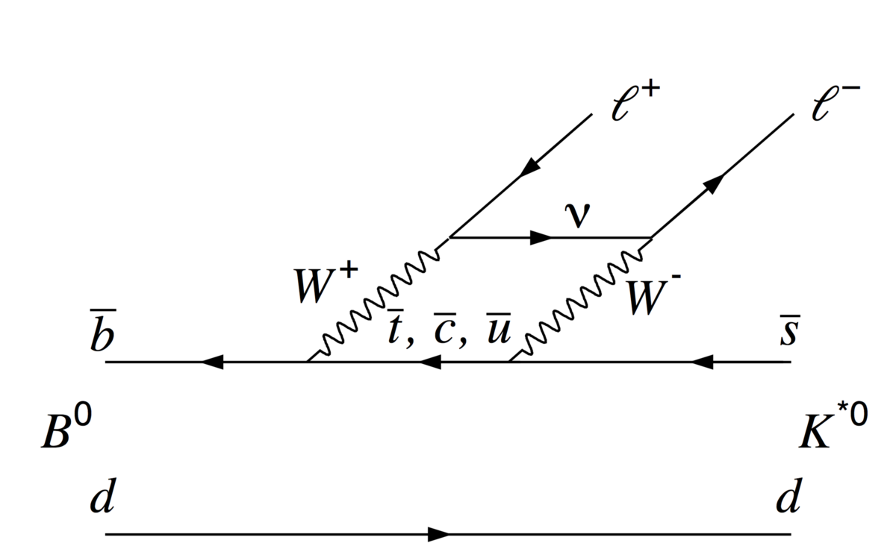
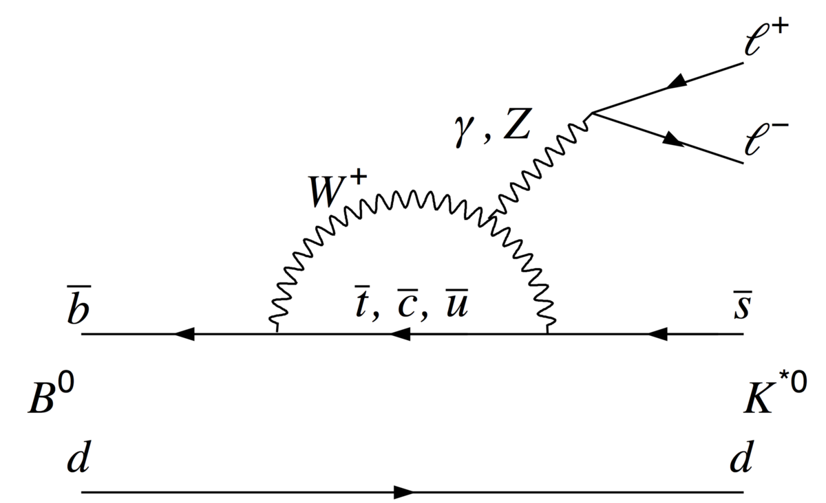

Rare B decays: $b→s(d)ll$
Test Standard Model with weak interaction loop diagrams (Flavour Changing Neutral Currents)

Slide 35
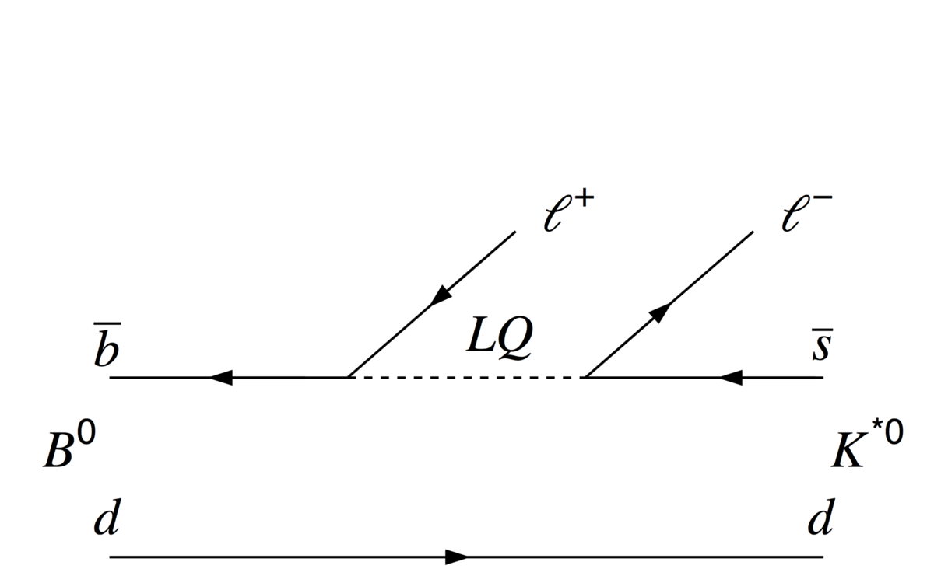
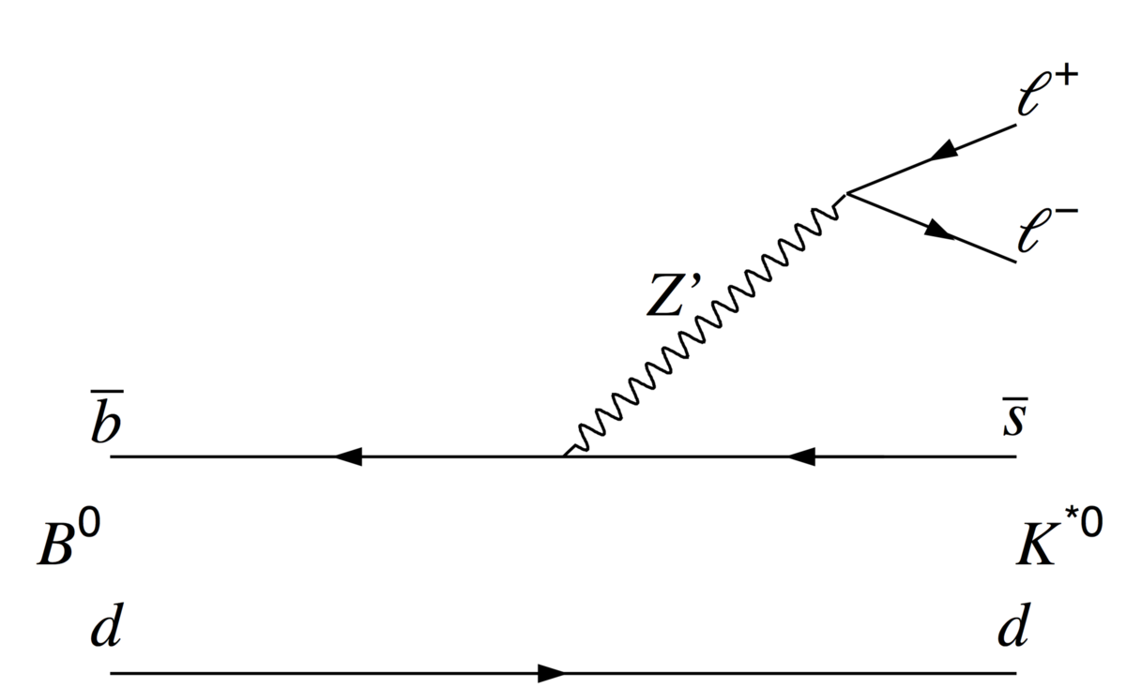
Rare B decays: $b→s(d)ll$
Test Standard Model with weak interaction loop diagrams (Flavour Changing Neutral Currents)
Transition uncommon in Standard Model,
sensitive to small contributions
from heavy new particles!

Slide 36
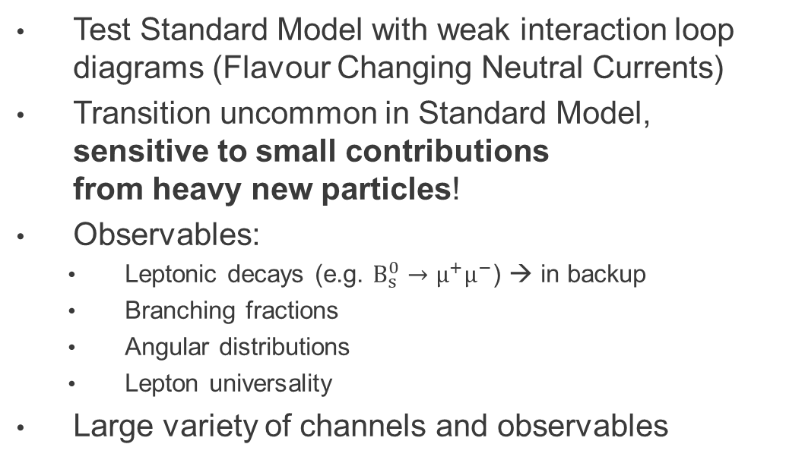
Rare B decays: $b→s(d)ll$
Test Standard Model with weak interaction loop diagrams (Flavour Changing Neutral Currents)
Transition uncommon in Standard Model,
sensitive to small contributions
from heavy new particles!
Observables:
  Leptonic decays (e.g. $B_{s}^{0}→μ^{+}μ^{−}$) → in backup
  Branching fractions
  Angular distributions
  Lepton universality
Large variety of channels and observables

Slide 37



Semileptonic rare decays: $q^{2}$
Physics depends on $q^{2}=m_{ℓℓ}^{2}$:
Resonances (e.g. $J/ψ,ϕ$)
Photon pole at low $q^{2}$
Vector or axial vector current

Slide 38











Semileptonic rare B decays: anomalies
Measurements of semileptonic rare B decays deviate from predictions….
$$B_{s}^{0}→φμ^{+}μ^{−}$$
[PRL 125 (2020) 011802]
[JHEP 06 (2014) 133]
$$B_{}^{0}→K^{∗0}μ^{+}μ^{−}$$
[PRL 127 (2021) 151801]
M
$$B_{}^{0}→K^{∗0}μ^{+}μ^{−}$$
[JHEP 06 (2014) 133]
[JHEP 11 (2016) 047,
JHEP 04 (2017) 142]
$$Λ_{b}^{0}→Λ^{0}μ^{+}μ^{−}$$
[JHEP 09 (2018) 145,
PRD 93 (2016) 074501]
Note: these deviations are consistent (interpreted in EFT framework, see backup)

Slide 39





Lepton universality: $R_{K},R_{K^{∗}}$
From SM expect equal
muonic, electronic decay rate
Measure double ratio with respect to $J/ψ$ modes
Consistent with SM, shift versus previous results
due to contribution from misID backgrounds
[PRL 131 (2023) 051803, PRD 108 (2023) 032002]

Slide 40






Lepton universality: $R_{φ}$
[arXiv:2410.13748]
First measurement with $B_{s}^{0}→ϕℓℓ$:
lower statistics but higher purity due to very narrow $ϕ$ resonance
First LHCb measurement at high $q^{2},$above $J/ψ,ψ(2S)$ resonances
Consistent with SM, much more limited by statistics than $R_{K},R_{K^{∗}}$
2$σ$
$$1σ$$

Slide 41


Semileptonic decays & LFU
Semileptonic $b→clν$ most common decay mode!
Include neutrino in final state → missing mass
Still, used at LHCb for
  $b$-hadron production measurements
  Mixing and CP violation tests
  $|V_{ub}|, |V_{cb}|$ measurements
Test lepton universality: $τ$ vs. $μ,e$ rates
Precise SM prediction available
At least 1 neutrino produced in $τ$ decay: more missing mass
LHCb does $τ^{−}→μ^{−}ν_{τ}{\overline{ν}}_{μ}$ or $τ^{−}→{3π}^{−}ν_{τ}$

Slide 42






$R(D^{+},D^{∗+})$muonic
[arXiv:2406.03387]
Simultaneous $R\left(D^{+}\right),R(D^{∗+})$
determination with 2015, 2016
data, using $τ^{−}→μ^{−}ν_{τ}{\overline{ν}}_{μ}$
Multidimensional fit in
3 variables ($m_{miss}^{2},E_{μ},q^{2}$)

Slide 43


$R(D^{+},D^{∗+})$muonic
[arXiv:2406.03387]
Simultaneous $R\left(D^{+}\right),R(D^{∗+})$
determination with 2015, 2016
data, using $τ^{−}→μ^{−}ν_{τ}{\overline{ν}}_{μ}$
Multidimensional fit in
3 variables ($m_{miss}^{2},E_{μ},q^{2}$)
$R\left(D^{∗}\right)=0.249±0.043±0.047$
$R\left(D\right) =0.402±0.082±0.066$
By itself 0.8$σ$ from SM predictions,
preliminary average $3.3σ→3.2σ$
Work on extending LFU tests
to full dataset ongoing

Slide 44

Summary: rare decays, lepton universality
Deviations found in rare decays, both $b→sμμ$ and $b→see$
(branching fraction and angular observables)
Lepton universality holds in semileptonic loop-level decays
(consistent with New Physics in $b→sμμ$ equal to $b→see$)
Deviations from lepton universality found in
semileptonic tree-level decays: $b→cτν/b→clν$
(consistent with New Physics in $b→cτν$ only)
Consistent interpretations possible (with Effective Field Theory)
Much more I could not show:
  Charm and strange decays
  Radiative ($b→sγ$) decays
  Lepton Flavour / Lepton Number / Baryon Number Violation
[LHCb-PAPER-2024-047, in preparation]
[LHCb-PAPER-2024-030, in preparation]
[arXiv:2405.13103]

Slide 45

Spectroscopy and exotic hadrons

Slide 46


Spectroscopy
Many new hadrons discovered at LHC: 75 total, 67 at LHCb

Slide 47

Spectroscopy
Many new hadrons discovered at LHC: 75 total, 67 at LHCb
23 new hadrons are exotic: (partially) four- or five-quark states
Nature of states is unclear: tightly (tetra/pentaquark)
or loosely bound (hadronic molecule)?
Key to study of non-perturbative QCD
New naming scheme proposed by LHCb: [arXiv:2206.1523]
tightly or loosely-bound?

Slide 48



$J/ψϕ$states in diffractive processes
[arXiv:2407.14301]
Measurement of $J/ψ+ϕ$ cross section in pp interactions with no other activity: diffractive processes
Surprisingly, observed resonant structures in $J/ψϕ$mass spectrum;
evidence for $χ_{c1}\left(4274\right)$ ($4.2σ$),
observation of $χ_{c0}(4500)$ ($5.5σ$)
Consistent with previous
“charmonium-like” states found
in $B^{+}→J/ψϕK^{+}$ decays!
First such a correspondence
apart from $χ_{c1}(3872)$ state

Slide 49



$χ_{c1}(3872)$: what state is it?
[arXiv:2406.17006]
$χ_{c1}(3872)$ best-known non-conventional
state (“charmonium-like”), discovered 2003
Existence at threshold of $D^{0}{\overline{D}}^{∗0}$ mass
suggests loosely bound $D^{0}−{\overline{D}}^{∗0}$ molecule
Prompt production in hadron collisions
suggests conventional $c\overline{c}$-state
This paper: measure $\frac{Γ_{χ_{c1}\left(3872\right)→ψ\left(2S\right)γ}}{Γ_{χ_{c1}\left(3872\right)→J/ψγ}}$
Generally larger than 1 for non-molecular
states, which is exactly what is measured!
Looks like $χ_{c1}(3872)$ has a significant
compact component, either $c\overline{c}$ or tetraquark

Slide 50


Weak mixing angle at LHCb
Weak mixing angle $\sin^{2}θ_{W}$
fundamental parameter of SM
Previously tested at LEP; since 2015,
LHC started to contribute
Strategy: measure $\sin^{2}θ_{eff}^{ℓ}∝\sin^{2}θ_{W}$
from forward-backward asymmetry $A_{FB}$
in $Z^{0}→μ^{+}μ^{−}$ decay, in bins of
difference in pseudorapidity $Δη$
[arXiv:2410.02502]

Slide 51


Weak mixing angle: results
LHCb finds $\sin^{2}θ_{eff}^{ℓ}=0.23147(44)(5)(23)$, resp.
statistical, systematic, theoretical (PDF) uncertainties,
consistent with other estimates
Improvement in
precision of
previous LHCb
measurement
by more than
factor 2
Still limited by
statistical
uncertainties!
[arXiv:2410.02502]

Slide 52
LHCb detector upgrades

Slide 53

LHCb Upgrade 1
Goals:
Luminosity increase by factor 5;
collect ~ $14 {fb}^{−1}$ by 2026, $41 {fb}^{−1}$ by 2033
Hardware trigger removed →
2x efficiency in hadronic/electronic modes
Required
Upgrade of most detectors, fully replaced tracking detectors (higher granularity)
Full readout and DAQ replacement to read out detector at 40 MHz

Slide 54
LHCb Upgrade 1 detector
A whole new detector!
CERN-LHCC-2011-001
Detector channels Readout
DAQ

Slide 55


VELO
CERN-LHCC-2013-021
New pixel detector (replacing strips)
Within vacuum of LHC beam pipe; 2 moveable halves (5.1 mm from beam closed, 30 mm open)
Dedicated RF foil for protection
Very radiation hard
Data rate: 3 Tbit/s
Performing well now,
after recovery from
January 2023 incident

Slide 56

SciFi
CERN-LHCC-2014-001
Scintillating Fibretracker developed for high occupancy
Spatial resolution 80 μm
Hit efficiency > 99%
Performing well, with occupancy even higher
than in design specifications

Slide 57



Upstream Tracker
4 planes made of silicon strips
with finer segmentation and
improved acceptance
  Fast pT determination for
  track extrapolation,
  reduction of ghost tracks
  Detect long-lived particles decaying after VELO ($K_{S}^{0}, Λ^{0}$)
Successfully running together with rest of detector
CERN-LHCC-2014-001

Slide 58



Trigger
CERN-LHCC-2014-016
CERN-LHCC-2020-006
All subdetectors read out at 30 MHz –
Real Time Analysis with software trigger
HLT1 reduces 30 MHz to 1 MHz with partial event
reconstruction (tracking, vertexing, muon ID),
based on GPUs in new data centre
Calibrate detector in “real-time” such that HLT2 uses
best-quality tracking, PID
Hadronic yield $/fb^{−1}$ is 2x
that of Run 2
40 Tbit/s is highest
throughput of all LHC

Slide 59


And how was 2024?
A lot of hard work finally yielded fruit in 2024
Total of 9.56 $fb^{−1}$ collected,
same as all of Run 1 and 2!
Note: some of this data was
affected by start-up issues
(until about mid-June)
How does performance look
like in good quality data?
Link to luminosity plots

Slide 60


Upgrade performance: particle ID
Particle ID holding up under harsher Run 3 conditions
[LHCb-FIGURE-2024-031]
[LHCb-FIGURE-2024-010]

Slide 61
Upgrade performance: trigger
Trigger performance much better for hadrons…
[LHCb-FIGURE-2024-030]

Slide 62
Upgrade performance: trigger
Trigger performance much better for hadrons… and electrons!
[LHCb-FIGURE-2024-030]

Slide 63
Upgrade 2
Goal: increase of luminosity by factor 7.5;
aim for 300 fb-1 after Run 6

Slide 64
Upgrade 2
Goal: increase of luminosity by factor 7.5;
aim for 300 fb-1 after Run 6
Will reach unprecedented precision
Detector environment will be challenging:
Pile-up ~40 interactions
200 Tb/s of produced data
Detector upgrades: performance
in harsher environment
Better granularity
Fast timing (~10 ps)
Radiation hardness
Upgrade 1

Slide 65

Upgrade 2
Goal: increase of luminosity by factor 7.5;
aim for 300 fb-1 after Run 6
Will reach unprecedented precision
Detector environment will be challenging:
Pile-up ~40 interactions.
200 Tb/s of produced data.
Detector upgrades: performance
in harsher environment
Better granularity
Fast timing (~10 ps)
Radiation hardness
Large step, e.g. in constraining
unitarity triangle
Upgrade 2

Slide 66

Conclusions
LHCb achieved excellent performance over Runs 1 and 2,
collecting $9 fb^{−1}$ at $\sqrt{s}=7, 8, 13 TeV$
Unitarity triangle tested to high precision; Standard Model still holds on
Rare decays and lepton universality tests strongly probe new heavy particles;
eagerly awaiting new results to resolve hints of New Physics
Fantastic set of spectroscopy and electroweak results,
many of which were never expected
LHCb Upgrade 1 detector running well!
Collected 9.56 $fb^{−1}$in 2024, more than total Run 1 and 2 dataset;
most of it should be useful for physics analysis
Work for Upgrade 2 is ongoing to make the ultimate step in precision

Slide 67
¡Gracias por su atención!

Slide 68



Meson mixing
Neutral flavoured mesons ($K, D, B$) only have
non-zero quantum numbers
that are not invariant for weak interaction!
Very dependent on meson system
Described with Hamiltonian,
oscillation frequency $Δm$
and lifetime difference $ΔΓ$

Slide 69

Effective field theory
Are anomalies consistent with each other?
Use effective field theory at B-hadron scale,
just like beta decay four-point interaction!

Slide 70



Effective field theory
An EFT probes different couplings:
Fermion operators $O_{i}$, Wilson coefficients $C_{i}$
Grouped by leptonic current: (SM,NP)
  $C_{7}$ photon penguin
  ${(C}_{10})C_{9}$ (axial) vector
  ${(C}_{P})C_{S}$ (pseudo) scalar
Note: operators, coefficients with opposite quark current handedness from SM marked with $O_{i}^{′}$,$C_{i}^{′}$ (negligible in SM)
Global fits indicate consistent deviation:
universal reduction in $C_{9}$?
SM
[Algueró et al.,
Eur.Phys.J.C 83, 648 (2023)]

Slide 71

Measurements with electrons at LHCb
[arXiv:2103.11769]
Electrons provide extra challenge in LHCb,
because of significant bremsstrahlung in material
If bremsstrahlung is emitted before magnet,
momentum is underestimated
Recover bremsstrahlung by
searching for photon clusters in calorimeter
If found, correct electron momentum
Still, mass shape worse for electron modes

Slide 72

Measurements with electrons at LHCb
[arXiv:2103.11769]
Electrons provide extra challenge in LHCb,
because of significant bremsstrahlung in material
If bremsstrahlung is emitted before magnet,
momentum is underestimated
Recover bremsstrahlung by
searching for photon clusters in calorimeter
If found, correct electron momentum
Still, mass shape worse for electron modes
Additionally, electrons more difficult for hardware trigger (than muons)
Electron sample divided based on hardware trigger category: electron, rest-of-event, or hadron trigger

Slide 73




Leptonic: $B_{(s)}^{0}→l^{+}l^{−}$ decays
Excellent decays to study $b→s\left(d\right)ll$ transition
  Precise theory predictions (4% uncertainty)
  Helicity suppression: very rare in SM
  Scalar contributions not helicity suppressed
  $→$ enhanced relative to SM!
Only $B_{(s)}^{0}→μ^{+}μ^{−}$ in current experimental reach
Predictions
  $B\left(B_{s}^{0}→μ^{+}μ^{−}\right)=\left(3.66±0.14\right){×10}^{−9}$
  $B\left(B_{}^{0}→μ^{+}μ^{−}\right)=\left(1.03±0.05\right){×10}^{−10}$
  $\frac{B\left(B_{}^{0}→μ^{+}μ^{−}\right)}{B\left(B_{s}^{0}→μ^{+}μ^{−}\right)}=0.0281±0.0006$ (extra clean test)
Fleischer et al., JHEP 05 (2017) 156
Bobeth et al. PRL 112 (2014) 101801
Beneke et al. JHEP 10 (2019) 232

Slide 74

Searching for $B_{s}^{0}→μ^{+}μ^{−}$
[PRL 120 (2018) 061801]

Slide 75



Branching fraction of $B_{s}^{0}→μ^{+}μ^{−}$
$B\left(B_{s}^{0}→μ^{+}μ^{−}\right)=$
$\left({3.09}_{−0.43−0.11}^{+0.46+0.15}\right){×10}^{−9}$
with significance > 10$σ$
Similar uncertainty to
previous LHC combination
$B_{}^{0}→μ^{+}μ^{−}$ and $B_{s}^{0}→μ^{+}μ^{−}γ$
compatible with background-
only at 1.7$σ$, 1.5$σ$
Measurement of $τ(B_{s}^{0}→μ^{+}μ^{−})$
is testing CP state of decay
(more data needed)
[LHCb-PAPER-2021-007]

Slide 76


Effective lifetime
[LHCb-PAPER-2021-007]
$B_{(s)}^{0}→μ^{+}μ^{−}$ decay proceeds through CP-odd state in SM;
CP-even, CP-odd states of $B_{s}^{0}$ have different lifetime →
measure effective lifetime $τ_{eff}$ to test CP-even contribution, scalar NP
$τ\left(B_{s}^{0}→μ^{+}μ^{−}\right)=2.07±0.29±0.03$ps (previously $2.04±0.44±0.05$ ps)
1.5 sigma from SM$,$2.2 sigma from extreme non-SM
Run 3 data needed to start providing significant constraints

Slide 77


Plume and SMOG
CERN-LHCC-2021-002
Probe for LUminosity MEasurement (PLUME):
new dedicated luminometer
Quartz tablets + PMTs for online+offline per- bunch luminosity measurement
Running continuously, accurate luminosity estimate
SMOG2 gas system for fixed-target physics
New storage cell for gas upstream of
nominal interaction point
Gas density increased by up to two orders
of magnitude → much higher luminosity
Gas targets: He, Ne, Ar
(+ possibly H2, D2, N2, Kr, Xe)
Simultaneous p-p and p-gas data taking
Running smoothly and data taken in parallel
CERN-LHCC-2019-005

Slide 78

LHCb Upgrade 2 detector

Slide 79


Advantages of $b$-hadrons
Heaviest quark forming hadrons decaying weakly
Many possible decay modes,
and even more observables!
  Very rich spectrum of possibilities!
  O(600) modes (incl. searches) for $B^{+}/B^{0}$, O(100) for $B_{s}^{0},Λ_{b}^{0}$
Weak decay of $b$-hadron crosses generations:
  No large branching fractions (largest $5\%$)
  Sensitive to small SM and New Physics effects!
Lifetime and boost at LHCb give decay length of $O(1 cm)$; precise lifetime measurement possible

