Slide 1
SILAFAE 2024
Mayda Velasco -- Electroweak
Physics @ the LHC

Slide 2
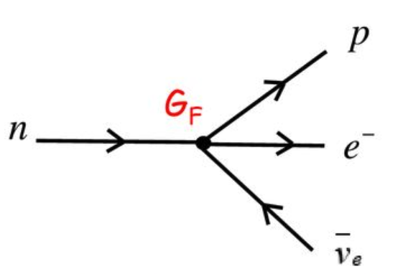
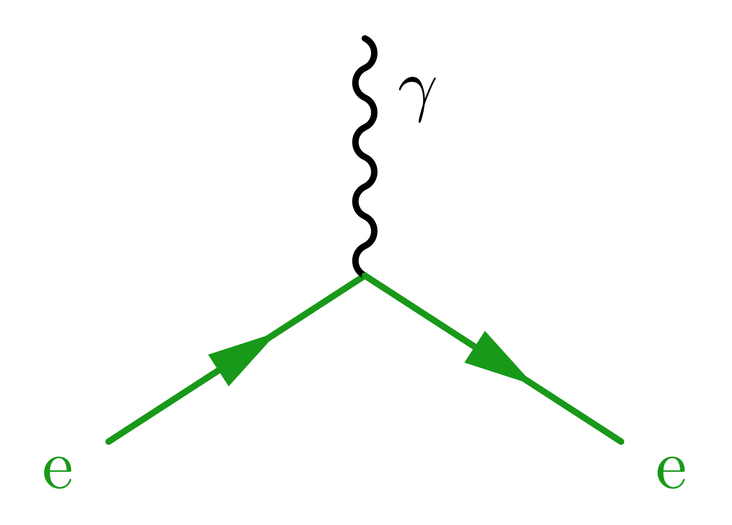
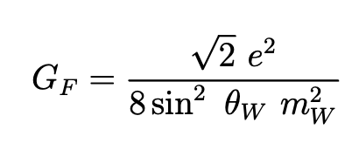
Electroweak physics, then & Now...
Significant progress, basic drivers continue to be the same
Fermi proposed 1st theory of weak interaction: β-decay explained by a 4-point interaction, involving a force with no range
Wu et al confirmed the "law of conservation of parity" is invalid for β-decay
E F T
1960s
1950s
B-Field
g - 2
1957
1933
Glashow, Salam & Weinberg unified the electromagnetic force and the weak interaction. What we call the ELECTROWEAK FORCE.
Yang & Lee suggested handedness of spins of particles in weak interaction violates conservation laws

Slide 3
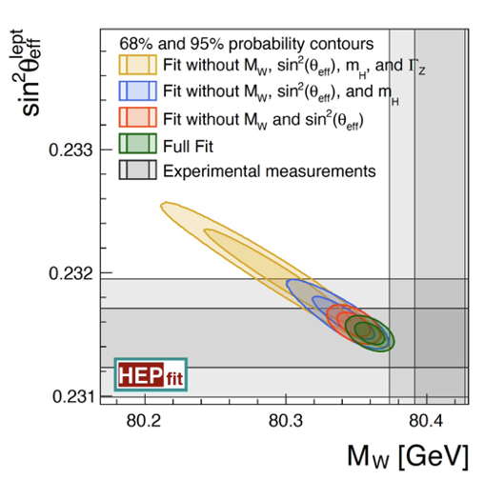
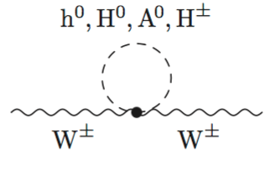
Motivation for Precision Electroweak @ the LHC
Test self-consistency of Standard M.
Electroweak sector is over-constrained
Identify tensions between direct & indirect measurements
Deviations may be due to new physics
${sin2 θ}_{eff}^{l}$ = ${sin2 θ}_{W} \left(1+Δk\right)=(1−M_{W}^{2}/M_{z}^{2})$ $\left(1+Δk\right)$

Slide 4
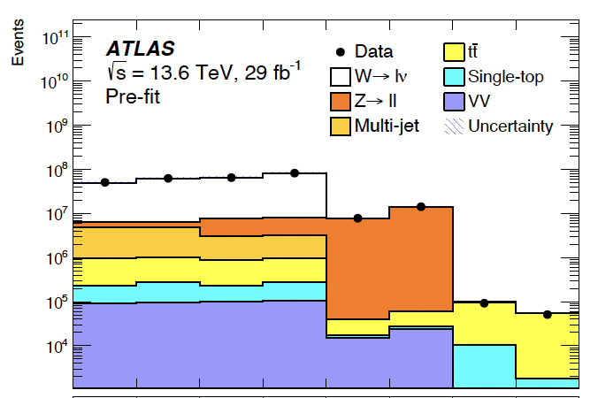
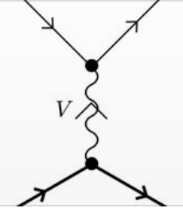
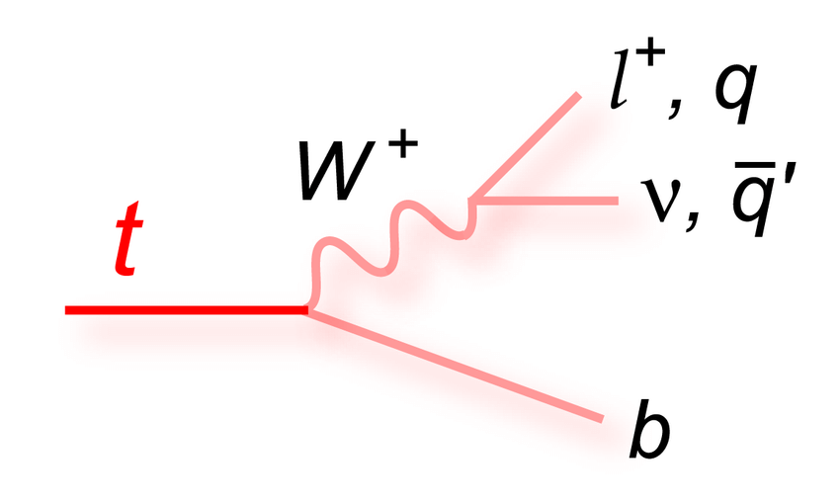
only Discussing 2024 Competitive or unique results
Z-boson: ${ sin2 θ}_{eff}^{l}$
W-boson: M_{W} & Γ_{W}
Lepton & CKM Universality
Tau lepton: g-2
from γγ ◊ ττ
Multi-boson:
Trilinear & quartic couplings
Vector-boson scattering
cds.cern.ch:2903866
arxiv.org: 2405.18661

Slide 5
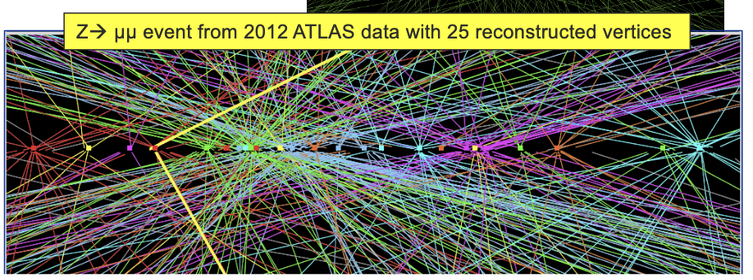
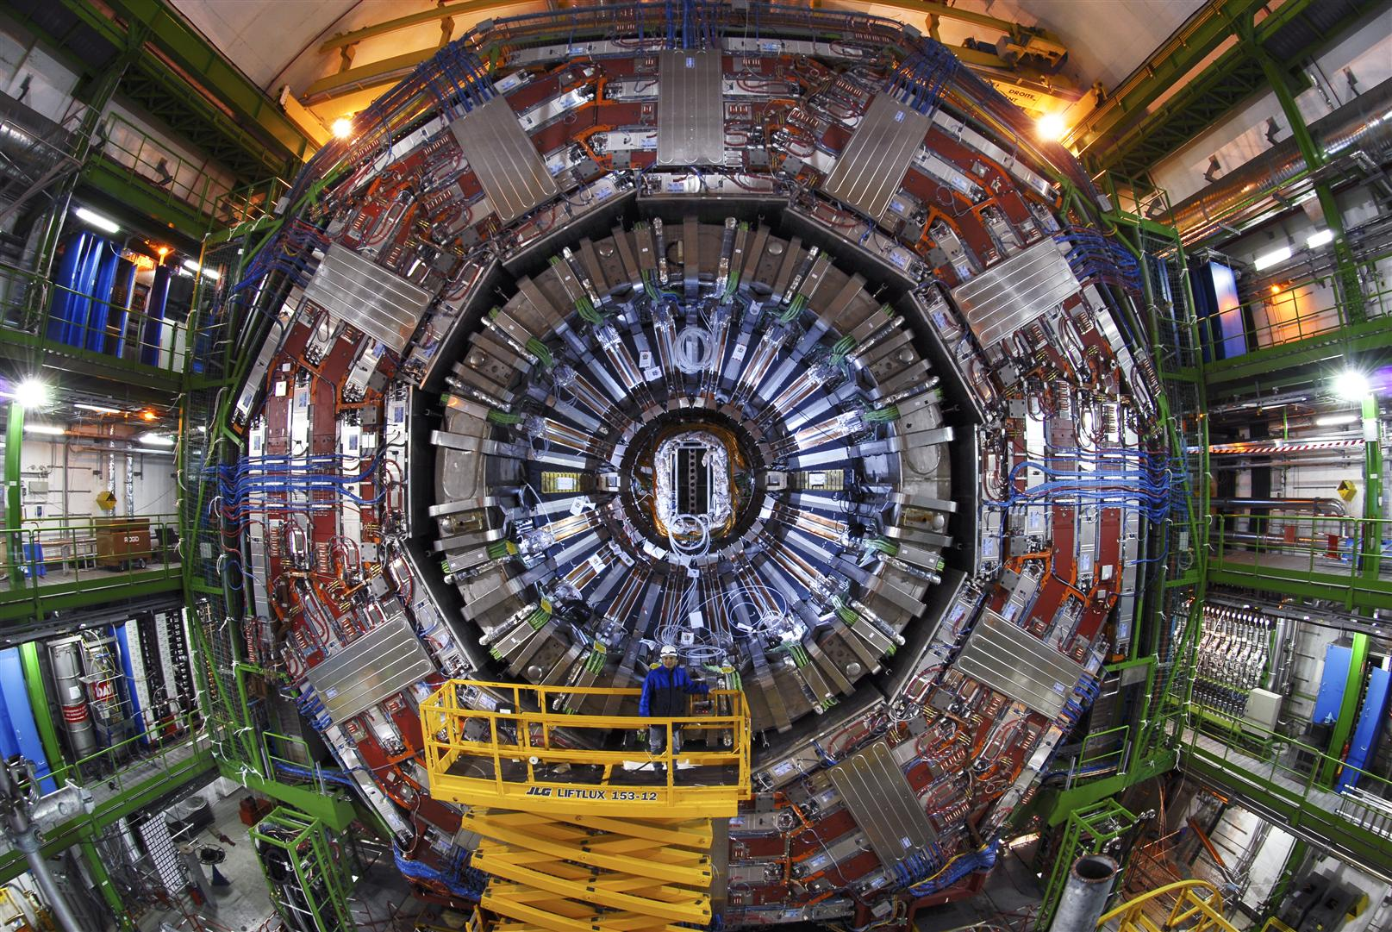
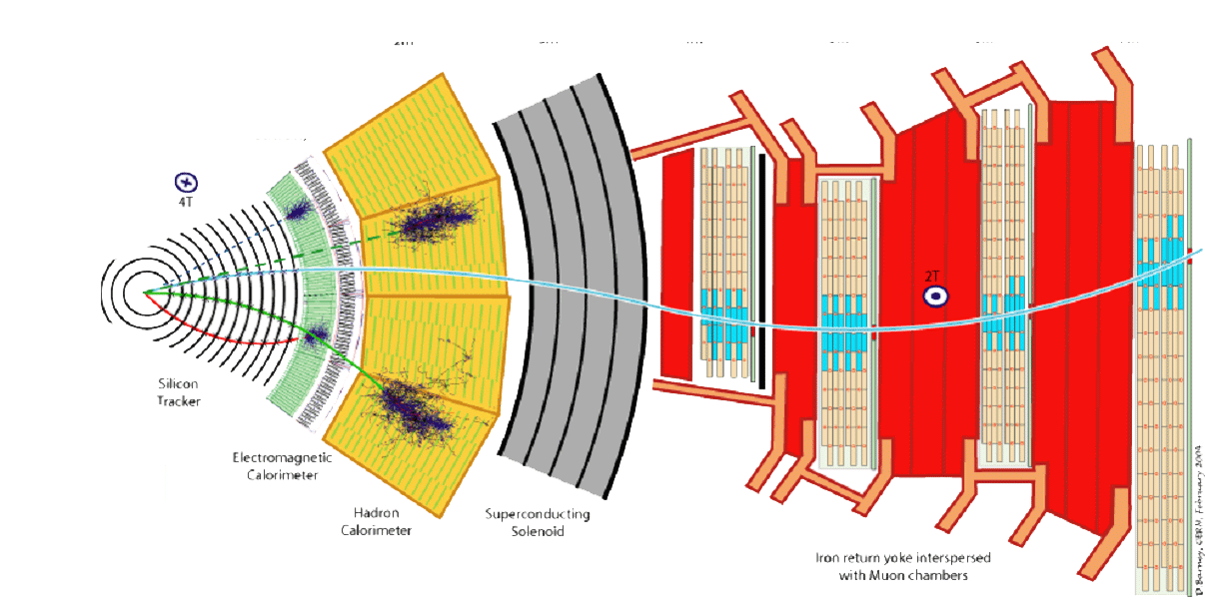
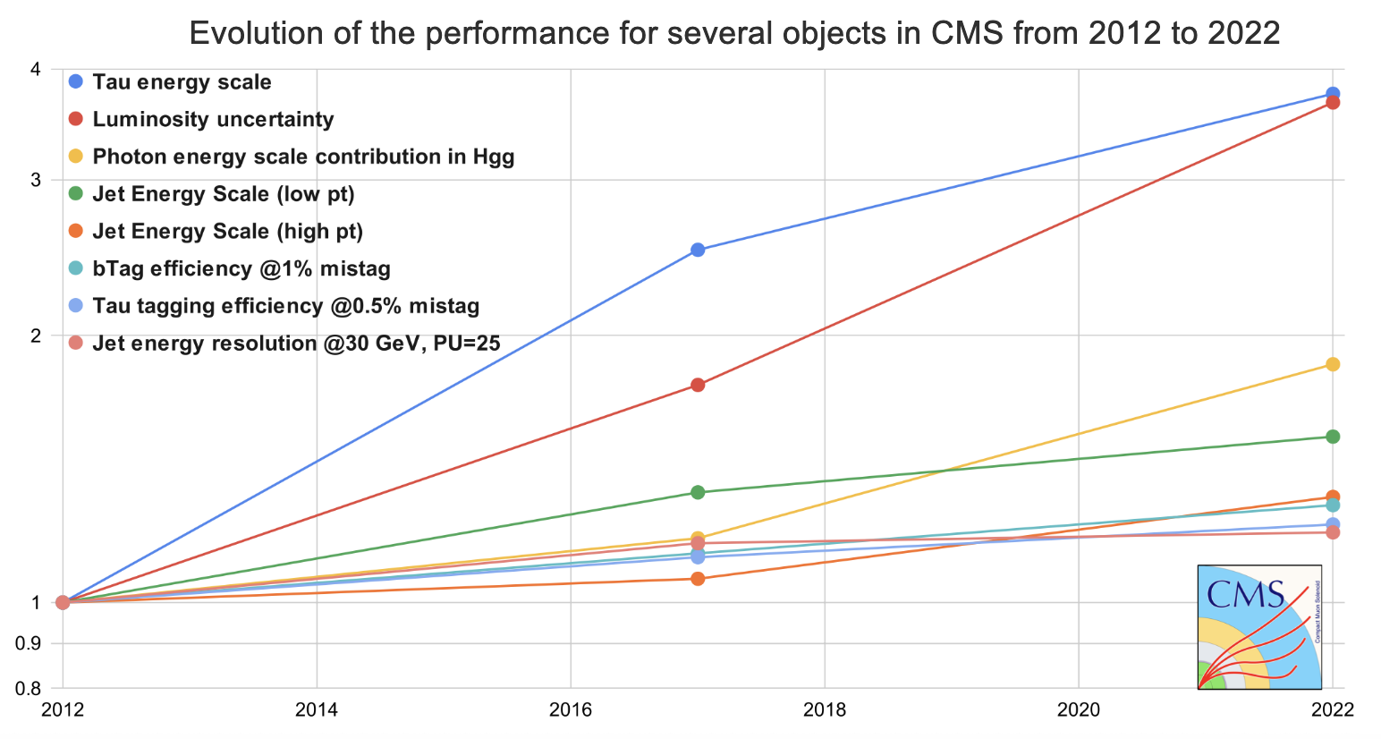
CMS
Transverse
View
Reconstruct and identify:
γ, e, μ , τ & charge hadrons – p, π$±$, k$±$
Jets: light & heavy quarks (c, b)
ν from Missing Energy

Slide 6
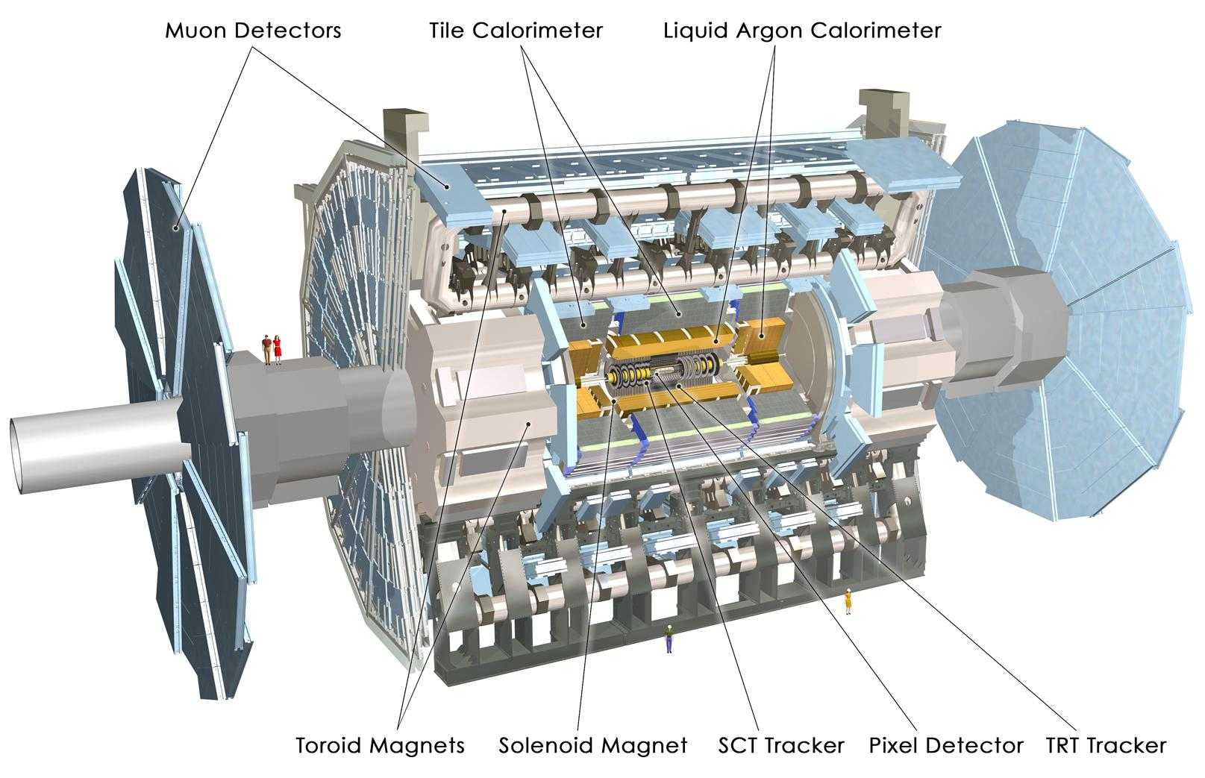
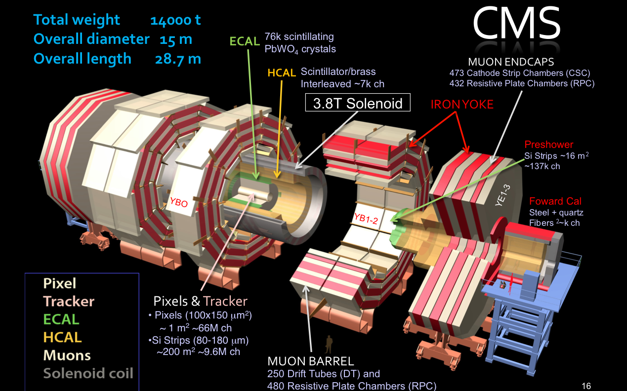
LHC collisions: kinematics
2

Slide 7
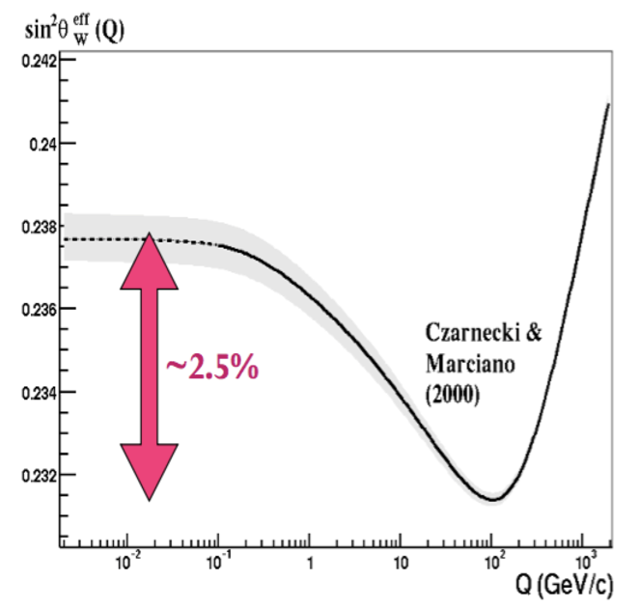
$$Z− boson$$
$${ sin2 θ}_{eff}^{l}$$
Z’s on-shell

Slide 8
From Drell-Yan production of e⁺e⁻ & μ⁺μ⁻
${sin2 θ}_{eff}^{l}$ = ${k sin2θ}_{W}, where k=1+Δk contains corrections$
Photon-fermion:
Z⁰-fermion:
Vector and Axial components of the Z⁰ couplings strength:
The coupling factor has an enhanced sensitivity to sin²θ_{W} at the lepton-Z⁰ vertex: for sin²θ_{W} ~ 0.23 a 1% variation :
changes lepton factor ( containing Q_{l} ) by about 8%
changes quark factor ( containing Q_{q} ) by about 1.5% ( 0.4%) for the u ( d or s ) quark.
where “ T ” is ½ (- ½) for + (-) charged fermions

Slide 9
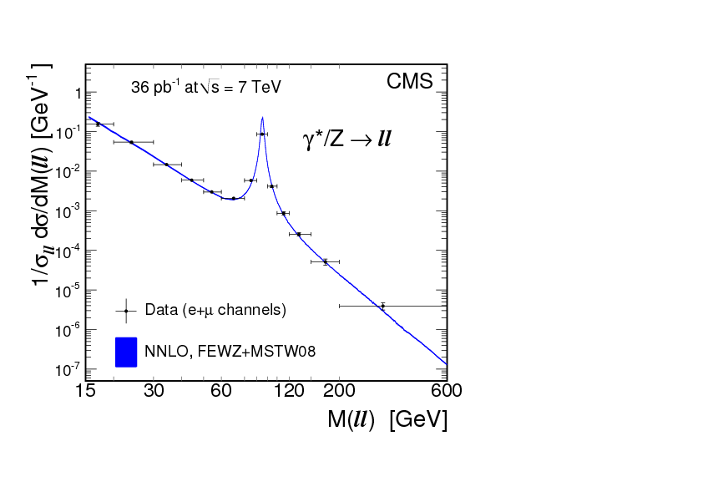
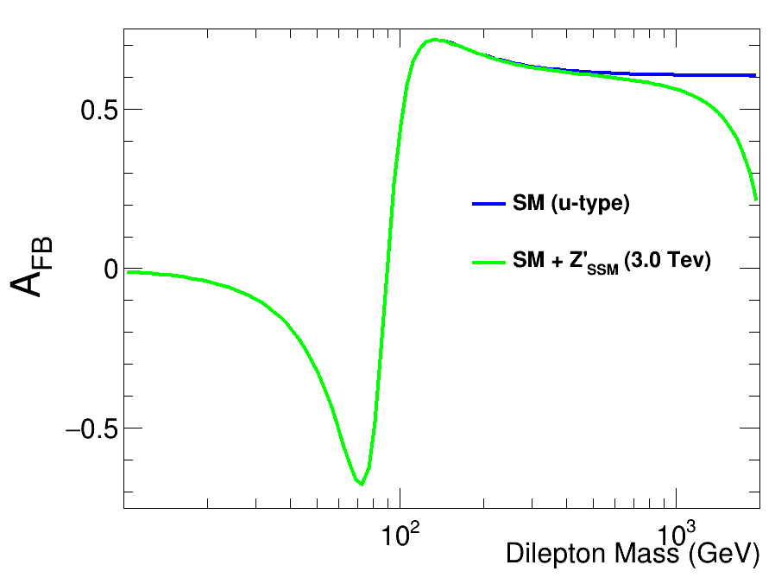
forward-backward asymmetry, A_{FB}, of the polar-angle of the lepton vs the l⁺l⁻ mass is used to measure ${sin2 θ}_{eff}^{l}$
2
γ
2
γ
Z⁰
2
$${→sin2 θ}_{eff}^{l}$$
2
Z⁰

Slide 10
A₄ : Parity violating coefficient of polarization components of the D.Y. Cross sections
A_{FB} increases with Z⁰ rapidity ➔ y
Valence quarks significant contribution to A_{FB} because cosθ →1 has more sensitivity to A₄
Dependence of A_{FB} & A₄ ( M_{ll}, y ) crucial to reduce systematic uncertainties ${in sin2 θ}_{eff}^{l}$

Slide 11
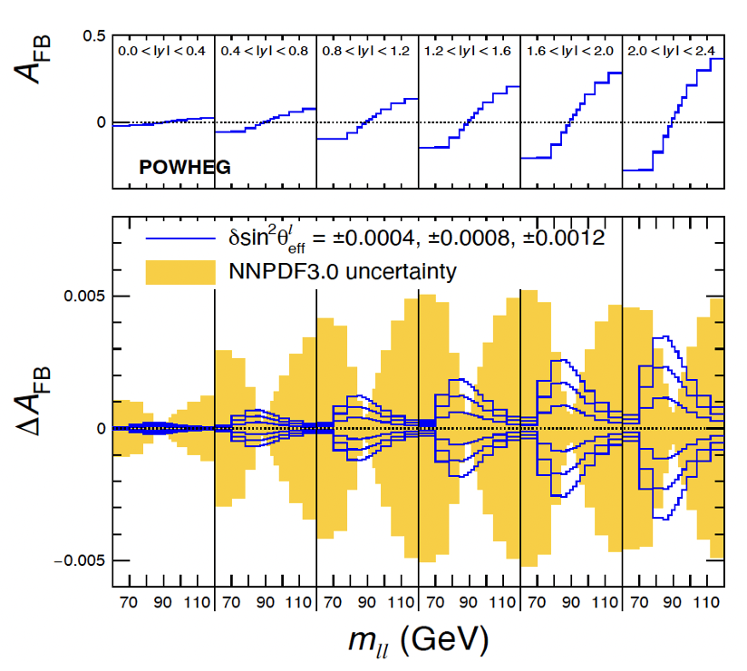
large uncertainty… due to Parton Distribution Functions of the proton
In situ reduction of PDF errors with
PDF reweighting/profiling
A_{FB} is sensitive to both ${sin2 θ}_{eff}^{l}$& PDFs…
However:
The Z⁰-peak yields a measurement of ${sin2 θ}_{eff}^{l},$
Above & below the Z⁰-peak the axial coupling
are well known, and A_{FB} is not as sensitive to ${sin2 θ}_{eff}^{l}$, but it is sensitive to PDFs
Therefore, sidebands of M_{ll} spectra are used to constraints PDFs using the same Drell Yan data

Slide 12
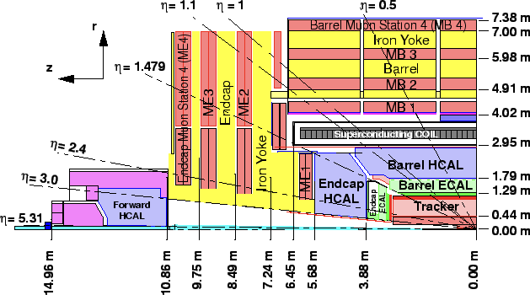
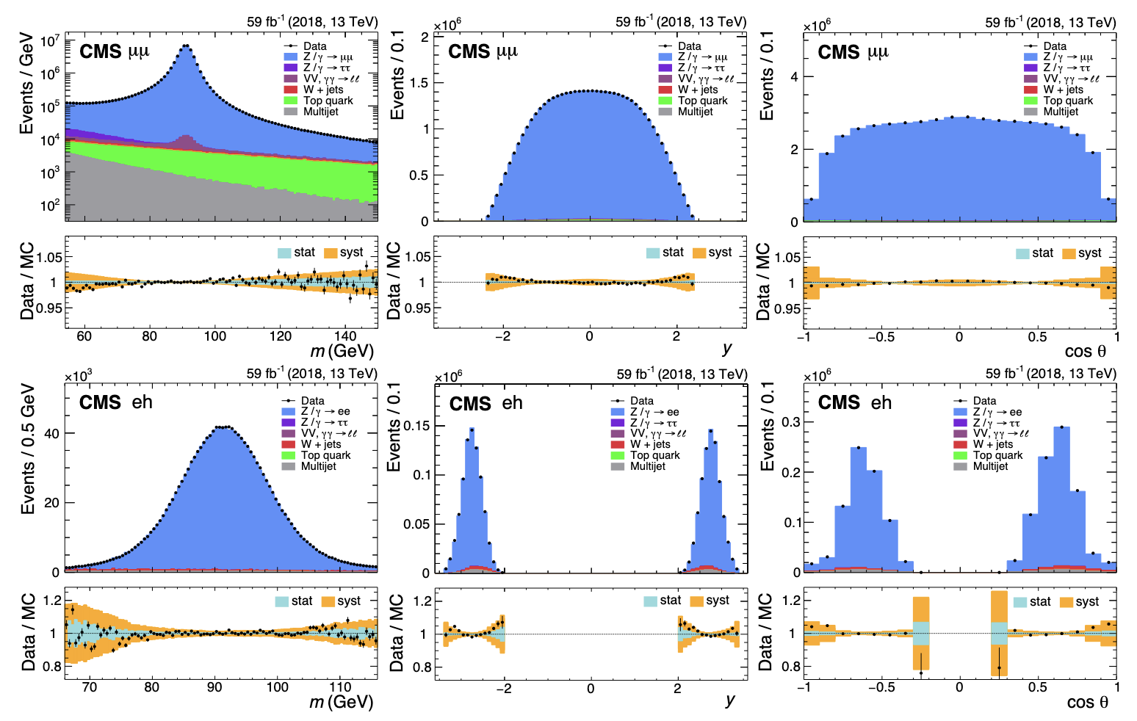
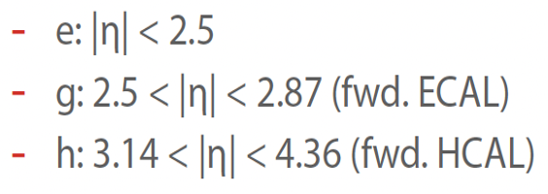
y=0
CMS… measured via Z/𝛾*→l⁺l⁻
From A_{FB} (same as Run 1) weighted by y & cosθ
→ cancellation of acceptance and efficiencies
Fit A₄ coefficient (New) while unfolding differential distributions as a function of M_{ll} & y
→ smaller theory and PDF uncertainties
y~4.3
Added information from regions outside the tracker to expand the acceptance in the di-electron channel to increase A_{FB} acceptance in rapidity y
M_{ll}
Rapidity y
cosθ

Slide 13
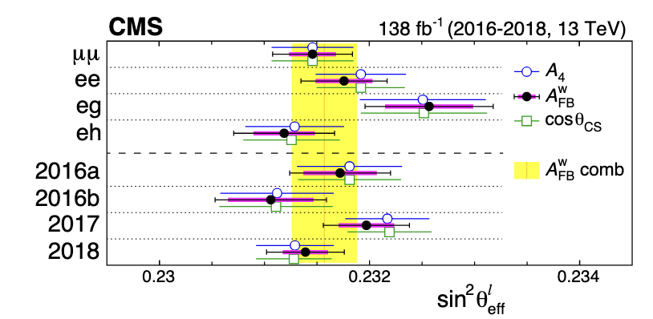
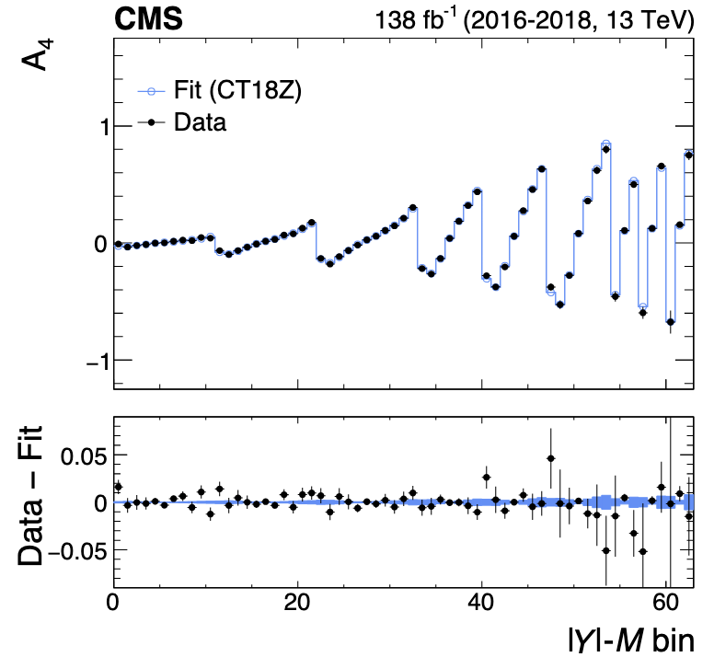
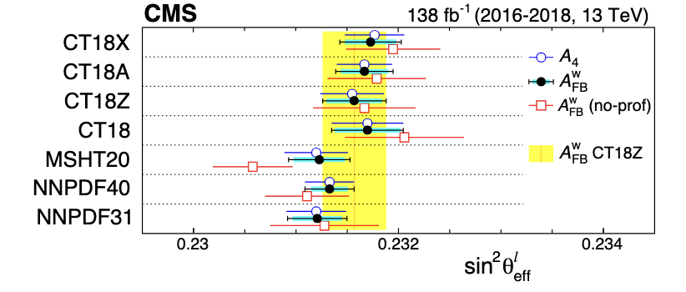
Most recent CMS result @13 TeV ${sin2 θ}_{eff}^{l}$
Most precise measurement of ${sin2 θ}_{eff}^{l} @$ hadron colliders comparable precision to LEP & SLD
arXiv:2408.07622
Most precise measurement at hadron colliders, precision comparable to LEP & SLD
Current prediction from global EW fits ${ sin2 θ}_{eff}^{l}$= 0.23155 ± 0.00004

Slide 14
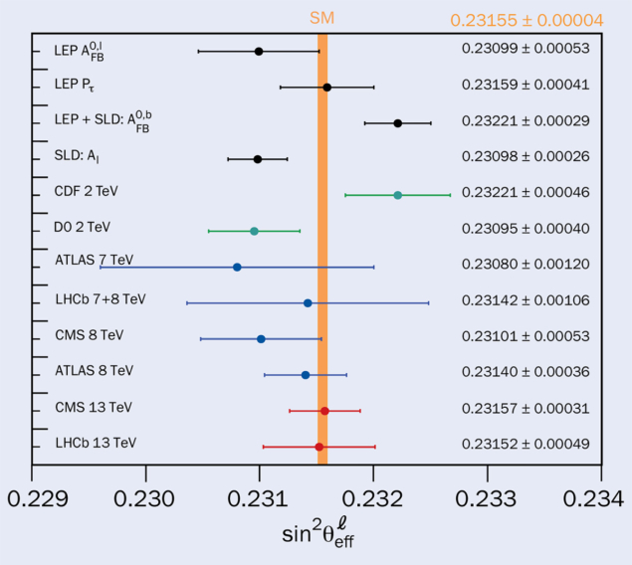
${sin2 θ}_{eff}^{l}$: Evidence of ongoing new era of precision Electro-Weak measurements
Further reduction in PDF errors needed to differentiate SM from models, like Higgs Doublet
Prediction from
global EW fits
${ sin2 θ}_{eff}^{l}$=
0.23155 ± 0.00004

Slide 15
W boson: Mass M_{W}
and Width Γ_{W}

Slide 16
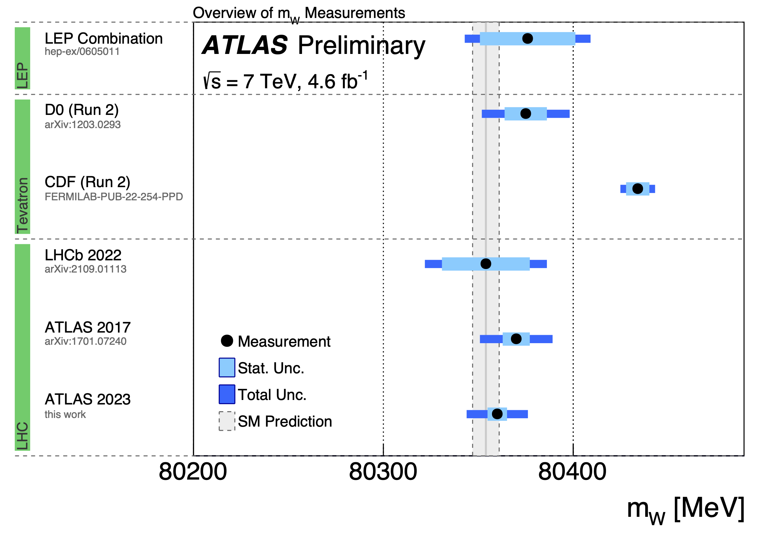
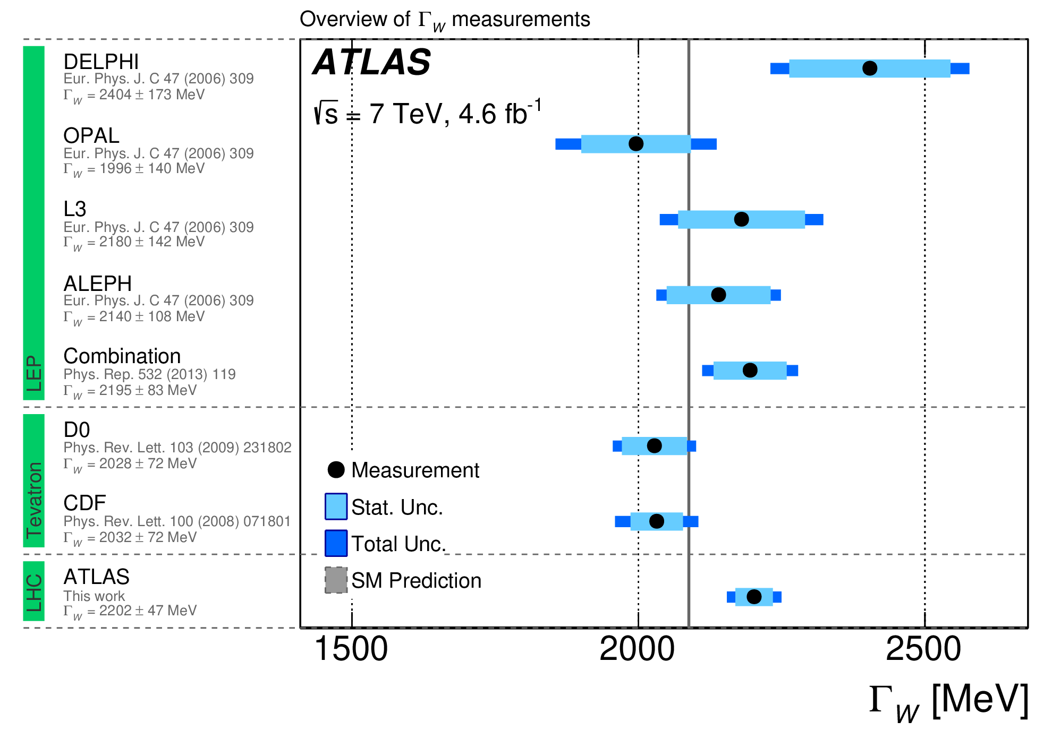
Hadron colliders deemed unsuited for precise measurement given the theoretical and experimental uncertainties
LEP-200 WW-production had a clean environment
1st Tevatron & later LHC proved
them wrong!
M_{W} precision of ΔM_{W} = 6 MeV from global EW fits
ATLAS: M_{W} = 80366.5 ± 15.9 MeV
Γ_{W} = 2202 ± 47 MeV
Significant tension between CDF & LHC+EW

Slide 17
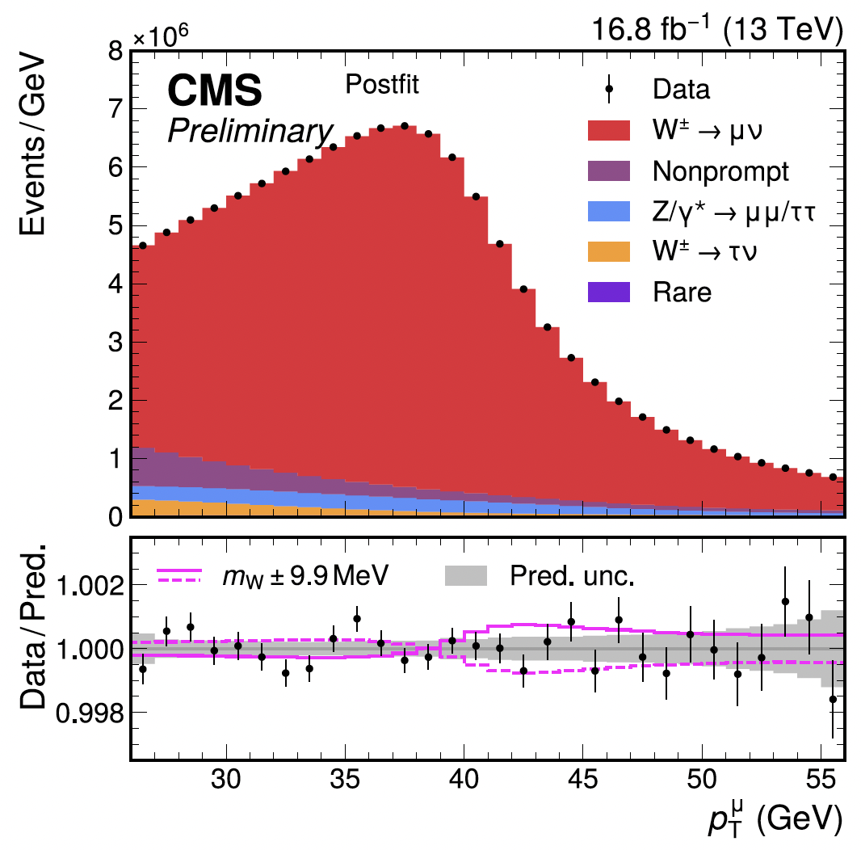
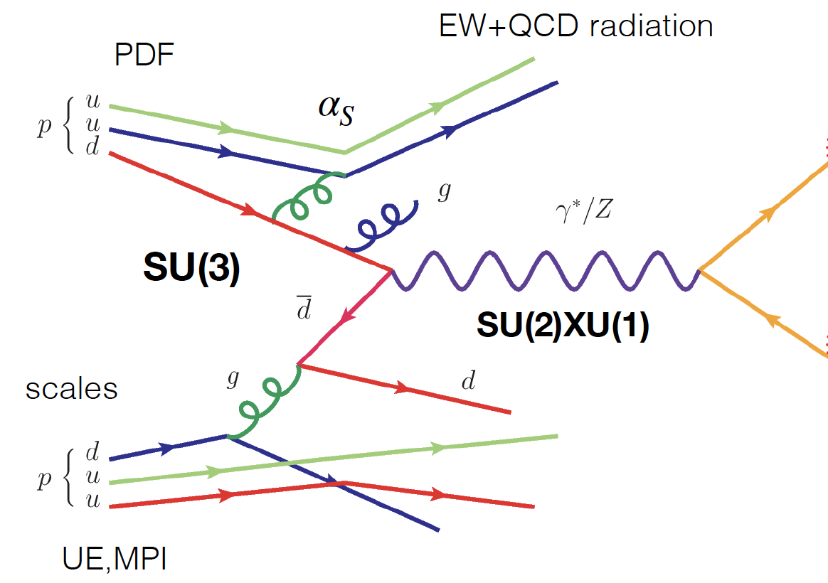
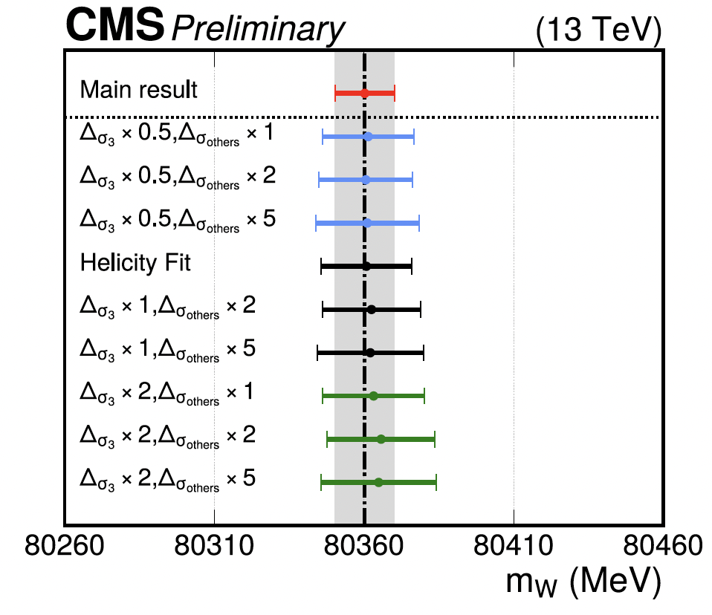
Latest m_{W} coming from CMS from two methods
Nominal theory-dependent fit
Helicity cross section fit reduced theory uncertainty at the cost of larger statistical unc.
M_{W} = 80360.2 ± 9.9 MeV
M_{W} = 80360.8 ± 15.2 MeV
d
u
u
W⁺
d
u
u
νs forces us to use indirect observables to infer constraints on
the mass ⇒ many systematic uncertainties to control

Slide 18
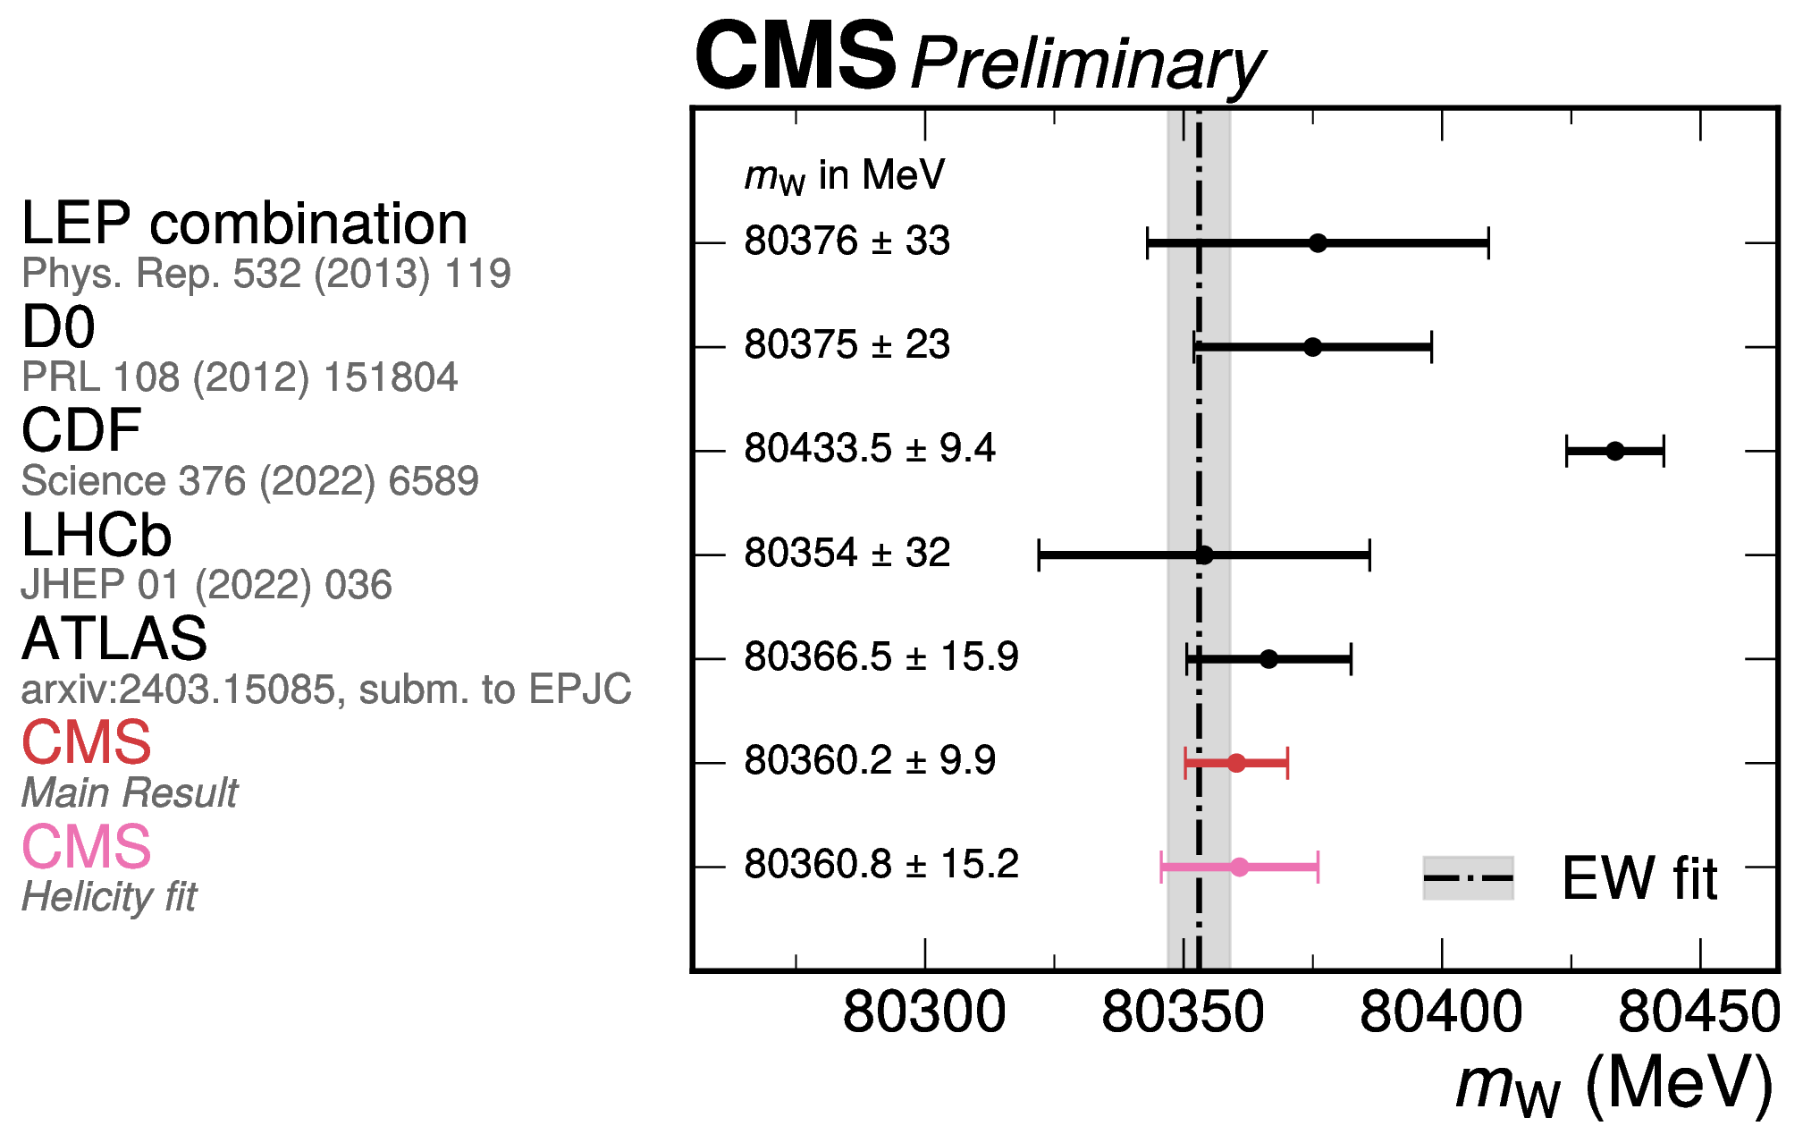
CMS m_{W} result
Measured with uncertainty of 9.9 MeV
- Precision comparable to CDF, but consistent with SM
Uses a well-understood portion of 13 TeV data
- 16.8 fb-1 from 2016 run (~ 30 pileup)
- Large sample (>100M) of W→μν
Theoretical modelling
- Use most accurate model & uncertainties available
- Rely on in-situ constraints from the W data itself
Muon calibration: from J/ψ, validated with the Z
Fit to granular distribution of p_{T}^{μ} x η^{μ} x charge
CMS-PAS-SMP-23-002

Slide 19
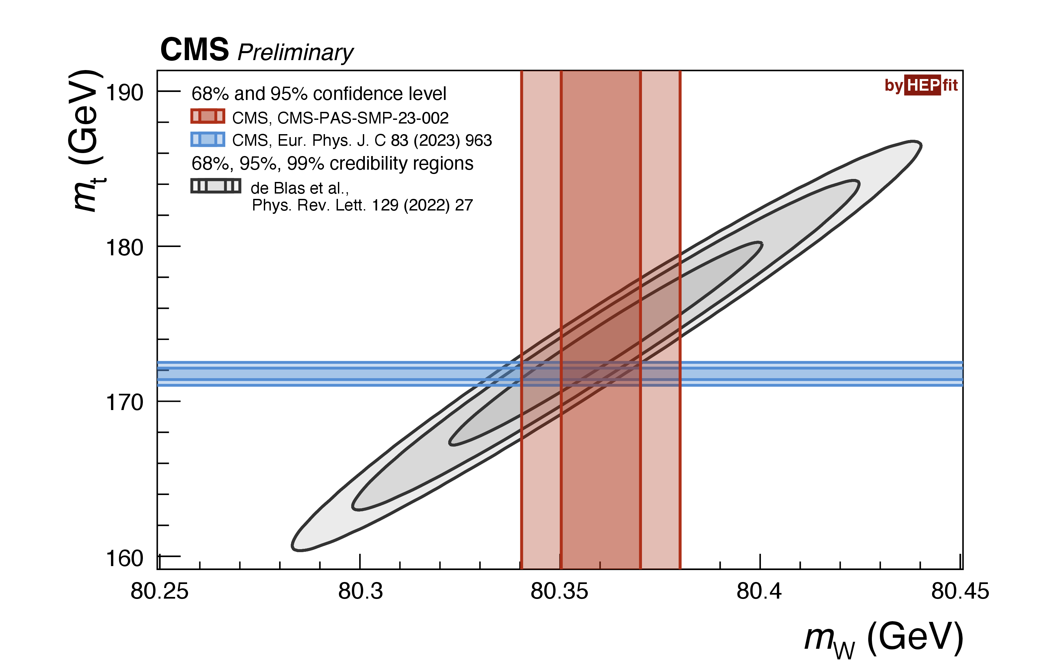
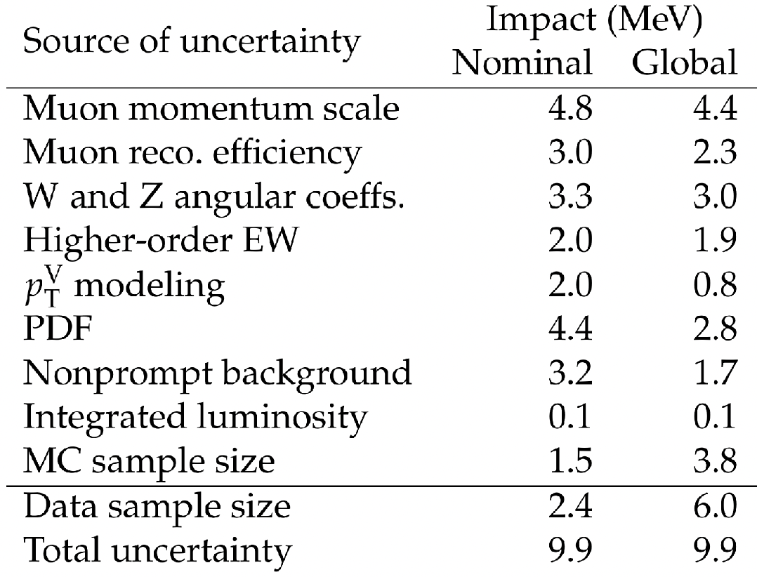
The Standard Model Appears to wins for now
Measurements: Exploit state-of-the-art improvements in theoretical QCD & EW calculations & uncertainty modelling, in-situ constraints from data… more needs to be done!
Separate stat.
component of the syst.

Slide 20
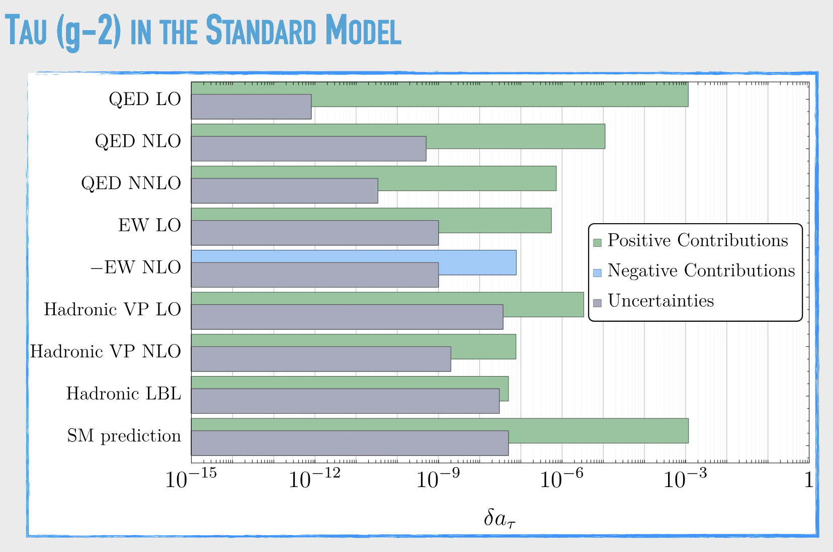
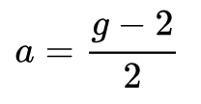
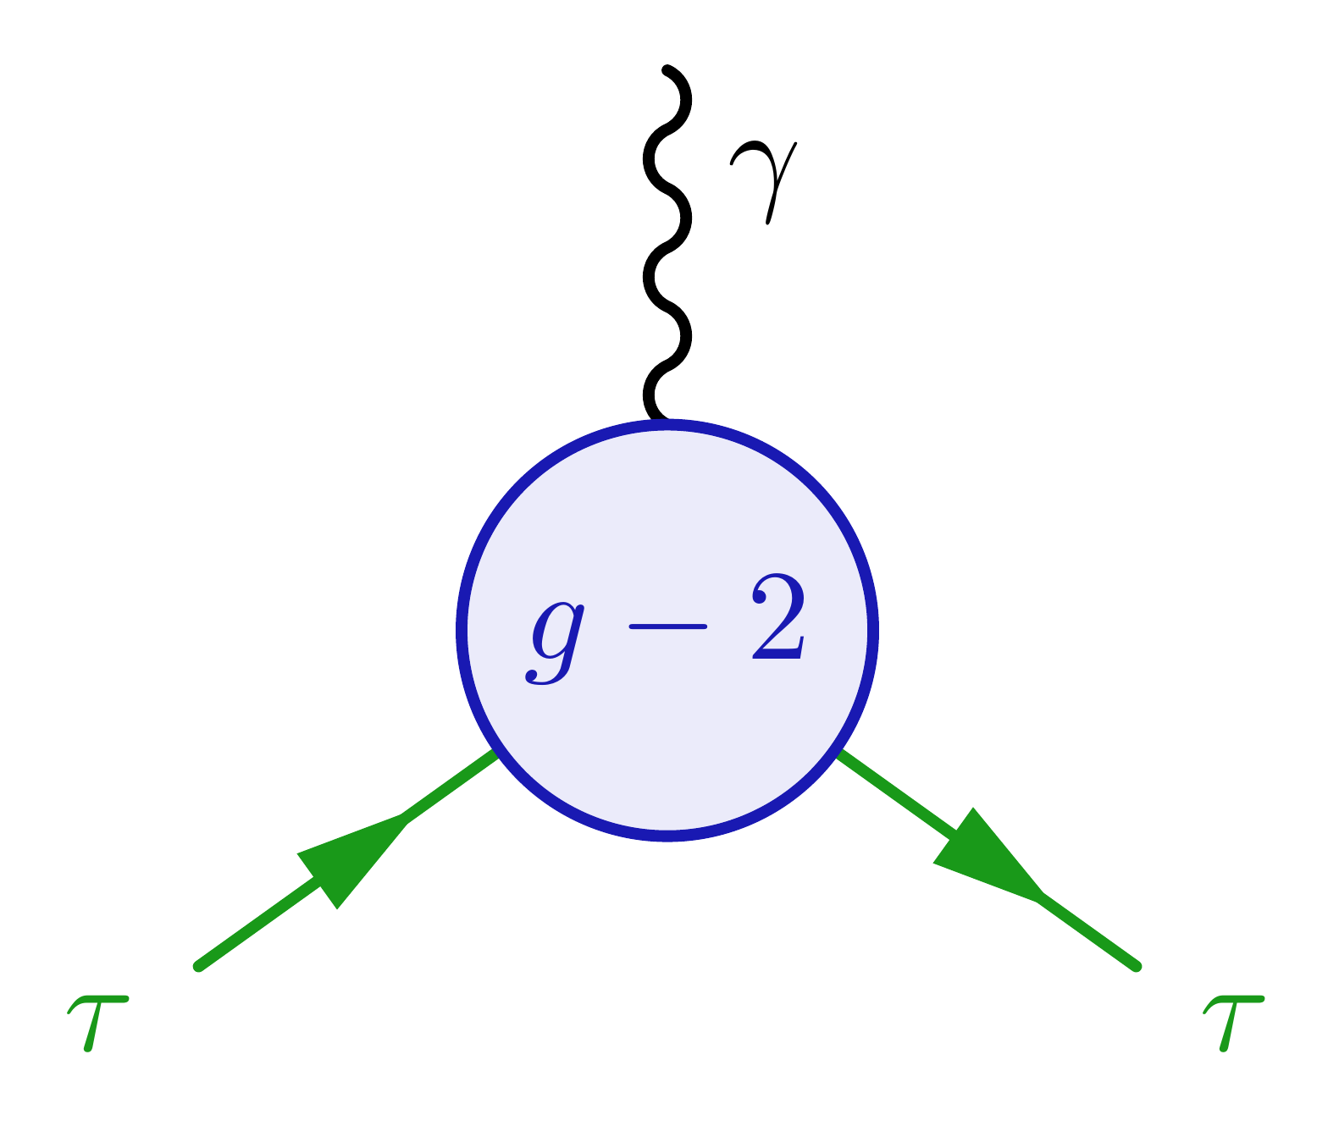
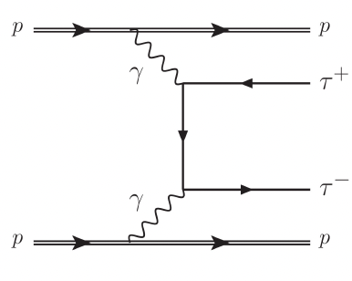
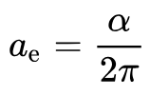
Anomalous magnetic moment g-2 of the tau
~

Slide 21
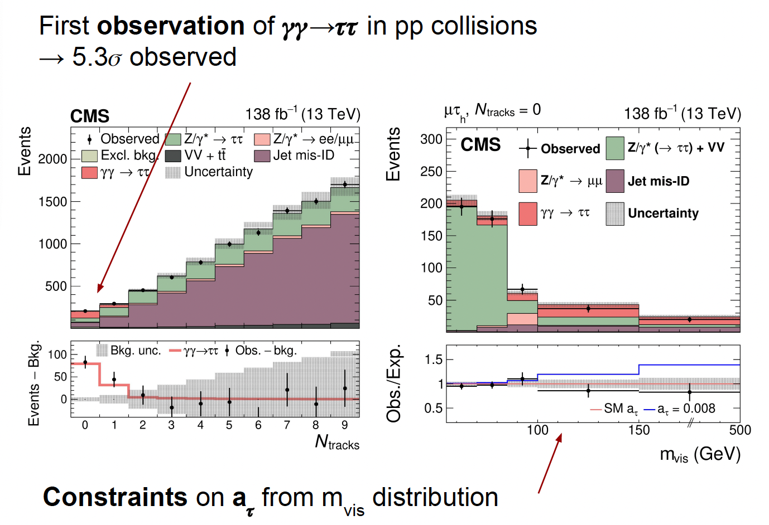
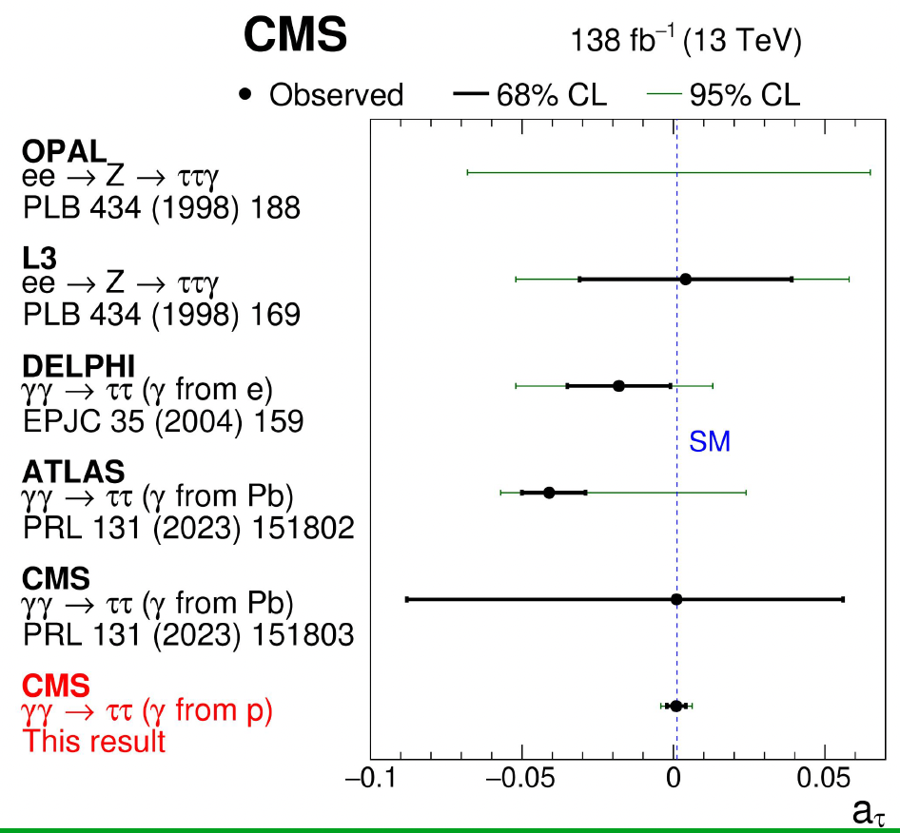
γγ ◊ ττ: g-2 of the τ
SM:

Slide 22
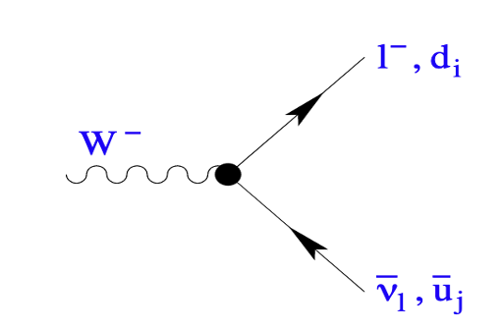
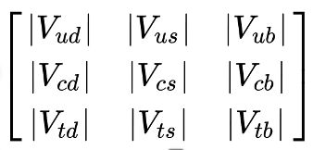
Lepton Universality
&
Hadronic decays of the W-boson & Unitarity
More in the flavor physics talks

Slide 23
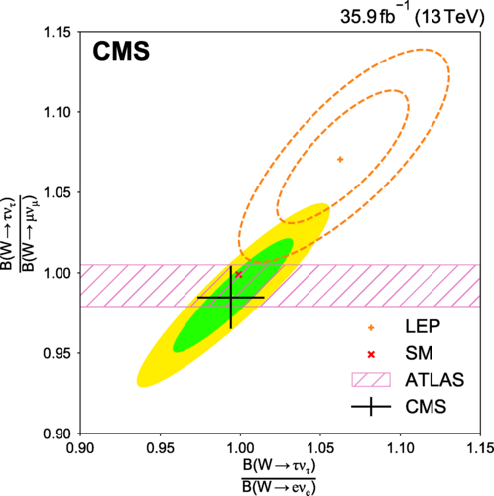
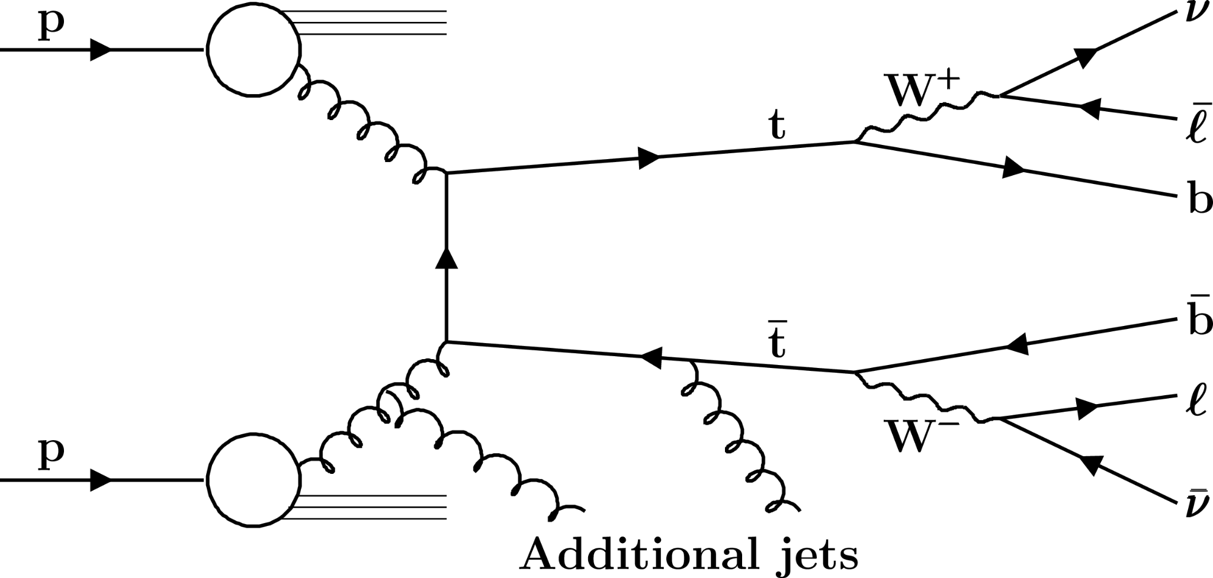
Lepton Universality
Clean source of Ws: ttbar source of tagged Ws one decaying leptonically & study the 2nd
*
* which was as precise as
the 2020 PDG value based on
D-mesons
Phys. Rev. D 105, 072008 (2022) “old”
Average leptonic & inclusive hadronic branching fractions:
(10.89 ± 0.08)% & (67.32 ± 0.23)%

Slide 24
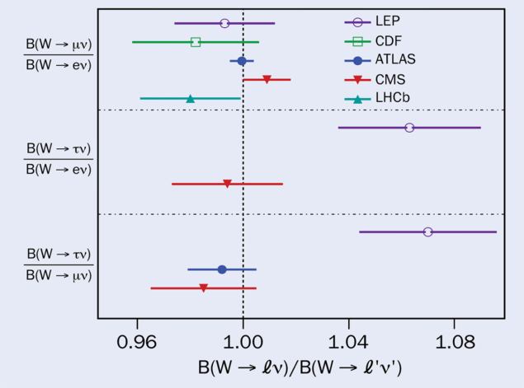
Latest Lepton universality test
R(μ/e)=0.9995 ± 0.0045
arXiv:2403.02133

Slide 25
W-boson hadronic decays
R_{c}^{W} = 0.489 ± 0.005 (stat) ± 0.019 (syst)
|V_{cs}| = 0.959 ± 0.021 ➔ compared with the 0.975 ± 0.006 world average
CMS-PAS-SMP-24-009

Slide 26
Multibosons:
@ the final state… &
@ the vertex
Crucial to understand the SM & search for new physics
Muti-bosons involved/produced in many ways

Slide 27
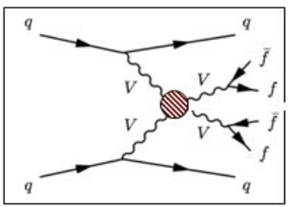
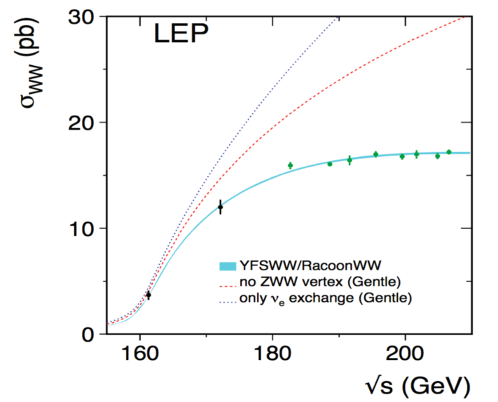
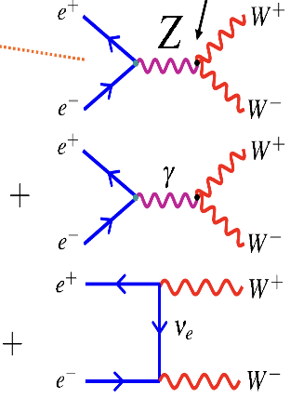
Future: Standard Model (i) W_{L}W_{L} → W_{L}W_{L} vanishes, only (ii) W_{T}W_{T} → W_{T}W_{T} is present
Past: Prediction of existence of Z⁰ to restore unitarity e$+$e$−$ → W$+$W$−$
Physics Reports 532 (2013) 119
(i) $≠0:$
additional
particles are
responsible
for EWSB
M_{H}
M_{VV}

Slide 28
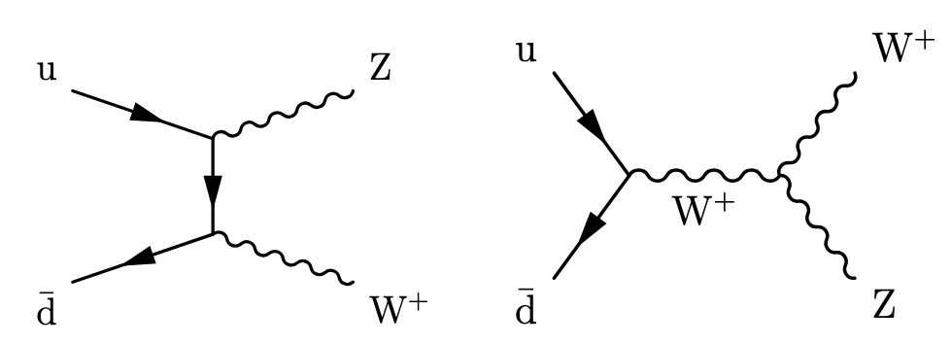
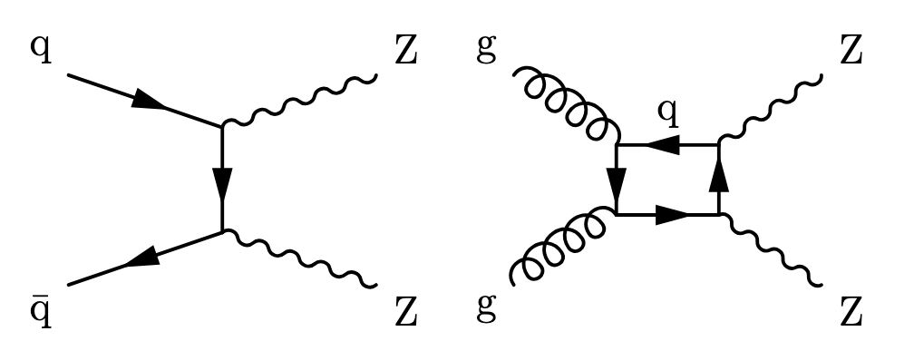
– Vector boson fusion & Trilinear coupling –
– Trilinear Coupling –
Boson
EWK
Diboson
– Trilinear & Quartic Coupling –
– Vector boson Scattering,
Trilinear & Quartic coupling –
Triboson
Diboson
EWK
Radiative
Trilinear
Quartic
Quartic

Slide 29
Vector boson Fusion and vector Boson scattering topology
Signal topology:
2 jets with large pseudo-rapidity gap (𝚫𝜼_{𝒋𝒋}) and invariant mass (𝒎_{𝒋𝒋})
𝑽 = {𝑾, 𝒁, γ} decay products emitted centrally with respect to the 2 jets
Little QCD activity between the jets
Missing transverse energy due to the escaping neutrinos (if any)

Slide 30
Diboson
Boson
EWK
Triboson
Diboson
EWK

Slide 31
Multibosons search for New physics
→ Direct searches (resonances)
Vector Boson Fusion better signal to background and available phase-space
→ Indirect evidence for new physics via deviations in known SM processes
(1) Structure of EWSB not exactly as assume
e.g. study Diboson Polarization and Vector Boson Scattering
(2) If new particles are too heavy:
Search for Anomalous Couplings
Trilinear & Quartic
New operators as defined in the: Standard Model Effective Field Theory (SMEFT)
“The present educated view of the standard model, and of general relativity, is again that there are leading terms in effective field theory”
S. Weinberg, hep-th/970227

Slide 32
More on anomalous couplings and SMEFT

Slide 33
Dim-5 operators
Dim-5 Weinberg operator
Violates lepton conservation & can generate neutrino mass
ATLAS & CMS set limits on same-sign using lljj
μμ, eμ, and ee final states
Upper limits on effective Majorana mass in μμ:
ATLAS: 16.7 GeV
CMS: 10.8 GeV
Arxiv:2206.08956
Arxiv:2305.14931
Arxiv:2403.15016

Slide 34
Ultimate test will come from Combination of Many Standard Model processes
Many new results from ATLAS and CMS with limits on anomalous SMEFT dim-6 and dim-8 operators with full run-2 dataset
Many differential cross sections available to improve sensitivity.
One observable ⇒ several contributing operators
One operator ⇒ affects several observables.
Ultimately ⇒ global analysis, efforts already reported first results
CMS-PAS-SMP-24-003
ATL-PHYS-PUB-2022-037

Slide 35
TriPle Gauge Couplings: Longitudinal polarization in pp→WZ
Enhance 00 contribution with high p_{Z}^{T} selection.
BDT to separate 00 from TT+0T+T0.
Likelihood fit of BDT discriminant. ⇒ extract f₀₀, f_{0T+T0}, total norm.
Polarization templates used in predicted signal and background fractions
arXiv:2402.16365
JHEP 07 (2022) 032

Slide 36
Triboson production: 1st observation of WZγ & WWγ

Slide 37
Vector Boson Scattering pp→VVjj where V=W, Z, γ

Slide 38
Vector Boson Scattering pp→ Wγjj

Slide 39
Conclusion
Plenty to do!!! Electroweak physics continues to be one of our strongest tools to search for Physics Beyond the Standard Model.

