Slide 1
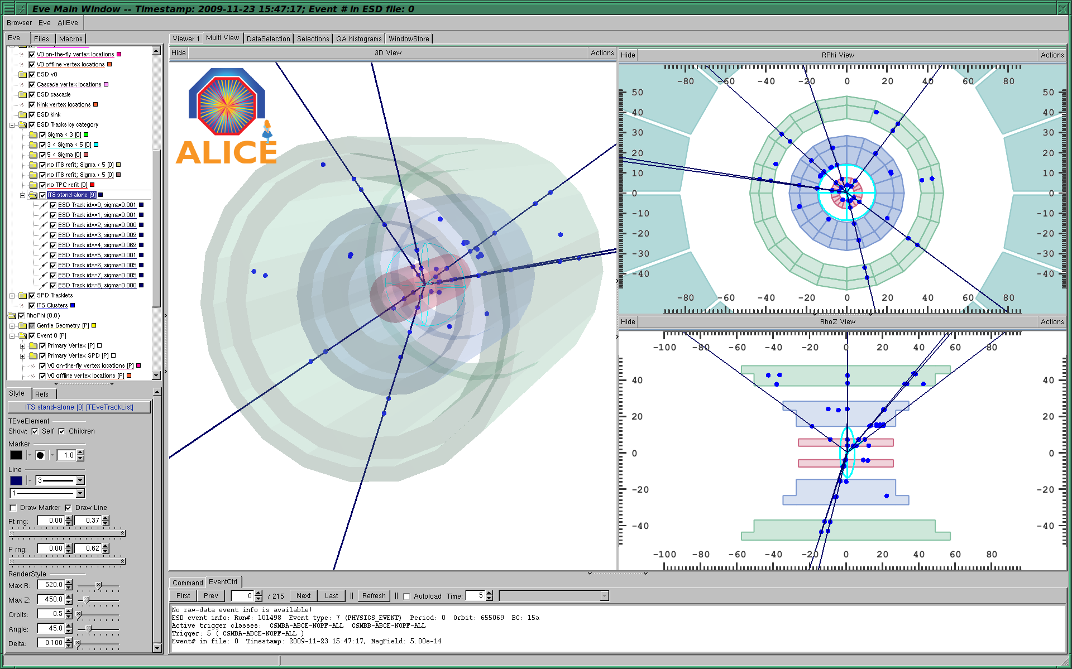
THE FIRST ALICE RESULTS WITH PP COLLISIONS AT 900 GEV or after 20 years of work…
Guy Paić for
the ALICE collaboration
Instituto de Ciencias Nucleares

Slide 2
outline
The LHC second start
ALICE
the first data configuration
The first data
The full orchestra
Preliminary performance
Conclusions

Slide 3
Milestones
Date | Day | Achieved
Nov 20 | 1 | Each beam circulating. Key beam instrumentation working.
Nov 23 | 4 | First collisions at 450 GeV. First ramp (reached 560 GeV).
Nov 26 | 7 | Magnetic cycling established (reproducibility).
Nov 27 | 8 | Energy matching.
Nov 29 | 10 | Ramp to 1.18 TeV.
Nov 30 | 11 | Experiment solenoids on.
Dec 04 | 15 | Aperture measurement campaign finished. LHCb and ALICE dipoles on.
Dec 05 | 16 | Machine protection (Injection, Beam dump, Collimators) ready for safe operation with pilots.
Dec 06 | 17 | STABLE BEAMS, 4 on 4 pilots at 450 GeV, rates around 1Hz.
Dec 08 | 19 | Ramp colliding bunches to 1.18 TeV
Dec 11 | 22 | Collisions with STABLE BEAMS, 4 on 4 at 450 GeV, > 10¹⁰ per bunch, rates around 10Hz.
Dec 13 | 24 | Ramp 2 bunches per beam to 1.18 TeV. Collisions for 90mins.
Dec 14 | 25 | Collisions with STABLE BEAMS, 16 on 16 at 450 GeV, > 10¹⁰ per bunch, rates around 50Hz.
Dec 16 | 27 | Ramp 4 on 4 to 1.18 TeV. Squeeze to 7 m.

Slide 4
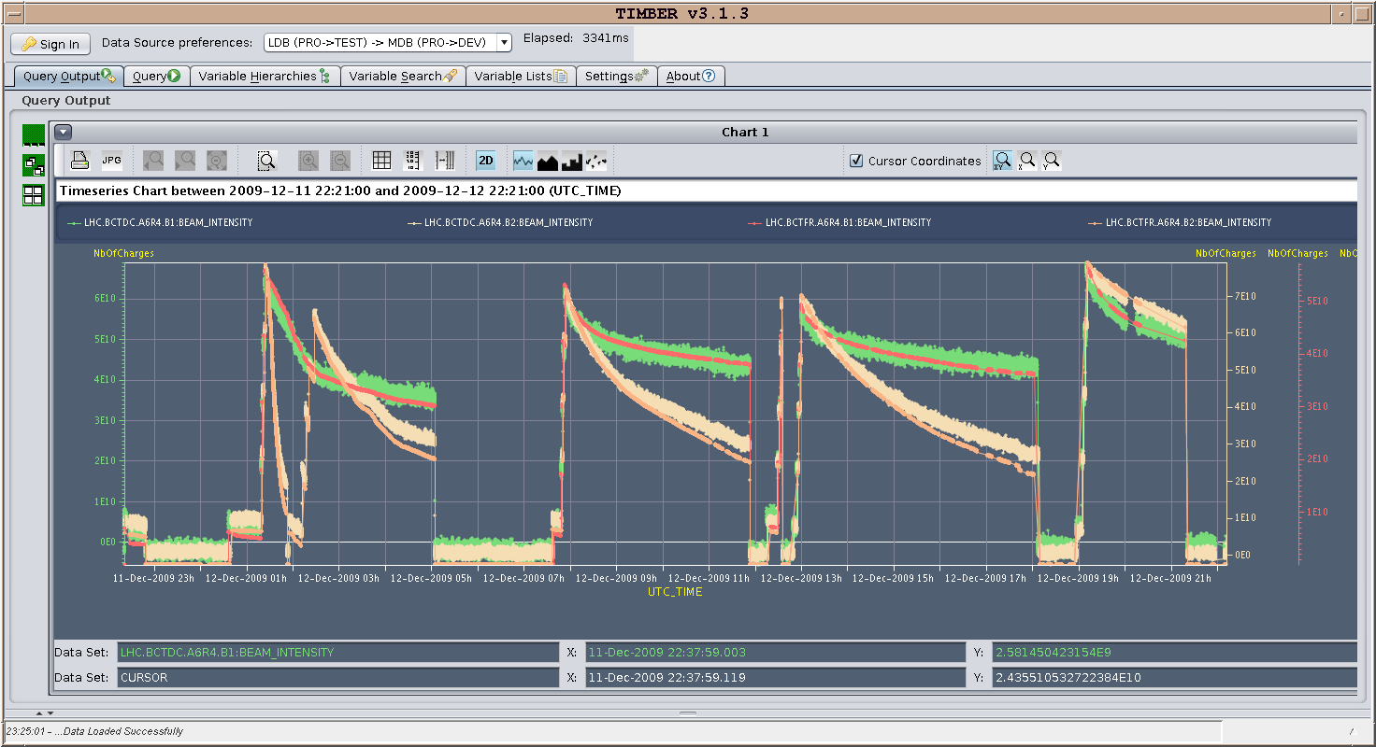
13.12.2009: 24 hours running - currents

Slide 5
Very smooth and fast ramping of the operations!

Slide 6





























Who is ALICE
~ 1000 Members from both NP and HEP communities
~30 Countries
~100 Institutes
~ 150 MCHF capital cost
(+ ‘free’ magnet)
History
1990-1996: Design
1992-2002: R&D
2000-2010: Construction
2002-2007: Installation
2008 -> : Commissioning
3 TP addenda along the way: 1996 : muon spectrometer 1999 : TRD
2006 : EMCAL

Slide 7
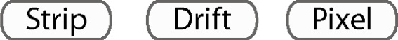



The ALICE detector
Size: 16 x 26 meters
Weight: 10,000 tons

Slide 8
It was not always like that!

Slide 9
ALICE 19 years ago..
attended by over 60 physicists
experimental areas will be finalized by end ‘91
start of physics operation foreseen for 1998
.. should it slip, we stretch the construction schedule ..

Slide 10
A tremendous preparation
Beyond the hardware commissioning
  Software development
  Alignement with cosmic rays…..

Slide 11
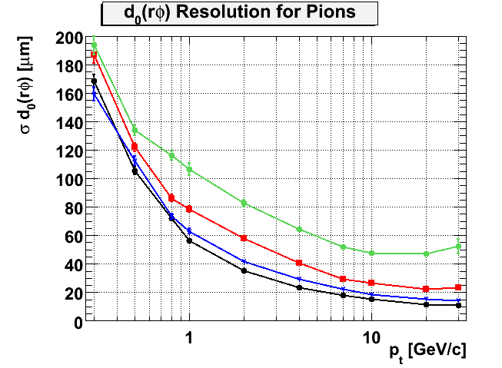
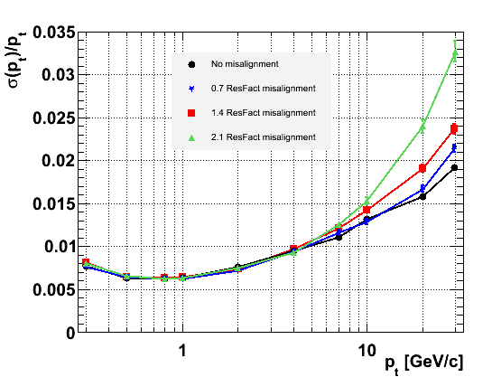
Impact of ITS misalignment on ITS+TPC tracking resolutions
d₀ resolution
p_{t} resolution
no misal
misal 10 μm
misal 20 μm
misal 30 μm
no misal
misal 10 μm
misal 20 μm
misal 30 μm
Target
residual
misalignment
effect of misalignment:
→ large worsening
factor 2 at high p_{t}
plus 5 μm
effect of misalignment
above 10 GeV/c

Slide 12
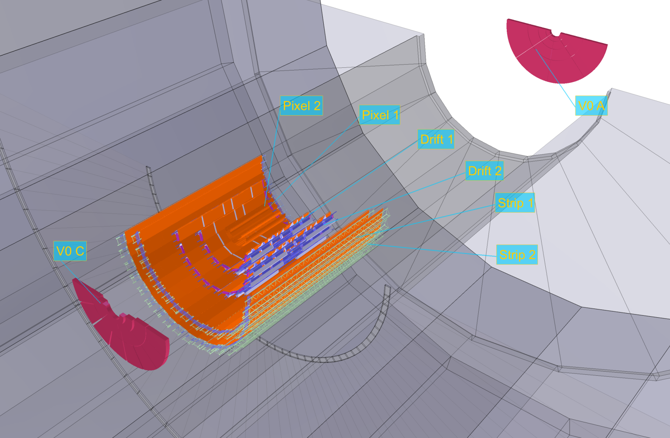
ALICE configuration for First Collisions on Monday 23/11
Trigger: Fast-Or from 2 inner layers (Silicon Pixels) in coincidence with bunches
On:
“splash-resistant” detectors:
  6 layers of Inner Tracking System
  V0 scintillators
  (+ calorimetry:
  Zero Degree Calo
  Photon Spectrometer
  EM Calorimeter)
Off:
everything else

Slide 13
When ALICE met the beams
(ca 16:35 on Nov 23rd)

Slide 14
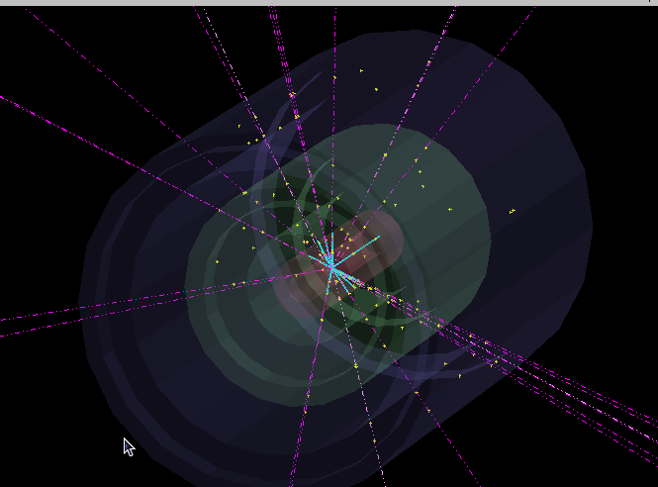
The first event

Slide 15
Sequence of events:
  beam 1 injected, captured, circulating
  data taking started
  at 16:38 beam 2 injected on “P2” bucket, captured, circulating
  as soon as beam 2 injected, the ALICE trigger rate jumps
  from a few 10⁻³ s⁻¹ (with beam 1 bunch only) to ~ 10⁻¹ s⁻¹
    → no further adjustment needed
  within seconds, the first event popped up on the display
  at 17:21 the beams were dumped and the run closed with 284 events
Sufficient for the first LHC paper!

Slide 16
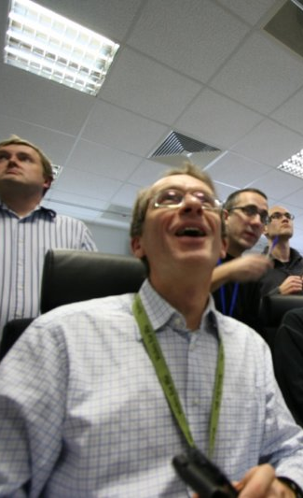
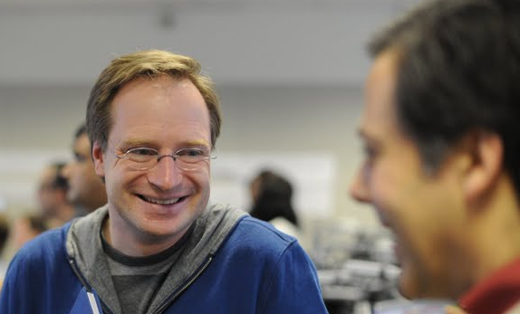
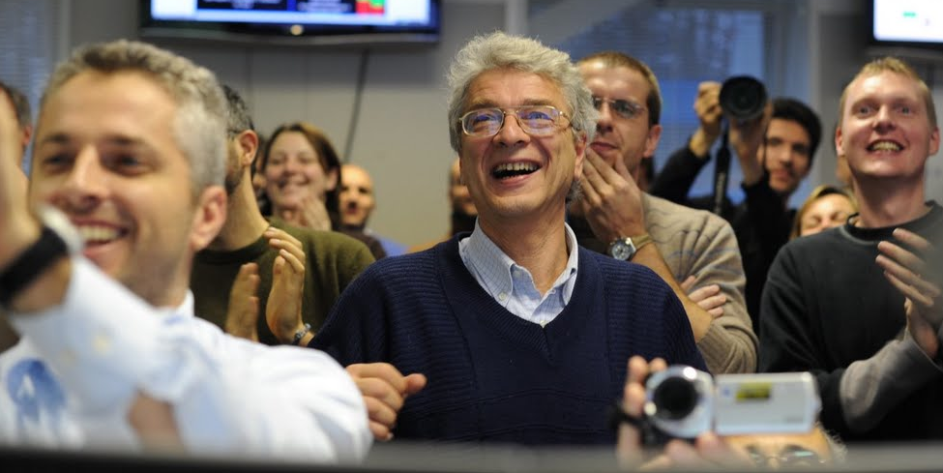

Relief and jubilation..
Collisions in ALICE !!
~ 16:42
.. and some celebration..

Slide 17
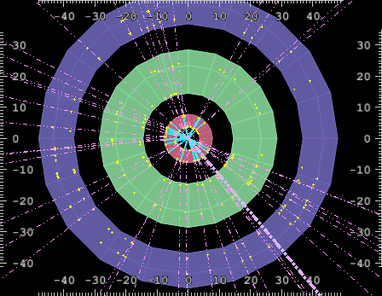
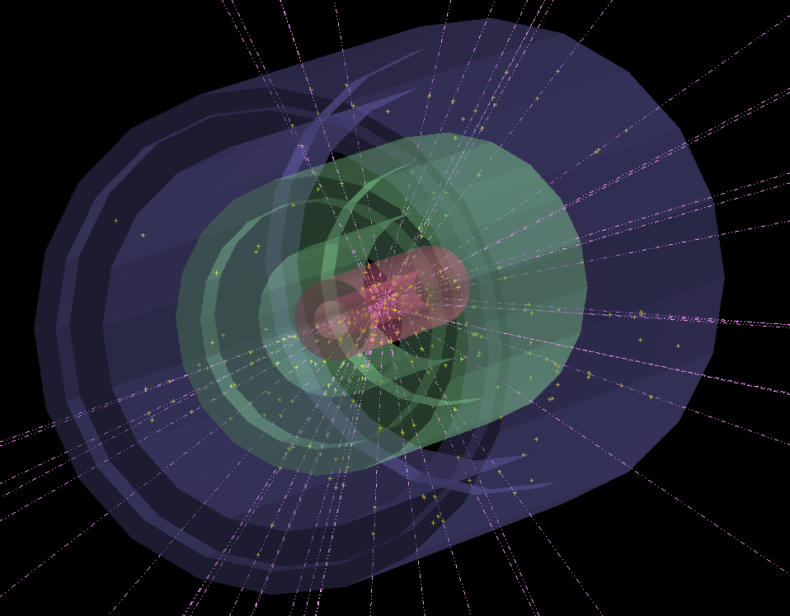
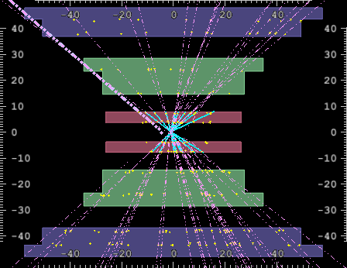
A high multiplicity event…

Slide 18
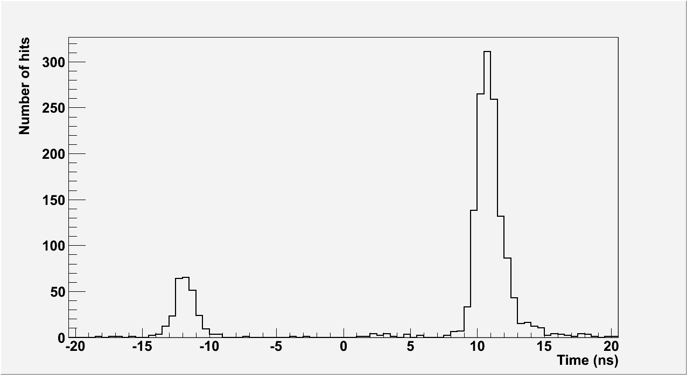

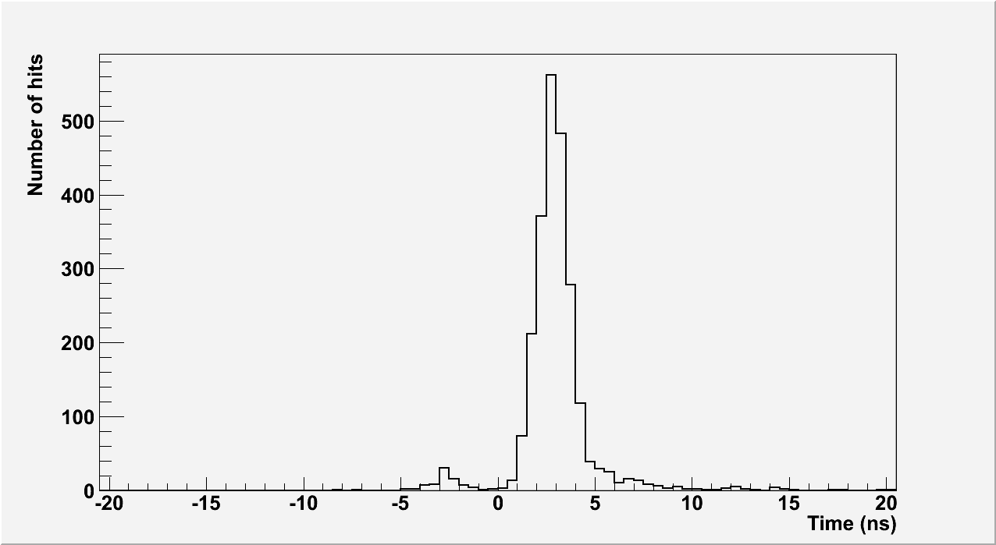
Timing in V0 scintillators
V0-A side
V0-A
from interaction region
from beam line
V0-C
V0-C side
from interaction region
from beam line

Slide 19
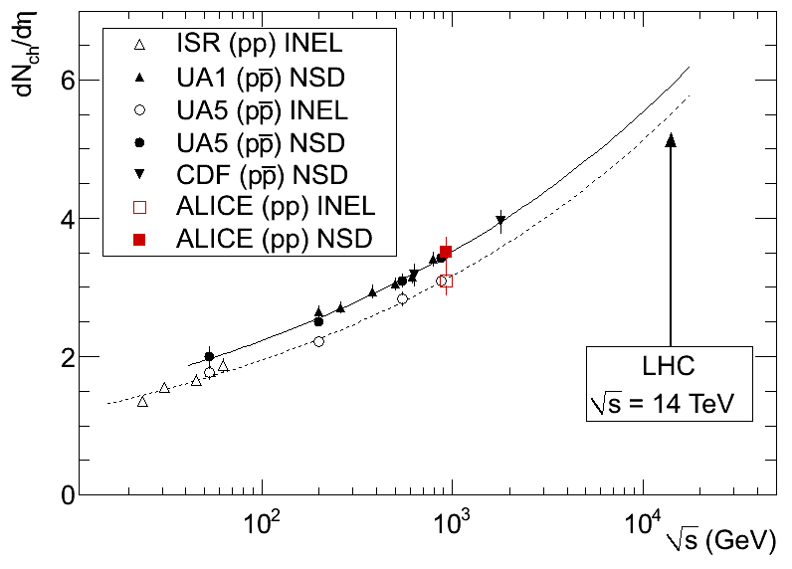
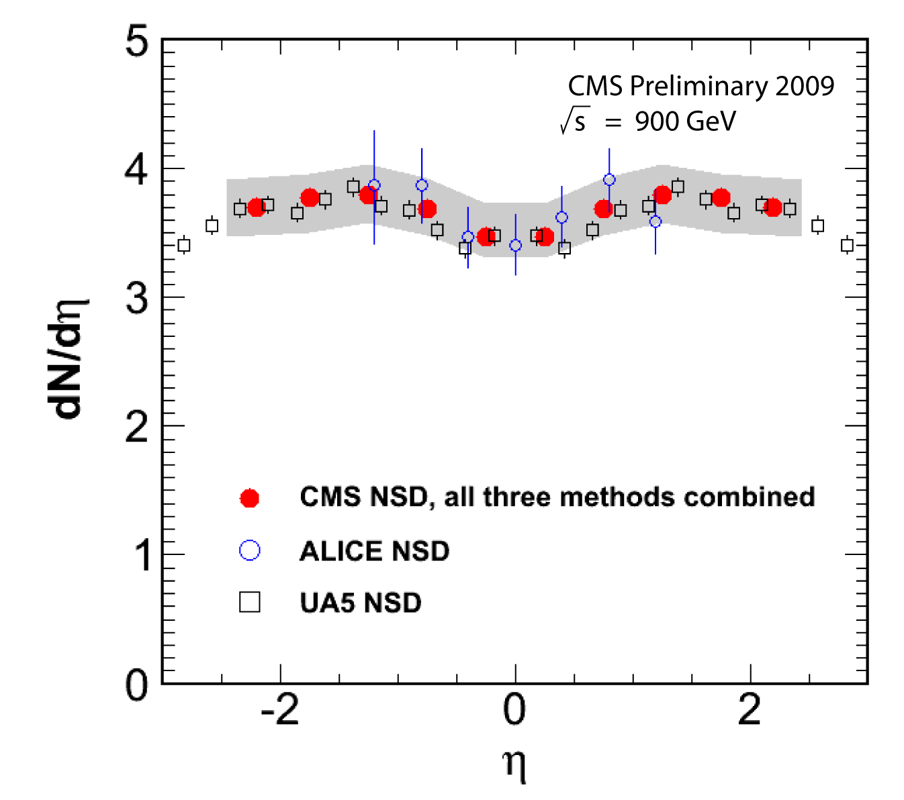
The first paper a week after the first collisions = tremendous readiness!
last time measured at the ISR for pp
And the first citations!

Slide 20
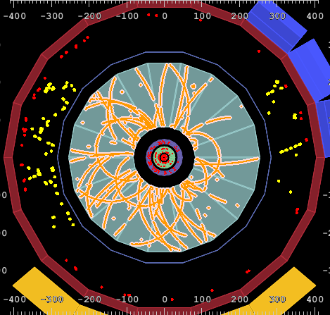
And now all together!

Slide 21
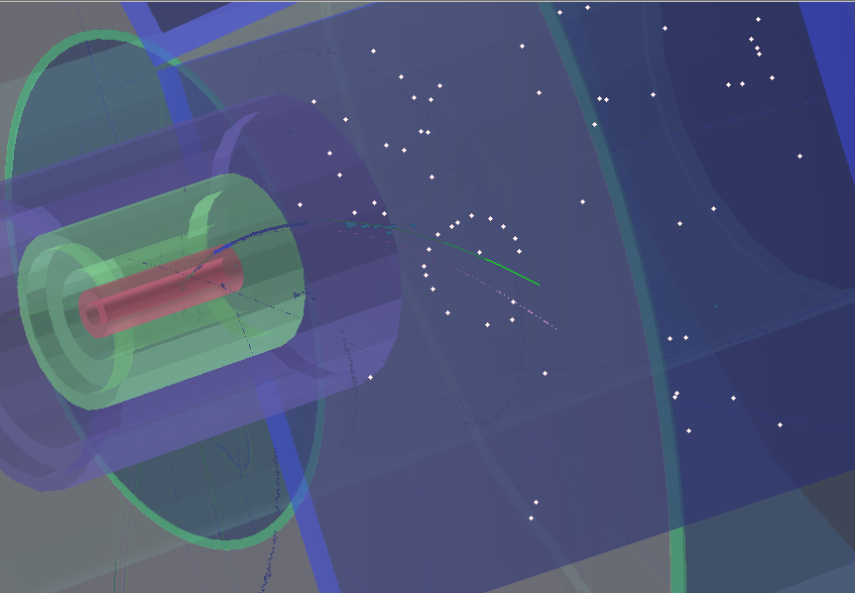
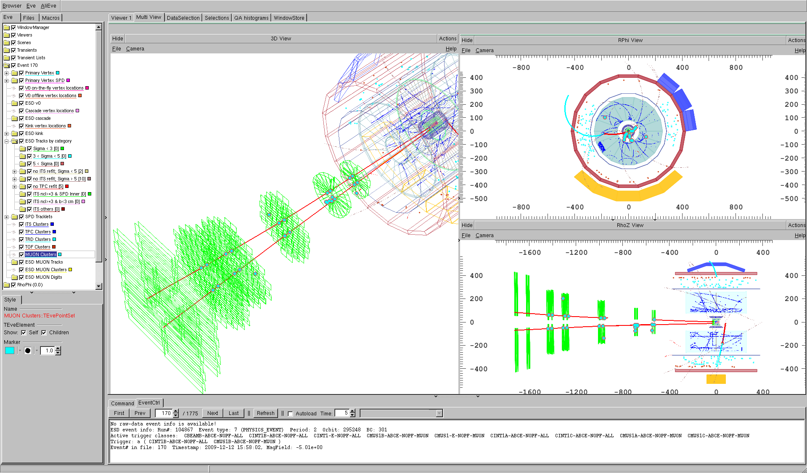
All the systems ready!
HMPID
Cherenkov Ring
TRD track
TPC track
TPC, TRD, TOF, HMPID
On 6th December, ‘stable beams’
were declared & we could switch on
all ALICE detectors for the first time..
ITS
Muon Spectrometer

Slide 22
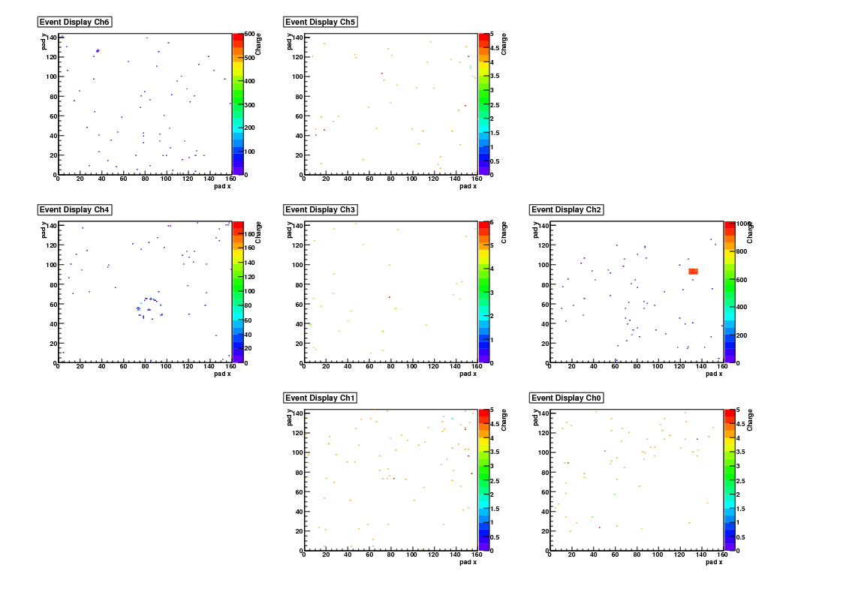
The seven Hmpid modules

Slide 23
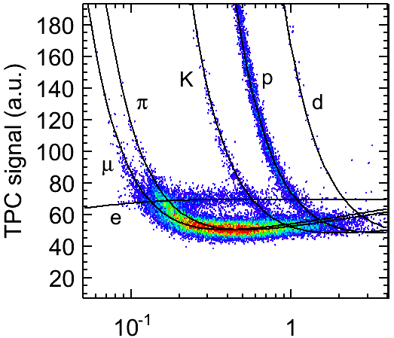
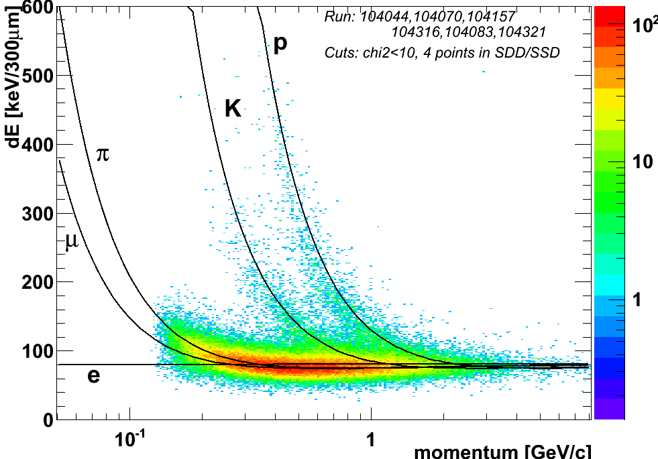
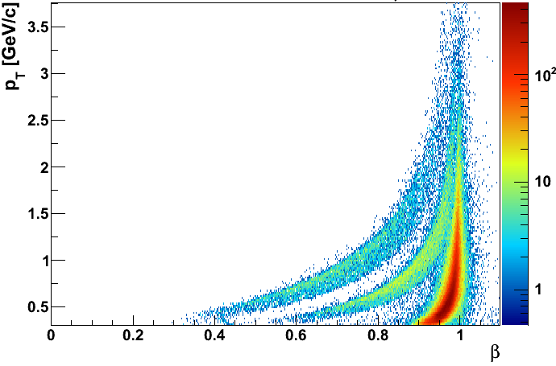
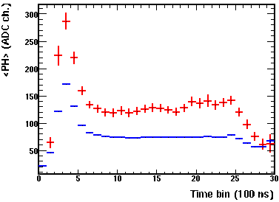
The basic quality of ALICE - PID is here
ITS
Total events collected: > 1 M
‘Good pp interactions’: 500 k
- 100 k : B = 0 (alignment)
- 10 k : B reversed (systematics)
- 30 k : √s = 2.36 TeV
No vertex cut !
TPC
all plots:
preliminary calibration & alignment !
TOF
TRD
ALICE special: Particle Identification
(very important for heavy ion physics later in 2010)
Protons
Electrons
Kaons
Pions
Pions
velocity v/c
15/2/2006 LHCC Status Report J. Schukraft

Slide 24
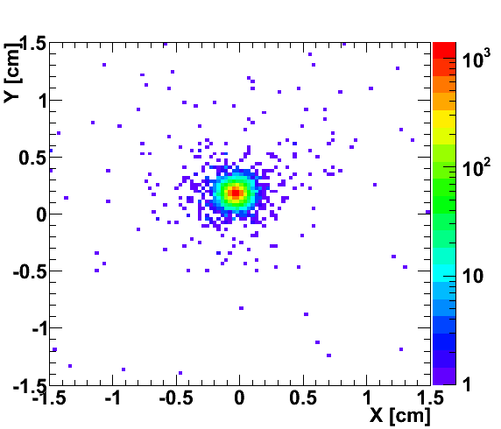
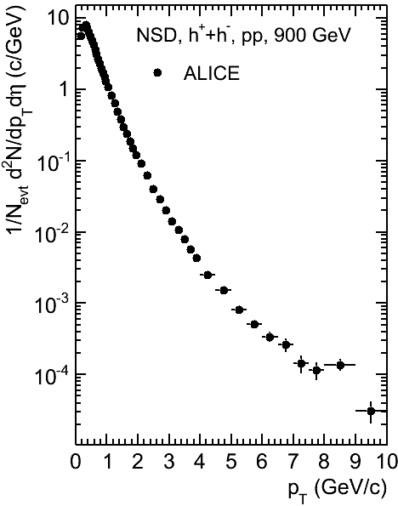
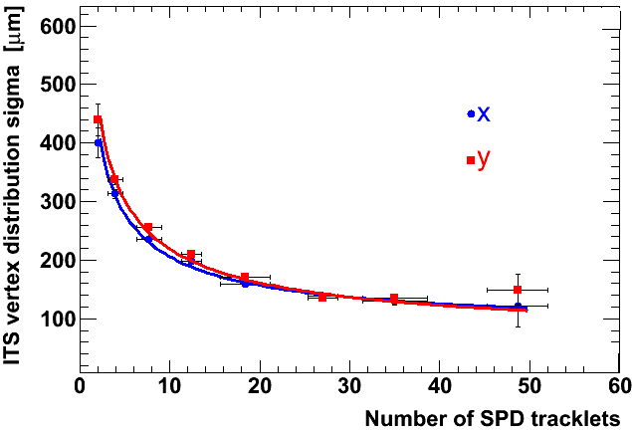
Tracking also
Beam spot at 2.36 TeV
SPD Vertex resolution versus # tracks
TPC p_{t} spectrum
Preliminary
preliminary alignment !

Slide 25
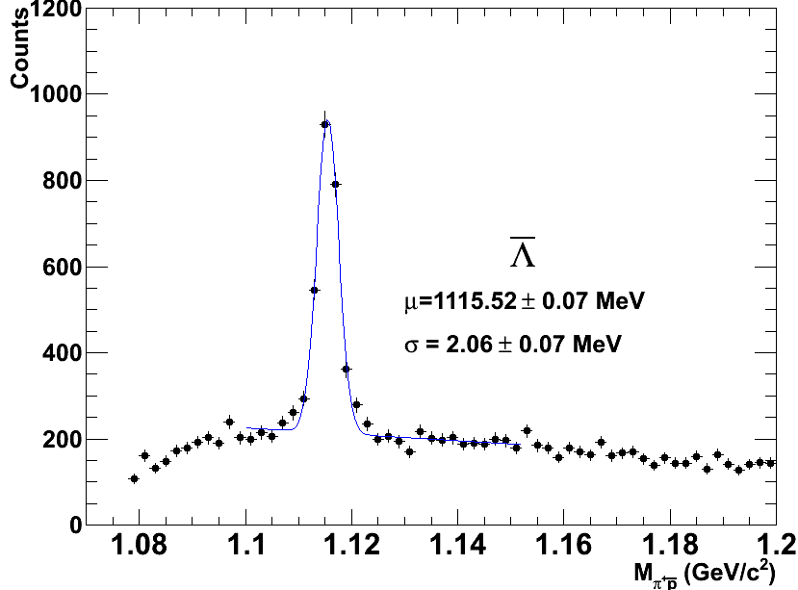
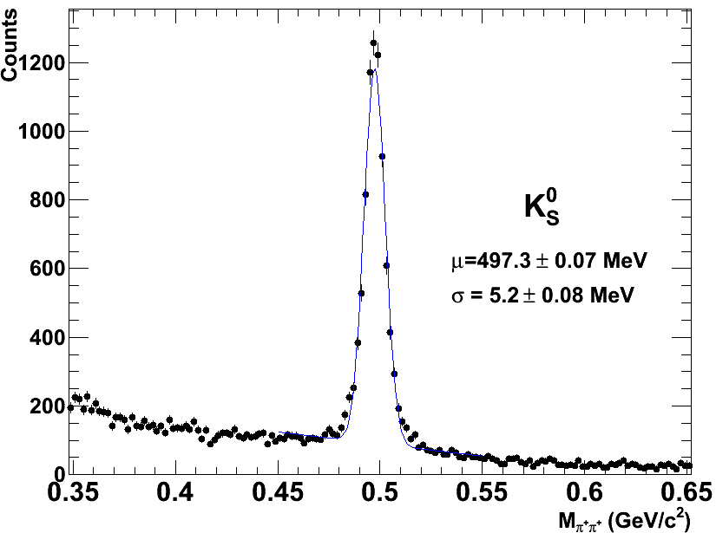
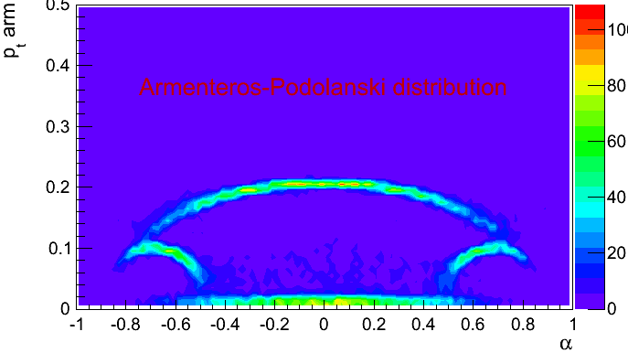

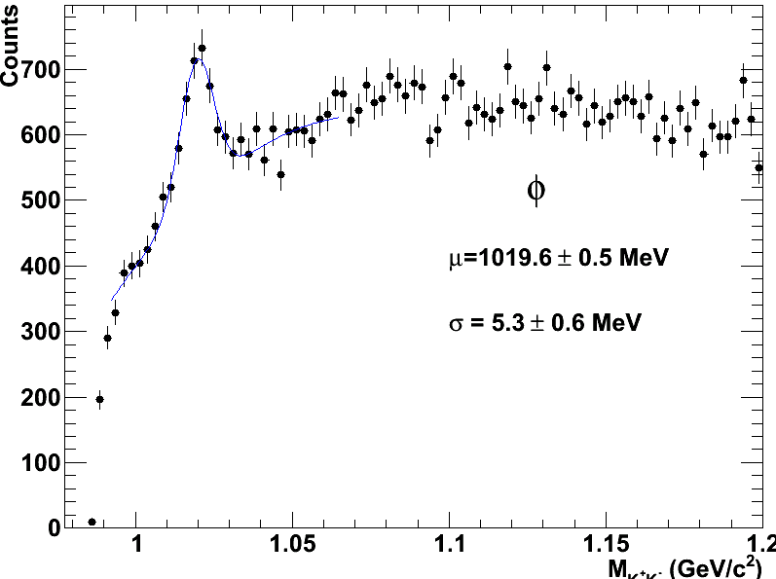
The Particle Zoo Revisited:
… National Geographic was sort of correct..
K⁰_{s} → ππ
Λ → πp
PDG: 1115.7 MeV
PDG: 497.6 MeV
Λ → πp
PDG: 1115.7 MeV
Φ → Κ⁺Κ⁻
PDG: 1019.5 MeV

Slide 26
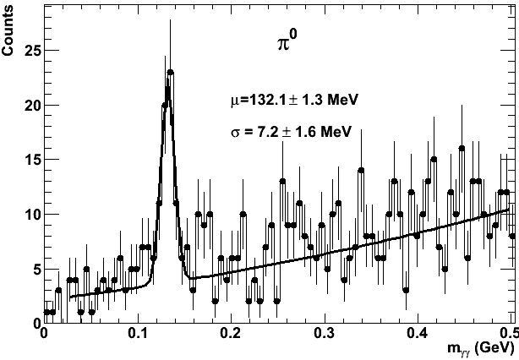
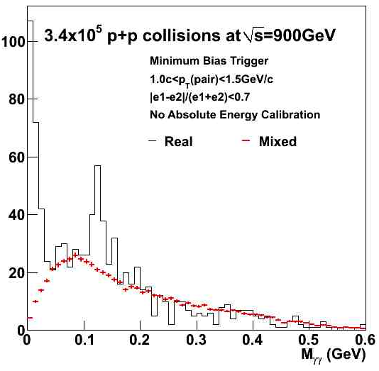
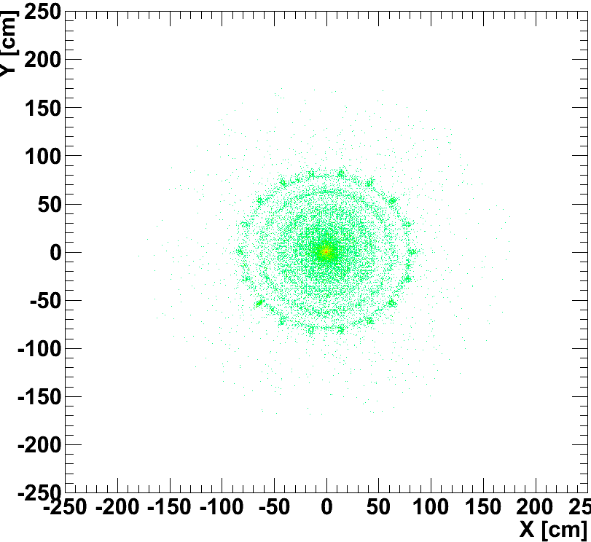
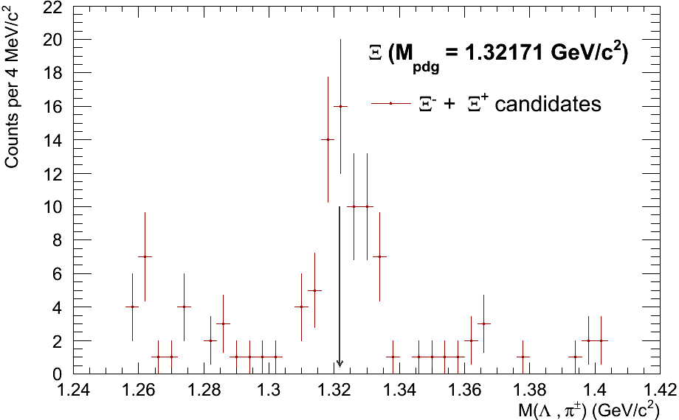
More Particles..
PHOS (9 m²)
π⁰ → γγ → e⁺e⁻ e⁺e⁻
π⁰ → γγ
1 < p_{t} < 1.5 GeV
γ-ray image of ALICE
photon conversion vertices
SSD
TPC Vessel 1
SDD
Ξ → Λπ → πp π
SPD
TPC Rods
TPC Vessel 2

Slide 27
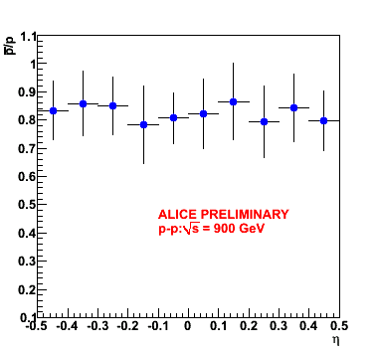
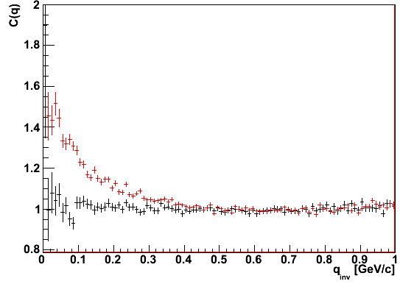
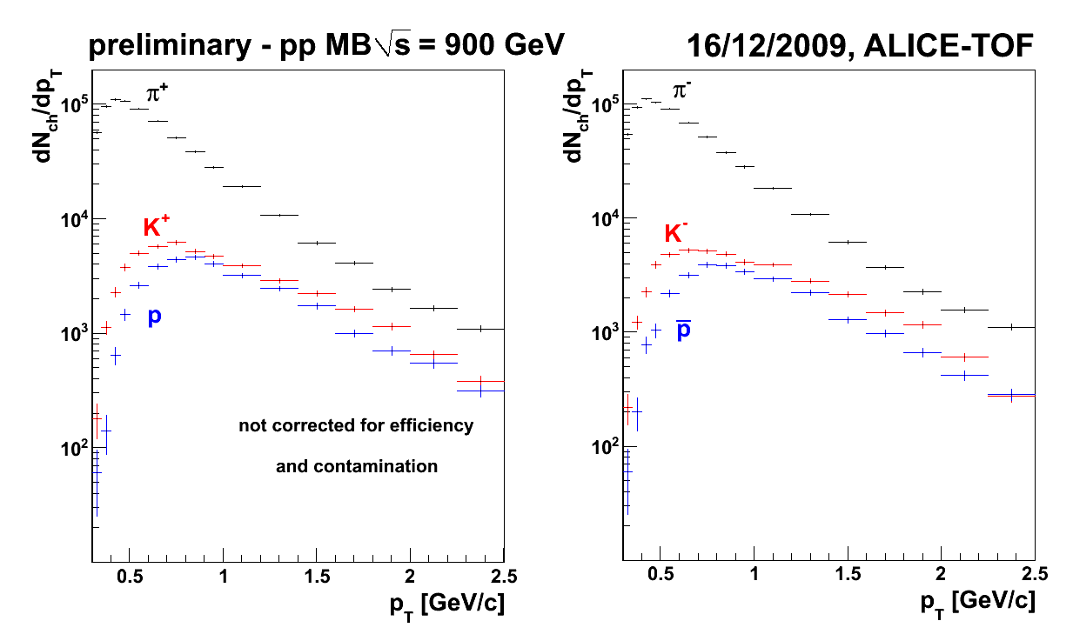

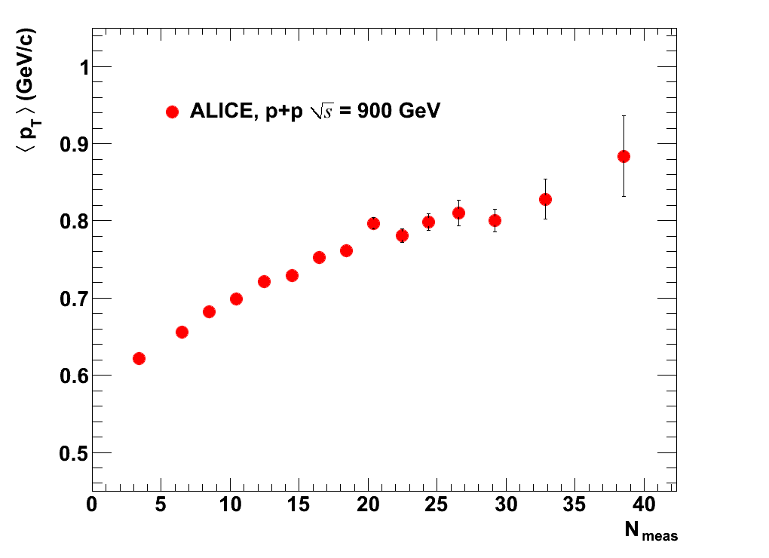
A taste of things to come..
π⁻ HBT correlation function
to study space-time evolution
(also reference for heavy ion data)
p/p ratio
to study Baryon Transport via
di-quark stopping or gluon junctions
Data
Monte Carlo (no HBT correlations)
Work in progress ….
‘raw’ plots: no/incomplete correction for efficiency, acceptance, resolution, background, …
<p_{t}> in 0.3 to 4 GeV
<p_{t}> versus multiplicity
to tune Monte Carlo programs
(and watch for surprises ?)
TOF PID spectra
to study particle production

Slide 28
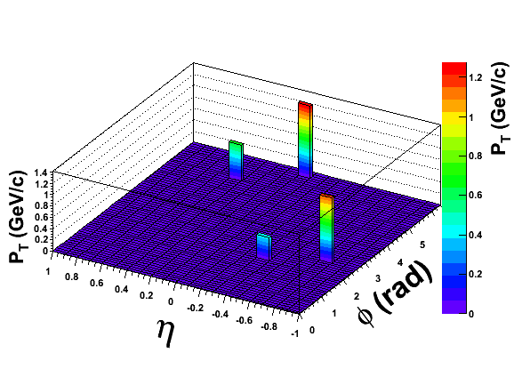
And η-φ

Slide 29
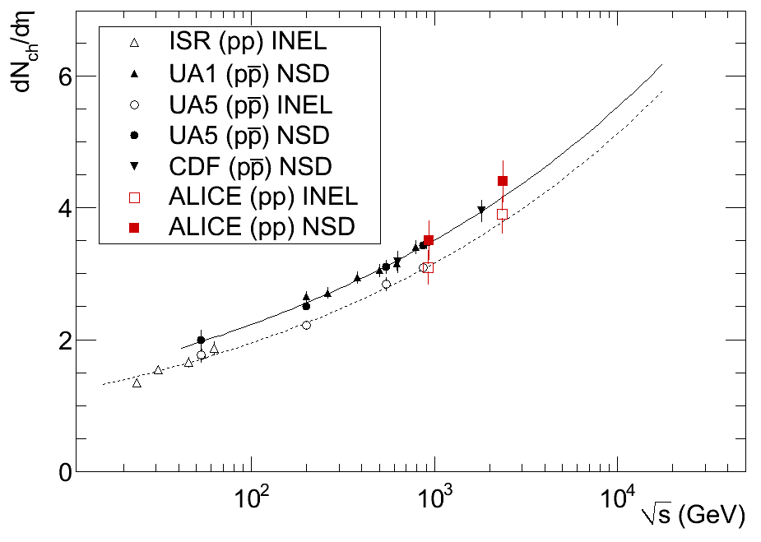
Up, up and away
Work in progress..
dN/dη at 2.36 TeV
statistical error negligible
final systematic error under evaluation
(still 7% for the time being)
LHC
√s = 2.36 TeV
LHC
√s = 900 GeV

Slide 30
Heavy ions in 2010!

Slide 31
conclusions
The performance of the machine and of all th experiments has been outstanding
From the “proof of existence “ we have to move to discoveries that will be probably our deal in 2010
2010 will not be solely the bicentenary of the Mexican revolution but also the dawn of new physics!

