Slide 1
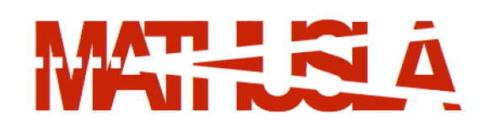
The
Cosmic-Ray Project
P. Camarri
Università di Roma Tor Vergata and INFn Roma Tor Vergata
On behalf of the MATHusla collaboration
2022/2023 Meeting of the Cosmic Ray Division of the Mexican Physical Society
March 27th, 2023

Slide 2
Outline
Basic description and goals of the Mathusla experiment
The reasons for a layer of RPCs in the Mathusla detector
Cosmic-ray physics with MATHUSLA

Slide 3
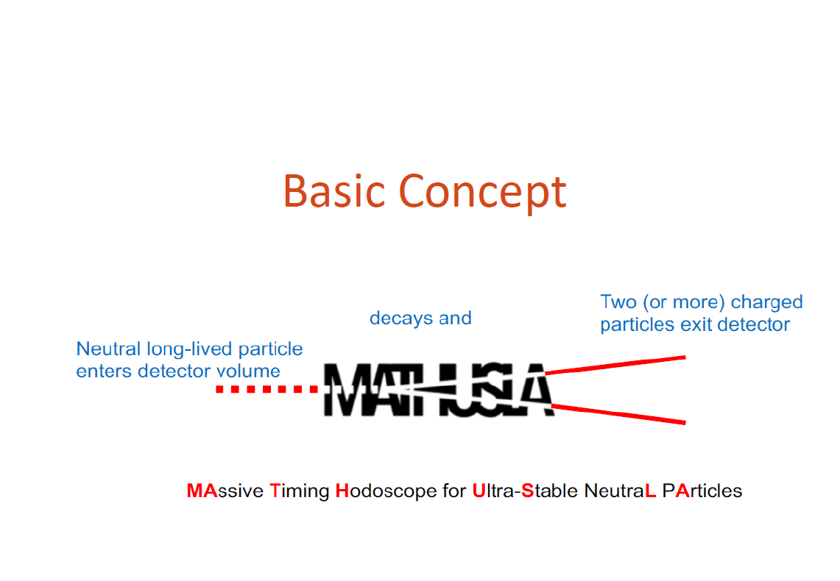

Slide 4
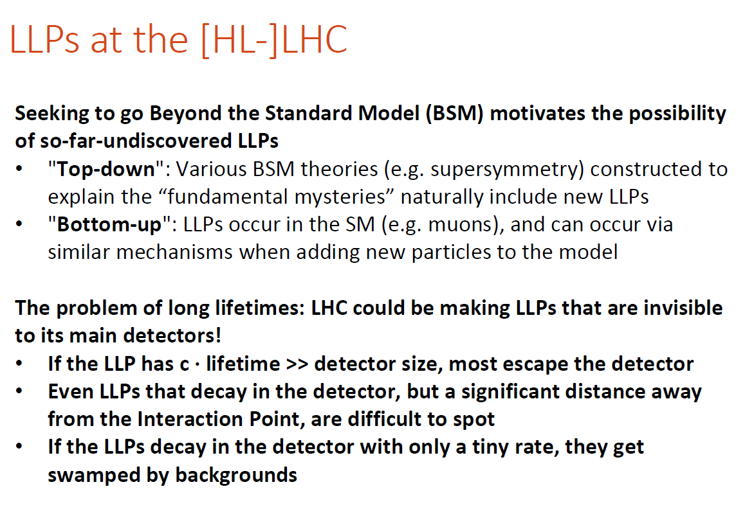

Slide 5
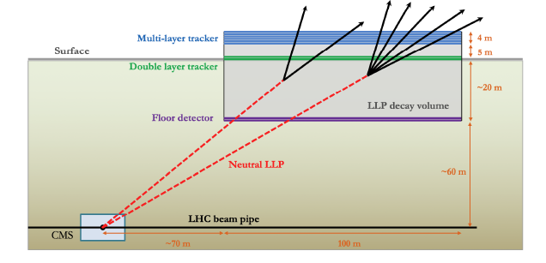
An external LLP detector for HL-LHC
100m x 100m x 25m decay volume
Displacement from IP: 70m horizontally, 60m vertically

Slide 6
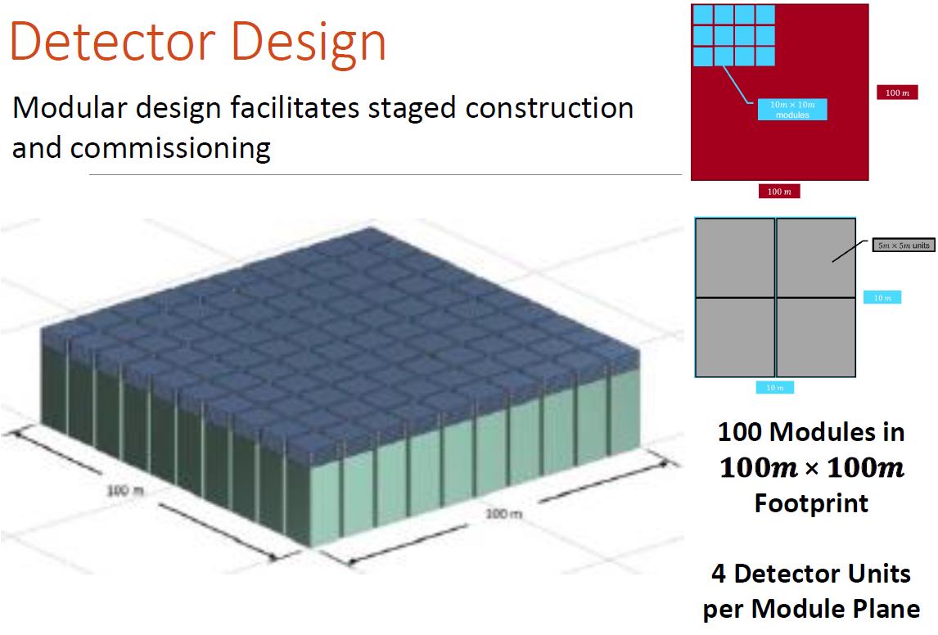

Slide 7
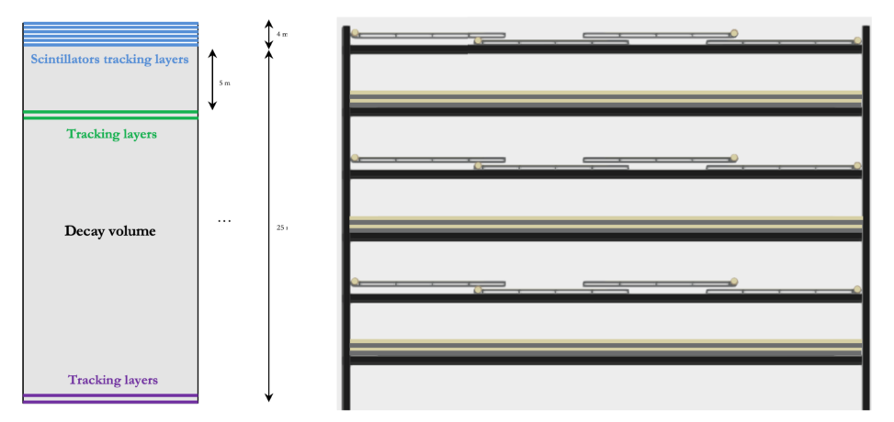
Detector Design
Each module is composed of:
6 tracking layers on top
+ 2 floor layers
+ 2 mid-level layers

Slide 8
The reasons for a layer of RPCs in MATHUSLA (1)
RPCs give the following supplemental information:
  Lower multi-hit probability in one strip due to the finer segmentation of the RPC read-out strips
  Estimation of the pulse charge from the «time-over-threshold» measurement; this gives an approximate evaluation of the hit multiplicity in one strip provided the number of simultaneous hits is significantly > 1
  However, the information from the RPC layer is crucial for cosmic-ray studies with MATHUSLA: linear response for hit density up to 10⁴ hits/m² in the detection of air-shower cores, thanks to the «big-pad» analog read-out, to be compared to the scintillator digital response.

Slide 9
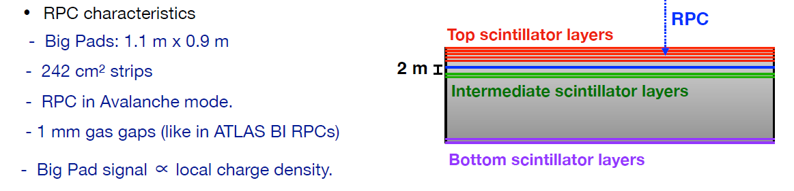
The reasons for a layer of RPCs in MATHUSLA (2)
(11-mm pitch)

Slide 10
Scheme of a Resistive Plate Chamber
H
HV
A RPC is just a gas filled plane capacitor with high resistivity electrodes
External signal pick-up electrodes can be easily tailored with any shape (11 mm in this case)
Chamber size: 0.9x2.2 m²; Time resolution < 1 ns
Eco-friendly gas mixture for operation in avalanche mode
Two “big pads” of 0.9x1.1 m² allow the analog readout

Slide 11
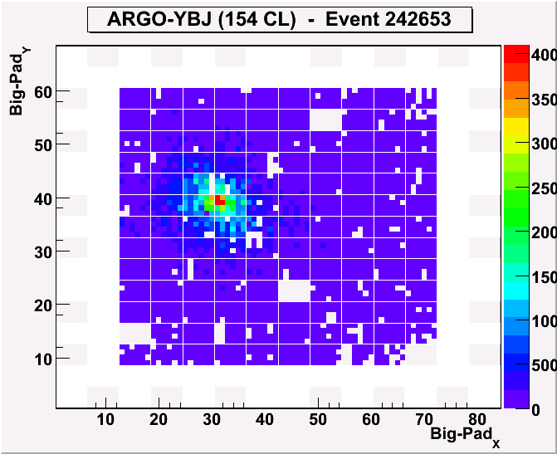
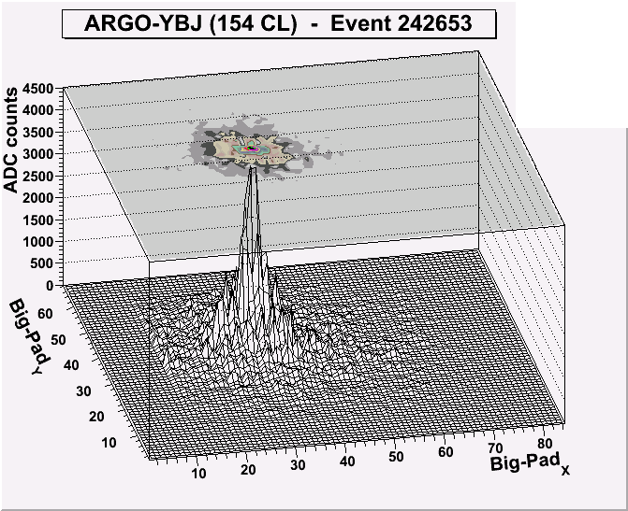
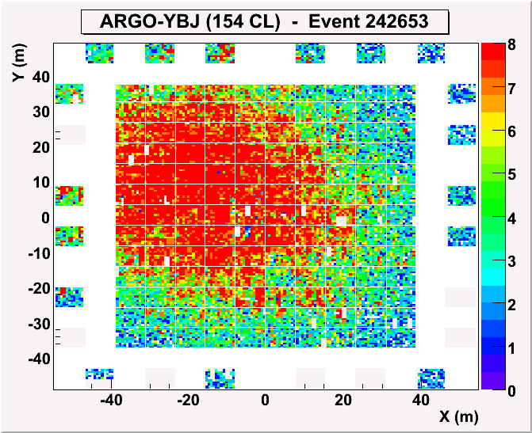
The RPC analog readout in ARGO-YBJ
Extending the dynamical range up to PeV
0
4000
3500
Analog
3000
2500
2000
0
1500
Crucial to extend the covered energy range above 100 TeV, where the strip read-out saturates
Max digital density ~20/m² Max analog dens ~10⁴/m²
4000
0
1000
3500
3000
500
2500
Digital
Fs: 4000 -> 1300/m²

Slide 12
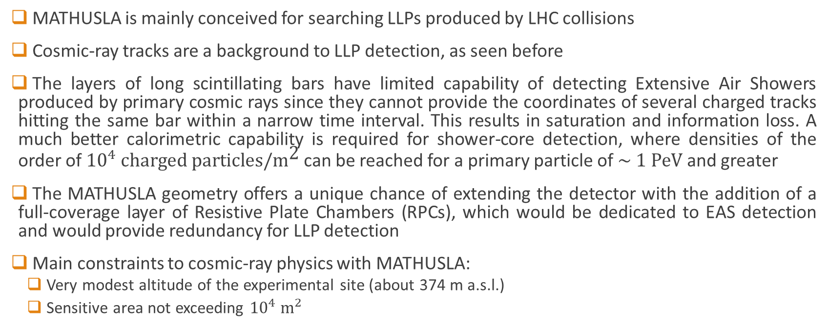
Cosmic-ray physics with MATHUSLA (1)
MATHUSLA is mainly conceived for searching LLPs produced by LHC collisions
Cosmic-ray tracks are a background to LLP detection, as seen before
The layers of long scintillating bars have limited capability of detecting Extensive Air Showers produced by primary cosmic rays since they cannot provide the coordinates of several charged tracks hitting the same bar within a narrow time interval. This results in saturation and information loss. A much better calorimetric capability is required for shower-core detection, where densities of the order of ${10}^{4}$ $\text{charged} \text{particles}\text{/}{\text{m}}^{\text{2}}$ can be reached for a primary particle of $\sim 1 \text{PeV}$ and greater
The MATHUSLA geometry offers a unique chance of extending the detector with the addition of a full-coverage layer of Resistive Plate Chambers (RPCs), which would be dedicated to EAS detection and would provide redundancy for LLP detection
Main constraints to cosmic-ray physics with MATHUSLA:
  Very modest altitude of the experimental site (about 374 m a.s.l.)
  Sensitive area not exceeding ${10}^{4} {\text{m}}^{2}$

Slide 13
Cosmic-ray physics with MATHUSLA (2)
Taking into account all this, cosmic-ray studies with MATHUSLA may be focused on the following items:
Cosmic-ray composition (measurement of the atomic number Z of the primary particle)
Bundles of parallel muons. They can be observed when the electro-photonic component of the shower is absorbed before the shower hits the detector («pure muonic shower»). For vertical showers they can be seen only at low energy, while for inclined or almost horizontal showers they can be observed also at high or very high energy due to the larger thickness of the atmosphere. This study is crucial both again for cosmic-ray composition studies and for discriminating among different high-energy hadronic interaction models.

Slide 14
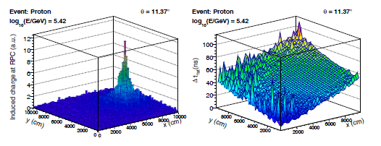
EAS detection in MATHUSLA
The space-time-charge information provided by the RPC big pads allow the EAS front reconstruction, its inclination with respect to the horizontal plane and the local hit density
Simulated event for a vertical primary proton of 263 GeV
Induced charge on the RPC big pads in the event
Time delay of the RPC big pads with respect to the first hit in the event

Slide 15
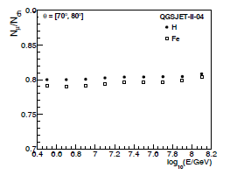

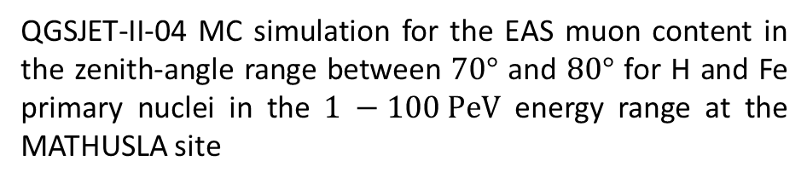
Muon bundles in MATHUSLA (1)
If the EAS arrival direction is greater than about $65°$, muons are the main component of the EAS.
At the MATHUSLA site, inclined EAS from H and Fe primary nuclei of $\sim 1 − \sim 100 \text{PeV}$ have an average muon content of about $\left(80±1\right)\%$, as predicted by QGSJET-II-04 MC simulations
QGSJET-II-04 MC simulation for the EAS muon content in the zenith-angle range between $70°$ and $80°$ for H and Fe primary nuclei in the $1 −100 \text{PeV}$ energy range at the MATHUSLA site

Slide 16
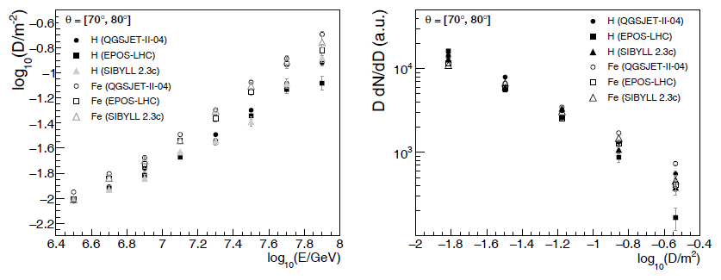

Muon bundles in MATHUSLA (2)
The average value and the spectrum of the local muon density $D$ in MATHUSLA for inclined EAS events generated by H and Fe primaries in the $1 −100 \text{PeV}$ energy range have been simulated and studied using several high-energy hadronic interaction models, assuming that the primary energy spectra have a behaviour $\sim E^{−2}$
Above $10 \text{PeV}$ the local magnitude of $D$ increases linearly with the primary energy in log scale and it is greater for heavy primaries than for light ones.
The $D$ spectra for EAS with a high content of muons are harder than the $D$ spectra for EAS with a low muon multiplicity, and a slight spread is observed depending on the high-energy hadronic interaction model: so, such curves can be used to test the prediction of different models and discriminate among them.
Left: local muon density D vs primary energy (log-log scale)
Right: D times (D spectrum) (log-log scale)

Slide 17
The MATHUSLA collaboration and progress status
The Letter of Intent (2019 + addendum in 2020) was signed by 83 researchers from USA (Spokesperson: Prof. Henry Lubatti, University of Washington, Seattle), Canada, Europe (11 from Italy), Israel, Central and South America
The Technical Design Report is being written, and is expected to be presented to CERN soon

Slide 18
Conclusions
MATHUSLA is a planned external LLP detector for the HL-LHC that can probe deep into the LLP parameter space in a variety of Beyond-the-Standard-Model scenarios, including many DM models
Significant recent progress and ongoing effort:
  Extruded scintillators, fibers, SiPMs, trigger, DAQ
  MC studies of rare backgrounds
  Tracking algorithms for MATHUSLA’s specific environment
  Cosmic-ray physics case
TDR will be produced soon, followed by prototype module and full detector for HL-LHC
New collaborators are very welcome!

Slide 19
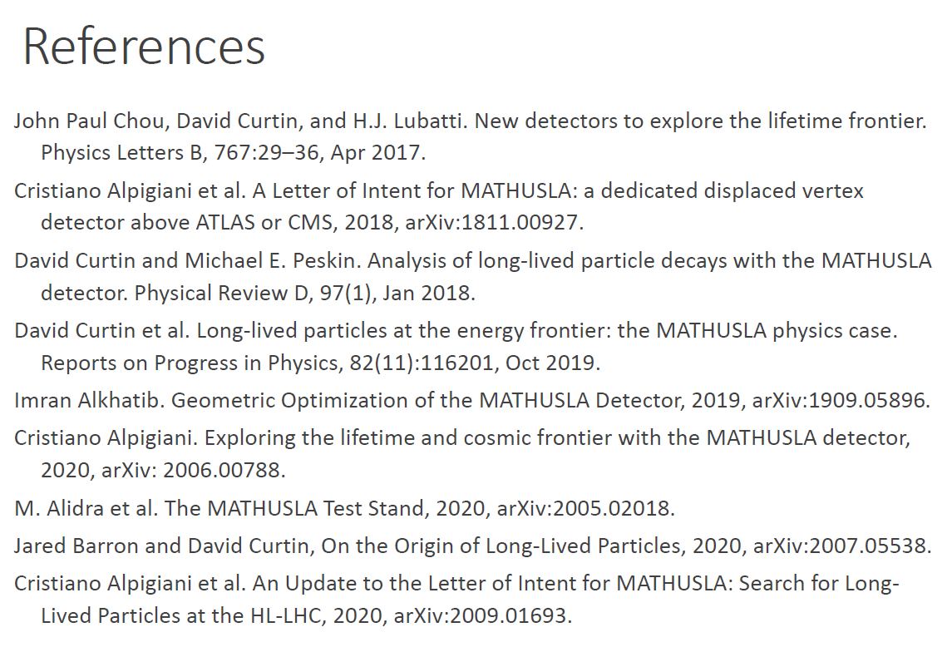
Further references

Slide 20
Backup slides

Slide 21
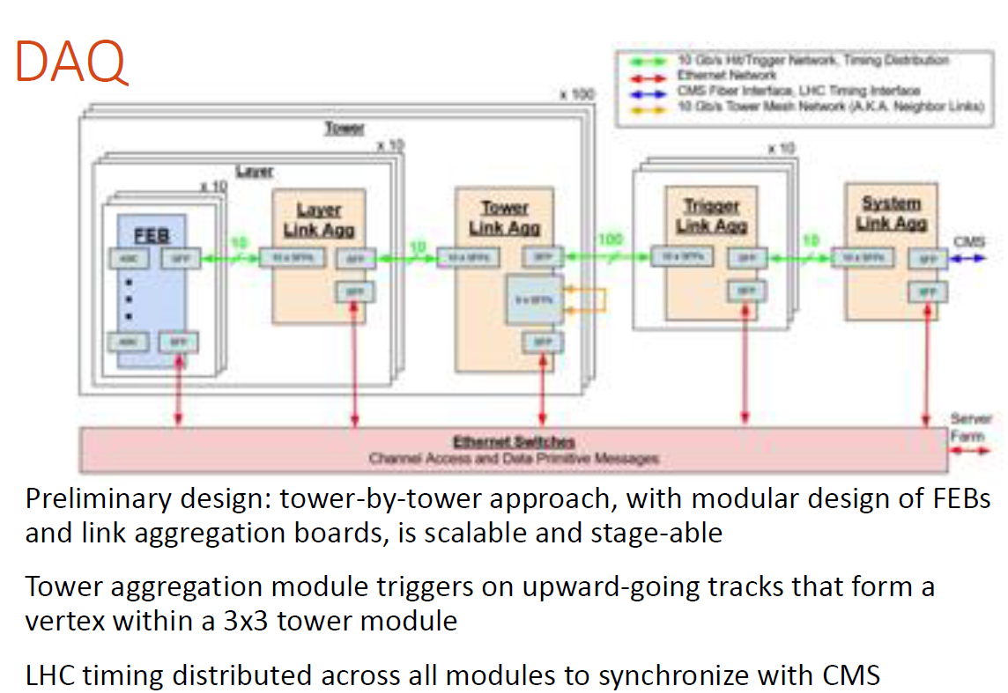

Slide 22
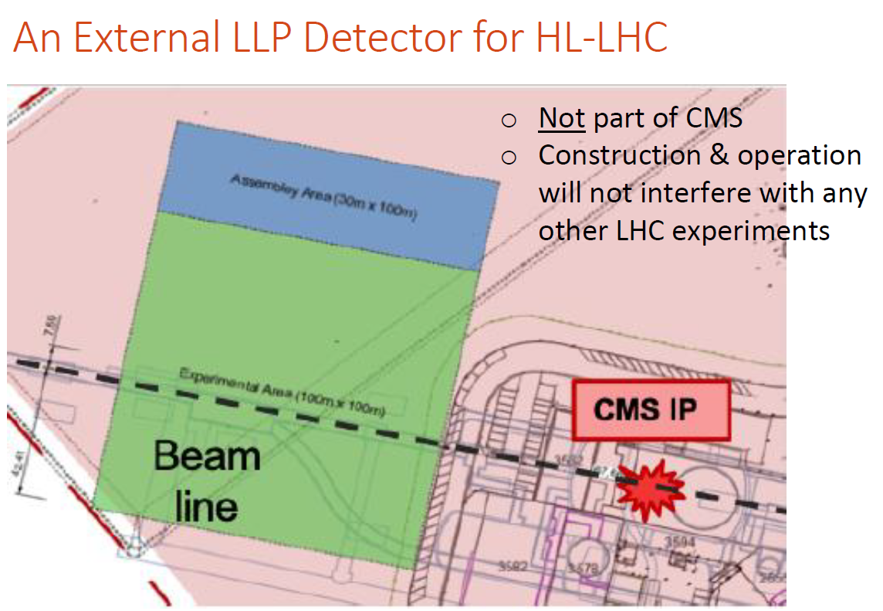

Slide 23
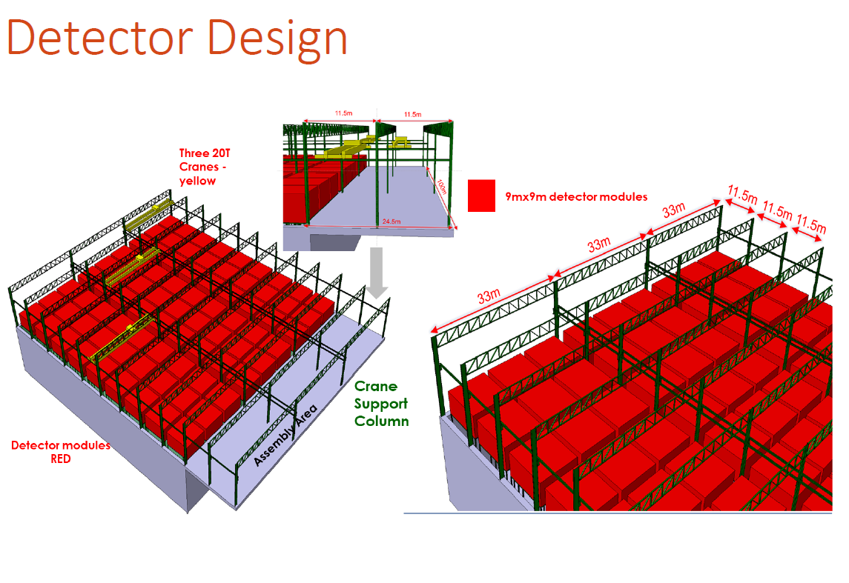

Slide 24
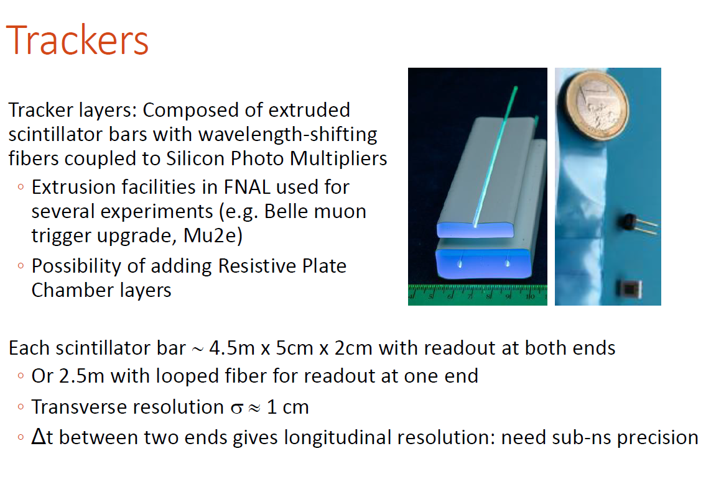

2.4m x 3.5cm x 1.5cm
$$\sim 15 \text{cm}$$

Slide 25
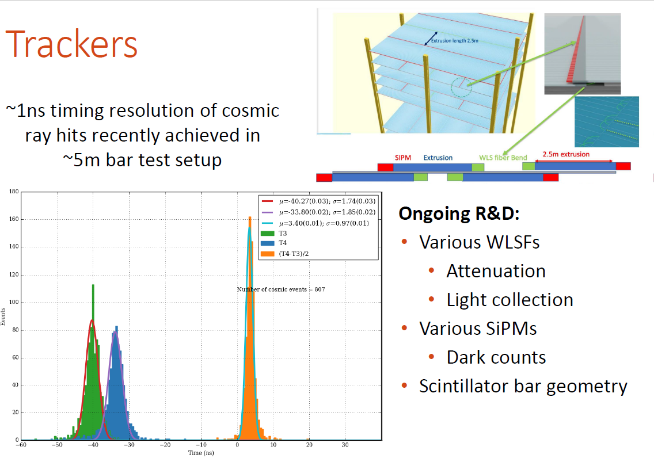

Slide 26
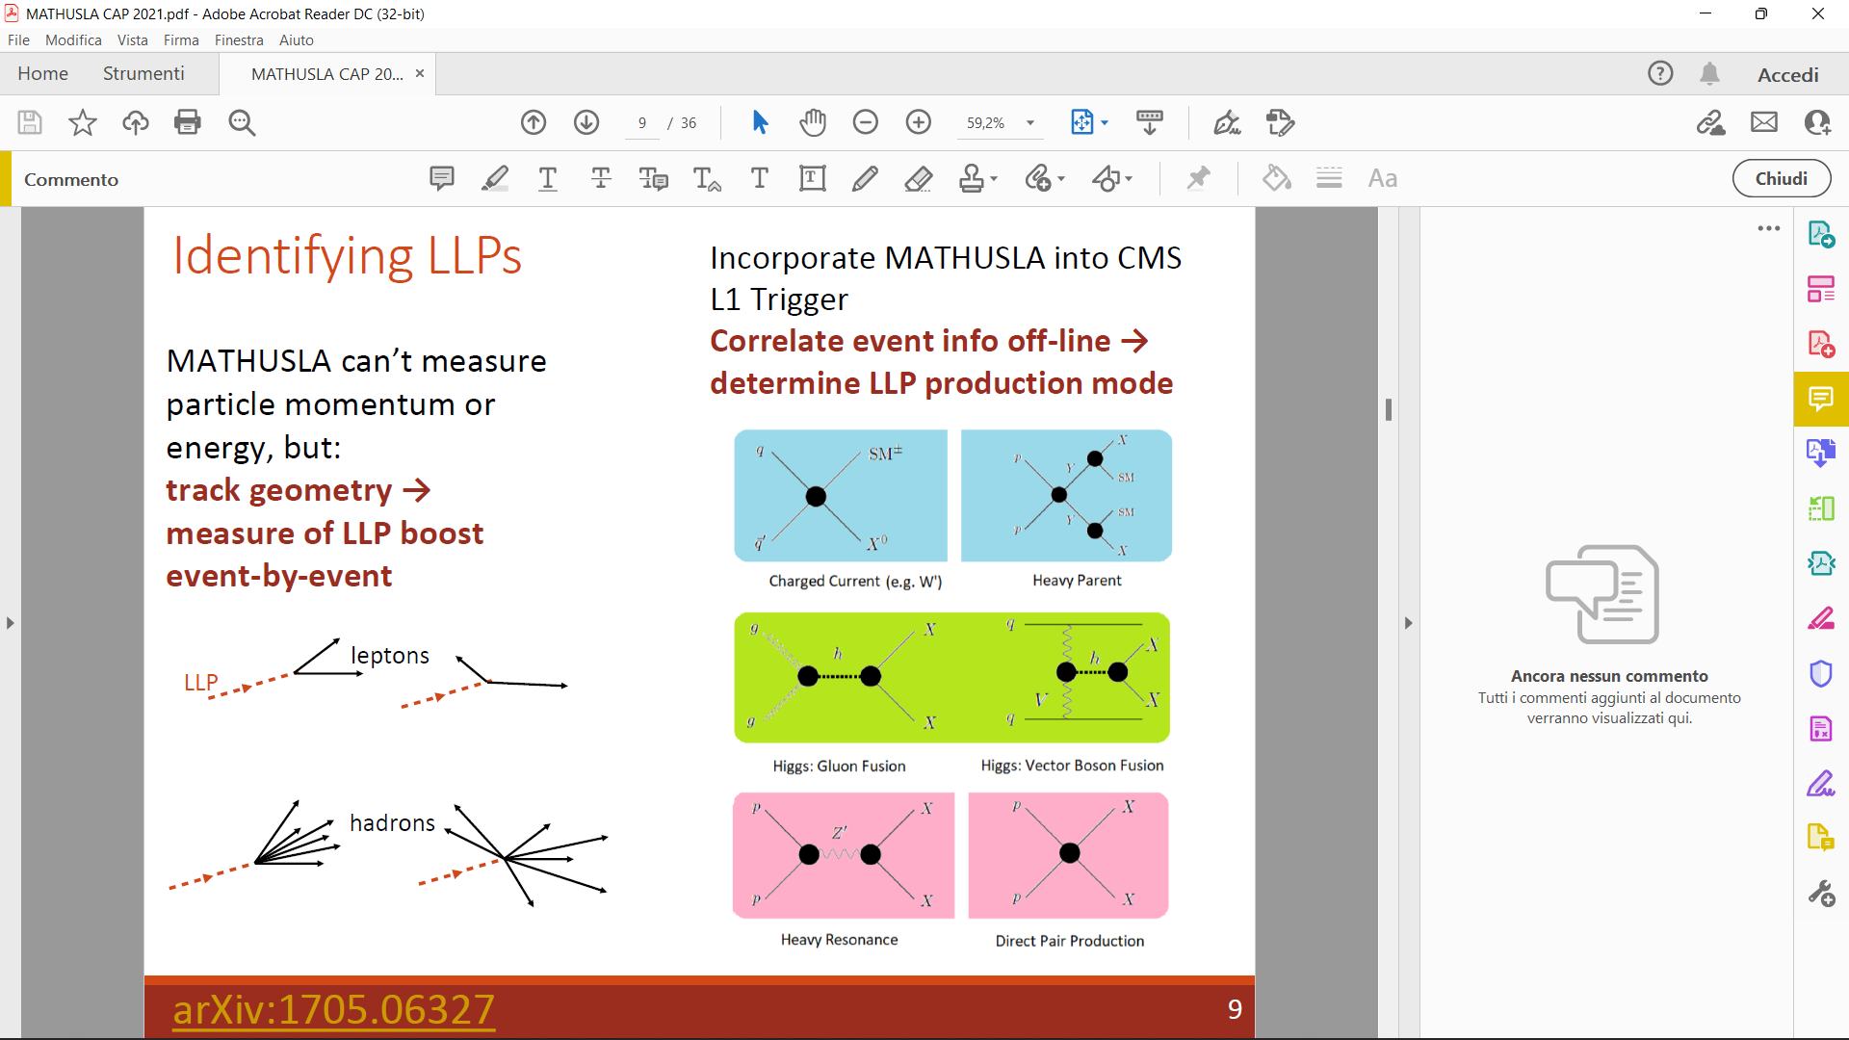

Slide 27
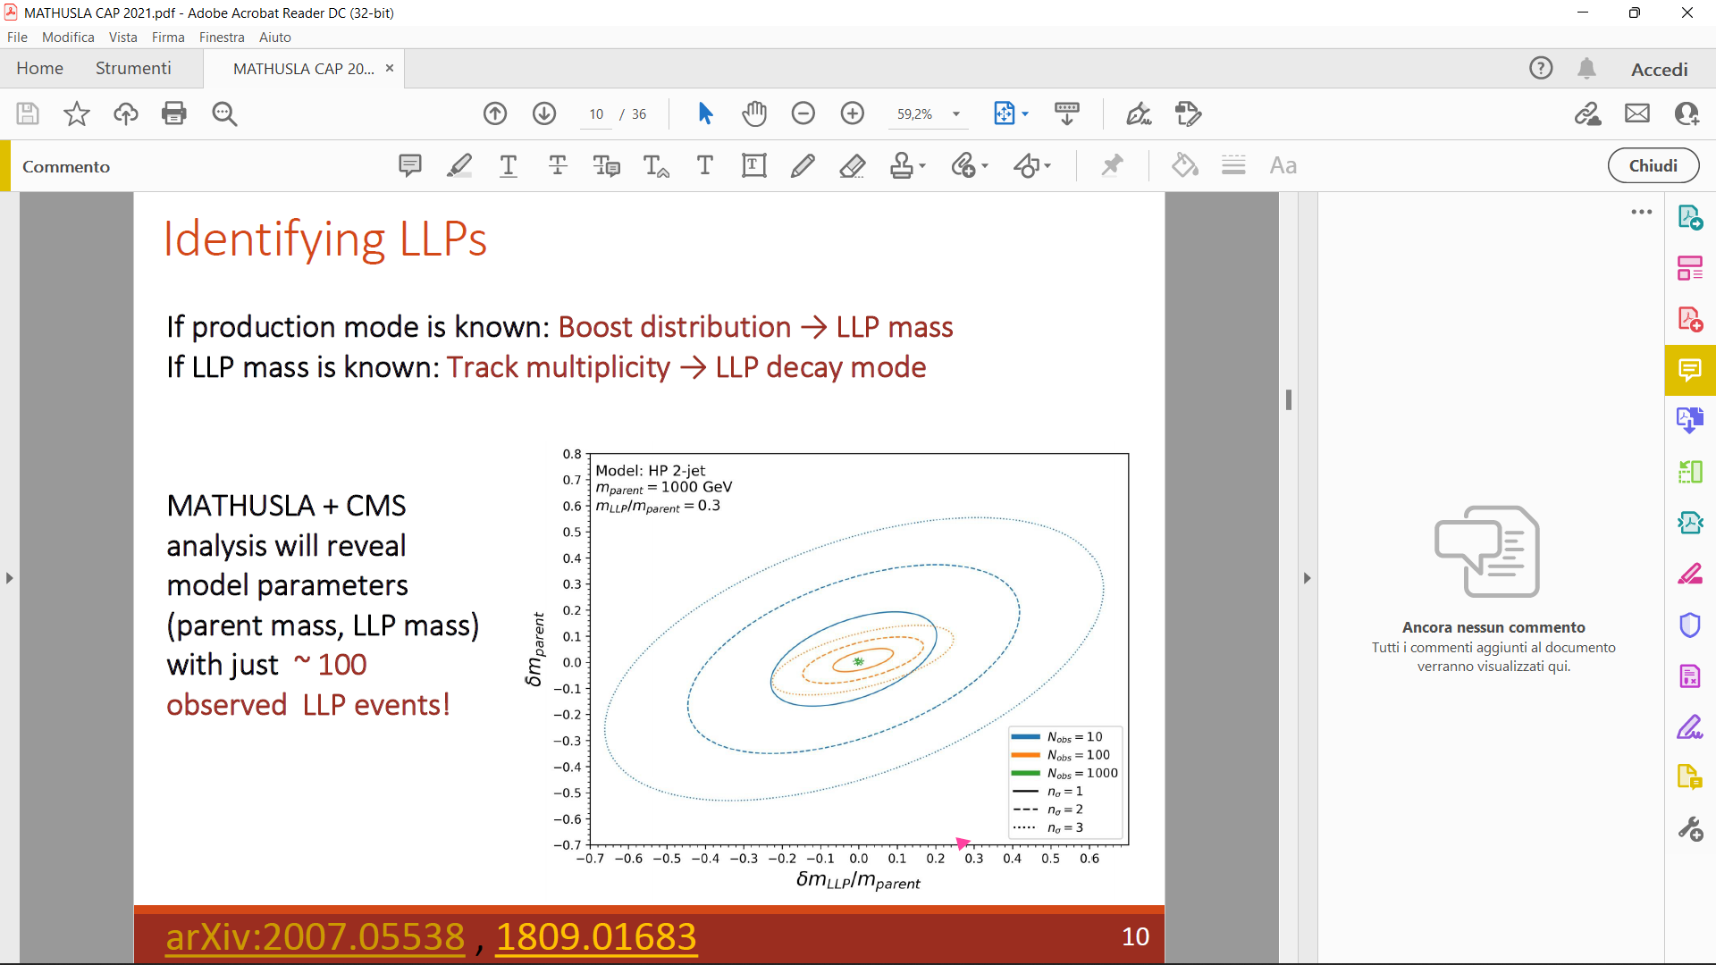
can

Slide 28
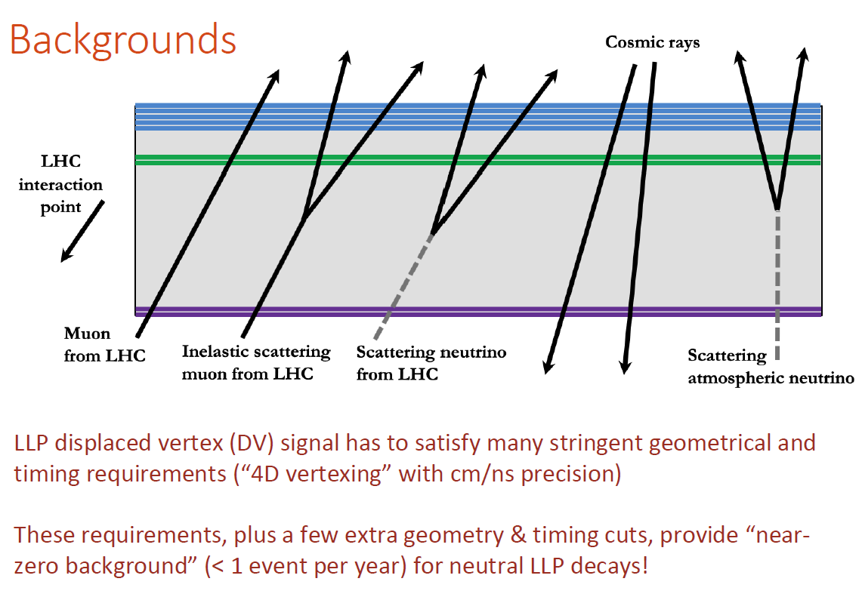
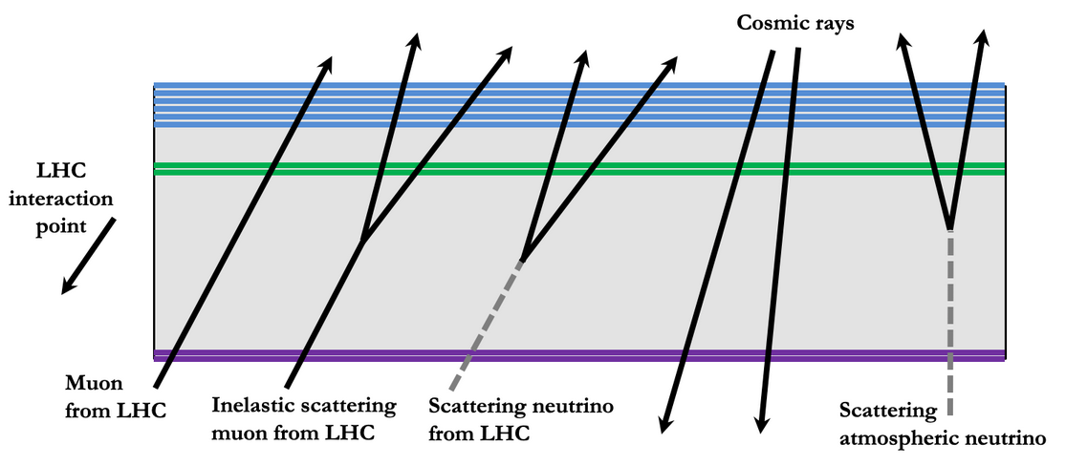

Slide 29
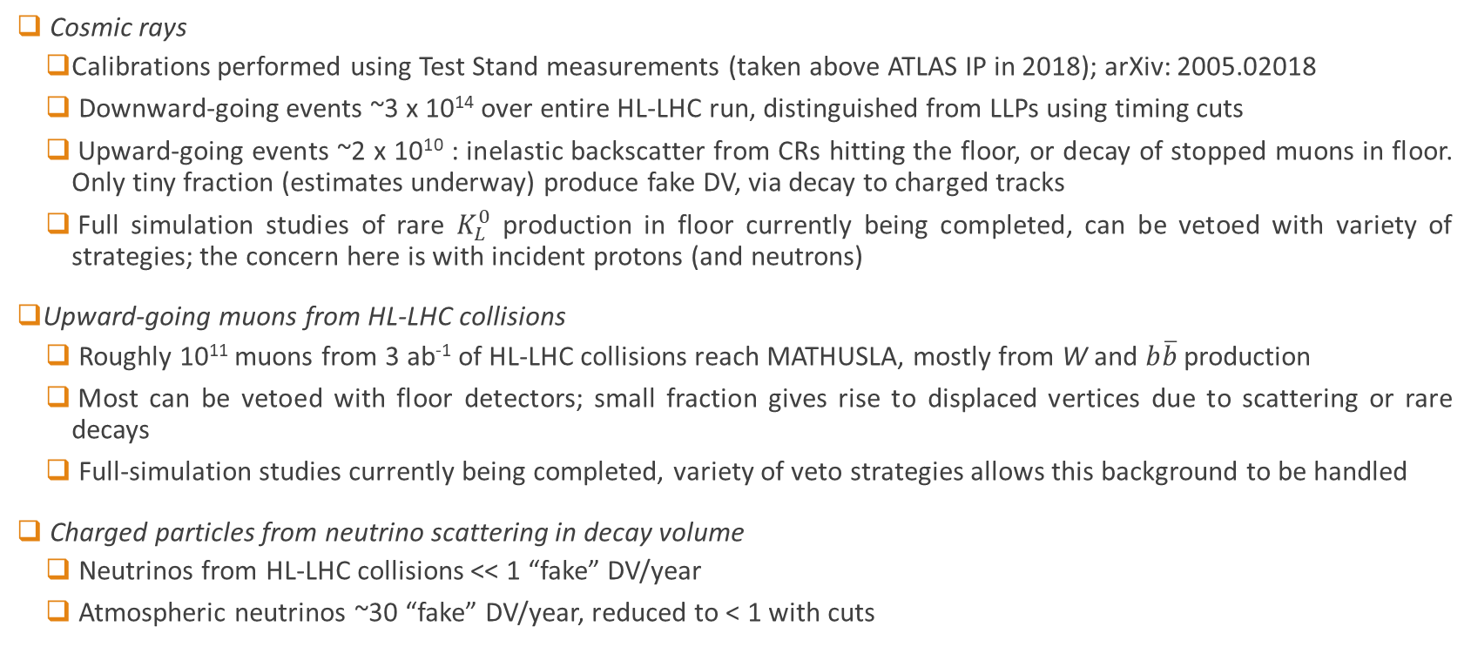
Backgrounds
Cosmic rays
  Calibrations performed using Test Stand measurements (taken above ATLAS IP in 2018); arXiv: 2005.02018
  Downward-going events ~3 x 10¹⁴ over entire HL-LHC run, distinguished from LLPs using timing cuts
  Upward-going events ~2 x 10¹⁰ : inelastic backscatter from CRs hitting the floor, or decay of stopped muons in floor. Only tiny fraction (estimates underway) produce fake DV, via decay to charged tracks
  Full simulation studies of rare $K_{L}^{0}$ production in floor currently being completed, can be vetoed with variety of strategies; the concern here is with incident protons (and neutrons)
Upward-going muons from HL-LHC collisions
  Roughly 10¹¹ muons from 3 ab⁻¹ of HL-LHC collisions reach MATHUSLA, mostly from W and $b\overline{b}$ production
  Most can be vetoed with floor detectors; small fraction gives rise to displaced vertices due to scattering or rare decays
  Full-simulation studies currently being completed, variety of veto strategies allows this background to be handled
Charged particles from neutrino scattering in decay volume
  Neutrinos from HL-LHC collisions << 1 “fake” DV/year
  Atmospheric neutrinos ~30 “fake” DV/year, reduced to < 1 with cuts

Slide 30
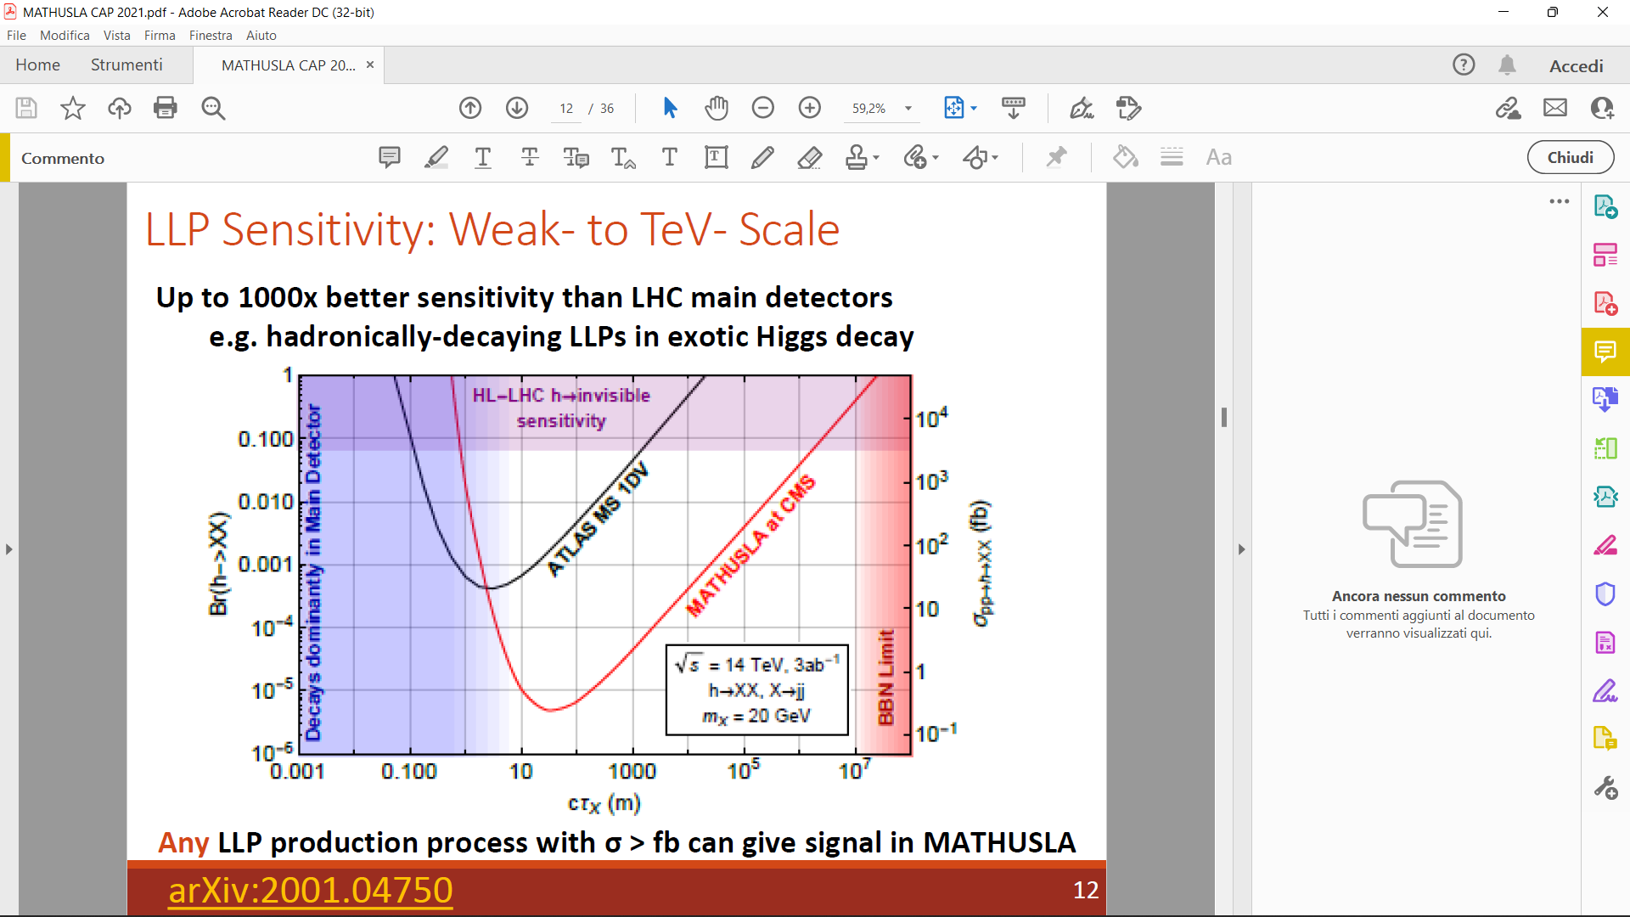

Slide 31
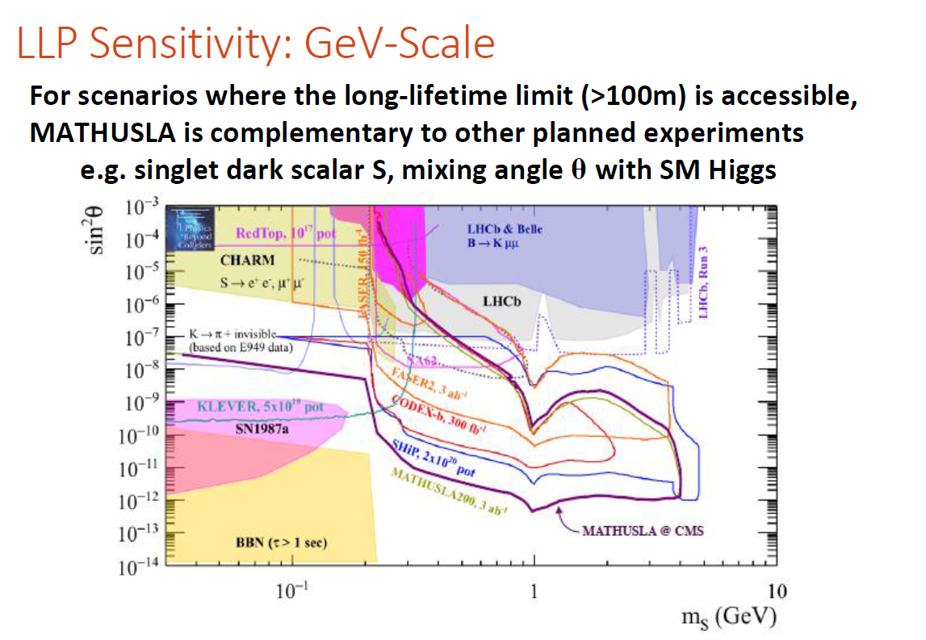

Slide 32
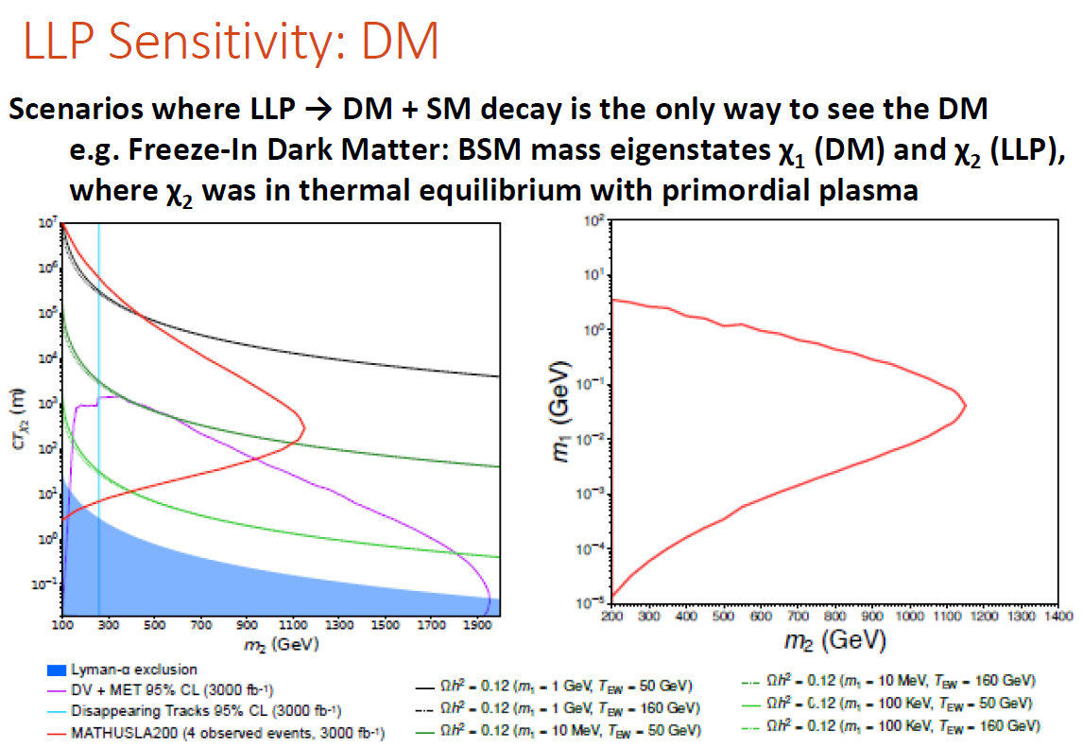

Slide 33
More benchmark models for LLP search
Physics Beyond Colliders CERN report;
J. Phys. G: Nucl. Part. Phys. 47 010501
For more sensitivity projections, see the MATHUSLA physics case; arXiv 1806.07396

Slide 34
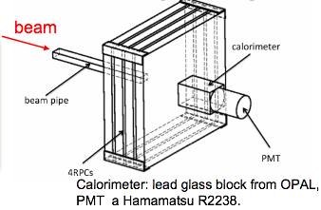
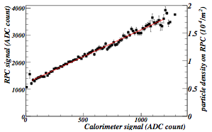
RPC intrinsic linearity: test at the BTF facility
4 RPCs
60 x 60 cm²
Linearity of the RPC @ BTF
at INFN Frascati Lab:
electrons (or positrons)
E = 25-750 MeV (0.5% resolution)
<N>=1÷10⁸particles/pulse
10 ns pulses, 1-49 Hz
beam spot uniform on 3⨉5 cm²
The RPC signal vs the calorimeter signal
➔ Linearity up to ≈ 2・10⁴ particle/m²

Slide 35
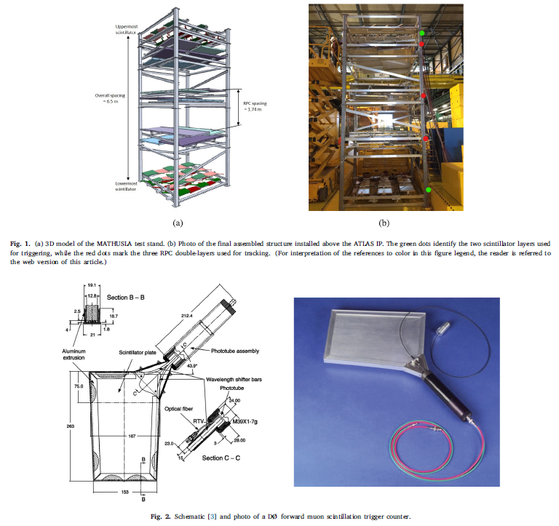
The MATHUSLA Test Stand (1)
A small-scale experiment, the MATHUSLA test stand, was constructed and installed on the surface above the interaction point of the ATLAS detector (LHC Point 1) and collected data during 2018.
The test stand was operational both during LHC pp collisions and when the LHC was not operating.
The goal was to measure the rate of muons from LHC pp collisions reaching the surface, as well as the rate of inelastic backscattering from cosmic rays that could create upward-going tracks, and to determine how well simulation models could reproduce the data.
This information is a very useful input for future studies on the background expectations for the proposed MATHUSLA experiment.
The test stand used scintillation counters recovered from the Tevatron Run II D∅ forward muon trigger system; they were arranged to form two planes of 2.5 × 2.5 m² area each
Spare RPCs of the ARGO-YBJ experiment were arranged in six layers between the scintillator planes, and used to track charged particles crossing the test stand.

Slide 36
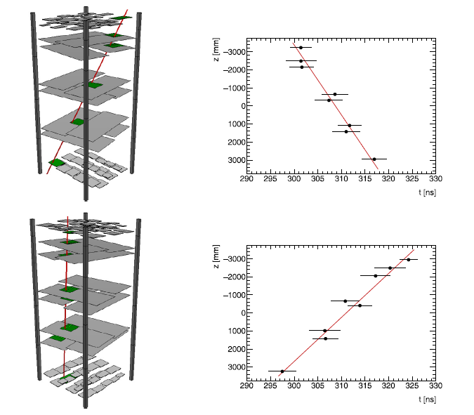
The MATHUSLA Test Stand (2)
Example of a downward-going track
Example of an upward-going track

Slide 37
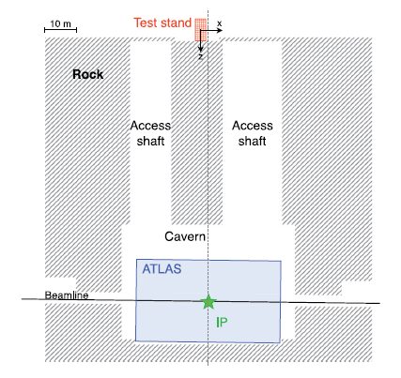
The MATHUSLA Test Stand (3)
Schematic view, in the vertical plane, of the position of the MATHUSLA Test Stand with respect to the ATLAS detector

Slide 38
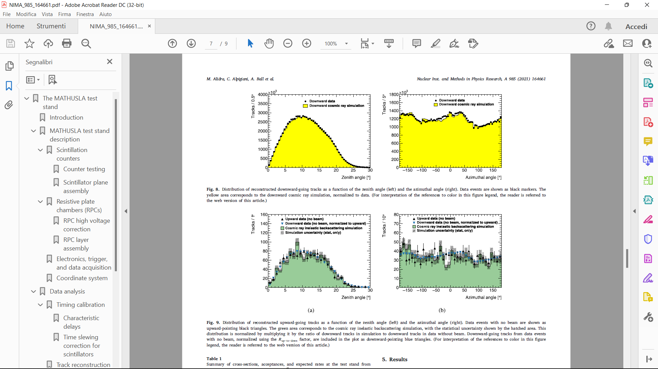
The MATHUSLA Test Stand (4)
Experimental and simulated angular distributions for downward-going tracks
Experimental and simulated angular distributions for single upward-going tracks (no LHC beam) from cosmic-ray albedo

Slide 39
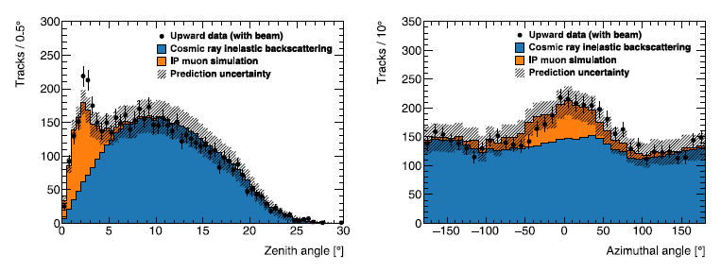
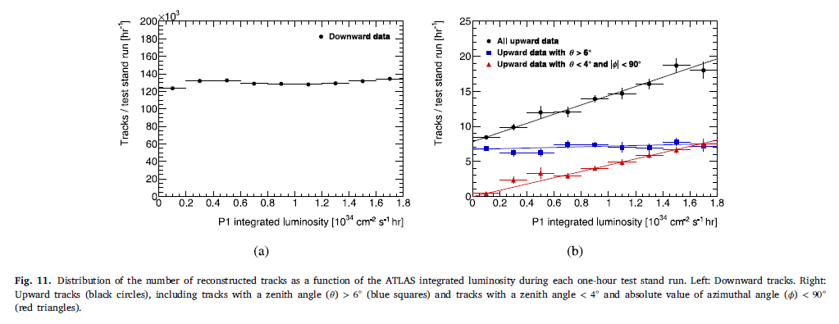
The MATHUSLA Test Stand (5)
Experimental and simulated angular distributions for upward-going tracks (with LHC beam)
The test-stand results confirm the background assumptions in the MATHUSLA proposal and demonstrate that there are no unexpected sources of background.
These results give confidence in the MATHUSLA projected physics reach.
NIM A 985 (2021) 164661

