Slide 1
Mass of Excited Mesons
Gustavo Paredes Torres
Dra. Laura Xiomara Gutiérrez Guerrero ​
Dr. Adnan Bashir

Slide 2
contents
Introduction
Contact Interaction Model
Schwinger–Dyson and Bethe–Salpeter equations
Mesons and Diquarks
First Radial Excitation
Results
Conclusions

Slide 3
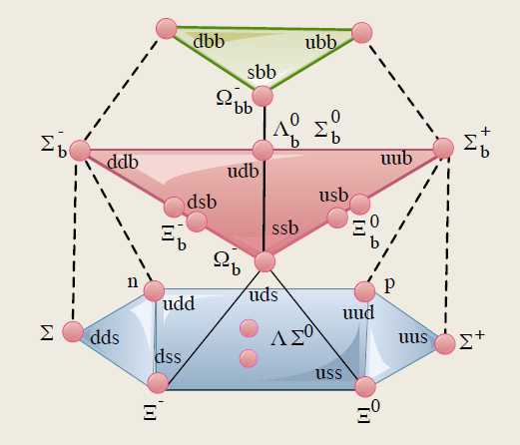
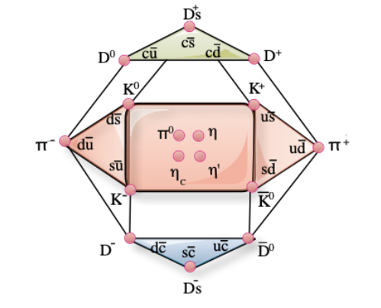
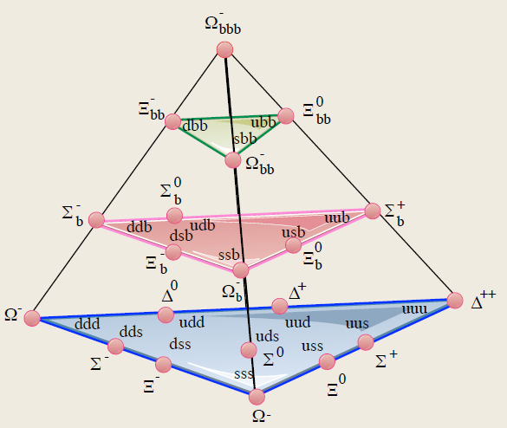
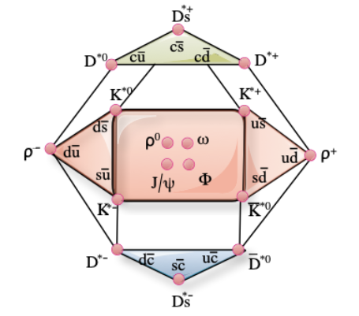
Introduction
Multiplets of mesons and baryons:
Vector mesons:
Baryons 1/2:
Pseudoscalar mesons:
Baryons 3/2:
Notes:
Multipletes de hadrones se acomodan según sun números cuánticos en planos de Y hipercarga, I isospín , Carga Q etc
Bases de barione calculadas y/o obsrvadas, los mas pesados no todos calculados.
2X \overline{2}=3+1
3X \overline{3}=8+1
3X3X3=10+8+8+1
4X4X4=20+20+20+4

Slide 4
Introducción
[1] L. X. Gutiérrez-Guerrero, A. Bashir, I. C. Cloët, and C. D. Roberts, Phys. Rev. C, 81, 065202 (2010).
[2] H. L. L. Roberts, A. Bashir, L. X. Gutierrez-Guerrero, C. D. Roberts, and D. J. Wilson, Phys. Rev. C, 83, 065206 (2011).
[3] Hannes L. L. Roberts, Lei Chang, Ian C. Cloët, and Craig D. Roberts, Few Body Syst., 51,1–25 (2011).
[4] Hua-Xing Chen, Wei Chen, Xiang Liu, Yan-Rui Liu, and Shi-Lin Zhu, Rept. Prog. Phys., 076201 (2017).
[5] Ya Lu, Chen Chen, Craig D. Roberts, Jorge Segovia, Shu-Sheng Xu, and Hong-Shi Zong, Phys. Rev. C, 96, 015208 (2017).
[6] L. X. Gutiérrez-Guerrero, Adnan Bashir, Marco A. Bedolla, E. Santopinto, Phys. Rev. D, 100, 114032 (2019).
Notes:
Literatura referente al modelo de CI

Slide 5
Introducción
[7] P. L. Yin, C. Chen, G. Krein, C. D. Roberts, J. Segovia and S. S. Xu, Phys. Rev. D, 100, 034008 (2019).​
​
[8] Marco A. Bedolla, J. J. Cobos-Martínez, Adnan Bashir, Phys.Rev.D, 92, 054031 (2015).​
​
[9] Khepani Raya, Marco A. Bedolla, J. J. Cobos-Martínez, and Adnan Bashir, Few Body Syst., 59, 133 (2018).​
​
[10] Shu-Sheng Xu, Chen Chen, Ian C. Cloet, Craig D. Roberts, Jorge Segovia, and Hong-Shi Zong,Phys. Rev. D,92, 114034 (2015).​
​
[11] Marco Antonio Bedolla, Jacopo Ferretti, Craig D Roberts, and Elena Santopinto,Eur. Phys. J. C, 80,1004 (2020)​.
​
​
​
​

Slide 6
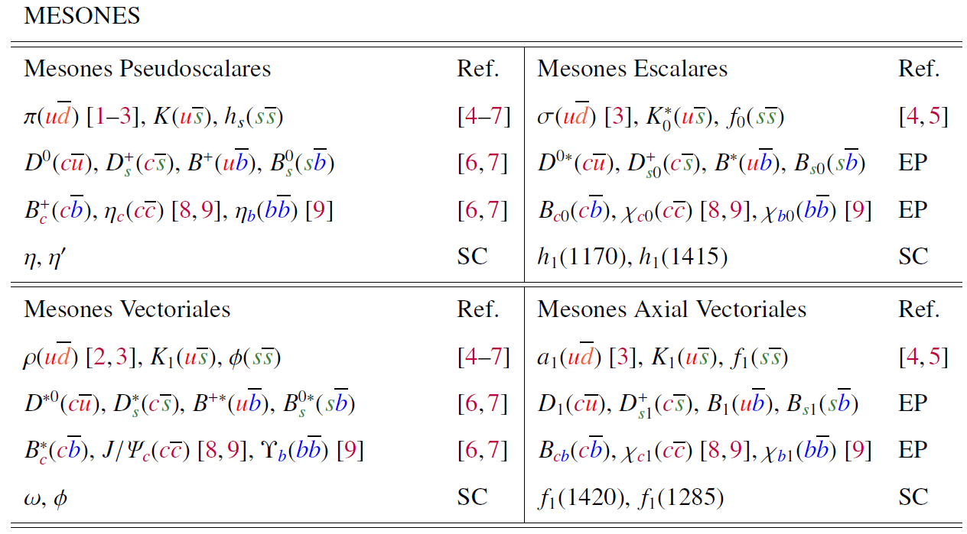
Introduction
Notes:
Resumen de las partículas utilizando CI

Slide 7
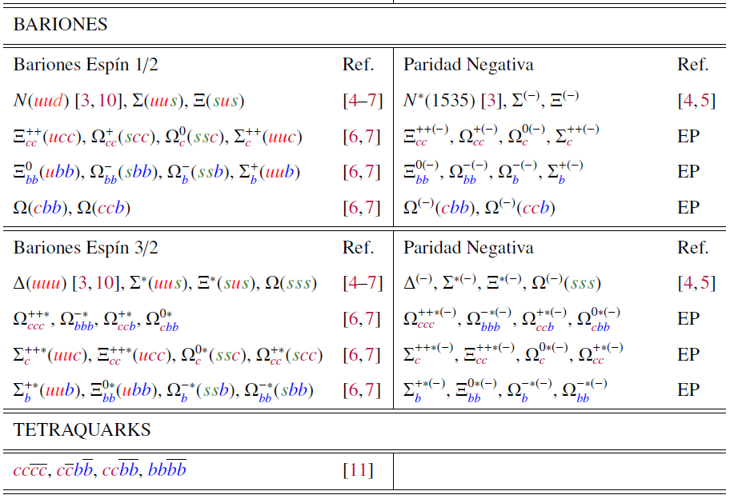
Introduction

Slide 8
Introduction
Several labs are trying to measure heavy particles:
BELLE searches resonances of Ξ_{c} and Ω_{c}
A.J. Schwartz, Proc. Sci., CHARM2016, 042 [arXiv:1701.07159], (2017).
Jefferson Lab studies hadrons in terms of their form factors. G. Aznauryan et al., Int. J. Mod. Phys. E 22, 1330015 (2013).
PANDA searches for baryons with s and c quarks.
Q.-Y. Lin, X. Liu, and H.-S. Xu, Phys. Rev. D 90, 014014 (2014).
LHCb searches for baryons with quarks c and b.
R. Aaij et al. (LHCb Collaboration), Phys. Rev. Lett. 122 (2019).

Slide 9
Introduction
On the theoretical side there are several approaches to calculate hadrons:
Poincaré Covariant Analysis for Continuous QCD.
R. Aaij et al. (LHCb Collaboration), Phys. Rev. Lett. 122, (2018).
Lattice.
Z. S. Brown, W. Detmold, S. Meinel, and K. Orginos,Z. S. Brown, W. Detmold,
S. Meinel, and K. Orginos, Phys. Rev. D 90, 094507 (2014).
Formalism of the Faddeev Equation (Fadv).
B. Silvestre-Brac, Few-Body Syst. 20, 1 (1996).
Bag model.
P. Hasenfratz, R. R. Horgan, J. Kuti, and J. M. Richard, Phys. Lett. 94B, 401 (1980).
Quark counting rules (QCR).
J. D. Bjorken, AIP Conf. Proc. 132, 390 (1985).

Slide 10
Introduction
The constituent model of the quark (CQM1, CQM2).
J. Vijande, H. Garcilazo, A. Valcarce, and F. Fernandez, PhyS. Rev. D70, 054022 (2014)
Relativistic quark model (RQM).
A. P. Martynenko, Phys. Lett. B 663, 317 (2008).
Instanton quark model (IQM).
S. Migura, D. Merten, B. Metsch, and H.-R. Petry, Eur. Phys. J. A 28, 41 (2006).
Hypercentral model (HCM).
B. Patel, A. Majethiya, and P. C. Vinodkumar, Pramana 72, 679 (2009).
QCD sum rules (SR).
J.-R. Zhang and M.-Q. Huang, Phys. Lett. B 674, 28 (2009).
Non-Relativistic QCD (NRQCD).
F. J. Llanes-Estrada, O. I. Pavlova, and R. Williams, Eur. Phys. J. C 72, 2019 (2012).

Slide 11
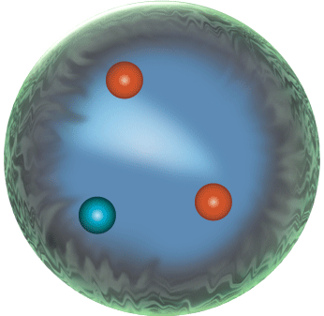
QUARK’s MASS
We can distinguish among two different types of quark masses.
The current mass that appears in the renormalized Lagrangian of QCD.
Due to interactions, quarks and gluons acquire constituent/dressed mass dynamically within hadrons.
$$m_{u}+m_{u}+m_{d}≃10 MeV$$
$m_{proton}≈1000 MeV$
Notes:
Una tercera masa es la masa Desnuda es la que aparece en el Lagrangiano desnudo.

Slide 12
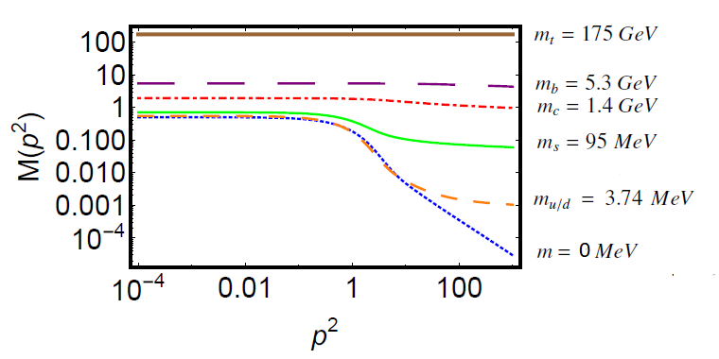
Current vs constituent mass
The breaking of chiral symmetry causes the difference between the current and constituent masses.
About the same mass is generated for each quark (300 MeV); for the heavier quarks it is less noticeable because of the large value of their explicit mass.
DCSB is the mechanism that generates 98% of the mass of visible matter.
Notes:
Realce en el infrarrojo con respecto a la masa corriente.
A medida que aumenta la masa corriente de los quarks los efectos de la DCSB son menores.
Incluso en una masa corriente cero “limite quiral” hay generación dinámica de masas
dynamic breaking of chiral symmetry

Slide 13
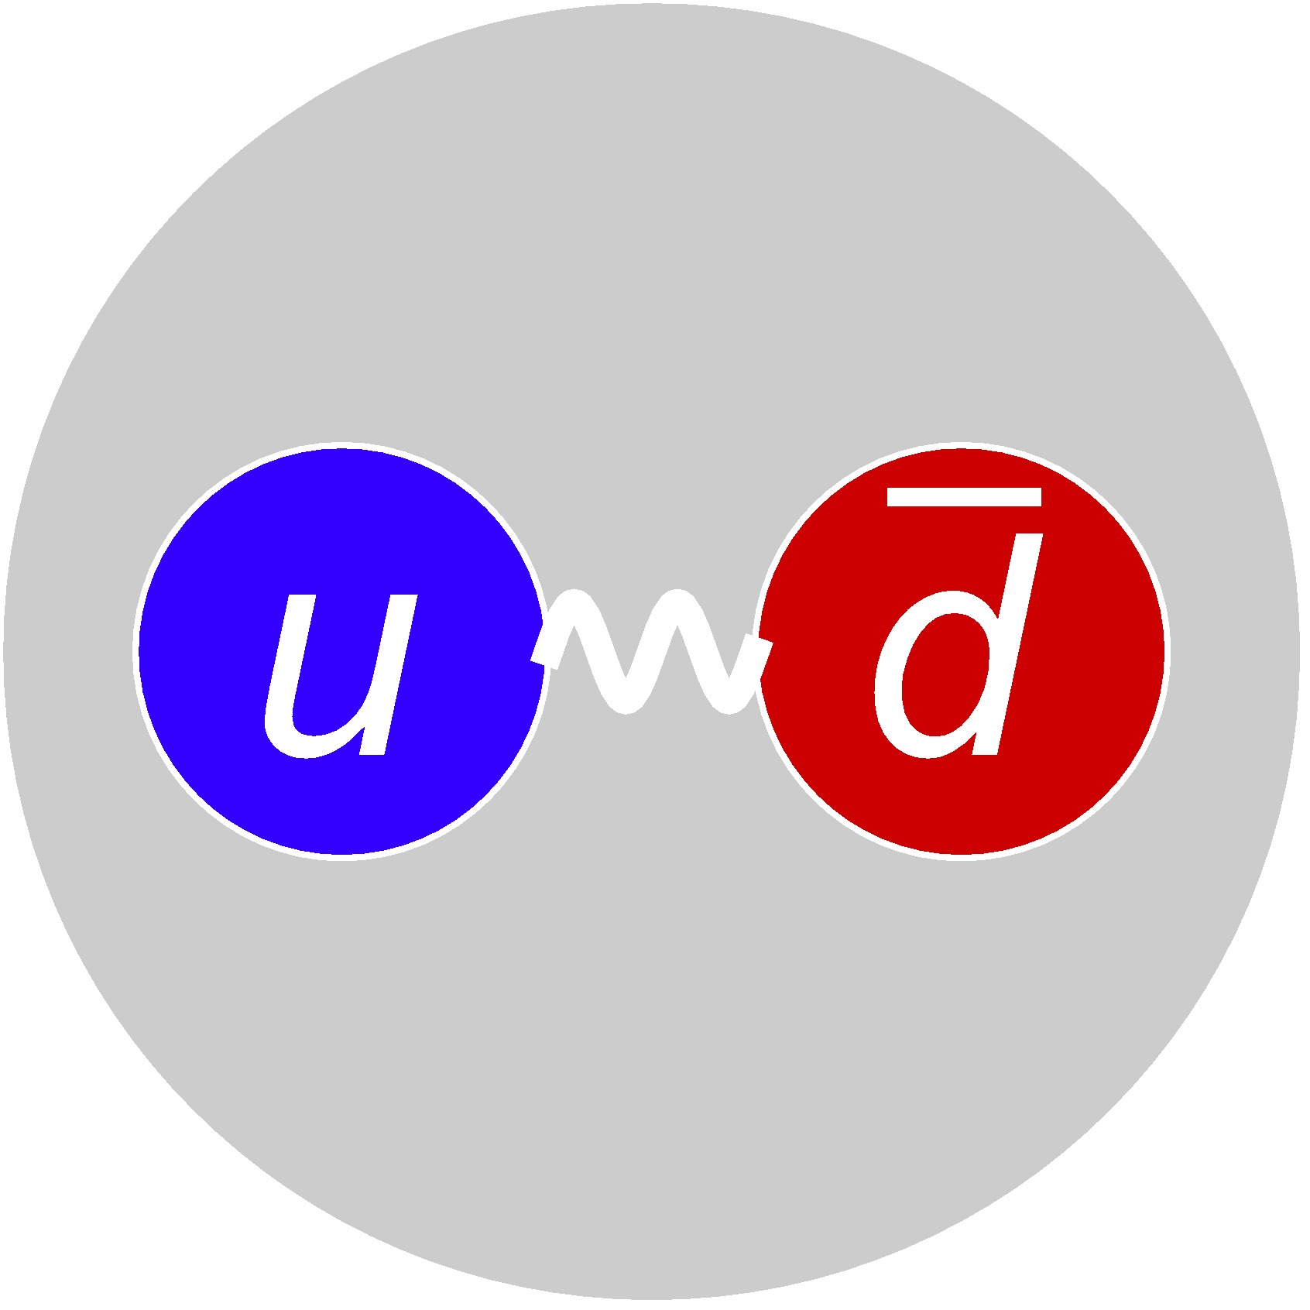
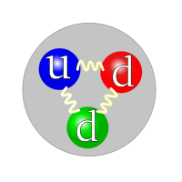
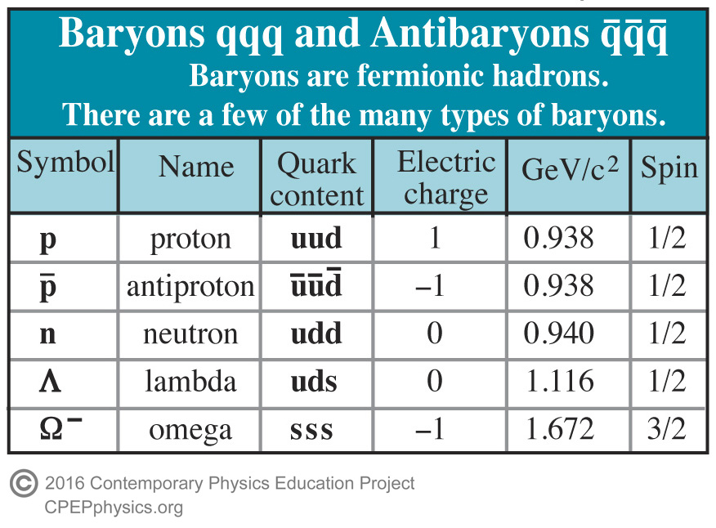
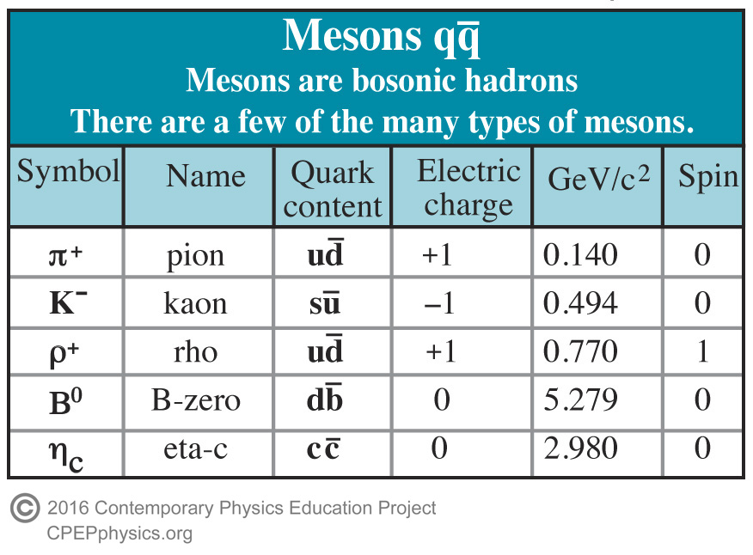
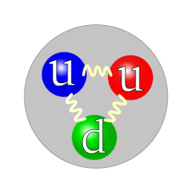
Hadrones: Mesones y bariones
La materia visible esta constituida por protones y neutrones ($e^{−},u y d$) llamados Bariones.
Los Bariones ($qqq$). Son fermiones $s=\frac{1}{2},\frac{3}{2}$
Mesones ($q\overline{q}$). Son Bosones $s=1$
$$π^{+}$$
$$m_{u}+m_{u}+m_{d}≃10 MeV$$
$m_{protón}≈1000 MeV$
Neutrón
Protón

Slide 14
SDE FOR THE QUARK PROPAGATOR
Ideal for studying non-perturbative phenomena as no assumptions are made about the value of the coupling.
Complete Propagator, dressed
Bare propagator, tree level
Dressed quark-gluon vertex
Dressed gluon propagator
Gap equation
$Σ\left(p\right)$ Self-energy
Notes:
.Exactas, invariantes de poincare (Lorentz + translaciones esp. minkoski), infinitas en número,
Consistentes con confinamiento, DCSB y QCD perturbativa.
En el espacio Euclideano. Vértice completo = vértice a nivel árbol – corrección al vértice al gluon y al propagador de quark,
DEBEMOS TRUNCARLAS.

Slide 15
CONTACT INTERACTION MODEL
Simplified QCD model, where UV divergences are regularized to preserve QCD symmetries, compatible with confinement and DCSB.
The gluon propagator is considered as a constant:
Interaction strength in infrared
Gluon mass scale
It is one of the most drastic approximations of this model. However, according to our present knowledge, the gluon propagator does become constant in the infrared, at least to the Landau gauge. Therefore, in the Landau gauge it is a very good approximation for all those observables that only depend on infrared physics such as the hadron mass.
Notes:
El propagador no depende del momento
mg=escala de masa del gluon generada dinámicamente.
air = fuerza de interacción en el infrarrojo. Matrices de GellMann
IC reproduce muy bien las masas y las constantes de decaimiento.
Simple de usar
Buenas aproximaciones para Q^2 pequeñas. (momentos pequeños)
Sustituto útil, en dominios donde QCD es incapaz de entrar.

Slide 16
CONTACT INTERACTION MODEL
The vertex is assumed to be tree level, that is (bare vertex):
Feynman diagram for $q\overline{q}$ scattering:
It is the gauge for which the sensitivity to differences between the bare quark-gluon vertex and the full vertex is less noticeable. Furthermore, it is a gauge that is easily implemented in numerical simulations of regularized QCD lattice.
Notes:
El propagador no depende del momento
mg=escala de masa del gluon generada dinámicamente.
air = fuerza de interacción en el infrarrojo. Matrices de GellMann
IC reproduce muy bien las masas y las constantes de decaimiento.
Simple de usar
Buenas aproximaciones para Q^2 pequeñas. (momentos pequeños)
Sustituto útil, en dominios donde QCD es incapaz de entrar.

Slide 17
CONTACT INTERACTION MODEL
With CI the equation of the quark propagator takes the form:
It has quadratic and logarithmic divergences, that is why it must be regularized, for this, a proper time regularization scheme is used:
Notes:
4 fermiones a un punto no es renormalizable, Z’s =1.
M es una constante.
Función gamma-incompleta.
f es el sabor del quark

Slide 18
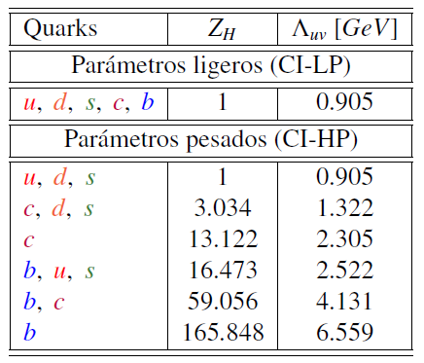
QUAKR DRESSED MASS RESULTS.
Using the following parameters:
Light parameters
Light parameters
Heavy parameters
Heavy parameters
L. X. Gutiérrez-Guerrero, A. Bashir, I. C. Cloët, and C. D. Roberts, Phys. Rev. C, 81, 065202 (2010).
With these parameters we calculate the masses of bound states of quarks, i.e. mesons and diquarks.
Notes:
Consideramos mu=md por la simetría de isospín.

Slide 19
BETHE-SALPETER EQUATION
Describes bound states of two particles such as mesons (flavored quarks $f_{1}$ and $f_{2}$).
The mesons appear as poles of the Green function.
BS equation:
BS wave function:
Interaction kernel $q\overline{q}$
BS amplitude
Quark propagator
E. E. Salpeter and H. A. Bethe, Phys. Rev. 84, 1232 (1951).
Notes:
Índices de color r, s, t, u
F1 y f2 son los sabores del quark y antiquark
H es el meson como pi, rho etc

Slide 20
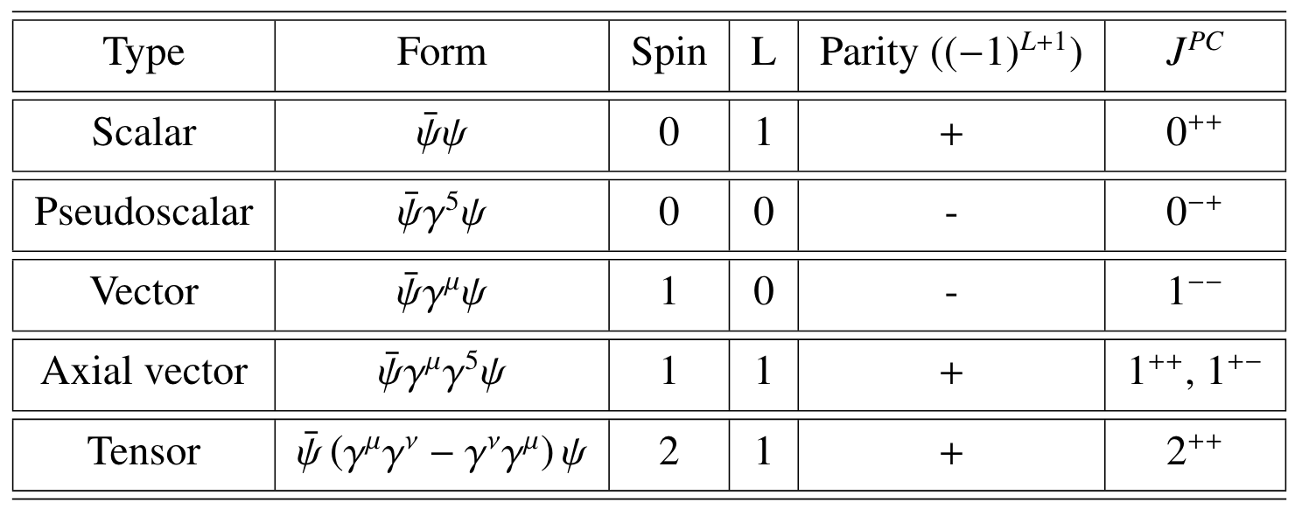
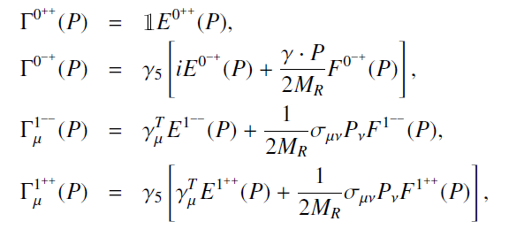
BS AMPLITUDES IN CI
Mesons types:
BS amplitude:
In the CI Model the BSA does not depend on k, the relative momentum:
$M_{R}$ is the reduced mass.
Notes:
T matrices de Paulli
C= (-1)^{L+S}
k, P momento relativo y total del par quark-antiquark
E, F, G y H funciones escalares de Lorentz de k^2 y k.P

Slide 21
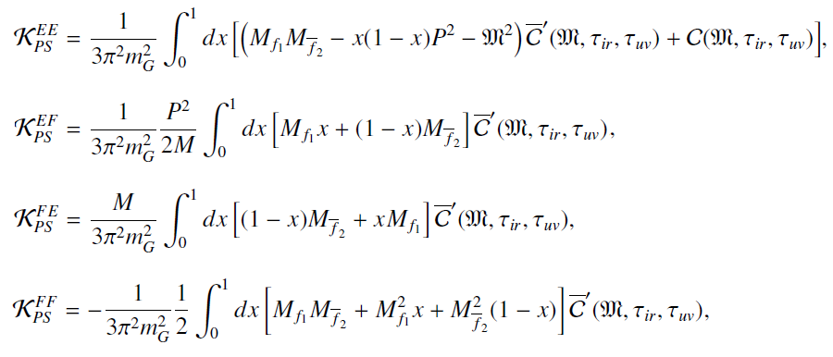
MASSES OF MESONS
We solve the BS equation in the form of eigenequation:
We look for the solution with:
Marco A. Bedolla, J. J. Cobos-Martínez, Adnan Bashir, Phys.Rev.D, 92, 054031 (2015).

Slide 22
FIRST RADIAL EXCITATION
Estuding radial excited states shows a related zero. This zero is seen from the relative momentum dependence.
From the ABS independent of relative momentum, a zero cannot be obtained.
A zero is inserted by hand in the Interaction Kernel expressions.
Then $(1−d_{F}{ q}^{2})→0$ when ${ q}^{2}=\frac{1}{d_{F}}$, in [1] they use $\frac{1}{d_{F}}=M^{2}\left(1±0.2\right)$,and in [2] they use $\frac{1}{d_{F}}=2M^{2}\left(1±0.2\right)$.
[1] Hannes L. L. Roberts, Lei Chang, Ian C. Cloët , Craig D. Roberts Masses of ground and excited-state hadrons.
[2] Chen Chen, Lei Chang, Craig D. Roberts, Shaolong Wan, David J. Wilson
Spectrum of hadrons with strangeness
Notes:
BSA se normalizan a 1 para Q^2 yendo a cero.
Ahora se habla sobre diquarks.
Parejas de paridad de los mesones.

Slide 23
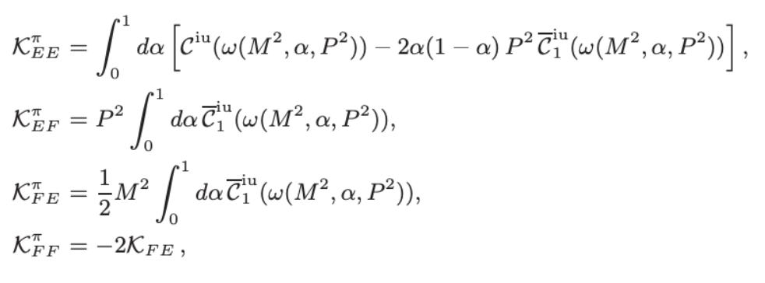
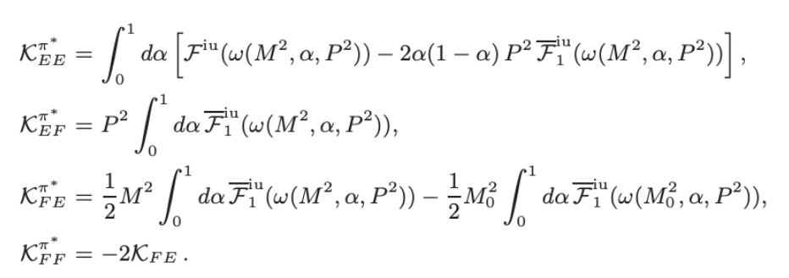
FIRST RADIAL EXCITATION
Then by the regularization of the integrals the matrix elements change:
With:

Slide 24
KERNEL FOR PSEUDOSCALAR MESONS
Using the Feynman parameterization we get:
Matrix equation:
Notes:
BSA se normalizan a 1 para Q^2 yendo a cero.
Ahora se habla sobre diquarks.
Parejas de paridad de los mesones.
Usamos M= M_R
air = fuerza de interacción en el infrarrojo/mg

Slide 25
DIQUARKS
They are correlations of two quarks within a baryon.
Trivial changes in the BS equations of the mesons will give us those of the diquarks.
Mesons:
$0^{−}$ Pseudoscalars
$0^{+}$ Scalars
$1^{−}$ Vector
$1^{+}$ Axial Vector
Diquarks:
$0^{+}$ Scalars
$0^{−}$ Pseudoscalars
$1^{+}$ Axial Vector
$1^{−}$ Vector
Notes:
Fue una idea introducida para describir al barión como compuesto de dos partículas un quark y un diquark .
Reduce en problema de 3 cuerpos a dos.
Los diquarks 0⁺ y 1⁺ son pareja de paridad de los mesones π y ρ. Por lo tanto la ecuación de BS que describe estos mesones es la misma que describe la dinámica de los diquarks correspondientes.

Slide 26
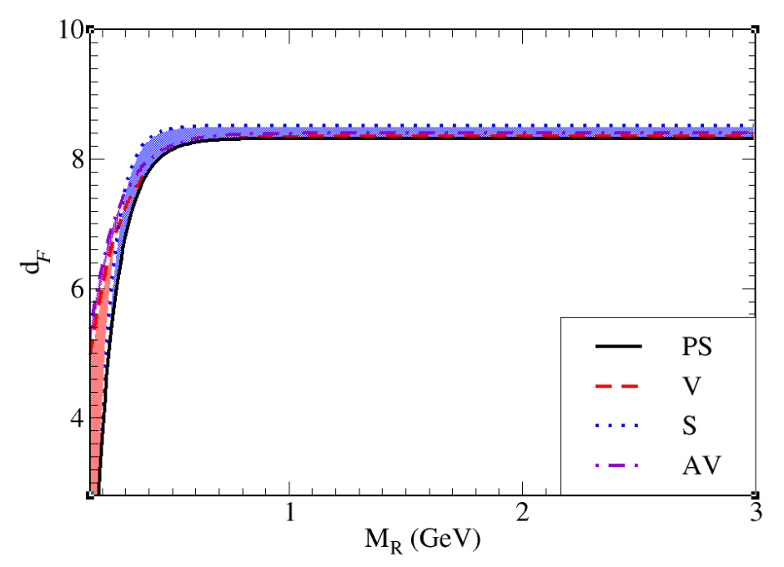
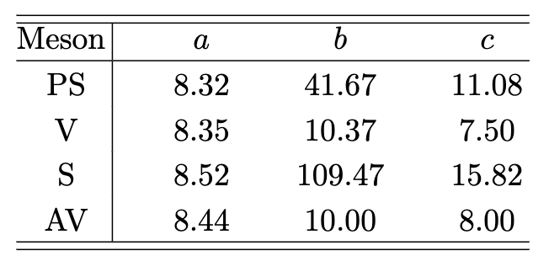
Analyzing the phenomenology of the known experimental results we propose a functional form for $d_{F}\left(M_{R}\right):$
(20)

Slide 27
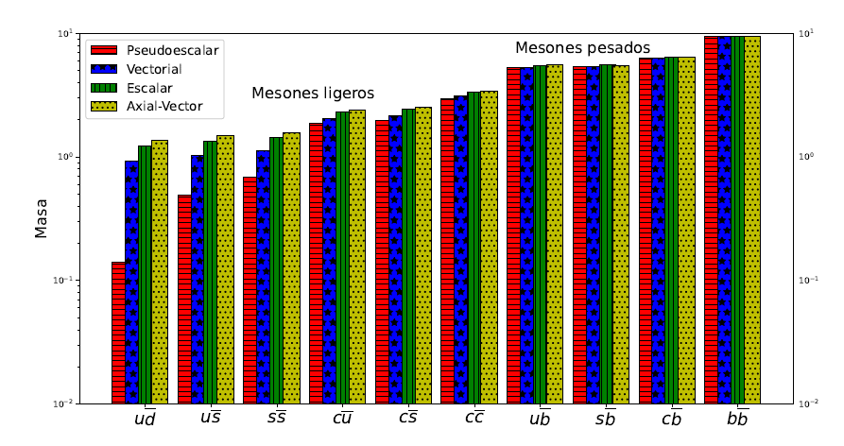
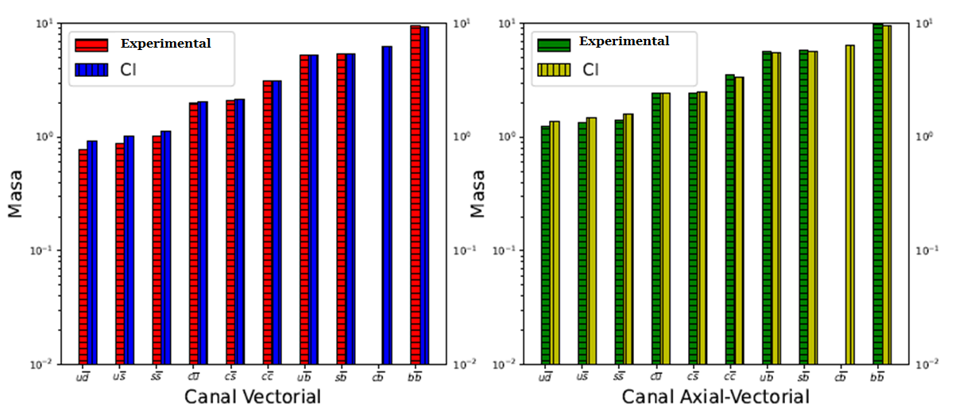
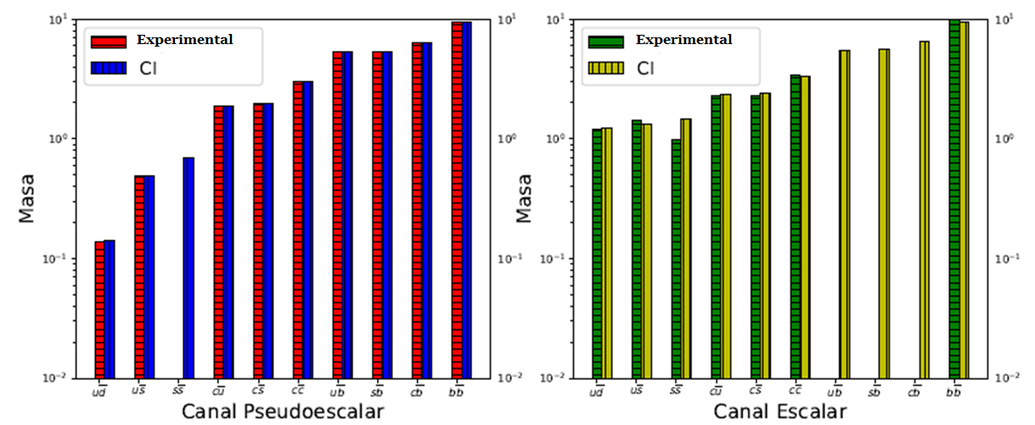
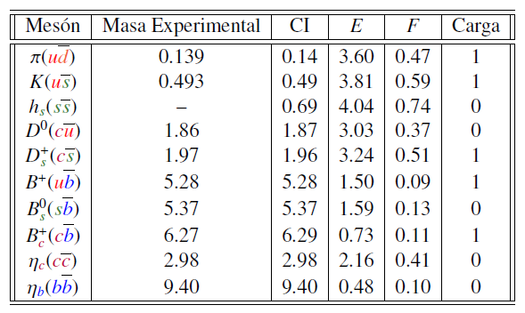
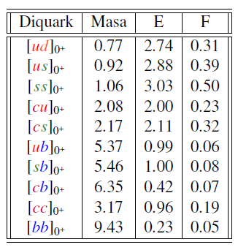
RESULTS
Using the advocated parameters we obtain:
Heavy mesons
Mesons
Expermental mass
Light mesons
Charge
Mass
Mass
Mass
Mass
Mass
Pseudoscalar
Scalar
Vector
Axial - Vector
L. X. Gutiérrez-Guerrero, Adnan Bashir, Marco A. Bedolla, E. Santopinto, Phys. Rev. D, 100, 114032 (2019).
Notes:
Canal av mas pesado y el pseudoescalar mas ligero.
Pion teorema de Goldstone que predice una partícula no masiva. Cuando se rompe una simetría continua.
Los resultados de los diquarks son novedosos, comparamos calculando los bariones

Slide 28
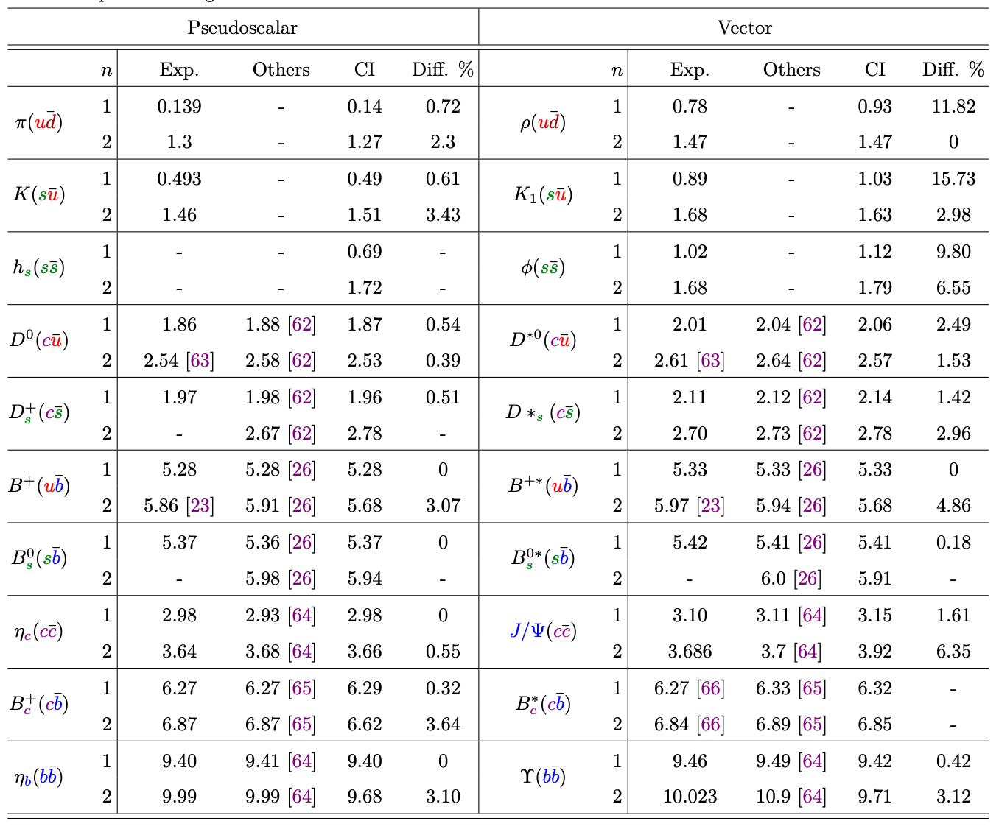
MESONES RESULTS 1ST EXCITATION
Using the proposed parameters we obtain the following preliminary results:
Notes:
Canal av mas pesado y el pseudoescalar mas ligero.
Pion teorema de Goldstone que predice una partícula no masiva. Cuando se rompe una simetría continua.
Los resultados de los diquarks son novedosos, comparamos calculando los bariones

Slide 29
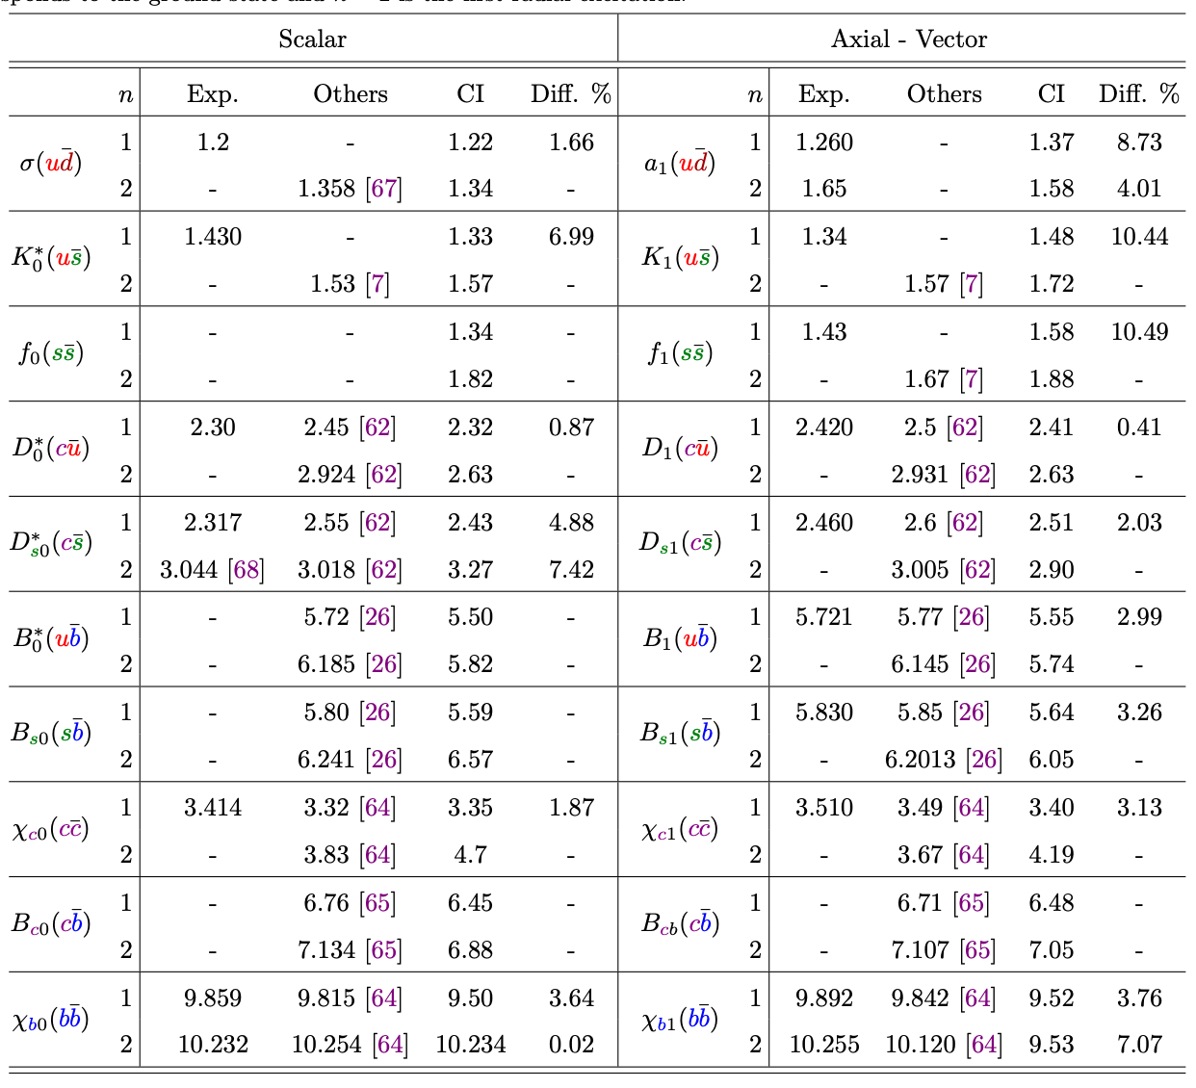
MESONES RESULTS 1ST EXCITATION
Notes:
Canal av mas pesado y el pseudoescalar mas ligero.
Pion teorema de Goldstone que predice una partícula no masiva. Cuando se rompe una simetría continua.
Los resultados de los diquarks son novedosos, comparamos calculando los bariones

Slide 30
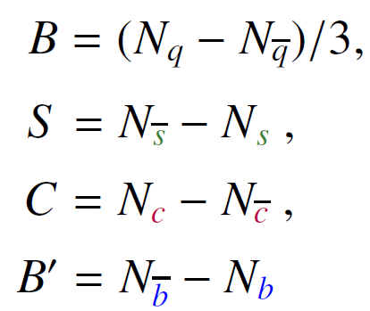
RELATIONS
The Gell-Mann-Okubo formula provides a sum rule for the masses of the hadrons in a specific multiplet :
Mass relation for pseudoscalar mesons is :
M. Gell-Mann, Phys. Rev. 125, 1067 (1962).
Mass relation for vector mesons is :
S. Okubo, Prog. Theor. Phys. 27, 949 (1962).
Notes:
Y, hipercarga
I isospín
Hay mas reglas por ejemplo relacionan el canal ps con el V.
Los cálculos de los diquark’s se revisan al calcular los bariones.
0
0.02

Slide 31
Baryons
The Faddeev equation has 64 Dirac structures: G. Eichmann, Phys. Rev. D84, 014014 (2011).
In the quark-diquark model that describes the baryons, there is a quark and a diquark that are constantly exchanged, so we have 8 Dirac structures. Such approach reproduces the nucleon mass with a 5% error :

Slide 32
Baryons
We consider a Faddeev amplitude 𝚿 that is composed of scalar and axial-vector diquark correlations :
$$P^{2}=−M_{B}^{2}$$

Slide 33
Baryons
The mass of the baryons is determined by a 𝟓×𝟓 matrix equation:
The Dirac matrices and in CI do not depend on the relative quark-diquark momentum:
s and a are scalars independent of relative momentum.

Slide 34
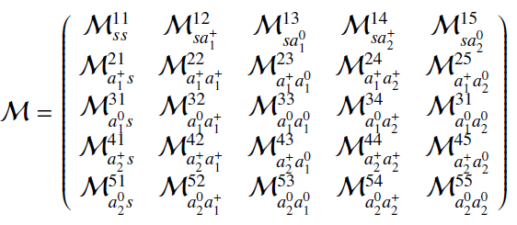
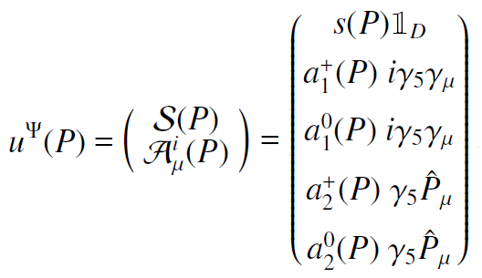
Baryons
The 5x5 matrix has the following form:
where each element is of the form:
Describes the breakdown of a diquark through the emission of a quark and the formation of another diquark.
Notes:
Ver t^f para describir se emite q1
U amplitud de Faddeev y Psi
M = kernel de interaciones

Slide 35
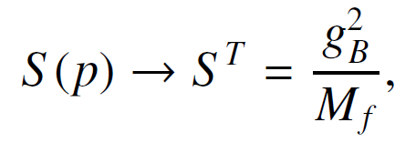
Baryons
Basis vectors in SU(5):
The flavor matrices are:
We use the static approximation for the exchanged quark propagator:
A. Buck, R. Alkofer and H. Reinhardt, Phys. Lett. B286, 29 (1992).

Slide 36
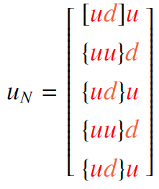
Baryons
Since the diquarks $0^{+}$ and $1^{+}$ have the same parity as the nucleons they are expected to be a dominant component in the nucleon:
So we can ignore the contributions of other diquarks.
Furthermore, the diquarks $0^{−}$ and $1^{−}$ are heavier and cannot be part of the ground state nucleon.
For the nucleon we have:

Slide 37
Nucleon
The eigenvalue equation for the nucleon is:
The first element is of the form:

Slide 38
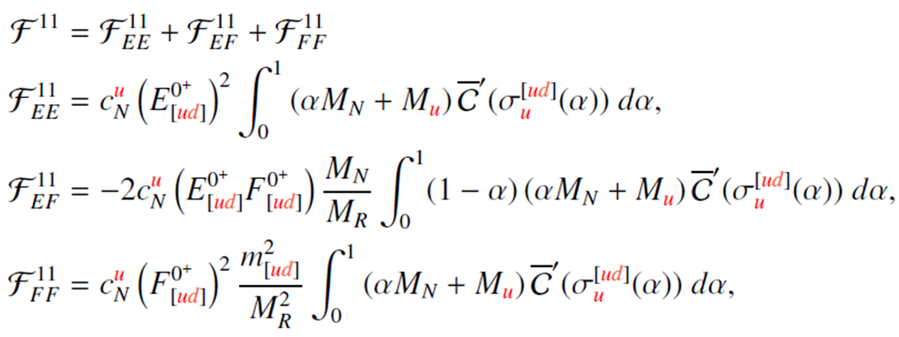
Nucleon
After using Feynman parametrization and regularization, we get:
Notes:
Se hizo un cambio de variable con F para incluir la integral y la traza

Slide 39
BARyoNS
The equation to be solved is:
We look for the solution with:
Notes:
Se hizo un cambio de variable con F para incluir la integral y la traza

Slide 40
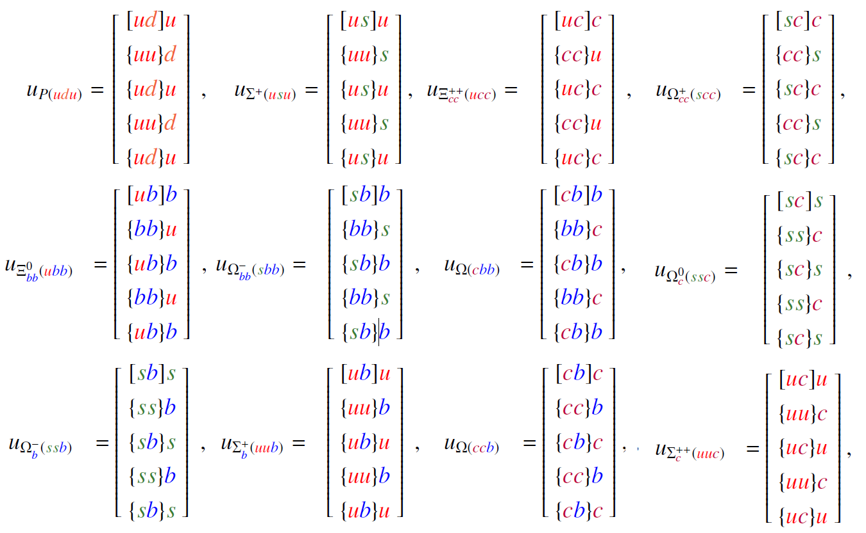
Baryons with spin 1/2
For different baryons with spin1/2 we have the vectors:

Slide 41
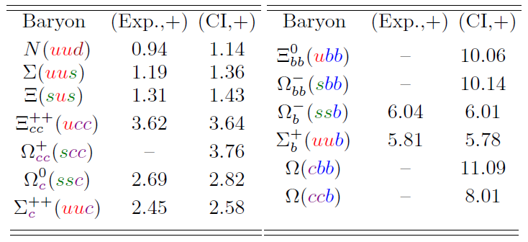
Baryons with spin 1/2
The results for the spin 1/2 baryons are:
L. X. Gutiérrez, Adnan Bashir, Marco A. Bedolla, E. Santopinto, Phys. Rev. D, 100, 114032 (2019).
The contribution of each diquark within the baryon is shown:

Slide 42
RESULTS FOR BARYONS
By inserting the zero by hand in the interaction kernel expressions in the Faddeev equation, we obtain:

Slide 43
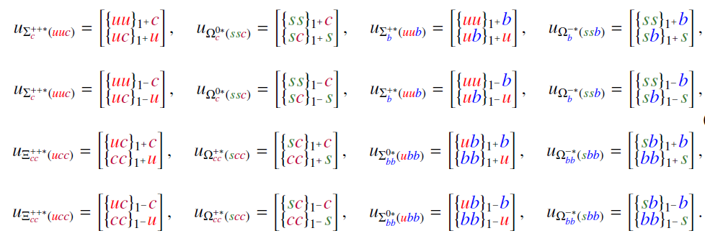
Baryons with SPIN 3/2
The color singlet bound states of negative and positive parity constructed from three quarks are:

Slide 44
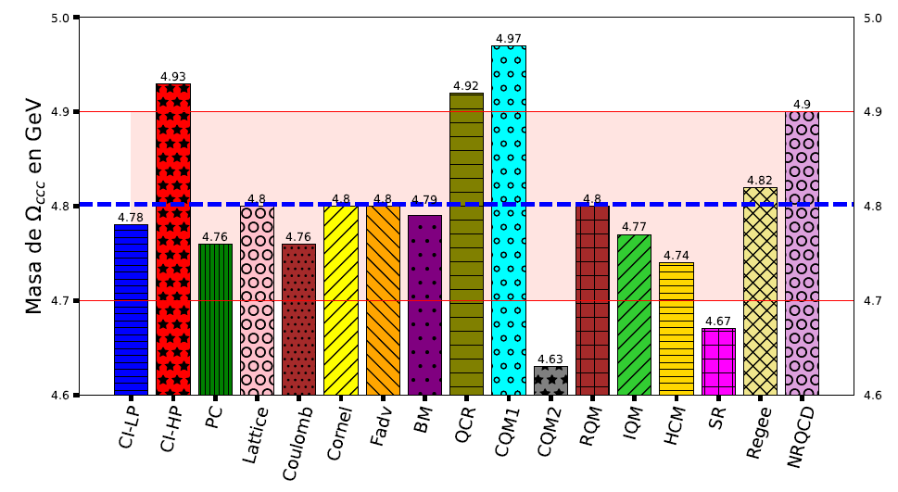
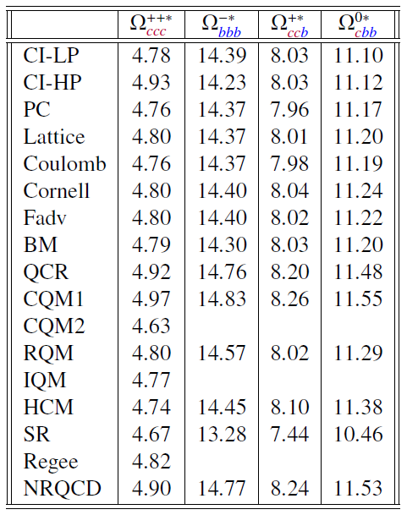
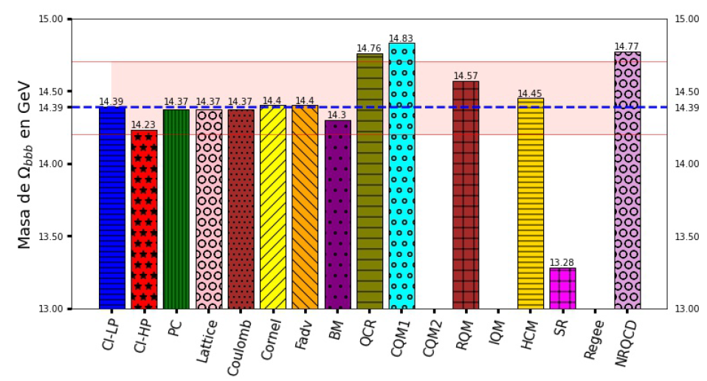
Baryons with SPIN 3/2
Comparison of heavy baryons masses with other approaches:
Mass
Mass
Notes:
Error del 2% en las graficas

Slide 45
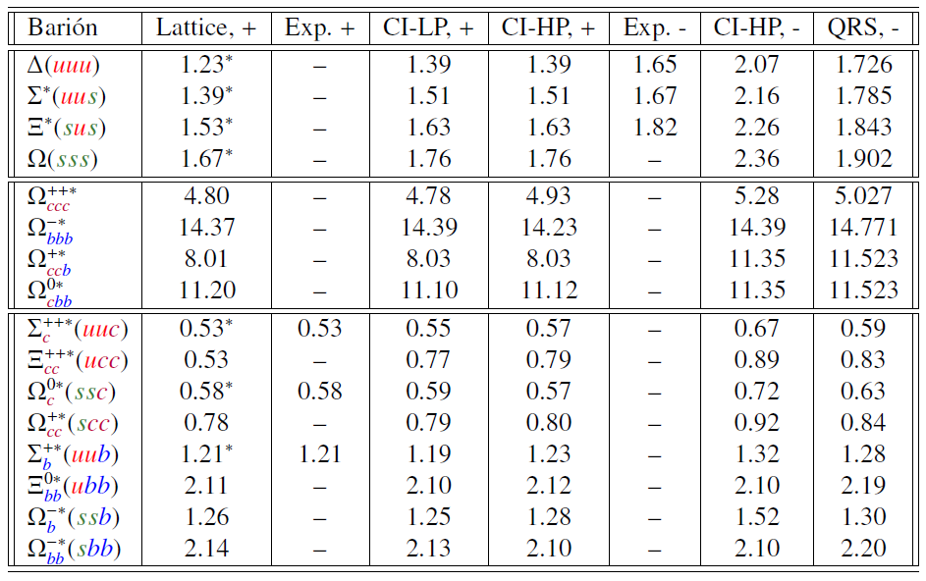
Baryons with SPIN 3/2
Masses of the baryons:
Notes:
Error del 2% en las graficas

Slide 46
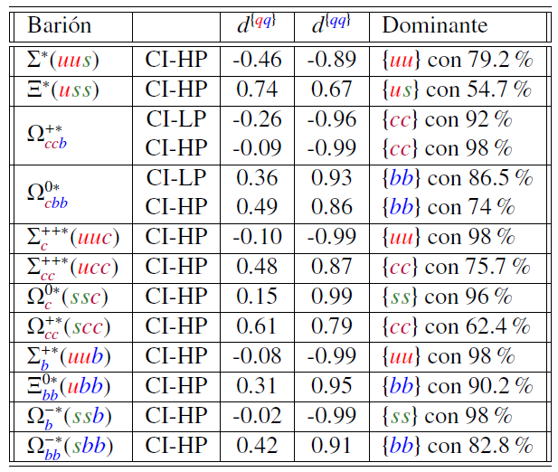
Baryons with SPIN 3/2
Contribution of the diquarks within the baryon:
Notes:
Error del 2% en las graficas

Slide 47
CONCLUSIONS
The CI model is easy to implement and teaches us a lot about hadrons.
The funtional form for df(MR) is interesting and we are trying to understand all its implications.
The results obtained are in agreement with other theoretical approaches as well as with the experimental results that already exist.
L. X. Gutiérrez-Guerrero, G. Paredes-Torres, and A. Bashir. Mesons and baryons: Parity partners. Phys. Rev. D, 104(9):094013, 2021.
Thank you

Slide 48
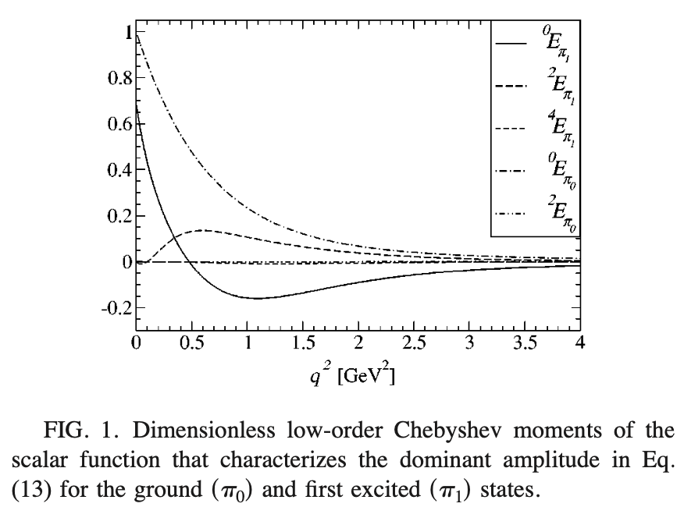
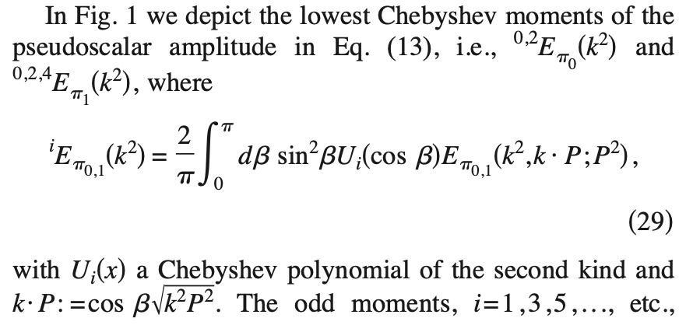
Pseudoscalar meson radial excitations. A. Holl, A. Krassnigg, C.D. Roberts (Jun, 2004) Published in: Phys.Rev.C 70 (2004) 042203

Slide 49
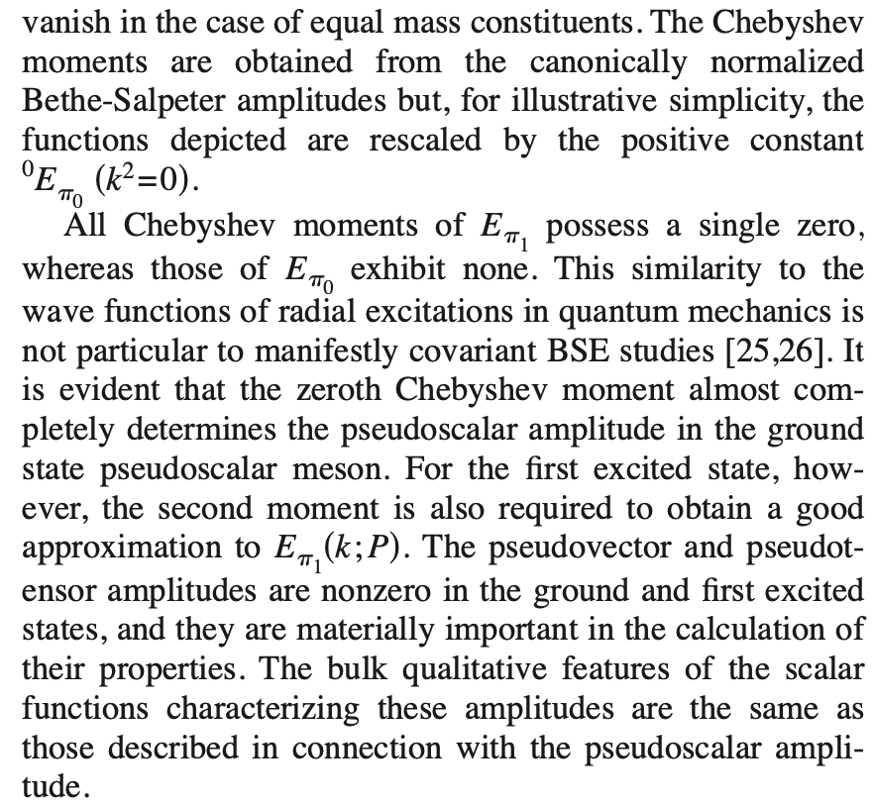

Slide 50
