Slide 1
New perspectives on tetraquarks
XXXVI Reunión Anual de la División de Partículas y Campos
Marco Antonio Bedolla Hernández
marco.bedolla@unach.mx
September 10, 2022

Slide 2
What is a tetrquark?
Is it forbidden by the theory?

Slide 3
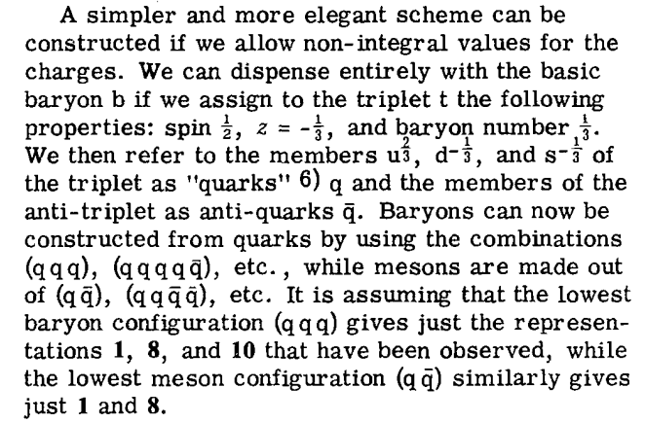
Quark Model
Providing spin and baryon number to quarks, it is possible to build mesons and baryons.
In 1964, M. Gell-Mann described the rules on how quarks could combine.
Murray Gell-Mann in 2007
Gell-Mann, M. (4 January 1964). "A Schematic Model of Baryons and Mesons". Physics Letters. 8 (3): 214–215.
There is not any mechanism that forbids the existence of hadrons with four or more quarks… just the experimental evidence…

Slide 4
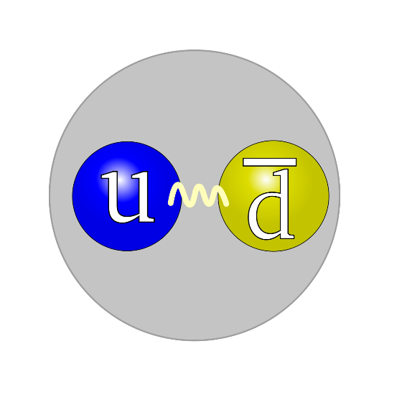
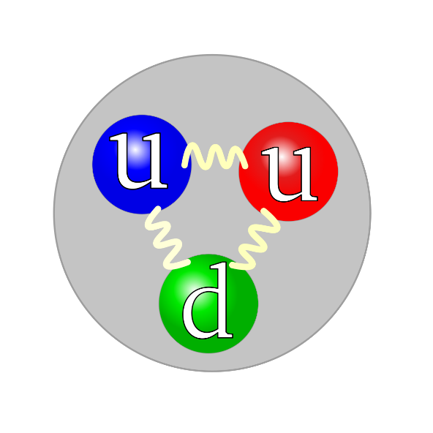
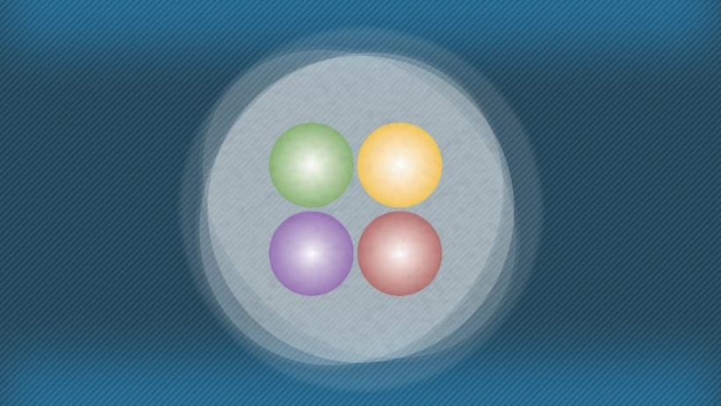
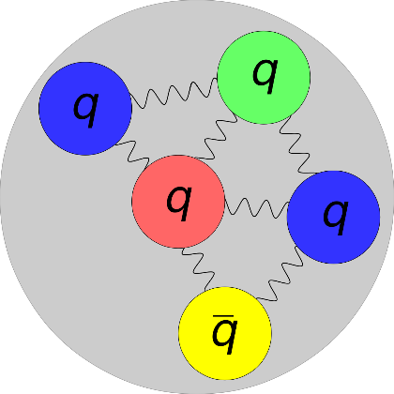
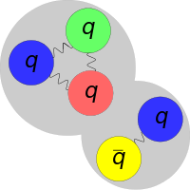
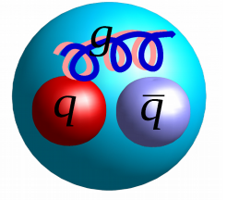
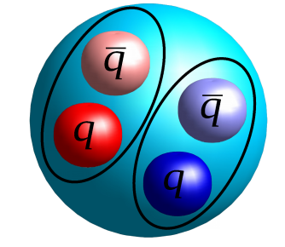
In hadron physics, we study strong interactions and their bound-states. Up to date we have
Mesons and barions
Pentaquarks
Tetraquarks
Hybrids & glueballs
Mesonic Molecule
Baryon-Meson Molecule

Slide 5
A really short history of tetraquarks
The first mention of a multiquark (tetraquark) state was in 1976.
R.L. Jaffe Phys. Rev. D15, 267 (1977);
R.L. Jaffe Phys. Rev. D15, 281 (1977);
Here, Jaffe used a modified version of the MIT Bag Model to study a meson-meson molecule bound-state
In 2004, Maiani et al. saw the possibility that scalar mesons might be tetraquarks candidates.
L. Maiani et. al. Phys. Rev. Lett. 93, 212002 (2004);
L. Maiani et. al. Phys. Rev. D71, 014028 (2005);
They use a diquark-antidiquark approach a study a possible quarks decay that could lead to a meson-meson molecular bound-state.
Have tetraquarks ever been detected?
Notes:
Lamentablemente, estos fenómenos no son obvios de lagrangiano de QCD. Sin estos QCD sería igual que QED, pero las interacciones entre tres y cuatro gluones estos fenómenos bastante interesantes

Slide 6
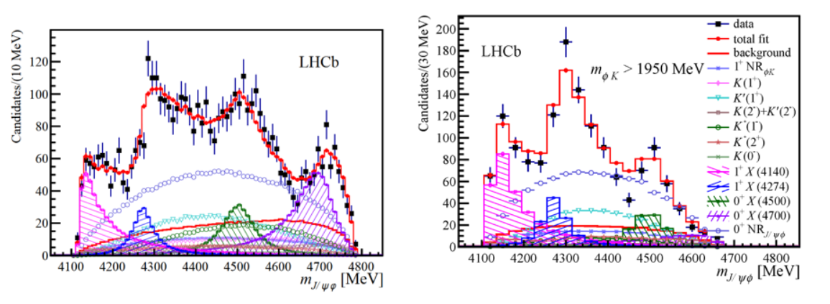
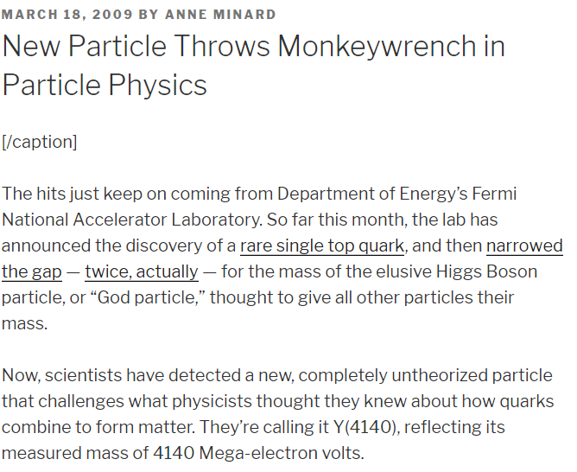
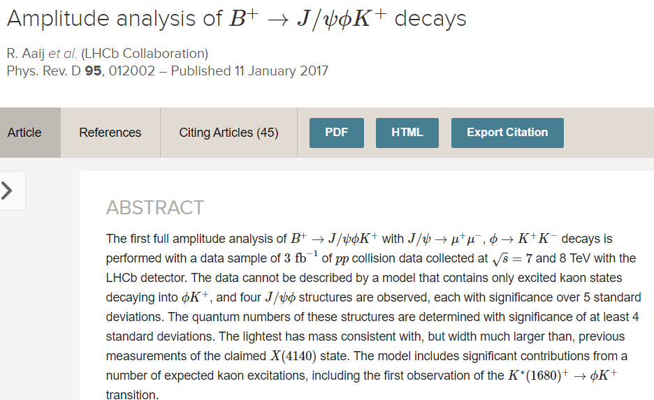
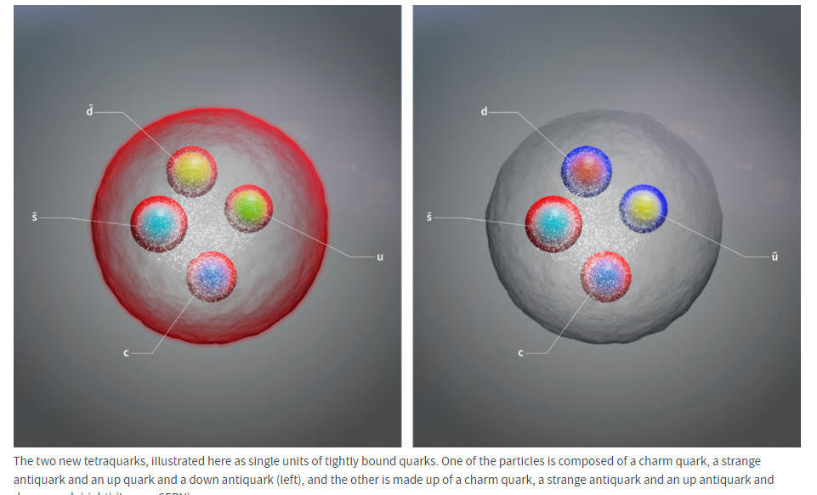
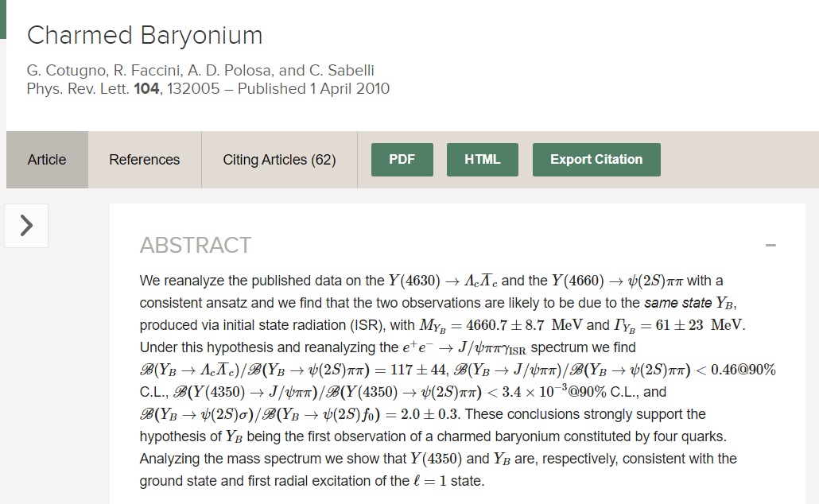

Slide 7
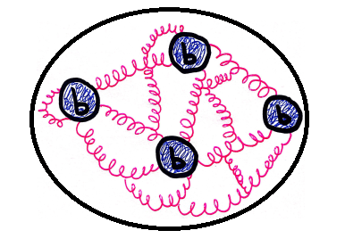
How we study tetraquarks?
Some studies treat tetraquarks via a quark-exchange model interaction.
However, this kind of interaction promotes the mesonic molecule bound-state interpretation.
We should not forget that a quark-quark(diquark) bound-state has color too…
And then we can bound a diquark and an antidiquark to form a tetraquark via gluon exchanges… in the same way we form mesons as a quark-antiquark pair.
Today, there are several theoretical studies to predict the main quantum numbers of tetraquarks, this helps to guide the energy region where they could be.
Notes:
El prmero se desarrolla para calcular la masa
En el segundo se calcula para el meson rho

Slide 8
Tetraquarks in the Diquark model
M.A. Bedolla, C.D. Roberts, E. Santopinto and J. Ferretti Eur.Phys.J.C 80 (2020) 11, 1004
M.A. Bedolla, Few-Body Syst (2019) 60: 24.
In this model, a tetraquark is seen as a point-diquarks bounded with a point-antiquark.
Because diquarks have color, they are confined particles.
Two diquarks can couple in a color-antisymmetric-triplet, or in a color-symmetric sextet
Color sextet lead to repulsive interactions. Thus, color-antitriplet diquarks are the only possibility to form bound-states
A diquark in its bound state is S-wave, so it spin is 0 or 1 .
To study scalar tetraquarks, Fermi-Dirac statistics only allows spin-1 diquarks couple to form flavor-singlet tetraquarks
Notes:
It a model which is independent of relative momentum
En el segundo se calcula para el meson rho

Slide 9
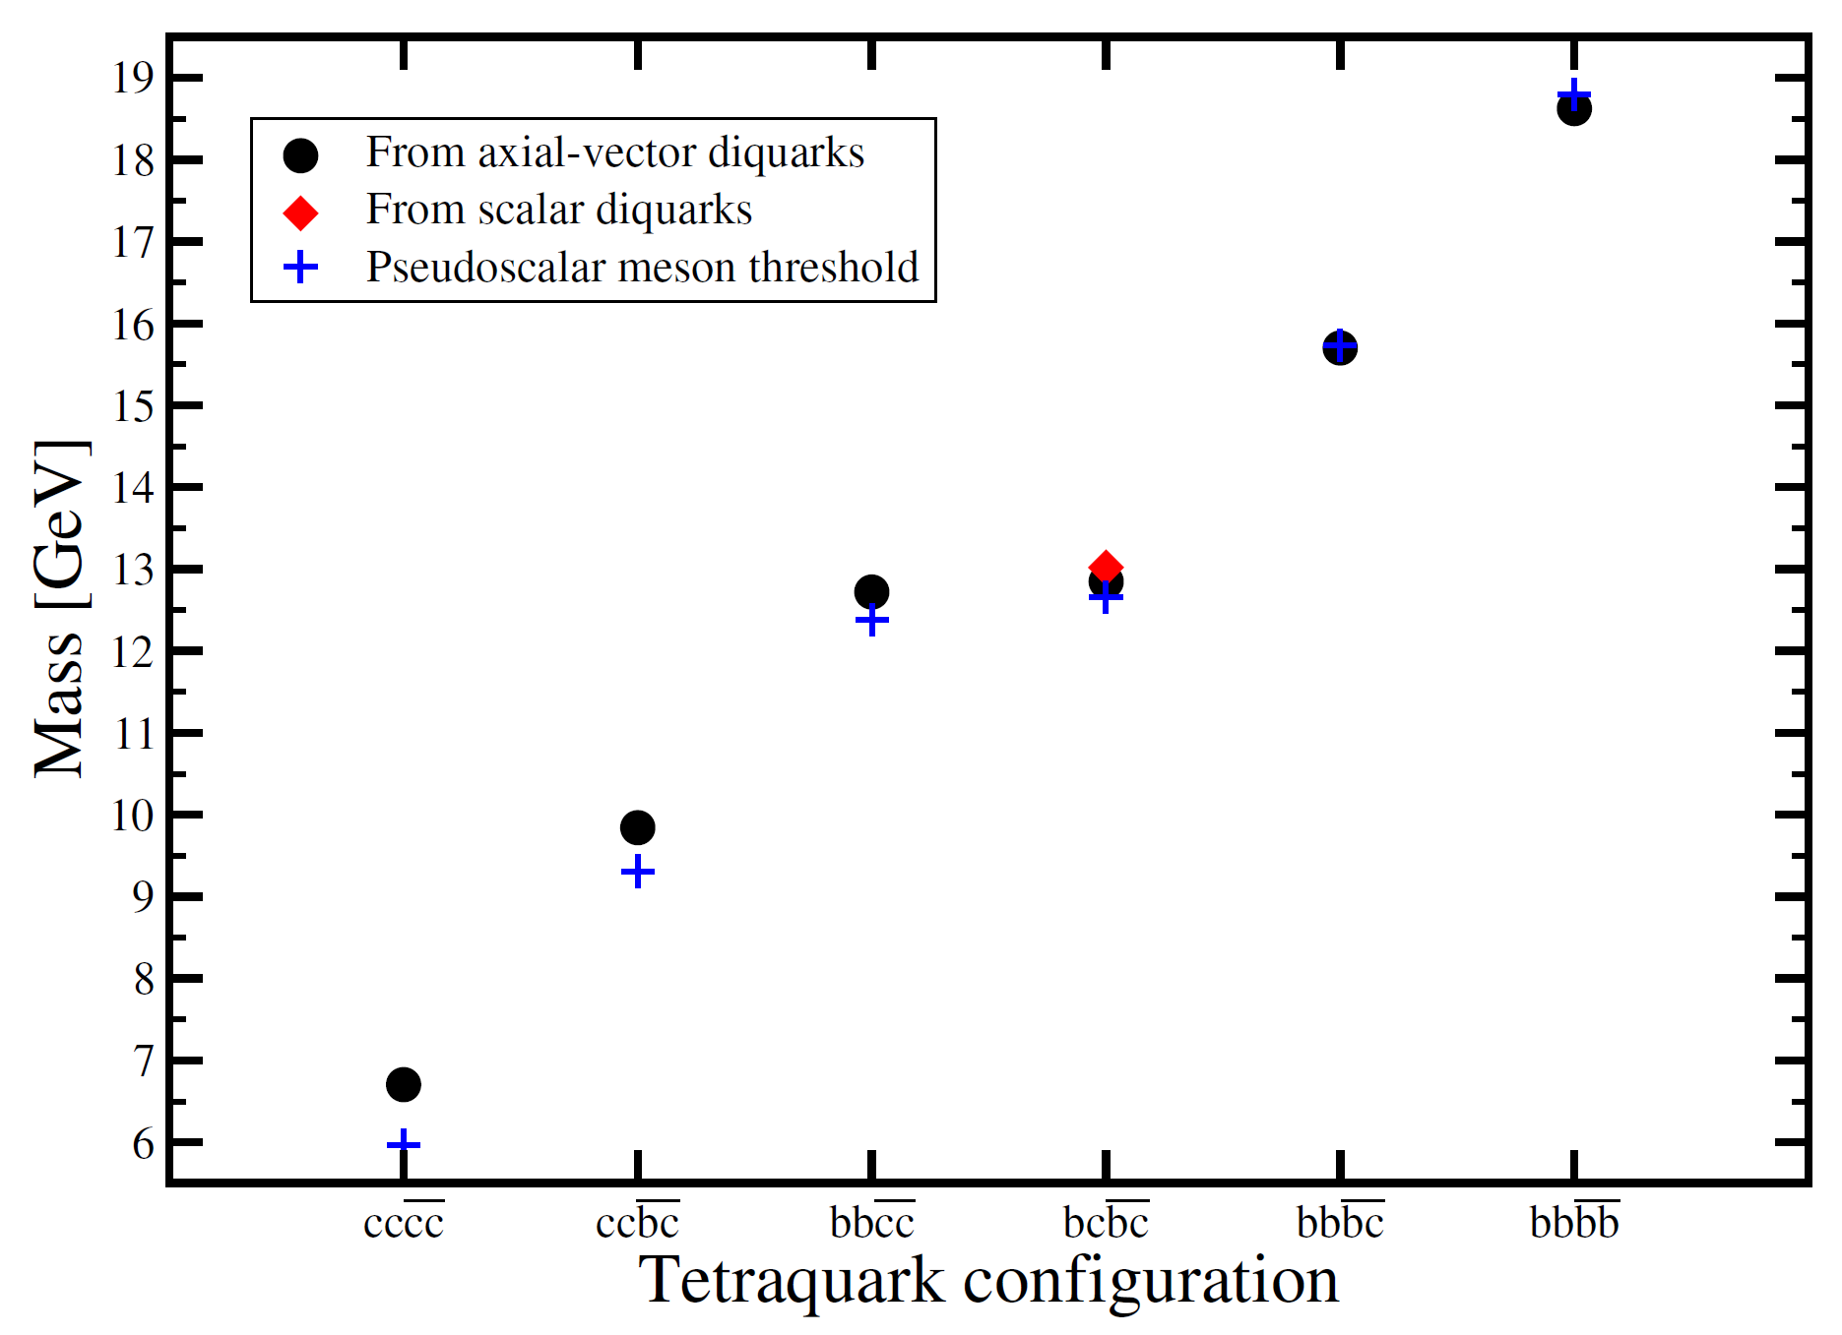
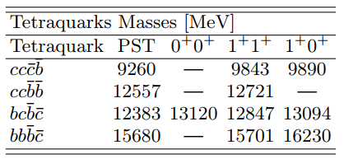
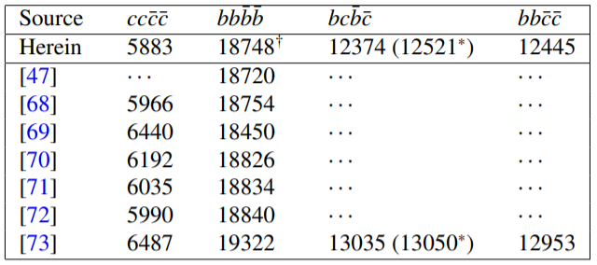
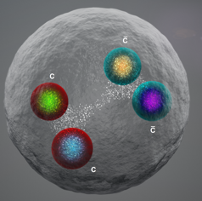
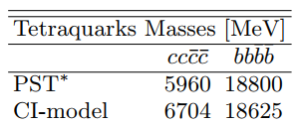
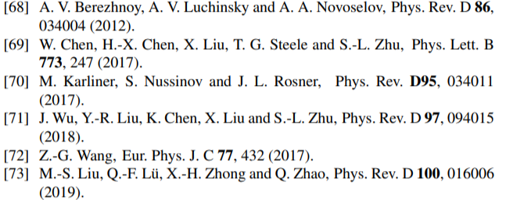
Tetraquarks in the Diquark model
M.A. Bedolla, C.D. Roberts, E. Santopinto and J. Ferretti Eur.Phys.J.C 80 (2020) 11, 1004
M.A. Bedolla, Few-Body Syst (2019) 60: 24.
Notes:
It a model which is independent of relative momentum
En el segundo se calcula para el meson rho

Slide 10
Final Remarks
Since 2004, there have been some tetraquarks candidates, most of them in the last three years.
We consider that more tetraquarks will be detected as the energy of accelerators increases.
In particular, the recent LHCb upgrade to 13.6 TeV (July this year) increases the possibility of creating and detecting new particles.
We study tetraquarks by considering a diquark-antidiquark picture via gluon exchange… in the same way mesons can be studied.
We expect our results to be close to the future detected heavy tetraquarks-particles
We are developing an scheme to study tetraquarks in the Bethe-Salpeter Schwinger-Dyson equation approach to study heavy-light tetraquarks (in collaboration with A. Bashir).

