Slide 1
Interplay between Temperature, Magnetic Field and the Dynamical Fermion Masses
Enif Guadalupe Gutiérrez Guerrero Collaborators: Bashir, Raya, Sánchez
Instituto de Física y Matemáticas
UMSNH
XII Mexican Workshop on Particles and Fields 2009
Mazatlán, Sinaloa

Slide 2
Contents
Introduction
Dynamical Mass Generation (DMG) for Fermions at Finite Temperature
DMG in Uniform Magnetic Field
DMG in Uniform Magnetic Field and at Finite Temperature.
Chiral Condensate

Slide 3
Introduction
Dynamical Mass Generation (DMG) for fermions is a non perturbative phenomenon which cannot be realized in perturbation theory. It takes place when the interactions are strong.
In the presence of a magnetic field, DMG takes place for couplings however small. This penomenon is called magnetic catalysis.
The presence of temperature tries to restore chiral symmetry.
We study the momentum dependent mass function in the presence of one or both ingredients and extract the fermion mass and chiral condensate. We also compare our results with earlier findings.

Slide 4
DMG at Finite Temperature
A. Ayala and A. Bashir, Phys. Rev. D67 076005 (2003).
Working with bare vertex and explicity in the imaginary-time formulation
of thermal field theory

Slide 5
DMG at Finite Temperature
After angular integration and keeping the lowest Matsubara frequency,
where
D.J- Gross, R.D. Pisarski and L-G- Yaffe, Rev. Mod. Phys. 53 43 (1981).
Analytic treatment implies that T_{c} =0.050533, in the Feynman Gauge.

Slide 6
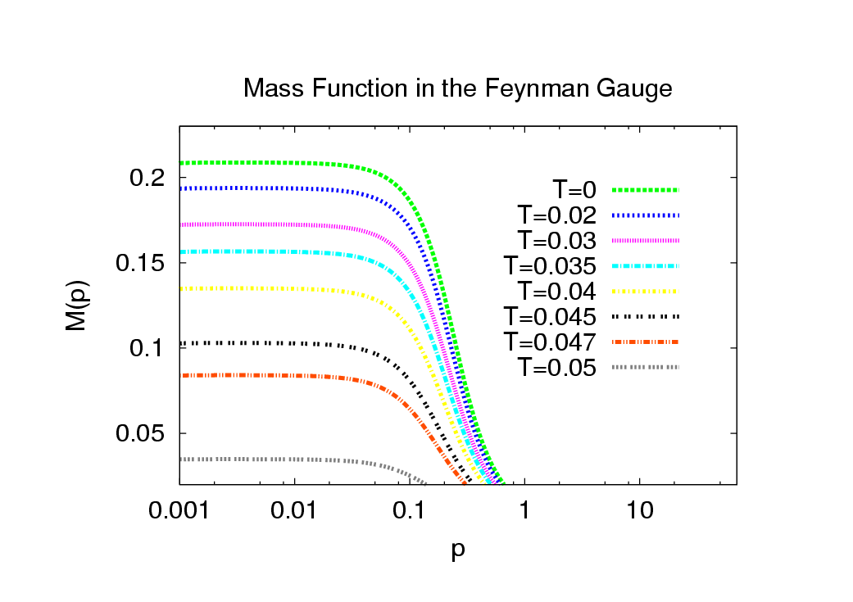
DMG at Finite Temperature
A. Ayala y A. Bashir, Phys. Rev. D67 076005 (2003).

Slide 7
DMG in Magnetic Fields
D.-S. Lee, C.N. Leung, Y.J. Ng, Phys. Rev. D55 6504 (1997).
Invoking the Ritus method and working with bare vertex in the Feynman gauge
where
For the lowest Landau level and in the constant mass approximation
constants are of order 1.

Slide 8
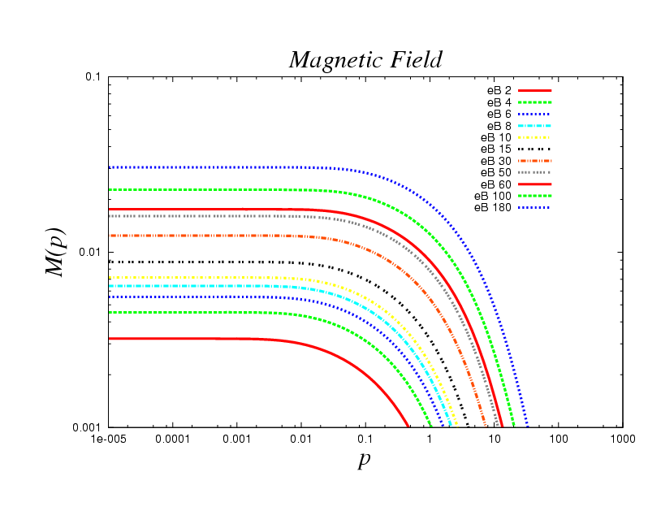
DMG in Magnetic Fields
Beyond constant mass approximation.
Magnetic Field favors the DMG.

Slide 9
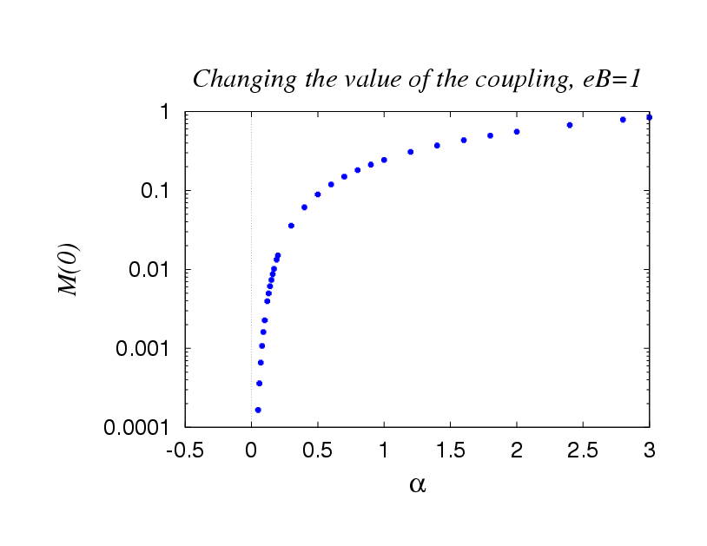
DMG in Magnetic Fields
Beyond constant mass approximation.
There is no criticality in coupling.

Slide 10
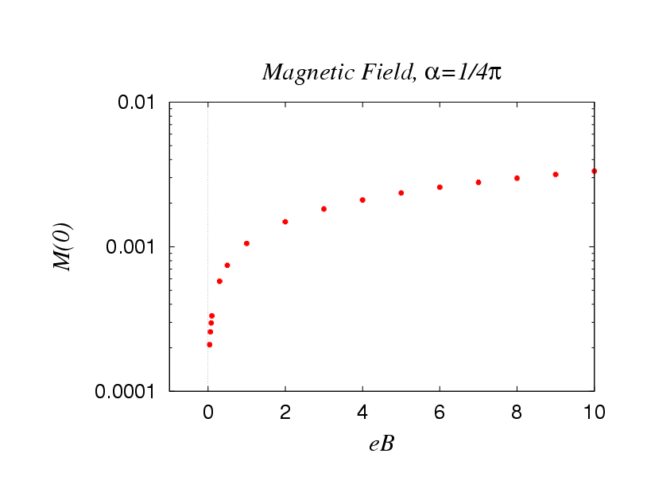
DMG in Magnetic Fields
Beyond constant mass approximation.
There is no criticality in eB.

Slide 11
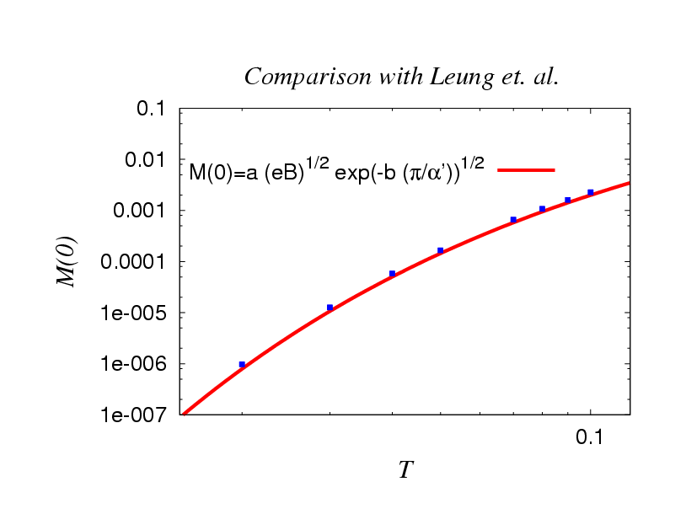
DMG in Magnetic Fields
a=1.28521, b=1.13083
Comparing results with those of Leung et. al.

Slide 12
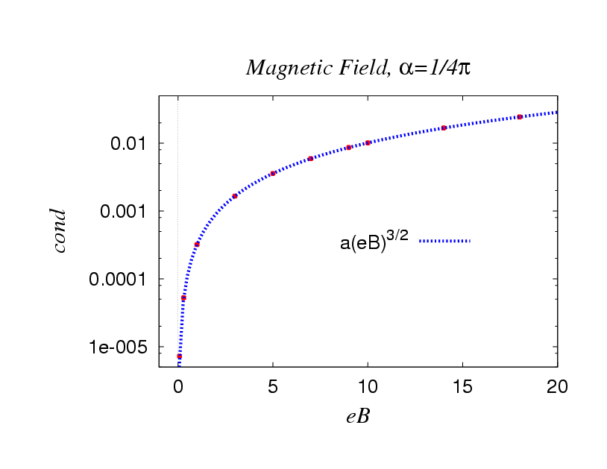
DMG in Magnetic Fields
I. A. Shushpanov, A. V. Smilga, Phys. Lett. B402 351 (1997).
D.-S. Lee, C.N. Leung , Y.J. Ng, Phys. Rev. D55 6504 (1997).
when
The condensate and the OPE.

Slide 13
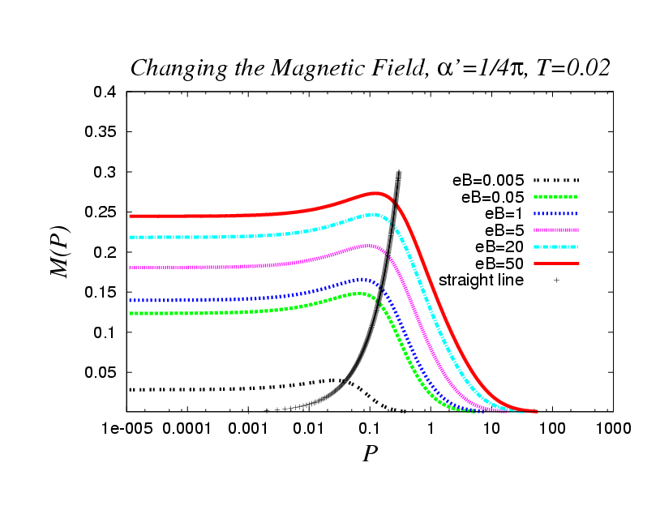
DMG at Finite T and Uniform B
We work with the lowest Matsubara frequency and the lowest Landau level

Slide 14
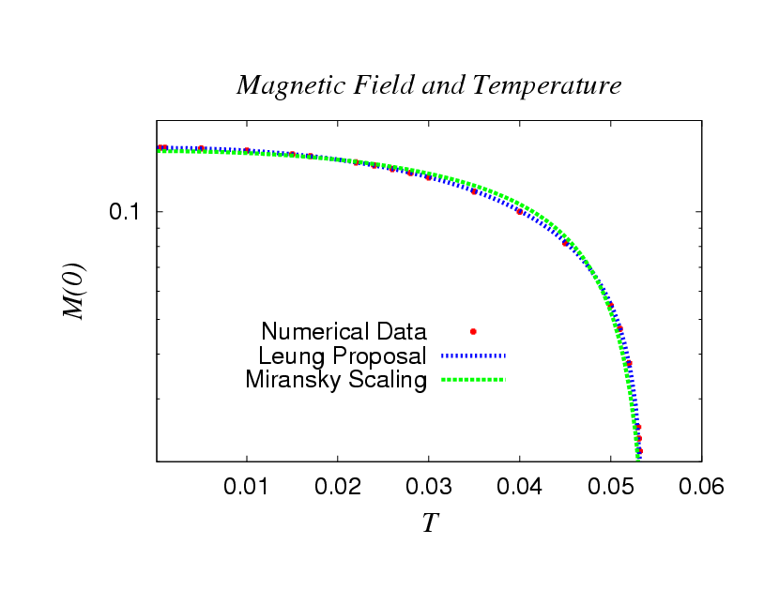
DMG at Finite T and Uniform B
Miransky like scaling
a = 0.7982, b = 0.1139
a=- 0.7564, b= 1.3228, c= 1.0544,

Slide 15
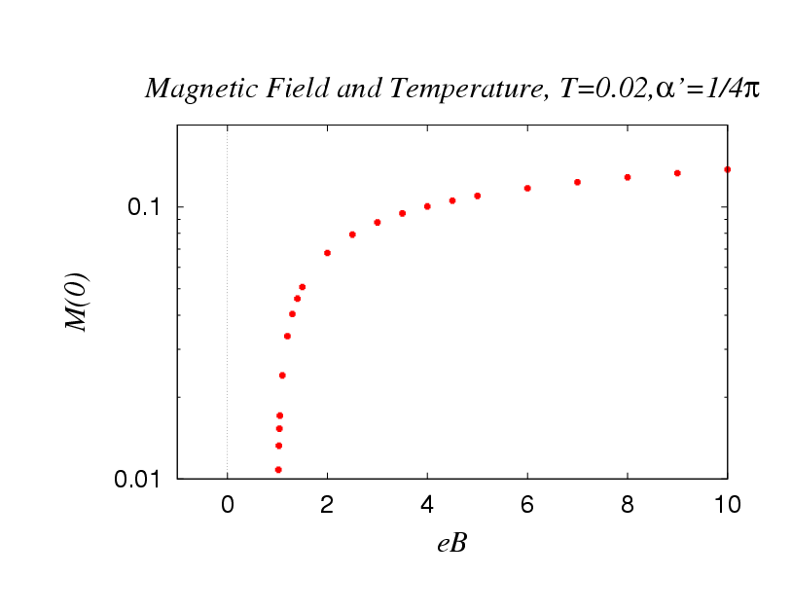
DMG at Finite T and Uniform B
There is criticality for the magnetic field

Slide 16
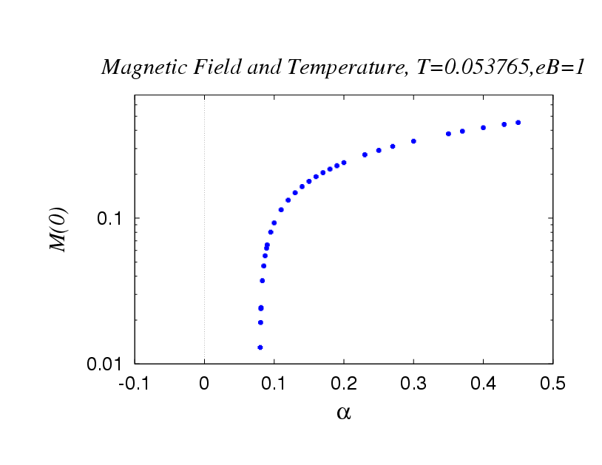
DMG at Finite T and Uniform B
There is also criticality for the coupling.

Slide 17
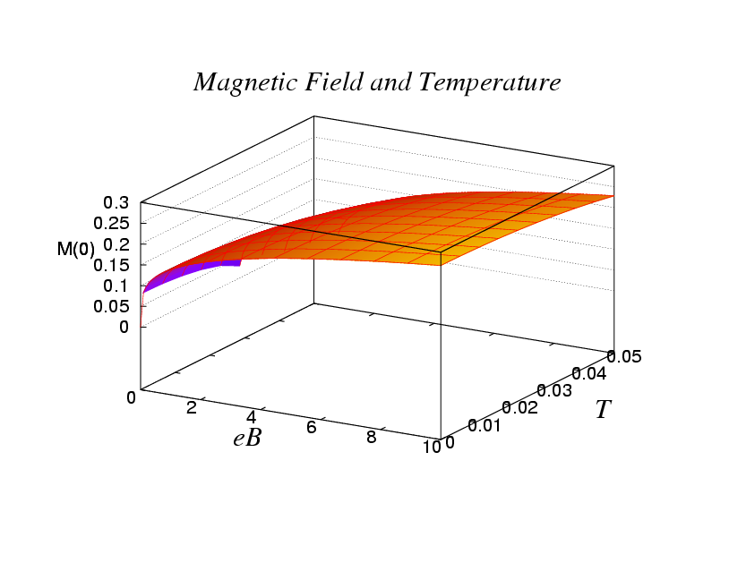
DMG at Finite T and Uniform B
eB favors the DMG but temperature doesn’t

Slide 18
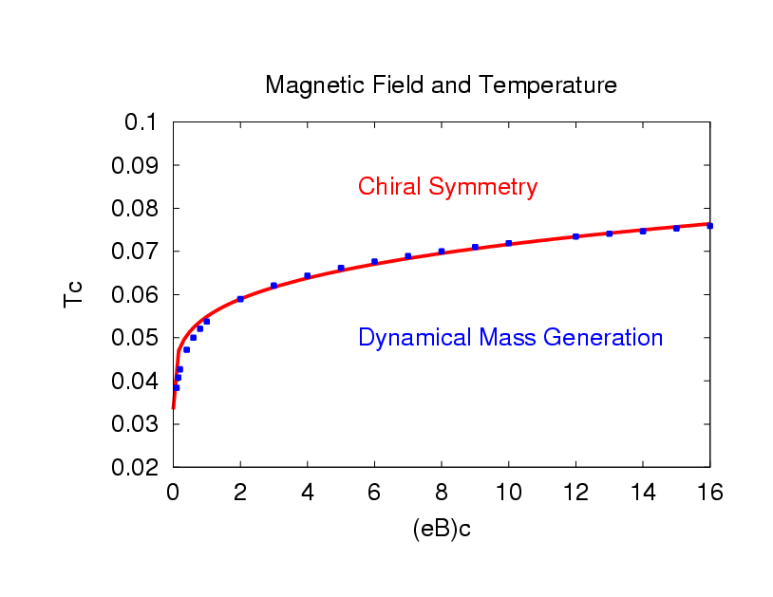
DMG at Finite T and Uniform B
a= .0505,
c= 0.0066
Criticality curve

Slide 19
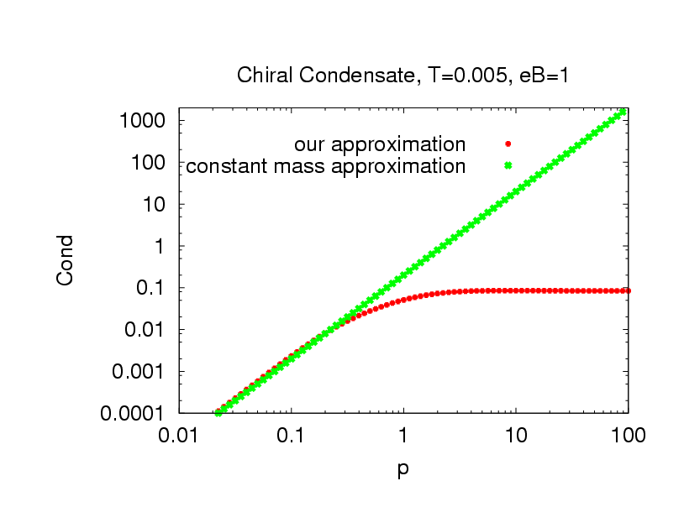
Chiral Condensate
H.D. Politzer, Nucl. Phys. B117 397 (1976)
when
Contrasting both approximations

Slide 20
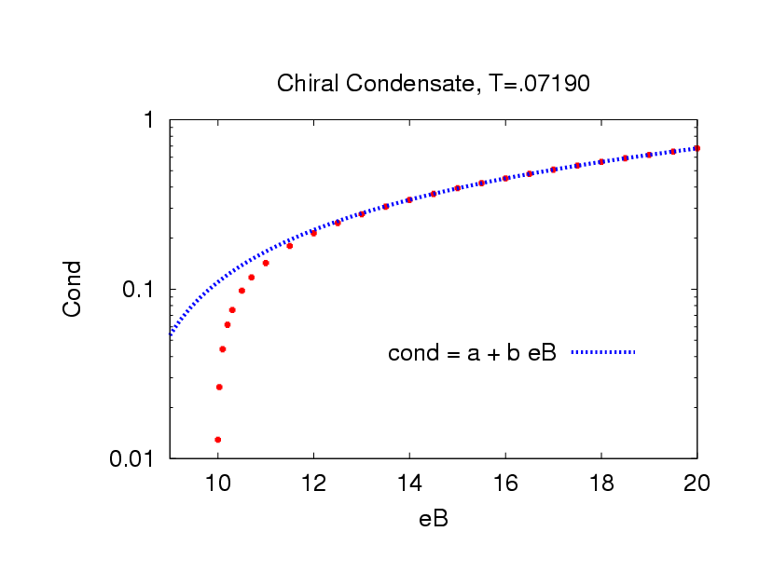
Chiral Condensate
a= -0.4566,
b= 0.0566
There is criticality for the magnetic field

Slide 21
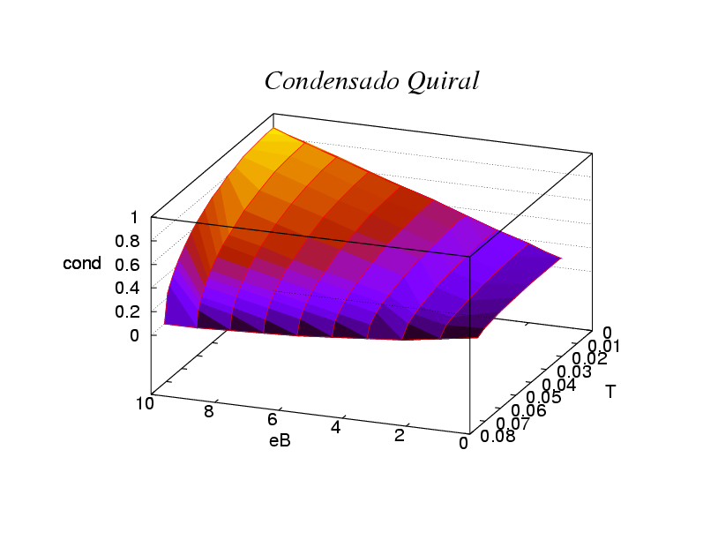
Chiral Condensate
eB favors the condensate but temperature doesn’t.

Slide 22
Conclusions
DMG (T, B=0):
We review the study of DMG in QED numerically. We obtain critical value for the temperature and coupling above this values fermions can acquire dynamical mass. We check the analytical predictions, and confirm that the mass function falls as 1/p² as p -> ∞. Moreover, we obtain new results for Feynman gauge.
DMG (T=0,B)
We review DMG and confirm there is no critical coupling or magnetic field intensity. We go beyond constant mass approximation. We also realize that the mass function falls as 1/p² as p -> ∞. We check our results with the analytical expresions.

Slide 23
Conclusions
DMG (T,B)
We study DMG without constant mass approximation and compare with earlier results. We work in the lowest Landau level and Matsubara frequency. We confirm the existence of critical values for coupling, temperature and magnetic field. The mass function falls as 1/p² for p -> ∞.
CHIRAL CONDENSATE
The asympotic behavior of the mass function guarantees that the condensate is independent of the momentum p when calculated through OPE. We find that the chiral condensate increases with the coupling and the magnetic field. However, the temperature tends to destroy it.

Slide 24
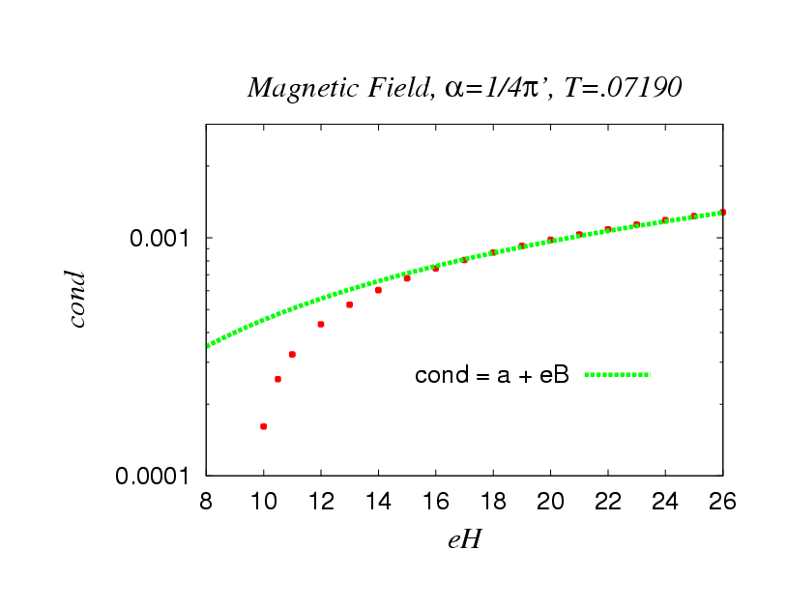
Chiral condensate
Using the trace of the propagator, we obtain the same behavior for the condensate

Slide 25
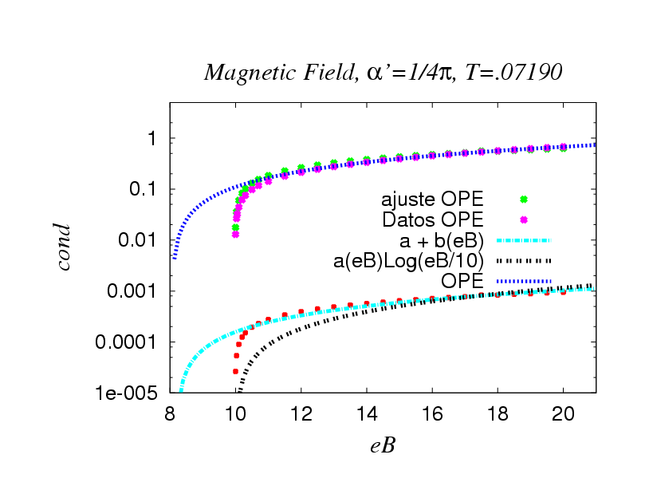
OPE

Slide 26
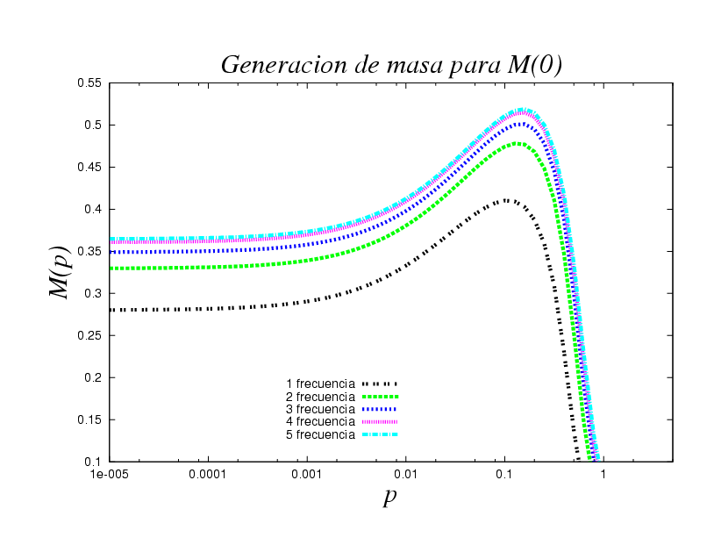
Matsubara Frecuencies

