Slide 1



Internal structure of pseudoscalar mesons: An algebraic model and its implications
Isela Melany Higuera Angulo
Adnan Bashir
IFM - UMSNH
May 12, 2021
Notes:
Good morning, My name is Isela Melany Higuera Angulo, I’m a PhD student at the Instituto de física y matemáticas of the UMSNH under the advice of the Dr Adnan Bashir.
Well, we are interested in studing the internal strucutre of hadrons, here in partícular pseudoscalar mesons (wich are particles of zero spin and negative parity) this through an algebraic model that leads to some non-perturbative objects (the distribution function) that give us information about this internal structure.
To start I will briefly mention the content.
en el estudio de la estructura interna de hadrones, y en este momento me estoy enfocando primeramente en los mesones pseudoescalares (las cuales son partículas de espín 0 y paridad negativa) ya que son estos las partículas más amigables con las que uno puede comenzar a trabajar por ejemplo el pión de donde partímos y posteriormente nos enfocamos en los mesones eta_c, eta_b y posteriormente en mesones con quarks de valencia de diferente sabor tales como el kaón, eta eta prima.

Slide 2
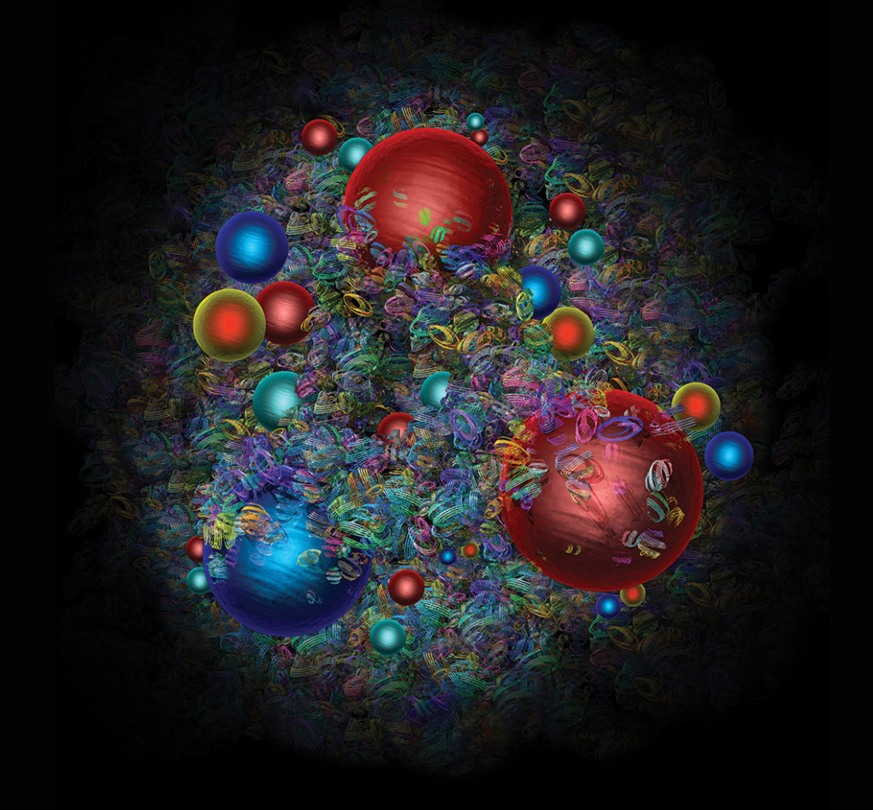
Content:
Introduction to the distribution functions: GPDs, PDFs and FFs.
Shwinger-Dyson equations.
Algebraic model and its implications.
Distribution functions results.
Transition form factors.
Conclusions.
Notes:
Fist of all I’m going to give an introduction to the distribution functions.
Then I will mentioned the equations that inspire the algebraic model
After that I will explain what the AM consists of
Next to this, I will show some distribution functions results.
Also, I will briefly talk about another functions that are the TFF with wich we can compare with some experimental results
And finally, the conclusions.

Slide 3
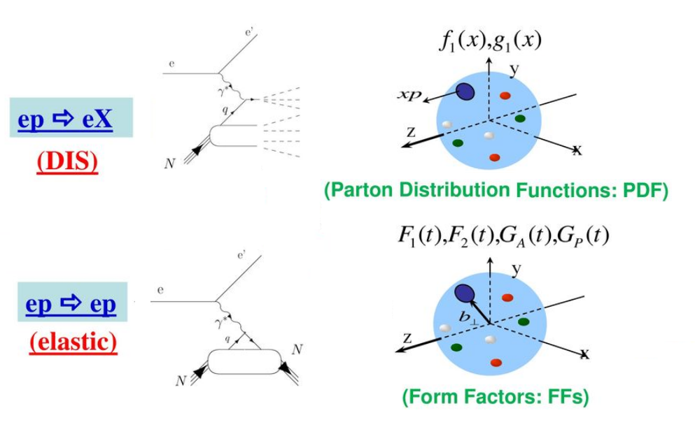
Introduction: PDFs y FFs
3
Notes:
In order to understand the internal structure of an hadron, we can extract the distribution functions from diferent scattering process, for example in a deep inelastic scattering where an electron interacts throgh a photon with an hadron and this one breaks in many other things we can extract the parton distribution functions wich tell us the probability of finding a parton within the hadron with a certain momentum fraction x of the total momentum of the hadron.
And in other proccess like the elastic scattering where the photon emited by the electron colides with the hadron but this one doesn’t broke we extract the form factor wich give us information about the charge distribution of the hadron, the charge radius, etc. But also…
Entonces hasta ahora hemos visto como podemos encontrar los factores de forma en una dispersión elástica y los PDFs para una dispersión inelástica…
Pero además, existen otros procesos conocidos como…

Slide 4
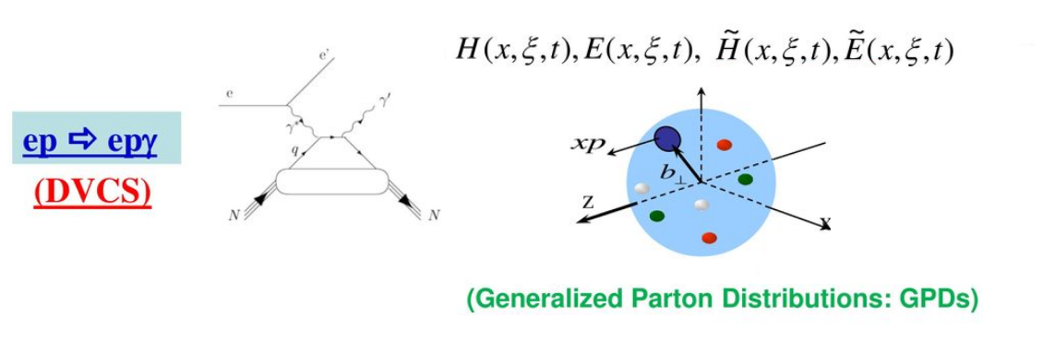






Introduction: GPDs
$$x+ξ$$
$$x−ξ$$
$$t$$
where
$$x+ξ$$
Is the relative longitudinal moment of the initial quark.
$$x−ξ$$
Is the relative longitudinal moment of the final quark.
$$t=Δ^{2}$$
Total square moment transferred to the hadron.
4
Notes:
Whe can extract another functions named generalized parton distribution functions or GPDs from the deep virtual comptom scattering, where the photon transfer moment to the hadron and in the process a virtual photon results at the end. This functions depend on the momentum x, xi wich tell us how collinear the photon collides with the quarks and the energy t.
Jefferson Lab Hall A [6$→$12 GeV]
Jefferson Lab CLAS experiment [6 GeV]
DESY, HERMES Collaboration [28 GeV]
CERN, COMPAS Collaboration [200 GeV]

Slide 5
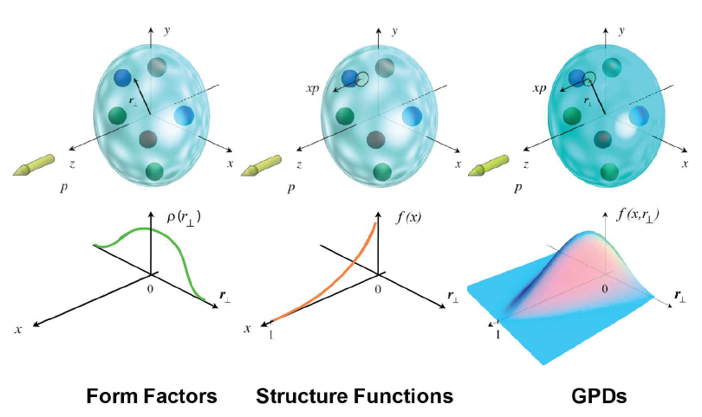
Introduction: FFs, PDFs, GPDs
Charge density
Form Factors
Estructure functions
Parton distribution functions
Generalized parton distribution functions
5
Notes:
So, a way to extract analyticaly this functions we can focus in the obtaining of the LFWF because with the light-cone formalism we can obtain this distribution functions. Then, our idea to do this is the following
Aquí observamos la densidad de carga la cuál es la transformada de Fourier de los FF, luego se tienen las funciones de estructura que tiene una relación directa con las PDFs y por último tenemos las GPDs que es una generalización de las antes mencionadas. Es decir, que los factores de forma y las PDFs son proyecciones de las GPDs.
Por otra parte, todas estas funciones de probabilidad se observan en el régimen no perturbativo (donde la cte de acoplamiento de QCD es lo suficientemente grande que no es posible utilizar teoría de perturbaciones).

Slide 6
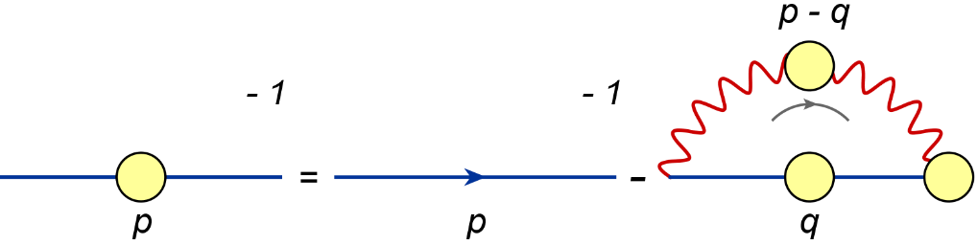
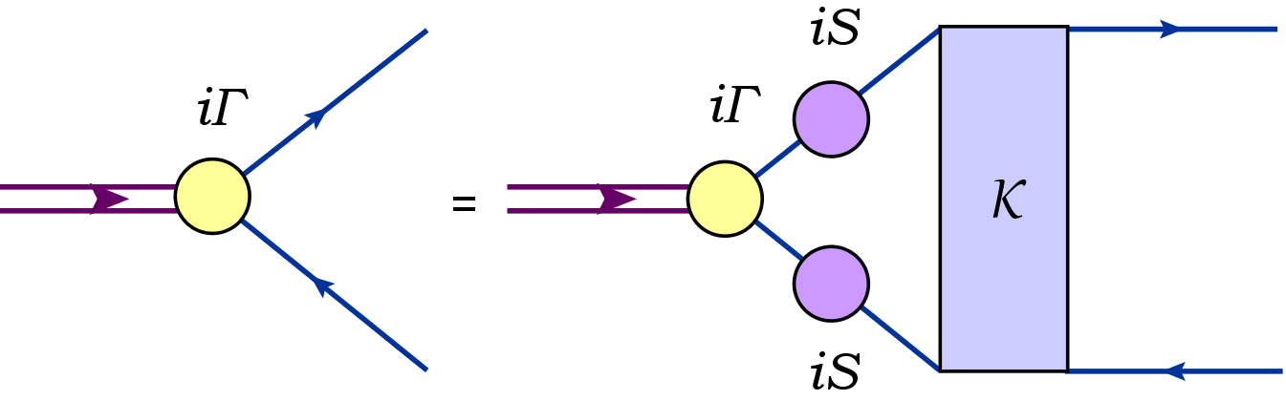
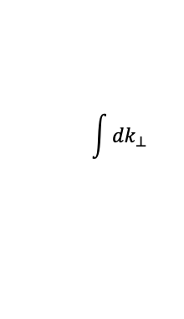

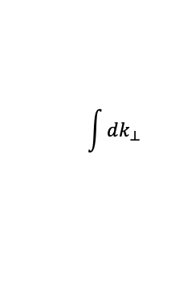
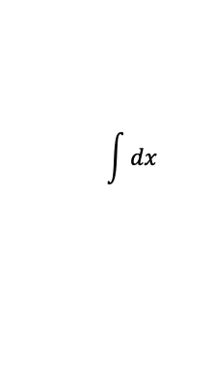
Bethe-Salpeter Wave Function (BSWF)
The SDE for the quark propagator is:
Projecting on the light front
LFWF
PDA
The meson Bethe-Salpeter equation (BSE) is:
$$\int{{dk}_{⊥}}$$
$$\int{{dk}_{⊥}}$$
GPD
The Bethe-Salpeter wave function (BSWF) is defined as:
$$\int{dx}$$
$$t=0, ξ=0$$
FFs
PDF
Alternative: Algebraic Model
6
Notes:
In other words from the LFWF we can use the overlap representation to get the GPDs, from the GPDs we can get the FFs and the PDFs doing an integration or aplying some limites, also we can extract the PDA with another simple integration (this PDA give us the probability of a quark-antiquark pair form a bound state). This LFWF can be obtain throgh the projection on the light-front the BSWF with two imputs: the quark SDE and the BSE.
So, the quark SDE is this, and the BSE is this.
The fully dressed quark propagator depends on itself, the quark-gluon vertex and the gluon propagator and the BSE depends on the BSA, the dressed quark progator and a kernel of quark and the antiquark interaction.
And Finally the BSWF that we need is defined as the sandwich of the quark and antiquark propagators and the BSA.
This two are an infinit tower of coupled integral equations, we can ampute them but we use an alternative that help us to calculate all this functions analytically.
This algebraic model is based on this SDEs because it takes the most general forms with some changes.
One of this changes is that at the low energy limit where we base our non-perturbative studies that mass can be taken as constant because we can see the quark as a constituent quark, it means that the valence quarks are fully dressed by the see quarks.

Slide 7
Algebraic Model
Notes:
According to this, we can present the algebraic model

Slide 8
Algebraic Model
The quark propagator and the BSA can be written as follows:
and
where, , , $k_{ω}=k+\frac{ω}{2}P$ and $P^{2}=−m_{M}^{2}$.
$ρ(ω)$ is the spectral density. Its shape determines the specific behavior of the associated BSA.
For our algebraic model:
The BSWF is rewritten as:
where
and
8
Notes:
This algebraic model proposed the following form to the quark propagator and the BSA. Here M is the quark or antiquark mass and as we said before is a constant. In the BSA we have Rho wich is the spectral density whos shape determines the specific behavior of the associated BSA. And for this model, we porposed this lambda that depends on the integration variable w of the BSA in this form. (Also, we can see, we use the dominant amplitude of the BSA general form).
Now, using this anzats and remenberging the form of the BSWF we can write it as is shown here, where this curly M has the matricial structure and D is the product of 3 terms with powers in the denominator
Then after some calculations, introducing Feynman parametrization and changing the order of integration the BSWF can be rewritten as here, where all the dependence of the momentum relative to the quark is in the denominator in this sigma term.
So now we proyect this BSWF on the light-front to obtain the LFWF.

Slide 9
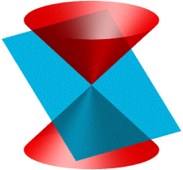
Algebraic Model: LFWF and PDA
The LFWF for pseudoscalar mesons can be obtained in the light cone formalism by projecting the meson BSE:
where
.
Then, from the Mellin moments of the LFWF
.
we obtain:
On the other hand, in the light-cone formalism the PDA can be expressed as:
9
Notes:
So, as we mentioned before, for a pseudoscalar meson the LFWF can be obatained by projecting on the light front the BSWF that we already have. Also, from the Mellin moments the LFWF can be rewritten as here.
On the other hands, in the light cone formalism the PDA is a projection of the LFWF as is shown here.
De acuerdo a todas estas funciones y formalismos vemos que podemos tener una relación entre ellas
Además, en el formalismo del frente de luz $n^{2}=0$y $n∙P=−m_{M}$.
Para un cuadrivector $k$ se tiene: $k=k_{∥}+k_{⊥}$, n$∙k=n∙k_{∥ }$y n$∙k_{⊥}=0$

Slide 10
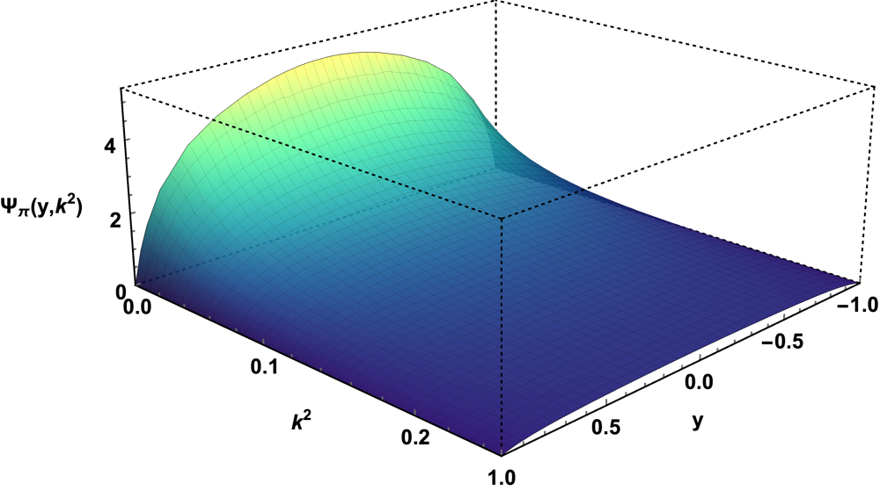
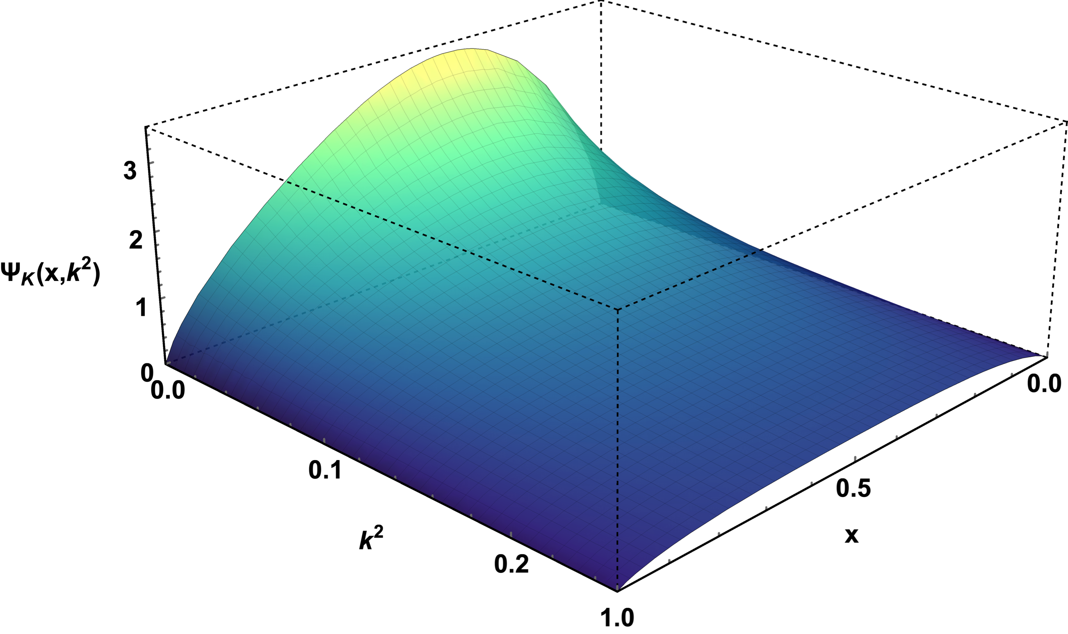
Algebraic Model: LFWF and PDA
Z.-F. Cuia, M. Dingb, F. Gaoc, K. Raya, Eur. Phys. J. C Preprint No. NJU-INP 020/20
In the light-cone formalism the PDA can be expressed as:
I$ntegrating over k_{⊥}$ we obtain a new relationship between the LFWF and the PDA:
Pion
Kaon
From
[Verde]: Pion.
[Azul]: Kaon.
[Rojo]: Kaón from C. Shi et al., Phys. Lett. B 738, 512 (2014).
10
Notes:
So, using the previous form to the LFWF, integrating over k perpendicular,and comparing the equations we can find a direct relationship between the PDA and the LFWF.
This equation is important because we can take one of the several PDA parametrization of a psedoscalar meson that exist in the literature and obtain the LFWF and with this all our distribution functions.
We took this Pion and Kaon PDA parametrization from here and we obtened the following LFWF. They keep the shape of the PDAs doing for the simetry or difference of the constituent quark masses.
Dado que en el formalismo del frente de luz la PDA es la proyección de la LFWF. Además debe cumplirse que la suma de todas las probabilidades sea 1.
De esta manera de acuerdo a la ecuación antes encontrada de la LFWF la PDA es esta para una densidad espectral arbitraria y un mayor que cero.
De acuerdo a estas ecuaciones también se obtuvo una relación directa de la LFWF y la PDA multiplicando sólo por un término adicional.
$M_{l}=310$MeV
$M_{s}=1.2M_{l}$
$m_{π}≈140 MeV$
$m_{K}≈490 MeV$

Slide 11
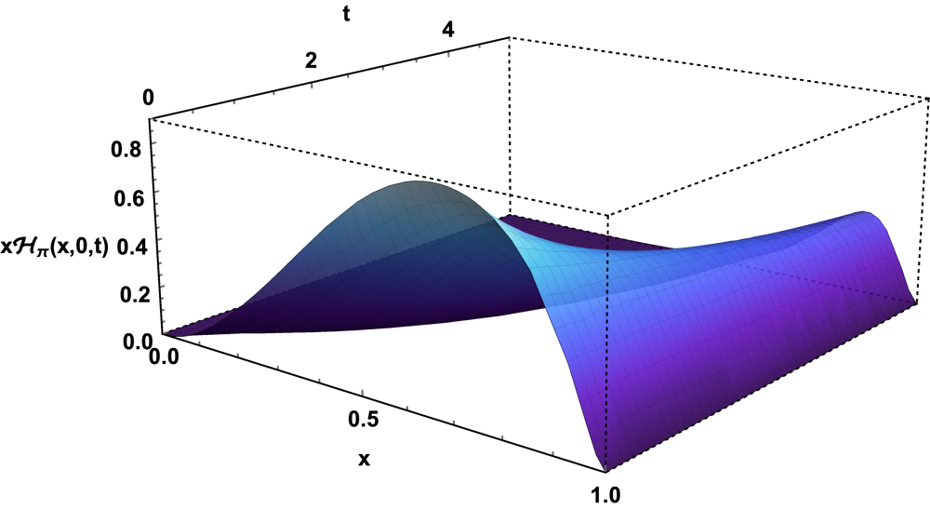
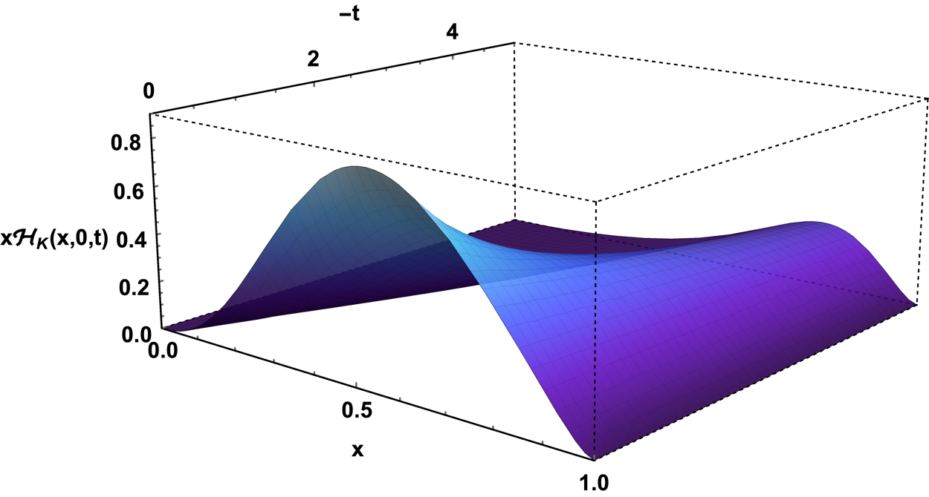
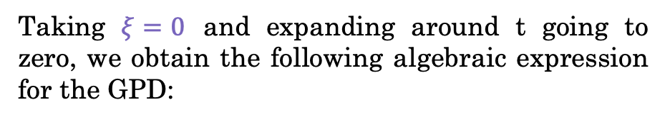
Distribution Functions: GPDs
Taking $ξ=0$ and expanding around t going to zero, we obtain the following algebraic expression for the GPD:
The GPD corresponding to the valence quarks can be obtained at a hadronic scale by means of the superposition configuration of the LFWF :
with
with
.
Pion
Kaon
11
Notes:
For our interest we can calculate the GPD and then do xi=0, anf after that through a Taylor expansion around t going to zero.
Where we have the tridimentional information of the mesons.
Recordando: $t=Δ^{2}$ es el momento transferido al hadrón y $ξ$ representa la colinealidad con la que colisiona el fotón.
$M_{l}=310$MeV
$M_{s}=1.2M_{l}$
Utilizando nuestro resultado previo de la LFWF en términos de la PDA, integrando sobre $k_{⊥}$ e introduciendo parámetros de Feynman obtenemos:

Slide 12



Distribution Functions: PDFs
GPD
$$\int{dx}$$
$$t=0, ξ=0$$
The PDF is defined in terms of the GPDs as follows :
FF
PDF
Where the normalization factor is:
Pion
Kaon
xs(x) AM
AM result
M. Ding et al., Chin. Phys. (Lett.) 44, 031002 (2020)
xu(x) AM
xs(x) de Eur. Phys. J. C Preprint No. NJU-INP 020/20
Eur. Phys. J. C Preprint No. NJU-INP 020/20
Where is considered
xu(x) de Eur. Phys. J. C Preprint No. NJU-INP 020/20
Where, again is considere
Also, we have
12
Notes:
$M_{l}=310$MeV
$$υ=1.1.$$
where according to the previous results this corresponds to the first term of the expansion of the GPD
So, this is the result of the PDF from the algebraic model and we campared that with another literature results from here. And for exameple, we can observed, they considered the PDFs as the square of the PDA and is in a total agreeement with our result because we have

Slide 13
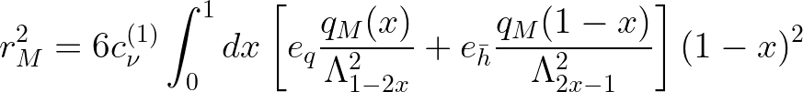

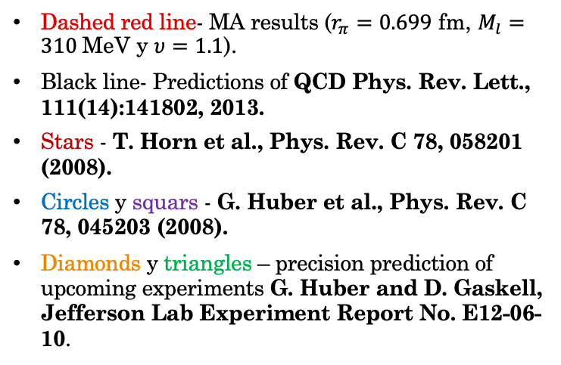
Distribution Functions: FFs
GPD
$$\int{dx}$$
$$t=0, ξ=0$$
The contribution of the quark ”q” to the elastic form factor is obtained by:
FF
PDF
The full FF of the meson is then:
Kaon
Pion
Red line- MA result ($r_{K}=0.56$ fm, $M_{l}=310$MeV, $M_{s}=1.2M_{l}$y $υ=0.275$).
Squars - S. R. Amendolia et al., Phys. Lett. B178, 435 (1986)
Diamonds - E. B. Dally et al., Phys. Rev. Lett. 45, 232 (1980).
Dashed red line- MA results ($r_{π}=0.699$ fm, $M_{l}=310$MeV y $υ=1.1$).
Black line- Predictions of QCD Phys. Rev. Lett., 111(14):141802, 2013.
Stars - T. Horn et al., Phys. Rev. C 78, 058201 (2008).
Circles y squars - G. Huber et al., Phys. Rev. C 78, 045203 (2008).
Diamonds y triangles – precision prediction of upcoming experiments G. Huber and D. Gaskell, Jefferson Lab Experiment Report No. E12-06-10.
AM
AM
13
Notes:
The full FF of the meson is then the sum of the quark and antiquark contribution, from where also can compute the charge radious. And this red line is our result from the algebraic model, we compared it with this experimental results and we can see that they are in agreement with our result
Our results are in agreement with previous results in the literature and experimental results for the FF, but in order to trust more in our model, we decided to compute another functions with wich we could compare with more experimental results…
${\begin{aligned} \\ \\ M\end{aligned}}_{l}=310$MeV
$$υ=1.1$$
t=-Q^2 y xi nos dice que tan colineal interactua el foton con el quark… Antes de continuar con los resultados me gustaría mencionar algunos puntos clave que quedaron por analizar durante este periodo de tiempo.
$r_{π}=0.699$ fm
$r_{K}=0.603$ fm
Where according to the previous results this corresponds to the first term of the expansion of the GPD
Performing a Taylor expansion on the FF we find that

Slide 14
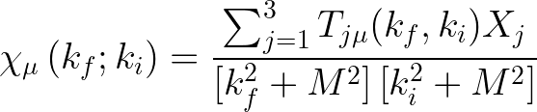
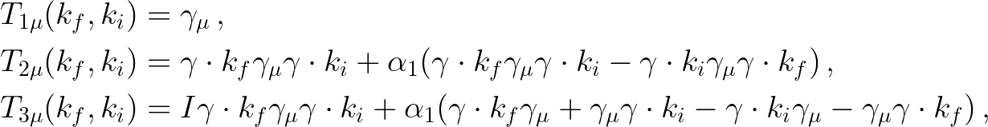
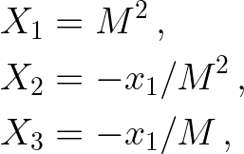



Transition Form Factors
The Transition Form Factors (TFF) of $γγ^{∗}→M$:
Pion
Red line- MA results for $α=0.07$ ($r_{K}=0.56$ fm, $M_{l}=310$MeV y $υ=1.1$).
Squars - J. Gronberg et al., Phys. Rev. D 57, 33 (1998)
Diamonds - H. J. Behrend et al., Z. Phys. C 49, 401 (1991).
Black line–SDEs results.
Purple dashed line– Conform limit:
AM $(α=0)$
AM $(α=0.07)$
where $l_{1}=l+k_{1}$, $l_{2}=l−k_{2}$. A$nd the kinematic conditions: k_{1}^{2}=Q^{2}, k_{1}^{2}$ $k_{2}^{2}=0 and 2k_{1}{∙k}_{2}=−(m_{M}^{2}+Q^{2})$.
Using the AM and the quark-photon vertex:
SDE
where
and
14
Notes:
He functions that describe the proces of transition of a photon an a virtual photon to a meson is the TFF, it can be express in this way, where we can see that we already have all the ingredients we need with the algebraic moddel, we just need to consider the kinematic conditions and the quark-glun vertex.
Por otro lado Q es la matriz que se asocia con las cargas de los quarks de valencia del mesón.

Slide 15
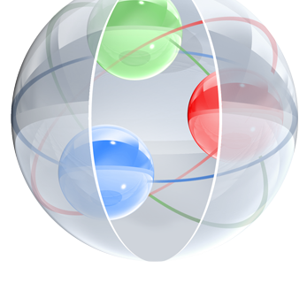
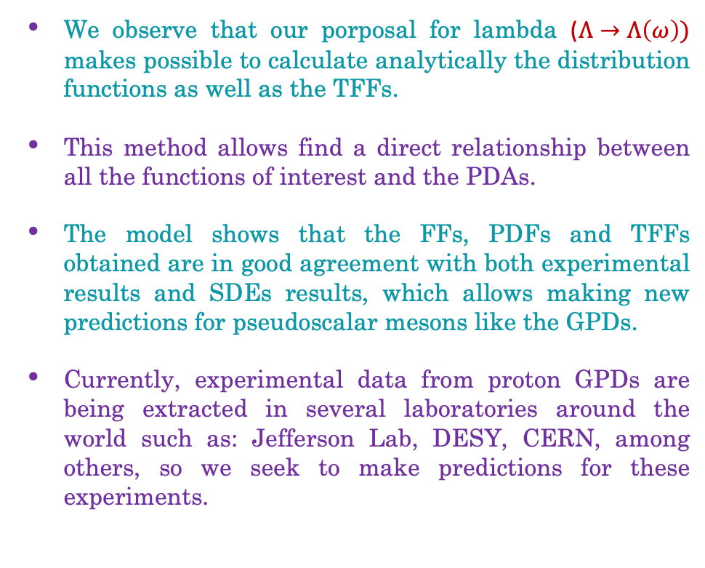
Conclusions
We observe that our porposal for lambda ($Λ→Λ\left(ω\right))$ makes possible to calculate analytically the distribution functions as well as the TFFs.
This method allows find a direct relationship between all the functions of interest and the PDAs.
The model shows that the FFs, PDFs and TFFs obtained are in good agreement with both experimental results and SDEs results, which allows making new predictions for pseudoscalar mesons like the GPDs.
Currently, experimental data from proton GPDs are being extracted in several laboratories around the world such as: Jefferson Lab, DESY, CERN, among others, so we seek to make predictions for these experiments.
15

Slide 16
Thanks!

