Slide 1
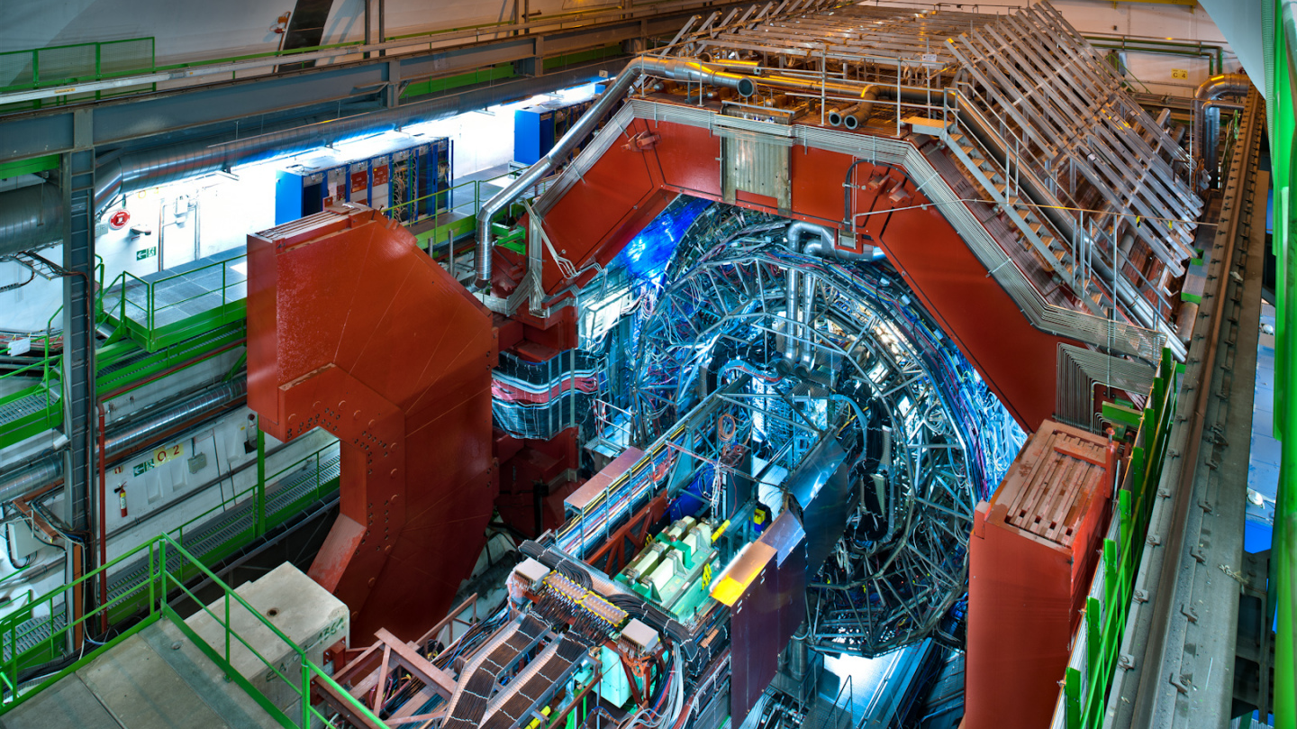
Alice
A large ion collider experiment
Guy Paic

Slide 2
Travel to the BEGINNINGI
The Big Bang Theory was first proposed in the late 1920’s.
It states that there was an infinitely small, infinitely dense point that contained everything that is the universe.
This singularity was incredibly dense and hot.

Slide 3
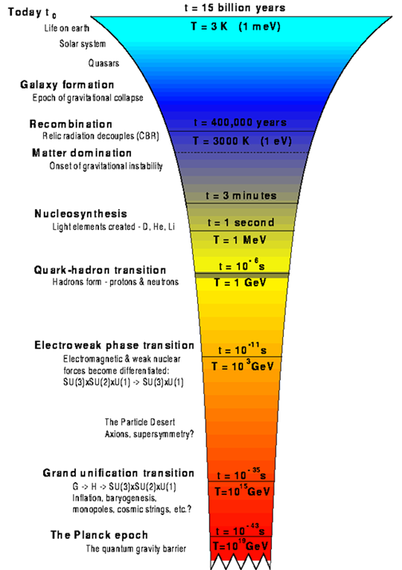
Dense matter the old question
  Penzias and Wilson 1965 discovered the cosmic microwave background radiation providing thus a strong basis for the hot universe scenario
  The temperature of the early Universe was too high for normal matter to exist as such. It needed to cool down in the expansion before the normal constituents of matter could condense from the high-energy soup and not be broken up immediately.
  As the temperature fell, the highest energies available in photons, gravitons and the like decreases; therefore higher-energy particle-antiparticle pairs cease to be created.
  When it became too cold for the most massive particle-antiparticle pairs to be made, these pairs annihilated each other and turned back into photons.
  However, it seems that a slight asymmetry developed early that left what we call the particles slightly outnumbering the antiparticles, so that not everything annihilated: there was still some matter left over, as well as lots and lots of photons.

Slide 4
The three states + ONE
You know the 3 states of matter
Gas
Liquid
Solid
Learn about a new one!

Slide 5
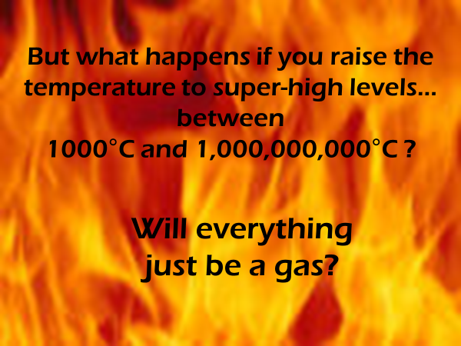

Slide 6
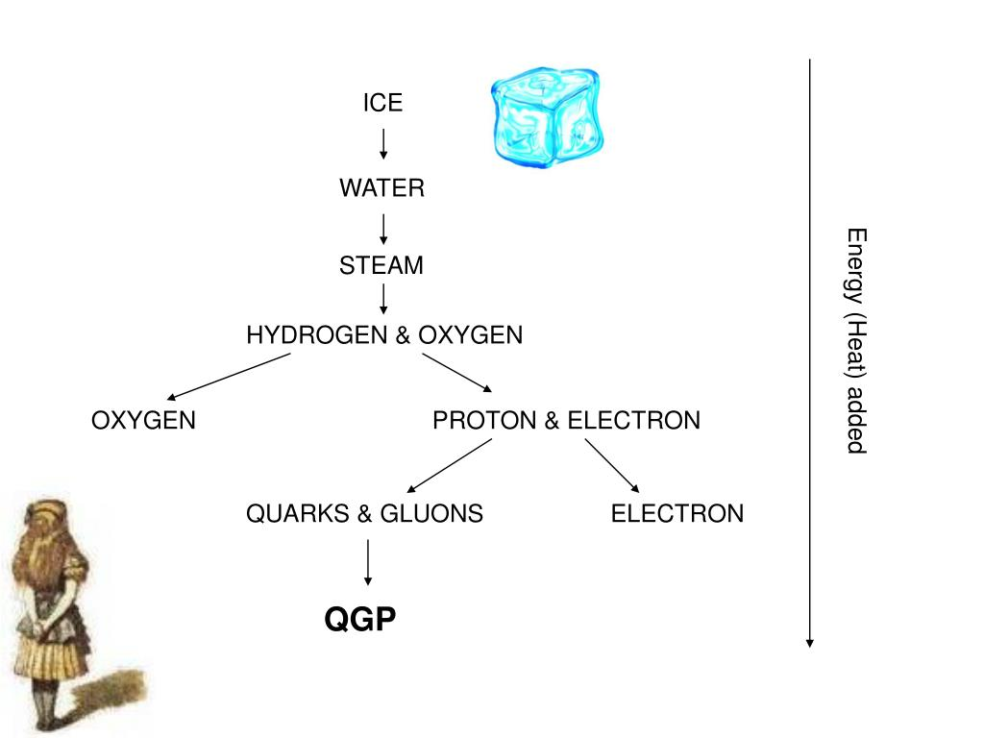

Slide 7
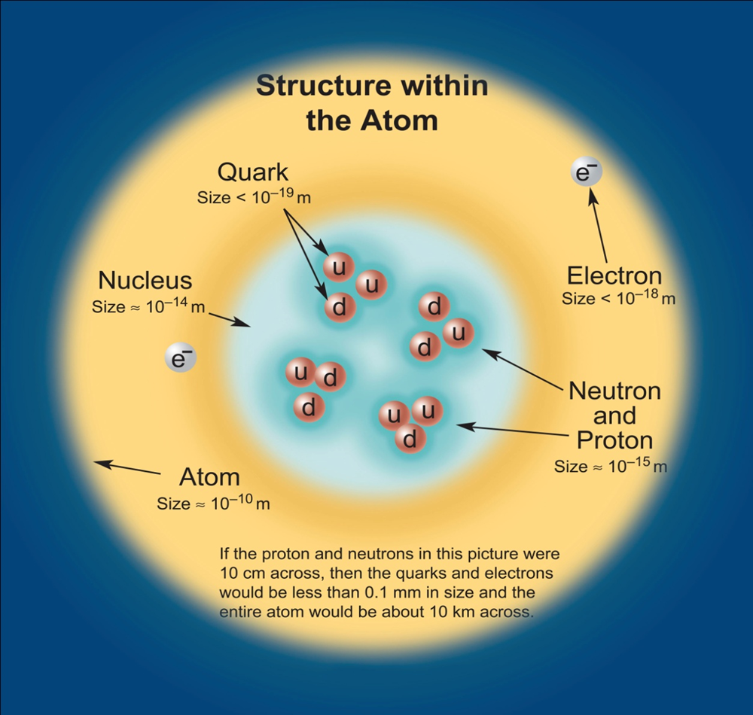
The new state state of matter!
Quark–gluon plasma is a state of matter in which the elementary particles that make up the hadrons of baryonic matter are freed of their strong attraction for one another under extremely high energy densities or temperature. These particles are the quarks and gluons that compose baryonic matter.

Slide 8
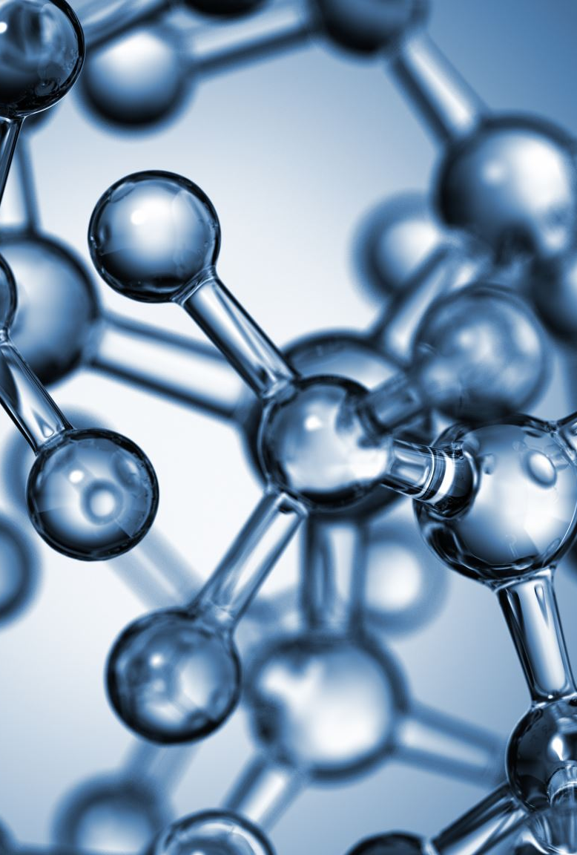
The quarks and gluons
Quarks are fundamental building blocks of matter. They are most commonly found inside protons and neutrons, the particles that make up the core of each atom in the universe
Protons and neutrons mainly contain two types of quarks. These are called up and down quarks. For reasons still unknown, nature also designed two copies each of the up and down quarks, identical except for having larger masses. The heavier copies of the up quark are called charm and top quarks; the copies of the down quark are named strange and bottom quarks. Converting energy into mass, accelerators produce these heavier, short-lived quarks through particle collisions
The gluons keeps all this zoo together! Gluons are the exchange particles which couple to the color charge. They carry simultaneously color and anticolor.

Slide 9
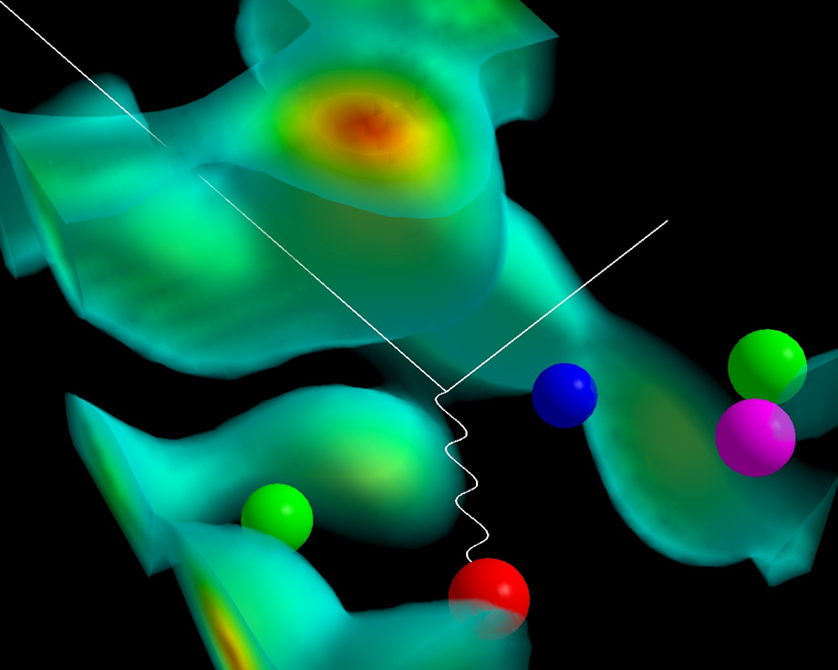
The family together!
Three quarks indicated by red, green and blue spheres (lower left) are localized by the gluon field.
A quark-antiquark pair created from the gluon field is illustrated by the green-antigreen (magenta) quark pair on the right. These quark pairs give rise to a meson cloud around the proton.
The masses of the quarks illustrated in this diagram account for only 3% of the proton mass. The gluon field is responsible for the remaining 97% of the proton's mass and is the origin of mass in most everything around us.

Slide 10
How to ¨recreate¨ quark gluon plasma
At extreme temperatures and/or densities nuclear matter ‘melts’ into a plasma of free quarks and gluons.This state of matter would have existed up to about 10 millionths of a second after the Big Bang, and could be created in the core of collapsing neutron stars.

Slide 11
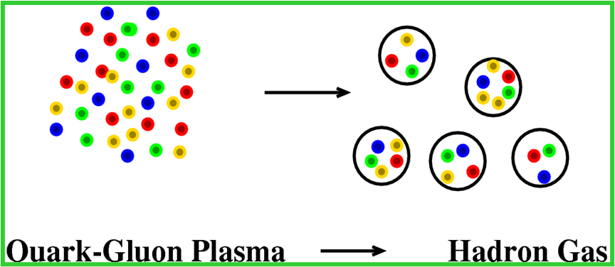
If we create a QGP in a collision of heavy ions than it lives a very short time: about ~10^⁻²³ seconds and then return – condenses into hadrons

Slide 12

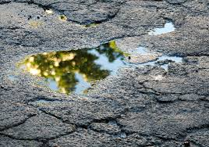
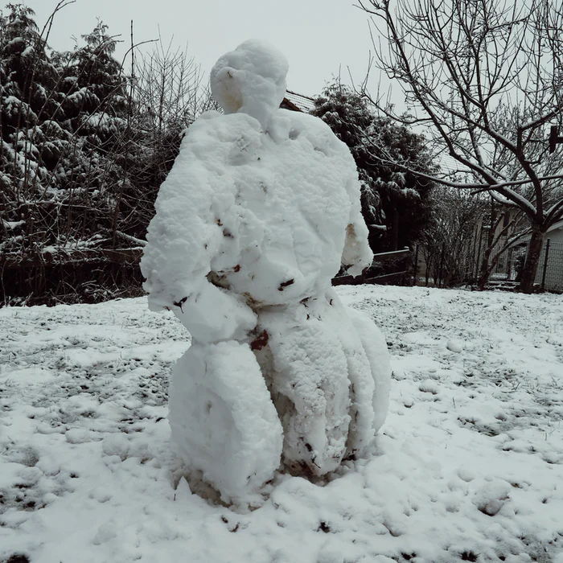
but complicated!
Suspected existence
Experimental data

Slide 13
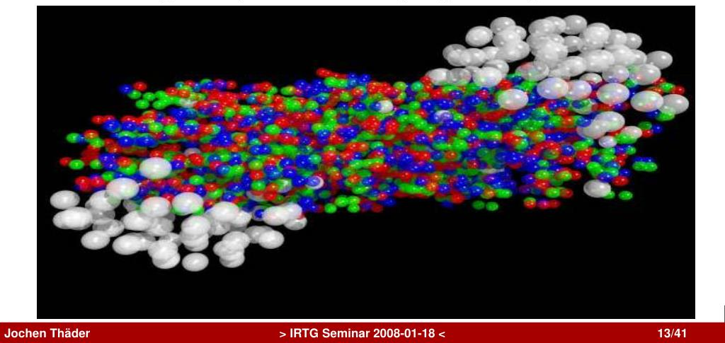
And now how to produce it!

Slide 14
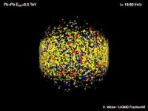

Slide 15
The small Bang in the Lab!
QCD predicts a phase transition from nuclear matter to a de-confined state of quarks, anti-quarks, and gluons –quark-gluon plasma (QGP).v
Happens at energy densities of ~ 1 GeV/fm3
Temperatures of ~ 150 MeV
Can create a QGP using ultra-relativistic heavy-ion collisions
Recreate the conditions existing ~ 1 micro-second after Big Bang

Slide 16
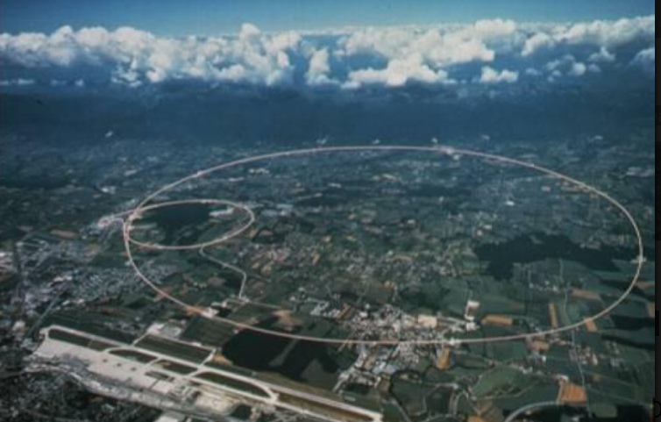
The machine to produce it: LHC + Detectors

Slide 17
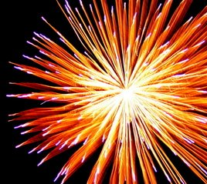
Like a giant firewok

Slide 18
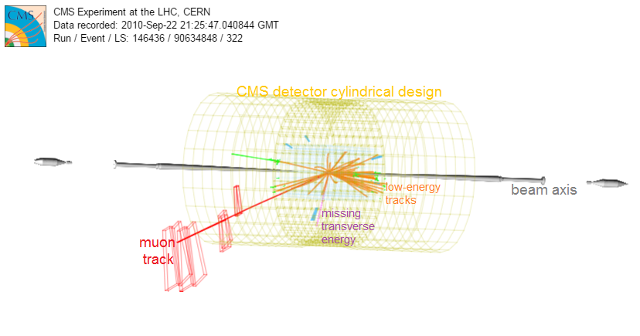
Typical design of a collider detector
Many different layers of detectors to be able to pickup all signalas

Slide 19
Use of magnetic field: two goals
Separate positively and negatively charged particles
Determine the momentum of the particles using the curvature of the tracks

Slide 20
The basic tasks of the análisis of data
Track finding
Track fitting

Slide 21
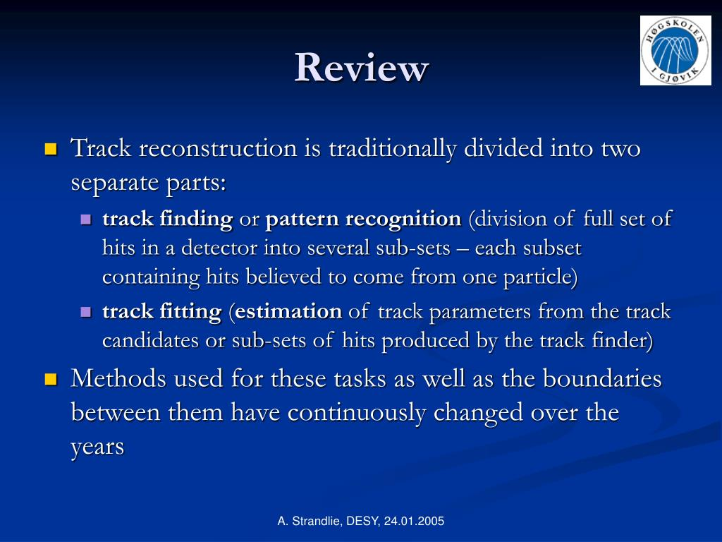

Slide 22
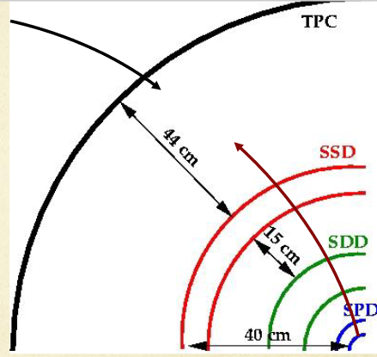

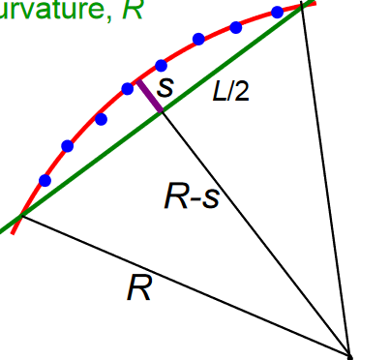
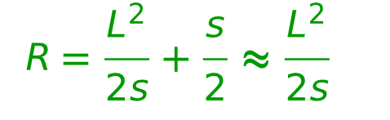
Measuring momentum
Circular motion transverse to uniform B field:

Slide 23

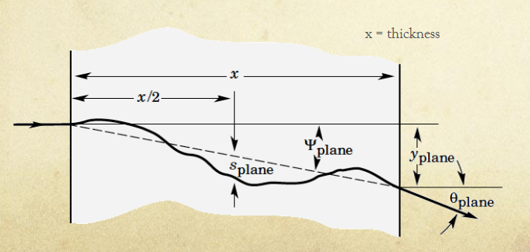
The things are not so easy!
Some tracks are not recorded
The track are not well behaved
Some spurious tracks may occur – we need to observe the origin of the tracks¨primaryand secondary vertices ¨

Slide 24
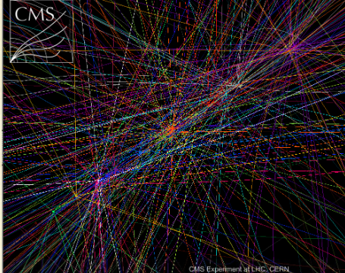
The primary vertex
The origin of the collisions a difficult task!

Slide 25
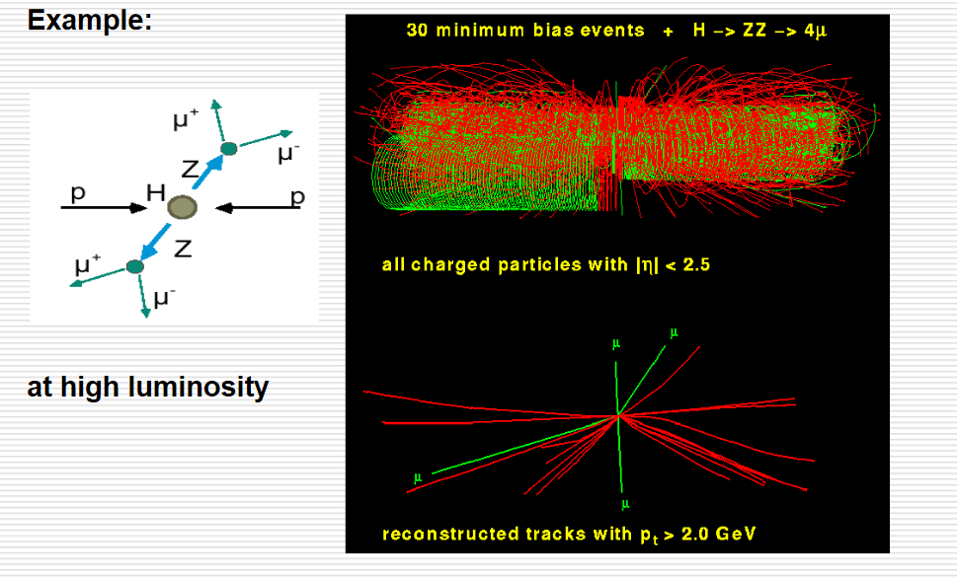

Slide 26
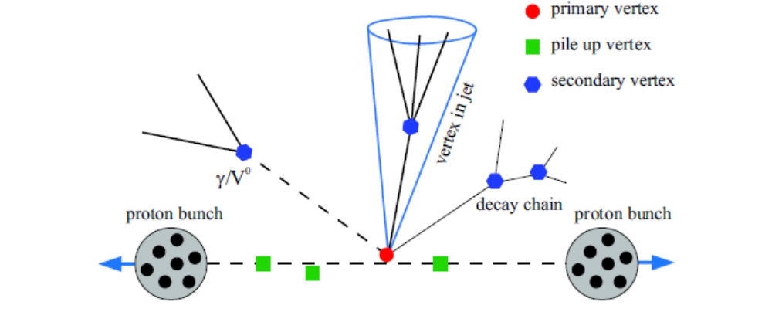
The zoo of primay and secondary vertices

Slide 27
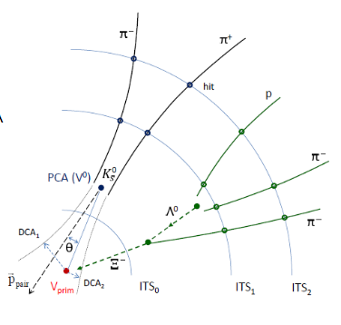
The secondary vertices

Slide 28

Another tool: particle identification
The particles are leaving different footprints

Slide 29

Ionisation time of flight
β=p/E
γ=E/m
Z
dE = E-E’
dX

Slide 30
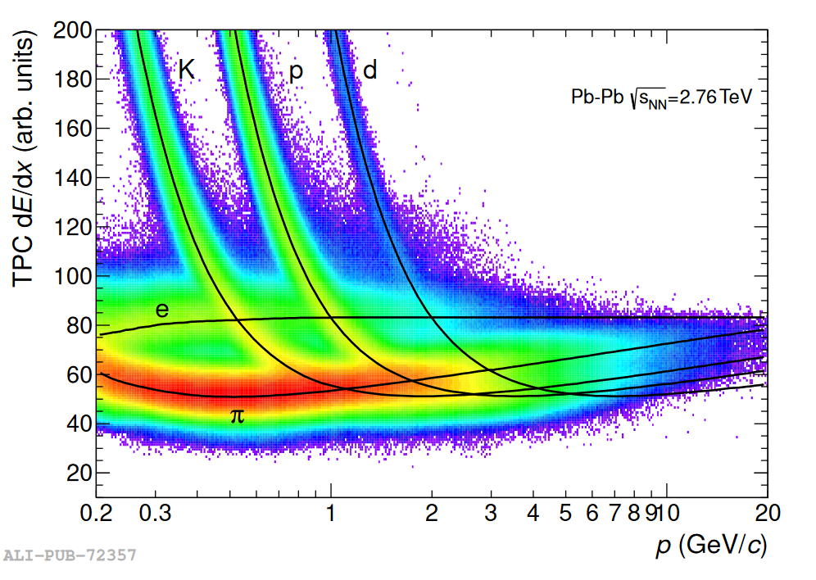
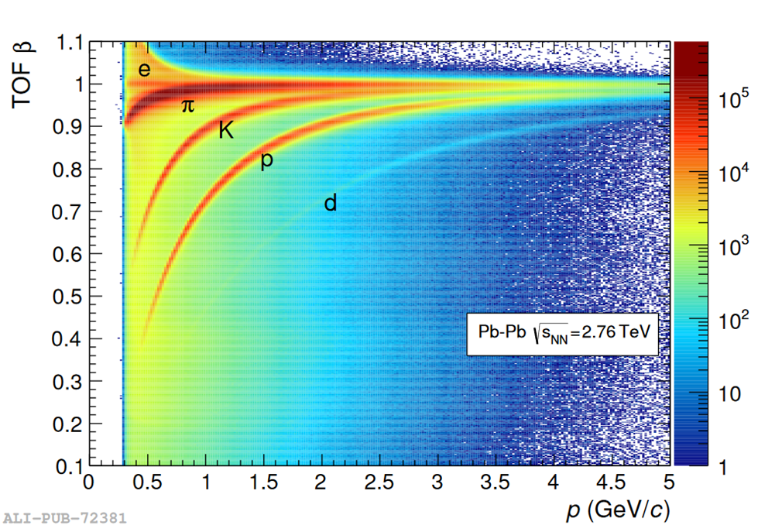
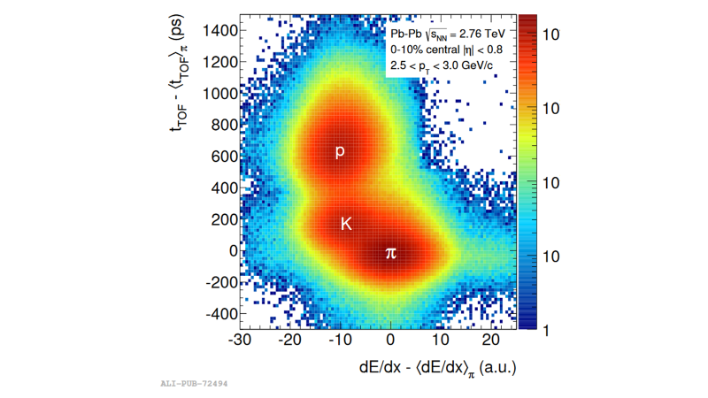
`the performance

Slide 31
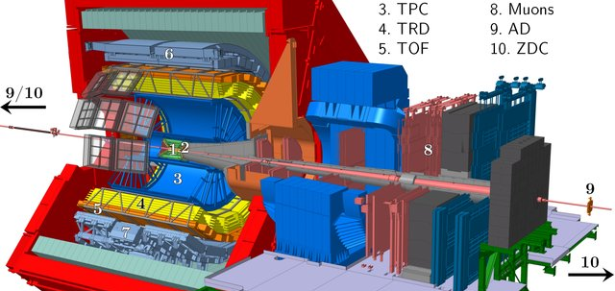

Slide 32
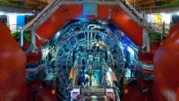

Slide 33
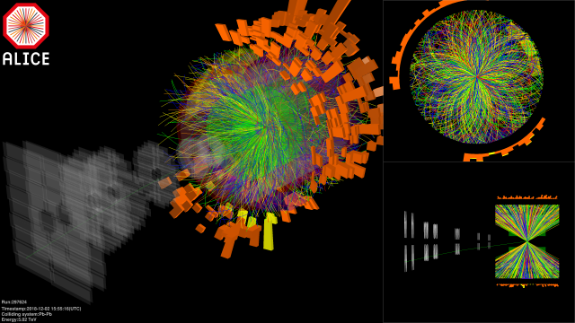

Slide 34
What do we measure?
Number of tracks
Momentum of tracks
Masses of the particles produced

Slide 35

And then: identify features indicating QGP like features

Slide 36
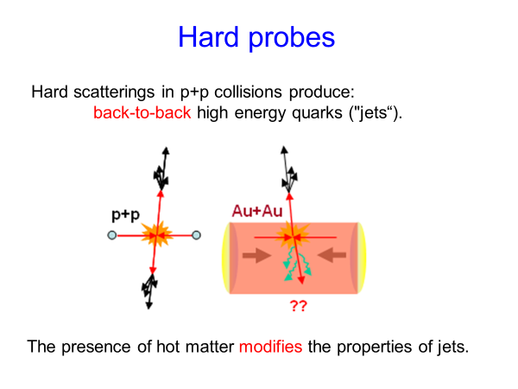

Slide 37
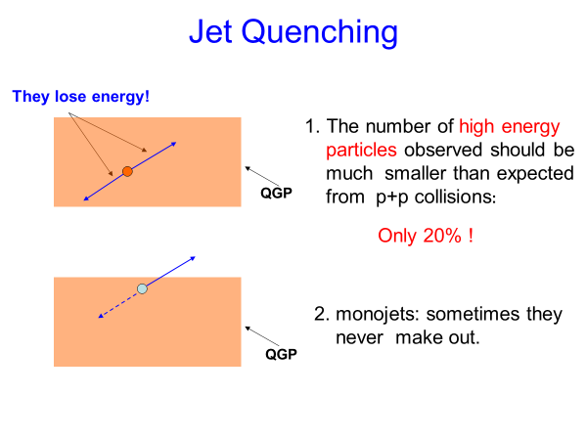

Slide 38
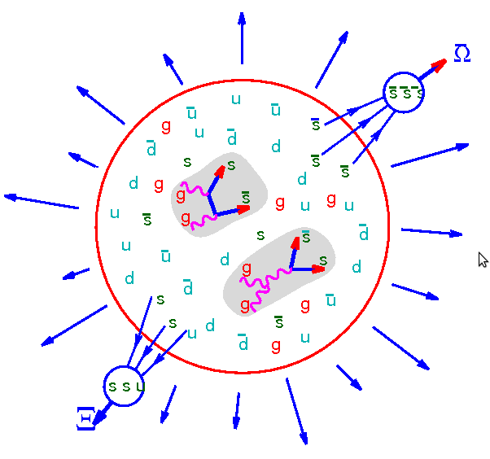

Strangeness enhancement
In the QGP:
Hadronic channels:

Slide 39
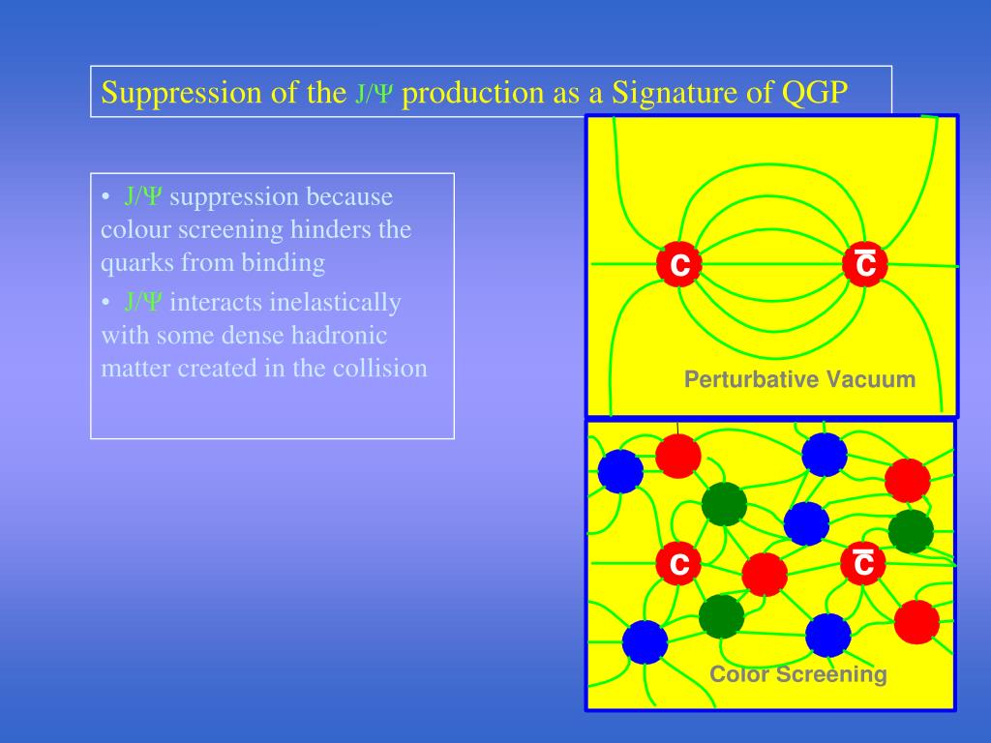

Slide 41

Instead of a conclusion
A very interesting field of investigation in spite of its maturity!
Field dominated by the experimental results

