Slide 1
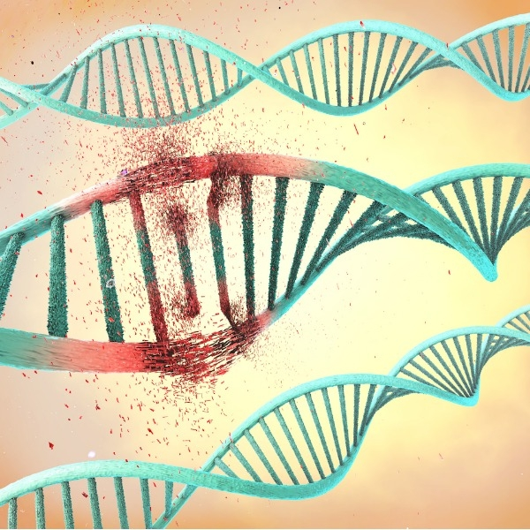
Masterclass 2011
Biology of the radiation

Slide 2
THE NUCLEAR PHYSICS HELPS THE FIGHT AGAINST CANCER

Slide 3
The main points
Differences between different radiations
Effects of radiation in biologic material
The uses of the destructive qualities of radiation in tissues to fight cancer

Slide 4
A short recollection of the ways radiation is absorbed

Slide 5
Interactions of Particles (not electrons)with Matter
Dominant interaction is due to the electromagnetic force, or coulomb interactions.
Ionization and excitation of atomic electrons in matter are the most common processes.
Radiation can become important, particularly for electrons.
The nuclear interactions play a less significant role

Slide 6
Interaction of photons with matter
x = length
μ = linear coefficient of attenuation= probability of interaction per unit of length
ATENUATION: N = N₀ e ^{-μ x}
Valid for
monoenergetic photons
N_{O}
N
When the electromagnetic radiation (X-rays or gammas ) enters in a natural medium the photons lose their numbers during their travel in the matter due to absorptions and dispersions
Similar to the absorption of light in a semitransparent window!

Slide 7
The particles lose energy in the matter
range
The range is the length (taken rectilinear) in the matter
Like a bullet in the wall

Slide 8
In contrast to conventional photon radiations where the dose distribution in the patient is primarily characterized by an exponential decline in dose with depth, charged particles demonstrate a phenomenon known as the Bragg peak. Particles at high energy deposit relatively little energy as they enter an absorbing material but tend to deposit extremely large amounts of energy in a very narrow peak, the Bragg peak, as they reach the end of their range (Fig. 1.2). The depth and magnitude of this Bragg peak is determined by the mass and charge, as well as the initial energy of the particle [

Slide 9
Important to understand
The Photons are losing energy in a stochastic way – that is every photon has a probability to survive after a given thickness of absorber.
Like if I have 100 dices and I decide to remove all the sixes after a throw. I will stay with a given number of dices in play after the first throw. I throw again, and again if I have many dices you can imagine that after many throws (analogous to the thickness of material I will still have dices on the table. This is called the logarithmic absorption
For charged particles the situation is different : every particle is losing energy continuously like a car without engine on a flat road: after a given path it will stop…. It means for each particle we can calculate the Range it will have in a given piece of material due to its energy, mass and charge.

Slide 10
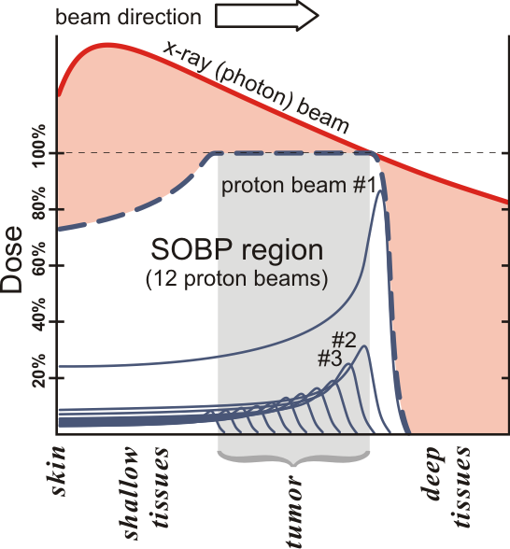
Spread-Out Bragg Peak (SOBP)

Slide 11
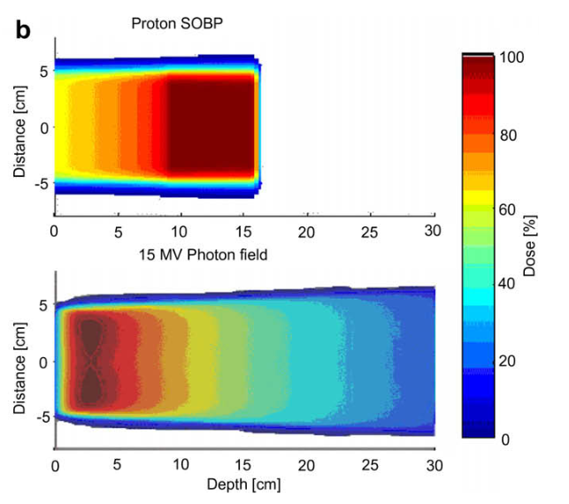

Slide 12
Key parameters of the radiotherapy

Slide 13
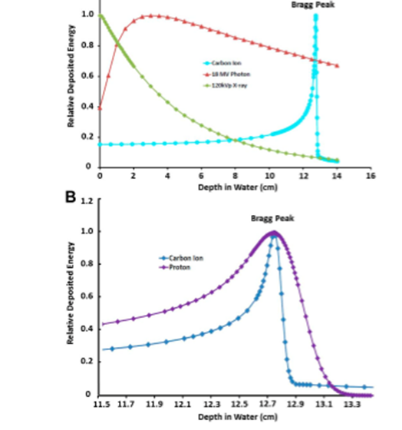
The energy loss for charged particles
The charged particles loose energy continuously but at a different rate:
The slower they move the more energy they
loose per unit of path!
A the atomic number of the particle ,q
the elementary charge and E is the energy
of the particle
This means that at the end of their course
they loose/deposit most of the enrgy

Slide 14
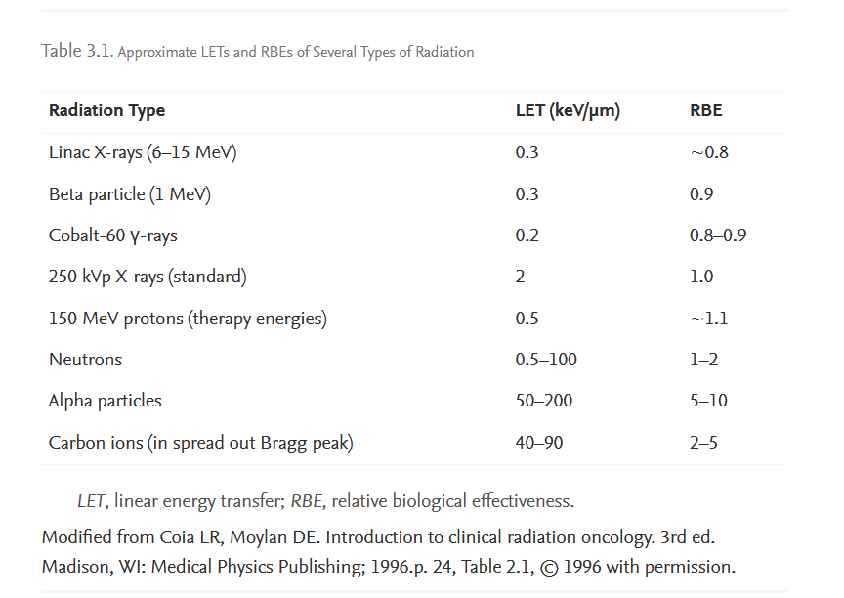
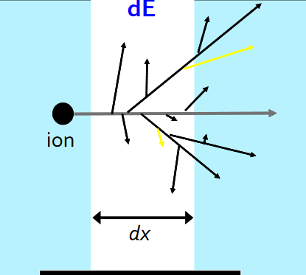
Linear energy transfer
LET describes the rate at which the energy is transferred per unit length of track (keV/μm).

Slide 15
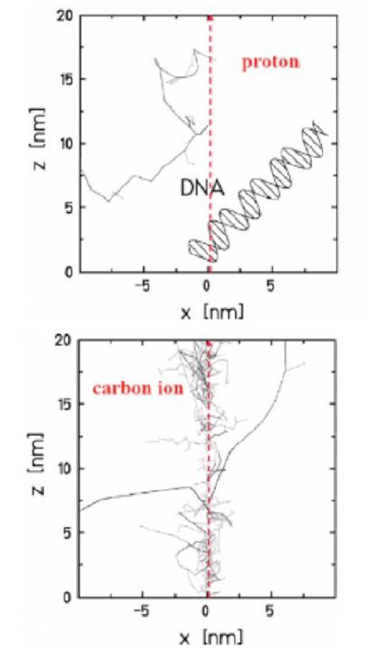
Difference between proton and carbon
Protons and heavier ions have excellent dose-localization properties
Ions produce a much denser track structure (primary ionizations and secondary electrons)
The closely spaced ionizations lead to a larger number of complex and clustered DSBs, which are difficult to repair and less sensitive to the presence of absence of oxygen

Slide 16
Absorbed dose
Absorbed dose is the quantity of the energy deposited in matter by ionizing radiation per unit mass. Absorbed dose is used in the calculation of dose uptake in living tissue in both radiation protection (reduction of harmful effects), and radiology (potential beneficial effects for example in cancer treatment)
The SI unit of measure is the gray (Gy), which is defined as one Joule of energy absorbed per kilogram of matter.[
The older, non-SI CGS unit rad, is sometimes also used, predominantly in the USA
The absorbed dose is a poor indicator of the biological effect of radiation,
the biological effect can depend on many other factors, including the type of radiation, energy, and type of tissue. The relative biological effectiveness can help give a better measure of the biological effect of radiation. The relative biological effectiveness for radiation of type R on a tissue is defined as the ratio

Slide 17
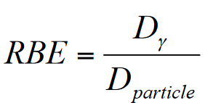
Relative biological effectiveness RBE
The RBE is defined as the ratio of doses to reach the same level of effect when comparing two modalities, e.g. a reference radiation and proton radiation.

Slide 18
Origin of the necessity for defining RBE
The reason for the altered biological effectiveness of carbon ions as compared to photons is the different way they transfer their energy on a microscopic scale.
The high-energetic photons transfer a large fraction of their energy to secondary electrons,
ions release a large number of secondary electrons with very low energies, mostly in the keV range.
The secondary electrons released by photons spread their energy over large distances from the primary interaction point while the secondary electrons originating from ions deposit their energy essentially within a small radius around the primary ion track (Krämer and Kraft 1994a, 1994b). This maximum radius decreases from 156 μm to 3 μm and 0.06 μm for carbon ion energies of 100, 10, and 1 MeV u−1, respectively (Elsässer et al2008). As the maximum track radius decreases and the LET increases with decreasing energy, the local dose around the carbon ion.

Slide 19
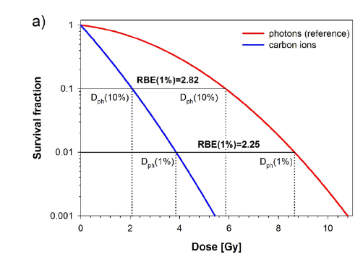
RBE photons vs carbon ions

Slide 21
Lets turn to the living organisms

Slide 22
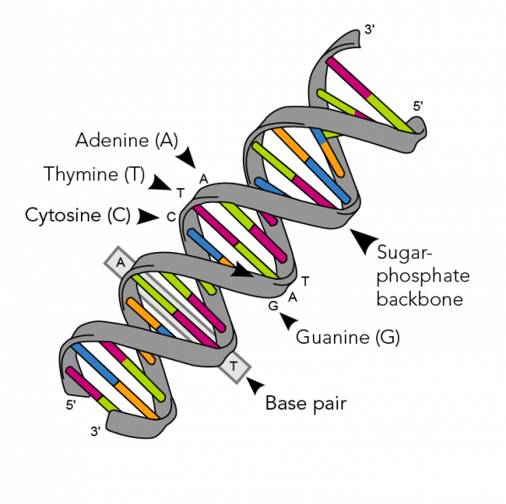
Basic information about biology -DNA
Every one of your cells contains deoxyribonucleic acid (DNA).It constantly tells your cells what to do. Every living organism has DNA in all of its cells.
A DNA molecule is built like a twisted ladder. The long rails are made of sugar and phosphate molecules. These are called the “backbone” of a DNA molecule. Each rung is a combination of four nucleotide bases. These are adenine, guanine, cytosine, and thymine. Each nucleotide has a letter that represents it. “A” stands for adenine, “G” for guanine, “C” for cytosine and “T” for thymine.

Slide 23
The biological effects ofradiation
The biological effects can be of two natures
A direct atack to the key element of the cells – the DNA
An indirect poisoning of vital elements

Slide 24
Direct action
Direct action can lead to either DNA damage or DNA mutations. Keep in mind that these are two different things.
DNA lesions involve physical damage. This includes changes to the chemical structure of the DNA molecule (numbers 2 and 3 in the list and diagram).
DNA mutations involve changes to the sequence of base pairs (number 1 on the list and diagram). If DNA damage is not repaired, it can lead to mutations. Mutations can prevent genes from making correct proteins. This can be very harmful to an organism.

Slide 25
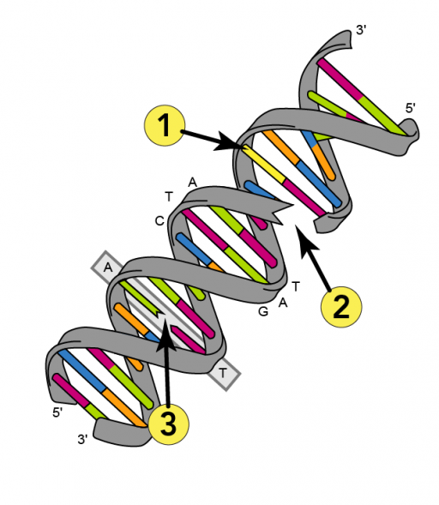
The ways to direct action…
Ionizing radiation can interact directly with a DNA molecule’s atoms. This prevents cells from reproducing. Direct action can also damage critical cellular systems. Sometimes, it can even lead to cancer.
Alpha particles, beta particles and X-rays can directly affect a DNA molecule in one of three ways:
Changing the chemical structure of the bases;
Breaking the sugar-phosphate backbone; or
Breaking the hydrogen bonds connecting the base pairs.

Slide 26
Indirect action
Ionizing radiation can also affect important molecules other than DNA. For example, it can break the bonds holding water molecules together. This creates hydrogen (H+) and hydroxyls (OH-) ions. These are called free radicals.
Free radicals are highly reactive. This means that they easily combine with other ions inside cells. For example, hydroxyl ions (OH-) can react with hydrogen atoms inside a DNA molecule to form hydrogen peroxide (H2O2). This can cause the types of DNA damage we talked about earlier. Over time, damage from free radicals can build up. Scientists think that free radical damage contributes to aging and diseases like cancer, Alzheimer’s and Parkinson’s.

Slide 27
Indirect action on the wáter molecules

Slide 28
The sensitivity of different cells
Some cells, like blood and reproductive cells, divide more often than others. These types of cells are much more sensitive to radiation. For example, embryos contain a lot of rapidly dividing cells. As a result, they are very sensitive to radiation. That is why pregnant women should limit their exposure to radiation. Fast-growing tumour cells are also very sensitive to radiation. That is why cancer therapy uses radiation to kill cancer cells.
You are surrounded by ionizing radiation. It can affect cells through direct and indirect action, causing DNA damage as well as mutations. This can be especially harmful to cells that divide very quickly. But sometimes this can be a good thing, like when doctors use radiation to fight cancer.

Slide 29
How the radiation affects the tissues
DNA serves two important cellular functions: It is the genetic material passed from parent to offspring and it serves as the information to direct and regulate the construction of the proteins necessary for the cell to perform all of its functions.
The damages of radiation can be dangerous and profitable:
We can kill cancerous cells!

Slide 30
cells are complex mechanisms
Radiation may pass through without doing any damage
Damage may occur but can be repaired
A damaged cell may reproduce itself in its damaged form
The cell may die

Slide 31
Determinants of biological effects
Rate of absorption
Area exposed
Variation in Species and individual sensitivity
Variation in cell sensitivity

Slide 32
Damage and recovery
Single strand breaks
Most DNA damage is repaired with no long term effects
Double-strand breaks
– potential for long term damage
Comparatively rare ( 1 double strand break for 25 single strand breaks)

Slide 33
Cell sensititvity
The degree of cell sensitivity is directly related to the reproductive capacity of cells and tissues, thus stems cells(germ cells) are more radiosensitive tan mature differentiated cells
Radiosensitivity is
Directly prorortiona{ to growth rate
Indirectly proportional to degree of specialization

Slide 34
Cell sensitivity
Most sensitive:
Hemapoietic cells
White blood cells
Red blood cells
Epithelial cells (Intestinal tract, skin, muscle cells
Least sensitive:
Nerve cells

Slide 35
The question
How to deliver the radiation where we want it to Kill malignant cells and spare sane ones

Slide 36
The problems with photon radiotherapy
The photons deposit the majority of their energy (and damage) before reaching a deep seated tumor
One therefore needs to make irradiations from different direction to spare the sane tissues

Slide 37
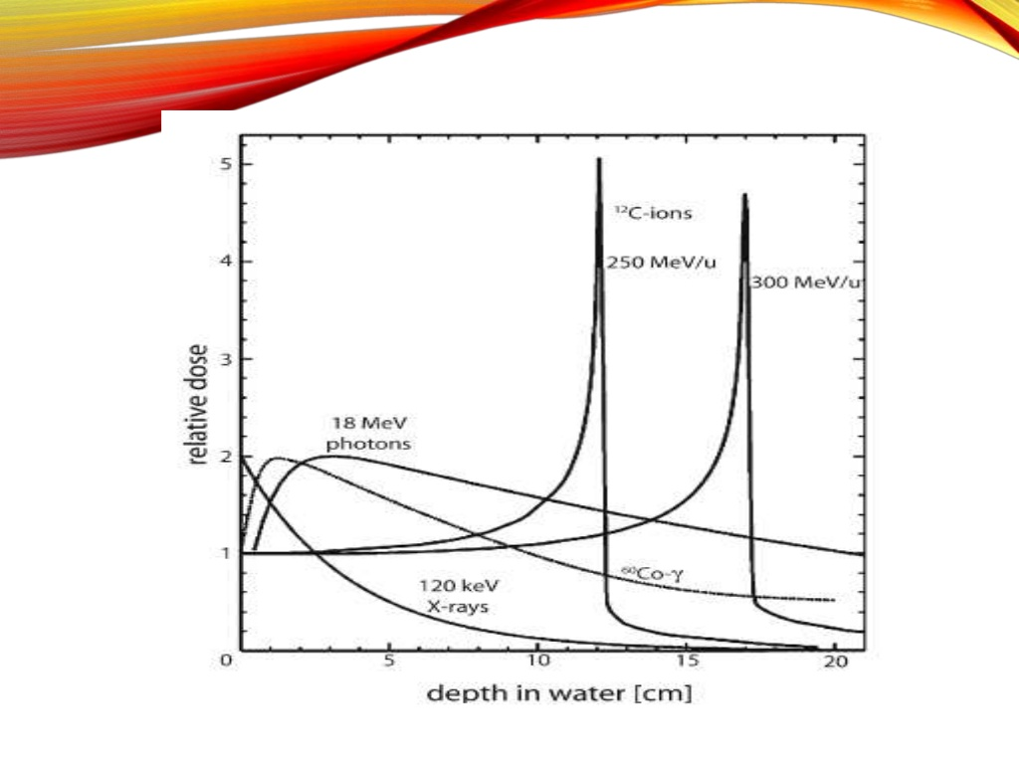
Case for heavy ions beams – delivery directly to the tumor!

Slide 38
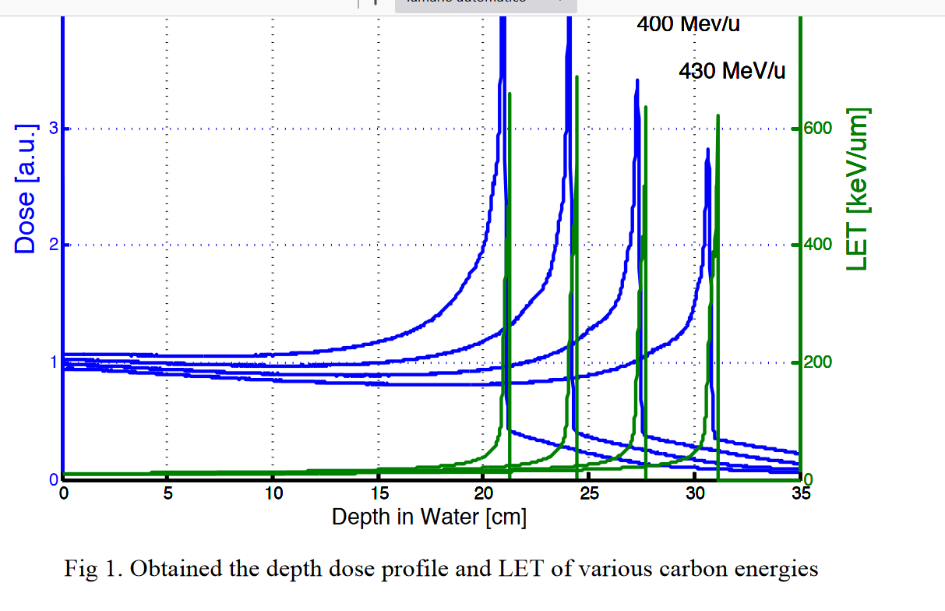

Slide 39
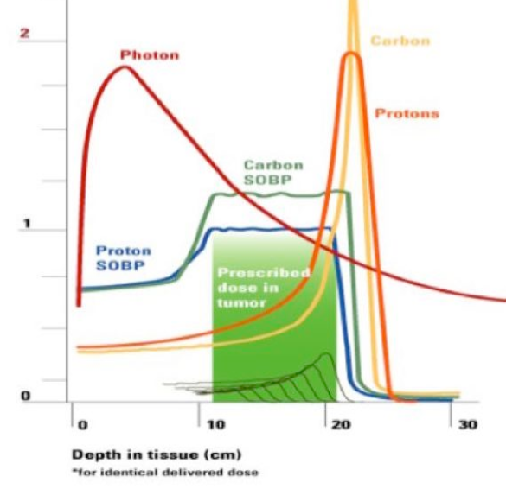
The variation in the dose deposition
Charged particles comprised of protons or heavier ions share the Bragg peak characteristic, which makes them dose-volume sparing RT modalities
Heavier ions have a larger peak to plateau ratio
Heavier ions have a sharper lateral dose fall-off (penumbra)
Heavier ions have a distal fragmentation (dose) tail

Slide 40
The lateral extent of dose deposition
The penumbra in favor of carbon ions – les damage to the healthy tissue.

Slide 41
Carbon ions win!
The carbon beams show more advantages on the biological properties compared with proton beams in radiation therapy. The carbon beam shows highlinear energy transfer (LET) to medium and it increases the relative biological effectiveness (RBE).
The accelerators for carbon ions everyday are gaining more spce in the tools to treat cancers.

Slide 42
Radioenhancers to improve dose delivery to tumors
Gold nanoparticles (GNPs) show considerable promise for dose enhancement in radiotherapy. The fundamental mechanisms of the radiosensitization effect are presented. Dose enhancement simulation studies performed until now to better understand the radiosensitization effect are described, as well as in vivo studies that have clearly pointed to the impact of GNPs as radiosensitizers for oncology applications.

