Slide 1
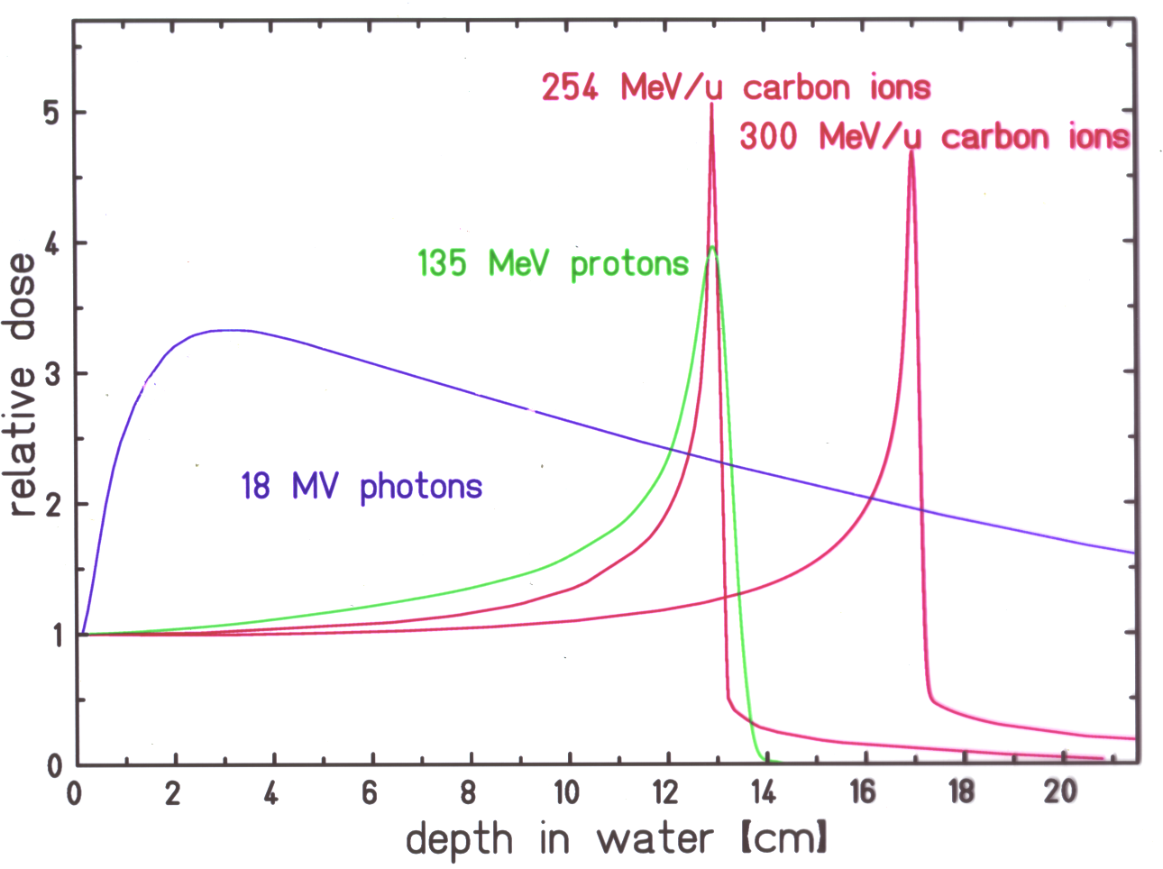
Depth dose distribution of various radiation modalities

Slide 2
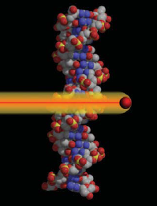
Durante & Loeffler,
Nature Rev Clin Oncol 2010
1
.
2
Tumor
1
.
0
0
.
8
Normal tissue
Relative dose
0
.
6
0
.
4
0
.
2
Potential advantages
0
.
0
0
5
0
1
0
0
1
5
0
2
0
0
Depth (mm)
Energy
LET
Dose
RBE
OER
Cell-cycle
dependence
Fractionation
dependence
Angiogenesis
Cell migration
high low
low high
low high
≈ 1 > 1
≈ 3 < 3
high low
high low
Increased Decreased
Increased Decreased
High tumor dose, normal tissue sparing
Effective for radioresistant tumors
Effective against hypoxic tumor cells
Increased lethality in the target because cells in radioresistant (S) phase are sensitized
Fractionation spares normal tissue more than tumor
Reduced angiogenesis and metastatization

Slide 3
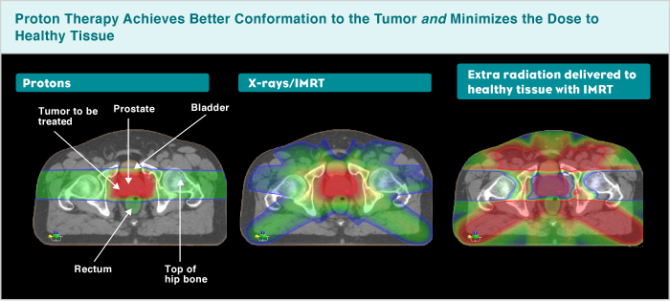
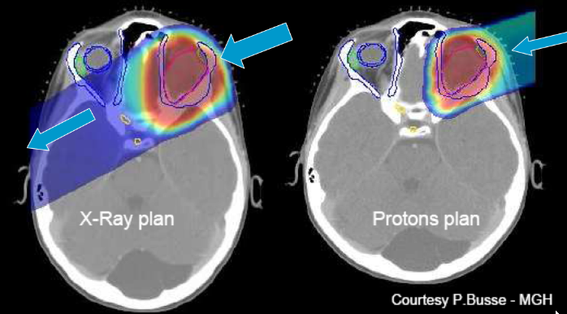
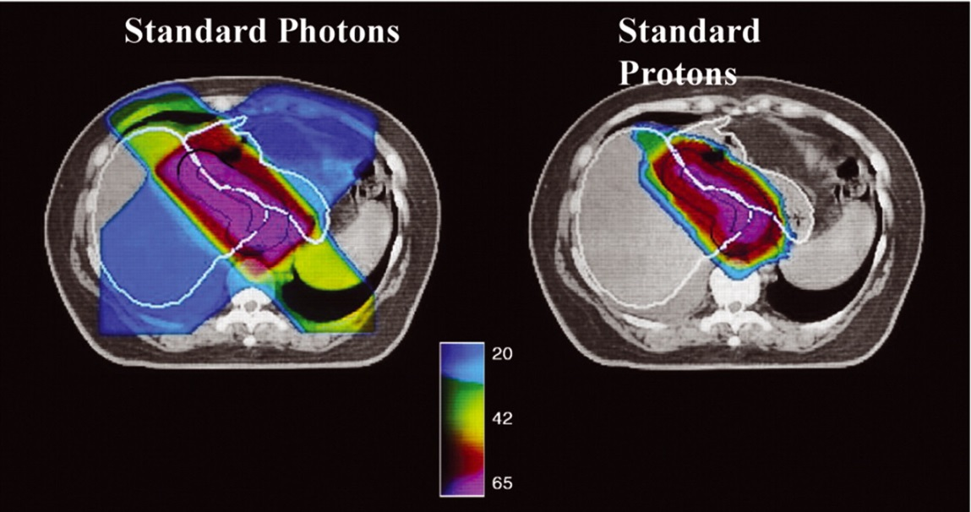
Treatment plans with protons: sparing of normal tissue, recommended especially for pediatric patients

Slide 5
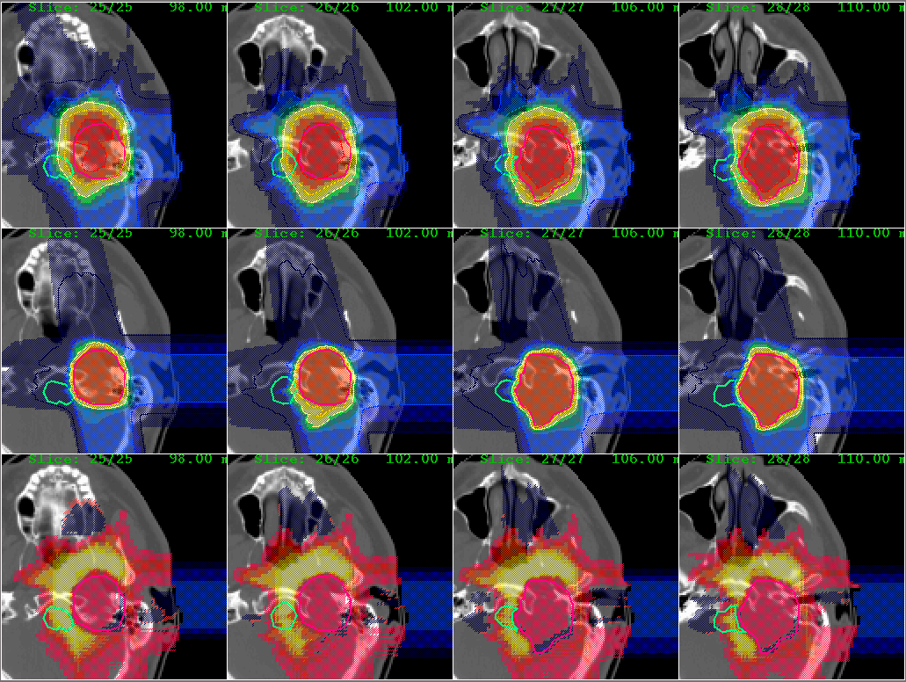
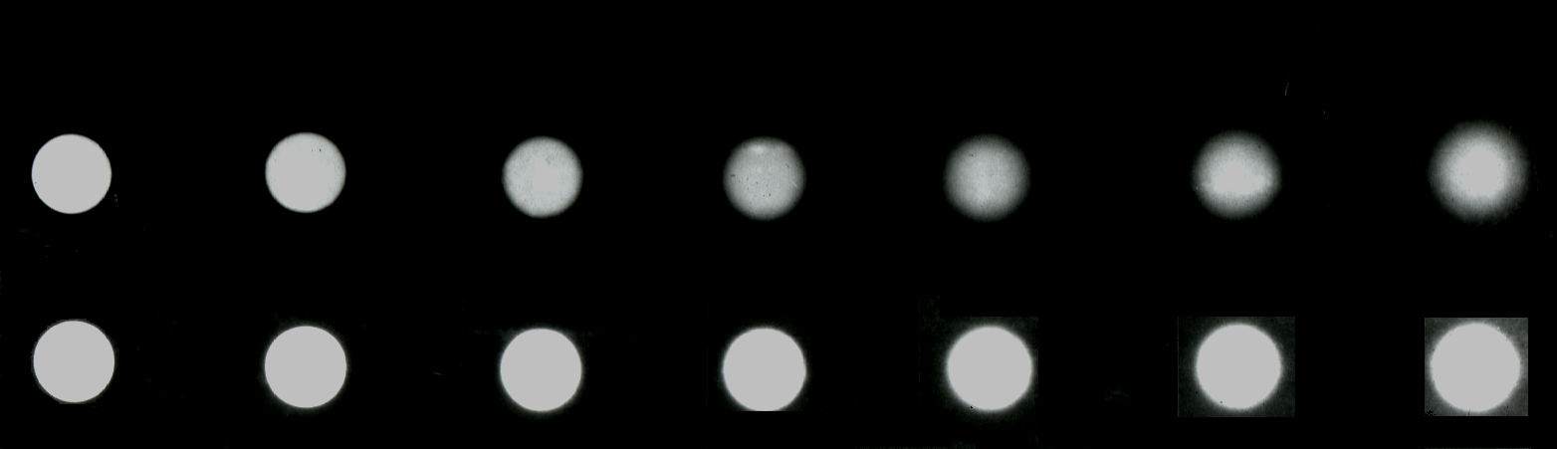
Comparison of Treatment Plans: C-ions vs. protons
C-ions (GSI)
H-ions (CapeTown, SA)
H
C

Slide 6
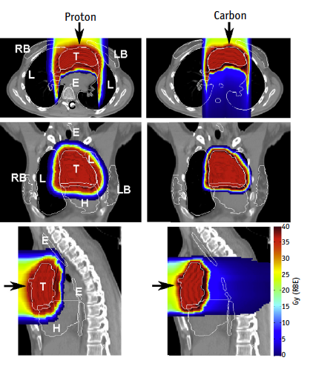
Hodgkin’s lymphoma : protons or C-ions?
Eley et al., Int. J. Radiat. Oncol. Biol. Phys. 2016

Slide 7
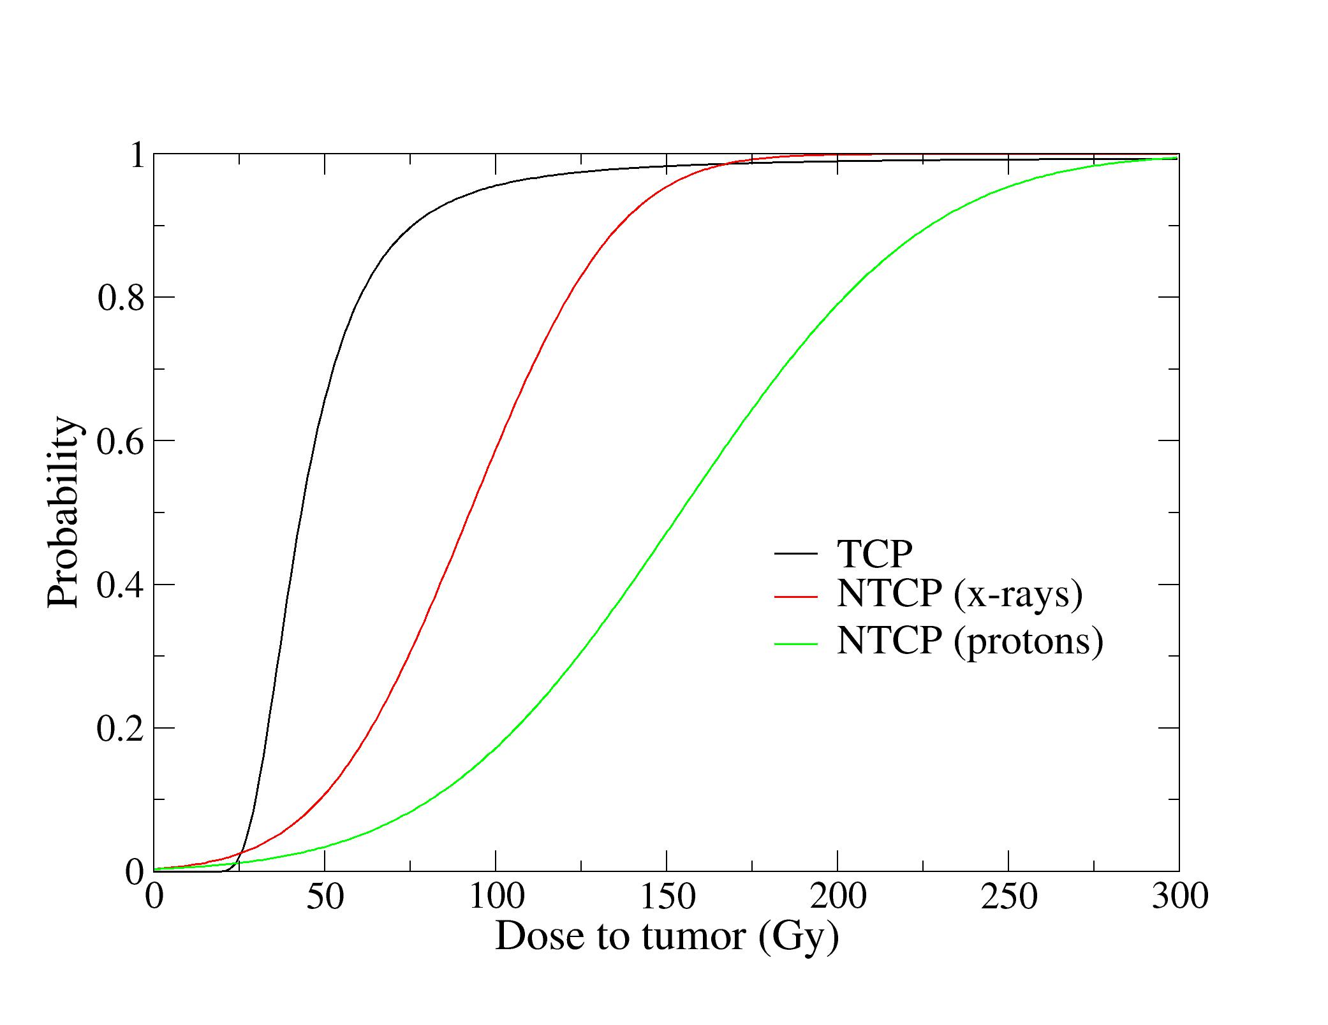

Slide 8
Hepatocellular carcinoma
C-ions
∼ 50% of the liver receives ∼ 0 Gy
Courtesy of Piero Fossati

Slide 9
Particle therapy in HCC
Durante, Ann. Transl. Med. 2016

Slide 15
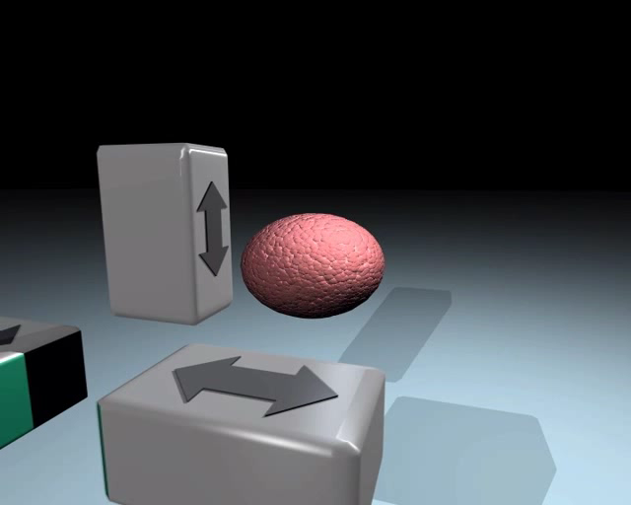

Slide 17
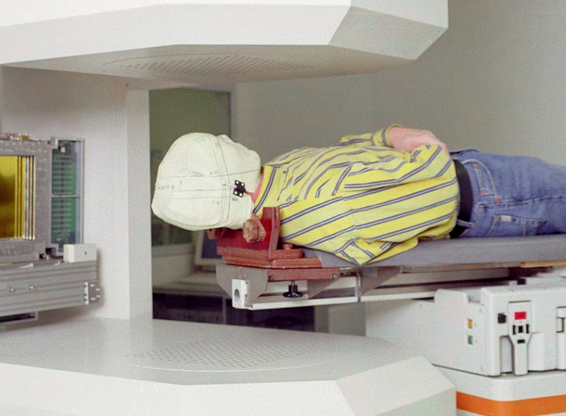
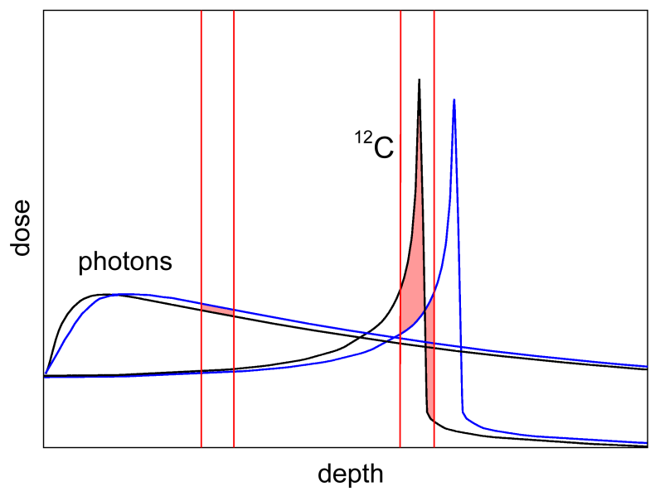
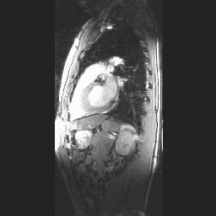
Range uncertainty
precision of stereotactic fixation:
1mm in the head to
3mm in the pelvic region
for ions: variations in radiological path length extremely important
not feasible for regions with internal motion (e.g. respiration in thorax and abdomen)

Slide 19
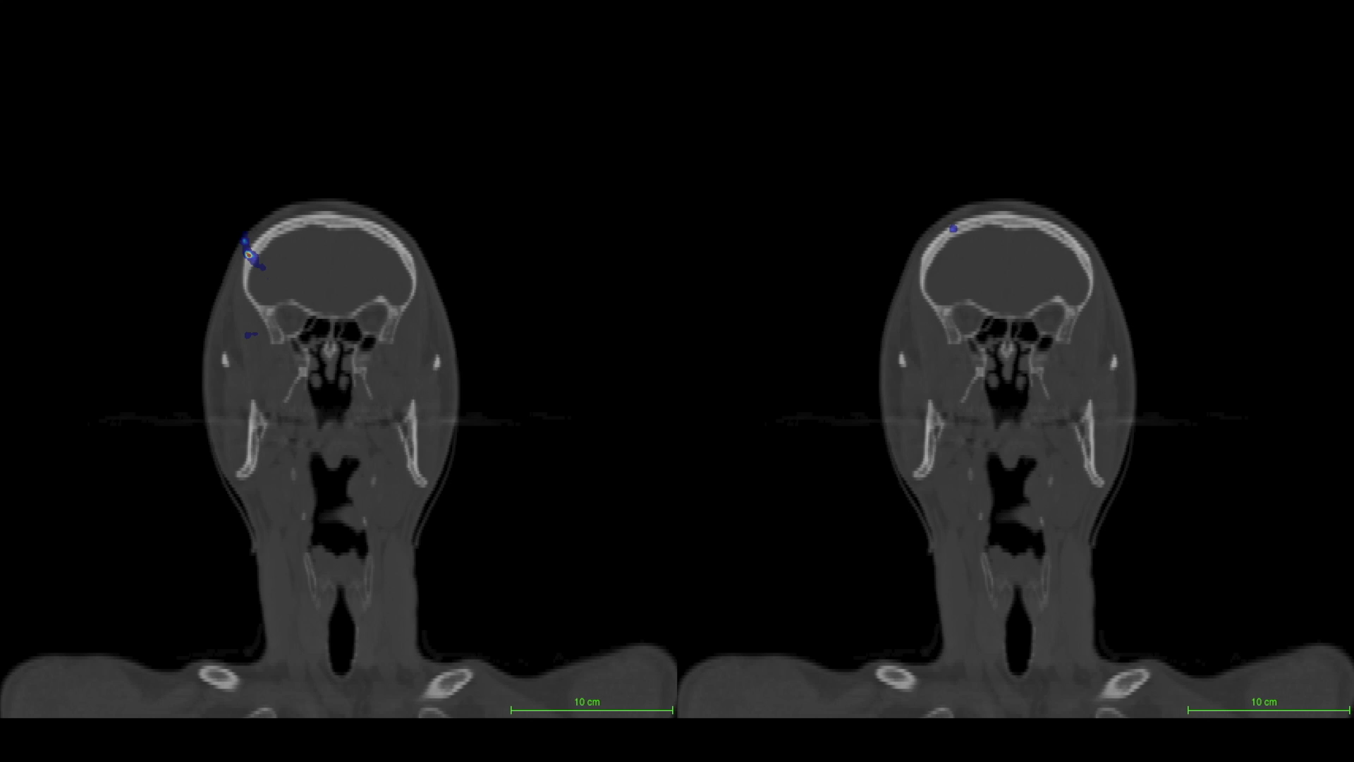

Slide 20
March 2014: 44 proton/7 heavy ion centers
Under construction: 25 proton/ 3 heavy ion centers
Only in USA, 27 new centers expected by 2017
NuPECC report „Nuclear Physics in Medicine“, 2014

Slide 21
Current use of particle therapy worldwide (PTCOG, 2013)
Country | Protons | C-ions (in operation) | Heavy ions (planned)
Russia | 3 | 0 | 1
Europe (eye) | 4 | - | -
Europe (deep tumors) | 6 | 2 | 3
USA | 11 | 0 | ?
Japan | 5 | 3 | 2
China | 1 | 1 | 2
Korea | 1 | 0 | 1
South Africa | 1 | 0 | 0
Treatment | Patients treated at 12.31.12
Protons | 93,895
C-ions | 10,105
Other ions | 3,500

Slide 22
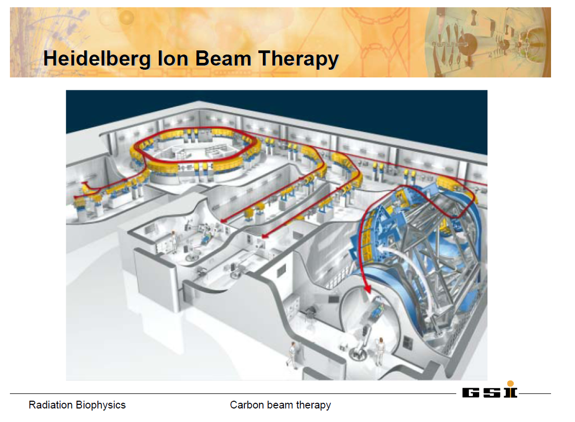
1st patient treated: November 2009

Slide 24
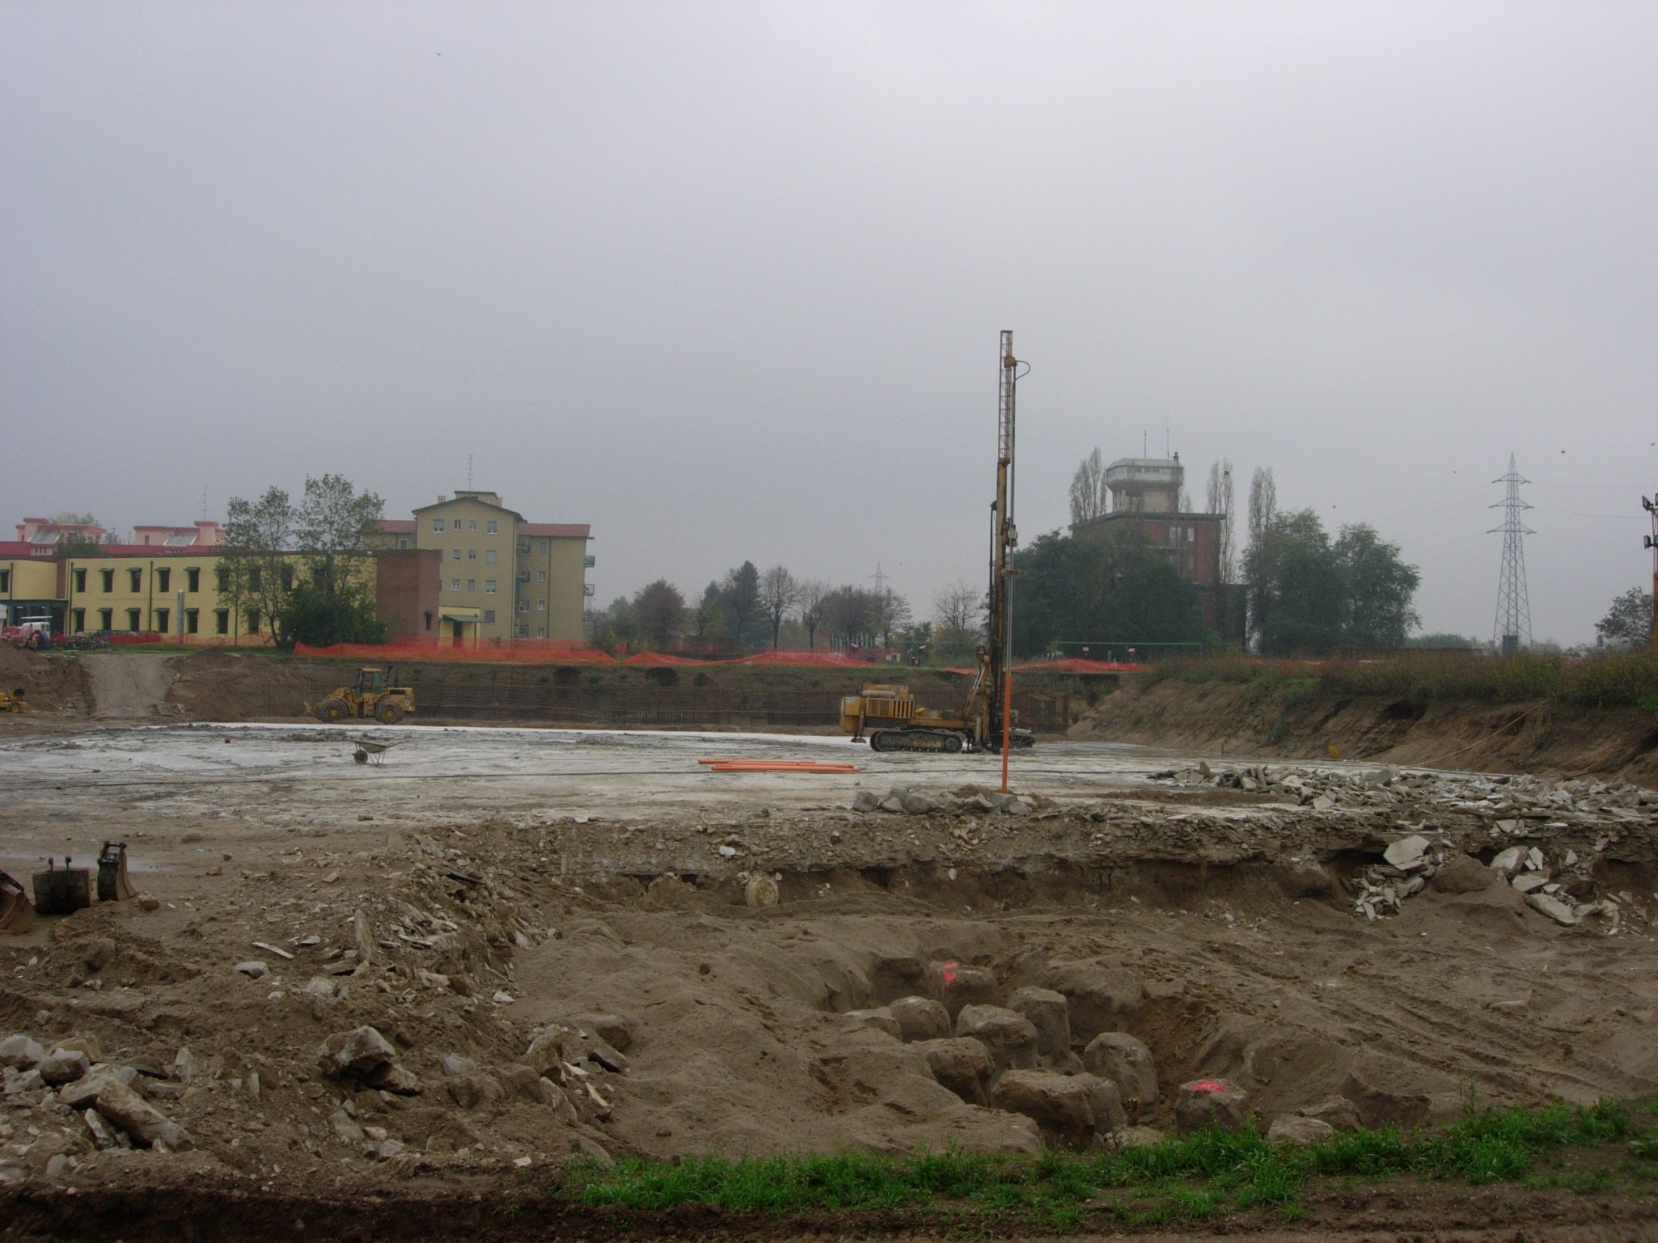
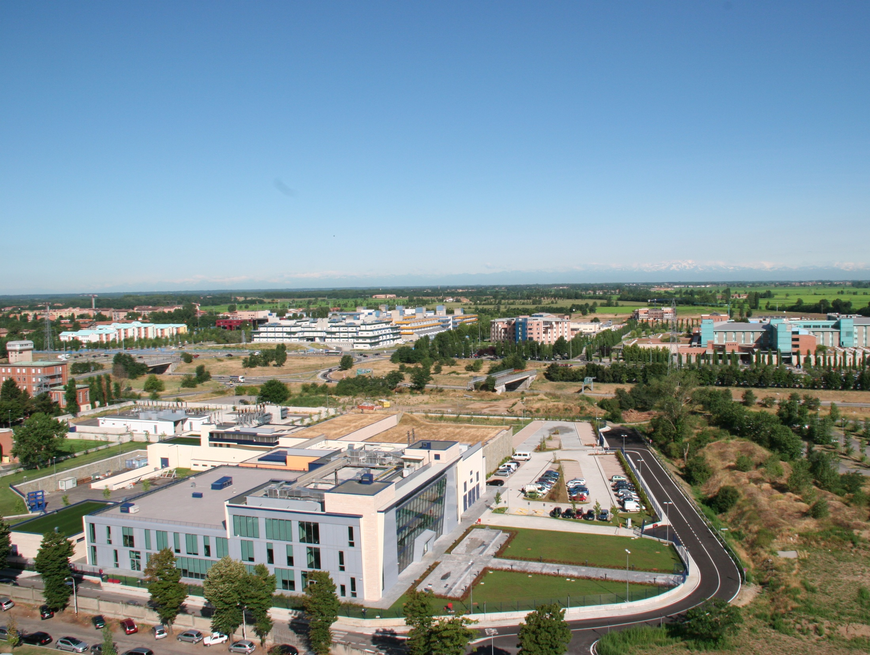
CNAO: National Centre for Oncological Hadrontherapy
Pavia, Italy
7 Novembre 2005

Slide 25

MedAustron- milestones and status
Milestones | Dates
Start of the construction | 02/2011
Building ready | 10/2012
1st beam in treatment room | 06/2014
Horizontal beam commissioned | 06/2015
Start of clinical operation | 12/2015
Full clinical operation | 2020

Slide 26
Selected research topics at GSI

Slide 27
New ions
Cancer stem cells
Hypofractionation
FLASH
Combined treatments
Radiogenomics
Biomarkers
Intra-tumoral heterogeneity (hypoxia)
Noncancer diseases
Second cancers

Slide 28
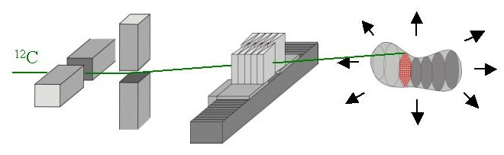
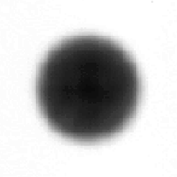
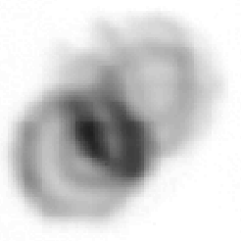
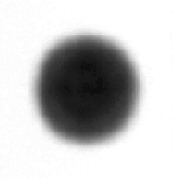
3D online motion compensation (3D-OMC)
magnetic scanner system
PMMA wedge system
suitable motion tracking system
dynamic treatment plan
static
moving,
non-compensated
moving,
compensated
real-time, highest precision
Bert & Durante Phys. Med. Biol. 2011

Slide 29
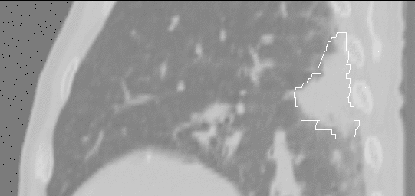

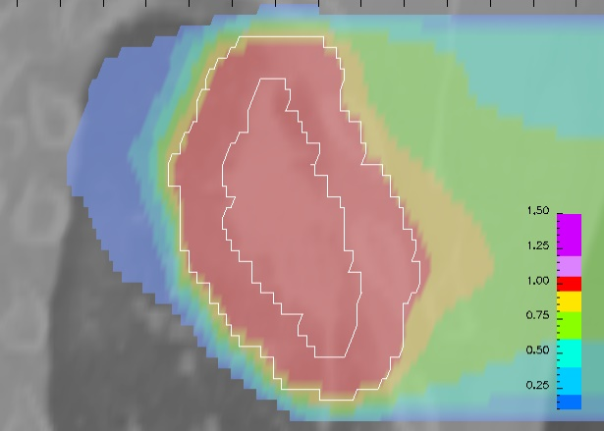
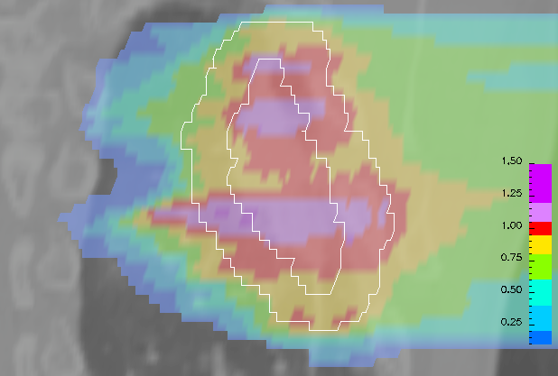
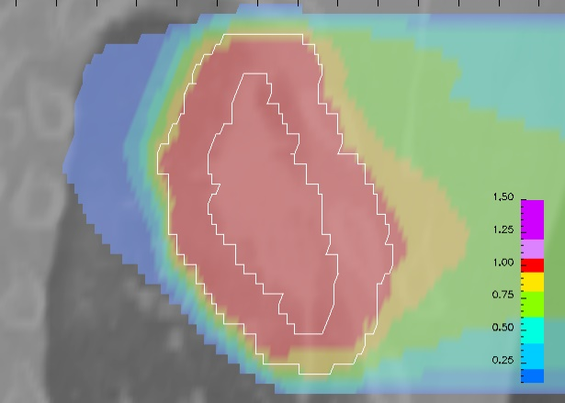
Influence of target motion
static
not compensated
compensated
Bert & Durante, Phys. Med. Biol. 2011
T=6.0s, Φ=270º

Slide 30

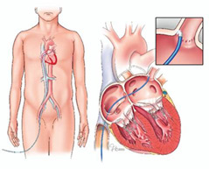
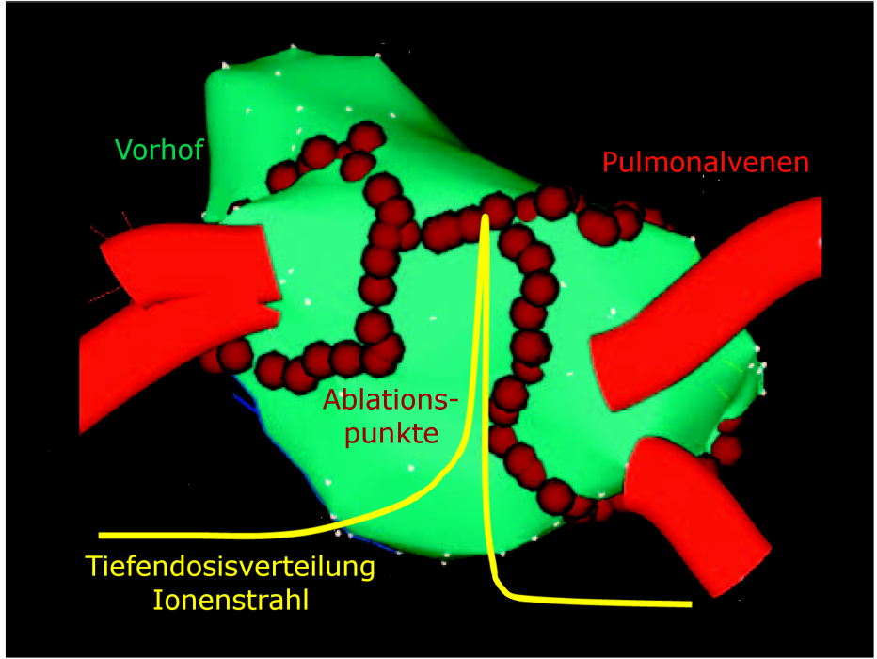
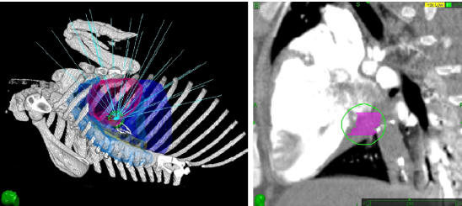
Treatment of noncancer diseases: cardiac arrhythmias?
Atrial fibrillation affects about 5% of middle-aged population and is associated with high risk of stroke and death
Catheter ablation of pulmunary vein is the current non-pharmacological solution (75% of success, severe complications in 6% of the patients)
Future: Atrial fibrilation
CyberHeart: cardiac lesion induced by a Cyberknife (Heart Rhythm., June 2010)

Slide 31
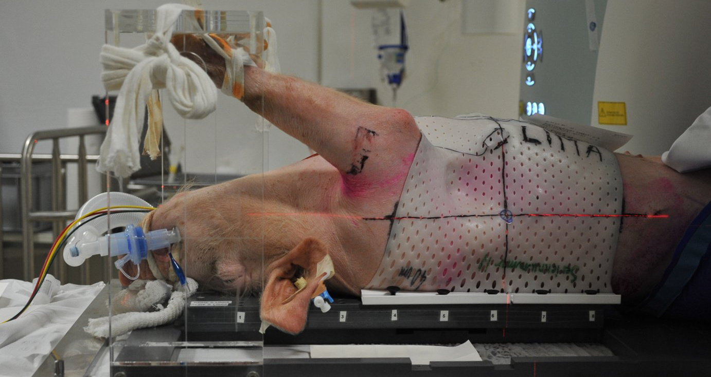
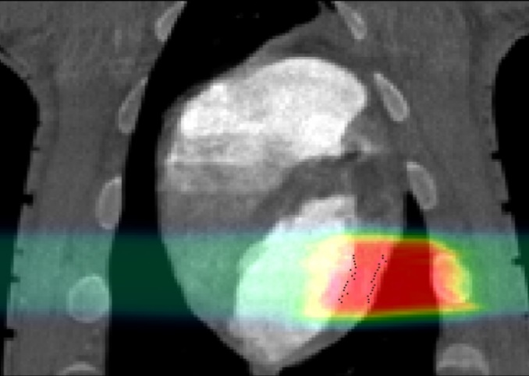
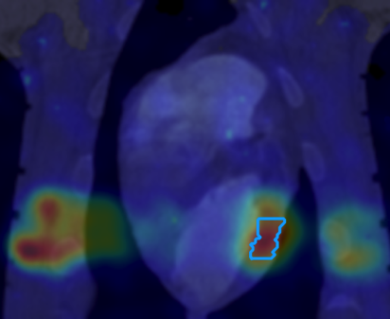
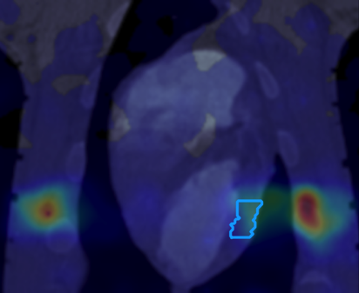
Noninvasive treatment of ventricular fibrillation by C-ions
Planned dose In-beam PET Offline PET
Lehmann et al., Sci. Rep. 2016; Rapp et al., Sci. Rep. 2019

Slide 32
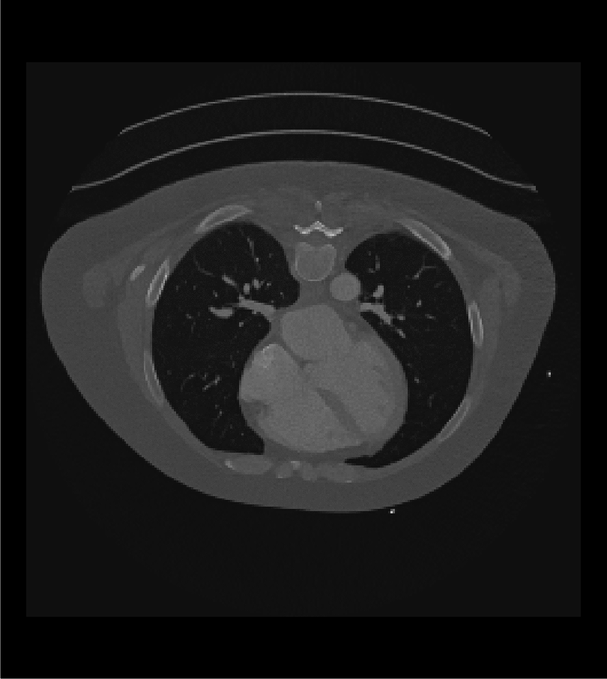
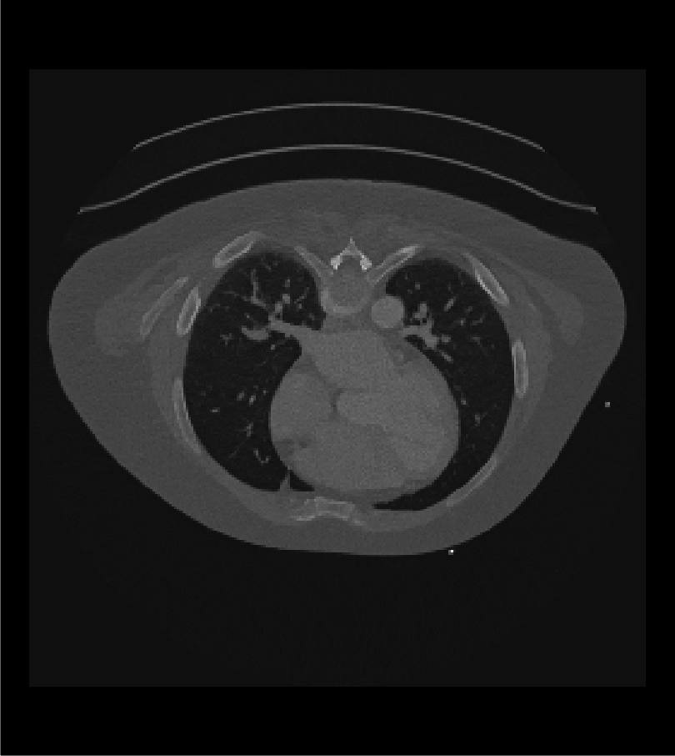
Mayo Clinics: 5D CT

Slide 33
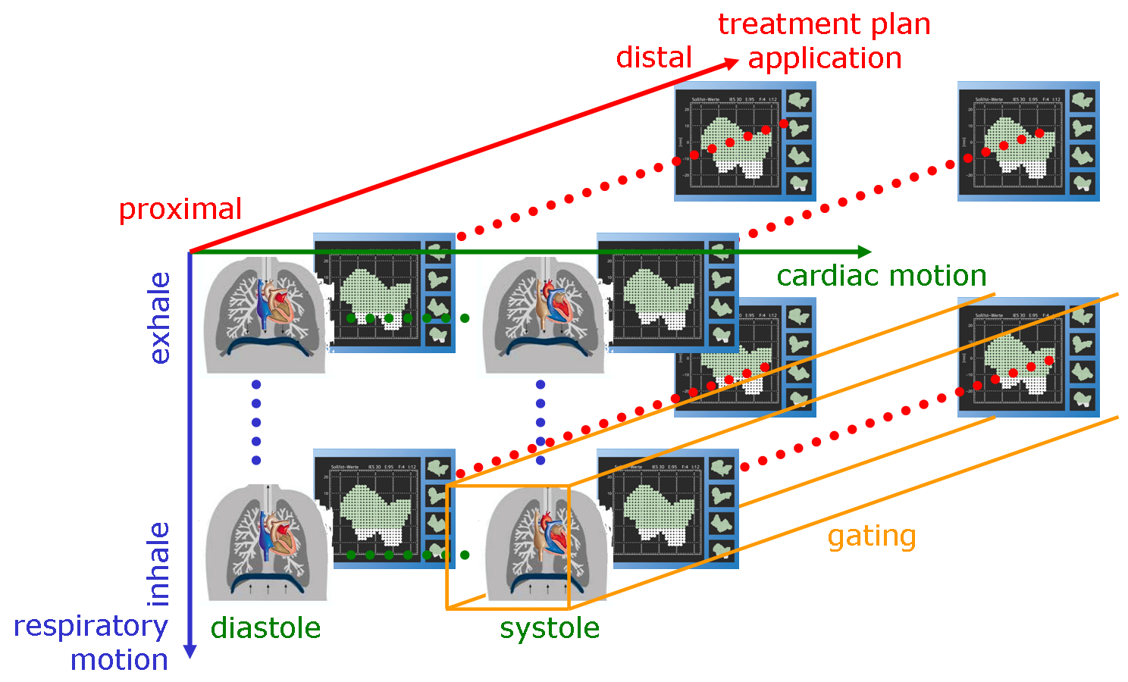
Particle 5D-TP (Bert et al., Med. Phys. 2012)

Slide 34
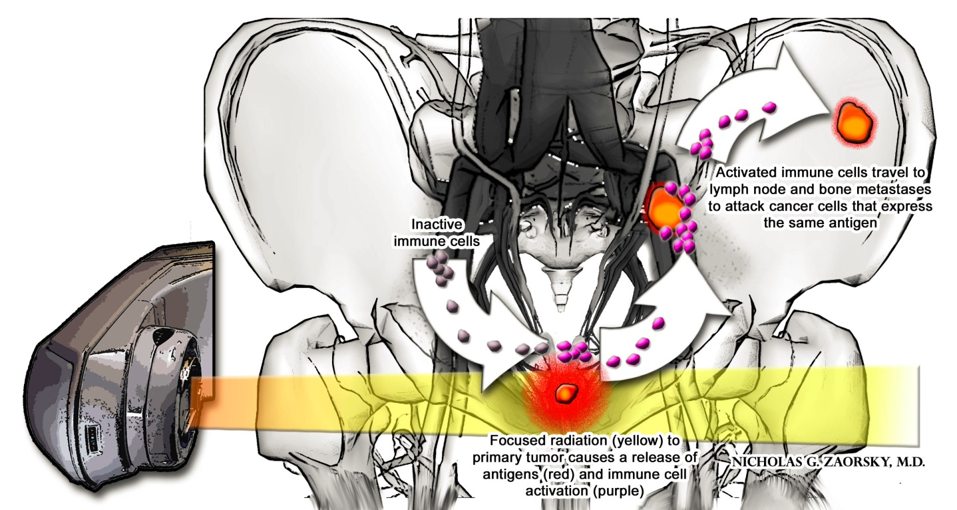
Abscopal effect – radiation-induced, immunogenic inactivation of metastases

Slide 35
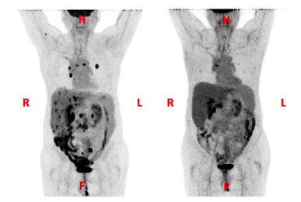

Combining RT and checkpoint inhibitors
NSCLC progressing after 3 lines of chemo
and chest RT: Multiple lung, bone
and liver metastasis
Courtesy of Silvia Formenti
RT to one liver met 6 Gy X 5 ( TD 30 GY)
Ipilimumab, 3 mg/Kg, after first RT q3 weeks, X 4 cycles
35

Slide 36
Particle therapy and immunotherapy
matter of ongoing discussion in literature

Slide 37
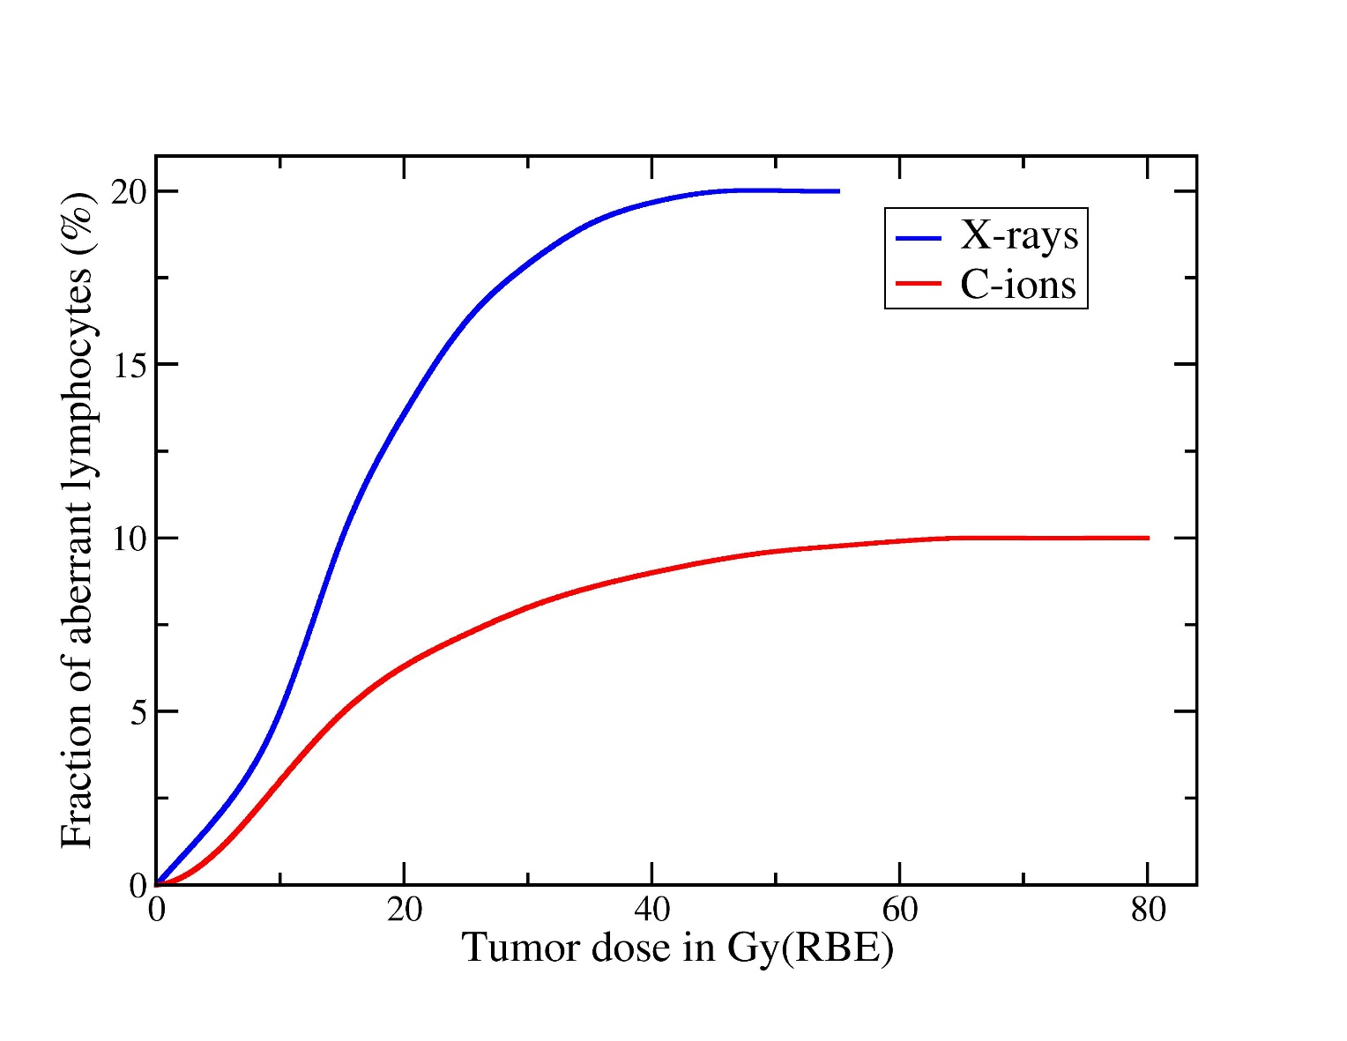
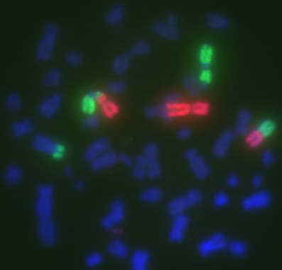
Advantages of particle RT for the immune system
Reduced integral dose of carbon ion therapy to healthy tissue
Result: circulating blood lymphocytes are better spared and are available for an efficient immune response
Durante et al., Int. J. Radiat. Oncol. Biol. Phys. 2000

Slide 38
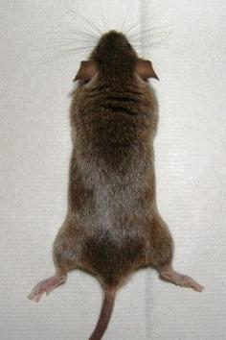
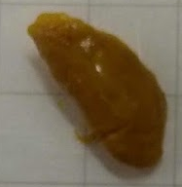
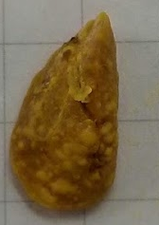
Reduction of lung metastases
CIRT+CPI
Negative control
Assessment of superficial nodules after fixation in Bouin‘s solution
NC = negative control
CPI = check point inhibitors only
CIRT = C-ions only, 10 Gy
XRT = photons, 10 Gy
N=2-3

Slide 39
Particle therapy clinics

Slide 40
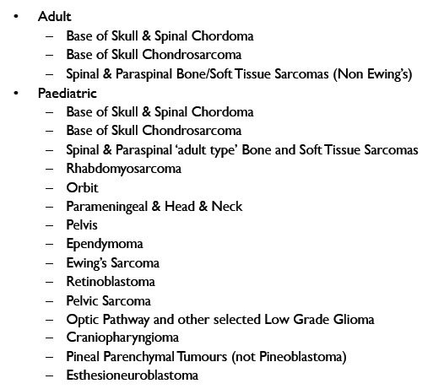
CLINICAL INDICATIONS
Established clinical indications
Skull base tumors
Spine tumors
Eye tumors (p)
Solid literature results
Pediatric tumors (p)
Head and Neck tumors
Prostate tumors
Courtesy of Marco Krengli, Novara
UK overseas clinical indications for protontherapy, courtesy of Simon Jolly, UCL
UK list of typical indications <2% patients

Slide 41
Proton Beam Therapy for Breast Cancer
About 200,000 new cases per year in U.S
Most affected at the most productive part of life
Most patients survive (> 2 millions survivors)
Most diagnosed at early stage
Majority receives radiation
“Horror” stories from side effects of radiation leads many women to choose mastectomy over BCT

Slide 42
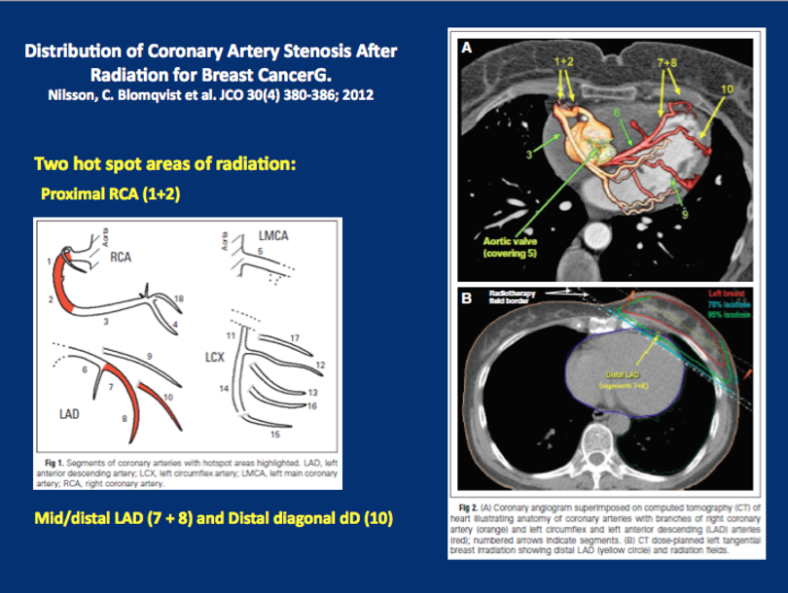
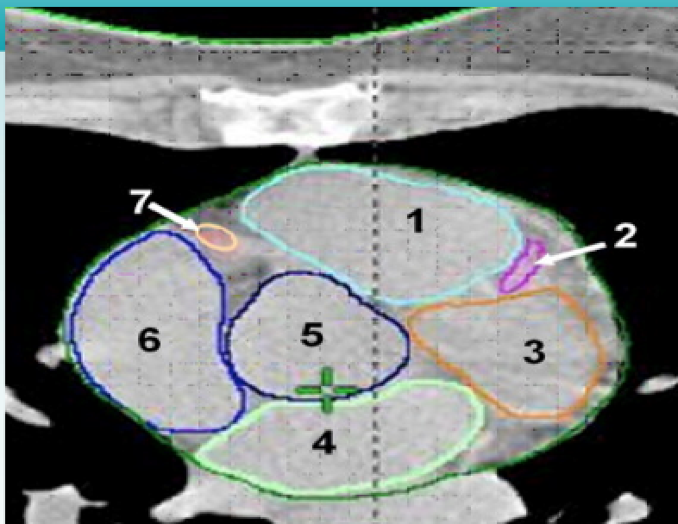

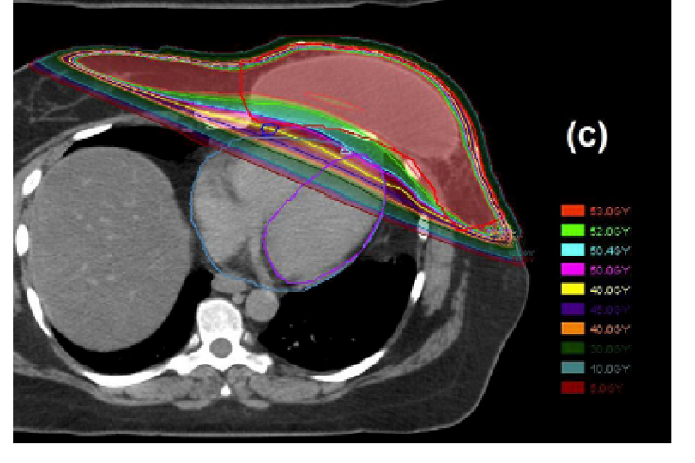
RCA
LAD
R Atrium
R Vent
Aorta
L Vent
L Atrium
42

Slide 43
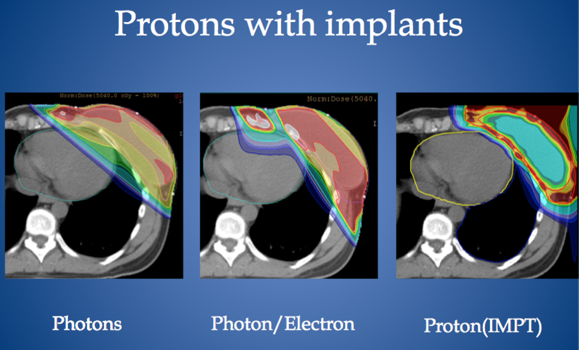

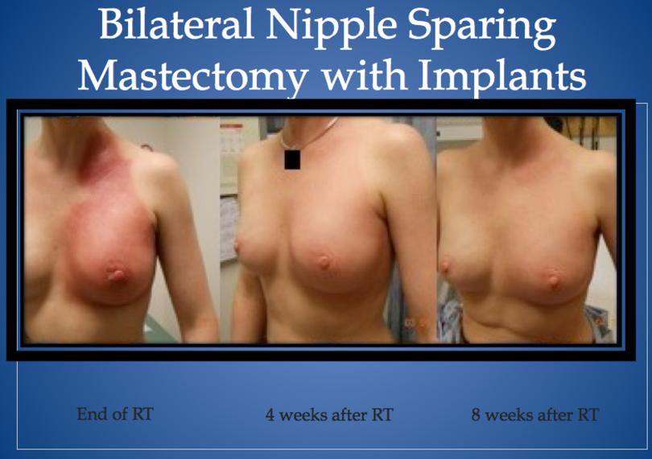
Post-mastectomy radiotherapy for left-side breast with or without immediate reconstruction
MacDonald et al, Int J Rad Onc Bio Phys, 1-7, 2013

Slide 44
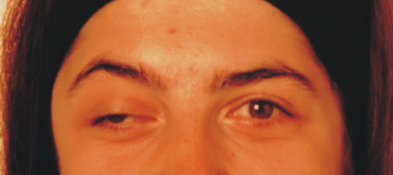
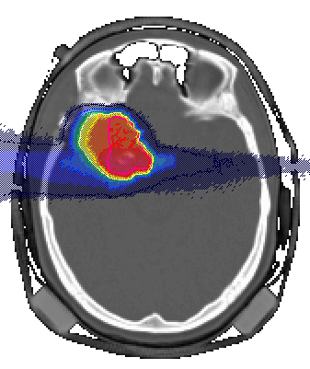


Clinical results
Patient:23 years old
Diagnosis: Chondrosarcoma
Subtotal surgery
Postoperative radiationtherapy:60Gye
3 fields with 20 fraction
vor Bestrahlung
6 Weeks after carbon tfeatment with a dose of 60 Gye
D.Schulz-Ertner et al.

Slide 45


Adenocystic Carcinoma combined photons and C12-Boost
Prior RT
6 weeks after RT

Slide 46

Adenoidcystic carcinomas: Photon-IMRT with and without carbon boost
carbon
IMRT only
Tumor control
[Schulz-Ertner, Cancer 2005]

Slide 47

Skull-base chordoma
Loeffler & Durante, Nat. Rev. Clin. Oncol. 2013

Slide 48
Long-term results of the chordoma patients treated at GSI
courtesy of Jürgen Debus

Slide 49


The NIRS experience
Clinical experiences have demonstrated that C-ion RT is effective in such regions as the head and neck, skull base, lung, liver, prostate, bone and soft tissues, and pelvic recurrence of rectal cancer, as well as for histological types including adenocarcinoma, adenoid cystic carcinoma, malignant melanoma and various types of sarcomas, against which photon therapy are less effective. Furthermore, when compared with photon and proton RT, a significant reduction of overall treatment time and fractions has been accomplished without enhancing toxicities.
NIRS annual report 2008, Tsujii et al.

Slide 50

A recent application: pancreas cancer
Pancreatic cancer ranks as the fifth leading cause of cancer related death in the world.
95% are adenocarcinomas
Approximately 34,000 patients die from pancreatic cancer per year in USA.
The 5 year survival rate of pancreatic cancer patients is no more than 10% and its average survival time after diagnosis is only 9 months.
Even after curative resection, 5 year survival rate is only 12%.
Tumor
~2 ~50
pO₂ (mmHg)
Notes:
Pancreatic cancer ranks as the fifth leading cause of cancer related death in Japan. The 5 year survival rate of pancreatic cancer patients is no more than 10.2% and even after curative resection,5 year survival rate is only 12.3%.

Slide 51

Survival Rates
Courtesy of Dr. Shigeru Yamada, NIRS
Combination of Gemcitabine and Carbon-ion therapy
1y-OS
43.2GyE+400mg/m² 50%
43.2GyE+700mg/m² 83%
43.2GyE+1000mg/m² 83%
45.6GyE+1000mg/m² ----
 | Year | n | Treatment | Survival |  | MST(m)
 |  |  |  | 12m | 24m
ECOG¹⁾ | 2008 | 34 | GEM+RT(50.4Gy) | 50% | 12% | 11.0
 |  | 37 | GEM | 32% | 4% | 9.2
NIRS |  | 30 | GEM+CIRT | 74% | 44% | 17.4
1) ASCO2008 Patric J. Loehrer Senior
Notes:
This is the overall survival rates. The one year overall survival rate were 50% at 400mg and 83% at 700 and 1000mg respectively. This trial is still ongoing. Our survival data of total patients is high compared to recent ECOG results.

