Slide 1


Study of the scalar box diagram through the Loop-Tree Duality
Jesús Andrés Aguilar-Quiroz and Dr. Roger J. Hernandez-Pinto
Facultad de Ciencias Fsico-Matematicas, Universidad Autonoma de Sinaloa, Culiacan, Mexico
Julio/2020

Slide 2
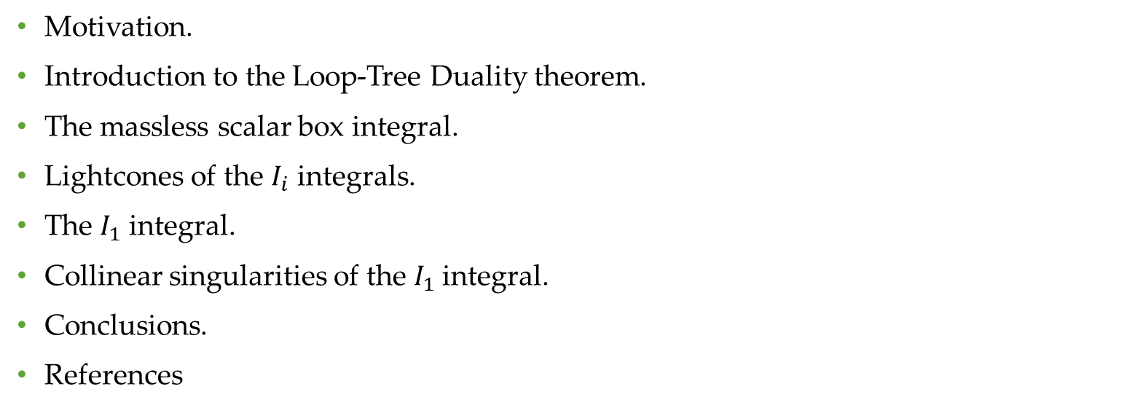
Content
Motivation.
Introduction to the Loop-Tree Duality theorem.
The massless scalar box integral.
Lightcones of the $I_{i}$ integrals.
The $I_{1}$ integral.
Collinear singularities of the $I_{1}$ integral.
Conclusions.
References

Slide 3
Motivation.
This work aims to study the scalar box diagram through the Loop-Tree Duality (LTD) theorem and to show the origin of singularities, whether IR or UV singularities.

Slide 4

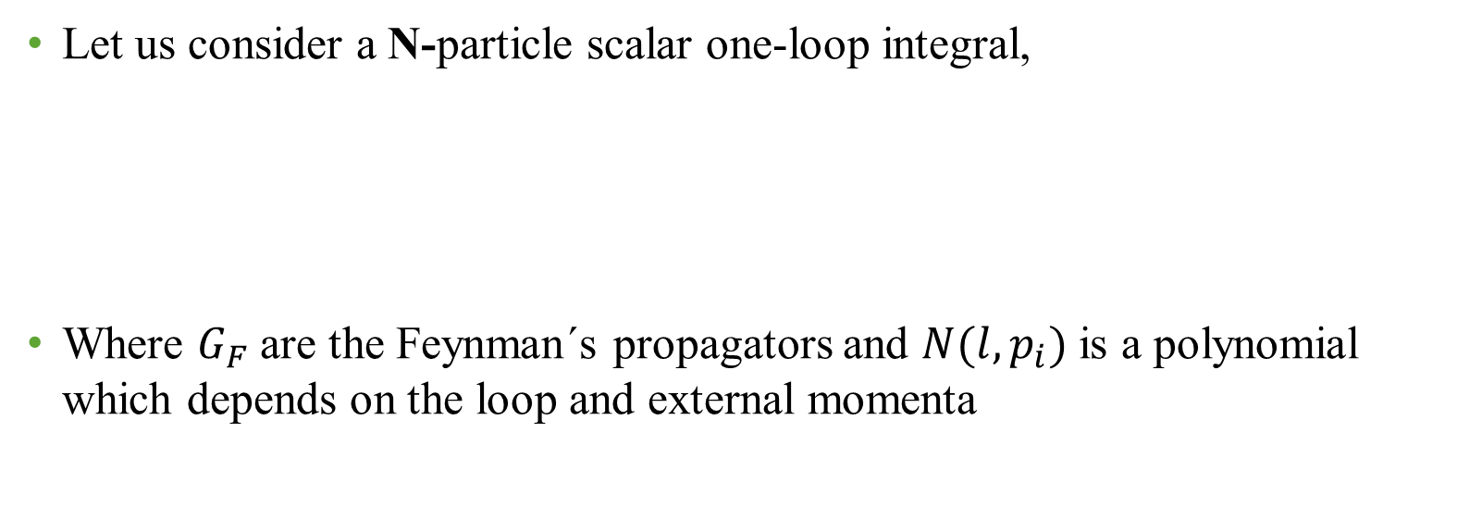
Introduction to the Loop-Tree Duality theorem.
Let us consider a N-particle scalar one-loop integral,
Where $G_{F}$ are the Feynman´s propagators and $N(l,p_{i})$ is a polynomial which depends on the loop and external momenta

Slide 5

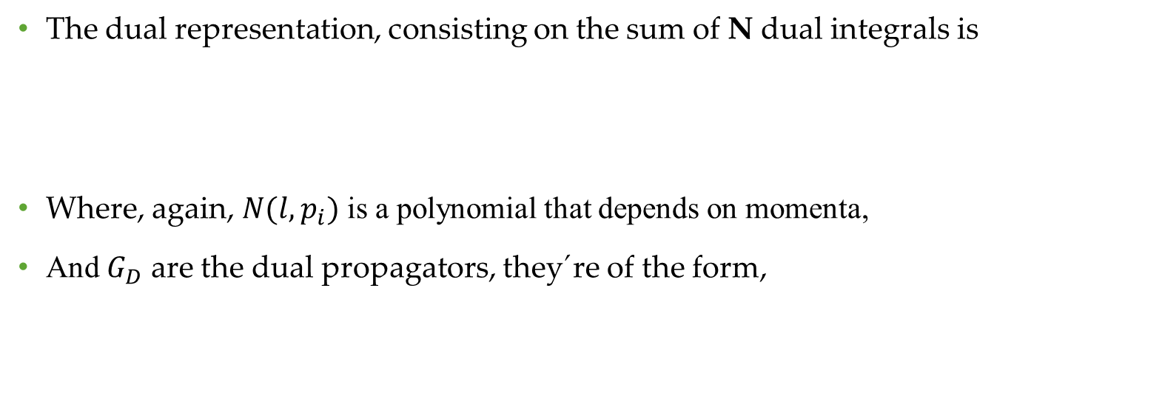
Introduction to the Loop-Tree Duality theorem.
The dual representation, consisting on the sum of N dual integrals is
Where, again, $N(l,p_{i})$ is a polynomial that depends on momenta,
And $G_{D}$ are the dual propagators, they´re of the form,

Slide 6


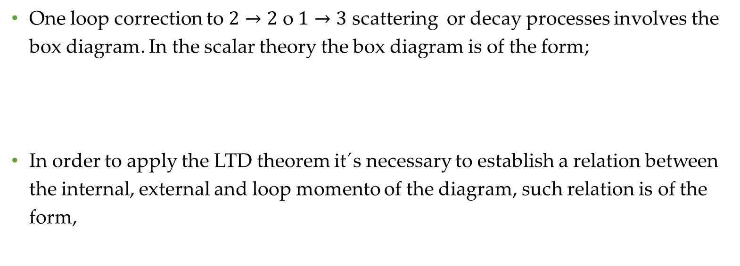
The massless scalar box integral.
One loop correction to $2→2$ o $1→3$ scattering or decay processes involves the box diagram. In the scalar theory the box diagram is of the form;
In order to apply the LTD theorem it´s necessary to establish a relation between the internal, external and loop momento of the diagram, such relation is of the form,

Slide 7
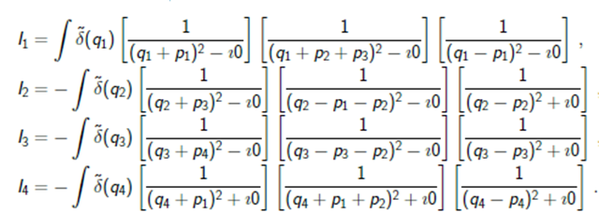
The massless scalar box integral.
This way using the parametrization of momenta and applying the LTD theorem we get a set of four dual integrals.
The sum of these dual integrals gives the box diagram integral

Slide 8

The massless scalar box integral.
Furthermore the bos diagram depends on three parameters $s_{12}$, $s_{13}$ and $s_{23}$ where $s_{ij}={(p_{i}^{}+p_{j}^{})}^{2}$
In order to compute the integrals we parametrize the external momenta as,

Slide 9
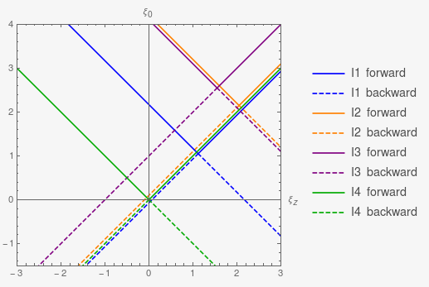


Lightcones of the $I_{i}$Integrals
The distinct lightcones for each integral $I_{i}$obtained from theparametrizations and the LTD theorem.
Soft singularities occurs at the origin while collinear are also present.
Collinear singularities occur on the integration domain.

Slide 10

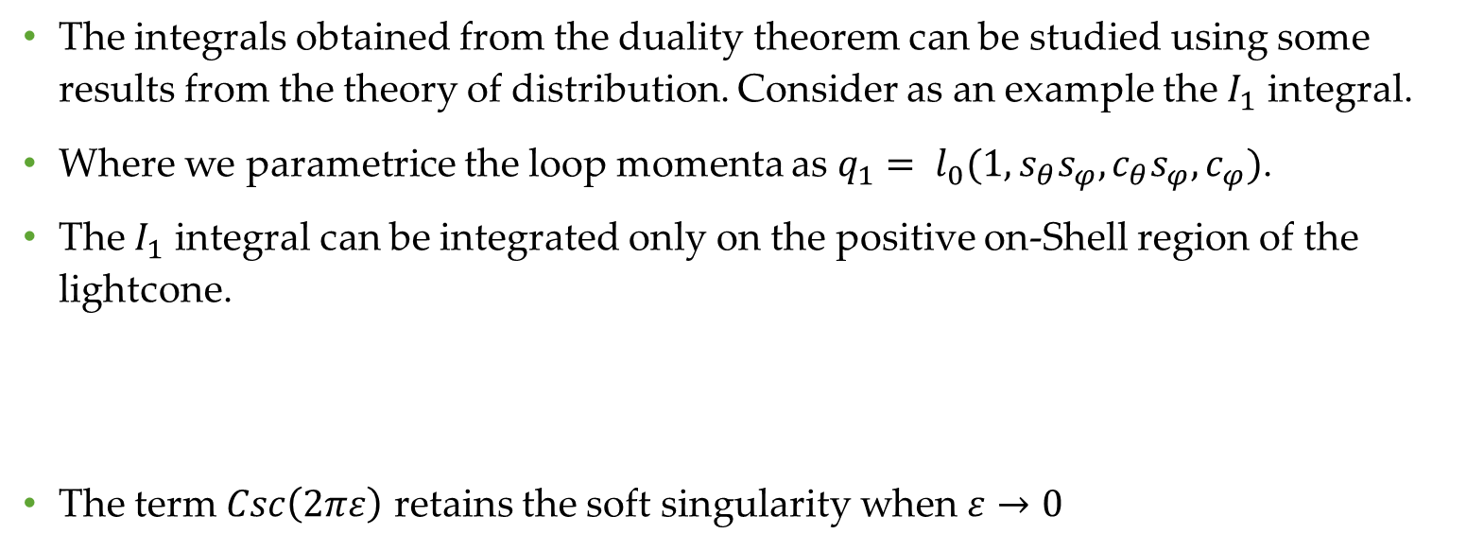

The $I_{1}$ integral.
The integrals obtained from the duality theorem can be studied using some results from the theory of distribution. Consider as an example the $I_{1}$ integral.
Where we parametrice the loop momenta as $q_{1}= l_{0}({1,s}_{θ}s_{φ},c_{θ}s_{φ}, c_{φ})$.
The $I_{1}$ integral can be integrated only on the positive on-Shell region of the lightcone.
The term $Csc\left(2πε\right)$ retains the soft singularity when $ε→0$

Slide 11
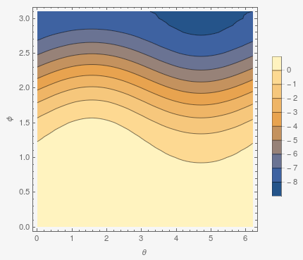
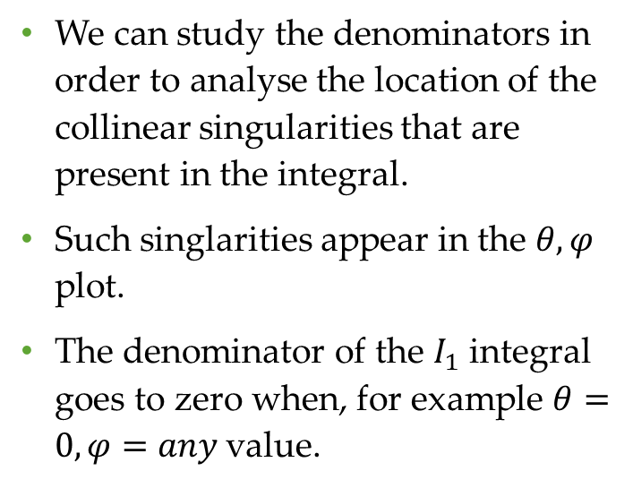

Collinear singularities of the $I_{1}$ integral.
We can study the denominators in order to analyse the location of the collinear singularities that are present in the integral.
Such singlarities appear in the $θ,φ$ plot.
The denominator of the $I_{1}$ integral goes to zero when, for example $θ=0,φ=any \text{value}$.

Slide 12
Conclusions.
In this work we have presented the study of the box diagram through the Loop-Tree Duality theorem.
We find the lightcones for each dual integral and studied the soft and collinear singularities wich are present in the known integral.
Such analysis can be applied to the rest of dual integrals.

Slide 13
References
[1] S. Catani, T. Gleisberg, F. Krauss, G. Rodrigo and J.-C. Winter, JHEP09(2008) 065.
[2] G. F. R. Sborlini, F. Driencourt-Mangin, R. Hernández-Pinto and G. Rodrigo, JHEP1608(2016) 160 [arXiv:1604.06699[hep-ph]].
[3] J. J. Aguilera-Verdugo, R. J. Hernandez-Pinto, G. Rodrigo, G. F. Sborlini and W. J. Torres Bobadilla,[arXiv:2006.11217 [hep-ph]].

Slide 14
Thank you!

