Slide 1





Initial Development of a Control System for the FDD Detector in the ALICE Experiment for Operation on LHC Run-3
XXXIV Annual Meeting of the Division of Particle and Fields of the Mexican Society of Physics
M.E. Juan Manuel Mejía Camacho
Dr. Juan Carlos Cabanillas Noris
Dr. Ildefonso León Monzón
Dr. Mario Iván Martínez Hernández
July 9th, 2020
Notes:
Hello, my name is Juan Manuel Mejía Camacho. In this occasion I will show you mainly the current status of the development of a Control System for the Fast Interaction Trigger Diffractive Detector in the ALICE experiment for operation on the Large Hadron Collider during Run-3 in next year.

Slide 2
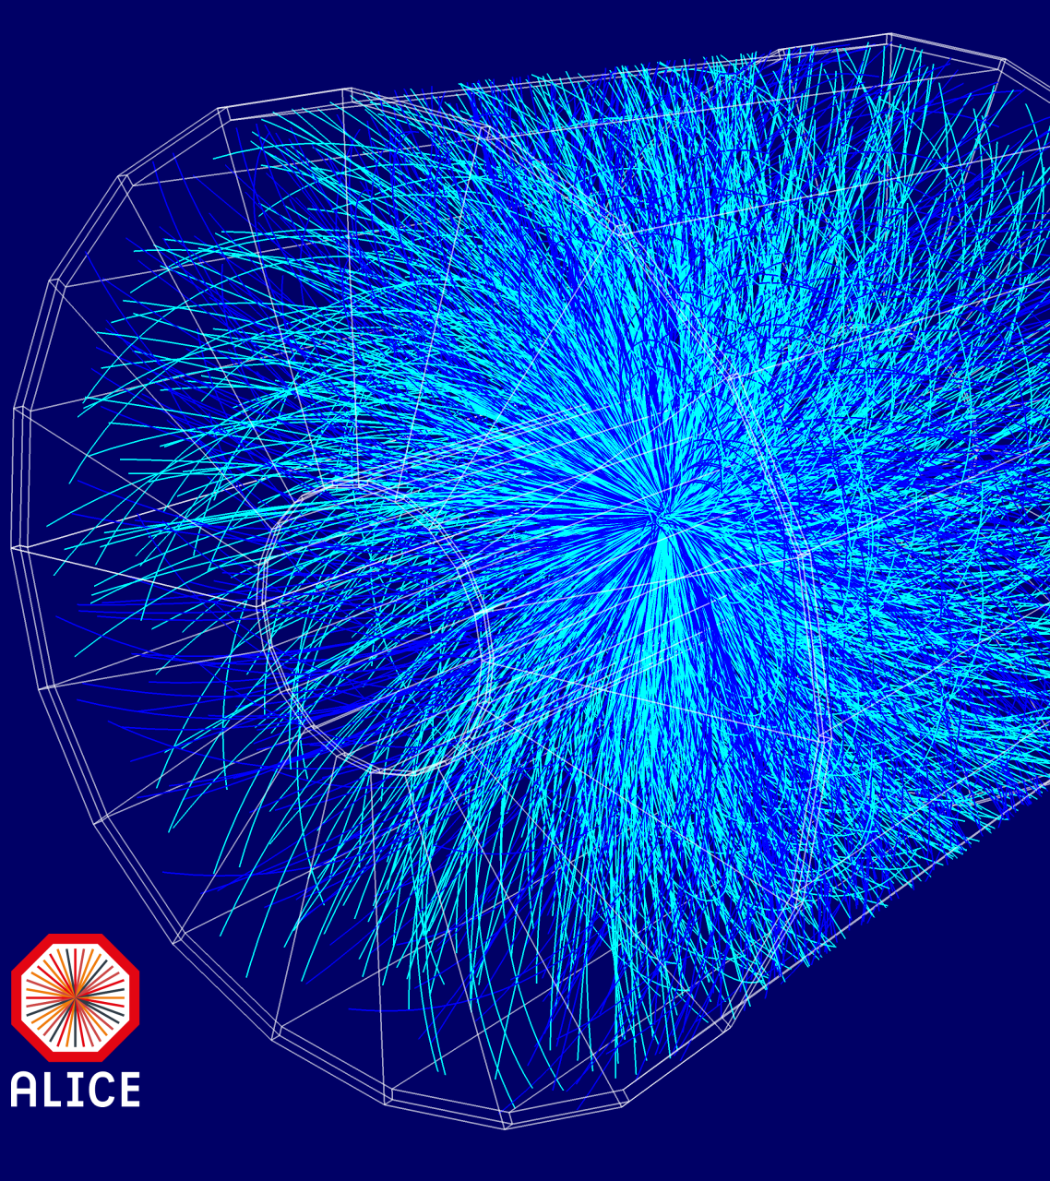
Content
XXXIV Annual Meeting of the Division of Particle and Fields
Diffractive events in ALICE
Fast Interaction Trigger Diffractive Detector
Hardware to be used with FDD
Detector Control System (DCS)
FDD-DCS development methodology
Conclusions
References
Notes:
The topics that will be shown during the presentation are going to be:
Diffractive events in ALICE
Fast Interaction Trigger Diffractive Detector
Hardware to be used with Fast Interaction Trigger Diffractive Detector (FDD)
Detector Control System (DCS)
Development methodology for the Control System (DCS) of the Fast Interaction Trigger Diffractive Detector.
Conclusions
References

Slide 3
Diffractive events in ALICE
The main characteristic of a diffractive process is the presence of a significant gap in the distribution of speed of the particles produced during collisions; that is, the absence of particles created in the collision whose direction is in a given interval.
The study of diffractive events with boson production is important for the understanding of the Parton composition (quarks and gluons inside the protons) of the exchanged object called Pomeron. In most high energy experiments, the selection of diffractive events is made by using this characteristic in different ways [1-2].
Notes:
The main characteristic of a diffractive process is the presence of a significant gap in the distribution of speed of the particles produced during collisions; that is, the absence of particles created in the collision whose direction is in a given interval.
The study of diffractive events with boson production is important for the understanding of the Parton composition (quarks and gluons inside the protons) of the exchanged object called Pomeron. In most high energy experiments, the selection of diffractive events is made by using this characteristic in different ways [1][2].

Slide 4
  Diffractive events in ALICE
The study of diffractive production in Large Hadron Collider (LHC) at CERN is of great interest, both for theoretical and experimental reasons [3].
The selection of diffractive events in ALICE is limited by the range over which speed gaps could be detected.
The study of diffractive events with ALICE experiment of the LHC in proton-proton (pp), lead-lead (Pb-Pb), and proton-lead (p-Pb) collisions could improve its efficiency with the installation of the Fast Interaction Trigger Diffractive Detector (FDD) for Run-3 in 2021.
Notes:
The study of diffractive production in Large Hadron Collider at CERN is of great interest, both for theoretical and experimental reasons [3]. The identification of diffractive events is not experimentally simple. At low energies, it is often possible to identify and measure the non-diffracted proton, but in the Large Hadron Collider, this becomes a great challenge, so they must have alternative methods for high energies.
The selection of diffractive events in ALICE is limited by the range over which speed gaps could be detected. Therefore, it is possible to achieve better measurements by extending the range of directions in which the production of particles or the absence of particles can be detected.
The study of diffractive events with ALICE experiment of the Large Hadron Collider (LHC) in proton-proton (pp), lead-lead (Pb-Pb), and proton-lead (p-Pb) collisions could improve its efficiency with the installation of the Fast Interaction Trigger Diffractive Detector (FDD) for Run-3 in 2021.

Slide 5
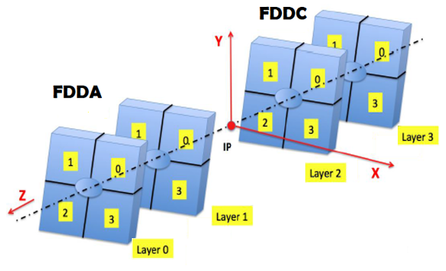
Fast Interaction Trigger Diffractive Detector (FDD)
XXXIV Annual Meeting of the Division of Particle and Fields
The FDD detector consists of two sub-detectors called FDDA and FDDC.
Each of them includes two detector layers, and each one of them consists of four scintillator modules arranged around the LHC beam pipe.
The FDDA and FDDC designations refer to the installation positions at both ends of the ALICE site concerning the interaction point (IP).
Figure 1. FDDA and FDDC sub-detectors nomenclature in the ALICE
experiment cavern.
Notes:
The Fast Interaction Trigger Diffractive Detector (FDD) consists of two sub-detectors called FDDA and FDDC.
Each of them includes two detector layers, and each one of them consists of four scintillator modules arranged around the Large Hadron Collider beam pipe.
The FDDA and FDDC designations refer to the installation positions at both ends of the ALICE cavern concerning the interaction point (IP). The approximate distance between the interaction point, and the FDDC and FDDA sub-detectors is 19m and 17m, respectively.

Slide 6
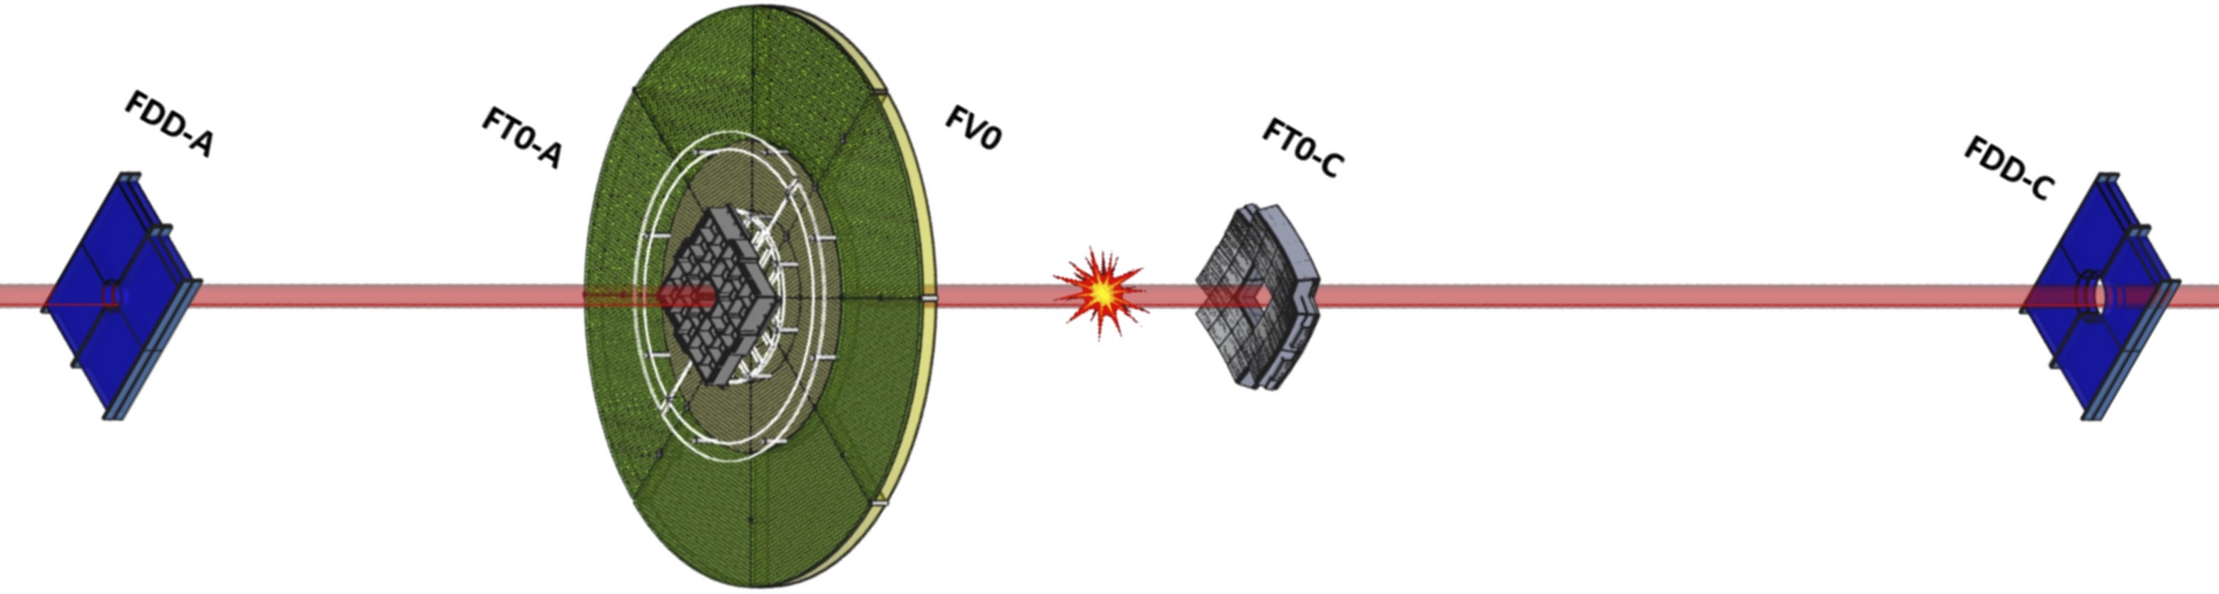
Fast Interaction Trigger Diffractive Detector (FDD)
The FDD detector is part of one of the three subdetectors that make up ALICE's Fast Interaction Trigger (FIT) project.
The FDD detector will increase the time resolution compare with ALICE Diffractive Detector (AD) used in Run-2 (2015-2018), and it will provide triggers at level zero for ALICE [4].
Figure 2. Detectors part of FIT project in ALICE for Run-3.
Notes:
The Fast Interaction Trigger Diffractive Detector (FDD) is part of one of the three subdetectors that make up ALICE's Fast Interaction Trigger (FIT) project, together with the FT0 and FV0 subdetectors; which plan to start operating in 2021.
The FDD detector will increase the time resolution compare with ALICE Diffractive Detector (AD) used in Run-2 between 2015 & 2018, and FDD will provide triggers at level zero for ALICE (must be fast as possible).

Slide 7
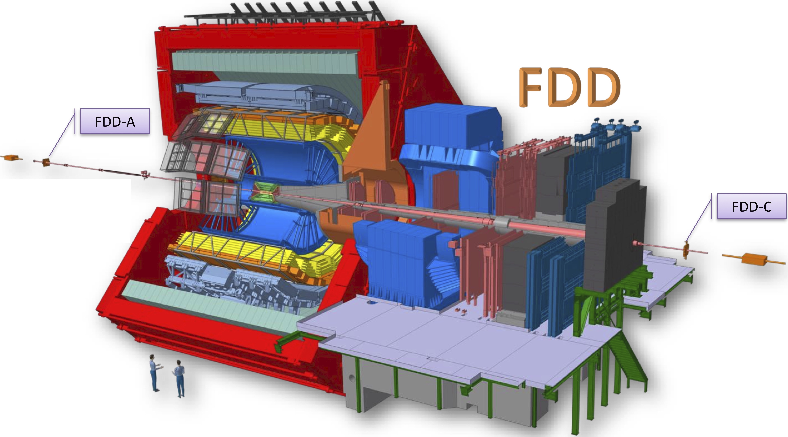
The FDD detector will be installed at ends A and C of the ALICE cavern for operation during Run-3 of LHC
XXXIV Annual Meeting of the Division of Particle and Fields
Figure 3. FDDA and FDDC location at ALICE
Notes:
The FDD detector will be installed at ends A and C of the ALICE cavern for operation during Run-3 of the Large Hadron Collider (LHC)

Slide 8
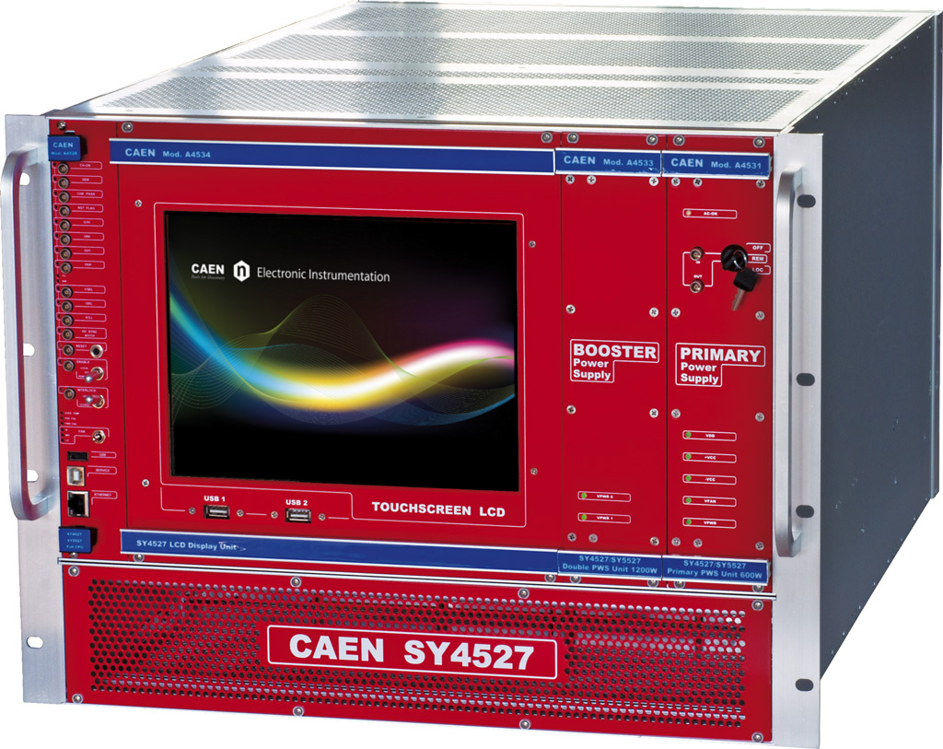
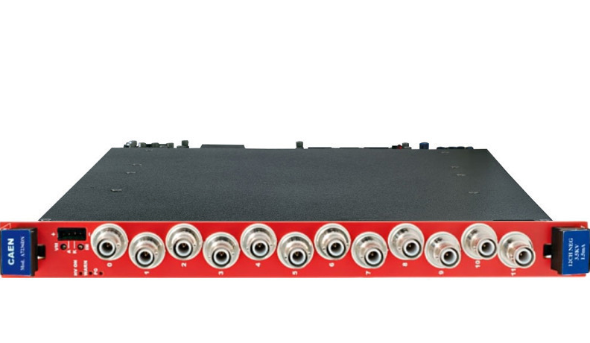
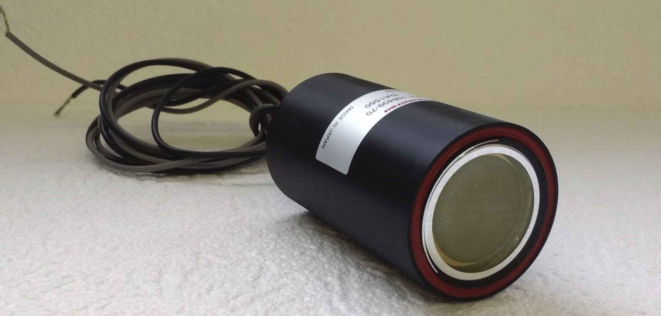
Hardware to be used with FDD
Figure 5. HV board A7236
Two HV boards will be used to power 16 PMTs (8 for each FDD subdetector).
Figure 4. Universal Multichannel Power Supply System
Figure 6. Photomultiplier tube H8409-70
Notes:
Figure 4. The main device to satisfy the high voltage requirements of the FDD detector is a universal multichannel power supply model SY4527 from the company CAEN, which has 16 slots to place voltage boards and branch controllers, where the latter are used to control other remote generators and distributors. This source is going to be located in the Counting Room (CR) number 4 of point 2 of the Large Hadron Collider.
Figure 5. The high voltage boards used inside the Universal Multichannel Power Supply System are from the CAEN brand A7236 model, which have the ability to provide up to 12 high voltage channels. The output voltages of these boards can be set from 0 to 3.5 kV with a maximum power of 4W per channel. Two of these boards are going to be used for the FDD detector.
Figure 6. Two of these High Voltage boards will be used to power the photomultipliers (PMTs) that collect the light coming from each of the modules of the FDD sub-detectors during the collisions in ALICE experiment.

Slide 9
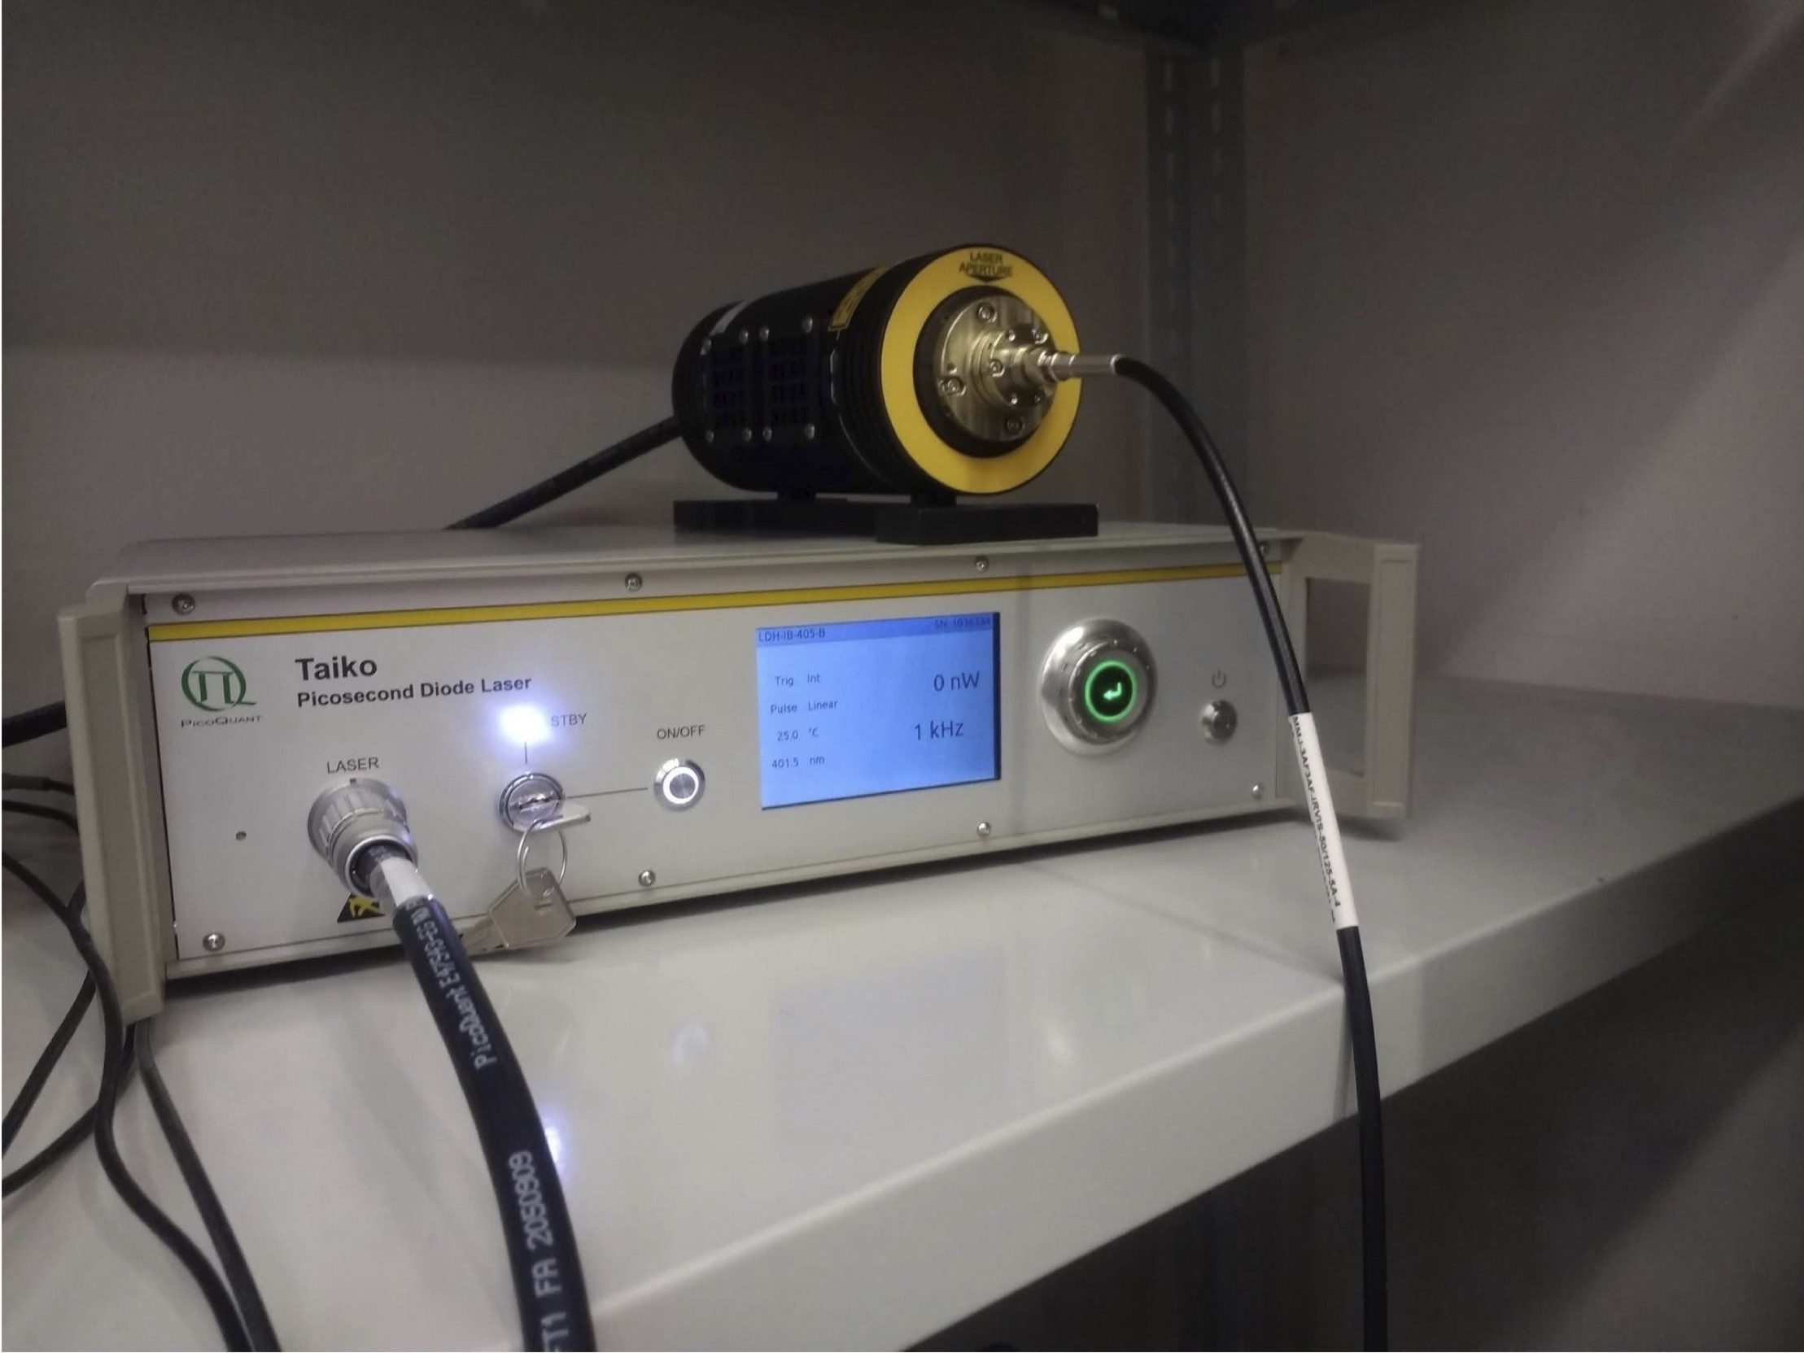
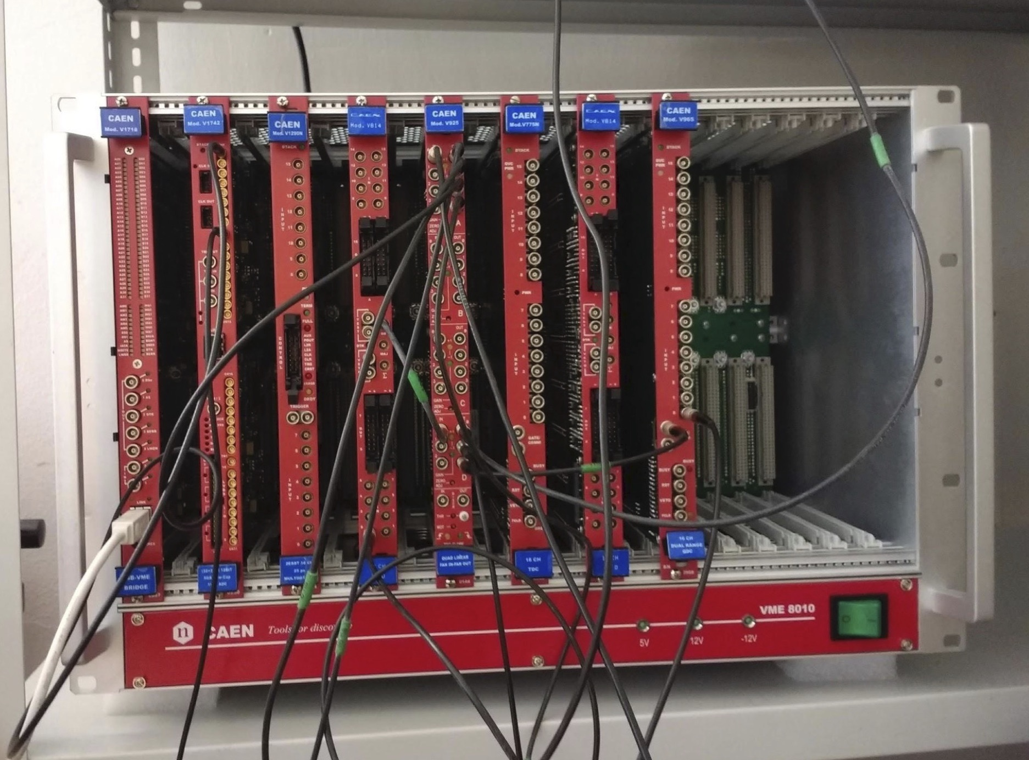
Hardware to be used with FDD
Figure 7. Taiko Laser Driver PDL M1 & Laser Diode Head
LDH-IB-405-B
Figure 8. VME crate
Notes:
Figure 7. The Taiko laser calibration system will allow for the monitoring of the FDD detector to adjust parameters to guarantee the best performance.
Figure 8. The electronics in the FDD for both sub-detectors (FDDA and FDDC) are located in a VME crate, which is used as a metal structure with the ability to interconnect electronic modules that are inserted into the slots of the crate, as well as their power supplies.

Slide 10
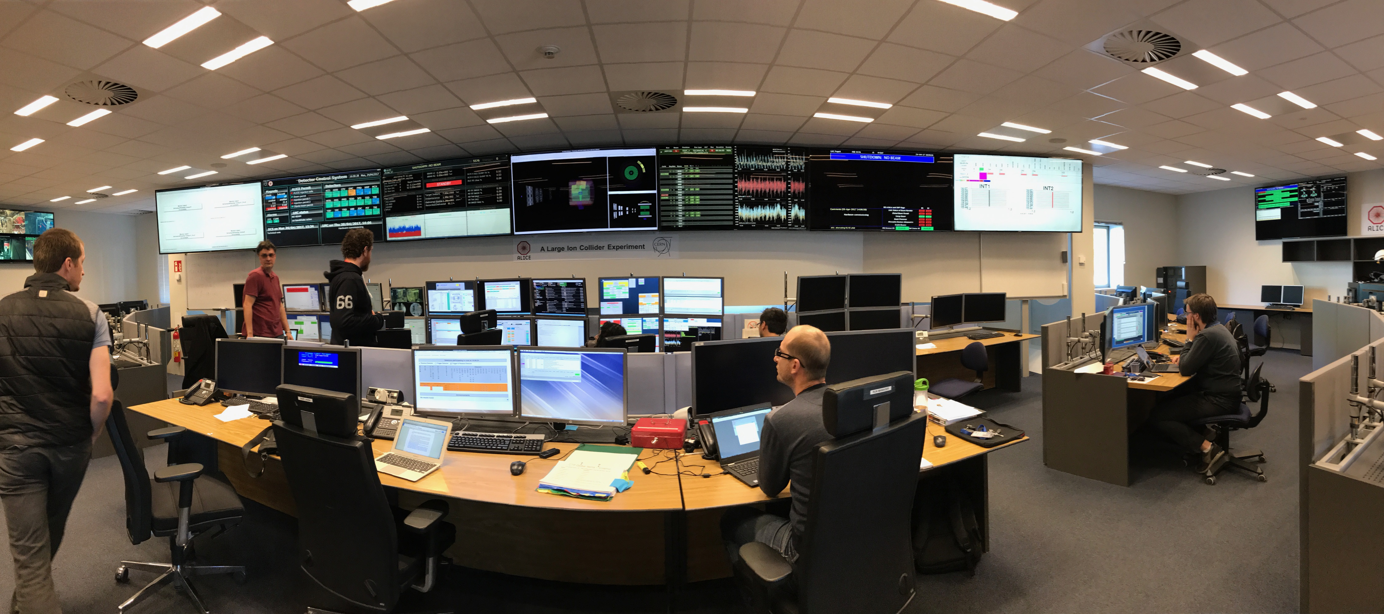
Detector Control System (DCS)
The main task of the ALICE control system is to ensure the safe and correct operation of the experiment.
XXXIV Annual Meeting of the Division of Particle and Fields
Notes:
The main task of the ALICE experiment control system is to ensure the safe and correct operation of the experiment. In addition, provide remote control and monitoring of all experimental equipment, so that the experiment can be operated from a single workplace. This place is known as the ALICE Run Control Center (ALICE RCC) at the point 2 of the Large Hadron Collider (LHC), through a single set of operator panels, or operated by remote users with access control permissions.

Slide 11
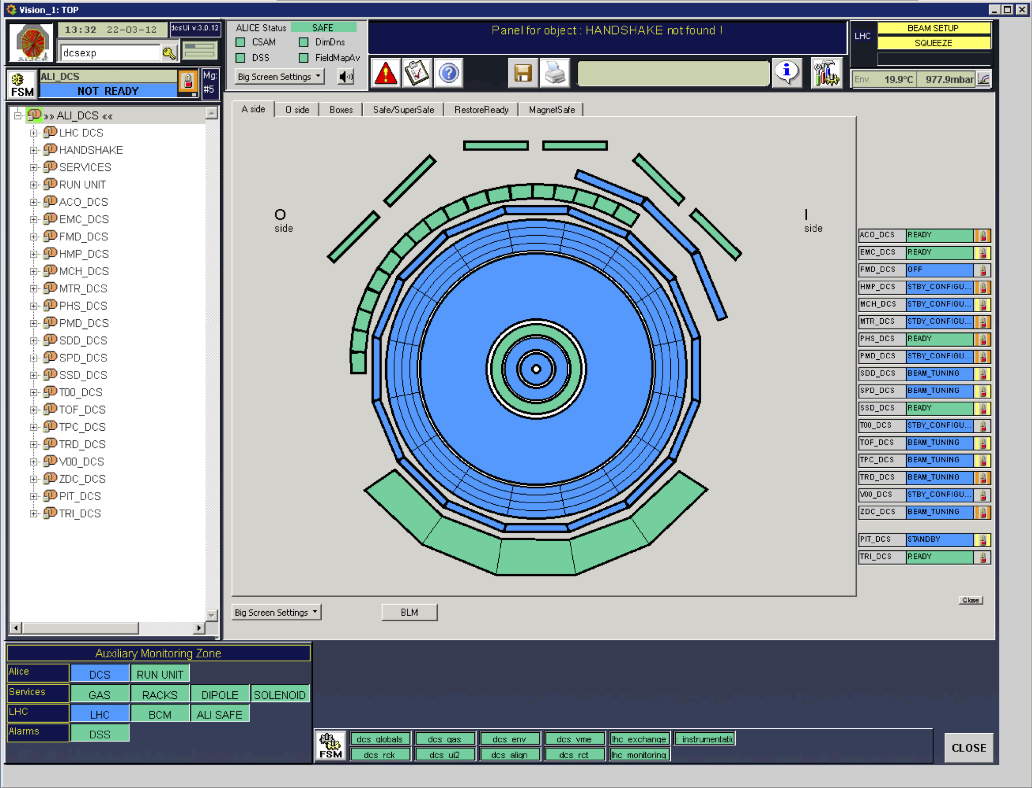
Detector Control System (DCS)
XXXIV Annual Meeting of the Division of Particle and Fields
The ALICE DCS is based on a commercial SCADA system named WinCC-OA®, running on a large Windows computer cluster [5].
The DCS is responsible for performing control, configuration, reading and monitoring of hardware devices.
It performs a hierarchical control of the subdetectors within ALICE experiment.
The DCS also does monitoring of external systems such as: LHC, electrical system, gas system and more.
Figure 9. User interface of ALICE DCS [6]
Notes:
The ALICE Detector Control System is based on a commercial Supervisory Control and Data Acquisition (SCADA) system named WinCC-OA®, running on a large Windows computer cluster.
In general, the Detector Control System is responsible for performing control, configuration, reading and monitoring of hardware devices.
It performs a hierarchical control of the subdetectors within ALICE experiment.
As well as monitoring of external systems such as: the Large Hadron Collider, electrical system, gas system and some others.

Slide 12
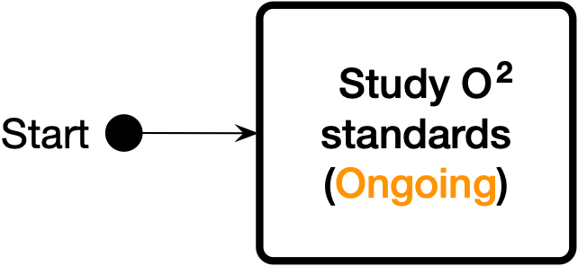
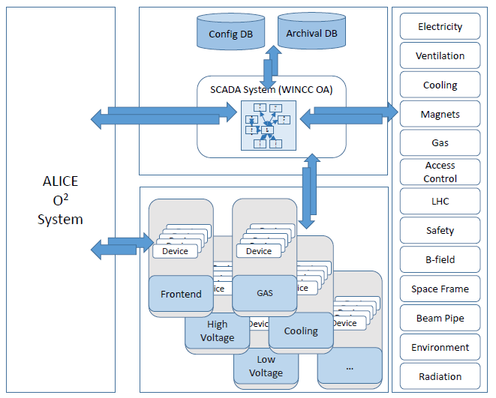
FDD-DCS development methodology
One of the main changes in Run-3 is to process online the data generated from the ALICE experiment during collisions [7].
Figure 10. Overall block diagram of the ALICE DCS update for Run 3 [8].
Notes:
Study of new standards for Run 3 is the first step on the development of the Control System for FDD detector. One of the main changes in Run-3 is to process online the data generated from the ALICE experiment during collisions [29]. Due to this update, the new regulations of the Online-Offline infrastructure (also known as O squared) that will operate in the ALICE experiment is currently being analyzed in detail, so the design of the Control System (DCS) of the FDD detector complies with these new standards.

Slide 13
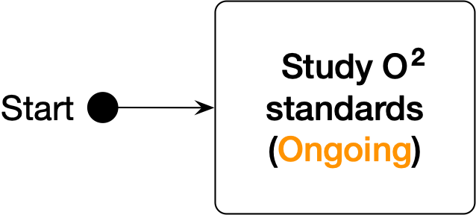
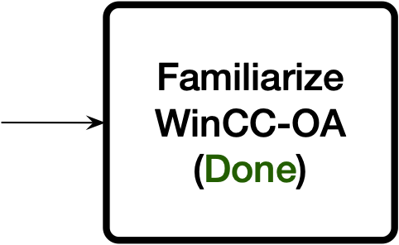
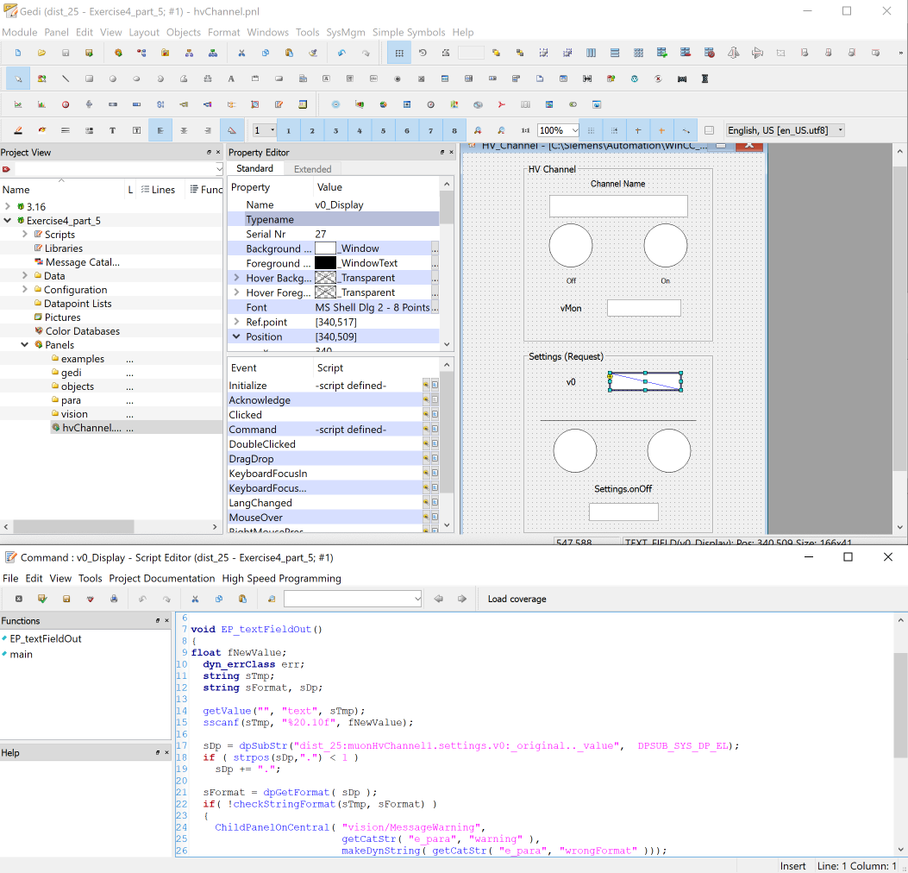
FDD-DCS development methodology
ALICE’s DCS architecture is based on the standards adopted by the LHC experiments at CERN, such as the SCADA system named WinCC-OA® [9-12].
Figure 11. WinCC-OA® programming user interface.
Notes:
ALICE’s DCS architecture is based on the standards adopted by the Larga Hadron Collider (LHC) experiments at CERN, such as the SCADA system named WinCC-OA®, extended in its capacities by the software Frameworks developed at CERN such as: JCOP. That is why one of the first steps that was already done is to obtain from CERN access to the version of the WinCC-OA® and Frameworks software that is compatible with the ALICE experiment and with the Large Hadron Collider system. The WinCC-OA® and JCOP Frameworks courses available at CERN were also already taken to learn the software development tools [9-12].

Slide 14
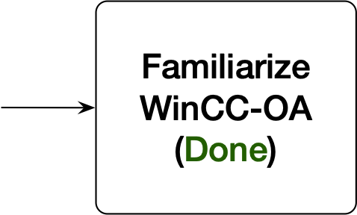
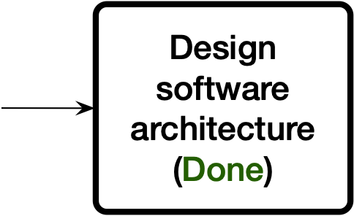
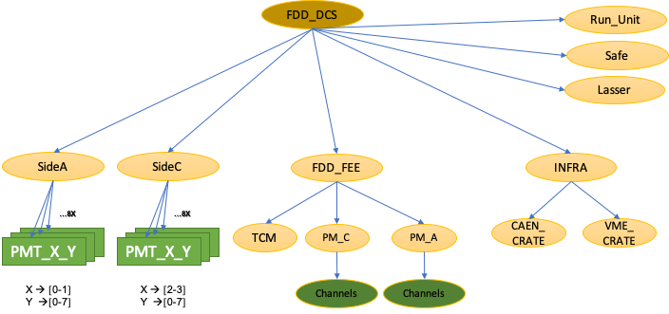
FDD-DCS development methodology
The software architecture currently proposed to ALICE group for the DCS of the FDD detector is compatible with the architecture required by the ALICE experiment.
The DCS software architecture has a hierarchical tree structure representing the operation of the subsystems and hardware devices.
Figure 12. Proposed software architecture for DCS of the FDD.
Notes:
The software architecture currently proposed for the Detector Control System (DCS) of the FDD detector is compatible with the architecture required by the ALICE experiment.
The software architecture of the Detector Control System also has a hierarchical tree structure representing the operation of the subsystems and hardware devices. The tree structure is made of nodes.
There are two types of nodes that serve as basic building blocks: Control Unit (CU) and Device Unit (DU). A Device Unit manages a device, for example, the software architecture of the Detector Control System for the FDD manages the photomultipliers (also known as PMT) used in each of the subdetectors FDD-A and FDD-C.

Slide 15
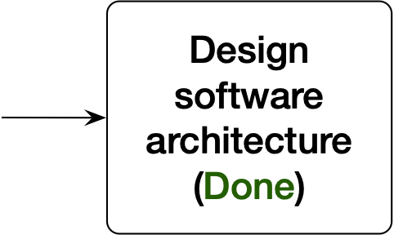
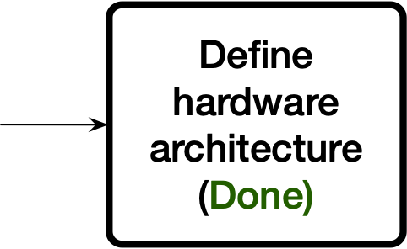
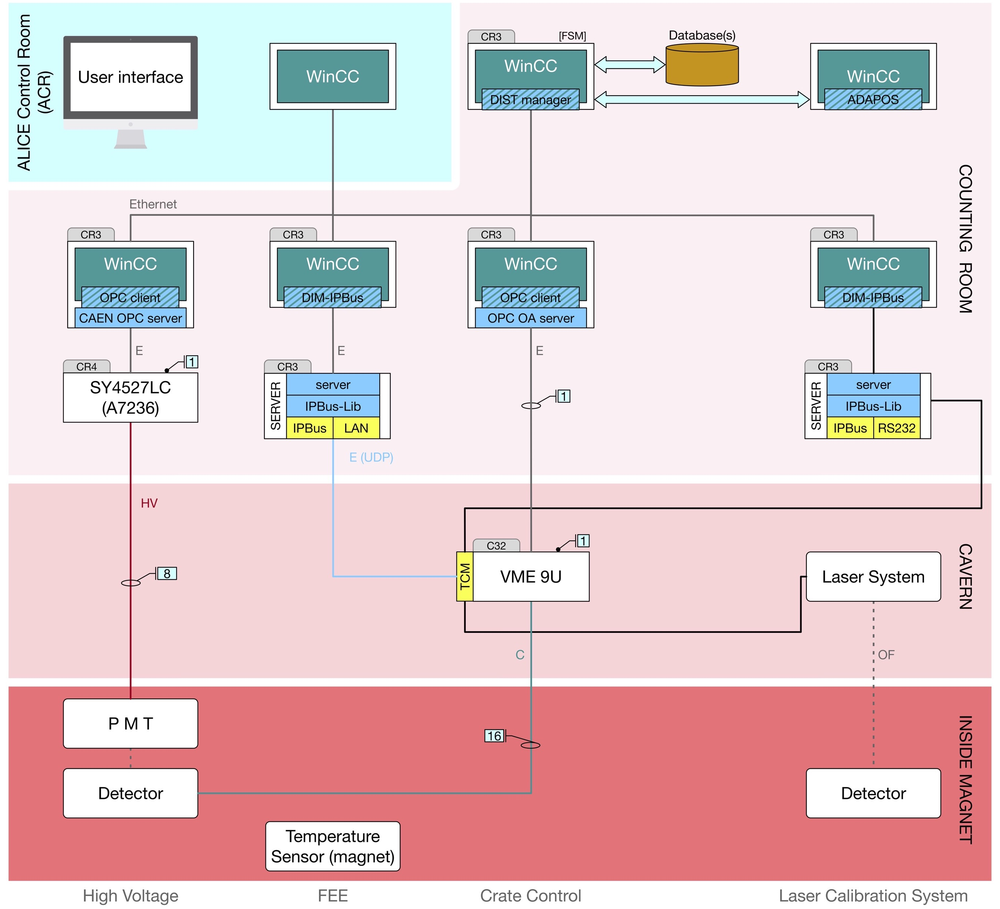
FDD-DCS development methodology
The hardware architecture currently defined for the Control System (DCS) of the FDD detector is compatible with the architecture required by the ALICE experiment.
The DCS of the FDD detector will interact with all the devices of the areas: Counting Room, Cavern and Inside Magnet.
Figure 13. Hardware architecture defined for DCS of the FDD.
Notes:
The hardware architecture currently defined for the Control System (DCS) of the FDD detector is compatible with the architecture required by the ALICE experiment.
The Control System (DCS) of the FDD detector will interact with all the devices of the areas Counting Room, Cavern and Inside the magnet with the objective of control, configuration, reading and monitoring of hardware devices of such architecture.

Slide 16
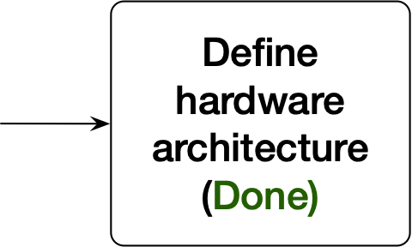
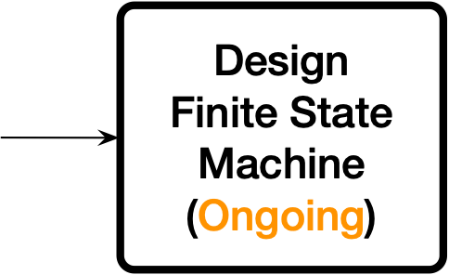
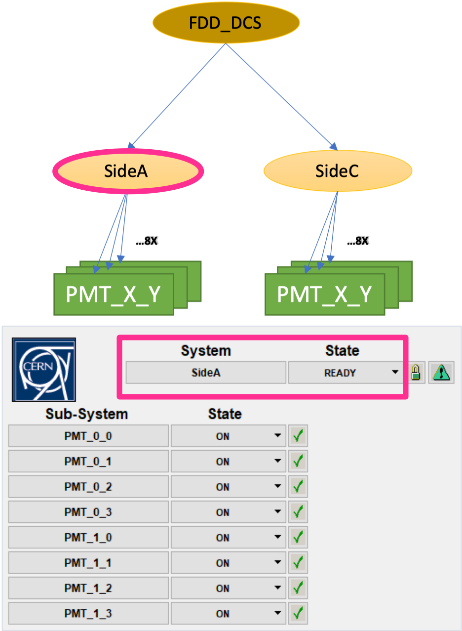
FDD-DCS development methodology
The FSM concept is a generic and intuitive mechanism to model the functionality of an equipment or an entire system.
A hierarchical architecture was defined to represent FDD-A and FDD-C subdetectors through the FSMs using SCADA system WinCC-OA®.
Figure 14. Finite State Machine for FDD Side A node.
Notes:
In the control context, the Finite State Machine (also known as FSM) concept is a generic and intuitive mechanism to model the functionality of an equipment or an entire system.
For each FDD subdetector, side A and side C, a hierarchical architecture was defined to represent the system to be controlled through the Finite State Machine (FSM) using SCADA system named WinCC-OA®, generally being able to start from the individual channels, in this case, the photomultiplier (PMT) channels and device modules until completing the different subsystems, for example the FDD side A subsystem.

Slide 17
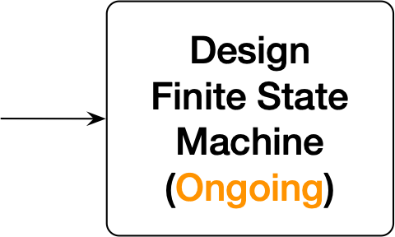
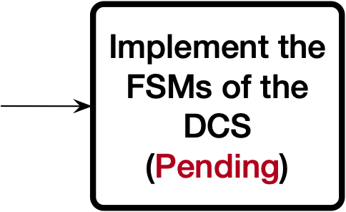
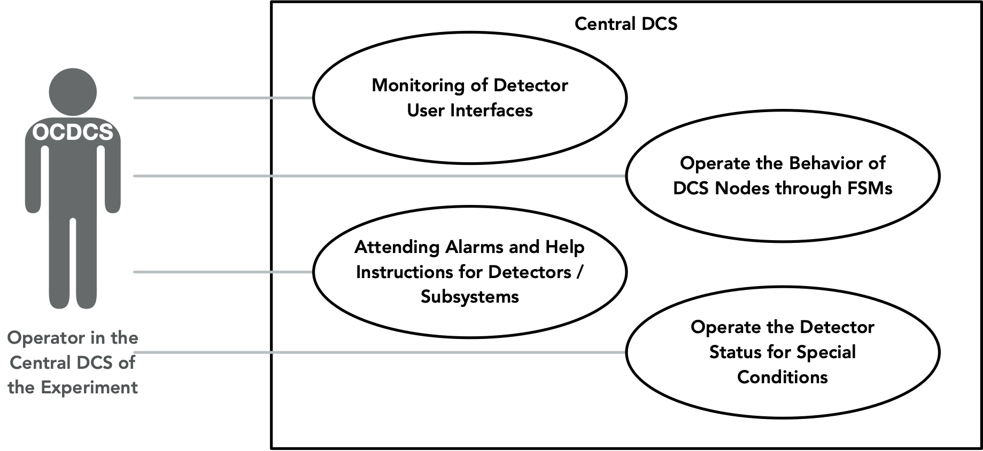
FDD-DCS development methodology
Once the FSMs for the Control System (DCS) of the FDD detector are defined, the next step is to represent such FSMs for each node using programming code. For this, we will first make use of UML diagrams.
The resulting UML diagramas will be considered for the modeling of the nodes in the software architecture of the DCS.
Figure 15. Elements that form the diagram of the Operator in the
Central DCS / DCS Shifter of the Experiment (OCDCS).
Notes:
Once the Finite State Machines (FSMs) for the Control System (DCS) of the FDD detector are defined, the next step is to represent such Finite State Machines (FSMs) for each node using programming code. For this, we will first make use of Unified Modeling Language diagrams (also known as UML diagrams), generating an abstraction to simplify and select the essential characteristics of each node.
Finally, the resulting UML diagramas will be considered for the modeling of the nodes in the software architecture of the Detector Control System (DCS)

Slide 18
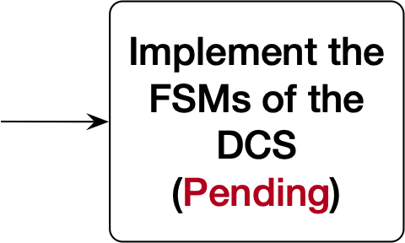
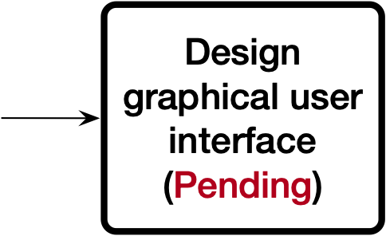
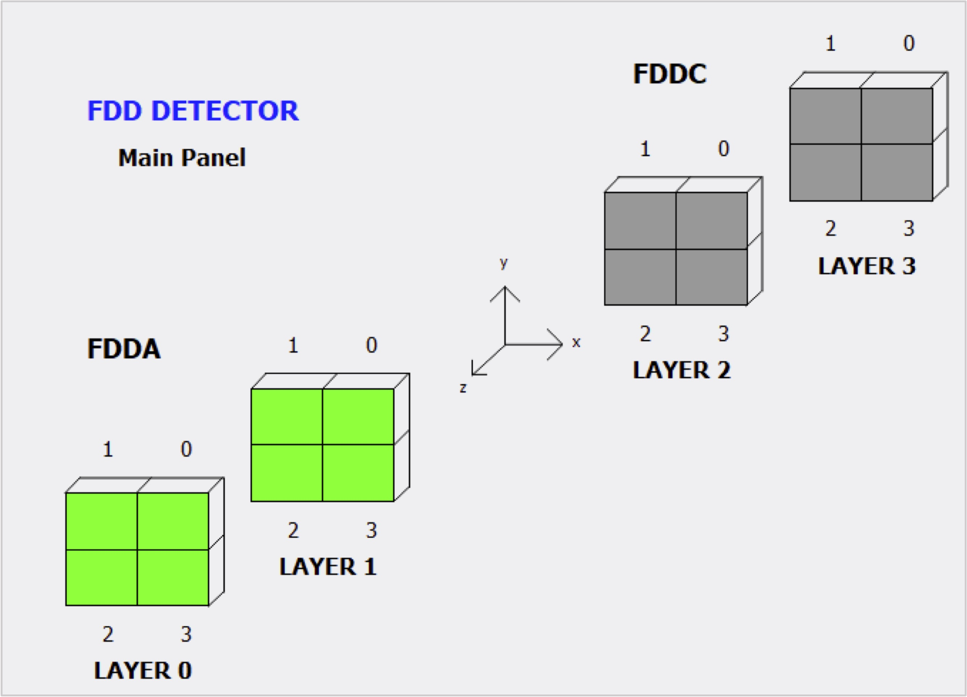
FDD-DCS development methodology
The next step is to design the UI, that will allow the Control System (DCS) operators of the FDD detector to interact with the devices and equipment of the ALICE experiment.
It must be use the tools and guidelines available [6], since it is important to maintain the uniformity between the operation panels used by the operators of the Central DCS and keep the interface user friendly.
Figure 16. Draft of main panel user interface for FDD detector.
Notes:
The next step is to design the user interface (UI), since this will allow the Control System (DCS) operators of the FDD detector to interact with the devices and equipment that make up the ALICE experiment.
To design the Detector Control System (DCS) user interface (UI), it must be use the tools and guidelines available [6], since it is important to maintain the uniformity between the operation panels used by the operators of the central Control System (DCS), as well as keeping the interface user friendly.

Slide 19
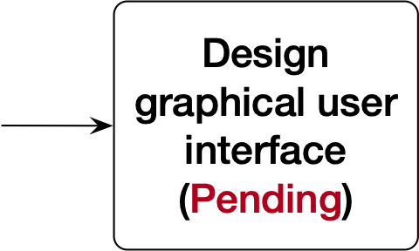
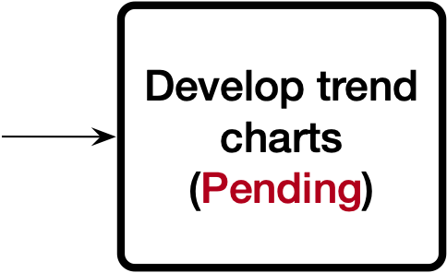
FDD-DCS development methodology
The DCS of the FDD detector will implement charts to visualize the temperature behavior, power supplies, and electronics; as well as the voltage and current values for HV (High Voltage) system.
Figure 17. Temperature charts of the Wiener crate and the electronic
boards in the ALICE experiment during Run-2 [4].
Notes:
In many applications it is necessary to generate a chart with the trends of parameters, such as temperature, voltage, current and others. These allow monitoring the current and past status of the detector and its components [34]. In the particular case of the FDD detector, in its Control System (DCS), it will be implemented to visualize charts of temperature behavior, power supplies, and electronics; as well as the voltage and current values for HV (High Voltage) power system.

Slide 20
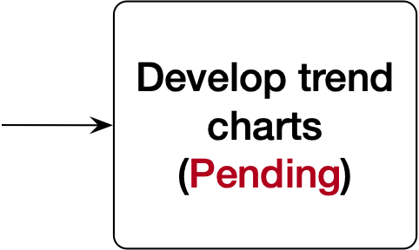
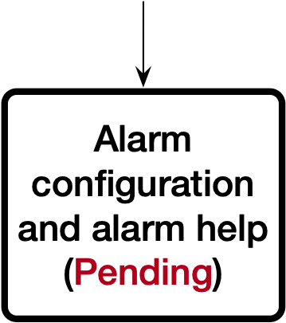
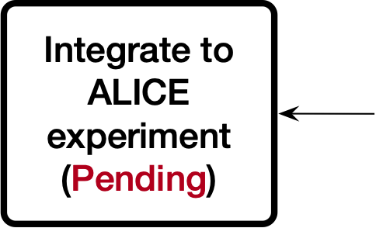
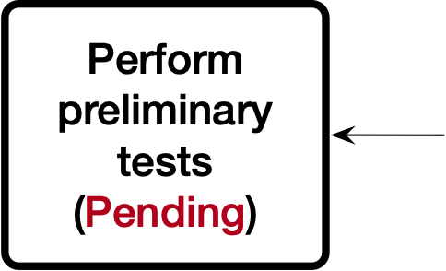
FDD-DCS development methodology
Configuration and alarms help will be specified for the FDD detector, which will consist of a set of procedures that the central DCS operator in the ALICE Experiment must follow to resolve the issue that triggered the alarm.
Once the development of the DCS software is complete, the testing stage will begin directly on the new FDD detector.
The requirements for the integration of the FDD DCS in the central DCS of ALICE will be met during Run 3 of the LHC. For this it is necessary to comply with the various requirements established by the ACC group of ALICE [15].
Notes:
The Control System (DCS) generates alarms if at least one of the previously defined critical parameters has a value that is outside the nominal range; and according to the level of deviation of the value, the necessary measures are taken, either by the operator responsible for the central DCS on duty or by the on-call expert of the detector. To assure the continuous operation of the FDD detector, help for alarms will be specified, which will consist of a set of procedures that the central DCS operator in the ALICE Experiment must follow to resolve the issue that triggered the alarm.
Once the development of the Detector Control System (DCS) software is complete, the testing stage will begin directly on the new FDD detector. The testing stage will begin with the installation, calibration and commissioning modes of operation, taking the FDD detector under an independent partitioning scheme. Subsequently, the testing stage will begin to integrate the detector into the ALICE central system.
The requirements for the integration of the FDD Detector Control System in the central DCS of ALICE will be met during Run 3 of the Large Hadron Collider (LHC). For this it is necessary to comply with the various requirements established by the ALICE Run Control Center (ACC group of ALICE). These requirements include: GO_SAFE / GO_SUPERSAFE commands, automatic storage of the parameters corresponding to the start / end of a run (SOR / EOR), implementation of the Finite State Machines of the main node of the tree of the detector's DCS and some others [15].

Slide 21
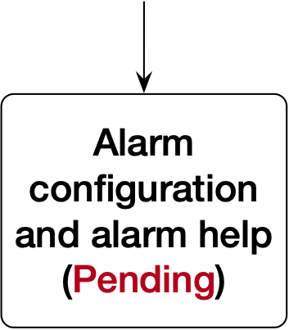
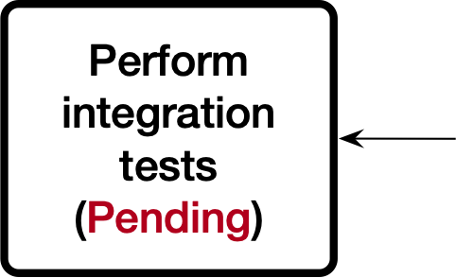
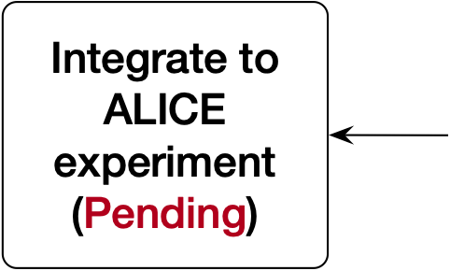
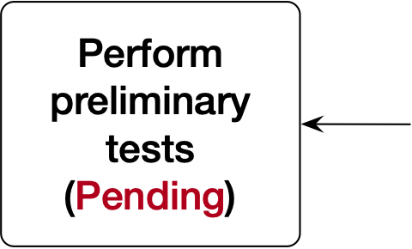
FDD-DCS development methodology
The parameters to measure the DSC performance of the FDD detector in physics Runs and its comparison with the other ALICE detectors during Run 3 will be the following:
Number of runs in which participated.
Total duration of physics data collection.
Data Taking Efficiency (DTE) of the experiment and the detectors [16].
End of Run (EOR) of detectors and systems [17].
Pause and Reconfigure (PAR) procedure executed, successful and failed [16],[18].
Notes:
ALICE's control system must provide constant monitoring and operation of the detector, both during data collection and the Large Hadron Collider (LHC) stops; as well as security. The parameters to measure the Control System (DSC) performance of the FDD detector in physics Runs and its comparison with the other ALICE detectors during Run 3 will be the following:
Number of runs in which the FDD detector participated.
Total duration of physics data collection.
Data Taking Efficiency (DTE) of the experiment and the detectors [16].
End of Run (EOR) of detectors and systems [17].
Pause and Reconfigure (PAR) procedure executed, successful and failed [16],[18].

Slide 22
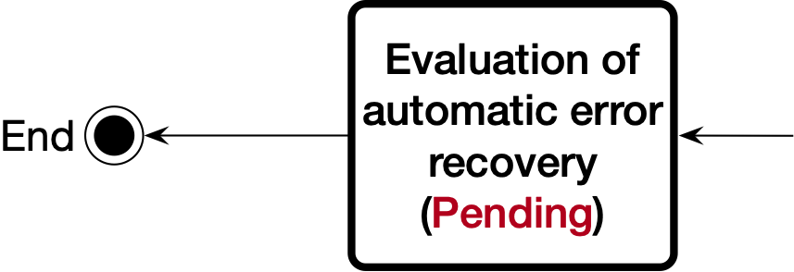
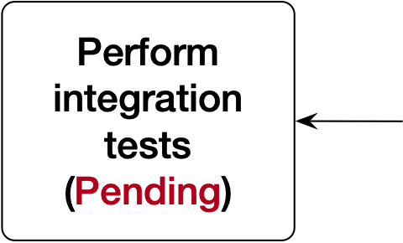
FDD-DCS development methodology
Evaluation of Artificial Intelligence (AI) algorithms will be carried out in the (DCS) to achieve automatic error recovery and more stable performance of the experiment.
The potential source of errors may be related to the variation of voltage and current levels in low voltage (LV) and high voltage (HV) power supplies, as well as changes in temperature.
Notes:
Finally, the ALICE experiment currently have limitations in error recovery without human intervention in the operation of control systems [19]. Therefore, the evaluation of Artificial Intelligence (AI) algorithms will be carried out in the Detector Control System (DCS) to achieve automatic error recovery and more stable performance of the experiment.
The potential source of errors may be related to the variation of voltage and current levels in low voltage (LV) and high voltage (HV) power supplies, as well as changes in temperature.

Slide 23
Conclusions
The main physics task of FDD detector will be to efficiently tag de presence/absence of photon-induced and/or diffractive process by monitoring the (lack of) activity in the forward direction during Run-3.
The software and hardware architecture already proposed will allow to release a fully operative DCS for the FDD detector to comply with the new Online-Offline (O²) infrastructure requirements of ALICE experiment.
The design of the DCS for the FDD detector is a challenging task due to the upgrade in ALICE's hardware and change of the data processing strategy. The data will be provided to the O² processing facilities in streamed mode for which the DCS data stream has to be diverted from its standard path.
The commissioning for the DCS of the FDD detector is expected for March 2021.
Notes:
The main physics task of FDD detector will be to efficiently tag de presence/absence of photon-induced and/or diffractive process by monitoring the (lack of) activity in the forward direction during Run-3.
The software and hardware architecture already proposed will allow to release a fully operative Control System (DCS) for the FDD detector to comply with the new Online-Offline (O2) infrastructure requirements of ALICE experiment.
The design of the Control System (DCS) for the FDD detector is a challenging task due to the upgrade in ALICE's hardware and change of the data processing strategy. The data will be provided to the O2 processing facilities in streamed mode for which the Detector Control System (DCS) data stream has to be diverted from its standard path.
The commissioning for the (Control System) DCS of the FDD detector is expected for Marzo 2021.

Slide 24
“Thanks for your attention”
Juan Manuel Mejía Camacho
Juan Carlos Cabanillas Noris

Slide 25
References
[1] O. Villalobos Baillie, “A Study of Diffractive Production in ALICE,” Journal of Physics: Conference Series, vol. 381, p. 012039, Sep. 2012, doi: 10.1088/1742-6596/381/1/012039.
[2] G. H. Corral and The ALICE Collaboration, “Diffractive physics in ALICE at the LHC,” Mexico City, Mexico, 2011, pp. 45–52, doi: 10.1063/1.3579430.
[3] K. Akiba et al., “LHC forward physics,” Journal of Physics G: Nuclear and Particle Physics, vol. 43, no. 11, p. 110201, Oct. 2016, doi: 10.1088/0954-3899/43/11/110201.
[4] Cabanillas-Noris, J.C., Martínez, M.I. y León-Monzón, I., “A Large Ion Collider Experiment (ALICE) Diffractive Detector Control System for RUN-II at the Large Hadron Collider,” International Journal of Mathematical, Computational, Physical, Electrical and Computer Engineering, vol. 10, No. 3, pp. 118-129, 2016.
[5] J. E. Rothberg, “Detector control systems in the LHC experiments,” in 9th Workshop on Electronics for LHC Experiments, Amsterdam, The Netherlands, 29 Sep - 3 Oct 2003, pp.18-27 (CERN-2003-006), Amsterdam, The Netherlands, Oct. 2003, pp. 18–27, doi: 10.5170/CERN-2003-006.18.
[6] ALICE Control Coordination (2007). The in ALICE. Ver. 3.0.2. ALICE DCS User Interface Component. CERN.
Recovered from: http://alicedcs.web.cern.ch/alicedcs/Software/Downloads/ AliceDcsUi_v3.0.pdf
[7] J. M. Jiménez, J. P. Tock, and K. Foraz, “The Long Shutdown 2 (LS2) Project,” Geneva, Switzerland, 2018, Accessed: Apr. 04, 2020. [Online]. Available: https://indico.cern.ch/event/702149/contributions/2879714/attachments/1595391/2526647/LS2_Project_introduced_to_ILOs_v2018.0.pdf.
[8] P. Buncic, M. Krzewicki, and P. Vande Vyvre, “Technical Design Report for the Upgrade of the Online-Offline Computing System,” CERN, Geneva, Switzerland, CERN-LHCC-2015-006. ALICE-TDR-019, 2015. [Online]. Available: http://cds.cern.ch/record/2011297.

Slide 26
References
[9] R. Kulaga, “WinCC-OA and the JCOP Framework Part 1 (JCOP Framework). WinCC-OA 3.15 & JCOP-Framework Course.,” presented at the WinCC-OA & JCOP-Framework Course, Geneva, Switzerland, 2020, Accessed: Apr. 05, 2020. [Online]. Available: https://readthedocs.web.cern.ch/display/ICKB/PVSS+Service+Training.
[10] R.-P. Silvola, “WinCC-OA and the JCOP Framework Part 2 (JCOP Framework). WinCC-OA 3.15 & JCOP-Framework Course.,” presented at the WinCC-OA & JCOP-Framework Course, Geneva, Switzerland, 2020, Accessed: Apr. 05, 2020. [Online]. Available: https://readthedocs.web.cern.ch/display/ICKB/PVSS+Service+Training.
[11] R.-P. Silvola, “WinCC-OA and the JCOP Framework Part 3 (JCOP Framework). WinCC-OA 3.15 & JCOP-Framework Course.,” presented at the WinCC-OA & JCOP-Framework Course, Geneva, Switzerland, 2020, Accessed: Apr. 05, 2020. [Online]. Available: https://readthedocs.web.cern.ch/display/ICKB/PVSS+Service+Training.
[12] R.-P. Silvola, “WinCC-OA and the JCOP Framework Part 4 (JCOP Framework cont.). WinCC-OA 3.15 & JCOP-Framework Course.,” presented at the WinCC-OA & JCOP-Framework Course, Geneva, Switzerland, 2020, Accessed: Apr. 05, 2020. [Online]. Available: https://readthedocs.web.cern.ch/display/ICKB/PVSS+Service+Training.
[13] P. Kimmel, UML demystified, 1st ed. Emeryville, California, USA: McGraw-Hill/Osborne, 2005.
[14] C. Fontela, UML: modelado de software para profesionales, 1st ed. Barcelona: Marcombo, 2012.
[15] P. Chochula, “User’s Guide to ALICE Detector Control System. Part 1: Introduction to DCS. Version 1.1. The ALICE DCS Training Course.” 2017, Accessed: Apr. 05, 2020. [Online]. Available: https://espace.cern.ch/alicecontrols/SitePages/Home.aspx.

Slide 27
References
[16] F. Carena et al., “The ALICE data acquisition system,” Nuclear Instruments and Methods in Physics Research Section A: Accelerators, Spectrometers, Detectors and Associated Equipment, vol. 741, pp. 130–162, 2014, doi: 10.1016/j.nima.2013.12.015.
[17] ALICE Collaboration, “ALICE Electronic Logbook,” 2017. https://alice-logbook.cern.ch/logbook/date_online.php?p_cont=bs (accessed Apr. 10, 2020).
[18] F. Carena et al., “Monitoring and improving the ALICE data taking efficiency,” in 2012 18th IEEE-NPSS Real Time Conference, Berkeley, CA, USA, Jun. 2012, pp. 1–6, doi: 10.1109/RTC.2012.6418393.
[19] G. De Cataldo, A. Franco, C. Pastore, I. Sgura, and G. Volpe, “The ALICE-HMPID Detector Control System: Its evolution towards an expert and adaptive system,” Nuclear Instruments and Methods in Physics Research Section A: Accelerators, Spectrometers, Detectors and Associated Equipment, vol. 639, no. 1, pp. 211–214, May 2011, doi: 10.1016/j.nima.2010.10.120.

