Slide 1



Anomalous magnetic and chromomagnetic moments
Luis Raúl Torres Rojas,
Adnan Bashir, Angel Miramontes
July 30, 2021

Slide 2
Content
Introduction
AMDM: QED & Electroweak contributions
ACDM: Strong & Electroweak contributions
Summary

Slide 3
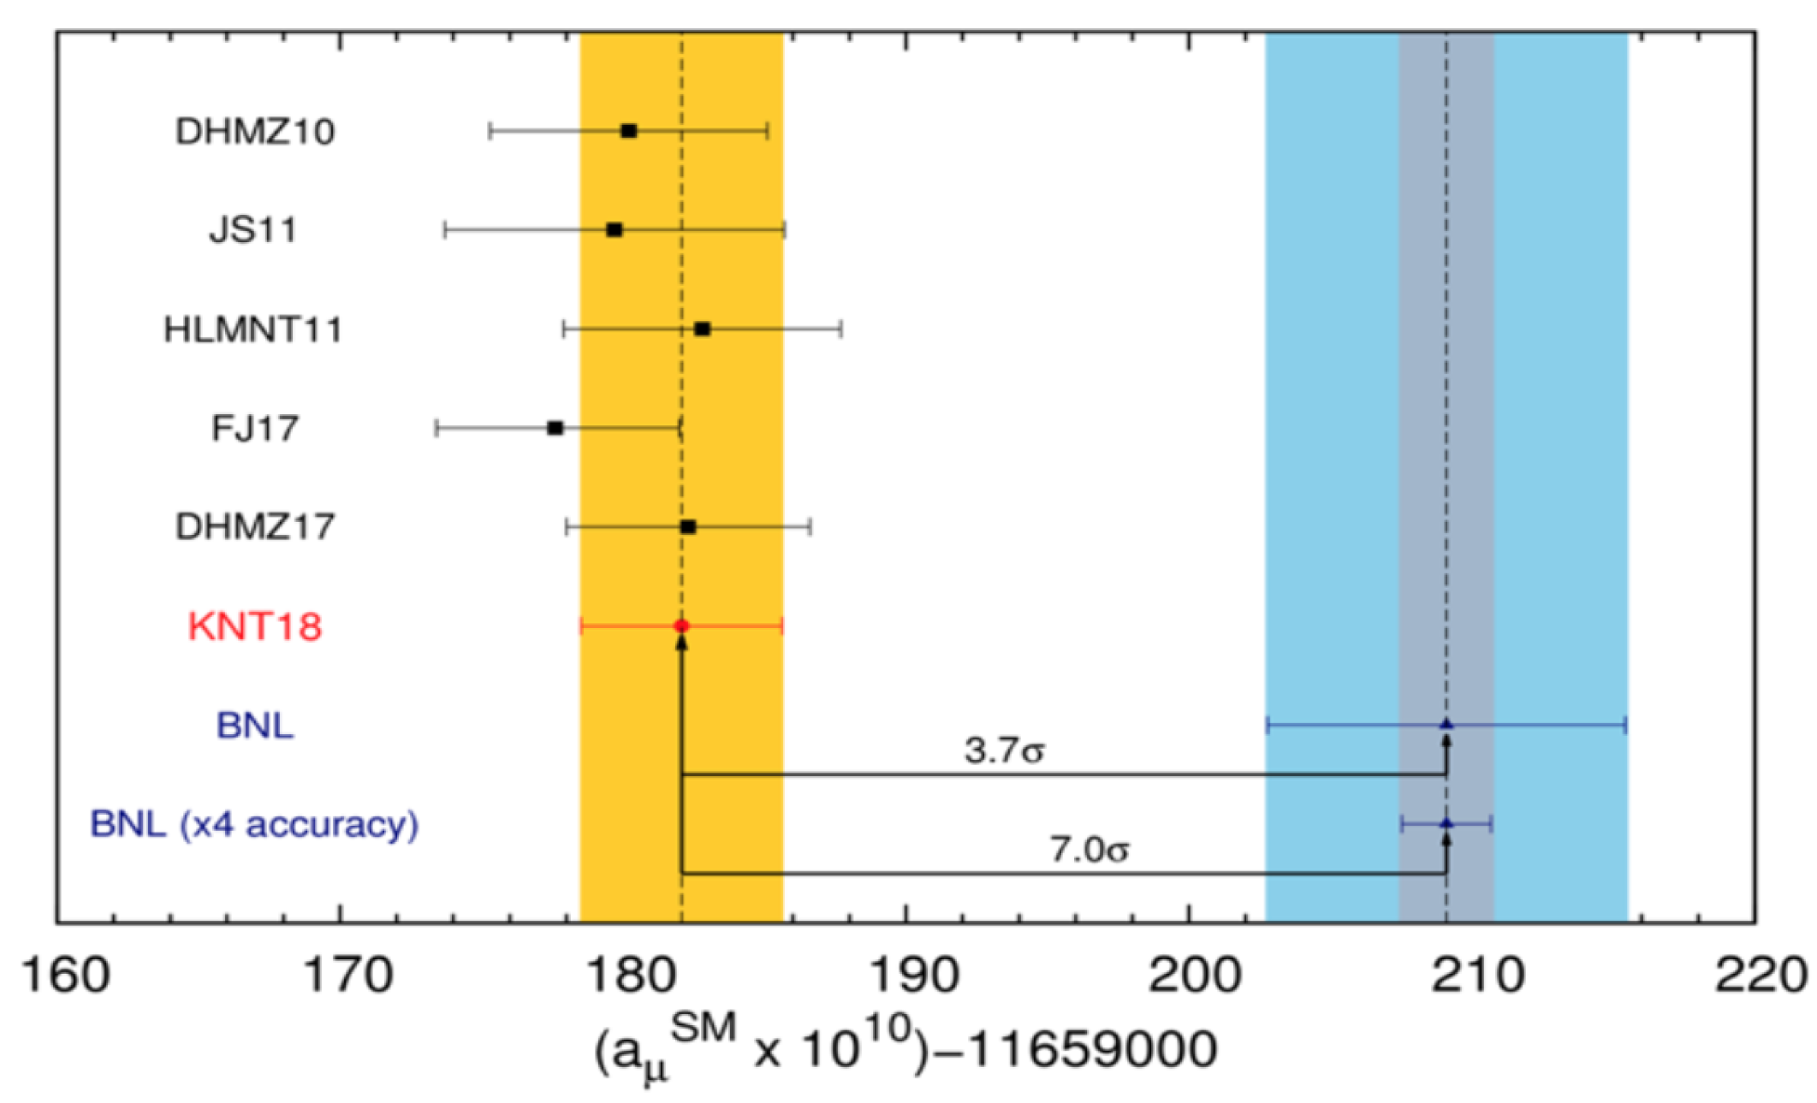
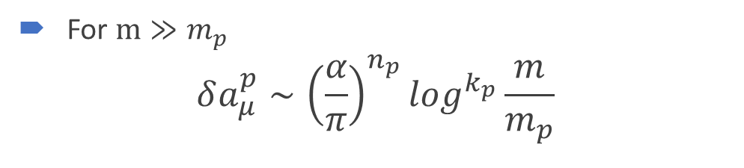
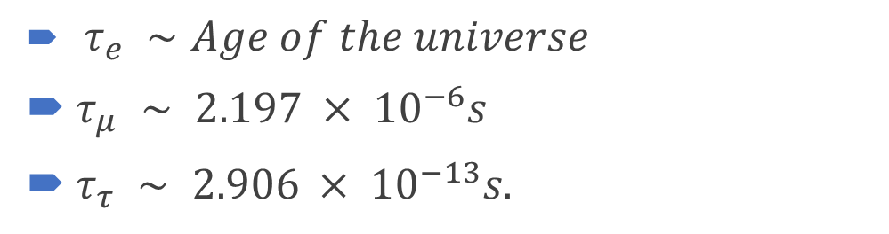
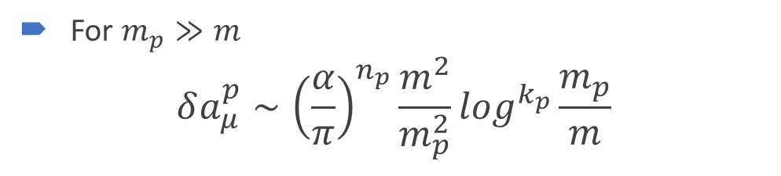
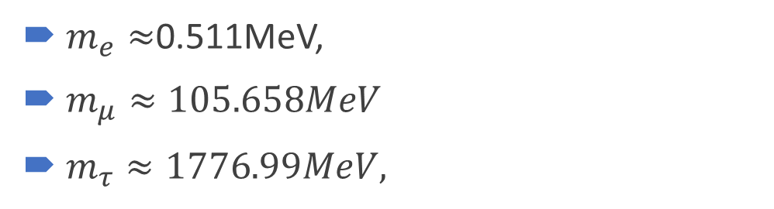
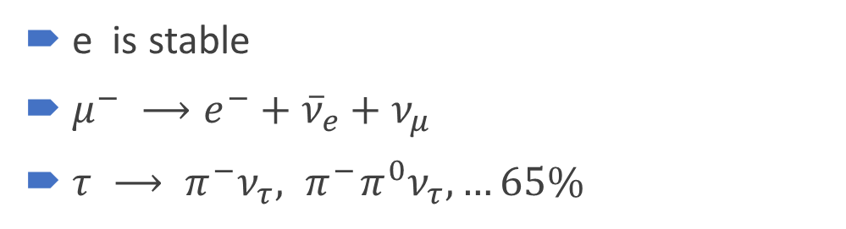
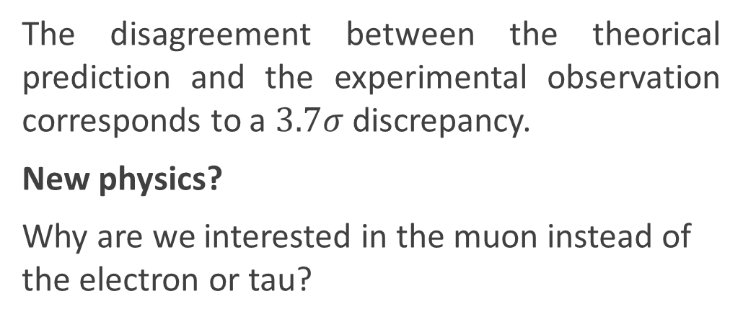
Introduction
The disagreement between the theorical prediction and the experimental observation corresponds to a $3.7σ$ discrepancy.
New physics?
Why are we interested in the muon instead of the electron or tau?
$τ_{e} ∼Age of the universe$
$τ_{μ} ∼ 2.197 × {10}^{−6}s$
$τ_{τ} ∼ 2.906 × {10}^{−13}s.$
e is stable
$μ^{−} ⟶e^{−}+{\overline{ν}}_{e}+ν_{μ}$
$τ ⟶ π^{−}ν_{τ},{ π}^{−}π^{0}ν_{τ},…65\%$
$m_{e}≈$0.511MeV,
$m_{μ}≈105.658MeV$
$m_{τ}≈1776.99MeV,$
For $m_{p}≫m$
$$δa_{μ}^{p}∼{\left(\frac{α}{π}\right)}^{n_{p}}\frac{m^{2}}{m_{p}^{2}}\log^{k_{p}}\frac{m_{p}}{m}$$
For $m≫m_{p}$
$$δa_{μ}^{p}∼{\left(\frac{α}{π}\right)}^{n_{p}}\log^{k_{p}}\frac{m}{m_{p}}$$

Slide 4
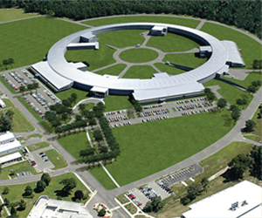
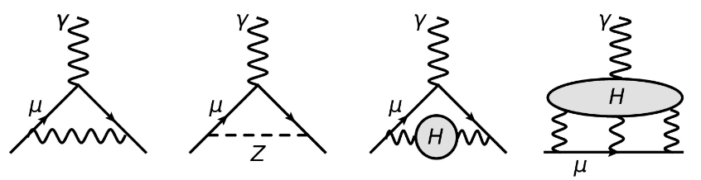
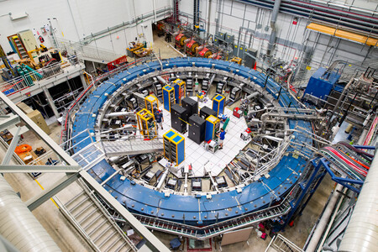
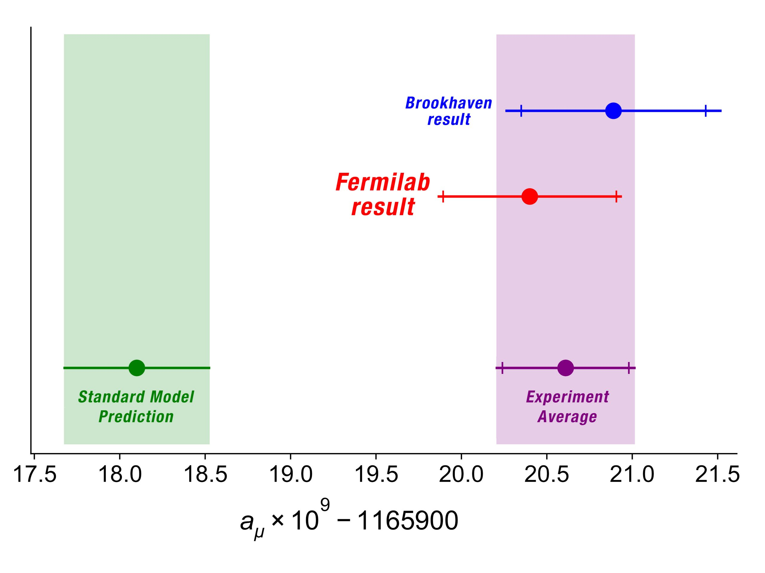
Introduction
Last year, the international theory community published a comprehensive SM prediction for the muon anomaly.
Aoyama, T. et al.(2020). The anomalous magnetic moment of the muon in the Standard Model. Physics reports
$$a_{μ}^{SM}=a_{μ}^{QED}+a_{μ}^{EW}+a_{μ}^{HAD}=\text{116 591 810(43)}×{10}^{−11}$$
The data obtained at Brookhaven National Laboratory in 2006 gives
$$a_{μ}^{exp}=\text{116 592 089(63)}×{10}^{−11}$$
$$a_{μ}^{new exp}=\text{116 59}\text{2 061(41)}×{10}^{−11}$$
Abi, B., et. Al.. (2021). Measurement of the positive muon anomalous magnetic moment to 0.46 ppm. Physical Review Letters, 126(14), 141801

Slide 5
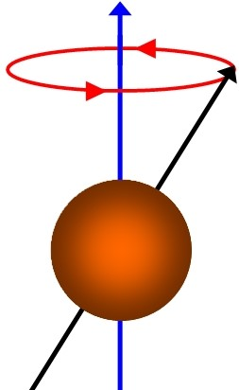
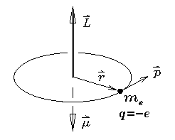

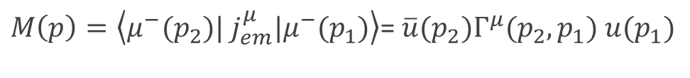
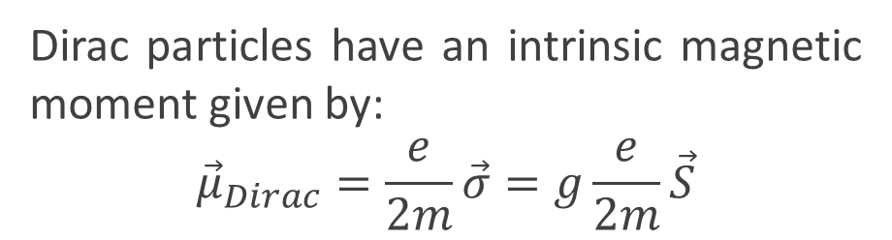
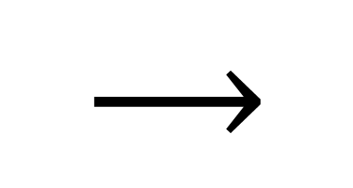

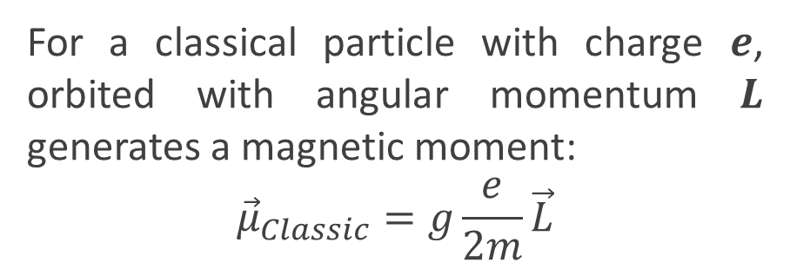





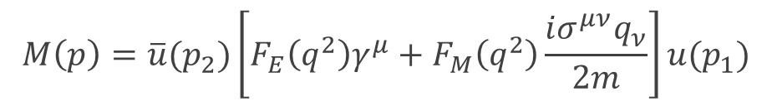
Introduction
For a classical particle with charge 𝒆, orbited with angular momentum 𝑳 generates a magnetic moment:
$${\vec{μ}}_{Classic}=g\frac{e}{2m}\vec{L}$$
Dirac particles have an intrinsic magnetic moment given by:
$${\vec{μ}}_{Dirac}=\frac{e}{2m}\vec{σ}=g\frac{e}{2m}\vec{S}$$
$$q=p_{2}−p_{1}$$
$M\left(p\right)=\left\langle μ^{−}(p_{2})| j_{em}^{μ}|μ^{−}(p_{1})\right\rangle$= $\overline{u}(p_{2})Γ^{μ}(p_{2},p_{1}) u(p_{1})$
$$g=2$$
$$⟶$$
$$M\left(p\right)=\overline{u}(p_{2})\left[F_{E}\left(q^{2}\right)γ^{μ}+F_{M}\left(q^{2}\right)\frac{iσ^{μν}q_{ν}}{2m}\right]u(p_{1})$$
Quantum effects
$$μ$$
$$μ$$
$$a_{μ}=F_{M}\left(0\right)=\frac{g−2}{2}$$
$$p_{1}$$
$$p_{2}$$

Slide 6
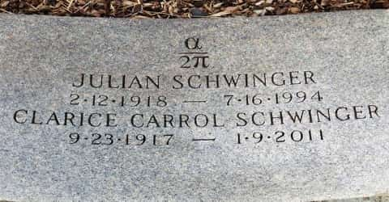

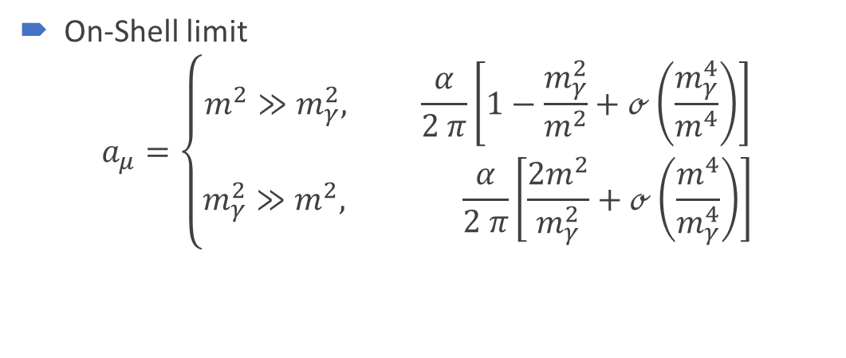
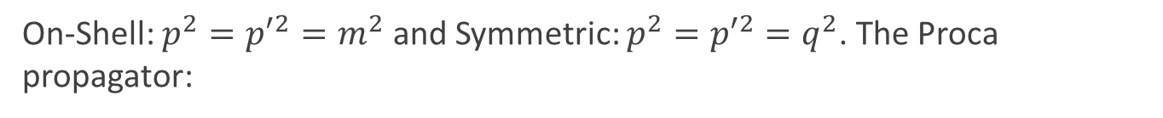


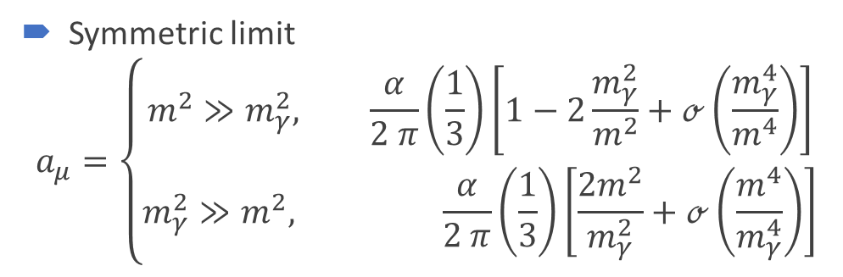




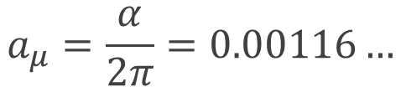




AMDM: QED
$$ieΓ_{1loop}^{μ}\left(p,p^{′}\right)=\int{\frac{d^{d}k}{{\left(2π\right)}^{d}}}\left(ieγ^{ν}\right)iS_{0}\left(p^{′}+k\right)\left(ieγ^{μ}\right)iS_{0}\left(p+k\right)(ieγ^{λ})iD_{0_{λν}}(k)$$
$$γ$$
$$q=p^{′}−p$$
$$p+k$$
$$p^{′}+k$$
On-Shell: $p^{2}={p′}^{2}=m^{2}$ and Symmetric: $p^{2}={p′}^{2}=q^{2}$. The Proca propagator:
$$γ$$
$$D_{0_{λν}}\left(k\right)=\frac{−1}{k^{2}−{m_{γ}}^{2}+iε}\left(g_{λν}−(1−ξ)\frac{g_{λν}}{k^{2}−ξm_{γ}}\right)$$
$$k$$
$$p$$
$$p′$$
$$l$$
$$l$$
Julian Schwinger [1948]
The famous result
$$a_{μ}=\frac{α}{2π}=0.00116…$$
$$a_{μ}^{QED}=\text{116584718.931(7)}×{10}^{−11}$$
On-Shell limit
$$a_{μ}=\left\{\begin{aligned}m^{2}≫m_{γ}^{2}, \frac{α}{2 π}\left[1−\frac{m_{γ}^{2}}{m^{2}}+ℴ\left(\frac{m_{γ}^{4}}{m^{4}}\right)\right] \\ m_{γ}^{2}≫m^{2}, \frac{α}{2 π}\left[\frac{2m^{2}}{m_{γ}^{2}}+ℴ\left(\frac{m^{4}}{m_{γ}^{4}}\right)\right]\end{aligned}\right.$$
Symmetric limit
$$a_{μ}=\left\{\begin{aligned}m^{2}≫m_{γ}^{2}, \frac{α}{2 π}\left(\frac{1}{3}\right)\left[1−2\frac{m_{γ}^{2}}{m^{2}}+ℴ\left(\frac{m_{γ}^{4}}{m^{4}}\right)\right] \\ m_{γ}^{2}≫m^{2}, \frac{α}{2 π}\left(\frac{1}{3}\right)\left[\frac{2m^{2}}{m_{γ}^{2}}+ℴ\left(\frac{m^{4}}{m_{γ}^{4}}\right)\right]\end{aligned}\right.$$
¡Gauge invariant!

Slide 7



































AMDM: Electroweak
$Z_{0}$ contribution
$$γ$$
$$γ$$
$$γ$$
$$γ$$
$$W^{−}$$
$$φ^{+}$$
$$φ^{−}$$
$$φ^{+}$$
$$ν_{l}$$
$$ν_{l}$$
$$z_{0}$$
$$φ_{z_{0}}$$
$$l$$
$$l$$
$$l$$
$$l$$
$$l$$
$$l$$
$$l$$
$$l$$
W contribution
Higgs
contribution
$$γ$$
$$γ$$
$$γ$$
$$h$$
$$φ^{−}$$
$$W^{+}$$
$$W^{−}$$
$$W^{+}$$
$$ν_{l}$$
$$ν_{l}$$
$$l$$
$$l$$
$$l$$
$$l$$
$$l$$
$$l$$
$$a_{μ}^{EW}=153.6\left(1.0\right)×{10}^{−11}$$

Slide 8
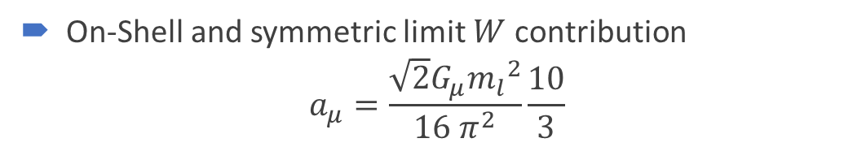




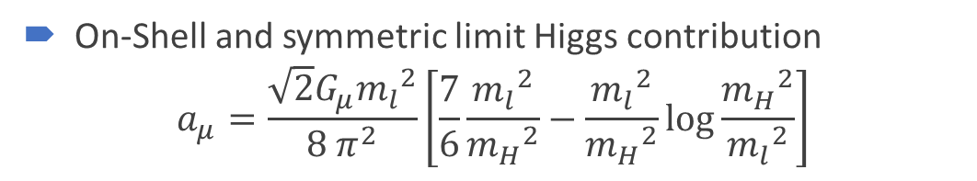

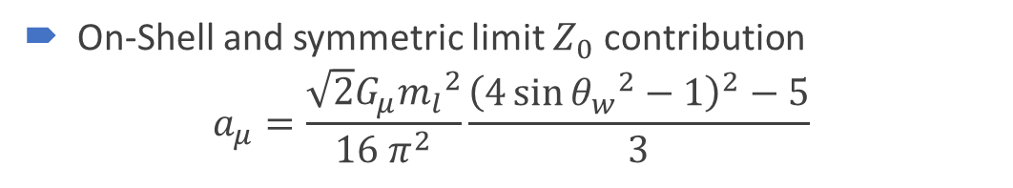








AMDM: Electroweak
$$γ$$
Sum over all the corresponding magnetic form factors of the four diagrams, we obtain a finite result and the gauge term drops out
$$W^{−}$$
$$W^{+}$$
$$ν_{l}$$
$$l$$
$$l$$
On-Shell and symmetric limit $W$ contribution
$$a_{μ}=\frac{\sqrt{2}G_{μ}{m_{l}}^{2}}{16 π^{2}}\frac{10}{3}$$
$$γ$$
¡Gauge invariant!
On-Shell and symmetric limit $Z_{0}$ contribution
$$a_{μ}=\frac{\sqrt{2}G_{μ}{m_{l}}^{2}}{16 π^{2}}\frac{{\left(4{\sin{θ_{w}}}^{2}−1\right)}^{2}−5}{3}$$
$$z_{0}$$
¡Gauge invariant!
$$l$$
$$l$$
On-Shell and symmetric limit Higgs contribution
$$a_{μ}=\frac{\sqrt{2}G_{μ}{m_{l}}^{2}}{8 π^{2}}\left[\frac{7}{6}\frac{{m_{l}}^{2}}{{m_{H}}^{2}}−\frac{{m_{l}}^{2}}{{m_{H}}^{2}}\log{\frac{{m_{H}}^{2}}{{m_{l}}^{2}}}\right]$$
¡Gauge invariant!
$$h$$
$$l$$
$$l$$

Slide 9
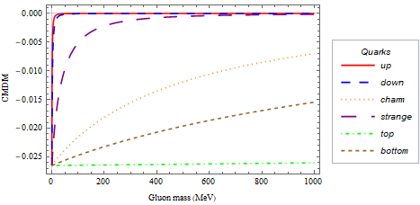
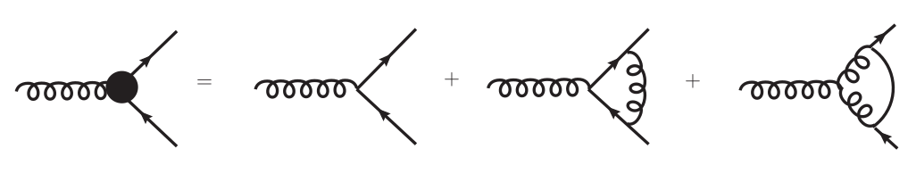
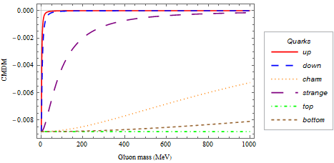

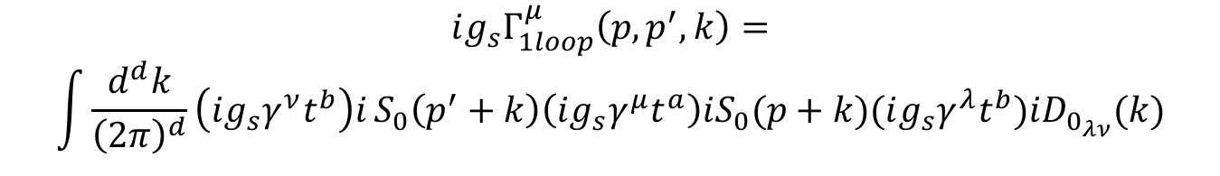






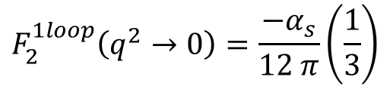




ACDM: Strong Interactions
$$g$$
$$q=p^{′}−p$$
$$ig_{s}Γ_{1loop}^{μ}\left(p,p^{′},k\right)=$$
$$\int{\frac{d^{d}k}{{\left(2π\right)}^{d}}\left(ig_{s}γ^{ν}t^{b}\right)i}S_{0}\left(p^{′}+k\right)\left(ig_{s}γ^{μ}t^{a}\right)iS_{0}(p+k)(ig_{s}γ^{λ}t^{b})iD_{0_{λν}}(k)$$
$$p+k$$
$$p^{′}+k$$
$$g$$
The corresponding quantity for QCD is the anomalous cromomagnetic dipole moment (CMDM) of quarks which has not yet been precisely known
$$p$$
$$k$$
$$p′$$
$$q$$
$$q$$
On-Shell limit
$$F_{2}^{1loop}\left(q^{2}→0\right)=\frac{−α_{s}}{12 π}$$
Bermudez, et. al. (2017). Quark-gluon vertex: A perturbation theory primer and be-yond. Phys. Rev. D, 95(3), 03
¡Gauge invariant!
Symmetric limit
$$F_{2}^{1loop}\left(q^{2}→0\right)=\frac{−α_{s}}{12 π}\left(\frac{1}{3}\right)$$

Slide 10
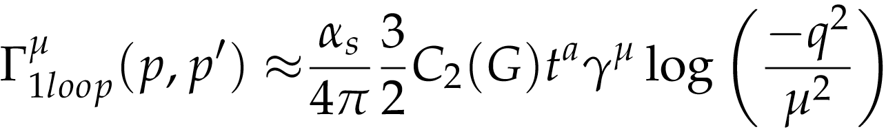
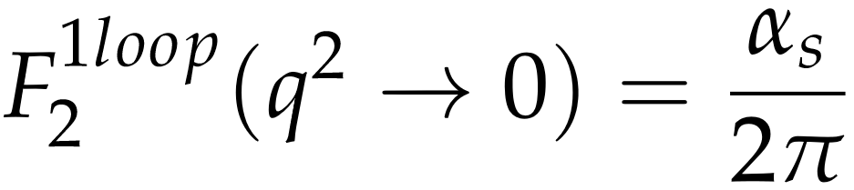
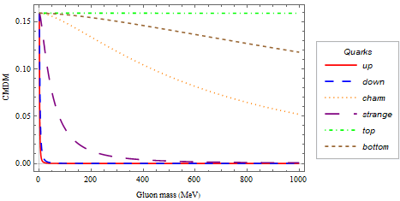
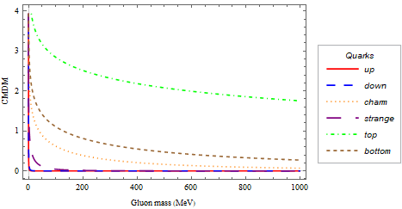









ACDM: Strong Interactions
The non-abelian diagram of the quark-gluon vertex induces a logarithmic divergence at the level of one loop at the conventional on-shell limit.
$$g$$
$$q=p^{′}−p$$
On Shell limit
$$p−k$$
$$p^{′}−k$$
$$k$$
Bermudez, R., et. Al. (2017). Quark-gluon vertex: A perturbation theory primer and be-yond. Physical Review D, 95(3), 03
$$p$$
$$p′$$
$$q$$
$$q$$
$$ig_{s}Γ_{1loop}^{μ}\left(p,p^{′},k\right)=\int{\frac{d^{d}k}{{\left(2π\right)}^{d}}\left(−g_{s}f^{abc}V^{μνλ}\left(q,p^{′}−k,p−k\right)\right)iD_{0_{να}}(p^{′}−k)\left(ig_{s}γ^{α}t^{b}\right)i}S_{0}\left(k\right)\left(ig_{s}γ^{β}t^{c}\right)iD_{0_{λβ}}(p^{′}−k)$$
Symmetric limit
¡Gauge invariant!

Slide 11
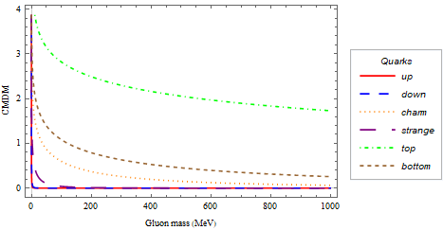
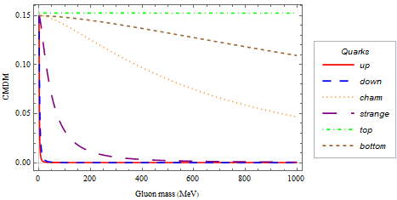










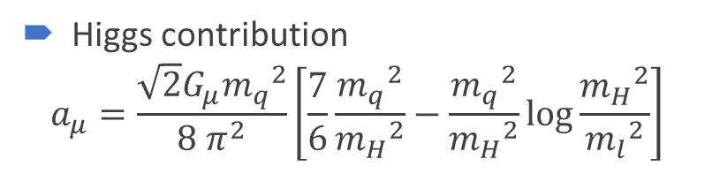








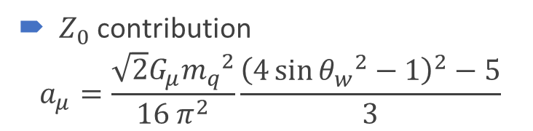
















ACDM: Electroweak
$$g$$
$$q$$
$$g$$
$$q$$
$$Z_{0}$$
$$H_{0}$$
$$p$$
$$p′$$
$$p$$
$$p′$$
$$q$$
$$k$$
$$q$$
$$q$$
$$k$$
$$q$$
$$g$$
$$q$$
$W$ contribution
$$a_{μ}=−\frac{\sqrt{2}G_{μ}{m_{q}}^{2}}{6 π^{2}}$$
$Z_{0}$ contribution
$$a_{μ}=\frac{\sqrt{2}G_{μ}{m_{q}}^{2}}{16 π^{2}}\frac{{\left(4{\sin{θ_{w}}}^{2}−1\right)}^{2}−5}{3}$$
$$γ$$
$$p′$$
¡Gauge invariant!
$$p$$
$$q$$
$$k$$
$$q$$
$γ$ contribution
$$a_{μ}=\frac{α}{2π}{Q_{q}}^{2} \left(\frac{1}{3}\frac{α}{2π}{Q_{q}}^{2} \right)$$
Higgs contribution
$$a_{μ}=\frac{\sqrt{2}G_{μ}{m_{q}}^{2}}{8 π^{2}}\left[\frac{7}{6}\frac{{m_{q}}^{2}}{{m_{H}}^{2}}−\frac{{m_{q}}^{2}}{{m_{H}}^{2}}\log{\frac{{m_{H}}^{2}}{{m_{l}}^{2}}}\right]$$
$$g$$
$$q$$
$$W^{±}$$
On-shell
Symmetric
$$p′$$
$$p$$
Choudhury, I. D., & Lahiri, A. (2015). Anomalous chromomagnetic moment of
quarks. Modern Physics Letters A, 30(23), 1550113.
$$q$$
$$k$$
$$q$$

Slide 12
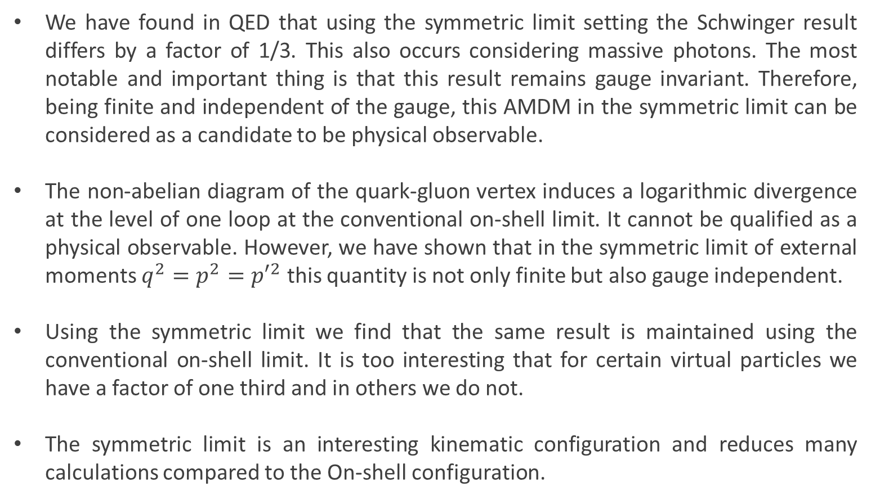
Summary
We have found in QED that using the symmetric limit setting the Schwinger result differs by a factor of 1/3. This also occurs considering massive photons. The most notable and important thing is that this result remains gauge invariant. Therefore, being finite and independent of the gauge, this AMDM in the symmetric limit can be considered as a candidate to be physical observable.
The non-abelian diagram of the quark-gluon vertex induces a logarithmic divergence at the level of one loop at the conventional on-shell limit. It cannot be qualified as a physical observable. However, we have shown that in the symmetric limit of external moments $q^{2}=p^{2}={p′}^{2}$ this quantity is not only finite but also gauge independent.
Using the symmetric limit we find that the same result is maintained using the conventional on-shell limit. It is too interesting that for certain virtual particles we have a factor of one third and in others we do not.
The symmetric limit is an interesting kinematic configuration and reduces many calculations compared to the On-shell configuration.

Slide 13
THANK YOU!

Slide 15
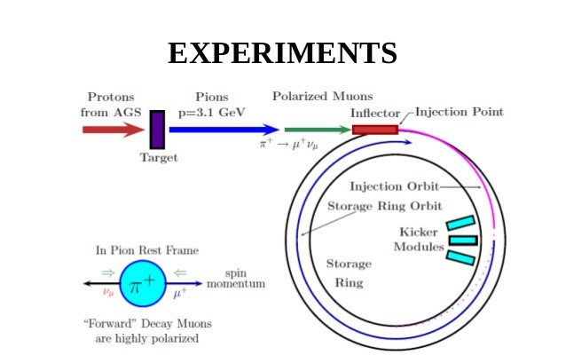
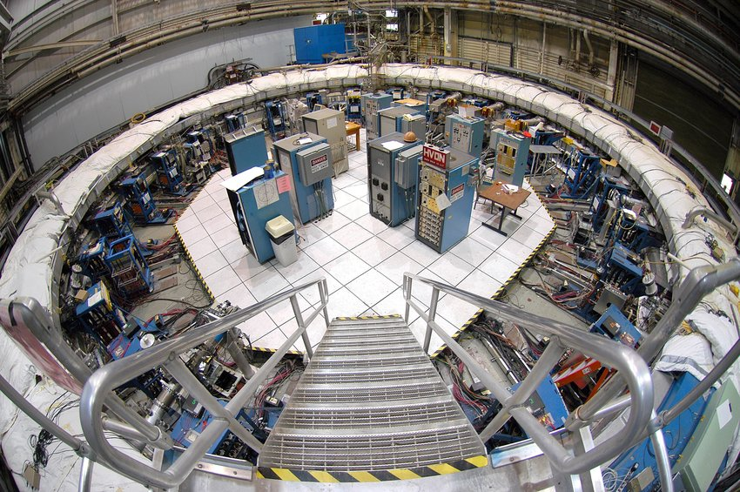
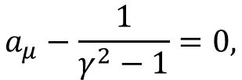
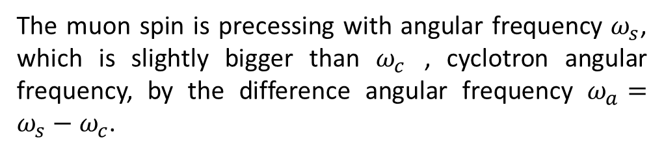
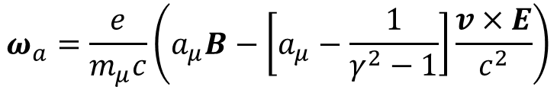
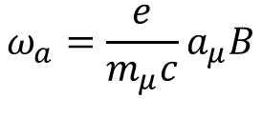
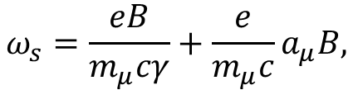
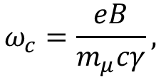

The muon spin is precessing with angular frequency $ω_{s}$, which is slightly bigger than $ω_{c}$ , cyclotron angular frequency, by the difference angular frequency $ω_{a}=ω_{s}−ω_{c}$.
$$ω_{c}=\frac{eB}{m_{μ}cγ},$$
$$ω_{s}=\frac{eB}{m_{μ}cγ}+\frac{e}{m_{μ}c}a_{μ}B,$$
$$ω_{a}=\frac{e}{m_{μ}c}a_{μ}B$$
Thomas-Bargmann-Michel-Telegdi (BMT) equation
$$ω_{a}=\frac{e}{m_{μ}c}\left(a_{μ}B−\left[a_{μ}−\frac{1}{γ^{2}−1}\right]\frac{v×E}{c^{2}}\right)$$
$$a_{μ}−\frac{1}{γ^{2}−1}=0,$$
$$E_{magic}=γm_{μ}c^{2}≃3.098GeV$$

