Slide 1
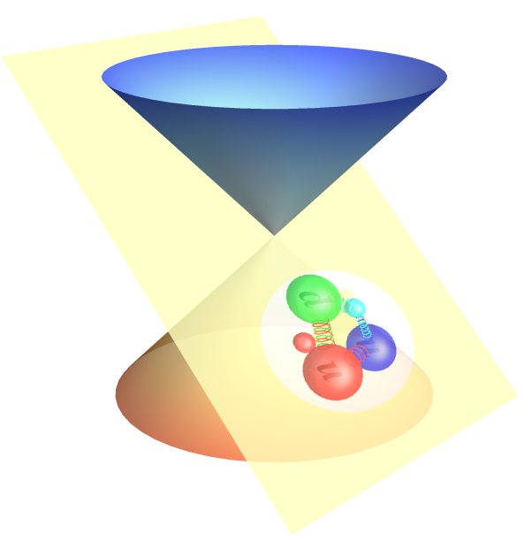



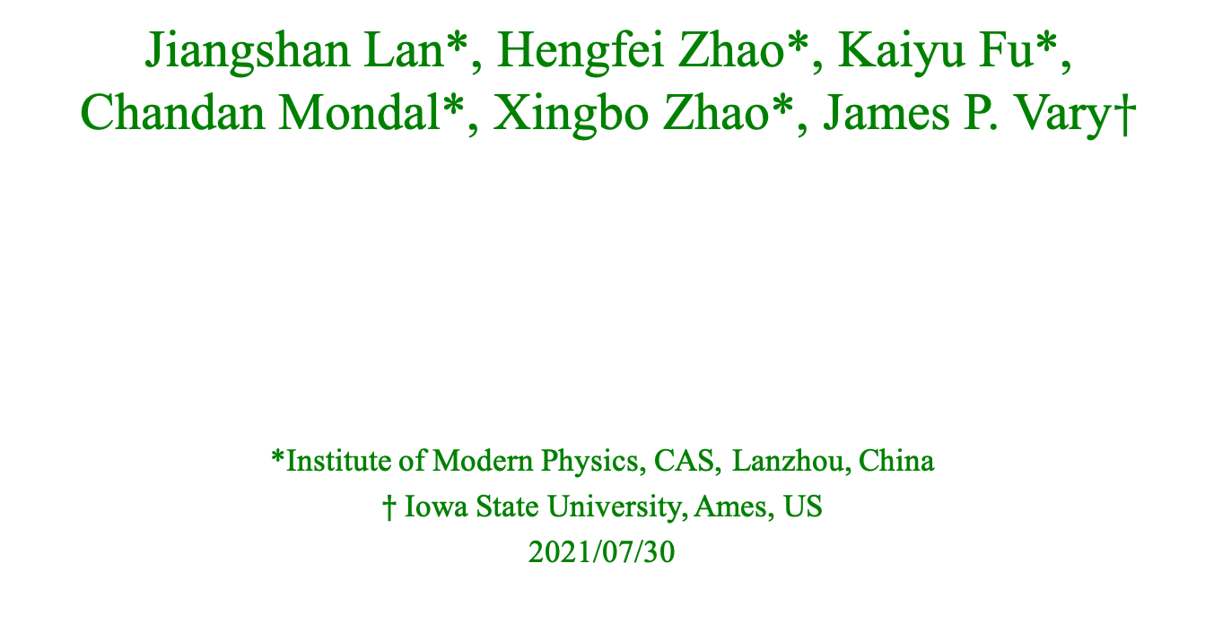
Light Meson Structure from
Basis Light-front Quantization
Jiangshan Lan*, Hengfei Zhao*, Kaiyu Fu*,
Chandan Mondal*, Xingbo Zhao*, James P. Vary$†$
*Institute of Modern Physics, CAS, Lanzhou, China
$†$Iowa State University, Ames, US
2021/07/30

Slide 2
Outline
Basis Light-front Quantization approach
Application to Light Mesons
  Leading Fock sector (based on NJL interacton)
  With one dynamical gluon
Summary and Future Plan

Slide 3
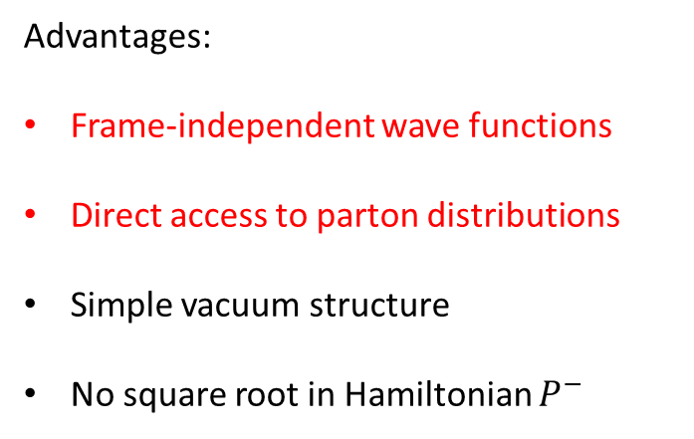




Light-front Quantization
[Dirac, 1949]
Equal time quantization
Light-front quantization
Advantages:
Frame-independent wave functions
Direct access to parton distributions
Simple vacuum structure
No square root in Hamiltonian $P^{−}$
$$x^{1},x^{2},x^{3}$$
$${x^{−}=x}^{0}−x^{3},$$
$$x^{⊥}=x^{1,2}$$
$$P^{0},\overset{⃑}{P}$$
$${P^{−}=P}^{0}−P^{3},$$
${P^{+}=P}^{0}+P^{3}$,$P^{⊥}=P^{1,2}$
Prof. Zhao’s talk
QCD and hadron structure-A8 12:35-12:55
Notes:
Light front was first proposed by Dirac, at 1949.
1. First, what is light-front. Different from equal time theory. We define light-front time as a linear combination of the regular time and one of the spatial coordinate, usually we choose z direction.
So our field quantized at this equal light-front time plane. Where in equal time quantization, they quantized at this equal time plane.
X minus is longitudinal coordinate. P minus is light front Hamiltonian. P plus is longitudinal momentum.
This is light front version of schordinger equation.
Please note that it is not just a coodernate transformation, it is a new theory in a different quantization.
Why go to light front? For we can get Frame Independent wavefunction. Which encods all the information of the bound state structure. It has simple vacuum structure. The theory is boost invariant. And there is no square root in Hamiltonian p minus.

Slide 4
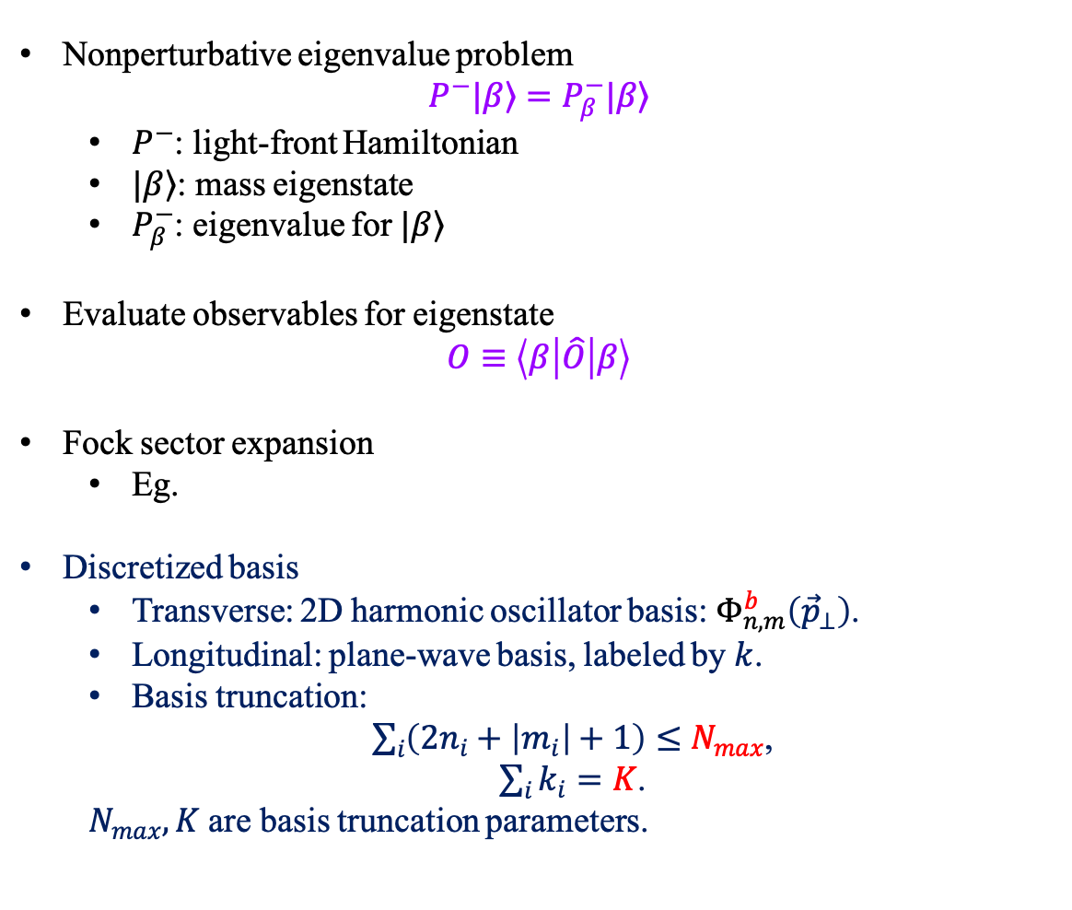
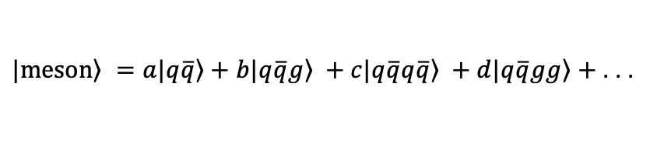
Basis Light-front Quantization
[Vary et al, 2008]
Nonperturbative eigenvalue problem
$$P^{−}|\left.β\right\rangle =P_{β}^{−}|\left.β\right\rangle$$
  $P^{−}$: light-front Hamiltonian
  $|\left.β\right\rangle$: mass eigenstate
  $P_{β}^{−}$: eigenvalue for $|\left.β\right\rangle$
Evaluate observables for eigenstate
$$O≡\left\langle β | \hat{O} | β\right\rangle$$
Fock sector expansion
  Eg.
Discretized basis
  Transverse: 2D harmonic oscillator basis:${ Φ}_{n,m}^{b}\left({\vec{p}}_{⊥}\right)$.
  Longitudinal: plane-wave basis, labeled by $k$.
  Basis truncation:
  $\sum_{i}{\left(2n_{i}+\left|m_{i}\right|+1\right)}≤N_{max}$,
  $\sum_{i}{k_{i}}=K$.
  $N_{max}, K$ are basis truncation parameters.
$\left.|meson\right\rangle =a\left.|q\overline{q}\right\rangle +b\left.|q\overline{q}g\right\rangle +c\left.|q\overline{q}q\overline{q}\right\rangle +d\left.|q\overline{q}gg\right\rangle +$. . .
Prof. Zhao’s talk
QCD and hadron structure-A8 12:35-12:55
Large $N_{max}$ and $K$ : High UV cutoff & low IR cutoff
Notes:
1.

Slide 5
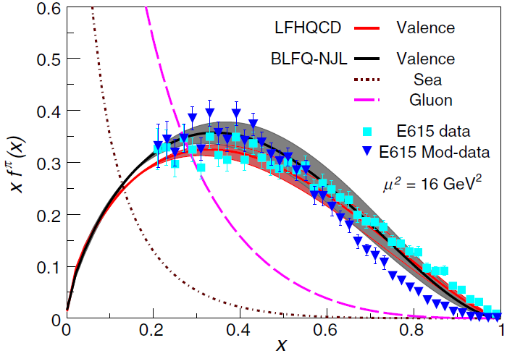
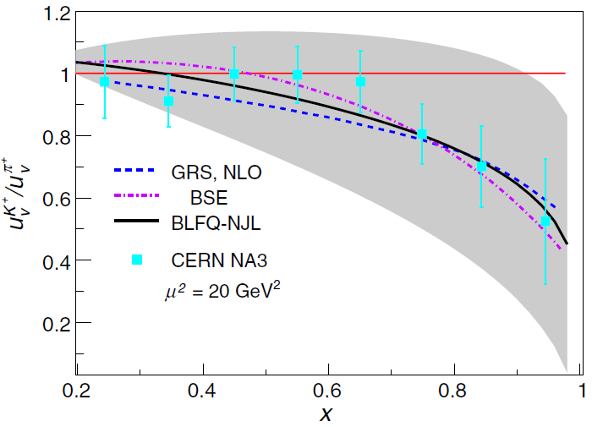
PDF from BLFQ and QCD Evolution for Light Mesons
$$H_{eff}=\frac{\vec{k_{⊥}^{2}}+m_{q}^{2}}{x}+\frac{\vec{k_{⊥}^{2}}+m_{\overline{q}}^{2}}{1−x}+κ^{4}x\left(1−x\right){\vec{r}}_{⊥}^{2}−\frac{κ^{4}}{{\left(m_{q}+m_{\overline{q}}\right)}^{2}}∂_{x}\left(x\left(1−x\right)∂_{x}\right)+H_{eff}^{NJL}$$
PDF for the valence quark result from the light-front wave functions obtain by diagonalizing the effective Hamiltonian.
Pion PDF
Valence u PDF Kaon/Pion
[Lan, Mondal, Jia, Zhao, Vary, PRL122, 172001(2019)]
Agree with experimental results

Slide 6
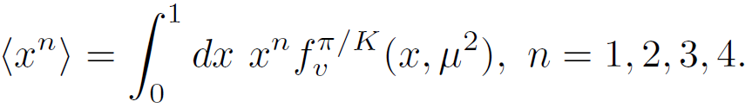
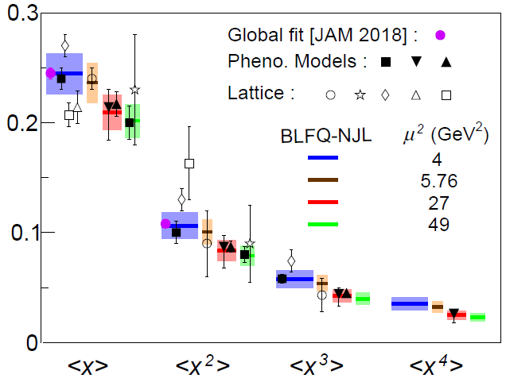
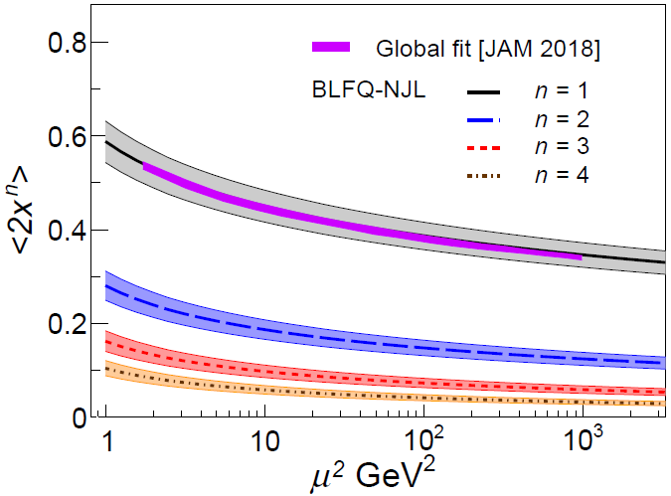
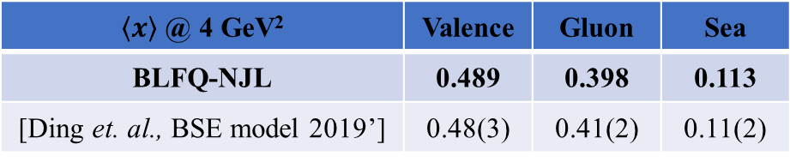
The Moments of Pion Valence Quark PDF
 | Valence | Gluon | Sea
BLFQ-NJL | 0.489 | 0.398 | 0.113
[Ding et. al., BSE model 2019’] | 0.48(3) | 0.41(2) | 0.11(2)
Agree with other results
[Lan, Mondal, Jia, Zhao, Vary, PRD101,034024(2020)]

Slide 7
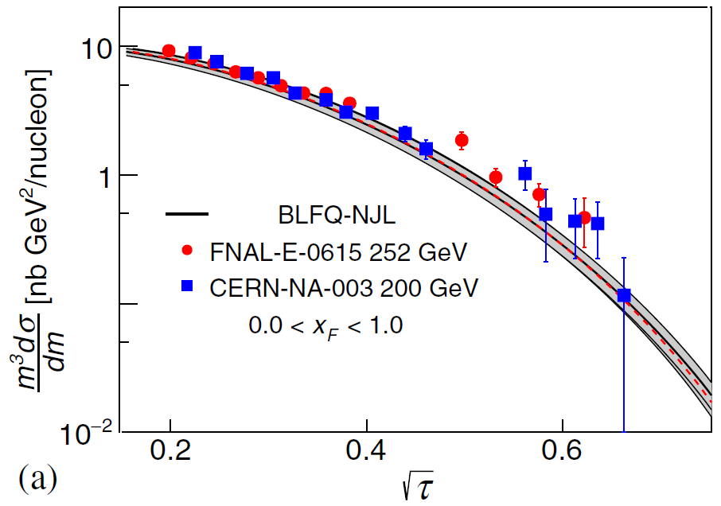
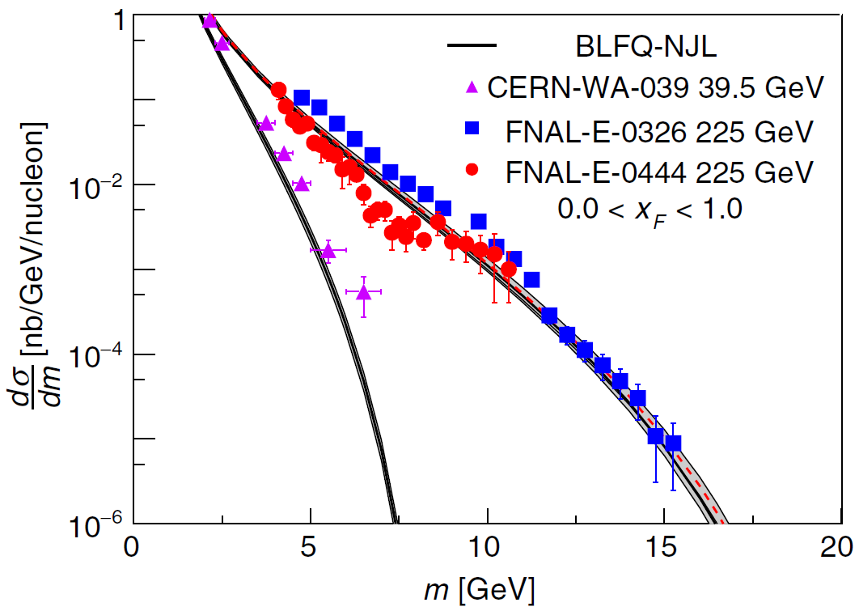

Drell-Yan Cross Section
[S. D. Drell and T.-M. Yan, PRL (1970)]
[T. Becher et al, JKEP07(2008)030]; [P. C. Barry et al, PRL121(2018)152001]
[C. Anastasiou et al, PRL91(2003)182002]
[nCTEQ 2015]
$$\frac{m^{3}d^{2}σ}{dmdY}=\frac{8πα^{2}}{9}\frac{m^{2}}{s}\sum_{ij}{dx_{1}dx_{2}{\tilde{C}}_{ij}(x_{1},x_{2},s,m,μ_{f})f_{i/π}(x_{1},μ_{f})f_{j/N}(x_{2},μ_{f})}$$
W
W
C
W
Pt
Agree with experimental data (FNAL E615, 326, 444, & CERN NA3, WA-039).
[Lan, Mondal, Jia, Zhao, Vary, PRD101,034024(2020)]

Slide 8
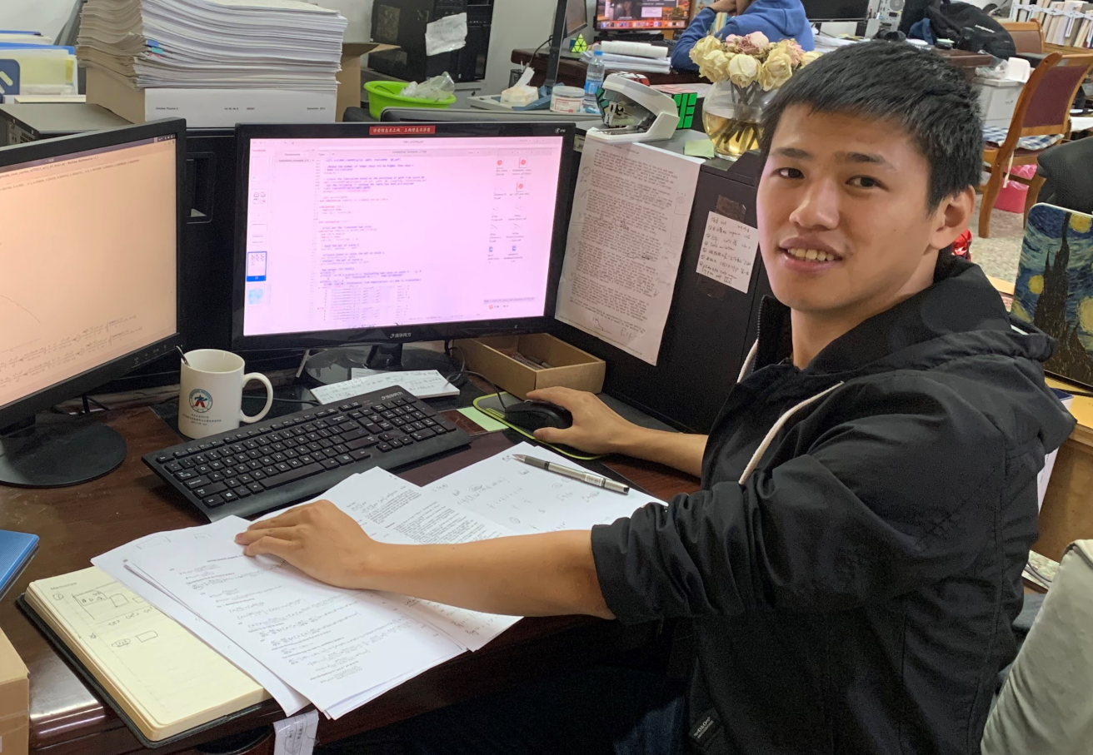


$$\left.|π\right\rangle =\left.|q\overline{q}\right\rangle +…$$
$$\left.|π\right\rangle =a\left.|q\overline{q}\right\rangle +b\left.|q\overline{q}g\right\rangle +…$$

Slide 9
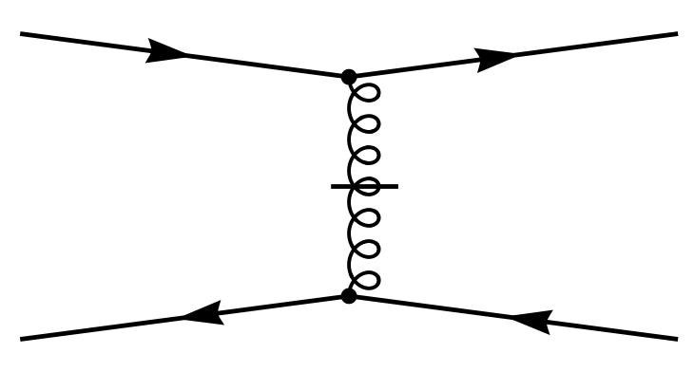
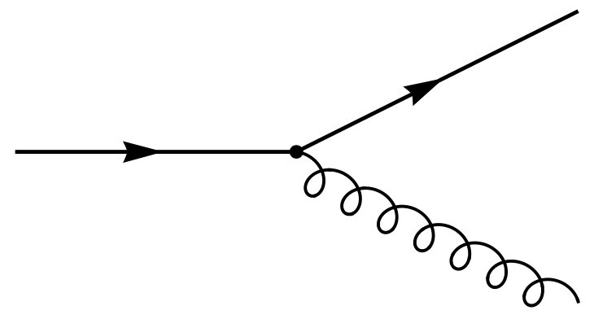
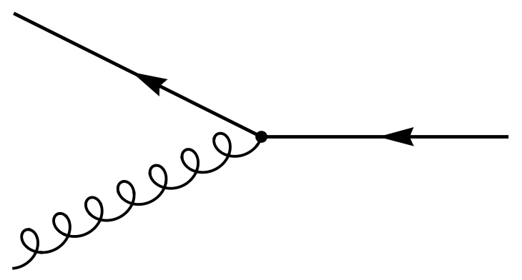





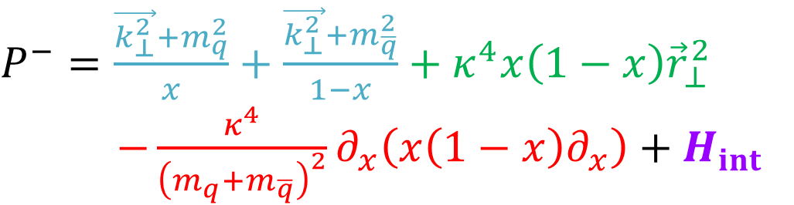

Interaction Part of Hamiltonian
$$\left.|π\right\rangle =a\left.|q\overline{q}\right\rangle +b\left.|q\overline{q}g\right\rangle +…$$
 |  | 0
$$H_{int}$$
$$\left.|q\overline{q}\right\rangle$$
$$\left.|q\overline{q}g\right\rangle$$
$$\left\langle q\overline{q}|\right.$$
$$\left\langle q\overline{q}g|\right.$$
$P^{−}=\frac{\vec{k_{⊥}^{2}}+m_{q}^{2}}{x}+\frac{\vec{k_{⊥}^{2}}+m_{\overline{q}}^{2}}{1−x}+κ^{4}x\left(1−x\right){\vec{r}}_{⊥}^{2}$
$−\frac{κ^{4}}{{\left(m_{q}+m_{\overline{q}}\right)}^{2}}∂_{x}\left(x\left(1−x\right)∂_{x}\right)+H_{int}$

Slide 10
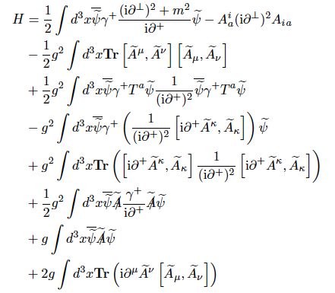

Light-front QCD Hamiltonian
$$P_{LFQCD}^{−}$$

Slide 11
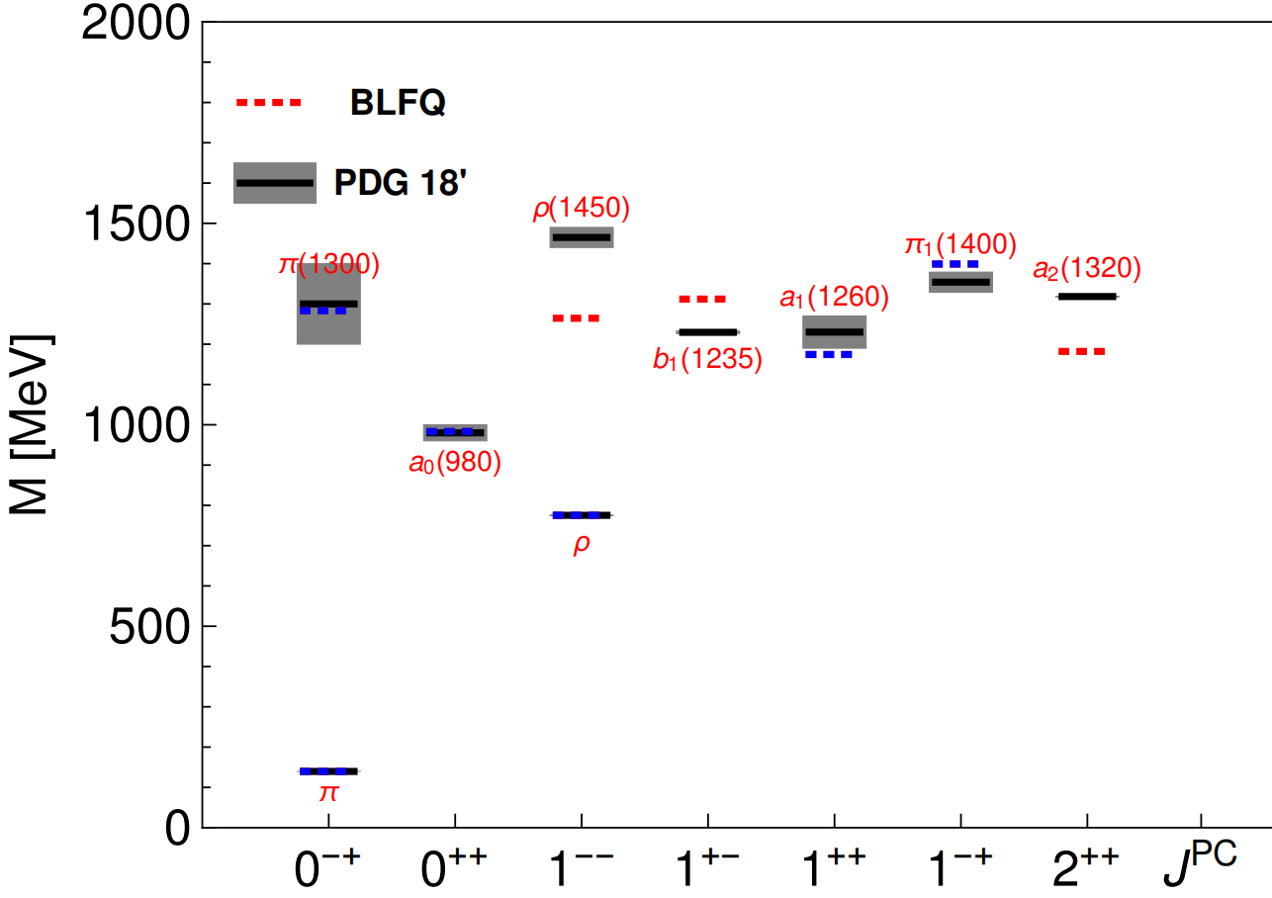
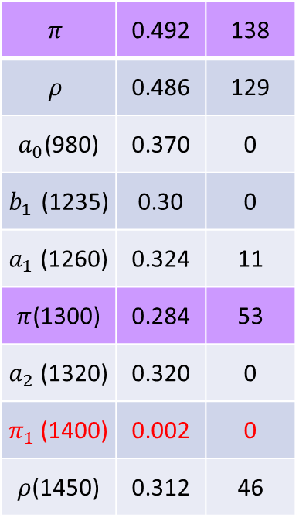

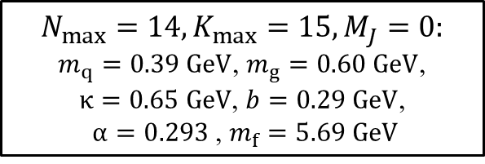
Mass Spectrum
norm$q\overline{q}$
DC[MeV]
$$π$$ | 0.492 | 138
$$ρ$$ | 0.486 | 129
$a_{0}$(980) | 0.370 | 0
$b_{1}$(1235) | 0.30 | 0
$a_{1}$(1260) | 0.324 | 11
$π$(1300) | 0.284 | 53
$a_{2}$(1320) | 0.320 | 0
$π_{1}$(1400) | 0.002 | 0
$ρ$(1450) | 0.312 | 46
$$N_{max}=14,K_{max}=15, M_{J}=0:$$
$m_{q}=0.39 GeV$, $m_{g}=0.60 GeV$,
$κ=0.65 GeV$, $b=0.29 GeV$,
$α=0.293$, $m_{f}=5.69 GeV$
Fix the parameters by fitting six blue states
[Lan, Fu, Mondal, Zhao, Vary, arXiv 2106.04954]

Slide 12
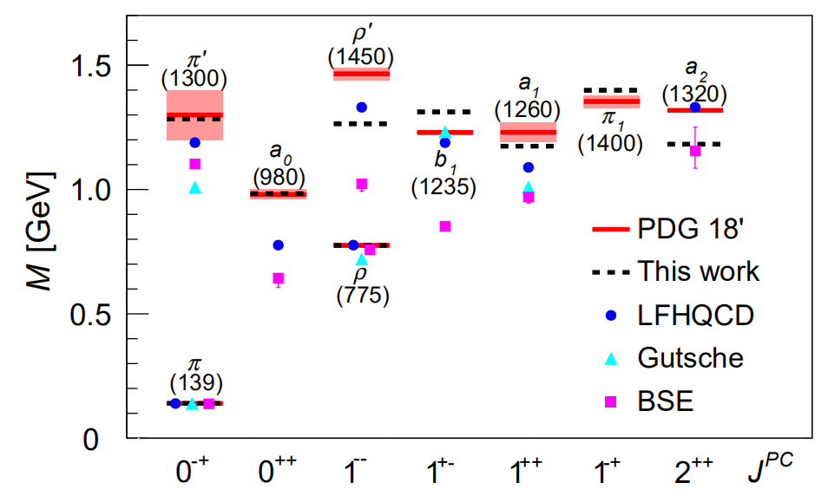

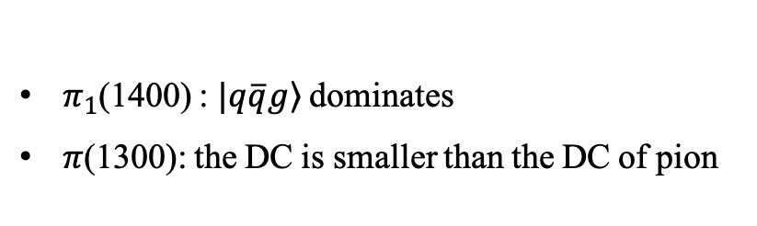
Mass Spectrum
norm$q\overline{q}$
DC[MeV]
$$π$$ | 0.492 | 138
$$ρ$$ | 0.486 | 129
$a_{0}$(980) | 0.370 | 0
$b_{1}$(1235) | 0.306 | 0
$a_{1}$(1260) | 0.324 | 11
$π$(1300) | 0.284 | 53
$a_{2}$(1320) | 0.320 | 0
$π_{1}$(1400) | 0.002 | 0
$ρ$(1450) | 0.312 | 46
Fischer 14’
$π_{1}$(1400) : $\left.|q\overline{q}g\right\rangle$dominates
$π$(1300): the DC is smaller than the DC of pion
[Lan, Fu, Mondal, Zhao, Vary, arXiv 2106.04954]

Slide 13
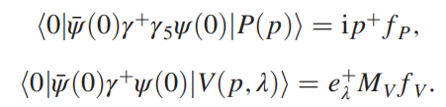
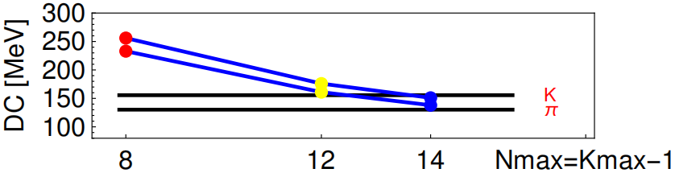
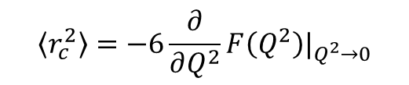
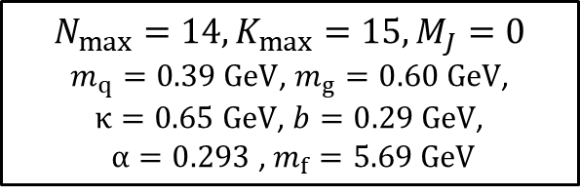
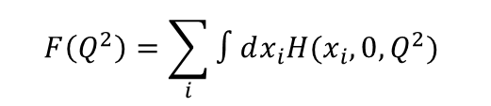
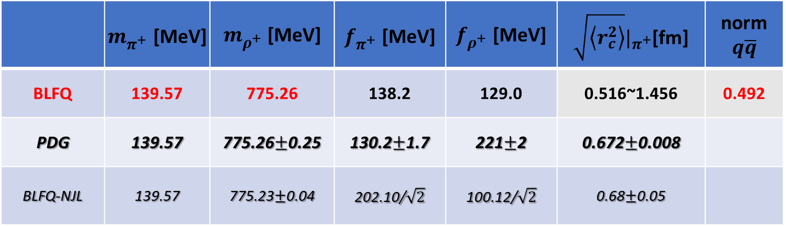
Pion Mass, DC, Radii
$$\left\langle r_{c}^{2}\right\rangle =−6\frac{∂}{∂Q^{2}}F\left(Q^{2}\right)|_{Q^{2}→0}$$
$$F\left(Q^{2}\right)=\sum_{i}{∫dx_{i}H(x_{i},0,Q^{2}) }$$
 | $m_{π^{+}}^{}$[MeV] | $m_{ρ^{+}}^{}$ [MeV] | $f_{π^{+}}^{}$ [MeV] | $f_{ρ^{+}}^{}$ [MeV] | $\sqrt{\left\langle r_{c}^{2}\right\rangle }|_{π^{+}}$[fm] | norm$q\overline{q}$
BLFQ | 139.57 | 775.26 | 138.2 | 129.0 | 0.516~1.456 | 0.492
PDG | 139.57 | 775.26$±$0.25 | 130.2$±$1.7 | 221$±$2 | 0.672$±$0.008
BLFQ-NJL | 139.57 | 775.23$±$0.04 | 202.10/$\sqrt{2}$ | 100.12/$\sqrt{2}$ | 0.68$±$0.05
[Tanabashi, et al, PRD(2018)]
[Jia, Vary, PRC(2018)]
BLFQ
$$N_{max}=14,K_{max}=15, M_{J}=0$$
$m_{q}=0.39 GeV$, $m_{g}=0.60 GeV$,
$κ=0.65 GeV$, $b=0.29 GeV$,
$α=0.293$, $m_{f}=5.69 GeV$
[Lan, Fu, Mondal, Zhao, Vary, arXiv 2106.04954]

Slide 14
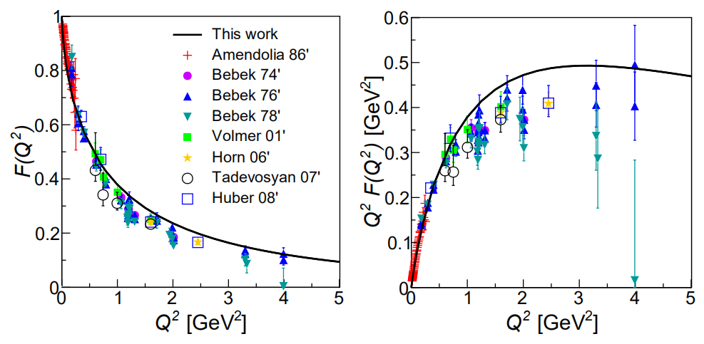
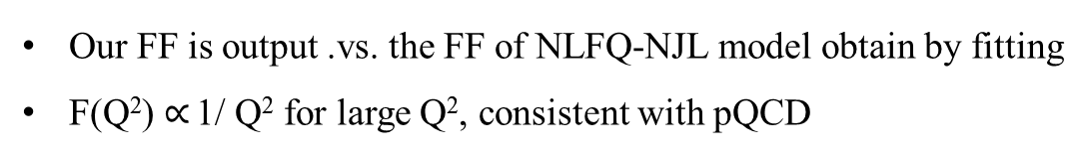
Pion Electromagnetic Form Factor
Our FF is output .vs. the FF of NLFQ-NJL model obtain by fitting
F(Q²) $∝$ 1/ Q² for large Q², consistent with pQCD
[Lan, Fu, Mondal, Zhao, Vary, arXiv 2106.04954]

Slide 15
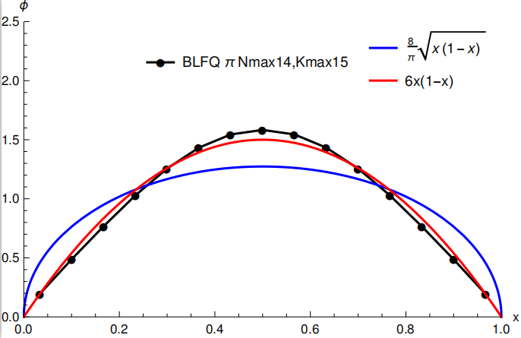
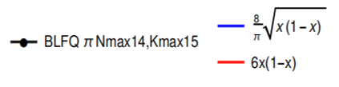
Pion PDA
Ads/QCD
pQCD
Endpoint behavior agrees with pQCD
[Jia and Vary, PRC 99, 035206 (2019]

Slide 16
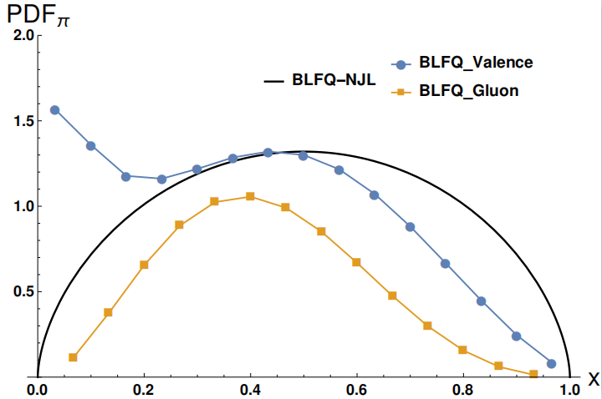
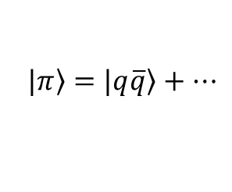
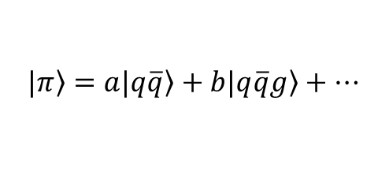







Pion initial PDF
$$\left.|π\right\rangle =\left.|q\overline{q}\right\rangle +…$$
$$\left.|π\right\rangle =a\left.|q\overline{q}\right\rangle +b\left.|q\overline{q}g\right\rangle +…$$
large $x$
$$μ_{0BLFQ−NJL}^{2}=0.240 {GeV}^{2}$$
${\left\langle x\right\rangle }_{gluon}=0$; ${\left\langle x\right\rangle }_{valence u}=0.5$
${(1−x)}^{0.596}$
$$μ_{0BLFQ}^{2}=0.34 {GeV}^{2}$$
${\left\langle x\right\rangle }_{gluon}=0.216$; ${\left\langle x\right\rangle }_{valence u}=0.392$
${(1−x)}^{1.4}$
[Lan, Fu, Mondal, Zhao, Vary, arXiv 2106.04954]

Slide 17
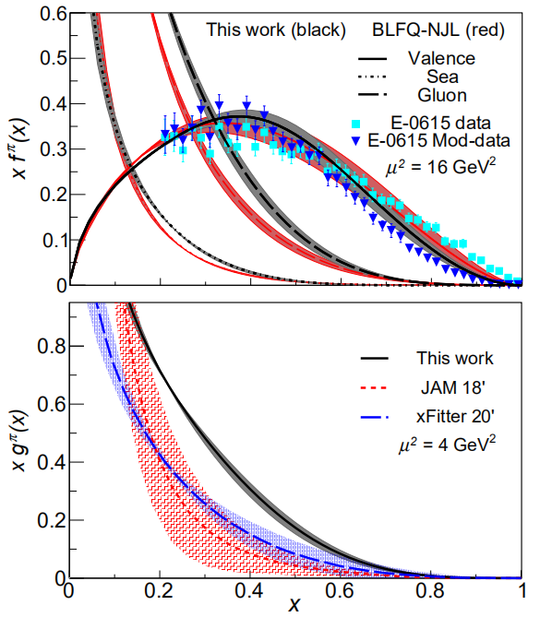
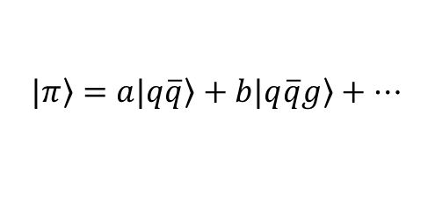
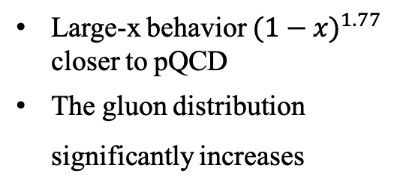
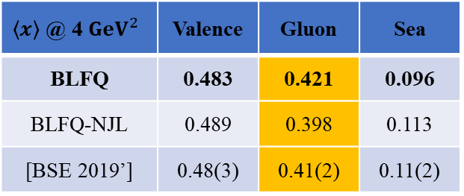
Pion PDF
$$\left.|π\right\rangle =a\left.|q\overline{q}\right\rangle +b\left.|q\overline{q}g\right\rangle +…$$
Large-x behavior ${(1−x)}^{1.77}$ closer to pQCD
The gluon distribution significantly increases
$\left\langle x\right\rangle$ @ 4 ${GeV}^{2}$ | Valence | Gluon | Sea
BLFQ | 0.483 | 0.421 | 0.096
BLFQ-NJL | 0.489 | 0.398 | 0.113
[BSE 2019’] | 0.48(3) | 0.41(2) | 0.11(2)
[Lan, Fu, Mondal, Zhao, Vary, arXiv 2106.04954]

Slide 18
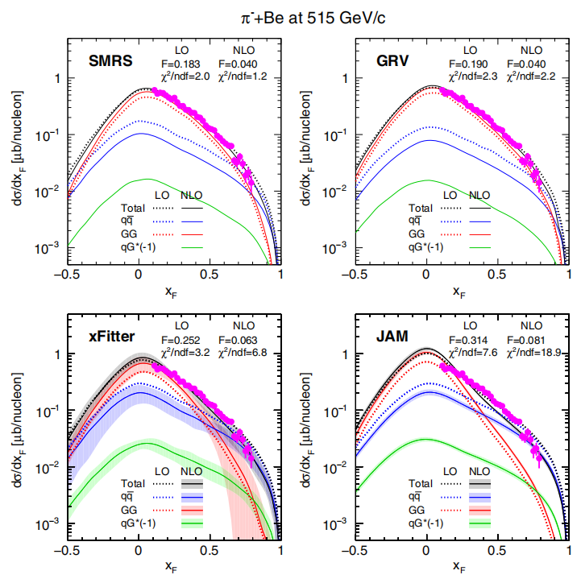
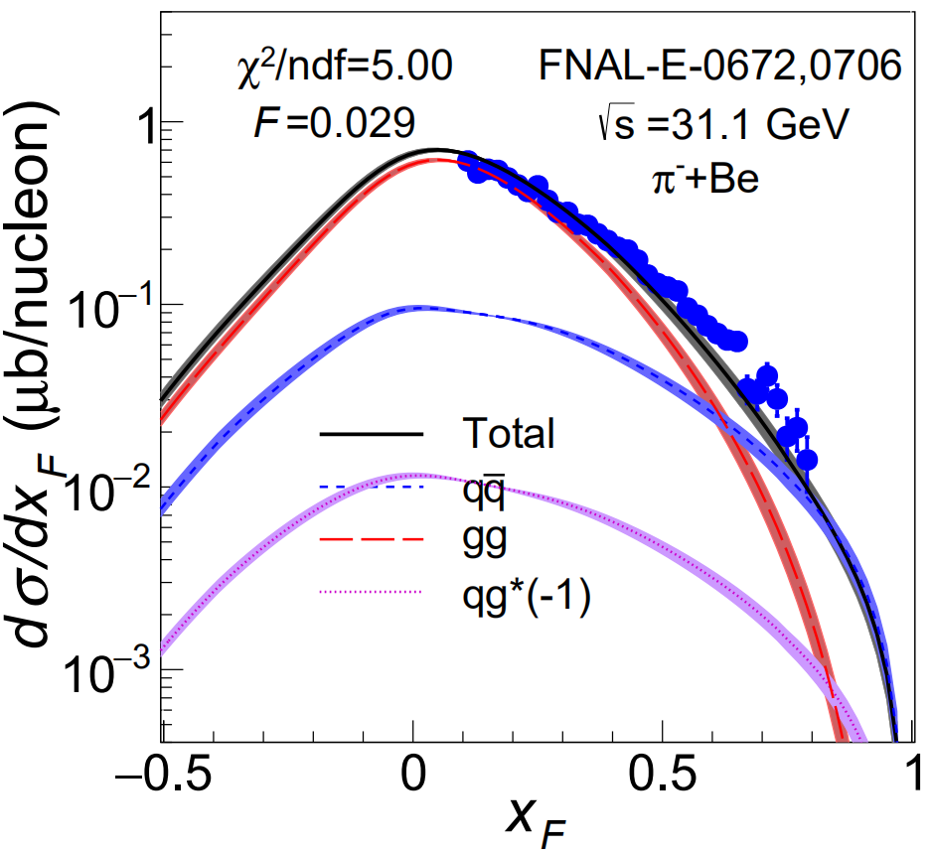
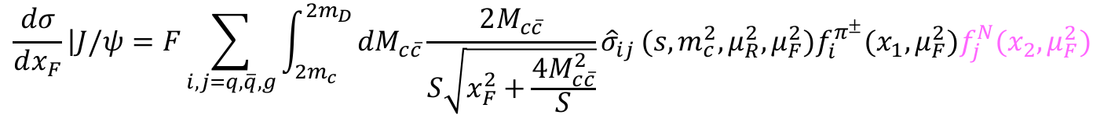
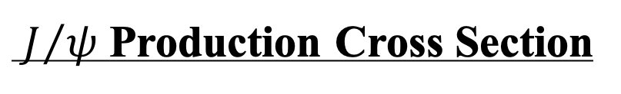


$J/ψ$ Production Cross Section
[Wen-Chen Chang, et al, PRD 102 (2020) 054024];
[P. Nason, et al, NPB 303 (1988) 607];
[M. L. Mangano, et al, NPB 405 (1993) 507]
$π^{±} N→J/ψ X$
[nCTEQ 2015]
$$\frac{dσ}{dx_{F}}\left|J/ψ\right.=F\sum_{i,j=q,\overline{q},g}{\int_{2m_{c}}^{{2m}_{D}}{dM_{c\overline{c}}\frac{2M_{c\overline{c}}}{S\sqrt{x_{F}^{2}+\frac{4M_{c\overline{c}}^{2}}{S}}}{\hat{σ}}_{ij}}(s,m_{c}^{2},μ_{R}^{2},μ_{F}^{2})f_{i}^{π^{±}}(x_{1},μ_{F}^{2})f_{j}^{N}(x_{2},μ_{F}^{2})}$$
$$\sqrt{S}$$
(from Chang, et al PRD 20’ )
CEM
Agree with experimental data (FNAL E672, E706).
[Lan, Fu, Mondal, Zhao, Vary, arXiv 2106.04954]

Slide 19
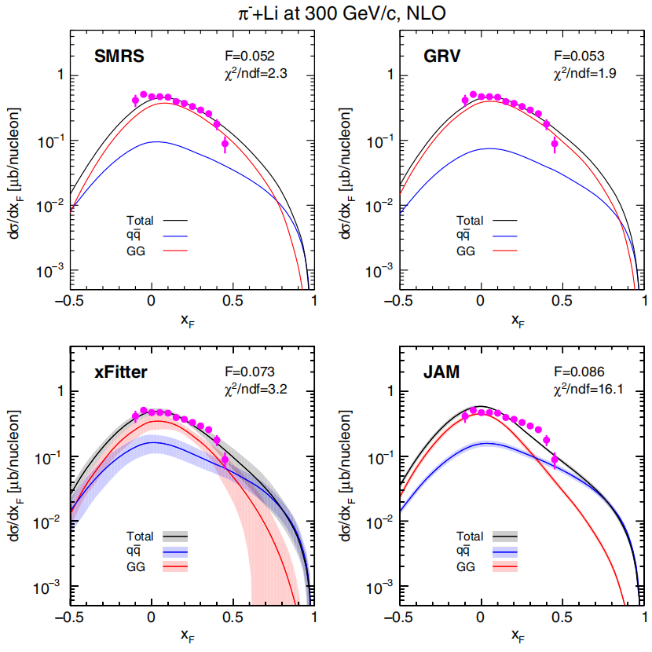
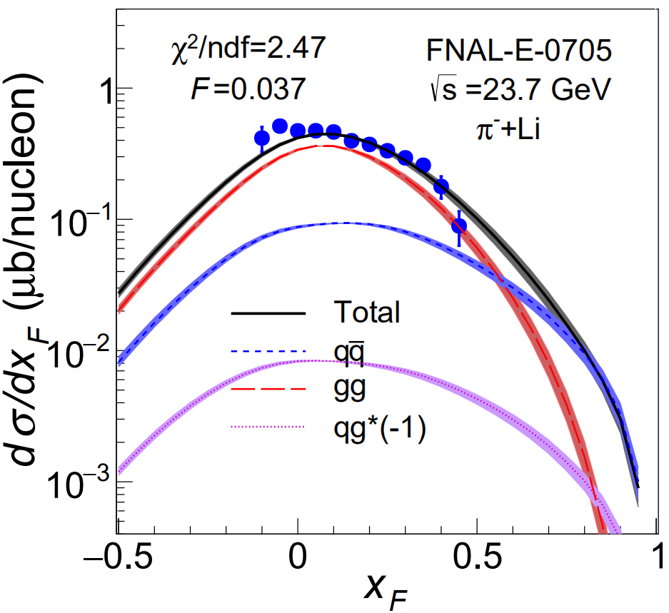

$J/ψ$ Production Cross Section
[Wen-Chen Chang, et al, PRD 102 (2020) 054024];
[P. Nason, et al, NPB 303 (1988) 607];
[M. L. Mangano, et al, NPB 405 (1993) 507]
$π^{±} N→J/ψ X$
[nCTEQ 2015]
$$\frac{dσ}{dx_{F}}\left|J/ψ\right.=F\sum_{i,j=q,\overline{q},g}{\int_{2m_{c}}^{{2m}_{D}}{dM_{c\overline{c}}\frac{2M_{c\overline{c}}}{S\sqrt{x_{F}^{2}+\frac{4M_{c\overline{c}}^{2}}{S}}}{\hat{σ}}_{ij}}(s,m_{c}^{2},μ_{R}^{2},μ_{F}^{2})f_{i}^{π^{±}}(x_{1},μ_{F}^{2})f_{j}^{N}(x_{2},μ_{F}^{2})}$$
$$\sqrt{S}$$
(from Chang, et al PRD 20’ )
CEM
Agree with experimental data (FNAL E705).
7%Li6+93%Li7
[Lan, Fu, Mondal, Zhao, Vary, arXiv 2106.04954]

Slide 20
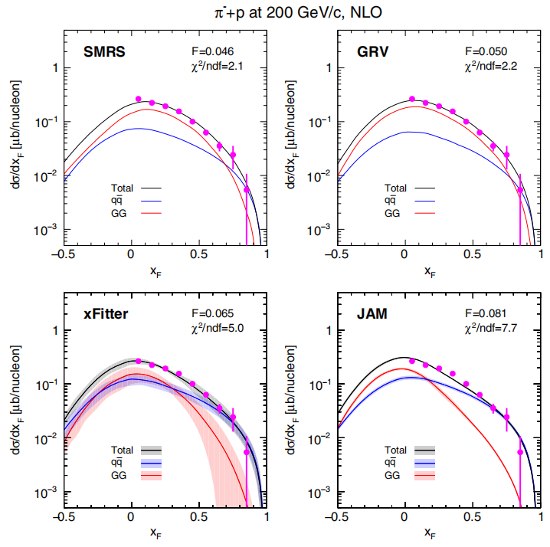
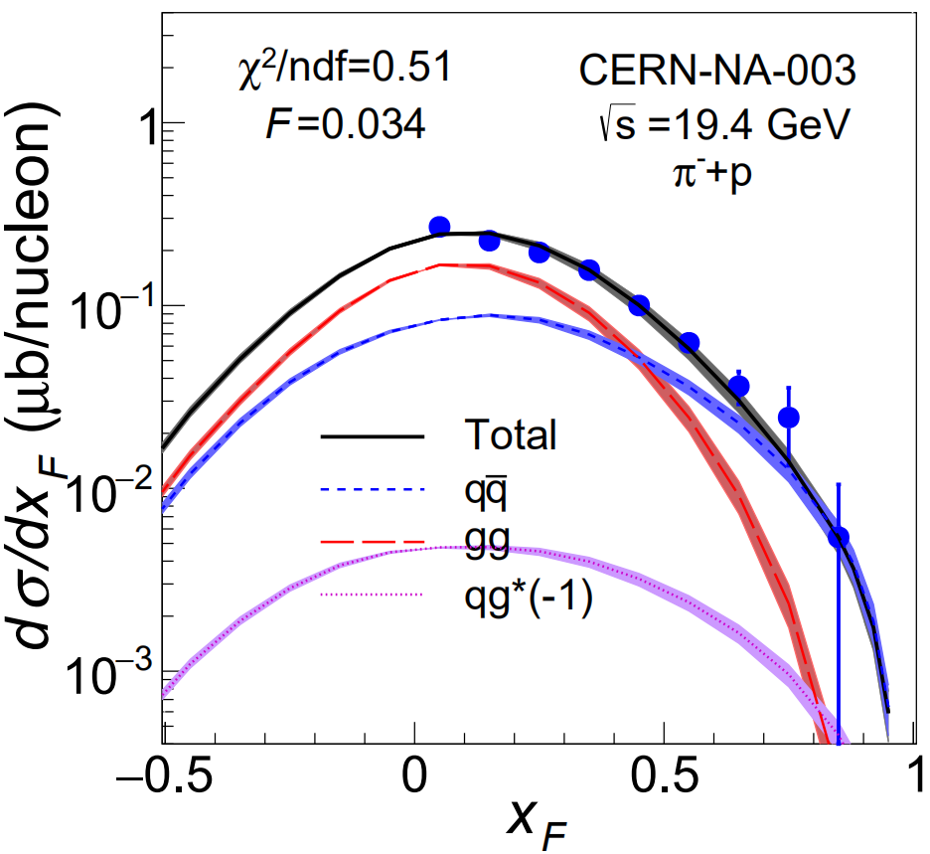

$J/ψ$ Production Cross Section
[Wen-Chen Chang, et al, PRD 102 (2020) 054024];
[P. Nason, et al, NPB 303 (1988) 607];
[M. L. Mangano, et al, NPB 405 (1993) 507]
$π^{±} N→J/ψ X$
[nCTEQ 2015]
$$\frac{dσ}{dx_{F}}\left|J/ψ\right.=F\sum_{i,j=q,\overline{q},g}{\int_{2m_{c}}^{{2m}_{D}}{dM_{c\overline{c}}\frac{2M_{c\overline{c}}}{S\sqrt{x_{F}^{2}+\frac{4M_{c\overline{c}}^{2}}{S}}}{\hat{σ}}_{ij}}(s,m_{c}^{2},μ_{R}^{2},μ_{F}^{2})f_{i}^{π^{±}}(x_{1},μ_{F}^{2})f_{j}^{N}(x_{2},μ_{F}^{2})}$$
$$\sqrt{S}$$
(from Chang, et al PRD 20’ )
CEM
Agree with experimental data (CERN NA3).
[Lan, Fu, Mondal, Zhao, Vary, arXiv 2106.04954]

Slide 21
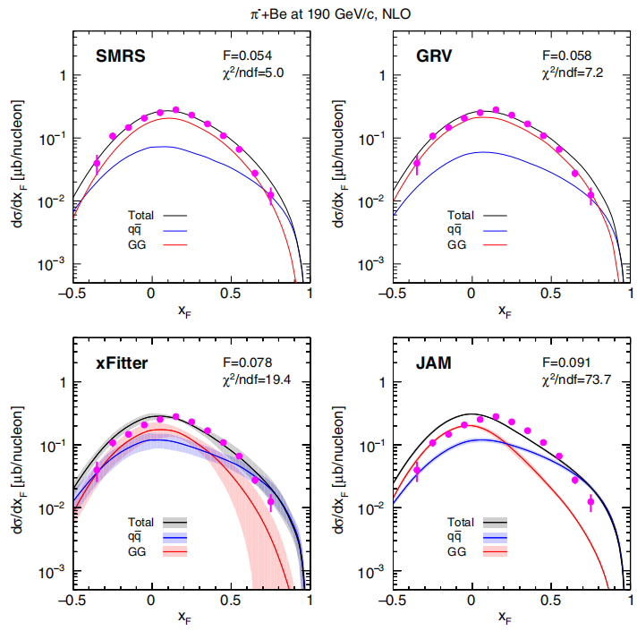


$J/ψ$ Production Cross Section
[Wen-Chen Chang, et al, PRD 102 (2020) 054024];
[P. Nason, et al, NPB 303 (1988) 607];
[M. L. Mangano, et al, NPB 405 (1993) 507]
$π^{±} N→J/ψ X$
[nCTEQ 2015]
$$\frac{dσ}{dx_{F}}\left|J/ψ\right.=F\sum_{i,j=q,\overline{q},g}{\int_{2m_{c}}^{{2m}_{D}}{dM_{c\overline{c}}\frac{2M_{c\overline{c}}}{S\sqrt{x_{F}^{2}+\frac{4M_{c\overline{c}}^{2}}{S}}}{\hat{σ}}_{ij}}(s,m_{c}^{2},μ_{R}^{2},μ_{F}^{2})f_{i}^{π^{±}}(x_{1},μ_{F}^{2})f_{j}^{N}(x_{2},μ_{F}^{2})}$$
$$\sqrt{S}$$
(from Chang, et al PRD 20’ )
CEM
Agree with experimental data (CERN W11).
[Lan, Fu, Mondal, Zhao, Vary, arXiv 2106.04954]

Slide 22




$J/ψ$ Production Cross Section
$$\frac{dσ}{dx_{F}}\left|J/ψ\right.=F\sum_{i,j=q,\overline{q},g}{\int_{2m_{c}}^{{2m}_{D}}{dM_{c\overline{c}}\frac{2M_{c\overline{c}}}{S\sqrt{x_{F}^{2}+\frac{4M_{c\overline{c}}^{2}}{S}}}{\hat{σ}}_{ij}}(s,m_{c}^{2},μ_{R}^{2},μ_{F}^{2})f_{i}^{π^{±}}(x_{1},μ_{F}^{2})f_{j}^{N}(x_{2},μ_{F}^{2})}$$
$π^{±} N→J/ψ X$
CEM
[nCTEQ 2015]
[Chang, et al, PRD 102 (2020) 054024];
[Nason, et al, NPB 303 (1988) 607];
[Mangano, et al, NPB 405 (1993) 507]
Agree with experimental data (FNAL E672, E706, E705, CERN NA3,WA11).
[Lan, Fu, Mondal, Zhao, Vary, arXiv 2106.04954]

Slide 23



Pion Structure Function
[Lan, Mondal, Jia, Zhao, Vary, PRD101,034024(2020)]
$$\left.|π\right\rangle =a\left.|q\overline{q}\right\rangle +b\left.|q\overline{q}g\right\rangle +…$$
$$F_{2}^{π}\left(β,μ^{2}\right)=\sum_{q,g}{e_{q}^{2}β\{f_{q}^{π}\left(β,μ^{2}\right)+f_{\overline{q}}^{π}\left(β,μ^{2}\right)+\frac{α_{s}\left(μ^{2}\right)}{2π}[C_{q,2}⨂\left(f_{q}^{π}+f_{\overline{q}}^{π}\right)+2C_{g,2}⨂f_{g}^{π}]\}}$$
$$μ=2m_{c}=3 GeV$$
better than BLFQ-NJL results
Higher initial scale
less gluon/sea quark at small x
in future
$$\left.|π\right\rangle =a\left.|q\overline{q}\right\rangle +b\left.|q\overline{q}g\right\rangle +c\left.|q\overline{q}q\overline{q}\right\rangle +…$$

Slide 24

Conclusions
Lightfront Hamiltonian approach: mass spectrum structure
Compared to NJL interaction, dynamical gluon in light meson:
  Explains the properties of exotic state $π_{1}(1400)$
  Improves endpoint behavior in PDF/PDA
  Generates more gluon at moderate x/less gluon at small x
  Agree with $J/ψ$ production cross section
  Improves $π$ structure function at small x
Systematically expandable by including higher Fock sectors
  $$\left|Meson\right\rangle =\left|q\overline{q}\right\rangle +\left|q\overline{q}g\right\rangle +\left|q\overline{q}q\overline{q}\right\rangle +…$$
Thank you !
Questions/suggestions: jiangshanlan@impcas.ac.cn

