Slide 1




19th International Conference on Hadron Spectroscopy and Structure
$P_{c}$ Resonances in the Compact Pentaquark Picture
Wiriya Ruangyoo
Working with: Kanokphon Phumphan, Chia-Chu Chen, Ayut Limphirat, Yupeng Yan
School of Physics and Center of Excellence in High Energy Physics and Astrophysics, Suranaree University of Technology, Thailand
Department of Physics, National Cheng Kung University, Taiwan
30 July 2021

Slide 2
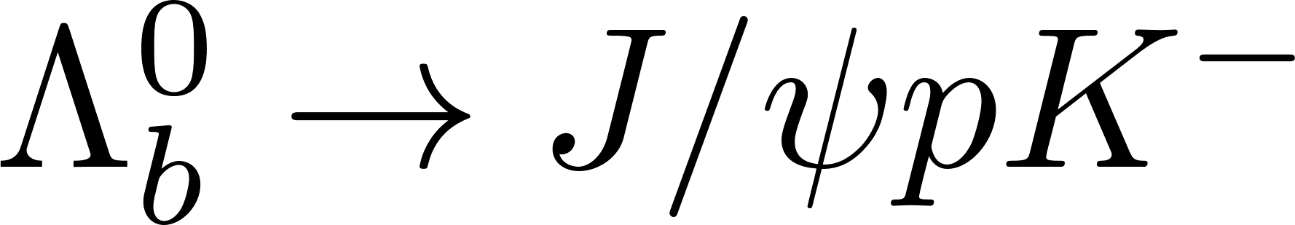
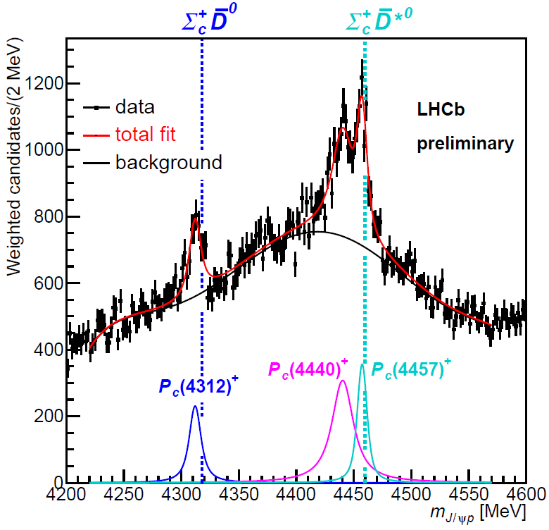
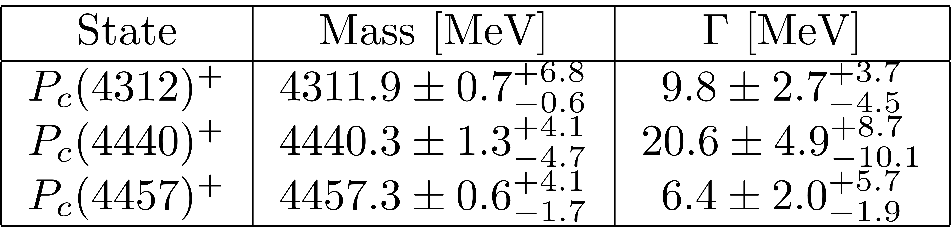
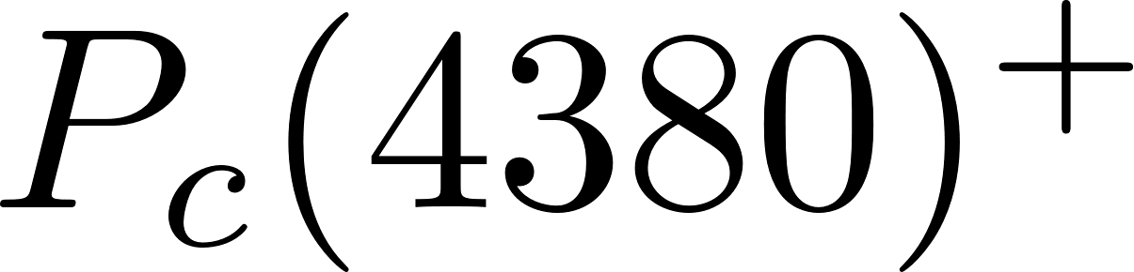




Introduction
Hidden-charm pentaquark $P_{c}$
The observation of
$${\frac{1}{2}}^{−}$$
Predicted J^{P}:
$${{\frac{1}{2}}^{−}\text{,} \frac{3}{2}}^{−}$$
Summary of$P_{c}$ properties
Broad peak
R. Aaij et al., Phys. Rev. Lett. 122(22):222001(2019)
Wiriya Ruangyoo
2

Slide 3
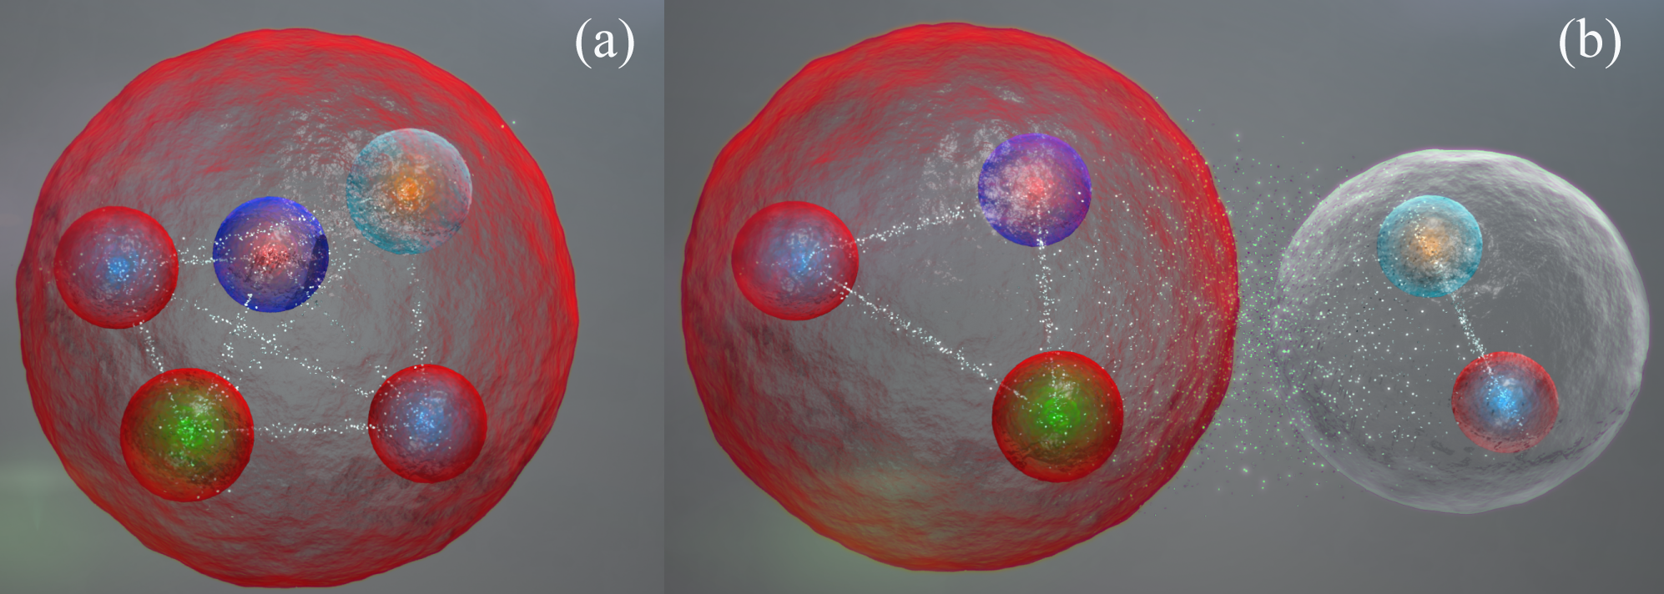
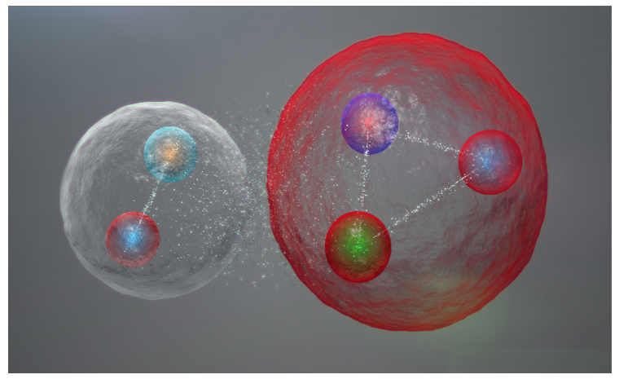
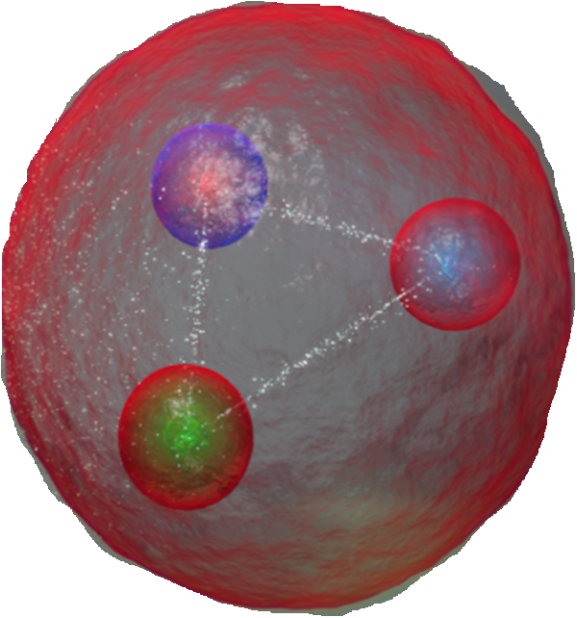
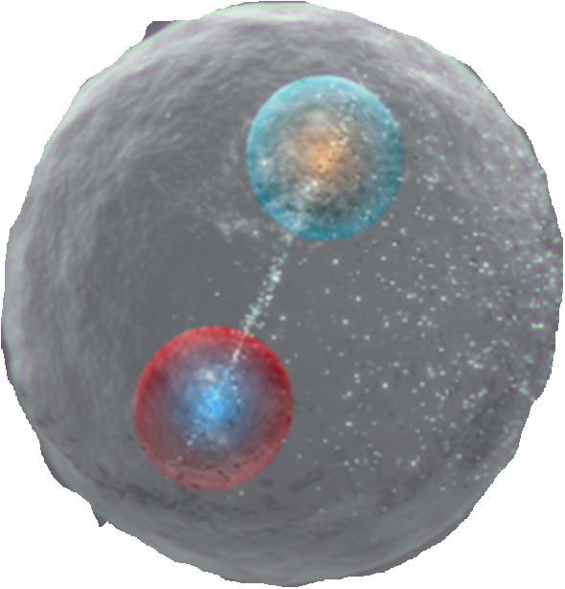
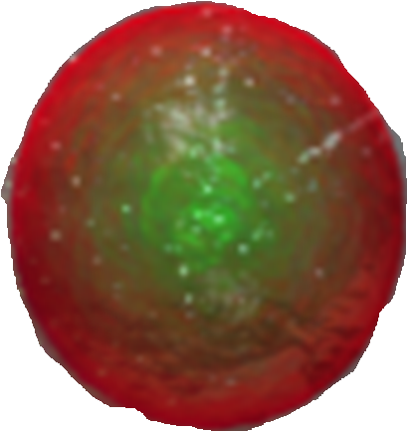
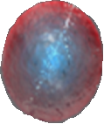



























Introduction
The possible bound states of $P_{c}$
$$u$$
$$u$$
$$\overline{c}$$
$$u$$
$$d$$
$$u$$
$$c$$
$$c$$
$$\overline{c}$$
$$d$$
$$c$$
$$d$$
$$d$$
$$c$$
$$u$$
$$u$$
$$\overline{c}$$
$$\overline{c}$$
$$u$$
$$u$$
$$J/ψ$$
$$p$$
$$p$$
$$J/ψ$$
(a) tightly-bound state (Pentaquark structure)
(b) loosely-bound state (Molecular structure).
Quark model framework
CERN (2019)
3

Slide 4
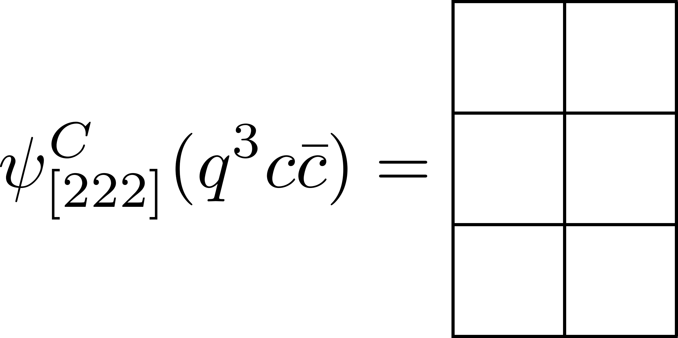
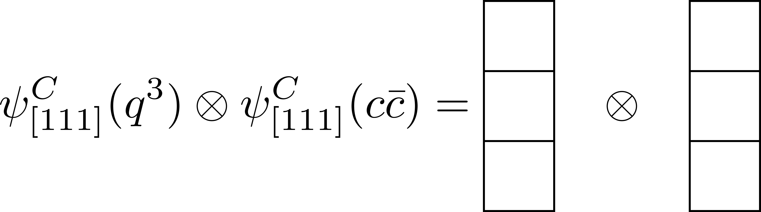
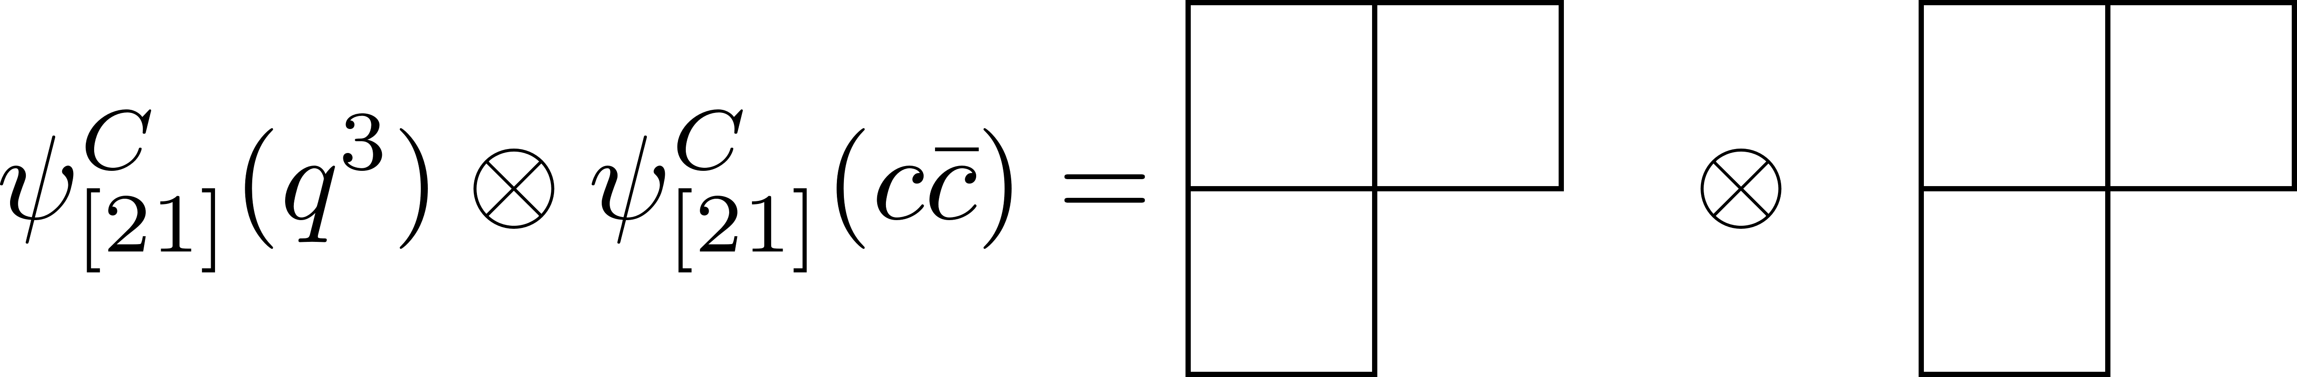
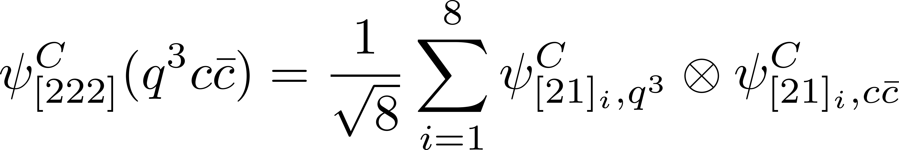

The $P_{c}$ wave functions
The general form of the total wave function can be represented as
The wave function conditions of hadrons :
  The color wave function must be color singlet for any multiquarks
  The total wave function should be antisymmetric wave function
The color wave function of pentaquark is represented in the Young tabloid as
There are two possible color wave functions for color singlet.
The explicit color wave function can be calculated by
Wiriya Ruangyoo
4

Slide 5

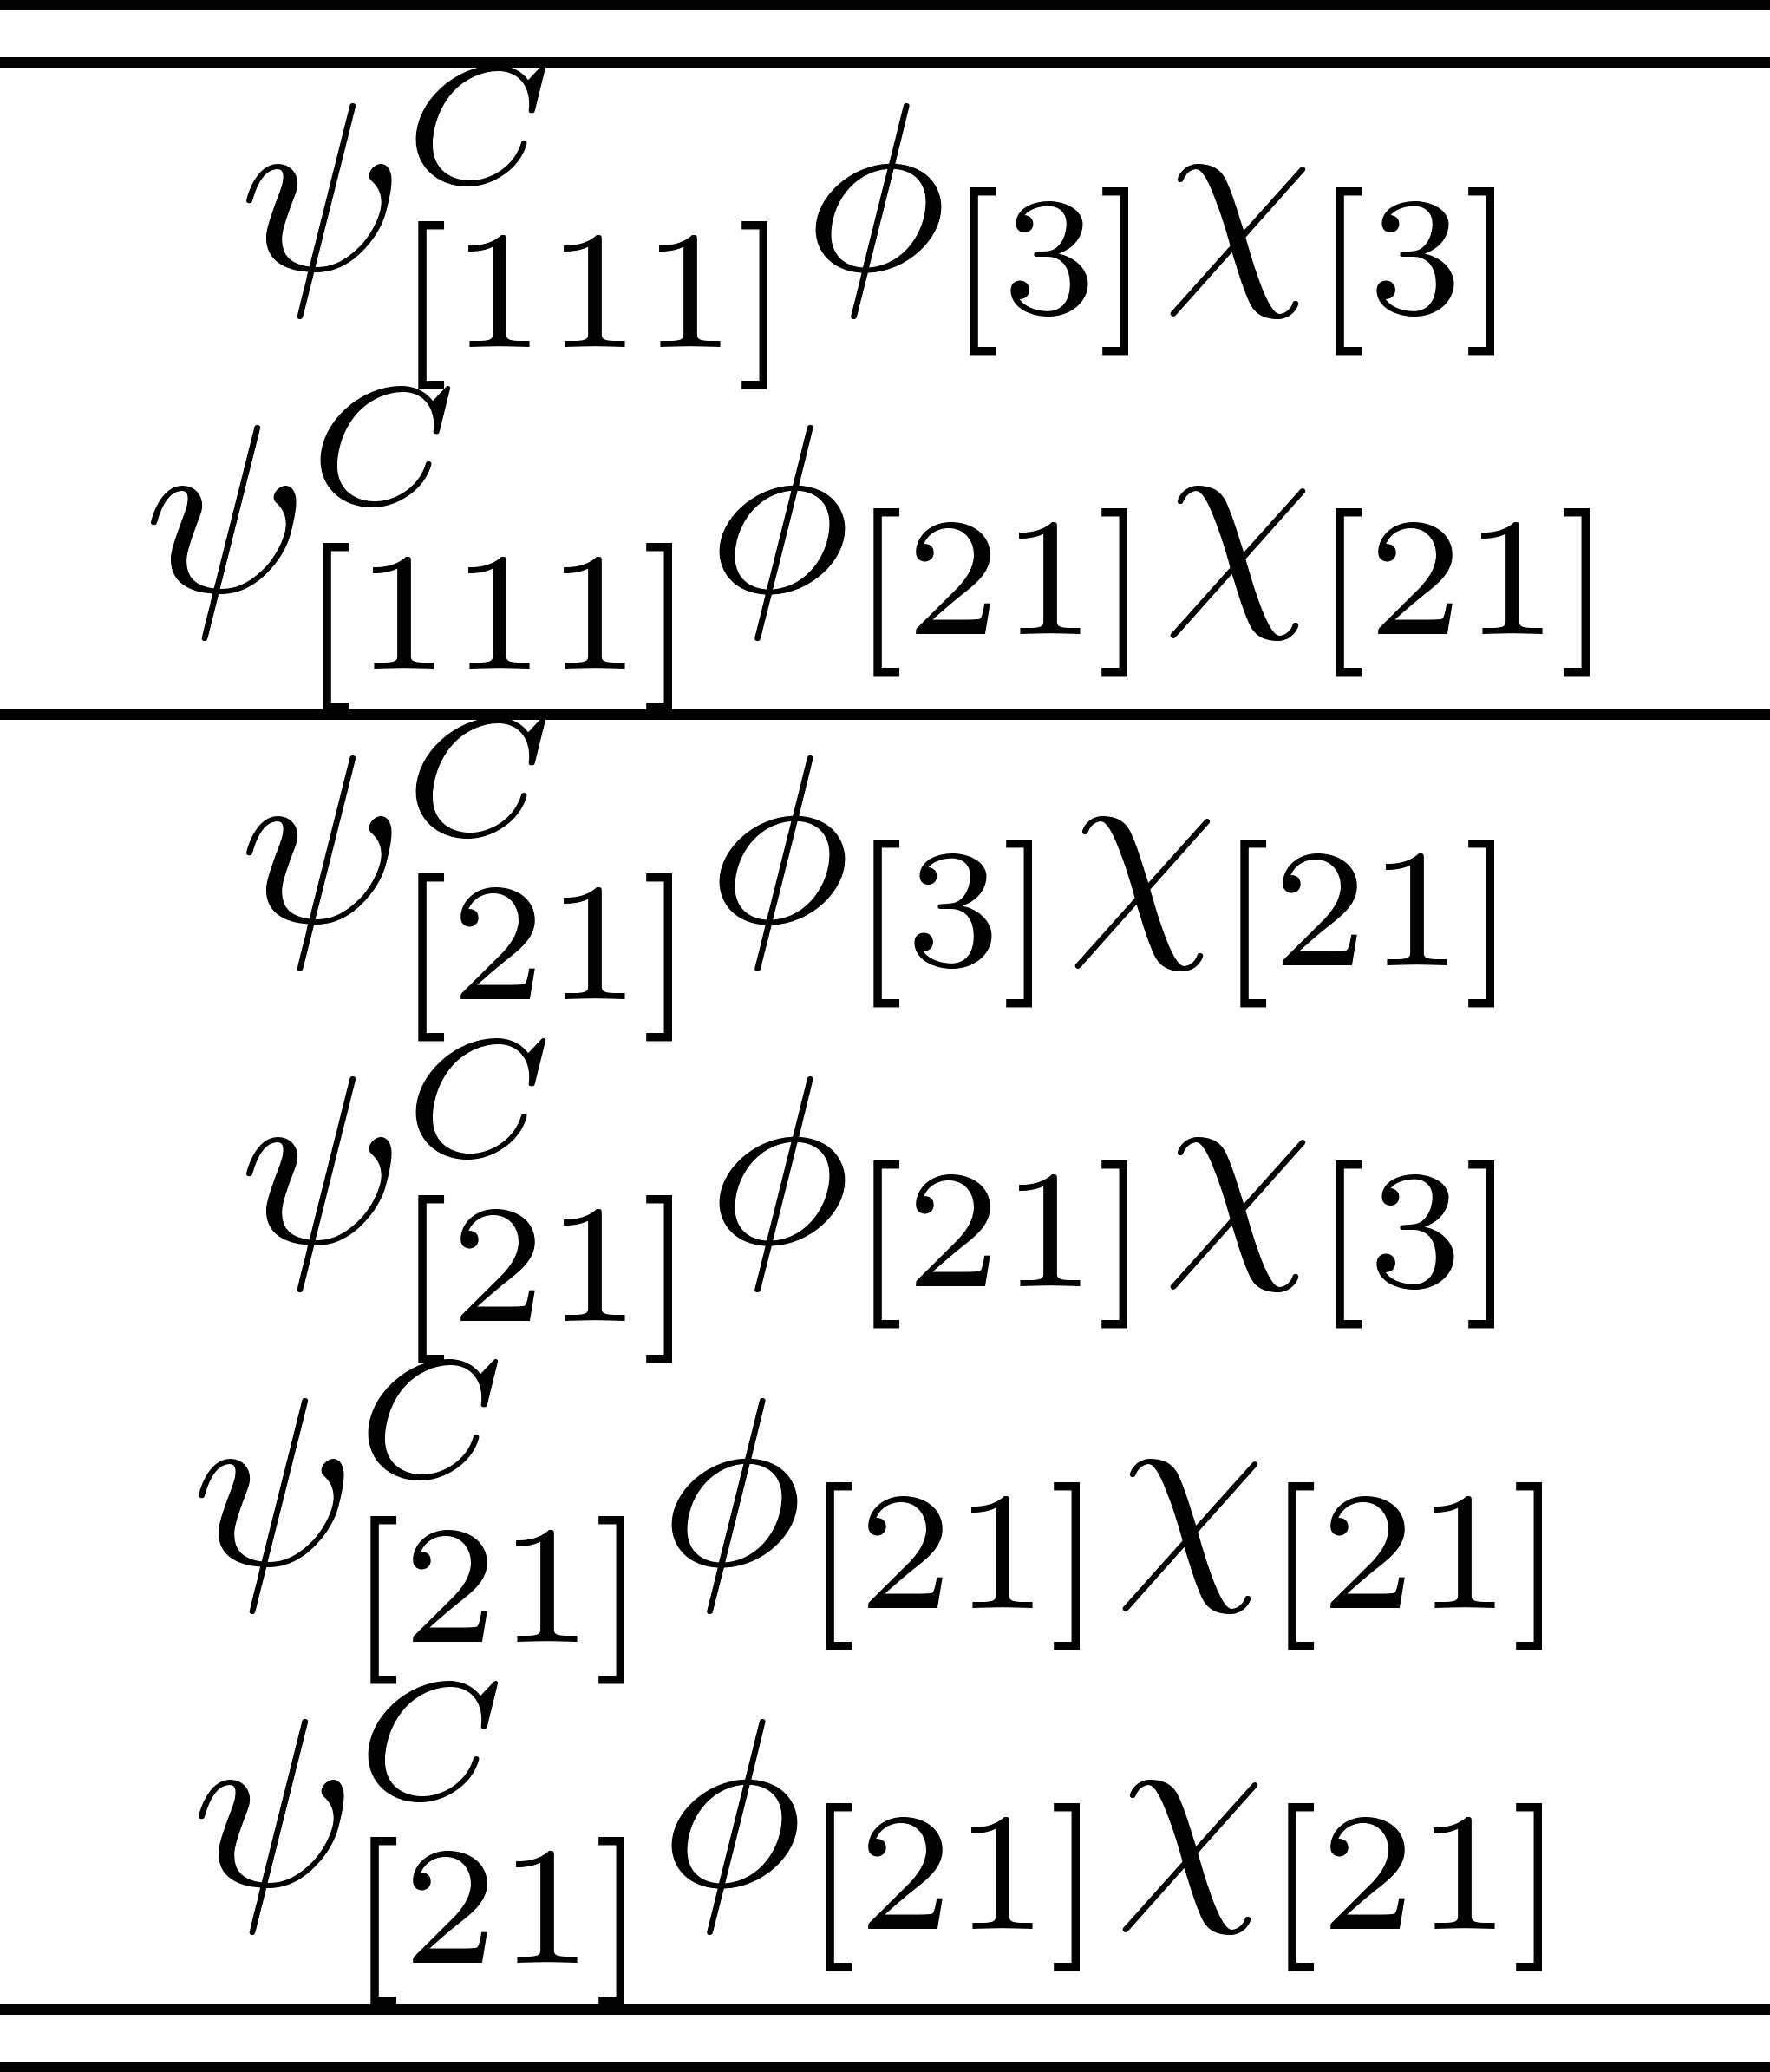
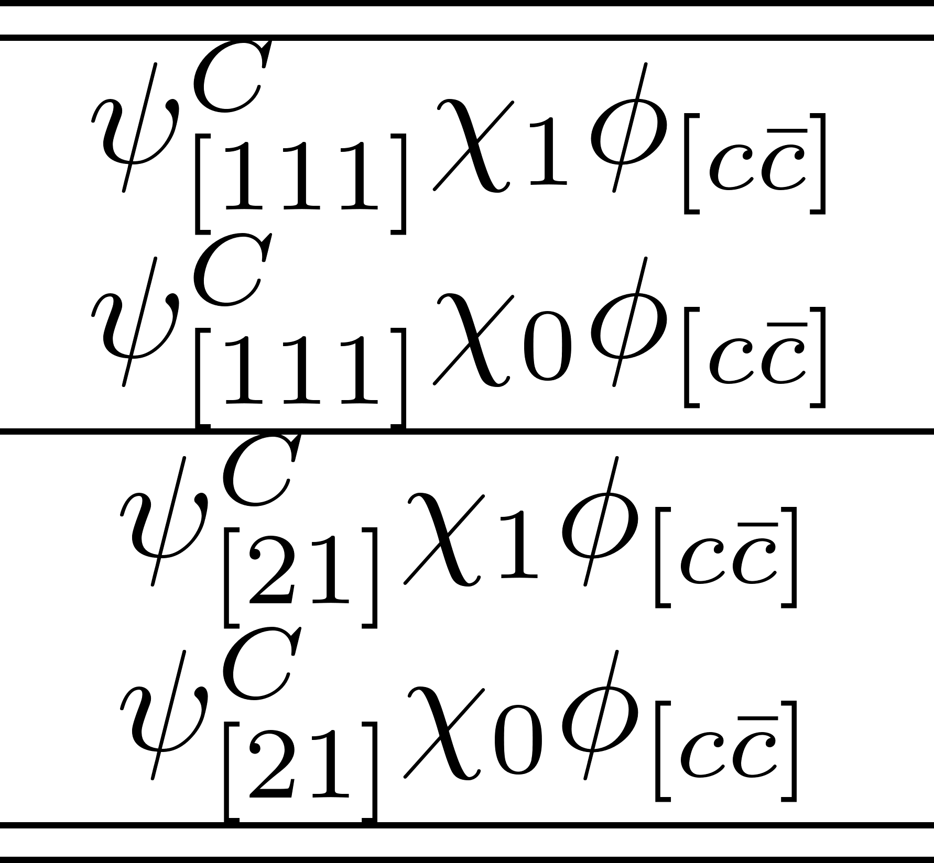

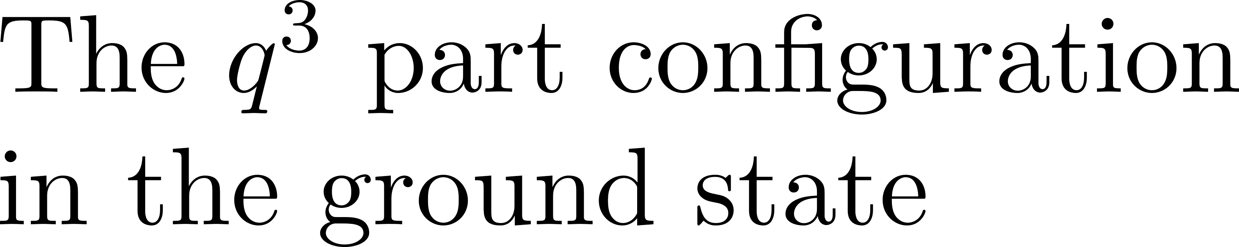

The $P_{c}$ wave functions
The total wave function for the ground pentaquark states is required the antisymmetric wave function for the light quark ($q$).
$$⨂$$
Wiriya Ruangyoo
5
Master’s thesis defense 18

Slide 6
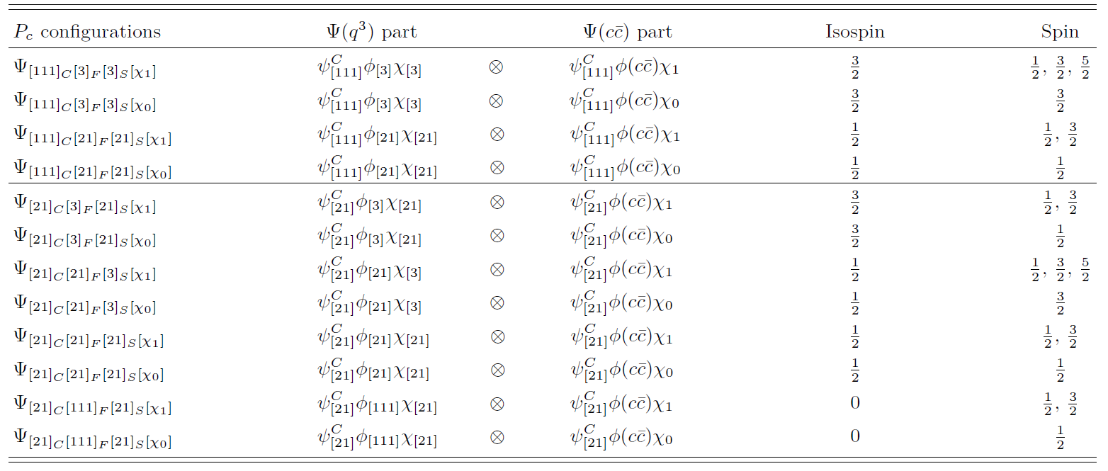
The $P_{c}$ wave functions
The wave functions
The spatial-spin-flavor-color wave function of $P_{c}$ at ground state can be shown in table below.
Wiriya Ruangyoo
6
Master’s thesis defense 19

Slide 7
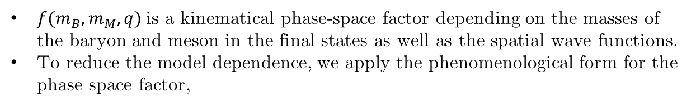
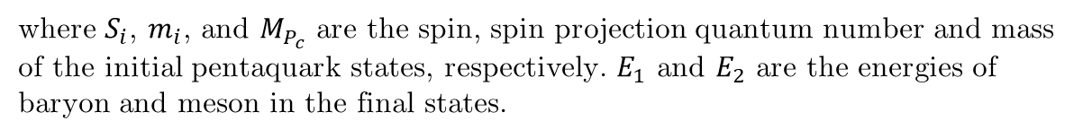
Strong decay study
The decay width for two- body decay is evaluated in the non-relativistic approximation
where $S_{i}$, $m_{i}$, and $M_{P_{c}}$ are the spin, spin projection quantum number and mass of the initial pentaquark states, respectively. $E_{1}$ and $E_{2}$ are the energies of baryon and meson in the final states.
$f(m_{B},m_{M},q)$is a kinematical phase-space factor depending on the masses of the baryon and meson in the final states as well as the spatial wave functions.
To reduce the model dependence, we apply the phenomenological form for the phase space factor,
J. Vandermeulen, Z. Phys. C 37, 563 (1988)
$\left\langle ψ_{f}^{SFC} | \vec{O} | ψ_{i}^{SFC}\right\rangle$is the spin-flavor-color transition amplitudes
Wiriya Ruangyoo
7
Master’s thesis defense 27

Slide 8
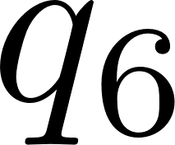
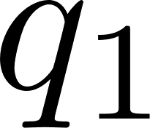
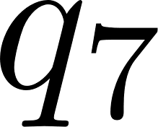

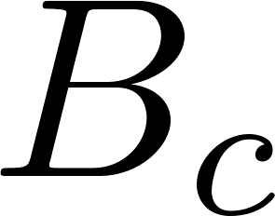
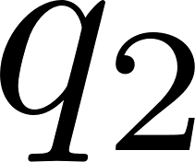
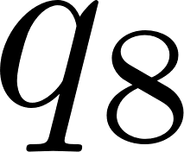


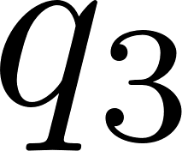
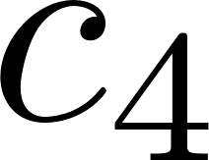
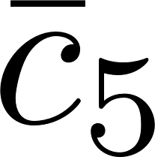

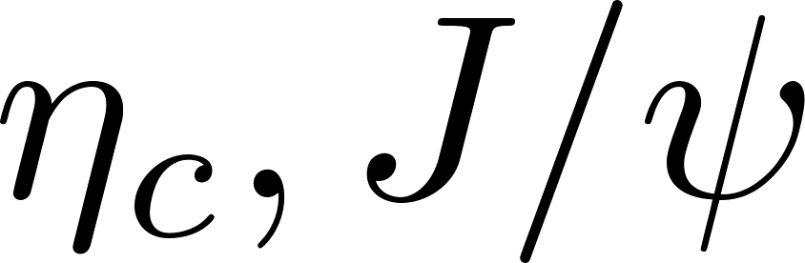
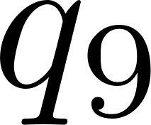
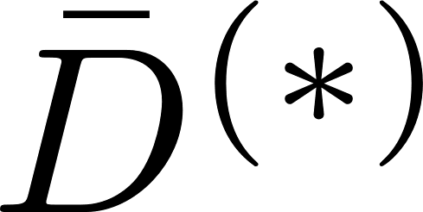

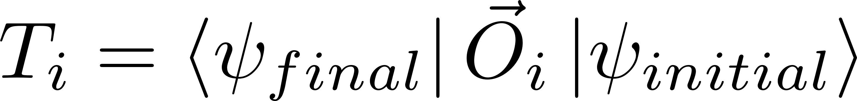
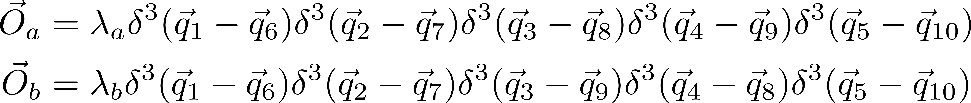
Transition Amplitude
(a) Hidden charm decay process(Direct process)
(b) Open charm decay process(Cross process)
The general transition amplitude between pentaquark and final particles (baryon and meson) can be formed as,
where ${\vec{O}}_{i}$denote the operator between initial and final particles with the diagram. In this case, the operator takes the form as,
Wiriya Ruangyoo
8
Master’s thesis defense 25

Slide 9
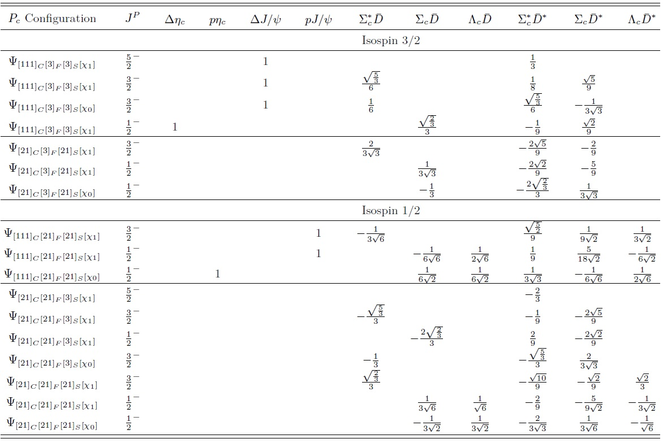
Spin-Flavor-Color transition amplitude
Wiriya Ruangyoo
9

Slide 10
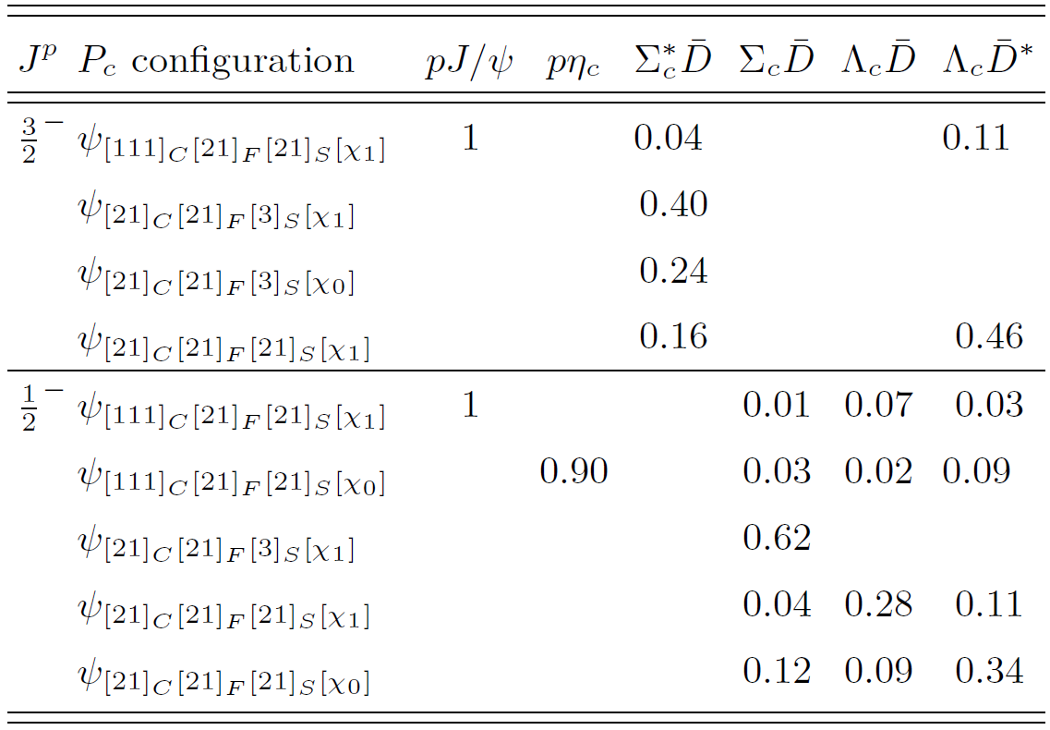
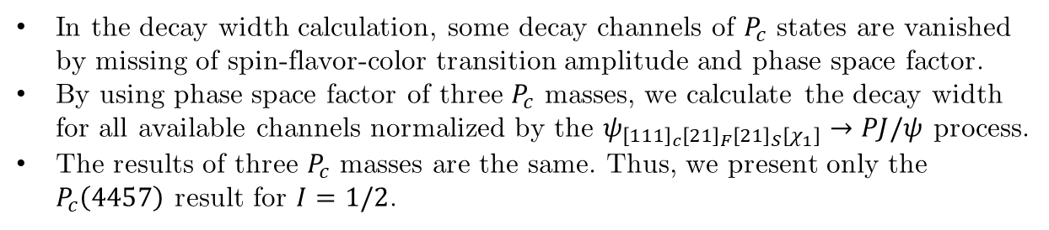
Results
Conclusions
In the decay width calculation, some decay channels of $P_{c}$ states are vanished by missing of spin-flavor-color transition amplitude and phase space factor.
By using phase space factor of three $P_{c}$ masses, we calculate the decay width for all available channels normalized by the $ψ_{{\left[111\right]}_{c}{\left[21\right]}_{F}{\left[21\right]}_{S}\left[χ_{1}\right]}→PJ/ψ$ process.
The results of three $P_{c}$ masses are the same. Thus, we present only the $P_{c}\left(4457\right)$ result for $I=1/2$.
Wiriya Ruangyoo
10
Master’s thesis defense 36

Slide 11
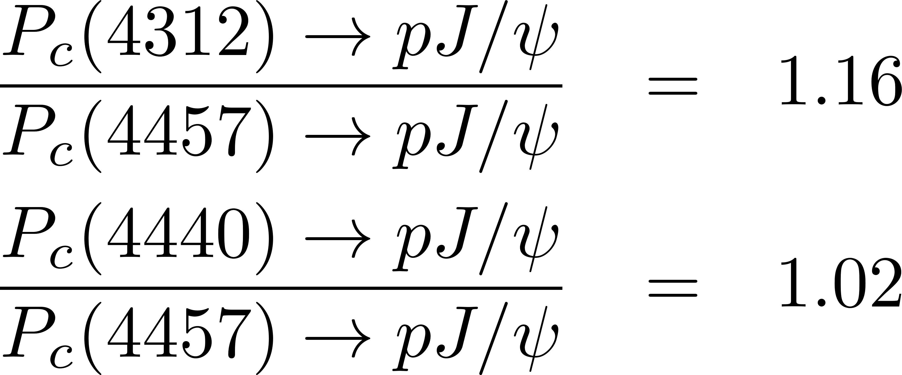

results
Conclusions
Due to the mass closeness, the $PJ/ψ$ partial decay widths are almost the same, that is
Thus, this work indicate that $P_{c}(4440)$ may not compact pentaquark state since its decay much larger than others, and that may assign $J=\frac{1}{2}$ to $P_{c}\left(4312\right)$ and $J=\frac{3}{2}$ to $P_{c}\left(4457\right)$.
Wiriya Ruangyoo
11
Master’s thesis defense 36

Slide 12
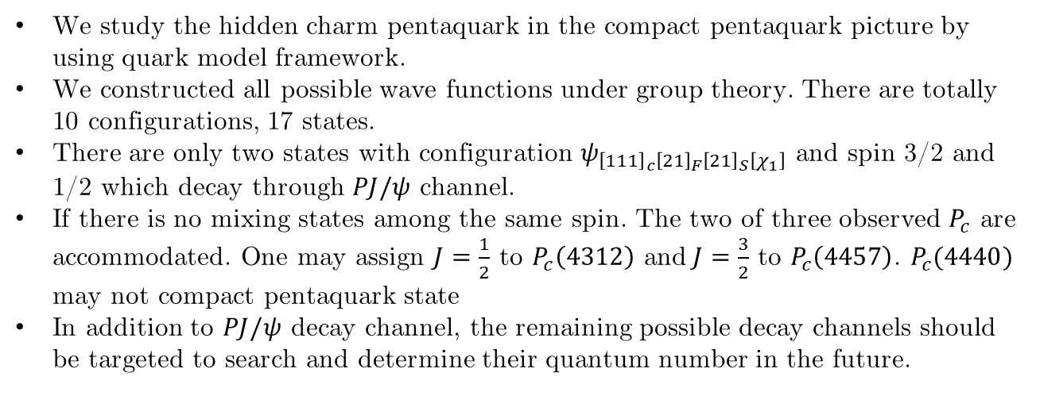
Summary
Conclusions
We study the hidden charm pentaquark in the compact pentaquark picture by using quark model framework.
We constructed all possible wave functions under group theory. There are totally 10 configurations, 17 states.
There are only two states with configuration $ψ_{{\left[111\right]}_{c}{\left[21\right]}_{F}{\left[21\right]}_{S}\left[χ_{1}\right]}$ and spin 3/2 and 1/2 which decay through $PJ/ψ$ channel.
If there is no mixing states among the same spin. The two of three observed $P_{c}$ are accommodated. One may assign $J=\frac{1}{2}$ to $P_{c}\left(4312\right)$ and $J=\frac{3}{2}$ to $P_{c}\left(4457\right)$. $P_{c}(4440)$ may not compact pentaquark state
In addition to $PJ/ψ$ decay channel, the remaining possible decay channels should be targeted to search and determine their quantum number in the future.
Wiriya Ruangyoo
12
Master’s thesis defense 36

Slide 13
Wiriya Ruangyoo
Master’s thesis defense 39

