Slide 1

Study of heavy bottom mesons in a variational approach
Zahra Ghalenovi
Collaborate with Masoumeh Moazzen Sorkhi
Kosar University of Bojnord, Iran

Slide 2
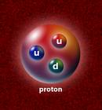
Outline
The Potential Model
Meson Masses
Meson Decay Constants
Leptonic Decay Widths of Mesons

Slide 3
The Potential Model

Slide 4
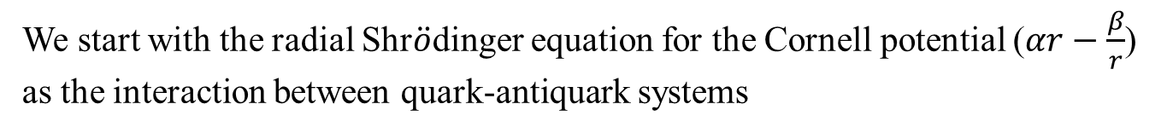

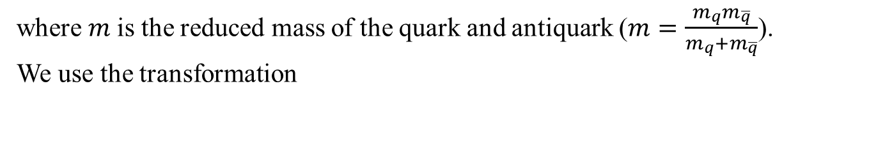
We start with the radial Shr$\ddot{o}$dinger equation for the Cornell potential ($αr−\frac{β}{r}$) as the interaction between quark-antiquark systems
$[\frac{−1}{2m}\left(\frac{d^{2}}{dr^{2}}+\frac{2}{r}\frac{d}{dr} \right)+$ $αr−\frac{β}{r}+\frac{l\left(l+1\right)}{{2mr}^{2}}]φ\left(r\right)=Eφ(r)$
where $m$is the reduced mass of the quark and antiquark ($m=\frac{m_{q}m_{\overline{q}}}{m_{q}+m_{\overline{q}}}$).
We use the transformation
$$φ\left(r\right)=r^{−1}R(r)$$
to reduce the equation to the form of
$[\frac{d^{2}}{dr^{2}}−\frac{l\left(l+1\right)}{r^{2}}−$ $2mαr+\frac{2mβ}{r}+2mE]R\left(r\right)=0$

Slide 5
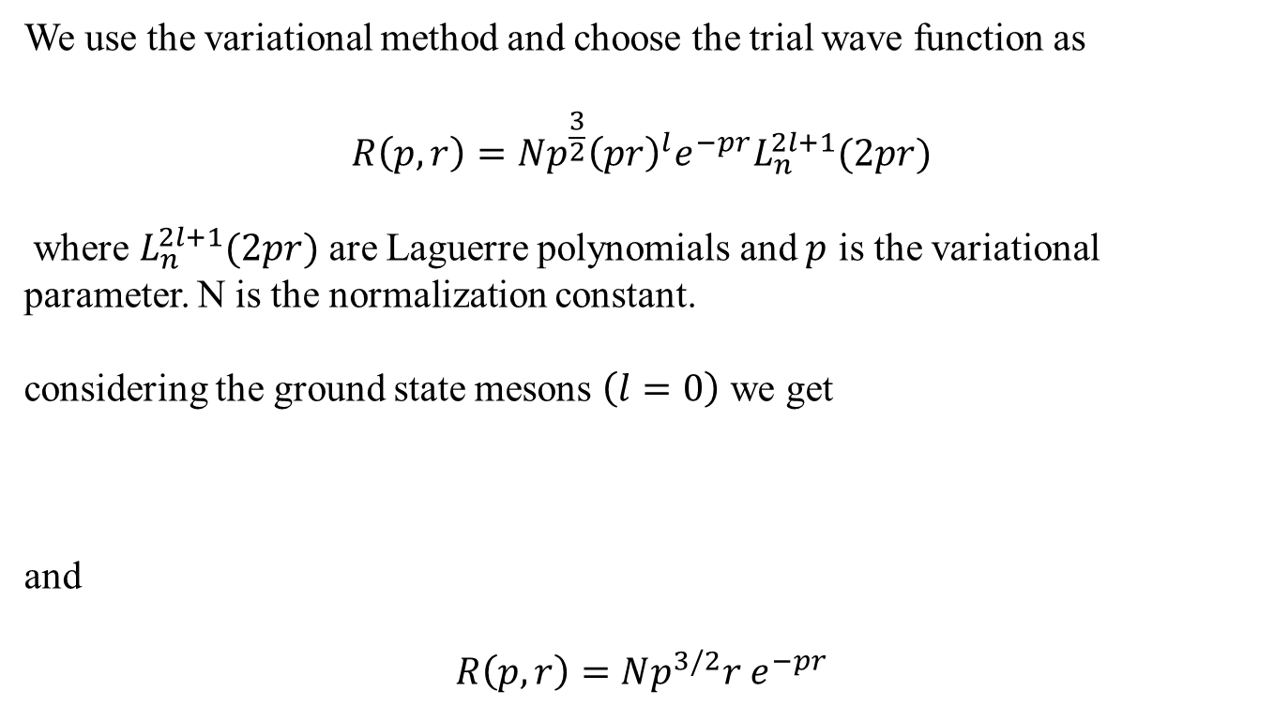

We use the variational method and choose the trial wave function as
$$R\left(p,r\right)=Np^{\frac{3}{2}}{\left(pr\right)}^{l}e^{−pr}L_{n}^{2l+1}(2pr)$$
where $L_{n}^{2l+1}(2pr)$ are Laguerre polynomials and $p$ is the variational parameter. N is the normalization constant.
considering the ground state mesons $\left(l=0\right)$ we get
and
$$R\left(p,r\right)=Np^{3/2}{r e}^{−pr}$$
$[\frac{d^{2}}{dr^{2}}−$ $2mαr+\frac{2mβ}{r}+2mE]R\left(r\right)=0$

Slide 6
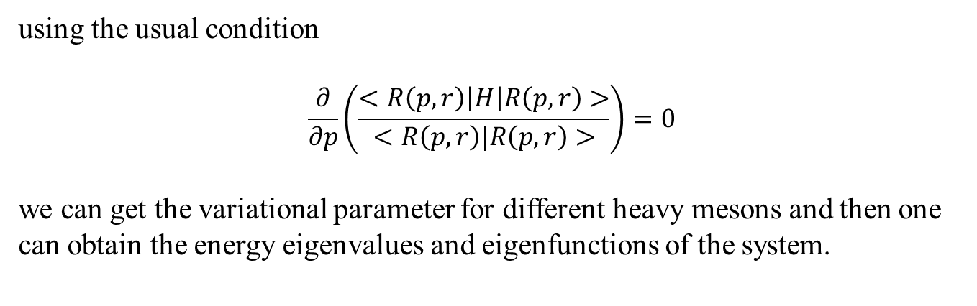
using the usual condition
$$\frac{∂}{∂p}\left(\frac{<R\left(p,r\right)\left|H\right|R\left(p,r\right)>}{<R\left(p,r\right)|R\left(p,r\right)>}\right)=0$$
we can get the variational parameter for different heavy mesons and then one can obtain the energy eigenvalues and eigenfunctions of the system.

Slide 7
Meson Masses

Slide 8
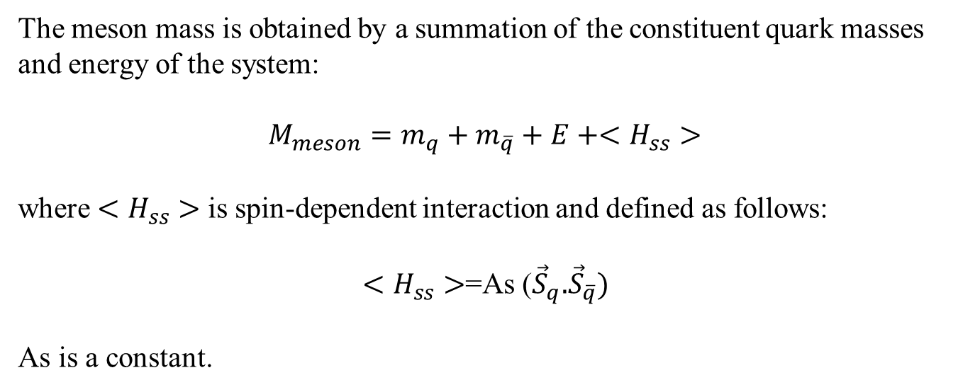
The meson mass is obtained by a summation of the constituent quark masses and energy of the system:
$$M_{meson}=m_{q}+m_{\overline{q}}+E+<H_{ss}>$$
where $<H_{ss}>$ is spin-dependent interaction and defined as follows:
$<H_{ss}>$=As (${\vec{S}}_{q}.{\vec{S}}_{\overline{q}})$
As is a constant.

Slide 9
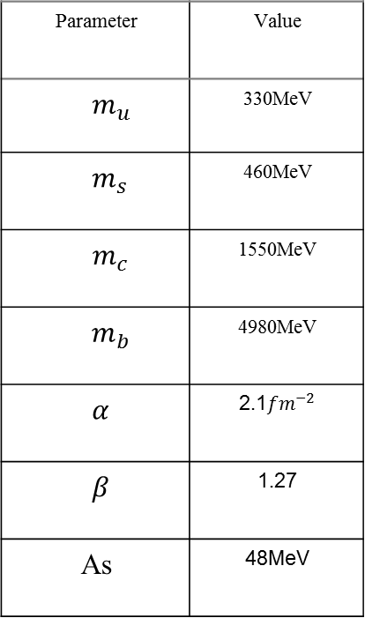
Model Parameters
Value | Parameter
330MeV | $$m_{u}$$
460MeV | $$m_{s}$$
1550MeV | $$m_{c}$$
4980MeV | $$m_{b}$$
2.1${fm}^{−2}$ | $$α$$
1.27 | $$β$$
48MeV | As

Slide 10
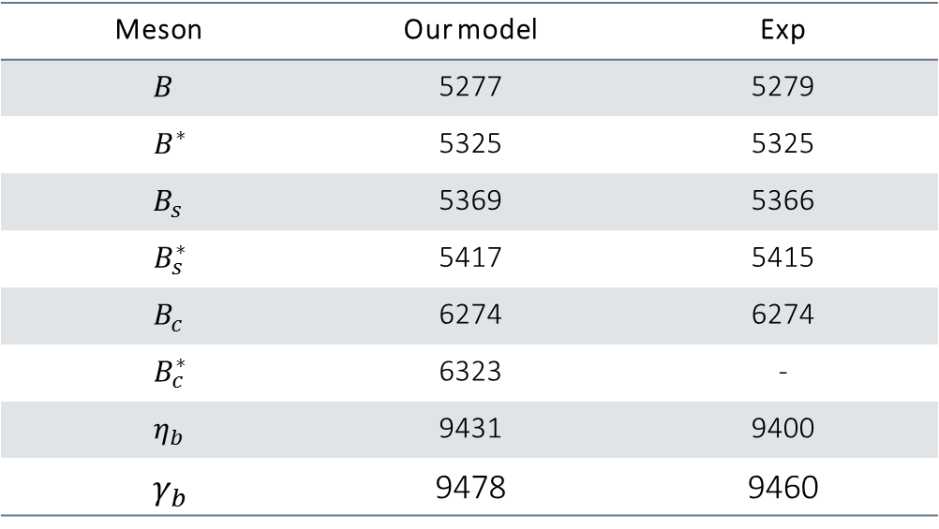
Heavy bottom meson masses (in MeV)
Exp | Our model | Meson
5279 | 5277 | $$B$$
5325 | 5325 | $$B^{∗}$$
5366 | 5369 | $$B_{s}$$
5415 | 5417 | $$B_{s}^{∗}$$
6274 | 6274 | $$B_{c}$$
- | 6323 | $$B_{c}^{∗}$$
9400 | 9431 | $$η_{b}$$
9460 | 9478 | $$γ_{b}$$

Slide 11
Decay Constants

Slide 12
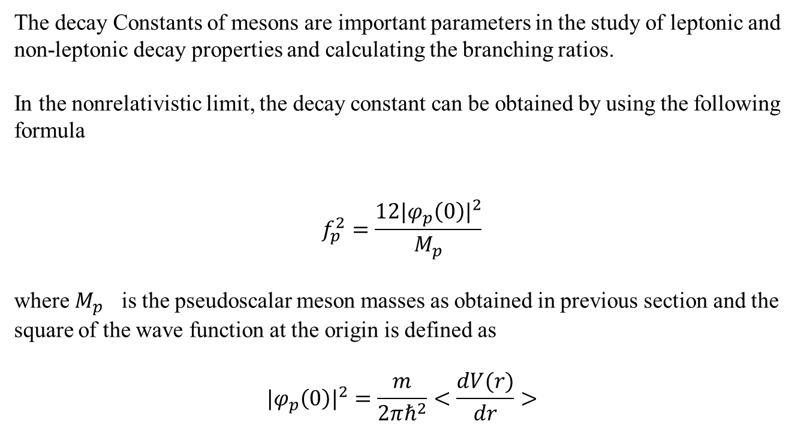
The decay Constants of mesons are important parameters in the study of leptonic and non-leptonic decay properties and calculating the branching ratios.
In the nonrelativistic limit, the decay constant can be obtained by using the following formula
$$f_{p}^{2}=\frac{12{|φ_{p}\left(0\right)|}^{2}}{M_{p}}$$
where $M_{p}$ is the pseudoscalar meson masses as obtained in previous section and the square of the wave function at the origin is defined as
$${|φ_{p}\left(0\right)|}^{2}=\frac{m}{2πℏ^{2}}<\frac{dV(r)}{dr}>$$

Slide 13
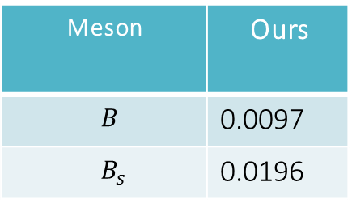
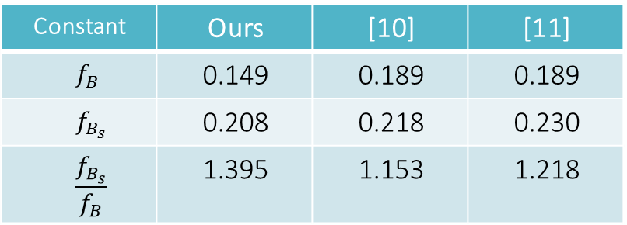
${|φ_{p}\left(0\right)|}^{2}$ for pseudoscalar B mesons (in units of ${GeV}^{3})$
Ours | Meson
0.0097 | $$B$$
0.0196 | $$B_{s}$$
The decay constants of pseudoscalar B mesons (in units of GeV)
[11] | [10] | Ours | Constant
0.189 | 0.189 | 0.149 | $$f_{B}$$
0.230 | 0.218 | 0.208 | $$f_{B_{s}}$$
1.218 | 1.153 | 1.395 | $$\frac{f_{B_{s}}}{f_{B}}$$

Slide 14
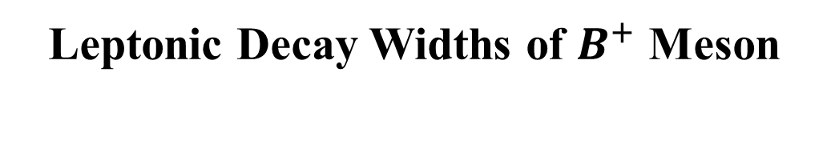
Leptonic Decay Widths of $B^{+}$ Meson

Slide 15
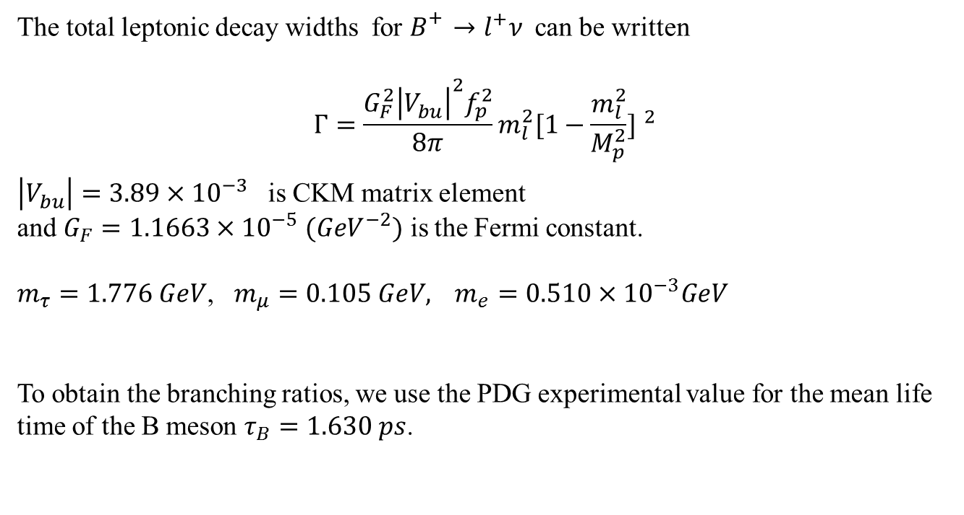
The total leptonic decay widths for $B_{}^{+}→l^{+}ν$can be written
$$Γ=\frac{G_{F}^{2}{\left|V_{bu}^{}\right|}^{2}f_{p}^{2}}{8π}m_{l}^{2}{[1−\frac{m_{l}^{2}}{M_{p}^{2}}] }^{2}$$
${\left|V_{bu}^{}\right|=3.89×{10}^{−3}}^{}$is CKM matrix element
and $G_{F}=1.1663×{10}^{−5} ({GeV}^{−2})$ is the Fermi constant.
$m_{τ}=1.776 GeV$, $m_{μ}=0.105 GeV,{ m}_{e}=0.510×{10}^{−3}GeV$
To obtain the branching ratios, we use the PDG experimental value for the mean life time of the B meson $τ_{B}=1.630 ps$.

Slide 16
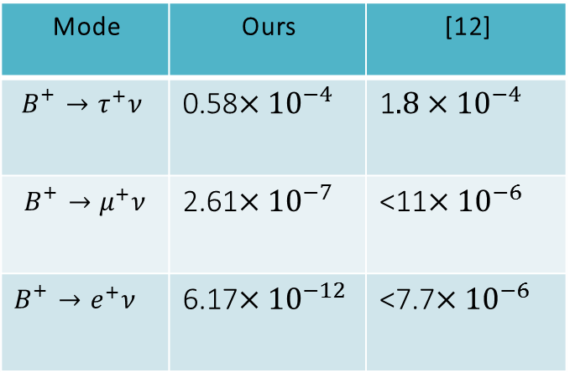
The leptonic branching ratios for B meson
[12] | Ours | Mode
1$.8×{10}^{−4}$ | 0.58$×{10}^{−4}$ | $$B_{}^{+}→τ^{+}ν$$
<11$×{10}^{−6}$ | 2.61$×{10}^{−7}$ | $$B_{}^{+}→μ^{+}ν$$
<7.7$×{10}^{−6}$ | 6.17$×{10}^{−12}$ | $$B_{}^{+}→e^{+}ν$$

Slide 17
References
[1] Z. Ghalenovi and M. Moazzen, Eur phys J. Plus 135, 399 (2020)
[2] N. Devlani and K. Ria, Nucl. Phys. 55, 544 A (2010).
[3] I.J.R. Aitchison, J.J. Dudek, Eur. J. Phys. 23, 605 (2002)
[4] M. Tanabashi et al. [Particle Data Group], Phys. Rev. D 98, 030001 (2018).
[5] TW. Chiu et al., Phys. Lett. B 651, 171 (2007).
[6] Z. Ghalenovi, M. Hamzavi and A.A. Rajabi, Acta. Phys. Polon. B 42, 8 (2011).
[7] J. Vijande, F. Fern´andez F, A. Valcarce, J. Phys. G 31, 481 (2005).
[8] D. Ebert et al., Eur. Phys. J. C 71, 1825 (2011)
[9] N. Devlani V. Kher and K. Ria, Eur. Phys. Jour. A 50, 154 (2014)
[10] D. Ebert, D. Faustov and R. N. Galkin, Phys. Lett. B 635, 93 (2006)
[11] A. Bazavov et al., Phys. Rev. D 98, 7 (2018).
[12] L. A. Corwin: leptonic decays of the charged B meson, The Ohio State University SlAC-914 (2008)

Slide 18
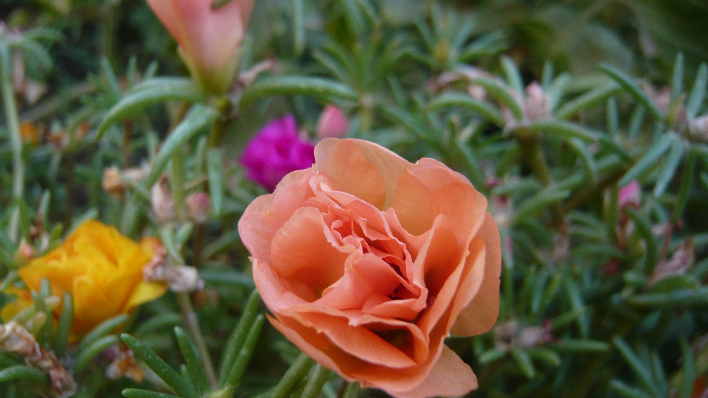

Thanks for your attentioan

