Slide 1
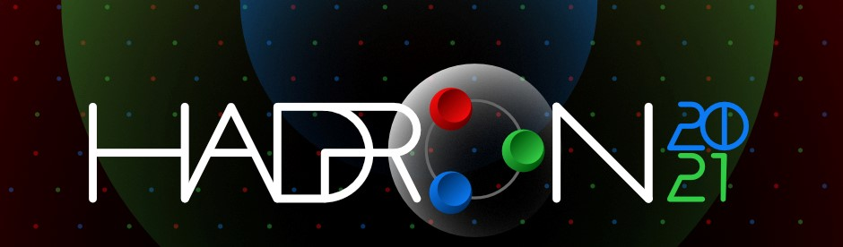

Charmonium spectrum and Color-octet heavy-quark potential from the instanton vacuum
Kihoon Hong
Collaborate with Hyun-Chul Kim & Ulugbek Yakhshiev
Department of Physics, Inha University, Incheo, South Korea
kihoon7065@naver.com

Slide 2

Contents
Introduction
  Heavy-Quark Potential
  Heavy-quark potential in the instanton vacuum
    Color-singlet heavy-quark potential with perturbative corrections
  (by M. Musakhanov, N. Rakhimov and U. T. Yakhshiev [1])
    Color-octet heavy-quark potential
    Spin-dependent parts of the $Q\overline{Q}$ potentail
Results
    Charmonium energy spectrum
    Eigenvalues of the color-octet Hamiltonian
Outlook
    Hadronic transitions between charmonium resonances
Summary
[1] M.Musakhanov et al, PhysRevD.102.076022

Slide 3
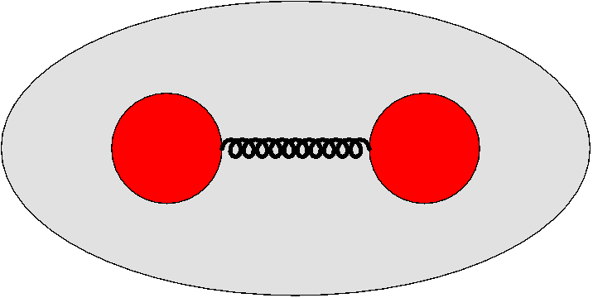
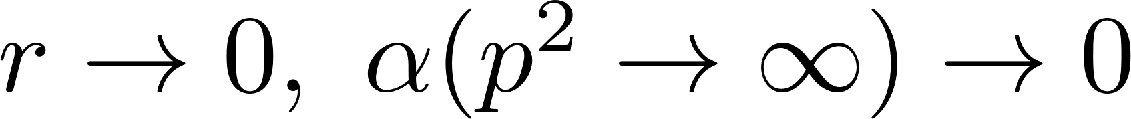



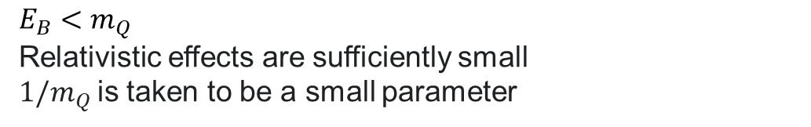
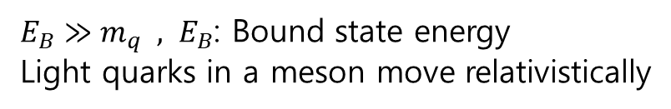
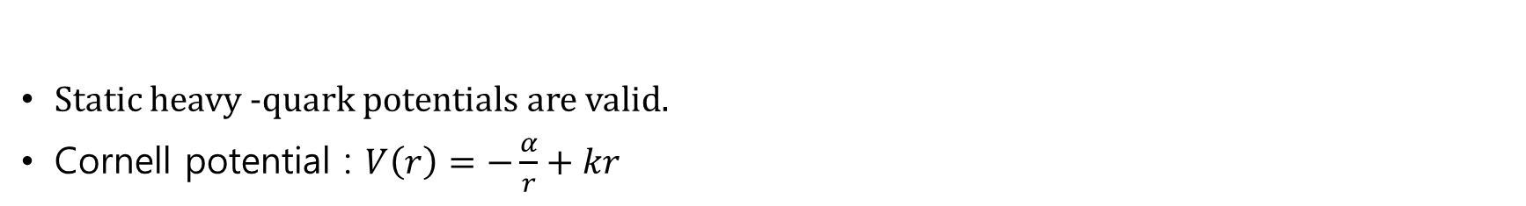
Heavy-quark Potential
Quark
Antiquark
Light mesons
$E_{B}≫m_{q} , E_{B}$: Bound state energy
Light quarks in a meson move relativistically
Quarkonia
$E_{B}<m_{Q}$
Relativistic effects are sufficiently small
$1/m_{Q}$is taken to be a small parameter
Strong interaction
Static heavy -quark potentials are valid.
Cornell potential : $V\left(r\right)=−\frac{α}{r}+kr$
: Asymptotic freedom
one-gluon exchange perturbative potential
Phenomenological confining potential
: confinement

Slide 4




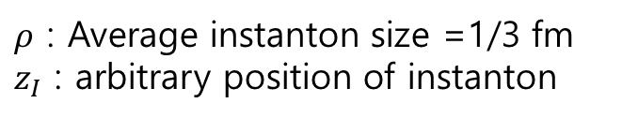
Instanton
In Euclidean space, the instanton is a large fluctuation of the gluon field corresponding to quantum tunneling from one vacuum(minimum of the potential energy) to the neighbor one:
: Instanton
: Antiinstanton
To find the best tunneling trajectory having the largest amplitude one has thus to minimize the YM action, it becomes
: self-duality condition
Gauge field satisfying with these equations is called a singular gauge instanton solution:
$ρ$ : Average instanton size =1/3 fm
$z_{I}$ : arbitrary position of instanton

Slide 5

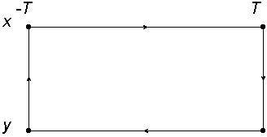




Potential from Wilson Loop
The $Q\overline{Q}$ state at time $T$ is represented as
: Wilson line
We assume that the heavy quark and antiquark masses $m_{Q,\overline{Q}}→∞$ and they are in static state during $T→∞$.
Heavy quark potential from the correlation function:
$$T≫r (=x−y)$$
$$W\left(C\right)=U\left(\vec{x},−T;\vec{x} ,T\right)U(\vec{y},T;\vec{x},−T)$$
$$V=−\lim_{T→∞}{\frac{1}{T}\ln\left\langle W\left(C\right)\right\rangle }$$

Slide 6
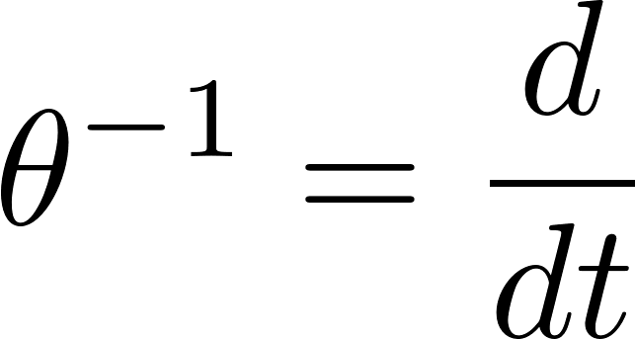


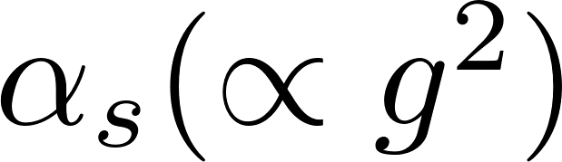

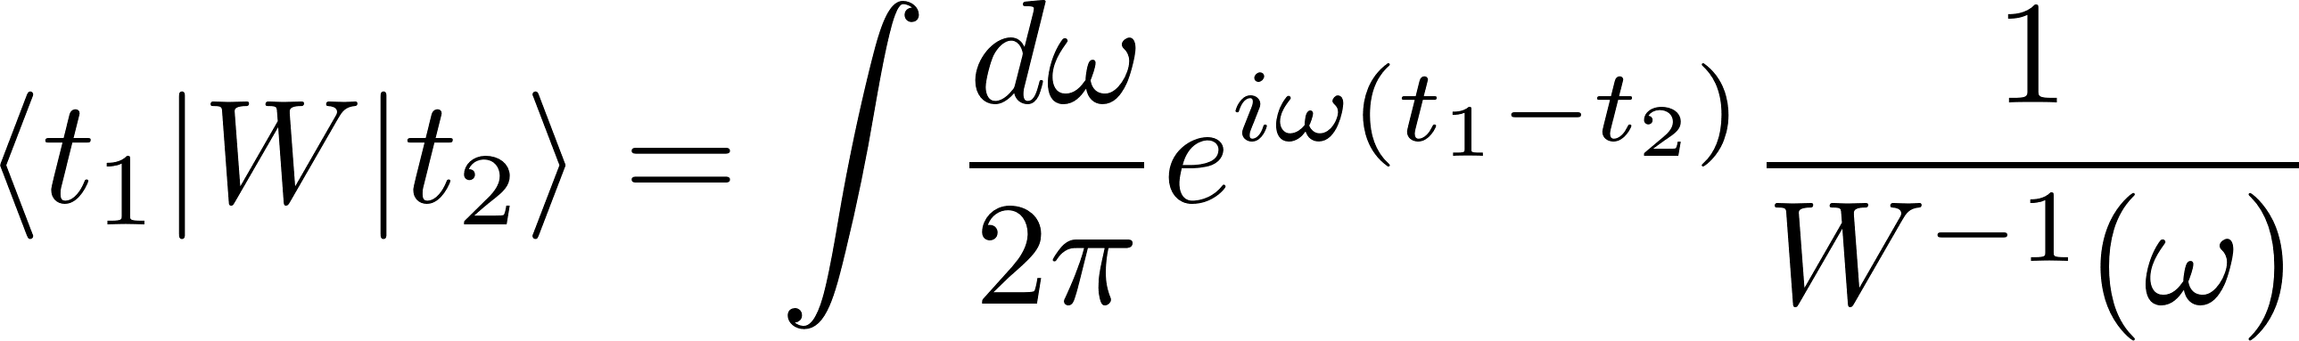

Color-singlet heavy-quark potential (Including perturbative corrections)[1,2]
Averaged Wilson loop($Q\overline{Q}$ correlator) can be written as
Using the Fourier transformation of $W^{−1}$: $W^{−1}\left(ω\right)=iω+f\left(ω\right)+g\left(ω\right)$
(1)
order of
(2)
Correlation function from the Fourier transformation :
[1] Diakonov et al, Phys. Lett. B 226, 372 (1989)
[2] M.Musakhanov et al, PhysRevD.102.076022

Slide 7

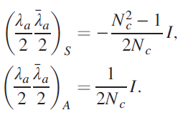
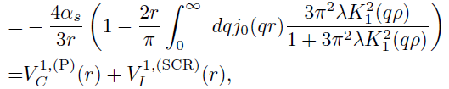
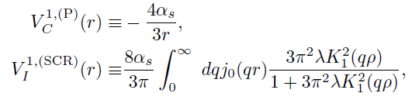
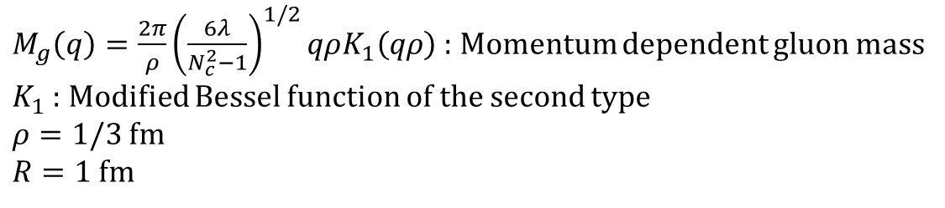
Color-singlet heavy-quark potential (Including perturbative corrections) [2]
$M_{g}\left(q\right)=\frac{2π}{ρ}{\left(\frac{6λ}{N_{c}^{2}−1}\right)}^{1/2}qρK_{1}\left(qρ\right)$ : Momentum dependent gluon mass
$K_{1}$ : Modified Bessel function of the second type
$ρ=1/3$ fm
$R=1$fm
In the color-singlet state

Slide 8
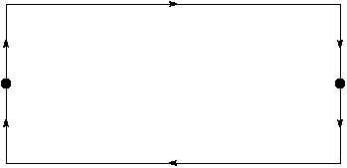
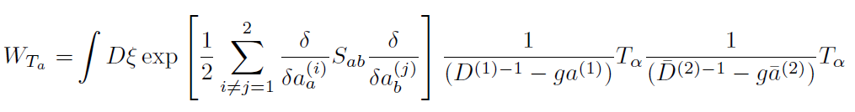
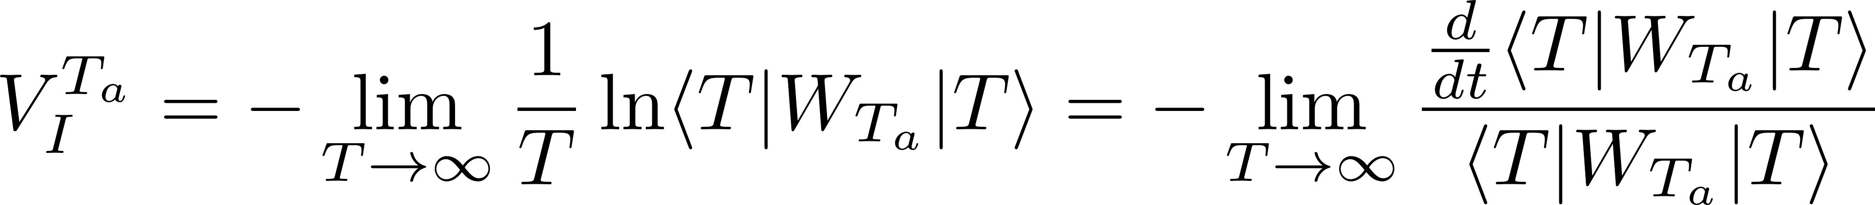
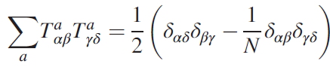
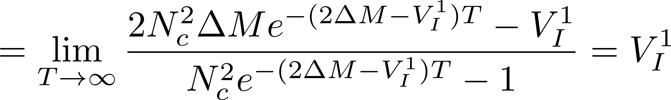

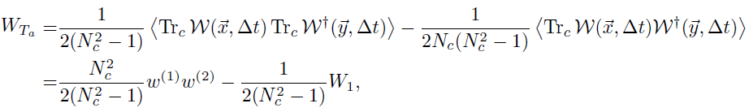

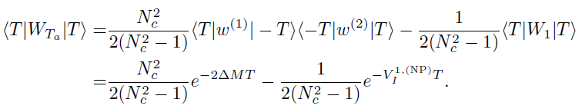


Color-octet heavy-quark potential
Color-octet Wilson loop $W_{T^{a}}$ can be represented by inserting the color exchange operator $T_{a}$
$$T_{a}$$
$$T_{a}$$
Using identity
:cluster decomposition for one-instanton calculation

Slide 9
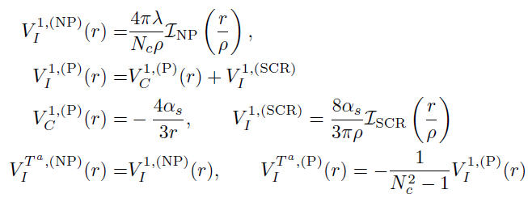
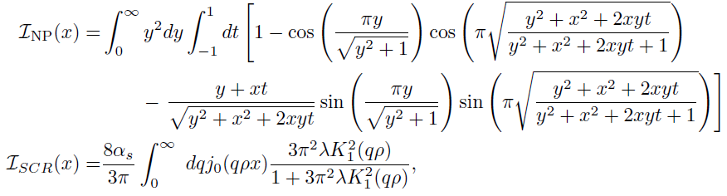
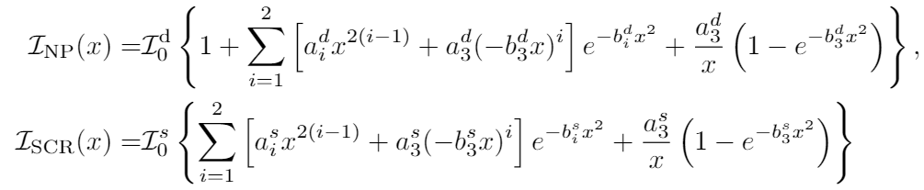
Instanton effects
In the color-singlet state
In the color-octet state
We obtain the color-singlet factor is $−4/3$ and the color-octet factor 1/6 in the OGE perturbative corrections as we expected.

Slide 10
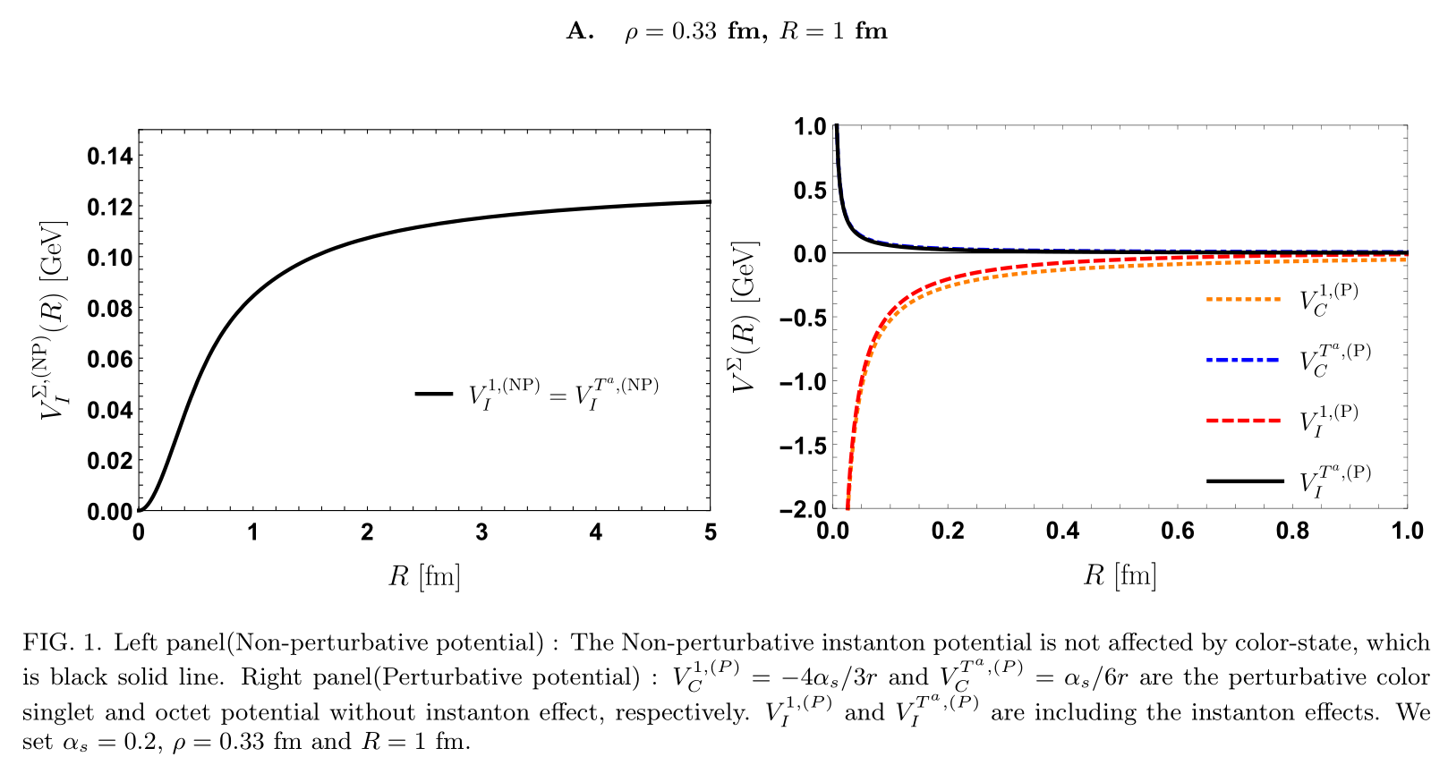
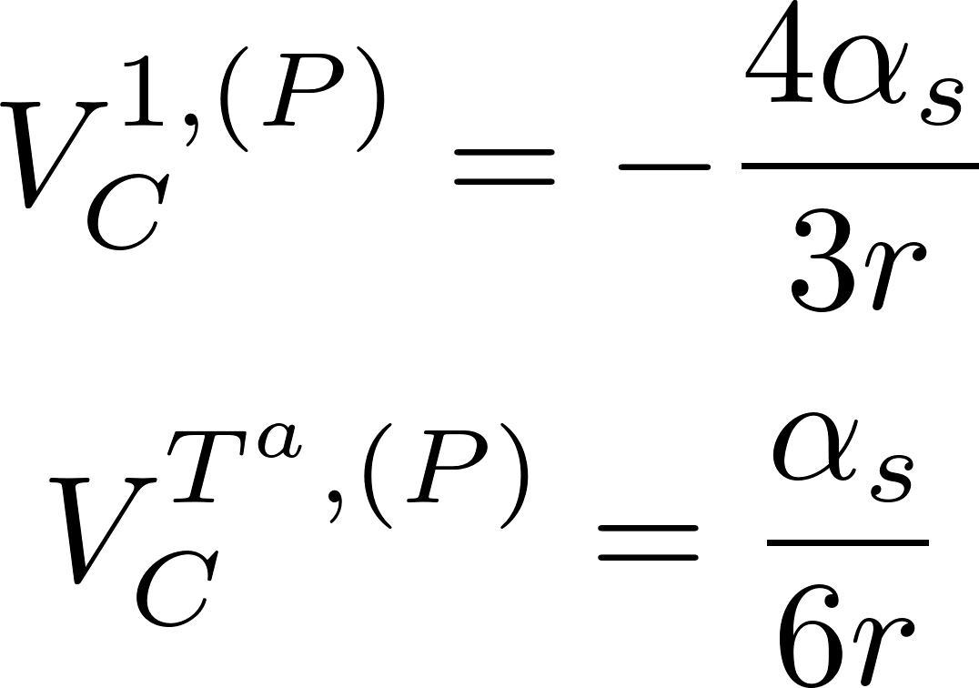

Color-singlet & octet $Q\overline{Q}$ potential

Slide 11
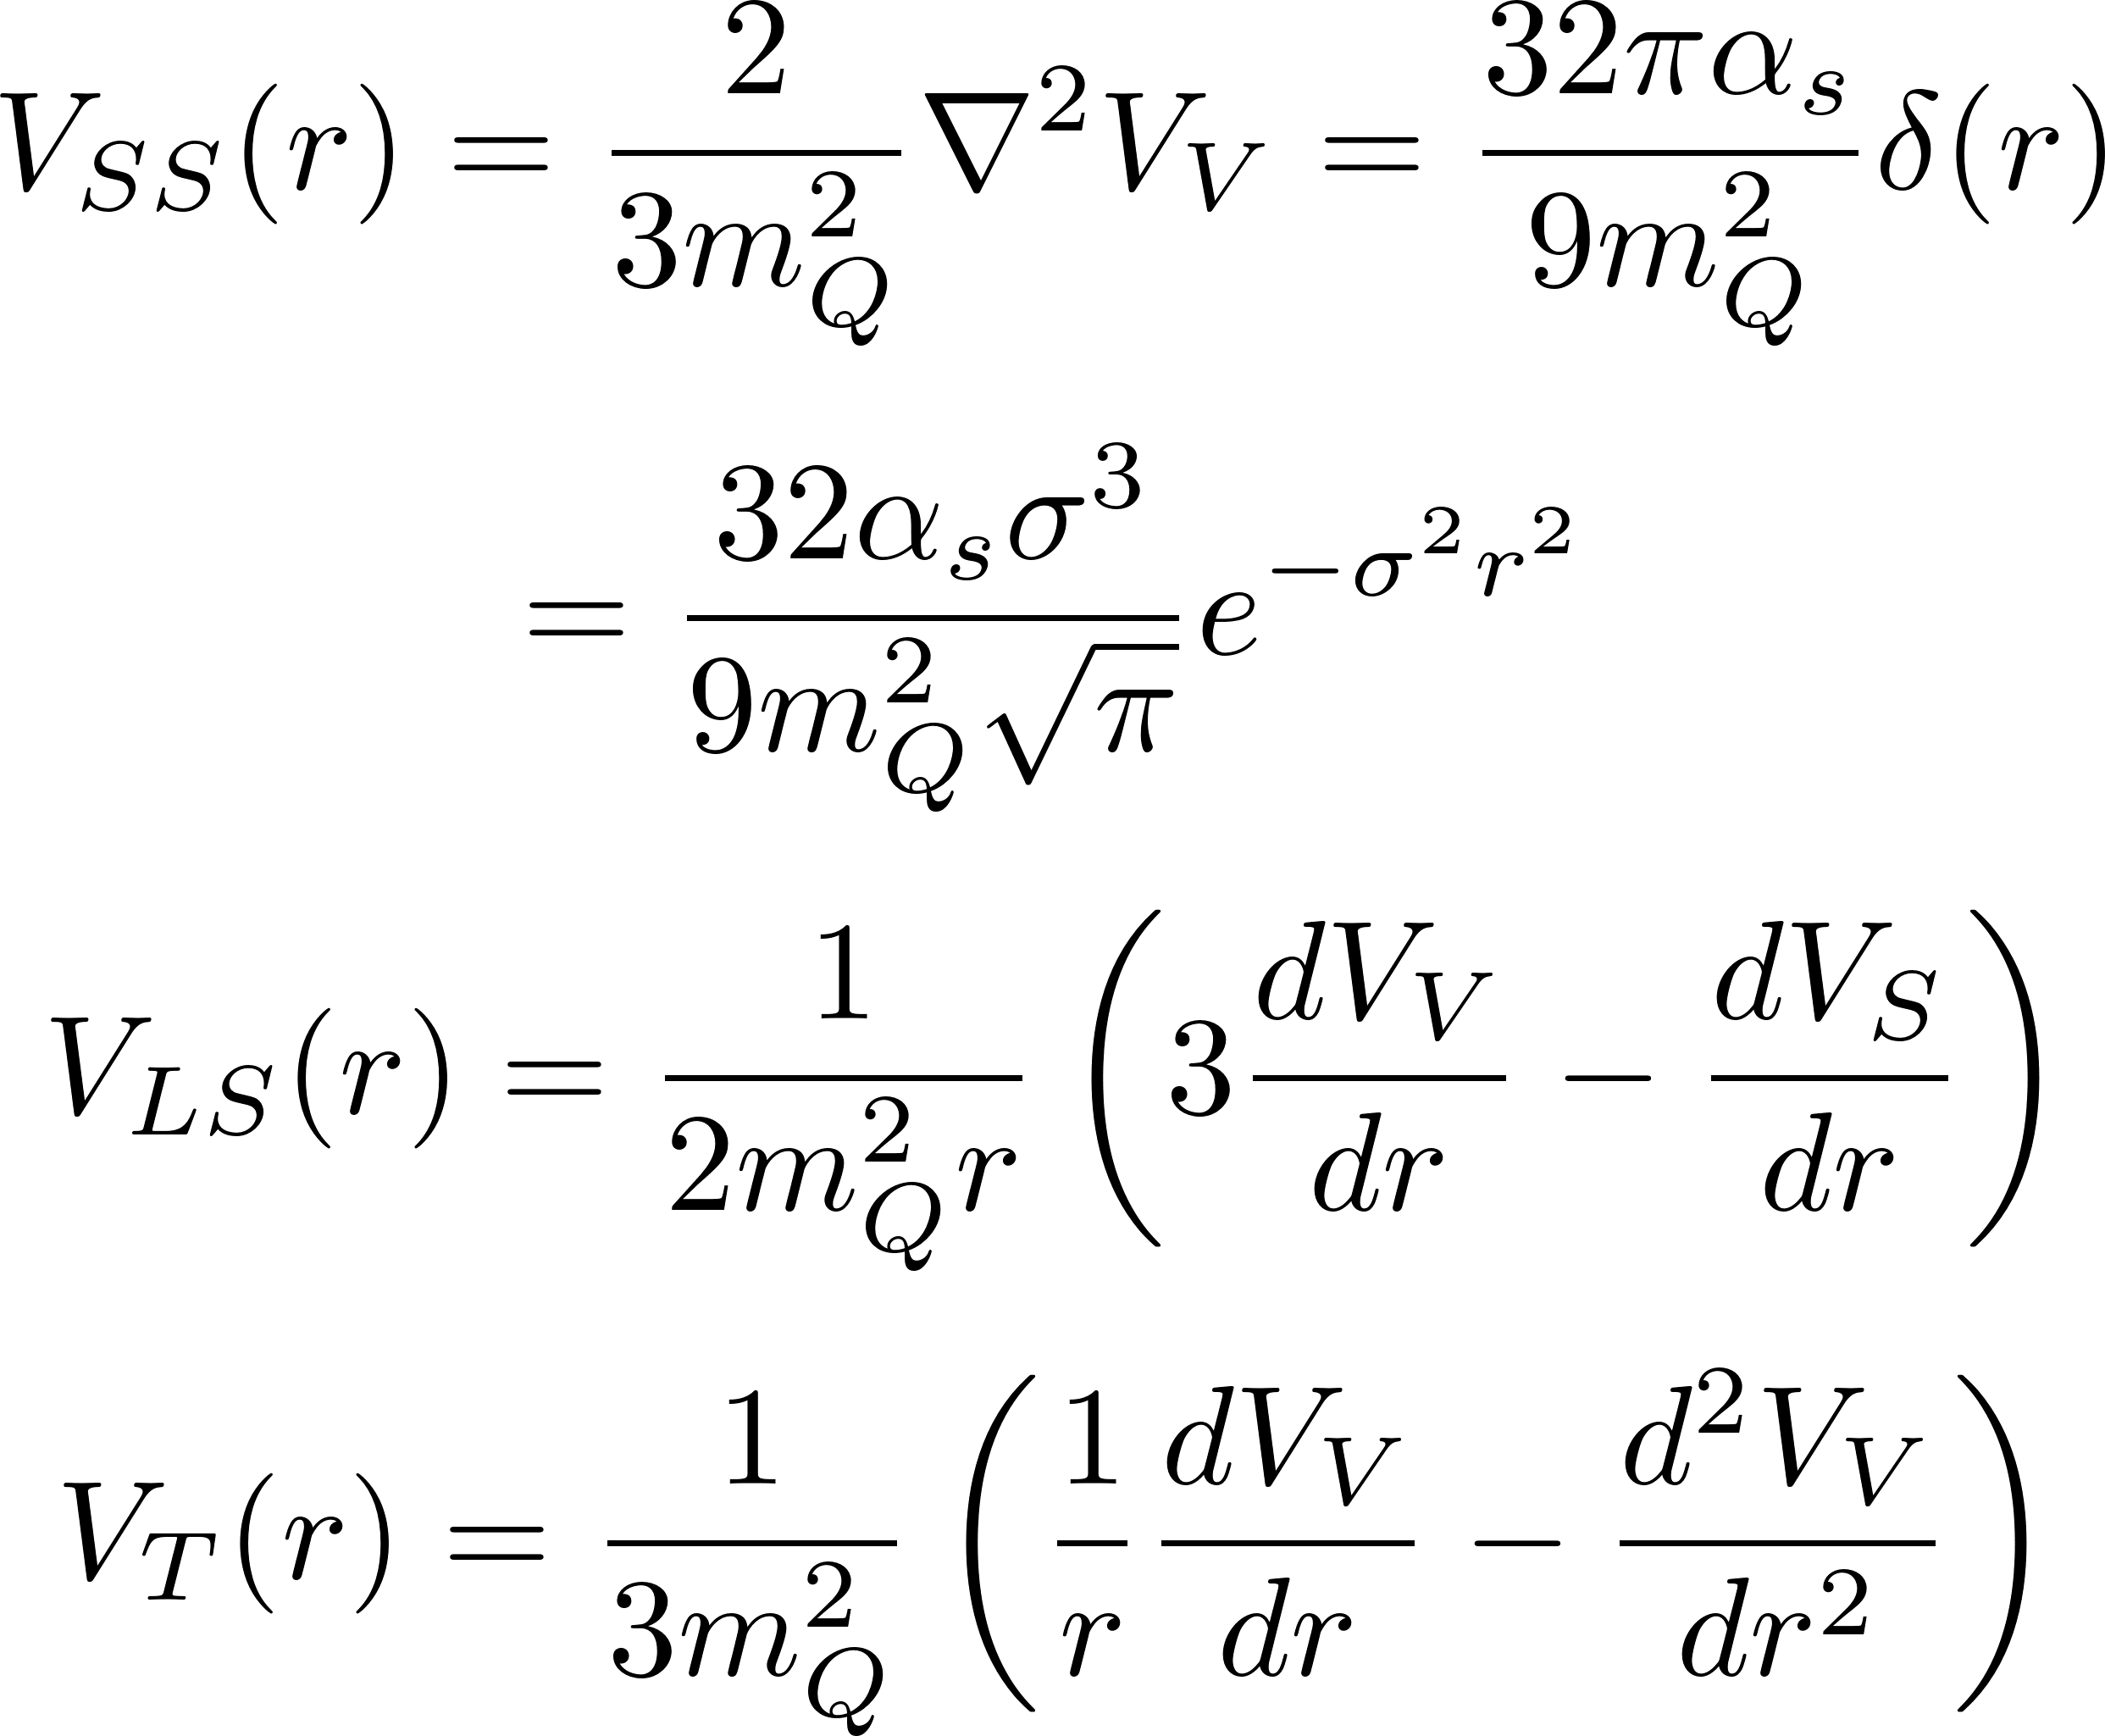
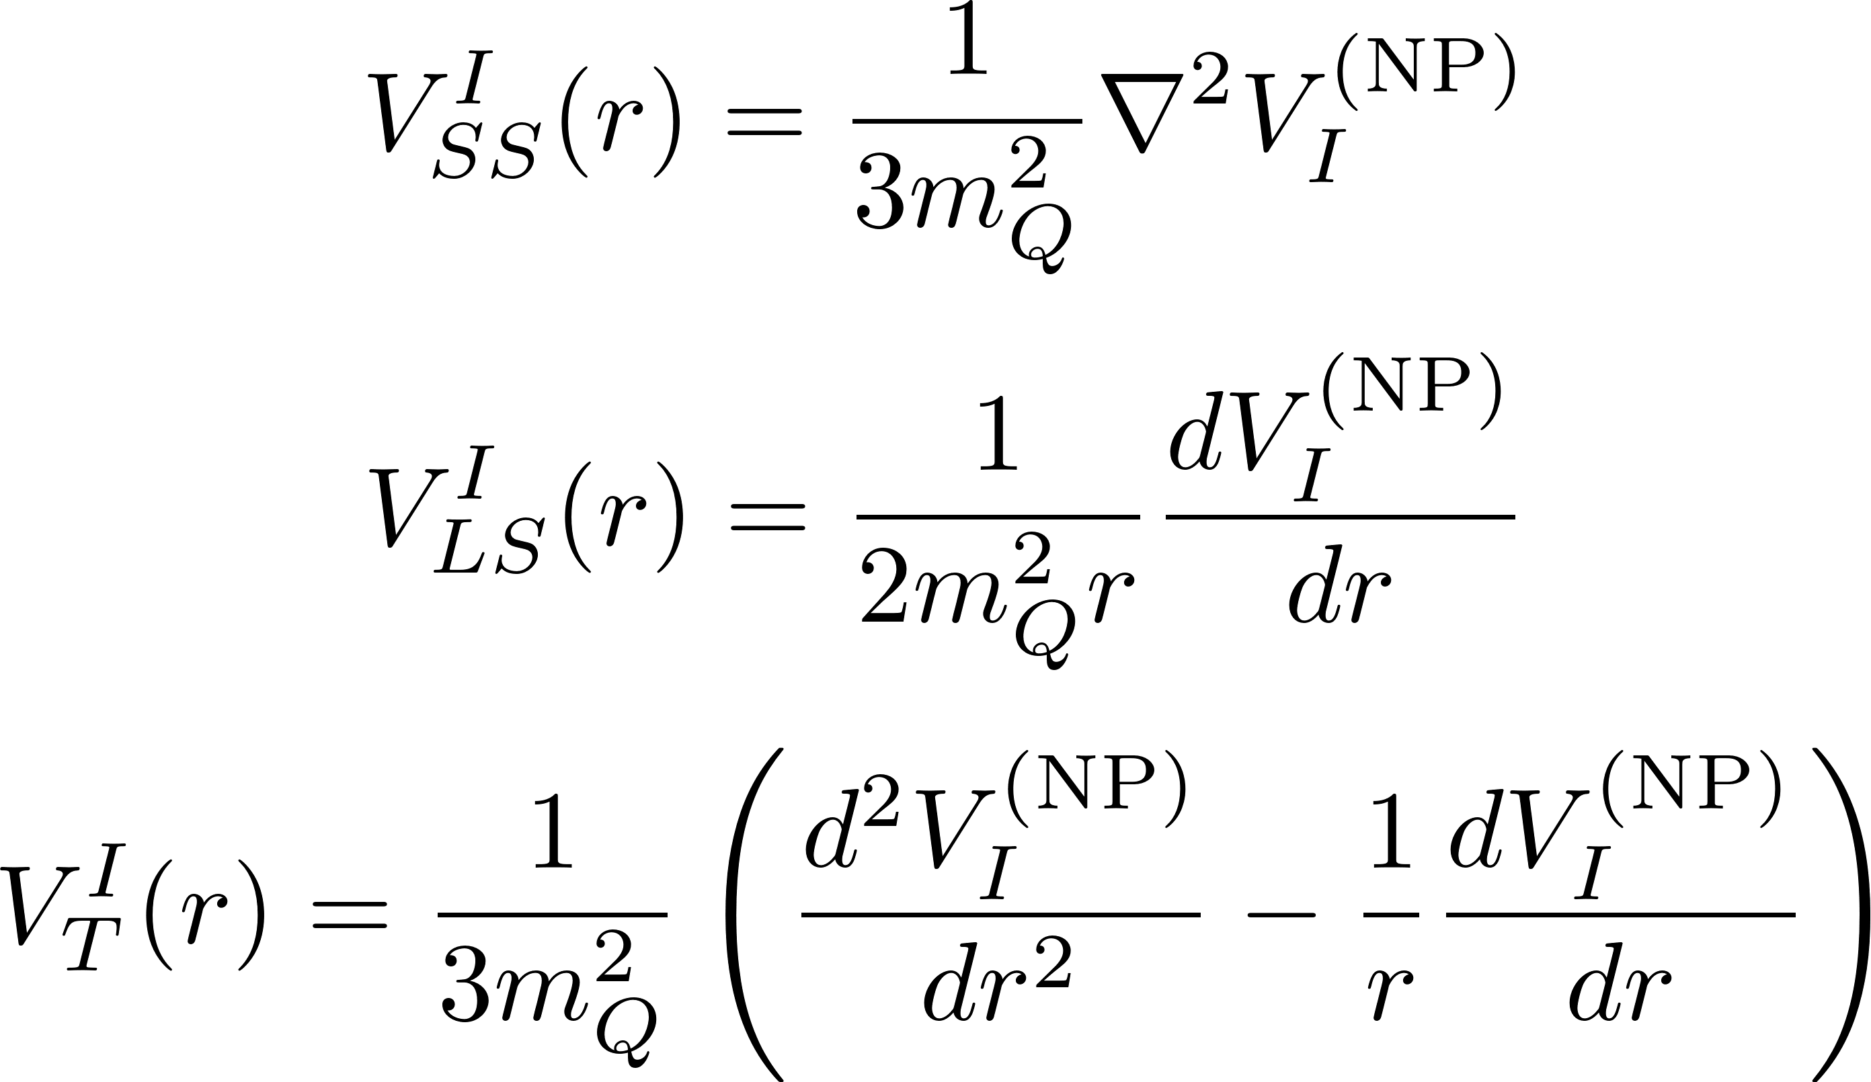
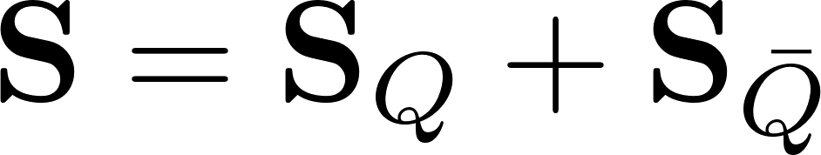
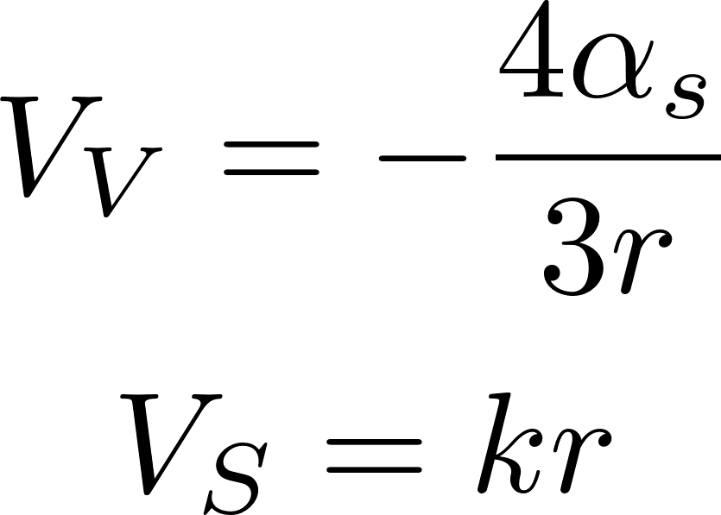
Spin-dependent parts of the $Q\overline{Q}$ potential
The spin-dependent parts of the Cornell potential and the one gluon exchange correction of the instanton effects is represented by Breit Fermi equation [3, 4]
The spin-dependent parts of the pseudo- particle case is defined as [3]
[3] E. Eichten and F. Feinberg, Phys. Rev. D173090 (1981)
[4] M. B. Voloshin, Progress in Particle and Nucl Phys. 61 (2008) 455-511

Slide 12
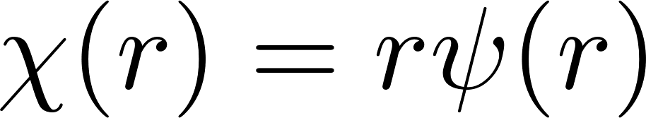
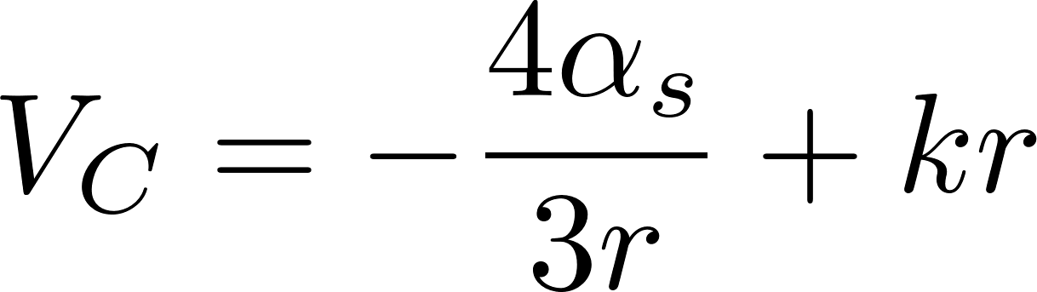
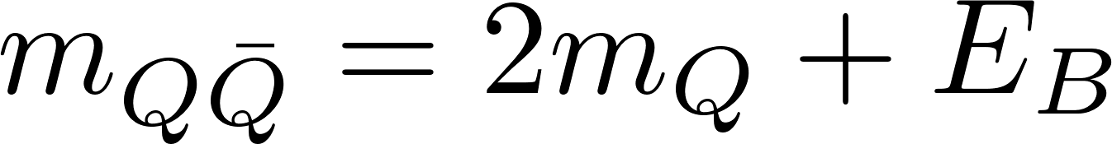
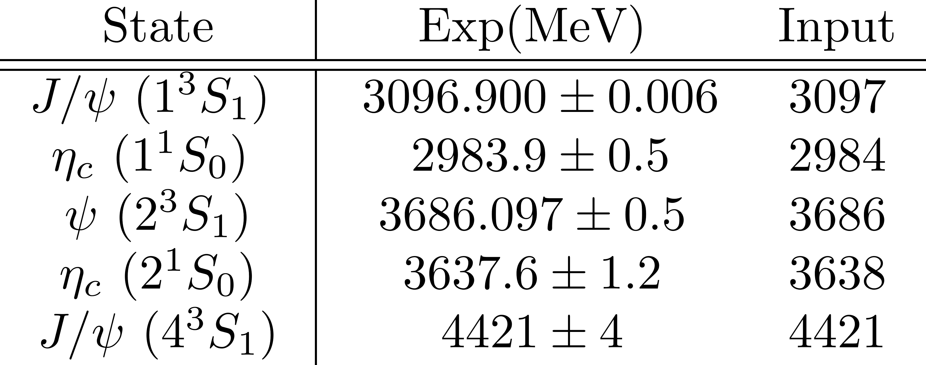
Eigenvalues of the Hamiltonian
$m_{Q\overline{Q}}$: mass of the quarkonia
$E_{B}$: Bound state energy (eigenvalue of the Hamiltonian)
For the charmonium case, we use the mass values as the input data:

Slide 13


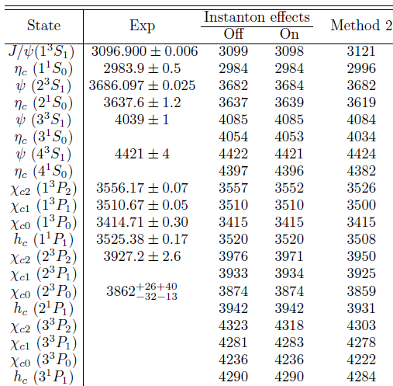
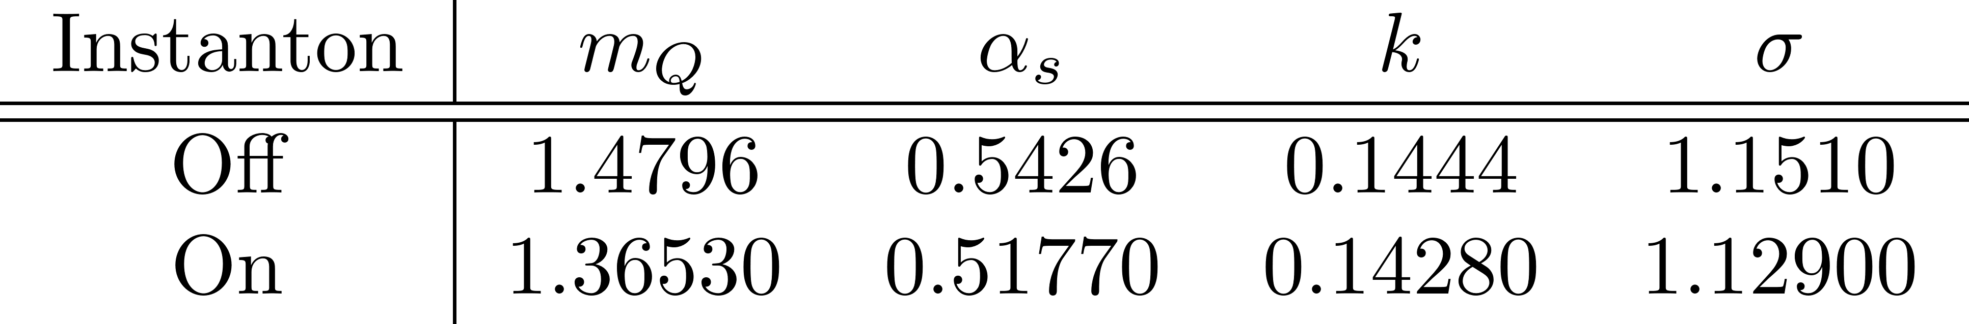

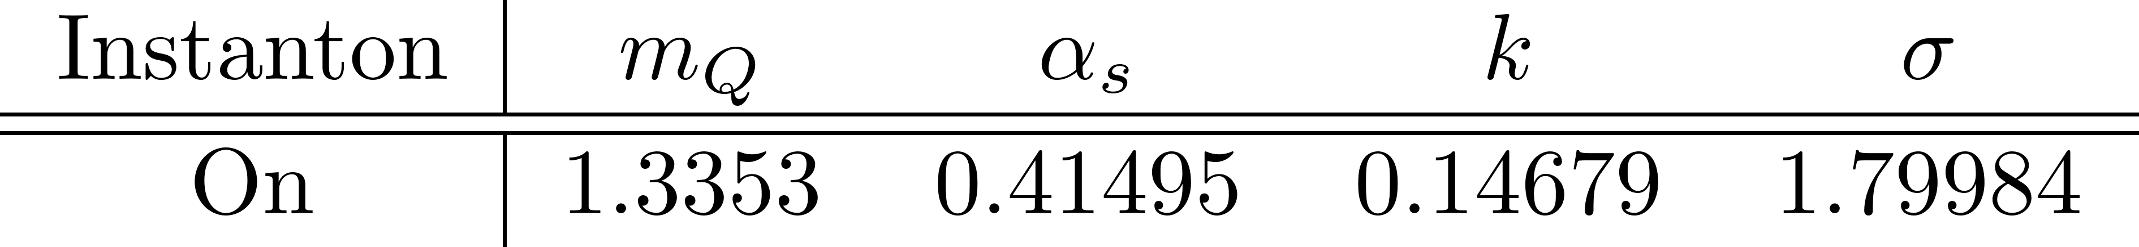
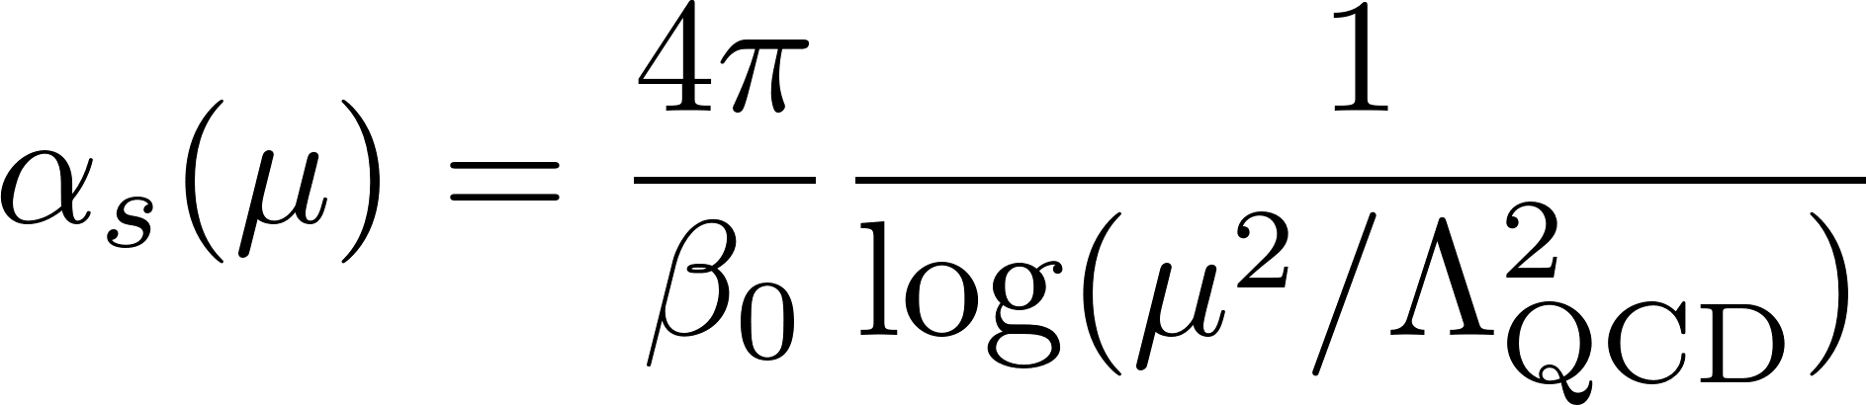
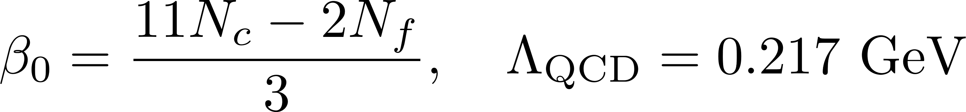
Results: Charmonium spectrum
fitting parameters
The running coupling constant at the one-loop level:
For the case of the instanton effects off: $V_{I}=0, V_{SD}^{I}=0$
We used the instanton parameters $ρ=1/3$ fm and $R=1$ fm

Slide 14
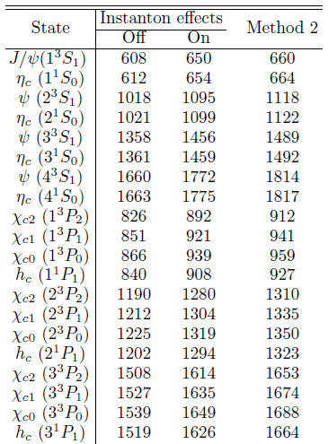

Eigenvalues of the Color-octet Hamiltonian
Bound state energy ($E_{B}$)
Unobservable quantities.
Physical implications are yet unknown.

Slide 15
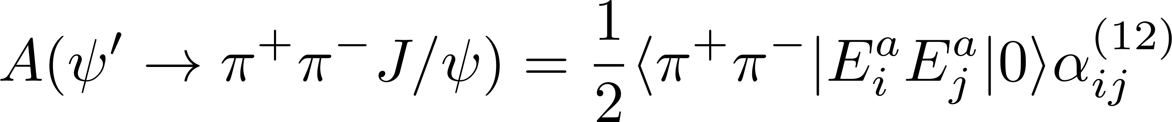
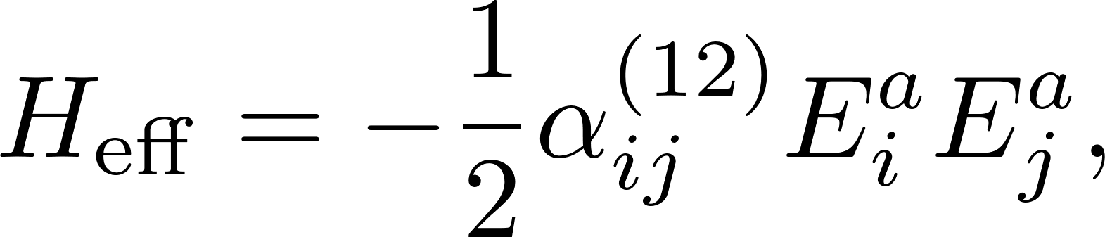
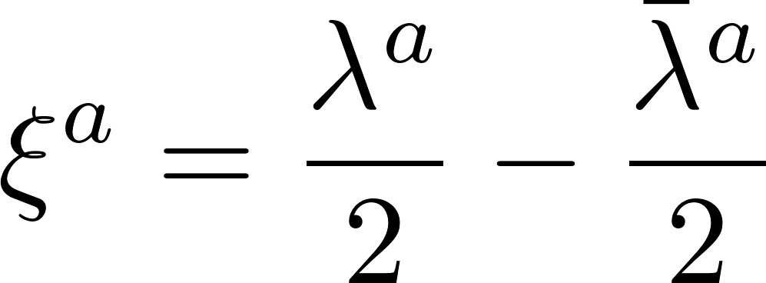
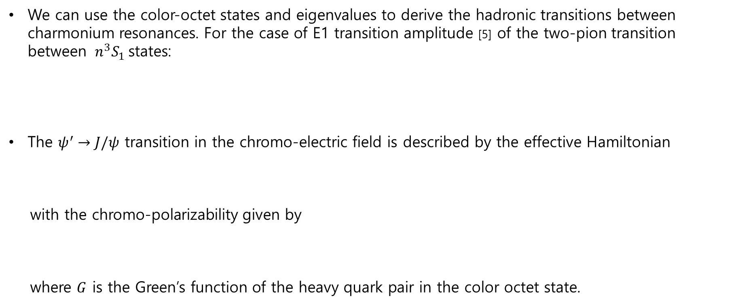
Why we need the color-octet? (Outlooks)
We can use the color-octet states and eigenvalues to derive the hadronic transitions between charmonium resonances. For the case of E1 transition amplitude [5] of the two-pion transition between $n^{3}S_{1}$states:
The $ψ^{′}→J/ψ$ transition in the chromo-electric field is described by the effective Hamiltonian
with the chromo-polarizability given by
where $G$ is the Green’s function of the heavy quark pair in the color octet state.
[5] M. B. Voloshin, Progress in Particle and Nucl Phys. 61 (2008) 455-511

Slide 16
Summary

Slide 17

Summary & Outlook
We showed the non-perturbative color-octet heavy quark potential in the instanton vacuum:
The perturbative one gluon exchange instanton effects make the color-singlet(octet) heavy quark potential a little weaker Instanton makes a screening effects.
We obtained the charmonium spectrum and the bound energies in the color-octet states.
Using the color-octet potential derived in the present work, we are going to calculate chromo-polarizabilities of quarkonia.
From this chromo-polarizability, we will show hadronic transition between charmonium resonances.

Slide 18
Thank you for your attention

Slide 19
Back Up

Slide 20

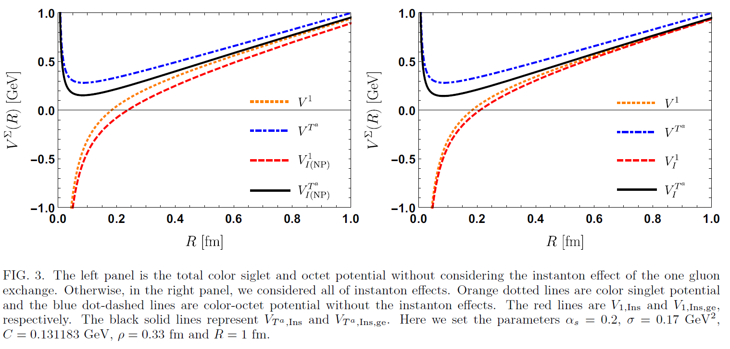

Results
Results

Slide 21
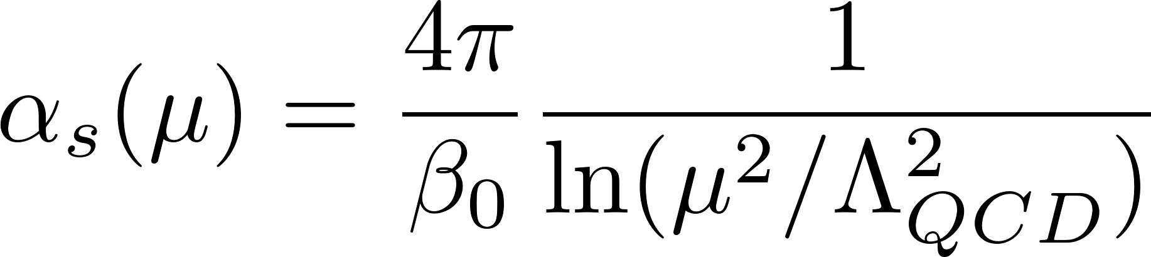
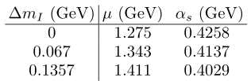




Why we use the instanton?
In the pQCD, the running coupling constant $α_{s}$ at the one loop level is given by the expression [3-6]:
Table 1 [8]. The result using Cornell potential gives a 51% difference from one of pQCD. On the other hand, the instanton effects as in M-I and M-Iib give the difference 17% and 14%, respectively.
[3] M. Peter, Phys. Rev. Lett. 78, 602 (1997).
[4]M. Peter, Nucl. Phys. B501, 471 (1997).
[5] Y. Schroder, Phys. Lett. B 447, 321 (1999).
[6] A. V. Smirnov, V. A. Smirnov, and M. Steinhauser, Phys. Rev. Lett. 104, 112002 (2010).
[7] C. Anzai, Y. Kiyo, and Y. Sumino, Phys. Rev. Lett. 104, 112003 (2010).
[8] Yakhshiev et al, PhysRevD.98.114036

