Slide 1
Quark Sivers Function at Small-$x$: Return of a Spin-Dependent Odderon
M. Gabriel Santiago
With Yuri Kovchegov

Slide 2
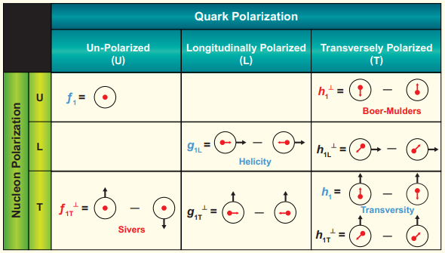
Quark Sivers function
TMDs give the transverse momentum part of the three-dimensional structure of hadrons
Finding the small-$x$ asymptotics of these functions is an ongoing effort
The Sivers TMD is the density of unpolarized quarks with transverse momentum and longitudinal momentum fraction in a proton with transverse polarization

Slide 3
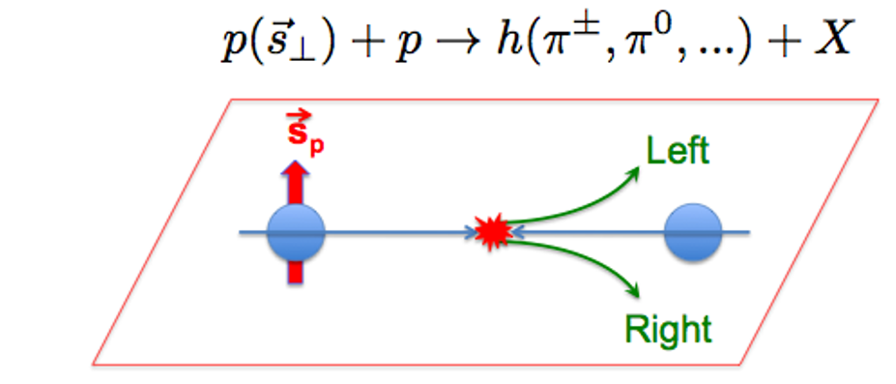
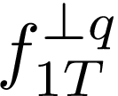
Quark Sivers function
The Sivers function captures orbital angular momentum and spin-orbit coupling as seen in single spin asymmetries
The unintegrated quark density and Sivers function are defined by the non-local operator product
Analogous TMD for gluons has known small-$x$ asymptotics!

Slide 4
Spin-Dependent Odderon
Boer et al (2016) showed that at small-$x$ the $T$-odd gluon TMDs are generated by a gauge link which couples an odderon exchange to the proton’s spin
The odderon is an elusive $C$-odd three gluon exchange
Szymanowski and Zhou (2016) showed that the odderon contributes to cross sections when the proton’s wave function is asymmetric in the transverse plane
The D0 and TOTEM collaborations recently announced odderon in the asymmetry between and collisions [2012.03981 [hep-ex]]
Does the quark Sivers function have this same contribution? Zhou et al (2019) showed that the answer is yes!

Slide 5
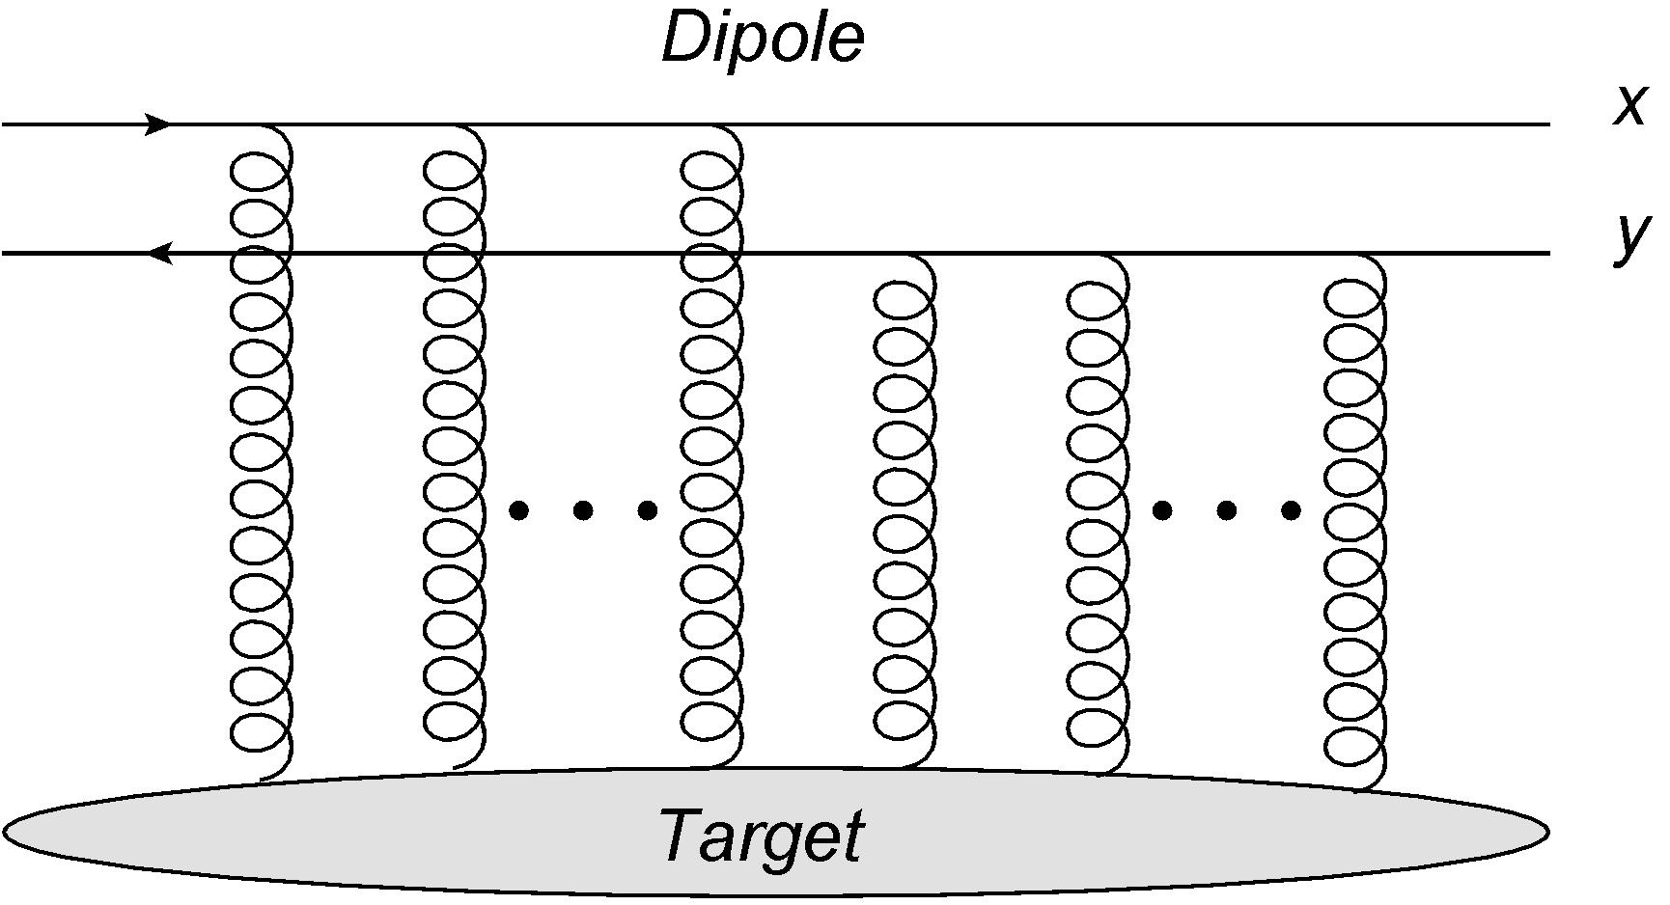
Small-$x$ TMDs from polarized Wilson lines
Kovchegov and Sievert (2019) constructed the helicity and quark transversity TMDs using a high-energy scattering operator formalism
The strategy is to rewrite the TMD operator definitions as dipole correlators
*in
or gauge

Slide 6
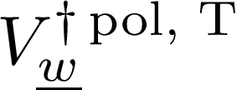
Small-$x$ TMDs from polarized Wilson lines
The quark correlator can be rewritten in terms of Wilson lines
The polarized Wilson line makes the correlator a transverse polarized dipole

Slide 7
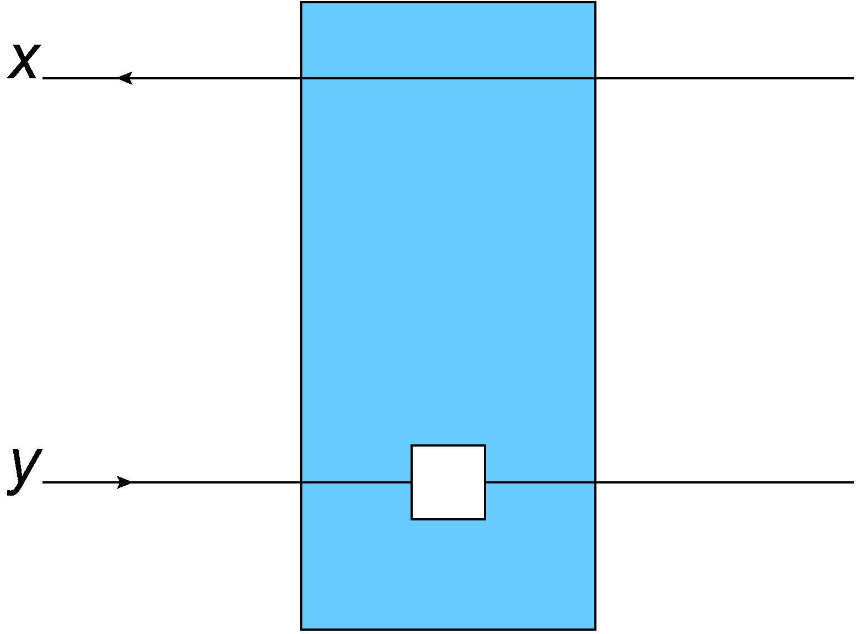
Small-$x$ TMDs from polarized Wilson lines
Define new polarized dipoles by adding spin-dependent interaction
Helicity interaction comes at sub-eikonal level, transversity at sub-sub-eikonal
Define evolution for new polarized dipoles to get TMD evolution!
Can we apply this formalism to the Sivers function?

Slide 8
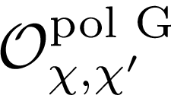
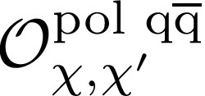
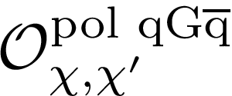
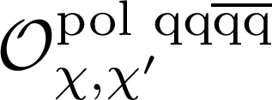
General polarized Wilson line
Insert sub- or sub-sub-eikonal operator into ordinary Wilson lines

Slide 9
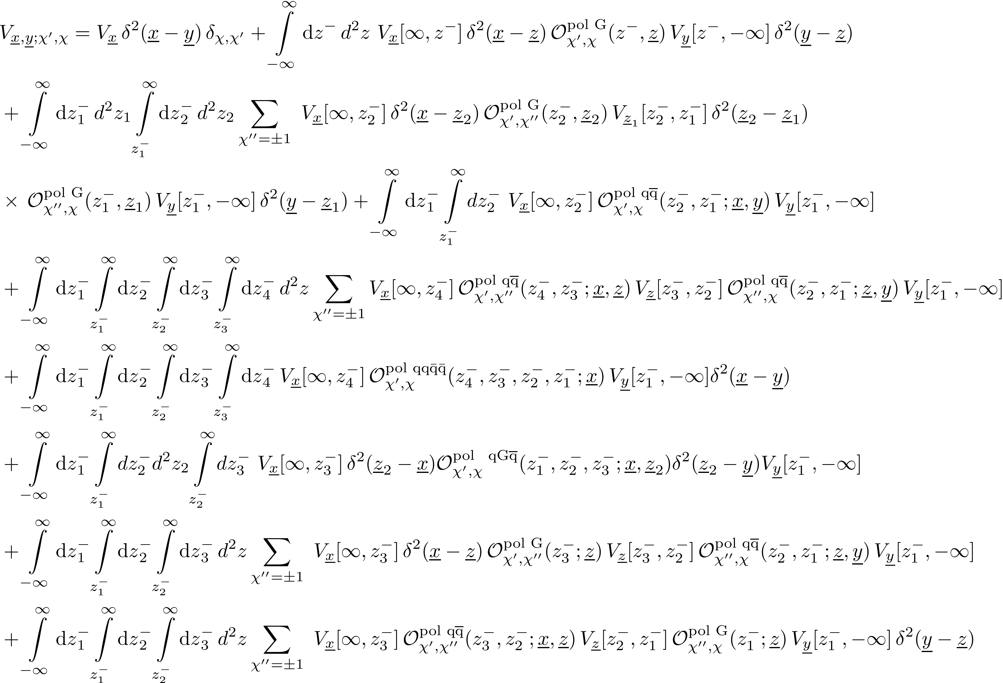
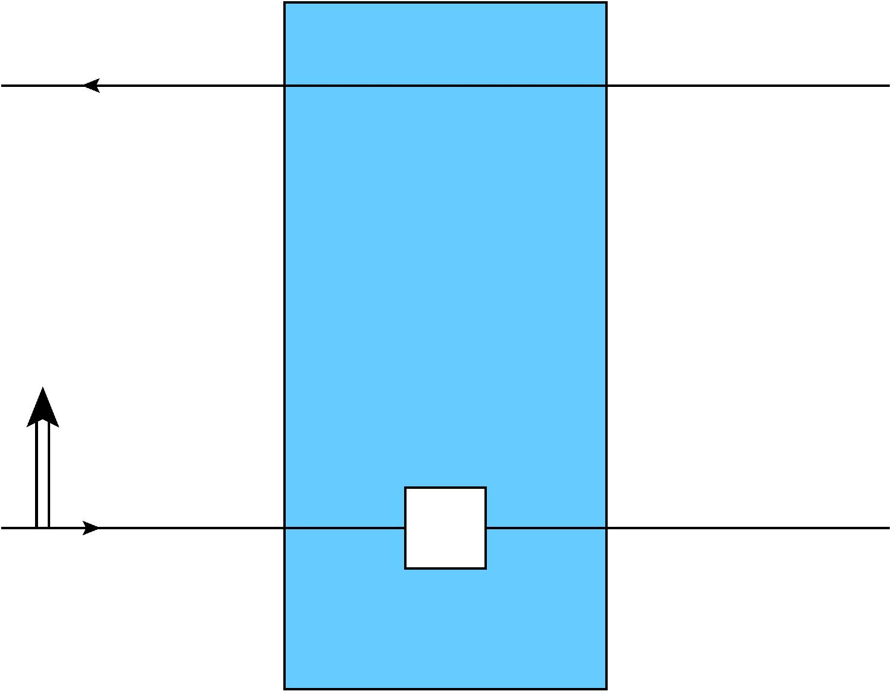
General polarized Wilson line
Full sub-sub-eikonal polarized fundamental Wilson line for TMDs which depend on the proton’s transverse spin
$$χ,$$
$$S$$
$$χ′$$
cf. Altinoluk et al (2020), Chirilli (2021) sub-eikonal propagator

Slide 10
Eikonal Small-$x$ Sivers function
Apply the formalism to rewrite the Sivers function in terms of polarized transverse Wilson lines
The quark-quark correlator which yields the leading order Sivers function is
By symmetry, the Sivers function must come from the imaginary part of the Wilson line correlators

Slide 11
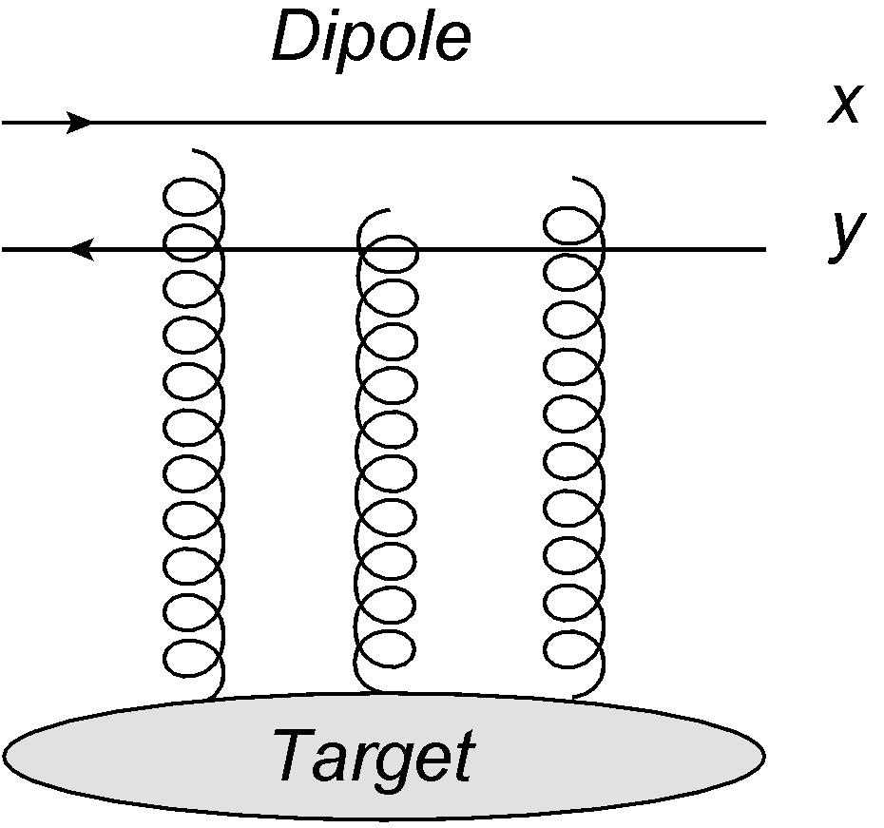
Dipole Odderon
In the color dipole picture, it is the antisymmetric, imaginary piece of a dipole correlator

Slide 12
Small-$x$ Sivers = Odderon
The imaginary correlator in the Sivers function is exactly the odderon amplitude, so we have
Agreement with the results of Zhou et al (2019) as well as the small-$x$ gluon $T$-odd TMDs, spin-dependent odderon!
Intrinsic asymmetry in the proton transverse momentum structure

Slide 13
Sub-Eikonal Quark Sivers Function
Extract sub-eikonal terms from polarized Wilson line which couple proton transverse spin to unpolarized quarks
Write Sivers function in terms of new dipoles
Here with the internal longitudinal momentum fraction and the center of mass energy squared

Slide 14
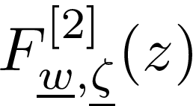
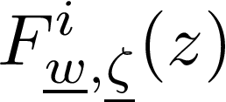
Large-N_{c} Small-x Evolution
Quark exchange operators are suppressed
At large N_{c} the dipoles do not mix
The initial condition for is zero, so we just need to evolve

Slide 15
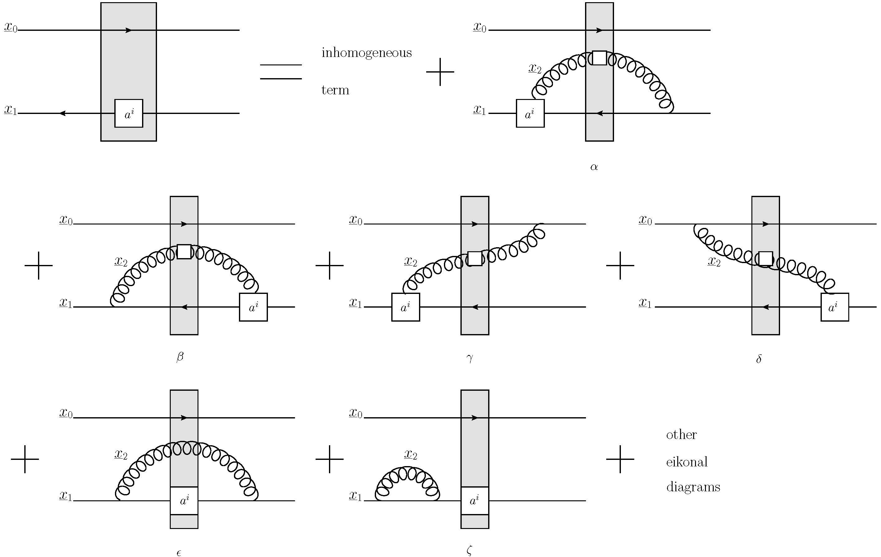
Large-N_{c} Small-x Evolution
Diagrams for one step in evolution

Slide 16
Large-N_{c} Small-x Evolution
Summing the sub-eikonal contributions from each diagram we obtain a closed set of double logarithmic (DLA) evolution equations
Here is an auxiliary ‘neighbor’ dipole and is the dipole size

Slide 17
Sub-Eikonal Small-x Asymptotics
Solving the large-N_{c} equations and plugging the dipole back into the Sivers function yields the sub-eikonal small-x asymptotics
The sub-eikonal correction has no power correction from evolution, similar to the odderon!

Slide 18
Outlook
Small-$x$ Sivers function is dominated by eikonal spin-dependent odderon with a sub-eikonal, energy independent correction
Odderon small-$x$ evolution is known to have a zero intercept at LO and NLO in $α_{s}$ (Bartels, Lipatov, Vacca (2000), Kovchegov (2013)), at large $N_{c}$ (Bartels and Vacca (2013)), and in supersymmetric Yang-Mills (Brower, Djuric, Tan (2009), Caron-Huot and Herranen (2018)), so we expect no suppression of Sivers at very small-$x$
Opens the possibility to see spin-dependent odderon in spin asymmetries of SIDIS (and DY) with future colliders such as EIC!
Polarized Wilson line can be used to find the small-$x$ asymptotics for the rest of the leading twist TMDs

Slide 19
References
D. Boer, M. G. Echevarria, P. Mulders, and J. Zhou, Phys. Rev. Lett. 116, 122001 (2016), arXiv:1511.03485 [hep-ph].
L. Szymanowski and J. Zhou, Phys. Lett. B760, 249 (2016), arXiv:1604.03207 [hep-ph].
Y. V. Kovchegov and M. D. Sievert, Phys. Rev. D99, 054032 (2019), arXiv:1808.09010 [hep-ph].
Y. V. Kovchegov and M. D. Sievert, Phys. Rev. D99, 054033 (2019), arXiv:1808.10354 [hep-ph].
V. M. Abazov et al. (D0, TOTEM), (2020), arXiv:2012.03981 [hep-ex].
H. Dong, D.-X. Zheng, and J. Zhou, Phys. Lett. B 788, 401 (2019), arXiv:1805.09479 [hep-ph].
T. Altinoluk, G. Beuf, A. Czajka, and A. Tymowska, (2020), arXiv:2012.03886 [hep-ph].
G. A. Chirilli, (2021), arXiv:2101.12744 [hep-ph].
J. Bartels, L. Lipatov, and G. Vacca, Phys.Lett. B477, 178 (2000), arXiv:hep-ph/9912423 [hep-ph].
Y. V. Kovchegov, AIP Conf. Proc. 1523, 335 (2013), arXiv:1212.2113 [hep-ph].
J. Bartels and G. P. Vacca, Eur. Phys. J. C 73, 2602 (2013), arXiv:1307.3985 [hep-th].
R. C. Brower, M. Djuric, and C.-I. Tan, JHEP 0907, 063 (2009), arXiv:0812.0354 [hep-th].
S. Caron-Huot and M. Herranen, JHEP 02, 058 (2018), arXiv:1604.07417 [hep-ph].

Slide 20
Thank You

Slide 21
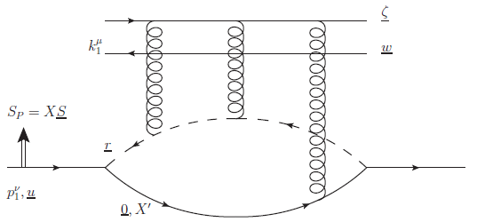
Diquark model calculation
We can estimate the small-$x$ Sivers function in the diquark model, where the interaction between the point-particle proton $ψ_{P}$, the quark field $ψ$, and the scalar diquark $φ$ is

Slide 22
Diquark model calculation
Plugging the diquark model odderon into our Sivers function result gives
Nonzero spin-dependent odderon!
Interesting behavior as , Sivers function does not vanish

Slide 23
Sub-Eikonal Small-x Asymptotics
We can solve the equation by taking a Mellin-Laplace transform and then evaluating the inverse transform with the saddle-point approximation
The dipole (dipole i) oscillates, but the integral over (z’) is dominated by the lower limit, yielding a contribution which is independent of (Bjorken-x)

